Slide 1
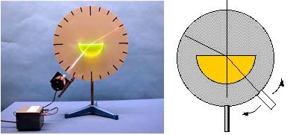
7A-21 Refraction

Slide 2
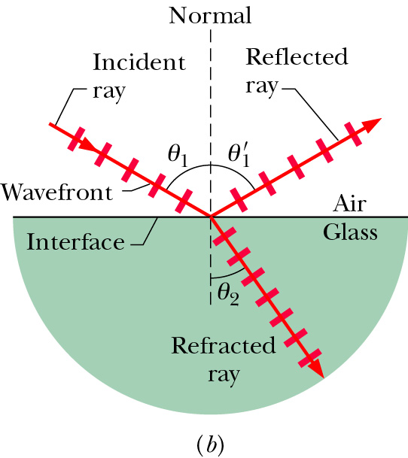
Speed of light in medium
Light can travel through matter medium as well as free space (vacuum). Inside matter, the speed of light v is generally less than c.
index of refraction
When light encounters an interface between different media, it can generally both reflect and refract.

Slide 3

Law of reflection and Refraction
$$θ_{1}^{}=θ_{1}^{′}$$
medium | n
vacuum | 1
air | 1.0003
water | 1.33
glass | 1.5 – 1.66
Snell’s Law

Slide 4
Exercise
The refraction index for air and glass are 1.0 and 1.5, respectively. The incident angle θ₁ is 30º, what are the reflection angle θ’₁ and refraction angle θ₂ ?
A). θ’₁ =30º and θ₂=19.5º
B). θ’₁ =30º and θ₂=15º
C). θ’₁ =19.5º and θ₂=30º
D). θ’₁ =15º and θ₂=19.5º
E). θ’₁ =30º and θ₂=22.5º

Slide 5
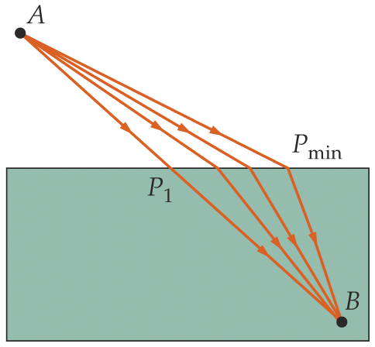
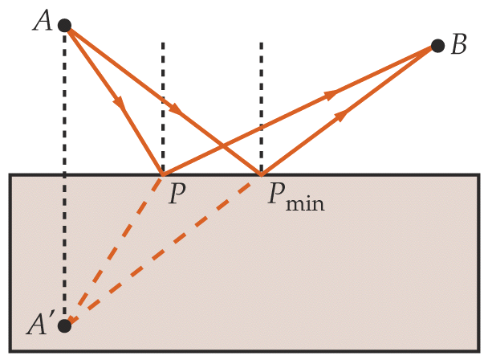
Fermat’s Principle
The path taken by light traveling from one point to another is such that the time of travel is a minimum.
path: geometric ray is assumed for light.
minimum time ≠ shortest path length
reflection
refraction

Slide 6
Intensity of Reflected and Refracted Light
Maxwell’s Equations with proper boundary conditions lead to solutions for E and B for reflected and refracted light in terms of E and B for the incident light and the properties of the media involved.
polarization
The relative intensities
depend on
the direction of E (and B) relative to the plane of incidence.
as well as the incident angle and the media properties.
For normal incidence, all directions are the equivalent, and

Slide 7
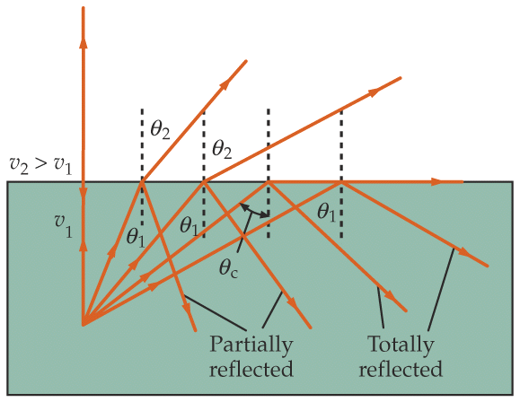
Total Internal Reflection
All light can be reflected, none refracting, when light travels from a medium of higher to lower indices of refraction.
medium 2
e.g., glass (n=1.5) to air (n=1.0)
But θ cannot be greater than 90° !
medium 1
In general, if sin θ₁ > (n₂ / n₁), we have NO refracted ray;
we have TOTAL INTERNAL REFLECTION.
Critical angle above which this occurs.

Slide 8
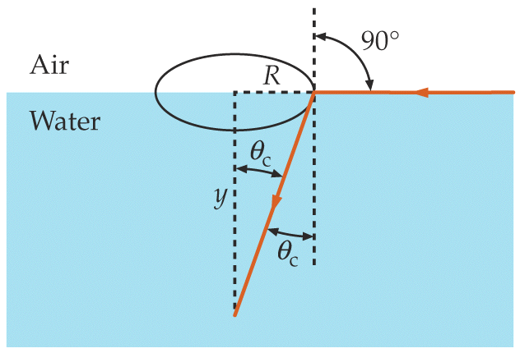
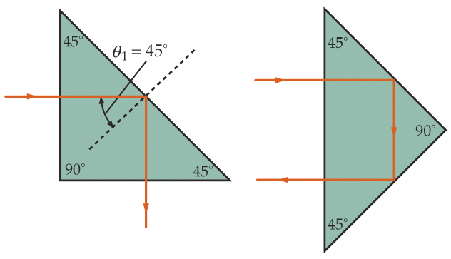
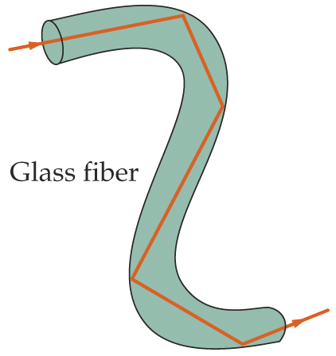
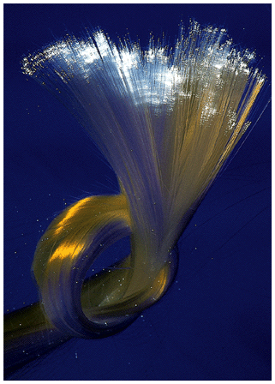
Examples
Fish’s view of the world
Prism used as reflectors
(e.g., glass with n=1.5)
Optical fiber
(e.g., glass with n=1.5)
in air
in water

Slide 9
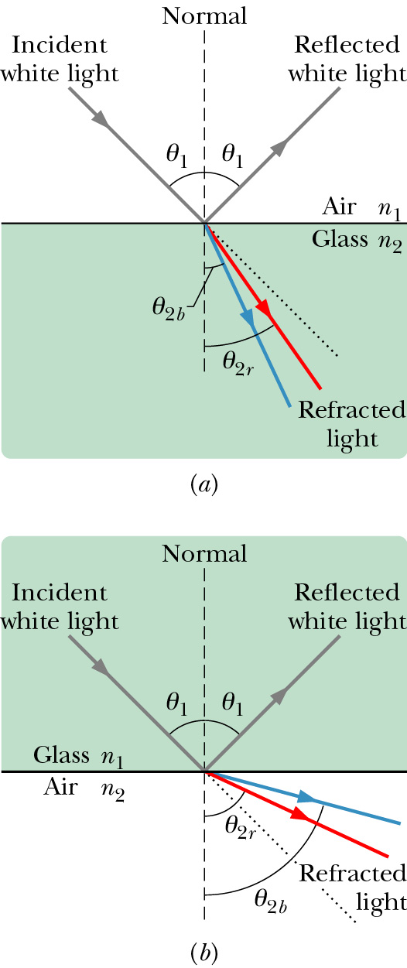
Chromatic Dispersion
The index of refraction of a medium is usually a function of the wavelength of the light. It is larger at shorter wavelengths.
Consequently, a light beam consisting of rays of different wavelength (e.g., sun light) will be
refracted at different angles at the interface of
two different media. This spreading of light is
called chromatic dispersion.
White light: It consists of components of nearly all the colors in the visible spectrum with approximately uniform intensities.
The component of a beam of white light with shorter wavelength tends to be bent more.
Spectrometer (such as a prism)

Slide 10
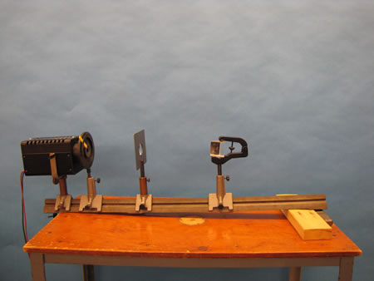
7A-22 Refraction by Prisms

Slide 11
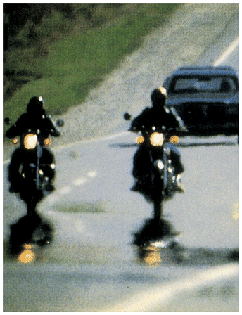
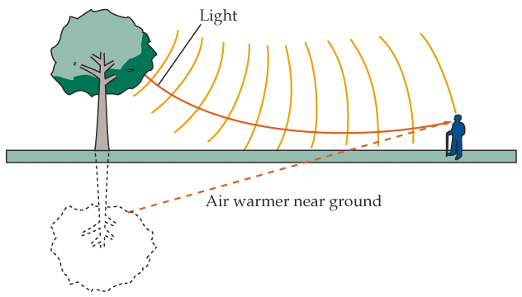
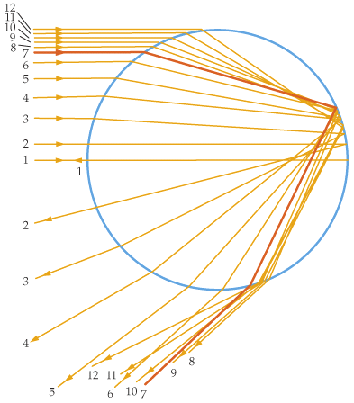
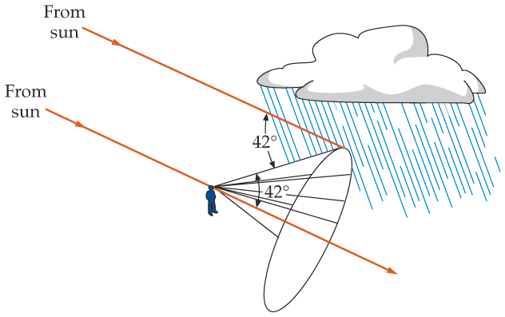
Mirage and Rainbow
Mirage
water droplet
red is outside.
intensity max at 42°
rainbow

Slide 12
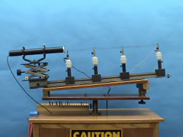
7A-20 Hot Air Refraction
Notes:
Glowing hot wire

Slide 13
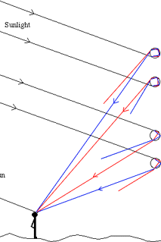
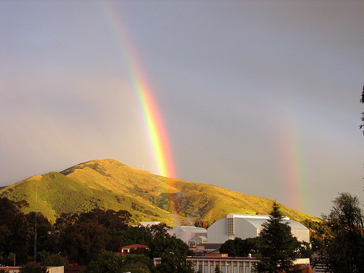
Double Rainbow
Secondary rainbow
Primary rainbow

Slide 14
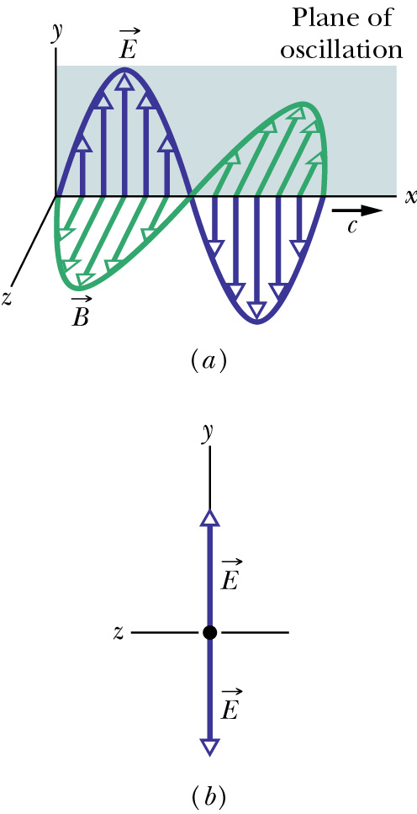
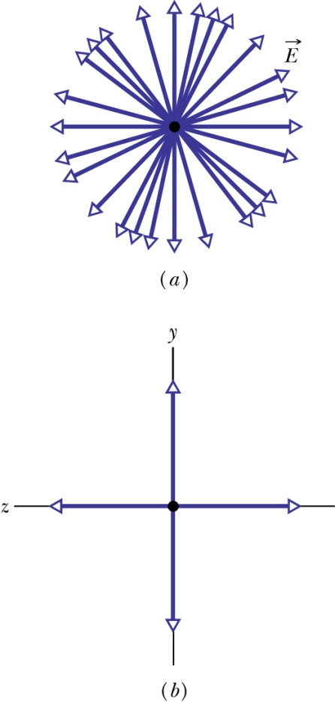
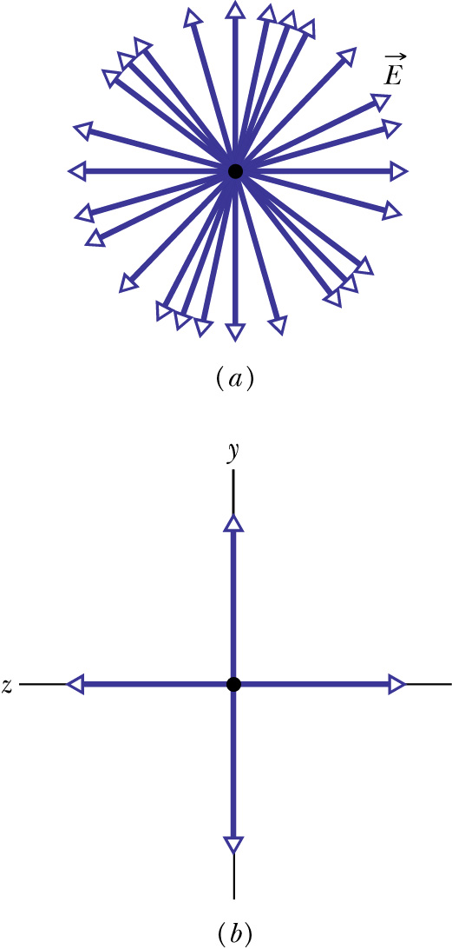
Polarization of Electromagnetic Waves
Polarization is a measure of the degree to which the electric field (or the magnetic field) of an electromagnetic wave oscillates preferentially along a particular direction.
Linear combination of many linearly polarized rays of random orientations
partially polarized
unpolarized
linearly polarized
components
Looking at E head-on
unequal y- and z-amplitudes
equal y- and z-amplitudes

Slide 15
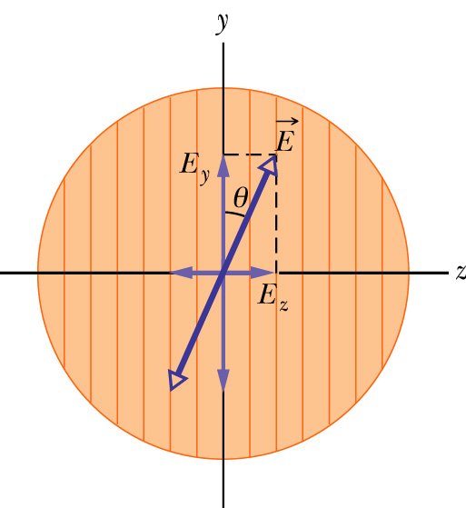
Polarizer: polarization by absorption
An electric field component parallel to the transmission axis is passed by a polarizer; a component perpendicular to it is absorbed.
transmission axis
dichroism (tourmaline, polaroid,…)
So if linearly polarized beam with E is incident on a polarizer as shown,
Zero if θ=π/2, I₀ if θ=0
If unpolarized beam is incident instead,
Polarization can rotate in time if linearly polarized beams of different phases are combined.

Slide 16
Exercise
A beam of un-polarized lights with intensity I is sent through two polarizers with transmission axis perpendicular to each other. What’s the outgoing light intensity?
½ I
2 I
0
1.5 I

Slide 17
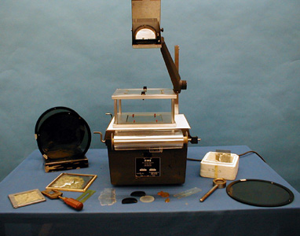
7B-22 Polarizer Effects

Slide 18
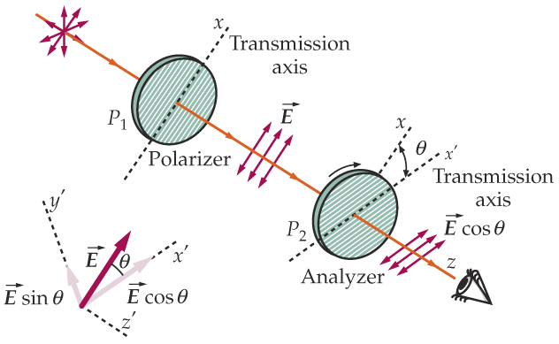
Example: two polarizers
This set of two linear polarizers produces LP (linearly polarized) light. What is the final intensity?
  P₁ transmits 1/2 of the unpolarized light:
  I₁ = 1/2 I₀
  P₂ projects out the E-field component parallel to x’ axis:
= 0 if θ = π/2
(i.e., crossed)

Slide 19
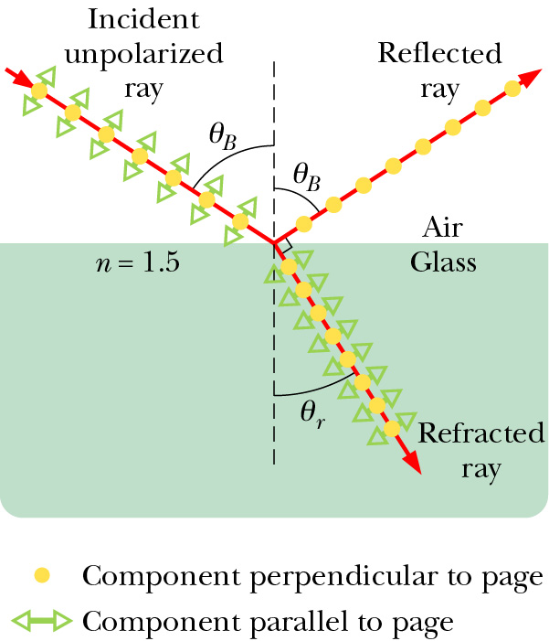
Polarization by Reflection
Unpolarized light can be broken
into two components of equal
magnitude: one with its electric
vector perpendicular to the
plane of incidence and the other
with its electric vector parallel
to the plane of incidence.
The reflected (or refracted) light
is partially polarized: due to
difference in the reflectivity of
the two components (larger for
the perpendicular component).
Full polarization occurs at Brewster’s angle where

Slide 20
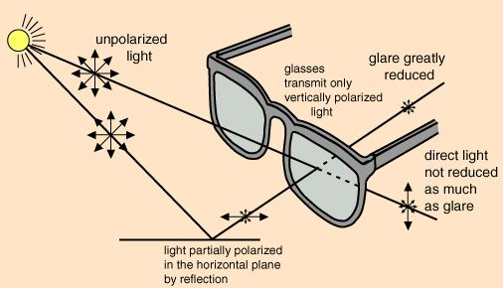
Example: Sunglasses cut down glare
transmission axis

Slide 21
Quiz: Unpolarized light of intensity I₀ is sent through 3 polarizers, each of the last two rotated 45° from the previous polarizer so that the last polarizer is perpendicular to the first. What is the intensity transmitted by this system?
a) 0.71 I₀
b) 0.50 I₀
c) 0.25 I₀
d) 0.125 I₀
e) 0

Slide 22
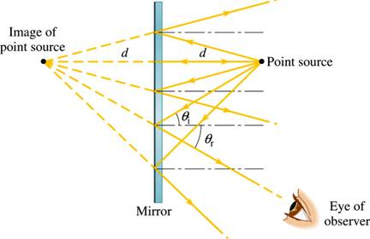
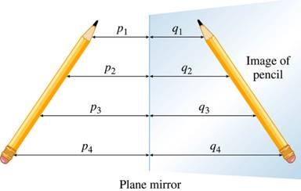
Image by Reflection from a Plane Mirror
point object
Only small fraction of reflected rays received.
Virtual image at same distance from but on the other side of the mirror as the object
it is called a virtual image since no rays actually go through the image,
extended object
An extended object can be broken into infinite number of point objects.
Image has the same height and
orientation as the object.
Notes:
A plane mirror preserves the physical characteristics of any object.

Slide 23
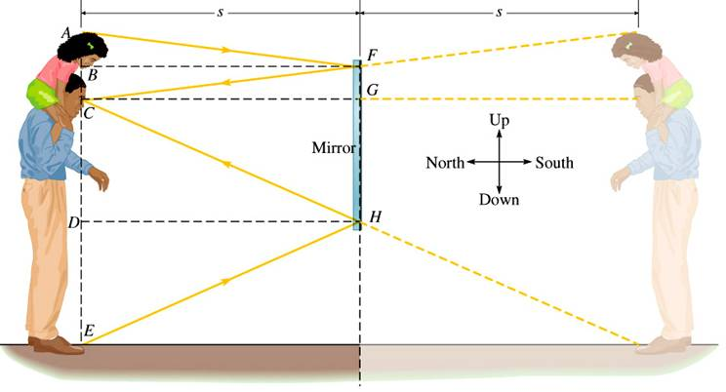
“Full Length” Mirror
Only half the object (and image) size is needed.

Slide 24
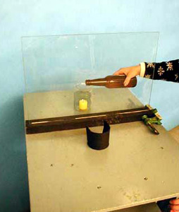
7A-05 Candle Illusion

Slide 25
Exercise
A person is standing still 2 meters in front of a mirror, then the mirror is moved 1 meter towards him and then stopped. What’s the distance between the person and his image before and after the mirror is moved?
a) 2m and 1m
b) 3m and 2m
c) 4m and 2m
d) 5m and 4m

Slide 26
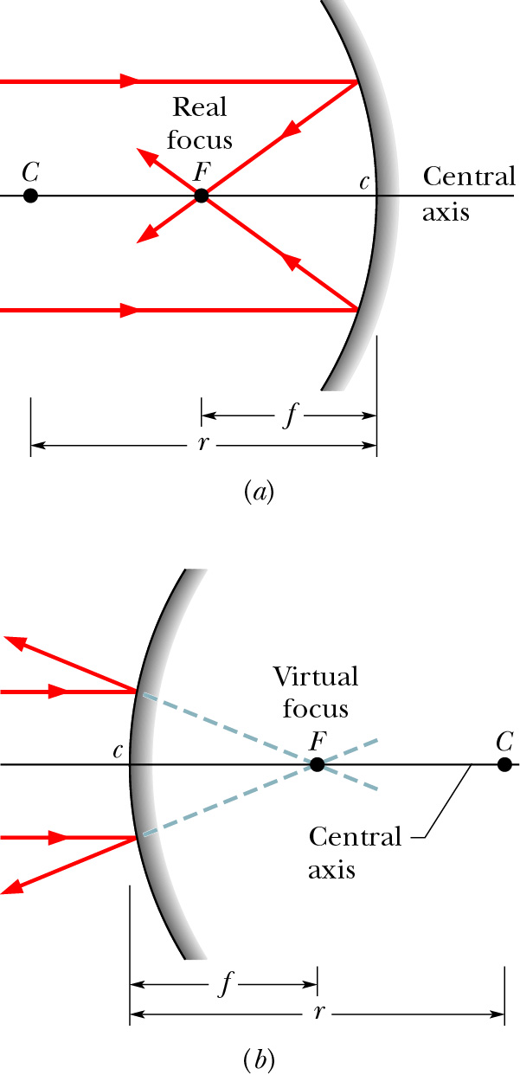
Focal Point of a Spherical Mirror
concave mirror:
When parallel rays incident upon a spherical mirror, the reflected rays or the extensions of the reflected rays all converge toward a common point, the focal point of the mirror. Distance f is the focal length.
Real focal point: the point to which the
reflected rays themselves pass through.
This is relevant for concave mirrors.
f
convex mirror
Virtual focal point: the point to which
the extensions of the reflected rays pass
through. This is relevant for convex
mirrors.
Rays can be traversed in reverse. Thus, rays which (would) pass through F and strike the mirror will emerge parallel to the central axis.
f

Slide 27
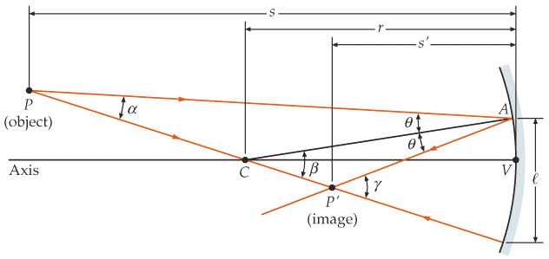
Some Geometry
θ
If θ is small, or rays are paraxial
r
mirror equation

Slide 28
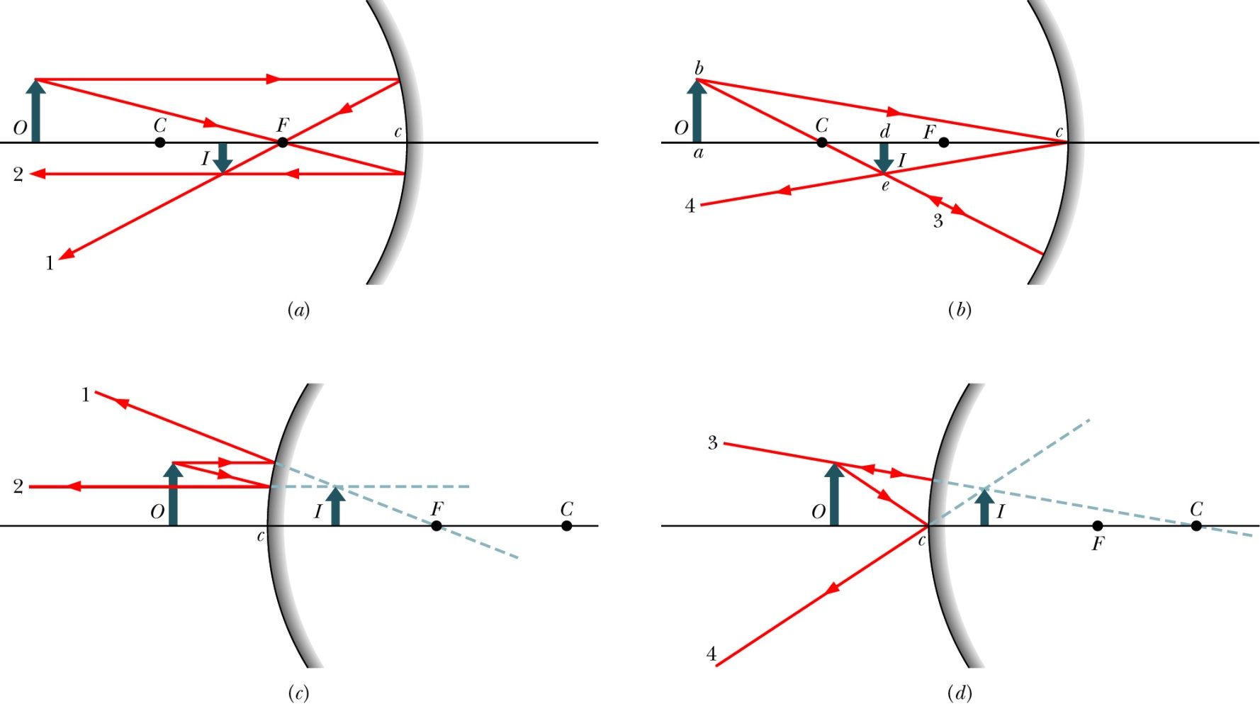
Locating Images
only using the parallel, focal, and/or radial rays.
Real images form on the side of a mirror where the objects are,
and virtual images form on the opposite side.

Slide 29
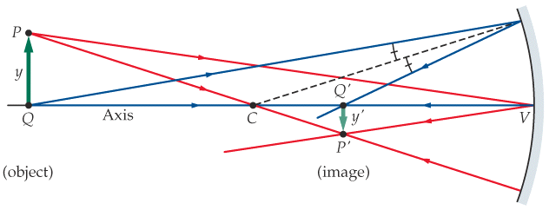
Mirror Equation and Magnification
(f = r/2)
s is positive if the object is in front of the mirror (real object)
s is negative if it is in back of the mirror (virtual object)
s’ is positive if the image is in front of the mirror (real image)
s’ is negative if it is in back of the mirror (virtual image)
m is positive if image and object have the same orientation (upright)
m is negative if they have opposite orientation (inverted)
f and r are positive if center of curvature in front of mirror (concave)
f and r are negative if it is in back of the mirror (convex)
Notes:
The equation applies to convex mirrors.
The equation applies to extended objects, as long as the spatial extension is small enough to preserve the validity of small angle approximation.
The sign convention needs to be followed.

Slide 30
Quiz: A man is standing still in front of a mirror, and the mirror is moved toward him at 1 m/s. What is the speed of the man’s image relative to the ground?
a) 0.5 m/s
b) 1 m/s
c) 1.5 m/s
d) 2 m/s
e) 2.5 m/s

Slide 31
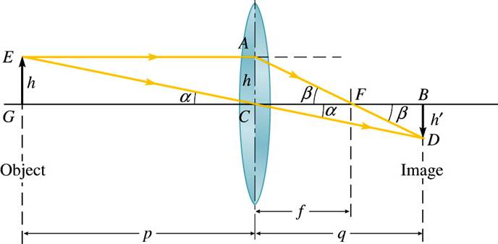
Lens Equation
( < 0 )
True for thin lens and paraxial rays.
magnification m = h’/h = - q/p

Slide 32
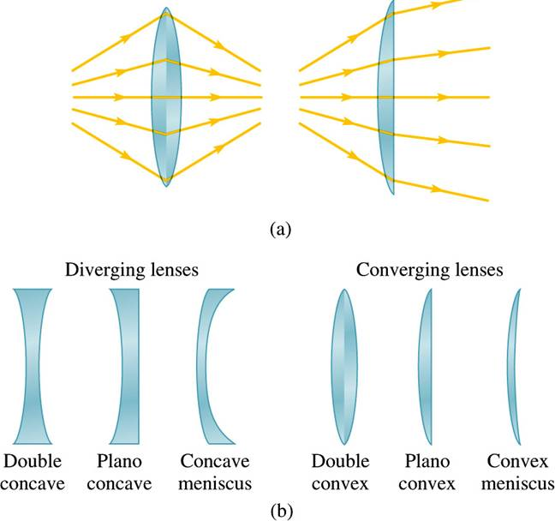
Thin Lenses
A lens is a piece of transparent material with two refracting surfaces whose central axes coincide. A lens is thin if its thickness is small compared to all other lengths (s, s’, radii of curvature).
f > 0
Convergent lens
Net convex – thicker in the middle
Parallel rays converge to real focus.
f > 0
r₁>0
r₂<0
f < 0
Divergent lens
Net concave – thinner in the middle
Parallel rays diverge from virtual focus.
f < 0
r₁<0
r₂>0

Slide 33
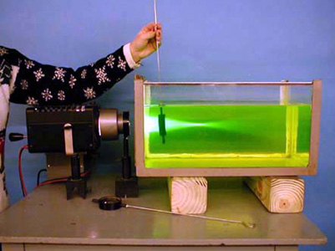
7A-31 Effect on Medium on Lens

Slide 34
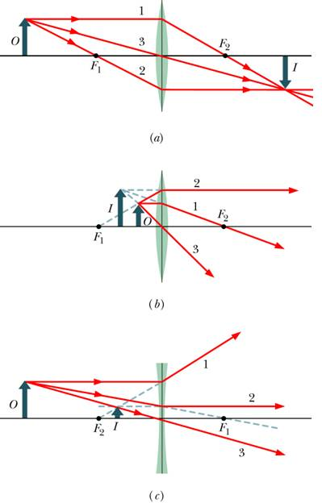
Signs in the Lens Equation for Thin Lenses
p is positive for real object
q is positive for real image
q is negative for virtual image
m is positive if image is upright
m is negative if image is inverted
f is positive if converging lens
f is negative if diverging lens
p is negative for virtual object

Slide 35
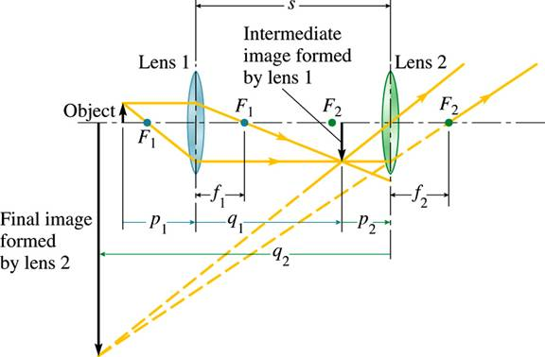
Lenses in Combination
First lens:
Second lens:
( < f₂ here)
What if p₂> f₂ ?
Total transverse magnification
In this example, p₁> 0, q₁> 0, p₂> 0, q₂< 0

Slide 36
Compound Lenses
For a virtual object, the object distance is negative.
1
q₁ > 0
p > 0
p₂ < 0
Virtual object
2
Power (Unit: diopter )adds up in compound lenses
q > 0

Slide 37
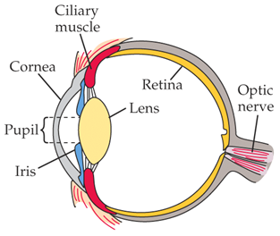
The Eye
≈ 2.5 cm
f depends on p
p ↓ => f↓ to keep q at ≈ 2.5 cm

Slide 38
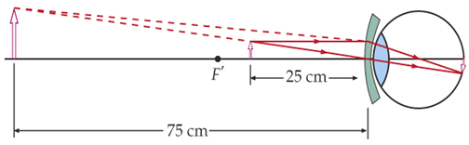
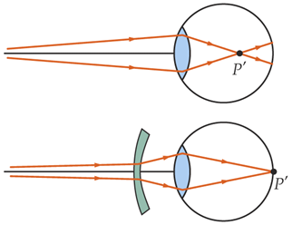
Corrective Lenses
Hyperopia: A person has near point = 75 cm
Can’t focus near.
Correct to 25 cm by conv. lens
Use a lens of +2.67D
Myopia(nearsighted) e.g., far point = 40 cm
Can’t focus far.
Corrected by diverging lens
Use a lens of -2.5D
Forgot to bring the glass? Not a problem.
Notes:
diopter

Slide 39
Magnifying Lens
An object is placed near the focal point of a magnifying lens. The
angle subtended by the image is tanθ = y/f . Without the lens, the
largest angle subtended by the object is achieved when the object
is placed at the near point, tanθ’ = y/x_{np}.
θ’
θ
x_{np}
f
For small angles, the angular magnification

