Slide 1
Final Exam (ch.13-ch.19)
. time: Thu 05/03 10:20 am- 12:20 pm
. Location: room 114 of physics building.
If you can not make it, please let me know by Wednesday 04/25 so that I can arrange a make-up exam. If you have special needs, e.g. exam time extension, and has not contact me before, please bring me the letter from the Office of the Dean of Students before Wednesday 04/25. No requested will be accepted after that. Deadline is already passed
AOB
•30 problems.
•Prepare your own scratch paper, pencils, erasers, calculators etc.
•Use only pencil for the answer sheet
•No cell phones, no text messaging which is considered cheating.
•No crib sheet of any kind is allowed. Equation sheet will be provided and will also be posted on the web.

Slide 2
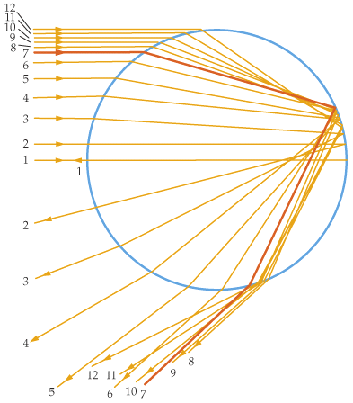
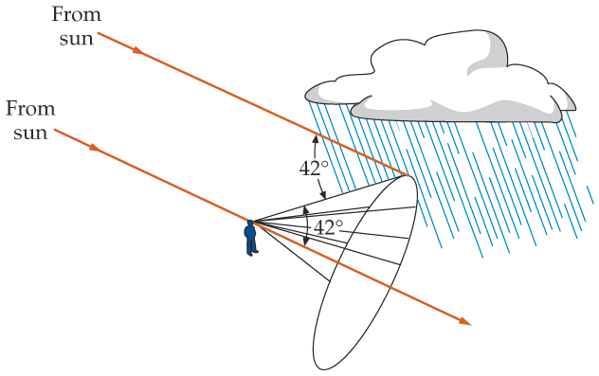
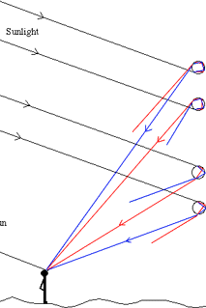
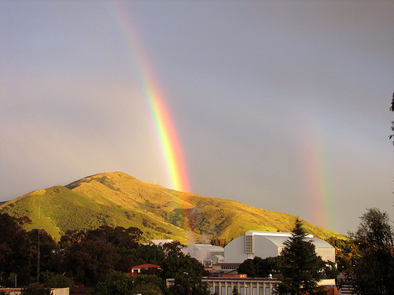
Mirage and Rainbow
water droplet
red is outside.
intensity max at 42°
rainbow
Notes:
Ripples, you can never catch the rainbow.

Slide 3
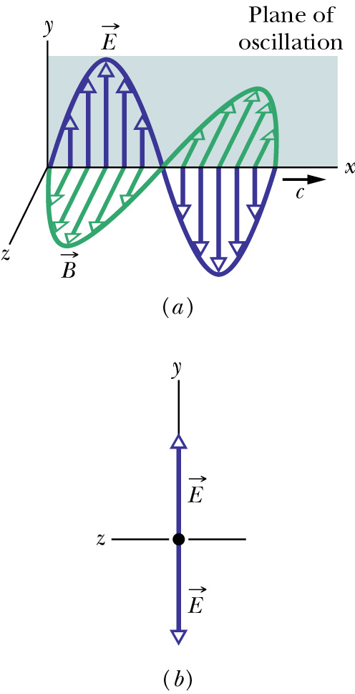
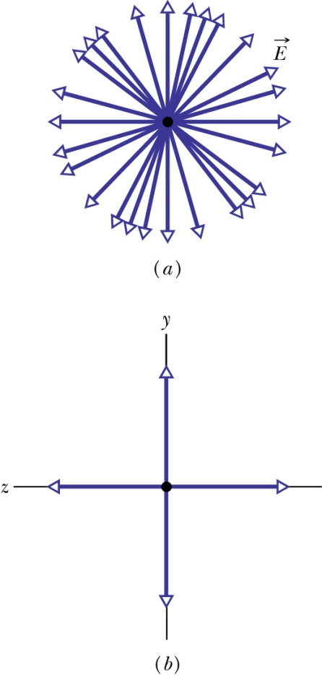
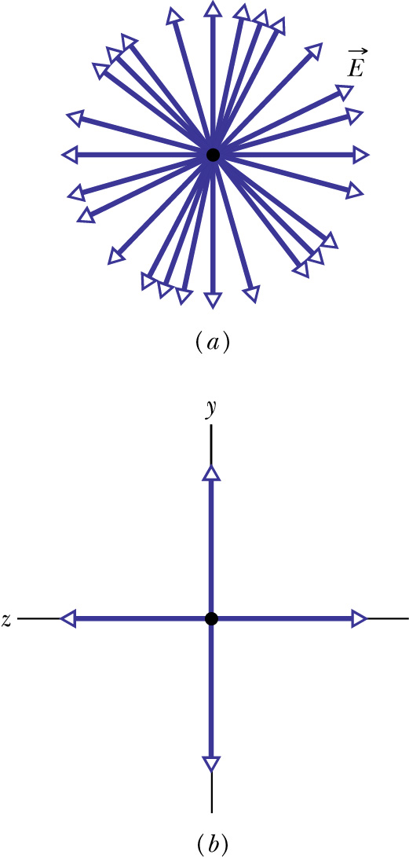
Polarization of Electromagnetic Waves
Polarization is a measure of the degree to which the electric field (or the magnetic field) of an electromagnetic wave oscillates preferentially along a particular direction.
Linear combination of many linearly polarized rays of random orientations
partially polarized
unpolarized
linearly polarized
components
Looking at E head-on
unequal y- and z-amplitudes
equal y- and z-amplitudes
Notes:
Take many sanpshots, the E is along random orientation.

Slide 4
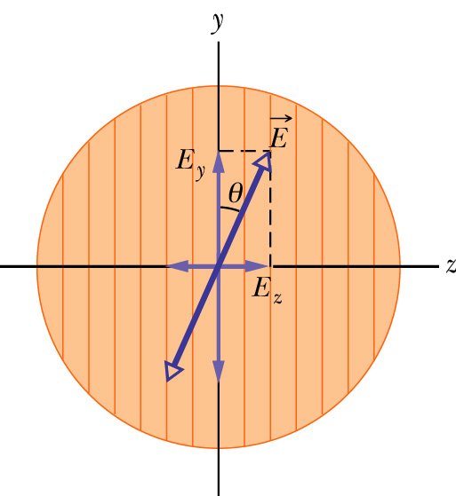
Polarizer: polarization by absorption
An electric field component parallel to the transmission axis is passed by a polarizer; a component perpendicular to it is absorbed.
transmission axis
dichroism (tourmaline, polaroid,…)
So if linearly polarized beam with E is incident on a polarizer as shown,
Zero if θ=π/2, I₀ if θ=0
If unpolarized beam is incident instead,
The intensity will reduce by a factor of two.
The light will become polarized along the transmission axis

Slide 5
Quiz (Bonus)
A beam of un-polarized lights with intensity I is sent through two polarizers with transmission axis perpendicular to each other. What’s the outgoing light intensity?
½ I
2 I
0
1.5 I

Slide 6
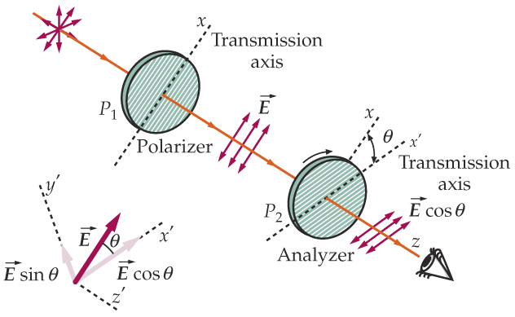
Example: two polarizers
This set of two linear polarizers produces LP (linearly polarized) light. What is the final intensity?
  P₁ transmits 1/2 of the unpolarized light:
  I₁ = 1/2 I₀
  P₂ projects out the E-field component parallel to x’ axis:
= 0 if θ = π/2
(i.e., crossed)

Slide 7
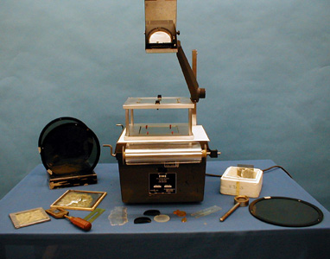
7B-22 Polarizer Effects

Slide 8
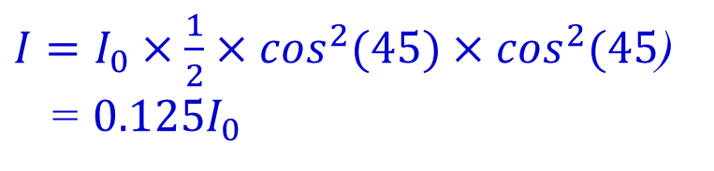
Quiz (bonus): Unpolarized light of intensity I₀ is sent through 3 polarizers, each of the last two rotated 45° from the previous polarizer so that the last polarizer is perpendicular to the first. What is the intensity transmitted by this system?
(hint: sin²(45°)=0.5)
a) 0.71 I₀
b) 0.50 I₀
c) 0.25 I₀
d) 0.125 I₀
e) 0
$I=I_{0}×\frac{1}{2}×\cos^{2}(45)×\cos^{2}(45$)
= ${0.125I}_{0}$

Slide 9
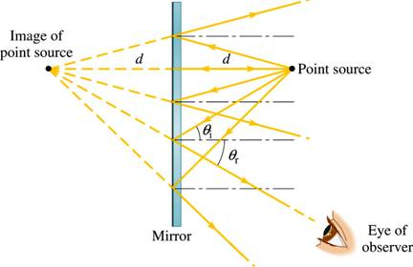
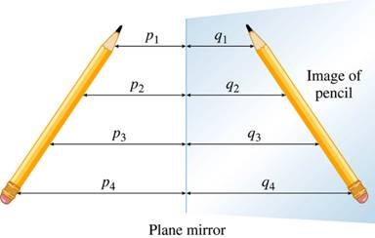
Image by Reflection from a Plane Mirror
point object
Only small fraction of reflected rays received.
Virtual image at same distance from but on the other side of the mirror as the object
it is called a virtual image since no rays actually go through the image,
extended object
An extended object can be broken into infinite number of point objects.
Image has the same height and
orientation as the object.
Notes:
A plane mirror preserves the physical characteristics of any object.

Slide 10
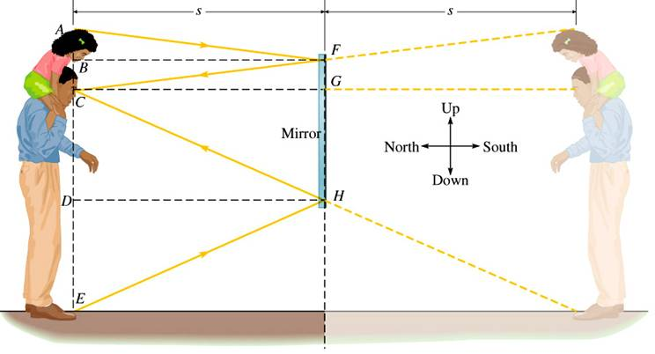
“Full Length” Mirror
Only half the object (and image) size is needed.

Slide 11
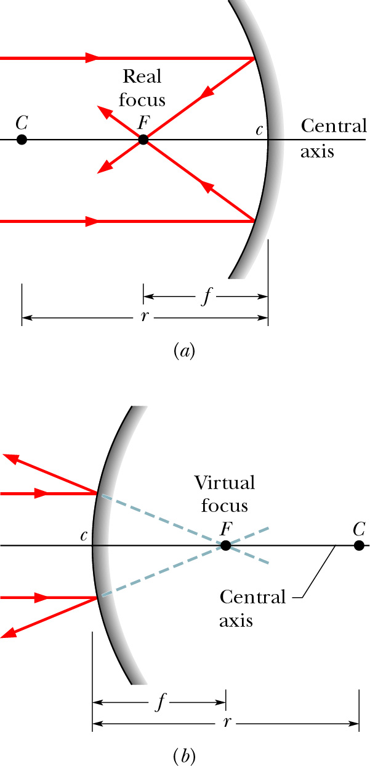
Focal Point of a Spherical Mirror
concave mirror:
When parallel rays incident upon a spherical mirror, the reflected rays or the extensions of the reflected rays all converge toward a common point, the focal point of the mirror. Distance f is the focal length.
Real focal point: the point to which the
reflected rays themselves pass through.
This is relevant for concave mirrors.
f
convex mirror
Virtual focal point: the point to which
the extensions of the reflected rays pass
through. This is relevant for convex
mirrors.
Rays can be traversed in reverse. Thus, rays which (would) pass through F and strike the mirror will emerge parallel to the central axis.
f

Slide 12
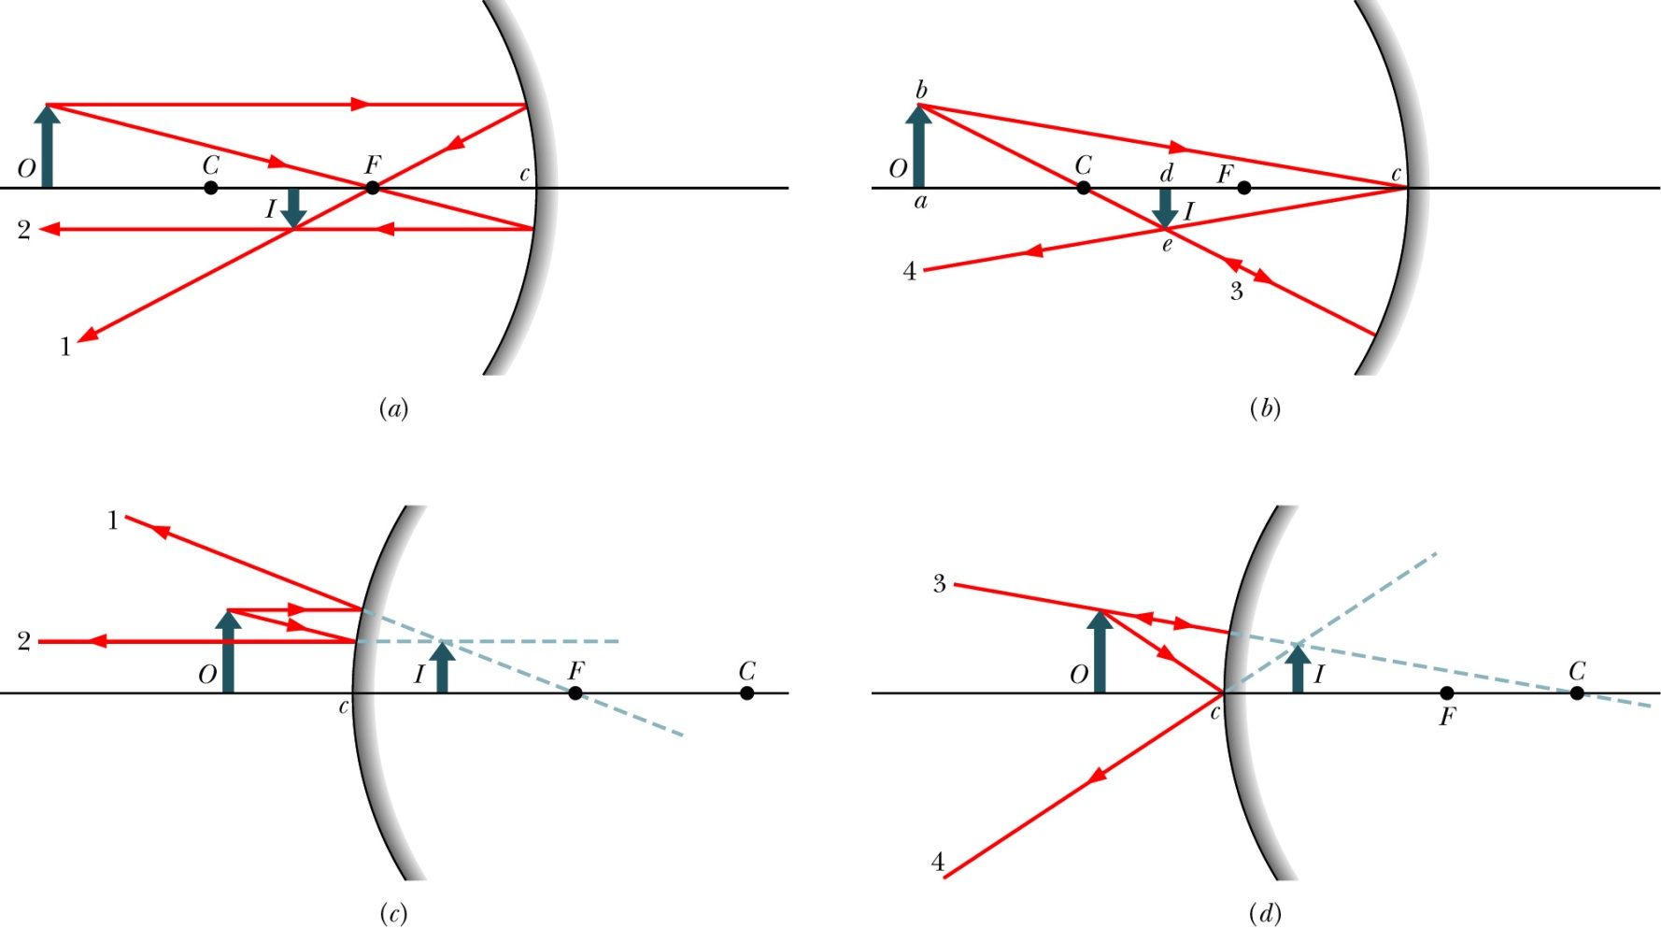
Locating Images
only using the parallel, focal, and/or radial rays.
Real images form on the side of a mirror where the objects are,
and virtual images form on the opposite side.

Slide 13
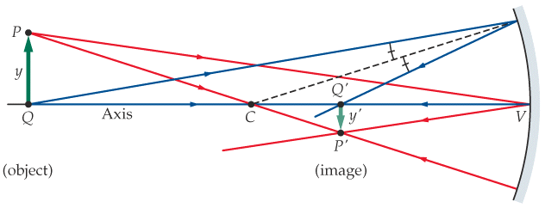
Mirror Equation and Magnification
(f = r/2)
s is positive if the object is in front of the mirror (real object)
s is negative if it is in back of the mirror (virtual object)
s’ is positive if the image is in front of the mirror (real image)
s’ is negative if it is in back of the mirror (virtual image)
m is positive if image and object have the same orientation (upright)
m is negative if they have opposite orientation (inverted)
f and r are positive if center of curvature in front of mirror (concave)
f and r are negative if it is in back of the mirror (convex)
Notes:
The equation applies to convex mirrors.
The equation applies to extended objects, as long as the spatial extension is small enough to preserve the validity of small angle approximation.
The sign convention needs to be followed.

Slide 14
Quiz (Bonus)
An object is placed 4 cm in front of a concave mirror of focal length 20 cm. The image will be formed
A. 5 cm in front of the mirror.
B. 5 cm behind the mirror.
C. 10 cm in front of the mirror.
D. 10 cm behind the mirror.
E. 0.05 cm behind the mirror.
¼ +1/x = 1/20
X = -5 cm
5 cm behind the mirror.

Slide 15
Quiz (bonus)
A person is standing still 2 meters in front of a mirror, then the mirror is moved 1 meter towards him and then stopped. What’s the distance between the person and his image before and after the mirror is moved?
a) 2m and 1m
b) 3m and 2m
c) 4m and 2m
d) 5m and 4m

Slide 16
Backup

Slide 17
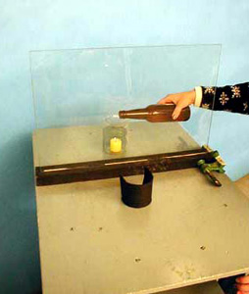
7A-05 Candle Illusion

