Slide 1
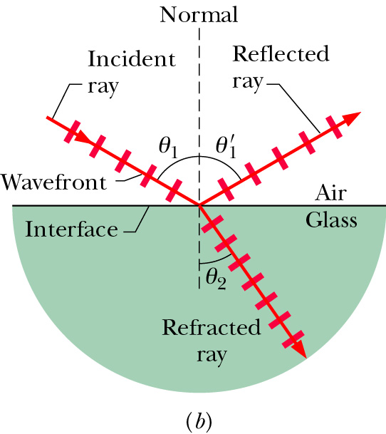

Law of reflection and Refraction
$$θ_{1}^{}=θ_{1}^{′}$$
medium | n
vacuum | 1
air | 1.0003
water | 1.33
glass | 1.5 – 1.66
Snell’s Law

Slide 2
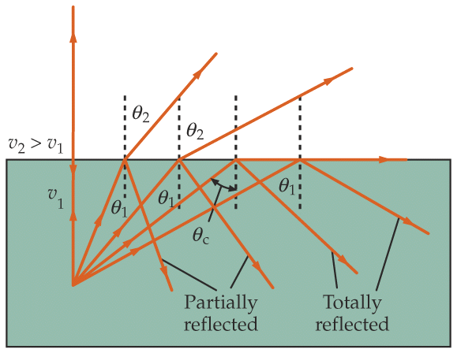
Total Internal Reflection
All light can be reflected, none refracting, when light travels from a medium of higher to lower indices of refraction.
medium 2
e.g., glass (n=1.5) to air (n=1.0)
But θ cannot be greater than 90° !
medium 1
In general, if sin θ₁ > (n₂ / n₁), we have NO refracted ray;
we have TOTAL INTERNAL REFLECTION.
Critical angle above which this occurs.

Slide 3
Quiz (Bonus)
The refraction index of water and glass are 1.33 and 1.5 respectively. The refraction index of air is ~1.0. When light incident from air to the glass. What’s the critical angle.
41.8 degree
62.5 degree
There’s no critical angle in this case.
Quiz (Bonus)
When light incident from glass to water. What’s the critical angle.
41.8 degree
62.5 degree
There’s no critical angle in this case.

Slide 4
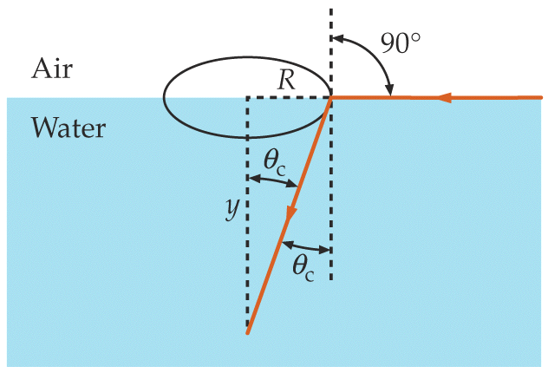
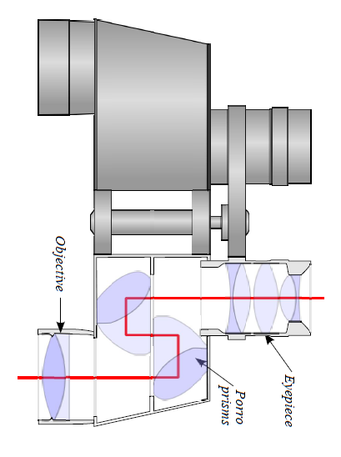
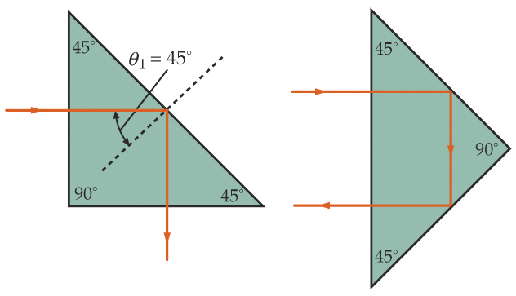
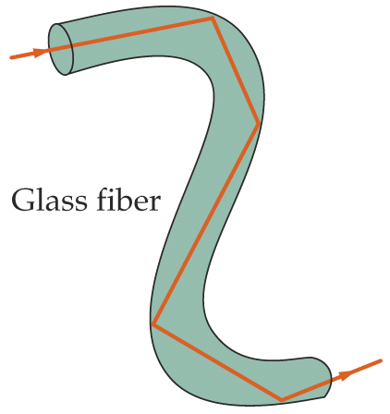
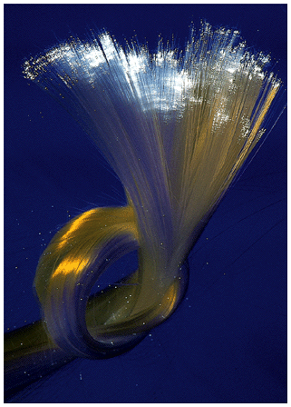
Examples
Fish’s view of the world
Prism used as reflectors
(e.g., glass with n=1.5)
Optical fiber
(e.g., glass with n=1.5)
in air
in water
Notes:
Field of vision

Slide 5
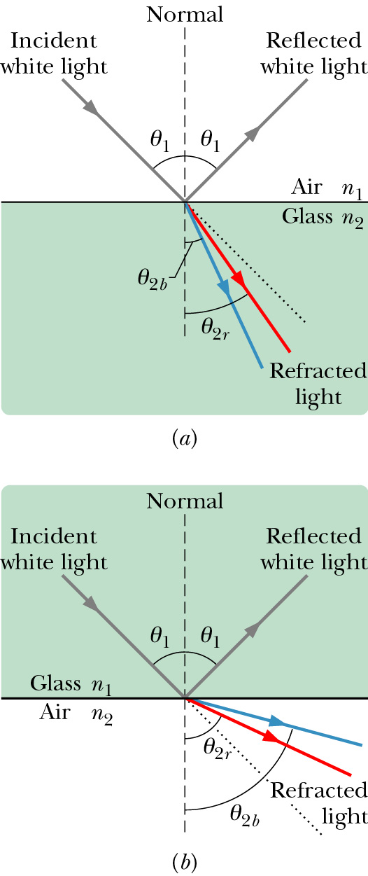
Chromatic Dispersion
The index of refraction of a medium is usually a function of the wavelength of the light. It is larger at shorter wavelengths.
Consequently, a light beam consisting of rays of different wavelength (e.g., sun light) will be
refracted at different angles at the interface of
two different media. This spreading of light is
called chromatic dispersion.
White light: It consists of components of nearly all the colors in the visible spectrum with approximately uniform intensities.
The component of a beam of white light with shorter wavelength tends to be bent more.
Spectrometer (such as a prism)

Slide 6
Quiz (Bonus)
Which of the following diagrams correctly demonstrates chromatic dispersion
Left
right
air
blue
red
Glass
Glass
red
blue

Slide 7
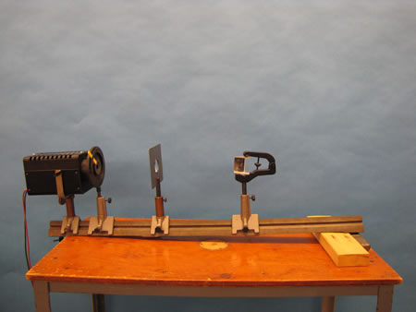
7A-22 Refraction by Prisms
red
Glass
blue
Notes:
A large Plexiglas prism is mounted on the lens board. A narrow beam of light is directed toward one side of the prism causing the light to be refracted. In addition to ordinary refraction, dispersion and minimum angle of deviation can also be shown.

Slide 8
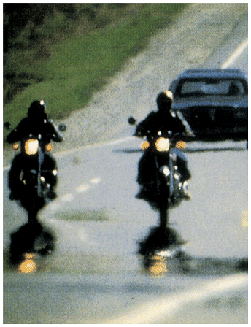
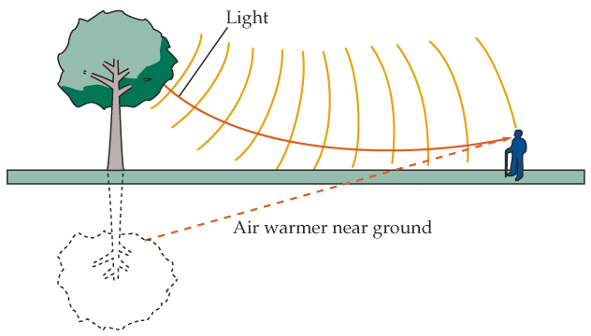
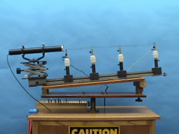
Mirage and Rainbow
Mirage
7A-20 Hot Air Refraction
Notes:
Ripples,
Using a cylindrical lens, a laser beam is spread into a horizontal line. The spread beam passes over a glowing hot wire. As the wire is heated to red hot, the beam, projected onto the wall, shows strong distortions resulting from the varying index of refraction of the turbulent air.
Directions: Turn on the laser to project the horizontal line on the far wall. (You might need to adjust the cylindrical lens up or down a bit.) The beam should be passing just above the wire coil. Slowly turn up the rheostat until the wire starts to glow red. (Do not go beyond this point significantly or you will likely burn out the wire.) Waving a card or fan over the wire will cause further disturbances in the air and create an undulating line on the wall.
Suggestions for Presentation: Ask the students if they have ever observed the distortions associated with the air over a hot pavement or above the desert sands, etc. Discuss what causes a light ray to change direction, other than reflection. (There must be a change in the index of refraction.) The heated air causes turbulence that is sufficient to create considerable changes in the index of refraction locally. The air outside this area is fairly stable and does not undergo index changes of a magnitude to be readily observable.
tch the rainbow.

Slide 9
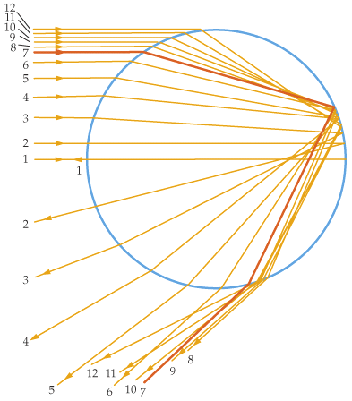
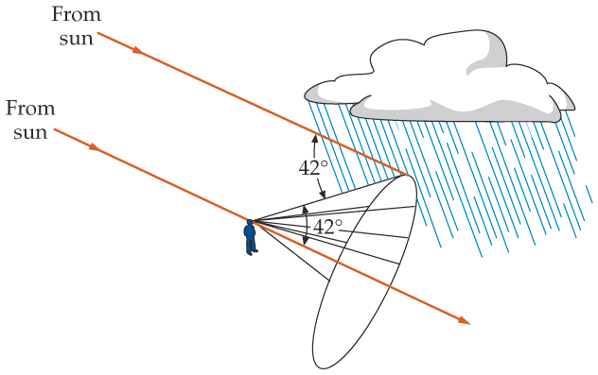
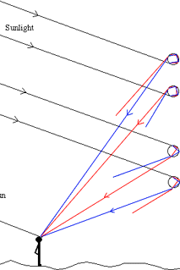
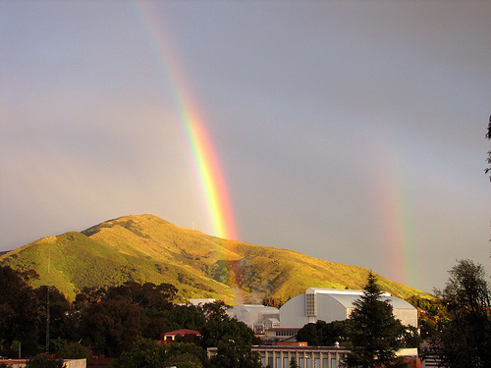
Mirage and Rainbow
water droplet
red is outside.
intensity max at 42°
rainbow
Notes:
Ripples, you can never catch the rainbow.

Slide 10
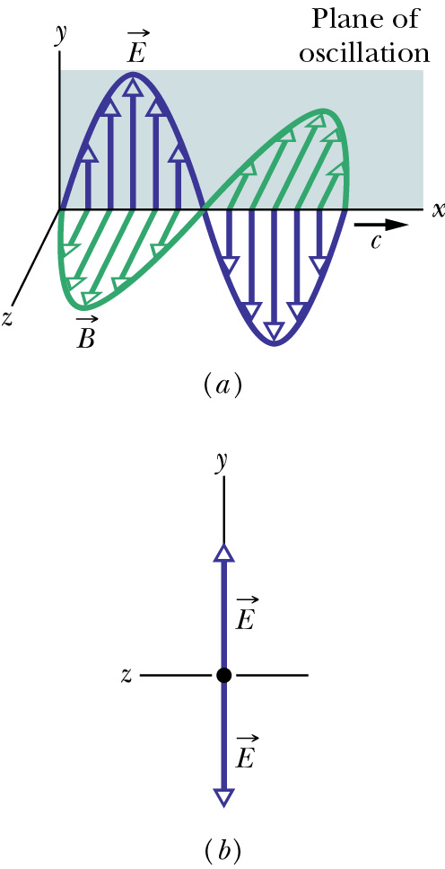
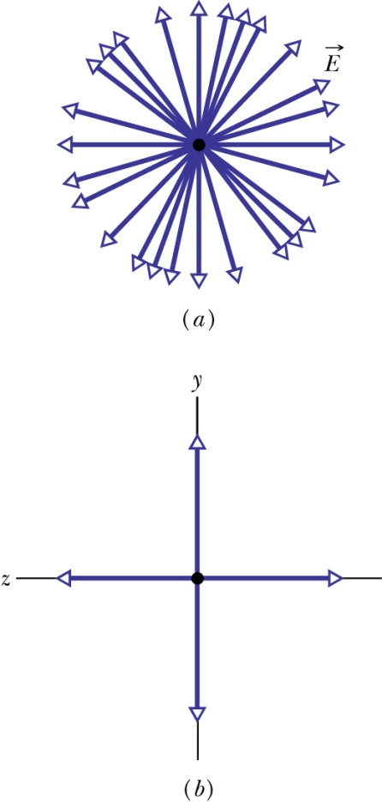
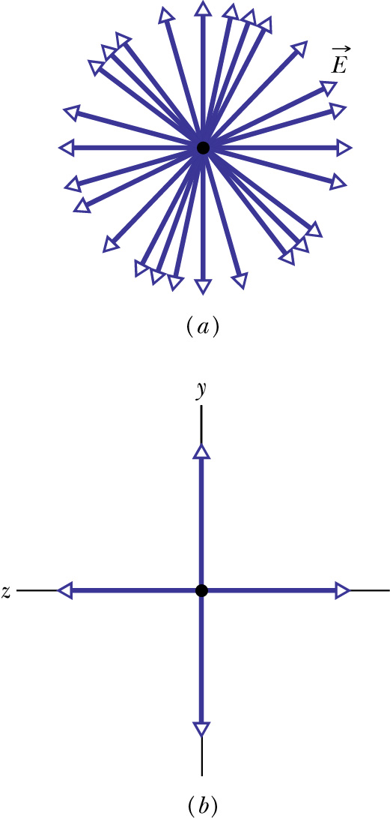
Polarization of Electromagnetic Waves
Polarization is a measure of the degree to which the electric field (or the magnetic field) of an electromagnetic wave oscillates preferentially along a particular direction.
Linear combination of many linearly polarized rays of random orientations
partially polarized
unpolarized
linearly polarized
components
Looking at E head-on
unequal y- and z-amplitudes
equal y- and z-amplitudes
Notes:
Take many sanpshots, the E is along random orientation.

Slide 11
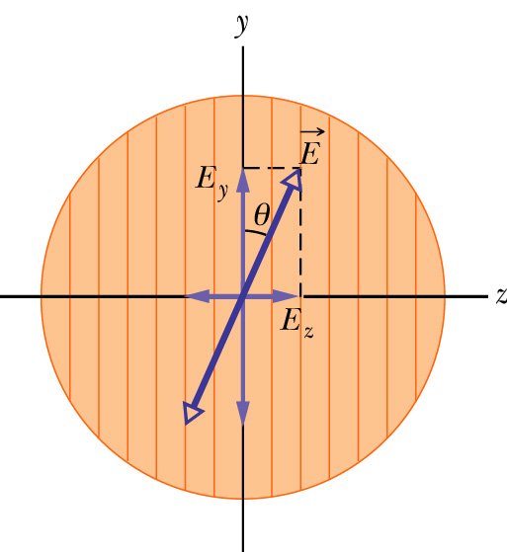
Polarizer: polarization by absorption
An electric field component parallel to the transmission axis is passed by a polarizer; a component perpendicular to it is absorbed.
transmission axis
dichroism (tourmaline, polaroid,…)
So if linearly polarized beam with E is incident on a polarizer as shown,
Zero if θ=π/2, I₀ if θ=0
If unpolarized beam is incident instead,
The intensity will reduce by a factor of two.
The light will become polarized along the transmission axis

Slide 12
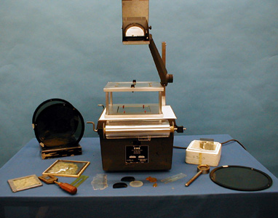
7B-22 Polarizer Effects

Slide 13
Quiz (Bonus)
A beam of un-polarized lights with intensity I is sent through two polarizers with transmission axis perpendicular to each other. What’s the outgoing light intensity?
½ I
2 I
0
1.5 I

Slide 14
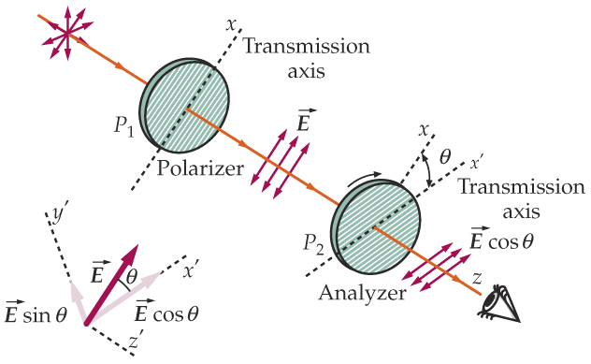
Example: two polarizers
This set of two linear polarizers produces LP (linearly polarized) light. What is the final intensity?
  P₁ transmits 1/2 of the unpolarized light:
  I₁ = 1/2 I₀
  P₂ projects out the E-field component parallel to x’ axis:
= 0 if θ = π/2
(i.e., crossed)

Slide 15
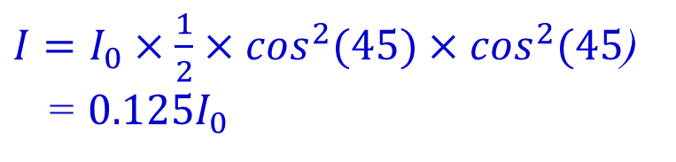
Quiz (bonus): Unpolarized light of intensity I₀ is sent through 3 polarizers, each of the last two rotated 45° from the previous polarizer so that the last polarizer is perpendicular to the first. What is the intensity transmitted by this system?
(hint: sin²(45°)=0.5)
a) 0.71 I₀
b) 0.50 I₀
c) 0.25 I₀
d) 0.125 I₀
e) 0
$I=I_{0}×\frac{1}{2}×\cos^{2}(45)×\cos^{2}(45$)
= ${0.125I}_{0}$

Slide 16
Backup

Slide 17
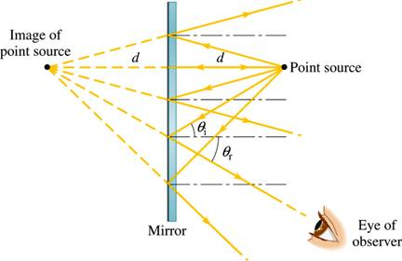
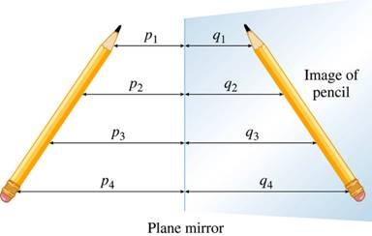
Image by Reflection from a Plane Mirror
point object
Only small fraction of reflected rays received.
Virtual image at same distance from but on the other side of the mirror as the object
it is called a virtual image since no rays actually go through the image,
extended object
An extended object can be broken into infinite number of point objects.
Image has the same height and
orientation as the object.
Notes:
A plane mirror preserves the physical characteristics of any object.

Slide 18
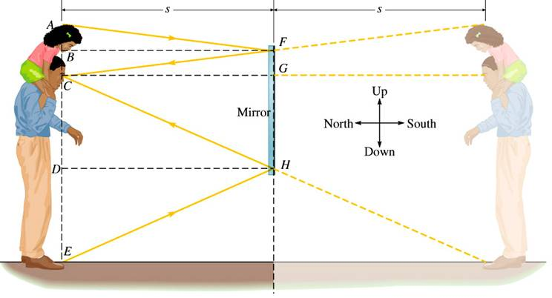
“Full Length” Mirror
Only half the object (and image) size is needed.

Slide 19
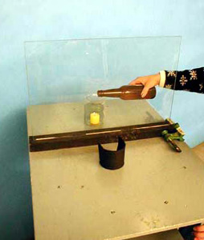
7A-05 Candle Illusion

Slide 20
Quiz (bonus)
A person is standing still 2 meters in front of a mirror, then the mirror is moved 1 meter towards him and then stopped. What’s the distance between the person and his image before and after the mirror is moved?
a) 2m and 1m
b) 3m and 2m
c) 4m and 2m
d) 5m and 4m

Slide 21
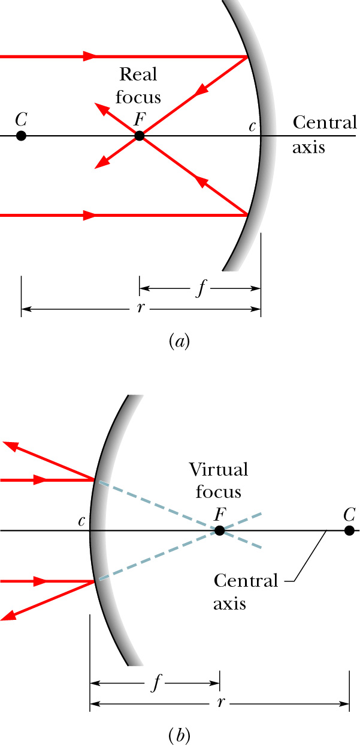
Focal Point of a Spherical Mirror
concave mirror:
When parallel rays incident upon a spherical mirror, the reflected rays or the extensions of the reflected rays all converge toward a common point, the focal point of the mirror. Distance f is the focal length.
Real focal point: the point to which the
reflected rays themselves pass through.
This is relevant for concave mirrors.
f
convex mirror
Virtual focal point: the point to which
the extensions of the reflected rays pass
through. This is relevant for convex
mirrors.
Rays can be traversed in reverse. Thus, rays which (would) pass through F and strike the mirror will emerge parallel to the central axis.
f

Slide 22
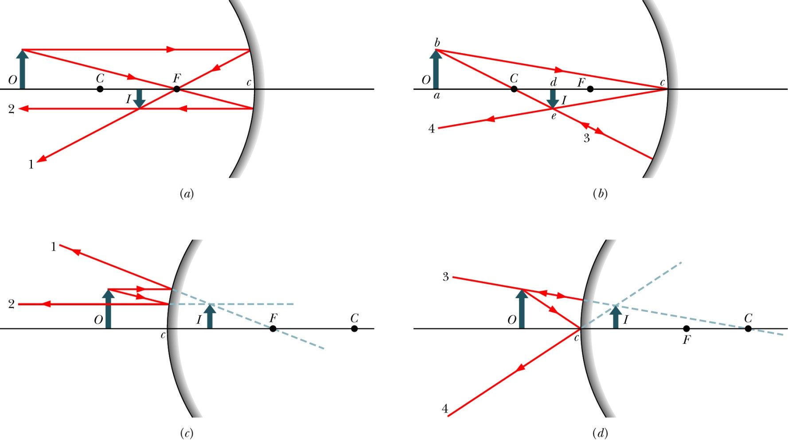
Locating Images
only using the parallel, focal, and/or radial rays.
Real images form on the side of a mirror where the objects are,
and virtual images form on the opposite side.

Slide 23
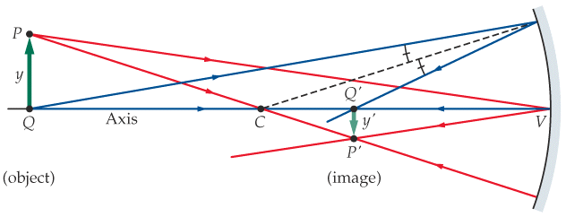
Mirror Equation and Magnification
(f = r/2)
s is positive if the object is in front of the mirror (real object)
s is negative if it is in back of the mirror (virtual object)
s’ is positive if the image is in front of the mirror (real image)
s’ is negative if it is in back of the mirror (virtual image)
m is positive if image and object have the same orientation (upright)
m is negative if they have opposite orientation (inverted)
f and r are positive if center of curvature in front of mirror (concave)
f and r are negative if it is in back of the mirror (convex)
Notes:
The equation applies to convex mirrors.
The equation applies to extended objects, as long as the spatial extension is small enough to preserve the validity of small angle approximation.
The sign convention needs to be followed.

Slide 24
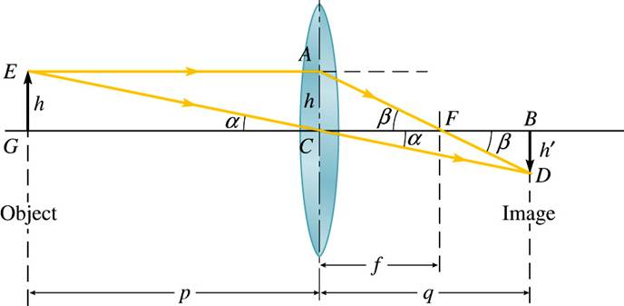
Lens Equation
( < 0 )
True for thin lens and paraxial rays.
magnification m = h’/h = - q/p

Slide 25
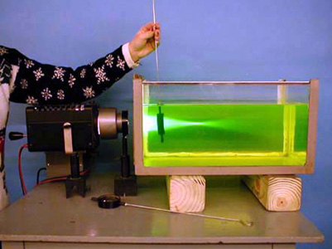
7A-31 Effect on Medium on Lens

Slide 26
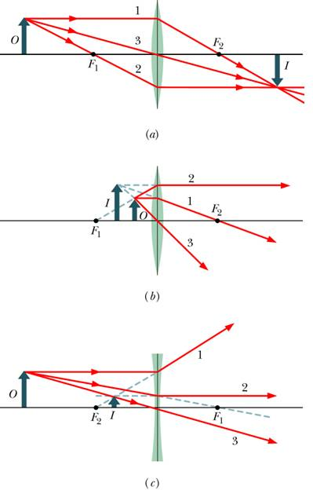
Signs in the Lens Equation for Thin Lenses
p is positive for real object
q is positive for real image
q is negative for virtual image
m is positive if image is upright
m is negative if image is inverted
f is positive if converging lens
f is negative if diverging lens
p is negative for virtual object

Slide 27
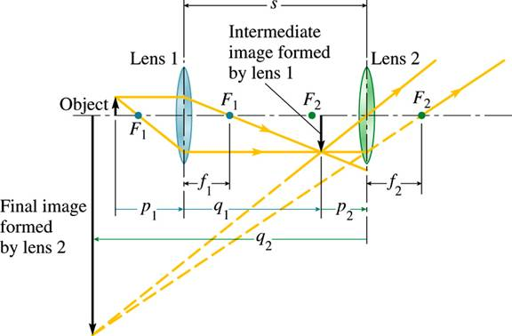
Lenses in Combination
First lens:
Second lens:
Total transverse magnification
In this example, p₁> 0, q₁> 0, p₂> 0, q₂< 0

