Slide 1
Final exam (focusing on chapter 9 – 19, excl. 17)
Time: Tue 05/04 3:30pm – 5:30pm
Location: physics building room 112
AOB
  multiple choice problems.
  Prepare your own scratch paper, pencils, erasers, etc.
  Use only pencil for the answer sheet
  Bring your own calculators
  No cell phones, no text messaging, no computers
  No crib sheet of any kind is allowed. Equation sheet will be provided.
When filling the scantron
  Write your name in the top respective field of the scantron sheet, sign your name on the signature line of the scantron sheet.
  Record your PUID number, which starts with “00”, on your scantron sheet.
  fill in bubbles below your name and ID fields
Notes:
Write your name in the top respective field of the scantron sheet, sign your name on the signature line of the scantron sheet.
Record your PUID number, which starts with “00”, on your scantron sheet.

Slide 2
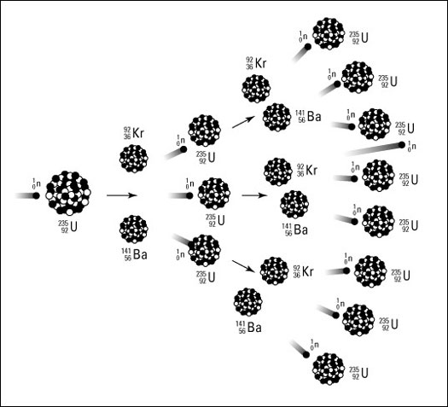
Each of these fission reactions is initiated by a neutron, and each reaction emits several more neutrons.
These neutrons can then initiate more fission reactions, etc. ➔ Chain Reactions.
A chain reaction can thus release enormous quantities of energy.
But achieving a chain reaction is difficult.
  Natural uranium is only 0.7% U-235; it is mostly U-238, which absorbs neutrons without fission.
  If too many neutrons are absorbed or escape, the chain reaction dies.

Slide 3
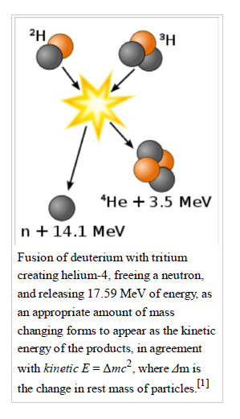

Fusion
Each fusion produce 17.6 MeV = $17.6×{10}^{6} eV ×1.6×{10}^{−19}$ J
= $2.8×{10}^{−12}$J
Each fission ~ $200 MeV$
$= 3.2×{10}^{−11}J$
Which is larger but a single U235 has a lot more nucleons than deuterium and tritium. Under the same mass, fusion will produce much more powerful energy than fission.

Slide 4

How much U-235 is needed to build a fission bomb as powerful as 20kiloton TNT ?
$20 kiloton=8.4×{10}^{13 }J.$
Each fission = $3.2×{10}^{−11}J$
One needs $2.6×{10}^{24} fissions, i.e.$ $U^{235} atoms.$
that is $2.6×{10}^{24}$/$6.02×{10}^{23} moles=4.3 moles$
M(U235) is 235 g/mole, which leads to 1kg U235.

Slide 5

How much Tritium is needed to build a fusion bomb as powerful as 20kiloton TNT ?
$20 kiloton=8.4×{10}^{13 }J.$
Each fusion =$2.8×{10}^{−12}$J
One needs $3.0×{10}^{25} fusions, i.e.$ $tritium atoms.$
that is $3.0×{10}^{25}$/$6.02×{10}^{23} moles=50 moles$
M(tritium) is 3 g/mole, which leads to 150g tritium.

Slide 6

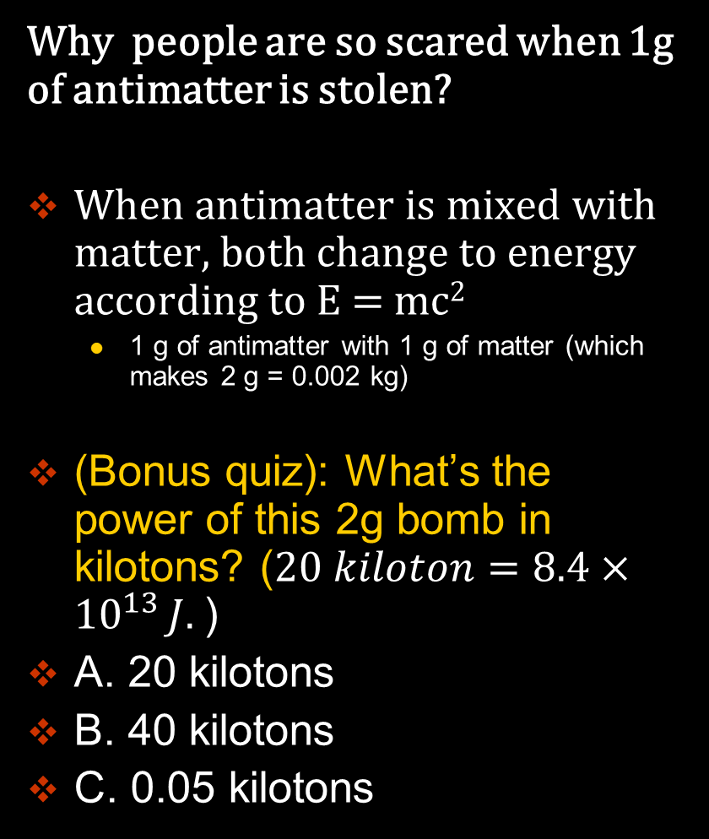
The antimatter bomb: the Sci-Fi Bomb
Why people are so scared when 1g of antimatter is stolen?
When antimatter is mixed with matter, both change to energy according to E = mc²
  1 g of antimatter with 1 g of matter (which makes 2 g = 0.002 kg)
(Bonus quiz): What’s the power of this 2g bomb in kilotons? ($20 kiloton=8.4×{10}^{13 }J.$)
A. 20 kilotons
B. 40 kilotons
C. 0.05 kilotons

Slide 7

The antimatter bomb: the Sci-Fi Bomb
Why people are so scared when 1g of antimatter is stolen?
When antimatter is mixed with matter, both change to energy according to E = mc²
  1 g of antimatter with 1 g of matter (which makes 2 g = 0.002 kg)
E= 0.002 x (300,000,000)² kg m²/s² = 1.8 x 10¹⁴ J
$20 kiloton=8.4×{10}^{13 }J.$
It’s as powerful as a 40kiloton TNT bomb.

Slide 8
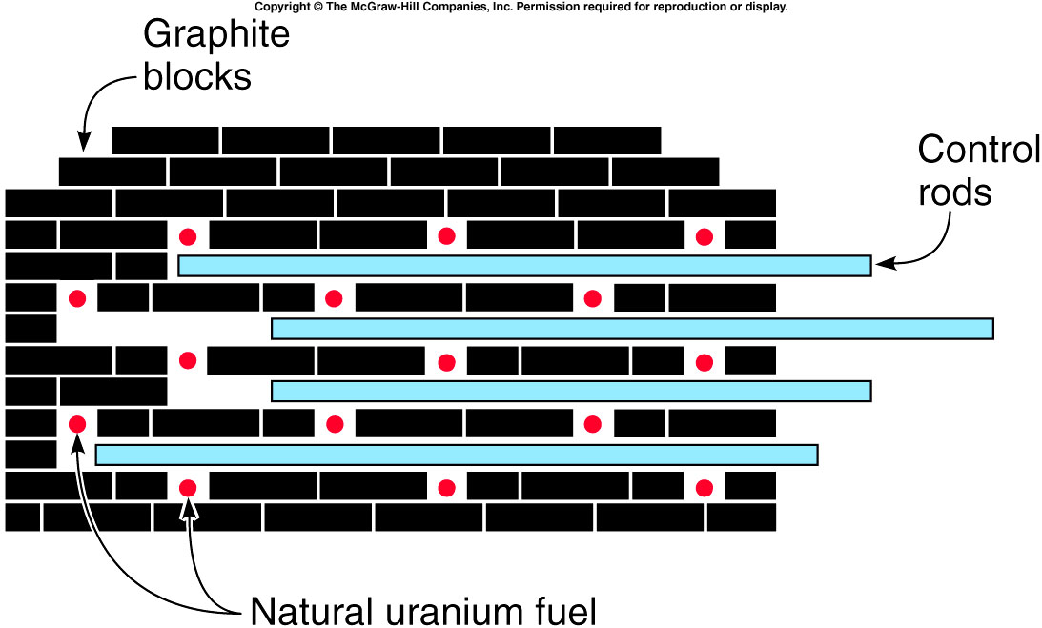
Nuclear Reactors
Fermi’s strategy to achieve a chain reaction with natural or slightly enriched uranium:
  Slow the neutrons down between fission reactions using a material called a moderator.
  Control rods are used to absorb the neutrons to slow the reaction as desired.
Fermi’s “pile” was the first human-produced nuclear reactor.
Graphite blocks served as the moderator.
Control rods were cadmium, but today’s reactors use boron.

Slide 9
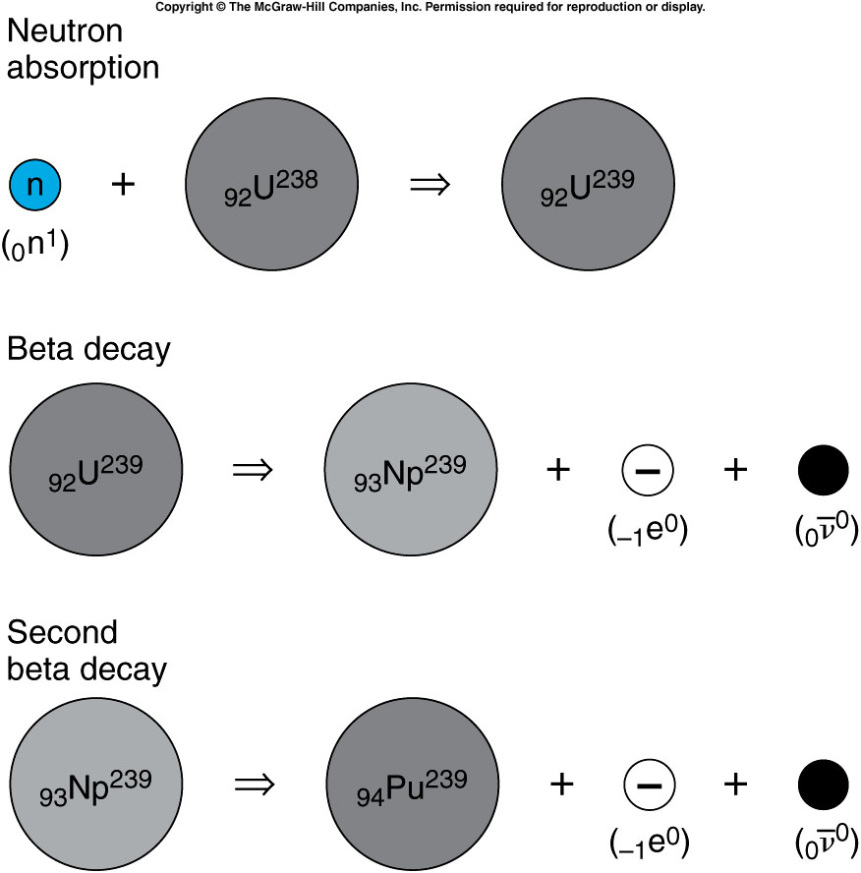
Although fission does not result when a U-238 nucleus absorbs a neutron, a series of reactions produces plutonium, the primary fuel in fission bombs.
half-life: 23 min
Plutonium-239 is relatively stable, with a half-life of 24,000 years.
The production of plutonium-239 is a by-product of a reactor.
It can be separated from the uranium using chemical techniques, since it is a different element.
half-life: ~2 days
half-life: ~24000 years
Notes:
In the fuel rod, most are U238.
Np: neptunium-239.

Slide 10
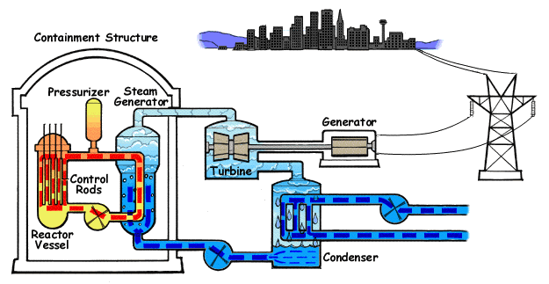

Modern Power Reactors
Most reactors today use ordinary (light) water as the moderator.
This requires enrichment of the fuel to 3% U-235 (nature: ~0.7%)
The advantage is that the water can also be used as a coolant.
Animated Diagram of a Pressurized Water Reactor. (PWR)

Slide 11
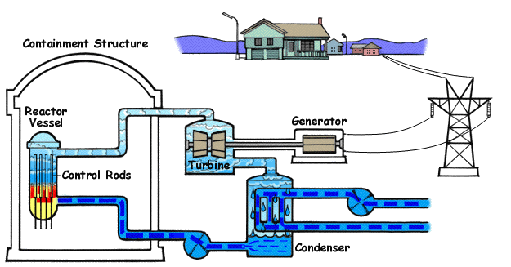

Modern Power Reactors
Most reactors today use ordinary (light) water as the moderator.
This requires enrichment of the fuel to 3% U-235 (nature: ~0.7%)
The advantage is that the water can also be used as a coolant.
Animated Diagram of a Boiling Water Reactor (BWR)

Slide 12
(Bonus quiz): Do the control rods in a nuclear reactor absorb or emit neutrons?
They absorb neutrons.
They emit neutrons.
They both absorb and emit neutrons.
They neither absorb nor emit neutrons.
    The control rods in a reactor absorb neutrons and are removed or inserted to control the number of neutrons in the chain reaction.

Slide 13
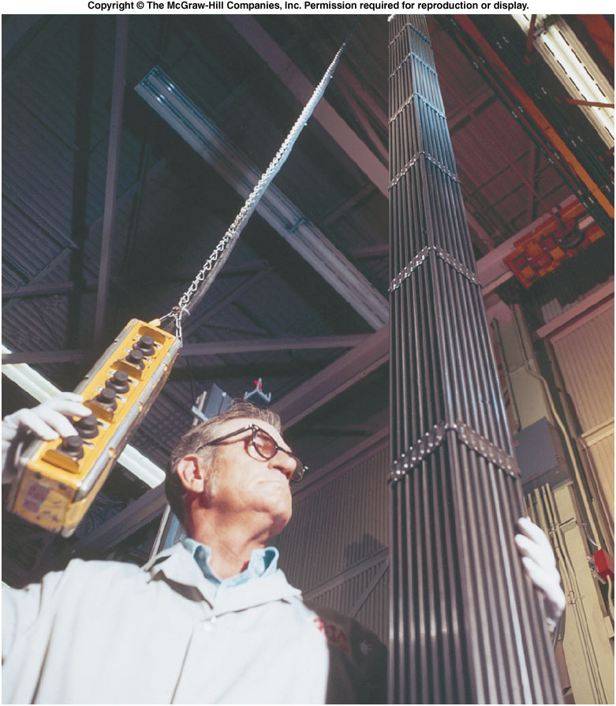
Safety and Environmental Concerns
Fuel rods must be replaced as the fuel is used up and fission products build up.
The spent fuel rods containing uranium, plutonium, and radioactive fission fragments must be stored or disposed of carefully.
  Our current policy is to bury
  these radioactive materials in
  a solid rock formation.
  Most of the fission fragments
  have half-lives of several years
  or less, and do not have to be
  isolated nearly as long as
  plutonium-239 does.
  In spite of the need for careful
  waste disposal, nuclear power
  still causes far lass atmospheric
  pollution (and no greenhouse
  gases) than burning fossil fuels
  such as coal or oil.

Slide 14
Chernobyl and Fukushima Reactor
The nuclear reactor at Chernobyl use Graphite as the moderator, and water was the coolant. Because the coolant water was not also the moderator, the loss of the water would actually increase the reaction.
The Fukushima I Nuclear reactors are BWR.
The BWR is a lot safer since water also serves as moderator. Without moderator, the chain reaction rate decrease.
But without the coolant, i.e. the water, the decay heat can leads to reactor meltdown.
Further reading:
  http://en.wikipedia.org/wiki/Fukushima_I_nuclear_accidents
  http://en.wikipedia.org/wiki/Chernobyl

Slide 15
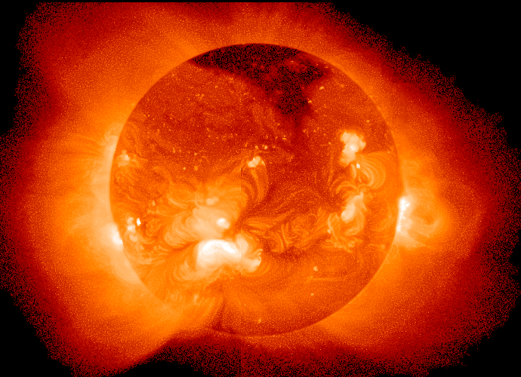
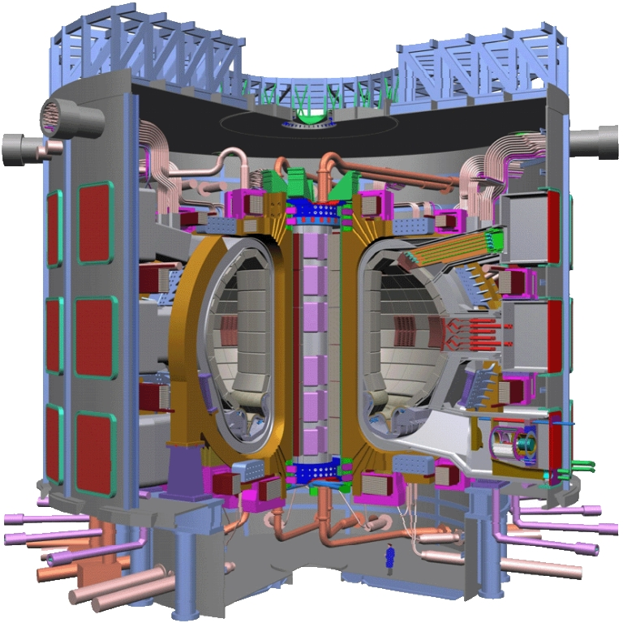
Can we generate power from controlled fusion?
The Sun is a fusion reactor (not controlled).
₃Li⁶ + ₀n¹→₁H³ + ₂He⁴
1 H² per 6420 H¹ in nature
  1 egg cut of H² in a bath tub of water
1 egg cut of H² + ₃Li⁶ in a laptop battery ➔200000 kW.hour
ITER (the International Thermonuclear Experimental Reactor)

Slide 16
(Bonus) Quiz: If the coolant material is also the moderator material like in the light water reactor (BWR or PWR), can the loss of coolant ever lead to a meltdown in a reactor using natural uranium?
Yes.
No.

Slide 17
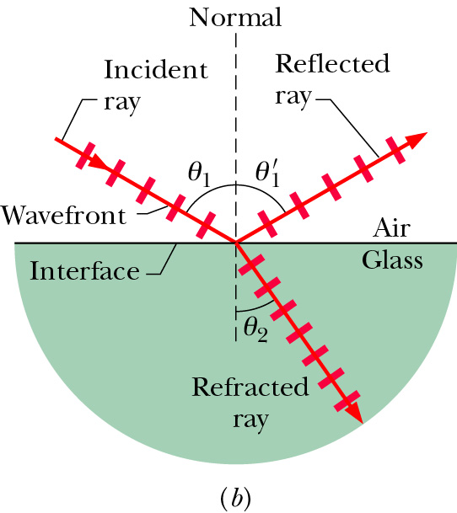

Law of reflection and Refraction
$$θ_{1}^{}=θ_{1}^{′}$$
medium | n
vacuum | 1
air | 1.0003
water | 1.33
glass | 1.5 – 1.66
Snell’s Law

Slide 18
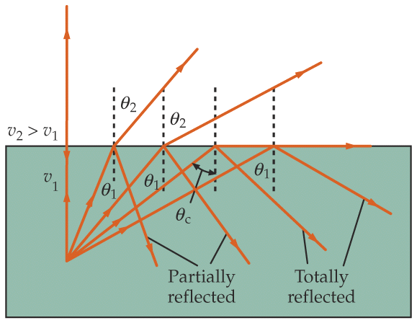
Total Internal Reflection
All light can be reflected, none refracting, when light travels from a medium of higher to lower indices of refraction.
medium 2
e.g., glass (n=1.5) to air (n=1.0)
But θ cannot be greater than 90° !
medium 1
Demos: 7A-23 Total Internal Reflection
In general, if sin θ₁ > (n₂ / n₁), we have NO refracted ray;
we have TOTAL INTERNAL REFLECTION.
Critical angle above which this occurs.

Slide 19
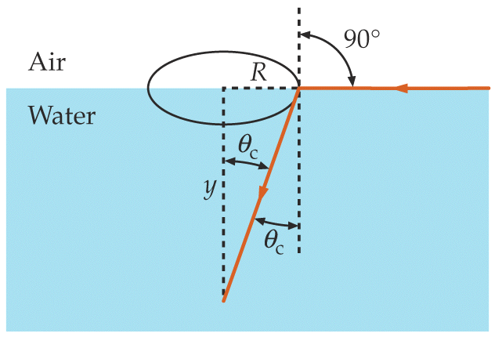
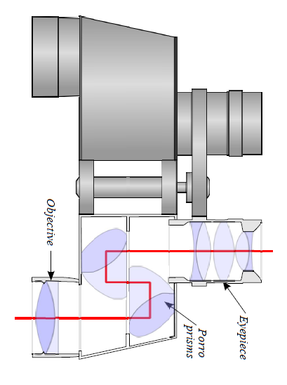
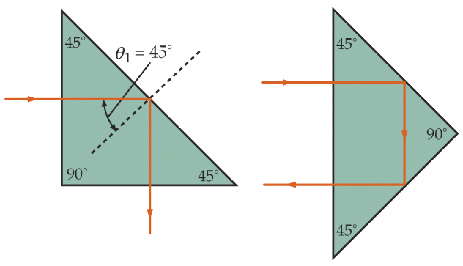
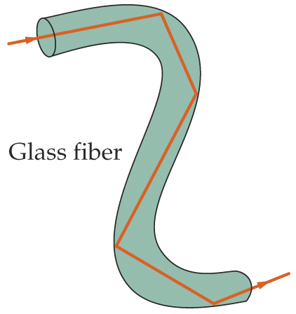
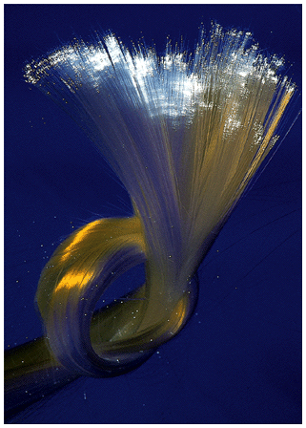
Examples
Fish’s view of the world
Prism used as reflectors
(e.g., glass with n=1.5)
Optical fiber
(e.g., glass with n=1.5)
in air
in water
Notes:
Field of vision

Slide 20
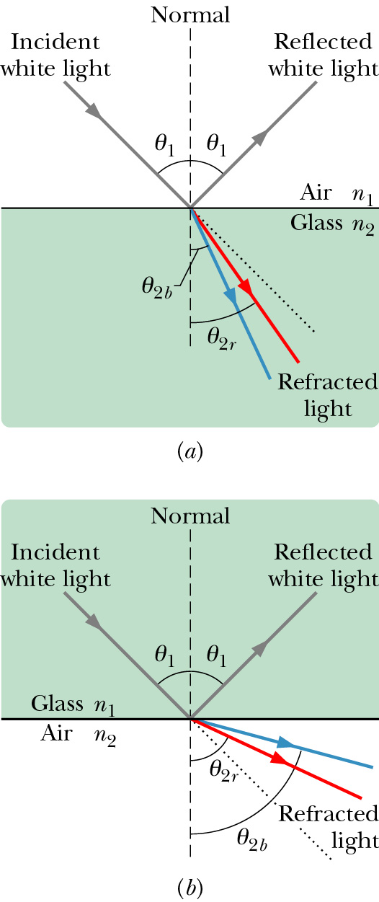
Chromatic Dispersion
The index of refraction of a medium is usually a function of the wavelength of the light. It is larger at shorter wavelengths.
Consequently, a light beam consisting of rays of different wavelength (e.g., sun light) will be
refracted at different angles at the interface of
two different media. This spreading of light is
called chromatic dispersion.
White light: It consists of components of nearly all the colors in the visible spectrum with approximately uniform intensities.
The component of a beam of white light with shorter wavelength tends to be bent more.
Spectrometer (such as a prism)

Slide 21
Quiz (Bonus)
Which of the following diagrams correctly demonstrates chromatic dispersion
Left
right
air
blue
red
Glass
Glass
red
blue

Slide 22
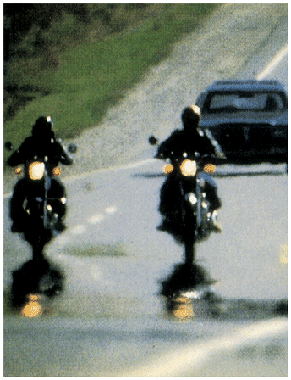
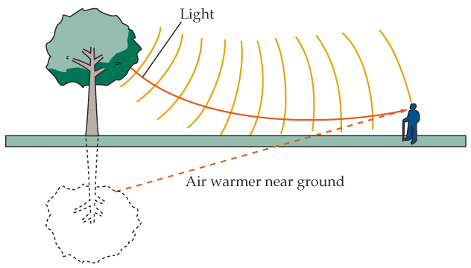
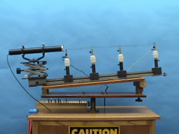
Mirage and Rainbow
Mirage
7A-20 Hot Air Refraction
Notes:
Ripples,
Using a cylindrical lens, a laser beam is spread into a horizontal line. The spread beam passes over a glowing hot wire. As the wire is heated to red hot, the beam, projected onto the wall, shows strong distortions resulting from the varying index of refraction of the turbulent air.
Directions: Turn on the laser to project the horizontal line on the far wall. (You might need to adjust the cylindrical lens up or down a bit.) The beam should be passing just above the wire coil. Slowly turn up the rheostat until the wire starts to glow red. (Do not go beyond this point significantly or you will likely burn out the wire.) Waving a card or fan over the wire will cause further disturbances in the air and create an undulating line on the wall.
Suggestions for Presentation: Ask the students if they have ever observed the distortions associated with the air over a hot pavement or above the desert sands, etc. Discuss what causes a light ray to change direction, other than reflection. (There must be a change in the index of refraction.) The heated air causes turbulence that is sufficient to create considerable changes in the index of refraction locally. The air outside this area is fairly stable and does not undergo index changes of a magnitude to be readily observable.
tch the rainbow.

Slide 23
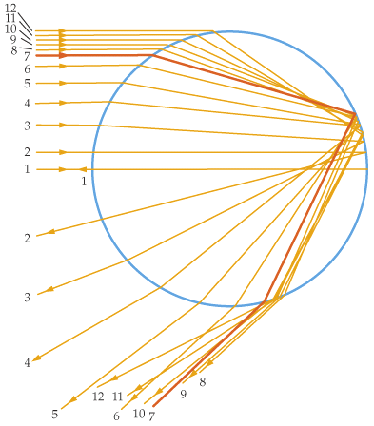
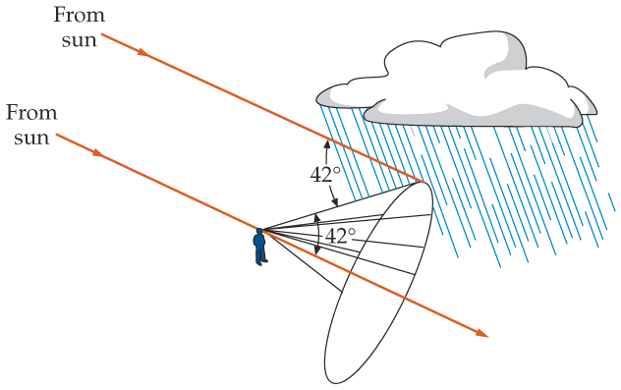
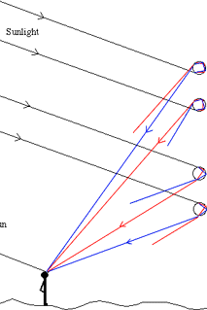
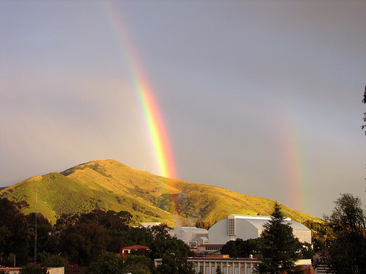
Mirage and Rainbow
water droplet
red is outside.
intensity max at 42°
rainbow
Notes:
Ripples, you can never catch the rainbow.

Slide 24
Quiz (Bonus)
The refraction index of water and glass are 1.33 and 1.5 respectively. The refraction index of air is ~1.0. When light incident from air to the glass. What’s the critical angle.
41.8 degree
62.5 degree
There’s no critical angle in this case.
Quiz (Bonus)
When light incident from glass to water. What’s the critical angle.
41.8 degree
62.5 degree
There’s no critical angle in this case.

