Slide 1
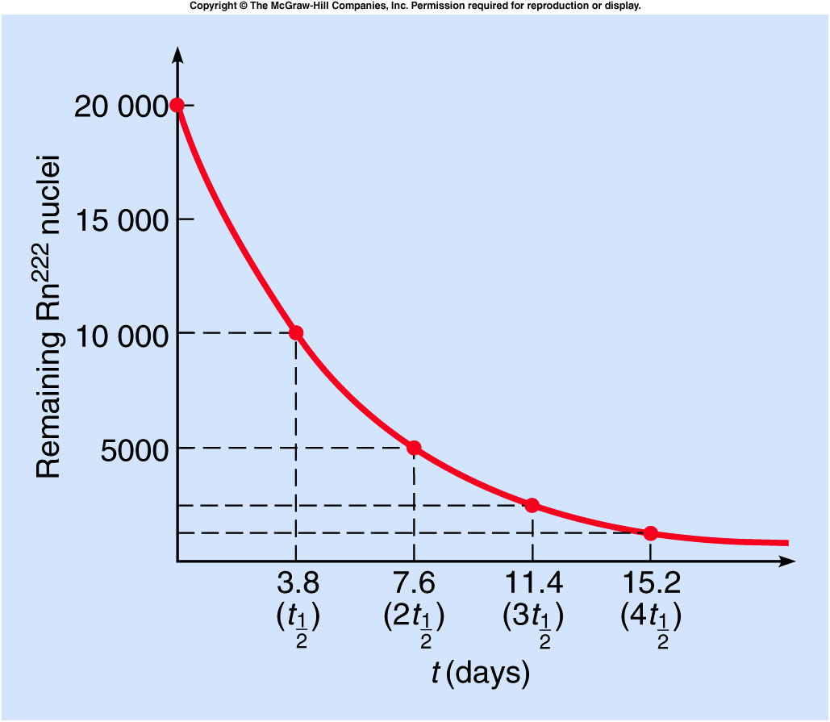
Different radioactive isotopes have different average times that elapse before they decay.
The half-life is the time required for half of the original number of atoms to decay.
  For example, the half-life of radon-222 is about 3.8 days.
If we start with 20,000 atoms of radon-222, 3.8 days later we would have 10,000 remaining.
After 7.6 days, half of the 10,000 would have decayed, leaving 5,000.
After three half-lives, only 2500 would remain.
After four half-lives, only 1250 would remain.

Slide 2
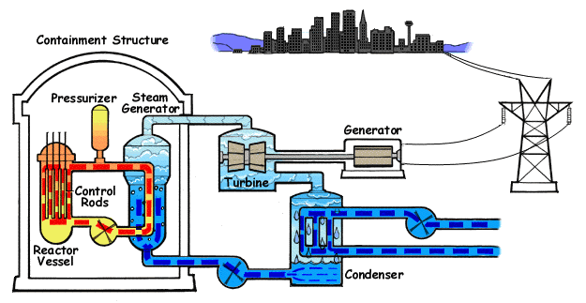

Modern Power Reactors
Most reactors today use ordinary (light) water as the moderator.
This requires enrichment of the fuel to 3% U-235 (nature: ~0.7%)
The advantage is that the water can also be used as a coolant.
Animated Diagram of a Pressurized Water Reactor. (PWR)

Slide 3
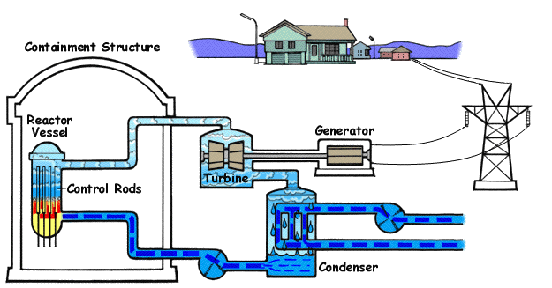

Modern Power Reactors
Most reactors today use ordinary (light) water as the moderator.
This requires enrichment of the fuel to 3% U-235 (nature: ~0.7%)
The advantage is that the water can also be used as a coolant.
Animated Diagram of a Boiling Water Reactor (BWR)

Slide 4
Chernobyl and Fukushima Reactor
The nuclear reactor at Chernobyl use Graphite asthe moderator, and water was the coolant. Because the coolant water was not also the moderator, the loss of the water would actually increase the reaction.
The Fukushima I Nuclear reactors are BWR.
The BWR is a lot safer since water also serves as moderator. Without moderator, the chain reaction rate decrease.
But without the coolant, i.e. the water, the decay heat can leads to reactor meltdown.
Further reading:
  http://en.wikipedia.org/wiki/Fukushima_I_nuclear_accidents
  http://en.wikipedia.org/wiki/Chernobyl

Slide 5
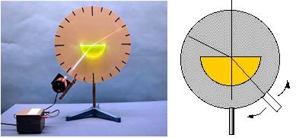
7A-21 Refraction

Slide 6
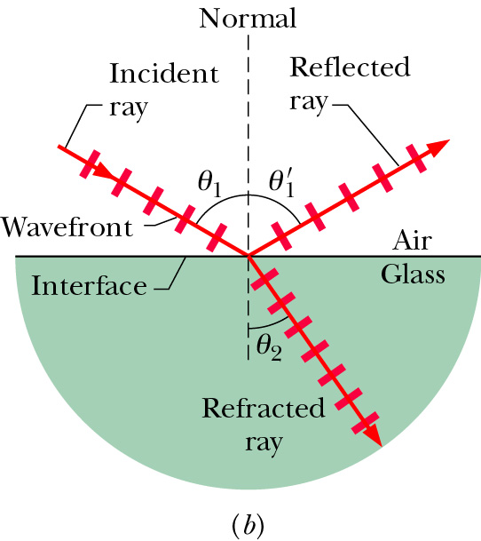
Speed of light in medium
Light can travel through matter medium as well as free space (vacuum). Inside matter, the speed of light v is generally less than c.
index of refraction
When light encounters an interface between different media, it can generally both reflect and refract.

Slide 7

Law of reflection and Refraction
$$θ_{1}^{}=θ_{1}^{′}$$
medium | n
vacuum | 1
air | 1.0003
water | 1.33
glass | 1.5 – 1.66
Snell’s Law

Slide 8
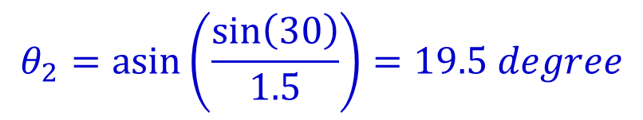
Exercise
The refraction index for air and glass are 1.0 and 1.5, respectively. The incident angle θ₁ is 30º, what are the reflection angle θ’₁ and refraction angle θ₂ ?
A). θ’₁ =30º and θ₂=19.5º
B). θ’₁ =30º and θ₂=15º
C). θ’₁ =19.5º and θ₂=30º
D). θ’₁ =15º and θ₂=19.5º
E). θ’₁ =30º and θ₂=22.5º
$$θ_{2}=\operatorname{asin}\left(\frac{\sin\left(30\right)}{1.5}\right)=19.5 degree$$

Slide 9
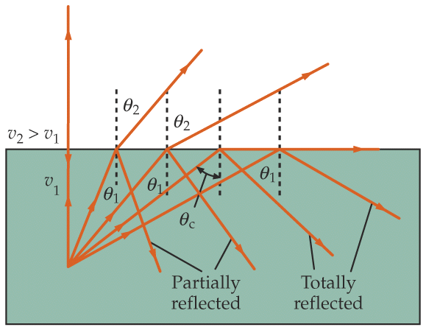
Total Internal Reflection
All light can be reflected, none refracting, when light travels from a medium of higher to lower indices of refraction.
medium 2
e.g., glass (n=1.5) to air (n=1.0)
But θ cannot be greater than 90° !
medium 1
In general, if sin θ₁ > (n₂ / n₁), we have NO refracted ray;
we have TOTAL INTERNAL REFLECTION.
Critical angle above which this occurs.

Slide 10
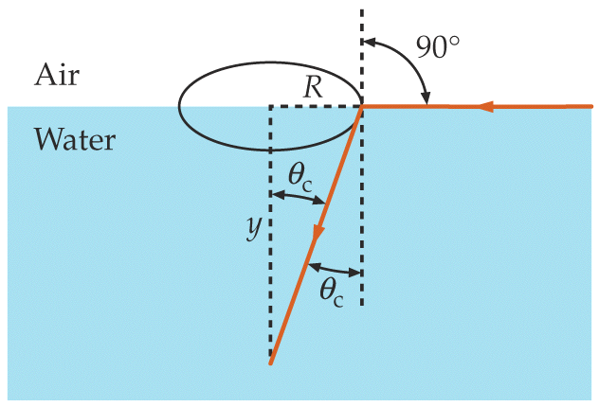
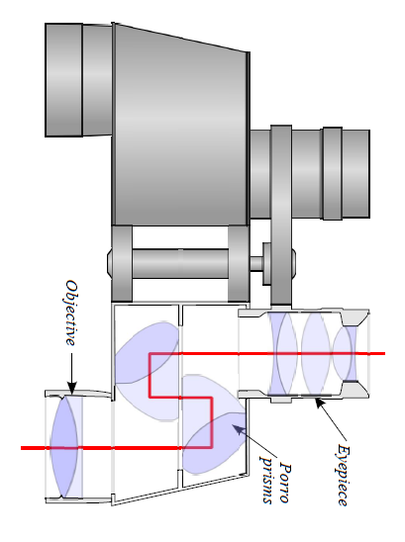
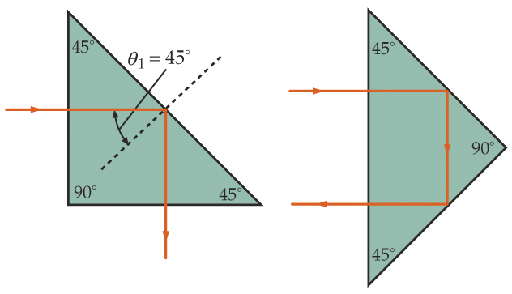
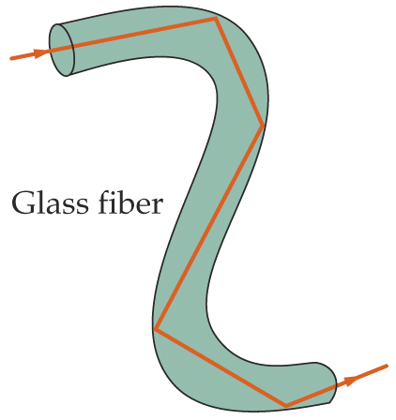
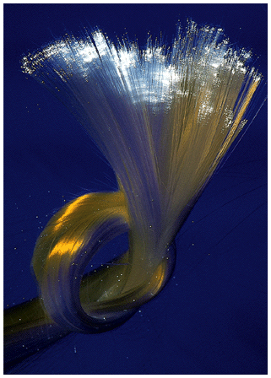
Examples
Fish’s view of the world
Prism used as reflectors
(e.g., glass with n=1.5)
Optical fiber
(e.g., glass with n=1.5)
in air
in water
Notes:
Field of vision

Slide 11
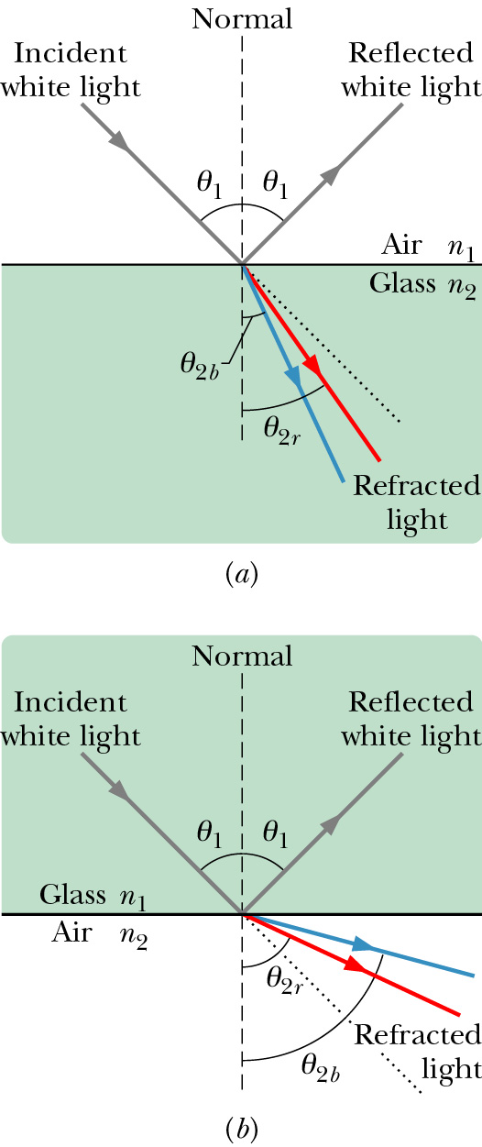
Chromatic Dispersion
The index of refraction of a medium is usually a function of the wavelength of the light. It is larger at shorter wavelengths.
Consequently, a light beam consisting of rays of different wavelength (e.g., sun light) will be
refracted at different angles at the interface of
two different media. This spreading of light is
called chromatic dispersion.
White light: It consists of components of nearly all the colors in the visible spectrum with approximately uniform intensities.
The component of a beam of white light with shorter wavelength tends to be bent more.
Spectrometer (such as a prism)

Slide 12
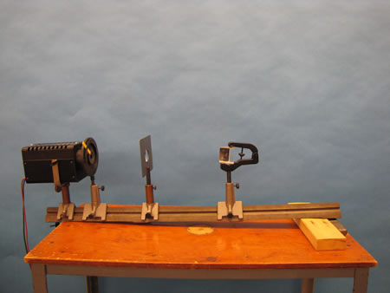
7A-22 Refraction by Prisms

Slide 13
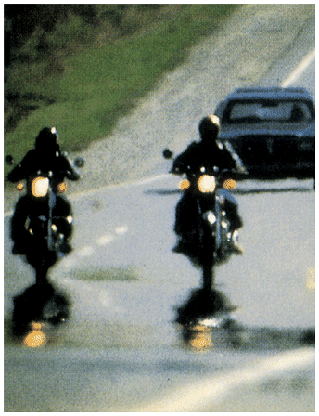
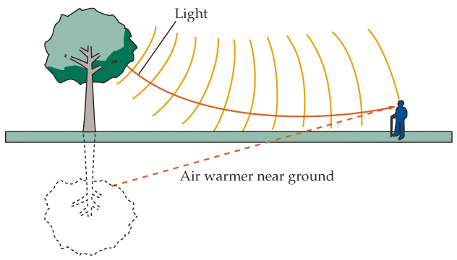
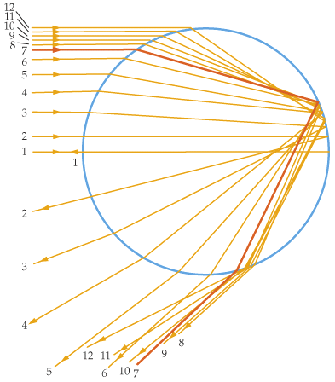
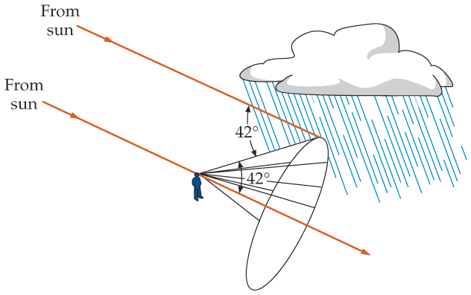
Mirage and Rainbow
Mirage
water droplet
red is outside.
intensity max at 42°
rainbow
Notes:
Ripples, you can never catch the rainbow.

Slide 14
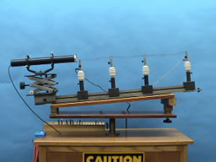
7A-20 Hot Air Refraction
Notes:
Glowing hot wire, ripples.

Slide 15
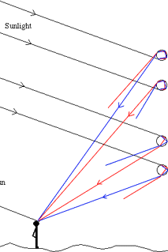
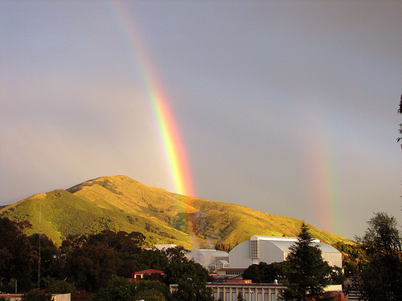
Double Rainbow
Secondary rainbow
Primary rainbow

Slide 16
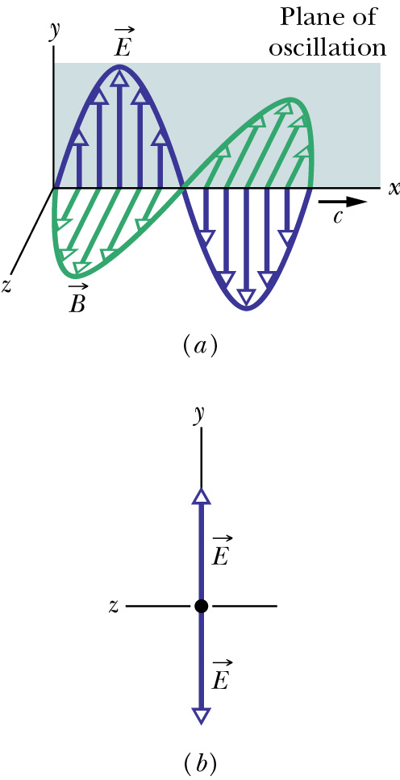
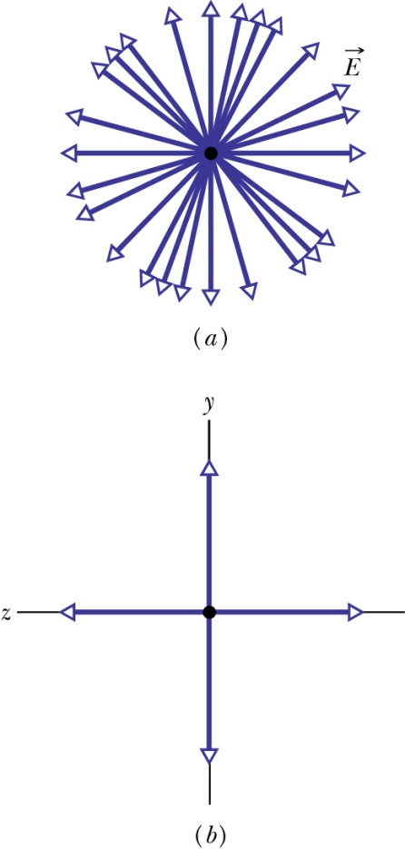
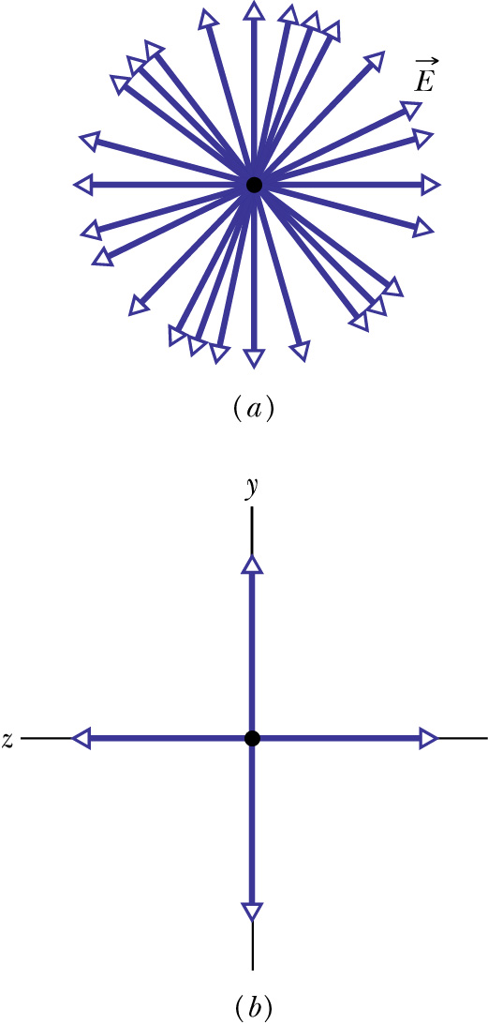
Polarization of Electromagnetic Waves
Polarization is a measure of the degree to which the electric field (or the magnetic field) of an electromagnetic wave oscillates preferentially along a particular direction.
Linear combination of many linearly polarized rays of random orientations
partially polarized
unpolarized
linearly polarized
components
Looking at E head-on
unequal y- and z-amplitudes
equal y- and z-amplitudes

Slide 17
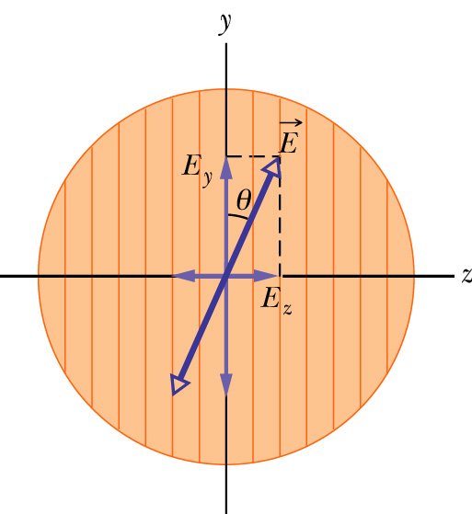
Polarizer: polarization by absorption
An electric field component parallel to the transmission axis is passed by a polarizer; a component perpendicular to it is absorbed.
transmission axis
dichroism (tourmaline, polaroid,…)
So if linearly polarized beam with E is incident on a polarizer as shown,
Zero if θ=π/2, I₀ if θ=0
If unpolarized beam is incident instead,
Polarization can rotate in time if linearly polarized beams of different phases are combined.

Slide 18
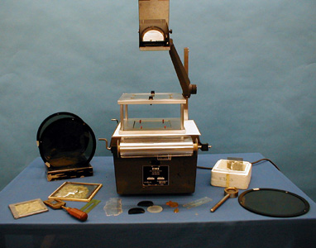
7B-22 Polarizer Effects

Slide 19
Exercise
A beam of un-polarized lights with intensity I is sent through two polarizers with transmission axis perpendicular to each other. What’s the outgoing light intensity?
½ I
2 I
0
1.5 I

