Slide 1
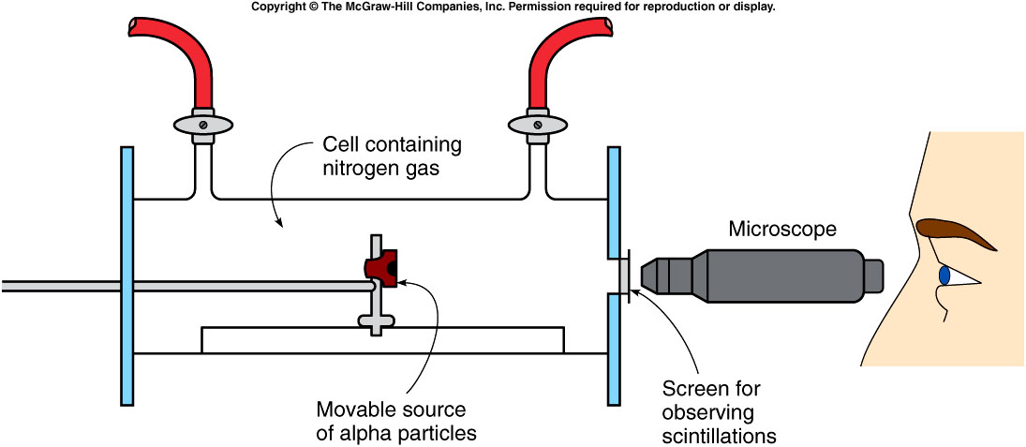
The Structure of the Nucleus
Rutherford uncovered the first nuclear building block.
  A beam of alpha particles scattered off nitrogen gas.
  A new particle emerged that was positively charged like the alpha particles, but behaved more like the hydrogen nuclei previously observed in other experiments.

Slide 2
Hydrogen nuclei were being emitted from a gas cell containing only nitrogen.
Could the hydrogen nuclei actually be a basic constituent of the nucleus of other elements?
We now call this particle a proton.
  Charge +e = 1.6 x 10⁻¹⁹ C
  Mass = 1/4 mass of alpha particle, 1835 x mass of electron

Slide 3
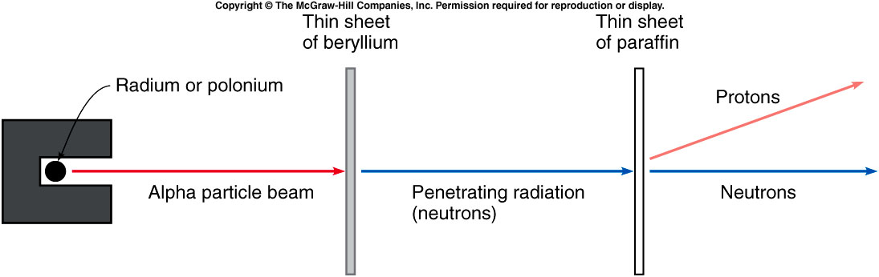
What other particles made up the nucleus?
Bothe and Becker bombarded thin beryllium samples with alpha particles.
  A very penetrating radiation was emitted.
  Originally assumed to be gamma rays, this new radiation proved to be even more penetrating.
Chadwick used the penetrating emission from the alpha bombardment of beryllium to bombard a piece of paraffin.
Notes:
Paraffin wax contains mostly carbon and proton.

Slide 4
Protons emerged from the paraffin when placed in the path of the penetrating radiation coming from the beryllium.
  This indicated a new neutral particle with a mass equal to the proton was colliding with protons in the paraffin.
This new particle was called a neutron.
  No charge -- electrically neutral
  Mass very close to the proton’s mass

Slide 5
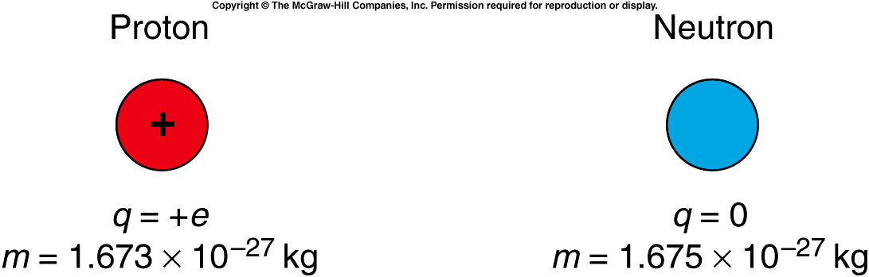
The basic building blocks of the nucleus are the proton and the neutron.
  Their masses are nearly equal.
  The proton has a charge of +1e while the neutron is electrically neutral.
This explains both the charge and the mass of the nucleus.
  An alpha particle with charge +2e and mass 4 x mass of the proton is composed of two protons and two neutrons.
  A nitrogen nucleus with a mass 14 times the mass of a hydrogen nucleus and a charge 7 times that of hydrogen is composed of seven protons and seven neutrons.

Slide 6
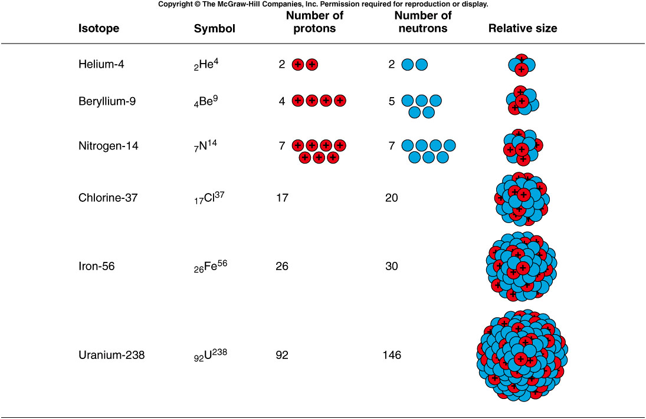
Notes:
Mention a little about the strong interaction. Electric interaction repel each other but the nucleus is still stable.

Slide 7
This also explains isotopes.
  Atoms of the same element can have different values of nuclear mass.
    Different isotopes have the same number of protons in the nucleus, but different numbers of neutrons.
    Two common isotopes of chlorine both have 17 protons, but one has 18 neutrons and the other has 20 neutrons.
  The chemical properties of an element are determined by the number and arrangement of the electrons outside of the nucleus.
  For a neutral atom with a net charge of zero, the number of electrons outside the nucleus must equal the number of protons inside the nucleus. This is the atomic number.
  The total number of protons and neutrons are called mass number
Notes:
Chemical properties determined by the number of electrons. Different elements have similar chemical properties. ➔ isotopes.

Slide 8
Plutonium-239 is a radioactive isotope of plutonium produced in nuclear reactors.
Plutonium has an atomic number of 94.
How many protons and how many neutrons are in the nucleus of this isotope?
94 protons, 94 neutrons
94 protons, 145 neutrons
145 protons, 94 neutrons
94 protons, 239 neutrons
239 protons, 94 neutrons
With an atomic number of 94, all isotopes of plutonium have 94 protons.
The isotope plutonium-239 has 239 - 94 = 145 neutrons.

Slide 9
Radioactive Decay
Becquerel discovered natural radioactivity in 1896.
By 1910, Rutherford and others demonstrated that one element was actually being changed into another during radioactive decay.
The nucleus of the atom itself is modified when a decay occurs.
  For example, Marie and Pierre Curie isolated the highly radioactive element radium which emitted primarily alpha particles.
Notes:
Are all the nucleus stable?
Becquerel found some nature material can expose the photographic plate wrapped in the dark box.

Slide 10
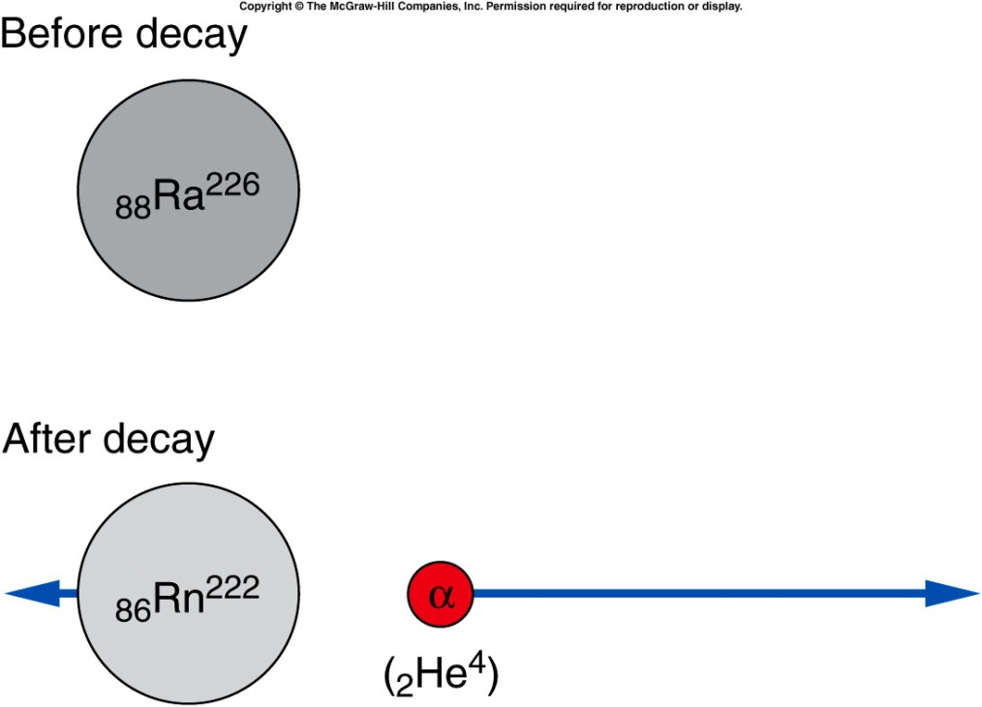
  The dominant isotope of radium contains a total of 226 nucleons: ₈₈Ra²²⁶
    The atomic number, 88, is the number of protons.
    The mass number, 226, is the total number of protons and neutrons.
  When radium-226 undergoes alpha decay, it emits an alpha particle (2 protons and 2 neutrons).
    The nucleus remaining after the decay has 88 - 2 = 86 protons, 226 - 4 = 222 nucleons, and 222 - 86 = 136 neutrons.
    This is the element radon-222.

Slide 11
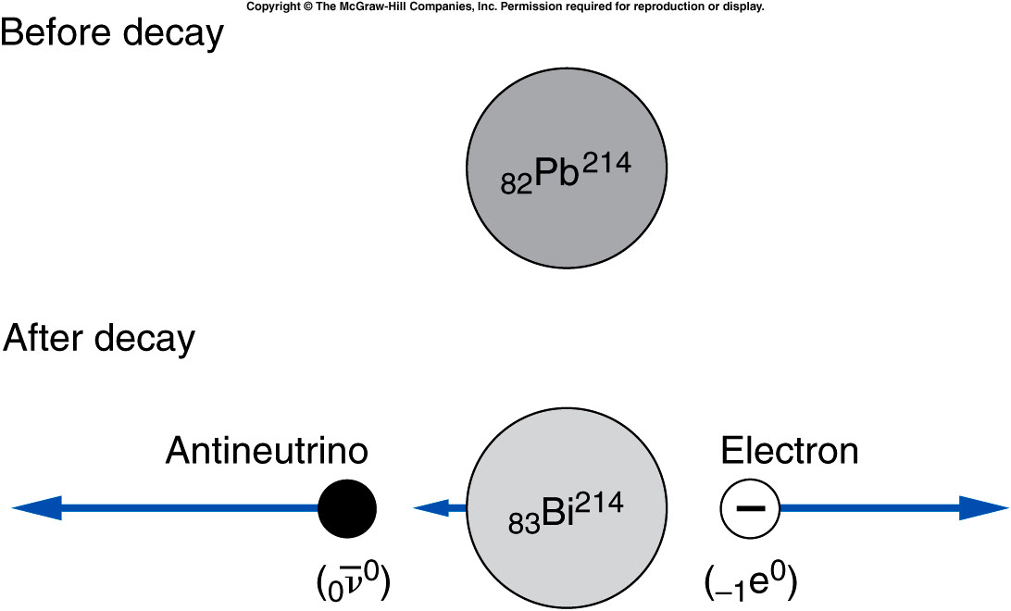
Beta decay is the emission of either an electron or a positron (the electron’s antiparticle).
  For example, lead-214 emits an electron.
  One of the neutrons inside the nucleus changes into a proton, yielding a nucleus with a higher atomic number.
  In the process, an electron is emitted (to conserve charge) and a neutrino (or in this case, an antineutrino, the neutrino’s antiparticle) is emitted to conserve momentum.

Slide 12
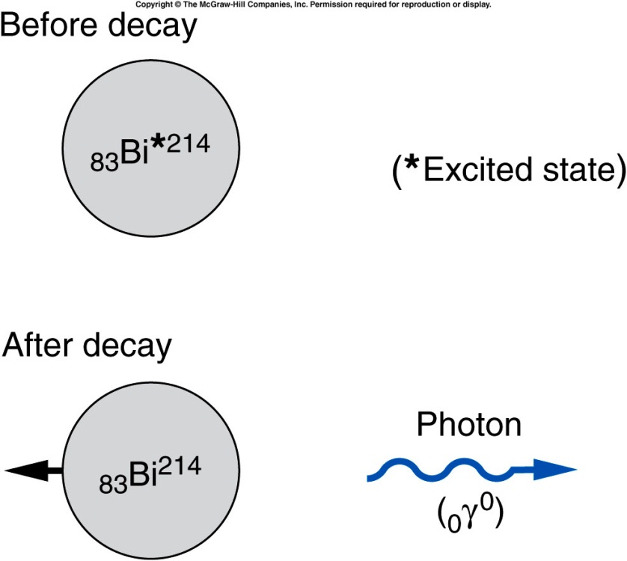
Gamma decay is the emission of a gamma particle or photon.
  The number of protons and of total nucleons does not change.
  The nucleus decays from an excited state to a lower energy state.
  The lost energy is carried away by the photon.
Notes:
Bi: Bismuth

Slide 13
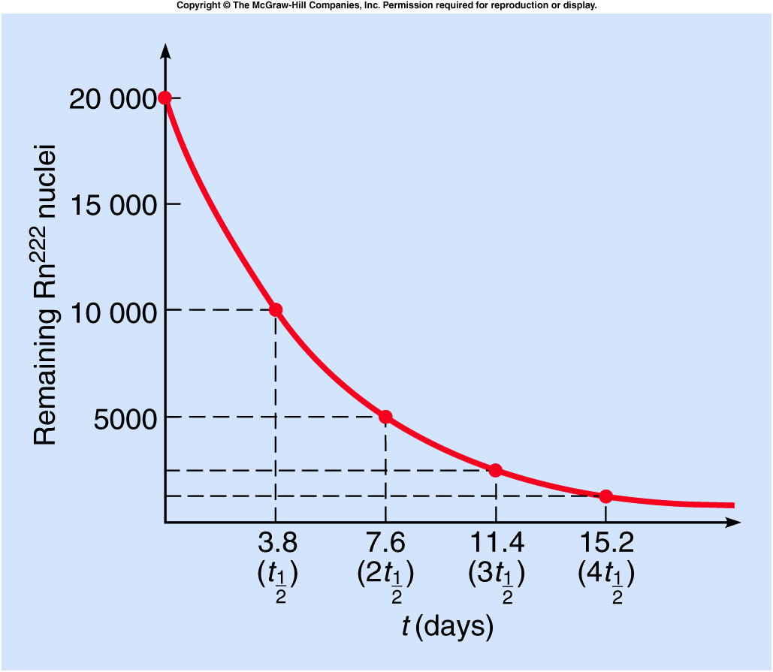
Different radioactive isotopes have different average times that elapse before they decay.
The half-life is the time required for half of the original number of atoms to decay.
  For example, the half-life of radon-222 is about 3.8 days.
If we start with 20,000 atoms of radon-222, 3.8 days later we would have 10,000 remaining.
After 7.6 days, half of the 10,000 would have decayed, leaving 5,000.
After three half-lives, only 2500 would remain.
After four half-lives, only 1250 would remain.

Slide 14
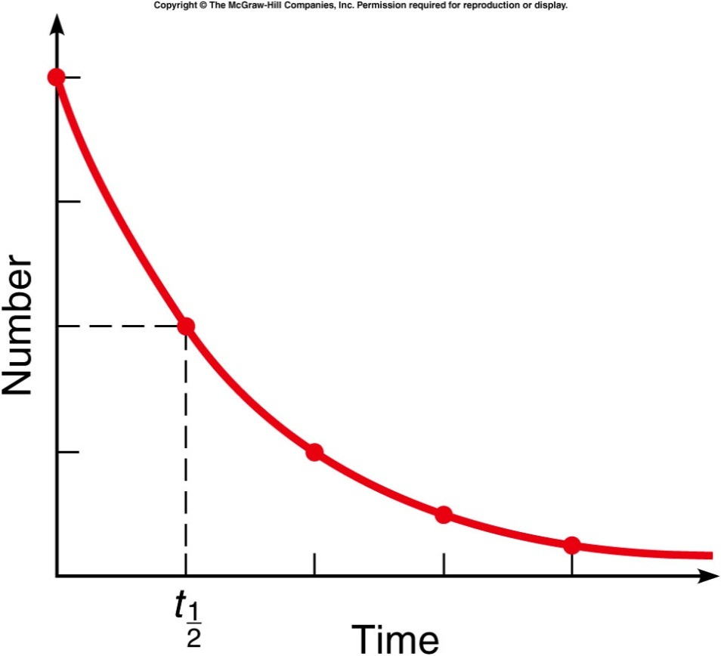
If we start with 10,000 atoms of a radioactive substance with a half-life of 2 hours, how many atoms of that element remain after 4 hours?
5,000
2,500
1,250
625
0
After 2 hours (one half-life), half of the original 10,000 atoms have decayed, leaving 5,000 atoms of the element.
After 4 hours (two half-lives), half of that remaining 5,000 atoms have decayed, leaving 2,500 atoms of the original element.

Slide 15
We are exposed to radiation every day.
How much exposure is likely to be dangerous?
“Rem” stands for “roentgen equivalent in man” and is a unit for measuring amounts of ionizing radiation.
A whole-body dose of 600 rems is lethal.
Currently radiation workers are allowed no more than 5 rems/yr.
Smaller doses are measured in millirems (mrems).
http://www.new.ans.org/pi/resources/dosechart/
Natural sources | mrems/yr
inhaled radon | 200
cosmic rays | 27
terrestrial radioactivity | 28
internal radioactivity | 40
Total: | 295
Human-produced sources | mrems/yr
medical | 53
consumer products | 10
other | 1
Total: | 64
Notes:
Radiation like small bullet. It can kill cells.

Slide 16

Mass and Energy
$$E=m×c^{2}$$
Mass and energy are related according to above equation.
Notes:
Now we are going into a different area. Nuclear reaction.

Slide 17
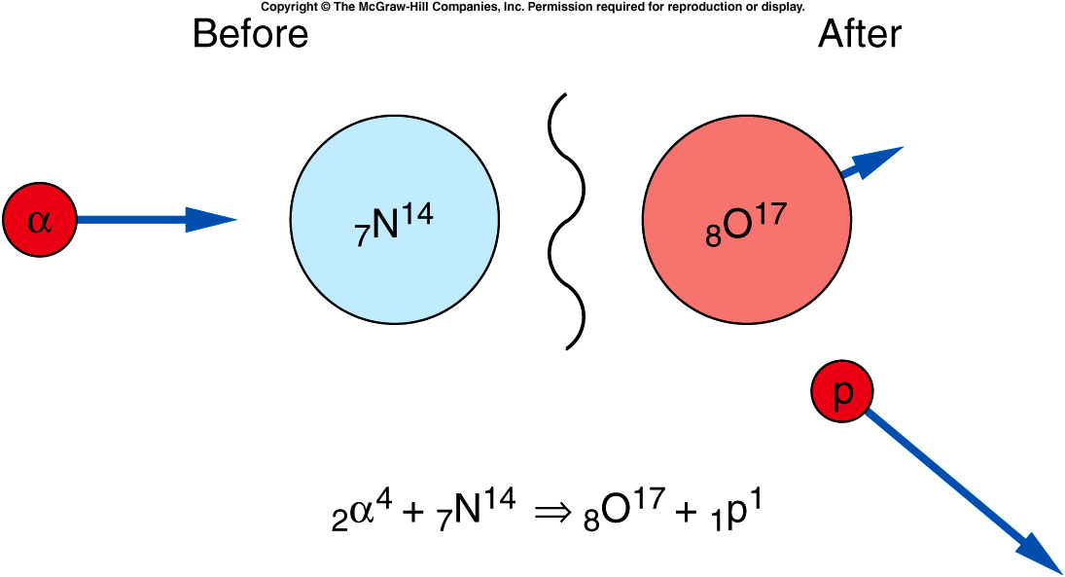
Nuclear Reactions and Nuclear Fission
In addition to spontaneous radioactive decays, changes in the nucleus may be produced experimentally through nuclear reactions.
Notes:
So far we talk only about a nuclear decay into different nucleus. Can multiple nucleus react to form new nucleus?
Rutherford experiment.

Slide 18
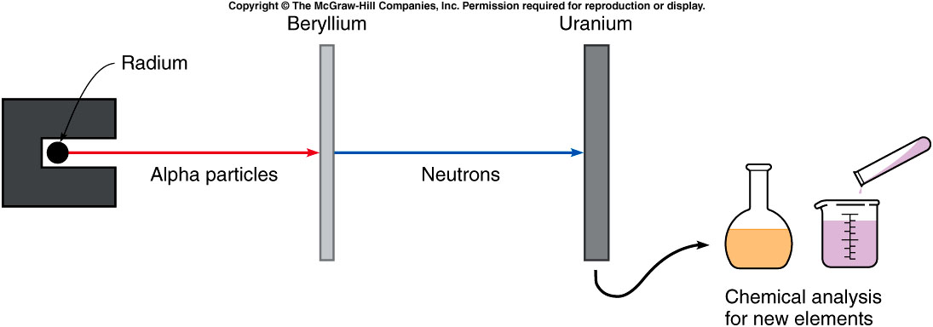
Fermi attempted to produce new elements by bombarding uranium with neutrons.
₂He⁴ + ₄Be⁹ ⇒ ₆C¹² + ₀n¹

Slide 19
What is the energy released in this reaction?
₂He⁴ + ₄Be⁹ ⇒ ₆C¹² + ₀n¹
Reactants
Be⁹ 9.012 186 u
He⁴ +4.002 603 u
13.014 789 u
Products
n 1.008 665 u
C¹² +12.000 000 u
13.008 665 u
Mass difference
13.014 789 u
-13.008 665 u
(0.006 124 u) x (1.66661 x 10⁻²⁷ kg/u)
= 1.017 x 10⁻²⁹ kg
Energy released
E = Δmc²
= (1.017 x 10⁻²⁹ kg) x (3.00 x 10⁸ m/s²)²
= 9.15 x 10⁻¹³ J
Notes:
Mention binding energy. i.e. potential energy, how tight they bind.

Slide 20
Quiz: If we start with 10,000 atoms of a radioactive substance with a half-life of 2 hours, how many atoms of that element remain after 8 hours?
5,000
2,500
1,250
625
0
After 8 hours (four half-lives), the number has been reduced by half a total of four times, leaving 625 atoms of the original 10,000 atoms of that element remaining.

Slide 21
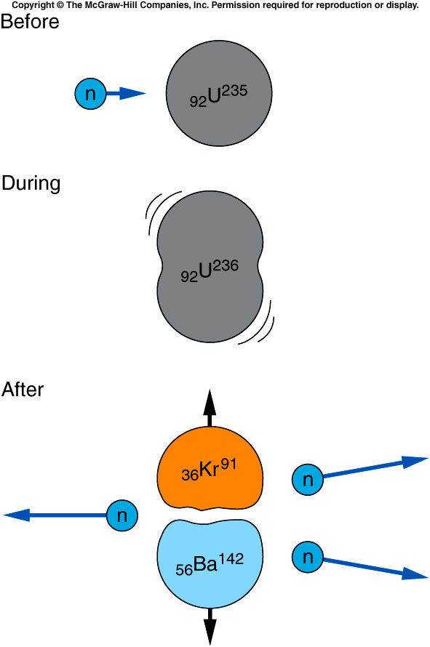

One element resulting from bombarding uranium with neutrons was barium.
This was astonishing since barium has an atomic number much less than uranium.
Lise Meitner and her nephew O. R. Frisch thought perhaps the uranium nucleus was splitting into two smaller nuclei, in a process called nuclear fission.
₀n¹ + ₉₂U²³⁵ ⇒ ₅₆Ba¹⁴² + ₃₆Kr⁹¹ + 3₀n¹
Each fission ~ $200 MeV$
$= 3.2×{10}^{−11}J$
Notes:
Kr: Krypton

Slide 22
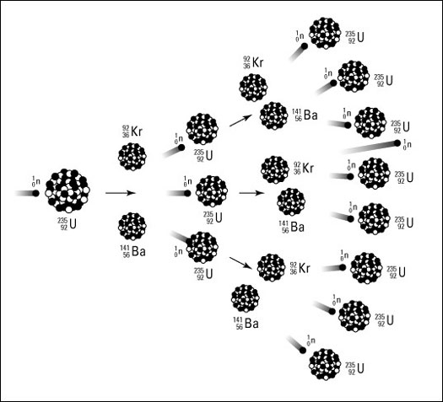
Each of these fission reactions is initiated by a neutron, and each reaction emits several more neutrons.
These neutrons can then initiate more fission reactions, etc. ➔ Chain Reactions.
A chain reaction can thus release enormous quantities of energy.
But achieving a chain reaction is difficult.
  Natural uranium is only 0.7% U-235; it is mostly U-238, which absorbs neutrons without fission.
  If too many neutrons are absorbed or escape, the chain reaction dies.

Slide 23
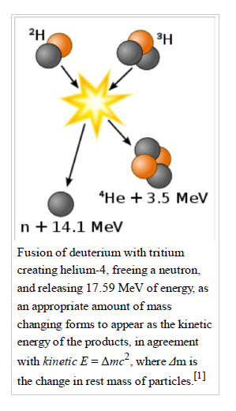

Fusion
Each fusion produce 17.6 MeV = $17.6×{10}^{6} ×1.6×{10}^{−19}$ J
= $2.8×{10}^{−12}$J

Slide 24
Nuclear Weapons and Nuclear Fusion
In a nuclear reactor, the objective is to release energy from fission reactions in a controlled manner.
In a bomb, the objective is to release energy very quickly.
  A critical mass of U-235 is just large enough for a self-sustaining chain reaction.
  For a subcritical mass, too many neutrons escape to sustain the chain reaction.
  For a supercritical mass, more than one nuetron will be absorbed by other U-235 nuclei, and the chain reaction will grow very rapidly.
  Achieving a supercritical mass quickly enough so that it doesn’t blow apart prematurely presented a major problem.

Slide 25

How much U-235 is needed to build a fission bomb as powerful as 20kiloton TNT ?
$20 kiloton=8.4×{10}^{13 }J.$
Each fission = $3.2×{10}^{−11}J$
One needs $2.6×{10}^{24} fissions, i.e.$ $U^{235} atoms.$
that is $2.6×{10}^{24}$/$6.02×{10}^{23} moles=4.3 moles$
M(U235) is 235 g/mole, which leads to 1kg U235.

Slide 26
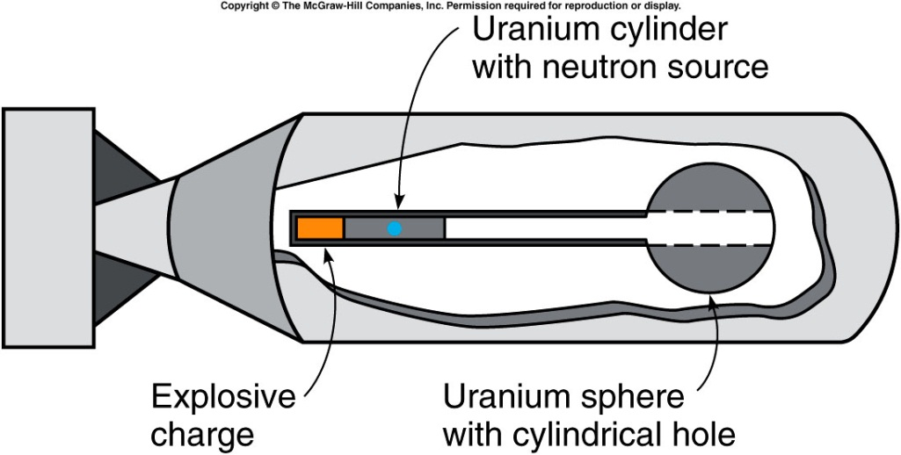
Little Boy Uranium Bomb
A subcritical-size cylinder of uranium-235 is fired into the hole in a subcritical sphere of uranium-235 to make a supercritical mass of uranium-235.
"By the end of 1945, because of the lingering effects of radioactive fallout and other after effects, the Hiroshima death toll was probably over 100,000. The five-year death total may have reached or even exceeded 200,000, as cancer and other long-term effects took hold."
13 and 18 kilotons of TNT

Slide 27
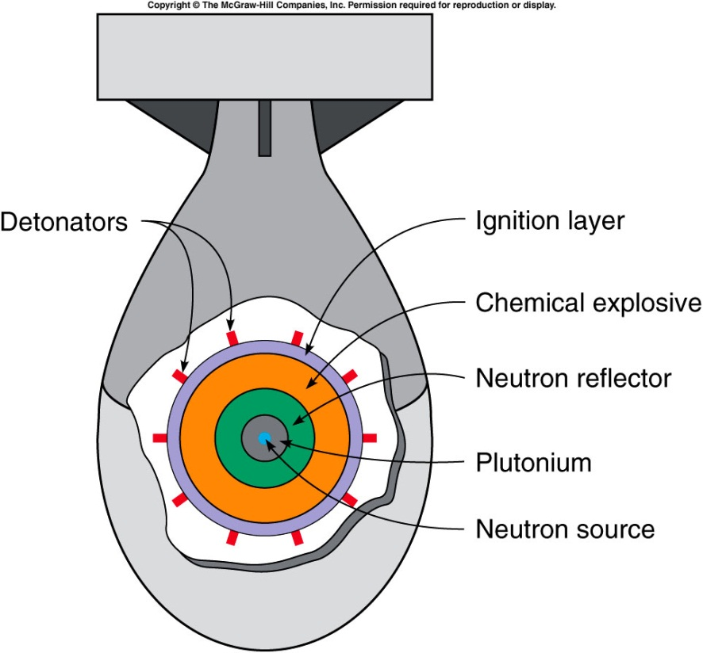
Fat Man Plutonium Bomb
Chemical explosives are arranged around a subcritical mass of plutonium-239.
When imploded by the explosives, the increased density makes this mass supercritical.
From Wikipedia:
“21 kilotons of TNT.
estimated 39,000 people were killed outright
by the bombing at Nagasaki, 25,000 were injured.
Thousands more died later from related blast and burn injuries,
hundreds more from exposure to the bomb's initial radiation.

Slide 28

How much Tritium is needed to build a fusion bomb as powerful as 20kiloton TNT ?
$20 kiloton=8.4×{10}^{13 }J.$
Each fusion =$2.8×{10}^{−12}$J
One needs $3.0×{10}^{25} fusions, i.e.$ $tritium atoms.$
that is $3.0×{10}^{25}$/$6.02×{10}^{23} moles=50 moles$
M(tritium) is 3 g/mole, which leads to 150g tritium.

Slide 29
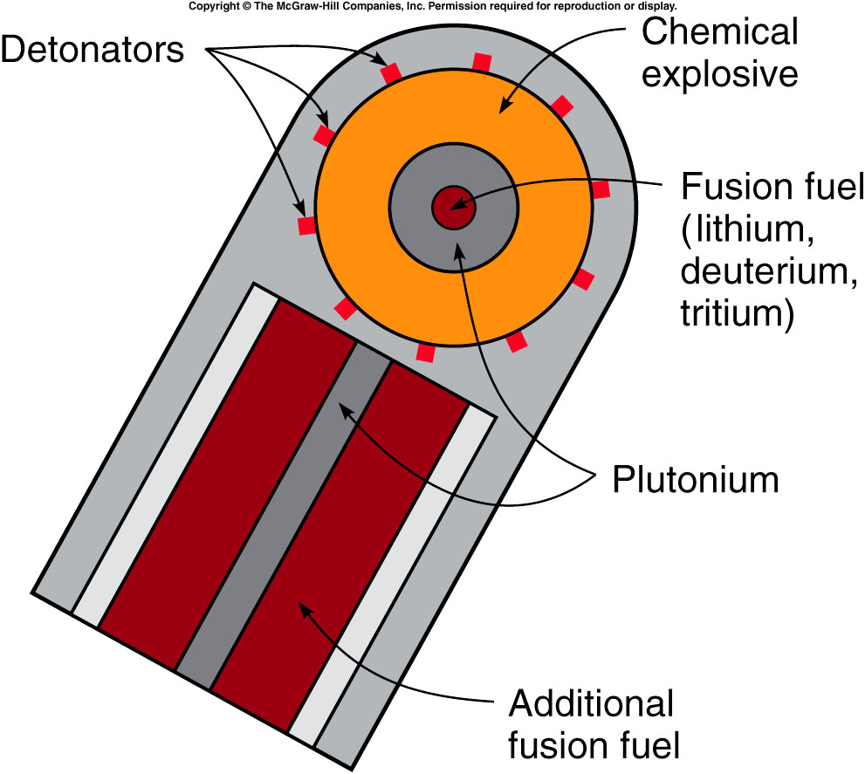
This reaction is very difficult to produce because all the nuclei are positively charged and so repel one another.
  High temperatures (a million degrees Celsius or more) and high densities are necessary to increase the probability of the reactions occurring.
  The resulting chain reaction is called a thermal chain reaction.
The easiest way to get both the high temperatures and the high densities required is to explode a fission bomb to initiate the fusion reaction.
The fission bomb produces the high temperature required, and the fission explosion compresses the fusion fuel enough for the fusion reactions to take place.

Slide 30

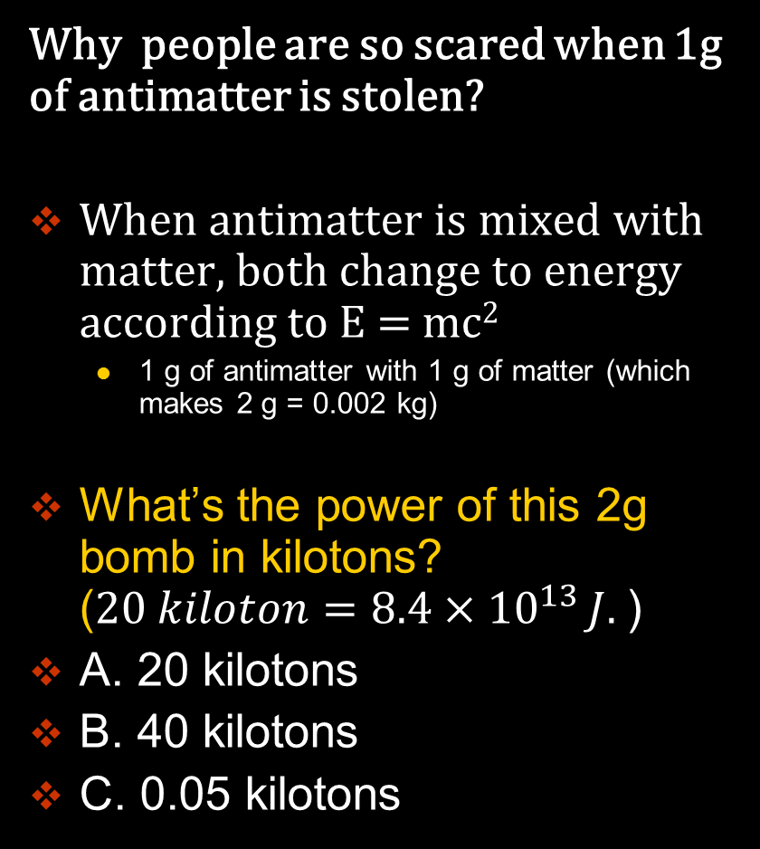
The antimatter bomb: the Sci-Fi Bomb
Why people are so scared when 1g of antimatter is stolen?
When antimatter is mixed with matter, both change to energy according to E = mc²
  1 g of antimatter with 1 g of matter (which makes 2 g = 0.002 kg)
What’s the power of this 2g bomb in kilotons? ($20 kiloton=8.4×{10}^{13 }J.$)
A. 20 kilotons
B. 40 kilotons
C. 0.05 kilotons

Slide 31

The antimatter bomb: the Sci-Fi Bomb
Why people are so scared when 1g of antimatter is stolen?
When antimatter is mixed with matter, both change to energy according to E = mc²
  1 g of antimatter with 1 g of matter (which makes 2 g = 0.002 kg)
E= 0.002 x (300,000,000)² kg m²/s² = 1.8 x 10¹⁴ J
$20 kiloton=8.4×{10}^{13 }J.$
It’s as powerful as a 40kiloton TNT bomb.

Slide 32
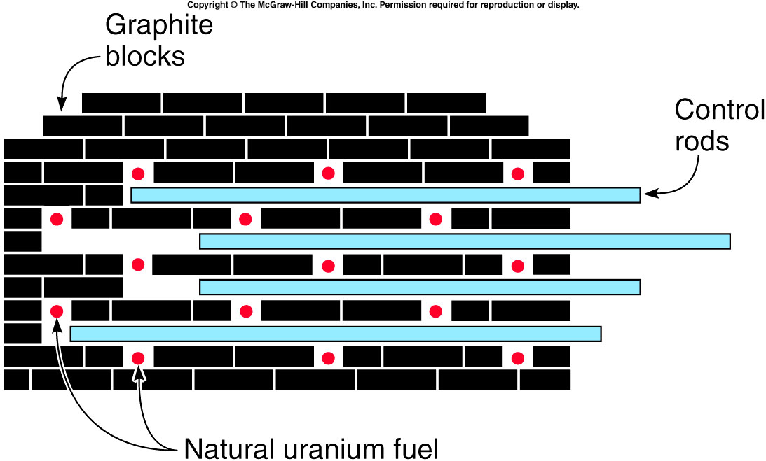
Nuclear Reactors
Fermi’s strategy to achieve a chain reaction with natural or slightly enriched uranium:
  Slow the neutrons down between fission reactions using a material called a moderator.
  Control rods are used to absorb the neutrons to slow the reaction as desired.
Fermi’s “pile” was the first human-produced nuclear reactor.
Graphite blocks served as the moderator.
Control rods were cadmium, but today’s reactors use boron.

Slide 33
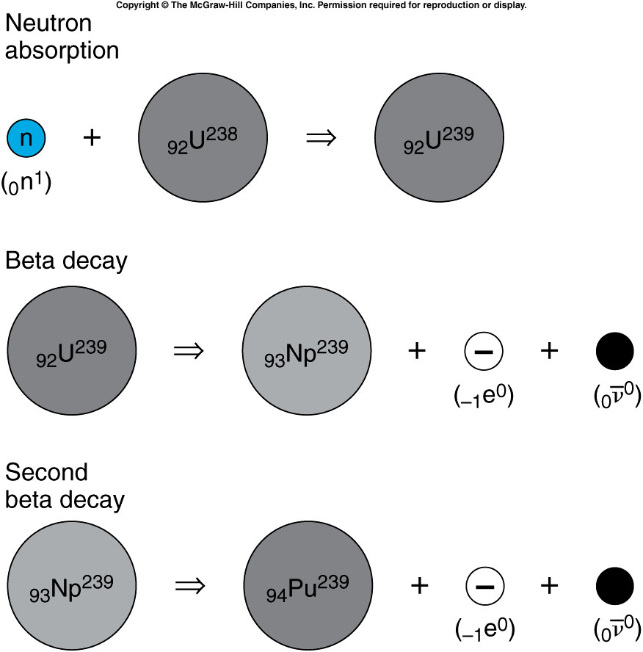
Although fission does not result when a U-238 nucleus absorbs a neutron, a series of reactions produces plutonium, the primary fuel in fission bombs.
Plutonium-239 is relatively stable, with a half-life of 24,000 years.
The production of plutonium-239 is a by-product of a reactor.
It can be separated from the uranium using chemical techniques, since it is a different element.
Notes:
Np: neptunium-239.

Slide 34
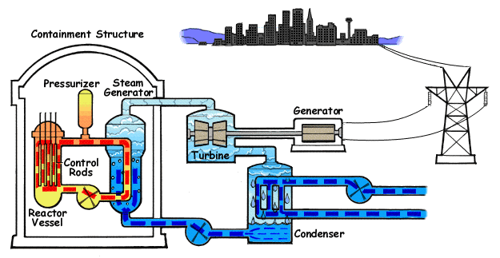

Modern Power Reactors
Most reactors today use ordinary (light) water as the moderator.
This requires enrichment of the fuel to 3% U-235 (nature: ~0.7%)
The advantage is that the water can also be used as a coolant.
Animated Diagram of a Pressurized Water Reactor. (PWR)

Slide 35
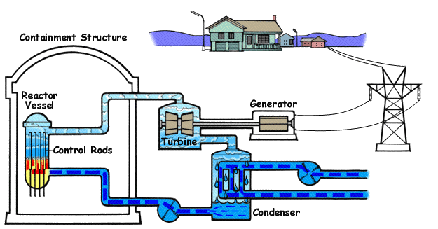

Modern Power Reactors
Most reactors today use ordinary (light) water as the moderator.
This requires enrichment of the fuel to 3% U-235 (nature: ~0.7%)
The advantage is that the water can also be used as a coolant.
Animated Diagram of a Boiling Water Reactor (BWR)

Slide 36
Do the control rods in a nuclear reactor absorb or emit neutrons?
They absorb neutrons.
They emit neutrons.
They both absorb and emit neutrons.
They neither absorb nor emit neutrons.
    The control rods in a reactor absorb neutrons and are removed or inserted to control the number of neutrons in the chain reaction.

Slide 37
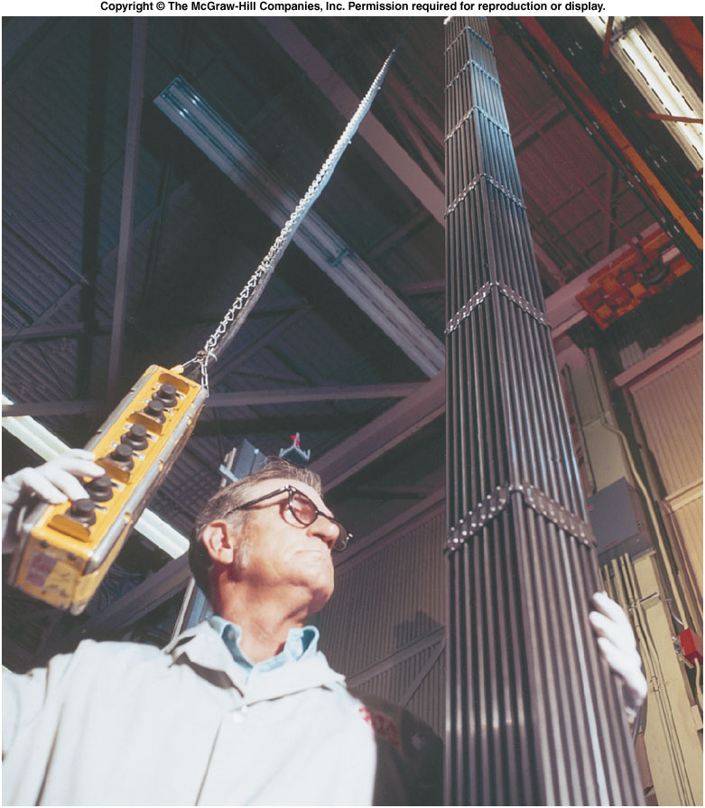
Safety and Environmental Concerns
Fuel rods must be replaced as the fuel is used up and fission products build up.
The spent fuel rods containing uranium, plutonium, and radioactive fission fragments must be stored or disposed of carefully.
  Our current policy is to bury
  these radioactive materials in
  a solid rock formation.
  Most of the fission fragments
  have half-lives of several years
  or less, and do not have to be
  isolated nearly as long as
  plutonium-239 does.
  In spite of the need for careful
  waste disposal, nuclear power
  still causes far lass atmospheric
  pollution (and no greenhouse
  gases) than burning fossil fuels
  such as coal or oil.

Slide 38
Chernobyl and Fukushima Reactor
The nuclear reactor at Chernobyl use Graphite asthe moderator, and water was the coolant. Because the coolant water was not also the moderator, the loss of the water would actually increase the reaction.
The Fukushima I Nuclear reactors are BWR.
The BWR is a lot safer since water also serves as moderator. Without moderator, the chain reaction rate decrease.
But without the coolant, i.e. the water, the decay heat can leads to reactor meltdown.
Further reading:
  http://en.wikipedia.org/wiki/Fukushima_I_nuclear_accidents
  http://en.wikipedia.org/wiki/Chernobyl

Slide 39
Why is the moderator needed to obtain a chain reaction using natural uranium?
The moderator controls the speed of the chain reaction.
The moderator slows the neutrons down to slow the chain reaction.
The moderator slows the neutrons down so that the chain reaction can continue.
The moderator absorbs the neutrons to control the number of neutrons.
The moderator serves to quickly reduce the speed of the fast neutrons emerging from a fission reaction below the speed at which the much more abundant U²³⁸ isotope is likely to absorb neutrons without fissioning. Both isotopes of uranium can undergo fission with slow neutrons.

Slide 40
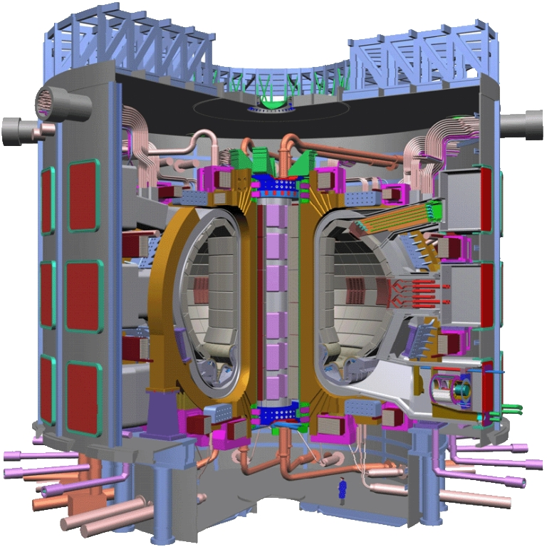
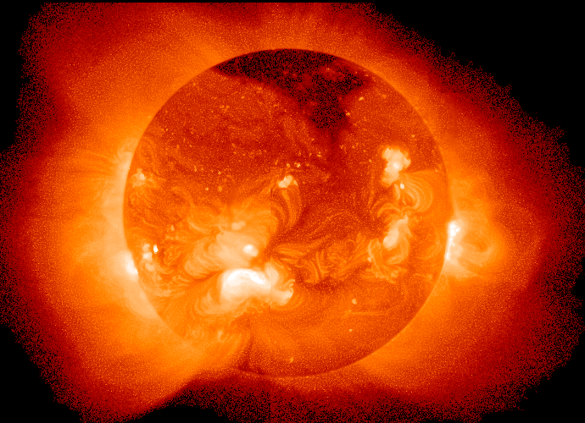

Can we generate power from controlled fusion?
The Sun is a fusion reactor (not controlled).
ITER (the International Thermonuclear Experimental Reactor)

Slide 41
Quiz: If the coolant material is also the moderator material like in the light water reactor, can the loss of coolant ever lead to a meltdown in a reactor using natural uranium?
Yes.
No.

