Slide 1
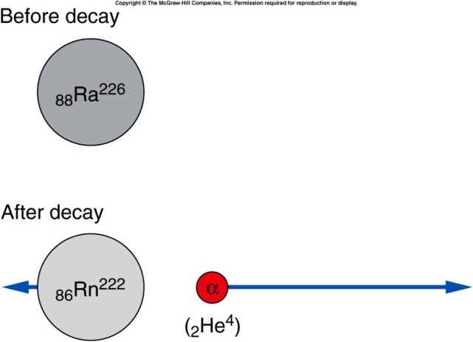
Alpha decay
Alpha particle is one of the decay product.
  For example, Marie and Pierre Curie isolated the highly radioactive element radium (₈₈Ra²²⁶) which emitted primarily alpha particles.
  The dominant isotope of radium contains a total of 226 nucleons: ₈₈Ra²²⁶
    The atomic number, 88, is the number of protons.
    The mass number, 226, is the total number of protons and neutrons.
  When radium-226 undergoes alpha decay, it emits an alpha particle (2 protons and 2 neutrons).
    The nucleus remaining after the decay has 88 - 2 = 86 protons, 226 - 4 = 222 nucleons, and 222 - 86 = 136 neutrons.
    This is the element radon-222.
Notes:
Are all the nucleus stable?
Becquerel found some nature material can expose the photographic plate wrapped in the dark box.

Slide 2
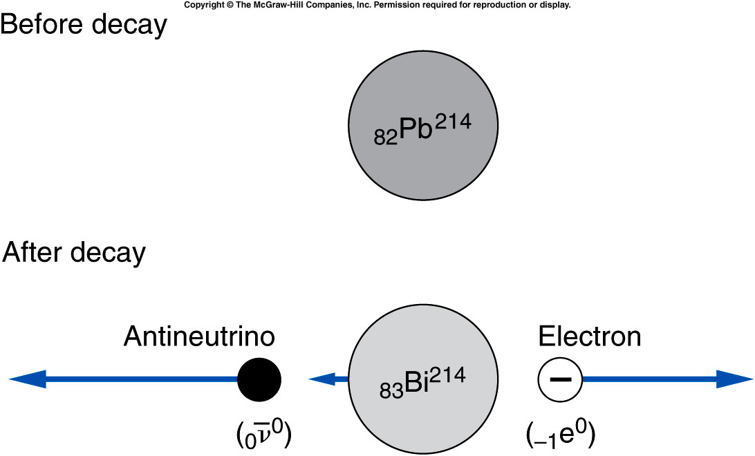
Beta decay is the emission of either an electron or a positron (the electron’s antiparticle).
  For example, lead-214 emits an electron.
  One of the neutrons inside the nucleus changes into a proton, yielding a nucleus with a higher atomic number.
  In the process, an electron is emitted (to conserve charge) and a neutrino (or in this case, an antineutrino, the neutrino’s antiparticle) is emitted to conserve momentum.
Notes:
Bismuth 214

Slide 3
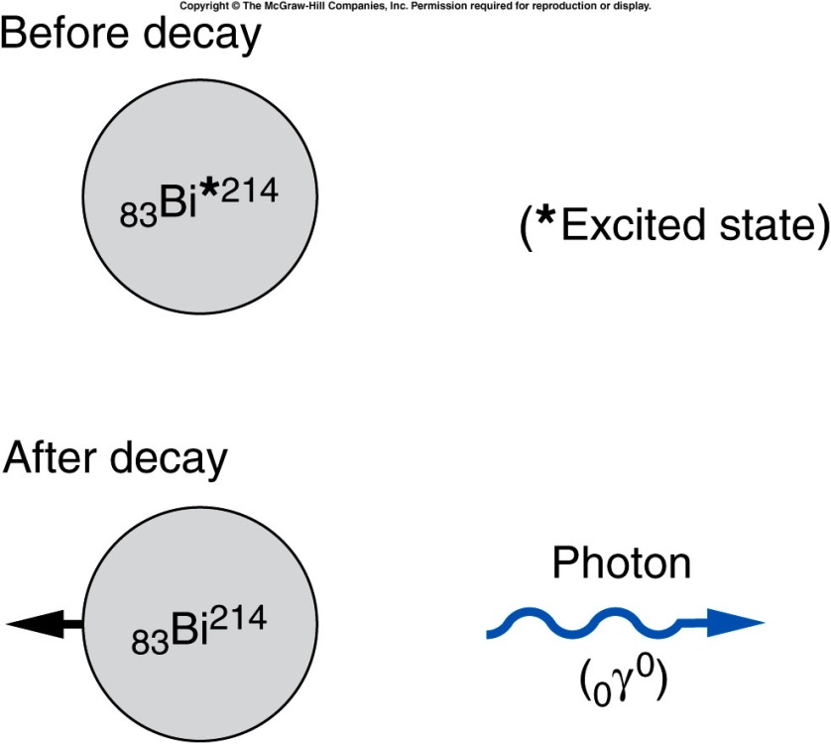
Gamma decay is the emission of a gamma particle or photon.
  The number of protons and of total nucleons does not change.
  The nucleus decays from an excited state to a lower energy state.
  The lost energy is carried away by the photon.
Notes:
Bi: Bismuth

Slide 4
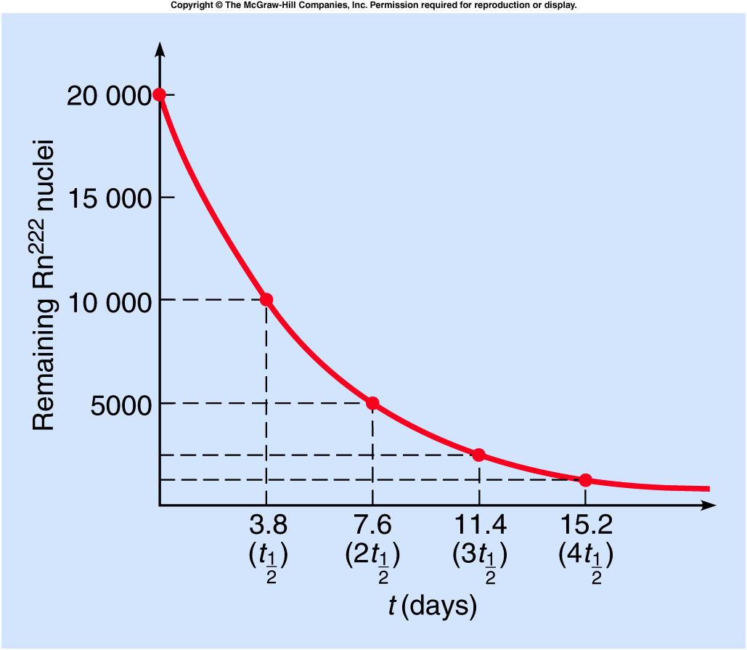
Different radioactive isotopes have different average times that elapse before they decay.
The half-life is the time required for half of the original number of atoms to decay.
  For example, the half-life of radon-222 is about 3.8 days.
If we start with 20,000 atoms of radon-222, 3.8 days later we would have 10,000 remaining.
After 7.6 days, half of the 10,000 would have decayed, leaving 5,000.
After three half-lives, only 2500 would remain.
After four half-lives, only 1250 would remain.

Slide 5
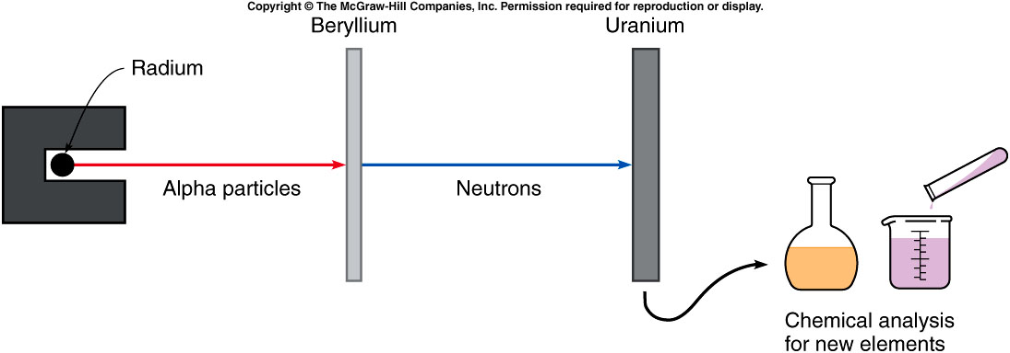
Fermi attempted to produce new elements by bombarding uranium with neutrons.
₂He⁴ + ₄Be⁹ ⇒ ₆C¹² + ₀n¹

Slide 6

Mass and Energy
$$E=m×c^{2}$$
Mass and energy are related according to above equation.
1 C x 1 V = 1 J
1 e (i.e. unit charge) = 1.6x10⁻¹⁹ C
1e x 1V = 1eV = 1.6x10⁻¹⁹ J
Notes:
Now we are going into a different area. Nuclear reaction.

Slide 7
What is the energy released in this reaction?
₂He⁴ + ₄Be⁹ ⇒ ₆C¹² + ₀n¹
(U: atomic weight)
Reactants
Be⁹ 9.012 186 u
He⁴ +4.002 603 u
13.014 789 u
Products
n 1.008 665 u
C¹² +12.000 000 u
13.008 665 u
Mass difference
13.014 789 u
-13.008 665 u
(0.006 124 u) x (1.66661 x 10⁻²⁷ kg/u)
= 1.017 x 10⁻²⁹ kg
Energy released
E = Δmc²
= (1.017 x 10⁻²⁹ kg) x (3.00 x 10⁸ m/s²)²
= 9.15 x 10⁻¹³ J
Notes:
Mention binding energy. i.e. potential energy, how tight they bind.

Slide 8
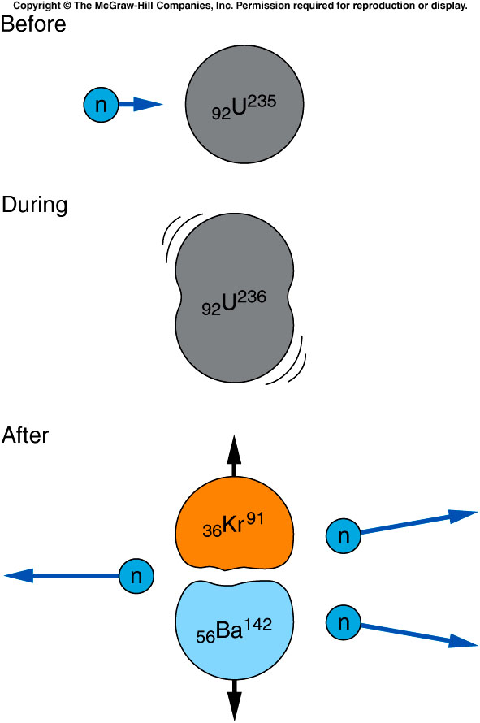

One element resulting from bombarding uranium with neutrons was barium.
This was astonishing since barium has an atomic number much less than uranium.
Lise Meitner and her nephew O. R. Frisch thought perhaps the uranium nucleus was splitting into two smaller nuclei, in a process called nuclear fission.
₀n¹ + ₉₂U²³⁵ ⇒ ₅₆Ba¹⁴² + ₃₆Kr⁹¹ + 3₀n¹
Each fission ~ $200 MeV$
$= 3.2×{10}^{−11}J$
Notes:
Kr: Krypton

Slide 9
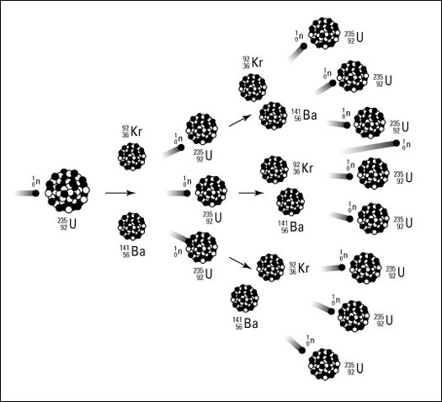
Each of these fission reactions is initiated by a neutron, and each reaction emits several more neutrons.
These neutrons can then initiate more fission reactions, etc. ➔ Chain Reactions.
A chain reaction can thus release enormous quantities of energy.
But achieving a chain reaction is difficult.
  Natural uranium is only 0.7% U-235; it is mostly U-238, which absorbs neutrons without fission.
  If too many neutrons are absorbed or escape, the chain reaction dies.

Slide 10
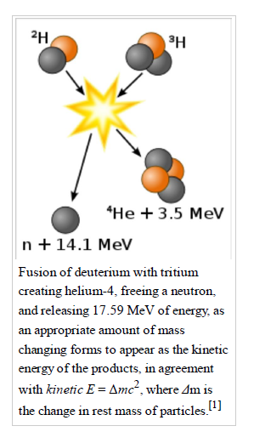

Fusion
Each fusion produce 17.6 MeV = $17.6×{10}^{6} eV ×1.6×{10}^{−19}$ J
= $2.8×{10}^{−12}$J
Each fission ~ $200 MeV$
$= 3.2×{10}^{−11}J$
Which is larger but a single U235 has a lot more nucleons than deuterium and tritium. Under the same mass, fusion will produce much more powerful energy than fission.

Slide 11
Nuclear Weapons and Nuclear Fusion
In a nuclear reactor, the objective is to release energy from fission reactions in a controlled manner.
In a bomb, the objective is to release energy very quickly.
  A critical mass of U-235 is just large enough for a self-sustaining chain reaction.
  For a subcritical mass, too many neutrons escape to sustain the chain reaction.
  For a supercritical mass, more than one nuetron will be absorbed by other U-235 nuclei, and the chain reaction will grow very rapidly.
  Achieving a supercritical mass quickly enough so that it doesn’t blow apart prematurely presented a major problem.

Slide 12
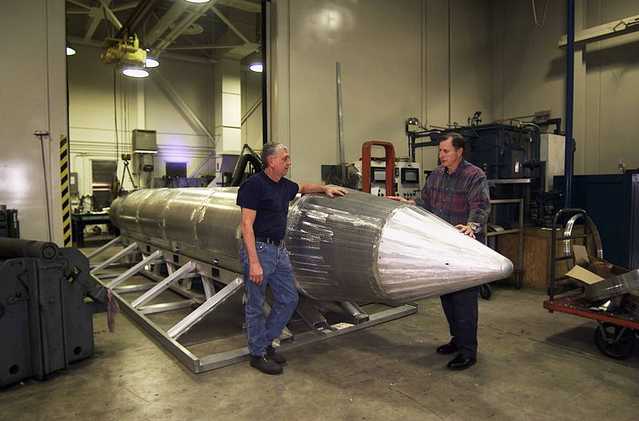

The Mother of All (conventional) Bombs
Wikipedia: “ The GBU-43/B Massive Ordnance Air Blast bomb (MOAB) (colloquially known as the Mother of All Bombs) is a large-yield conventional bomb developed for the United States military ………. it was touted as the most powerful….. bomb ever designed …. is equivalent to around 11 tons of TNT
Notes:
Hot air rise and mix with cold air to form turbulance→ mushroom cloud.

Slide 13
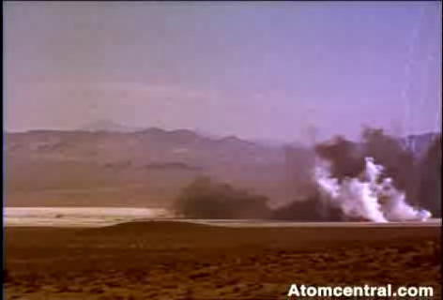
Fission Bomb
Notes:
Not sure about the yield but probably a few tens of kilotons.

Slide 14

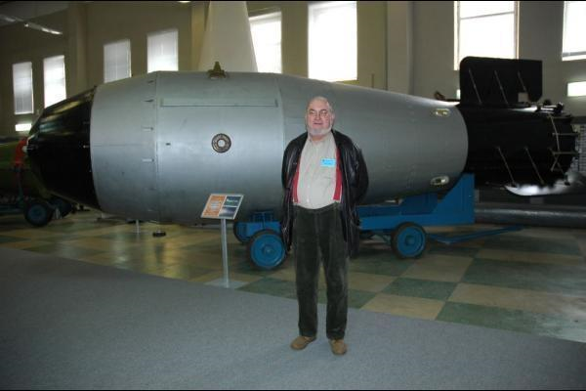
Fusion Bomb
Notes:
Tsar’s bomb: 57 megaton. The kind of all bombs.

Slide 15
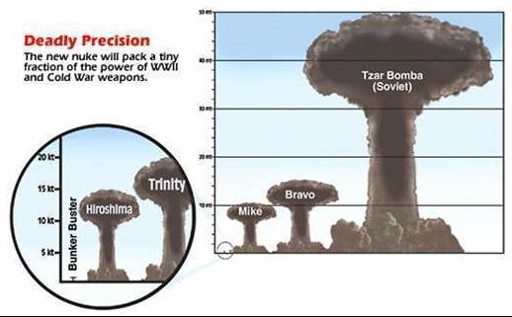

Slide 16

How much U-235 is needed to build a fission bomb as powerful as 20kiloton TNT ?
$20 kiloton=8.4×{10}^{13 }J.$
Each fission = $3.2×{10}^{−11}J$
One needs $2.6×{10}^{24} fissions, i.e.$ $U^{235} atoms.$
that is $2.6×{10}^{24}$/$6.02×{10}^{23} moles=4.3 moles$
M(U235) is 235 g/mole, which leads to 1kg U235.

Slide 17
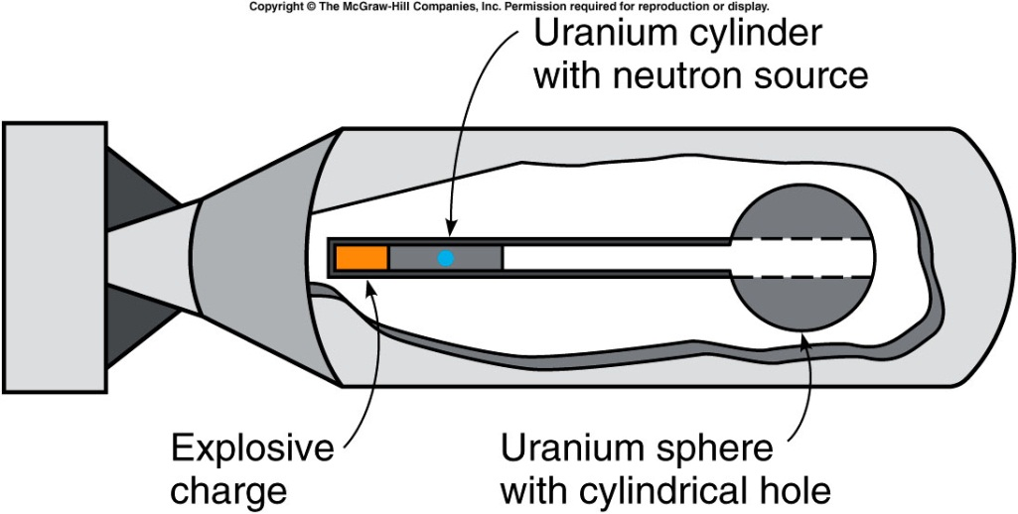
Little Boy Uranium Bomb
A subcritical-size cylinder of uranium-235 is fired into the hole in a subcritical sphere of uranium-235 to make a supercritical mass of uranium-235.
"By the end of 1945, because of the lingering effects of radioactive fallout and other after effects, the Hiroshima death toll was probably over 100,000. The five-year death total may have reached or even exceeded 200,000, as cancer and other long-term effects took hold."
13 and 18 kilotons of TNT

Slide 18
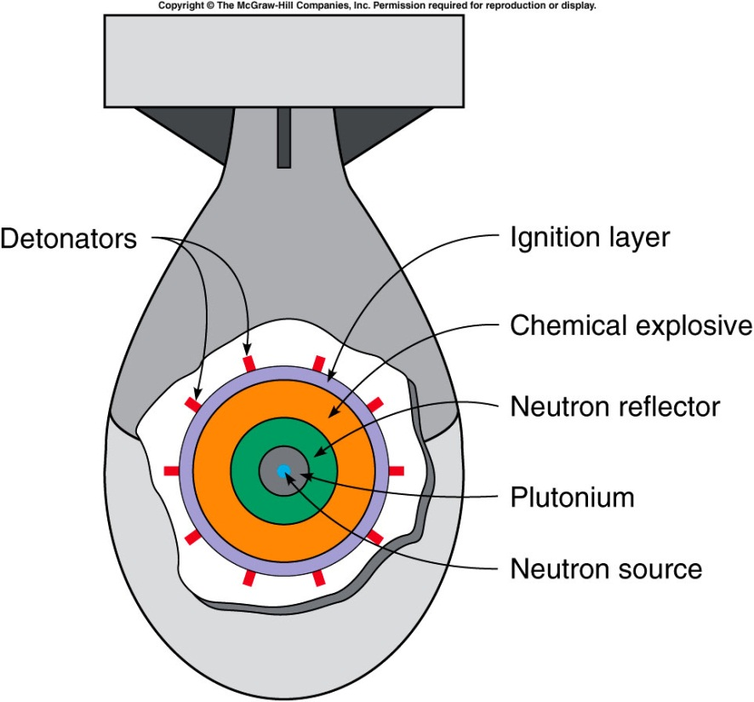
Fat Man Plutonium Bomb
Chemical explosives are arranged around a subcritical mass of plutonium-239.
When imploded by the explosives, the increased density makes this mass supercritical.
From Wikipedia:
“21 kilotons of TNT.
estimated 39,000 people were killed outright
by the bombing at Nagasaki, 25,000 were injured.
Thousands more died later from related blast and burn injuries,
hundreds more from exposure to the bomb's initial radiation.

Slide 19

How much Tritium is needed to build a fusion bomb as powerful as 20kiloton TNT ?
$20 kiloton=8.4×{10}^{13 }J.$
Each fusion =$2.8×{10}^{−12}$J
One needs $3.0×{10}^{25} fusions, i.e.$ $tritium atoms.$
that is $3.0×{10}^{25}$/$6.02×{10}^{23} moles=50 moles$
M(tritium) is 3 g/mole, which leads to 150g tritium.

Slide 20
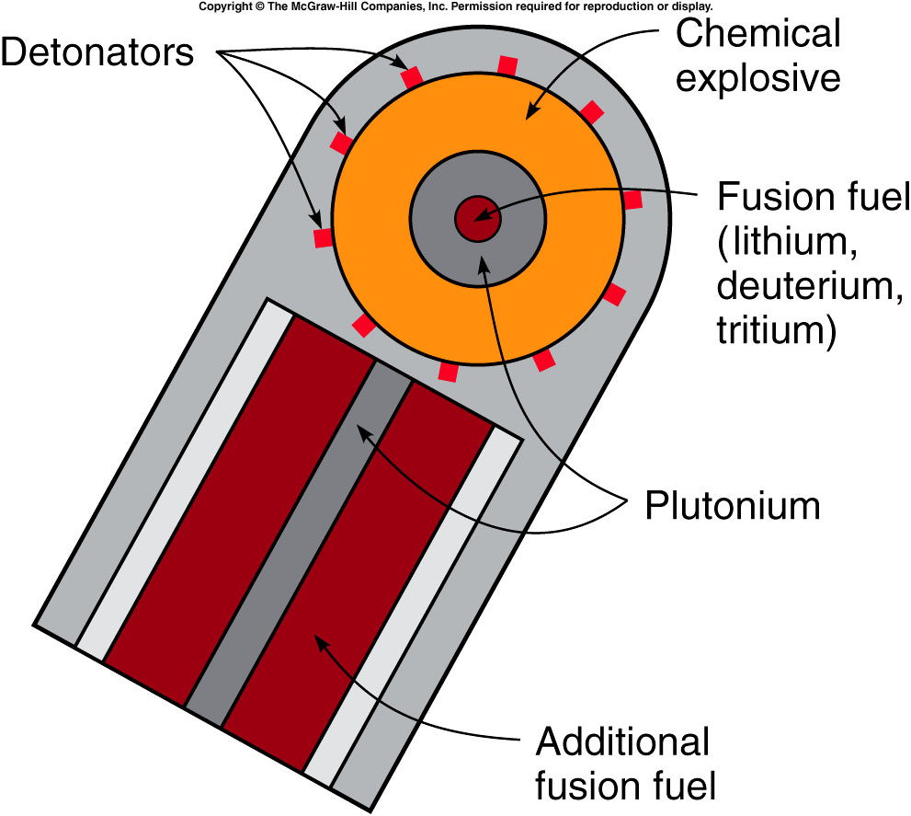
This reaction is very difficult to produce because all the nuclei are positively charged and so repel one another.
  High temperatures (a million degrees Celsius or more) and high densities are necessary to increase the probability of the reactions occurring.
  The resulting chain reaction is called a thermal chain reaction.
The easiest way to get both the high temperatures and the high densities required is to explode a fission bomb to initiate the fusion reaction.
The fission bomb produces the high temperature required, and the fission explosion compresses the fusion fuel enough for the fusion reactions to take place.

Slide 21

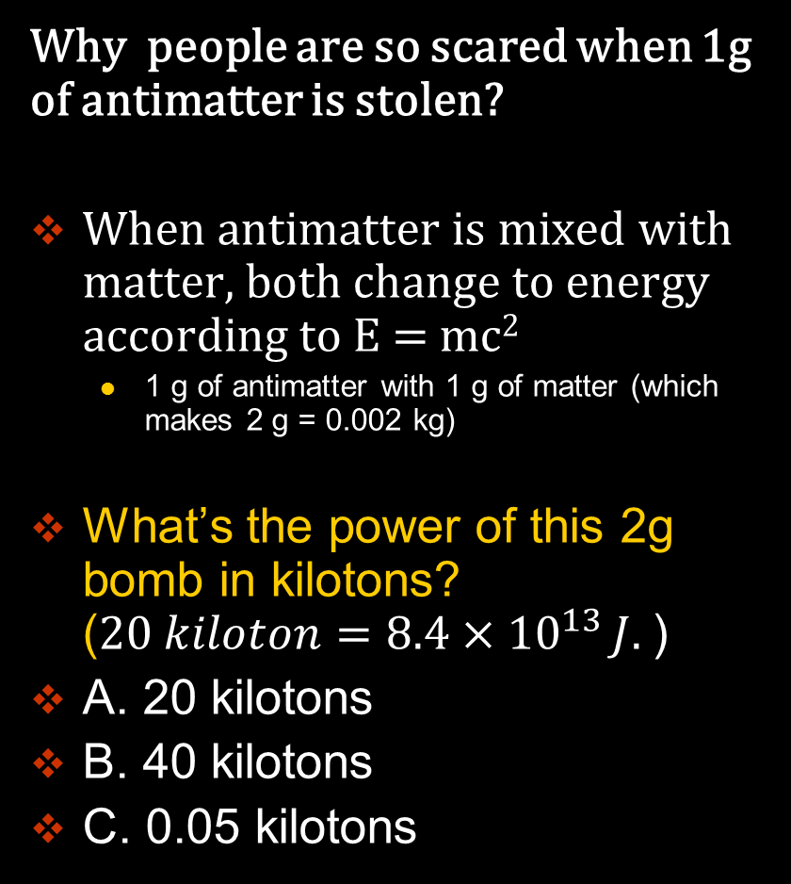
The antimatter bomb: the Sci-Fi Bomb
Why people are so scared when 1g of antimatter is stolen?
When antimatter is mixed with matter, both change to energy according to E = mc²
  1 g of antimatter with 1 g of matter (which makes 2 g = 0.002 kg)
What’s the power of this 2g bomb in kilotons? ($20 kiloton=8.4×{10}^{13 }J.$)
A. 20 kilotons
B. 40 kilotons
C. 0.05 kilotons

Slide 22

The antimatter bomb: the Sci-Fi Bomb
Why people are so scared when 1g of antimatter is stolen?
When antimatter is mixed with matter, both change to energy according to E = mc²
  1 g of antimatter with 1 g of matter (which makes 2 g = 0.002 kg)
E= 0.002 x (300,000,000)² kg m²/s² = 1.8 x 10¹⁴ J
$20 kiloton=8.4×{10}^{13 }J.$
It’s as powerful as a 40kiloton TNT bomb.

Slide 23
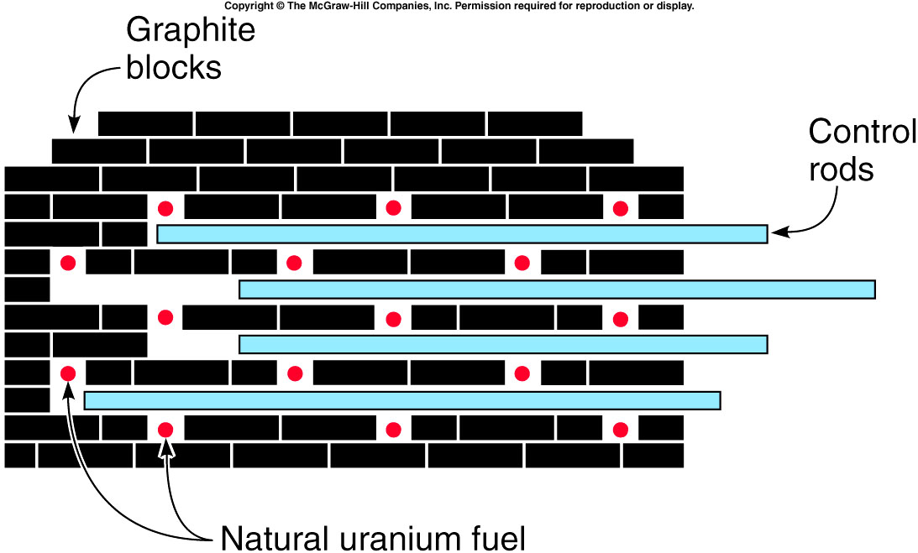
Nuclear Reactors
Fermi’s strategy to achieve a chain reaction with natural or slightly enriched uranium:
  Slow the neutrons down between fission reactions using a material called a moderator.
  Control rods are used to absorb the neutrons to slow the reaction as desired.
Fermi’s “pile” was the first human-produced nuclear reactor.
Graphite blocks served as the moderator.
Control rods were cadmium, but today’s reactors use boron.

Slide 24
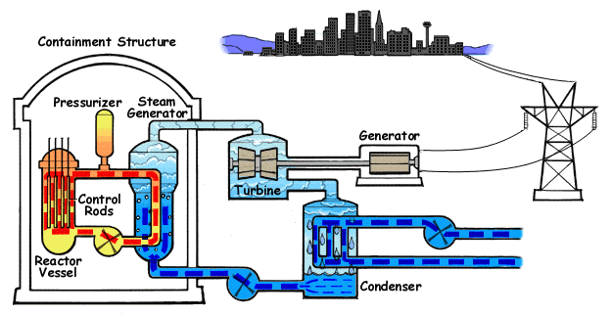

Modern Power Reactors
Most reactors today use ordinary (light) water as the moderator.
This requires enrichment of the fuel to 3% U-235 (nature: ~0.7%)
The advantage is that the water can also be used as a coolant.
Animated Diagram of a Pressurized Water Reactor. (PWR)

Slide 25


Modern Power Reactors
Most reactors today use ordinary (light) water as the moderator.
This requires enrichment of the fuel to 3% U-235 (nature: ~0.7%)
The advantage is that the water can also be used as a coolant.
Animated Diagram of a Boiling Water Reactor (BWR)

Slide 26
Do the control rods in a nuclear reactor absorb or emit neutrons?
They absorb neutrons.
They emit neutrons.
They both absorb and emit neutrons.
They neither absorb nor emit neutrons.
    The control rods in a reactor absorb neutrons and are removed or inserted to control the number of neutrons in the chain reaction.

Slide 27
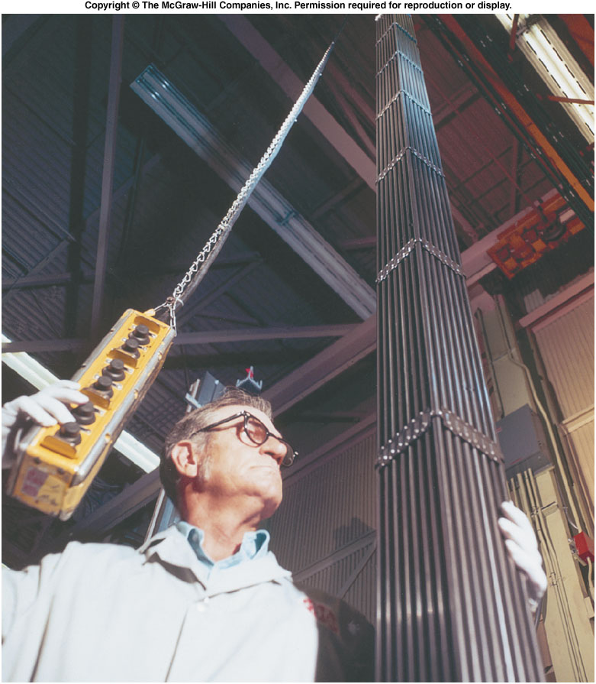
Safety and Environmental Concerns
Fuel rods must be replaced as the fuel is used up and fission products build up.
The spent fuel rods containing uranium, plutonium, and radioactive fission fragments must be stored or disposed of carefully.
  Our current policy is to bury
  these radioactive materials in
  a solid rock formation.
  Most of the fission fragments
  have half-lives of several years
  or less, and do not have to be
  isolated nearly as long as
  plutonium-239 does.
  In spite of the need for careful
  waste disposal, nuclear power
  still causes far lass atmospheric
  pollution (and no greenhouse
  gases) than burning fossil fuels
  such as coal or oil.

Slide 28
Chernobyl and Fukushima Reactor
The nuclear reactor at Chernobyl use Graphite asthe moderator, and water was the coolant. Because the coolant water was not also the moderator, the loss of the water would actually increase the reaction.
The Fukushima I Nuclear reactors are BWR.
The BWR is a lot safer since water also serves as moderator. Without moderator, the chain reaction rate decrease.
But without the coolant, i.e. the water, the decay heat can leads to reactor meltdown.
Further reading:
  http://en.wikipedia.org/wiki/Fukushima_I_nuclear_accidents
  http://en.wikipedia.org/wiki/Chernobyl

Slide 29
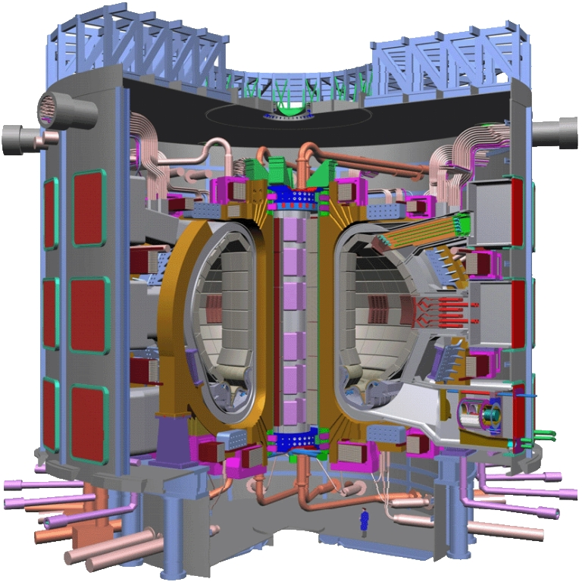
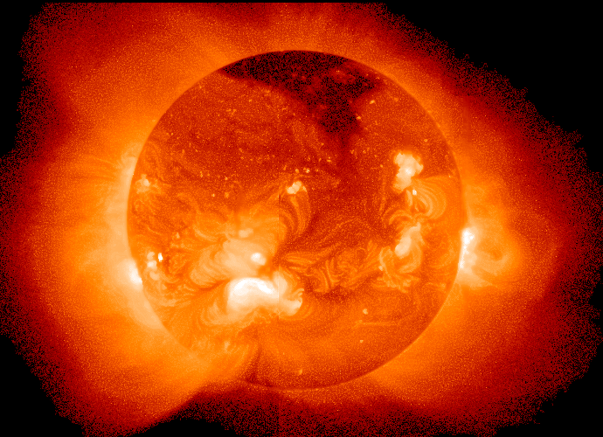

Can we generate power from controlled fusion?
The Sun is a fusion reactor (not controlled).
ITER (the International Thermonuclear Experimental Reactor)

Slide 30
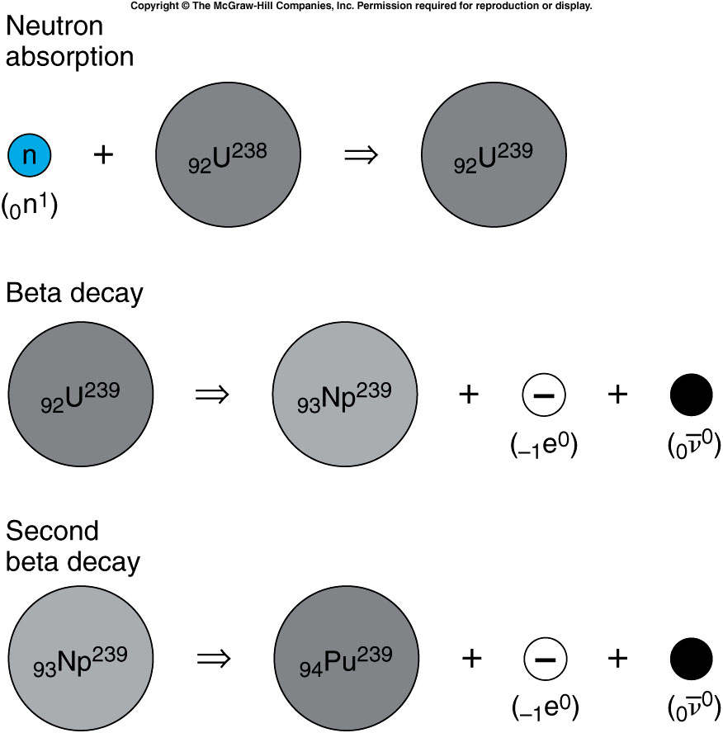
Although fission does not result when a U-238 nucleus absorbs a neutron, a series of reactions produces plutonium, the primary fuel in fission bombs.
Plutonium-239 is relatively stable, with a half-life of 24,000 years.
The production of plutonium-239 is a by-product of a reactor.
It can be separated from the uranium using chemical techniques, since it is a different element.
Notes:
In the fuel rod, most are U238.
Np: neptunium-239.

