Slide 1
Final exam (focusing on chapter 9 – 19, excl. 17)
Time: Tue 05/04 3:30pm – 5:30pm
Location: physics building room 112
AOB
  multiple choice problems.
  Prepare your own scratch paper, pencils, erasers, etc.
  Use only pencil for the answer sheet
  Bring your own calculators
  No cell phones, no text messaging, no computers
  No crib sheet of any kind is allowed. Equation sheet will be provided.
When filling the scantron
  Write your name in the top respective field of the scantron sheet, sign your name on the signature line of the scantron sheet.
  Record your PUID number, which starts with “00”, on your scantron sheet.
  fill in bubbles below your name and ID fields
Notes:
Write your name in the top respective field of the scantron sheet, sign your name on the signature line of the scantron sheet.
Record your PUID number, which starts with “00”, on your scantron sheet.

Slide 2
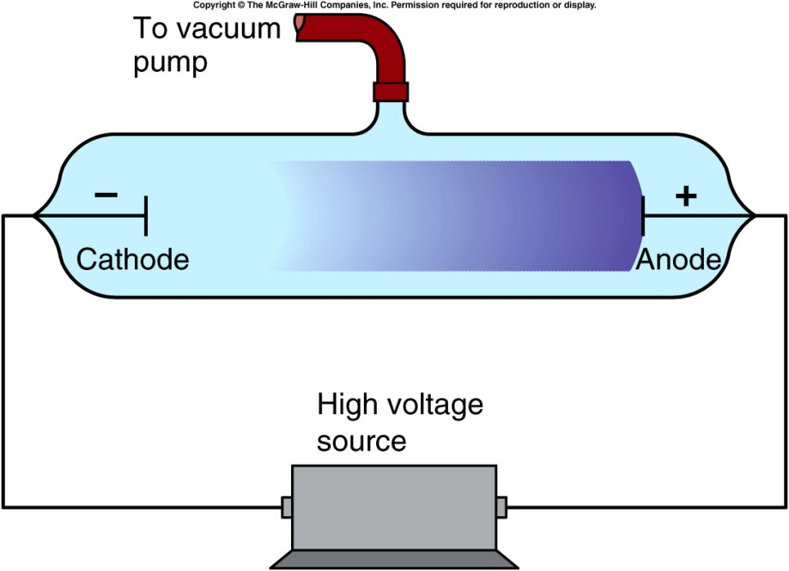
Cathode rays, Electrons, and X-rays
By the end of the nineteenth century, chemists were using the concept of atoms to explain their properties.
Physicists were less convinced.
  The discovery of cathode rays was the beginning of atomic physics.
Two electrodes are sealed in a glass tube.
As the tube is evacuated, a glow discharge appears in the gas between the electrodes.
With further evacuation, the discharge disappears, and a glow appears on the end of the tube opposite the cathode.
Notes:
Coat the tube with phosphorescent

Slide 3
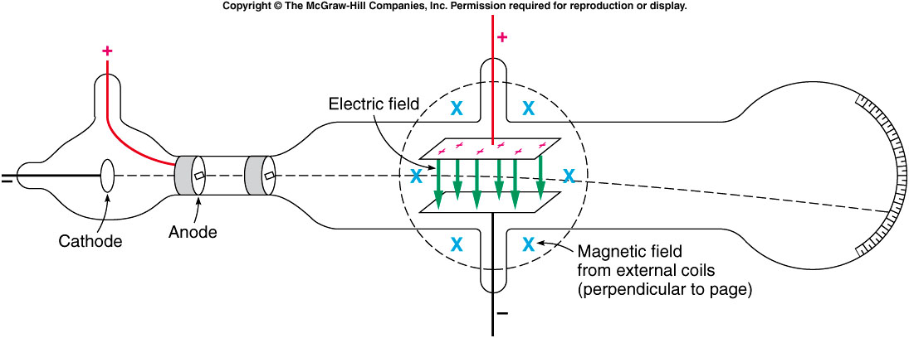
J. J. Thomson used both electric fields and magnetic fields to deflect the beam.
The combined effect allowed him to estimate the velocity of the particles.
With the deflection produced by the magnetic field alone, this allowed him to estimate the mass of the particles.
  We now call these particles electrons.

Slide 4
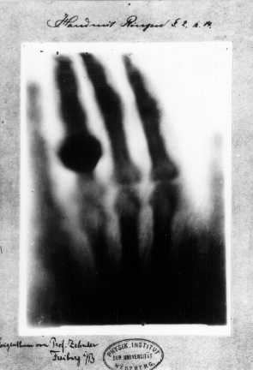
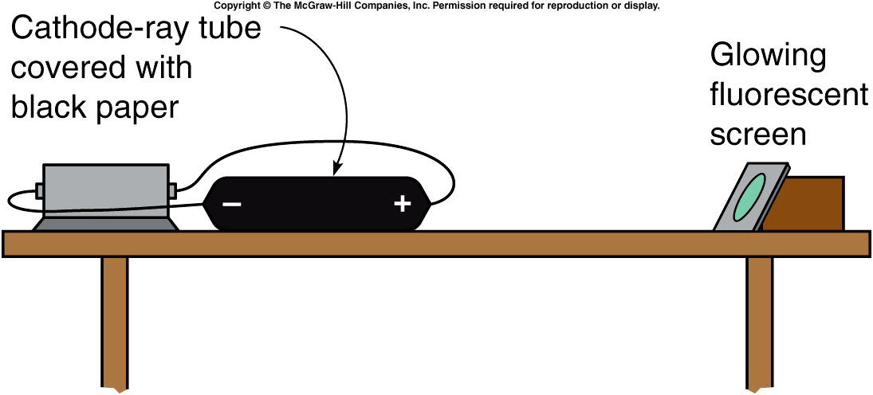
He noticed that a fluorescent material would glow when placed near his covered cathode-ray tube.
Cathode rays could not travel through air, but this new radiation did.
Because they were unknown, Roentgen called this new radiation X-rays.
1st Nobel Prize Winner
Wikipedia: “print of Roentgen’a first "medical" X-ray, of his wife's hand, taken on 22 December 1895”

Slide 5
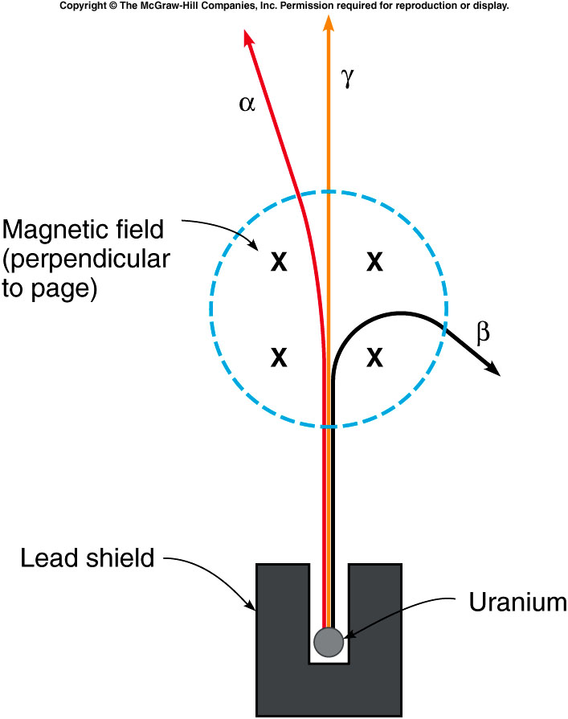
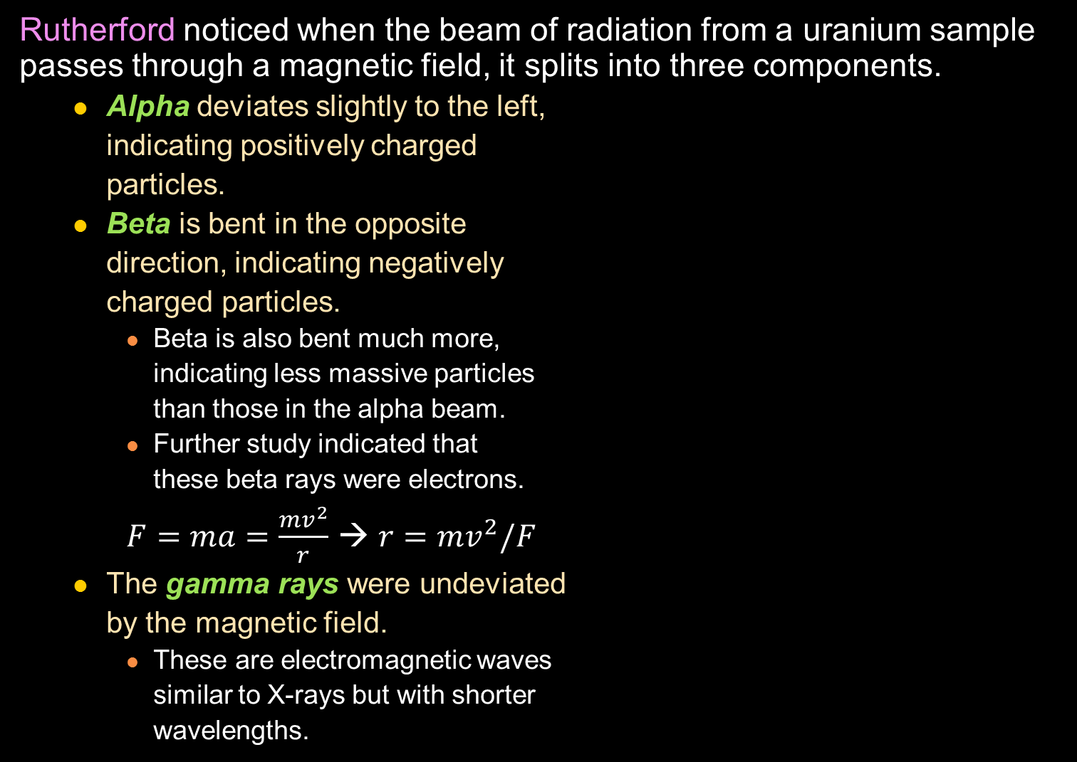
Rutherford noticed when the beam of radiation from a uranium sample passes through a magnetic field, it splits into three components.
  Alpha deviates slightly to the left,
  indicating positively charged
  particles.
  Beta is bent in the opposite
  direction, indicating negatively
  charged particles.
    Beta is also bent much more,
    indicating less massive particles
    than those in the alpha beam.
    Further study indicated that
    these beta rays were electrons.
    $F=ma=\frac{mv^{2}}{r}$ → $r=mv^{2}/F$
  The gamma rays were undeviated
  by the magnetic field.
    These are electromagnetic waves
    similar to X-rays but with shorter
    wavelengths.
Notes:
Use right hand rule to demonstrate the magnet force.

Slide 6
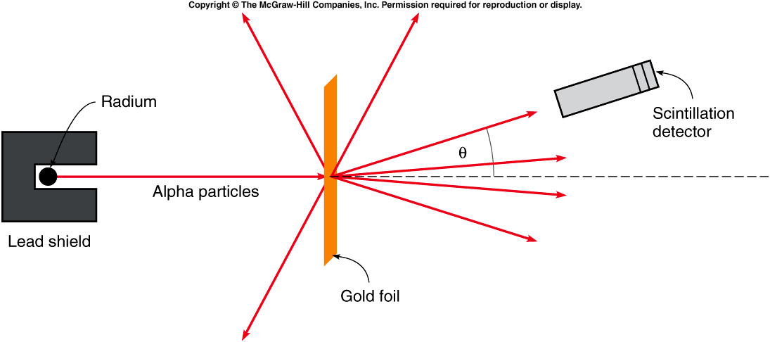
Rutherford realized that they would make effective probes for studying the structure of the atom.
  A beam of alpha particles was scattered from a thin gold foil.
  The size of the gold atoms would affect the angle of the scattered alpha particles.
  Most of them went straight through the foil, as expected.
  BUT, a few particles scattered back at much larger angles.

Slide 7
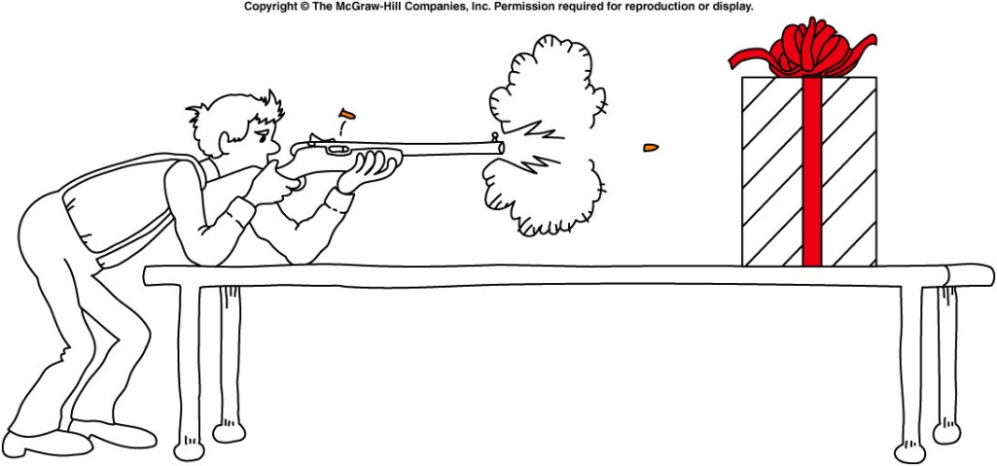

The backward scattering was as if someone had fired bullets into a piece of tissue paper and the bullets bounced back.
If most of the alpha particles go through, but a few are scattered through large angles, there must be very dense but small centers somewhere within the atoms.
  The nucleus of the atom had been discovered!
  The nucleus is the very dense center of the atom, containing most of its mass and all of its positive charge.
  The electrons are responsible for most of the atom’s size, but very little of its mass.
https://www.foodnetwork.ca/recipe/grand-plum-pudding/12722/
Notes:
The plum pudding model depicts the electrons as negatively-charged particles embedded in a sea of positive charge

Slide 8
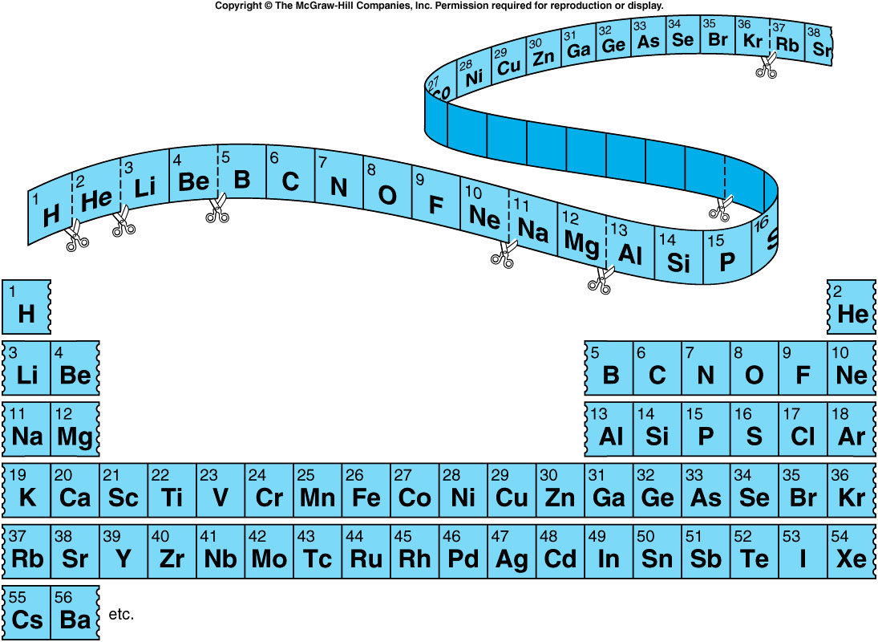
By listing the elements in order of increasing atomic mass, Mendeleev organized the elements into a table with elements of similar properties aligned into columns. This is called the periodic table.
One Atomic weight:
1/12 of the mass of an atom of carbon-12.

Slide 9
If 42 g of nitrogen reacts completely with 9 g of hydrogen (atomic weight 1) to form ammonia (NH₃), the atomic weight of nitrogen must be
    A. 3.
    B. 14.
    C. 49.
    D. 52.
    E. 55.
Assume X is the nitrogen atomic number:
42g/9g = X/(1x3) ➔ X = (42/9)x3 = 14.

Slide 10
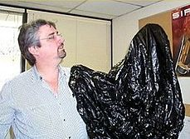
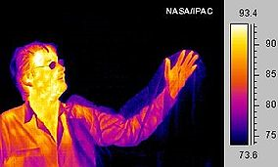
Quantization of light energy
To complete the picture of the atom, there was yet another piece of the puzzle that needed to be discovered...
A black body is:
an idealized physical body that absorbs all incident electromagnet radiation.
Because of this perfect absorptivity at all wavelengths, a black body is also the best possible emitter of thermal radiation, which depends on the body's temperature.

Slide 11
Quantization of light energy
Planck derived a formula that described the distribution of wavelengths emitted, depending on the temperature.
  His formula required that light could only be absorbed or emitted in discrete chunks or quanta, whose energy depended on the frequency or wavelength.
  where h = 6.626 x 10⁻³⁴ J s
  is called Planck’s constant.
This idea was indeed radical.
Einstein showed that the quantization of light energy explains a number of other phenomena.
  Photoelectric effect.
The idea of light quanta (photons) having energies E = hf prepared the way for a new model of the atom.

Slide 12
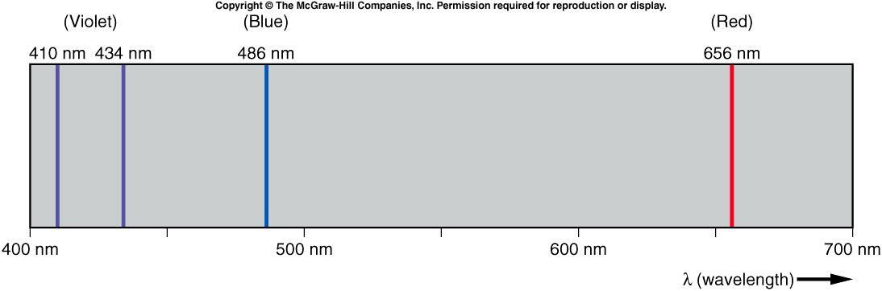
If a substance is heated and the emitted light is observed through a prism, each substance produces characteristic colors or wavelengths, called the atomic spectrum of that substance.
The spectrum of hydrogen is simple, with just four wavelengths in the visible portion.
Balmer discovered that the wavelengths of these four lines could be computed from a simple formula:
where n and m are both integers and R is the Rydberg constant:
R = 1.097 x 10⁷ m⁻¹

Slide 13
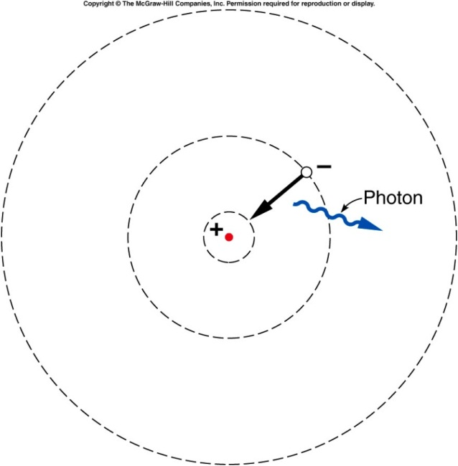
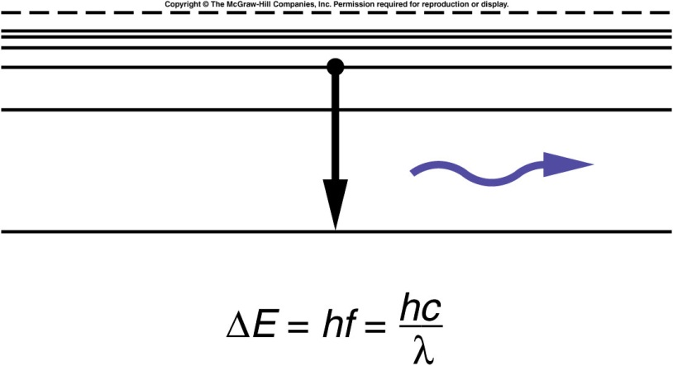
Bohr’s model of the atom
Bohr combined all these ideas:
  the discovery of the nucleus
  knowledge of the electron
  the regularities in the hydrogen spectrum
  the new quantum ideas of Planck and Einstein
He pictured the electron as orbiting
the nucleus in certain quasi-stable
orbits.
Light is emitted when the electron
jumps from one orbit to another.
The energy between the two orbits
determines the energy of the
emitted light quantum.

Slide 14
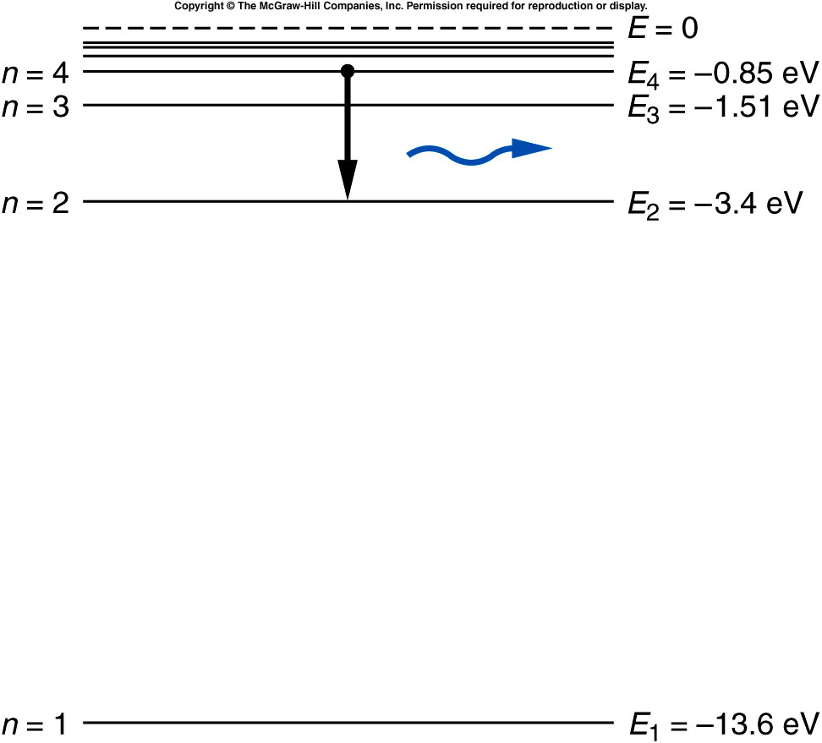
Bohr’s model of the atom
The hydrogen spectrum can be explained by representing the energies for the different electron orbits in an energy-level diagram.

Slide 15
What is the wavelength of the photon emitted in the transition from n = 4 to n = 2? Note: h = 6.626 x 10⁻³⁴ J s = 4.14 x 10⁻¹⁵ eV s
487 nm
4000 nm
12 nm
66 nm
2000000 nm

Slide 16
What is the wavelength of the photon emitted in the transition from n = 4 to n = 2?
∆E = E₄ - E₂
= - 0.85 eV - (-3.4 eV)
= 2.55 eV
E = hf where h = 6.626 x 10⁻³⁴ J s
= 4.14 x 10⁻¹⁵ eV s
f = E / h
= (2.55 eV) / (4.14 x 10⁻¹⁵ eV s)
= 6.16 x 10¹⁴ Hz
= c / f
= (3 x 10⁸) / (6.16 x 10¹⁴ Hz)
= 487 nm

Slide 17
Quiz: Among the following transition in atomic hydrogen, which gives radiation of the longest wavelength (i.e. lowest energy)?
A. n=4 to n=2
B. n=4 to n=3
C. n=3 to n=2.
E4 - E3 = 0.76 eV
E4 – E2 = 2.55 eV
E3 – E2 = 1.89 eV.
So B is the answer.

Slide 18
The Structure of the Nucleus
Rutherford. Bombarded nitrogen gas with alpha particles
  A new particle emerged We now call this particle a proton.
  Charge +e = 1.6 x 10⁻¹⁹ C
  Mass = 1/4 mass of alpha particle, 1835 x mass of electron
Bothe and Becker bombarded thin beryllium samples with alpha particles.
  A very penetrating radiation was emitted.
  Originally assumed to be gamma rays, this new radiation proved to be even more penetrating.
Chadwick determined it was a new particle which we now call neutron.
  No charge -- electrically neutral
  Mass very close to the proton’s mass

Slide 19
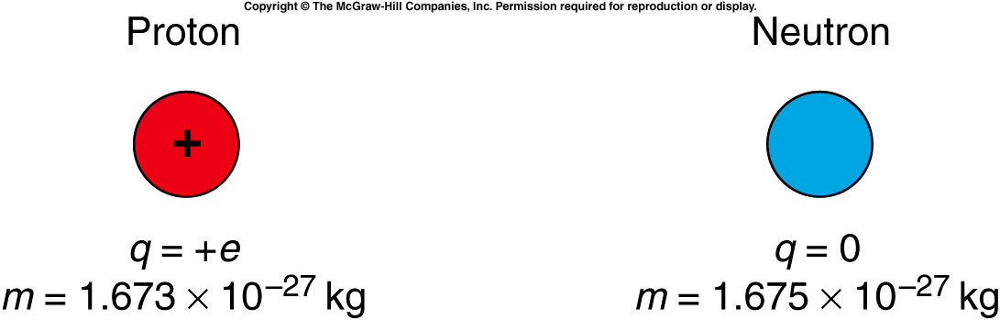
The basic building blocks of the nucleus are the proton and the neutron.
  Their masses are nearly equal.
  The proton has a charge of +1e while the neutron is electrically neutral.
This explains both the charge and the mass of the nucleus.
  An alpha particle with charge +2e and mass 4 x mass of the proton is composed of two protons and two neutrons.
  A nitrogen nucleus with a mass 14 times the mass of a hydrogen nucleus and a charge 7 times that of hydrogen is composed of seven protons and seven neutrons.

Slide 20
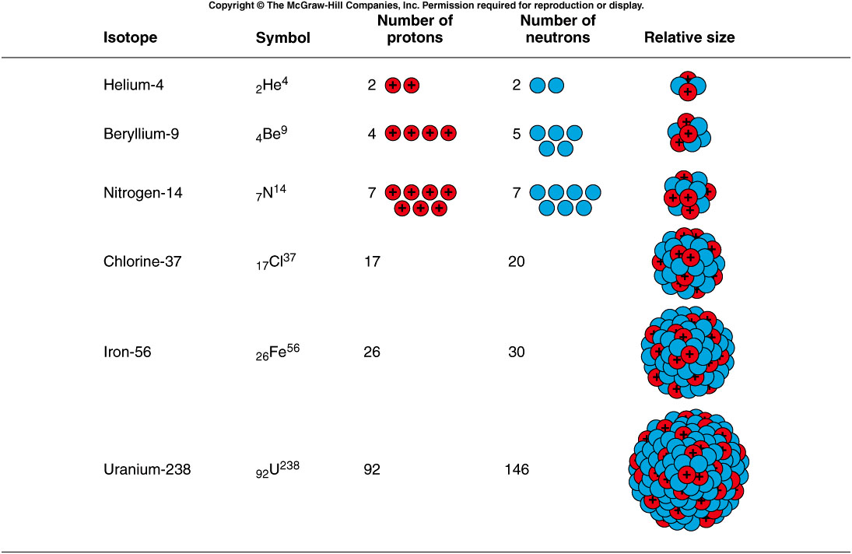
Notes:
Mention a little about the strong interaction. Electric interaction repel each other but the nucleus is still stable.

Slide 21
This also explains isotopes.
  Atoms of the same element can have different values of nuclear mass.
    Different isotopes have the same number of protons in the nucleus, but different numbers of neutrons.
    Two common isotopes of chlorine both have 17 protons, but one has 18 neutrons and the other has 20 neutrons.
  The chemical properties of an element are determined by the number and arrangement of the electrons outside of the nucleus.
  For a neutral atom with a net charge of zero, the number of electrons outside the nucleus must equal the number of protons inside the nucleus. This is the atomic number.
  The total number of protons and neutrons are called mass number
Notes:
Chemical properties determined by the number of electrons. Different elements have similar chemical properties. ➔ isotopes.

Slide 22
Plutonium-239 is a radioactive isotope of plutonium produced in nuclear reactors.
Plutonium has an atomic number of 94.
How many protons and how many neutrons are in the nucleus of this isotope?
94 protons, 94 neutrons
94 protons, 145 neutrons
145 protons, 94 neutrons
94 protons, 239 neutrons
239 protons, 94 neutrons
With an atomic number of 94, all isotopes of plutonium have 94 protons.
The isotope plutonium-239 has 239 - 94 = 145 neutrons.

Slide 23
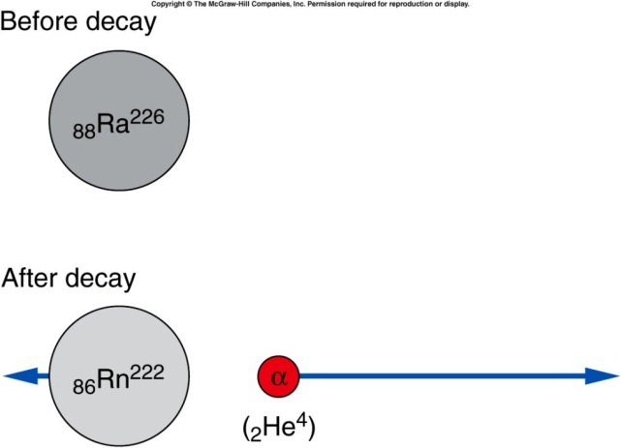
Alpha decay
Alpha particle is one of the decay product.
  For example, Marie and Pierre Curie isolated the highly radioactive element radium (₈₈Ra²²⁶) which emitted primarily alpha particles.
  The dominant isotope of radium contains a total of 226 nucleons: ₈₈Ra²²⁶
    The atomic number, 88, is the number of protons.
    The mass number, 226, is the total number of protons and neutrons.
  When radium-226 undergoes alpha decay, it emits an alpha particle (2 protons and 2 neutrons).
    The nucleus remaining after the decay has 88 - 2 = 86 protons, 226 - 4 = 222 nucleons, and 222 - 86 = 136 neutrons.
    This is the element radon-222.
Notes:
Are all the nucleus stable?
Becquerel found some nature material can expose the photographic plate wrapped in the dark box.

Slide 24
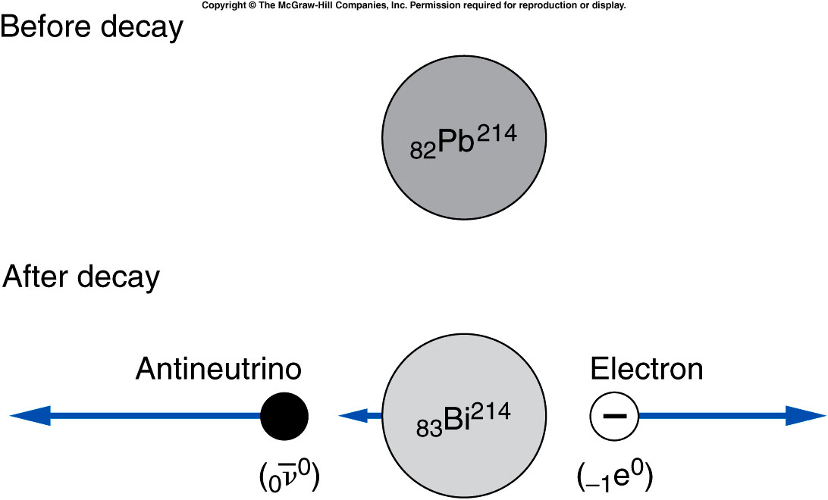
Beta decay is the emission of either an electron or a positron (the electron’s antiparticle).
  For example, lead-214 emits an electron.
  One of the neutrons inside the nucleus changes into a proton, yielding a nucleus with a higher atomic number.
  In the process, an electron is emitted (to conserve charge) and a neutrino (or in this case, an antineutrino, the neutrino’s antiparticle) is emitted to conserve momentum.

Slide 25
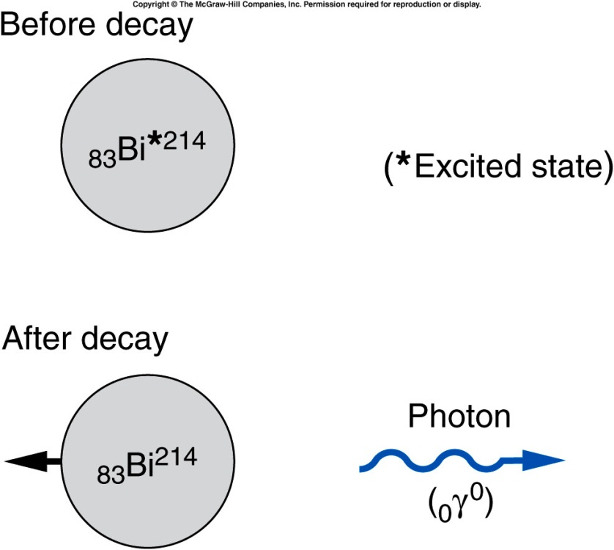
Gamma decay is the emission of a gamma particle or photon.
  The number of protons and of total nucleons does not change.
  The nucleus decays from an excited state to a lower energy state.
  The lost energy is carried away by the photon.
Notes:
Bi: Bismuth

Slide 26
Backups

Slide 27
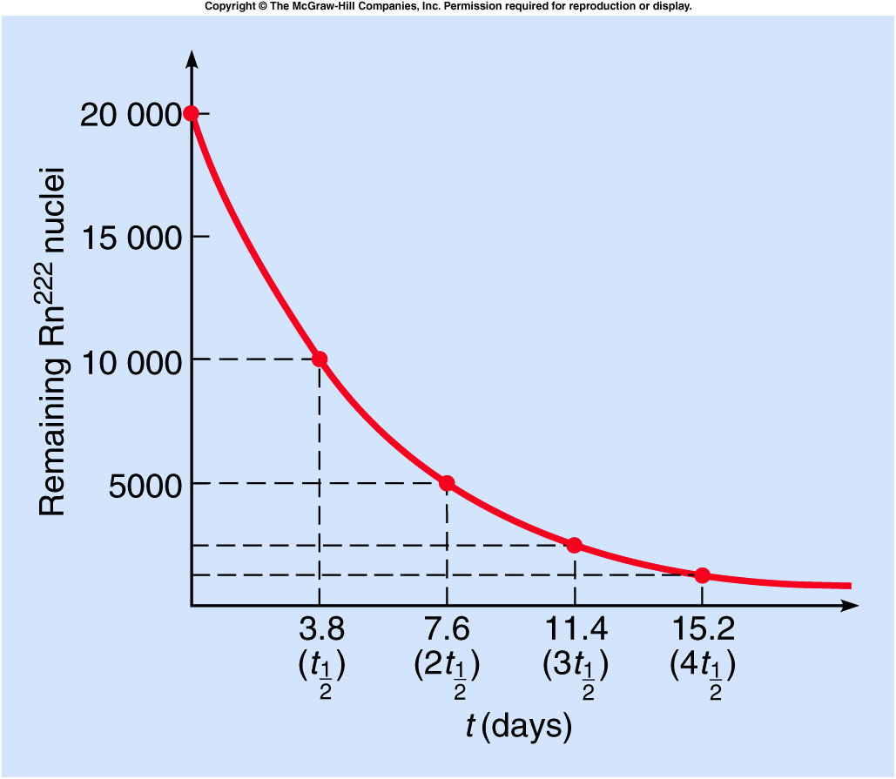
Different radioactive isotopes have different average times that elapse before they decay.
The half-life is the time required for half of the original number of atoms to decay.
  For example, the half-life of radon-222 is about 3.8 days.
If we start with 20,000 atoms of radon-222, 3.8 days later we would have 10,000 remaining.
After 7.6 days, half of the 10,000 would have decayed, leaving 5,000.
After three half-lives, only 2500 would remain.
After four half-lives, only 1250 would remain.

Slide 28
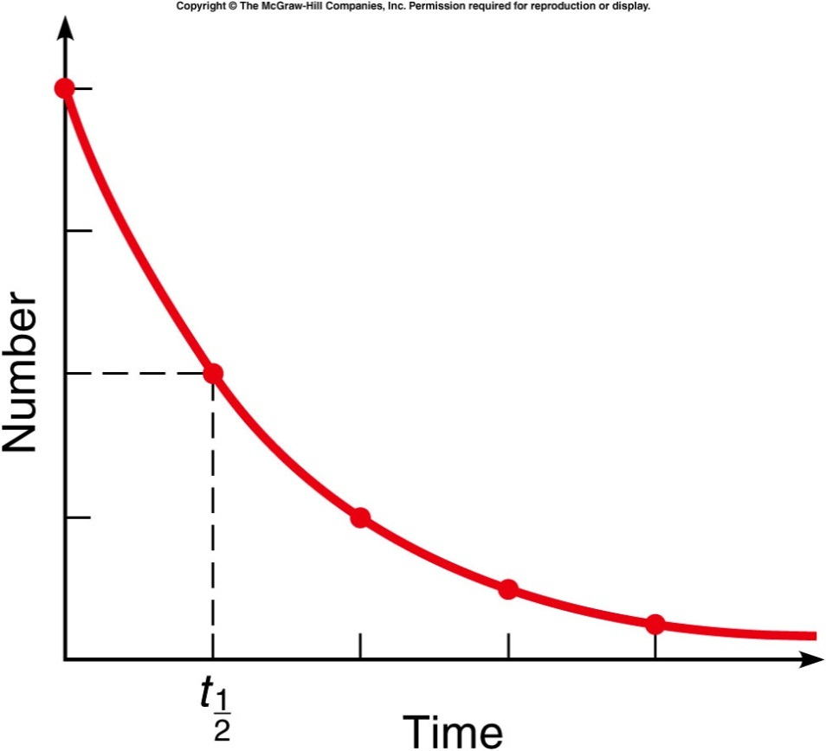
If we start with 10,000 atoms of a radioactive substance with a half-life of 2 hours, how many atoms of that element remain after 4 hours?
5,000
2,500
1,250
625
0
After 2 hours (one half-life), half of the original 10,000 atoms have decayed, leaving 5,000 atoms of the element.
After 4 hours (two half-lives), half of that remaining 5,000 atoms have decayed, leaving 2,500 atoms of the original element.

Slide 29
We are exposed to radiation every day.
How much exposure is likely to be dangerous?
“Rem” stands for “roentgen equivalent in man” and is a unit for measuring amounts of ionizing radiation.
A whole-body dose of 600 rems is lethal.
Currently radiation workers are allowed no more than 5 rems/yr.
Smaller doses are measured in millirems (mrems).
http://www.new.ans.org/pi/resources/dosechart/
Natural sources | mrems/yr
inhaled radon | 200
cosmic rays | 27
terrestrial radioactivity | 28
internal radioactivity | 40
Total: | 295
Human-produced sources | mrems/yr
medical | 53
consumer products | 10
other | 1
Total: | 64
Notes:
Radiation like small bullet. It can kill cells.

Slide 30

Mass and Energy
$$E=m×c^{2}$$
Mass and energy are related according to above equation.
Notes:
Now we are going into a different area. Nuclear reaction.

Slide 31
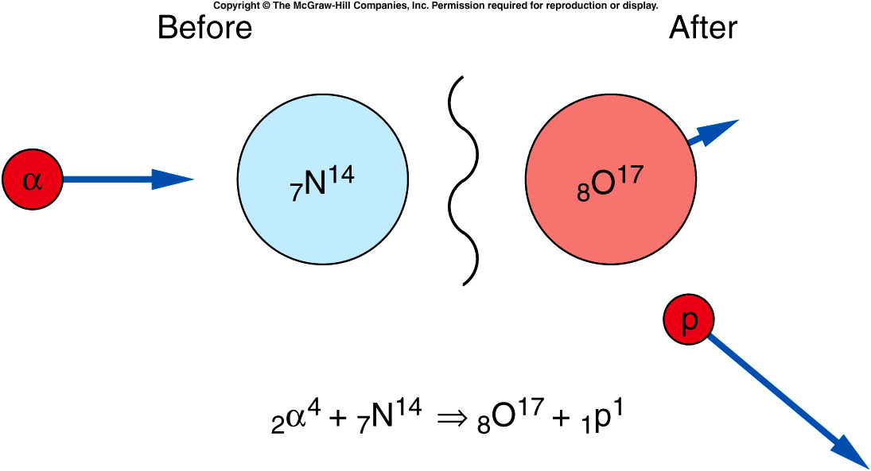
Nuclear Reactions and Nuclear Fission
In addition to spontaneous radioactive decays, changes in the nucleus may be produced experimentally through nuclear reactions.
Notes:
So far we talk only about a nuclear decay into different nucleus. Can multiple nucleus react to form new nucleus?
Rutherford experiment.

Slide 32
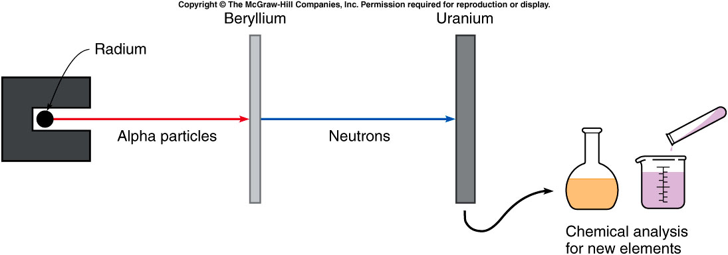
Fermi attempted to produce new elements by bombarding uranium with neutrons.
₂He⁴ + ₄Be⁹ ⇒ ₆C¹² + ₀n¹

Slide 33
Quiz: If we start with 10,000 atoms of a radioactive substance with a half-life of 2 hours, how many atoms of that element remain after 8 hours?
5,000
2,500
1,250
625
0
After 8 hours (four half-lives), the number has been reduced by half a total of four times, leaving 625 atoms of the original 10,000 atoms of that element remaining.

