Slide 1
Final exam (focusing on chapter 9 – 19, excl. 17)
Time: Tue 05/04 3:30pm – 5:30pm
Location: physics building room 112
AOB
  multiple choice problems.
  Prepare your own scratch paper, pencils, erasers, etc.
  Use only pencil for the answer sheet
  Bring your own calculators
  No cell phones, no text messaging, no computers
  No crib sheet of any kind is allowed. Equation sheet will be provided.
When filling the scantron
  Write your name in the top respective field of the scantron sheet, sign your name on the signature line of the scantron sheet.
  Record your PUID number, which starts with “00”, on your scantron sheet.
  fill in bubbles below your name and ID fields
Notes:
Write your name in the top respective field of the scantron sheet, sign your name on the signature line of the scantron sheet.
Record your PUID number, which starts with “00”, on your scantron sheet.

Slide 2
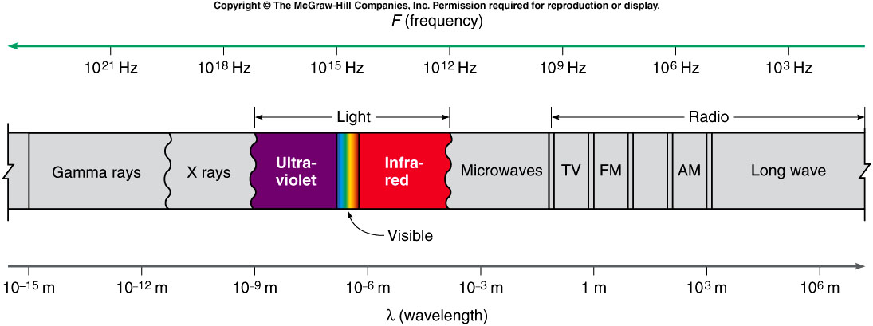
    Radio waves can be generated by accelerated charges in an oscillating electrical circuit.
    X rays can come from energy transitions of atomic electrons.
    Gamma rays originate inside an atomic nucleus.
    Infrared light is radiated by all warm bodies.
      Oscillating atoms within the molecules of the warm body serve as the antennas.

Slide 3
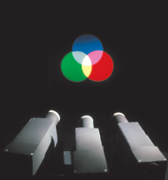
Color Mixing
The process of mixing two different wavelengths of light, such as red and green, to produce a response interpreted as another color, such as yellow, is additive color mixing.
  Combining the three primary colors blue, green, and red in different amounts can produce responses in our brains corresponding to all the colors we are used to identifying.
  Red and green make yellow, blue and green make cyan, and blue and red make magenta.
  Combining all three colors produces white.

Slide 4
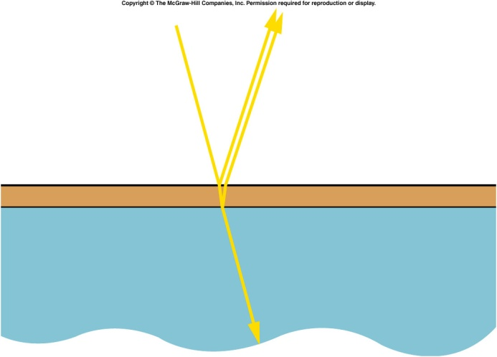
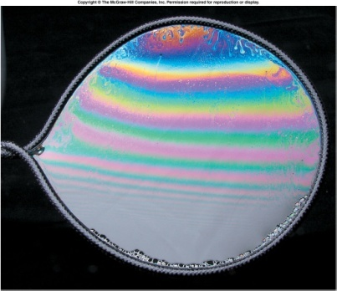
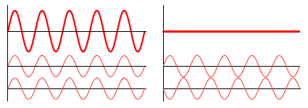
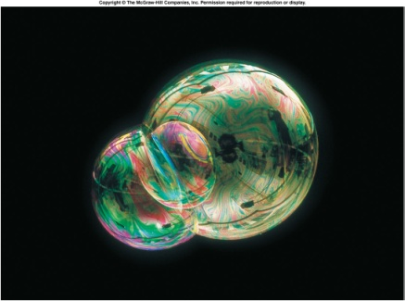
Thin film interference
Thin film interference occurs when light is reflected from the top surface and the underneath surface.
This provides the two beams of coherent light that interfere.
Since we normally observe this with white light we see colors because the path difference varies depending on the angle of observation
So different wavelengths (colors) have constructive and destructive interference at different places on the film.

Slide 5
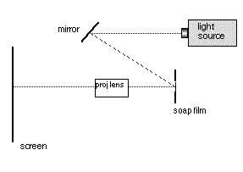
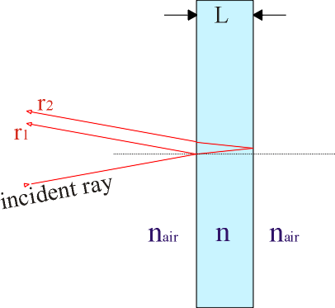
7B-11 Color in Thin Films
Studying thin-film interference effects
Why are the effects on white light and monochromatic light different ?
What kind of patterns appear on the screen ?
LIGHT REFLECTED FROM THE FRONT AND THE BACK OF A THIN SOAP FILM INTERFERES WITH ITSELF. INTERFERENCE OF MONOCHROMATIC LIGHT PRODUCES BRIGHT AND DARK FRINGES WHILE INTERFERENCE OF WHITE LIGHT PRODUCES COLORED BANDS (DIFFERENT FREQUENCIES OF LIGHT INTERFERE DIFFERENTLY).
Notes:
After the next slide, use the same setup for single slit diffraction.

Slide 6
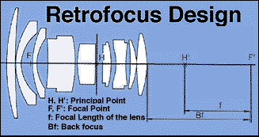
Coatings for lenses
As light passes from one transparent medium to another a few percent of the light will be reflected.
This is a particular problem in optical systems like lenses where there may be many glass elements.
For example if 96% of the light is transmitted at a surface after 8 surfaces only 72% of the light remains and the other 28% will be scattered everywhere.
Thin coatings are put on glass surfaces so that for particular wavelengths the light reflected from the top surface is exactly cancelled by the light from the bottom surface.
This is only true for a single wavelength and to reduce the reflections for a range of wavelengths requires multiple thin film layers very often just λ/4 thick.

Slide 7
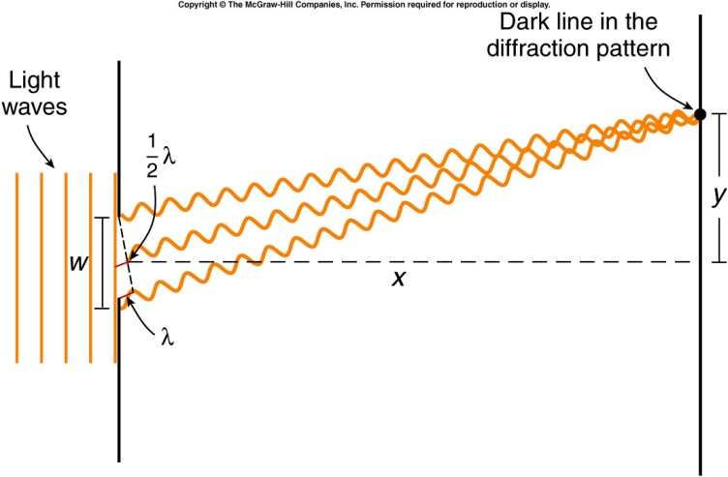
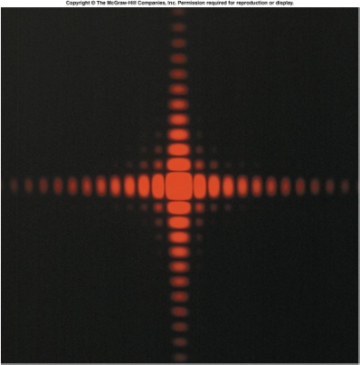
Diffraction
Interference occurs even for a single aperture and this is called diffraction. The pattern shown is from a square aperture and the pattern can be thought of as light from different parts of the aperture interfering.
As the aperture is made smaller the pattern actually expands.
This effect can limit our ability to see detail in small objects or to resolve two stars nearby to one another.
The position of the first dark fringe is given by y = λx/w. This means the central bright fringe has a width ~ 2y and increases as w gets smaller
That’s why the telescope with bigger aperture see clearer.

Slide 8
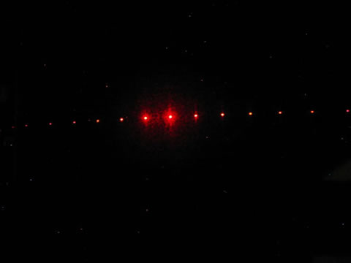
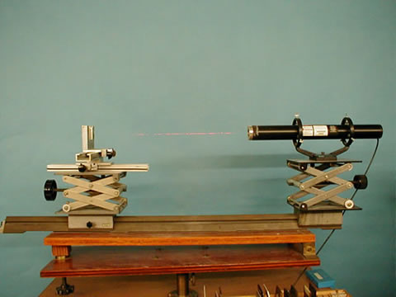
Demos: 7B-17 Laser Cart

Slide 9
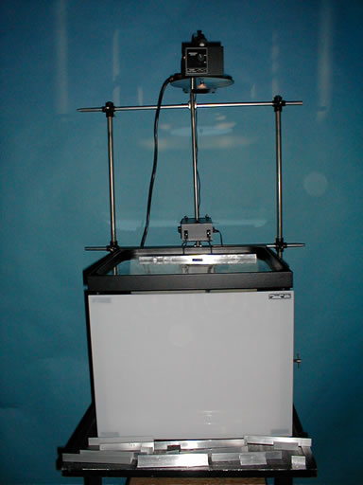
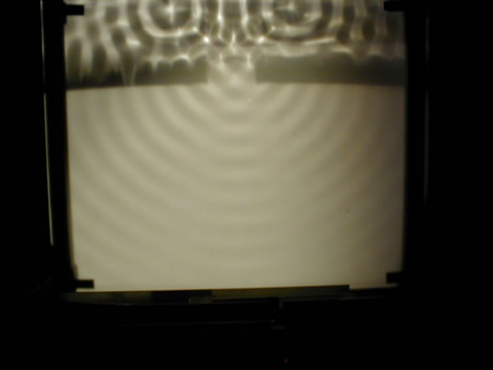
Demos: 7B-16 Ripple Tank

Slide 10
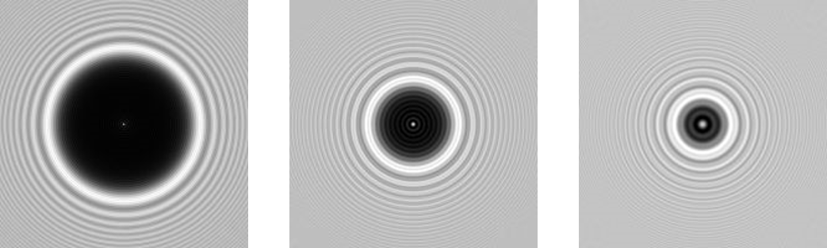
Diffraction
Light can bend around an object due to diffraction.
  When size of the object < wave length, A bright spot will show up in the center of the shadow of the object.
  https://en.wikipedia.org/wiki/Arago_spot
varying diameter (4 mm, 2 mm, 1 mm – left to right) at a distance of 1 m from the disc
Notes:
Talk about the history of putting a disk to block the light but see the bright spot right behind the disk.

Slide 11
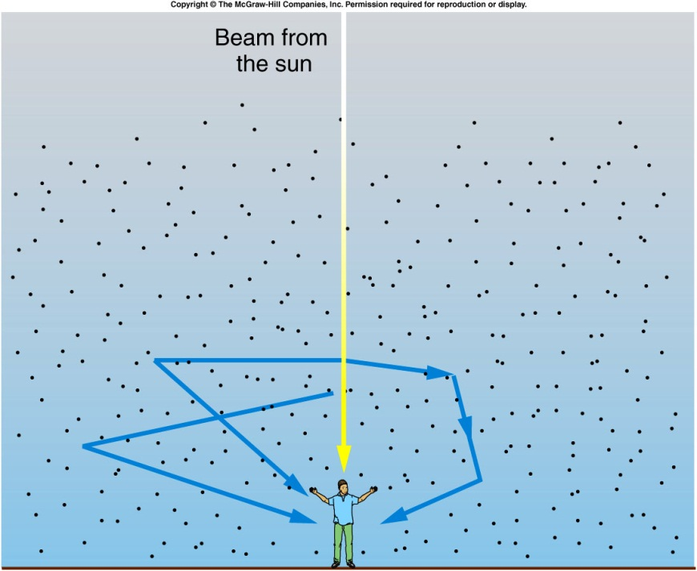
Why is the sky blue?
The white light coming from the sun is actually a mixture of light of different wavelengths (colors).
The shorter wavelengths of blue light are scattered by gas molecules in the atmosphere more than longer wavelengths such as red light.
The blue light enters our eyes after being scattered multiple times, so appears to come from all parts of the sky.

Slide 12
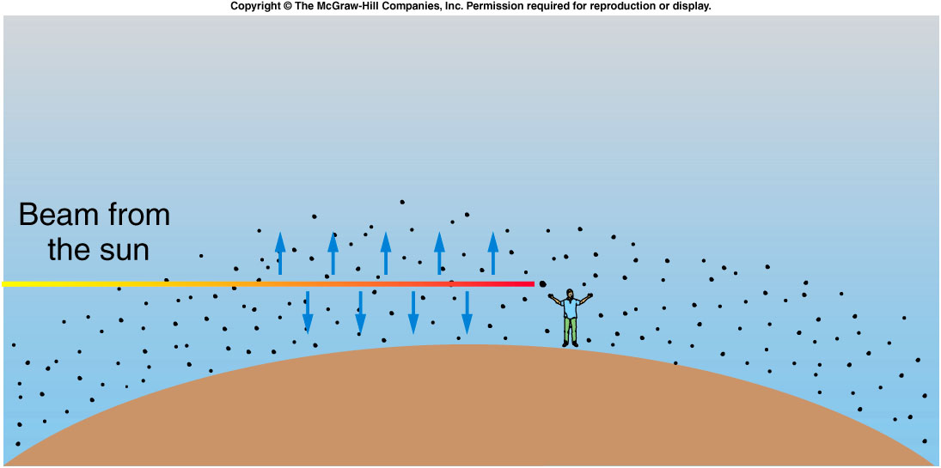
Why is the sunset red?
The shorter wavelengths of blue light are scattered by gas molecules in the atmosphere more than longer wavelengths such as red light.
When the sun is low on the horizon, the light must pass through more atmosphere than when the sun is directly above.
By the time the sun’s light reaches our eyes, the shorter wavelengths such as blue and yellow have been removed by scattering, leaving only orange and red light coming straight from the sun.

Slide 13
The Existence of Atoms: Evidence from Chemistry
Why believe in the existence of something we have never seen?
  Observations can provide convincing evidence.
  Much early evidence of atoms came from chemistry, the study of the differences in substances and how they can be combined to form other substances.
  Since certain substances were retrievable, early scientists were also tempted to believe that certain elements were made up of tiny indivisible atoms.

Slide 14
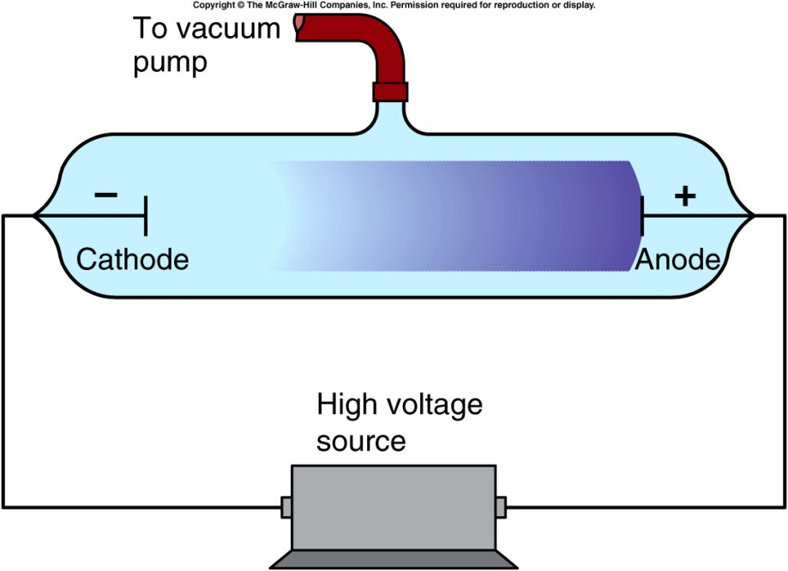
Cathode rays, Electrons, and X-rays
By the end of the nineteenth century, chemists were using the concept of atoms to explain their properties.
Physicists were less convinced.
  The discovery of cathode rays was the beginning of atomic physics.
Two electrodes are sealed in a glass tube.
As the tube is evacuated, a glow discharge appears in the gas between the electrodes.
With further evacuation, the discharge disappears, and a glow appears on the end of the tube opposite the cathode.
Notes:
Coat the tube with phosphorescent

Slide 15
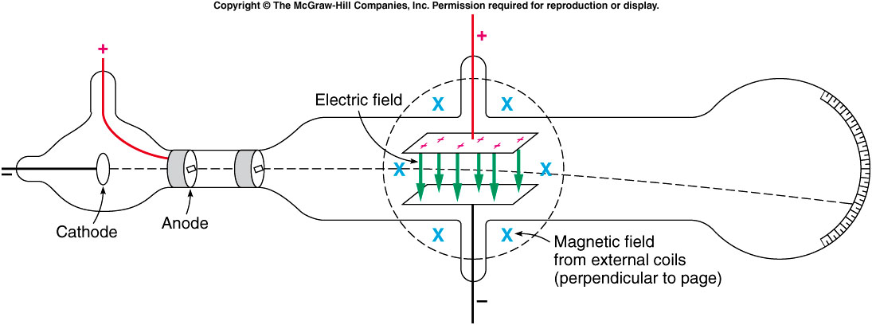
J. J. Thomson used both electric fields and magnetic fields to deflect the beam.
The combined effect allowed him to estimate the velocity of the particles.
With the deflection produced by the magnetic field alone, this allowed him to estimate the mass of the particles.
  We now call these particles electrons.

Slide 16
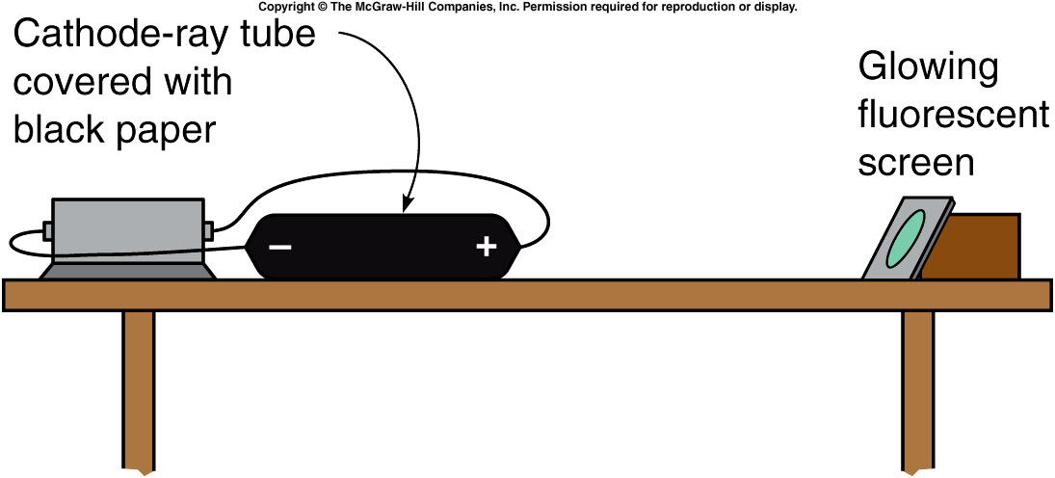
Thomson’s discovery provided the first known subatomic particle.
  The mass of an electron is 9.1 x 10⁻³¹ kg.
  The charge of an electron is 1.6 x 10⁻¹⁹ C.
  The electron was the first possible candidate for a building block of atoms.
The study of cathode rays led Roentgen to discover yet another type of radiation.

Slide 17
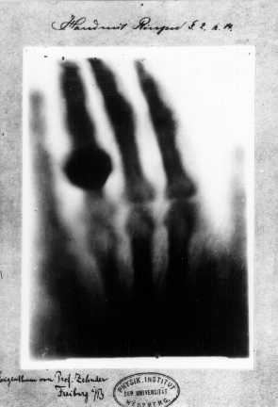
He noticed that a fluorescent material would glow when placed near his covered cathode-ray tube.
Cathode rays could not travel through air, but this new radiation did.
Because they were unknown, Roentgen called this new radiation X-rays.
1st Nobel Prize Winner
Wikipedia: “print of Roentgen’a first "medical" X-ray, of his wife's hand, taken on 22 December 1895”

Slide 18
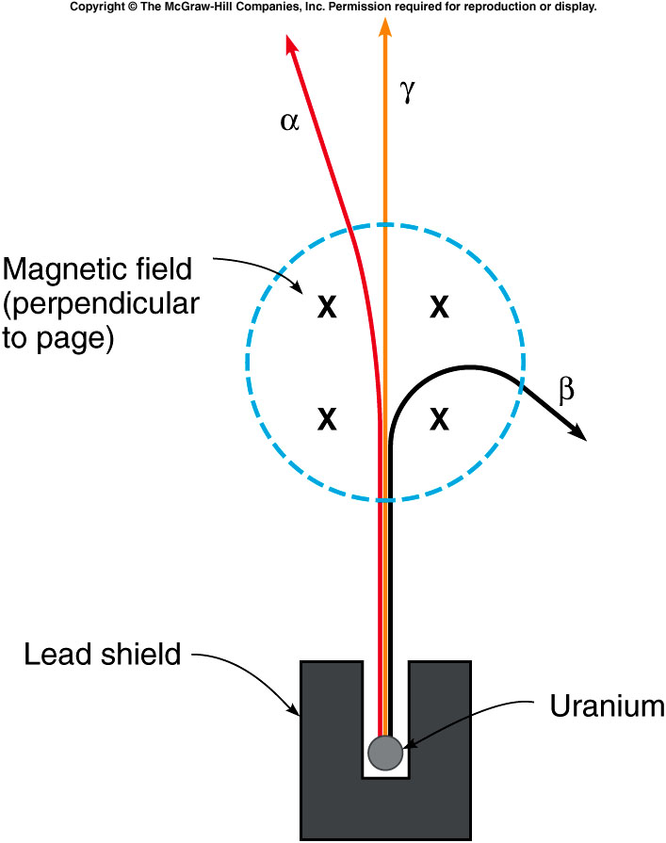
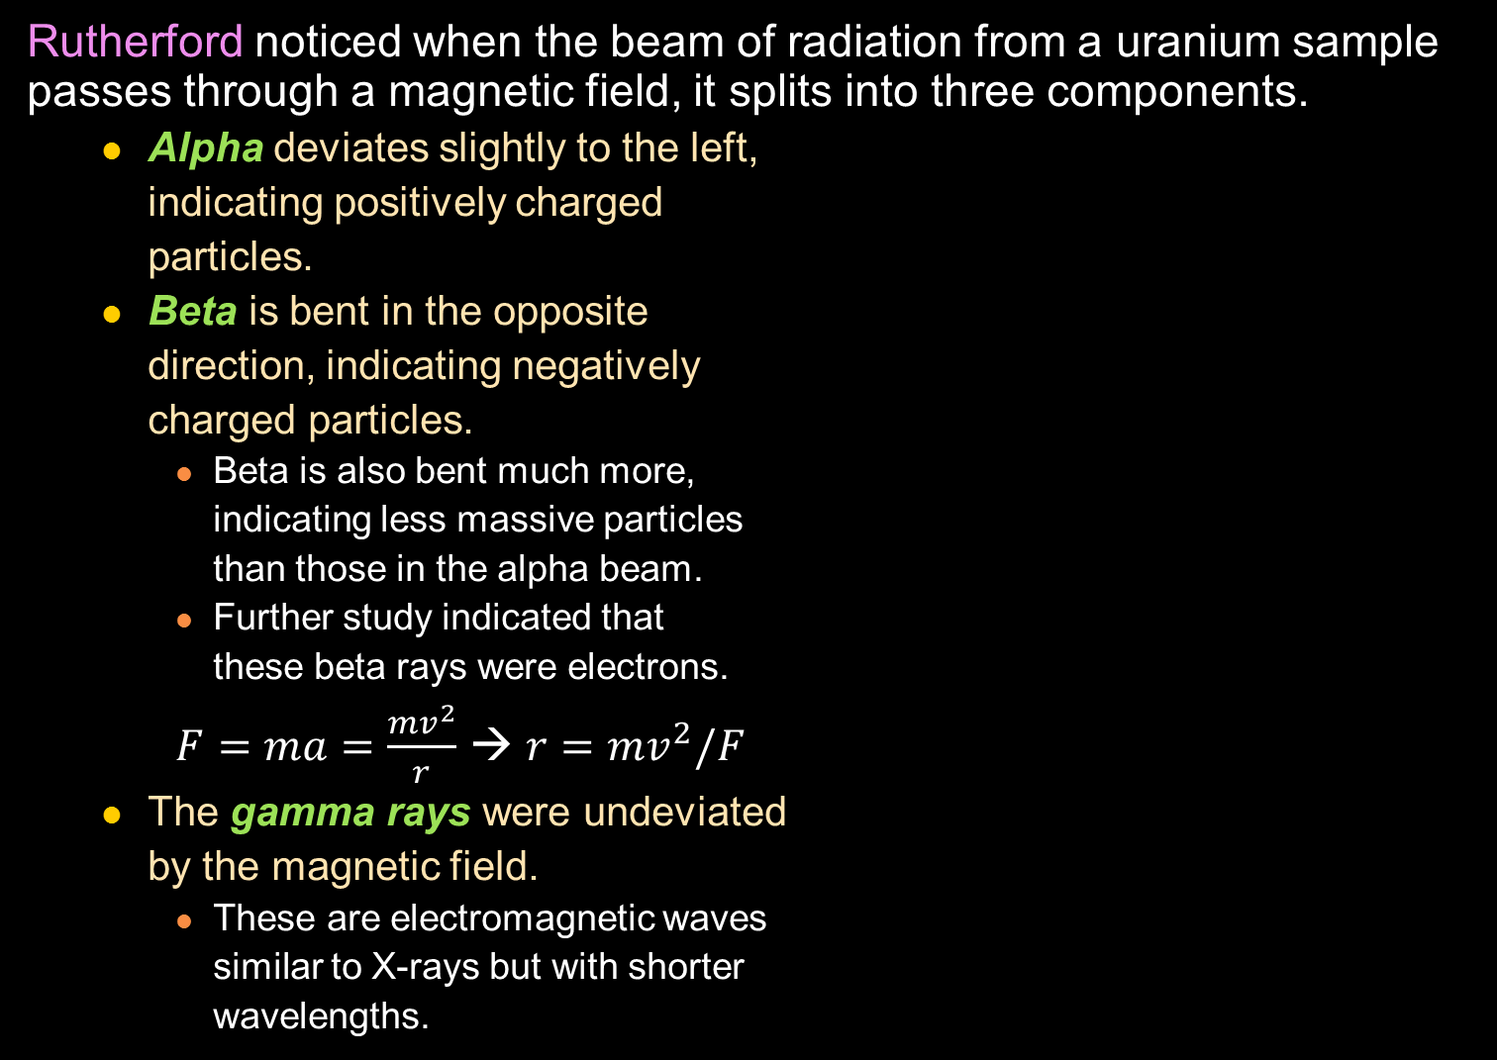
Rutherford noticed when the beam of radiation from a uranium sample passes through a magnetic field, it splits into three components.
  Alpha deviates slightly to the left,
  indicating positively charged
  particles.
  Beta is bent in the opposite
  direction, indicating negatively
  charged particles.
    Beta is also bent much more,
    indicating less massive particles
    than those in the alpha beam.
    Further study indicated that
    these beta rays were electrons.
    $F=ma=\frac{mv^{2}}{r}$ → $r=mv^{2}/F$
  The gamma rays were undeviated
  by the magnetic field.
    These are electromagnetic waves
    similar to X-rays but with shorter
    wavelengths.
Notes:
Use right hand rule to demonstrate the magnet force.

Slide 19
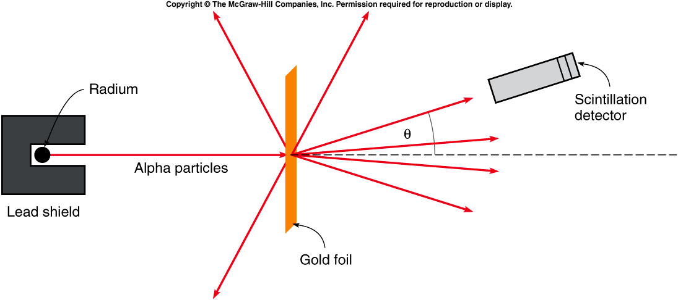
Rutherford realized that they would make effective probes for studying the structure of the atom.
  A beam of alpha particles was scattered from a thin gold foil.
  The size of the gold atoms would affect the angle of the scattered alpha particles.
  Most of them went straight through the foil, as expected.
  BUT, a few particles scattered back at much larger angles.

Slide 20
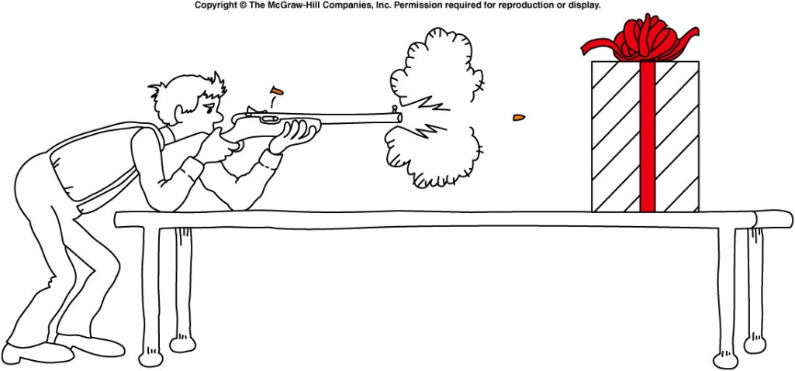
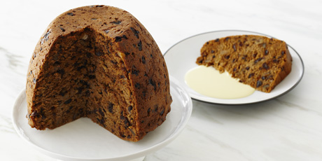
The backward scattering was as if someone had fired bullets into a piece of tissue paper and the bullets bounced back.
If most of the alpha particles go through, but a few are scattered through large angles, there must be very dense but small centers somewhere within the atoms.
  The nucleus of the atom had been discovered!
  The nucleus is the very dense center of the atom, containing most of its mass and all of its positive charge.
  The electrons are responsible for most of the atom’s size, but very little of its mass.
https://www.foodnetwork.ca/recipe/grand-plum-pudding/12722/
Notes:
The plum pudding model depicts the electrons as negatively-charged particles embedded in a sea of positive charge

Slide 21
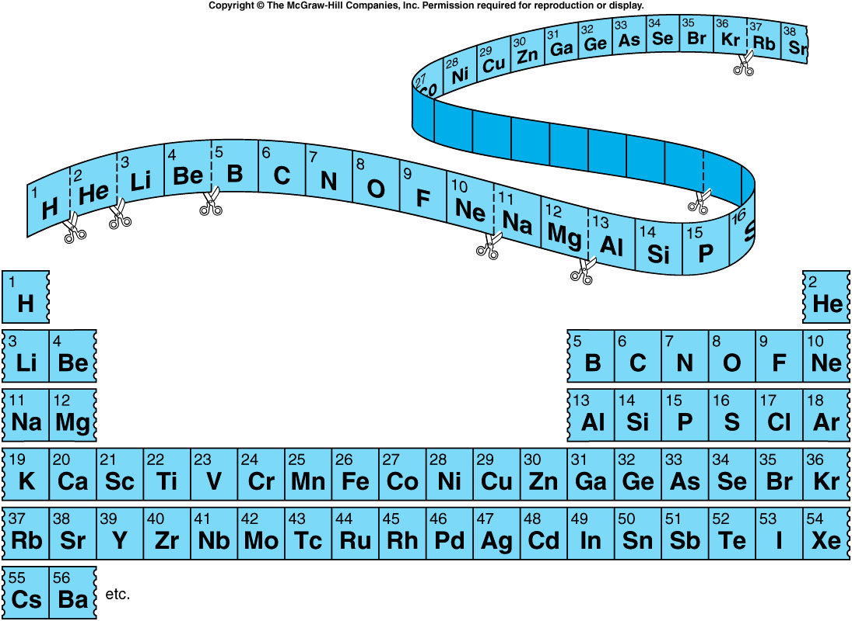
By listing the elements in order of increasing atomic mass, Mendeleev organized the elements into a table with elements of similar properties aligned into columns. This is called the periodic table.
One Atomic weight:
1/12 of the mass of an atom of carbon-12.

Slide 22
If 42 g of nitrogen reacts completely with 9 g of hydrogen (atomic weight 1) to form ammonia (NH₃), the atomic weight of nitrogen must be
    A. 3.
    B. 14.
    C. 49.
    D. 52.
    E. 55.
Assume X is the nitrogen atomic number:
42g/9g = X/(1x3) ➔ X = (42/9)x3 = 14.

Slide 23
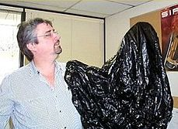
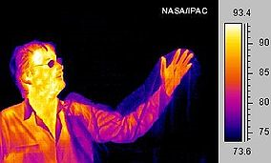
Quantization of light energy
To complete the picture of the atom, there was yet another piece of the puzzle that needed to be discovered...
A black body is:
an idealized physical body that absorbs all incident electromagnet radiation.
Because of this perfect absorptivity at all wavelengths, a black body is also the best possible emitter of thermal radiation, which depends on the body's temperature.

Slide 24
Quantization of light energy
Planck derived a formula that described the distribution of wavelengths emitted, depending on the temperature.
  His formula required that light could only be absorbed or emitted in discrete chunks or quanta, whose energy depended on the frequency or wavelength.
  where h = 6.626 x 10⁻³⁴ J s
  is called Planck’s constant.
This idea was indeed radical.
Einstein showed that the quantization of light energy explains a number of other phenomena.
  Photoelectric effect.
The idea of light quanta (photons) having energies E = hf prepared the way for a new model of the atom.

Slide 25
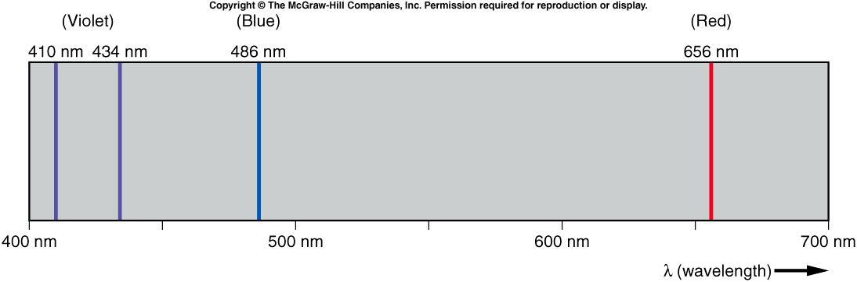
If a substance is heated and the emitted light is observed through a prism, each substance produces characteristic colors or wavelengths, called the atomic spectrum of that substance.
The spectrum of hydrogen is simple, with just four wavelengths in the visible portion.
Balmer discovered that the wavelengths of these four lines could be computed from a simple formula:
where n and m are both integers and R is the Rydberg constant:
R = 1.097 x 10⁷ m⁻¹

Slide 26
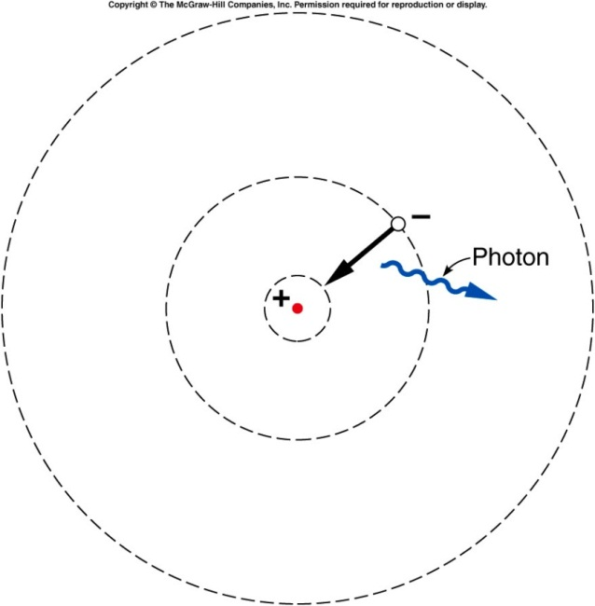
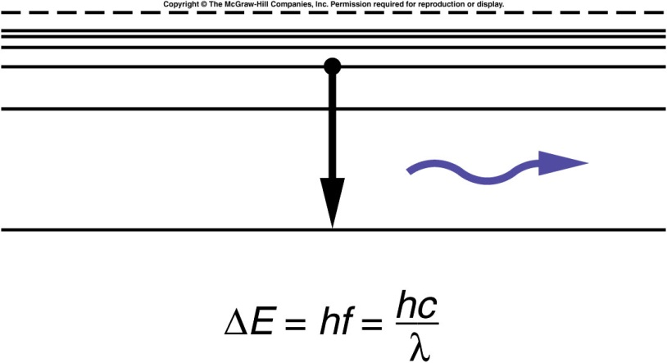
Bohr’s model of the atom
Bohr combined all these ideas:
  the discovery of the nucleus
  knowledge of the electron
  the regularities in the hydrogen spectrum
  the new quantum ideas of Planck and Einstein
He pictured the electron as orbiting
the nucleus in certain quasi-stable
orbits.
Light is emitted when the electron
jumps from one orbit to another.
The energy between the two orbits
determines the energy of the
emitted light quantum.

Slide 27
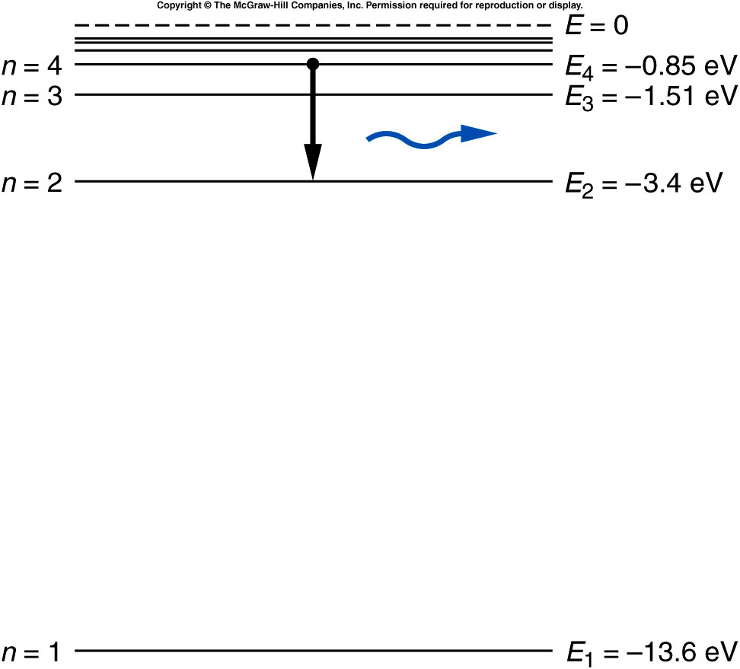
Bohr’s model of the atom
The hydrogen spectrum can be explained by representing the energies for the different electron orbits in an energy-level diagram.

Slide 28
What is the wavelength of the photon emitted in the transition from n = 4 to n = 2? Note: h = 6.626 x 10⁻³⁴ J s = 4.14 x 10⁻¹⁵ eV s
487 nm
4000 nm
12 nm
66 nm
2000000 nm

Slide 29
What is the wavelength of the photon emitted in the transition from n = 4 to n = 2?
∆E = E₄ - E₂
= - 0.85 eV - (-3.4 eV)
= 2.55 eV
E = hf where h = 6.626 x 10⁻³⁴ J s
= 4.14 x 10⁻¹⁵ eV s
f = E / h
= (2.55 eV) / (4.14 x 10⁻¹⁵ eV s)
= 6.16 x 10¹⁴ Hz
= c / f
= (3 x 10⁸) / (6.16 x 10¹⁴ Hz)
= 487 nm
If one shine a 487 nm light on the
Atom, electrons from n=2 orbit will jump to n=4 orbit, i.e. photoelectric effect.

Slide 30
Quiz: Among the following transition in atomic hydrogen, which gives radiation of the longest wavelength (i.e. lowest energy)?
A. n=4 to n=2
B. n=4 to n=3
C. n=3 to n=2.
E4 - E3 = 0.76 eV
E4 – E2 = 2.55 eV
E3 – E2 = 1.89 eV.
So B is the answer.

Slide 31
Backup slides

Slide 32
Cathode rays, Electrons, and X-rays
By the end of the nineteenth century, chemists were using the concept of atoms to explain their properties.
Physicists were less convinced.
  The discovery of cathode rays was the beginning of atomic physics.
Two electrodes are sealed in a glass tube.
As the tube is evacuated, a glow discharge appears in the gas between the electrodes.
With further evacuation, the discharge disappears, and a glow appears on the end of the tube opposite the cathode.
Notes:
Coat the tube with phosphorescent

Slide 33
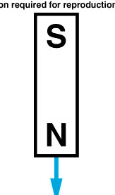
An invisible radiation seemed to emanate from the cathode to produce the glow on the opposite wall of the tube.
  The invisible radiation was called cathode rays.
If the north pole of a magnet is brought down toward the top of a cathode-ray tube, the spot of light is deflected to the left across the face of the tube.
  This indicates the cathode rays are negatively charged particles.

Slide 34
J. J. Thomson used both electric fields and magnetic fields to deflect the beam.
The combined effect allowed him to estimate the velocity of the particles.
With the deflection produced by the magnetic field alone, this allowed him to estimate the mass of the particles.
  We now call these particles electrons.

Slide 35
Thomson’s discovery provided the first known subatomic particle.
  The mass of an electron is 9.1 x 10⁻³¹ kg.
  The charge of an electron is 1.6 x 10⁻¹⁹ C.
  The electron was the first possible candidate for a building block of atoms.
The study of cathode rays led Roentgen to discover yet another type of radiation.

Slide 36
He noticed that a fluorescent material would glow when placed near his covered cathode-ray tube.
Cathode rays could not travel through air, but this new radiation did.
Because they were unknown, Roentgen called this new radiation X-rays.
1st Nobel Prize Winner
Wikipedia: “print of Roentgen’a first "medical" X-ray, of his wife's hand, taken on 22 December 1895”

Slide 37
Atomic Spectra and the Bohr Model of the Atom
The atom has a positively charged nucleus that contains most of the mass, and negatively charged electrons are arranged somehow around this nucleus.
  Could the atom be arranged like a tiny solar system, with the electrons in orbit around the nucleus?
  Why didn’t the electron spiral into the nucleus as it lost energy due to radiating electromagnetic waves?
  Why are the electromagnetic waves emitted only with particular wavelengths?

Slide 38
Quantization of light energy
To complete the picture of the atom, there was yet another piece of the puzzle that needed to be discovered...
A black body is:
an idealized physical body that absorbs all incident electromagnet radition.
Because of this perfect absorptivity at all wavelengths, a black body is also the best possible emitter of thermal radition, which depends on the body's temperature.

