Slide 1
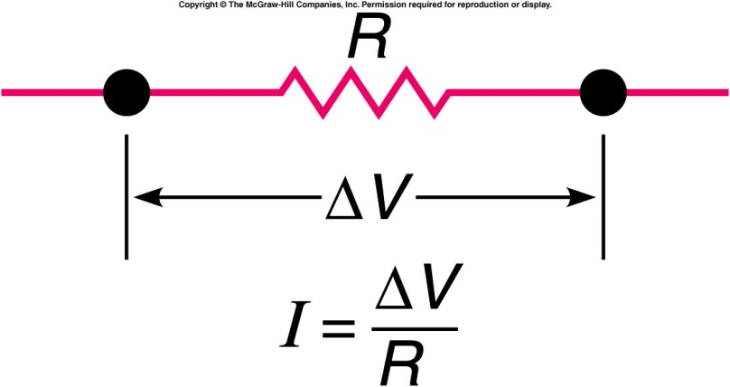
Ohm’s Law and Resistance
The electric current flowing through a given portion of a circuit is directly proportional to the voltage difference across that portion and inversely proportional to the resistance:
  Resistance R is the ratio of the voltage difference to the current for a given portion of a circuit, and is in units of ohms:
  1 ohm = 1 Ω = 1 V / A.
  The resistance of a wire is proportional to the length of the wire, inversely proportional to the cross-sectional area of the wire, and inversely proportional to the conductivity of the material.
  It also depends on the temperature of the material.

Slide 2
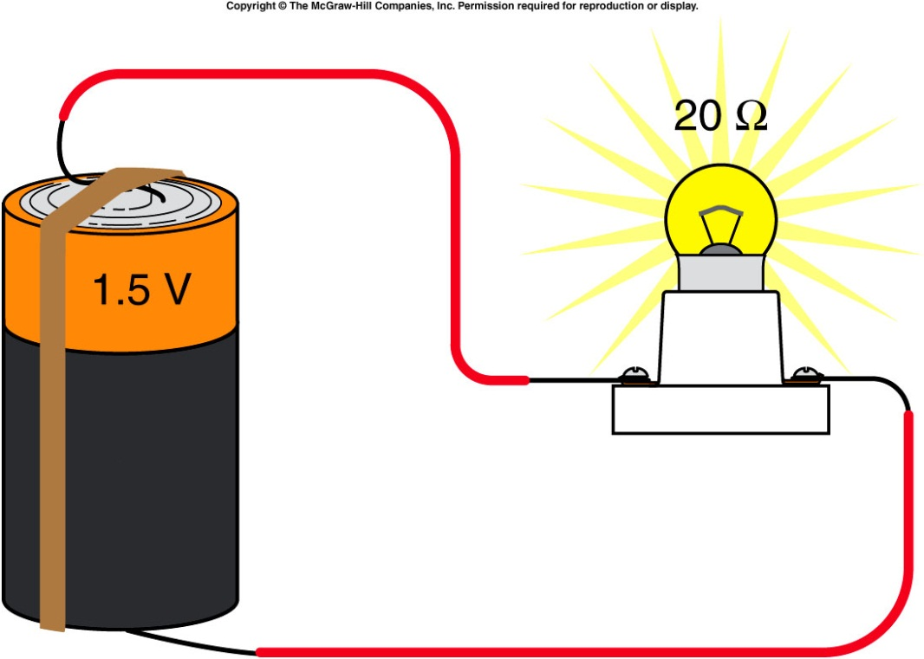
If we know the resistance of a given portion of a circuit and the applied voltage, we can calculate the current through that portion of the circuit.
For example, consider a 1.5-V battery connected to a light bulb with a resistance of 20 ohms.
the current can be found by applying Ohm’s Law:
I = 1.5 V / 20 Ω
= 0.075 A
= 75 mA

Slide 3
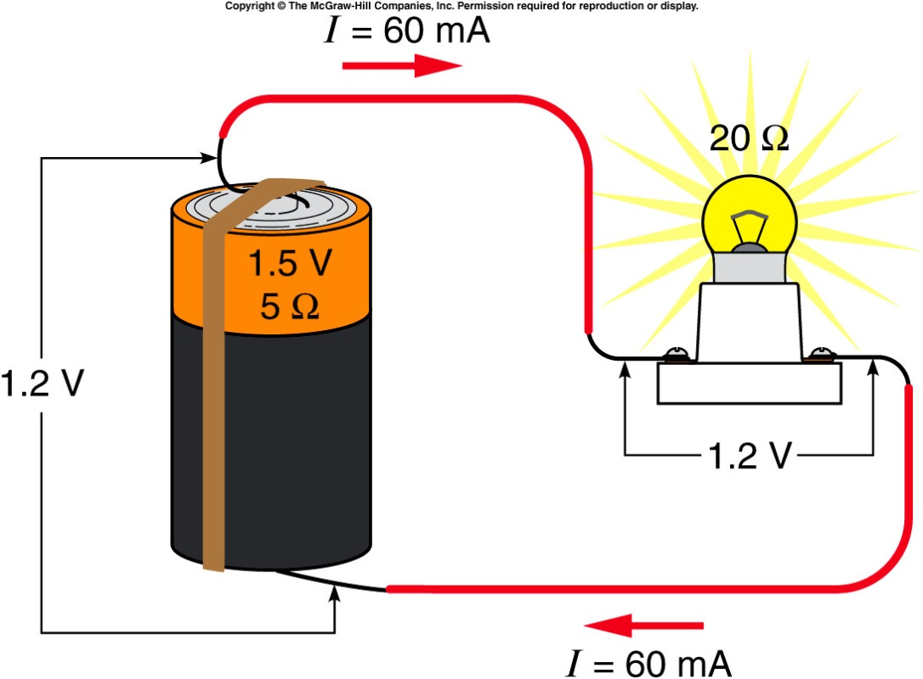
However, we ignored the resistance of the battery itself, as well as the very small resistance of the connecting wires.
  If the battery is fresh, its internal resistance is small and can often be neglected.
  As the battery is used, its internal resistance gets larger.
The voltage of the battery, 1.5 V, is called the electromotive force ε: the increase in potential energy per unit charge provided by the chemical reactions in the battery.

Slide 4
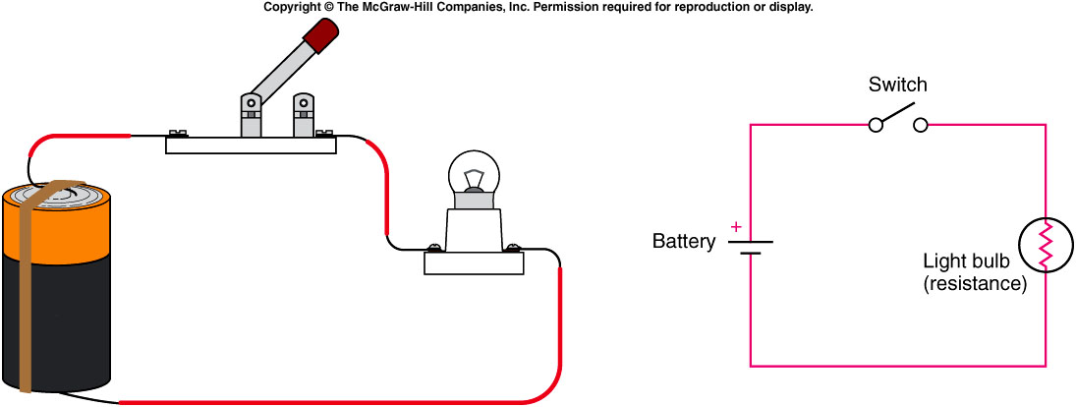
Series and Parallel Circuits
In a series circuit, there are no points in the circuit where the current can branch into secondary loops.
  All the elements line up on a single loop.
  The current that passes through one element must also pass through the others.

Slide 5
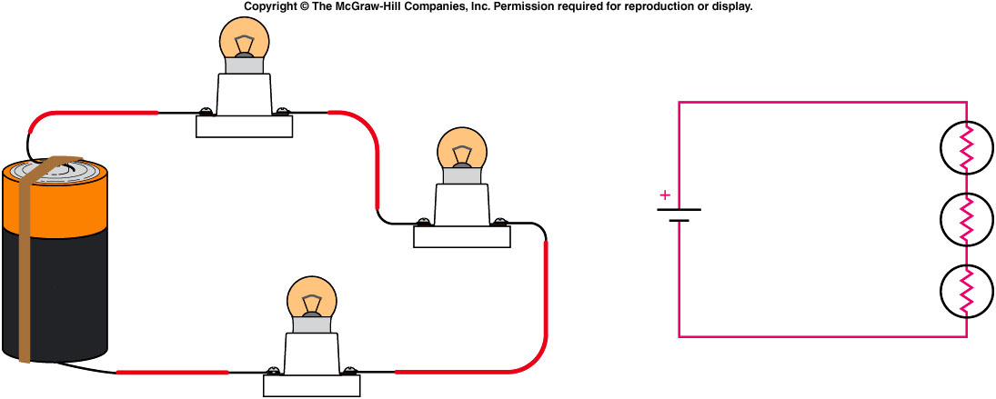
In a series combination of resistances, each resistance contributes to restricting the flow of current around the loop.
  The total series resistance of the combination R_{series} is the sum of the individual resistances:
  A common mistake is to think the current gets used up in passing through the resistances in a series circuit.
  The same current must pass through each component much like the continuous flow of water in a pipe.

Slide 6
It is the voltage that changes as the current flows through the circuit.
  Voltage decreases by Ohm’s Law: ΔV = I R
  as the current passes through each resistor.
The total voltage difference across the combination is the sum of these individual changes.
  If two light bulbs are connected in series with a battery, the current will be less than with a single bulb, because the total series resistance is larger.
  The bulbs will glow less brightly.

Slide 7
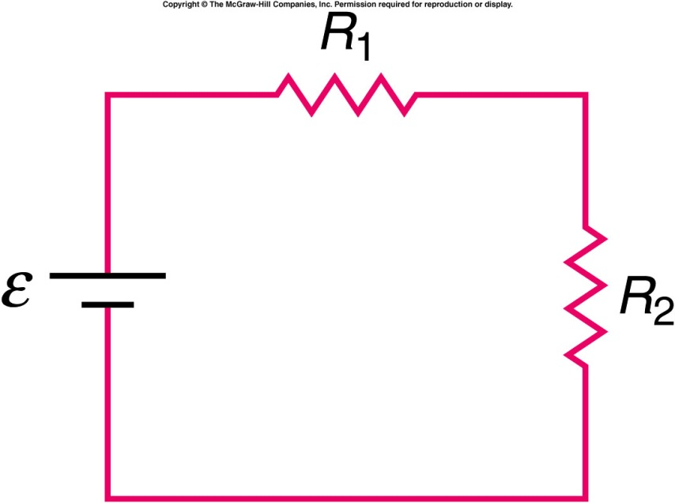
Two resistors are connected in series with a battery as shown. R₁ is less than R₂. Which of the two resistors has the greater current flowing through it?
R₁
R₂
The currents are the same
    The current is the same in each, since it is a series circuit.

Slide 8
Two resistors are connected in series with a battery as shown. R₁ is less than R₂. Which of the two resistors has the greatest voltage difference across it?
R₁
R₂
Both
Neither
The voltage difference is greater across R₂. According to Ohm's Law, V = IR, so for the same current, the larger the resistance the greater the potential difference.

Slide 9
If the internal resistance of the battery is 5 Ω, then the total resistance of the circuit is: R = R_{battery} + R_{bulb}
= 5 Ω + 20 Ω
= 25 Ω
Then the total current in the circuit is: I = ε / R
= 1.5 V / 25 Ω
= 0.06 A = 60 mA
And the voltage difference across the light bulb is:
ΔV = I R
= (0.06 A)(20 Ω)
= 1.2 V
If we measure the voltage difference across the battery or the light bulb, we will get 1.2 V.

Slide 10
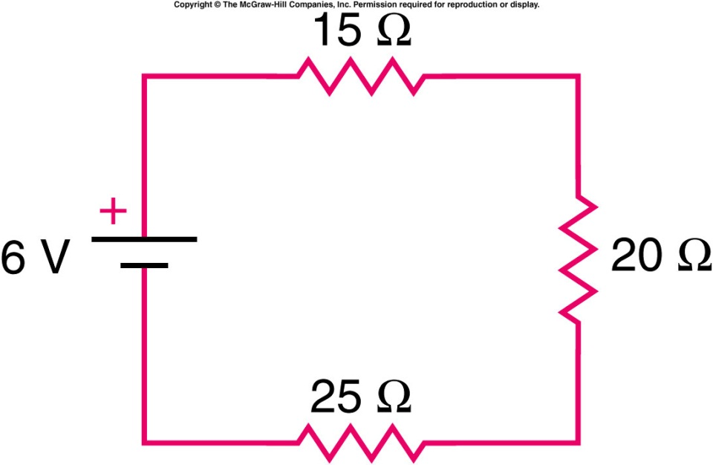
Quiz: What is the voltage difference across the 25-Ω resistance?
0.1 V
2.5 V
6 V
25 V
60 V

Slide 11
Quiz: What is the voltage difference across the 25-Ω resistance?
0.1 V
2.5 V
6 V
25 V
60 V

Slide 12
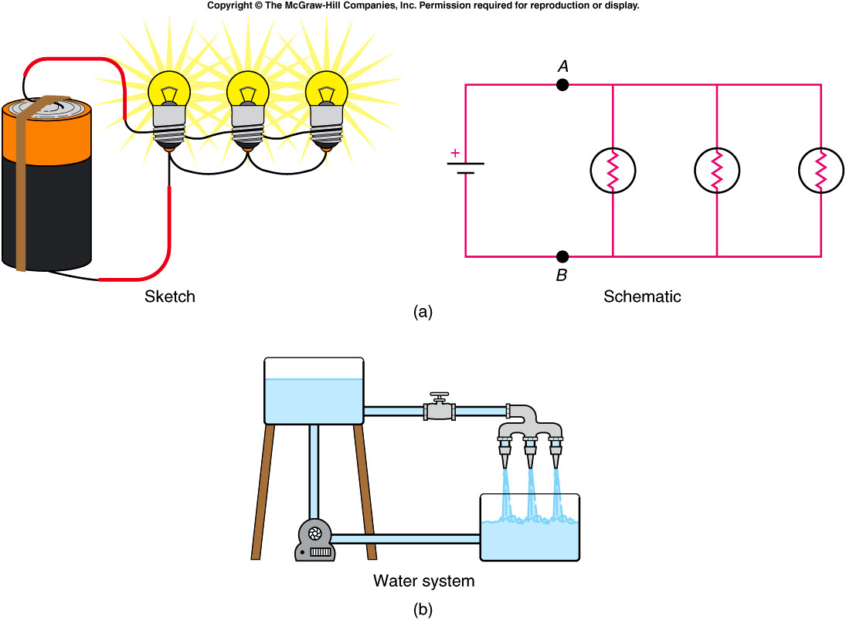
In a parallel circuit, there are points at which the current can branch or split up into different paths.
  The flow divides and later rejoins.
  The total cross-sectional area the current (or water) flows through is increased, therefore decreasing the resistance to flow:

Slide 13
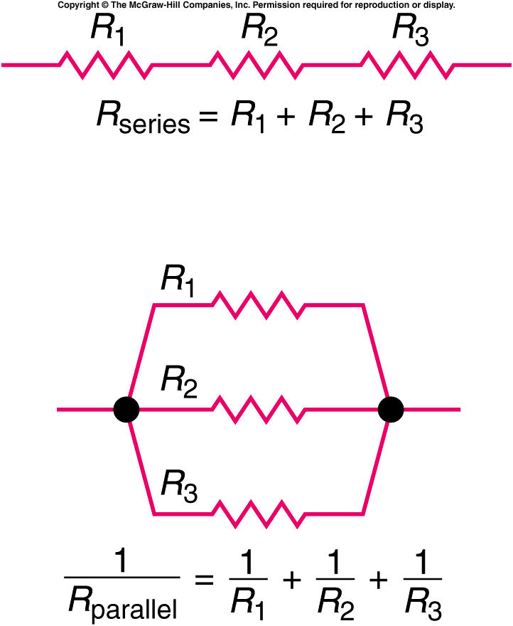

Slide 14
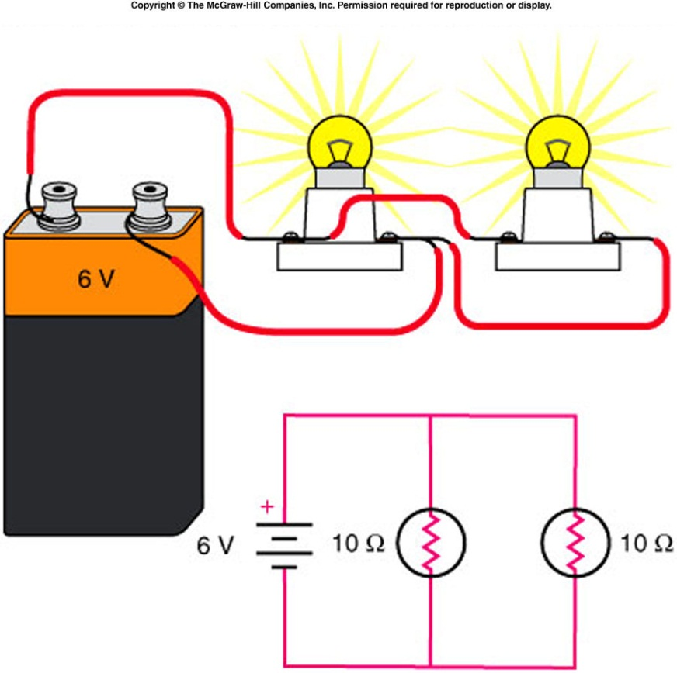
Two 10-Ω light bulbs are connected in parallel to one another, and this combination is connected to a 6-V battery. What is the total current flowing around the loop?
a) 0.6 A b) 1.2 A c) 6 A d) 12 A e) 60 A

Slide 15
How much current passes through each light bulb?
a) 0.6 A b) 1.2 A c) 6 A d) 12 A e) 60 A

Slide 16
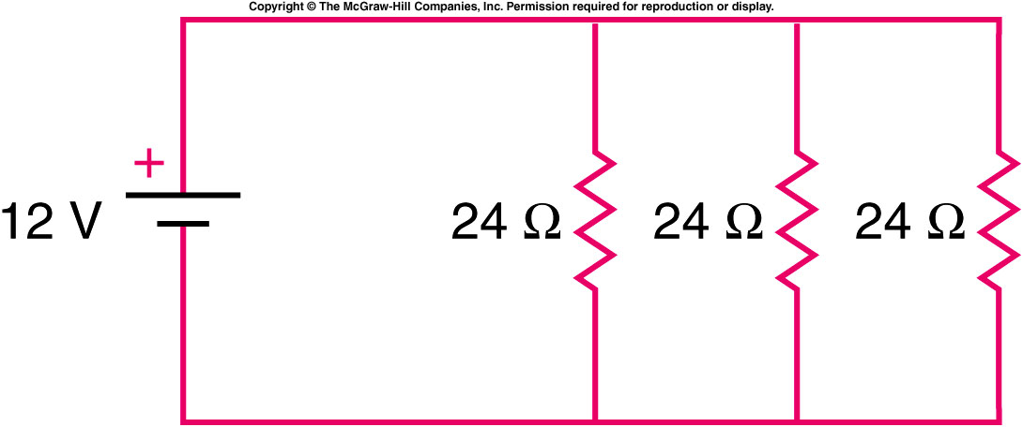
Three identical resistors, each 24 Ω, are connected in parallel with one another as shown. The combination is connected to a 12-V battery whose internal resistance is negligible.
What is the equivalent resistance of this parallel combination?
0.0417 Ω
0.125 Ω
8 Ω
24 Ω
72 Ω

Slide 17

What is the total current through the combination?
0.5 A
1.0 A
1.2 A
1.5 A
12 A
$$I_{total}= \frac{V_{total}}{R_{parallel}}= \frac{12 V}{8Ω}=1.5A$$

Slide 18
How much current flows through each resistor in the combination?
0.5 A
1.0 A
1.2 A
1.5 A
12 A

Slide 19
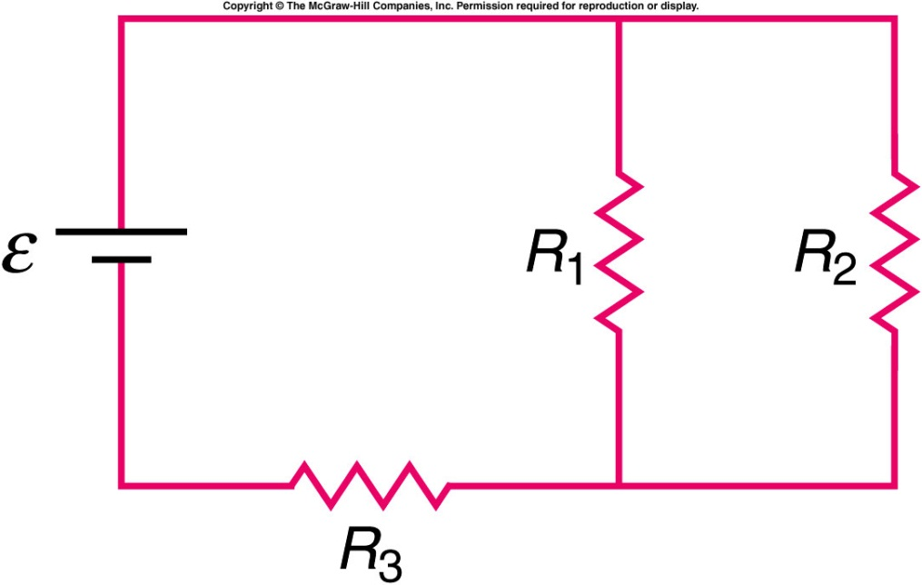
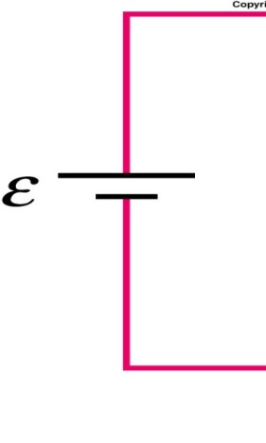


Are the two circuits equivalent to each other?
yes.
No
Depend on the value of each resistor.

Slide 20
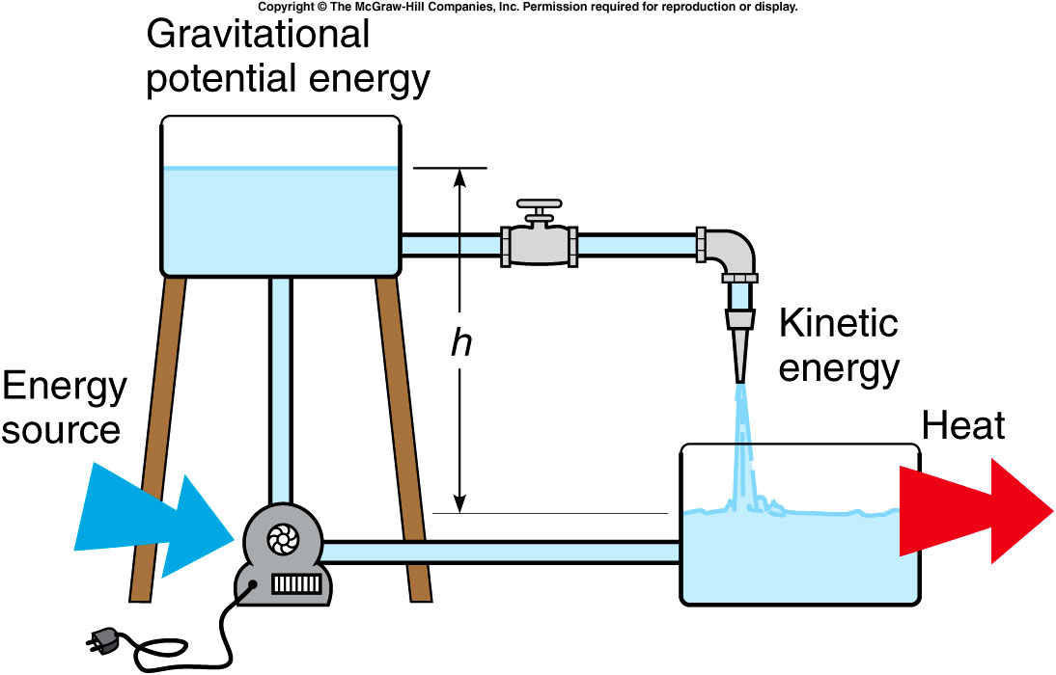
Electric Energy and Power
Energy is supplied to a water-flow system by the pump, which increases the gravitational potential energy of the water by lifting it up to a higher tank.
As the water flows down through pipes to a lower tank, gravitational potential energy is transformed into kinetic energy of the moving water.
Once the water comes to rest in the lower tank, the kinetic energy is dissipated by frictional or viscous forces which generate heat.

Slide 21
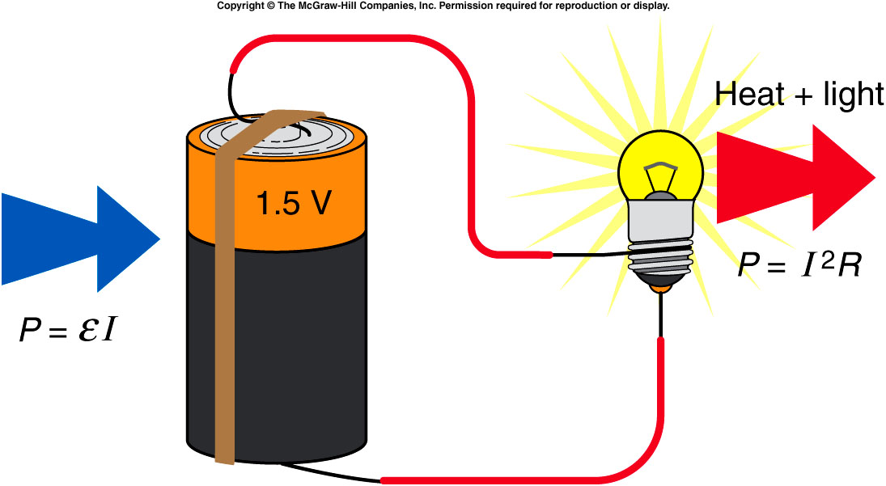
Similarly, in an electric circuit energy is supplied by a battery, which draws its energy from the potential energy stored in its chemical reactants.
  The battery increases the potential energy of electric charges as it moves positive charges toward the positive terminal and negative charges toward the negative terminal.
  When we provide an external conducting path from the positive to the negative terminal, charge flows from points of higher potential energy to points of lower potential energy.
As potential energy is lost, kinetic energy is gained by the electrons.
This kinetic energy is converted to heat by collisions with other electrons and atoms.

Slide 22
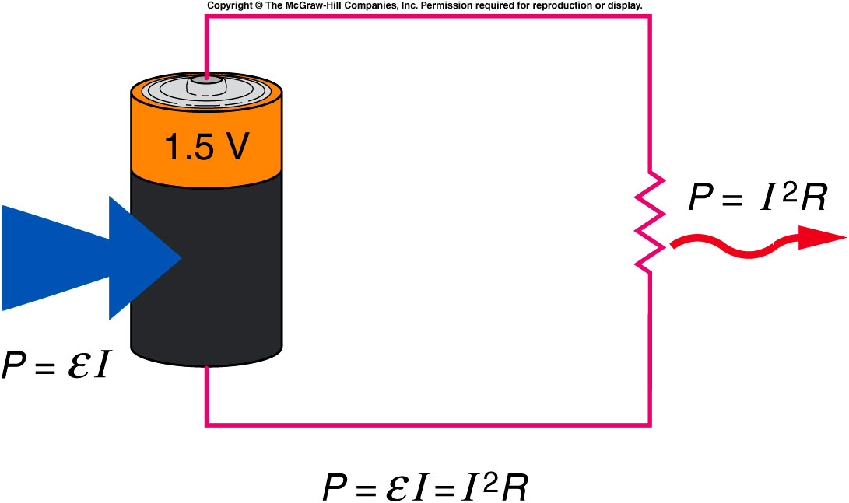
Energy source → potential energy → kinetic energy → heat
Since voltage is potential energy per unit charge, multiplying a voltage difference by charge yields energy.
Since current is the rate of flow of charge, multiplying a voltage difference by current yields power, the rate of energy use.
The power supplied by a source must equal the power dissipated in the resistances.

Slide 23
What is the power dissipated in a 20-Ω light bulb powered by two 1.5-V batteries in series?
0.15 W
0.45 W
3.0 W
6.67 W
60 W

Slide 24
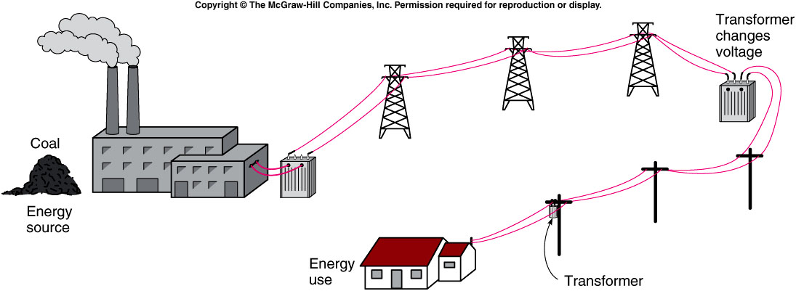
The ease with which electric power can be transmitted over considerable distances is one of its main advantages over other forms of energy.
  The source of the energy might be gravitational potential energy of water, chemical potential energy stored in fossil fuels, or nuclear potential energy stored in uranium.
  Power plants all use electric generators that convert mechanical kinetic energy produced by turbines to electric energy.
  These generators are the source of the electromotive force.

Slide 25
The unit of energy commonly used to discuss electric energy is the kilowatt-hour, which is a unit of power (the kilowatt) multiplied by a unit of time (an hour).
  1 kilowatt equals 1000 watts
  1 hour = 3600 seconds
  1 kilowatt-hour equals 3.6 million joules
The kilowatt-hour is a much larger unit of energy than the joule, but it is a convenient size for the amounts of electrical energy typically used in a home.

Slide 26
How much does it cost to light a 100-watt light bulb for one day? Assume an average rate of cost of 10 cents per kilowatt-hour.
a) 0.24 cents b) 2.4 cents c) 24 cents d) $2.40 e) $24
Energy used = power x time Cost = energy used x rate of cost
= (100 W)(24 hr) = (2.4 kWh)(10 cents / kWh)
= 2400 Wh = (2.4 kWh)(10 cents / kWh)
= 2.4 kWh = 24 cents

Slide 27
Alternating Current and Household Circuits
The current we draw from a wall outlet is alternating current (ac) rather than direct current (dc).
  Direct current implies that the current flows in a single direction from the positive terminal of a battery or power supply to the negative terminal
  Alternating current continually reverses its direction -- it flows first in one direction, then in the other, then back again.
  In North America the ac goes through 60 cycles each second (60 Hz).

Slide 28
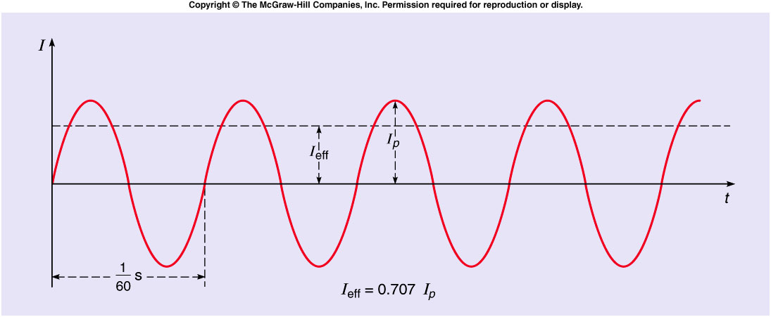
The plot of electric current as a function of time for an alternating current is a sinusoidal curve.
  The effective current or rms current is obtained by squaring the current, averaging this value over time, and taking the square root of the result.
  The effective current I_{eff} is 0.707 times the peak current I_{peak}.

Slide 29
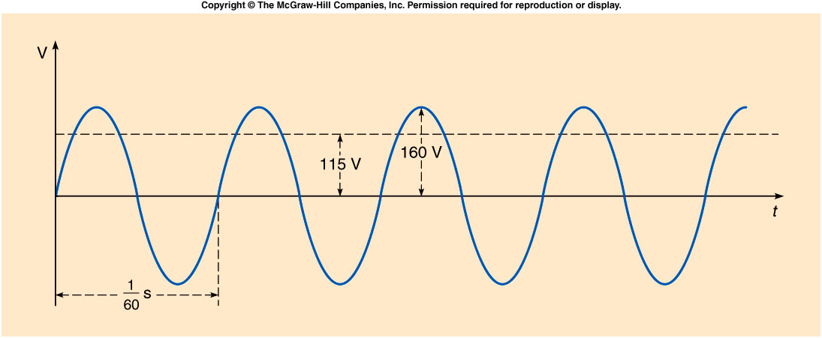
If we plot the voltage across an electrical outlet as a function of time, we get another sinusoidal curve.
  The effective value of this voltage is typically between 110 and 120 volts in North America.
  The standard household power supplied in this country is 115 volts, 60 hertz ac.

Slide 30
A 60-W light bulb is designed to operate on 120 V ac. What is the effective current drawn by the bulb?
0.2 A
0. 5 A
2.0 A
72 A
7200 A

Slide 31
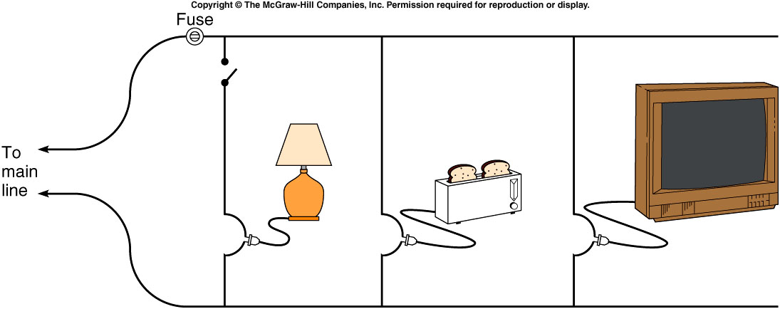
Household circuits are wired in parallel so that different appliances can be added to or removed from the circuit without affecting the voltage available.
  As you add more appliances, the total current drawn increases, because the total effective resistance of the circuit decreases when resistances are added in parallel.
  Since too large a current could cause the wires to overheat, a fuse or circuit breaker in series with one leg of the circuit will disrupt the circuit if the current gets too large.
  Appliances with larger power requirements (stoves, clothes dryers, etc) are usually connected to a separate 220-V line.

Slide 32
Quiz: In the circuit shown, R₃ is greater than R₂, and R₂ is greater than R₁. ε is the electromotive force of the battery whose internal resistance is negligible. Which of the three resistors has the greatest current flowing through it?
R₁
R₂
R₃
R₁ and R₂ are equal, and greater than R₃
They are all equal

Slide 33
Back Up Slides

Slide 34
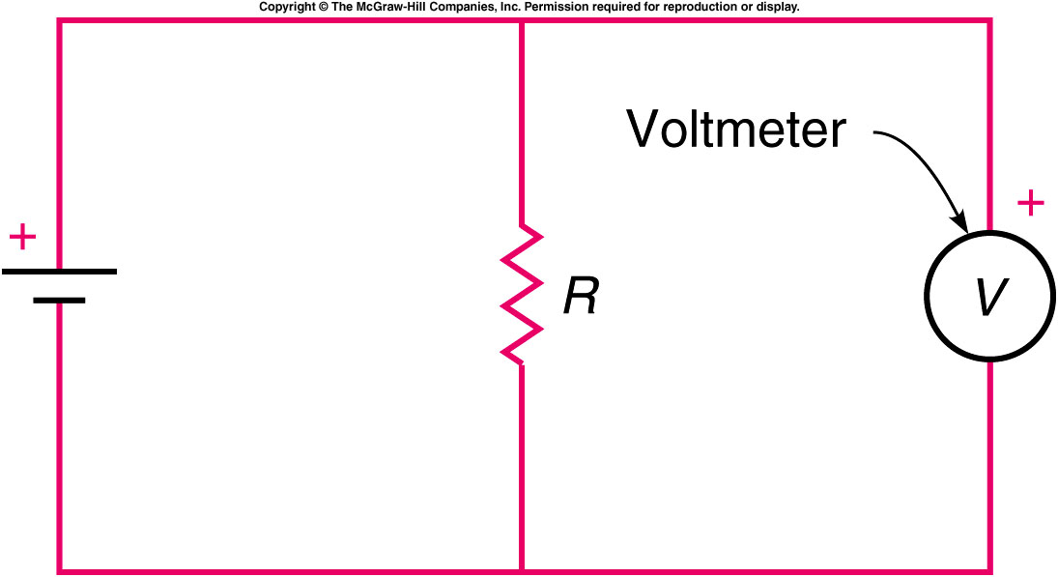
A voltmeter measures the voltage difference between two points in a circuit, or across an element in a circuit
  It is inserted in parallel with the element whose voltage difference is being measured.
  A voltmeter should have a large resistance, so that it does not divert much current from the component whose voltage is being measured.

Slide 35
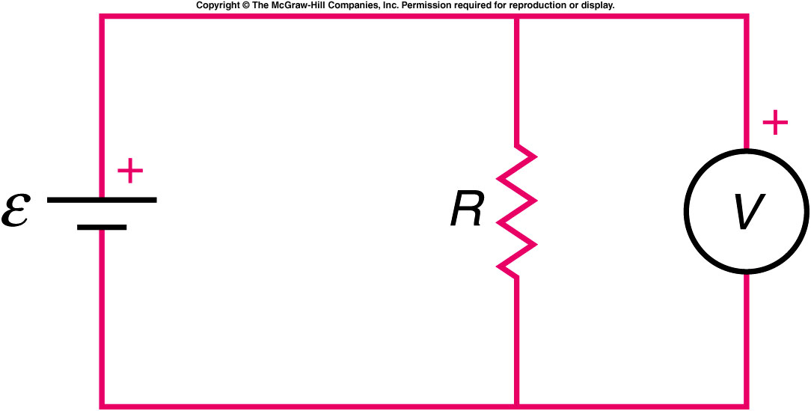
In the circuit shown, the circle with a V in it represents a voltmeter. Which of the following statements is correct?
The voltmeter is in the correct position for measuring the voltage difference across R.
No current will flow through the meter, so it will have no effect.
The meter will draw a large current.
The correct statement is (a). A voltmeter is a high-resistance device connected in parallel with whatever circuit element it is desired to measure the voltage across.

Slide 36
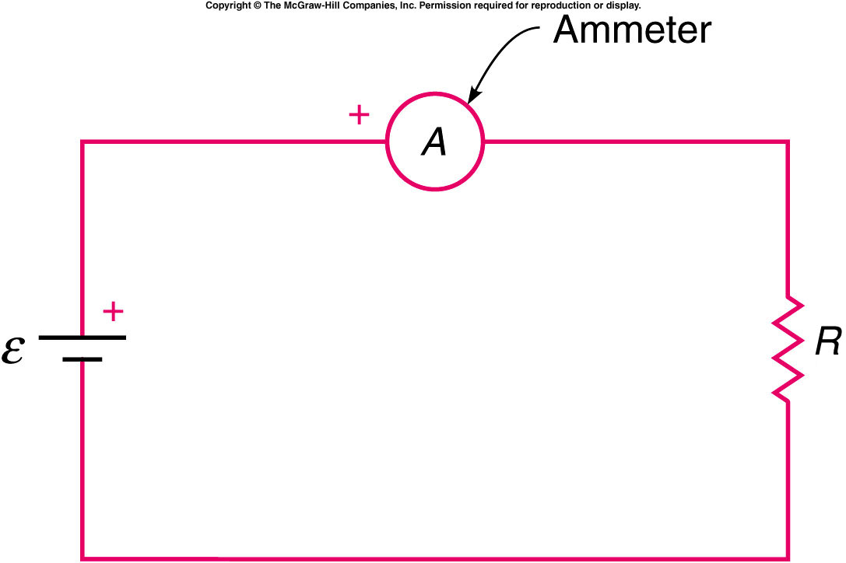
An ammeter measures the electric current flowing through a point in a circuit.
  It is inserted in series into the circuit whose current is being measured, so that all the current flows through it.
  An ammeter should have a small resistance, so that its effect on the current is small.
  If you place an ammeter directly across the terminals of a battery, you could damage the meter and the battery.

Slide 37
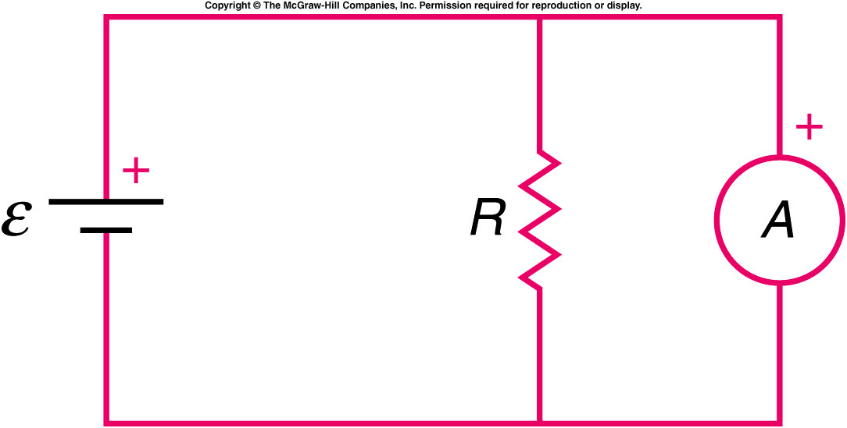
In the circuit shown, the circle with an A in it represents an ammeter. Which of the following statements is correct?
The meter is in the correct position for measuring the current through R.
No current will flow through the meter, so it will have no effect.
The meter will draw a significant current from the battery.
The answer is (c). An ammeter is a low-resistance device and is to be placed in series in the circuit, just as a flow-meter is placed in a fluid circuit.

