Slide 1
Exam#1 (chapter 1-8)
time: Wednesday 03/24 8:30 am- 9:20 am
Location: physics building room 112
If you have special needs, e.g. exam time extension, and has not contact me before, please bring me the letter from the Office of the Dean of Students before 03/17.
AOB
  multiple choice problems.
  Prepare your own scratch paper, pencils, erasers, etc.
  Use only pencil for the answer sheet
  Bring your own calculators
  No cell phones, no text messaging, no computers
  No crib sheet of any kind is allowed. Equation sheet will be provided.

Slide 2
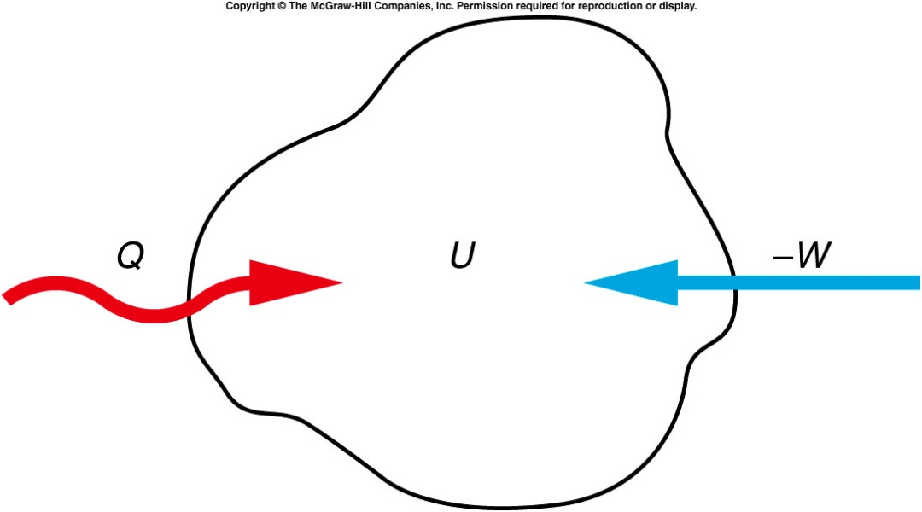
Joule’s Experiment and the First Law of Thermodynamics
Joule’s experiments led to Kelvin’s statement of the first law of thermodynamics.
  Both work and heat represent transfers of energy into or out of a system.
  If energy is added to a system either as work or heat, the internal energy of the system increases accordingly.
The increase in the internal
energy of a system is equal
to the amount of heat added
to a system minus the
amount of work done by the
system. ΔU = Q - W

Slide 3
The Flow of Heat
There are three basic processes for heat flow:
  Conduction
  Convection
  Radiation

Slide 4
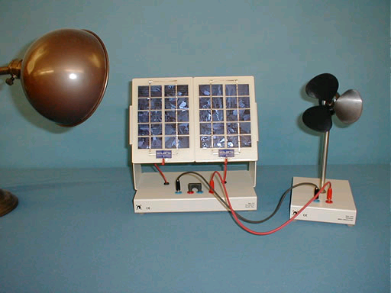
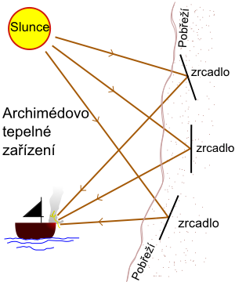
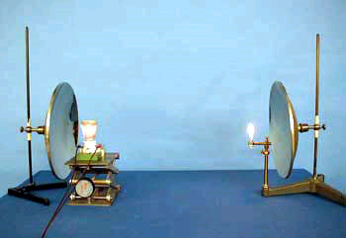
3D-05 Solar Panel
3D-03 Radiation--Match
http://www.youtube.com/watch?v=w5loiW3STzU&feature=results_main&playnext=1&list=PLFA6F13ACB19C86BF
"Archimedes heat ray", was used to focus sunlight onto approaching ships, causing them to catch fire.
Notes:
A coil-wire heater is placed at the focal point of a spherical mirror. An unlighted match is placed at the focal point of an identical mirror located about a meter away. Upon reflection from the mirror, the rays from the heater are parallel so that when they encounter the other mirror, these rays focus at the focal point. The concentrated radiation is enough to ignite the match.

Slide 5
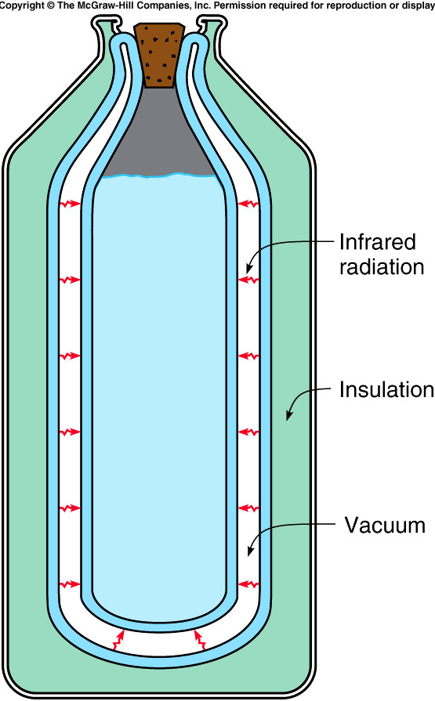
  To minimize heat loss
    Minimize all three kind of heat exchange.
Notes:
thermo bottle, cork （软木塞）

Slide 6
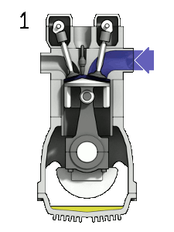
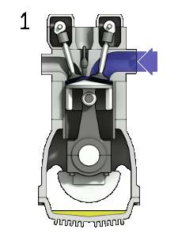
Heat Engines
A gasoline engine is a form of a heat engine, e.g. a 4-stroke engine
INTAKE stroke:
  the piston descends from the top to the bottom of the cylinder, reducing the pressure inside. A mixture of fuel and air, is forced by atmospheric pressure into the cylinder through the intake port. The intake valve then close.
COMPRESSION stroke:
  with both intake and exhaust valves closed, the piston returns to the top of the cylinder compressing the fuel-air mixture.
POWER stroke:
  the compressed air–fuel mixture in a gasoline engine is ignited by a spark plug. The compressed fuel-air mixture expand and move the piston back
EXHAUST stroke:
  during the exhaust stroke, the piston once again returns to top while the exhaust valve is open and expel the spent fuel-air mixture out through the exhaust valve(s).
Notes:
Crank the starter

Slide 7
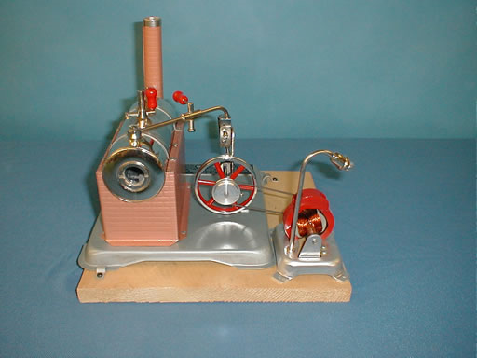
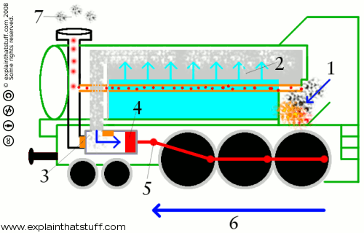
3E09, 3E10, 3E11, 3E12 Engines
A fire where the coal burns.
A boiler full of water that the fire heats up to make steam.
A cylinder and piston. Steam from the boiler is piped into the cylinder, causing the piston to move first one way then the other. This in and out movement (which is also known as "reciprocating") is used to drive...
A machine attached to the piston. That could be anything from a water pump to a factory machine... or even a giant steam locomotive running up and down a railroad.
Stirling Engine
Steam Engine
https://www.youtube.com/watch?v=g8LrAsL4oH0
Notes:
Boiler chimney
trains are still required to sound their horn at the designated location

Slide 8
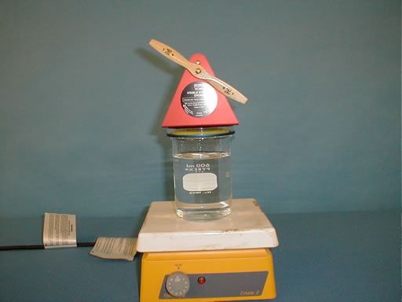
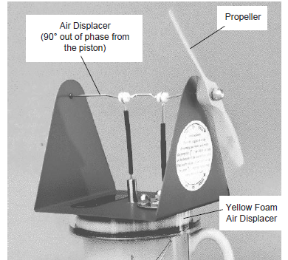
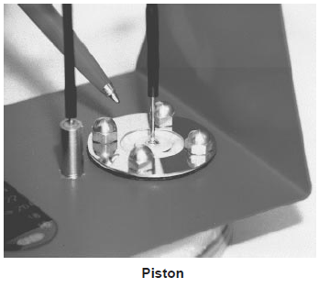
3E09, 3E10, 3E11, 3E12 Engines
running on a cup of hot water:
When the yellow foam inside the engine is near the top of the cylinder most of the air is on the bottom side (the hot side) where it is heated.
When the air gets hot it expands and pushes up on the piston. When the foam moves to the bottom of the engine it moves most of the air to the top of the engine.
The top of the engine is cool, allowing the air inside the engine to cool off (reject heat to the environment) and
the piston receives a downward push.
Stirling Engine
Steam Engine

Slide 9
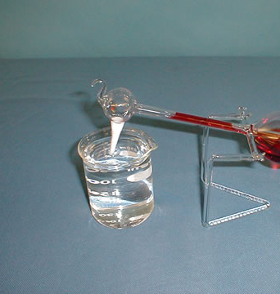
Demos: 3E-15 Drinking Bird

Slide 10
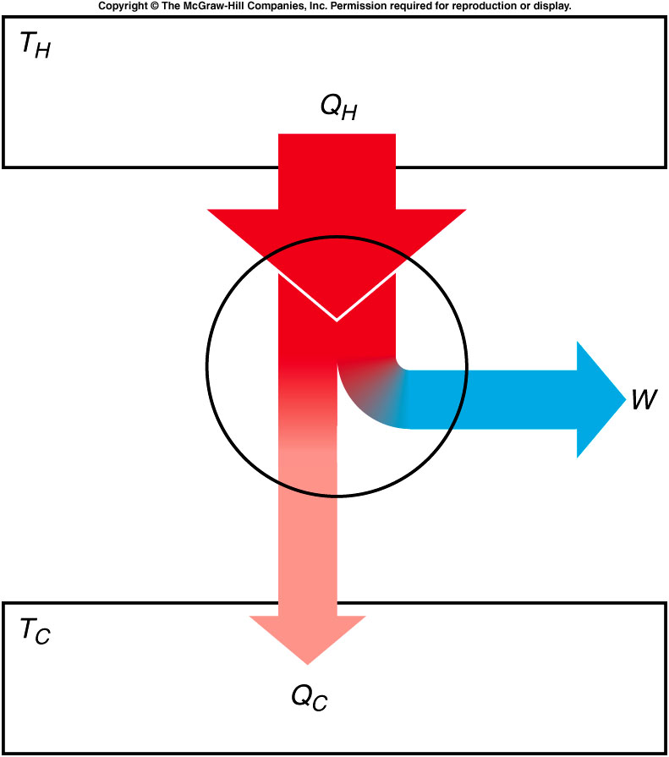
Efficiency
Efficiency is the ratio of the net work done by the engine to the amount of heat that must be supplied to accomplish this work.

Slide 11
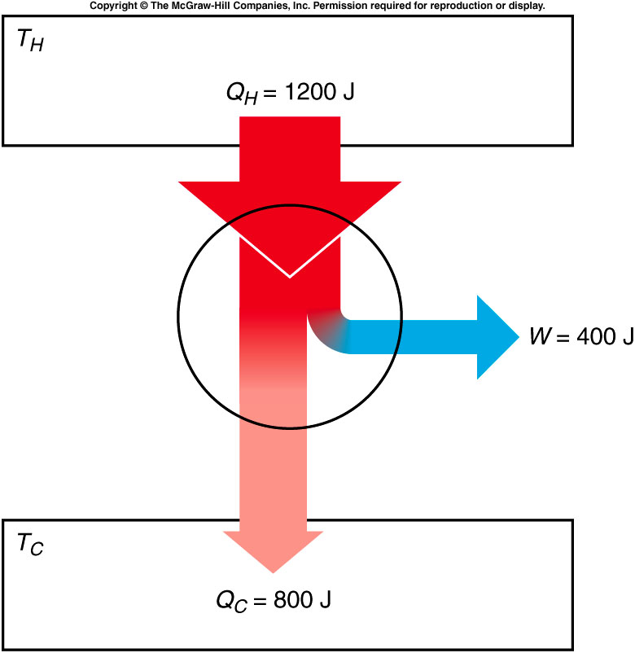
A heat engine takes in 1200 J of heat from the high-temperature heat source in each cycle, and does 400 J of work in each cycle. What is the efficiency of this engine?
33%
40%
66%
Q_{H} = 1200 J
W = 400 J
e = W / Q_{H}
= (400 J) / (1200 J)
= 1/3 = 0.33
= 33%

Slide 12
How much heat is released into the environment in each cycle?
33 J
400 J
800 J
1200 J
Q_{C} = Q_{H} - W
= 1200 J - 400 J
= 800 J

Slide 13
Carnot Engine
The efficiency of a typical automobile engine is less than 30%.
  This seems to be wasting a lot of energy.
  What is the best efficiency we could achieve?
  What factors determine efficiency?
The cycle devised by Carnot that an ideal engine would have to follow is called a Carnot cycle.
An (ideal, not real) engine following this cycle is called a Carnot engine.
Notes:
Can not be 100% efficiency since you can not completely control heat which is the kinetic energy of each moleclur.

Slide 14
Different Thermal Process
If the process is adiabatic, no heat flows into or out of the gas
In an isothermal process, the temperature does not change.
  The internal energy must be constant.
  The change in internal energy, ΔU, is zero.
  If an amount of heat Q is added to the gas, an equal amount of work W will be done by the gas on its surroundings, from ΔU = Q - W.
In an isobaric process, the pressure of the gas remains constant.
  The internal energy increases as the gas is heated, and so does the temperature.
  The gas also expands, removing some of the internal energy.
Experiments determined that the pressure, volume, and absolute temperature of an ideal gas are related by the equation of state:
  PV = NkT where N is the number of molecules
  and k is Boltzmann’s constant.

Slide 15
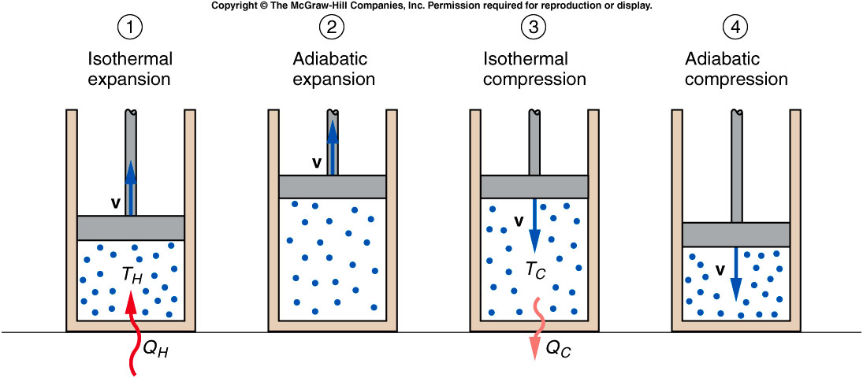
Heat flows into cylinder at temperature T_{H}. The fluid expands isothermally and does work on the piston.
The fluid continues to expand, adiabatically.
Work is done by the piston on the fluid, which undergoes an isothermal compression.
The fluid returns to its initial condition by an adiabatic compression.
Notes:
During 1st and 3rd step, if the temperature increase, the input energy will partially change to heat, i.e. not all intake energy does work. If temperature decrease, there’s a leak of heat causing inefficiency. Note: internal energy is 3/2NKT

Slide 16
Carnot Efficiency
The efficiency of Carnot’s ideal engine is called the Carnot efficiency and is given by:
This is the maximum efficiency possible for any engine taking in heat from a reservoir at absolute temperature T_{H} and releasing heat to a reservoir at temperature T_{C}.
  The temperature must be measured in absolute degrees.
Even Carnot’s ideal engine is less than 100% efficient.

Slide 17
A steam turbine takes in steam at a temperature of 400°C and releases steam to the condenser at a temperature of 120°C. What is the Carnot efficiency for this engine?
30%
41.6%
58.4%
70%
T_{H} = 400°C = 673 K
T_{C} = 120°C = 393 K
e_{C} = (T_{H} - T_{C} ) / T_{H}
= (673 K - 393 K) / (673 K)
= 280 K / 673 K
= 0.416 = 41.6%

Slide 18
Quiz: If the turbine takes in 500 kJ of heat in each cycle, what is the maximum amount of work that could be generated by the turbine in each cycle?
0.83 J
16.64 kJ
28 kJ
208 kJ
Q_{H} = 500 kJ
e = W / Q_{H} ,
so W = e Q_{H}
= (0.416)(500 kJ)
= 208 kJ

Slide 19
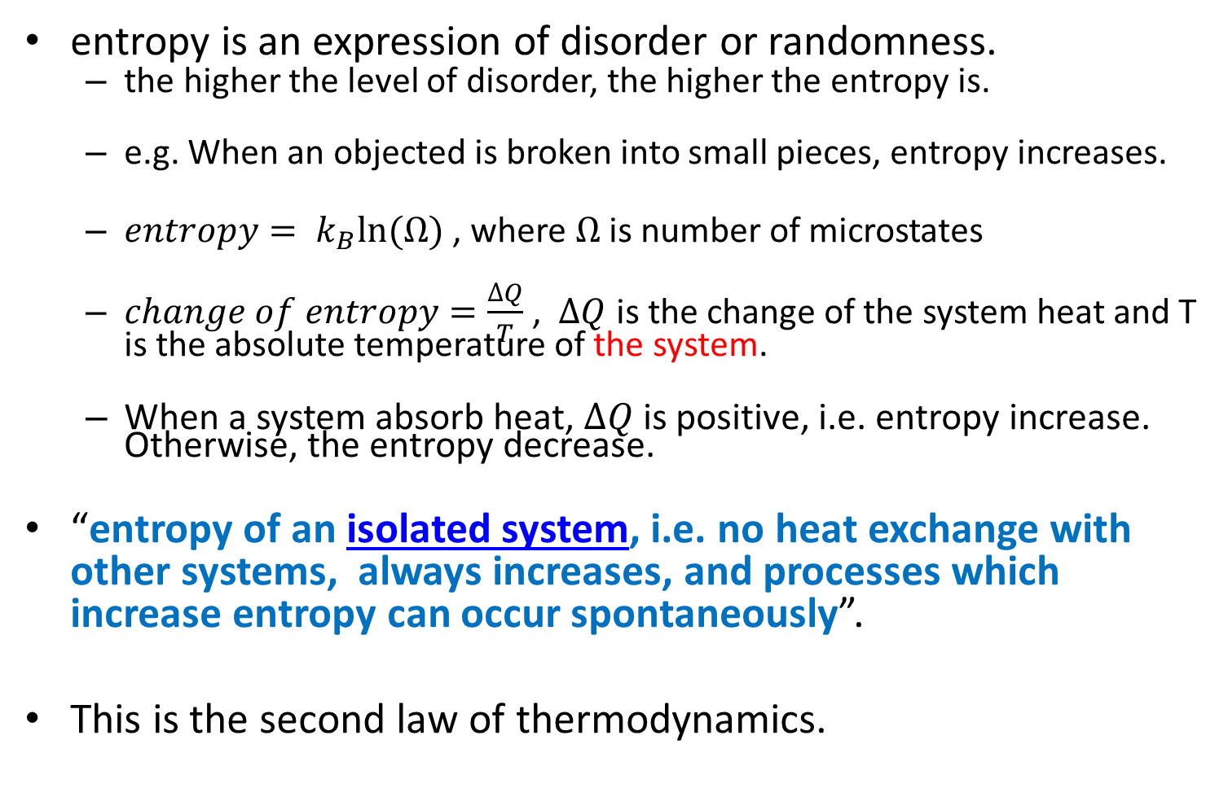
Entropy
entropy is an expression of disorder or randomness.
  the higher the level of disorder, the higher the entropy is.
  e.g. When an objected is broken into small pieces, entropy increases.
  $entropy= k_{B}ln⁡(Ω)$ , where $Ω$ is number of microstates
  $change of entropy=\frac{∆Q}{T}$ , $∆Q$ is the change of the system heat and T is the absolute temperature of the system.
  When a system absorb heat, $∆Q$ is positive, i.e. entropy increase. Otherwise, the entropy decrease.
“entropy of an isolated system, i.e. no heat exchange with other systems, always increases, and processes which increase entropy can occur spontaneously”.
This is the second law of thermodynamics.

Slide 20
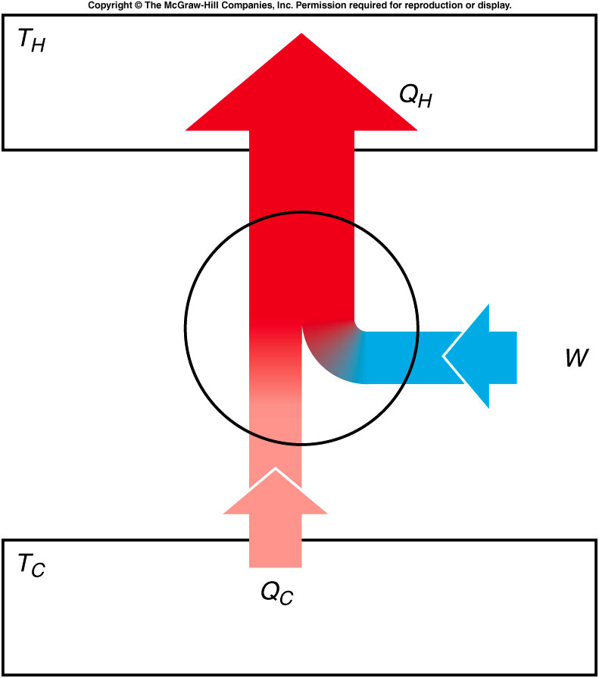
Heat Pumps, and Entropy
If a heat engine is run in reverse, then work W is done on the engine as heat Q_{C} is removed from the lower-temperature reservoir and a greater quantity of heat Q_{H} is released to the higher-temperature reservoir.
A device that moves heat from a cooler reservoir to a warmer reservoir by means of work supplied from some external source is called a heat pump.

Slide 21
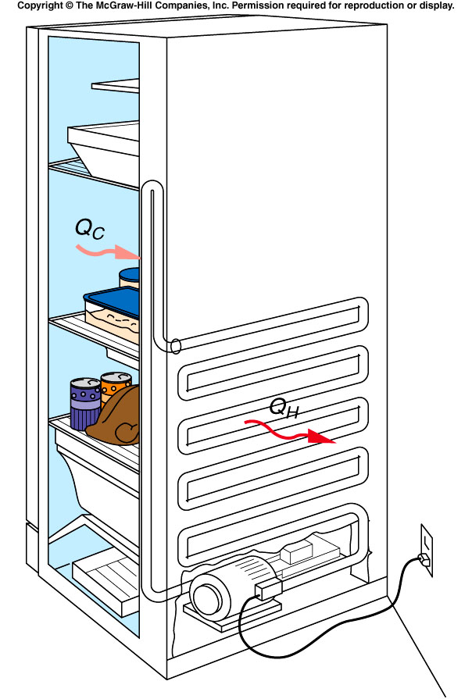
Refrigerators and Heat Pumps
A refrigerator is also a form of a heat pump.
It also moves heat from a cooler reservoir to a warmer reservoir by means of work supplied from some external source.
It keeps food cold by pumping heat out of the cooler interior of the refrigerator into the warmer room.
An electric motor or gas-powered engine does the necessary work.

Slide 22
Quiz: A heat pump uses 200 J of work to remove 300 J of heat from the lower-temperature reservoir. How much heat would be delivered to the higher-temperature reservoir?
100 J
200 J
300 J
500 J
W = 200 J
Q_{C} = 300 J
Q_{H} = W + Q_{C}
= 200 J + 300 J
= 500 J

