Slide 1
Vector and Scalar Quantities
77
73
72
75
82
71
84
77
80
68
64
83
57
56
55
73
66
80
88
88
75
83
90
92
91
Scalar has only amplitude, e.g. the temperature
Vector has both amplitude and direction, e.g. the wind

Slide 2
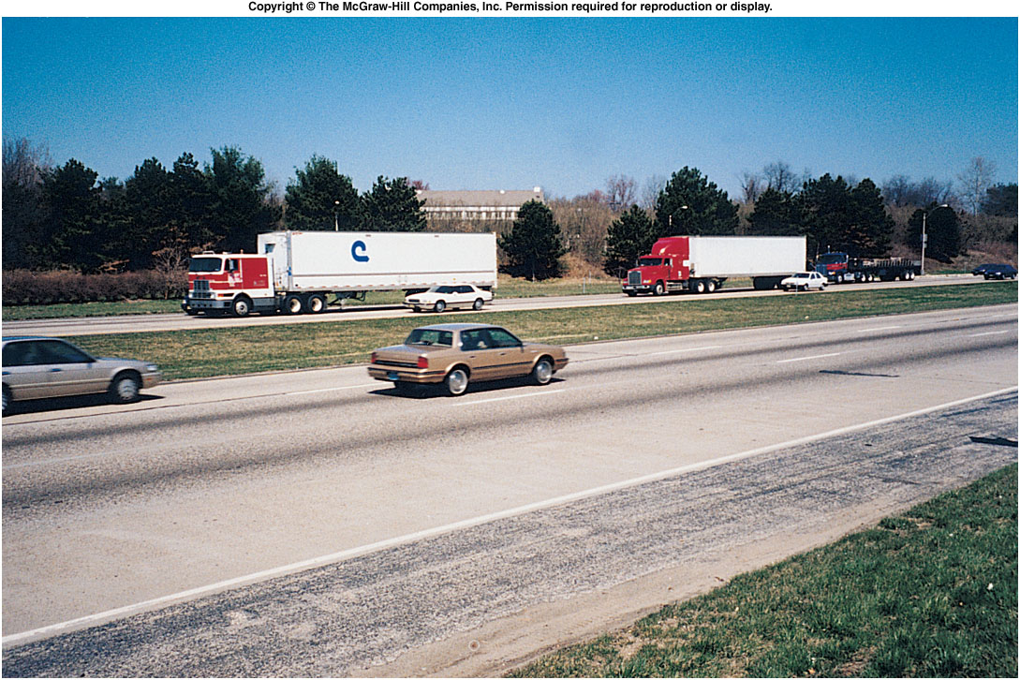
We need clear, precise definitions
of various physical quantities In order to describe a physics process
Some are used frequently in daily life (Speed)
Some are not (velocity, acceleration)
What’s the difference between:
average speed and instantaneous speed?
speed and velocity?
speed and acceleration?
Notes:
Fig. 2.co

Slide 3
Units System
There are many systems of units
For this class we use the SI system (International System of Units).
SI
Length – hand, foot, mile,… meter
Time – sundial, water clock, second
Mass – pound, ton, gram… kilogram
Volume – peck, bushel, cup … cubic meter
Area - acre, square mile, hectare square meter
When solving problems, use the same system for different quantities. Then covert it to any other systems at the end.

Slide 4
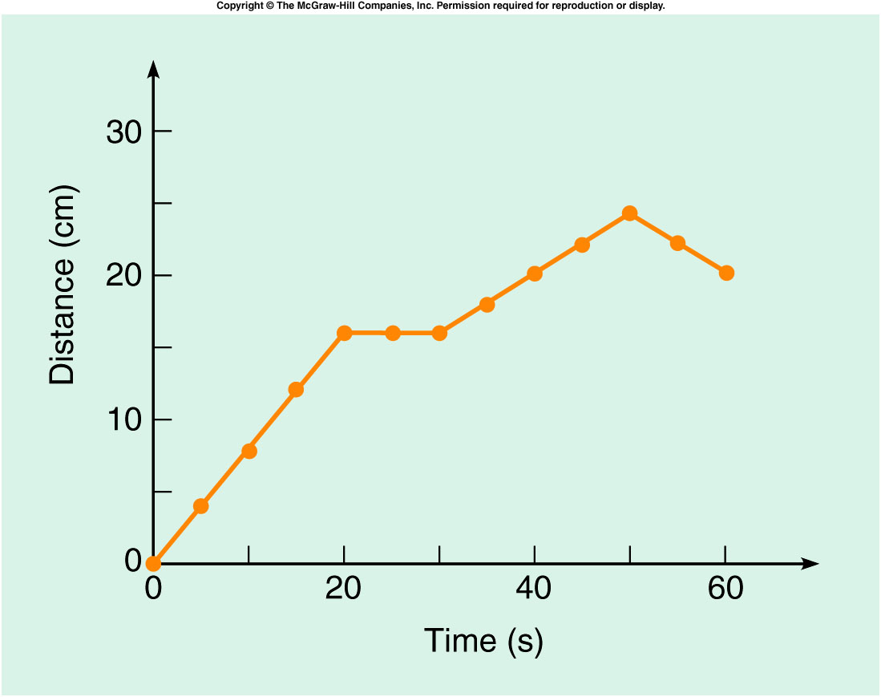
The slope at any point on the distance-versus-time graph represents the instantaneous velocity at that time.
Slope is change in vertical quantity divided by change in horizontal quantity, i.e.
$∆Y/∆X$, or $\frac{∆d}{∆t}=velocity$
Similar to everyday meaning:
  steepest “slope” is between 0 s and 20 s.
  slope is zero (flat) between 20 s and 30 s
  slope is negative between 50 s and 60 s
Notes:
Fig. 2.14

Slide 5
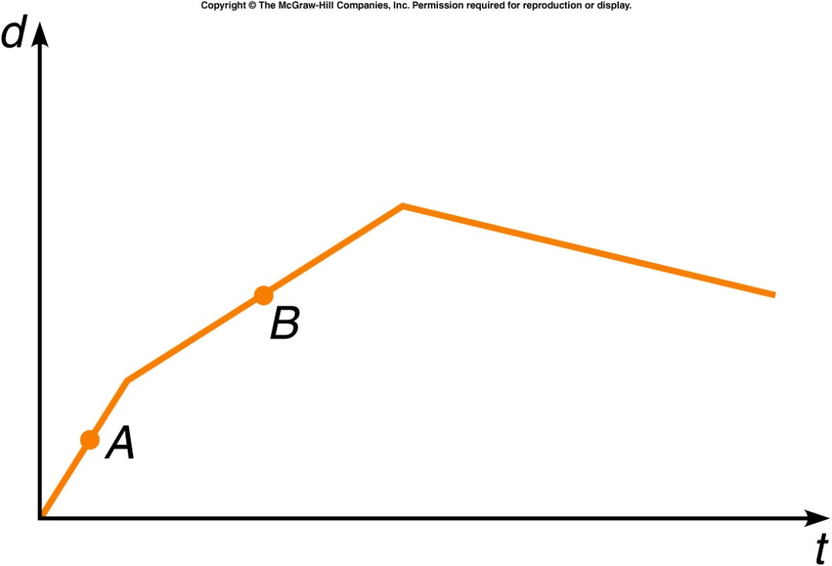
The graph shows the position of a car with respect to time. Does the car ever go backward?
Yes, during the first
segment (labeled A).
Yes, during the second
segment (labeled B).
Yes, during the third
segment (not labeled).
No, never.
The distance traveled is decreasing during the third segment, so at this time the car is moving backward.

Slide 6
Is the instantaneous velocity at point A greater or less than that at point B?
Greater than
Less than
The same as
Unable to tell from this graph
The instantaneous velocities can be compared by looking at their slopes. The steeper slope indicates the greater instantaneous velocity, so the velocity at A is greater.

Slide 7
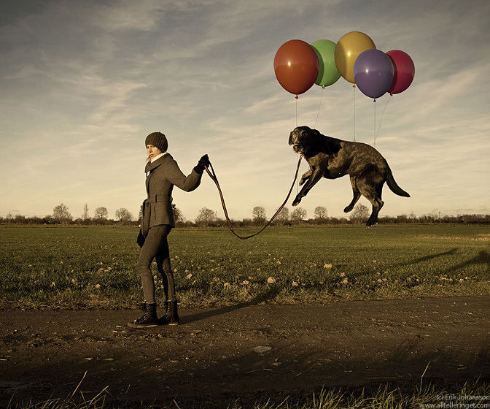
A floating dog
http://www.digitaljournal.com/image/71076
https://www.youtube.com/watch?v=6NvBGb5lf78

Slide 8
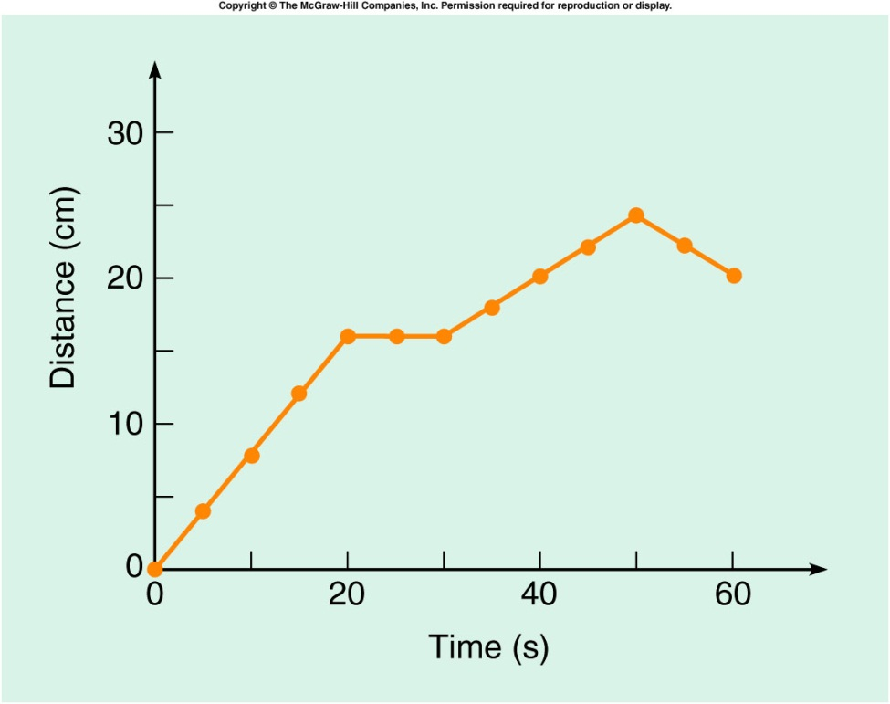
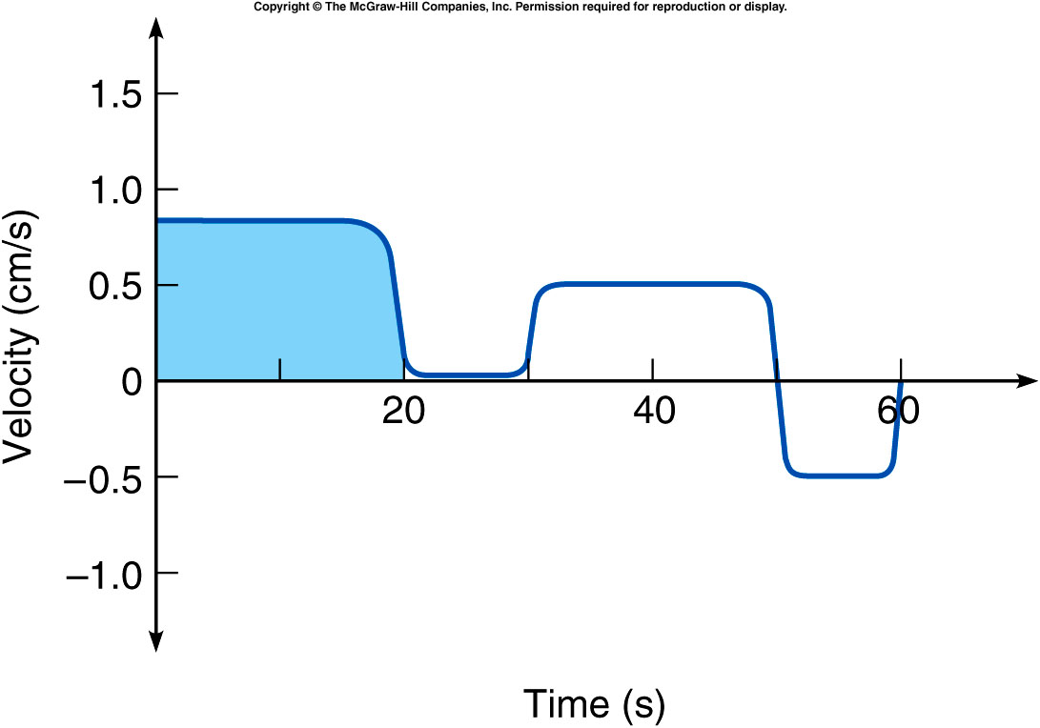
To summarize the car’s velocity information, let the horizontal axis represent time, and the vertical axis represent velocity.
The velocity is constant wherever the slope of the distance-vs-time graph is constant.
The velocity changes only when the distance graph’s slope changes.
Notes:
Fig. 2.14

Slide 9
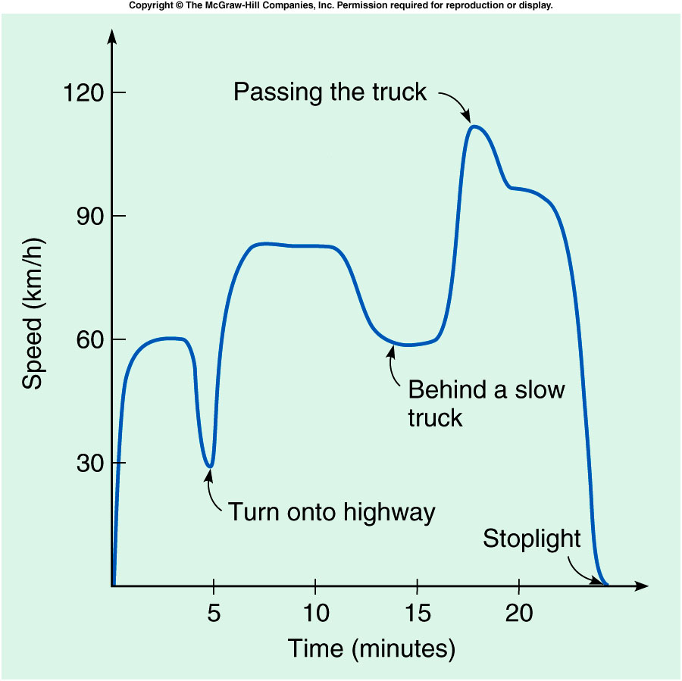
For example: a car traveling on a local highway
A steep slope indicates a rapid change in velocity (or speed), and thus a large acceleration.
A horizontal line has zero slope and represents zero acceleration.
Notes:
Fig. 2.14

Slide 10
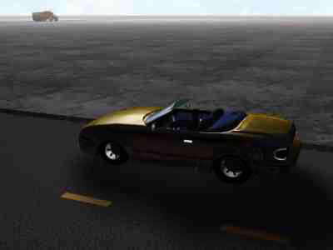

Slide 11
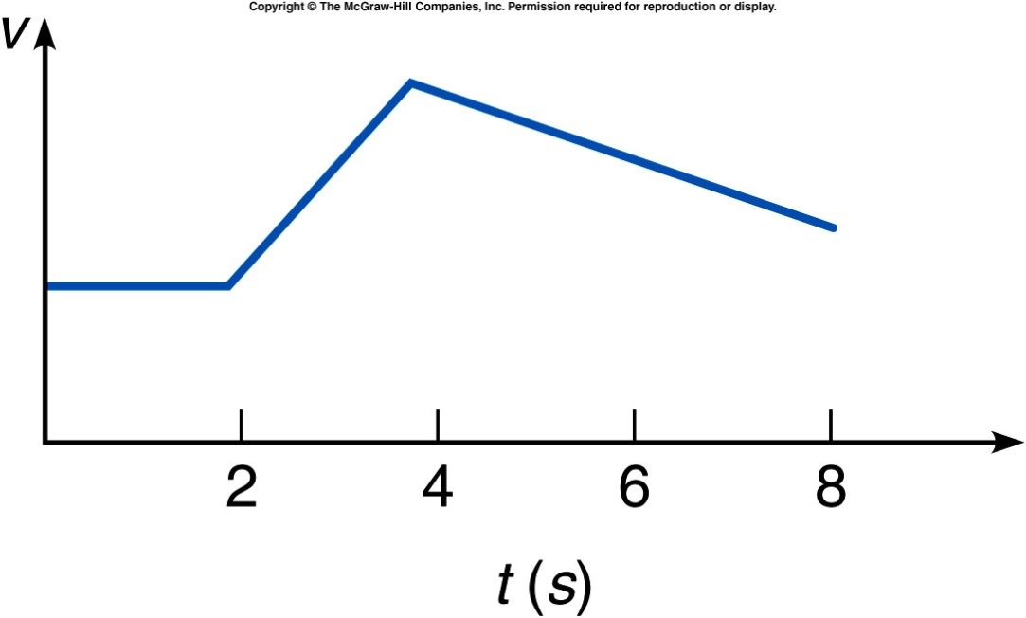
In the graph shown, is the velocity constant for any time interval?
Yes, between 0 s and 2 s.
Yes, between 2 s and 4 s.
Yes, between 4 s and 8 s.
Yes, between 0 s and 8 s.
No, never.
The velocity is a constant value between 0 s and 2 s. The velocity is not changing during this interval, so the graph has a zero (flat) slope.

Slide 12
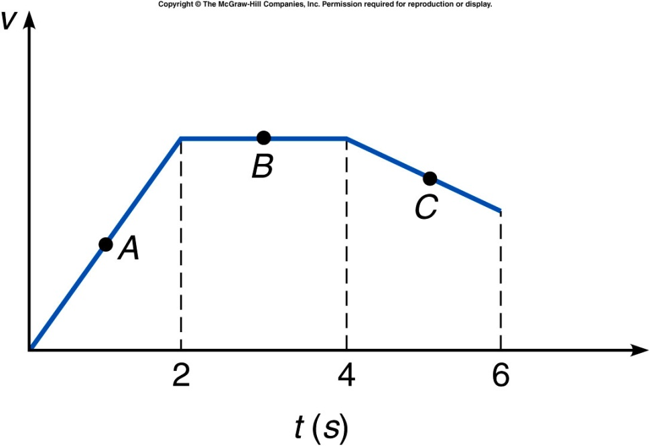
A car moves along a straight road as shown. Does it ever go backward?
Yes, between 0 s and 2 s.
Yes, between 2 s and 4 s.
Yes, between 4 s and 6 s.
No, never.
Although the velocity is decreasing between 4 s and 6 s, the velocity is still in the same direction (it is not negative), so the car is not moving backward.

Slide 13

How long a distance did this car go?
V(m/s)
6.0
0.0
10.0
t(sec)
The total distance 6.0 m/s X 10 s = 60 m

Slide 14
How long a distance did this car go?
V(m/s)
6.0
0.0
10.0
t(sec)
In each slice, velocity is ~ constant.
Add all slice up, one have the total distance
The total distance is the area covered by the velocity .vs. time graph.

Slide 15
During which time interval is the distance traveled by the car the greatest?
Between 0 s and 2 s.
Between 2 s and 4 s.
Between 4 s and 6 s.
It is the same for all time
intervals.
The distance traveled is greatest when the area under the velocity curve is greatest. This occurs between 2 s and 4 s, when the velocity is constant and a maximum.

Slide 16
Acceleration
is the rate at which velocity changes, i.e. Acceleration = Δv/Δt
  Unit is: length/(time x time), or meter/second² (SI)
  Our bodies don’t feel velocity, if the velocity is constant.
  Our bodies feel acceleration.
    Feel the difference inside an airplane when it’s landing and up in air cruising.
Acceleration can be either a change in the object’s speed or direction of motion.
Acceleration is also a vector quantity, with magnitude and direction.
  Acceleration is positive when velocity increase.
    airplane departure
  It is negative when velocity decrease.
    airplane landing

Slide 17
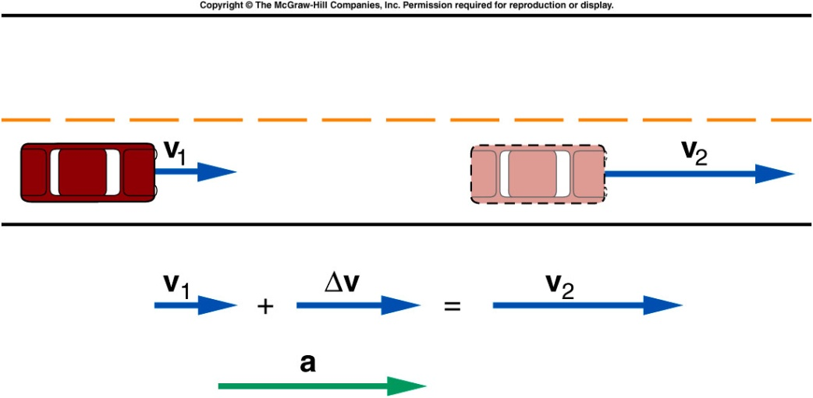
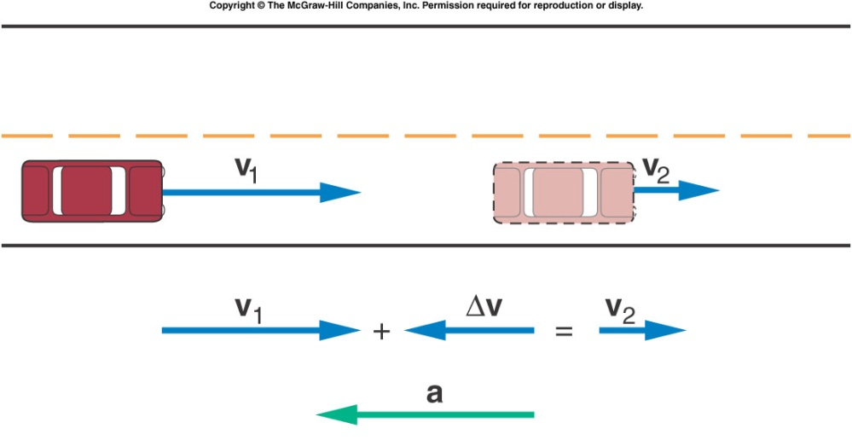
Acceleration (cont.)
  The direction of the acceleration vector is that of the change in velocity, ∆v.
  For the following example:
    If velocity is increasing, the acceleration is in the same direction as the velocity.
    If velocity is decreasing, the acceleration is in the opposite direction as the velocity.

Slide 18
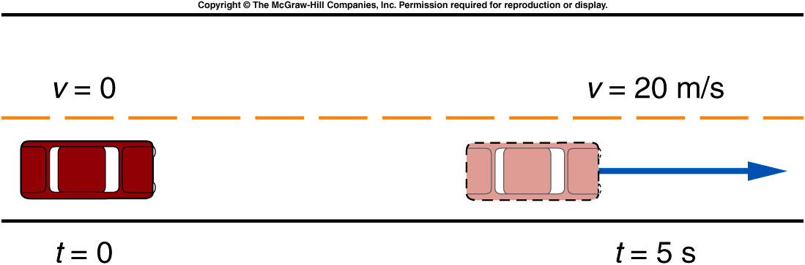
Average and Instantaneous Acceleration
A car starting from rest, accelerates to a velocity of 20 m/s due east in a time of 5 s.
Notes:
Fig. 2.02

Slide 19
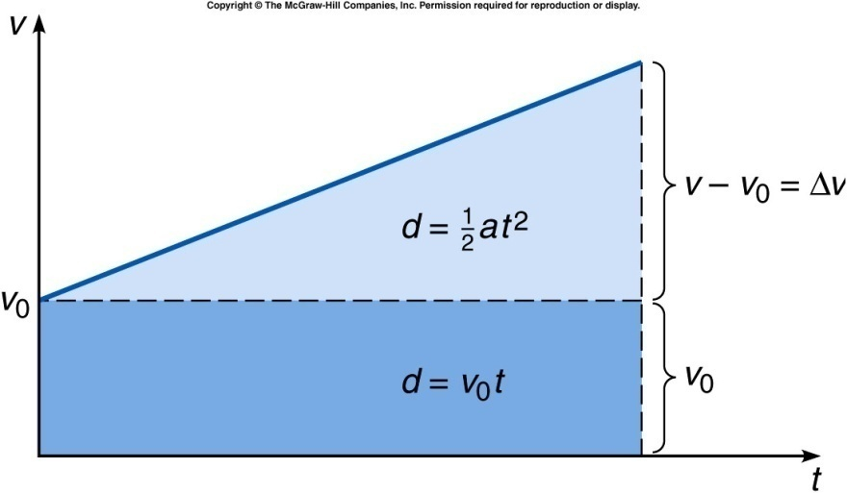

Straight line motion with constant acceleration
Quantify the relation among distance (d), velocity (v), acceleration (a) and time (t)
a = Δv/ Δt = (v-v₀)/(t-t₀). Set t₀ = 0.
v = v₀ + at
d is the area of
the right plot.
→Sum of large
Number of
Slices at all instant.
d = v₀t + ½*Δv t
since a = Δv/ Δt
→d = v₀t + ½*at²
$$d=0.5×\left(v−v_{0}\right)×t$$
a = $\left(v−v_{0}\right)/t$

Slide 20
Vector Addition
Vector addition: “tail to head technique”
Draw 1st vector to scale.
Draw 2nd vector by placing its tail at the head of the first vector
draw another vector from the tail of the 1st vector to the head of the 2nd one.
  i.e. addition of two vectors.
For addition any number of vectors.
Draw the succeeding vector by placing its tail at the head of the previous vector
Repeat this process until all vector are drawn
Draw the vector sum from the tail of the 1st vector to the head of the last one.
Notes:
Parallelogram
Vector is often expressed as arrow. The length of the arrow represent the amplitude. The direction of the arrow represent the direction of the vector.
Head and tail of a vector

Slide 21
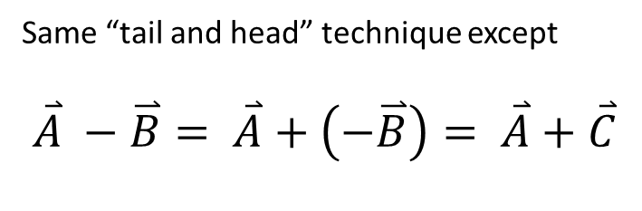
Vector Subtraction
Same “tail and head” technique except
$$\overset{⃑}{A} −\overset{⃑}{B}= \overset{⃑}{A}+\left(−\overset{⃑}{B}\right)= \overset{⃑}{A}+\overset{⃑}{C}$$
C
A
B
A
A
C
B
Notes:
Parallelogram
Vector is often expressed as arrow. The length of the arrow represent the amplitude. The direction of the arrow represent the direction of the vector.
Head and tail of a vector

Slide 22
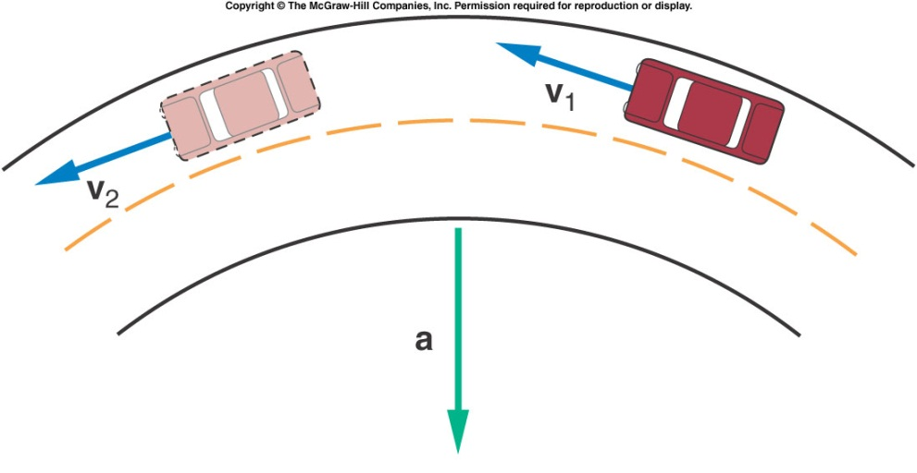
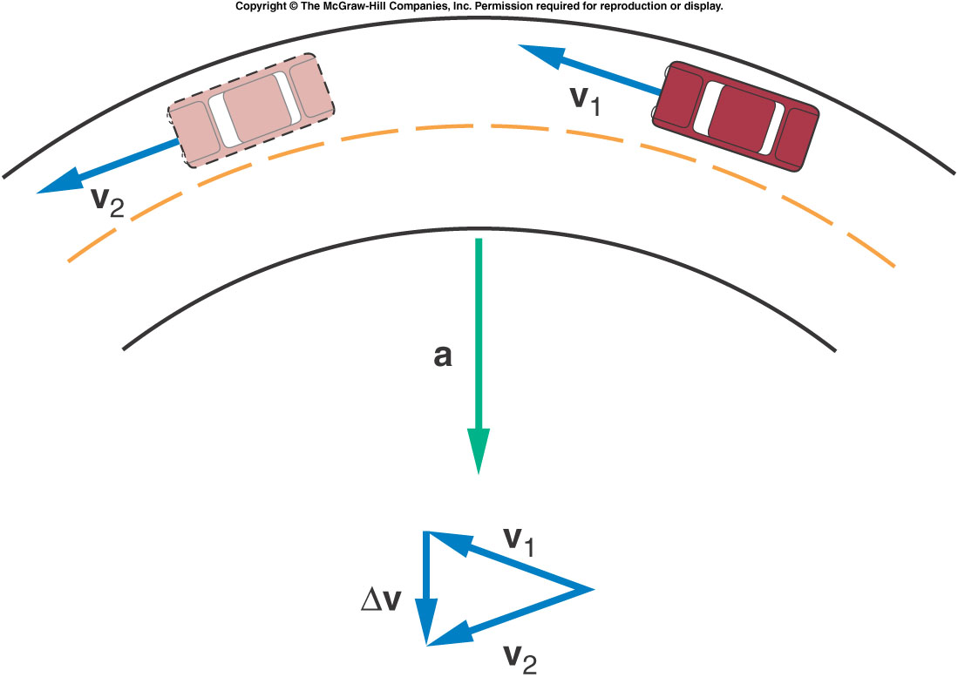
Constant Speed Circular Motion
  The direction of the acceleration vector is that of the change in velocity, ∆v = V₂-V₁.
  The acceleration
    at right angles to the velocity at any instant.
    point to the center of the circle.
-V₁
-V₁
V₂
V₂
-V₁
-V₁
V₂
V₂
Notes:
Make two moments closer and closer

Slide 23

Ch 2 CP4
-
d
+
x
v₀ = 14 m/s a = 2 m/s² v = 24m/s
What is the time?
What is the distance?
Computed at 1 second intervals.?
a) v = v₀ + at, 24m/s = 14m/s +2m/s² × t, t = 5s
b) d = v₀t + ½ at² = 14m/s × 5s + 0.5 × 2m/s² × 5s × 5s = 95m
c) 1 sec = 15 2 sec = 32 3 sec = 51 m 4 sec = 72

Slide 24
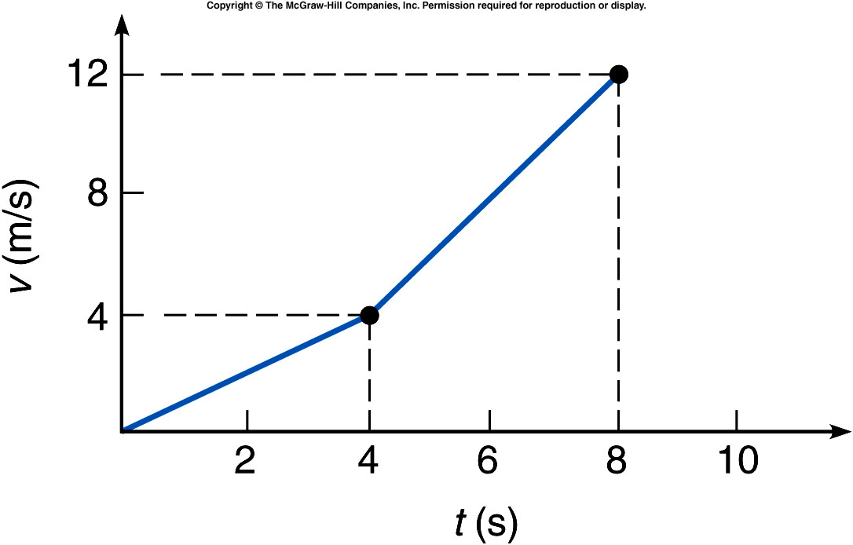
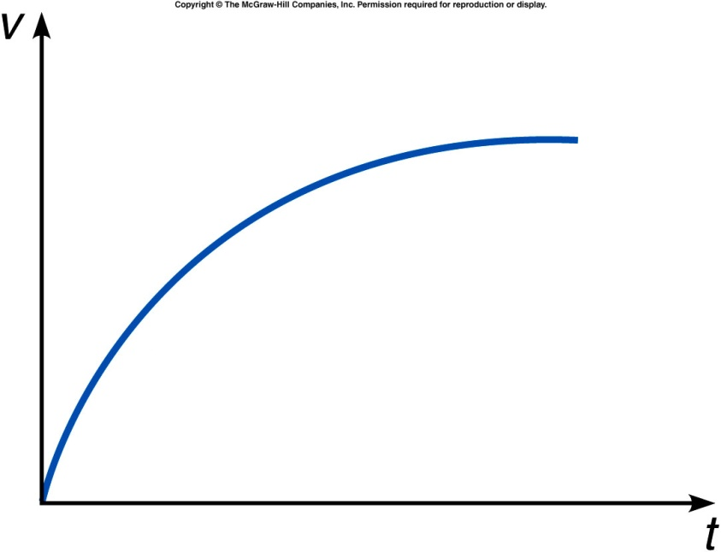
What is the average acceleration between 4 s and 8 s?
.
1.0 m/s²
2.0 m/s²
1.0 m/s
2.0m/s
Impossible to determine

Slide 25
In the graph shown, during which time interval is the acceleration greatest?
Between 0 s and 2 s.
Between 2 s and 4 s.
Between 4 s and 8 s.
The acceleration does
not change.
The acceleration is greatest between 2 s and 4 s.
The velocity is changing fastest, and the graph has the greatest slope, during this interval.

Slide 26
At which part the direction of the acceleration is opposite to that of velocity?
Part A
Part B
Part C
The acceleration does not
change.

Slide 27
The velocity graph of an object is shown. Is the acceleration of the object constant?
Yes.
No.
It is impossible to determine
from this graph.
The slope of the velocity curve gradually decreases with time, so the acceleration is decreasing. Initially the velocity is changing quite rapidly, but as time goes on the velocity reaches a maximum value and then stays constant.

Slide 28
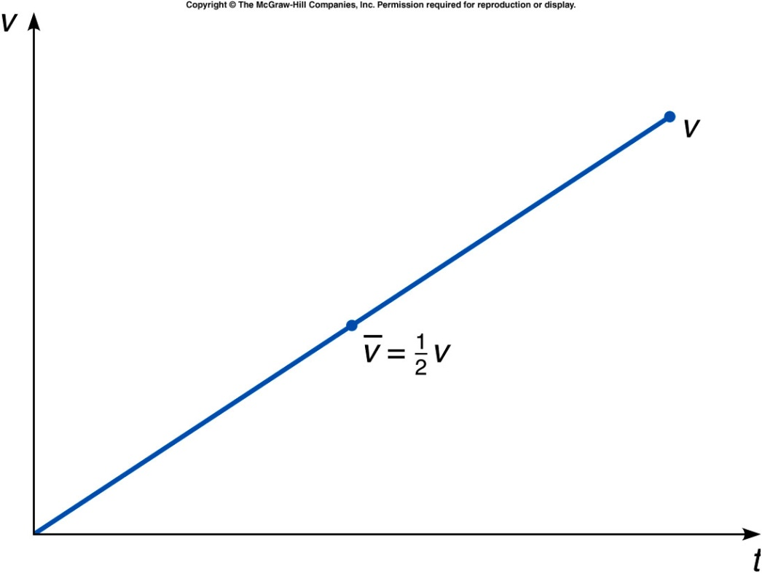
The velocity graph of an object is shown. Is the acceleration of the object constant?
Yes.
No.
It is impossible to determine
from this graph.

Slide 29
Test Quiz: What is the average acceleration between 0 s and 4 s?
.
1.0 m/s²
2.0 m/s²
1.0 m/s
2.0m/s
Impossible to determine

