Slide 1
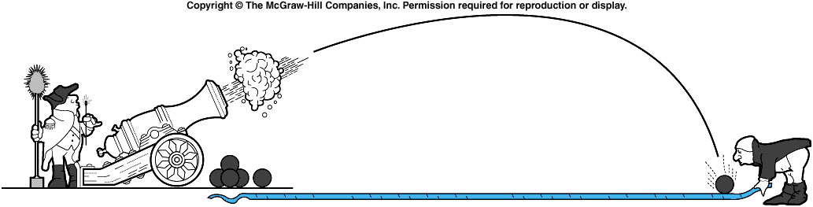
Subfields of Physics
Classical Physics
  Mechanics - forces and motion

Slide 2
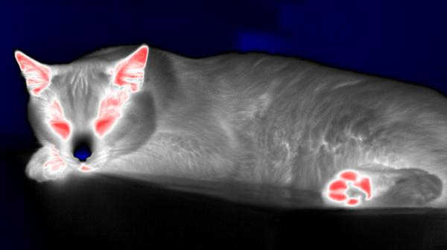
Subfields of Physics
Classical Physics
  Mechanics - forces and motion
  Thermodynamics - temperature, heat, energy

Slide 3

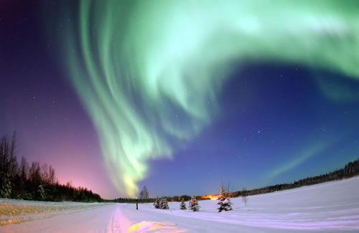
Subfields of Physics
Classical Physics
  Mechanics - forces and motion
  Thermodynamics - temperature, heat, energy
  Electricity and Magnetism

Slide 4

Subfields of Physics
Classical Physics
  Mechanics - forces and motion
  Thermodynamics - temperature, heat, energy
  Electricity and Magnetism
  Optics – light

Slide 5
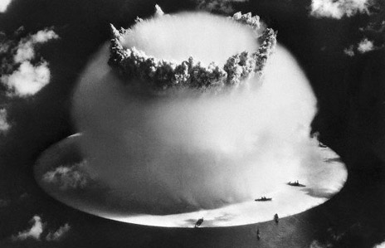
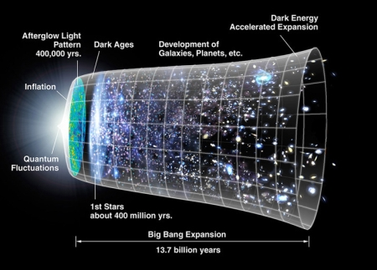
Subfields of Physics
Modern Physics
  Atomic physics - atoms
  Nuclear physics - nucleus of the atom
My research area.

Slide 6
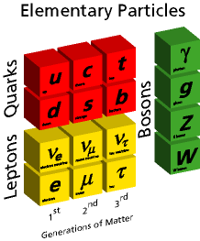
Subfields of Physics
Modern Physics
  Atomic physics - atoms
  Nuclear physics - nucleus of the atom
  Particle physics - subatomic particles: quarks, etc
Building blocks
Quarks – up, down, strange, charm, beauty,top
Leptons - electron, muon, tau, 3 neutrinos
Force carriers – γ, g, W, Z
Missing pieces
Building blocks – Higgs, supersymmetry…
Questions – Dark energy, dark matter…..
Speculation – parallel universes, extra dimensions..

Slide 7
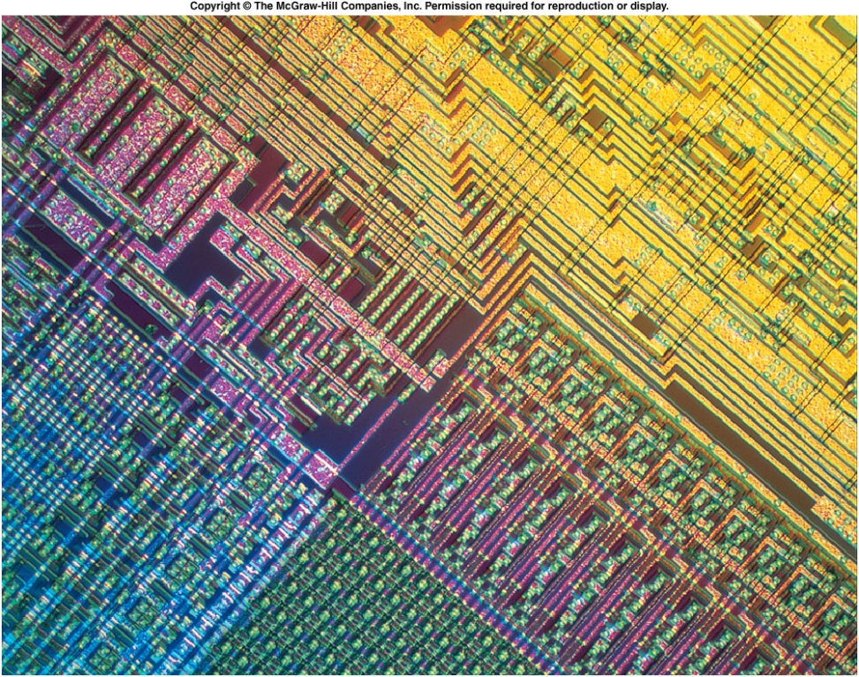
Subfields of Physics
Modern Physics
  Atomic physics - atoms
  Nuclear physics - nucleus of the atom
  Particle physics - subatomic particles: quarks, etc
  Condensed matter physics - solids and liquids

Slide 8
Subfields of Physics
Interdisciplinary Fields
  Biophysics
  Geophysics
  Astrophysics
Physicists: fundamental understanding
Engineers: practical applications
  Often overlapping roles

Slide 9
Scope of Physics
The study of the basic nature of matter
The most fundamental science
  Explains fundamental interactions of chemistry, biology, etc. at the atomic or molecular level
The most quantitative science
  Heavy use of mathematics
  Numerical measurements
Can be described more simply and cleanly than other sciences
NOT just a collection of facts to memorize!

Slide 10
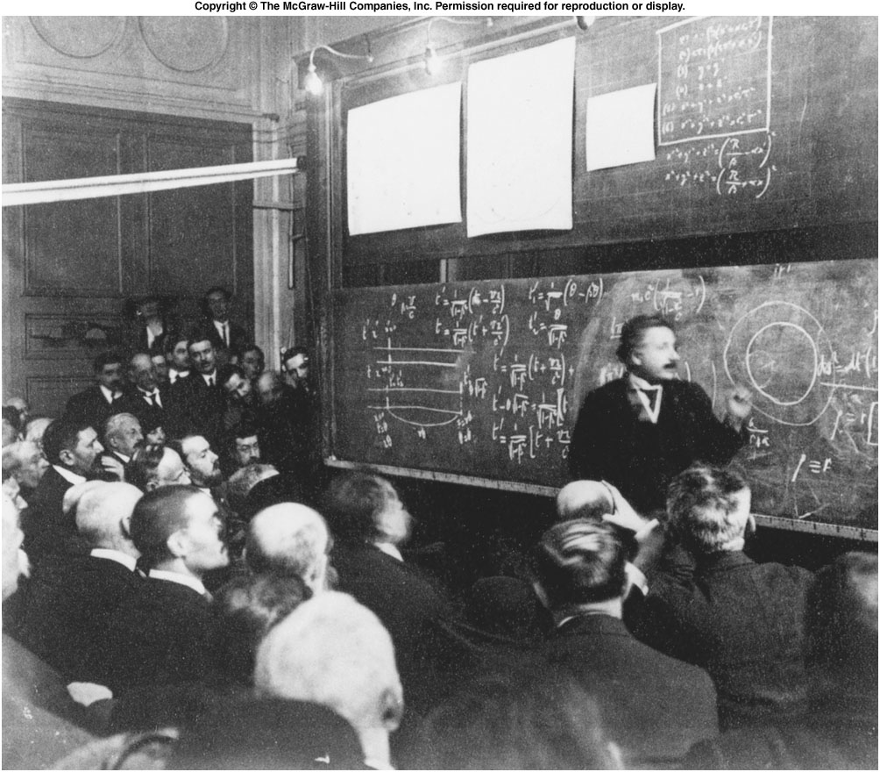
Fig. 1.2
Notes:
A lot of equations in the board. Mathematics is the language used in physics.

Slide 11
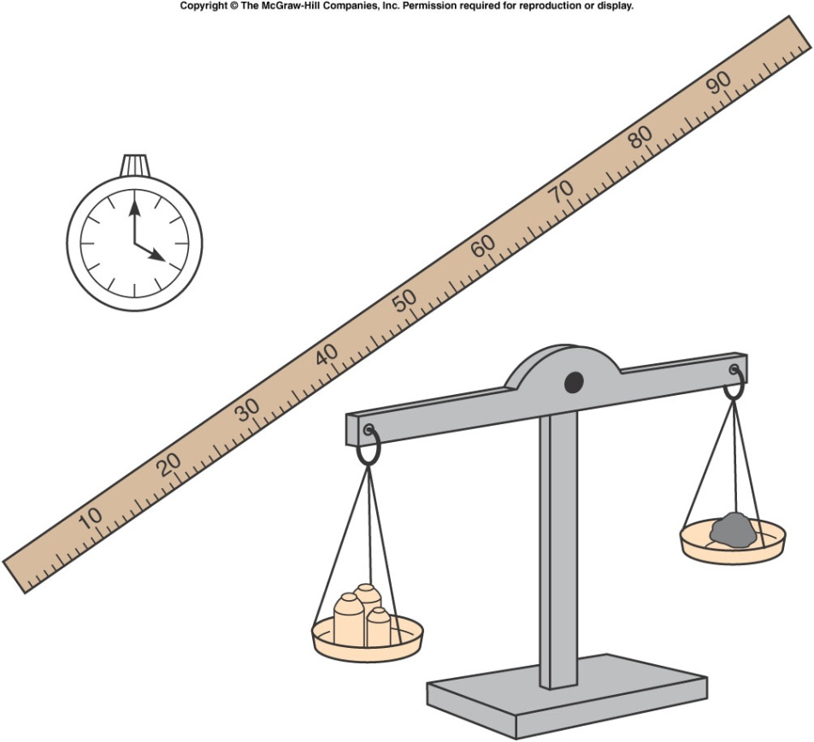
Fundamentals Quantities
Mathematics is needed to quantify any physics Interpretations.
fundamental quantities
Length (distance)
Time
Coordinate system (reference point, direction, clock)
Mass ( so much of something)
These quantities are expressed in different Unit.

Slide 12
Units System
There are many systems of units
For this class we use the SI system (International System of Units).
SI
Length – hand, foot, mile,… meter
Time – sundial, water clock, second
Mass – pound, ton, gram… kilogram
Volume – peck, bushel, cup … cubic meter
Area - acre, square mile, hectare square meter
When solving problems, use the same system for different quantities. Then covert it to any other systems at the end.

Slide 13
Conversions, prefixes and scientific notation
giga | 1,000,000,000 |  | 10⁹ | billion
mega | 1,000,000 |  | 10⁶ | million
kilo | 1,000 |  | 10³ | thousand
centi | 1/100 | 0.01 | 10⁻² | hundredth
milli | 1/1000 | 0.001 | 10⁻³ | thousandth
micro | 1/1,000,000 | 1/10⁶ | 10⁻⁶ | millionth
nano | 1/1,000,000,000 | 1/10⁹ | 10⁻⁹ | billionth
1 in | 2.54cm
1cm | 0.394in
1ft | 30.5cm
1m | 39.4in | 3.281ft
1km | 0.621mi
1mi | 5280ft | 1.609km
1lb | 0.4536kg | g =9.8
1kg | 2.205lbs | g=9.8
Appendix b

Slide 14
From Wikipedia:Air Canada Flight 143 was a scheduled domestic passenger flight between Montreal and Edmonton that ran out of fuel on July 23, 1983, at an altitude of 41,000 feet (12,000 m), midway through the flight. The crew was able to glide the Boeing 767 aircraft safely to an emergency landing at a former Royal Canadian Air Force base in Gimli, Manitoba, that had been turned into a motor racing track. This unusual aviation incident earned the aircraft the nickname "Gimli Glider".^{[1]}
The subsequent investigation revealed that a combination of company failures, human errors and confusion over unit measures had led to the aircraft being refuelled with insufficient fuel for the planned flight.^{[2]}

Slide 15
From Wikipedia: The Mars Climate Orbiter (formerly the Mars Surveyor '98 Orbiter) was one of two NASA spacecraft in the Mars Surveyor '98 program, …….
The Mars Climate Orbiter was intended to enter orbit at an altitude of 140.5–150 km (460,000-500,000 ft.) above Mars. However, a navigation error caused the spacecraft to reach as low as 57 km (190,000 ft.). The spacecraft was destroyed by atmospheric stresses and friction at this low altitude. The navigation error arose because Lockheed Martin, the contractors for the craft's thrusters, did not use SI units to express their performance^{[1][2]}.

Slide 16
Vector and Scalar Quantities
77
73
72
75
82
71
84
77
80
68
64
83
57
56
55
73
66
80
88
88
75
83
90
92
91
Scalar has only amplitude, e.g. the temperature
Vector has both amplitude and direction, e.g. the wind

Slide 17
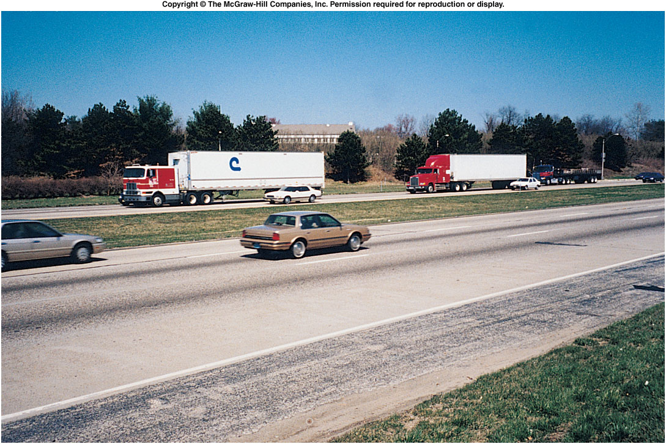
We need clear, precise definitions
of various physical quantities In order to describe a physics process
Some are used frequently in daily life (Speed)
Some are not (velocity, acceleration)
What’s the difference between:
average speed and instantaneous speed?
speed and velocity?
speed and acceleration?
Notes:
Fig. 2.co

Slide 18
Speed
Speed is how fast something is moving.
  Speed is a scalar.
  The units may be miles per hour, or meters per second (SI unit), or kilometers per hour, or inches per minute, etc.
Convert 70 kilometers per hour to miles per hour:
1 km = 0.6214 miles
1 mile = 1.609 km

Slide 19

Ch 2 #8
-
d
+
x
Car travels with a speed of 25 m/s
What is the speed in km/s, km/h?
1000 m = 1 km 25/1000 km/sec
= 0.025 km/s or 25x10⁻³ km/sec
b) 3600 s = 1 hour 1m = (1/1000)km
25 x 10⁻³ x 3600km/hr = 90km/h

Slide 20
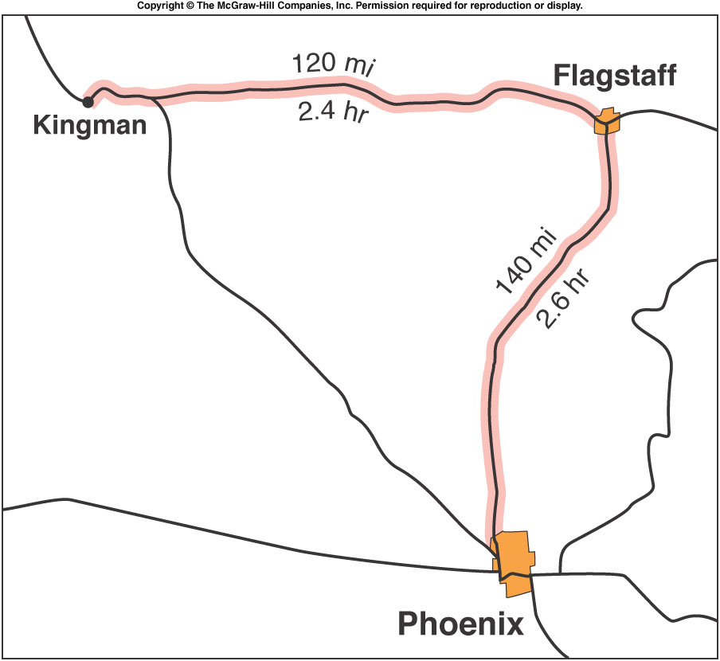
Average Speed
Average speed is total distance divided by total time.
Kingman to Flagstaff:
  120 mi ÷ 2.4 hr = 50 mph
Flagstaff to Phoenix:
  140 mi ÷ 2.6 hr = 54 mph
Total trip:
120 mi + 140 mi = 260 mi
2.4 hr + 2.6 hr = 5.0 hr
260 mi ÷ 5.0 hr = 52 mph
Notes:
Fig. 2.02

Slide 21
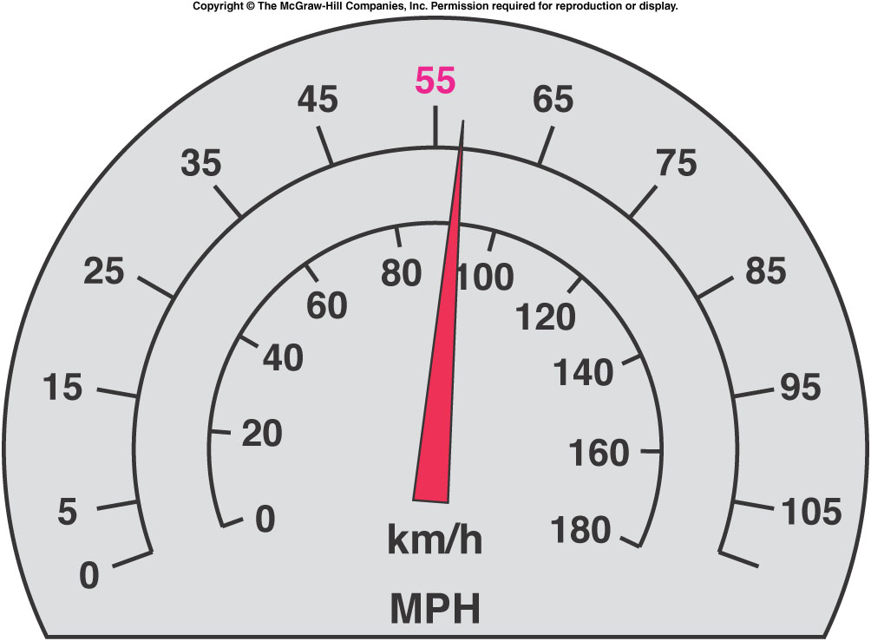
Instantaneous Speed
is the speed at that precise instant in time.
  It is the average speed, over a short enough time that the speed does not change much
    s = distance/Δt, where Δt→0 sec.
The speedometer tells us how fast we are going at a given instant in time.
Notes:
Meter hand

Slide 22
Velocity
Velocity involves direction of motion as well as how fast the object is going.
  Velocity has the same Unit as speed, i.e. meter/second in SI system.
  Velocity is vector, having a magnitude (the speed) and also a direction (which way the object is moving).
A change in velocity can be a change in the object’s speed or direction of motion.
Instantaneous velocity is a vector quantity having:
a size (magnitude) equal to the instantaneous speed at a given instant in time, and
a direction equal to the direction of motion at that instant.

Slide 23
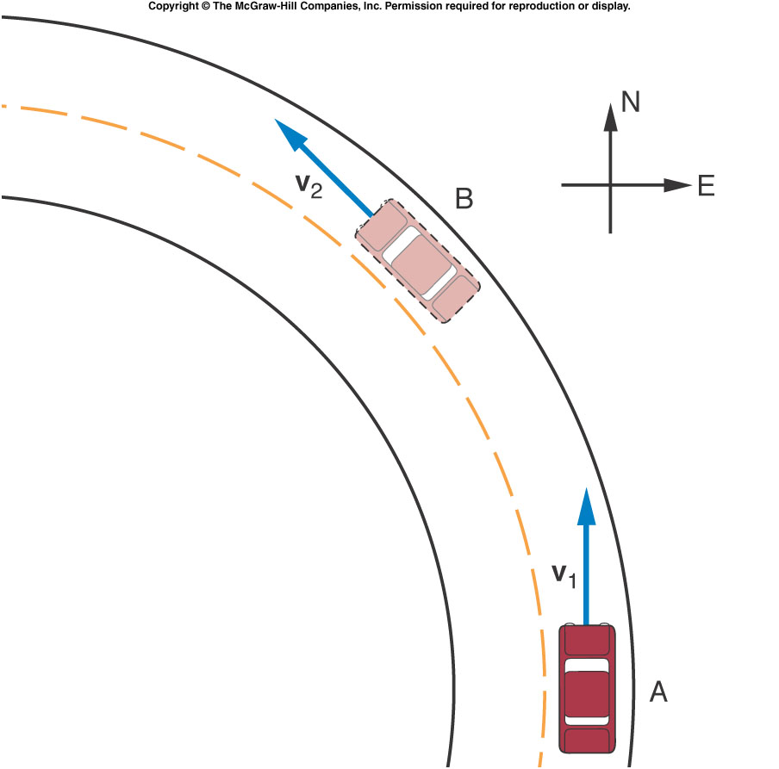
A car goes around a curve at constant speed. Is the car’s velocity changing?
Yes
No
Impossible to determine

Slide 24
Test Quiz:A car travels a distance of 600 meters in 1 minutes. What’s the average speed of the car?
40 m/s
600 m/s
20 m/s
10 m/s
40 m/s

Slide 25
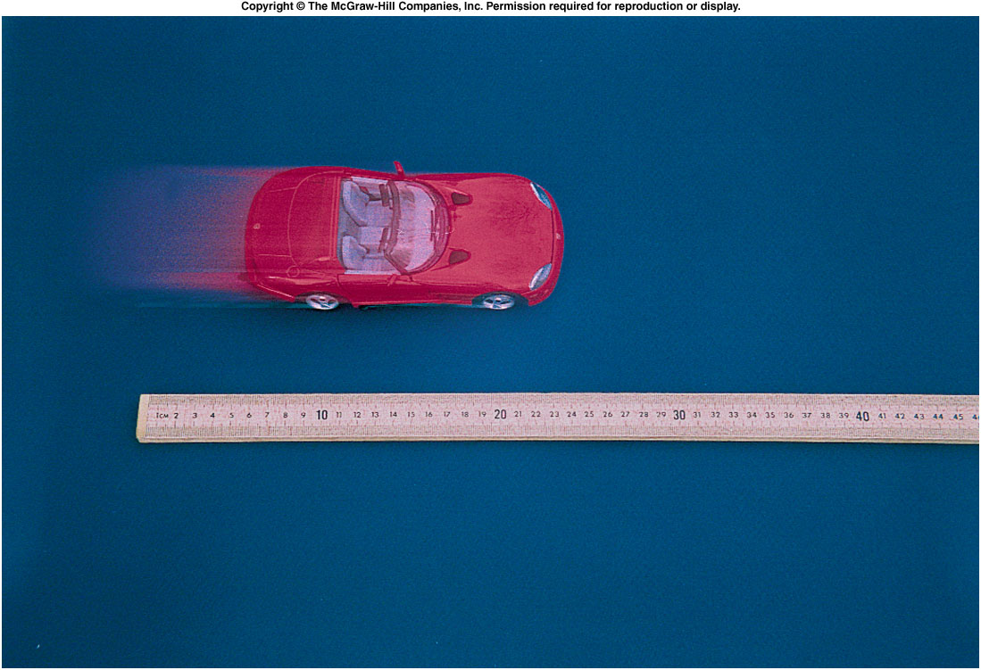
Graphing Motion
To describe the car’s motion, we could note the car’s position every 5 seconds.
Time | Position
0 s | 0 cm
5 s | 4.1 cm
10 s | 7.9 cm
15 s | 12.1 cm
20 s | 16.0 cm
25 s | 16.0 cm
30 s | 16.0 cm
35 s | 18.0 cm

Slide 26
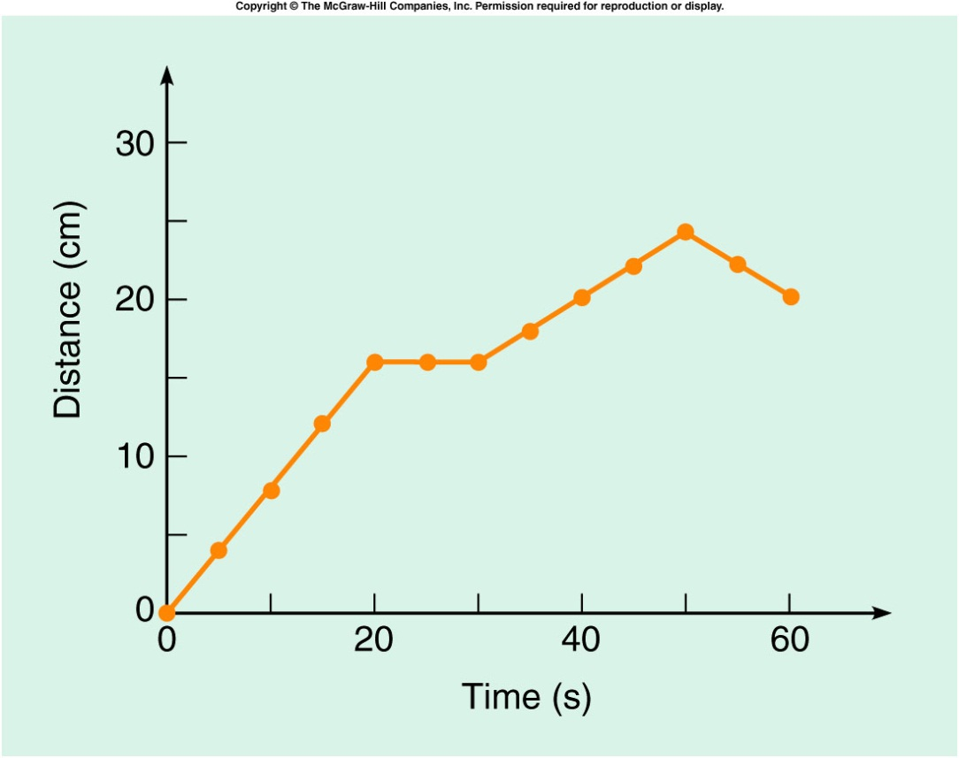
To graph the data in the table, let the horizontal axis represent time, and the vertical axis represent distance.
Time | Position
0 s | 0 cm
5 s | 4.1 cm
10 s | 7.9 cm
15 s | 12.1 cm
20 s | 16.0 cm
25 s | 16.0 cm
30 s | 16.0 cm
35 s | 18.0 cm
Notes:
Fig. 2.14

Slide 27

The graph displays information in a more useful manner than a simple table.
When is the car moving the fastest?
When is it moving the slowest?
When is the car not moving at all?
At what time does the car start moving in the opposite direction?
Notes:
Fig. 2.14

Slide 28
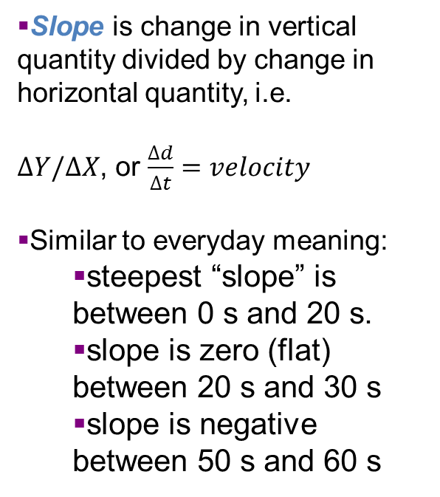
The slope at any point on the distance-versus-time graph represents the instantaneous velocity at that time.
Slope is change in vertical quantity divided by change in horizontal quantity, i.e.
$∆Y/∆X$, or $\frac{∆d}{∆t}=velocity$
Similar to everyday meaning:
  steepest “slope” is between 0 s and 20 s.
  slope is zero (flat) between 20 s and 30 s
  slope is negative between 50 s and 60 s
Notes:
Fig. 2.14

Slide 29
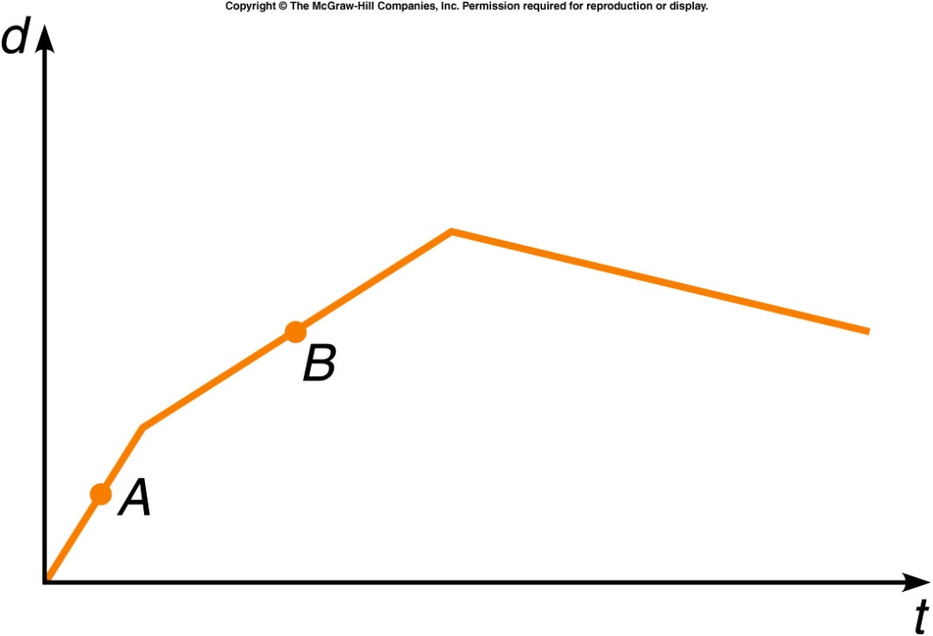
The graph shows the position of a car with respect to time. Does the car ever go backward?
Yes, during the first
segment (labeled A).
Yes, during the second
segment (labeled B).
Yes, during the third
segment (not labeled).
No, never.
The distance traveled is decreasing during the third segment, so at this time the car is moving backward.

Slide 30
Is the instantaneous velocity at point A greater or less than that at point B?
Greater than
Less than
The same as
Unable to tell from this graph
The instantaneous velocities can be compared by looking at their slopes. The steeper slope indicates the greater instantaneous velocity, so the velocity at A is greater.

Slide 31
More on subfield of physics
Notes:
Did not have time to go through in last class

Slide 32
Subfields of Physics
Classical Physics
  Mechanics - forces and motion

Slide 33
Subfields of Physics
Classical Physics
  Mechanics - forces and motion
  Thermodynamics - temperature, heat, energy

Slide 34
Subfields of Physics
Classical Physics
  Mechanics - forces and motion
  Thermodynamics - temperature, heat, energy
  Electricity and Magnetism

Slide 35
Subfields of Physics
Classical Physics
  Mechanics - forces and motion
  Thermodynamics - temperature, heat, energy
  Electricity and Magnetism
  Optics – light

Slide 36
Subfields of Physics
Modern Physics
  Atomic physics - atoms
  Nuclear physics - nucleus of the atom
My research area.

Slide 37
Subfields of Physics
Modern Physics
  Atomic physics - atoms
  Nuclear physics - nucleus of the atom
  Particle physics - subatomic particles: quarks, etc
Building blocks
Quarks – up, down, strange, charm, beauty,top
Leptons - electron, muon, tau, 3 neutrinos
Force carriers – γ, g, W, Z
Missing pieces
Building blocks – Higgs, supersymmetry…
Questions – Dark energy, dark matter…..
Speculation – parallel universes, extra dimensions..

Slide 38
Subfields of Physics
Modern Physics
  Atomic physics - atoms
  Nuclear physics - nucleus of the atom
  Particle physics - subatomic particles: quarks, etc
  Condensed matter physics - solids and liquids

Slide 39
Subfields of Physics
Interdisciplinary Fields
  Biophysics
  Geophysics
  Astrophysics
Physicists: fundamental understanding
Engineers: practical applications
  Often overlapping roles

