Slide 1
PHYS 214: The Nature of Physics, Spring 2021
Instructor:
Prof. Wei Xie
Office: Room: 254, Physics Building
Phone: 765-494-8743
Email: wxie@purdue.edu
Lecture:
Monday, Wednesday and Friday: 08:30-09:20 am.
Room 112, Physics Building
please read the textbook before the corresponding lecture according to the Class Schedule at the end of the syllabus.
one pre-lecture quiz before each lecture most of the time.
quizzes during every class using the iClicker starting from the second week.
  purchase an Iclicker from the bookstore.
  register your Iclicker serial number (clicker ID) in the student grade book on CHIP (NOT the Iclicker Web site).

Slide 2
Homework and Pre-lecture Quizzes through CHIP
All homework assignments and pre-lecture quizzes are to be worked on and submitted using the Computerized Homework in Physics (CHIP) system.
http://chip.physics.purdue.edu/public/214/spring2021/
The first time you log on to CHIP this semester using your career account username and password, immediately do two things:
  Register your iClicker for this course (even if you registered it for another course),
  Open and read the on-line Instructions link at http://chip.physics.purdue.edu/public/stu/handout.pdf
  http://chip.physics.purdue.edu/public/instruct.html
You must sign on to CHIP using your userid and password to find out which problems are assigned to you.
Each correct response submitted before the primary deadline and within the allowed attempt number limits will receive 100% credit. No credit is given after that. Attempt number limit for numerical problems is 5 tries. Past the attempt number limits, you will receive no credits.

Slide 3
Opening the Pre-Lecture Quiz immediately begins the count-down 5 minute clock. Once you start the clock, you must finish the Quiz in one sitting.
If you have medical or other emergencies and wish to request special excuses for submitting CHIP homework late, you need to contact me. I can set up a grace period for you for particular assignments.
All the questions related to CHIP should be sent to wxie@purdue.edu.
Getting Help from Office Hours
discussing with your classmate on homework and quizzes are strongly encouraged. Study group is a good way to go.
One TA in the help center online at:
  https://purdue-edu.zoom.us/j/6103643619
  Wed.: 10:30 am - 12:00 pm
  Fri.: 10:30 am - 12:00 pm
You can also get help from me through office hours. The preferred way of communication with me is Email. I used to have an open-door policy where you may visit me at any time. Due to the covid-19 situation, all office hours will be done online. Just send me an email to have it arranged.

Slide 4
Exams
Midterm Exam : Wednesday 03/24 (tentative), 8:30am-9:20am in room 114 (covers Chap. 1 - 9), unless noted otherwise.
Final Exam: to be announced.
If you have a conflict or are sick, you must contact me as soon as possible before the exam. Generally, you should not assume that a make-up exam will be given and unexcused absences will be scored as zero. All exams are closed book. All formulas you may need are provided in the exams themselves.
If you have official university permission to obtain special arrangement for an exam (such as extended time), please contact me well before the scheduled exam date so that proper arrangements can be made.

Slide 5
Grade
Grades will generally be based on the following maximum points:
Pre-Lecture Quizzes 10%
Homework 30%
Lecture Quizzes 10%
Midterm Exam: 20%
Final Exam 30%
Total 100%
Drop course
I will sign any drop slip as W until February 22. Past this date, we are required to add F to W if your grade is failing at that point in the course.
Textbook:
The Physics of Everyday Phenomena (8th Edition, Vol. 1) by W. T. Griffith and J. W. Brosing (McGraw-Hill , ISBN 978-0073513904).
Course Web site:
Brightspace (lecture notes, lecture recordings, announcements, etc.)

Slide 6
Classroom Guidance Regarding Protect Purdue
The Protect Purdue Plan, which includes the Protect Purdue Pledge, is campus policy and as such all members of the Purdue community must comply with the required health and safety guidelines. Required behaviors in this class include: staying home and contacting the Protect Purdue Health Center (496-INFO) if you feel ill or know you have been exposed to the virus, properly wearing a mask in classrooms and campus building, at all times (e.g., mask covers nose and mouth, no eating/drinking in the classroom), disinfecting desk/workspace before and after use, maintaining appropriate social distancing with peers and instructors (including when entering/exiting classrooms), refraining from moving furniture, avoiding shared use of personal items, maintaining robust hygiene (e.g., handwashing, disposal of tissues) prior to, during and after class, and following all safety directions from the instructor.
Students who are not engaging in these behaviors (e.g., wearing a mask) will be offered the opportunity to comply. If non-compliance continues, possible results include instructors asking the student to leave class and instructors dismissing the whole class. Students who do not comply with the required health behaviors are violating the University Code of Conduct and will be reported to the Dean of Students Office with sanctions ranging from educational requirements to dismissal from the university.
Any student who has substantial reason to believe that another person in a campus room (e.g., classroom) is threatening the safety of others by not complying (e.g., not properly wearing a mask) may leave the room without consequence. The student is encouraged to report the behavior to and discuss the next steps with their instructor. Students also have the option of reporting the behavior to the Office of the Student Rights and Responsibilities. See also Purdue University Bill of Student Rights.

Slide 7
Attendance Policy during COVID-19
Students are expected to attend all classes in-person unless they are ill or otherwise unable to attend class. If they feel ill, have any symptoms associated with COVID-19, or suspect they have been exposed to the virus, students should stay home and contact the Protect Purdue Health Center (496-INFO)
In the current context of COVID-19, in-person attendance cannot be a factor in the final grades. However, timely completion of alternative assessments can certainly be part of the final grade. Students need to inform the instructor of any conflict that can be anticipated and will affect the timely submission of an assignment or the ability to take an exam.
Classroom engagement is extremely important and associated with your overall success in the course. The importance and value of course engagement and ways in which you can engage with the course content even if you are in quarantine or isolation, will be discussed at the beginning of the semester. Student survey data from Fall 2020 emphasized students’ views of in-person course opportunities as critical to their learning, engagement with faculty/TAs, and ability to interact with peers.
Only the instructor can excuse a student from a course requirement or responsibility. When conflicts can be anticipated, such as for many University-sponsored activities and religious observations, the student should inform the instructor of the situation as far in advance as possible. For unanticipated or emergency conflicts, when advance notification to an instructor is not possible, the student should contact the instructor/instructional team as soon as possible by email, through Brightspace, or by phone. In cases of bereavement, quarantine, or isolation, the student or the student’s representative should contact the Office of the Dean of Students via email or phone at 765-494-1747. Our course Brightspace includes a link to the Dean of Students under ‘Campus Resources.

Slide 8
Accessibility
Purdue University strives to make learning experiences as accessible as possible. If you anticipate or experience physical or academic barriers based on disability, you are welcome to let me know so that we can discuss options. You are also encouraged to contact the Disability Resource Center at: drc@purdue.edu or by phone: 765-494-1247. More details are available on our course Brightspace under Accessibility Information.
If you must quarantine or isolate at any point in time during the semester, please reach out to me via email so that we can communicate about how you can continue to learn remotely. Work with the Protect Purdue Health Center (PPHC) to get documentation and support, including access to an Academic Case Manager who can provide you with general guidelines/resources around communicating with your instructors, be available for academic support, and offer suggestions for how to be successful when learning remotely. Your Academic Case Manager can be reached at acmq@purdue.edu. Importantly, if you find yourself too sick to progress in the course, notify your academic case manager and notify me via email or Brightspace. We will make arrangements based on your particular situation

Slide 9
Counseling and Psychological Services
If you find yourself beginning to feel some stress, anxiety and/or feeling slightly overwhelmed, try WellTrack. Sign in and find information and tools at your fingertips, available to you at any time.
If you need support and information about options and resources, please contact or see the Office of the Dean of Students. Call 765-494-1747. Hours of operation are M-F, 8 am- 5 pm.
If you find yourself struggling to find a healthy balance between academics, social life, stress, etc. sign up for free one-on-one virtual or in-person sessions with a Purdue Wellness Coach at RecWell. Student coaches can help you navigate through barriers and challenges toward your goals throughout the semester. Sign up is completely free and can be done on BoilerConnect. If you have any questions, please contact Purdue Wellness at evans240@purdue.edu.
If you’re struggling and need mental health services: Purdue University is committed to advancing the mental health and well-being of its students. If you or someone you know is feeling overwhelmed, depressed, and/or in need of mental health support, services are available. For help, such individuals should contact Counseling and Psychological Services (CAPS) at 765-494-6995 during and after hours, on weekends and holidays, or by going to the CAPS office of the second floor of the Purdue University Student Health Center (PUSH) during business hours.

Slide 10
Emergency Response
In the event of a major campus emergency, course requirements, deadlines and grading percentages are subject to changes that may be necessitated by a revised semester calendar or other circumstances. In such case, student will be contacted by e-mail and an announcement will be made on the course website.
To report an emergency, call 911.
If you experience any symptoms of COVID-19 or suspect you may have been exposed to someone with COVID-19 stay home and call the Protect Purdue Health Center at 765-496-INFO.
To obtain updates regarding an ongoing emergency, sign up for Purdue Alert text messages, view www.purdue.edu/ea.
There are nearly 300 Emergency Telephones outdoors across campus and in parking garages that connect directly to the PUPD. If you feel threatened or need help, push the button and you will be connected immediately.
If we hear a fire alarm during class we will immediately suspend class, evacuate the building, and proceed outdoors. Do not use the elevator.
If we are notified during class of a Shelter in Place requirement for a tornado warning, we will suspend class and shelter in [the basement].
If we are notified during class of a Shelter in Place requirement for a hazardous materials release, or a civil disturbance, including a shooting or other use of weapons, we will suspend class and shelter in the classroom, shutting the door and turning off the lights.

Slide 11

An Old (and Fundamental!) Question:
What is the Structure of Matter in the Universe?

Slide 12

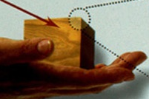
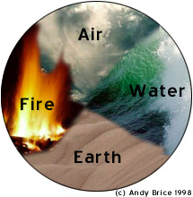
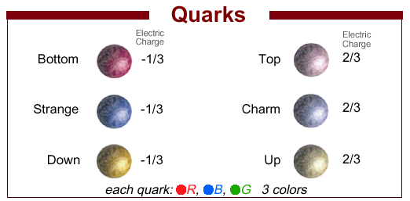

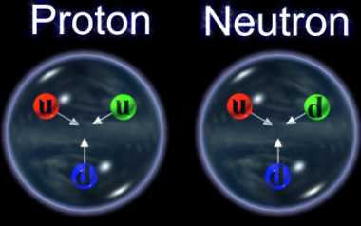
Structure of matter in the Universe
Wood
Huge scale
Iron
Gravitational
Universe
Current building block
Leptons: electron, muon, etc
scale ~ 10⁻¹⁰ m
Electromagnetic
scale ~ 10⁻¹⁵ m
Strong

Slide 13
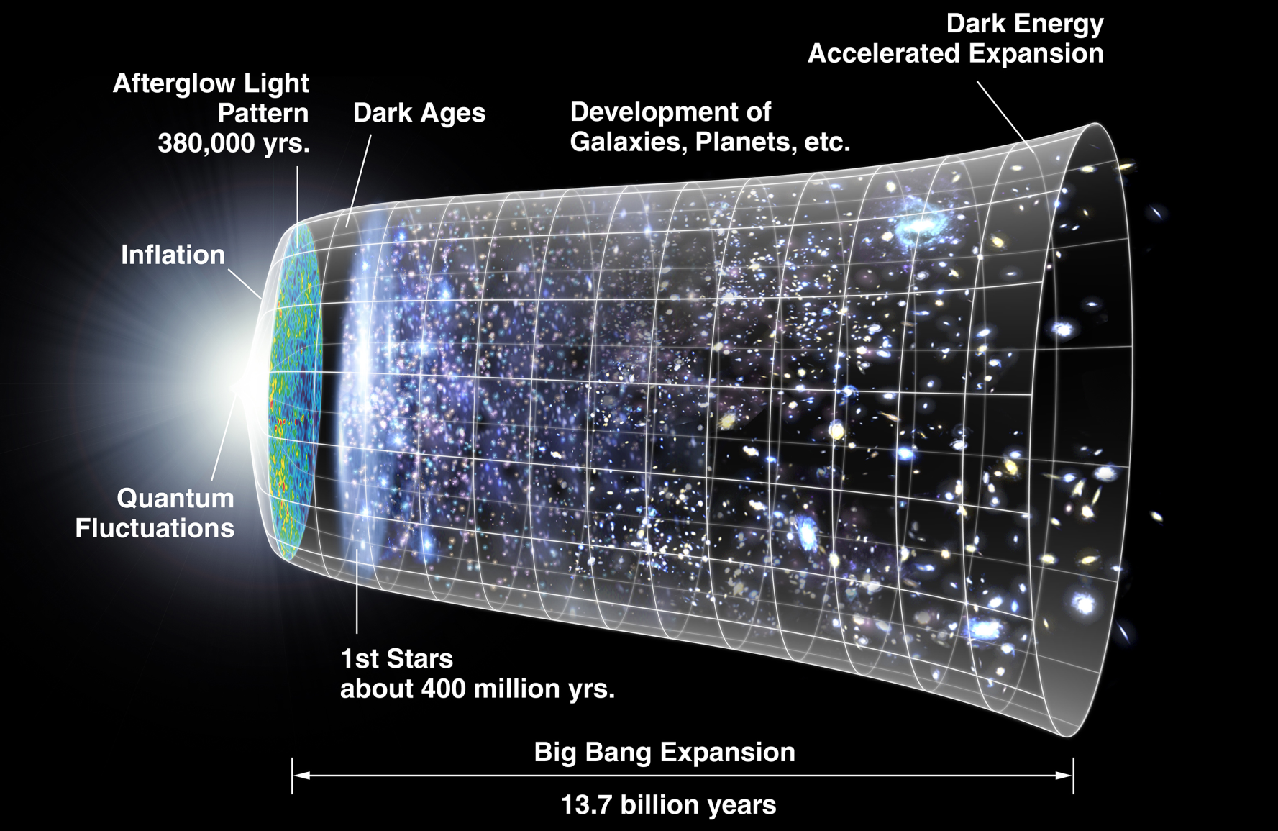
The Birth Evolution of Our University: The Big Bang Theory:

Slide 14
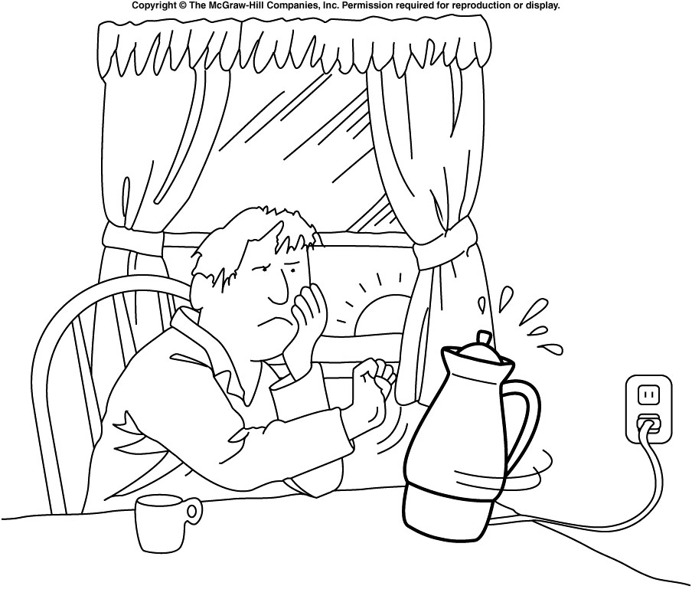
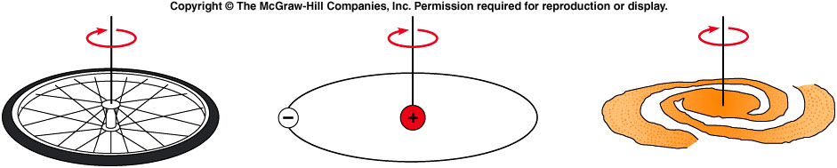
Why study everyday phenomena?
The same physical principles that govern our everyday experiences also govern the entire universe
  A bicycle wheel, an atom, and a galaxy all operate according to laws for angular momentum.

Slide 15

Scientific Method
Observations:
  Two of them
  Mixture of Different colors
  The colors in the fainter rainbow in reverse order
Generalization:
  In most cases just one
  It always appears when sun is on our back.
  Usually seen after rain
Theory:
  It’s caused by the reflection of light in the water droplets in air.
Prediction:
  One can create rainbow when watering garden.
Notes:
Fig.1.01

Slide 16


Slide 17
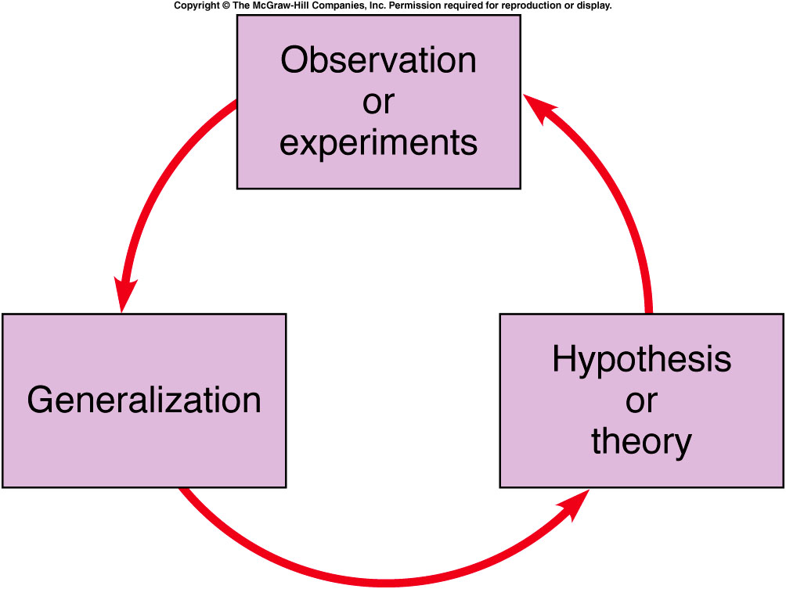
An acceptable theory must
  agree with what is observed.
  must have predictions that can be tested
  must stand up to criticism to EVOLVE.
Notes:
Fig.1.03

Slide 18
Which of the following represent the best Theory we currently have?
Einstein’s Theory of Relativity
Newton’s Law of Gravitation
Newton’s Law of Gravitation is a approximation of Einstein’s Theory of Relativity when object’s moving speed is slow.

Slide 19
Scope of Physics
The study of the basic nature of matter
The most fundamental science
  Explains fundamental interactions of chemistry, biology, etc. at the atomic or molecular level
The most quantitative science
  Heavy use of mathematics
  Numerical measurements
Can be described more simply and cleanly than other sciences
NOT just a collection of facts to memorize!

Slide 20
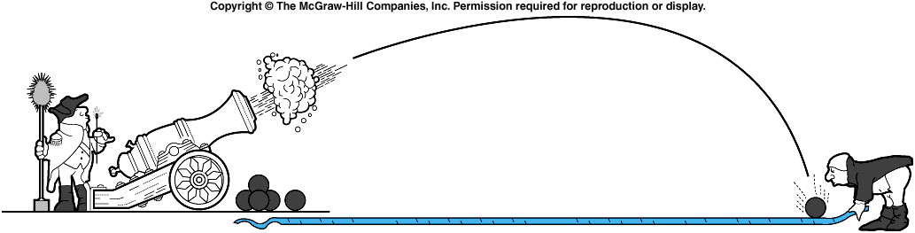
Subfields of Physics
Classical Physics
  Mechanics - forces and motion

Slide 21
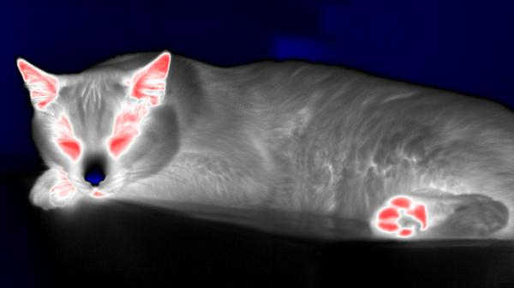
Subfields of Physics
Classical Physics
  Mechanics - forces and motion
  Thermodynamics - temperature, heat, energy

Slide 22

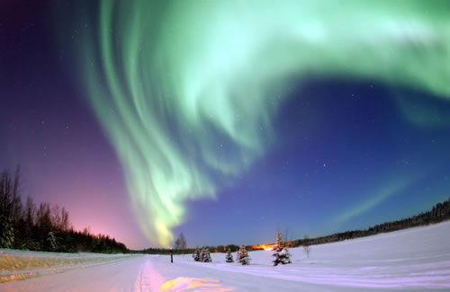
Subfields of Physics
Classical Physics
  Mechanics - forces and motion
  Thermodynamics - temperature, heat, energy
  Electricity and Magnetism

Slide 23

Subfields of Physics
Classical Physics
  Mechanics - forces and motion
  Thermodynamics - temperature, heat, energy
  Electricity and Magnetism
  Optics – light

Slide 24
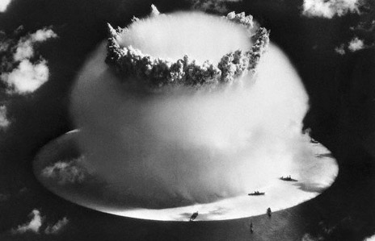
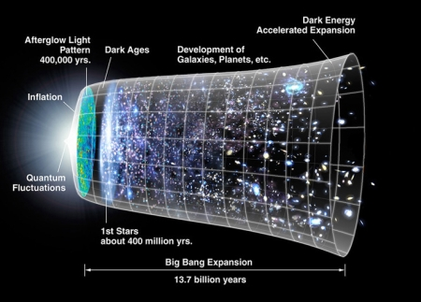
Subfields of Physics
Modern Physics
  Atomic physics - atoms
  Nuclear physics - nucleus of the atom
My research area.

Slide 25

Subfields of Physics
Modern Physics
  Atomic physics - atoms
  Nuclear physics - nucleus of the atom
  Particle physics - subatomic particles: quarks, etc
Building blocks
Quarks – up, down, strange, charm, beauty,top
Leptons - electron, muon, tau, 3 neutrinos
Force carriers – γ, g, W, Z
Missing pieces
Building blocks – Higgs, supersymmetry…
Questions – Dark energy, dark matter…..
Speculation – parallel universes, extra dimensions..

Slide 26
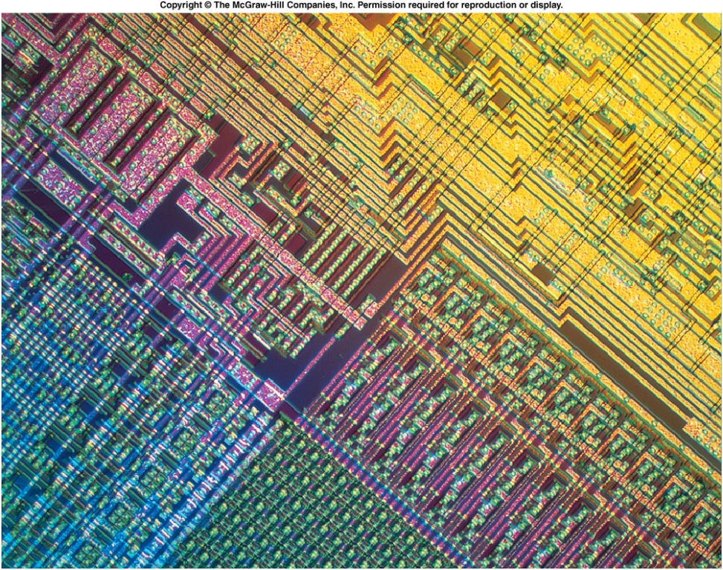
Subfields of Physics
Modern Physics
  Atomic physics - atoms
  Nuclear physics - nucleus of the atom
  Particle physics - subatomic particles: quarks, etc
  Condensed matter physics - solids and liquids

Slide 27
Subfields of Physics
Interdisciplinary Fields
  Biophysics
  Geophysics
  Astrophysics
Physicists: fundamental understanding
Engineers: practical applications
  Often overlapping roles

Slide 28
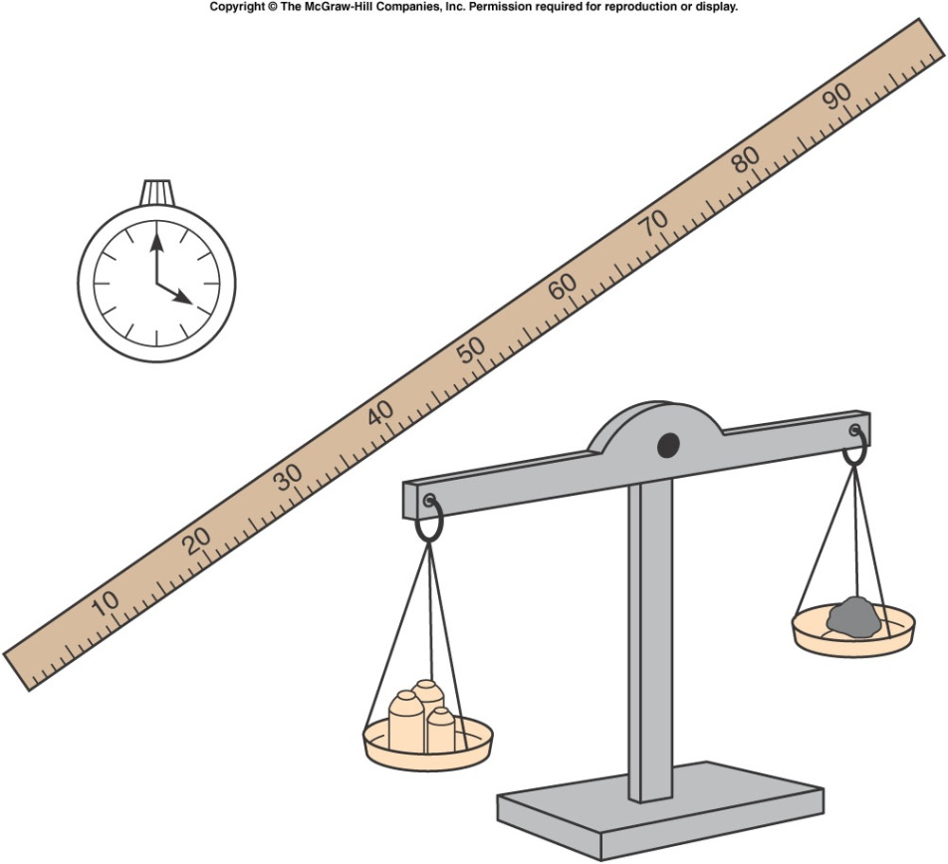
Fundamentals Quantities
Mathematics is needed to quantify any physics Interpretations.
fundamental quantities
Length (distance)
Time
Coordinate system (reference point, direction, clock)
Mass ( so much of something)
These quantities are expressed in different Unit.

Slide 29
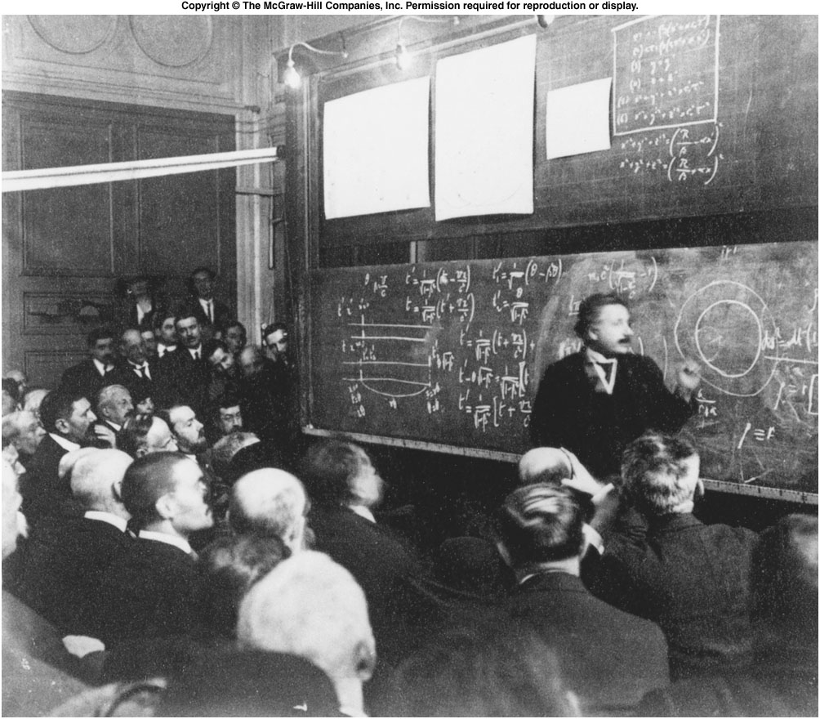
Fig. 1.2
Notes:
A lot of equations in the board. Mathematics is the language used in physics.

Slide 30
Units System
There are many systems of units
For this class we use the SI system (International System of Units).
SI
Length – hand, foot, mile,… meter
Time – sundial, water clock, second
Mass – pound, ton, gram… kilogram
Volume – peck, bushel, cup … cubic meter
Area - acre, square mile, hectare square meter
When solving problems, use the same system for different quantities. Then convert it to any other systems you want

Slide 31
Conversions, prefixes and scientific notation
giga | 1,000,000,000 |  | 10⁹ | billion
mega | 1,000,000 |  | 10⁶ | million
kilo | 1,000 |  | 10³ | thousand
centi | 1/100 | 0.01 | 10⁻² | hundredth
milli | 1/1000 | 0.001 | 10⁻³ | thousandth
micro | 1/1,000,000 | 1/10⁶ | 10⁻⁶ | millionth
nano | 1/1,000,000,000 | 1/10⁹ | 10⁻⁹ | billionth
1 in | 2.54cm
1cm | 0.394in
1ft | 30.5cm
1m | 39.4in | 3.281ft
1km | 0.621mi
1mi | 5280ft | 1.609km
1lb | 0.4536kg | g =9.8
1kg | 2.205lbs | g=9.8
Appendix b

Slide 32
From Wikipedia: The Mars Climate Orbiter (formerly the Mars Surveyor '98 Orbiter) was one of two NASA spacecraft in the Mars Surveyor '98 program, …….
The Mars Climate Orbiter was intended to enter orbit at an altitude of 140.5–150 km (460,000-500,000 ft.) above Mars. However, a navigation error caused the spacecraft to reach as low as 57 km (190,000 ft.). The spacecraft was destroyed by atmospheric stresses and friction at this low altitude. The navigation error arose because Lockheed Martin, the contractors for the craft's thrusters, did not use SI units to express their performance^{[1][2]}.

