Slide 1
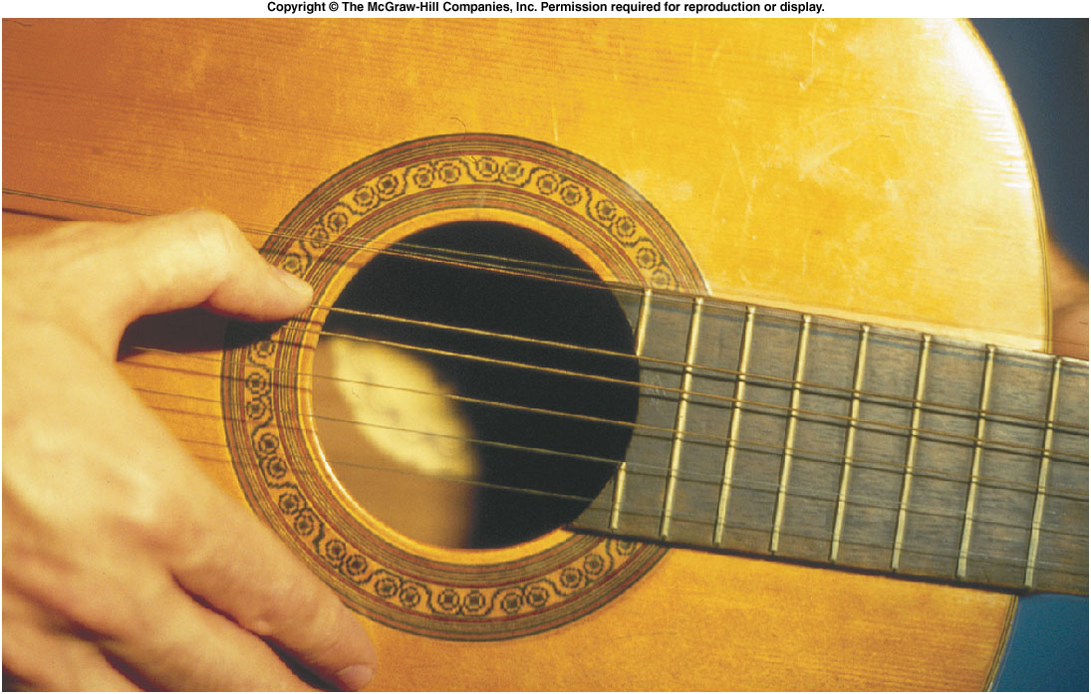
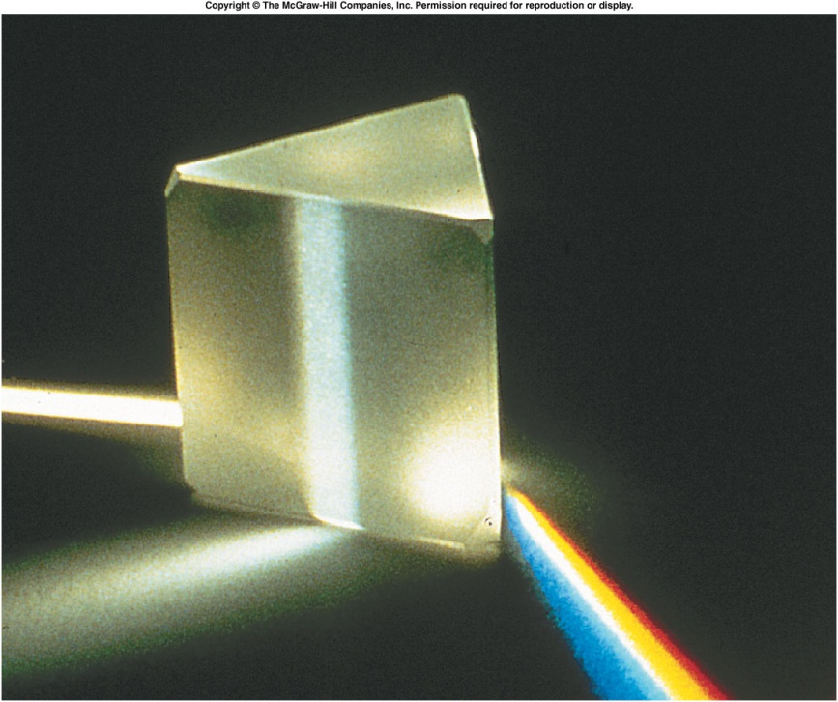
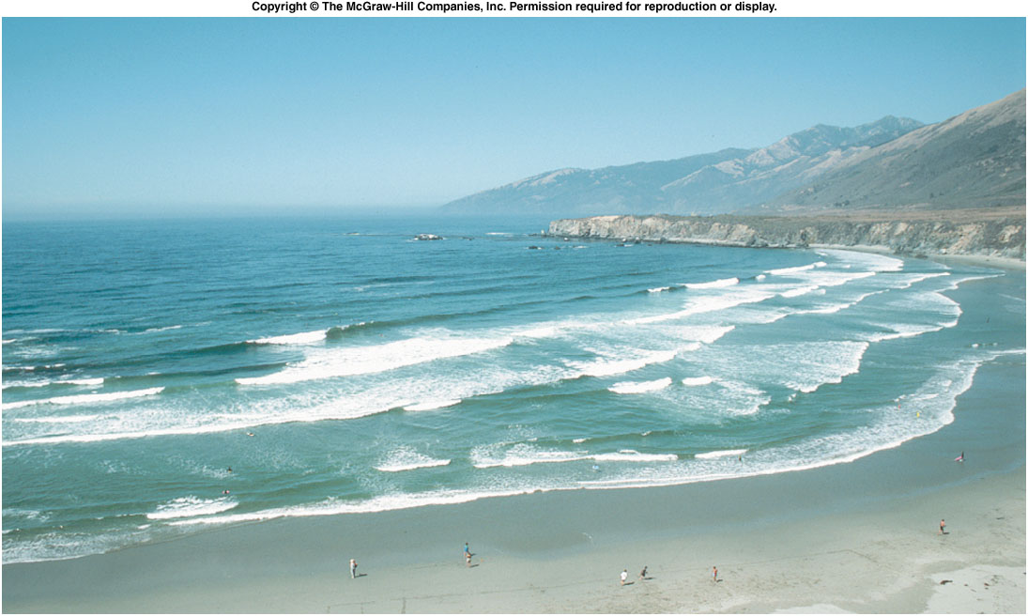
Sound
waves...
light
waves...
water
waves...

Slide 2
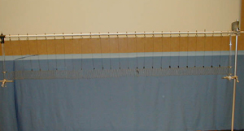
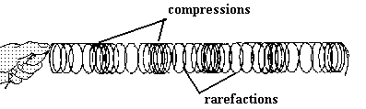
1S-13 Slinky on Stand
Creating longitudinal compression waves in a slinky
What happens when you pull back and release one end of the slinky ?

Slide 3
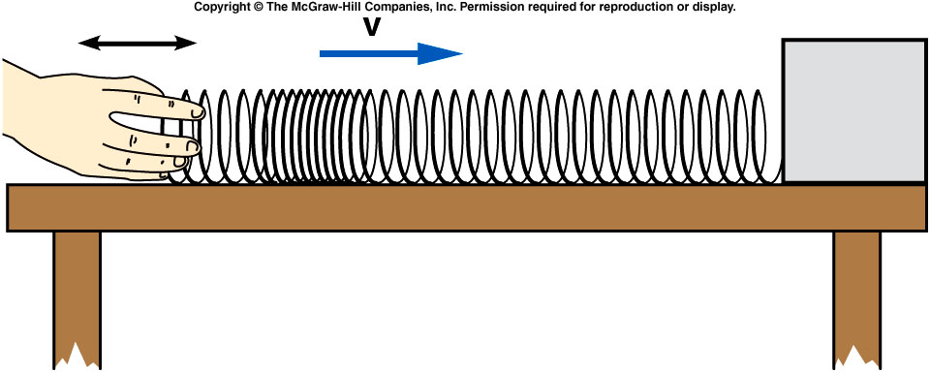
Moving one end of the Slinky back and forth created a local compression where the rings of the spring are closer together than in the rest of the Slinky.
The slinky tries to return to equilibrium. But inertia cause the links to pass beyond. This create a compression. Then the links comes back to the equilibrium point due to the restoration force, i.e. the elastic force.
The speed of the pulse may depend on factors such as tension in the Slinky and the mass of the Slinky.

Slide 4
Energy is transferred through the Slinky as the pulse travels.
  The work done in moving one end of the Slinky increases both the potential energy of the spring and the kinetic energy of individual loops.
  This region of higher energy then moves along the Slinky and reaches the opposite end.
  There, the energy could be used to ring a bell or perform other types of work.
Energy carried by water waves does substantial work over time in eroding and shaping a shoreline.

Slide 5
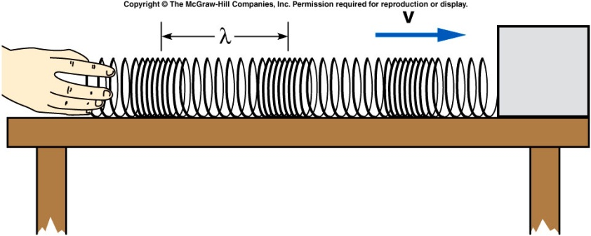
If instead of moving your hand back and forth just once, you continue to produce pulses, you will send a series of longitudinal pulses down the Slinky.
  If equal time intervals separate the pulses, you produce a periodic wave.
  The time between pulses is the period T of the wave.
  The number of pulses or cycles per unit of time is the frequency f = 1/T.
  The distance between the same points on successive pulses is the wavelength λ.
  A pulse travels a distance of one wavelength in a time of one period.
  The speed is then the wavelength divided by the period:

Slide 6
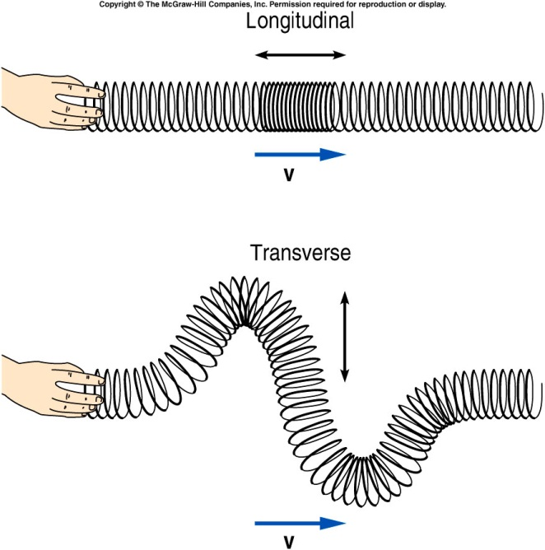
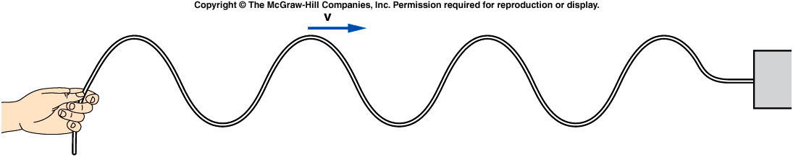
The pulse we have been discussing is a longitudinal wave: the displacement or disturbance in the medium is parallel to the direction of travel of the wave or pulse.
Sound waves are
longitudinal.

Slide 7

A longitudinal wave traveling on a Slinky has a period of 0.25 s and a wavelength of 30 cm. What is the speed of the wave?
0.25 cm/s
0.30 cm/s
1 cm/s
7.5 cm/s
120 cm/s

Slide 8
A longitudinal wave traveling on a Slinky has a period of 0.25 s and a wavelength of 30 cm. What is the frequency of the wave?
0.25 Hz
0.30 Hz
0.83 Hz
1.2 Hz
4 Hz

Slide 9
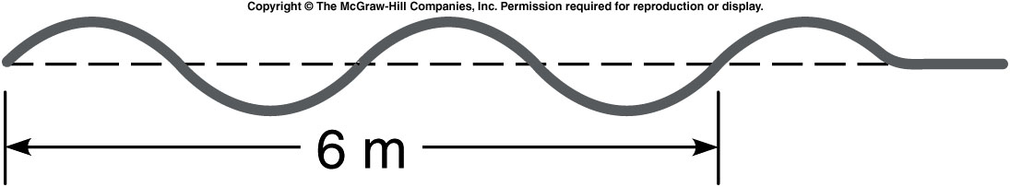
A wave on a rope is shown below. What is the wavelength of this wave?
a) 1/6 m b) 1 m c) 2 m d) 3 m e) 6 m
In 6 m, the wave goes through 2 complete cycles.
The wavelength (length of one complete cycle) is (6 m)/2 = 3 m.

Slide 10
If the frequency of the wave is 2 Hz, what is the wave speed?
a) 1/6 m/s b) 2/3 m/s c) 2 m/s d) 3 m/s e) 6 m/s

Slide 11
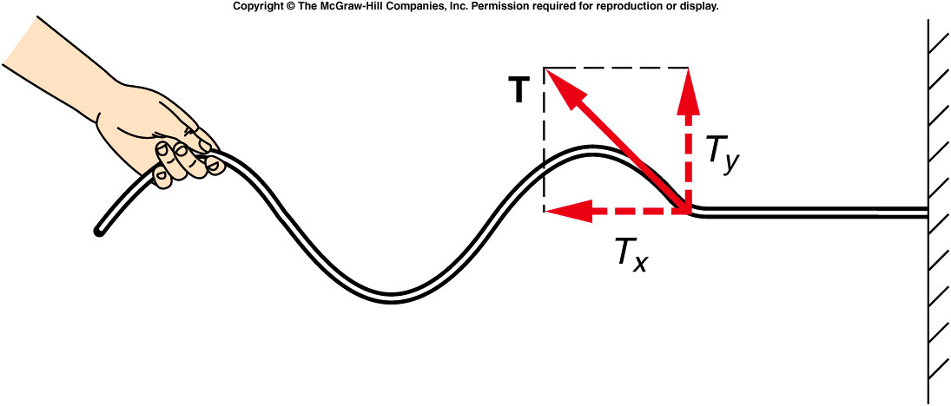
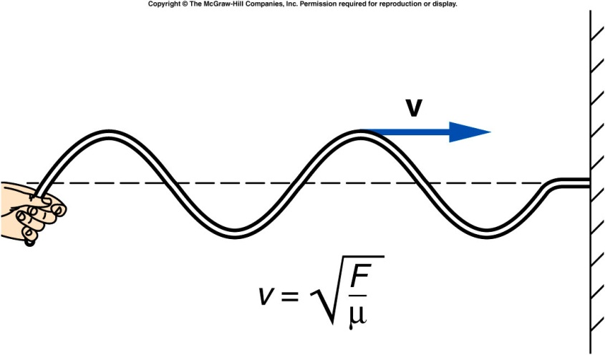
As the raised portion of a pulse approaches a given point on the rope, the tension in the rope acquires an upward component.
  The resulting upward force
  causes this next segment
  to accelerate upward, and
  so on down the rope.
The speed of the pulse
depends on how fast
succeeding segments
can be started moving
(accelerated).
By Newton’s second law, this is proportional to the force and inversely proportional to the mass of the segment:
A larger tension produces a larger acceleration.
The speed of the pulse will increase with the
tension and decrease with the mass per unit
length of the rope:

Slide 12
A rope has an overall length of 10 m and a total mass of 2 kg. The rope is stretched with a tension of 50 N. One end of the rope is fixed, and the other is moved up and down with a frequency of 4 Hz.
What is the speed of waves on this rope?
a) 5.0 m/s b) 7.07 m/s c) 15.8 m/s d) 50 m/s e) 250 m/s

Slide 13
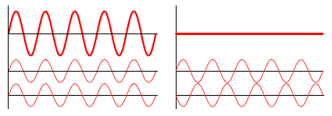
Principle of Superposition:
When two or more waves combine, the resulting disturbance or displacement is equal to the sum of the individual disturbances.
When the two waves are moving the same way at the same time, they are in phase.
  The resulting combined wave will be larger (have a greater height).
If one wave is moving
upward when the other
wave is moving downward,
the two waves are
completely out of phase
  If the two waves have the
  same height, the resulting
  combined displacement will
  be zero.
The result of adding two waves together depends on their phases as well as on their height or amplitude.
When waves are in phase, we have constructive interference.
When waves are out of phase, we have destructive interference.

Slide 14
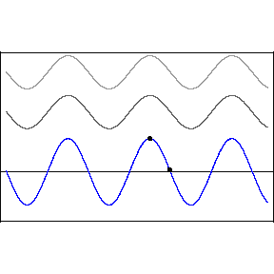
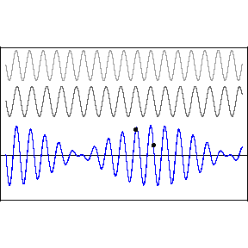

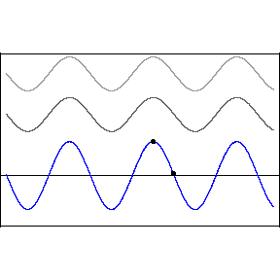
Examples of wave superposition

Slide 15
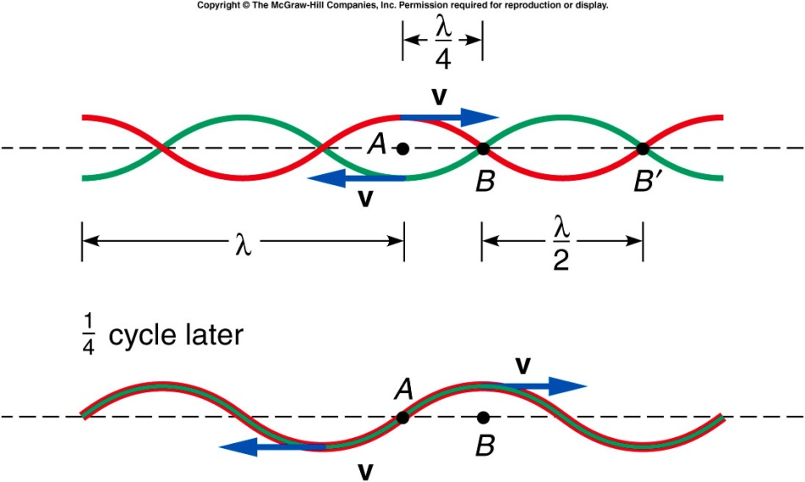
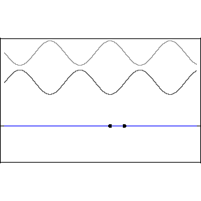
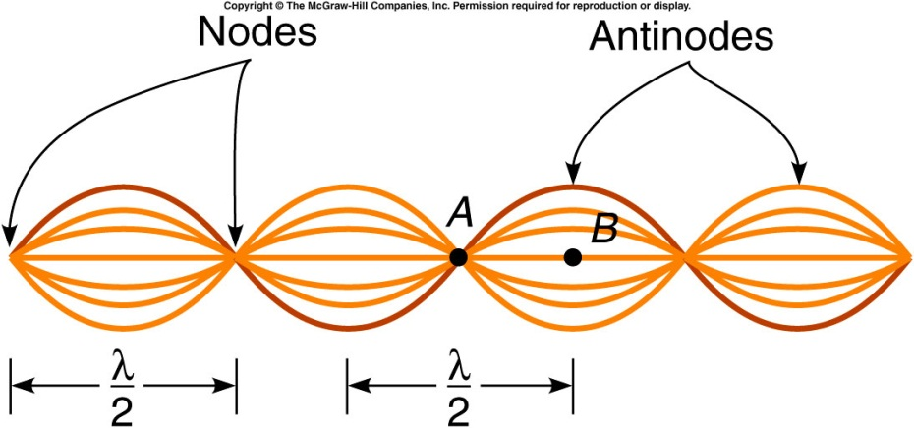

When two waves are traveling in opposite directions, such as when a wave is reflected back on itself, the principle of superposition can be applied at different points on the string.
  At point A, the two waves cancel each other at all times.
  At this point, the string will not oscillate at all; this is called a node.
At point B, both waves will be in phase at all times.
The two waves always add, producing a displacement twice that of each wave by itself.
This is called an antinode.

Slide 16
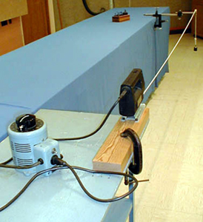
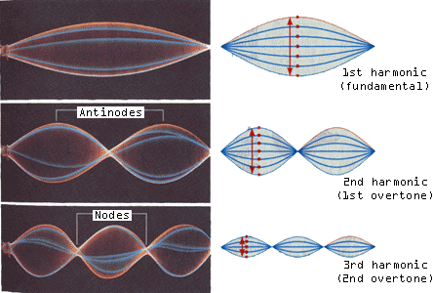
1S-41 Standing Waves in Rope
Creating transverse standing waves on heavy cable
How might we create different wave patterns on the cable ?
How is this related to tuning a guitar ?
BY ADJUSTING THE SPEED OF THE JIGSAW OR THE TENSION IN THE CORD, DIFFERENT STANDING WAVE PATTERNS CAN BE GENERATED BETWEEN THE FIXED ENDS. THOUGH THE WAVELENGTH OF THE STANDING WAVE IS FIXED BY THE LENGTH BETWEEN THE FIXED POINTS, THE FREQUENCY DEPENDS ON THE TENSION IN THE CABLE. YOU TUNE A GUITAR BY CHANGING THIS TENSION.

Slide 17
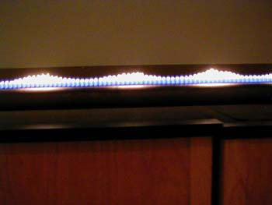
4B-01 Standing Waves in a Gas
What happens when an acoustic standing wave is introduced in the tube ?
Effects of acoustic standing wave on air pressure
The wave pattern indicates a pressure non-uniformity within the tube.

Slide 18
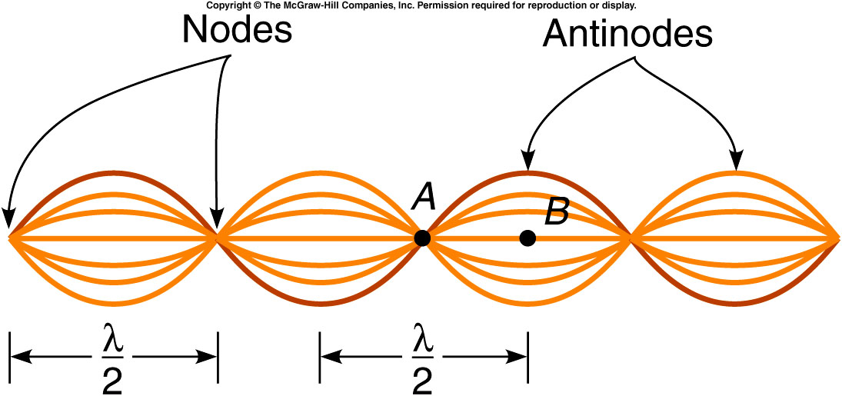
This pattern of oscillation is called a standing wave.
  The waves traveling in opposite directions interfere in a way that produces a standing or fixed pattern.
  The distance between adjacent nodes or adjacent antinodes is half the wavelength of the original waves.
  At the nodes, it is
  not moving at all.
  At points between
  the nodes and
  antinodes, the
  amplitude has
  intermediate
  values.

Slide 19
Quiz: A rope has an overall length of 10 m and a total mass of 2 kg. The rope is stretched with a tension of
50 N. One end of the rope is fixed, and the other is moved up and down with a frequency of 4 Hz.
What is the wavelength?
a) 0.20 m b) 3.95 m c) 10 m d) 15.8 m e) 25 m/s

Slide 20
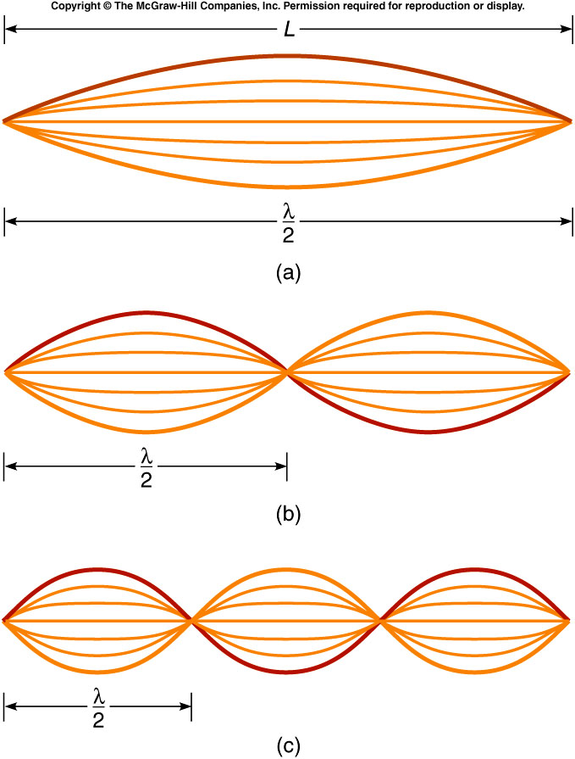
For a string fixed at both ends, the simplest standing wave,
the fundamental or first harmonic,
has nodes at both ends and an
antinode in the middle.
The second harmonic has a node
at the midpoint of the string, and
a wavelength equal to L.
The third harmonic has four nodes
(counting the ones at the ends) and
three antinodes, and a wavelength
equal to two-thirds L.

Slide 21
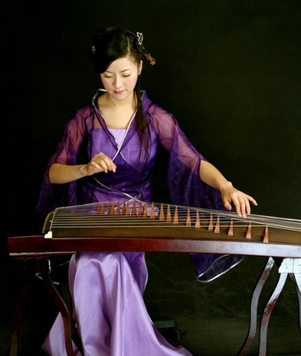
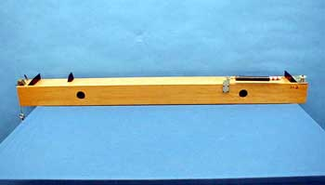
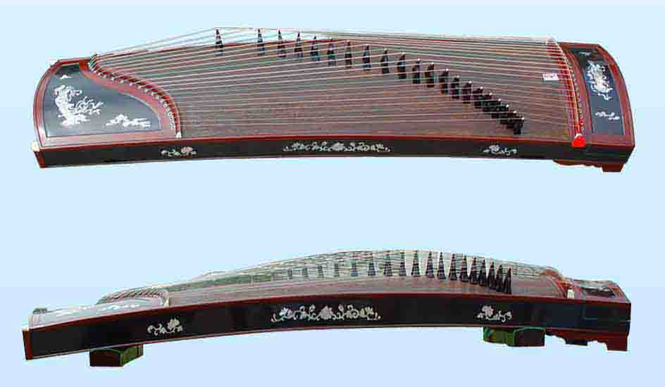
4B-10 MONOCHORD
What is the purpose of tightening or loosening the string ? What role do the frets play ?
Chinese Zither
Real Musical Instrument
CHANGING TENSION OF THE STRING AFFECTS THE SPEED OF WAVE PROPAGATION AND CHANGES THE FUNDAMENTAL FREQUENCY
THE BRIDGE ACTS AS A FRET THAT EFFECTIVELY CHANGES THE LENGTH OF THE WIRE AND THE FUNDAMENTAL FREQUENCY

Slide 22
A guitar string has a mass of 4 g, a length of 74 cm, and a tension of 400 N. These values produce a wave speed of 274 m/s.
What is its fundamental frequency?
1.85 Hz
3.70 Hz
185 Hz
274 Hz
370 Hz

Slide 23
A guitar string has a mass of 4 g, a length of 74 cm, and a tension of 400 N. These values produce a wave speed of 274 m/s.
What is the frequency of the second harmonic?
92.5 Hz
123 Hz
185 Hz
370 Hz
740 Hz

Slide 24
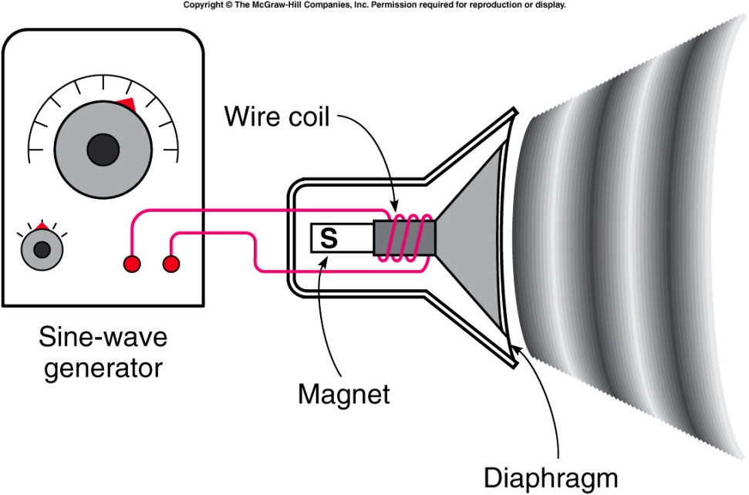
Sound Waves
A sound wave consists of pressure variations in air.
  The diaphragm of a speaker oscillates back and forth, producing regions of higher pressure and lower pressure.
  These regions propagate through the air as variations in air pressure and density, forming a longitudinal sound wave.
  In room temperature air, sound waves travel with a speed of 340 m/s or 750 MPH.
  Sound waves can also travel through liquids and solids, often with higher speeds.

Slide 25
Interference phenomena such as standing waves can be observed in sound waves.
  Many musical instruments produce standing waves in a tube or pipe.
  If the tube is closed at one end, such as a bottle, there is a displacement node at the closed end.
  At the open end, there is a displacement antinode.
The frequency of the standing wave can be found from the
speed of sound in air and the wavelength:
where the wavelength is determined by the length of the tube.

Slide 26
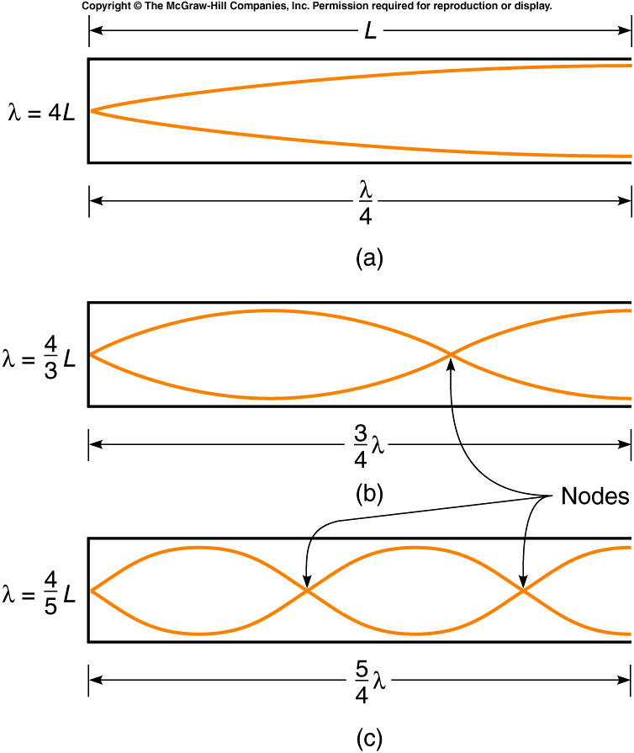
The standing-wave patterns for the first three harmonics for a tube open at one end and closed at the other are represented as follows:
The first harmonic or fundamental has a wavelength four times longer than the length of the tube.
The wavelength of the second harmonic is equal to four-thirds of the length of the tube.
The wavelength of the third harmonic is equal to four-fifths of the length of the tube.
etc.

Slide 27
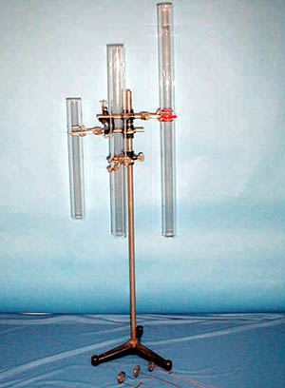


4B-13 Hoot Tubes (Resonance in Pipes)
Creating acoustic resonances in glass tubes with hot air
If the same heated grid is used, why do the different tubes give off different sounds ?
L’
L
Why does horizontal tube not emit sound ?
1st Harmonic: λ = 4L , f = v/λ
Length of tube determines resonant frequency
THE HOT AIR FROM THE HEATED GRID GENERATES A DISTURBANCE THAT CAN BE THOUGHT OF AS “NOISE.”
THE RESONANT FREQUENCY OF THE PARTICULAR TUBE DETERMINES WHICH COMPONENTS OF THIS NOISE ARE AMPLIFIED.
Notes:
rotate the tube to a horizontal position. Or vertical position
The details of the mechanism producing the sound here are quite complicated. Just tell the students that the turbulence set up in the hot air passing through the grid generates a disturbance that can be thought of as “noise.”

Slide 28
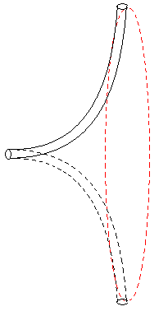
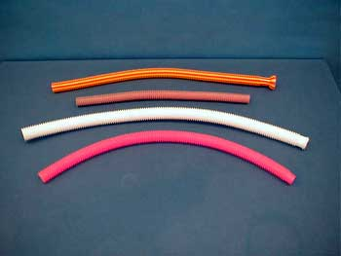
4B-14 Whirly Tubes
Forcing air thru a tube to create acoustic resonances
Why do different tubes give off different sounds ? How can we increase the pitch emitted from any one whirly tube ?
AIR FLOWS UP THE TUBE DUE TO THE “CENTRIFUGAL” EFFECT FROM ROTATION. THE SOUND RESULTS FROM THE AIR PASSING OVER THE CORRUGATIONS IN THE TUBE. FASTER WHIRLING RESULTS IN HIGHER FREQUENCY OF SOUND (HIGHER PITCH).

Slide 29
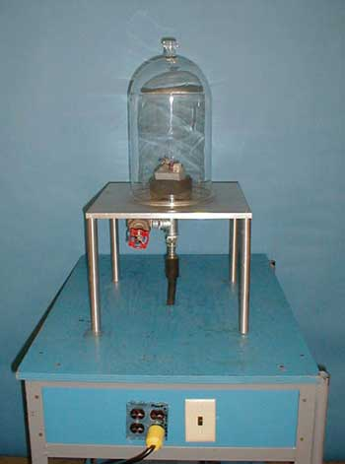
4A-03 Sound Production in Bell Jar
Investigating the medium through which sound waves propagate
Where does the sound go when the bell jar is evacuated ?
We know waves carry energy and can do work, so what happens to the energy emitted by the tone generator ?
AIR MOLECULES PROVIDE THE MEDIUM THROUGH WHICH ACOUSTIC WAVES PROPAGATE. WHEN THAT MEDIUM IS NOT PRESENT, SOUND CANNOT PROPAGATE.

Slide 30
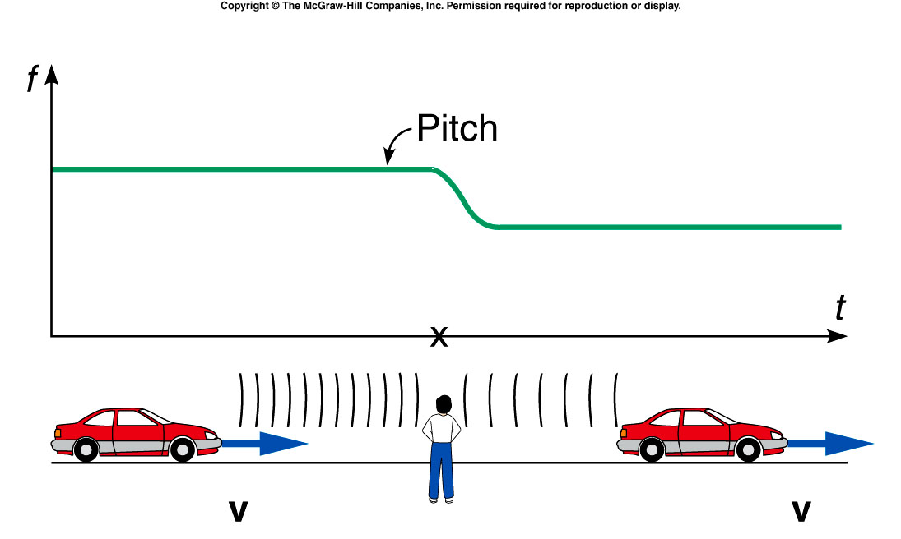
The Doppler Effect
A moving source of sound, such as a car horn, seems to change pitch depending on its motion relative to the listener.
As a car passes a stationary observer, the horn’s pitch changes from a higher pitch to a lower pitch.

Slide 31
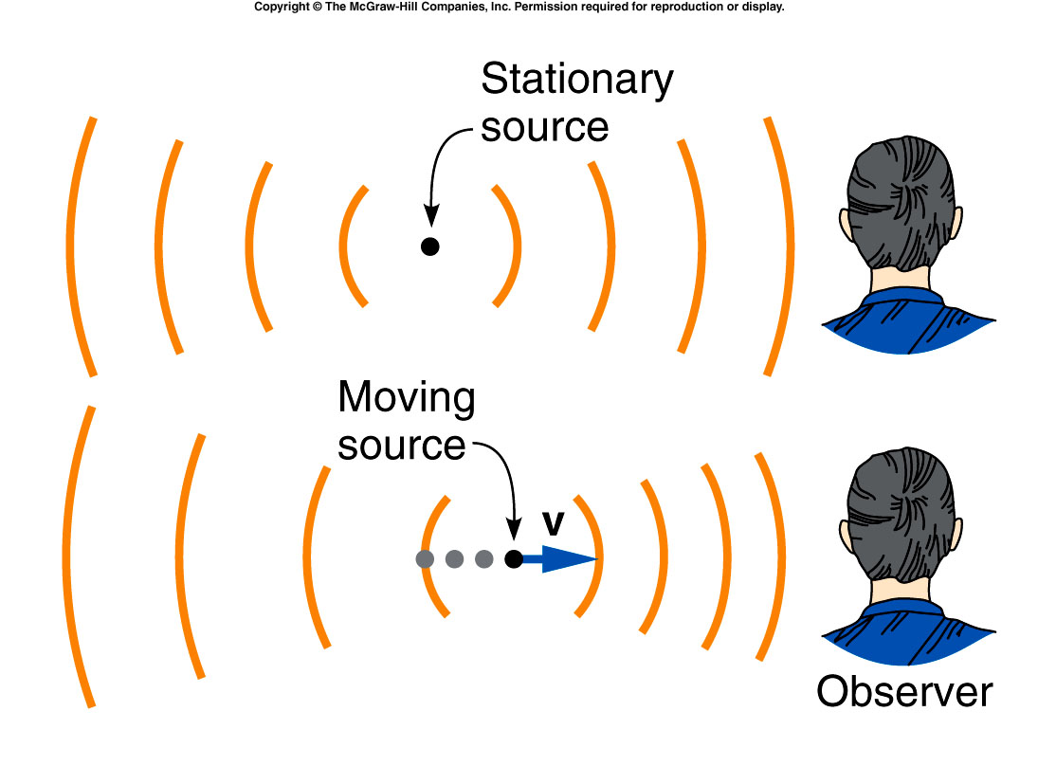
The Doppler Effect
Comparing the wavefronts for a stationary car horn and for a moving car horn illustrates why the pitch changes.
When the car is approaching the observer, the wavefronts reaching the observer are closer together.
When the car is moving away from the observer, the wavefronts reaching the observer are farther apart.

Slide 32
The Doppler Effect
http://www.physics.purdue.edu/class/applets/phe/dopplereff.htm

Slide 33
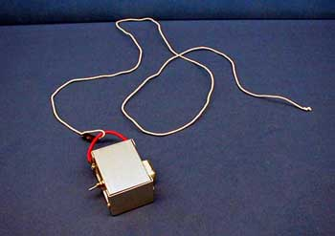
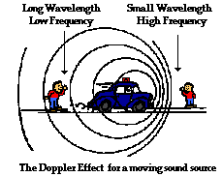
4C-01 Doppler Effect
Investigating change in sound due to the Doppler effect
At what point in circular movement does sound change ? What is relative motion between source and listener at these points ?
WHEN THE SOURCE MOVES TOWARD (AWAY FROM) LISTENER, THE FREQUENCY OF SOUND, OR PITCH, INCREASES (DECREASES).

Slide 34
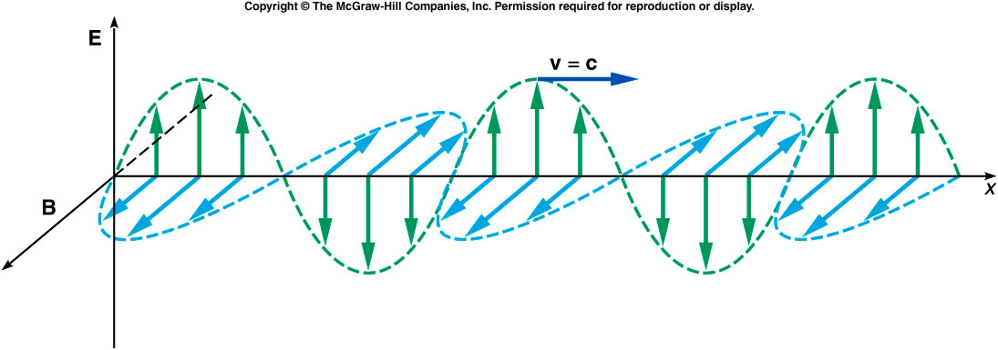
Electromagnetic Waves
An electromagnetic wave consists of time-varying electric and magnetic fields, in directions perpendicular to each other as well as to the direction the wave is traveling.

Slide 35
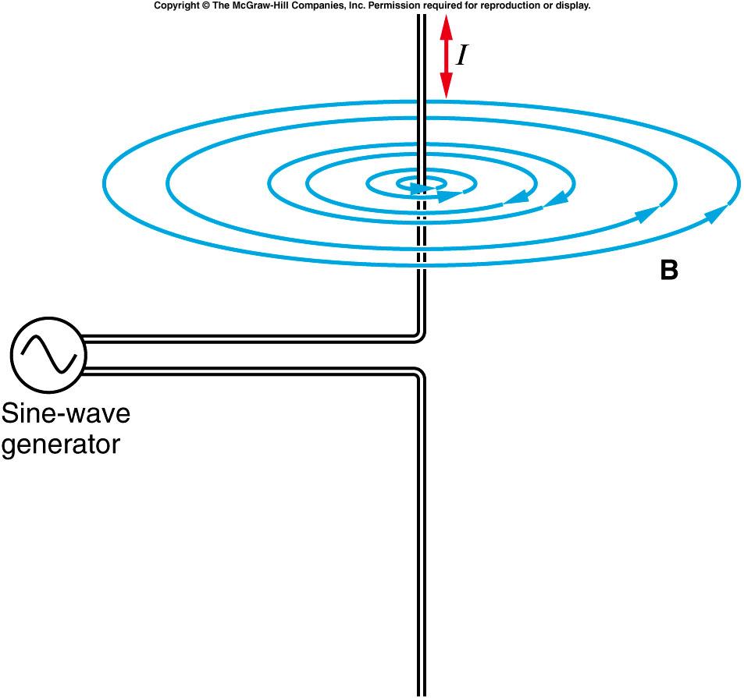
The electric and the magnetic fields can be produced by charged particles.
  An electric field surrounds any charged particle.
  A magnetic field surrounds moving charged particles.
A rapidly alternating electric current in a wire generates magnetic fields whose direction and magnitude change with time.
This changing magnetic field in turn produces a changing electric field.

Slide 36
Likewise, a changing electric field produces a magnetic field.
Maxwell realized a wave involving these fields could propagate through space:
  A changing magnetic field produces a changing electric field, which produces a changing magnetic field, etc...
  Thus a transverse wave of associated changing electric and magnetic fields is produced.

Slide 37
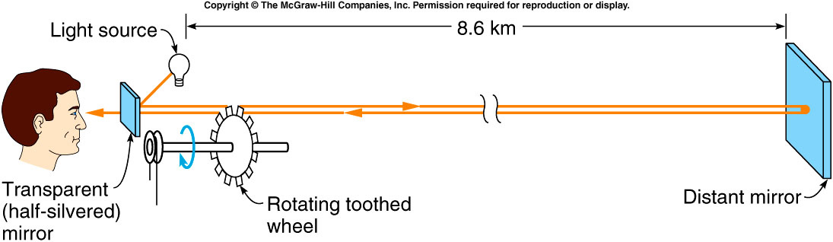
Maxwell predicted the speed of electromagnetic waves in a vacuum using the Coulomb constant k in Coulomb’s law and the magnetic force constant k′ in Ampere’s law:
This was equal to the known value for the speed of light!
Fizeau’s wheel for measuring the speed of light

Slide 38
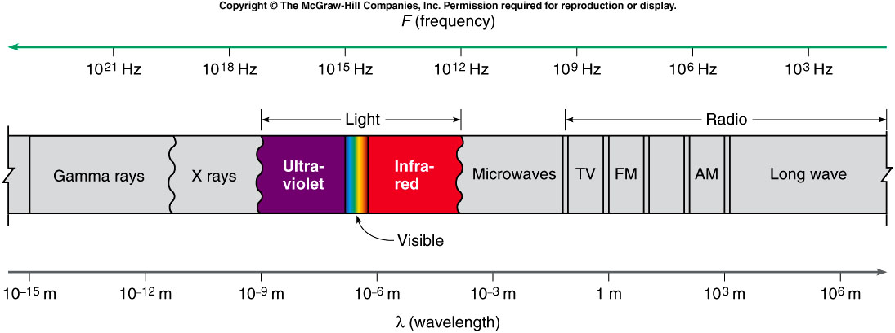
There is a wide spectrum of frequencies and wavelengths of electromagnetic waves.
  Different types of electromagnetic waves have different wavelengths and frequencies.
  Together they form the electromagnetic spectrum.

Slide 39
There is a wide spectrum of frequencies and wavelengths of electromagnetic waves.
  Since they all travel at the speed of light c in a vacuum, their frequencies and wavelengths are related by: v = c = f λ

Slide 40
What is the frequency of radio waves with a wavelength of 10 m?
1 x 10⁷ Hz
3 x 10⁷ Hz
2 x 10⁷ Hz
5 x 10⁷ Hz
7 x 10⁷ Hz
λ = 10 m f = v / λ
v = c = 3 x 10⁸ m/s = (3 x 10⁸ m/s) / 10 m
v = f λ = 3 x 10⁷ Hz

Slide 41
  Waves in different parts of the electromagnetic spectrum differ not only in wavelength and frequency but also in how they are generated and what materials they will travel through.
    Radio waves are generated by accelerated charges in an oscillating electrical circuit.
    X rays come from energy transitions of atomic electrons.
    Gamma rays originate inside an atomic nucleus.

Slide 42
  Waves in different parts of the electromagnetic spectrum differ not only in wavelength and frequency but also in how they are generated and what materials they will travel through.
    Infrared light is radiated by all warm bodies.
    Oscillating atoms within the molecules of the warm body serve as the antennas.

Slide 43
  Waves in different parts of the electromagnetic spectrum differ not only in wavelength and frequency but also in how they are generated and what materials they will travel through.
    X rays will pass through materials that are opaque to visible light.
    Radio waves will pass through walls that light cannot penetrate.

Slide 44
  Different wavelengths of visible light are associated with different colors.
    Violet is about 3.8 x 10⁻⁷ m.
    Wavelengths shorter than the violet comprise ultraviolet light.
    Red is about 7.5 x 10⁻⁷ m.
    Wavelengths longer than the red comprise infrared light.
    In between, the colors are red, orange, yellow, green, blue, indigo, and violet.

Slide 45
Wavelength and Color
How do we perceive ?
What causes different objects to have
?
Why is the sky ?
color
different colors
BLUE

Slide 46
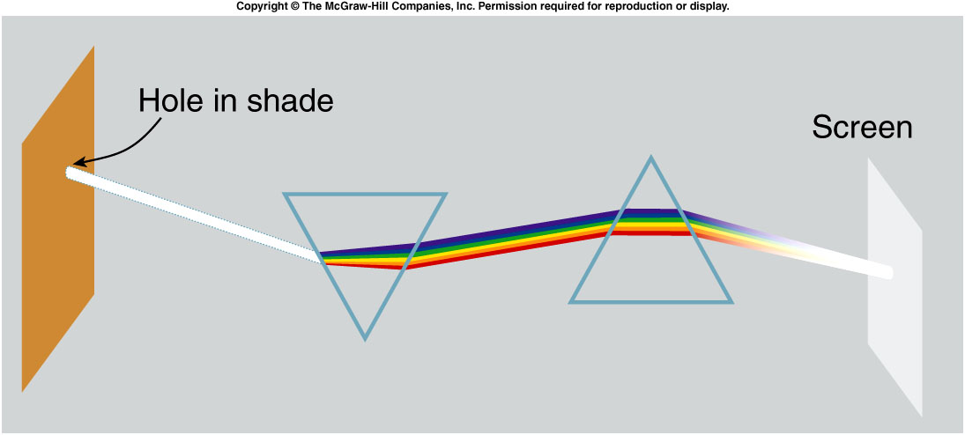
Newton demonstrated that white light is a mixture of colors.
  He showed that white light from the sun, after being split into different colors by one prism, can be recombined by a second prism to form white light again.

Slide 47
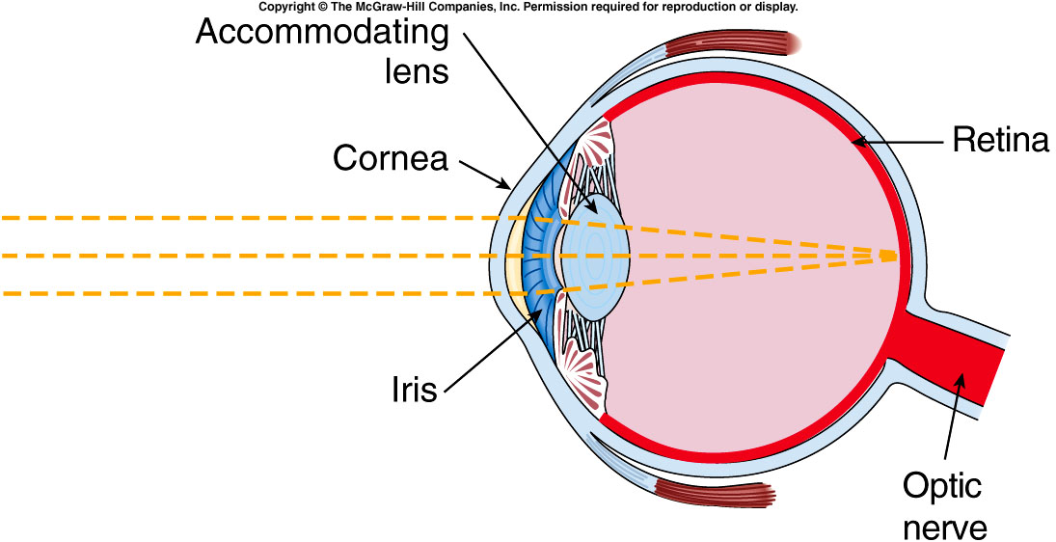
How do our eyes distinguish color?
  Light is focused by the cornea and lens onto the retina.
  The retina is made up of light-sensitive cells called rods and cones.
  Three types of cones are sensitive to light in different parts of the spectrum.

Slide 48
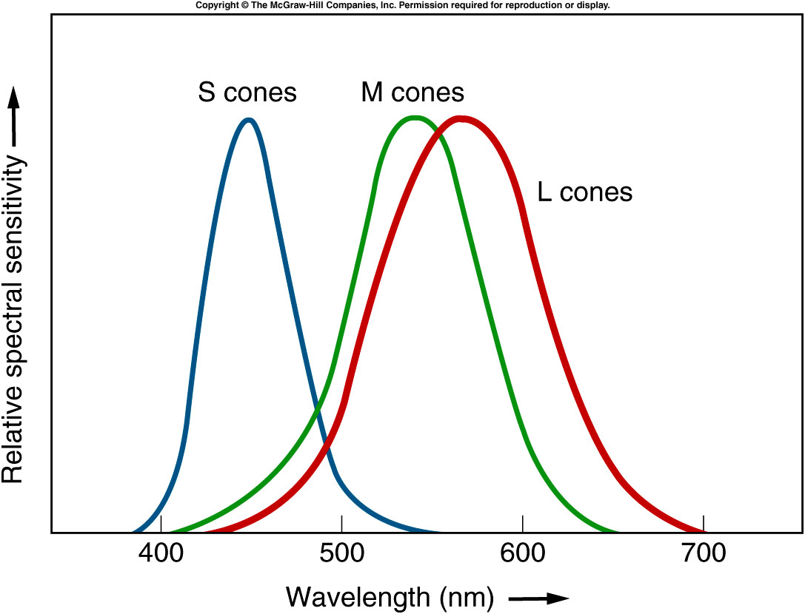
  S cones are most sensitive to shorter wavelengths.
  M cones are most sensitive to medium wavelengths.
  L cones are most sensitive to longer wavelengths.
  The sensitivity ranges overlap, so that light near the middle of the visible spectrum will stimulate all three cone types.
Light of 650 nm wavelength stimulates L cones strongest and S cones weakest;
the brain identifies the color red.

Slide 49
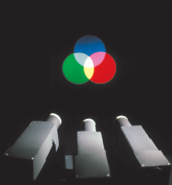
Color Mixing
The process of mixing two different wavelengths of light, such as red and green, to produce a response interpreted as another color, such as yellow, is additive color mixing.
  Combining the three primary colors blue, green, and red in different amounts can produce responses in our brains corresponding to all the colors we are used to identifying.
  Red and green make yellow, blue and green make cyan, and blue and red make magenta.
  Combining all three colors produces white.

Slide 50
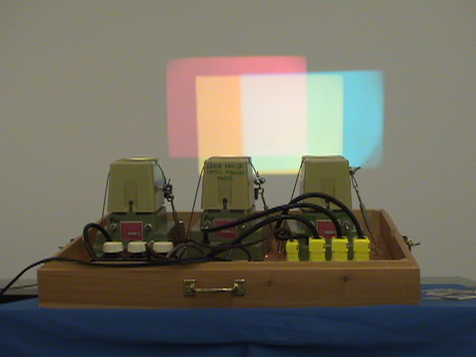
7C-01: Color by Addition

Slide 51
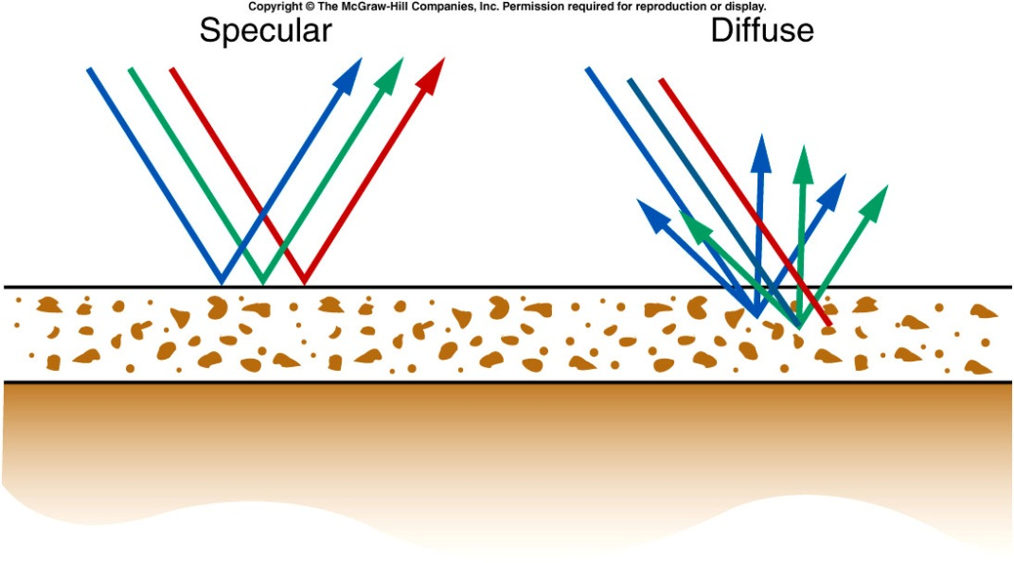
Color Mixing
The pigments used in paints or dyes work by selective color mixing.
  They absorb some wavelengths of light more than others.
When light strikes an object, some of the light undergoes specular reflection: all the light is reflected as if by a mirror.
The rest of the light undergoes diffuse reflection: it is reflected in all directions.
Some of the light may be selectively absorbed, affecting the color we see.
  If red light is absorbed, we see blue-green.

Slide 52
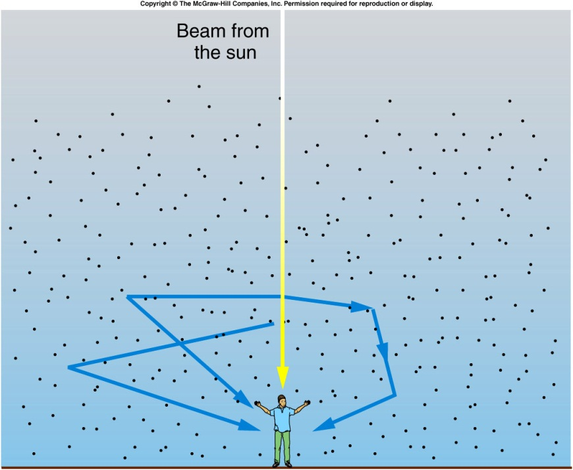
Why is the sky blue?
The white light coming from the sun is actually a mixture of light of different wavelengths (colors).
The shorter wavelengths of blue light are scattered by gas molecules in the atmosphere more than longer wavelengths such as red light.
The blue light enters our eyes after being scattered multiple times, so appears to come from all parts of the sky.

Slide 53
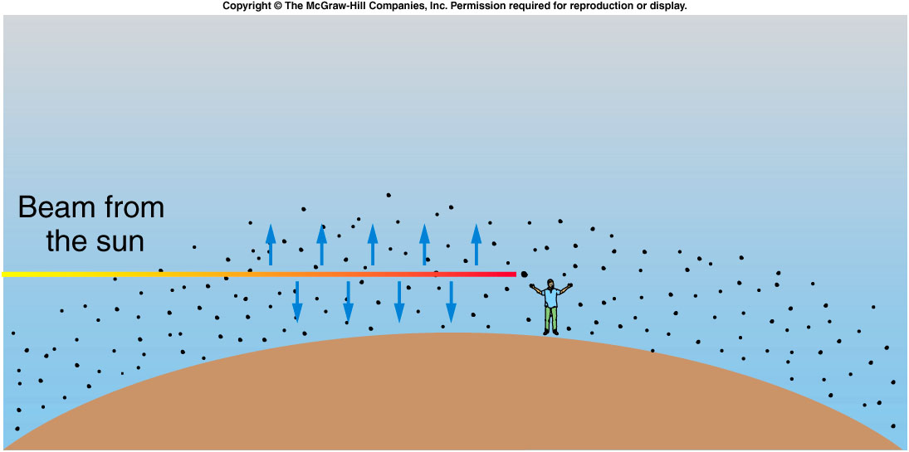
Why is the sunset red?
The shorter wavelengths of blue light are scattered by gas molecules in the atmosphere more than longer wavelengths such as red light.
When the sun is low on the horizon, the light must pass through more atmosphere than when the sun is directly above.
By the time the sun’s light reaches our eyes, the shorter wavelengths such as blue and yellow have been removed by scattering, leaving only orange and red light coming straight from the sun.

Slide 54
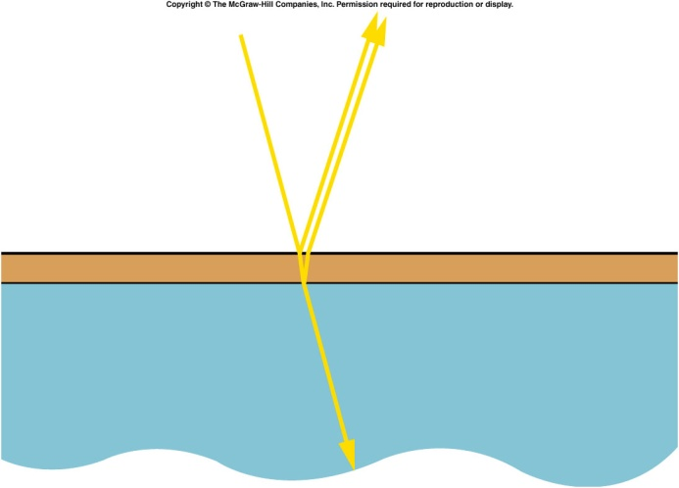


Thin film interference
Thin film interference occurs when light is reflected from the top surface and the underneath surface.
This provides the two beams of coherent light that interfere.
Since we normally observe this with white light we see colors because the path difference varies depending on the angle of observation
So different wavelengths (colors) have constructive and destructive interference at different places on the film.

Slide 55


7B-11 Color in Thin Films
Studying thin-film interference effects
Why are the effects on white light and monochromatic light different ?
What kind of patterns appear on the screen ?
LIGHT REFLECTED FROM THE FRONT AND THE BACK OF A THIN SOAP FILM INTERFERES WITH ITSELF. INTERFERENCE OF MONOCHROMATIC LIGHT PRODUCES BRIGHT AND DARK FRINGES WHILE INTERFERENCE OF WHITE LIGHT PRODUCES COLORED BANDS (DIFFERENT FREQUENCIES OF LIGHT INTERFERE DIFFERENTLY).
Notes:
After the next slide, use the same setup for single slit diffraction.

Slide 56

Coatings for lenses
As light passes from one transparent medium to another a few percent of the light will be reflected.
This is a particular problem in optical systems like lenses where there may be many glass elements.
For example if 96% of the light is transmitted at a surface after 8 surfaces only 72% of the light remains and the other 28% will be scattered everywhere.
Thin coatings are put on glass surfaces so that for particular wavelengths the light reflected from the top surface is exactly cancelled by the light from the bottom surface.
This is only true for a single wavelength and to reduce the reflections for a range of wavelengths requires multiple thin film layers very often just λ/4 thick.
This is why camera lenses usually have a blue green color. Often binocular lenses are ruby red.

Slide 57


Diffraction
Interference occurs even for a single aperture and this is called diffraction. The pattern shown is from a square aperture and the pattern can be thought of as light from different parts of the aperture interfering.
As the aperture is made smaller the pattern actually expands.
This effect can limit our ability to see detail in small objects or to resolve two stars nearby to one another.
The position of the first dark fringe is given by y = λx/w. This means the central bright fringe has a width ~ 2y and increases as w gets smaller
That’s why the telescope with bigger aperture see clearer.

Slide 58
Is it possible for an electromagnetic wave to travel through a vacuum?
A. Yes.
B. No.
Waves are traveling in an eastward direction on a lake. Is the water in the lake necessarily moving in that direction?
Yes.
No.
Notes:
Water moves up and down.

Slide 59
A wave can be propagated on a blanket by holding adjacent corners in your hands and moving the end of the blanket up and down. Is this wave transverse or longitudinal?
Longitudinal
Tranverse.
Suppose that we increase the tension in a rope, keeping the frequency of oscillation of the end of the rope the same. What effect does this have on the wavelength of the wave produced?
an increase in velocity
an increase in frequency.
a decrease in wavelength.

Slide 60
A band playing on a flat-bed truck is approaching you rapidly near the end of a parade. Will you hear the same pitch for the various instruments as someone down the street who has already been passed by the truck?
A. The pitch increases as the band approaches and decreases as it is going away
B. The pitch decreases as the band approaches and increases as it is going away
C. The pitch remain unchanged.

Slide 61
Quiz: What is the frequency of light waves with a wavelength of 6 x 10⁻⁷ m?
1 x 10¹⁴ Hz
3 x 10¹⁵ Hz
2 x 10¹² Hz
5 x 10¹⁴ Hz
7 x 10⁷ Hz
λ = 6 x 10⁻⁷ m f = v / λ
v = c = 3 x 10⁸ m/s = (3 x 10⁸ m/s) / 6 x 10⁻⁷ m
v = f λ = 5 x 10¹⁴ Hz

