Slide 1
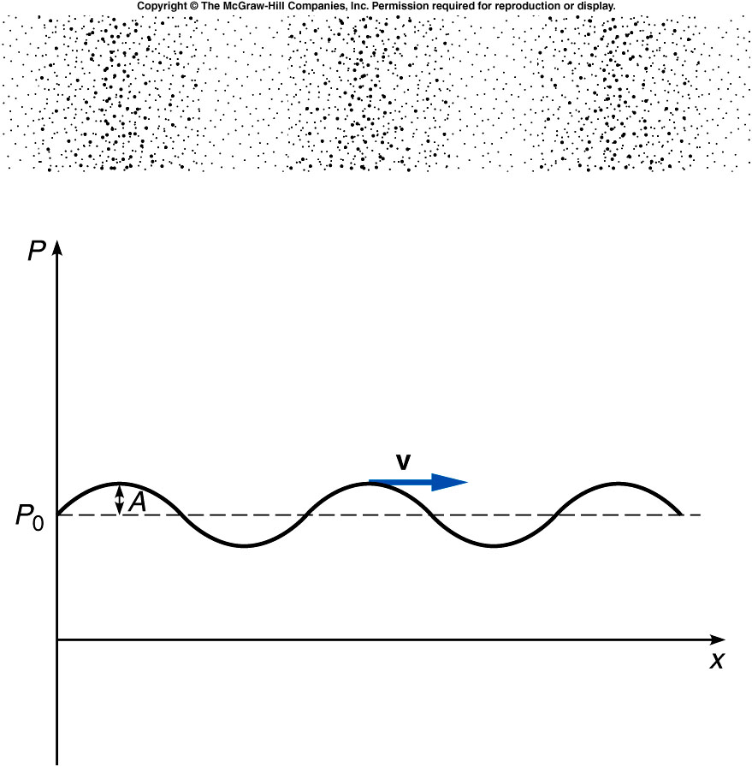
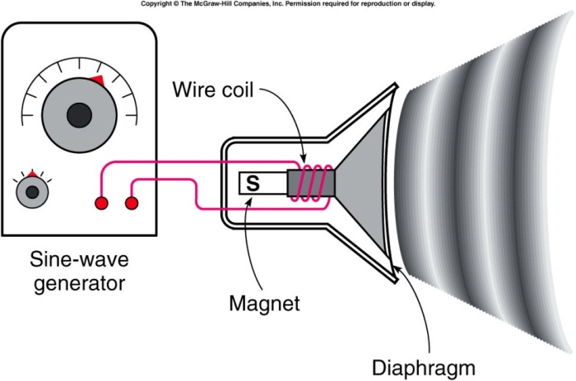
Sound Waves
A sound wave consists of pressure variations in air.
  The diaphragm of a speaker oscillates back and forth, producing regions of higher pressure and lower pressure.
  These regions propagate through the air as variations in air pressure and density, forming a longitudinal sound wave.
  In room temperature air, sound waves travel with a speed of 340 m/s or 750 MPH.
  Sound waves can also travel through liquids and solids, often with higher speeds.
Notes:
Compare the sound wave with the slinky. The front of the speaker push the air as I push the slinky. A longitudinal wave forms.

Slide 2
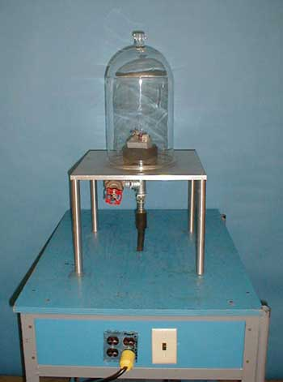
4A-03 Sound Production in Bell Jar
Investigating the medium through which sound waves propagate
Quiz:
Can sound travel in vacuum?
A: yes
B: No

Slide 3
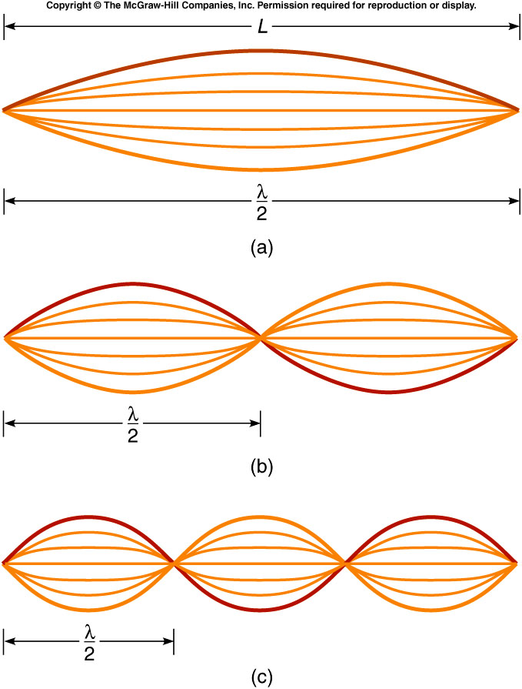
For a string fixed at both ends, the simplest standing wave,
the fundamental or first harmonic,
has nodes at both ends and an
antinode in the middle.
The second harmonic has a node
at the midpoint of the string, and
a wavelength equal to L.
The third harmonic has four nodes
(counting the ones at the ends) and
three antinodes, and a wavelength
equal to two-thirds L.
Notes:
Mention keeping the string tension fixed so that the wave speed is constant. Then change the frequency will change the wave length, e.g. The lower frequency produce a larger wave length.

Slide 4
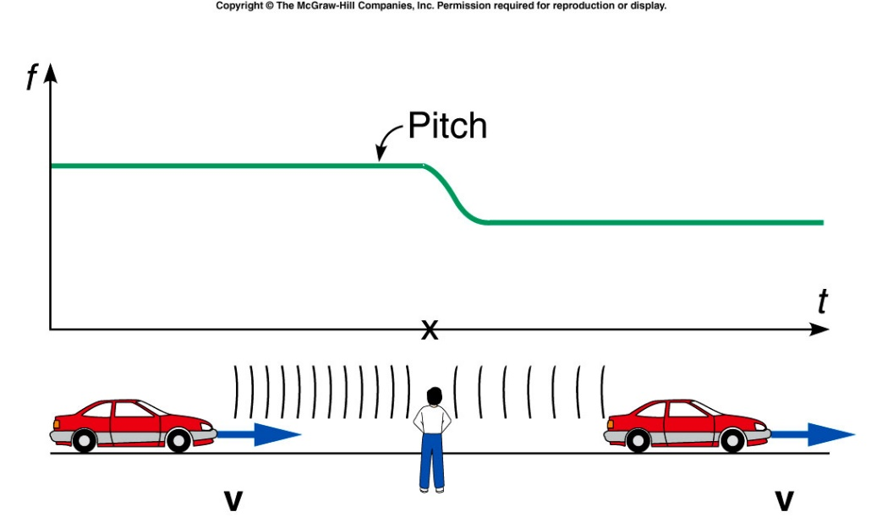
The Doppler Effect
A moving source of sound, such as a car horn, seems to change pitch depending on its motion relative to the listener.
As a car passes a stationary observer, the horn’s pitch changes from a higher pitch to a lower pitch.
https://www.youtube.com/watch?v=6lb1P3CKC_w

Slide 5
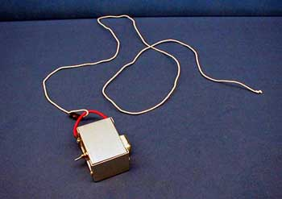
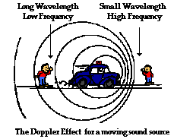
4C-01 Doppler Effect
Investigating change in sound due to the Doppler effect
At what point in circular movement does sound change ? What is relative motion between source and listener at these points ?
WHEN THE SOURCE MOVES TOWARD (AWAY FROM) LISTENER, THE FREQUENCY OF SOUND, OR PITCH, INCREASES (DECREASES).
Notes:
A loud tone generator is attached to a long cord and whirled in a near-horizontal circle

Slide 6
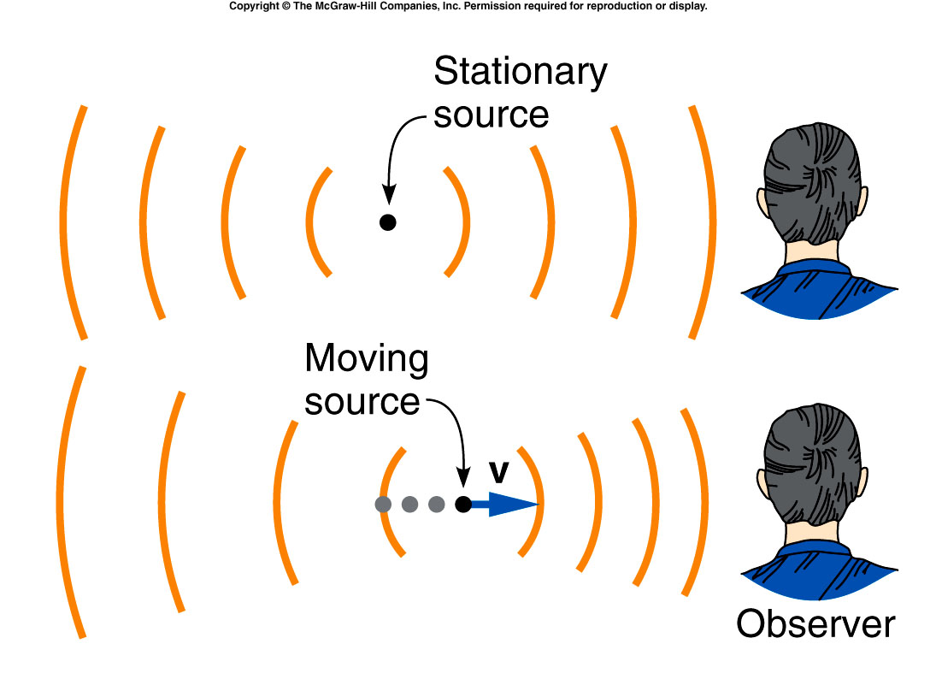
The Doppler Effect
Comparing the wavefronts for a stationary car horn and for a moving car horn illustrates why the pitch changes.
When the car is approaching the observer, the wavefronts reaching the observer are closer together.
When the car is moving away from the observer, the wavefronts reaching the observer are farther apart.
http://www.physics.purdue.edu/class/applets/phe/dopplereff.htm

Slide 7
Shock wave
When object move fast than the speed of sound, it produce shockwave
from explosion
  https://www.youtube.com/watch?v=EZHDUFucc-g
  From Chelyabinsk meteor 2013
  https://www.youtube.com/watch?v=tq02C_3FvFo
Notes:
20 m (66 ft) near-Earth asteroid with a speed of 19.16 ± 0.15 kilometres per second (60,000^{[5]}–69,000 km/h or 40,000^{[5]}–42,900 mph). 400–500 kilotons of TNT

Slide 8
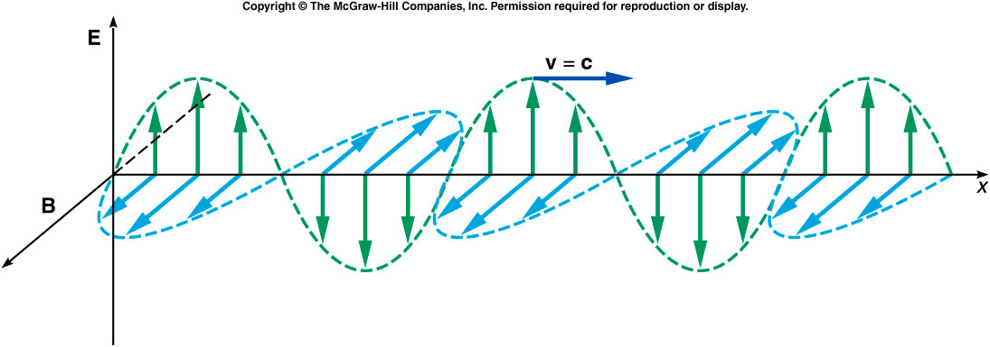
Electromagnetic Waves
An electromagnetic wave consists of time-varying electric and magnetic fields, in directions perpendicular to each other as well as to the direction the wave is traveling.

Slide 9
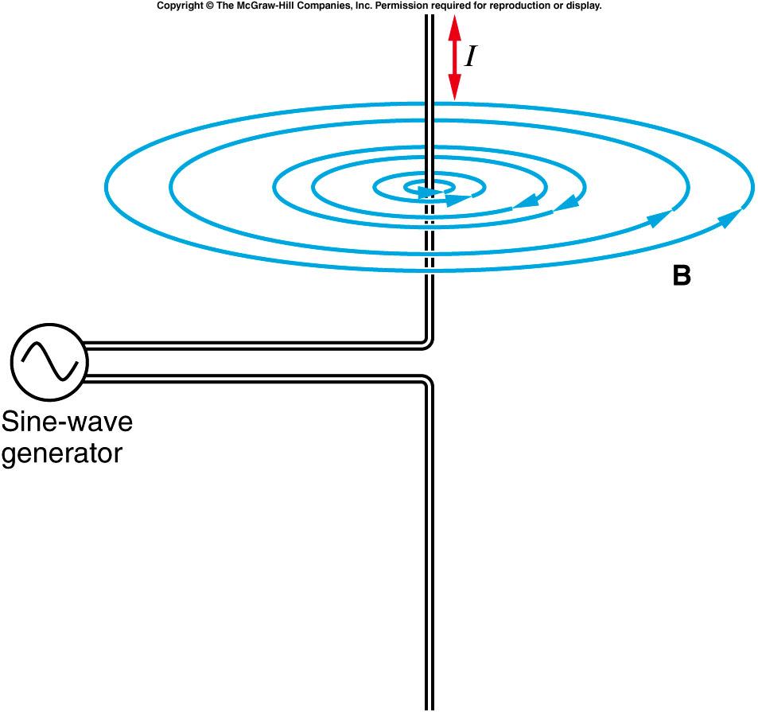
The electric and the magnetic fields can be produced by charged particles.
  An electric field surrounds any charged particle.
  A magnetic field surrounds moving charged particles.
A rapidly alternating electric current in a wire generates magnetic fields whose direction and magnitude change with time.
This changing magnetic field in turn produces a changing electric field.
Likewise, a changing electric field produces a magnetic field, etc
Thus a transverse wave of associated changing electric and magnetic fields is produced
Notes:
A constant current produce a static magnetic field. A changing current produce a changing magnetic field.

Slide 10
4A-03 Sound Production in Bell Jar
Investigating the medium through which sound waves propagate
Quiz:
Can Light travel in vacuum?
A: yes
B: No
Notes:
10 points for all students

Slide 11
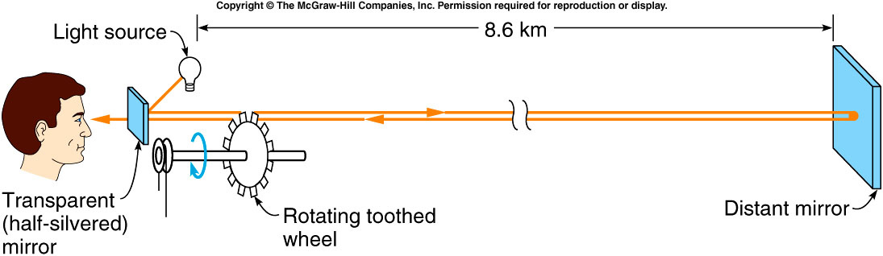
Maxwell predicted the speed of electromagnetic waves in a vacuum using the Coulomb constant k in Coulomb’s law and the magnetic force constant k′ in Ampere’s law:
This was equal to the known value for the speed of light!
Fizeau’s wheel for measuring the speed of light

Slide 12
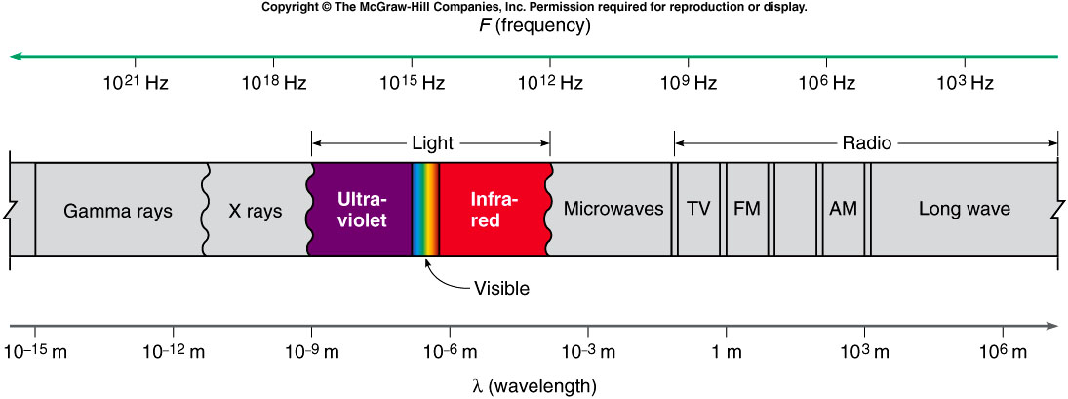
There is a wide spectrum of frequencies and wavelengths of electromagnetic waves.
  Different types of electromagnetic waves have different wavelengths and frequencies.
  Together they form the electromagnetic spectrum.

Slide 13
There is a wide spectrum of frequencies and wavelengths of electromagnetic waves.
  Since they all travel at the speed of light c in a vacuum, their frequencies and wavelengths are related by: v = c = f λ

Slide 14
What is the frequency of radio waves with a wavelength of 10 m in vaccum?
1 x 10⁷ Hz
3 x 10⁷ Hz
2 x 10⁷ Hz
5 x 10⁷ Hz
7 x 10⁷ Hz
λ = 10 m f = v / λ
v = c = 3 x 10⁸ m/s = (3 x 10⁸ m/s) / 10 m
v = f λ = 3 x 10⁷ Hz

Slide 15
    Radio waves can be generated by accelerated charges in an oscillating electrical circuit.
    X rays can come from energy transitions of atomic electrons.
    Gamma rays originate inside an atomic nucleus.
    Infrared light is radiated by all warm bodies.
      Oscillating atoms within the molecules of the warm body serve as the antennas.

Slide 16
  Different wavelengths of visible light are associated with different colors.
    Violet is about 3.8 x 10⁻⁷ m.
    Wavelengths shorter than the violet comprise ultraviolet light.
    Red is about 7.5 x 10⁻⁷ m.
    Wavelengths longer than the red comprise infrared light.
    In between, the colors are red, orange, yellow, green, blue, indigo, and violet.

Slide 17
Wavelength and Color
How do we perceive ?
What causes different objects to have
?
Why is the sky ?
color
different colors
BLUE

Slide 18
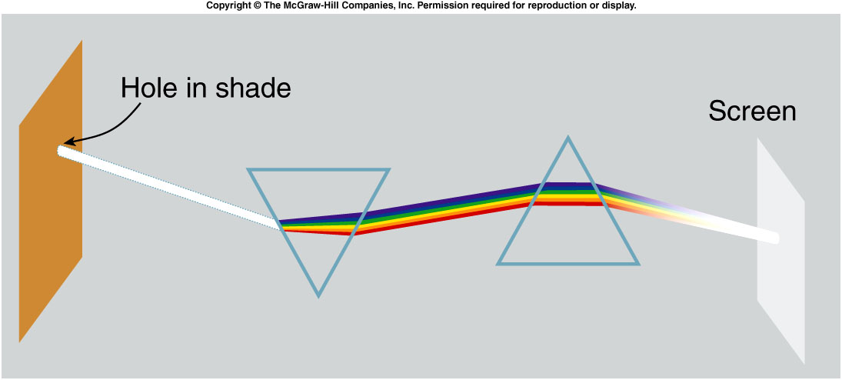
Newton demonstrated that white light is a mixture of colors.
  He showed that white light from the sun, after being split into different colors by one prism, can be recombined by a second prism to form white light again.

Slide 19
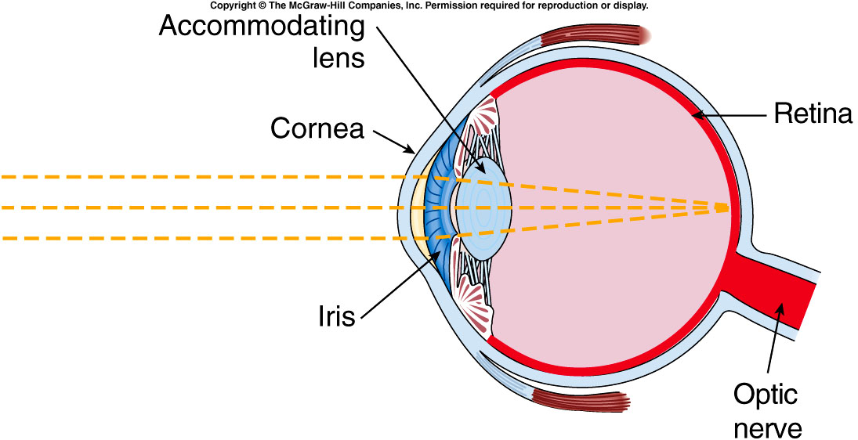
How do our eyes distinguish color?
  Light is focused by the cornea and lens onto the retina.
  The retina is made up of light-sensitive cells called rods and cones.
  Three types of cones are sensitive to light in different parts of the spectrum, i.e. different colors.

Slide 20
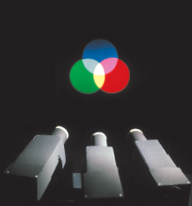
Color Mixing
The process of mixing two different wavelengths of light, such as red and green, to produce a response interpreted as another color, such as yellow, is additive color mixing.
  Combining the three primary colors blue, green, and red in different amounts can produce responses in our brains corresponding to all the colors we are used to identifying.
  Red and green make yellow, blue and green make cyan, and blue and red make magenta.
  Combining all three colors produces white.

Slide 21
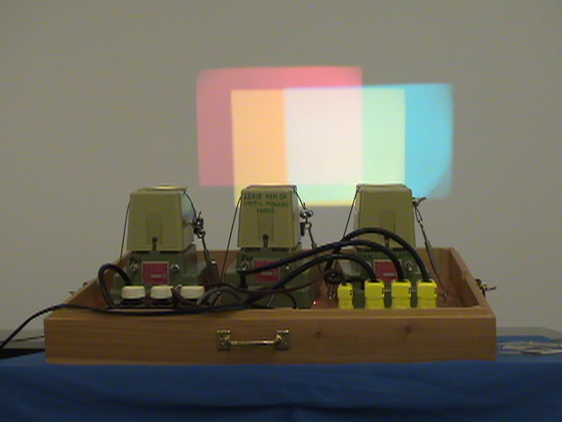
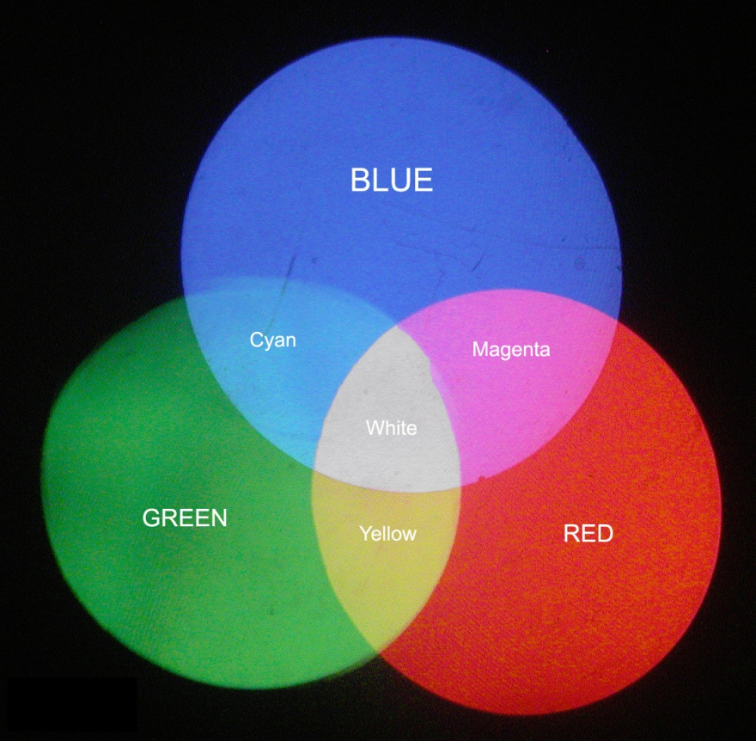
7C-01: Color by Addition
Notes:
Show it using the flashlight and the filter.

Slide 22
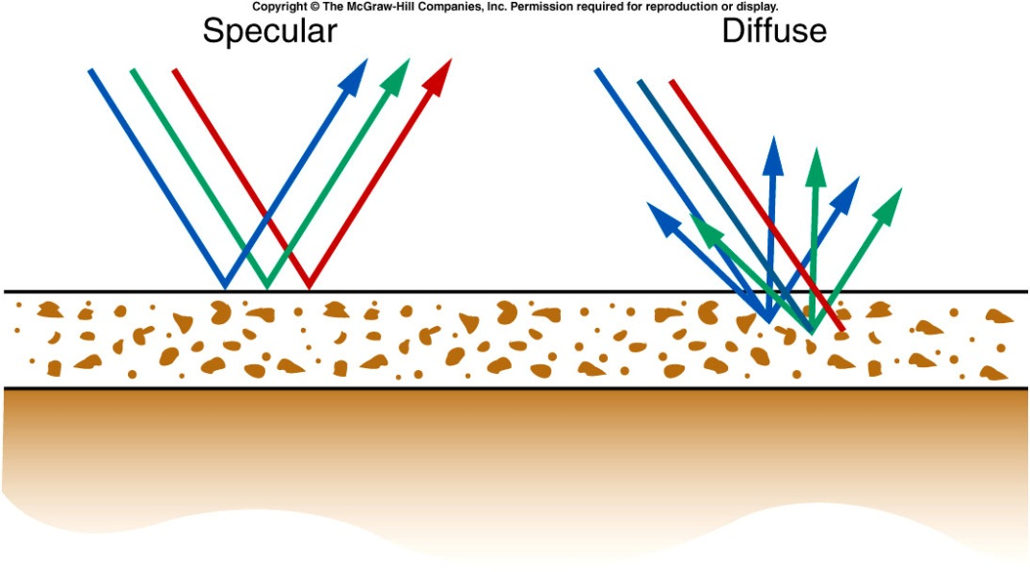
Color Mixing
The pigments used in paints or dyes work by selective color mixing.
  They absorb some wavelengths of light more than others.
When light strikes an object, some of the light undergoes specular reflection: all the light is reflected as if by a mirror.
The rest of the light undergoes diffuse reflection: it is reflected in all directions.
Some of the light may be selectively absorbed, affecting the color we see.
  If red light is absorbed, we see blue-green.

Slide 23
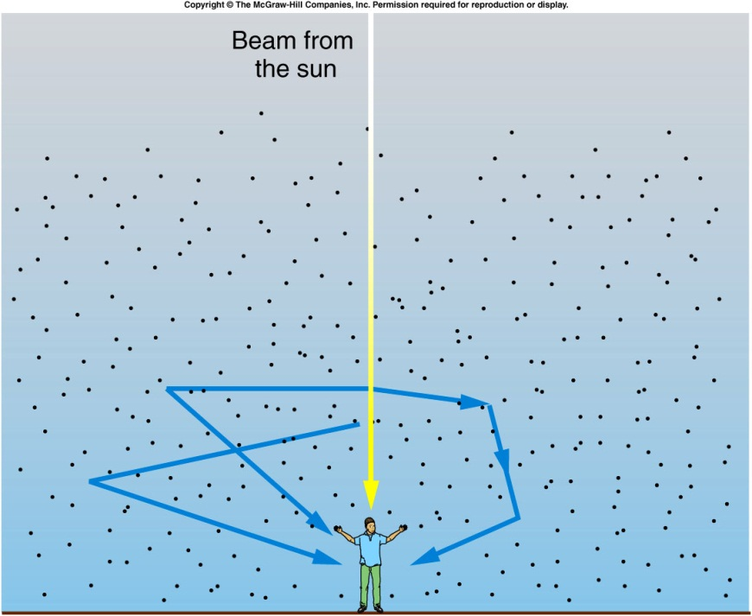
Why is the sky blue?
The white light coming from the sun is actually a mixture of light of different wavelengths (colors).
The shorter wavelengths of blue light are scattered by gas molecules in the atmosphere more than longer wavelengths such as red light.
The blue light enters our eyes after being scattered multiple times, so appears to come from all parts of the sky.

Slide 24
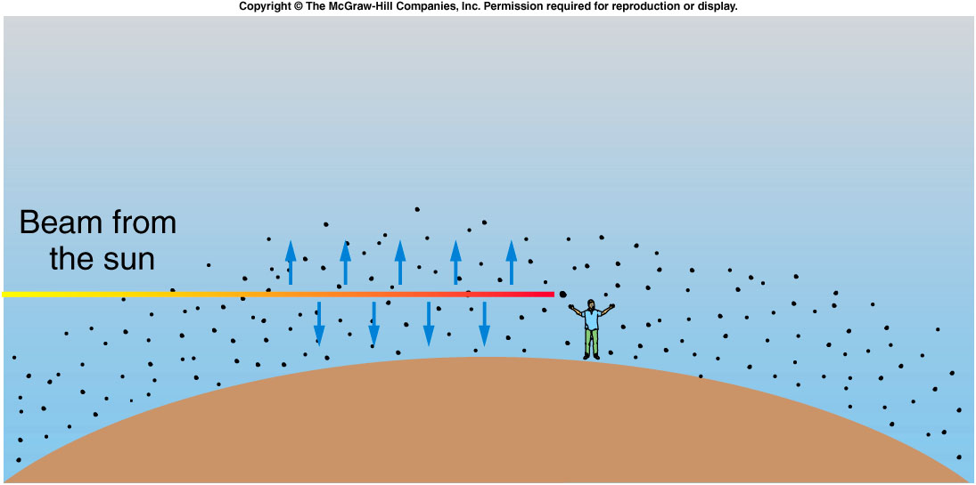
Why is the sunset red?
The shorter wavelengths of blue light are scattered by gas molecules in the atmosphere more than longer wavelengths such as red light.
When the sun is low on the horizon, the light must pass through more atmosphere than when the sun is directly above.
By the time the sun’s light reaches our eyes, the shorter wavelengths such as blue and yellow have been removed by scattering, leaving only orange and red light coming straight from the sun.

Slide 25
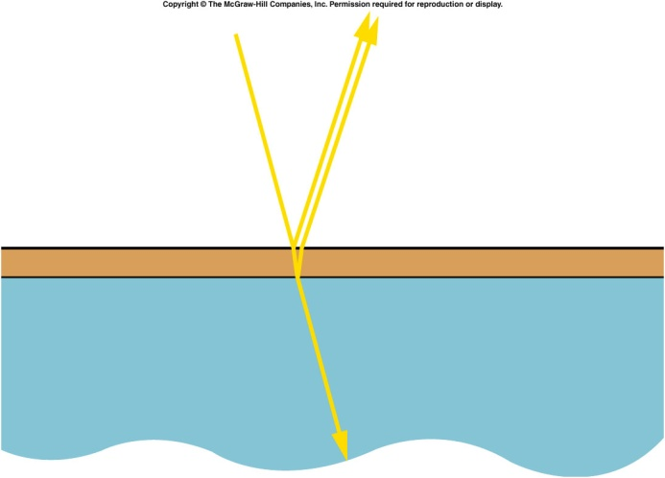
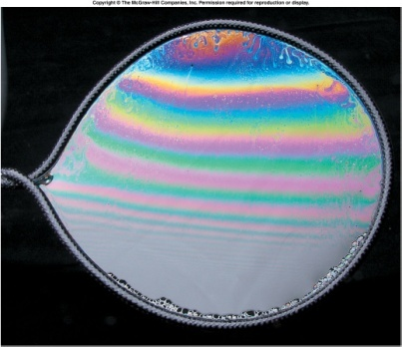
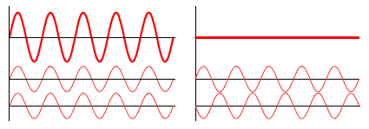
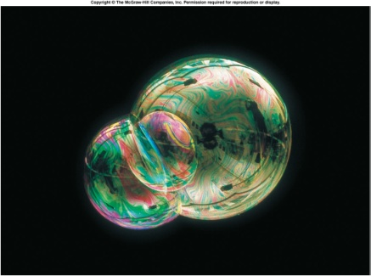
Thin film interference
Thin film interference occurs when light is reflected from the top surface and the underneath surface.
This provides the two beams of coherent light that interfere.
Since we normally observe this with white light we see colors because the path difference varies depending on the angle of observation
So different wavelengths (colors) have constructive and destructive interference at different places on the film.

Slide 26
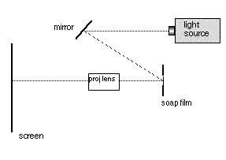
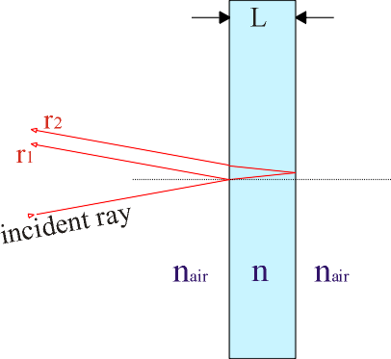
7B-11 Color in Thin Films
Studying thin-film interference effects
Why are the effects on white light and monochromatic light different ?
What kind of patterns appear on the screen ?
LIGHT REFLECTED FROM THE FRONT AND THE BACK OF A THIN SOAP FILM INTERFERES WITH ITSELF. INTERFERENCE OF MONOCHROMATIC LIGHT PRODUCES BRIGHT AND DARK FRINGES WHILE INTERFERENCE OF WHITE LIGHT PRODUCES COLORED BANDS (DIFFERENT FREQUENCIES OF LIGHT INTERFERE DIFFERENTLY).
Notes:
After the next slide, use the same setup for single slit diffraction.

Slide 27
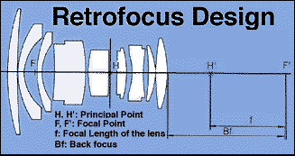
Coatings for lenses
As light passes from one transparent medium to another a few percent of the light will be reflected.
This is a particular problem in optical systems like lenses where there may be many glass elements.
For example if 96% of the light is transmitted at a surface after 8 surfaces only 72% of the light remains and the other 28% will be scattered everywhere.
Thin coatings are put on glass surfaces so that for particular wavelengths the light reflected from the top surface is exactly cancelled by the light from the bottom surface.
This is only true for a single wavelength and to reduce the reflections for a range of wavelengths requires multiple thin film layers very often just λ/4 thick.

Slide 28
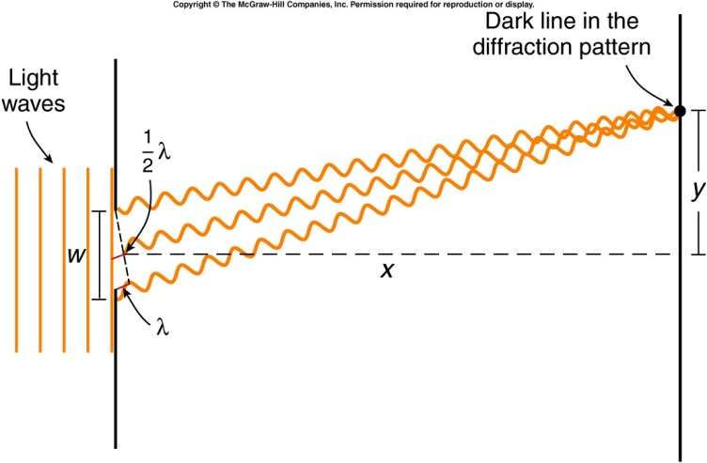
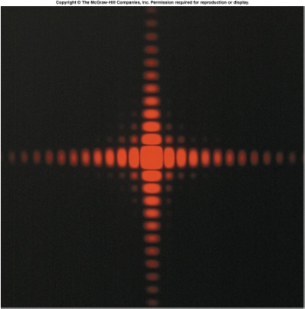
Diffraction
Interference occurs even for a single aperture and this is called diffraction. The pattern shown is from a square aperture and the pattern can be thought of as light from different parts of the aperture interfering.
As the aperture is made smaller the pattern actually expands.
This effect can limit our ability to see detail in small objects or to resolve two stars nearby to one another.
The position of the first dark fringe is given by y = λx/w. This means the central bright fringe has a width ~ 2y and increases as w gets smaller
That’s why the telescope with bigger aperture see clearer.

Slide 29
Is it possible for an electromagnetic wave to travel through a vacuum?
A. Yes.
B. No.
Waves are traveling in an eastward direction on a lake. Is the water in the lake necessarily moving in that direction?
Yes.
No.
Notes:
Water moves up and down.

Slide 30
A wave can be propagated on a blanket by holding adjacent corners in your hands and moving the end of the blanket up and down. Is this wave transverse or longitudinal?
Longitudinal
Tranverse.
Suppose that we increase the tension in a rope, keeping the frequency of oscillation of the end of the rope the same. What effect does this have on the wavelength of the wave produced?
an increase in velocity
an increase in frequency.
a decrease in wavelength.

Slide 31
A band playing on a flat-bed truck is approaching you rapidly near the end of a parade. Will you hear the same pitch for the various instruments as someone down the street who has already been passed by the truck?
A. The pitch increases as the band approaches and decreases as it is going away
B. The pitch decreases as the band approaches and increases as it is going away
C. The pitch remain unchanged.

Slide 32
Quiz: What is the frequency of light waves with a wavelength of 6 x 10⁻⁷ m?
1 x 10¹⁴ Hz
3 x 10¹⁵ Hz
2 x 10¹² Hz
5 x 10¹⁴ Hz
7 x 10⁷ Hz
λ = 6 x 10⁻⁷ m f = v / λ
v = c = 3 x 10⁸ m/s = (3 x 10⁸ m/s) / 6 x 10⁻⁷ m
v = f λ = 5 x 10¹⁴ Hz

