Slide 1
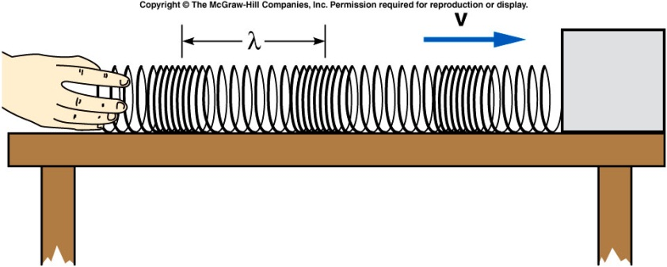
If instead of moving your hand back and forth just once, you continue to produce pulses, you will send a series of longitudinal pulses down the Slinky.
  If equal time intervals separate the pulses, you produce a periodic wave.
  The time between pulses is the period T of the wave.
  The number of pulses or cycles per unit of time is the frequency f = 1/T.
  The distance between the same points on successive pulses is the wavelength λ.
  A pulse travels a distance of one wavelength in a time of one period.
  The speed is then the wavelength divided by the period:

Slide 2
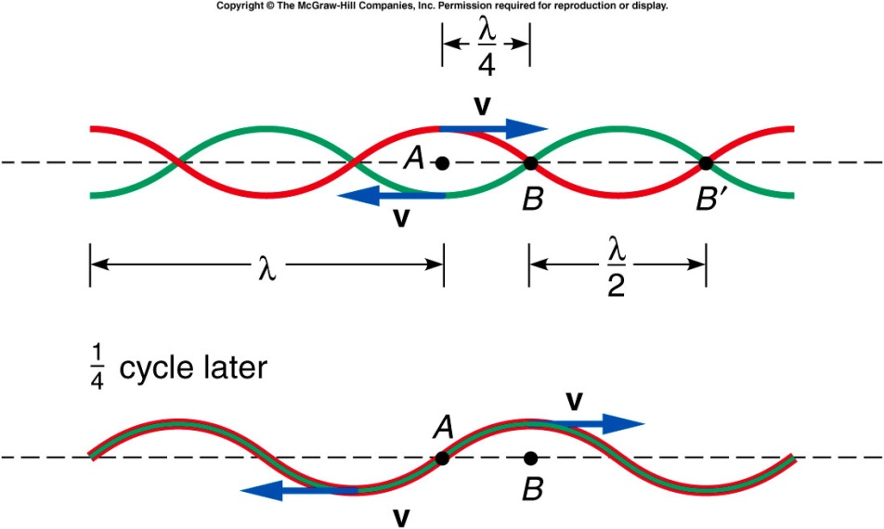
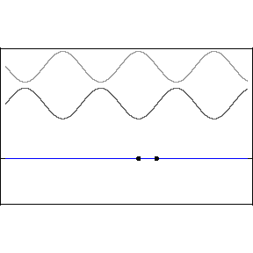
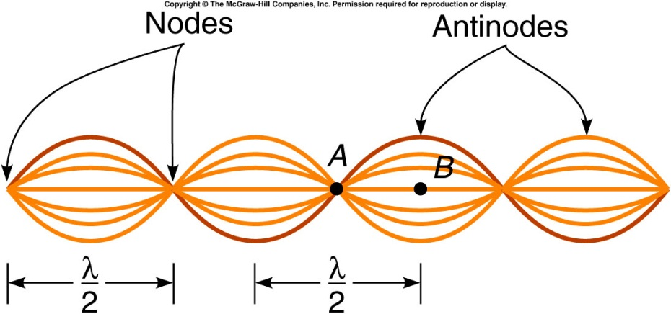

When two waves are traveling in opposite directions, such as when a wave is reflected back on itself, the principle of superposition can be applied at different points on the string.
  At point A, the two waves cancel each other at all times.
  At this point, the string will not oscillate at all; this is called a node.
At point B, both waves will be in phase at all times.
The two waves always add, producing a displacement twice that of each wave by itself.
This is called an antinode.

Slide 3
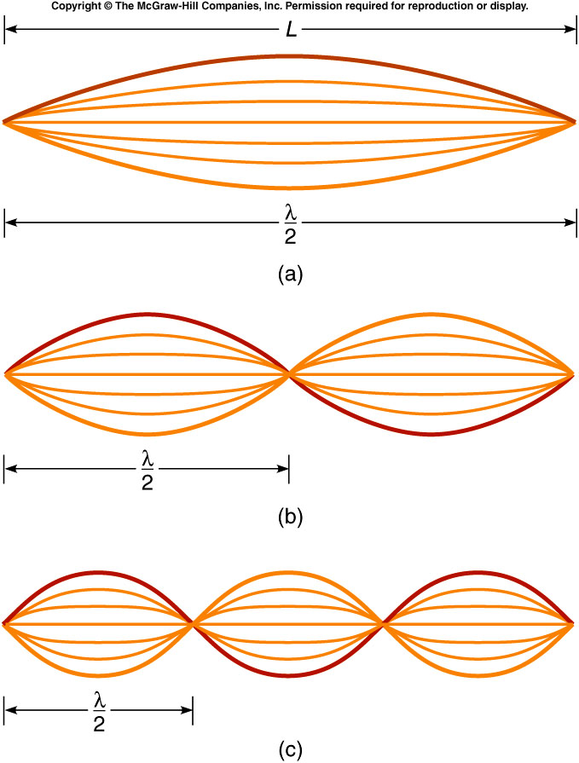
For a string fixed at both ends, the simplest standing wave,
the fundamental or first harmonic,
has nodes at both ends and an
antinode in the middle.
The second harmonic has a node
at the midpoint of the string, and
a wavelength equal to L.
The third harmonic has four nodes
(counting the ones at the ends) and
three antinodes, and a wavelength
equal to two-thirds L.
Notes:
Mention keeping the string tension fixed so that the wave speed is constant. Then change the frequency will change the wave length, e.g. The lower frequency produce a larger wave length.

Slide 4
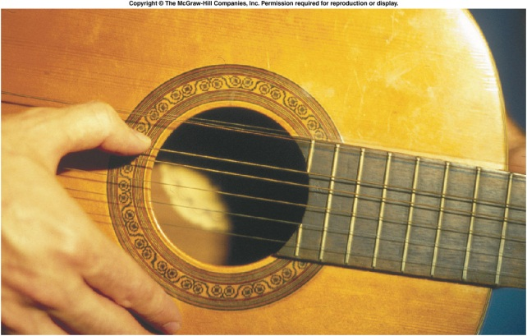
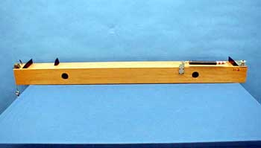
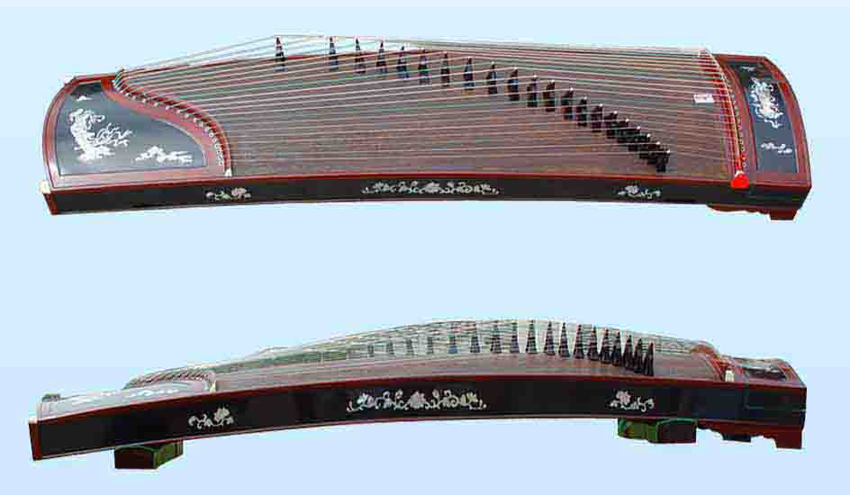
4B-10 MONOCHORD
What is the purpose of tightening or loosening the string ? What role do the frets play ?
Real Musical Instrument
Chinese Zither
CHANGING TENSION OF THE STRING AFFECTS THE SPEED OF WAVE PROPAGATION AND CHANGES THE FUNDAMENTAL FREQUENCY
THE BRIDGE ACTS AS A FRET THAT EFFECTIVELY CHANGES THE LENGTH OF THE WIRE AND THE FUNDAMENTAL FREQUENCY
Notes:
Each wire also passes over a small wooden bridge that can be moved back and forth
tightening or loosening the string
A high pitch sound corresponds to a high frequency sound wave and a low pitch sound corresponds to a low frequency sound wave

Slide 5
A guitar string has a mass of 4 g, a length of 74 cm, and a tension of 400 N. These values produce a wave speed of 274 m/s.
What is its fundamental frequency?
1.85 Hz
3.70 Hz
185 Hz
274 Hz
370 Hz

Slide 6
Quiz: A guitar string has a mass of 4 g, a length of 74 cm, and a tension of 400 N. These values produce a wave speed of 274 m/s. What is the frequency of the second harmonic?
92.5 Hz
123 Hz
185 Hz
370 Hz
740 Hz

Slide 7
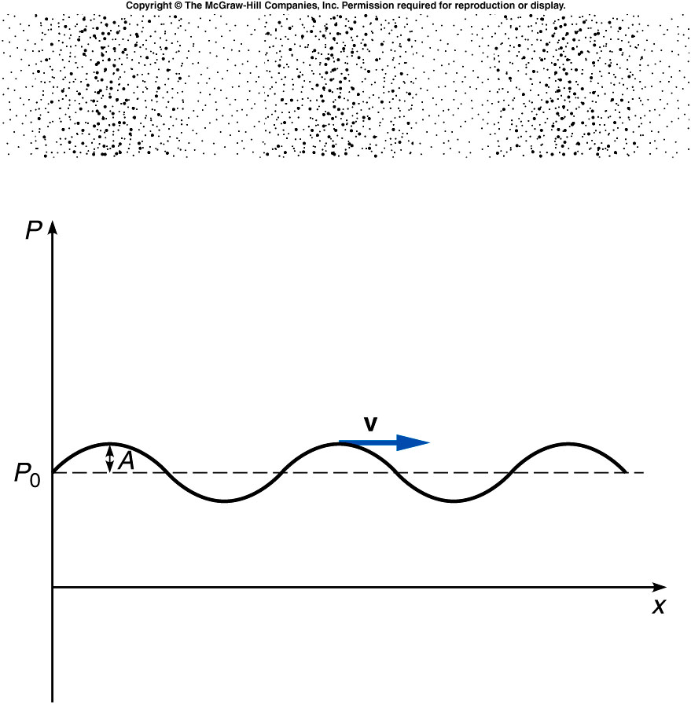
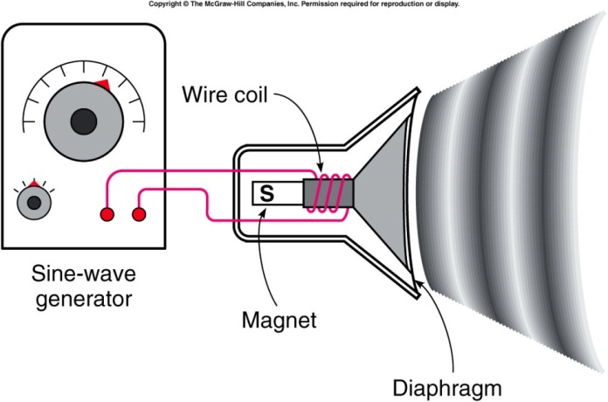
Sound Waves
A sound wave consists of pressure variations in air.
  The diaphragm of a speaker oscillates back and forth, producing regions of higher pressure and lower pressure.
  These regions propagate through the air as variations in air pressure and density, forming a longitudinal sound wave.
  In room temperature air, sound waves travel with a speed of 340 m/s or 750 MPH.
  Sound waves can also travel through liquids and solids, often with higher speeds.
Notes:
Compare the sound wave with the slinky. The front of the speaker push the air as I push the slinky. A longitudinal wave forms.

Slide 8
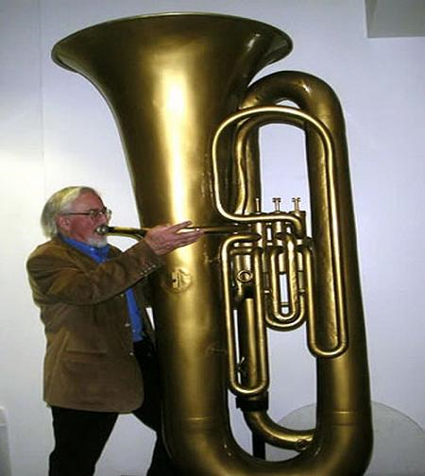
Interference phenomena such as standing waves can be observed in sound waves.
  Many musical instruments produce Tuba
  standing waves in a tube or pipe.
  If the tube is closed at one end, such as a bottle,
  there is a displacement node at the closed end.
  At the open end, there is a displacement antinode.
The frequency of the standing wave can be found from the
speed of sound in air and the wavelength:
where the wavelength is determined by the length of the tube.

Slide 9
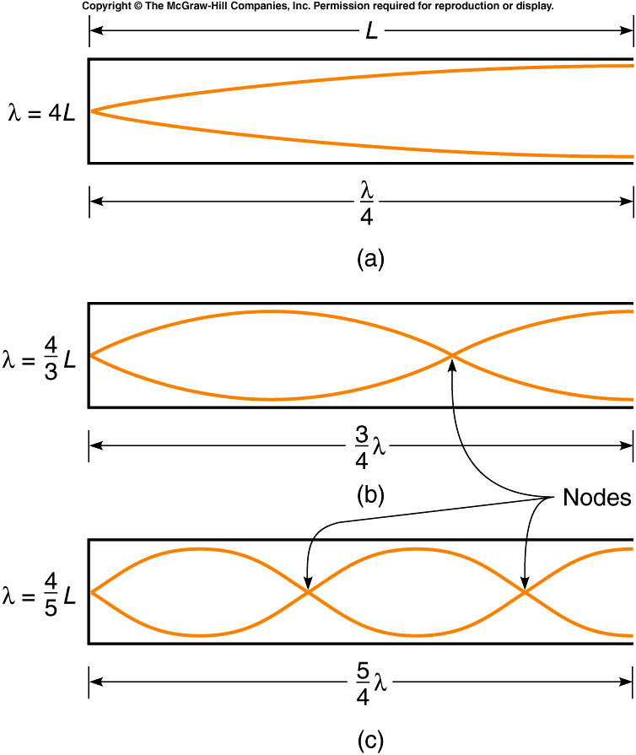
The standing-wave patterns for the first three harmonics for a tube open at one end and closed at the other are represented as follows:
The first harmonic or fundamental has a wavelength four times longer than the length of the tube.
The wavelength of the second harmonic is equal to four-thirds of the length of the tube.
The wavelength of the third harmonic is equal to four-fifths of the length of the tube.
etc.

Slide 10
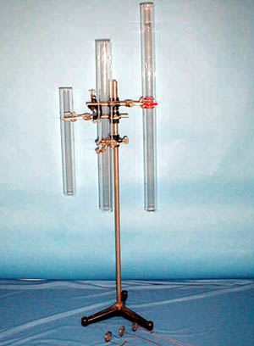


4B-13 Hoot Tubes (Resonance in Pipes)
Creating acoustic resonances in glass tubes with hot air
If the same heated grid is used, why do the different tubes give off different sounds ?
L’
L
Why does horizontal tube not emit sound ?
1st Harmonic: λ = 4L , f = v/λ
Length of tube determines resonant frequency
THE HOT AIR FROM THE HEATED GRID GENERATES A DISTURBANCE THAT CAN BE THOUGHT OF AS “NOISE.”
THE RESONANT FREQUENCY OF THE PARTICULAR TUBE DETERMINES WHICH COMPONENTS OF THIS NOISE ARE AMPLIFIED.
Notes:
The grid simulate the closed end of the tube.
A high pitch sound corresponds to a high frequency sound wave and a low pitch sound corresponds to a low frequency sound wave
rotate the tube to a horizontal position. Or vertical position
The details of the mechanism producing the sound here are quite complicated. Just tell the students that the turbulence set up in the hot air passing through the grid generates a disturbance that can be thought of as “noise.”

Slide 11
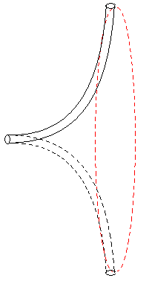
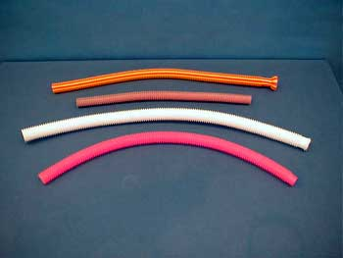
4B-14 Whirly Tubes
Forcing air thru a tube to create acoustic resonances
Why do different tubes give off different sounds ? How can we increase the pitch emitted from any one whirly tube ?
AIR FLOWS UP THE TUBE DUE TO THE “CENTRIFUGAL” EFFECT FROM ROTATION. THE SOUND RESULTS FROM THE AIR PASSING OVER THE CORRUGATIONS IN THE TUBE. FASTER WHIRLING RESULTS IN HIGHER FREQUENCY OF SOUND (HIGHER PITCH).
Notes:
The corrugation are a succession of circles.
A flexible corrugated tube is held at one end and whirled rapidly

Slide 12
Demos: 1S-42 Standing Waves (Metal Bar)
A metal bar can produce interesting sound.
Ancient Chinese fountain bowel
https://www.youtube.com/watch?v=hVsQ_m6281g
Notes:
Standing wave exist also somewhere else like the metal bars

Slide 13
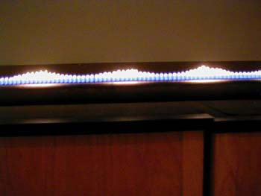
4B-01 Standing Waves in a Gas
What happens when an acoustic standing wave is introduced in the tube ?
Effects of acoustic standing wave on air pressure
The wave pattern indicates a pressure non-uniformity within the tube.
Notes:
Mention pasacal’s law that the pressure are the same in all directions.

Slide 14
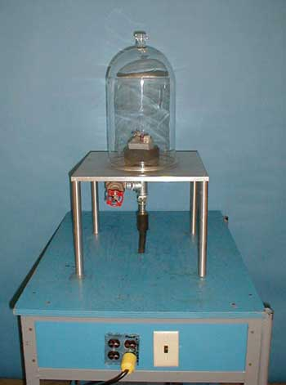
4A-03 Sound Production in Bell Jar
Investigating the medium through which sound waves propagate
Quiz:
Can sound travel in vacuum?
A: yes
B: No

Slide 15
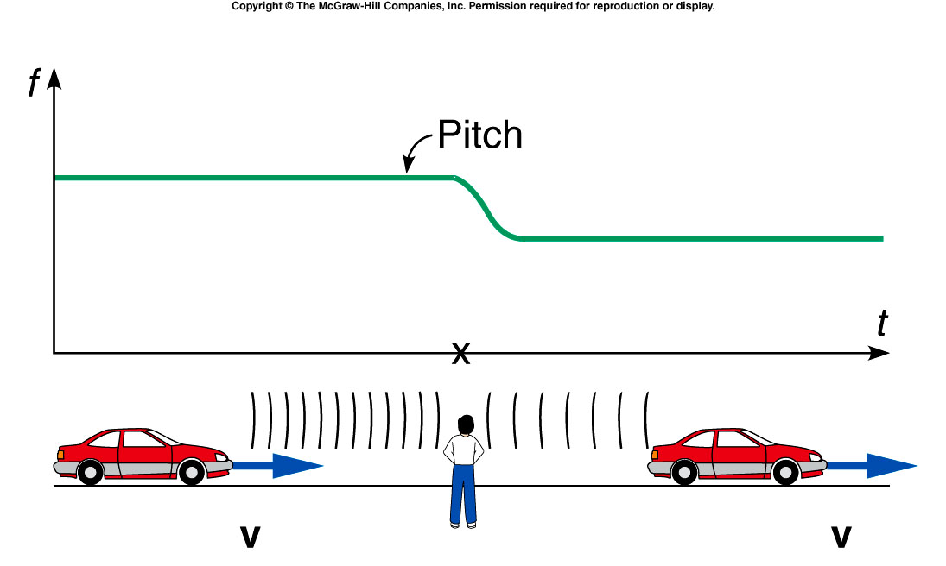
The Doppler Effect
A moving source of sound, such as a car horn, seems to change pitch depending on its motion relative to the listener.
As a car passes a stationary observer, the horn’s pitch changes from a higher pitch to a lower pitch.

Slide 16
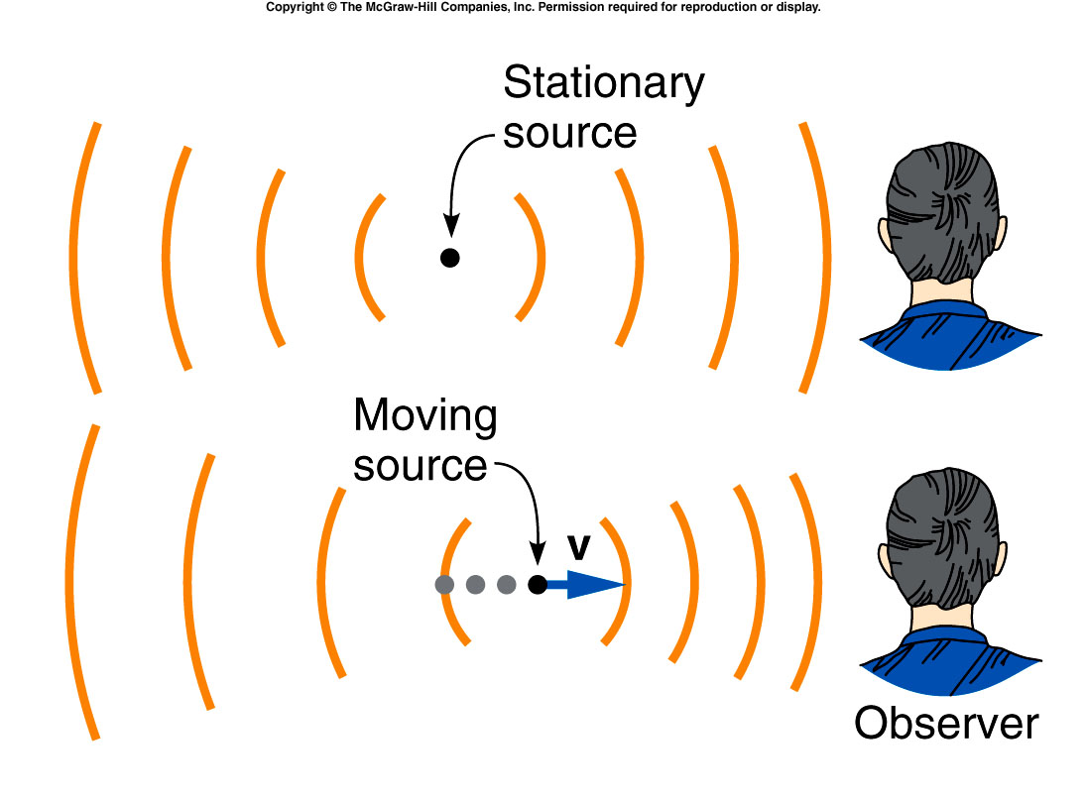
The Doppler Effect
Comparing the wavefronts for a stationary car horn and for a moving car horn illustrates why the pitch changes.
When the car is approaching the observer, the wavefronts reaching the observer are closer together.
When the car is moving away from the observer, the wavefronts reaching the observer are farther apart.

Slide 17
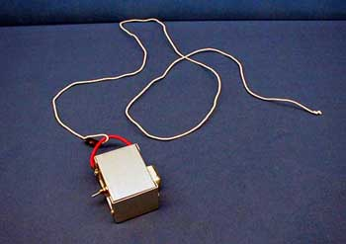
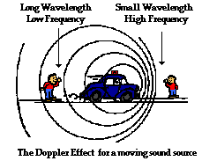
4C-01 Doppler Effect
Investigating change in sound due to the Doppler effect
At what point in circular movement does sound change ? What is relative motion between source and listener at these points ?
WHEN THE SOURCE MOVES TOWARD (AWAY FROM) LISTENER, THE FREQUENCY OF SOUND, OR PITCH, INCREASES (DECREASES).
Notes:
A loud tone generator is attached to a long cord and whirled in a near-horizontal circle

