Slide 1
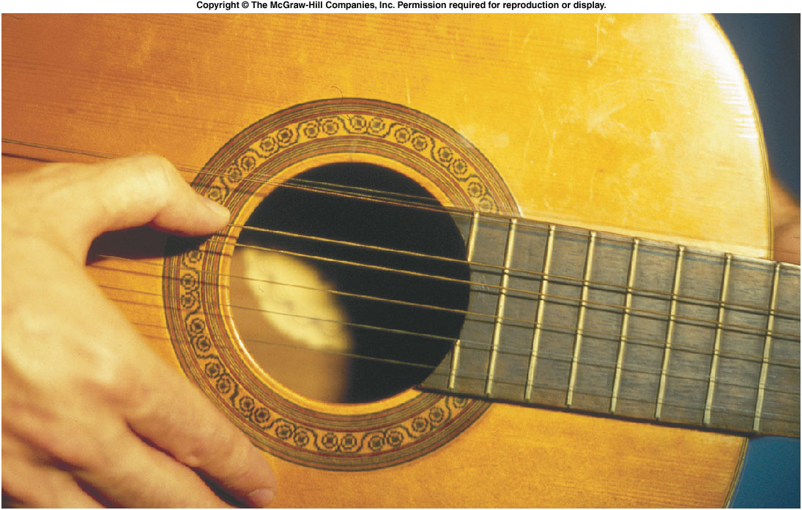
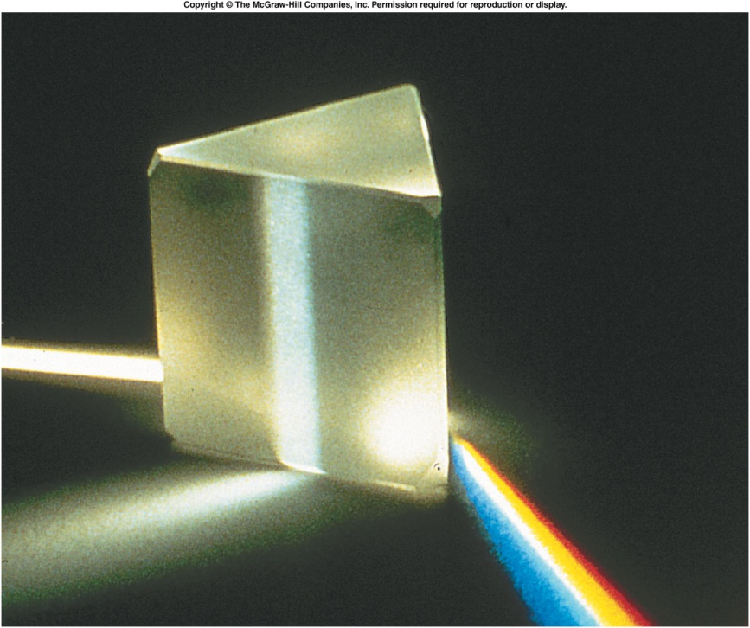
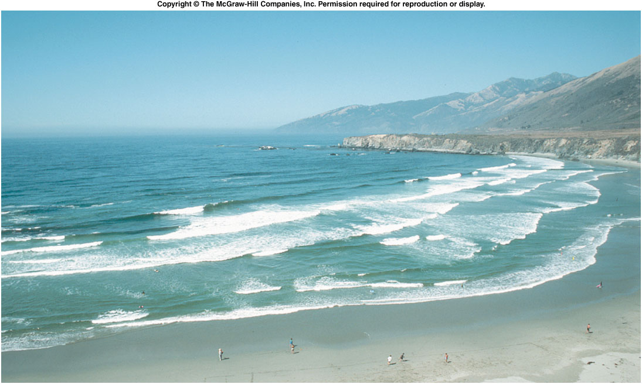
Sound
waves...
light
waves...
water
waves...

Slide 2
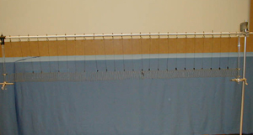
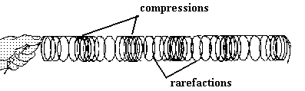
1S-13 Slinky on Stand
Creating longitudinal compression waves in a slinky
What happens when you pull back and release one end of the slinky ?

Slide 3
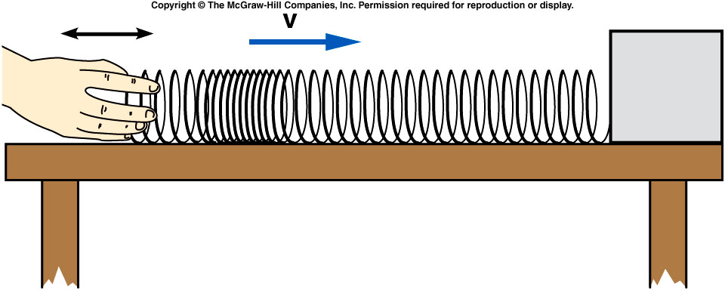
Moving one end of the Slinky back and forth created a local compression where the rings of the spring are closer together than in the rest of the Slinky.
The slinky tries to return to equilibrium. But inertia cause the links to pass beyond. This create a compression. Then the links comes back to the equilibrium point due to the restoration force, i.e. the elastic force.
The speed of the pulse may depend on factors such as tension in the Slinky and the mass of the Slinky.

Slide 4
Energy is transferred through the Slinky as the pulse travels.
  The work done in moving one end of the Slinky increases both the potential energy of the spring and the kinetic energy of individual loops.
  This region of higher energy then moves along the Slinky and reaches the opposite end.
  There, the energy could be used to ring a bell or perform other types of work.
Energy carried by water waves does substantial work over time in eroding and shaping a shoreline.

Slide 5
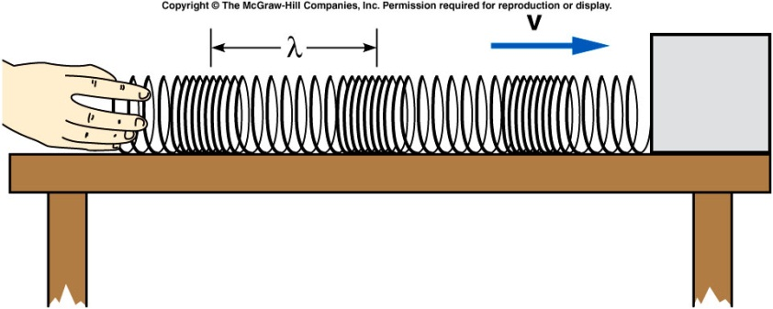
If instead of moving your hand back and forth just once, you continue to produce pulses, you will send a series of longitudinal pulses down the Slinky.
  If equal time intervals separate the pulses, you produce a periodic wave.
  The time between pulses is the period T of the wave.
  The number of pulses or cycles per unit of time is the frequency f = 1/T.
  The distance between the same points on successive pulses is the wavelength λ.
  A pulse travels a distance of one wavelength in a time of one period.
  The speed is then the wavelength divided by the period:

Slide 6
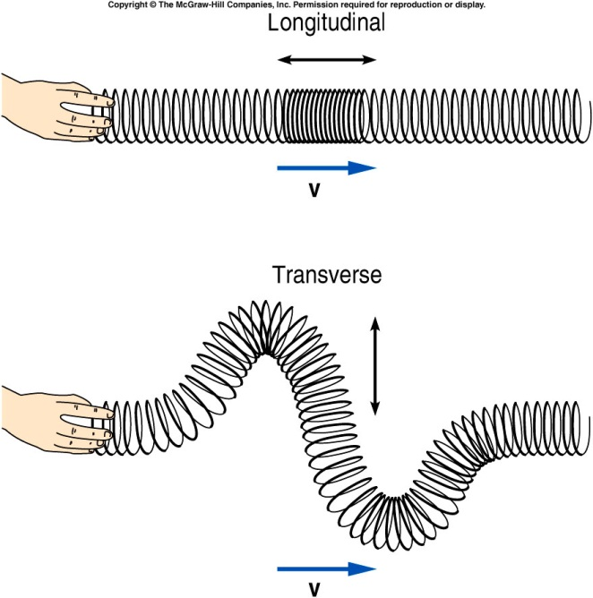
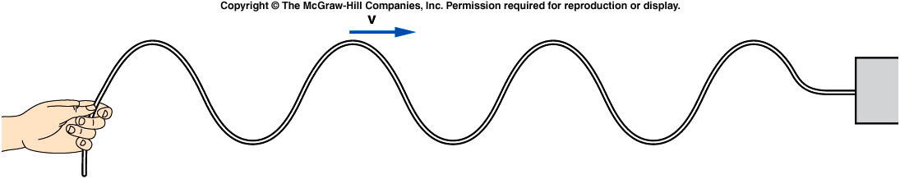
The pulse we have been discussing is a longitudinal wave: the displacement or disturbance in the medium is parallel to the direction of travel of the wave or pulse.
Sound waves are
longitudinal.

Slide 7

A longitudinal wave traveling on a Slinky has a period of 0.25 s and a wavelength of 30 cm. What is the speed of the wave?
0.25 cm/s
0.30 cm/s
1 cm/s
7.5 cm/s
120 cm/s

Slide 8
A longitudinal wave traveling on a Slinky has a period of 0.25 s and a wavelength of 30 cm. What is the frequency of the wave?
0.25 Hz
0.30 Hz
0.83 Hz
1.2 Hz
4 Hz

Slide 9
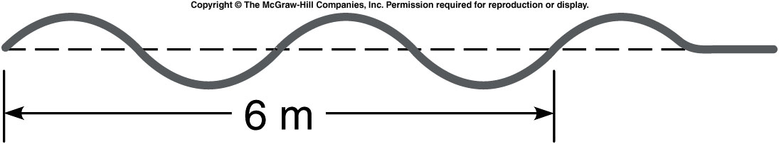
A wave on a rope is shown below. What is the wavelength of this wave?
a) 1/6 m b) 1 m c) 2 m d) 3 m e) 6 m
In 6 m, the wave goes through 2 complete cycles.
The wavelength (length of one complete cycle) is (6 m)/2 = 3 m.

Slide 10
If the frequency of the wave is 2 Hz, what is the wave speed?
a) 1/6 m/s b) 2/3 m/s c) 2 m/s d) 3 m/s e) 6 m/s

Slide 11
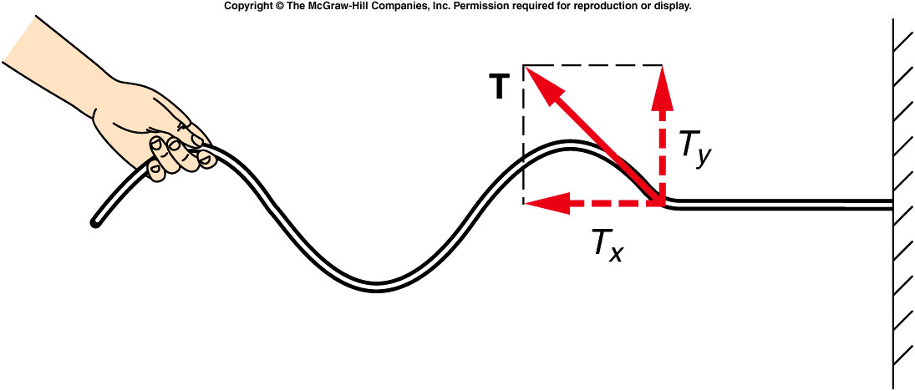
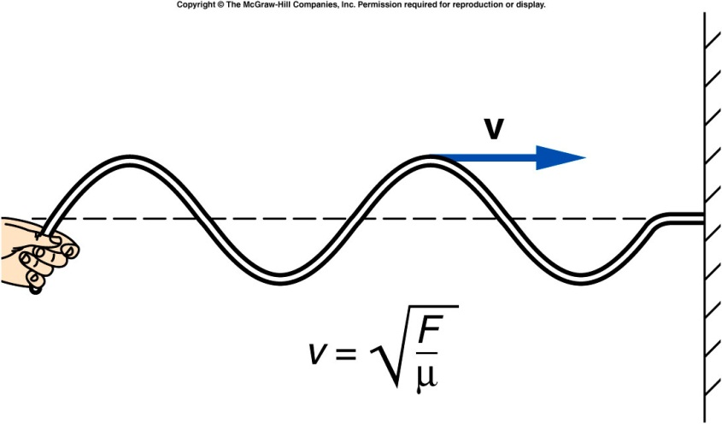
As the raised portion of a pulse approaches a given point on the rope, the tension in the rope acquires an upward component.
  The resulting upward force
  causes this next segment
  to accelerate upward, and
  so on down the rope.
The speed of the pulse
depends on how fast
succeeding segments
can be started moving
(accelerated).
By Newton’s second law, this is proportional to the force and inversely proportional to the mass of the segment:
A larger tension produces a larger acceleration.
The speed of the pulse will increase with the
tension and decrease with the mass per unit
length of the rope:

Slide 12
A rope has an overall length of 10 m and a total mass of 2 kg. The rope is stretched with a tension of 50 N. One end of the rope is fixed, and the other is moved up and down with a frequency of 4 Hz.
What is the speed of waves on this rope?
a) 5.0 m/s b) 7.07 m/s c) 15.8 m/s d) 50 m/s e) 250 m/s

Slide 13
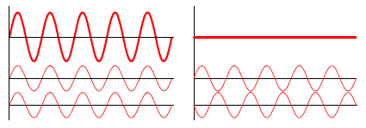
Principle of Superposition:
When two or more waves combine, the resulting disturbance or displacement is equal to the sum of the individual disturbances.
When the two waves are moving the same way at the same time, they are in phase.
  The resulting combined wave will be larger (have a greater height).
If one wave is moving
upward when the other
wave is moving downward,
the two waves are
completely out of phase
  If the two waves have the
  same height, the resulting
  combined displacement will
  be zero.
The result of adding two waves together depends on their phases as well as on their height or amplitude.
When waves are in phase, we have constructive interference.
When waves are out of phase, we have destructive interference.

Slide 14
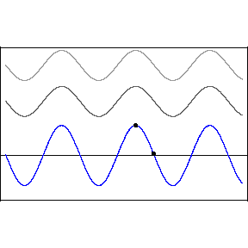
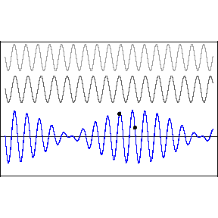

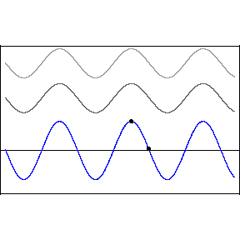
Examples of wave superposition

Slide 15
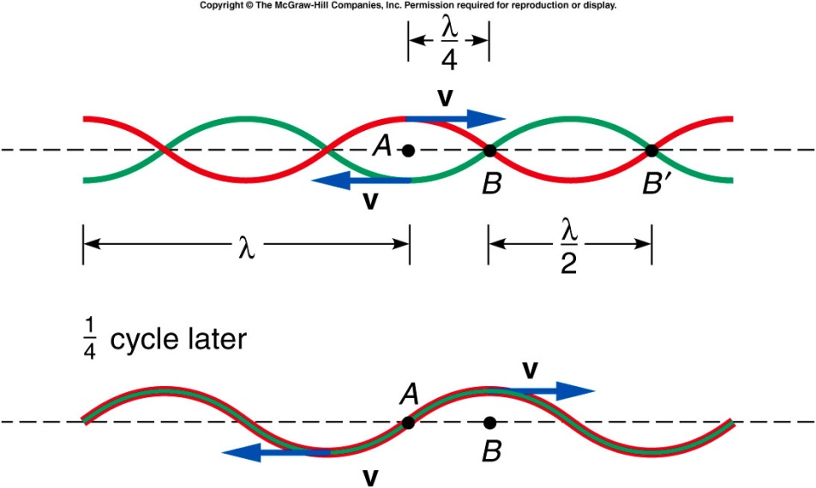
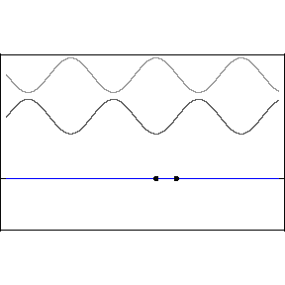
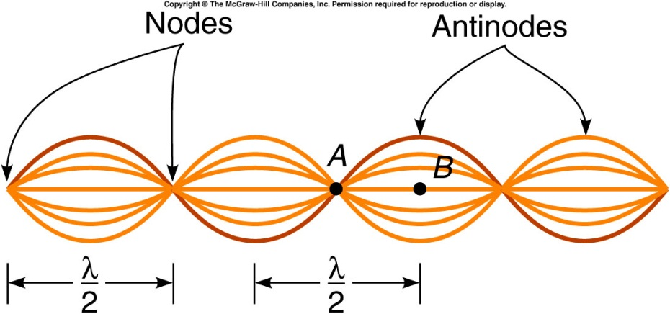

When two waves are traveling in opposite directions, such as when a wave is reflected back on itself, the principle of superposition can be applied at different points on the string.
  At point A, the two waves cancel each other at all times.
  At this point, the string will not oscillate at all; this is called a node.
At point B, both waves will be in phase at all times.
The two waves always add, producing a displacement twice that of each wave by itself.
This is called an antinode.

Slide 16
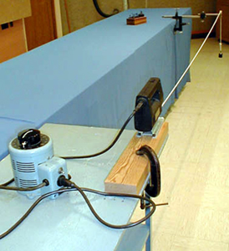
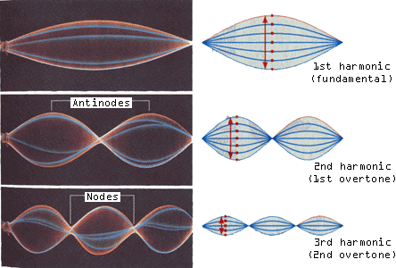
1S-41 Standing Waves in Rope
Creating transverse standing waves on heavy cable
How might we create different wave patterns on the cable ?
How is this related to tuning a guitar ?
BY ADJUSTING THE SPEED OF THE JIGSAW OR THE TENSION IN THE CORD, DIFFERENT STANDING WAVE PATTERNS CAN BE GENERATED BETWEEN THE FIXED ENDS. THOUGH THE WAVELENGTH OF THE STANDING WAVE IS FIXED BY THE LENGTH BETWEEN THE FIXED POINTS, THE FREQUENCY DEPENDS ON THE TENSION IN THE CABLE. YOU TUNE A GUITAR BY CHANGING THIS TENSION.

Slide 17
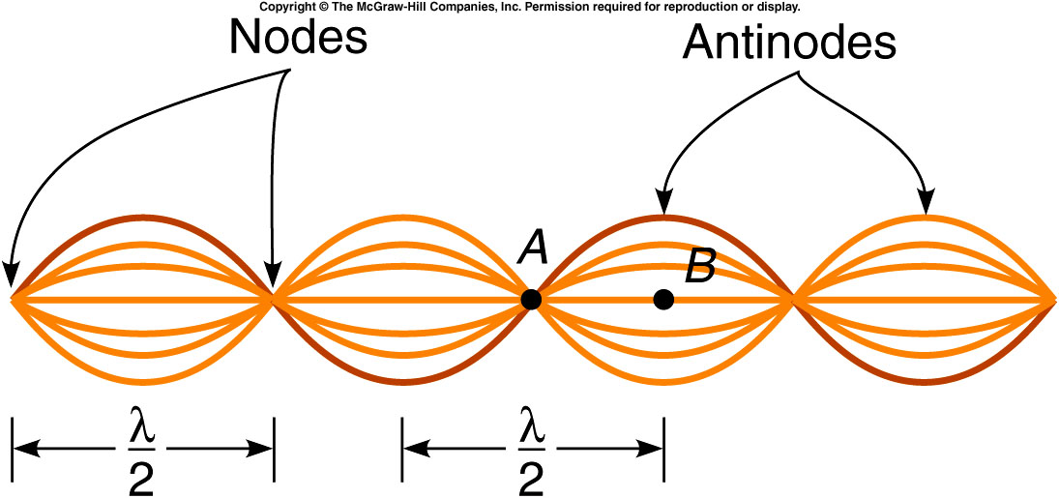
This pattern of oscillation is called a standing wave.
  The waves traveling in opposite directions interfere in a way that produces a standing or fixed pattern.
  The distance between adjacent nodes or adjacent antinodes is half the wavelength of the original waves.
  At the nodes, it is
  not moving at all.
  At points between
  the nodes and
  antinodes, the
  amplitude has
  intermediate
  values.

Slide 18
Quiz: A rope has an overall length of 10 m and a total mass of 2 kg. The rope is stretched with a tension of
50 N. One end of the rope is fixed, and the other is moved up and down with a frequency of 4 Hz.
What is the wavelength?
a) 0.20 m b) 3.95 m c) 10 m d) 15.8 m e) 25 m/s

