Slide 1
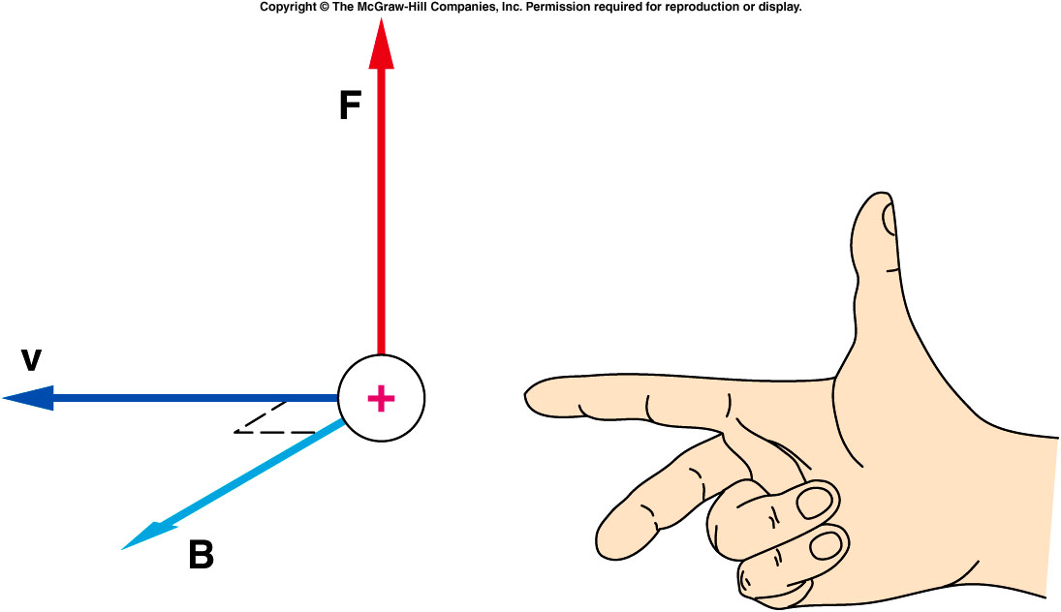
For this relationship to be valid, the velocity must be perpendicular to the field.
This actually defines the magnetic field as the force per unit charge and unit of velocity:
units: 1 tesla (T) = 1 N/A⋅m
If the index finger of the right hand points in the direction of the velocity of the charge, and the middle finger in the direction of the magnetic field, then the thumb indicates the direction of the magnetic force acting on a positive charge.

Slide 2

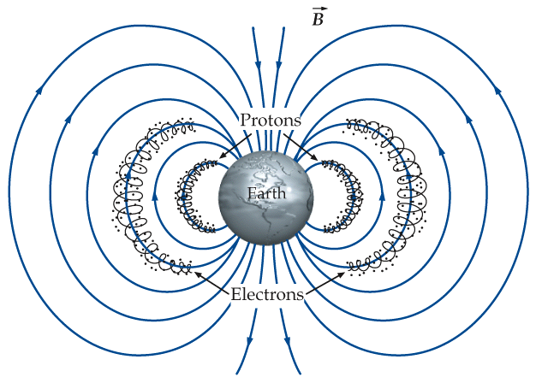
Polar Light
Van Allen belts
High energy particles leaked out of the belt and interact with the earth atmosphere.

Slide 3
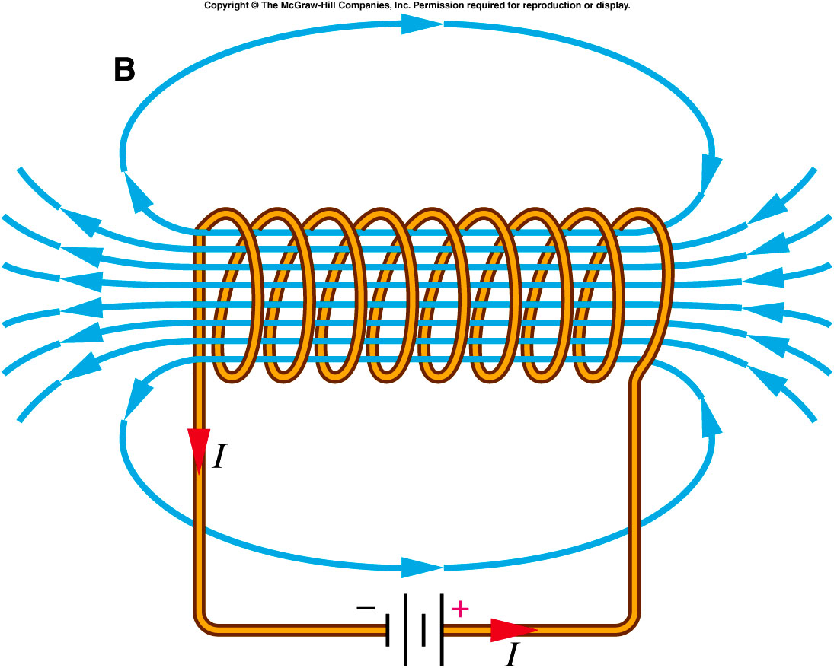
The magnetic field produced by a coil of wire will be stronger than one produced by a single loop carrying the same current.
  The magnetic field produced by each loop all add together.
  The resulting field
  strength is proportional
  to the number of turns
  N that are wound on
  the coil.
  The torque on the coil,
  when placed in an
  external magnetic field,
  is also proportional to
  both the current and
  the number of turns in
  the coil.

Slide 4
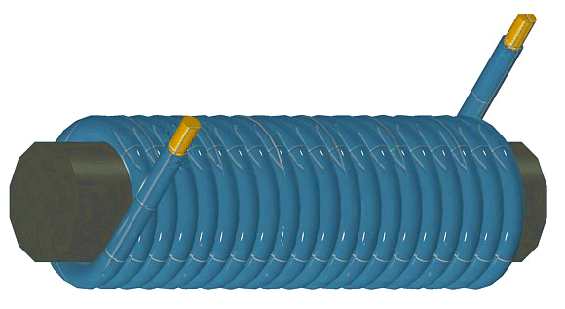
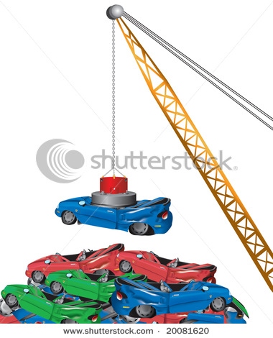
Can we utilize the similarities between a current-carrying coil of wire and a magnet?
The atom dipoles usually point to random direction.
By winding a coil around a steel needle or nail, the magnetic field produced is enhanced since atom dipoles are aligned to point to the same direction
The nail then behaves like a magnet that is stronger than most natural magnets.
This is an electromagnet.
Notes:
Car junkyard. Wire wrap around an iron rod can increase the field by hundred or thousands of time.

Slide 5
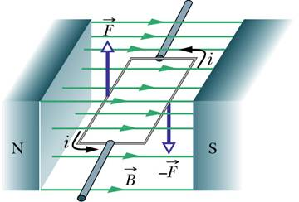
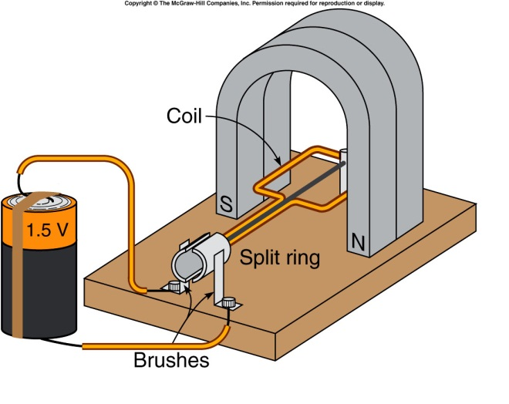
Consider a rectangular loop:
  Each segment of the rectangular loop is a straight wire.
  The force on each segment is given by F=IlB.
  Using the right-hand rule, you can verify that the loop will tend to rotate in the direction indicated.
  The forces on the two ends of
  the loop produce no torque
  about center of the loop,
  because their lines of action
  pass through the center of the
  loop.
  The forces on the other two
  sides combine to produce a
  torque that tends to line up the
  plane of the loop perpendicular
  to the magnetic field.

Slide 6
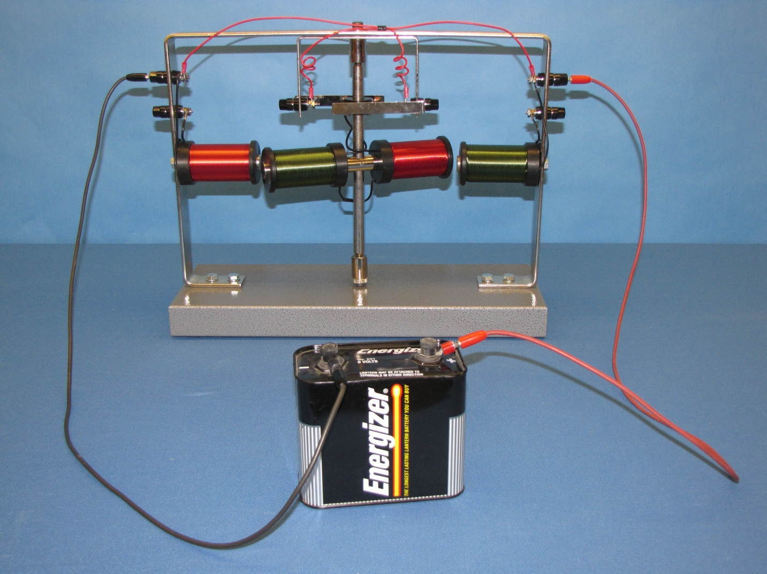
Electric Motor Model (6B-15)

Slide 7
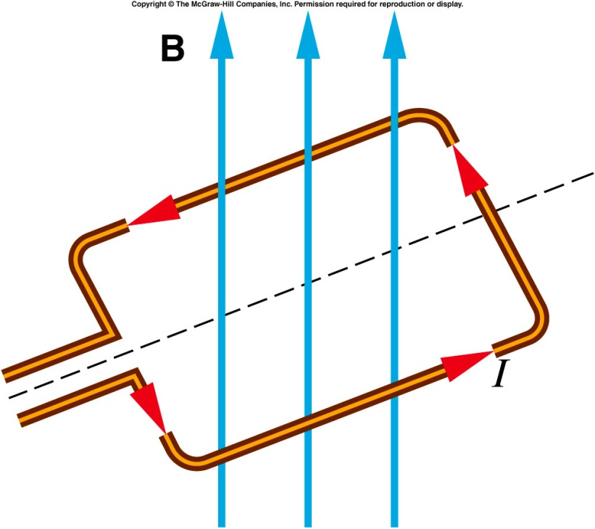
A current-carrying rectangular loop of wire is placed in an external magnetic field as shown. In what direction will this loop tend to rotate as a result of the magnetic torque exerted on it?
Clockwise
Counterclockwise
End view
The loop will rotate counterclockwise.
The forces on the long arms are outward and because they do not share a common line of action, impart a counterclockwise torque on the loop.
Notes:
One can also view the torque is caused by the interaction of the magnetic field by the coil and the external field

Slide 8
Faraday’s Law: Electromagnetic Induction
We have seen that an electric current produces a magnetic field.
  Can magnetic fields produce electric currents?
An electric field is produced when there is a changing magnetic field.
In a closed electric circuit, that means current is generated due to the changing magnetic field.

Slide 9
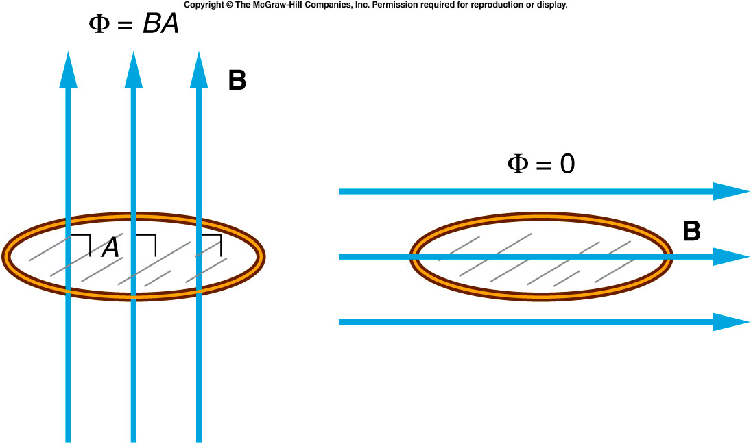

Magnetic flux (Φ) is a measure of how much magnetic field is passing through a loop of wire.
  It is at a maximum when the field lines are perpendicular to the plane of the loop, and it is zero when the field lines are parallel to the plane of the loop.
For a coil of N loops, the flux through the coil is equal to the flux through one loop, multiplied by the number of loops:
$$φ=N∙B_{⊥}∙A$$
$B_{⊥}$ is the field component perpendicular to A.

Slide 10
Faraday’s Law
  A voltage (electromotive force) is induced in a circuit when there is a changing magnetic flux passing through the circuit.
  The induced voltage is equal to the rate of change of the magnetic flux:
  This process is called electromagnetic inductance.

Slide 11
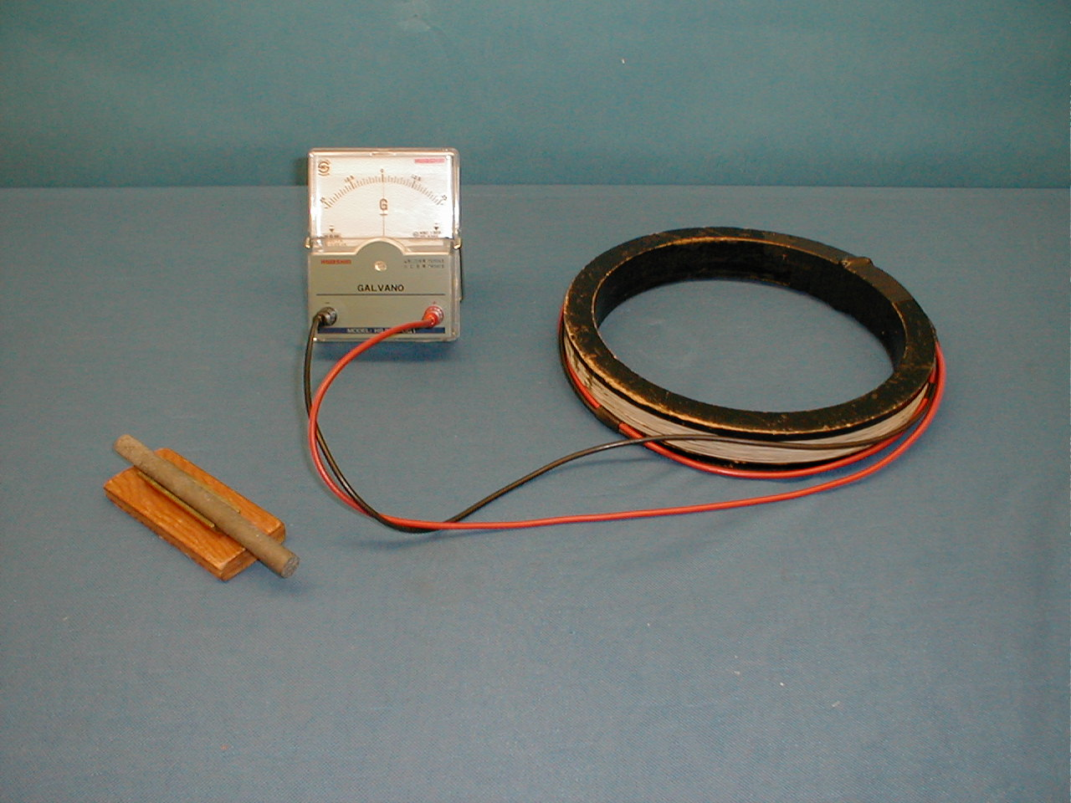
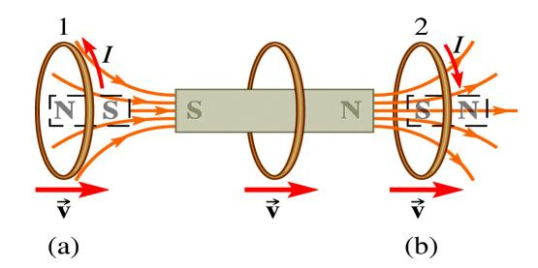
6D-04 Earth Magnetic Field Inductor
approaching
moving away
Notes:
The coil, held in the hand is tipped rapidly back and forth

Slide 12
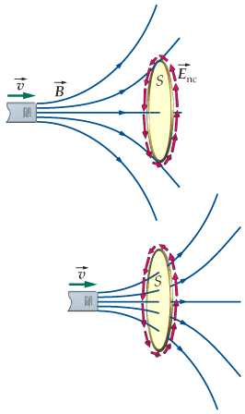
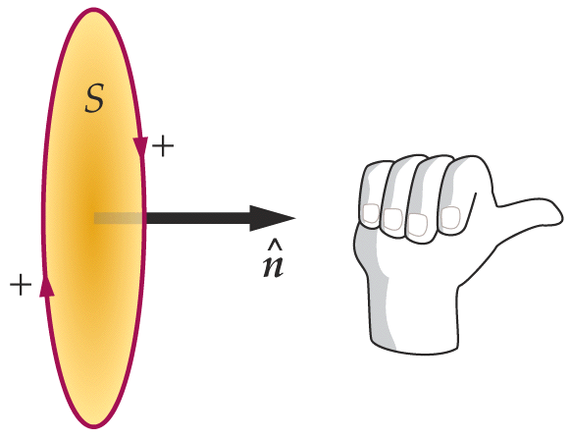
How to use Faraday’s law to determine the induced current direction
determine the sign of ∆Φ. Here ∆Φ >0
determine the sign of ε using faraday’s law. Here ε <0
RHR determines the positive direction for EMF ε
  Align you thumb approximately to the field direction.
  If ε>0, current follow the direction of the curled fingers.
  If ε<0, current goes to the opposite direction of the curled fingers.
N

Slide 13
Conducting Loop in a Changing Magnetic Field
Induced EMF has a direction such that it opposes the change in magnetic flux that produced it.
approaching
moving away
Magnetic moment μ created by induced currrent I repels the bar magnet.
Magnetic moment μ created by induced currrent I attracts the bar magnet.
Force on ring is repulsive.
Force on ring is attractive.
Notes:
Now the demonstration again

Slide 14
Quiz
The magnetic field is increasing, what’s the direction of the induced currents in the closed circular loop?
Clockwise
Counterclockwise
No induced currents.
Notes:
Everyone get 10 points for this quiz. Then go to the jumping ring.

Slide 15
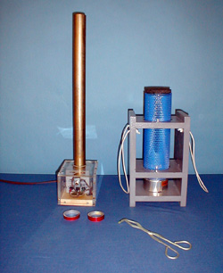
6D-11 Jumping Ring
Is there any differences in the two rings ?
Why one can jump up, the other can’t ?

Slide 16
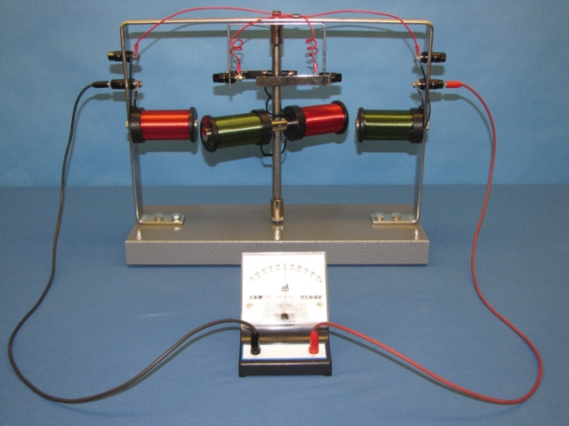
Demos: 6B-16 Electric Generator Model

Slide 17
A bit more

Slide 18
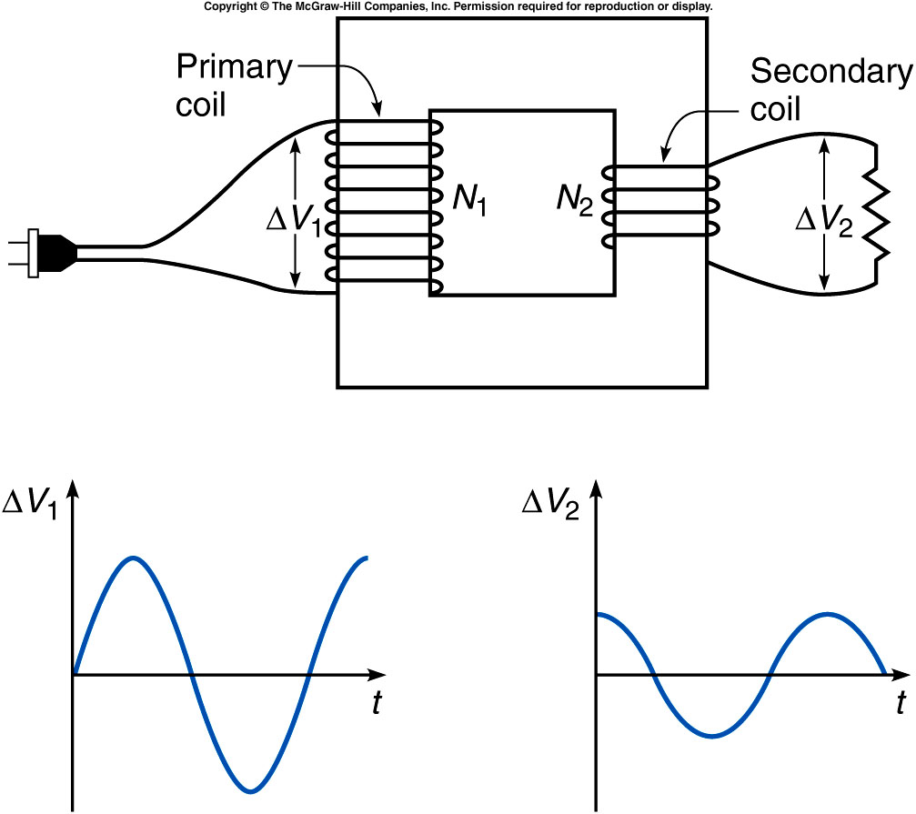

Transformer
  The ratio of the number of turns in the primary coil to the voltage on the primary coil is equal to the ratio of the number of turns on the secondary coil to the induced voltage in the secondary coil:
$$φ=N∙B_{⊥}∙A$$

Slide 19
A coil of wire with 50 turns has a uniform magnetic field of 0.4 T passing through the coil perpendicular to its plane. The coil encloses an area of 0.03 m². If the flux through the coil is reduced to zero by removing it from the field in a time of 0.25 s, what is the induced voltage in the coil?
a) 0.012 V b) 0.12 V c) 0.60 V d) 1.5 V e) 2.4 V

Slide 20
Primary coil of a transformer has 1000 turns of wire and the second coil has 10 turns of wire. The step-down voltage is 10 volt, what’s the input voltage?
100V
1000V
20V
15V
30V

Slide 21
High voltages are desirable for long-distance transmission of electrical power.
  The higher the voltage, the lower the current needed to transmit a given amount of power.
  Minimizing the current minimizes the heat lost to resistive heating (P=I²R).
  Transmission voltages as high as 230 kV = 230,000 V are not unusual.

Slide 22
Quiz:
Transformer is designed to step down line voltage of 110V to 22V. Primary coil has 400 turns of wire.
How many turns of wire on secondary coil?
A). 80 turns
B). 160 turns
C). 200 turns
D). 15 turns.
E). 20 turns
a) ΔV₂/ ΔV₁ = N₂/N₁ , N₂ = N₁(ΔV₂/ ΔV₁) = 400(22/110) = 80 turns

