Slide 1
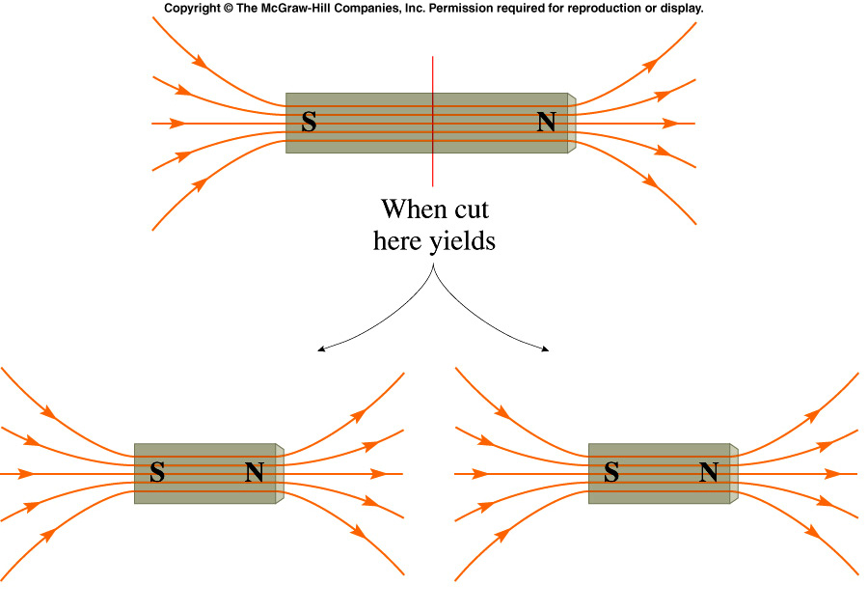
Magnetic Monopoles
Does there exist magnetic charge, just like electric charge? An entity which carried such magnetic charge would be called a magnetic monopole (having + or - magnetic charge).
How can you isolate this magnetic charge? Try cutting a bar magnet in half.
In fact no attempt has been successful in finding magnetic monopoles in nature.

Slide 2
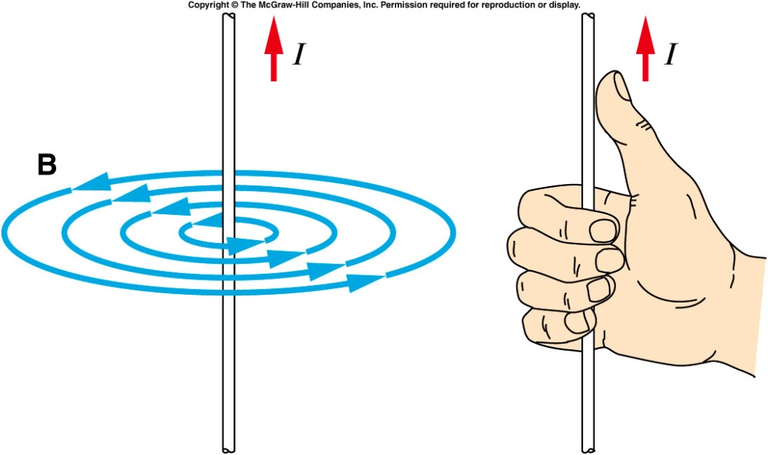
The magnetic field produced by the current is perpendicular to the direction of the current.
The magnetic field lines produced by a straight, current-carrying wire form circles centered on the wire.
  The right-hand rule gives the direction of the field lines: with the thumb in the direction of the current, the fingers curl in the direction of the field lines produced by that current.
  The effect gets weaker as
  the compass is moved
  away from the wire.
http://www.falstad.com/vector3dm/

Slide 3
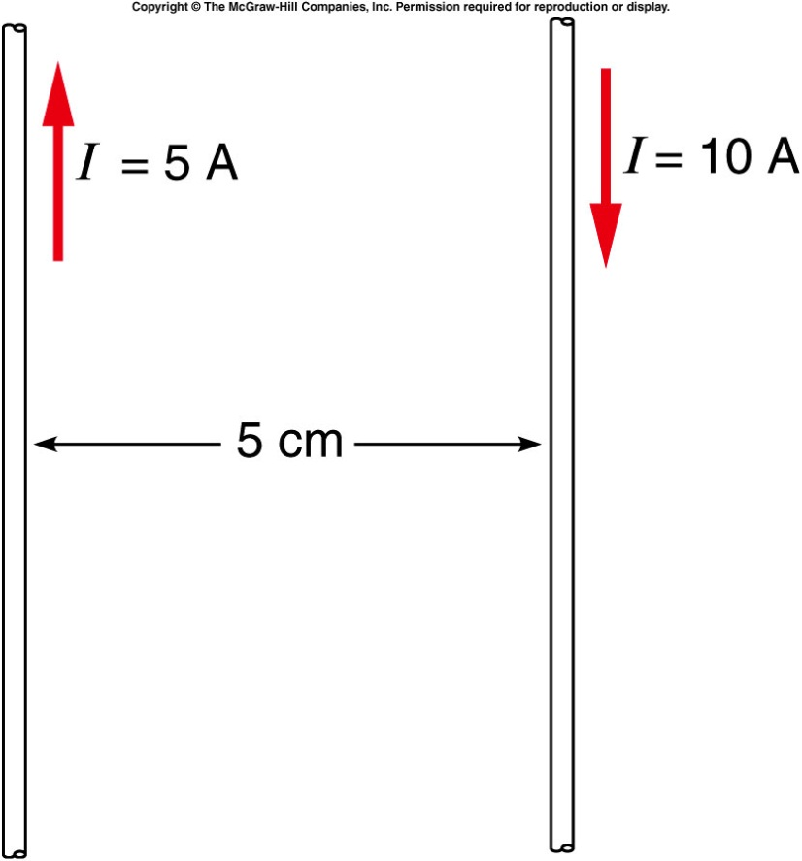
Quiz: Two long parallel wires carry currents of 5 A and 10 A in opposite directions as shown.
What are the directions of the forces on each wire?
The wires exert an attractive force on each other.
The wires exert a force repelling each other.
Each wire exerts a force on the other in the direction of the other wire’s current (the red arrows shown).
Each wire exerts a force on the other in the direction opposite to the other one’s current.
The wires exert no force on each other.
The wires repel each other.

Slide 4
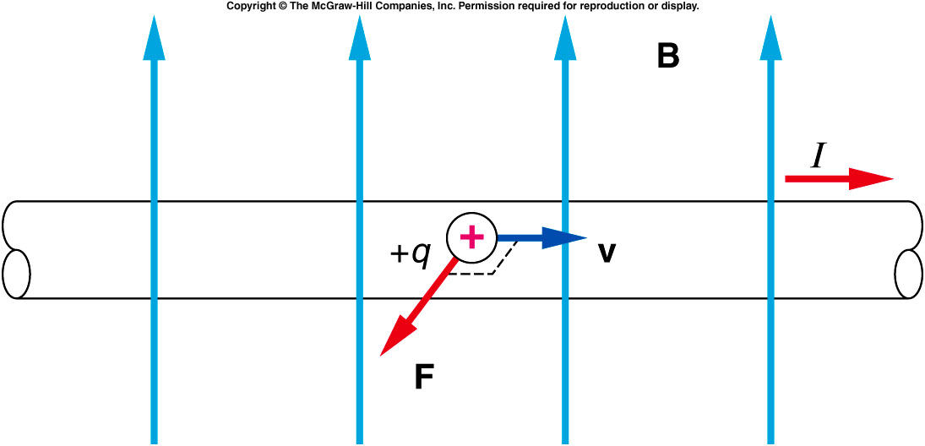
Magnetic forces are exerted by magnets on other magnets, by magnets on current-carrying wires, and by current-carrying wires on each other.
  The force exerted by one wire on the other is attractive
  when the currents are flowing in the same direction and
  repulsive when the currents are flowing in opposite
  directions.
  The magnetic force exerted on a moving charge of an electric current is perpendicular to both the velocity of the charges and to the magnetic field.
  This force is
  proportional to the
  quantity of the charge
  and the velocity of the
  moving charge and to
  the strength of the
  magnetic field:

Slide 5
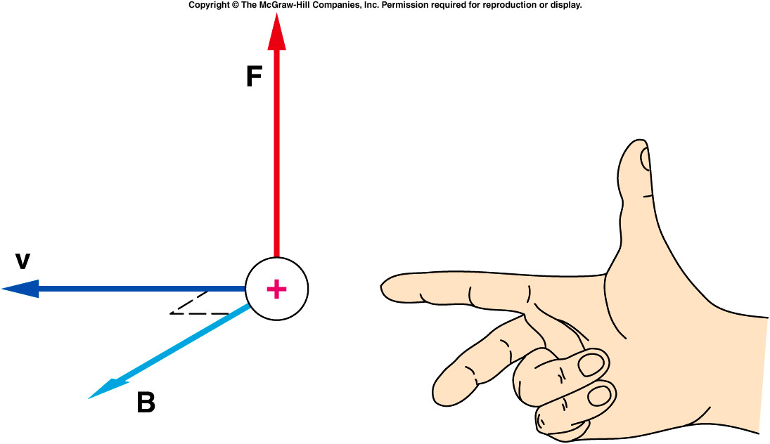
For this relationship to be valid, the velocity must be perpendicular to the field.
This actually defines the magnetic field as the force per unit charge and unit of velocity:
units: 1 tesla (T) = 1 N/A⋅m
If the index finger of the right hand points in the direction of the velocity of the charge, and the middle finger in the direction of the magnetic field, then the thumb indicates the direction of the magnetic force acting on a positive charge.

Slide 6
An Electron moves to the left in a space filled with magnetic field pointing into the page, what’s the direction of the force?
A). Up
B). Right
C). Left
D). down
E) out of the page

Slide 7
An Electron moves to the same direction as the magnetic field points to, i.e. into the page, what’s the direction of the force?
A). Up
B). Right
C). Left
D). down
E). No force on the electron

Slide 8
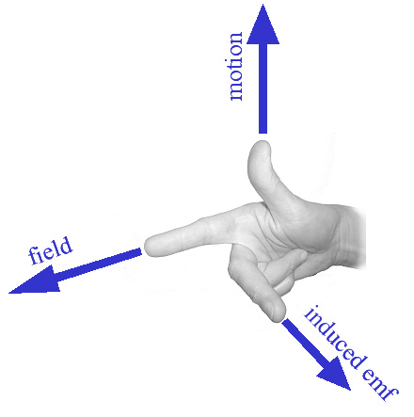
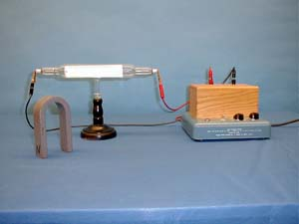
6B-02 Force on a Moving Charge
Investigating the behavior of moving charge in magnetic field
Which orientation of the magnet causes the beam to move upward ? Downward ?
Force
V┴
F = q (v┴ B)
B-Field
MAGNETIC FIELD CAUSES THE CHARGED PARTICLES TO DEFLECT. WE FIND THE DIRECTION OF FORCE WITH THE RIGHT-HAND RULE. THIS IS THE FORCE ON POSITIVE CHARGE!
Notes:
Discharge tube. Electron gun. Flourescent screen. Electron graze the screen cause the glow of green color.

Slide 9
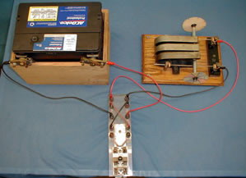
6B-06 Magnetic Force on a Current-Carrying Conductor
Finding the direction of Force on Current due to B-field
Based on the direction of the Magnetic Field and the direction that current flows, can you predict in which direction the Force points ?
B
F
I┴
F/L = I┴ B
Use right-hand rule to find direction of F
CURRENT FLOWING ALONG THE AXLE IS PERPENDICULAR TO THE MAGNETIC FIELD. THERE IS A FORCE ON THE AXLE, CAUSING IT TO ROLL. IF THE CURRENT IS REVERSED, THE AXLE ROLLS IN THE OPPOSITE DIRECTION.
Notes:
Forces along the rails

Slide 10
Two long parallel wires carry currents of 5 A and 10 A in opposite directions as shown.
What is the direction of the magnetic field produced by the 5-A wire at the position of the 10-A wire?
Perpendicular to the plane of the page and into the page
Perpendicular to the plane of the page and out of the page
Upward
Downward
Inward toward the other wire
Outward away from the other wire
Perpendicular to plane of page and into page

Slide 11
Two long parallel wires carry currents of 5 A and 10 A in opposite directions as shown.
What is the direction of the magnetic force acting on the 10-A wire?
Perpendicular to the plane of the page and into the page
Perpendicular to the plane of the page and out of the page
Upward
Downward
Inward toward the other wire
Outward away from the other wire

Slide 12
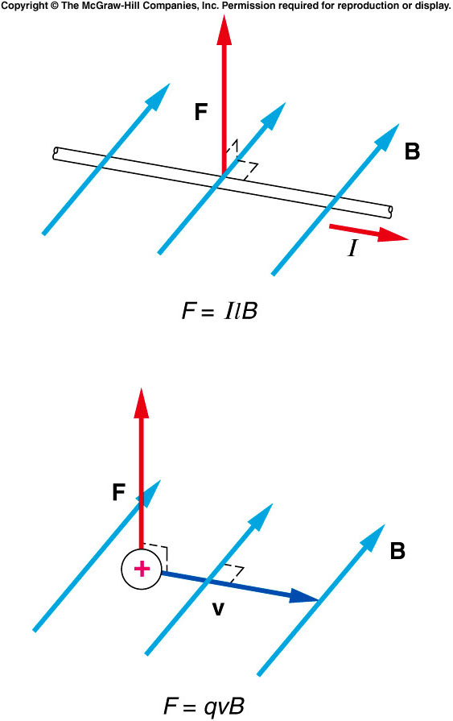
Because the force is perpendicular to the velocity of the particle, the force does no work on the particle.
  It cannot increase the particle’s kinetic energy; it only serves to change the direction of the particle’s motion.
  It provides a centripetal acceleration.
  If the charge is moving perpendicular to a uniform magnetic field, the particle will follow a circular path.
http://www.surendranath.org/Applets/Electricity/MovChgMag/MCM.html

Slide 13
Ch 14 CP 2
Small metal ball has charge q = +0.05C and mass, m = 0.025kg. Ball enters a region of magnetic field B = 0.5 T that is perpendicular to its velocity v = 200m/s. Centripetal acceleration = v²/r. What is radius of the curve ball will move thru in magnetic field?
200m
100m
250m
120m
50m
.
.
.
.
.
.
.
.

Slide 14
Ch 14 CP 2 (cont)
.
.
.
.
a) F = qv₁B = (0.05)(200)(0.5) = 5N
.
.
.
.
b) (see diagram) Force in –z direction
c) F = ma = qv₁B = 5N
a = 5N/0.025kg = 200 m/s²
d) v²/r = 200m/s² , r = v²/(200m/s²) = (200m/s)²/200m/s² = 200m

Slide 15
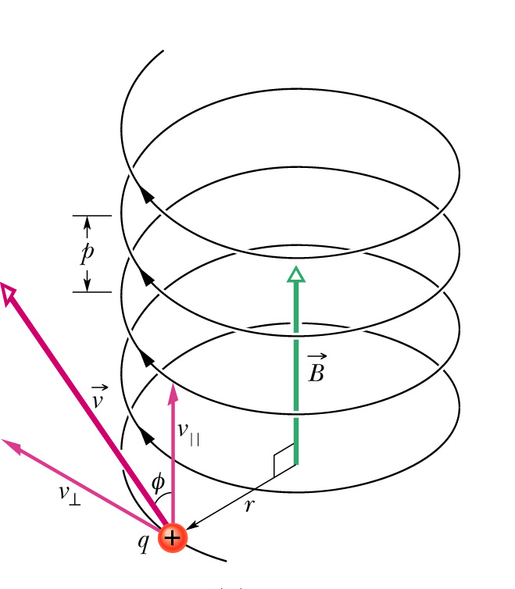
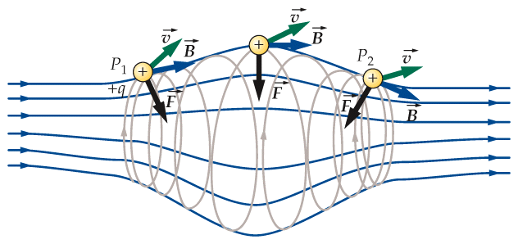
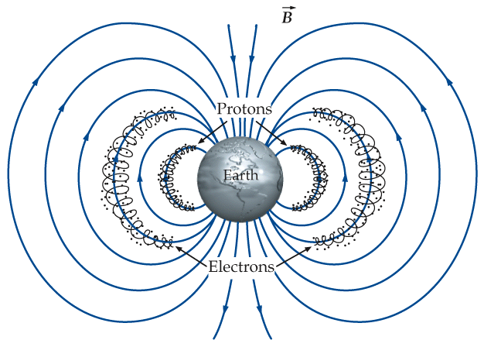
More complicated situations?
Also non-uniform B
v is not perpendicular to B
magnetic bottle
helical motion (spiral)
http://glencoe.mcgraw-hill.com/sites/0098458137/student_view0/chapter24/magnetic_field_applet.html
Van Allen belts

Slide 16
Quiz: A proton moves to the left in a space filled with magnetic field pointing into the page, what’s the direction of the force?
A). Up
B). Right
C). Left
D). down
E) out of the page

Slide 17
Back Up Slides

Slide 18
Alternating Current and Household Circuits
The current we draw from a wall outlet is alternating current (ac) rather than direct current (dc).
  Direct current implies that the current flows in a single direction from the positive terminal of a battery or power supply to the negative terminal
  Alternating current continually reverses its direction -- it flows first in one direction, then in the other, then back again.
  In North America the ac goes through 60 cycles each second (60 Hz).

Slide 19
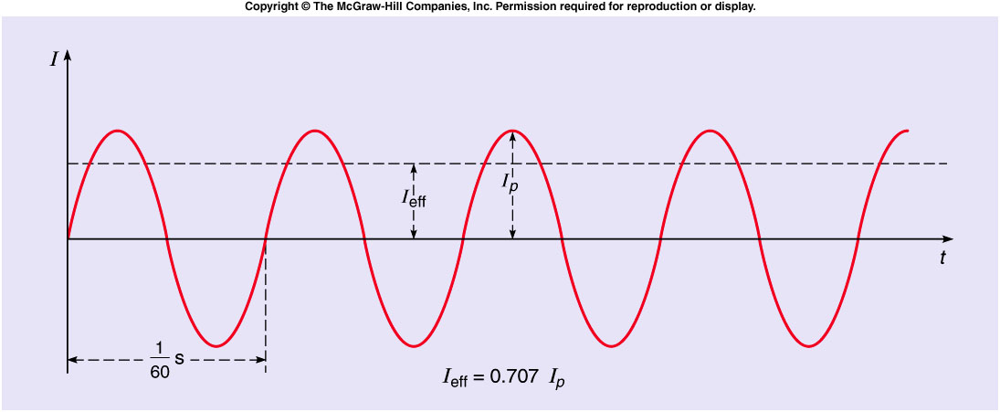
The plot of electric current as a function of time for an alternating current is a sinusoidal curve.
  The effective current or rms current is obtained by squaring the current, averaging this value over time, and taking the square root of the result.
  The effective current I_{eff} is 0.707 times the peak current I_{peak}.

Slide 20
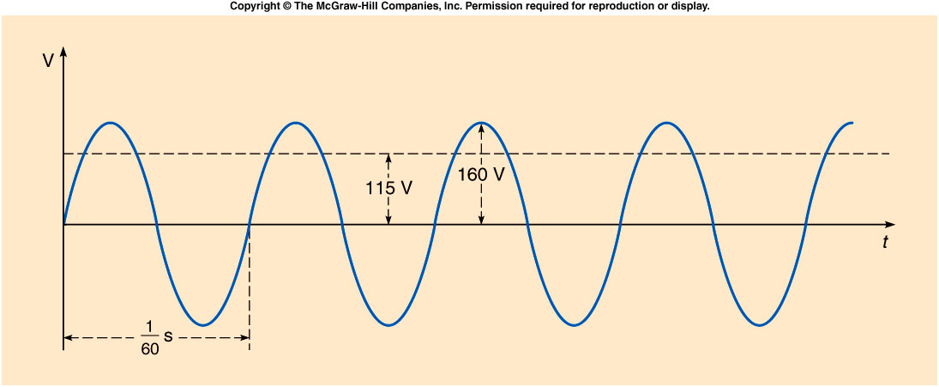
If we plot the voltage across an electrical outlet as a function of time, we get another sinusoidal curve.
  The effective value of this voltage is typically between 110 and 120 volts in North America.
  The standard household power supplied in this country is 115 volts, 60 hertz ac.

Slide 21
A 60-W light bulb is designed to operate on 120 V ac. What is the effective current drawn by the bulb?
0.2 A
0. 5 A
2.0 A
72 A
7200 A

Slide 22
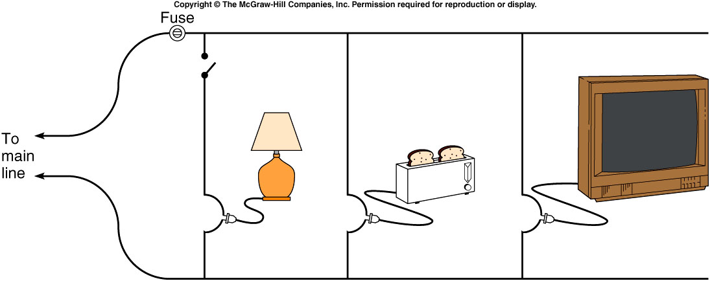
Household circuits are wired in parallel so that different appliances can be added to or removed from the circuit without affecting the voltage available.
  As you add more appliances, the total current drawn increases, because the total effective resistance of the circuit decreases when resistances are added in parallel.
  Since too large a current could cause the wires to overheat, a fuse or circuit breaker in series with one leg of the circuit will disrupt the circuit if the current gets too large.
  Appliances with larger power requirements (stoves, clothes dryers, etc) are usually connected to a separate 220-V line.

Slide 23
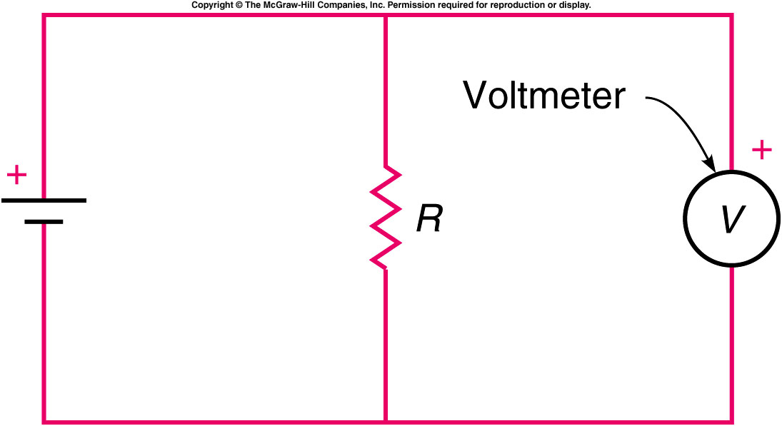
A voltmeter measures the voltage difference between two points in a circuit, or across an element in a circuit
  It is inserted in parallel with the element whose voltage difference is being measured.
  A voltmeter should have a large resistance, so that it does not divert much current from the component whose voltage is being measured.

Slide 24
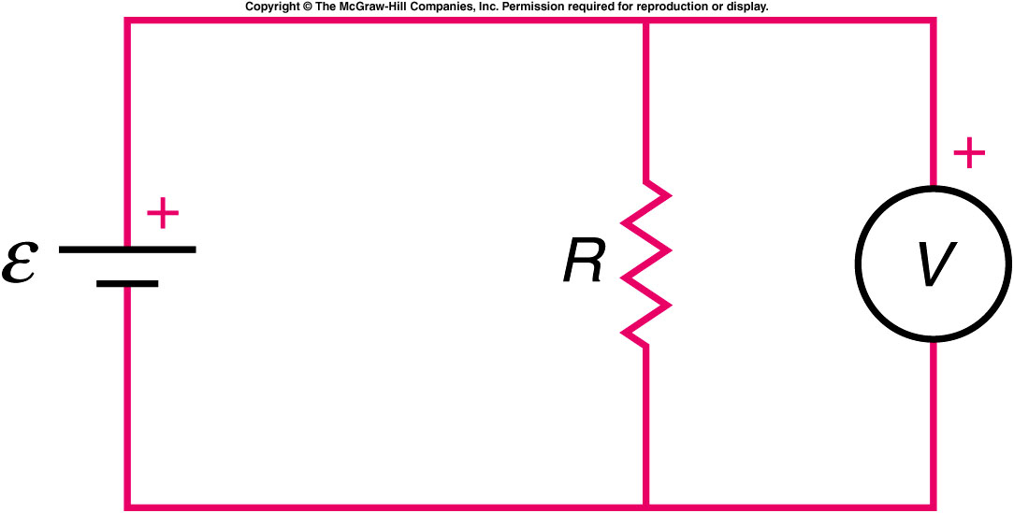
In the circuit shown, the circle with a V in it represents a voltmeter. Which of the following statements is correct?
The voltmeter is in the correct position for measuring the voltage difference across R.
No current will flow through the meter, so it will have no effect.
The meter will draw a large current.
The correct statement is (a). A voltmeter is a high-resistance device connected in parallel with whatever circuit element it is desired to measure the voltage across.

Slide 25
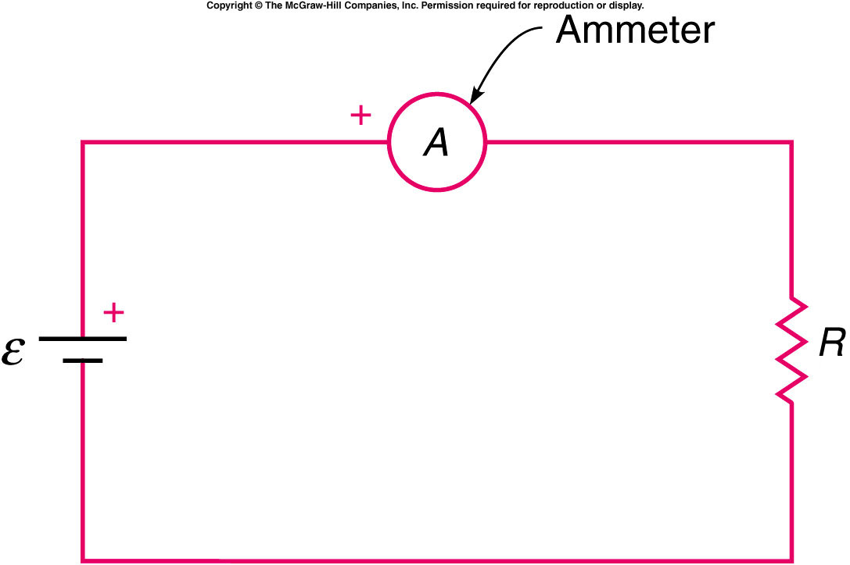
An ammeter measures the electric current flowing through a point in a circuit.
  It is inserted in series into the circuit whose current is being measured, so that all the current flows through it.
  An ammeter should have a small resistance, so that its effect on the current is small.
  If you place an ammeter directly across the terminals of a battery, you could damage the meter and the battery.

Slide 26
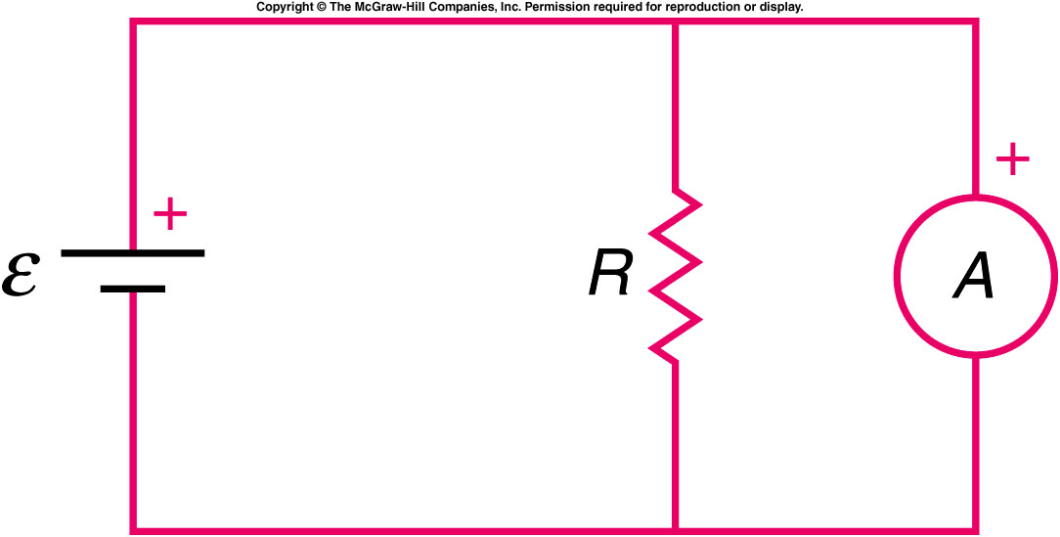
In the circuit shown, the circle with an A in it represents an ammeter. Which of the following statements is correct?
The meter is in the correct position for measuring the current through R.
No current will flow through the meter, so it will have no effect.
The meter will draw a significant current from the battery.
The answer is (c). An ammeter is a low-resistance device and is to be placed in series in the circuit, just as a flow-meter is placed in a fluid circuit.

