Slide 1
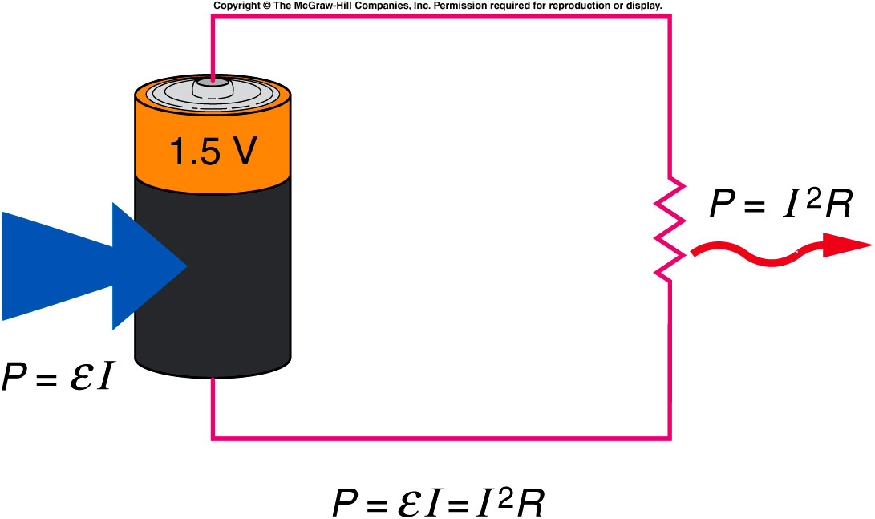
Energy source → potential energy → kinetic energy → heat
Since voltage is potential energy per unit charge, multiplying a voltage difference by charge yields energy.
Since current is the rate of flow of charge, multiplying a voltage difference by current yields power, the rate of energy use.
The power supplied by a source must equal the power dissipated in the resistances.

Slide 2
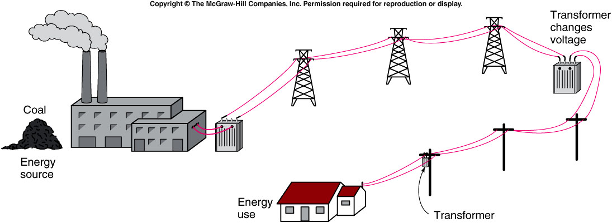
The ease with which electric power can be transmitted over considerable distances is one of its main advantages over other forms of energy.
  The source of the energy might be gravitational potential energy of water, chemical potential energy stored in fossil fuels, or nuclear potential energy stored in uranium.
  Power plants all use electric generators that convert mechanical kinetic energy produced by turbines to electric energy.
  These generators are the source of the electromotive force.

Slide 3
The unit of energy commonly used to discuss electric energy is the kilowatt-hour, which is a unit of power (the kilowatt) multiplied by a unit of time (an hour).
  1 kilowatt equals 1000 watts
  1 hour = 3600 seconds
  1 kilowatt-hour equals 3.6 million joules
The kilowatt-hour is a much larger unit of energy than the joule, but it is a convenient size for the amounts of electrical energy typically used in a home.

Slide 4
How much does it cost to light a 100-watt light bulb for one day? Assume an average rate of cost of 10 cents per kilowatt-hour.
a) 0.24 cents b) 2.4 cents c) 24 cents d) $2.40 e) $24
Energy used = power x time Cost = energy used x rate of cost
= (100 W)(24 hr) = (2.4 kWh)(10 cents / kWh)
= 2400 Wh = (2.4 kWh)(10 cents / kWh)
= 2.4 kWh = 24 cents

Slide 5
Quiz: What is the power dissipated in a 20-Ω light bulb powered by two 1.5-V batteries in series?
0.15 W
0.45 W
3.0 W
6.67 W
60 W

Slide 6
Magnets and the Magnetic Force
We are generally more familiar with magnetic forces than with electrostatic forces.
  Like the gravitational force and the electrostatic force, this force acts even when the objects are not touching one another.
Is there a relationship between electrical effects and magnetism?
  Maxwell discovered that the electrostatic force and the magnetic force are really just different aspects of one fundamental electromagnetic force.
Our understanding of that relationship has led to numerous inventions such as electric motors, electric generators, transformers, etc.

Slide 7
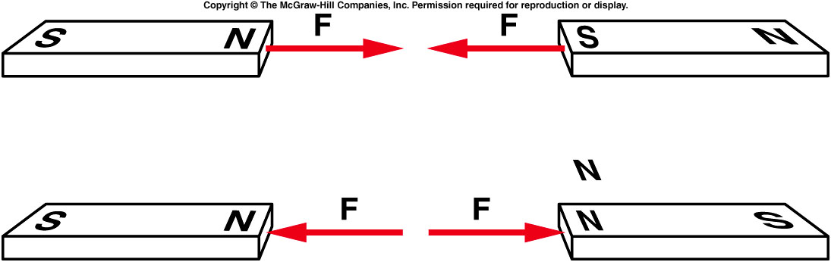
The force that two poles exert on one another varies with distance or pole strength.
  The magnetic force between two poles decreases with the square of the distance between the two poles, just as the electrostatic force does.
  Like poles repel one another, and unlike poles attract one another.

Slide 8
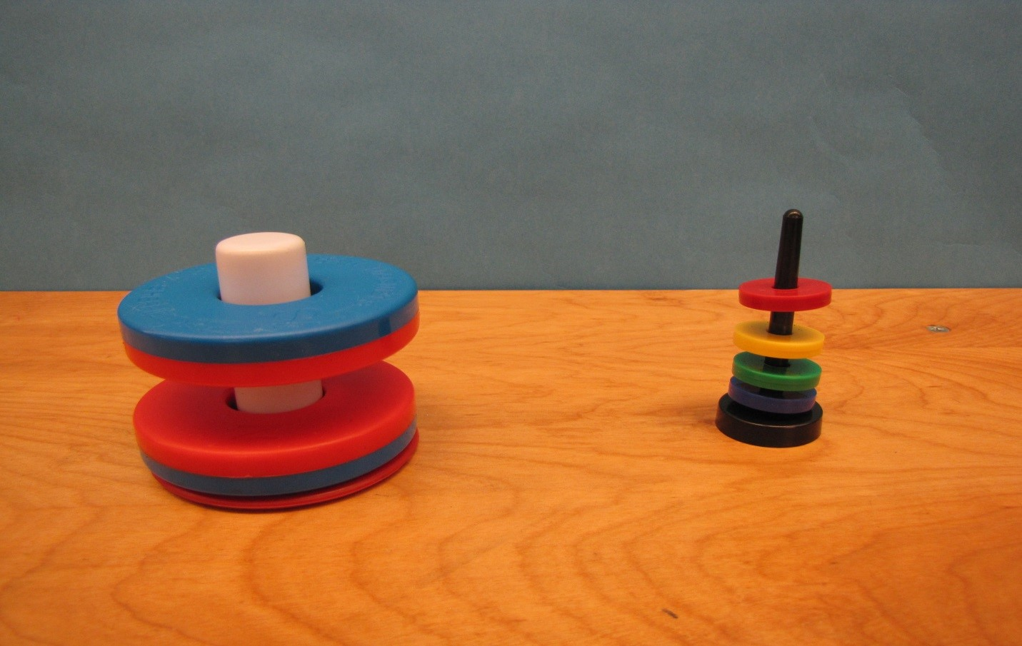
6A-07 Floating Magnets

Slide 9
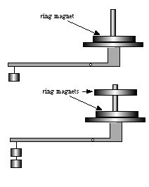
6A-02 Weighing a Suspended Magnet
Using equal and opposite forces between magnets to weigh magnet
Will the scale still balance when the second magnet floats ?
The scale will read the sum of forces acting on bottom magnet: F_{magnetic} + F_{gravity}
The top magnet is floating so: F_{magnetic} = F_{gravity}
The scale reads: F_{magnetic} + F_{gravity} = 2 F_{gravity} = 2mg
F_{magnetic}
F_{gravity}
F_{gravity}
?
F_{magnetic}
yes.
No.
Notes:
A ring magnet placed over a dowel rod is set on the pan of a platform balance. The balance is then adjusted. A second ring magnet, identical to the first, is placed over the dowel rod in such a way that the magnets repel each other. The second magnet is thus “floating” above the other. In this case the balance is upset and a weight equal to the weight of the second magnet is required to bring it back to balance. The demonstration shows that the second magnet’s weight is sensed by the balance even though it isn’t actually “touching” the apparatus.

Slide 10
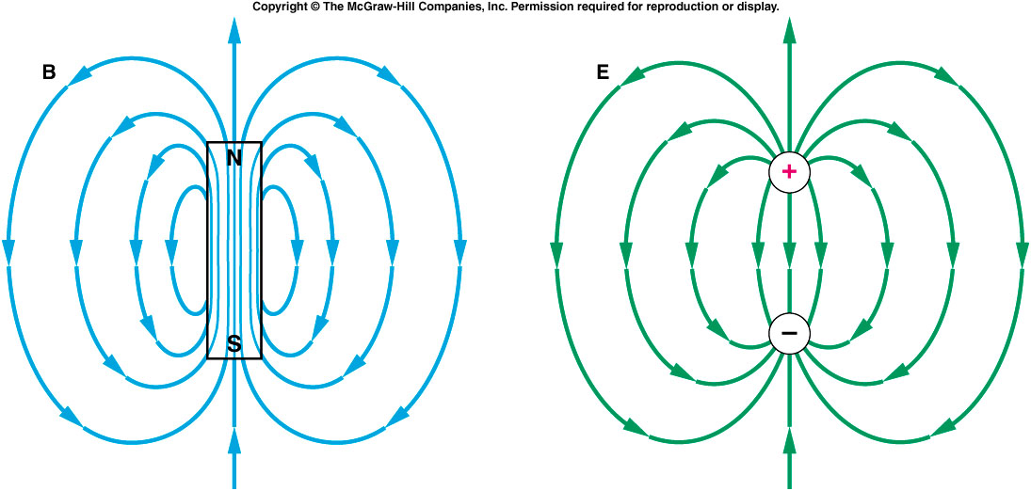
Magnetic field lines produced by a magnetic dipole form a pattern similar to the electric field lines produced by an electric dipole.
  Electric field lines originate on positive charges and terminate on negative charges.
  Magnetic field lines form continuous loops: they emerge from the north pole and enter through the south pole, pointing from the north pole to the south pole outside the magnet.
  Inside the magnet, they point from the south pole to the north pole.

Slide 11
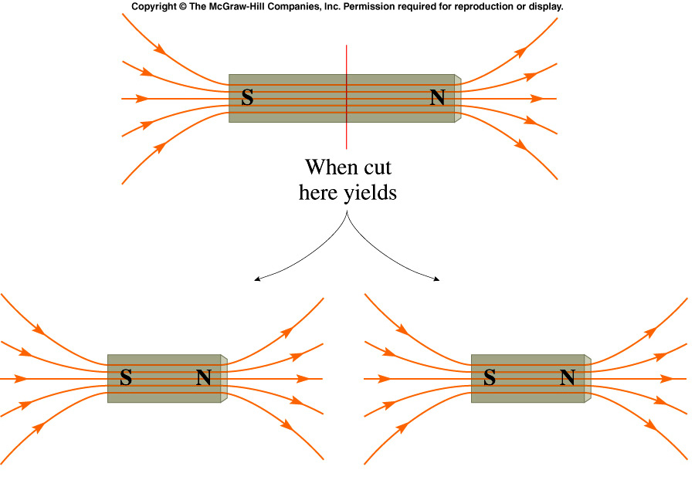
Magnetic Monopoles
Does there exist magnetic charge, just like electric charge? An entity which carried such magnetic charge would be called a magnetic monopole (having + or - magnetic charge).
How can you isolate this magnetic charge? Try cutting a bar magnet in half.
In fact no attempt has been successful in finding magnetic monopoles in nature.

Slide 12
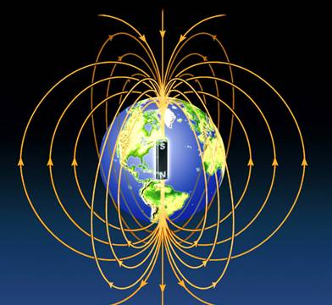
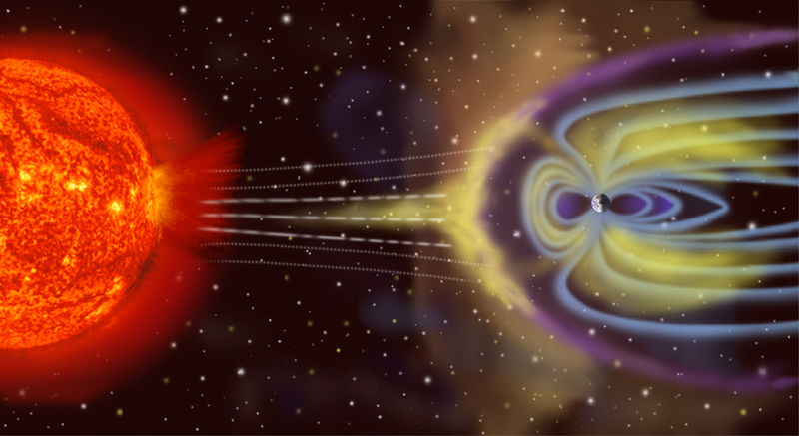
Is the Earth a magnet?
The north (north-seeking) pole of a compass needle points toward the Earth’s “North Pole.”

Slide 13
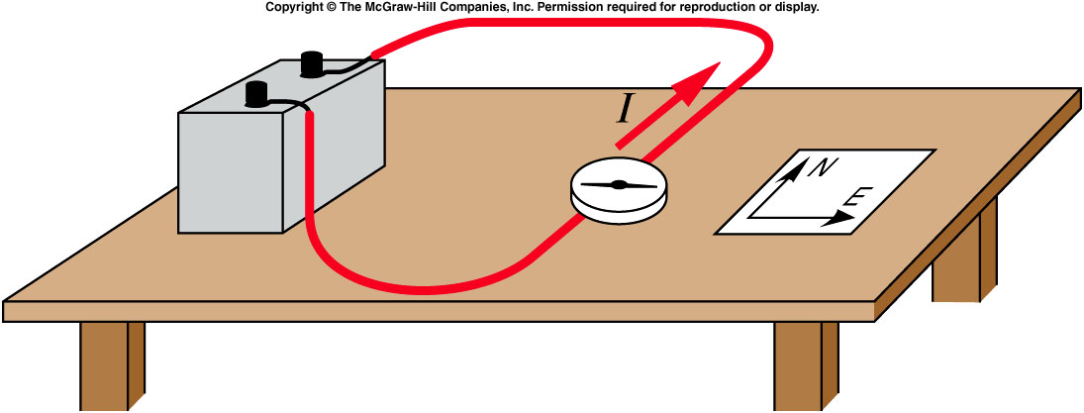
Magnetic Effects of Electric Currents
Oersted discovered that a compass needle was deflected by a current-carrying wire.
  With the wire oriented along a north-south line, the compass needle deflects away from this line when there is current flowing in the wire.

Slide 14
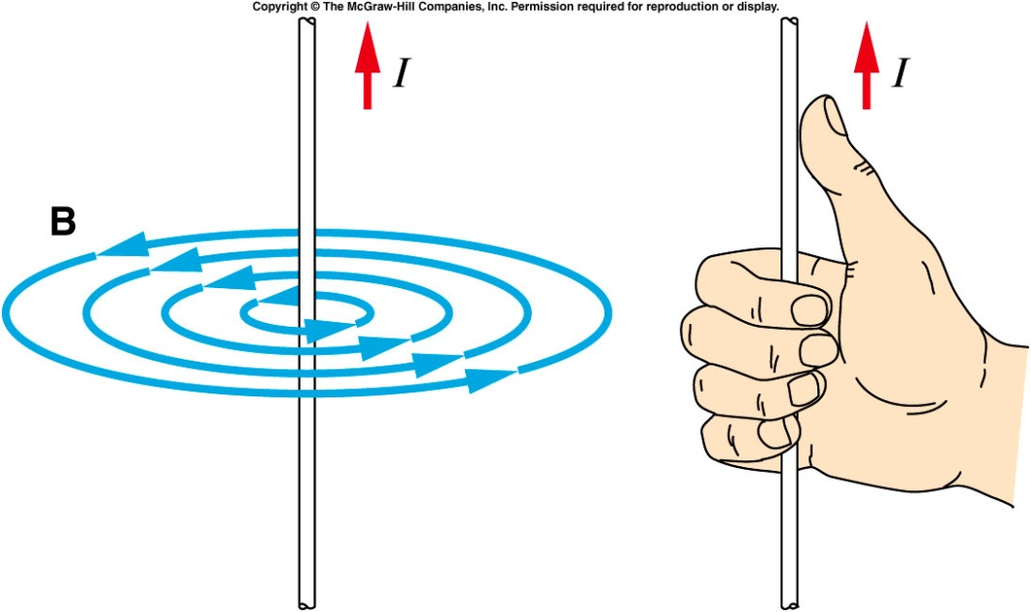
The magnetic field produced by the current is perpendicular to the direction of the current.
The magnetic field lines produced by a straight, current-carrying wire form circles centered on the wire.
  The right-hand rule gives the direction of the field lines: with the thumb in the direction of the current, the fingers curl in the direction of the field lines produced by that current.
  The effect gets weaker as
  the compass is moved
  away from the wire.

Slide 15

Two parallel current-carrying wires exert an attractive force on each other when the two currents are in the same direction, otherwise they repel.

Slide 16
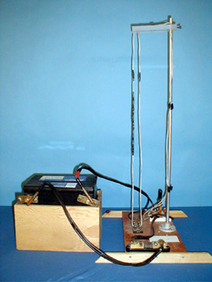
6B-10: magnetic force between two wires

Slide 17
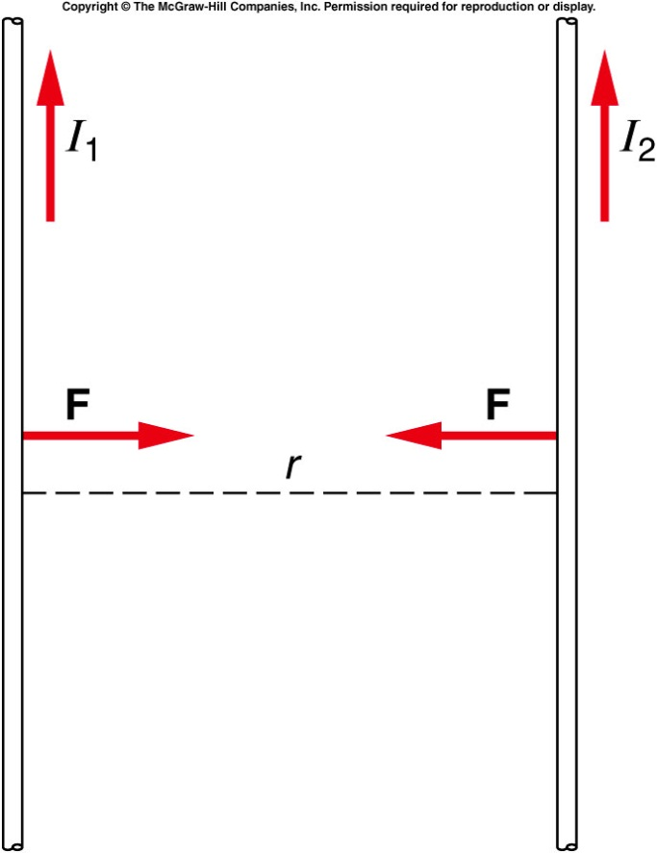
Two parallel current-carrying wires exert an attractive force on each other when the two currents are in the same direction, otherwise they repel.
  The force is proportional to the two currents (I₁ and I₂) and inversely proportional to the distance r between the two wires:
  One ampere (A) is the amount of current
  flowing in each of two parallel wires
  separated by a distance of 1 meter that
  produces a force per unit length on each
  wire of 2 x 10⁻⁷ N/m.

Slide 18
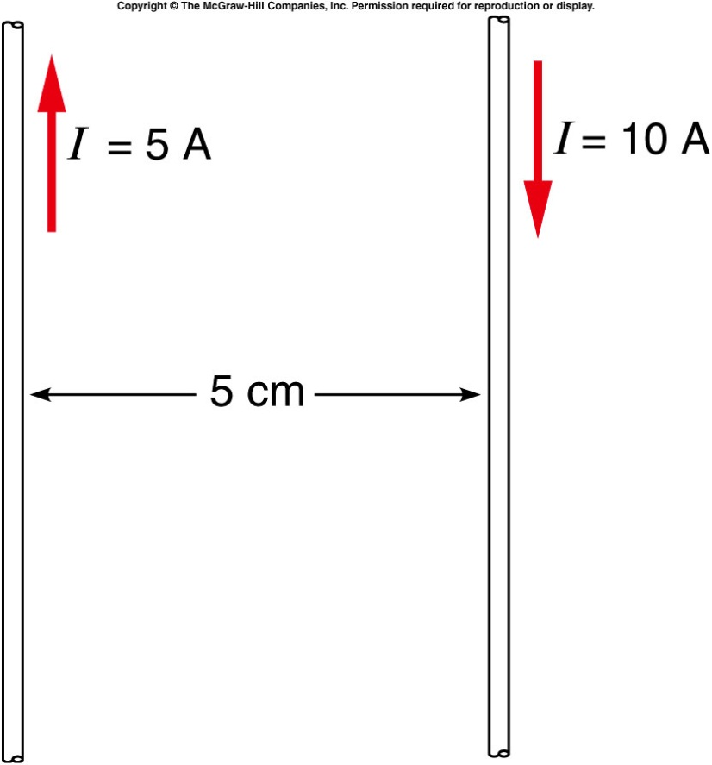
Two long parallel wires carry currents of 5 A and 10 A in opposite directions as shown.
What is the magnitude of the force per unit length exerted by one wire on the other?
2.0 x 10⁻⁶ N/m
5.0 x 10⁻⁶ N/m
2.0 x 10⁻⁴ N/m
50 N/m
1000 N/m

Slide 19
Two long parallel wires carry currents of 5 A and 10 A in opposite directions as shown.
What is the total force exerted on a 30-cm length of the 10-A wire?
2.0 x 10⁻⁶ N
3.0 x 10⁻⁶ N
2.0 x 10⁻⁵ N
6.0 x 10⁻⁵ N
2.0 x 10⁻⁴ N

Slide 20
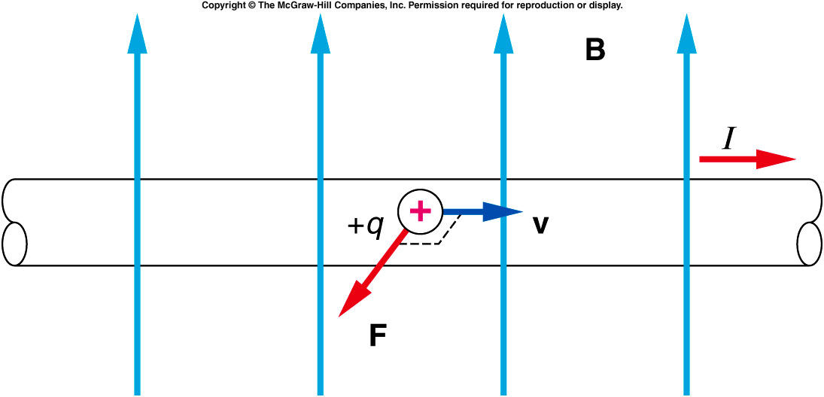
Magnetic forces are exerted by magnets on other magnets, by magnets on current-carrying wires, and by current-carrying wires on each other.
  The force exerted by one wire on the other is attractive
  when the currents are flowing in the same direction and
  repulsive when the currents are flowing in opposite
  directions.
  The magnetic force exerted on a moving charge of an electric current is perpendicular to both the velocity of the charges and to the magnetic field.
  This force is
  proportional to the
  quantity of the charge
  and the velocity of the
  moving charge and to
  the strength of the
  magnetic field:

Slide 21
Quiz: Two long parallel wires carry currents of 5 A and 10 A in opposite directions as shown.
What are the directions of the forces on each wire?
The wires exert an attractive force on each other.
The wires exert a force repelling each other.
Each wire exerts a force on the other in the direction of the other wire’s current (the red arrows shown).
Each wire exerts a force on the other in the direction opposite to the other one’s current.
The wires exert no force on each other.
The wires repel each other.

Slide 22
Back Up Slides

Slide 23
Alternating Current and Household Circuits
The current we draw from a wall outlet is alternating current (ac) rather than direct current (dc).
  Direct current implies that the current flows in a single direction from the positive terminal of a battery or power supply to the negative terminal
  Alternating current continually reverses its direction -- it flows first in one direction, then in the other, then back again.
  In North America the ac goes through 60 cycles each second (60 Hz).

Slide 24
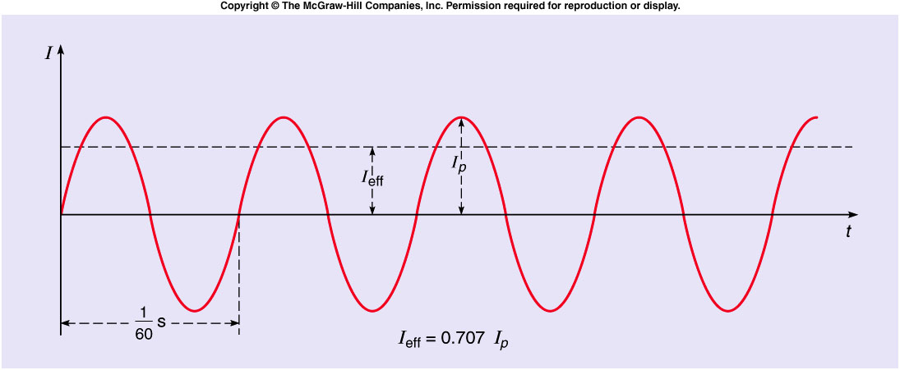
The plot of electric current as a function of time for an alternating current is a sinusoidal curve.
  The effective current or rms current is obtained by squaring the current, averaging this value over time, and taking the square root of the result.
  The effective current I_{eff} is 0.707 times the peak current I_{peak}.

Slide 25
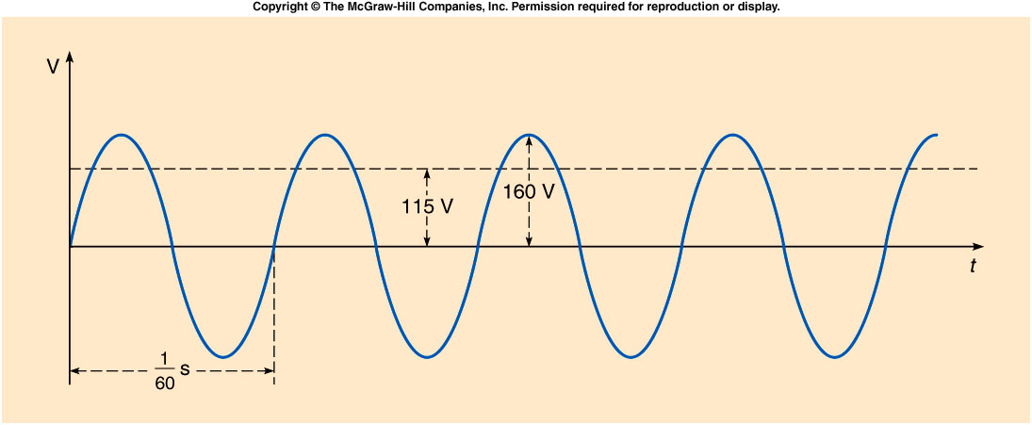
If we plot the voltage across an electrical outlet as a function of time, we get another sinusoidal curve.
  The effective value of this voltage is typically between 110 and 120 volts in North America.
  The standard household power supplied in this country is 115 volts, 60 hertz ac.

Slide 26
A 60-W light bulb is designed to operate on 120 V ac. What is the effective current drawn by the bulb?
0.2 A
0. 5 A
2.0 A
72 A
7200 A

Slide 27
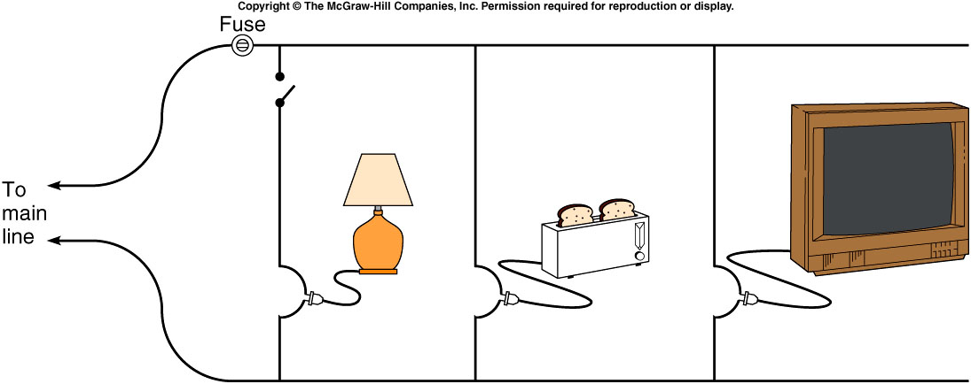
Household circuits are wired in parallel so that different appliances can be added to or removed from the circuit without affecting the voltage available.
  As you add more appliances, the total current drawn increases, because the total effective resistance of the circuit decreases when resistances are added in parallel.
  Since too large a current could cause the wires to overheat, a fuse or circuit breaker in series with one leg of the circuit will disrupt the circuit if the current gets too large.
  Appliances with larger power requirements (stoves, clothes dryers, etc) are usually connected to a separate 220-V line.

Slide 28
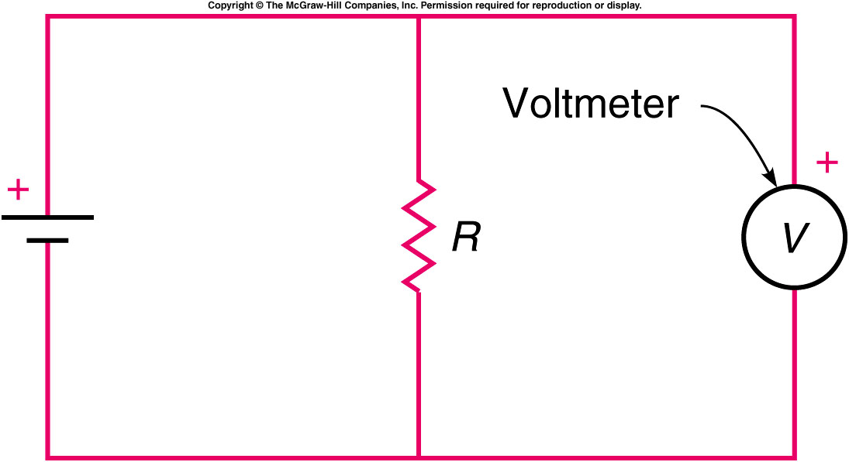
A voltmeter measures the voltage difference between two points in a circuit, or across an element in a circuit
  It is inserted in parallel with the element whose voltage difference is being measured.
  A voltmeter should have a large resistance, so that it does not divert much current from the component whose voltage is being measured.

Slide 29
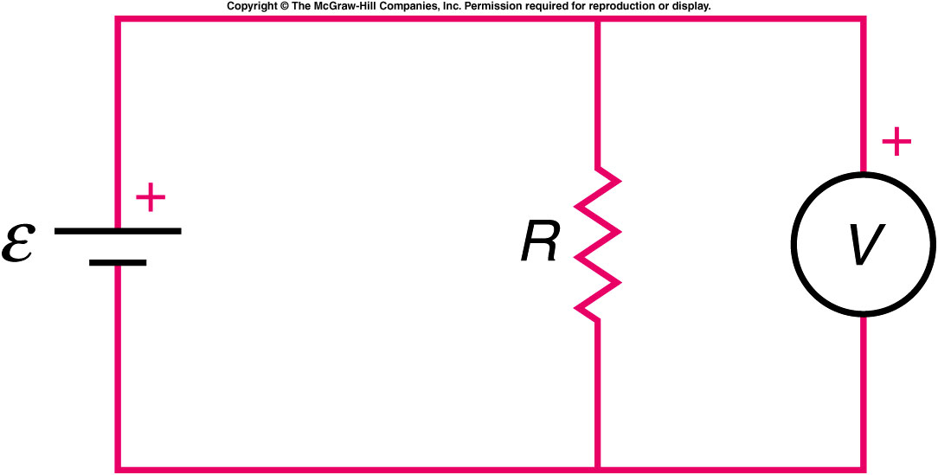
In the circuit shown, the circle with a V in it represents a voltmeter. Which of the following statements is correct?
The voltmeter is in the correct position for measuring the voltage difference across R.
No current will flow through the meter, so it will have no effect.
The meter will draw a large current.
The correct statement is (a). A voltmeter is a high-resistance device connected in parallel with whatever circuit element it is desired to measure the voltage across.

Slide 30
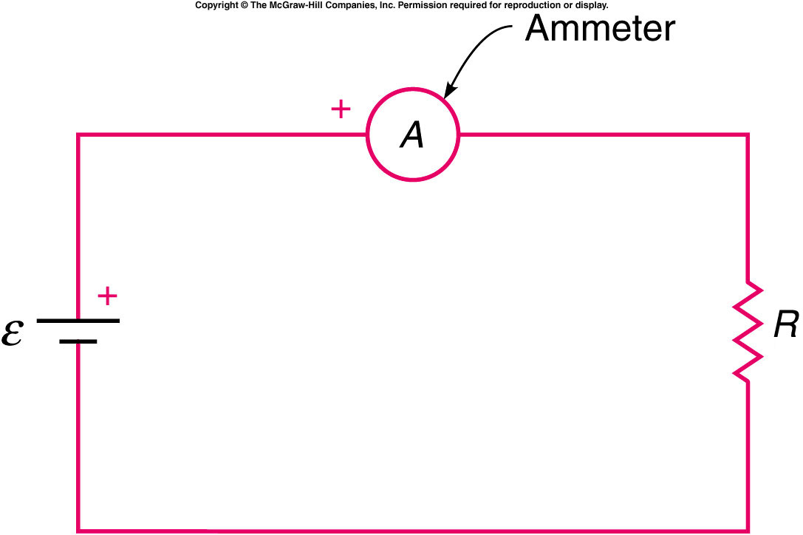
An ammeter measures the electric current flowing through a point in a circuit.
  It is inserted in series into the circuit whose current is being measured, so that all the current flows through it.
  An ammeter should have a small resistance, so that its effect on the current is small.
  If you place an ammeter directly across the terminals of a battery, you could damage the meter and the battery.

Slide 31
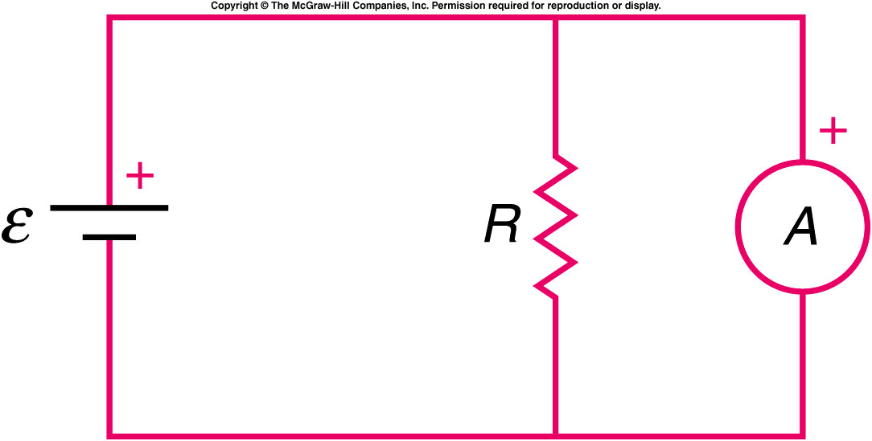
In the circuit shown, the circle with an A in it represents an ammeter. Which of the following statements is correct?
The meter is in the correct position for measuring the current through R.
No current will flow through the meter, so it will have no effect.
The meter will draw a significant current from the battery.
The answer is (c). An ammeter is a low-resistance device and is to be placed in series in the circuit, just as a flow-meter is placed in a fluid circuit.

