Slide 1
The Electric Field
How do the charges exert forces on each other, when they are not even touching?
  The concept of an electric field describes how one charge affects the space around it, which then exerts a force on another charge.
  The electric field at a given point in space is the electric force per unit positive charge that would be exerted on a charge if it were placed at that point.

Slide 2
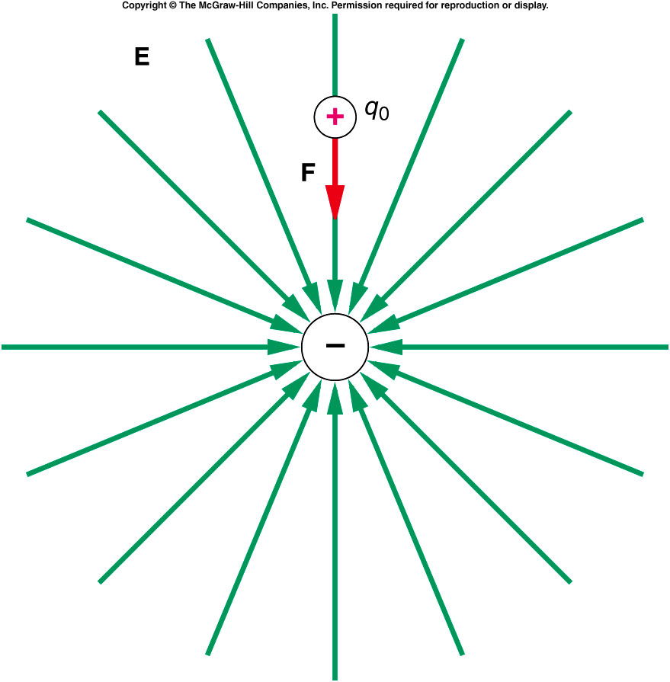
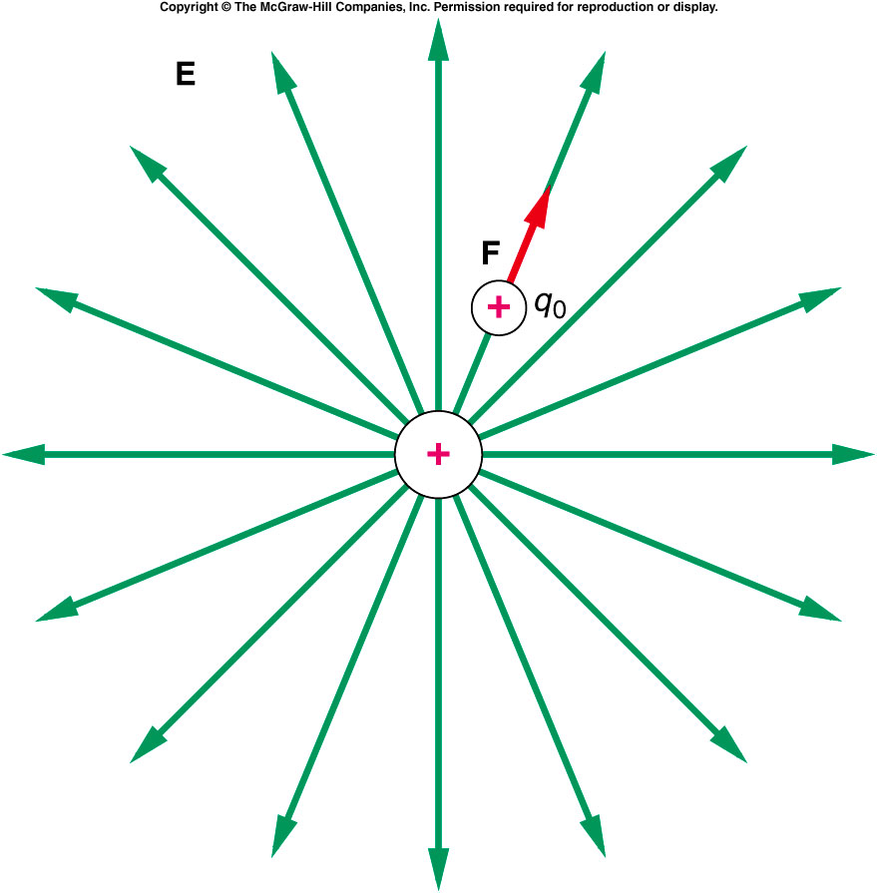
Are Q1 and Q2 positive or negative ?
Q1 is positive, Q2 is negative
Q1 is positive, Q2 is positive
Q1 is negative, Q2 is negative
Q1 is negative, Q2 is positive
Q2
Q1

Slide 3
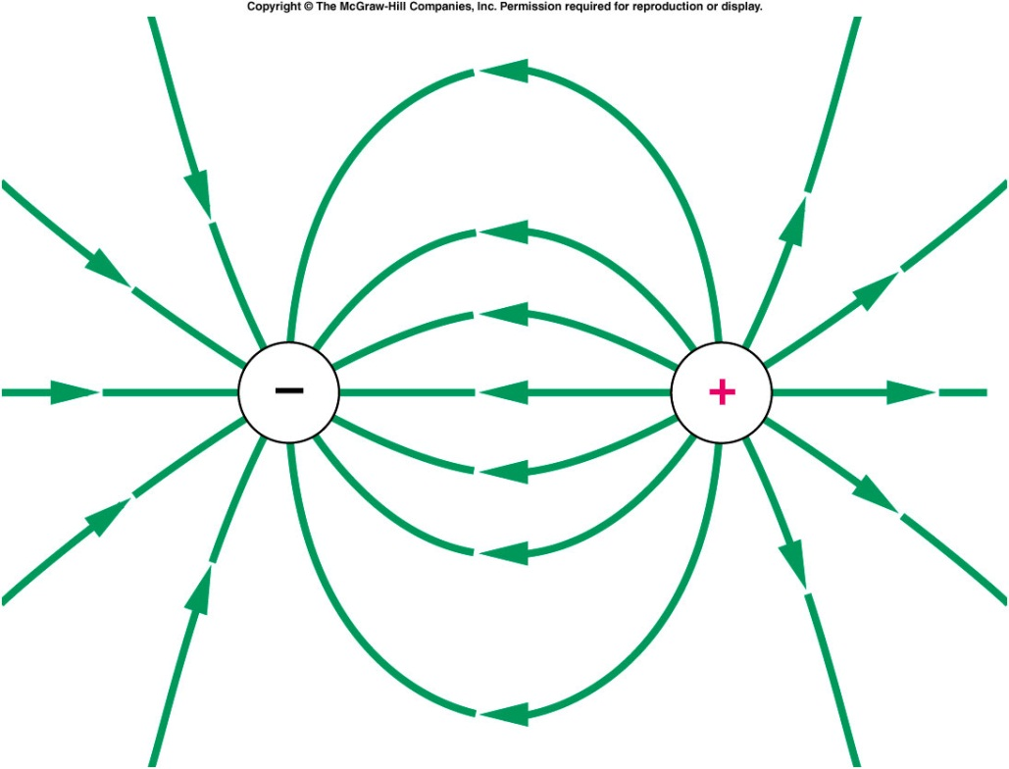
An electric dipole is two charges of equal magnitude but opposite sign, separated by a small distance.
  Electric field lines originate on positive charges and end on negative charges.
The field lines point away from the positive charge, and in toward the negative charge.
Notes:
This only true for static electricity

Slide 4
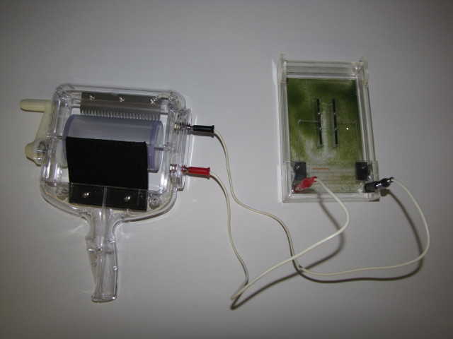
Demos: 5A-34 Electric Field Lines
Notes:
an observation tank which consists of a fine electrified powder in oil; several different electrode plates

Slide 5
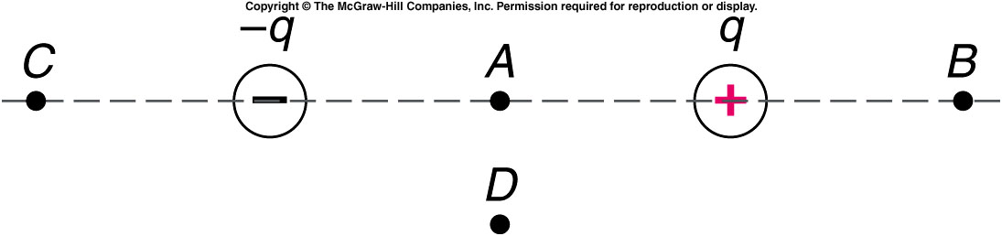
Two charges, of equal magnitude but opposite sign, lie along a line as shown. What are the directions of the electric field at points A, B, C, and D?
A:left, B:left, C:right, D:right
A:left, B:right, C:right, D:right
A:left, B:right, C:right, D:left
A:right, B:left, C:left, D:right
A:right, B:left, C:right, D:right

Slide 6
If we change the negative charge in the diagram for question 21 to a positive charge of the same magnitude, what are the directions of the electric field at points A, B, C, and D? (Indicate with arrows.)
q
q
C
A
B
•
+
•
•
+
D
•
A:n/a, B:right, C:left, D:down
A:n/a, B:right, C:left, D:up
A:n/a, B:left, C:right, D:left

Slide 7
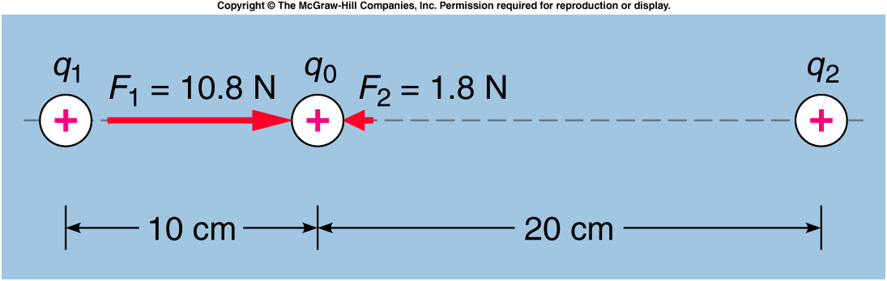
Quiz: What is the electric field at the location of the charge q₀ =4x10⁻⁶ C due to the other two charges?
2.25 N/C to the left
3.0 N/C to the left
4.5 N/C to the left
2.25 N/C to the right
3.0 N/C to the right
4.5 N/C to the right

Slide 8
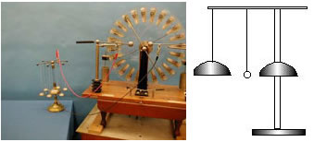
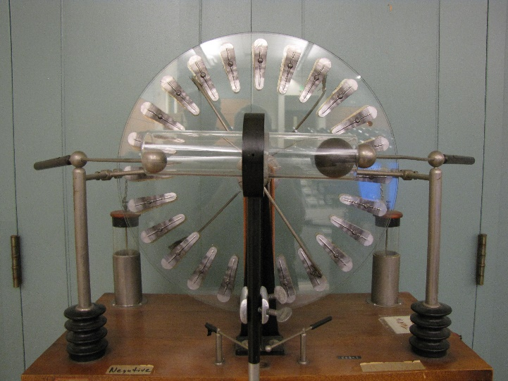
5A-10 Motion in an Electric Field
The effects of transferring charge
+
-
+
-
What is the movement of the balls ?
THE BALL IS ATTRACTED TO ONE TERMINAL THEN RECEIVES A CHARGE AND THEN IS REPELLED TO THE OTHER TERMINAL, WHERE IT PICKS UP THE OPPOSITE CHARGE AND IS REPELLED.
Notes:
A set of electric “chimes,” consisting of four bells suspended from conducting threads, and a central bell affixed to an insulating stand. A small ball is suspended from an insulating thread so it hangs between the two bells. The central bell is grounded (or attached to the opposite terminal), whereas the other four bells are are charged from a small Wimshurst machine. The hanging ball is attracted to the hanging bell by charge induction, causing the ball to strike the bell. The ball then picks up up the charge of the bell and is repelled, causing it to strike the central (grounded) bell. The ball is discharged and the process begins all over again.

Slide 9
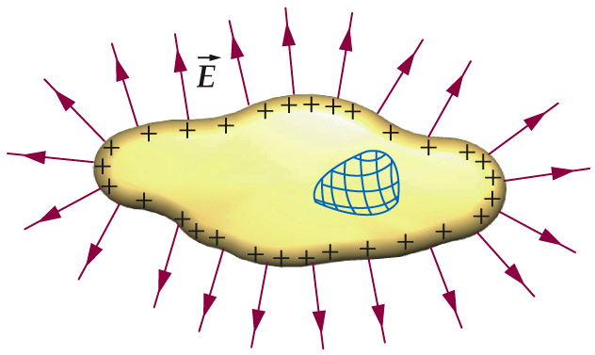
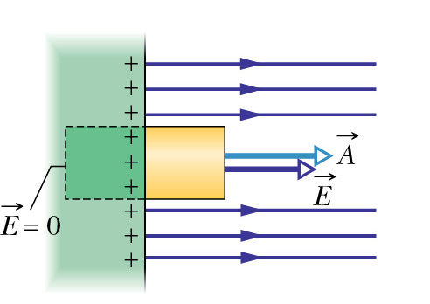
Charges and fields of a conductor
In electrostatic equilibrium, free charges inside a conductor do not move. Thus, E = 0 everywhere in the interior of a conductor.
Since E = 0 inside, there are no net charges anywhere in the interior. Net charges can only be on the surface(s).
The electric field must be perpendicular to the surface just outside a conductor, since, otherwise, there would be currents flowing along the surface.
Notes:
What’s a conductor? Any object with free moving charges.
Why the E above a conductor surface is different from a thin sheet of uniform charged.
Warm-up quiz give one of the reason. It’s because of the contribution from other sources.

Slide 10
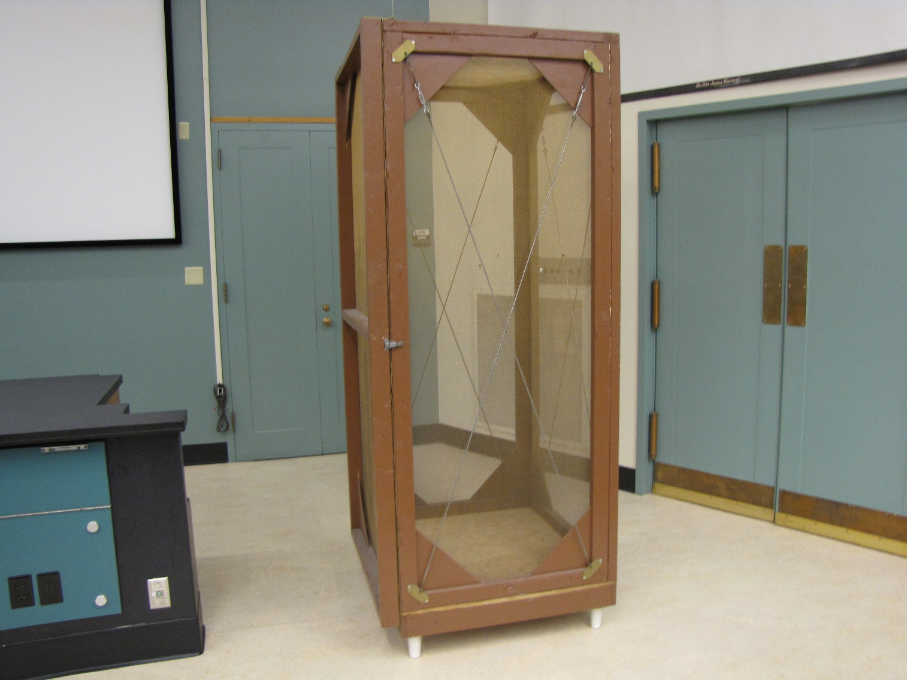
Demos: 5A-11 Electrostatic Shielding (Faraday Cage)
Notes:
Put a radio inside it.

Slide 11
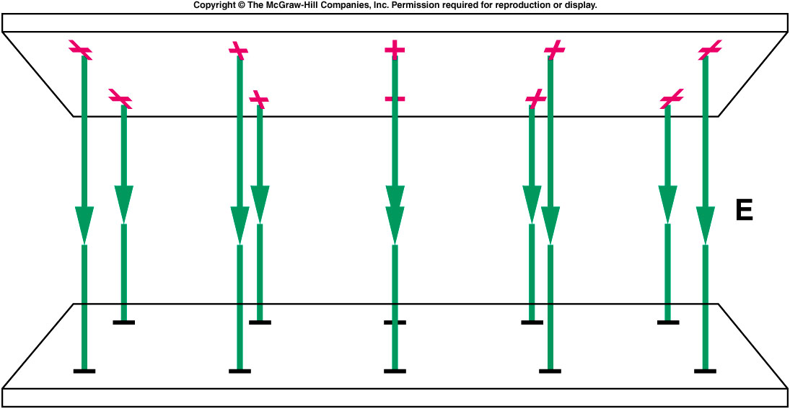
Electric Potential Energy and Electric Potential
The electrostatic force is a conservative force, which means we can define an electrostatic potential energy.
  We can therefore define electric potential or voltage.
Two parallel metal plates containing equal but opposite charges produce a uniform electric field between the plates.
This arrangement is an example of a capacitor, a device to store charge.

Slide 12
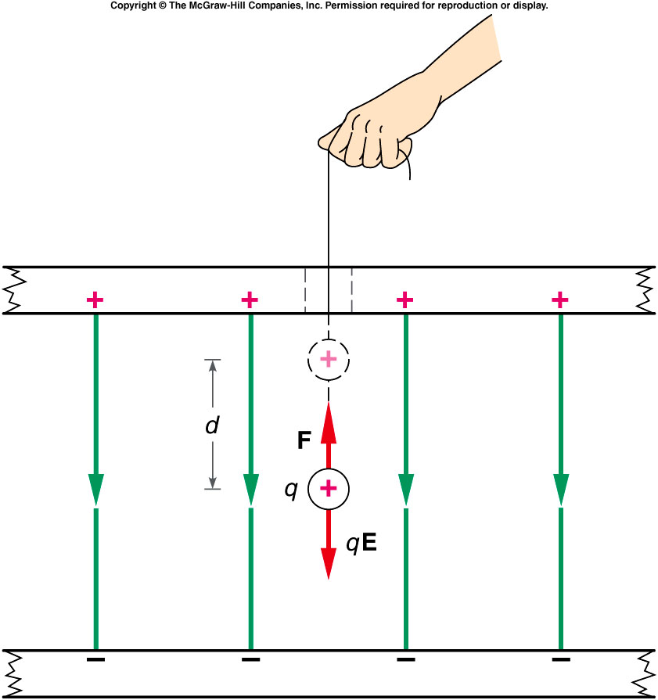
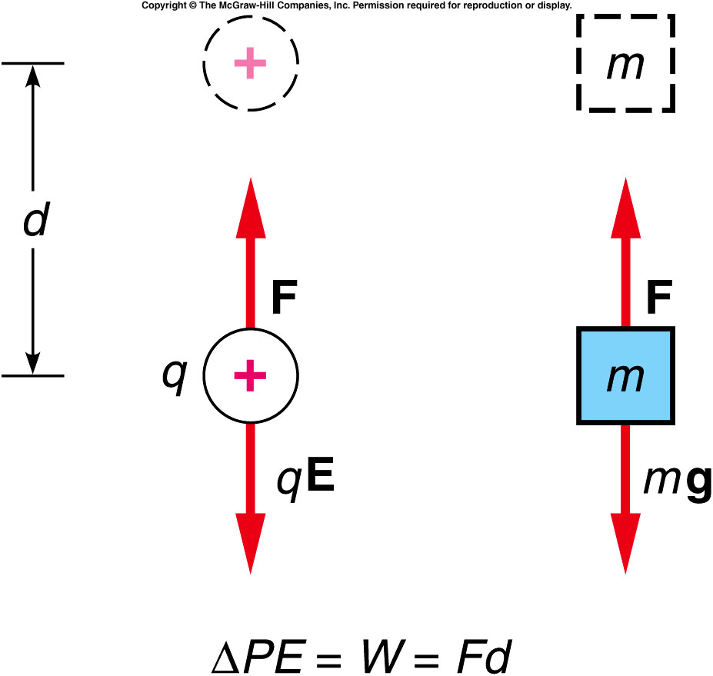
A positive test charge placed in the uniform electric field will experience an electrostatic force in the direction of the electric field.
An external force F, equal in magnitude to the electrostatic force qE, will move the charge q a distance d in the uniform field.
The external force does work on the charge and increases the potential energy of the charge.
The work done by the external force is qEd, the force times the distance.
This is equal to the increase in potential energy of the charge: ΔPE = qEd.
This is analogous to what happens when a mass m is lifted against the gravitational force.

Slide 13
Electric potential is related to electrostatic potential energy in much the same way as electric field is related to electrostatic force.
The change in electric potential is equal to the change in electrostatic potential energy per unit of positive test charge:
Electric potential and potential energy are closely related, but they are NOT the same.
  If the charge q is negative, its potential energy will decrease when it is moved in the direction of increasing electric potential.
It is the change in potential energy that is meaningful.

Slide 14
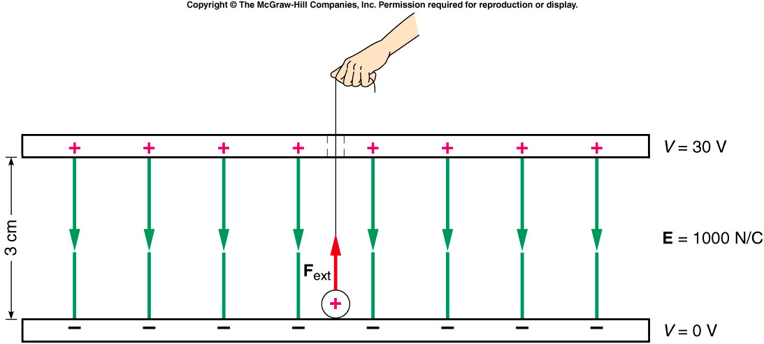
Two plates are oppositely charged so that they have a uniform electric field of 1000 N/C between them, as shown. A particle with a charge of +0.005 C is moved from the bottom (negative) plate to the top plate. What is the change in potential energy of the charge?
0.15 J
0.3 J
0.5 J
0.8 J
1.5 J

Slide 15
What is the change in electric potential from the bottom to the top plate?
0.15 V
0.3 V
5 V
30 V
150 V

Slide 16
Electric Potential Produced by a Point Charge
The field outside of a conducting sphere is the same as that produced by a point charge located at the center of the sphere.
For a positive point charge, the electric potential increases as we move closer to the charge.
For a negative point charge, the electric potential increases as we move away from the charge.
V = 0 at infinity
electric potential fall along the field line direction.
Notes:
Tell the to get V(q), one need calculus. Just ask students to take it as is. Then

Slide 17
A spherical shell is uniformly charged with a positive charge density σ. Which of the following statements is (are) true? Select one of (a) – (e).
An electron would have a higher potential energy at point A than at point B
A proton would have a higher potential energy at point A than at point B
The electric potential is lower at A than at B
The electric potential is higher at A than at B
1 and 3 only
1 and 4 only
2 and 3 only
2 and 4 only
None of them
A
B
σ

Slide 18
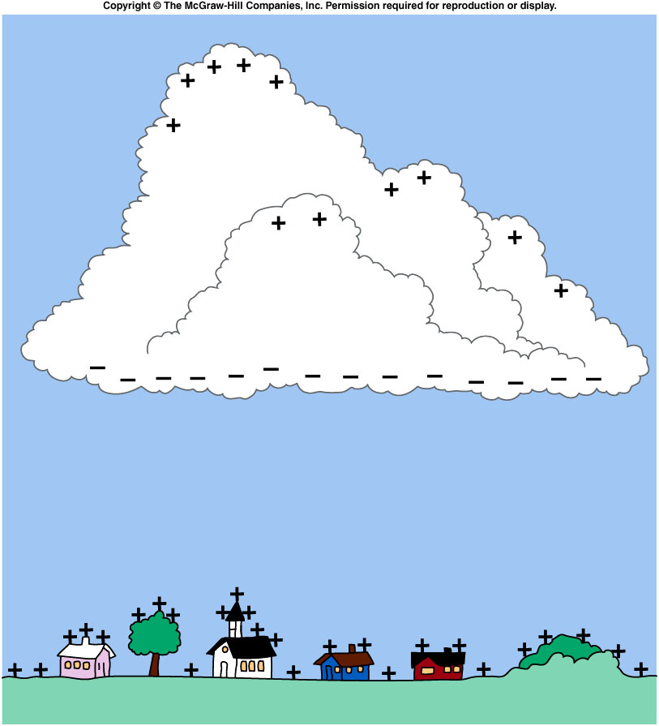
lightning
The electric field generated can be several thousand volts per meter; the potential difference between the cloud’s base and the earth can easily be several million volts!
This creates an initial flow of charge (the “leader”) along a path that offers the best conducting properties over the shortest distance.
The leader ionizes some of the atoms in the air along that path.
The following strokes all take place along this same path in rapid succession.
The heating and ionizing produce the lightning we see.
The thunder (sound waves) is produced at the same time, but takes longer to reach us since sound travels slower than light.
Notes:
Cosmic rays

Slide 19
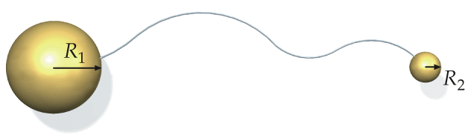
High Electric Field at Sharp Tips
Two conducting spheres are connected by a long conducting wire. The total charge on them is Q = Q₁+Q₂.
Potential is the same:
With same potential, sphere with smaller radius carry smaller amount of charge
The smaller the radius of curvature, the larger the electric field.
Notes:
Use the demo as the starting point of this slide.
Ask question: the whole object has the same potential, why the only the sharp tip act like a engin?

Slide 20
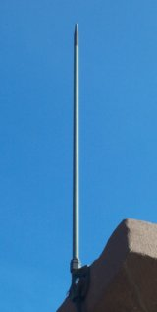
Lightning rod
Air “Break down” before too much charge accumulated, i.e. much weaker lightning which is much less destructive.
Golf court
Notes:
Tell first why lightning can cause damage: shock waves.
Cloud charge induce electric field in the lightning rod.

Slide 21
backup

Slide 22
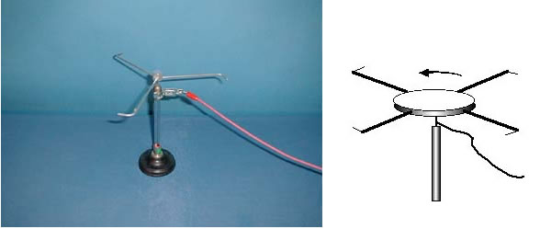
5A-23 Electric Wind
The emittance of electrically charged particles from highly charged object
What causes the arms to turn ?
The metal arms are charged by an electrostatic generator and the forces are greatest at the tips so charged particles are driven off by repulsion. Conservation of momentum makes the arms turn in the “electric wind”
The “wind” can be indirectly seen by the extinguishing of a candle. Before lighting strikes there is charge build up and lightning conductors have sharp tips to “attract” the lightning. The sun also has large electric and magnetic fields and emits the “solar wind”
Notes:
Where do we place the candle? three or one candle? the first apparatus seems can be rotated too.
The candle is attached to a stand and its position adjustable. Place the wick within about a centimeter of the sharp end of the conductor.

Slide 23
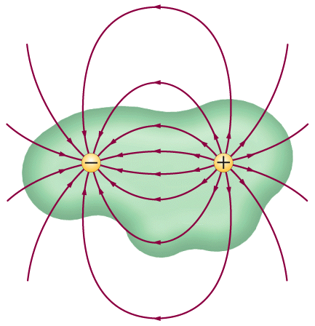
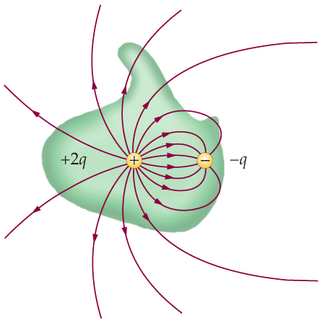
Gauss’s Law: Qualitative Statement
Form any closed surface around charges
Count the number of electric field lines coming through the surface, those outward as positive and inward as negative.
Then the net number of lines is proportional to the net charges enclosed in the surface.

Slide 24
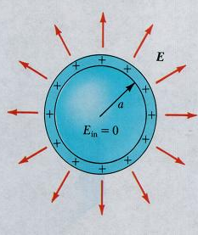
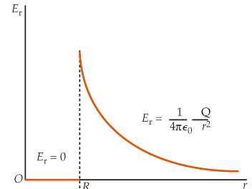
Uniformly charged conductor shell: Inside
E = 0 inside
By symmetry, the electric field
must only depend on r and is
along a radial line everywhere.
Apply Gauss’s law to the blue surface , we get E = 0.
The charge on the inner surface of the conductor must also be zero since E = 0 inside a conductor.
Discontinuity in E

