Slide 1
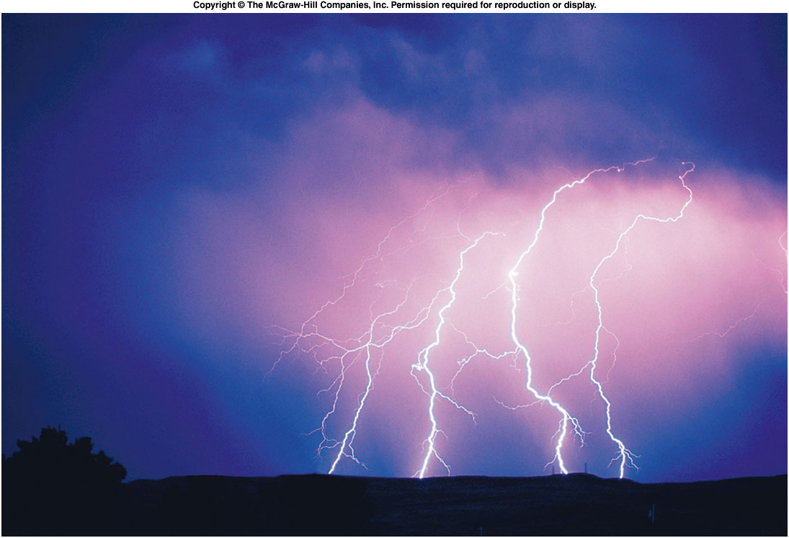
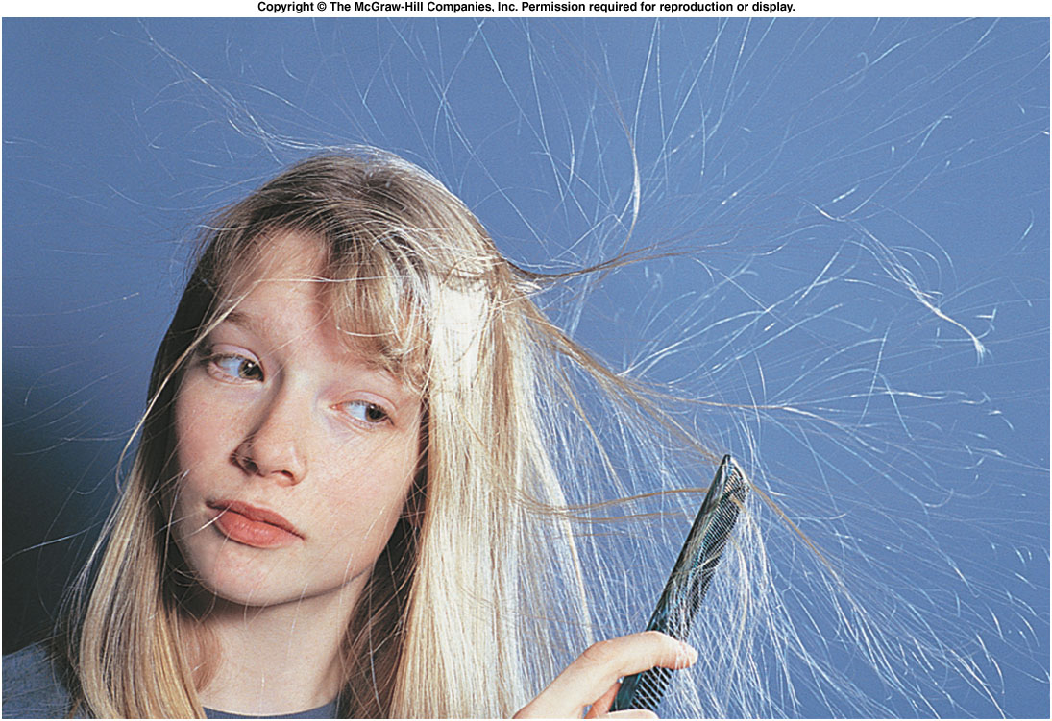
What does lightning have in common...
... with hair on a dry winter day?

Slide 2
Quantization of Charge
Fundamental unit: elementary charge e
An electron carries a charge of –e ; a proton carries a charge of +e
It is typically the electrons that move
between objects.
Coulomb (C):

Slide 3
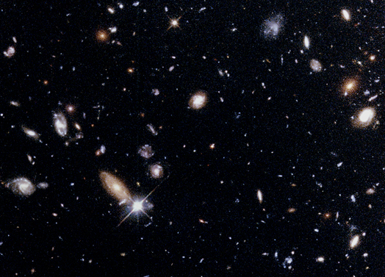
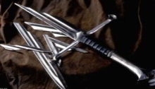
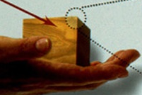
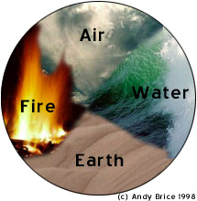
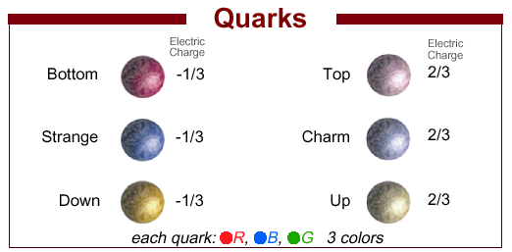
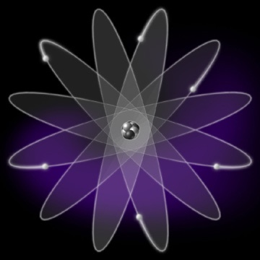
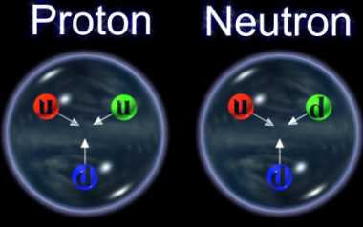
Structure of matter in the Universe
Wood
Huge scale
Iron
Gravitational
Universe
Current building block
Leptons: electron, muon, etc
scale ~ 10⁻¹⁰ m
Electromagnetic
scale ~ 10⁻¹⁵ m
Strong

Slide 4
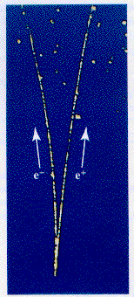
Conservation of Charge
The net electric charge is conserved in any physical process. But …
Charge can be transferred from one object to another.
Individual charges can also, in fact, be “destroyed” or “created”, but not net charges
(→ annihilation)
(← pair production)
Notes:
Sulfuric acid, Zinc Sulfate

Slide 5
Coulomb’s Law
Charges with the same sign repel each other, and charges with opposite signs attract each other.
The electrostatic force between two particles is proportional to the amount of electric charge that each possesses and is inversely proportional to the distance between the two squared.
q₁
q₂
by 1 on 2
1,2
1,2
1,2
r
Coulomb constant:
where ε₀ is called the permittivity constant.

Slide 6
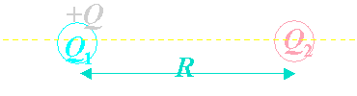
Exercise
One known charge Q₁ = Q > 0 and the other unknown positive charge Q₂ > 0 are held fixed at a separation d = R as shown.
Another (non-zero) charge Q₃ is introduced somewhere along the line connecting Q₁ and Q₂.
  Which of the following statements is true?
1. The force on Q₃ can be zero only if Q₃ is placed to the left of Q₁.
2. The force on Q3 can be zero only if Q3 is placed between Q1 and Q2.
3. The answer to above depends on the sign of Q_{3.}
4. The answer to above depends on the magnitudes of Q₁ and Q_{2 .}
5. The force on Q₃ can never be zero, no matter what the (non-zero!) charge Q₃ is.

Slide 7
Conductor vs. Insulator
Conductors: material in which electric charges can move around “freely”
  Metals, tap water, human body, …
Insulators: material in which electric charges are “frozen” in place
  Air, glass, plastic, …
Semi-conductor: material in which electric charges can move around but not as freely as in conductors
  Silicon, germanium, …
Cu 10²⁹ / m³
Ge 10¹⁹ / m³

Slide 8
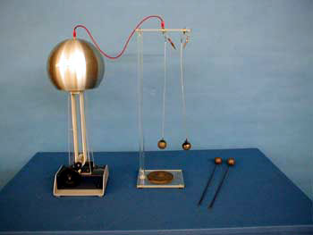
5 A 04 Conductors and insulators
The difference between conductors and insulators
What happens to the balls?
Are the two spheres conductors or insulators?
A: conductors
B: insulators.

Slide 9
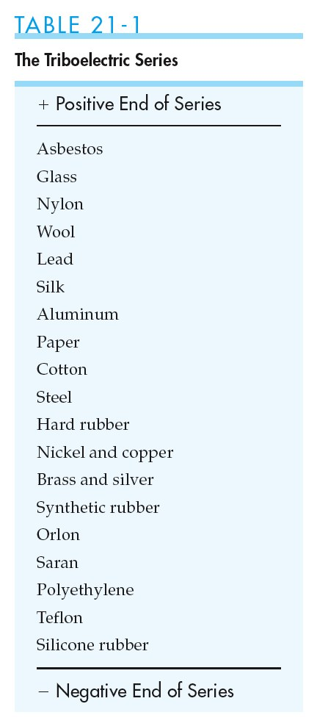
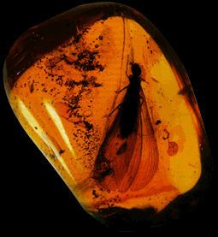
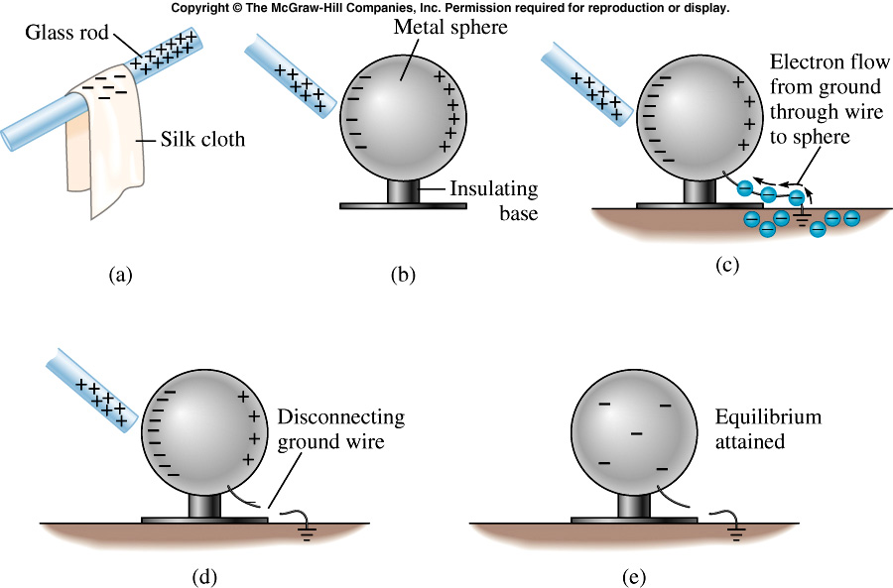
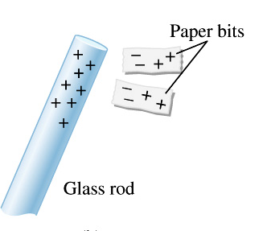
friction can cause electrons to move from one object to another.

Slide 10
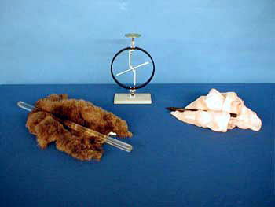
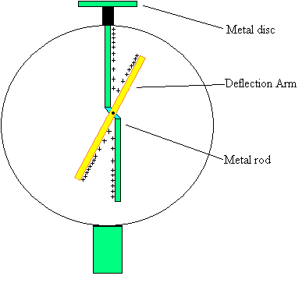
5A-01 Static Electricity
Demonstration that positive and negative charge exists
What information does the electroscope provide ?
++++++++
Rubbing the hard rubber rod with fur produces a negative charge on the rod
Rubbing the glass with silk produces a positive charge on the glass
If we bring a charged rod close to the electroscope it will repel opposite charge and the moving arm will be displaced. If we touch the electroscope with a charged rod then charge will be transferred
THE ELECTROSCOPE CAN’T DETERMINE THE SIGN OF THE CHARGE BUT IT DOES SHOW CHARGE EXISTS IN TWO KINDS + AND -

Slide 11
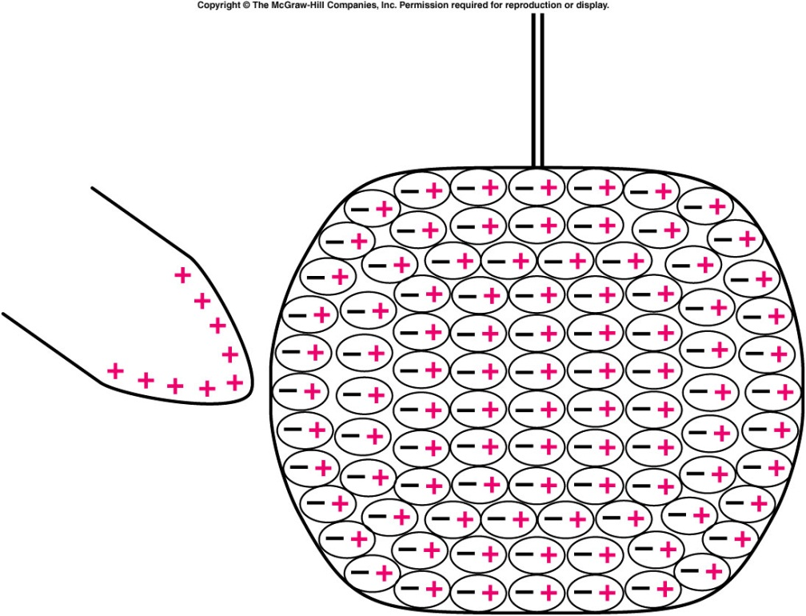
Why are insulators attracted to charged objects?
Recall that the pith balls were attracted to the charged rod before they were charged themselves.
  Electrons are not free to move in the insulating material of the pith balls.
  However, within each atom or molecule, charges can move.
  Each atom becomes an electric dipole: the center of the negative charge is slightly displaced from the center of the positive charge.
  The material is polarized.

Slide 12
Since the negatively charged surface is closer to the rod than the positively charged surface, it experiences a stronger electrostatic force.
  The overall effect is that the pith ball is attracted to the charged rod, even though the net (total) charge on the pith ball is zero.
  After the ball comes in contact with the charged rod, some of the charge on the
  rod is transferred to the
  pith ball.
  The pith ball is then
  positively charged like the
  rod, and so is repelled by
  the rod.
Notes:
I stopped here in sp2019

Slide 13
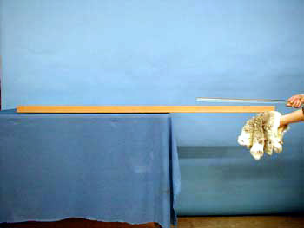
5A-03 Two-by-Four Electroscope
Showing the strength of the electromagnetic force.
How does the charged ebonite rod move the board ?
++++++++++
-------------
Rubbing the rod produces a surface charge. When it is brought close to the wood it attracts the opposite sign charge in the wood and there is an attractive force.

Slide 14
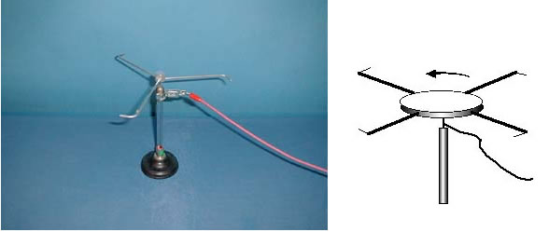
Demos: 5A-23 Electric Wind
MIT engineers fly first-ever plane with no moving parts | MIT News
https://www.youtube.com/watch?v=boB6qu5dcCw
Notes:
In MIT video, mention Bernuli’s principle on different pressure above and below airplane wings

Slide 15
Can We charged an object without touching it?
polarization by induction
grounding

Slide 16
Questions Chapter 12
Q2 Two pith balls are both charged by contact with a plastic rod that has been rubbed by cat fur,
A. What sign will the charges on the pith balls have? Explain.
B. Will the two pith balls attract or repel one another? Explain.
A.The sign of the charge is negative. B. They will repel
Q3 Two pith balls are charged by touching one to a glass rod that has been rubbed with a nylon cloth and the other to the cloth itself,
A. What sign will the charge on each pith ball have? Explain.
B. Will the two pith balls attract or repel one another? Explain.
The first ball will have positive charge the second negative charge
The two balls will attract each other

Slide 17
Q13 Will bits of paper be attracted to a charged rod even if they have no net charge?
Yes because the charge will attract the opposite charge in the paper
Q14 Why are pith balls initially attracted to a charged rod and later repelled by the same rod, even though they have not touched any other charged object?
Because once they touch the charged rod they pick up some of the charge and the ball is repelled
Q19 Can both the electrostatic force and the gravitational force be either attractive or repulsive?
No, the gravitational force is always attractive.

Slide 18
Quiz
If two charges are both doubled in magnitude without changing the distance between them, the force that one charge exerts on the other will
  A: remain to be the same
  B: doubles
  C: increase by a factor of 4.

Slide 19
How strong are Coulomb forces?
Electron and proton in a hydrogen atom
Compare electric and gravitational forces
electron and proton
m_{e} = 9.11x10⁻³¹ kg,
m_{p} =1.67x10⁻²⁷ kg

Slide 20
quiz
A Human weight 120 lb, which of the following is correct?
  A large fraction of the weight come from the attraction force between the charges on human body and earth.
  All the weight comes the attraction force between the charges on human body and earth.
  All the weight come from the gravitational forces. The electric forces are negligible.

