Slide 1

Purdue University, April 28, 2011
Dileptons as a probe of the Quark Gluon Plasma
Itzhak Tserruya

Slide 2
Outline
Introduction
SPS energy
  Low-mass region
  Intermediate mass region
Low energies: DLS and HADES
RHIC energy
  first results from PHENIX
  Thermal radiation at RHIC
Summary

Slide 3
Introduction
The Quark Gluon Plasma created in relativistic heavy ion collisions is characterized by two fundamental properties:
  Deconfinement
  Chiral Symmetry Restoration
Electromagnetic probes (real or virtual photons) are sensitive probes of both properties and in particular lepton pairs are unique probes of CSR.
Thermal radiation emitted in the form of dileptons (virtual photons) provides a direct fingerprint of the matter formed (QGP and HG) and a measurement of its temperature.
What have we learned in almost 20 years of dilepton measurements?

Slide 4
Origin of mass
Constituent quark masses generated by spontaneous chiral symmetry breaking
current quark masses:
m_{u} ≈ 4 MeV m_{d} ≈ 7 MeV
proton = uud neutron = udd
m_{Nucleon} ≈ 1 GeV
X
Origin of (our) mass:
~5% of the (visible) mass is due
to the Higgs field.
95% of the (visible) mass is due to
the spontaneous breaking of the
chiral symmetry.
Mass [MeV]
Current quark masses generated by spontaneous symmetry breaking (Higgs field)

Slide 5
Chirality
Two fundamental properties of the QGP:
  Deconfinement
  Chiral symmetry restoration
What is chirality?
  Comes from the greek word “χειρ” meaning hand
  An object or a system has chirality if it differs from its mirror image.
Such objects then come in two forms, L and R, which are mirror images of each other.
Simple definition:
  the chirality of a particle is determined by the projection of its spin along its momentum direction (this is in fact the definition of helicity. In the high energy limit chirality ≈ helicity))

Slide 6
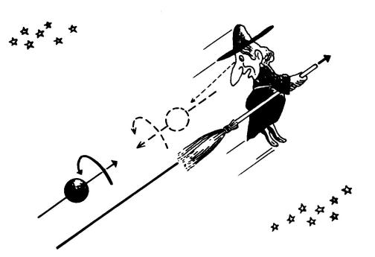
Chiral Symmetry
If a particle has mass both right- and left-handed components must exist.
The reason is that massive particles travel slower than the speed of light
and a particle that appears left-handed in a particular reference frame
will look right-handed from a reference frame moving faster than the
particle → chirality is not conserved
Right-handed
In a massless world chirality is conserved
(sufficient but not necessary condition)
Left-handed
Notes:
A massless fermion is Left (Right) handed if the projection of its spin on the direction
of motion of the particle is +1/2 (-1/2) value. The direction of spin is unaffected by a Lorentz boost along the direction of motion of the particle, and one can't boost to a frame where the particle moves in the opposite direction, because it moves at the speed of light. Therefore the chirality is fixed for all reference frames. Also since the particles do not change into anti-particles, the total chirality i.e. the number of left-handed particles minus the number of right handed particles, does not change as a result of the interaction and chirality is a conserved quantity.
But since particles other than the neutrinos have mass, the left and right are mixed when these interact so the conservation of chirality is broken.

Slide 7

Explicit and Spontaneous Chiral Symmetry Breaking (I)
QCD, the theory of the strong interaction, is encoded in a one line Lagrangian:
Free g field
q interaction with g field
Free q of mass m_{n} at rest
The mass term m_{n}ψ_{n}ψ_{n} explicitly breaks the chiral symmetry of the QCD Lagrangian
Chiral limit: m_{u} = m_{d} = m_{s} = 0
In this idealized world, the interactions quark-gluon conserve the quark chirality. (left–handed u,d,s, quarks remain left-handed forever) and as a consequence
all states have a chiral partner with opposite parity and equal mass
m_{u} and m_{d} are so small that our world should be very close to the chiral limit

Slide 8
Explicit and Spontaneous Chiral Symmetry Breaking (II)
In reality:
ρ (J^{P} = 1⁻) m=770 MeV
chiral partner a₁ (1⁺) m=1250 MeV → Δ ≈ 500 MeV
For the nucleons the splitting is even larger:
N (1/2⁺) m=940 MeV
chiral partner N* (1/2⁻) m=1535 MeV → Δ ≈ 600 MeV
The differences are too large to be explained by the small current quark masses
Chiral symmetry is spontaneously (≡ dynamically) broken

Slide 9
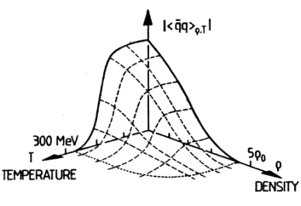
Chiral Symmetry Restoration
Spontaneous breaking of a symmetry is marked by:
* a non-zero order parameter, the quark condensate in the case of QCD:
Many models link the hadron masses to the quark condensate.
At high temperatures (T>T_{C}) or high baryon densities (ρ>ρ_{C}), numerical QCD calculations on the lattice predict that the quark condensate vanishes:
constituent mass → current mass
chiral symmetry (approximately) restored

Slide 10
How does CSR manifest itself ?
What happens when chiral symmetry is restored?
Meson properties (m,Γ) expected to be modified but how?
Is there an explicit connection between the spectral properties of hadrons (masses,widths) and the value of the chiral condensate <qq> ?
From the QCD Lagrangian, the only requirement is that parity doublets
should be degenerate in mass.
  how is the degeneracy of chiral partners realized ?
  do the masses drop to zero?
  do the widths increase (melting resonances)?
All very good questions with no good answer

Slide 11
The theoretical picture is confusing
Theoretical predictions for the in-medium modification of the ρ-meson properties
 | mass of ρ | width of ρ
Pisarski 1982
Leutwyler et al 1990 (π,N)
Brown/Rho 1991 ff
Hatsuda/Lee 1992
Dominguez et. al1993
Pisarski 1995
Rapp 1996 ff
Lattice QCD coming to the rescue: hadron spectral functions are being studied on the lattice.
Another example where experiment has the potential to guide the theory.

Slide 12
The Double Challenge
Experimental challenge
Need to detect a very weak source of e⁺e⁻ pairs
hadron decays (m>200 MeV/c² p_{T} > 200 MeV/c) ~ 4. 10⁻⁶ / πº
in the presence of several pairs per event from trivial origin
πº Dalitz decays ~ 10⁻² / πº
γ conversions (assume 1% radiation length) 2 . 10⁻² / πº
and hundreds of charged particles per event
in central Au+Au collision at RHIC dN_{ch} / dy ≈ 700
huge combinatorial background ∝ (dN_{ch} / dy )²
(pairing of tracks originating from unrecognized πº Dalitz decays and γ conversions
Analysis challenge
Electron pairs are emitted through the entire history of the collision:
    need to disentangle the different sources.
    need reference pp, dA data and precise data on each source separately.

Slide 13
Dileptons in A+A at a Glance:
Energy Scale
Time Scale
CBM
NA60
MPD
HADES
CBM
NA60
PHENIX + HBD STAR
PHENIX
HADES
CERES
DLS
MPD
CERES
PHENIX
DLS
//
//
//
85
90
10
158
[A GeV]
95
00
05
10
//
//
//
17
200
√s_{NN}
[GeV]
= Period of data taking

Slide 14
SPS
Low-masses
(m ≤ 1GeV/c²)

Slide 15
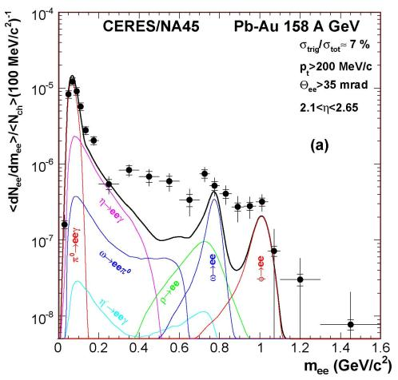
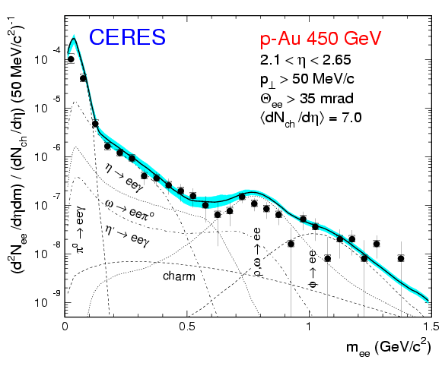
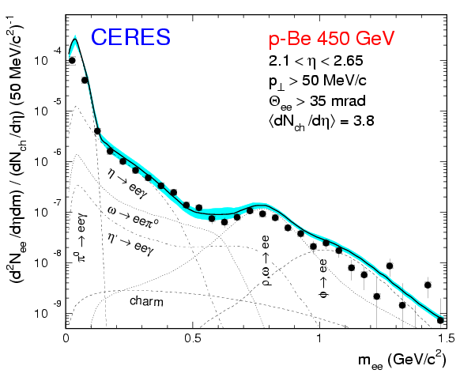
CERES Pioneering Results (I)
Strong enhancement of low-mass e⁺e⁻ pairs
(wrt to expected yield from known sources)
Last CERES result
(2000 Pb run PLB 666(2008) 425)
Enhancement factor (0.2 <m < 1.1 GeV/c² ): 2.45 ± 0.21 (stat) ± 0.35 (syst) ± 0.58 (decays)
No enhancement in pp
nor in pA

Slide 16
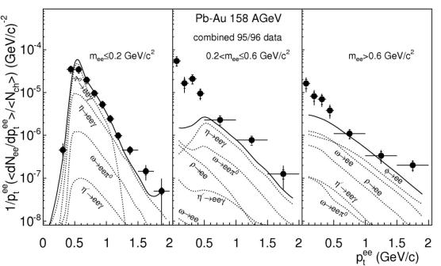
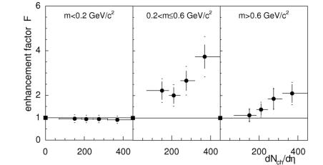
p_{T} and Multiplicity Dependencies
Enhancement is mainly at low p_{T}
Increases faster than linearly with multiplicity

Slide 17
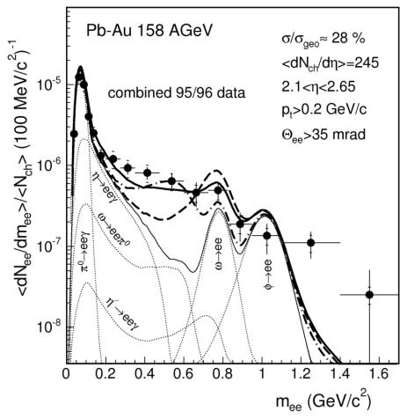
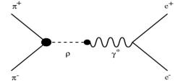
Dropping Mass or Broadening (I) ?
Interpretations invoke:
* π⁺π⁻ →ρ→ γ* → e⁺e⁻
thermal radiation from HG
CERES Pb-Au 158 A GeV 95/96 data
* vacuum ρ not enough to
reproduce data
* in-medium modifications of ρ:
broadening ρ spectral shape
(Rapp and Wambach)
dropping ρ meson mass
(Brown et al)

Slide 18
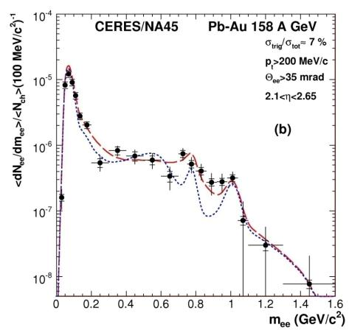
Dropping Mass or Broadening (I) ?
Interpretations invoke:
* π⁺π⁻ →ρ→ γ* → e⁺e⁻
thermal radiation from HG
CERES Pb-Au 158 A GeV 2000 data
* vacuum ρ not enough to reproduce data
* in-medium modifications of ρ:
broadening ρ spectral shape
(Rapp and Wambach)
dropping ρ meson mass
(Brown et al)
Data favor the broadening scenario.

Slide 19
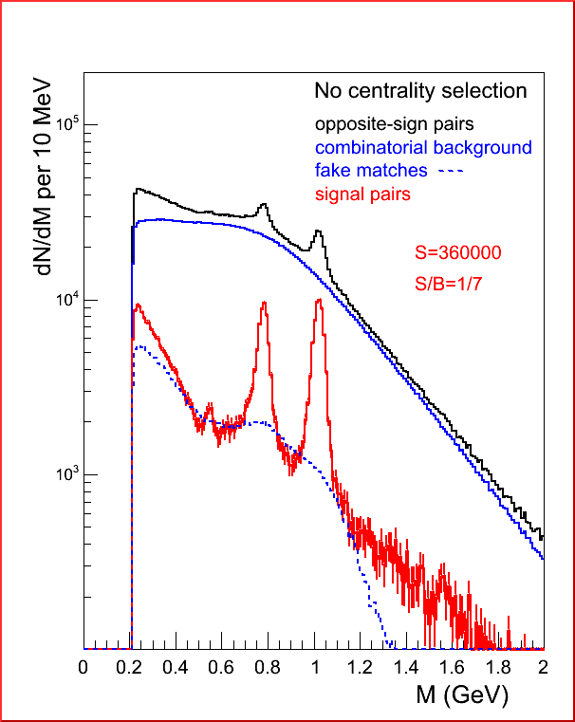
NA60 Low-mass dimuons in In-In at 158 AGeV
Real data !
Superb data!
Mass resolution:
23 MeV at the φ position
ω
φ
η
S/B = 1/7
ω, φ and even η peaks clearly visible in dimuon channel

Slide 20
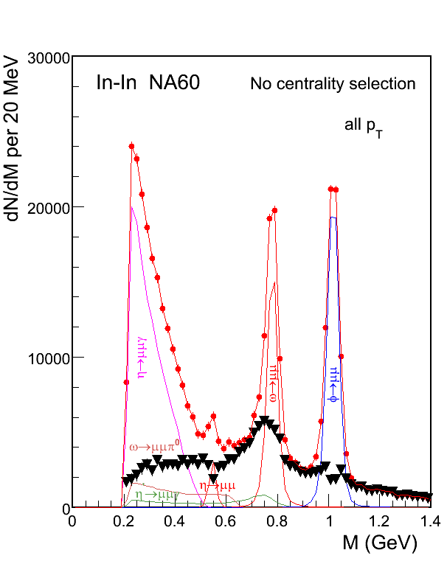
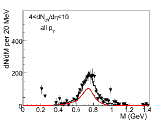
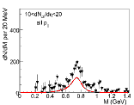
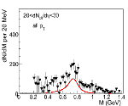
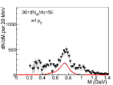
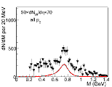
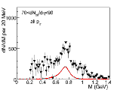
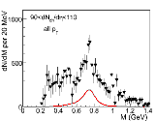
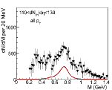
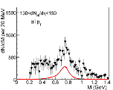
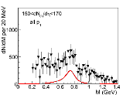
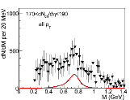
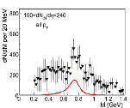
Dimuon Excess
Eur.Phys.J.C 49 (2007) 235
PRL 96 (2006) 162302
Dimuon excess isolated by subtracting the hadron cocktail (without the ρ)
Excess centered at the nominal ρ pole
Excess rises and broadens with centrality
More pronounced at low p_{T}
confirms & consistent with, CERES results

Slide 21
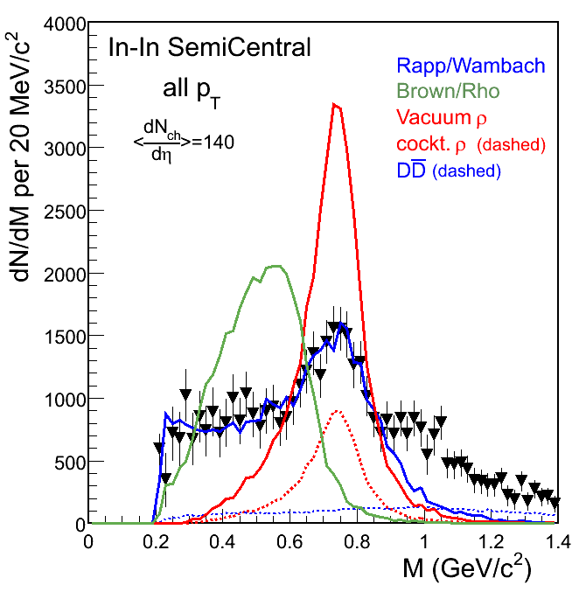
NA60 low mass: comparison with models
PRL 96 (2006) 162302
Subtract the cocktail from the data (without the ρ)
Excess shape consistent with broadening of the ρ
(Rapp-Wambach)
Mass shift of the ρ (Brown-Rho)
is ruled out
Is this telling us something
about CSR?
All calculations normalized to data at m_{μμ} < 0.9 GeV performed by Rapp et al., for <dN_{ch}/dη> = 140

Slide 22
SPS
Intermediate masses
(m = 1-3 GeV/c²)

Slide 23
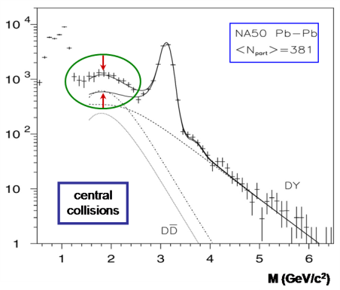
NA50 IMR Results
Drell-Yan and Open Charm are the main contributions in the IMR
p-A is well described by the sum of these two contributions (obtained from Pythia)
The yield observed in heavy-ion collisions exceeds the sum of DY and OC decays, extrapolated from the p-A data.
The excess has mass and p_{T} shapes similar to the contribution of the Open Charm (DY + 3.6OC nicely reproduces the data).
Drell Yan + 3.6 x Open charm
Drell Yan + Open charm
charm enhancement?

Slide 24
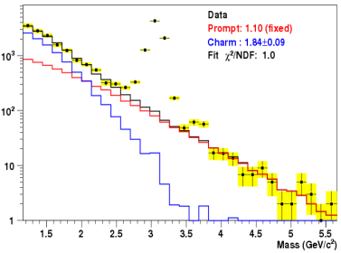
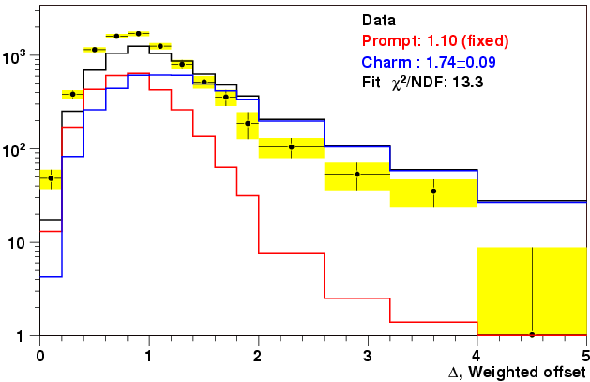
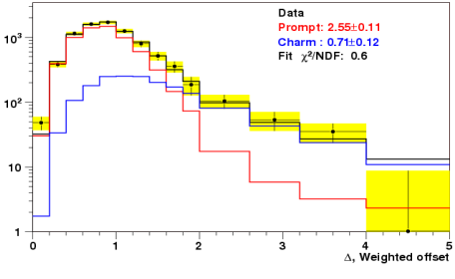
NA60: IMR excess in agreement with NA50
2.9±0.14
IMR yield in In-In collisions enhanced compared to expected yield from DY and OC
Can be fitted with fixed DY (within 10%) and OC enhanced by a factor of ~3
Fit range
4000 A, χ² <1.5
Full agreement with NA50
NA60:
IMR excess is a prompt source
… But the offset distribution (displaced vertex) is not compatible with this assumption
Fixed prompt and free open charm
Free prompt and open charm scaling factors
2.75±0.14
1.12±0.17

Slide 25
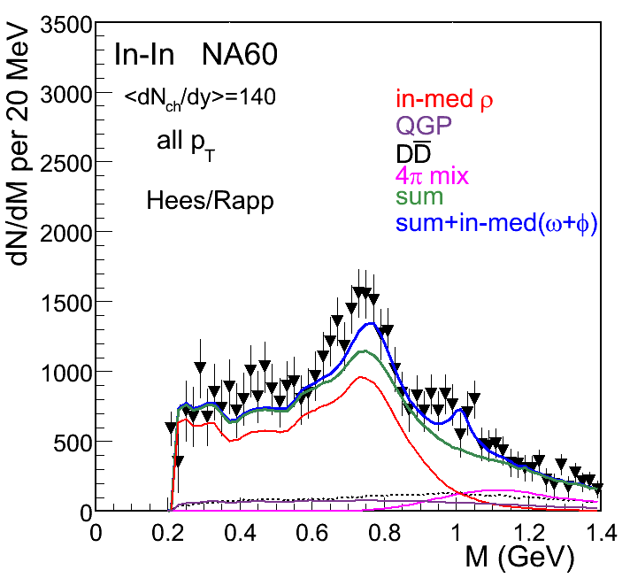
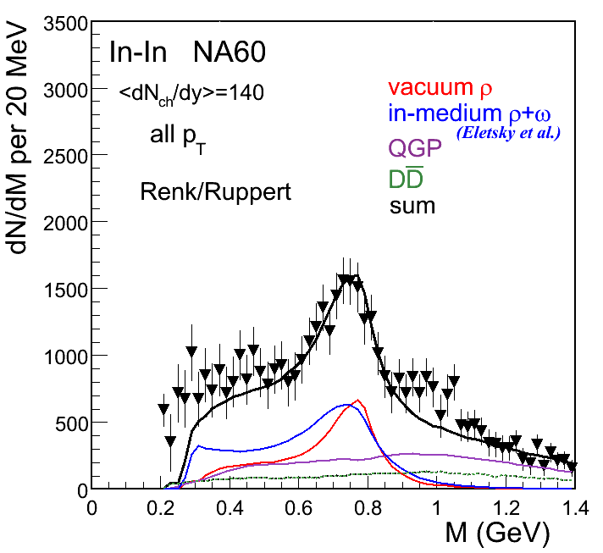
Origin of the IMR Excess
Hees/Rapp, PRL 97, 102301 (2006)
Renk/Ruppert, PRL 100,162301 (2008)
Dominant process in mass region m > 1 GeV/c²:
hadronic processes, 4π … partonic processes, qq annihilation
Quark-Hadron duality?

Slide 26
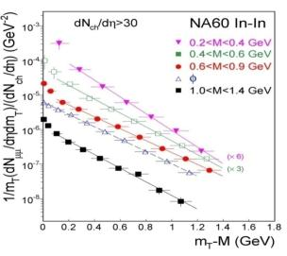
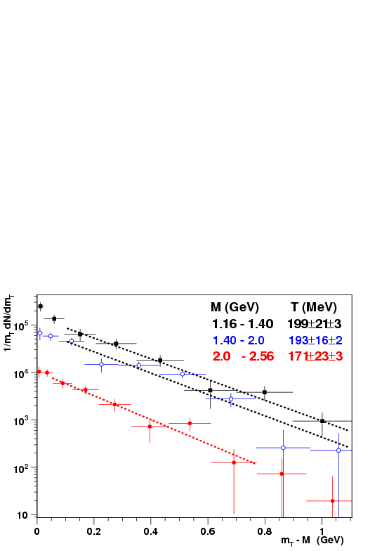
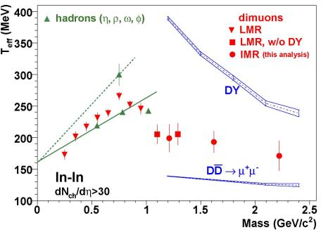
p_{T} distributions
Low-mass region
Intermediate mass region
Fit in 0.5<P_{T}<2 GeV/c
(as in LMR analysis)
The m_{T} spectra are exponential, the inverse slopes depend on mass.
→ Radial Flow
The m_{T} spectra are exponential, the inverse slopes do not depend on mass.
Thermal radiation from partonic phase?

Slide 27
Low-energies:
DLS and HADES

Slide 28
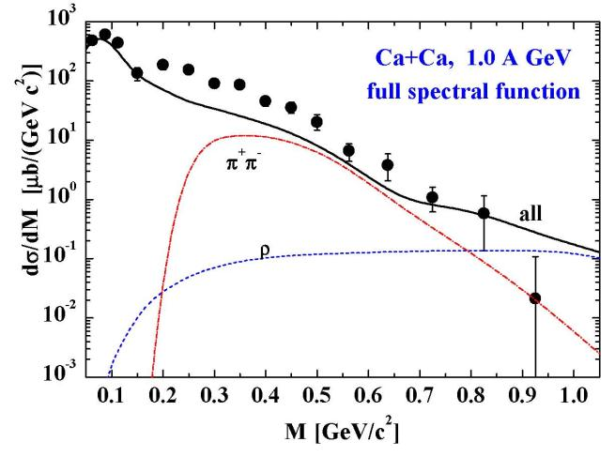
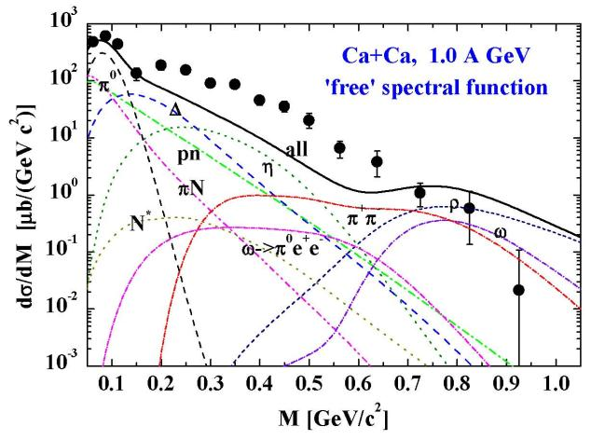
DLS “puzzle”
DLS data: Porter et al.,
PRL 79, 1229 (1997)
Calculations:
Bratkovskaya et al.,
NP A634, 168 (1998)
Enhancement not described by in-medium ρ spectral function
All other attempts to reproduce the DLS results failed
Main motivation for the HADES experiment
Strong enhancement over hadronic cocktail with “free” ρ spectral function

Slide 29
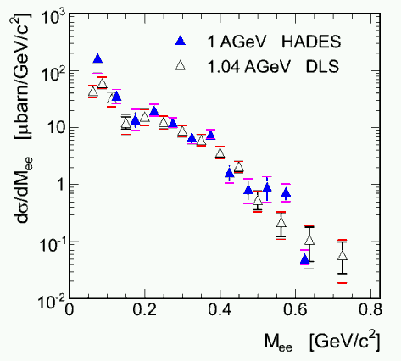
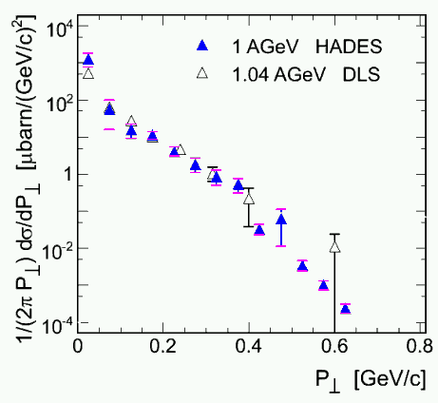
HADES confirms the DLS results
Mass distribution
p_{T} distribution
Notes:
This is for C+C

Slide 30
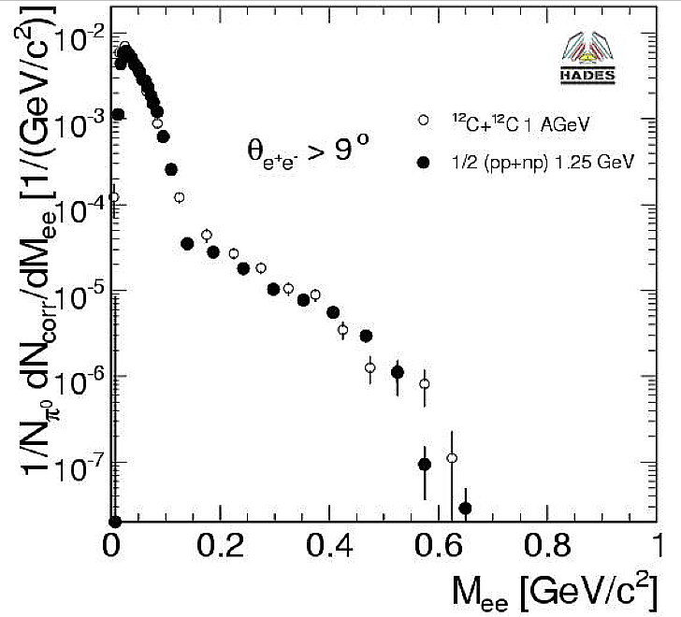
Putting the puzzle together (I)
C+C @ 1 AGeV – pp & pd @ 1.25 GeV
Spectra normalized to π⁰ measured in C+C and NN
C+C @ 1 AGeV:
<M_{π}>/A_{part} = 0.06 ± 0.07
N+N @ 1.25 GeV (using pp and pd measurements)
<M_{π}^{NN}>/A_{part} = 1/4(pp+2pn+nn)/2
= 1/2(pp+pn) = 0.076±0.015
Dielectron spectrum from C+C consistent with superposition of NN collisions!
No compelling evidence for in-medium effects in C+C

Slide 31
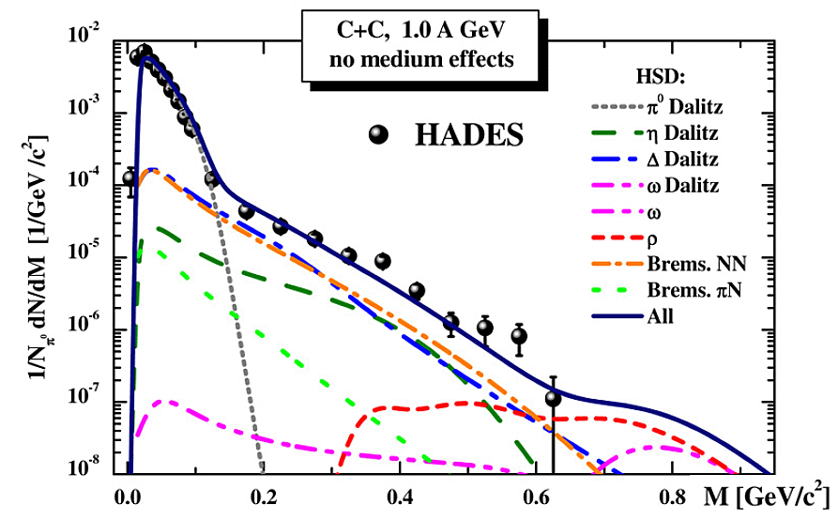
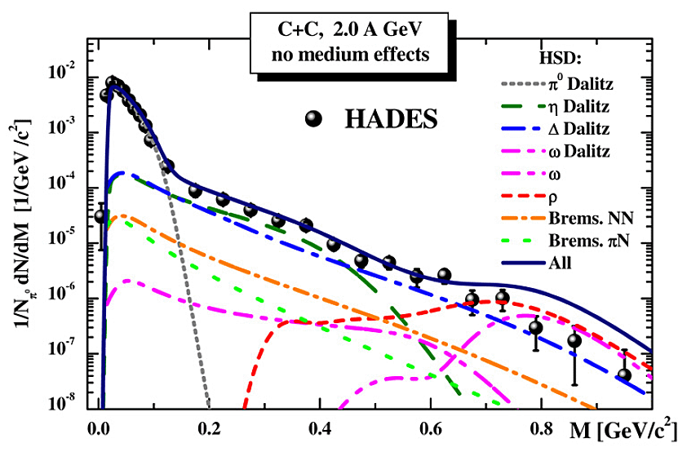
Putting the puzzle together (II)
Recent transport calculations:
enhanced NN bremsstrahlung , in line with recent OBE calculations
HSD: Bratkovskaya et al. NPA 807214 (2008)
The DLS puzzle seems to be reduced to an understanting of the elementary contributions to NN reactions.

Slide 32
RHIC

Slide 33
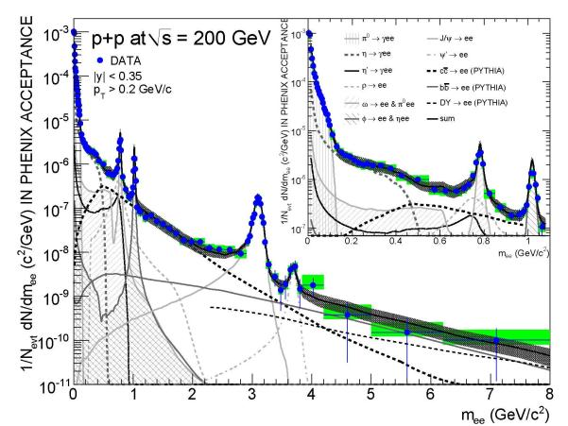
Dileptons in PHENIX: p+p collisions
Mass spectrum measured from m=0 up to m=8 GeV/c²
Very well understood in terms of:
  hadron cocktail at low masses
  heavy flavor + DY at high masses

Slide 34
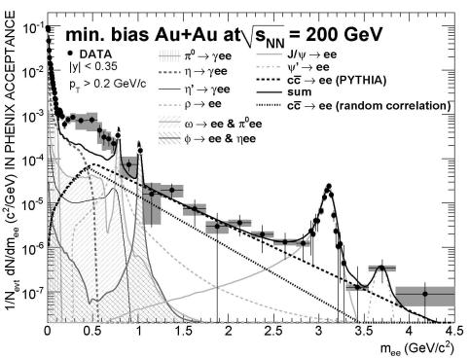
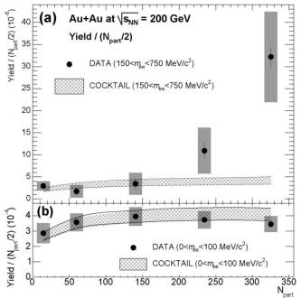
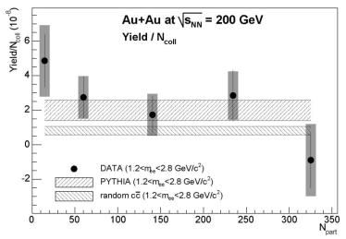
Dileptons in PHENIX: Au+Au collisions
Strong enhancement of e⁺e⁻ pairs at low masses:
m= 0.2 – 0.7 GeV/c².
Characteristic properties:
  Enhancement down to very low masses
  Enhancement concentrated in central collisions
  No enhancement in the IMR

Slide 35
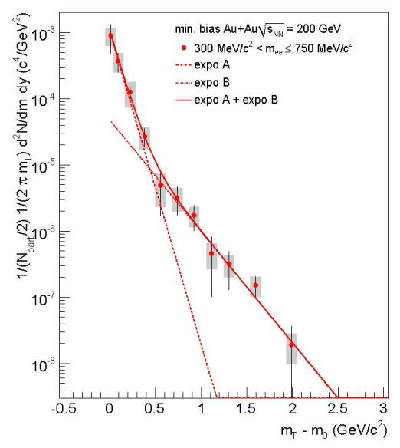
m_{T} distribution of low-mass excess
Excess present at all pair p_{T} but is more pronounced at low pair p_{T}
The excess m_{T} distribution exhibits two clear components
It is well described by the sum of two exponential distributions with inverse slope parameters:
T1 = 92 ± 11.4^{stat} ± 8.4^{syst} MeV
T1 = 258.3 ± 37.3^{stat} ± 9.6^{syst} MeV
PHENIX
All this is very different from the SPS results

Slide 36
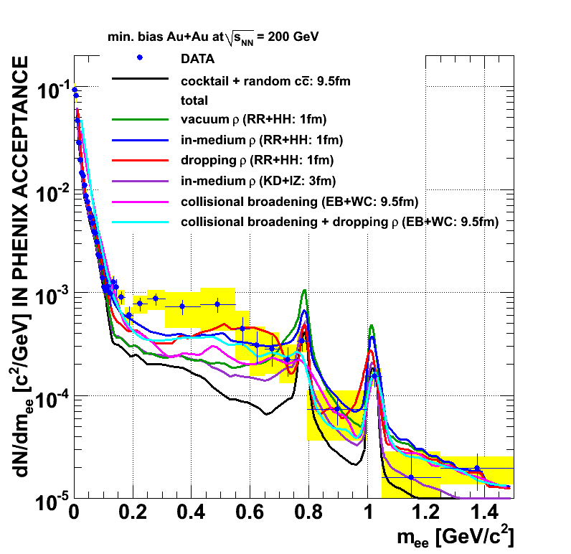
Comparison to theoretical model (Au+Au)
PHENIX
All models and groups that successfully described the SPS data fail in describing the PHENIX results

Slide 37
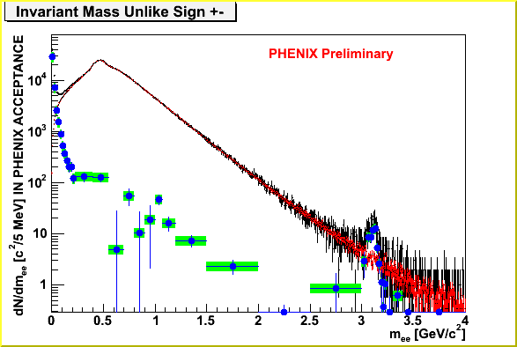
Dileptons in PHENIX: Au+Au collisions
Min bias Au+Au √s_{NN} = 200 GeV
arXiv: [nucl-ex]
Integral:180,000
above π⁰:15,000
All pairs
Combinatorial BG
Signal
BG determined by event mixing technique, normalized to like sign yield
Green band: systematic error w/o error on CB
PHENIX has mastered the event mixing technique to unprecedented precision (±0.25%). But with a S/B ≈ 1/200 the statistical significance is largely reduced and the systematic errors are large

Slide 38
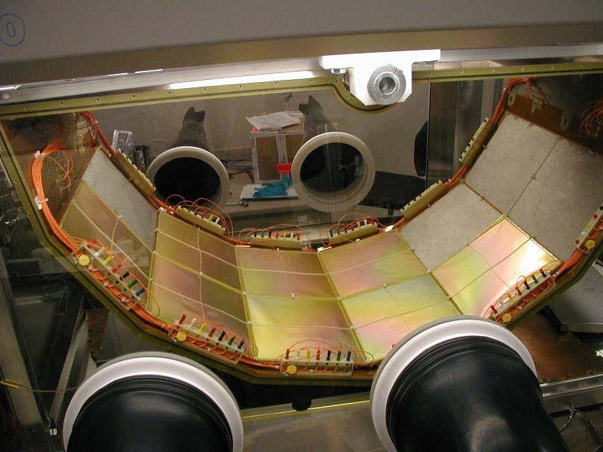
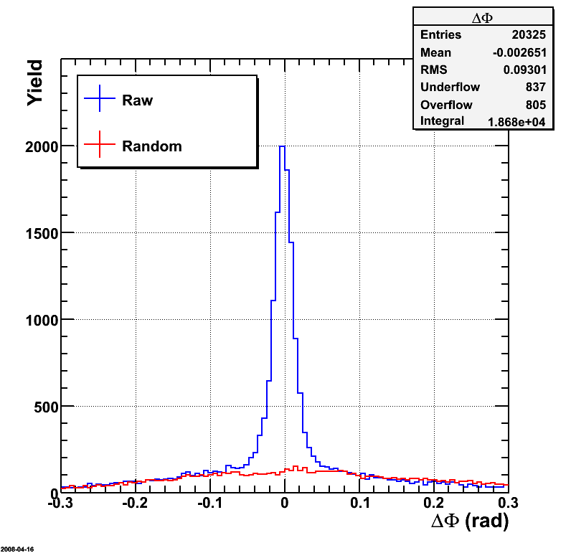







HBD
Matching resolution in z and φ
Single vs double e separation
Installed and fully operational since Run9
Hadron blindness
h in F and R bias e-h separation h rejection

Slide 39
Thermal Radiation at RHIC

Slide 40

Thermal radiation at RHIC (I)
Search for the thermal radiation in the dilepton spectrum
Avoid the huge physics background inherent to a real photon measurement.
Capitalize on the idea that every source of real photons should also emit virtual photons.
At m→0, the yield of virtual photons is the same as that of real photons
Real photon yield can be measured from virtual photon yield, observed as low mass e⁺e⁻ pairs

Slide 41

Enhancement of (almost real photons) low-mass dileptons
Restricted kinematic window: Low mass e⁺e⁻ pairs m<300MeV & 1<p_{T}<5 GeV/c
p+p:
Good agreement of p+p data and hadronic decay cocktail
Au+Au:
Clear enhancement visible above m_{π} =135 MeV for all p_{T}
1 < p_{T} < 2 GeV
2 < p_{T} < 3 GeV
3 < p_{T} < 4 GeV
4 < p_{T} < 5 GeV
Excess → Emission of almost real photons

Slide 42

Thermal radiation from the QGP at RHIC
exp + n_{coll} scaled pp
e⁺e⁻ invariant mass excess:
- transformed into a spectrum of real photons under the assumption that the excess is entirely due to internal conversion of photons.
- compared to direct (real) photon measurement (p_{T}>4GeV)
Good agreement in range of overlap
pQCD consistent with p+p down to p_{T}=1GeV/c
Au+Au data are above N_{coll} scaled p+p for p_{T} < 2.5 GeV/c
Fit Au+Au excess with exponential function + n_{coll} scaled p+p
NLO pQCD (W. Vogelsang)
T_{ave} = 221 ± 19^{stat} ± 19^{syst} MeV corresponds to
T_{ini} = 300 to 600 MeV τ₀ = 0.15 to 0.6 fm/c

Slide 43
Summary
DLS puzzle solved in C+C. Dilepton spectrum understood as mere superposition of NN collisions. Is that so also for heavier system? Onset of low-mass pair enhancement?
Consistent and coherent picture from the SPS:
  Low-mass pair enhancement: thermal radiation from the HG
  Approach to CSR proceeds through broadening (melting) of the resonances
  IMR enhancement: thermal radiation from partonic phase
RHIC results very intriguing:
  Strong enhancement of low-mass pairs down to very low masses
  No enhancement in the IMR
  Challenge for theoretical models
  Looking forward to more precise results with the HBD
First measurement of thermal radiation at RHIC

Slide 44






Relation between dilepton and virtual photon
Emission rate of (virtual) photon
e.g. Rapp, Wambach Adv.Nucl.Phys 25 (2000)
EM correlator
Matter property
Boltzmann factor
temperature
Emission rate of dilepton
Relation between them
Prob. γ*→l⁺l⁻
This relation holds for the yield after space-time integral
Dilepton
virtual photon
Virtual photon emission rate can be determined from dilepton emission rate
M ×dN_{ee}/dM gives virtual photon yield
For M→0, n_{γ}* → n_{γ}(real); real photon emission rate can also be determined

