Slide 1

Charmonium (and Open-Charm) production at the CERN- SPS
P. Cortese
Università del Piemonte Orientale and INFN – Alessandria, Italy
NA60 Collaboration
International Workshop on Heavy Quark Production
in Heavy-ion Collisions / January 4-6, 2011
Introduction
Charmonium suppression in p-A and A-A collisions
NA60 results on thermal dileptons
Preliminary results on the A-dependence of the open charm yield
Notes:
I will present results on charmonia and open-charm production from at the fixed target program of CERN SPS

Slide 2
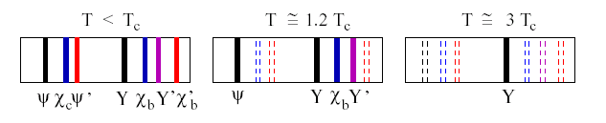
THE hard probe at SPS energy
Study of charmonium production/suppression in pA/AA collisions
AA collisions
Color screening and charmonium suppression
> 20 year long history
pA collisions
Initial/final state nuclear effects (shadowing, dissociation,...)
Reference for understanding dissociation in a hot medium
Production models (CSM, NRQCD, CEM, ....)
Notes:
Charmoniun production and in particular J/Psi production is the main probe that has been studied at the CERN SPS.

Slide 3
Experimental landscape
(Relatively) large amount of fixed-target data (SPS, FNAL, HERA)
AA collisions
NA38 (M.C. Abreu et al., PLB449(1999)128)
S-U 200 GeV/nucleon, 0<y<1
NA50 (B. Alessandro et al., EPJC39 (2005)335)
Pb-Pb 158 GeV/nucleon, 0<y<1
NA60 (R. Arnaldi et al., PRL99(2007) 132302)
In-In 158 GeV/nucleon, 0<y<1
pA collisions
NA50 (B. Alessandro et al., EPJC48(2006) 329)
p-Be,Al,Cu,Ag,W,Pb,400/450 GeV,-0.1<x_{F}<0.1
NA3 (J. Badier et al., ZPC20 (1983) 101)
p-p p-Pt, 200 GeV, 0<x_{F}<0.6
NA60 (E. Scomparin et al., nucl-ex/0907.3682, R. Arnaldi et al., nucl-ex/0907.5004) p-Be,Al,Cu,In,W,Pb,U 158/400 GeV,-0.1<x_{F}<0.35
E866 (M. Leitch et al., PRL84(2000) 3256)
p-Be,Fe,W 800 GeV,-0.10<x_{F}<0.93
HERAB (I. Abt et al., arXiv:0812.0734)
p-Cu (Ti) 920 GeV,-0.34<x_{F}<0.14

Slide 4
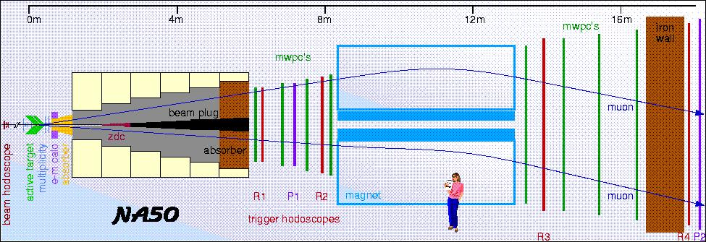
The NA38 and NA50 experiments
Centrality detectors
EM calorimeter (NA38-NA50) ➔ E_{T}
ZDC (NA50)
Multiplicity detector (NA50)
working also as an interaction detector
Muon spectrometer
Hadron absorber
Air-core toroidal magnet
MWPCs
redundant trigger system
Coverage:
2.92<y_{lab}<3.92
-0.5<cosθ_{CS}<0.5
Typical acceptances:
for J/ψ ~ 14%
for ψ’ ~ 15%

Slide 5
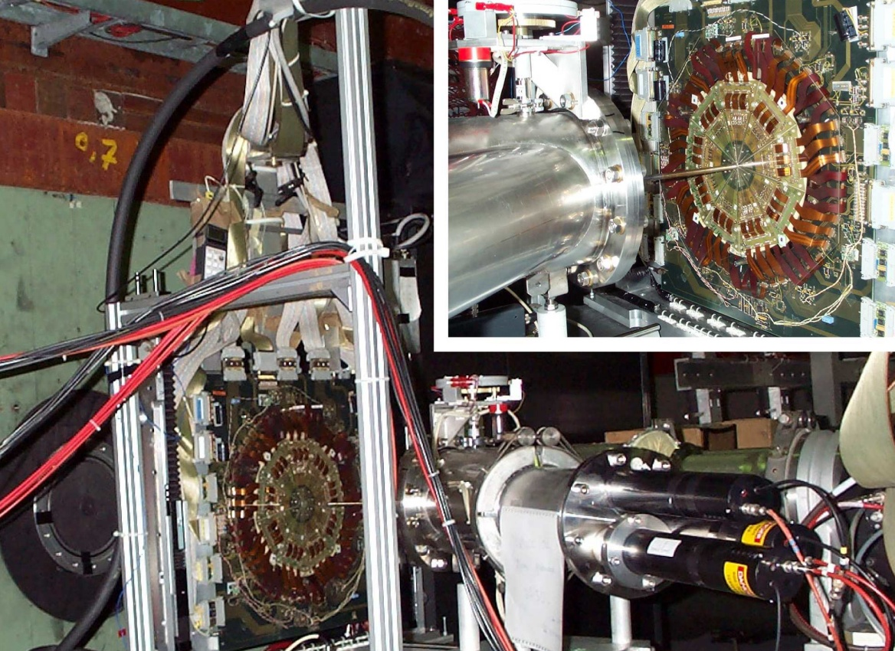
NA50 upgrades along the years
Experimental setup
1995-1996
Thick segmented target
1998
Thin target to avoid ion reinteractions
2000
Thin target under vacuum to eliminate Pb-Air parasitic interactions
Target identification in data analysis
1995-1996
with interactions detectors
1998-2000
Hit correlation between multiplicity detector planes

Slide 6
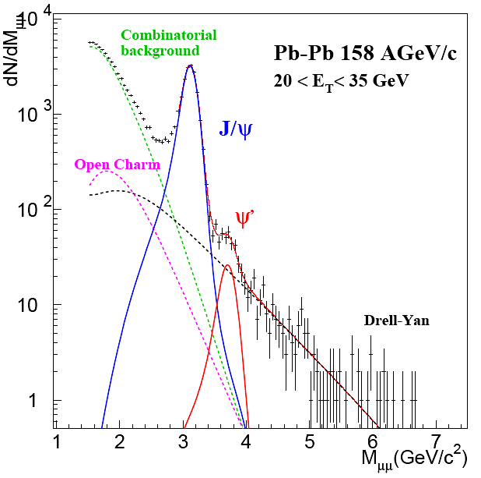
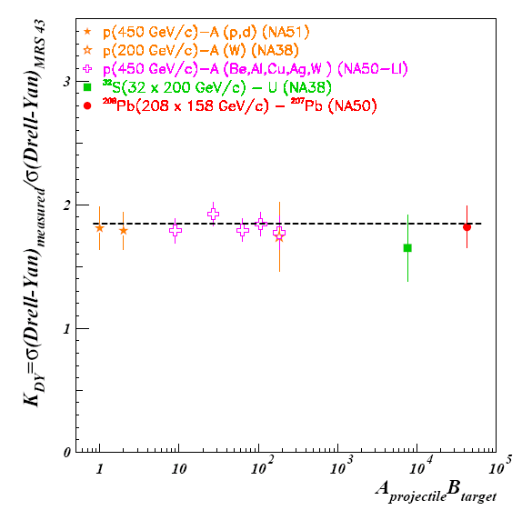
The reference for J/ψ data: Drell-Yan
Advantages
Unambiguous extraction from the invariant mass fit
Same systematics as the J/ψ (trigger, rec. efficiency, selection criteria)
Cancellation of eventual biases in the ratio
α(Drell-Yan)=1
Different production mechanism (q-q vs. g-g) but at SPS energies and in the NA50 kinematic domain shadowing is small
➔ σ(ψ)/σ(DY) proportional to σ(ψ)/N_{Coll}
Drawback
Drell-Yan cross section lower than J/ψ
➔ Error on DY dominates in the ratio
Drell-Yan

Slide 7
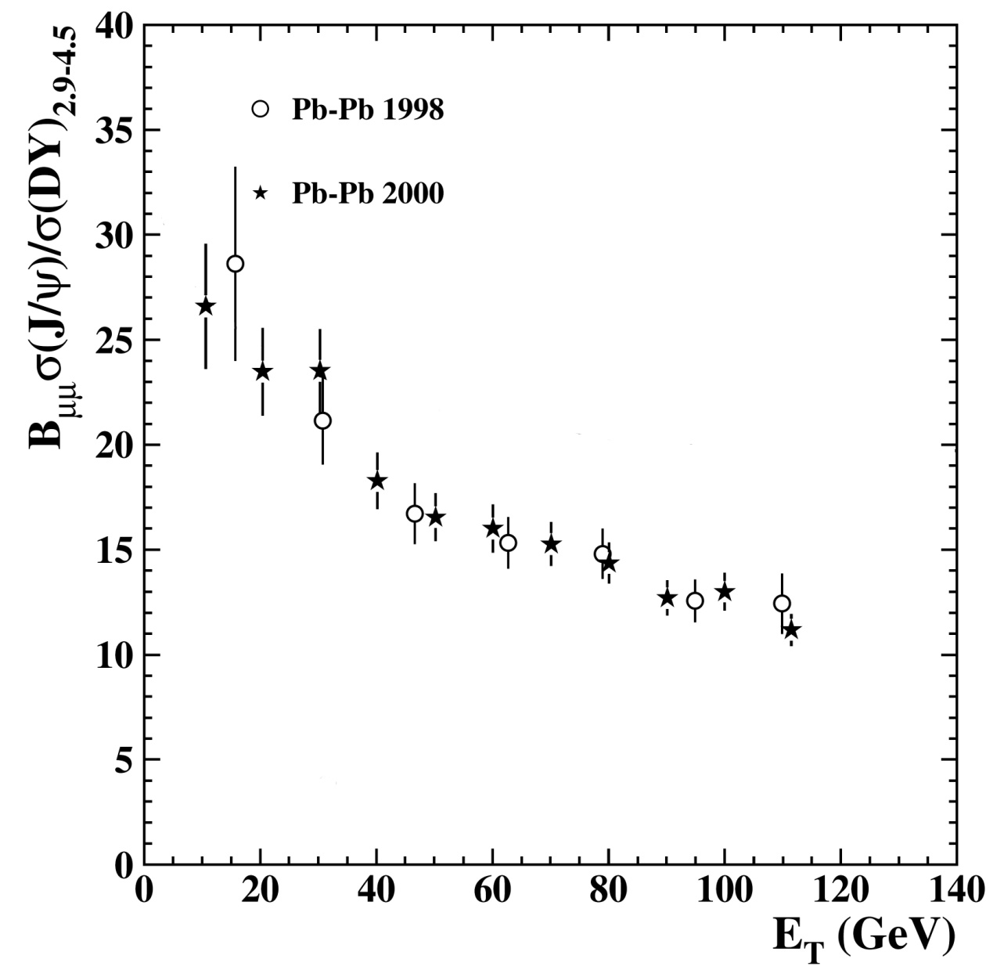
J/ψ suppression in Pb-Pb vs centrality
Nuclear modification factor
ψ/DY in p-p
Good agreement between the two golden data sets
Strong suppression of ψ yield going from peripheral to central collisions
… without estimating the cold-nuclear-matter reference little can be said about hot nuclear matter effects
Pb-Pb at 158 A*GeV
Peripheral collisions
Central collisions

Slide 8
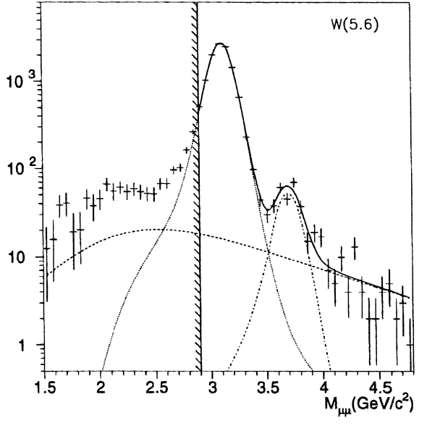
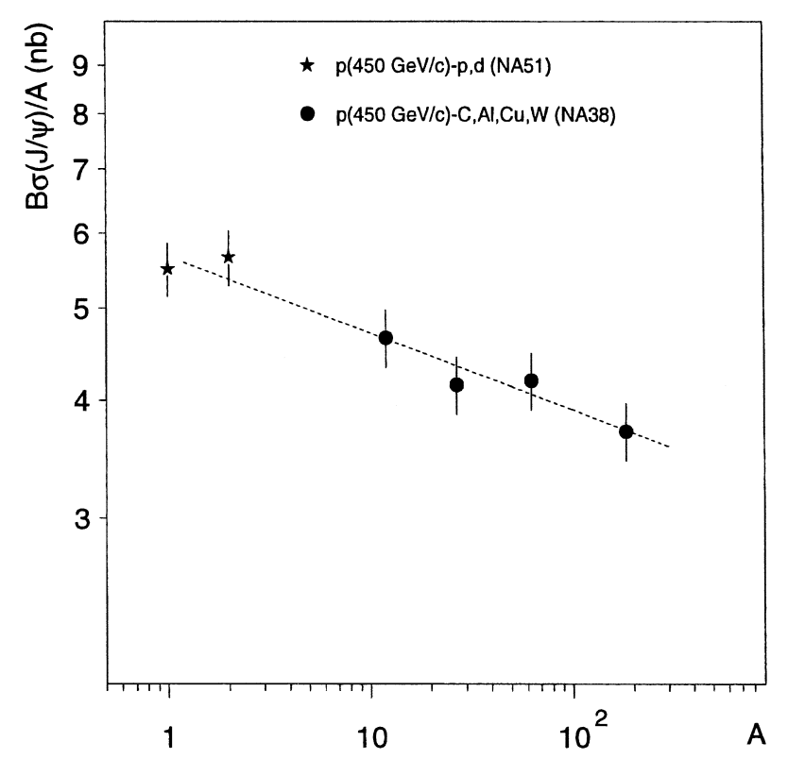
Measuring CNM reference in p-A
450 GeV
σ_{abs}=6.9±1.5
NA38 Collaboration
PLB 444 (1998) 516
First determination (problematic)
SPS A-A data has been taken at ~Z/A*400 GeV incident momentum
S and O induced reactions at 200 A*GeV
Pb-Pb at 158 A*GeV (and also In-In for consistency)
p-A at 400 (or 450 GeV)
Only recently CNM reference has been evaluated with 158 GeV primary proton beam by NA60

Slide 9
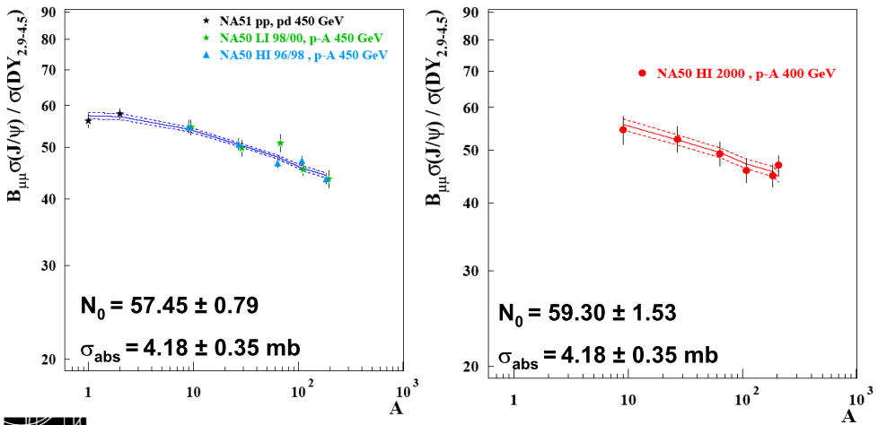
Re-measuring CNM effects: 1996-2000
σ_{abs}=4.3±0.7 for HI 97/98
σ_{abs}=4.4±1.0 for LI 98/00
σ_{abs}=3.4±1.2 for HI2000
All+NA51
3 data sets in different conditions
Use ψ/DY to reduce possible systematics
Updates in analysis procedures
Results are consistent and indicate lower absorption

Slide 10
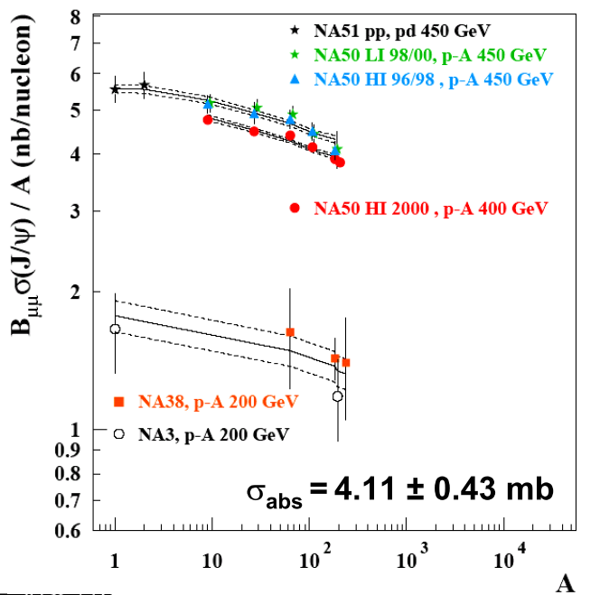
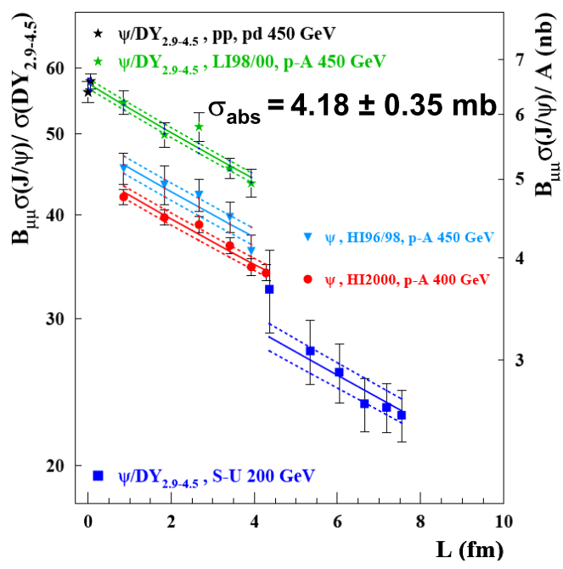
Comparing with lower energy data
Estimate the normalization of CNM reference at 158 GeV
  To do this had to assume that CNM effects do not depend on
  energy
p-A data at lower energy are compatible (large errors!)
Could also assume that only CNM effects are present in S-U 200 GeV

Slide 11
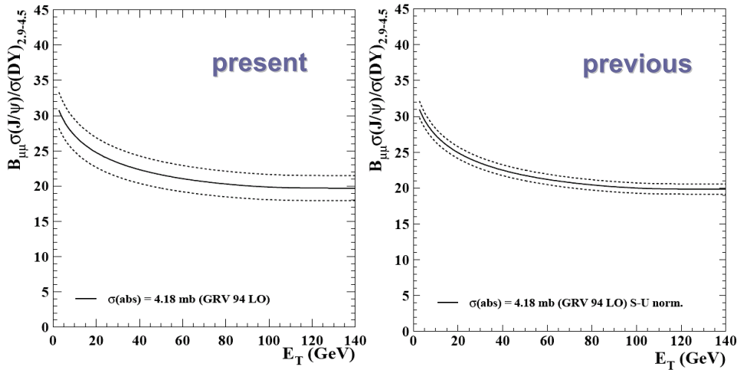
Extrapolating to A-A
Assuming energy independence of CNM effects…
…in p-A collisions
…in p-A collisions
+ no hot-nuclear matter effects in S-U
Larger error but minimal assumptions

Slide 12
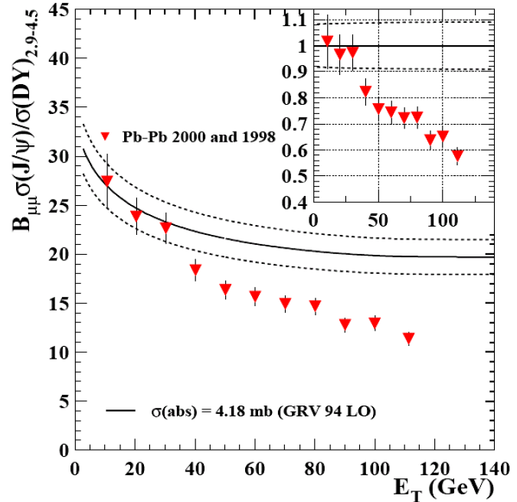
Anomalous J/ψ suppression
B_{µµ}σ(J/ψ)/σ(DY 2.9-4.5) Pb-Pb results do not follow the
normal absorption as extrapolated from p-A
Peripheral collisions:
Compatible with the
normal nuclear absorption.
Mid–centrality:
Departure from the normal
nuclear absorption.
Central collisions:
No saturation at high
centralities.

Slide 13
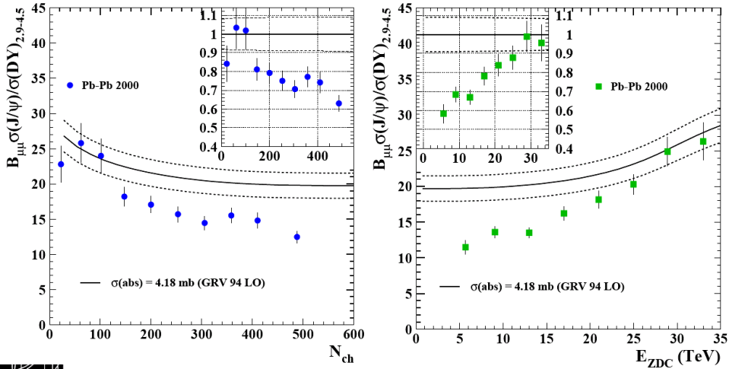
Other centrality estimators
Same behavior is observed using charged particle multiplicity or zero degree energy as centrality estimators

Slide 14
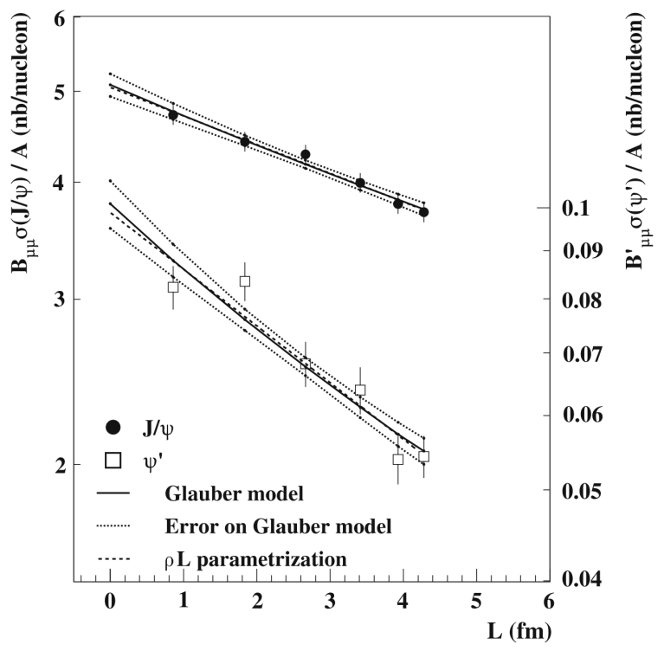
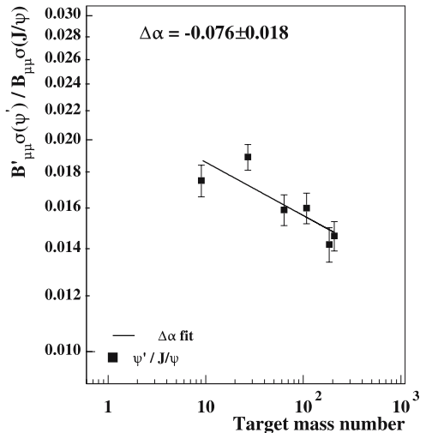
Ψ’ production
p-A: path in nuclei ➔ possibility to constrain the production mechanisms
A-A: different binding energy ➔ sensitivity to temperature of plasma or hadronic soup
Higher absorption for ψ’
Confirms E866 observation

Slide 15
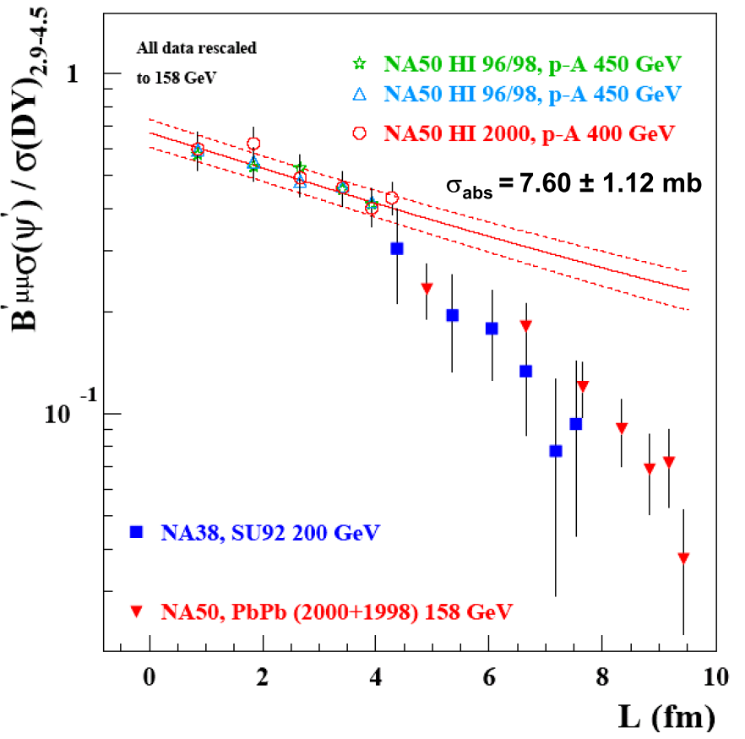
Ψ’ production in p-A and A-A
Suppression in p-A extrapolated to A-B assuming energy independence of σ_{abs}
Different behaviour
between p-A and A-B
collisions
Independently from assumptions on σ_{abs}
Stronger ψ’ absorption from
peripheral to central A-B
interactions.
ψ’ suppression in S-U collisions is compatible with Pb-Pb

Slide 16
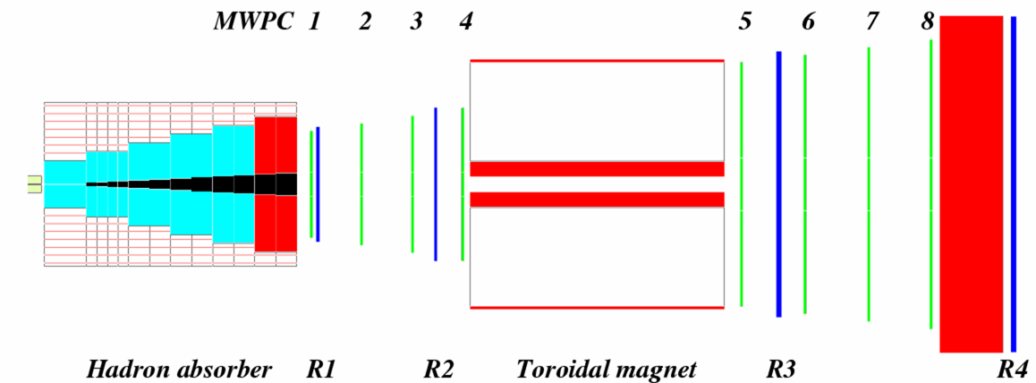
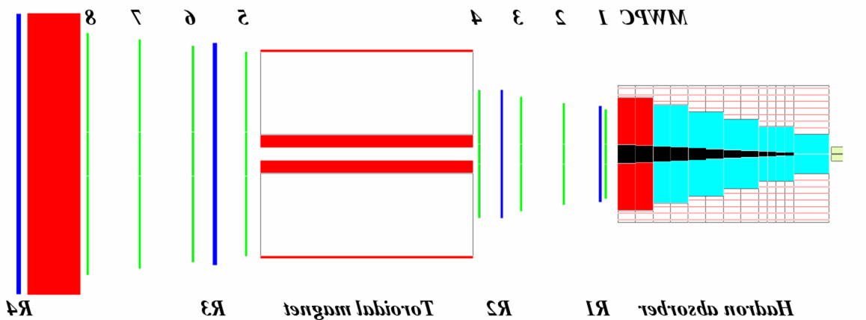

The NA60 experiment
NA60, the third generation experiment studying the production of muon pairs at the CERN SPS
Muon trigger
and tracking
2.5 T dipole magnet
NA10/38/50 spectrometer
beam tracker
vertex tracker
magnetic field
Iron wall
targets
hadron absorber
Matching in coordinate
and momentum space
Muon
Other
Data samples
In-In collisions at 158 GeV/nucleon
p-A collisions at 158 and 400 GeV
  9 nuclear targets, Al-U-W-Cu-In-Be1-Be2-Be3-Pb
  (mixed A-order to limit possible z-dependent systematics)

Slide 17
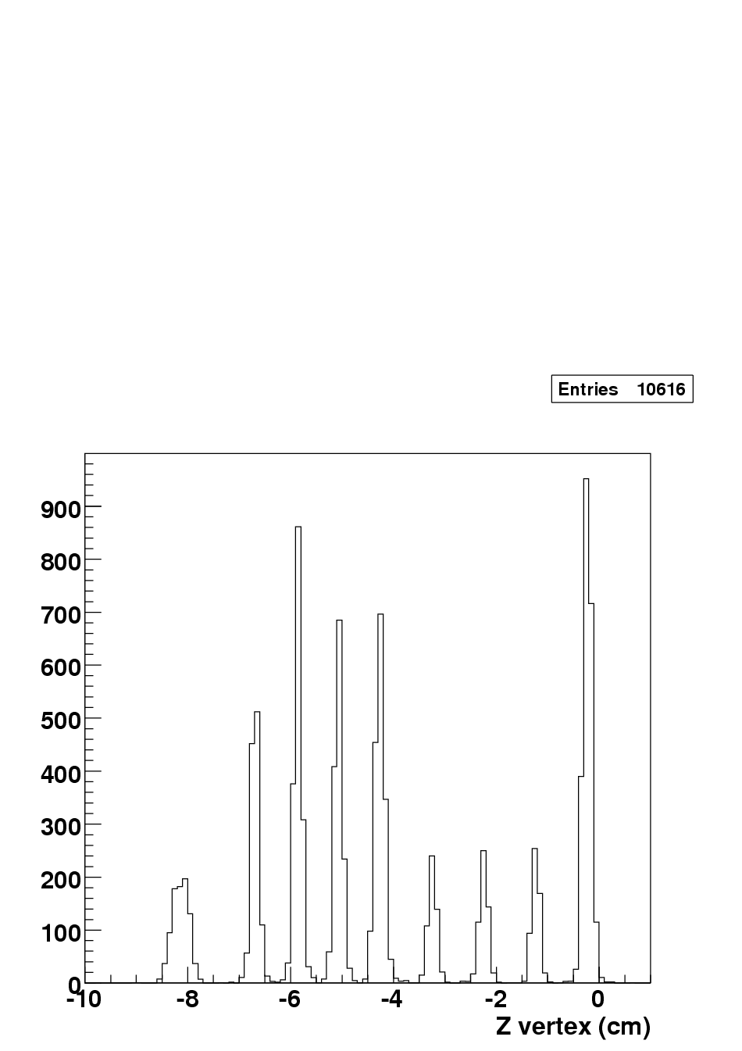
p-A collisions
Not enough DY statistics to extract (as in NA50) B_{μμ} σ_{J/ψ}/σ_{DY} target by target
W
Pb
Cu
In
U
Estimate of nuclear effects through relative cross sections:
Be
Al
all targets simultaneously on the beam
beam luminosity factors N_{i}^{inc} cancel out
(apart from a small beam attenuation
factor) → no systematic errors
→ acceptance and recostruction efficiencies do not completely cancel out
(these quantities and their time evolution are computed for each target)
→ each target sees the vertex spectrometer under a (slightly) different
angle: kinematic window is restricted, to reduce systematic
(0.28<y_{cm}<0.78 at 158GeV and -0.17<y_{cm}<0.33 at 400GeV)

Slide 18
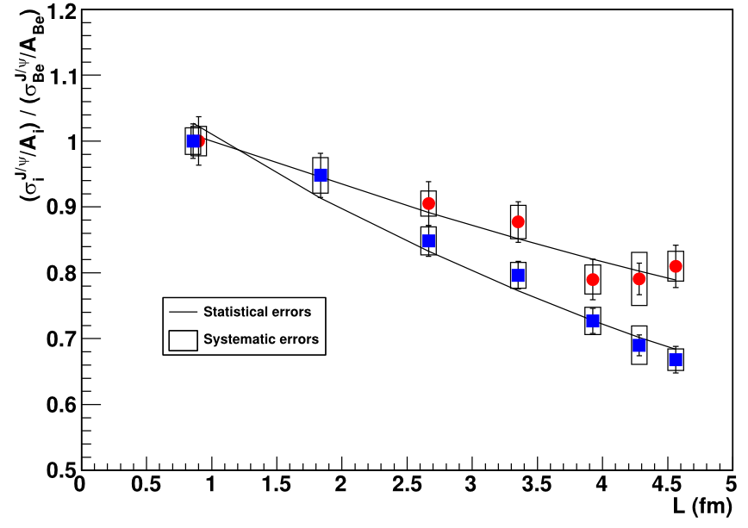
A-dependence of relative cross sections
→ increasing suppression of
the J/ψ yield as a function of A
larger suppression at 158 GeV
400 GeV
using a Glauber fit to extract σ_{abs}
158 GeV:
σ_{abs} ^{J/ψ} = 7.6 ± 0.7 ± 0.6 mb
400 GeV:
σ_{abs} ^{J/ψ} = 4.3 ± 0.8 ± 0.6 mb
158 GeV
NA60 Coll., arXiv:1004.5523
very good agreement with NA50 (4.6 ± 0.6mb)
systematic errors due to :
target thicknesses (<1.5%)‏
J/ψ y distribution (<1.5%)‏
reconstruction eff. calculation (<3%)‏
using
158 GeV:
= 0.882 ± 0.009 ± 0.008
400 GeV:
α = 0.927 ± 0.013 ± 0.009
shadowing neglected, as usually done at fixed target (but not correct!)

Slide 19
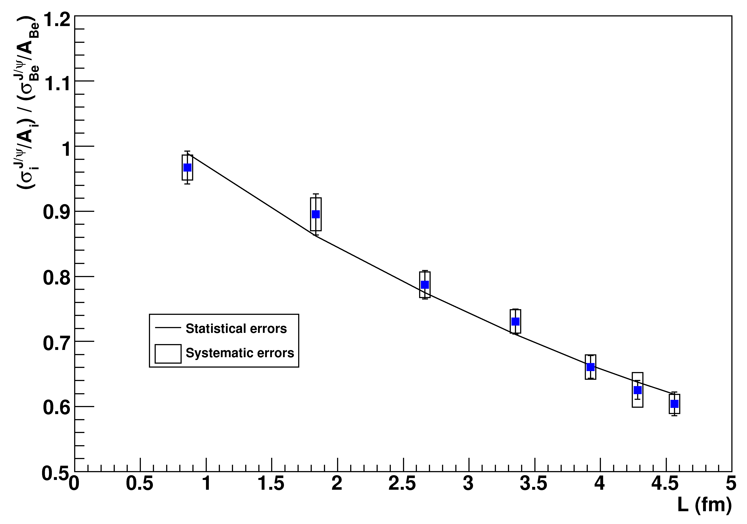
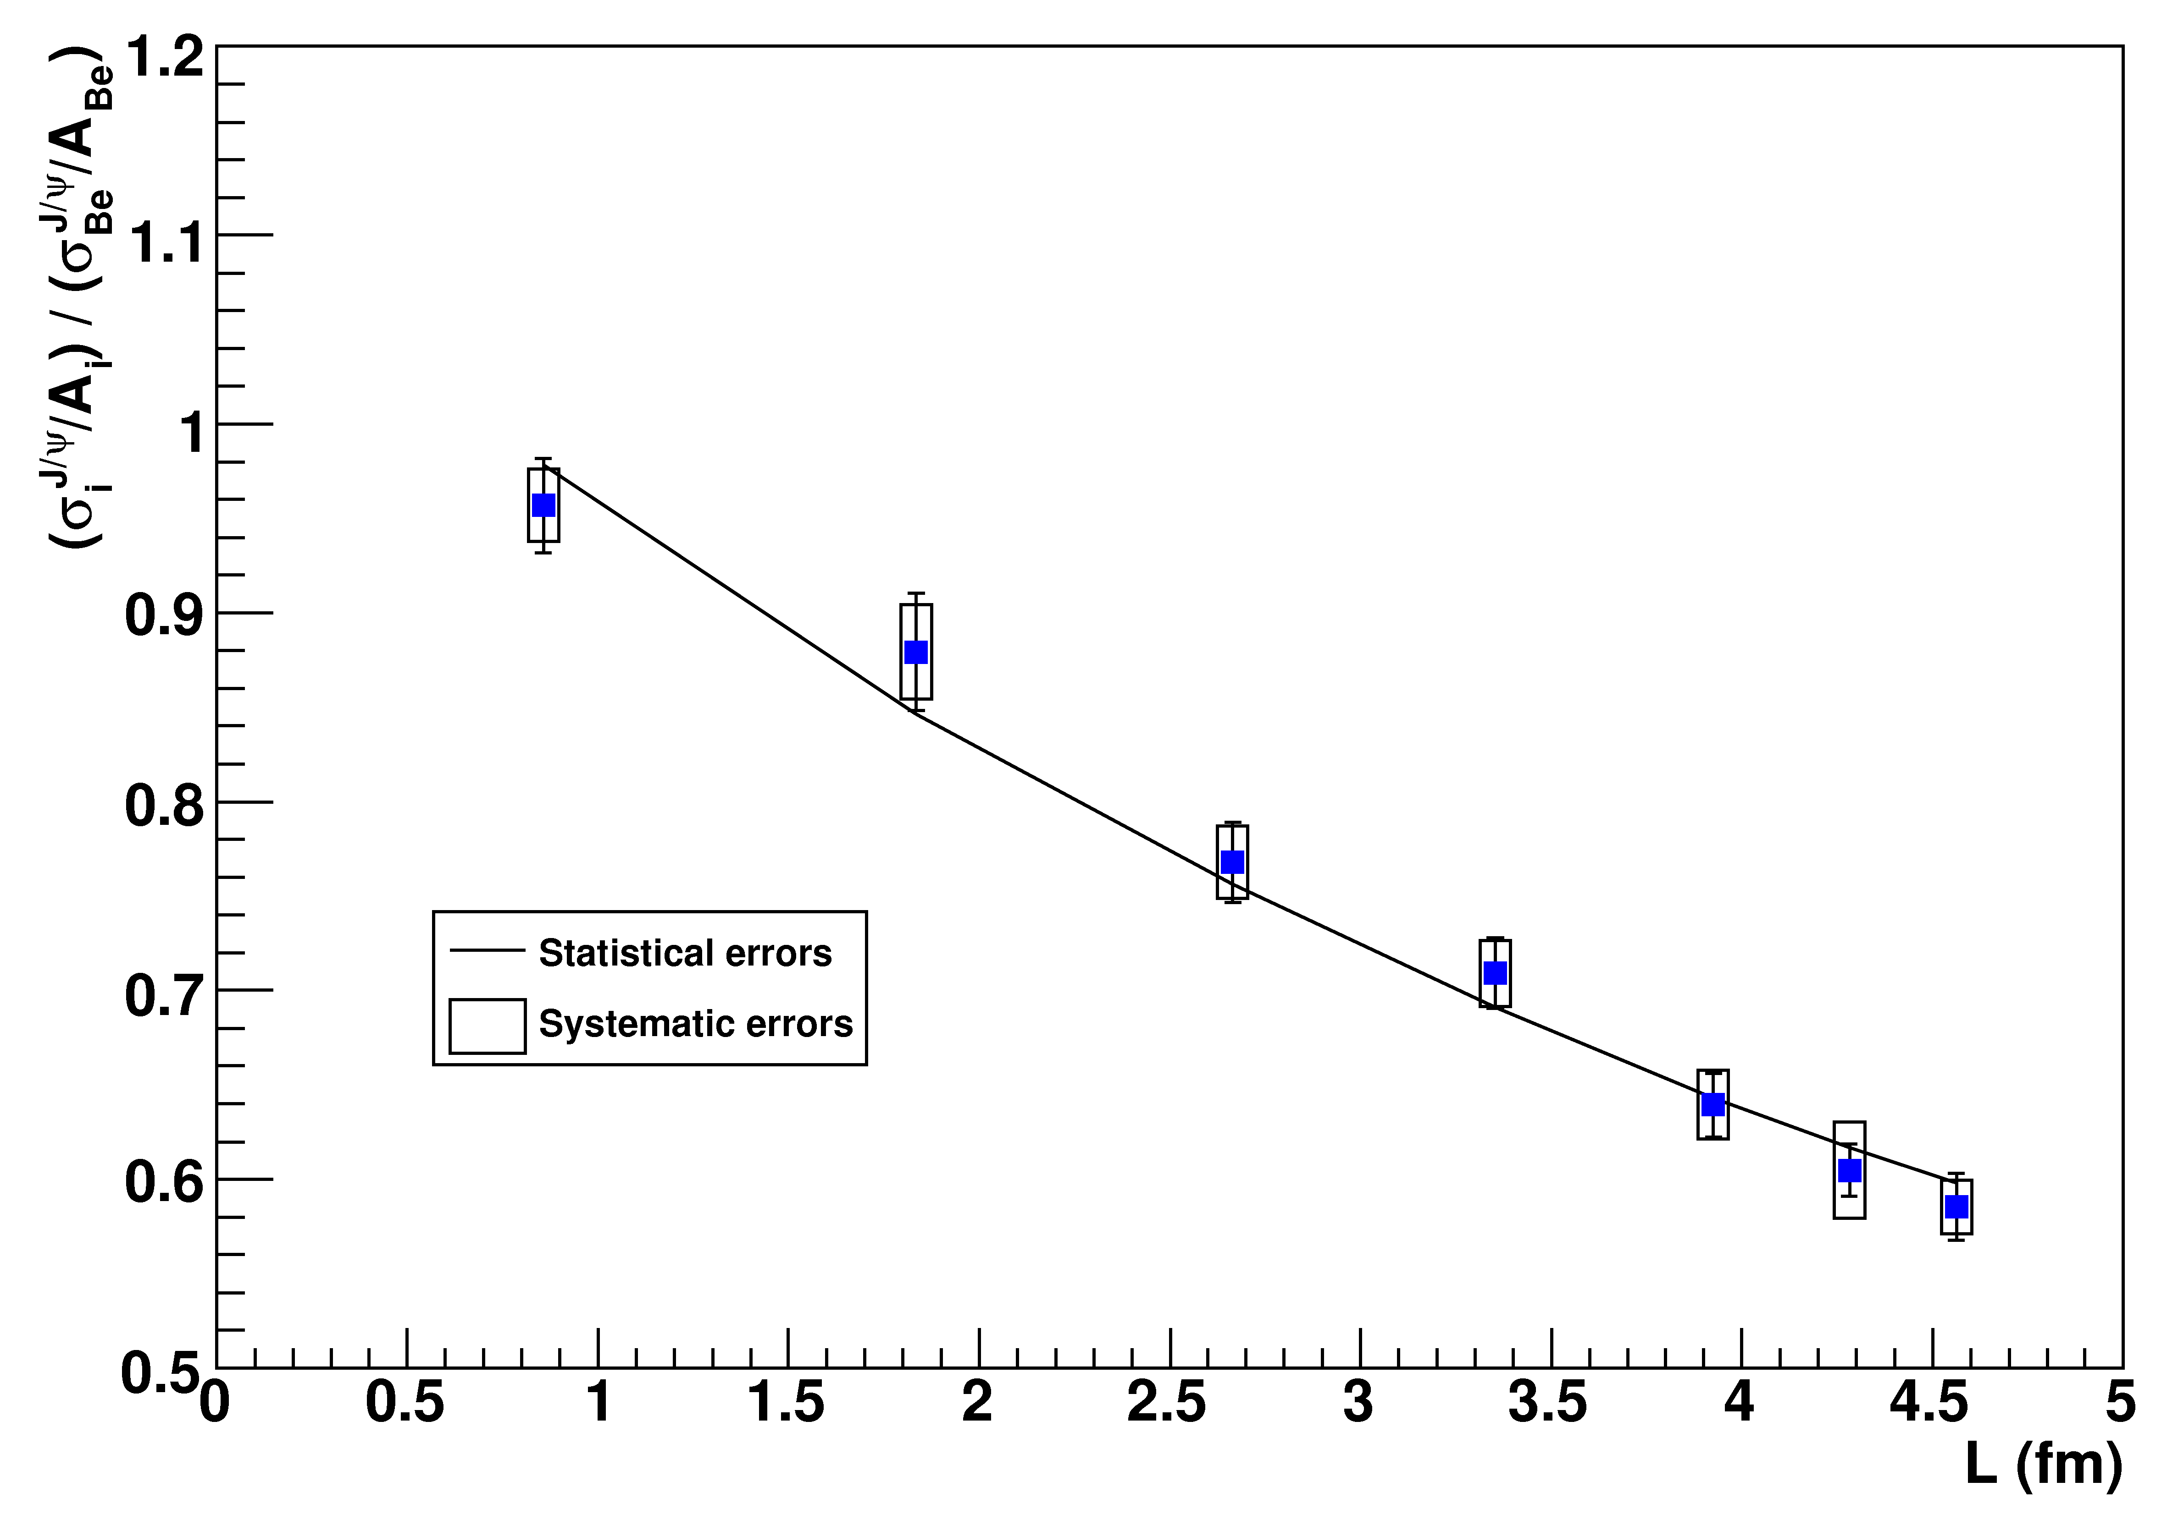
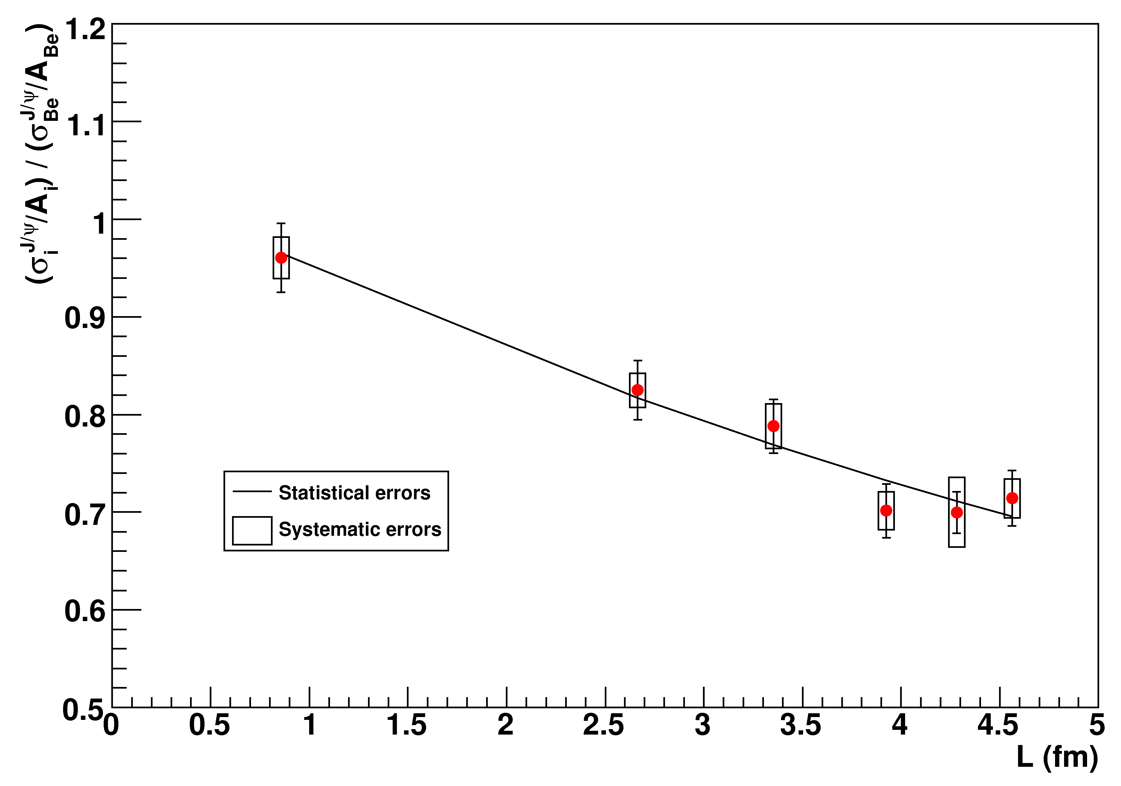
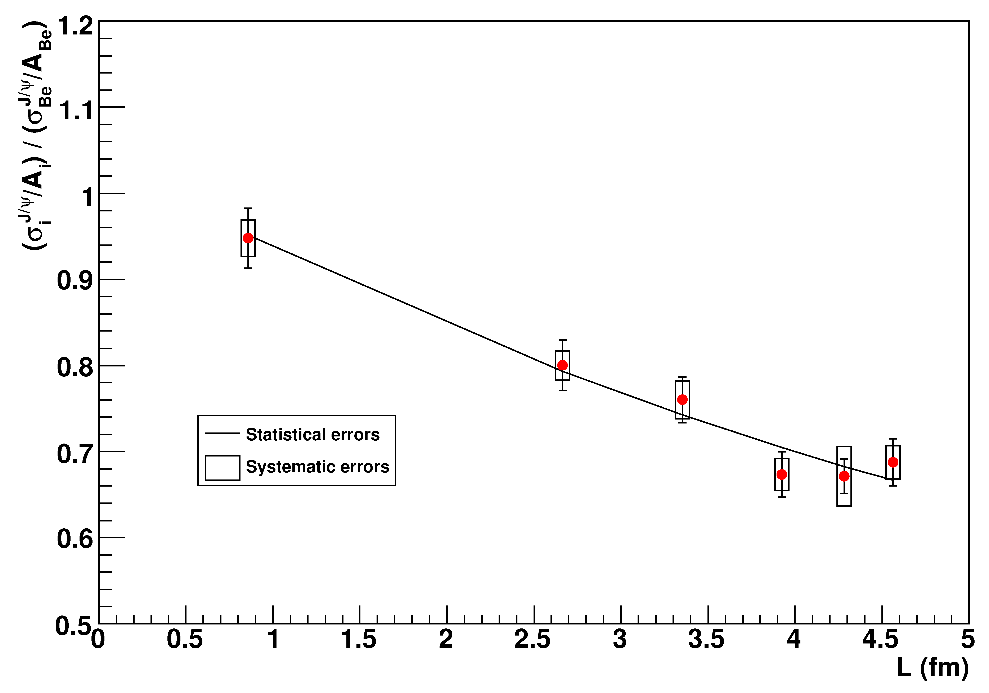
Shadowing at 400/158 GeV
We have evaluated (and corrected for) the (anti)shadowing effect
expected for our data points, within the EKS98 and EPS08 scheme
158 GeV,
EKS98
158 GeV,
EPS08
400 GeV,
EKS98
400 GeV,
EPS08
σ_{abs} ^{J/ψ,EKS} (158 GeV)=9.3±0.7±0.7 mb
σ_{abs} ^{J/ψ,EKS} (400 GeV)=6.0±0.9±0.7 mb
σ_{abs} ^{J/ψ,EPS} (158 GeV)=9.8±0.8±0.7 mb
σ_{abs} ^{J/ψ,EPS} (400 GeV)=6.6±1.0±0.7 mb
The Glauber fit now gives
Significantly higher than the “effective” values
Notes:
19
EPS as an upper limit for shadowing effects

Slide 20
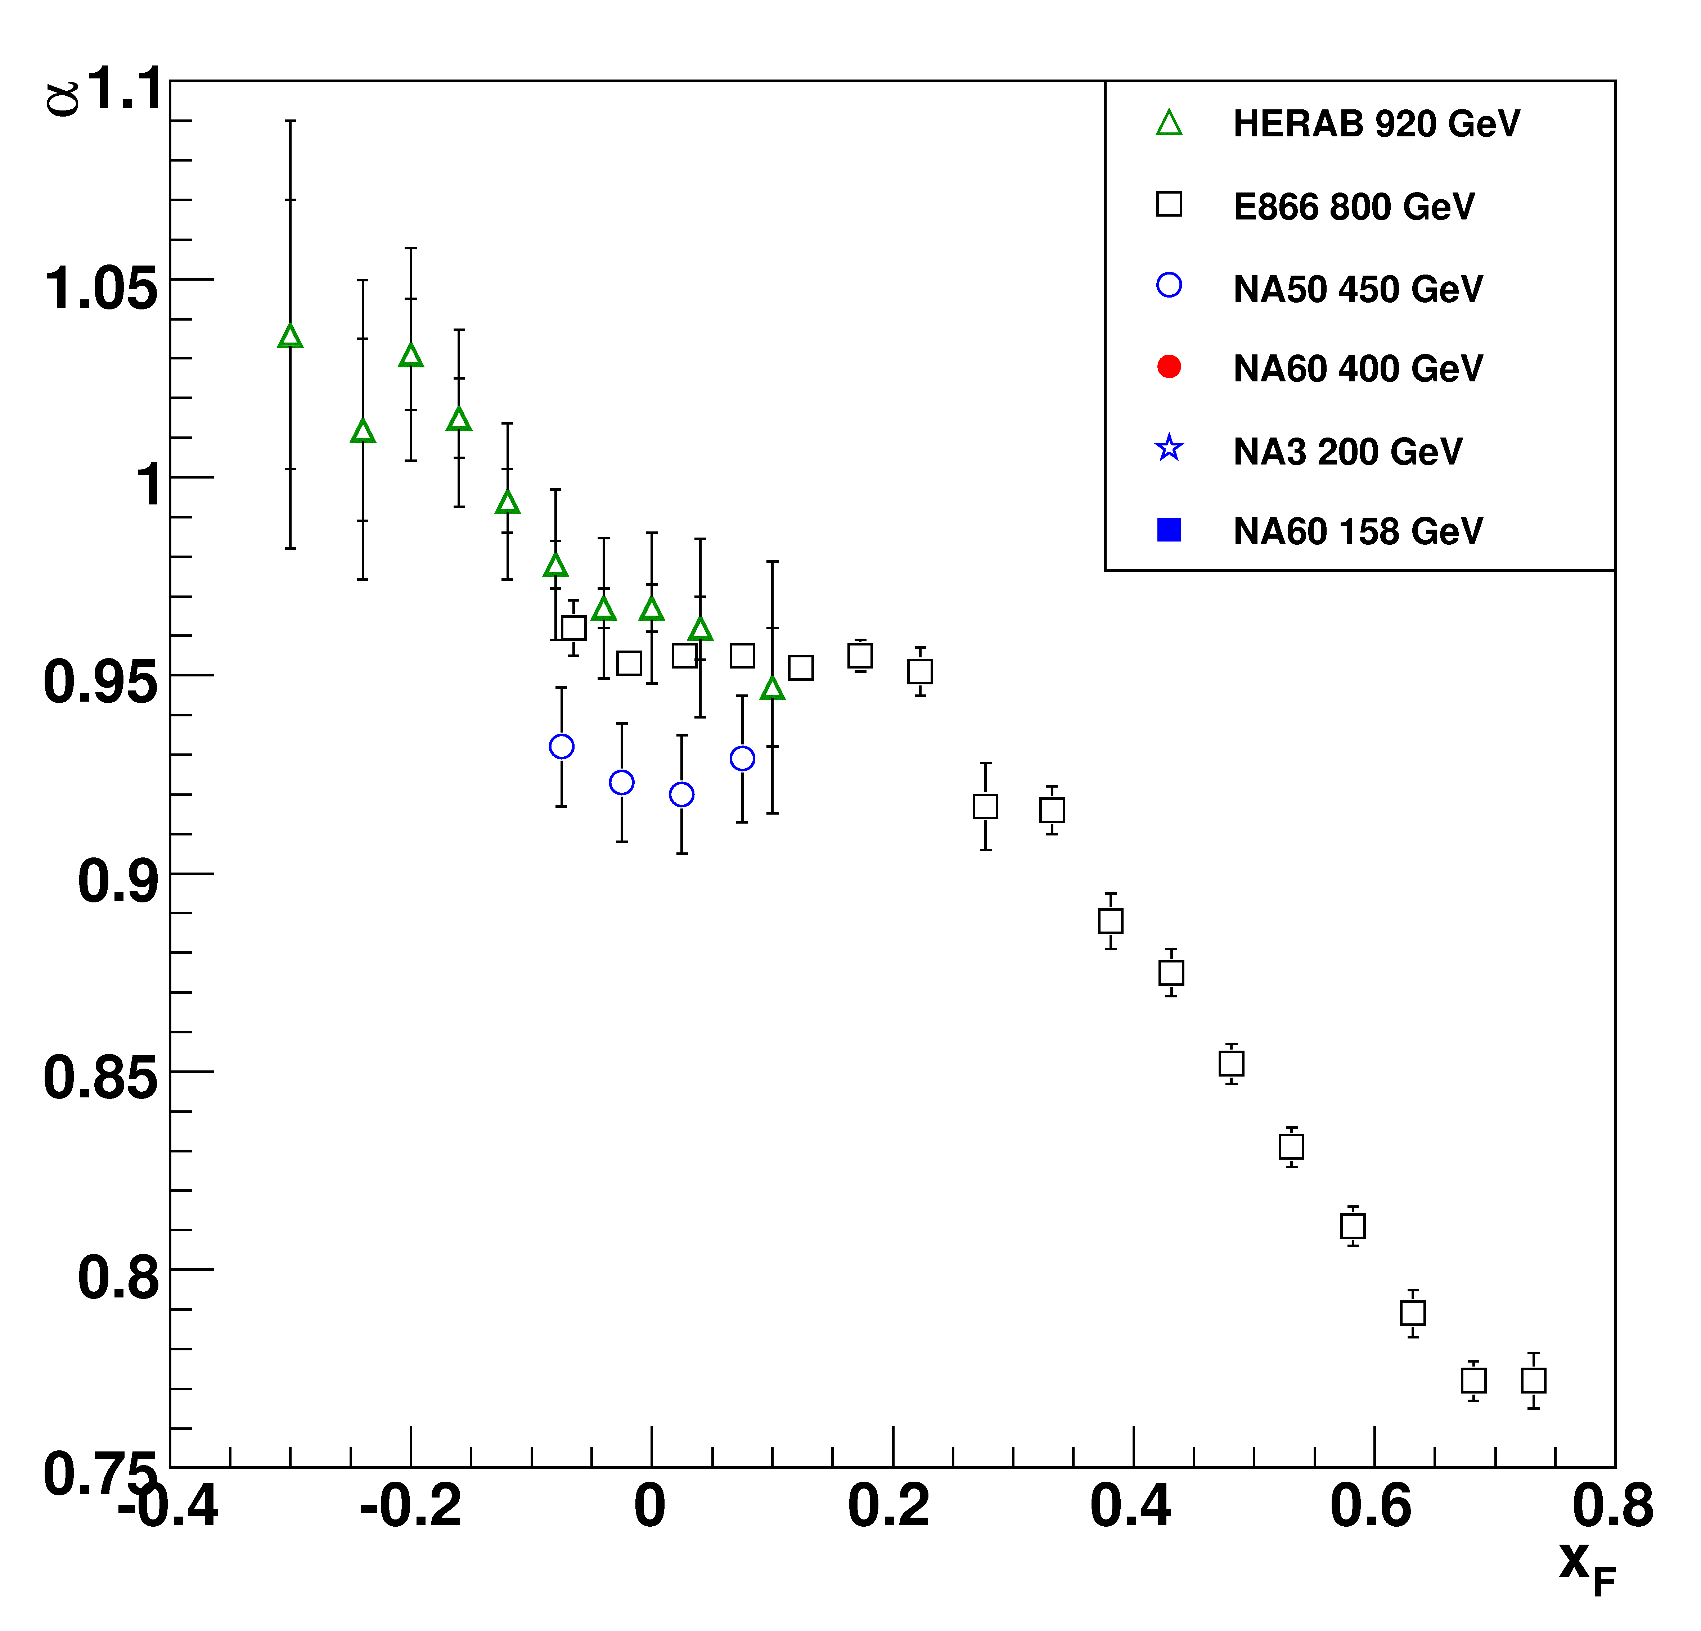
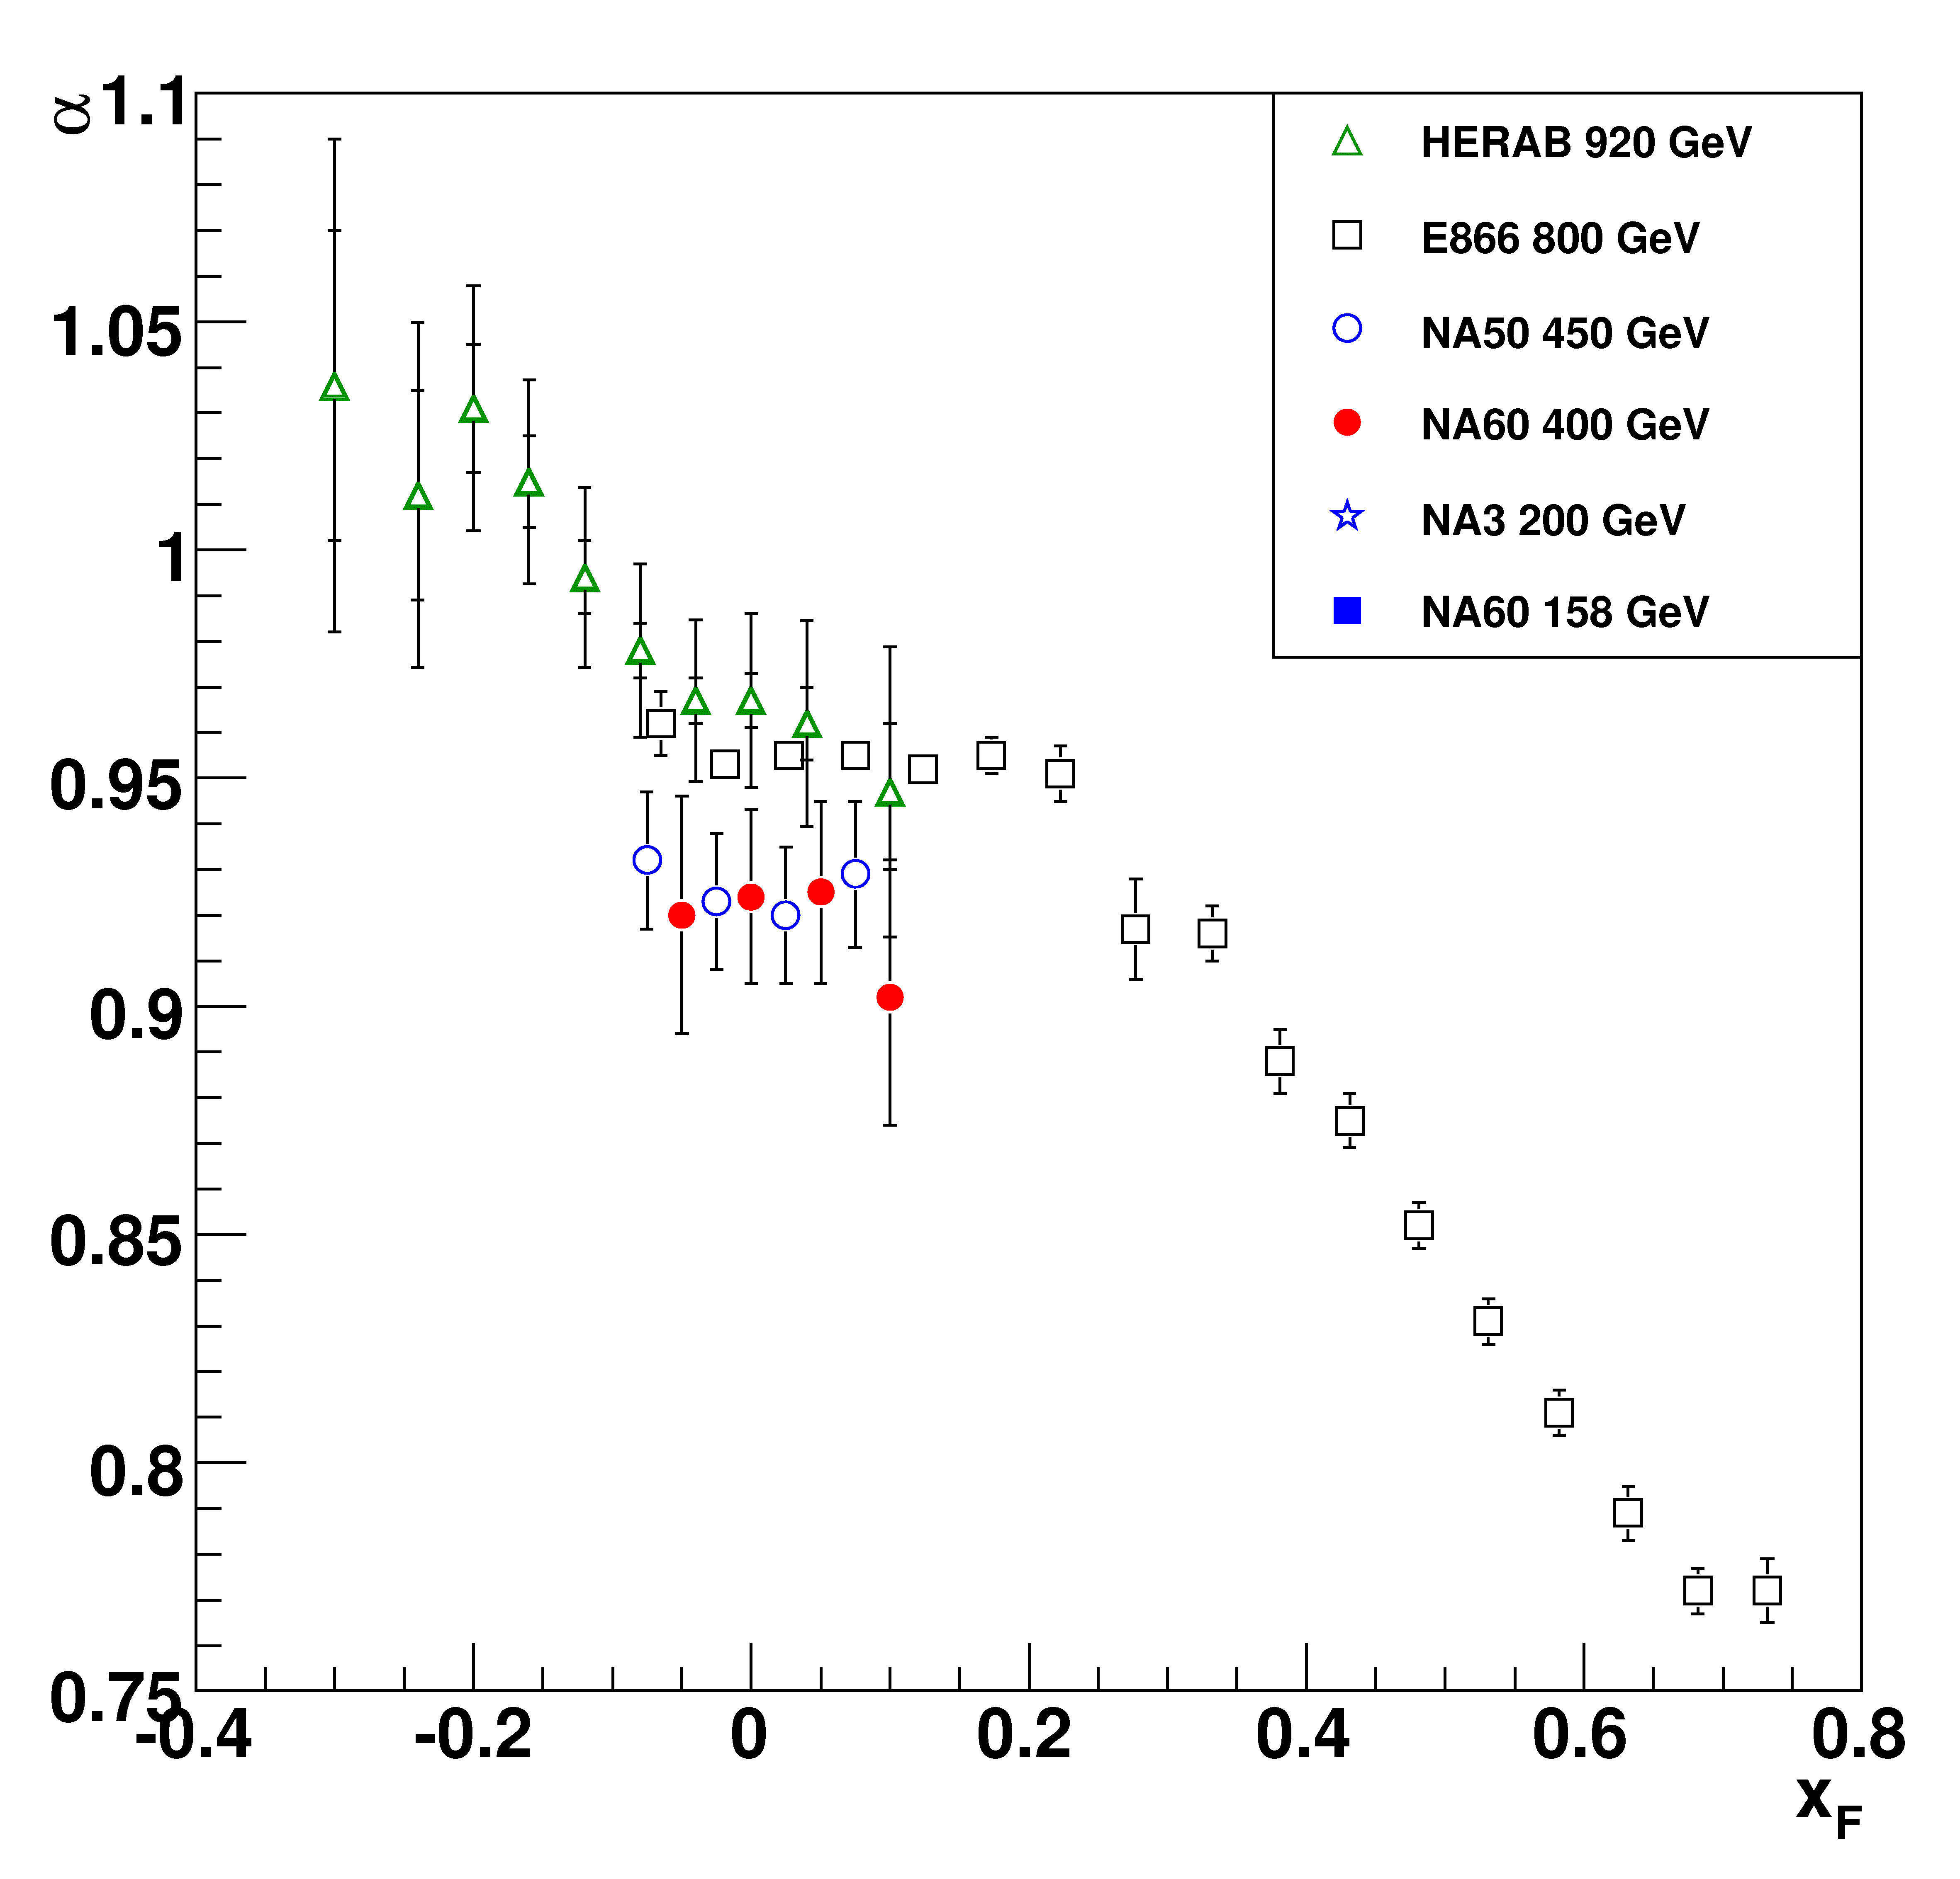
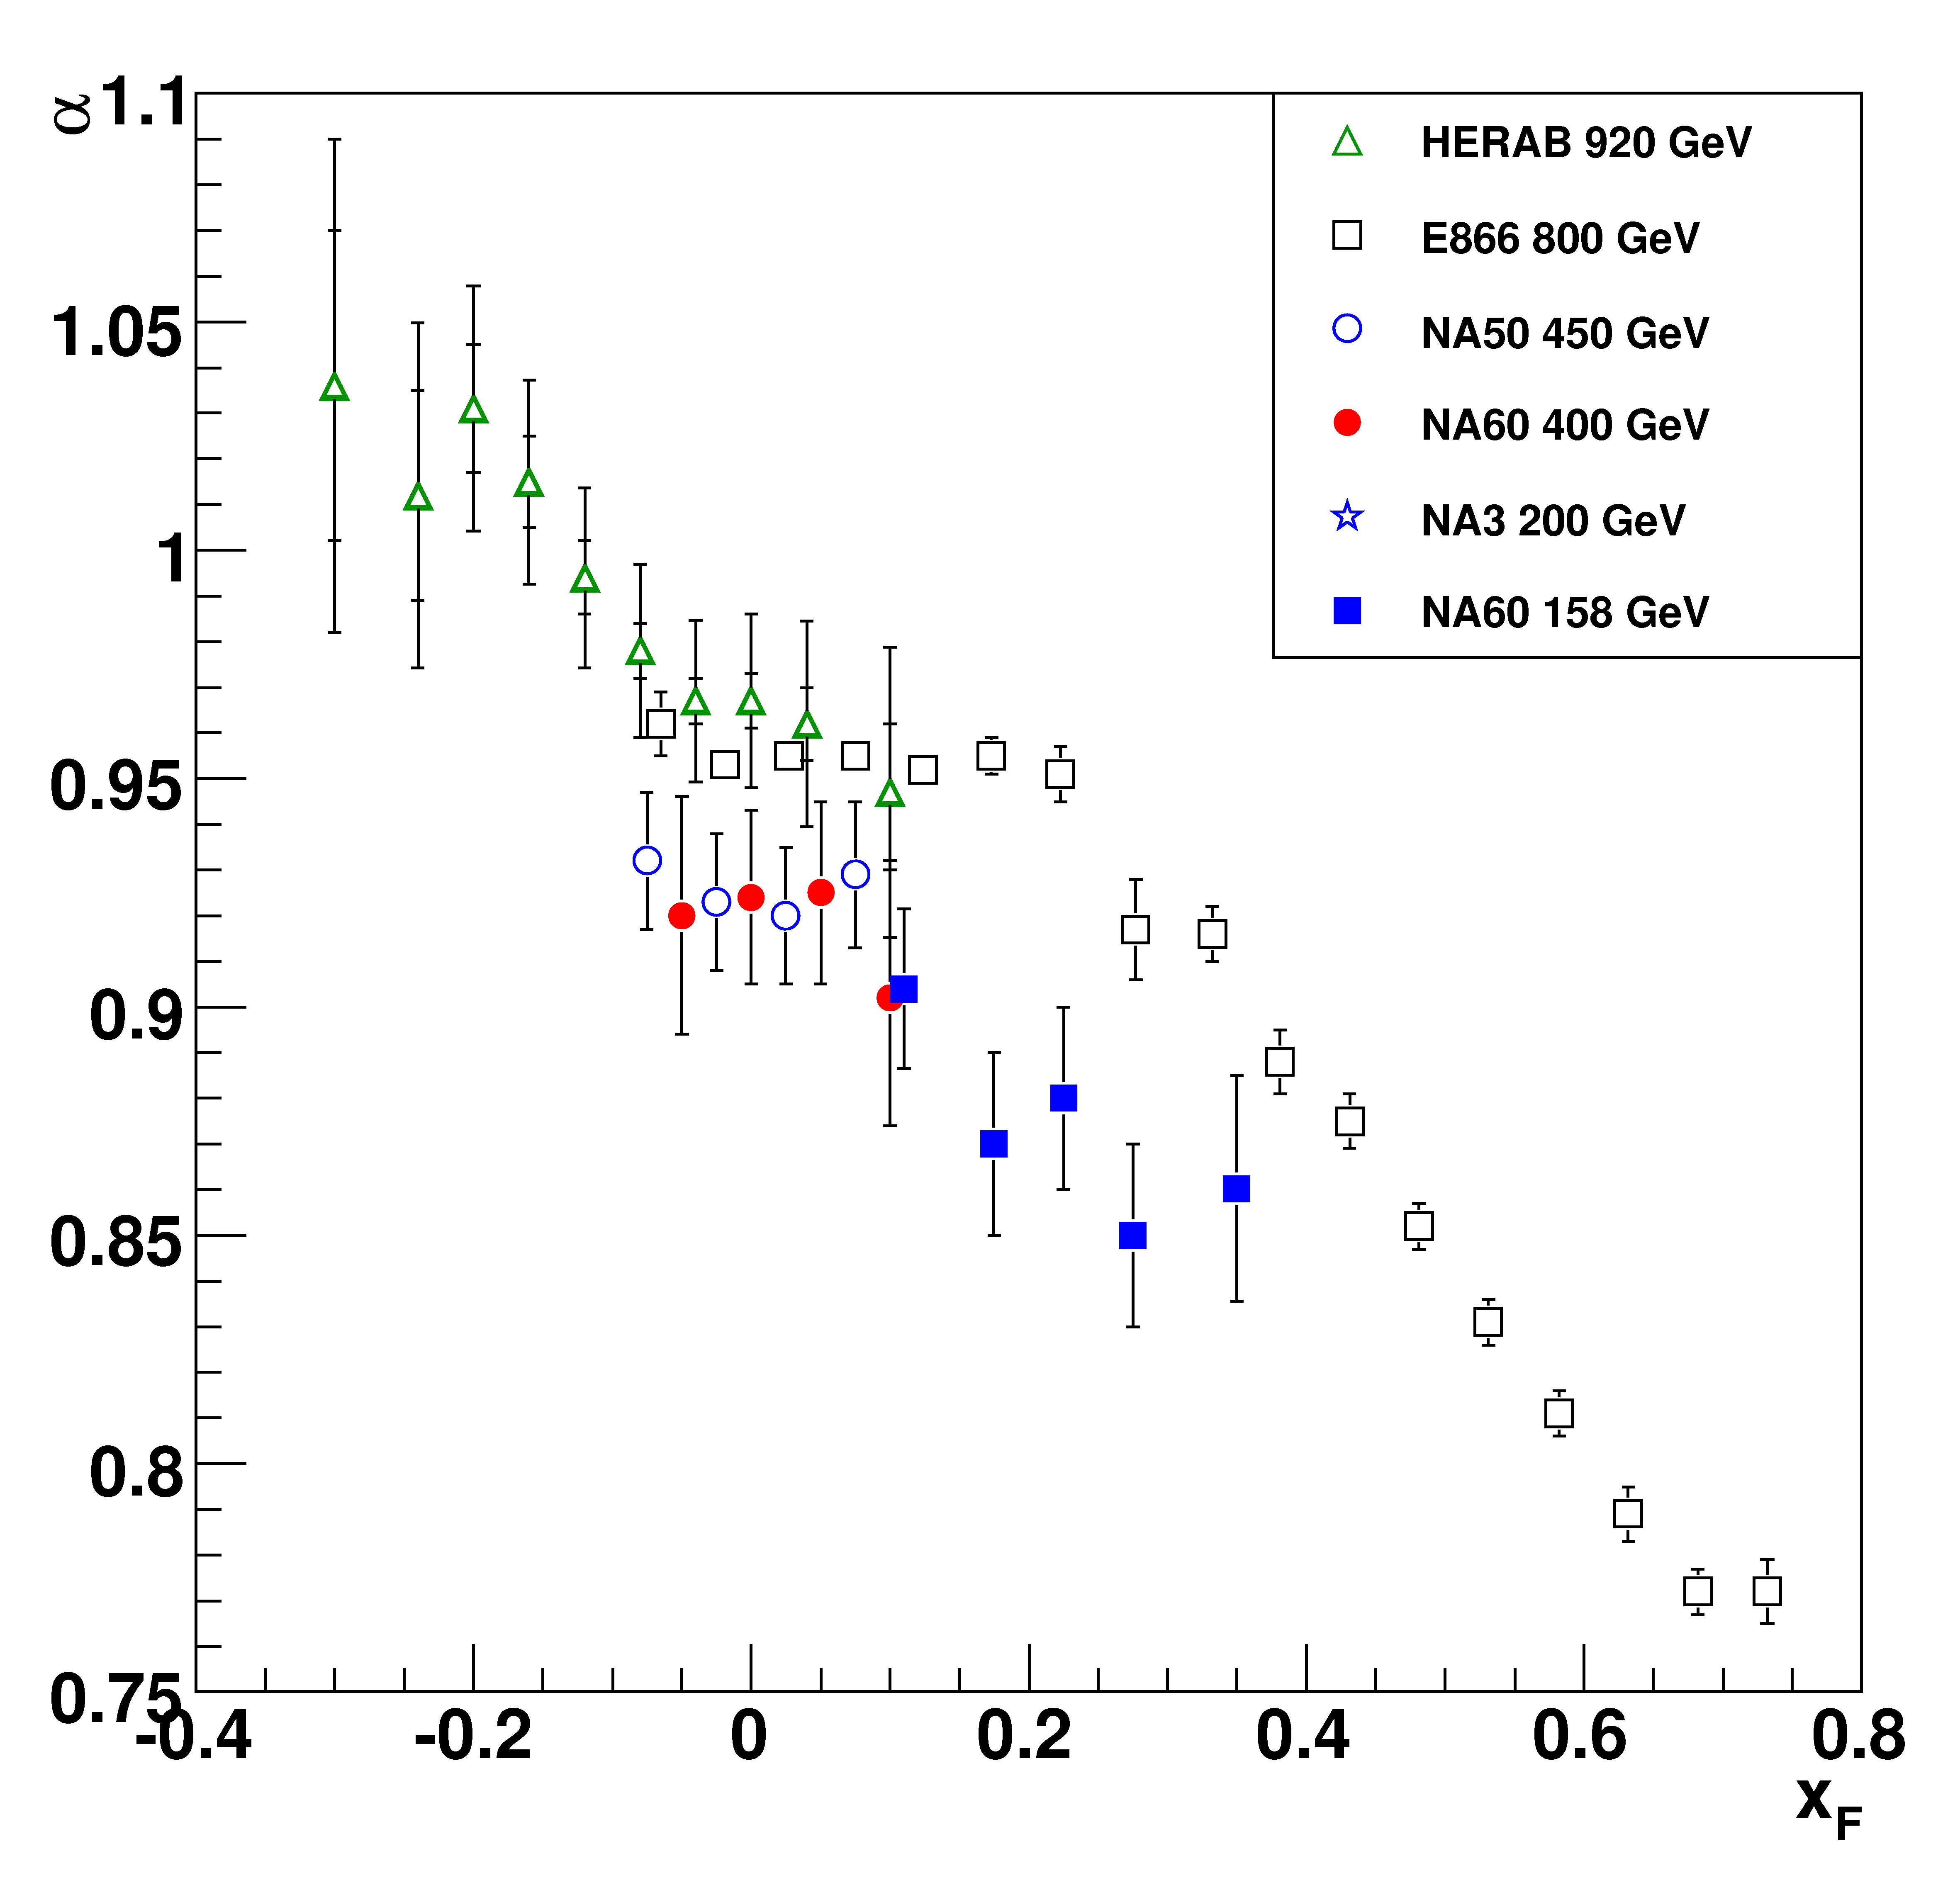
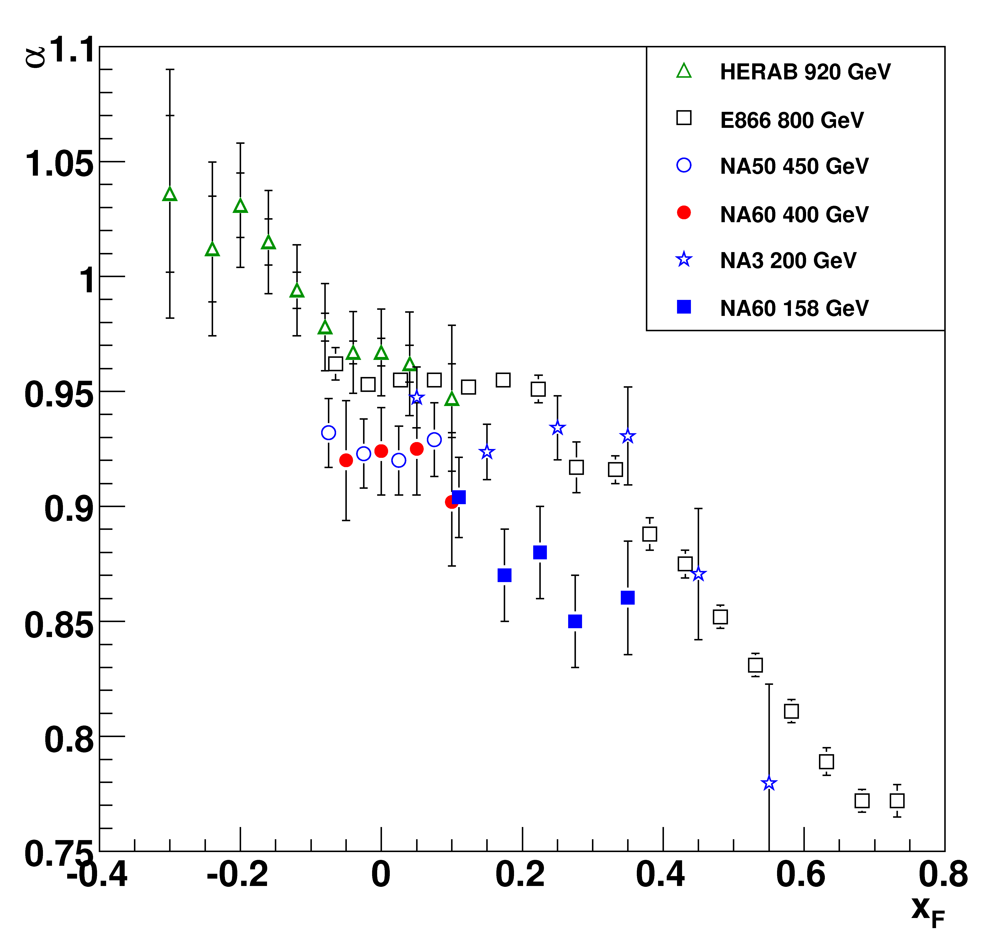
α vs x_{F}
NA60 pA results can be compared with α values from other
experiments (HERAB, E866, NA50 and NA3)
E. Scomparin et al., Nucl. Phys. A830 (2009) 239
In the region close to x_{F}=0,
increase of α with √s
NA60 400 GeV
very good agreement
with NA50
NA60 158 GeV:
smaller α, hints of a
decrease towards high x_{F} ?
discrepancy with NA3 ?
Systematic error on α for NA60 points ~0.01

Slide 21
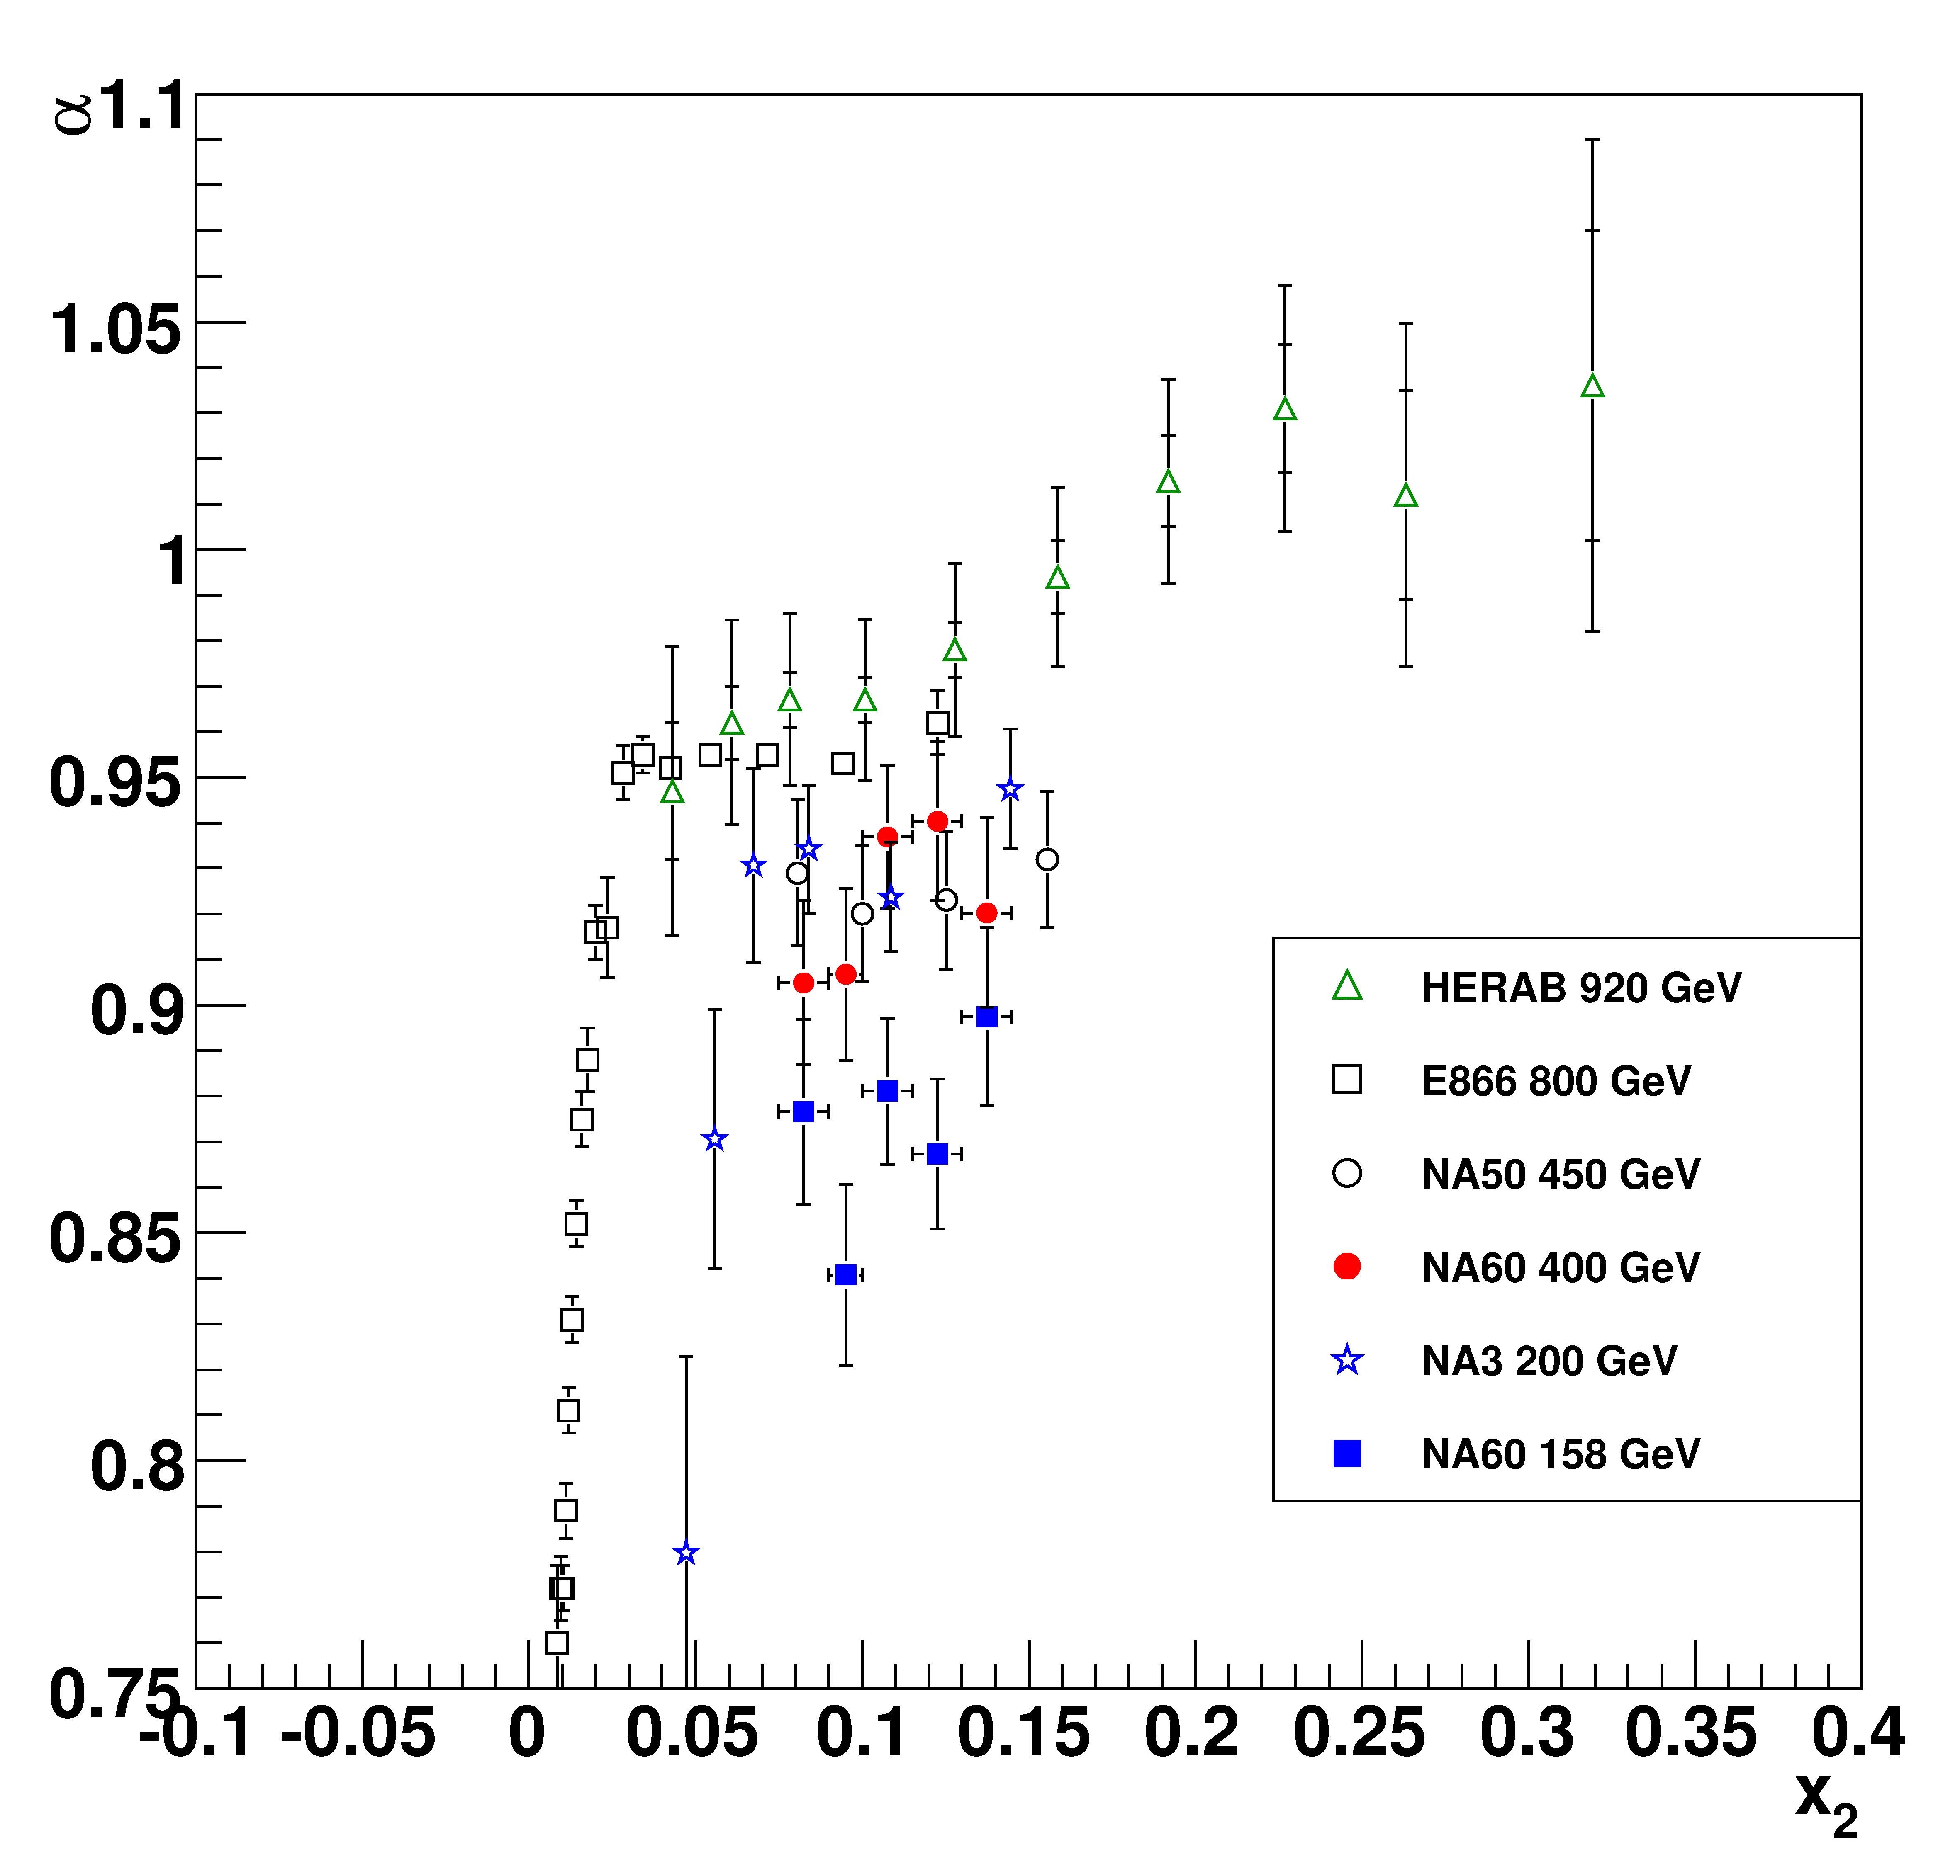
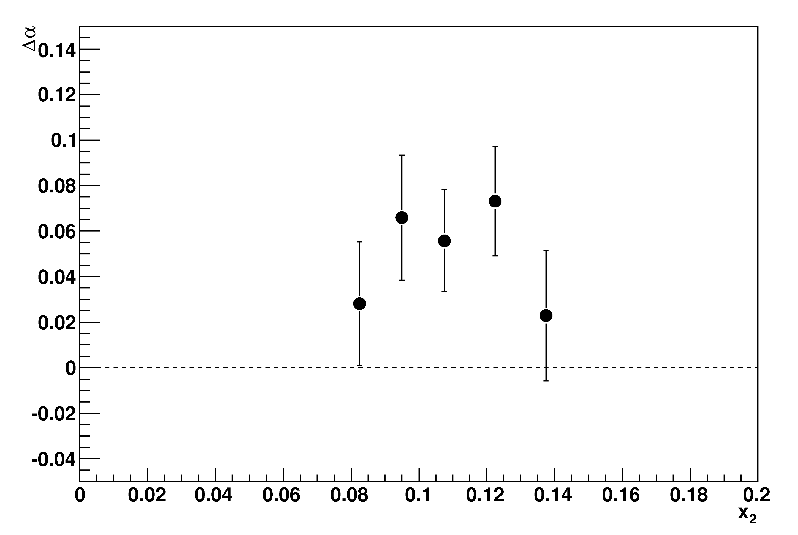
α vs x₂
Shadowing effects and final state absorption (in the 2→1 approach)
should scale with x₂
If parton shadowing and final
state absorption were the only
relevant mechanisms
→ α should not depend on √s at
constant x₂
NA60 data (two energies in the
same experimental conditions)
→ reduced systematics on Δα
Δα
NA60 Δα(400-158 GeV)
Δα ≠ 0 in the explored x₂ range
clearly other effects
should be present
x₂
NA60 Coll., arXiv:1004.5523

Slide 22
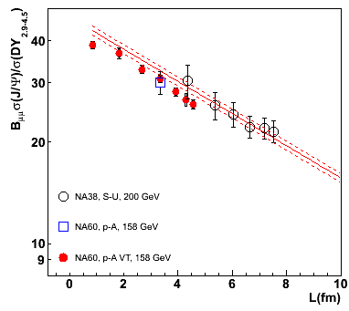
Reference for AA data
CNM effects, evaluated in pA, can be extrapolated to AA, assuming a
scaling with the L variable and taking into account that:
σ_{abs} shows an energy/kinematical
dependence
reference obtained from 158 GeV pA data (same energy/kinematical range as the AA data)
in AA collisions, shadowing affects both projectile and target
proj. and target antishadowing taken into account in the reference determination
The current reference is based on:
slope determined only from pA@158GeV
σ_{abs} ^{J/ψ} (158 GeV) = 7.6 ± 0.7 ± 0.6 mb
normalization to σ_{J/ψ}^{pp} determined from
pA@158 GeV (J/ψ/DY point) and (to
reduce the overall error) SU@200GeV
SU has been included in the fit, since it has a slope similar to pA at 158 GeV
advantage: small error on normalization (3%)
drawback: hypothesis that SU is “normal”‏
Notes:
Nuclear effects scale with L…Se uso solo pA PC point: 8% error. Con SU 3%. Differenza slopes 0.3 sigma

Slide 23
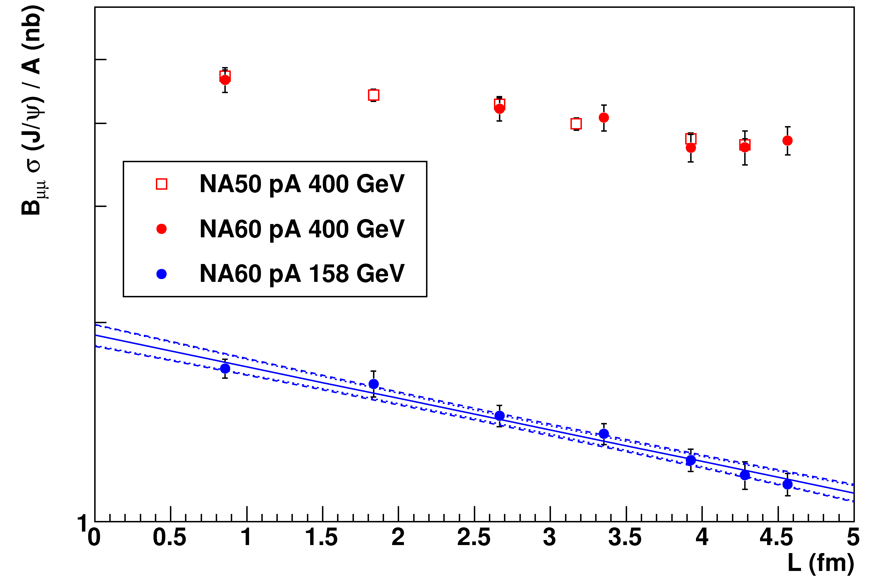
New result: J/ψ cross section in pA
J/ψ production cross sections for pA data
Preliminary
Systematic error on (absolute) luminosity estimation quite high
Relative luminosity estimate between 158 and 400 GeV
much better known (~2-3% systematic error)
Normalize NA60 400 GeV cross section ratios to NA50 results
158 GeV cross sections constrained by the relative normalization
Notes:
Banda blu-> errore su sigma e normalizzazione (1 sigma)

Slide 24
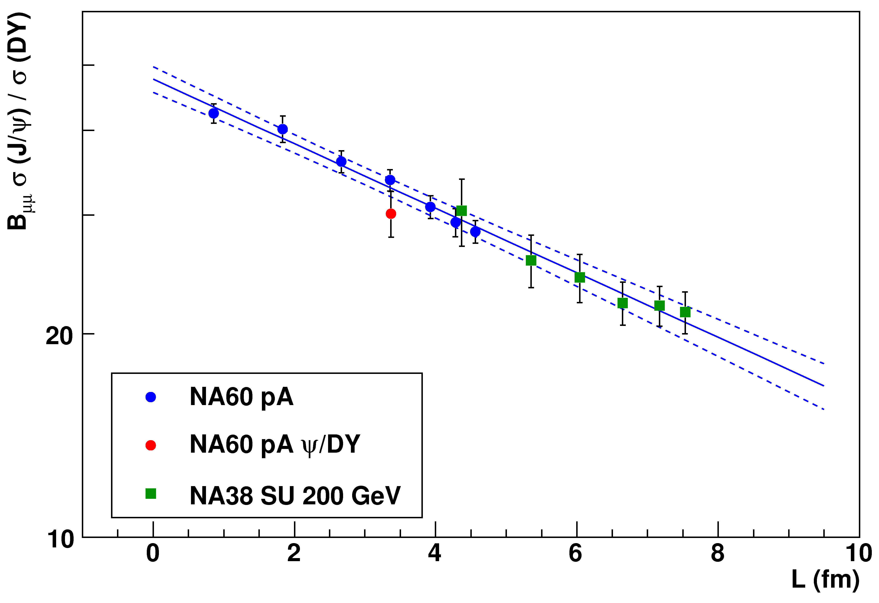
New reference using J/ψ cross sections
Alternative approach for the normalization of the pA reference
curve based on the pA J/ψ absolute cross section
To fully profit from this approach, a measurement of the absolute J/ψ
cross section in In-In would be needed. For the moment…
J/ψ/DY values are obtained rescaling the DY cross section
measured at 450 GeV by NA50 (not enough statistics at 158 GeV)
Main advantage: no assumption on SU, since it is not used
anymore in the fit
Preliminary
Difference with previous CNM reference ~1% well within errors
No practical consequence on anomalous J/Ψ suppression
Now possible to claim that in SU are present only CNM effects

Slide 25
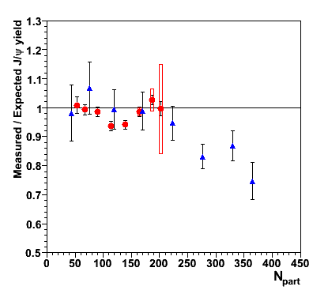
Anomalous suppression
In-In 158 GeV (NA60)
Pb-Pb 158 GeV (NA50)
Using the previously defined reference:
Central Pb-Pb:
→ still anomalously
suppressed
In-In:
almost no anomalous
suppression
B. Alessandro et al., EPJC39 (2005) 335
R. Arnaldi et al., Nucl. Phys. A830 (2009) 345
R.Arnaldi, P. Cortese, E. Scomparin Phys. Rev. C 81 (2009), 014903
Notes:
Ratio measured over expected

Slide 26
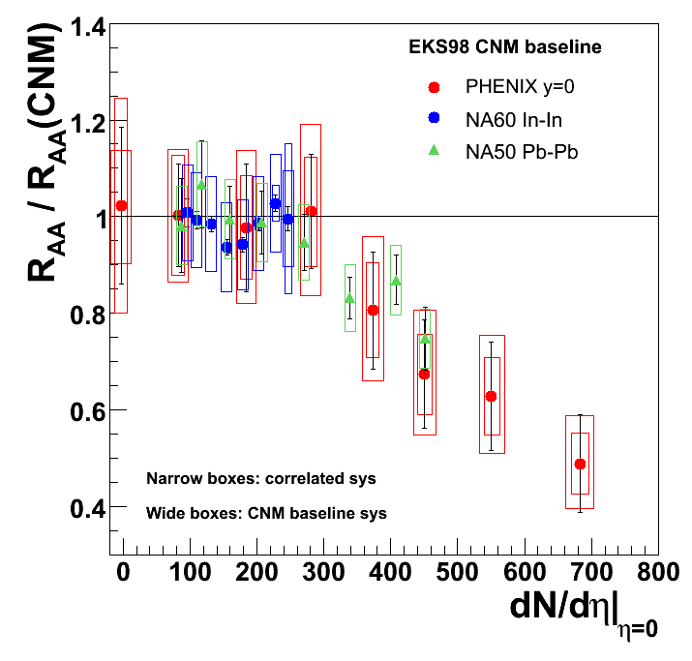
Anomalous suppression: SPS vs RHIC
SPS results compared with RHIC R_{AA} results normalized to R_{AA}(CNM)
Both Pb-Pb and Au-Au seem to
depart from the reference curve
at N_{part}~200
For central collisions more
important suppression in
Au-Au with respect to Pb-Pb
M. Leitch (E866), workshop on “Quarkonium in
Hot Media:From QCD to Experiment”, Seattle 2009
Agreement between SPS and RHIC
results as a function of the charged
particle multiplicity

Slide 27
Charmonia summary
J/ψ effective absorption cross section in p-A shows energy dependence
different α (158 vs. 400 GeV) at the same x₂
  effect not related to shadowing or √s(ψ-nucleon)
New reference for Pb-Pb and In-In based on p-A at the same energy
  Size of anomalous J/ψ suppression reduced but still significant in Pb-Pb
ψ’ more absorbed than J/ψ
Strong ψ’ suppression in Pb-Pb
Similar L pattern in Pb-Pb and SU

Slide 28
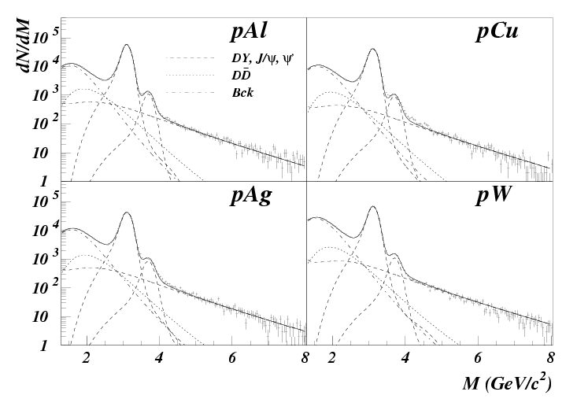
Open charm dimuons in p-A 450 GeV
NA50 tried to evaluate DD production studying the IMR in pA
DD pair detected with simultaneous semi-muonic decay
High beam intensities
→Large background levels (S/B ~0.05 at m_{μμ} = 1.5 GeV/c²)
NA50 had to impose
a constant DD/DY vs A
(i.e. α_{DD}= α_{DY} ~1 )
M.C. Abreu et al., EPJC14(2000) 443

Slide 29
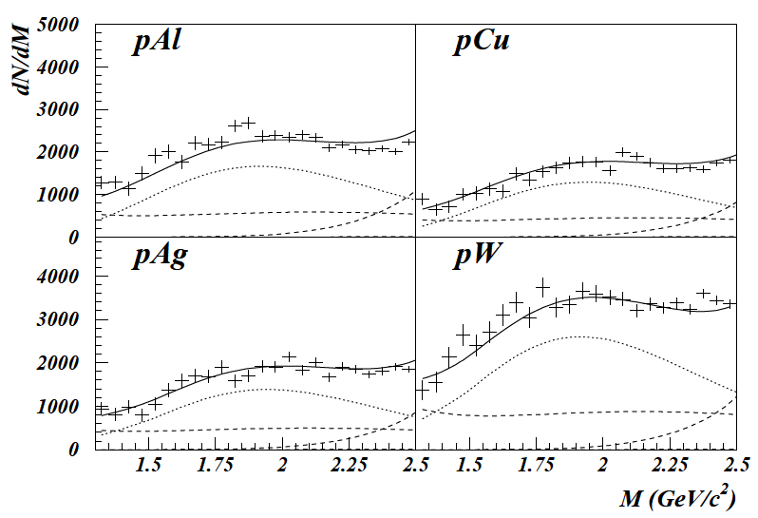
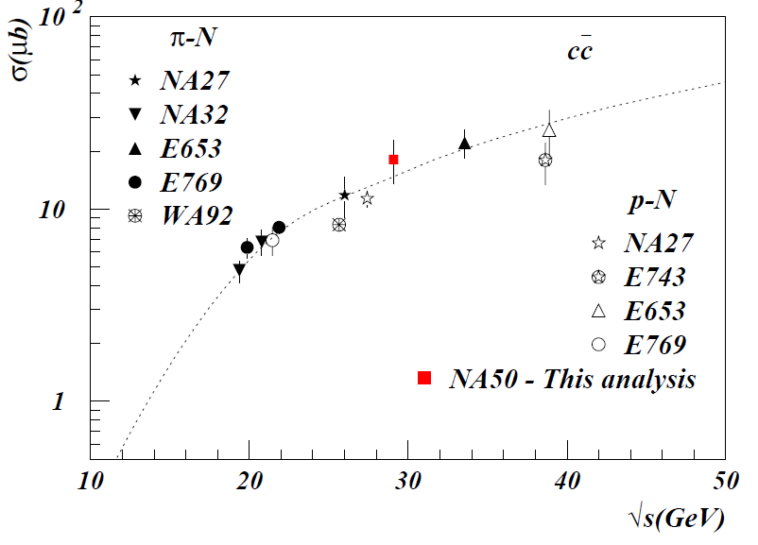
Charm cross section at √s 29.1 GeV
Good description of the invariant mass spectra as sum of DD and DY
Open charm
Drell Yan
Open charm cross section in agreement with world systematics

Slide 30
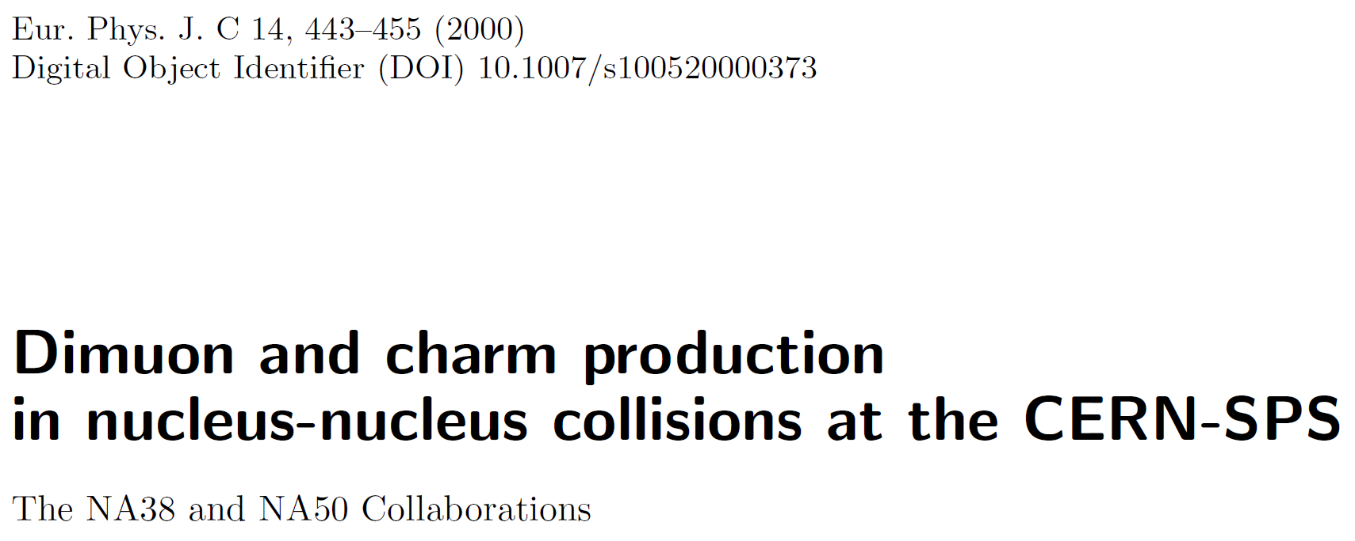
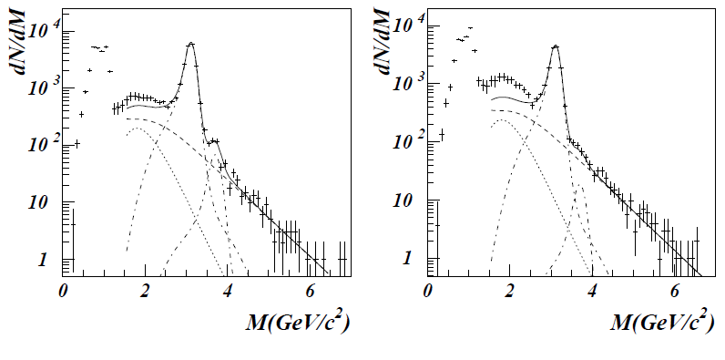
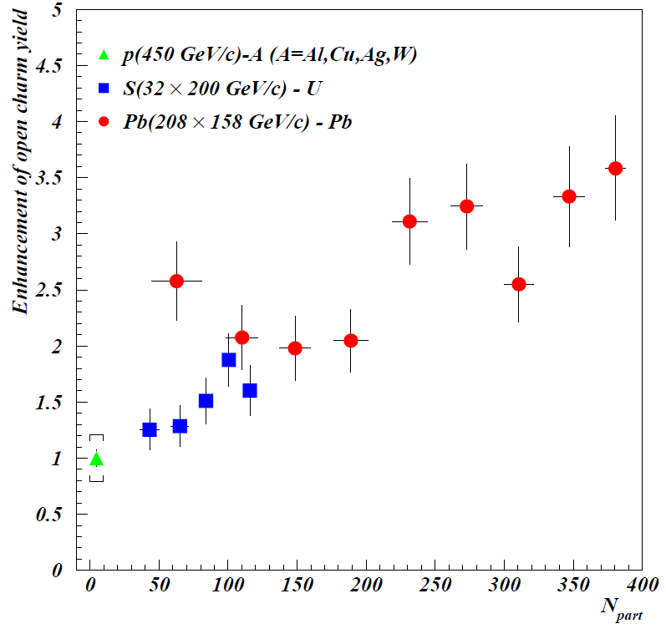
Dimuon excess wrt p-A
Pb-Pb peripheral
Pb-Pb central
Excess mass shape and kinematical distributions compatibile with open charm
Possible open-charm enhancement
Alternative explanation: direct radiation (from the plasma?)

Slide 31
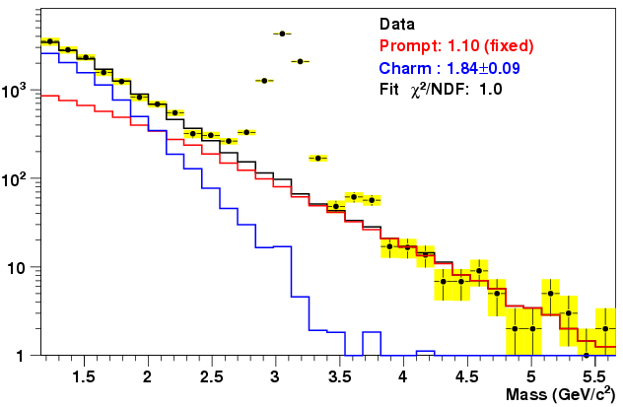
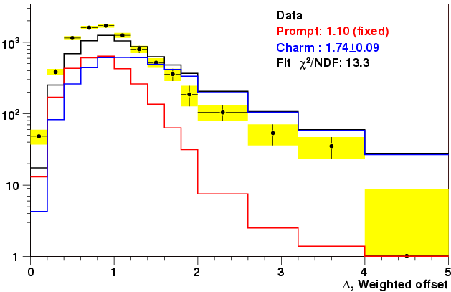
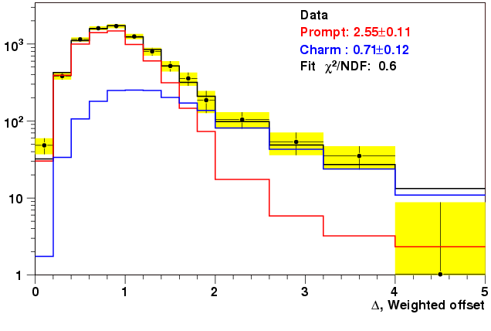
NA60 In-In: intermediate mass region
Eur.Phys.J. C59 (2009) 607
Mass spectrum is similar to NA50:
Good description by Drell-Yan + ~2×Open Charm (extrapolated from pA data)
Such explanation is rejected by the spectra of dimuon offsets wrt the interaction vertex!
Fit range
Data
Prompt: 2.29±0.08
Charm: 1.16±0.16
Fit χ²/NDF: 0.6
1.12±0.17
Prompt
~50μm
~1mm
Offset fit shows that the enhancement is not
due to Open Charm ⇒ the excess is prompt
Prompt

Slide 32
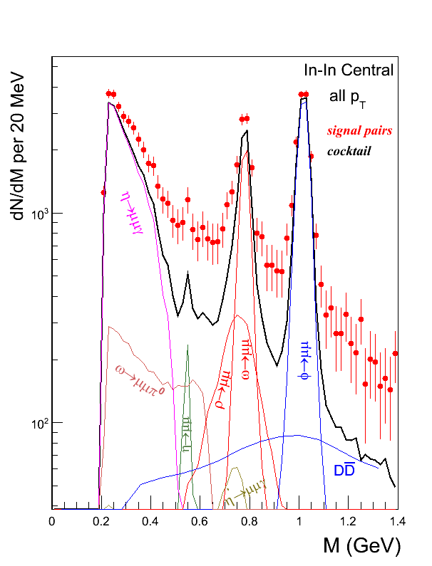
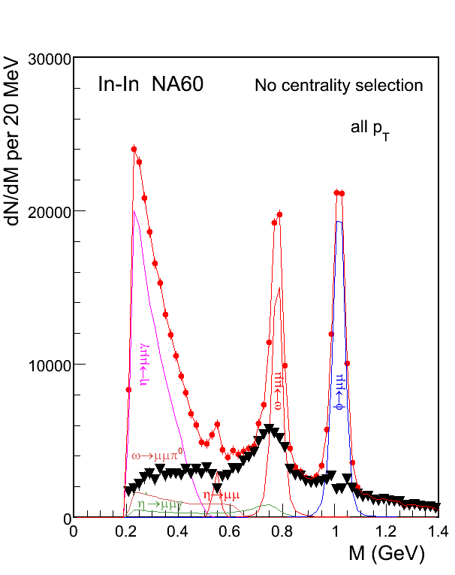
NA60 In-In: low mass region
Clear excess of data above decay ‘cocktail’ describing peripheral events
Phys. Rev. Lett. 96 (2006) 162302
Excess isolated subtracting the measured decay cocktail (without ρ), independently for each centrality bin
Based solely on local criteria for the major sources:
η, ω and φ ⇒ 2-3% accuracy.
⇒ No need of reference data (pA, peripheral data, models)
⇒ Less uncertainties (e.g. strangeness enhancement: η,φ)

Slide 33
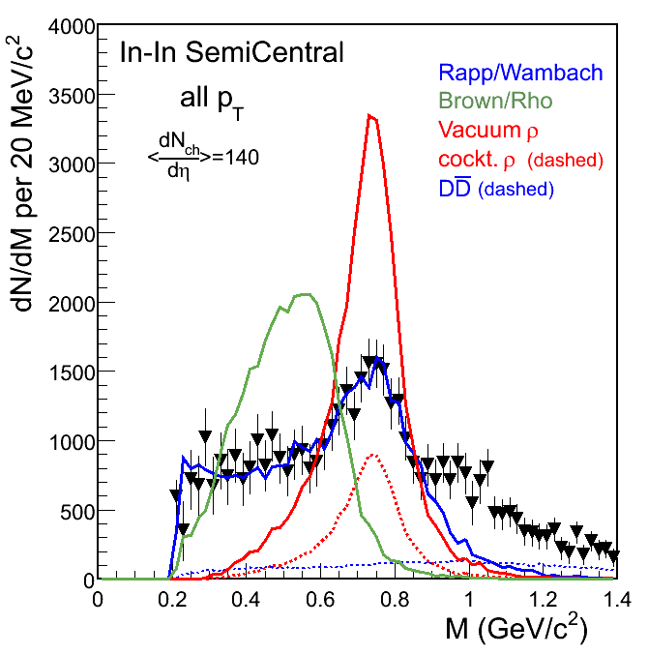
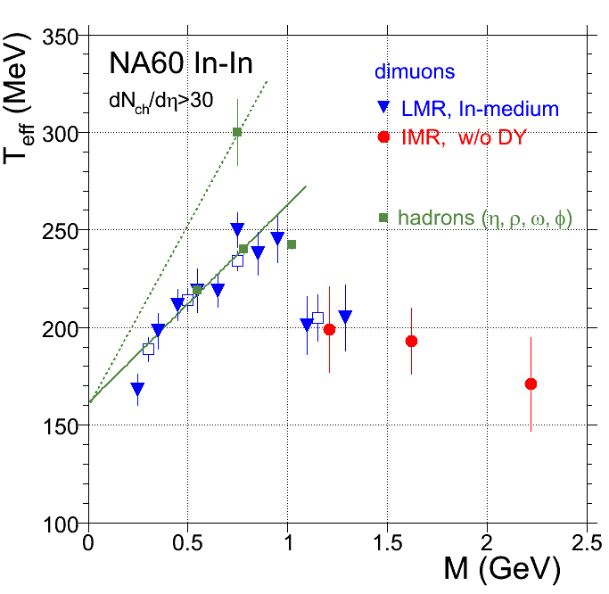
Effective temperature of excess dileptons
M<1 GeV thermal dilepton production largely mediated by the broad vector meson ρ via ππ→ρ→γ→μμ annihilation.
Hadronic nature supported by the rise of radial flow up to M=1 GeV
M>1 GeV sudden fall of radial flow of thermal dimuons occurs, naturally explained as a transition to a qualitatively different source, i.e.
mostly partonic radiation, qq→γ→μμ
Phys. Rev. Lett. 96 (2006) 162302
Phys. Rev. Lett. 100 (2008) 022302

Slide 34
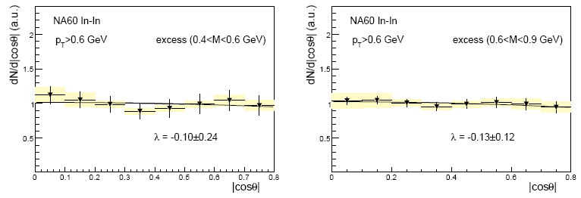

Polarization of excess dileptons
Analysis in CS reference frame. Same results in Gottfried Jackson reference frame
Lack of any polarization in excess supports emission from thermalized source.

Slide 35

Open charm production in p-A collisions
Open charm shares initial state effects with charmonium
  → a measurement of open charm in p-A collisions may help
  in understanding J/ψ suppression
Recent results from SELEX and E866 suggest rather strong
nuclear effects on open charm
E866/NuSea Preliminary
A. Blanco et al. (SELEX), EPJC64(2009) 637
M. Leitch (E866), workshop on “Heavy Quarkonia
Production in Heavy-Ion Collisions”, ECT* 2009

Slide 36


Open charm dimuons in p-A: NA60
High-mass DY statistics is low in NA60
  →Use the ratios ψ/DY from NA50 (EPJC48(2006)329)
  to fix the DY contribution
Good resolution on the
longitudinal position of the
vertex in the IMR (no problem
in target assignment)
400 GeV
DD
DY
Results given for the 400 GeV
sample only (at 158 GeV DD
contribution much smaller
than DY)

Slide 37

Open charm dimuons in p-A: results
Kinematic range: 3.2<y_{lab}<3.7 (-0.17<y_{cm}<0.33)
Study the ratio ψ/DD (reduce systematic errors)
Preliminary
Systematic errors
Fit starting point
Track χ²
ψ/DY (norm. and α_{J/ψ})
Background normalization
Using the measured α_{J/ψ} value one gets α_{DD} = 0.96±0.03
Anti-shadowing would suggest α_{DD} >1

Slide 38



x₂
x₂
Calculate the expected α (pure shadowing) for
DD pairs and J/ψ decaying into muons in the NA60 acceptance (400 GeV protons)
DD (PYTHIA)
pA 400 GeV
(3.2<y<3.7)
J/ψ
(2→1 calculation)
pA 400 GeV
(3.2<y<3.7)
x₁
x₁
x₁
Preliminary
Anti-shadowing would give:
approximately the same α for DD and J/ψ
α>1
Data suggests:
approximately the same α
α<1
α
DD MC
J/ψ MC
DD data
J/ψ data

Slide 39
Conclusions
NA60 performed detailed studies of charmonium suppression in pA
  Nuclear effects stronger when decreasing √s
  Build CNM reference
    with pA data taken in the same energy/kinematic
    domain of AA
    taking into account shadowing
Look for anomalous suppression in In-In and Pb-Pb
  Observed in central Pb-Pb collisions
  In In-In almost no anomalous suppression
With updated (correct) CNM reference seeming agreement between SPS and RHIC J/ψ data when studied as a function of dN_{CH}/dη
Open charm in pA can be studied looking at the IMR dimuons
  Preliminary results for pA at 400 GeV: α_{DD} close to 1

Slide 40

The NA60 collaboration
http://cern.ch/na60
CERN
Heidelberg
~ 60 people
13 institutes
8 countries
Palaiseau
Bern
BNL
Riken
Stony Brook
Yerevan
Lisbon
Torino
Clermont
Cagliari
Lyon
R. Arnaldi, R. Averbeck, K. Banicz, K. Borer, J. Buytaert, J. Castor, B. Chaurand, W. Chen, B. Cheynis, C. Cicalò, A. Colla, P. Cortese, S. Damjanović, A. David, A. de Falco, N. de Marco, A. Devaux, A. Drees, L. Ducroux, H. En’yo, A. Ferretti, M. Floris, P. Force, A.A. Grigoryan, J.Y. Grossiord, N. Guettet, A. Guichard, H. Gulkanyan, J. Heuser, M. Keil, L. Kluberg, Z. Li, C. Lourenço, J. Lozano, F. Manso, P. Martins, A. Masoni,
A. Neves, H. Ohnishi, C. Oppedisano, P. Parracho, P. Pillot, T. Poghosyan, G. Puddu, E. Radermacher,
P. Ramalhete, P. Rosinsky, E. Scomparin, J. Seixas, S. Serci, R. Shahoyan,P. Sonderegger, H.J. Specht,
R. Tieulent, E. Tveiten, G. Usai, H. Vardanyan, R. Veenhof and H. Wöhri
40
Notes:
40

Slide 41


Invariant mass spectra and fits
Fit the reconstructed invariant mass spectrum as a superposition
of the various expected sources: Drell-Yan, J/ψ, ψ’, open charm
DY
J/ψ, ψ’
DD
PC muons,
all targets
VT muons,
Pb target
J/ψ statistics,
after analysis
cuts
158 GeV, N_{J/ψ}^{PC} = 2.5×10⁴, N_{J/ψ}^{VT}= 1.0 ×10⁴
400 GeV, N_{J/ψ}^{PC} = 1.6×10⁴, N_{J/ψ}^{VT}= 6.0 ×10³
41
Notes:
41
χ2/ndf = 1.24 (PC 158 GeV)‏
VT scartati a 400 GeV →7300

Slide 42


Efficiency corrections
Reconstruction efficiency does not cancel in the ratio
Estimation based on a Monte-Carlo approach
  Inject realistic VT efficiencies (follow their time evolution)‏
  Finest granularity (8 pixels ~0.8*0.8 mm² where statistics is enough)‏
  Use “matching efficiency” and its time evolution as a check of
the goodness of the procedure
Matching rate data
Matching rate MC
Efficiency map
(4th plane, sensor 0)‏
42
Matching efficiency
Notes:
42

Slide 43


Other pA results: p_{T} distributions
<p_{T}²>= <p_{T}²>_{pp}+ ρ (A^{1/3}-1)
NA60 158 GeV
R. Arnaldi et al., Nucl. Phys. A830 (2009) 345
  p_{T} broadening observed (usually ascribed to Cronin effect)
  NA60 results suggest a smaller broadening at low √s
  NA3 result similar to higher √s values
  agreement NA60 vs NA50 at 400 GeV

Slide 44


Differential distributions: dN/dy
158 GeV
400 GeV
y-distribution wider at 400 GeV, as expected
Gaussian fit at 158 GeV gives μ_{y}=0.05±0.05, σ_{y}=0.51±0.02 (in agreement with NA3)
Peak position not well constrained at 400 GeV
Imposing μ_{y}=-0.2 (NA50 at 400 GeV) σ_{y}=0.81±0.03 (NA50 got 0.85)‏
44
Notes:
44

Slide 45

Comparison with previous experiments
HERA-B observes, at 920 GeV, a displacement of the center of
the x_{F} distribution towards negative values, increasing with A
(by a small amount, Δx_{F}< 0.01)‏
HERA-B
NA50
NA50 observes, at 400 GeV, a strong backward displacement
(Δy=0.2, corresponding to Δx_{F}= 0.045)‏
Mutually incompatible observations? NA60 data not precise
enough to discriminate between the two scenarioes
45
Notes:
45

Slide 46


Other pA results: polarization
Helicity
μ compatible with zero everywhere
no large differences between NA60, HERAB and PHENIX
as observed by HERAB,
|λ_{HE}|< |λ_{CS}|
p-A 158 GeV
HE
CS
R. Arnaldi et al., Nucl. Phys. A830 (2009) 345

Slide 47
Other AA results: polarization
First full measurement of the J/ψ angular distribution in nuclear collisions
vs. p_{T}
vs. centrality
Polarization is rather small everywhere: no p_{T} or centrality dependence
Positive azimuthal coefficient at low p_{T}?
Polarization in AA may be influenced by the hot medium
→ quantitative predictions needed!
R. Arnaldi et al.,
Nucl. Phys. A830 (2009) 345

