Slide 1


Medium Effects in Charmonium Transport
Xingbo Zhao
with Ralf Rapp
Department of Physics and Astronomy
Iowa State University
Ames, USA
Purdue University, West Lafayette, Jan. 6th 2011

Slide 2
Outline
charmonium transport approach
  charmonium equilibrium properties from lattice QCD
  J/ψ phenomenology in heavy-ion collisions
explicit calculation of charmonium regeneration rate
  3-to-2 to 2-to-2 reduction
summary and outlook

Slide 3
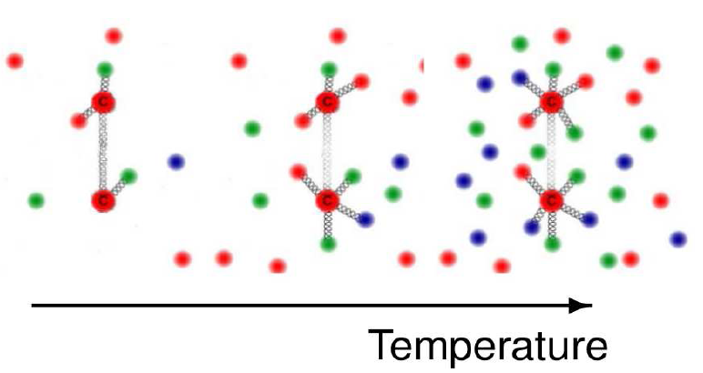
Charmonium in Heavy-Ion Collision
charmonium: a probe of QGP (deconfinement)
equilibrium properties obtained from lattice QCD
  free energy between two static quarks
  current-current correlator ( spectral function)
yields measured in heavy-ion collisions
  collision energy dependence (SPS, RHIC, LHC…)
  centrality, rapidity, transverse momentum dependence
[Matsui and Satz. ‘86]
?

Slide 4
Establishing the Link
  key questions:
    are J/ψ data compatible with eq. properties from lattice QCD?
    if yes, to what extent J/ψ data constrain eq. properties?
  challenges:
    dynamically expanding fireball
    ψ dissociation vs. regeneration
    slow chemical and kinetic equilibrium
    off- equilibrium system
  kinetic (transport) approach required
D
-
J/ψ
D
c
-
c
J/ψ

Slide 5
Kinetic Approach
Boltzmann transport equation:
[Zhang et al ’02, Yan et al ‘06]
α_{Ψ}: dissociation rate; β_{Ψ}: regeneration rate
integrate Boltzmann eq. over phase space rate equation:
[Thews et al ’01,
Grandchamp+RR ’01]
N_{ψ}^{eq}: equilibrium limit of ψ, estimated from statistical model
[Braun-Munzinger et al. ’00, Gorenstein et al. ‘01]
need microscopic input for and
key quantity determining and : ψ binding energy, ε_{B}

Slide 6
Link between Lattice QCD and Exp. Data
lQCD potential
lQCD correlator
Initial conditions
(Binding energy)
Kinetic equations
diss. & reg. rates
Experimental observables

Slide 7
Link between Lattice QCD and Exp. Data
lQCD potential
lQCD correlator
Initial conditions
(Binding energy)
Kinetic equations
diss. & reg. rates
Experimental observables

Slide 8
Charmonium In-Medium Binding
potential model employed
to evaluate
[Cabrera et al. ’07, Riek et al. ‘10]
[Petreczky et al ‘10]
V(r)=U(r) vs. F(r)? (F=U-TS)
2 “extreme” cases:
  V=U: strong binding
  V=F: weak binding
[Riek et al. ‘10]

Slide 9
Link between Lattice QCD and Exp. data
lQCD potential
lQCD correlator
Initial conditions
(Binding energy)
Kinetic equations
diss. & reg. rates
Experimental observables

Slide 10
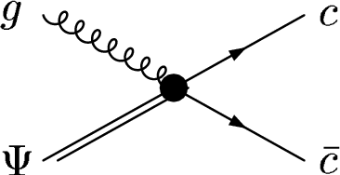
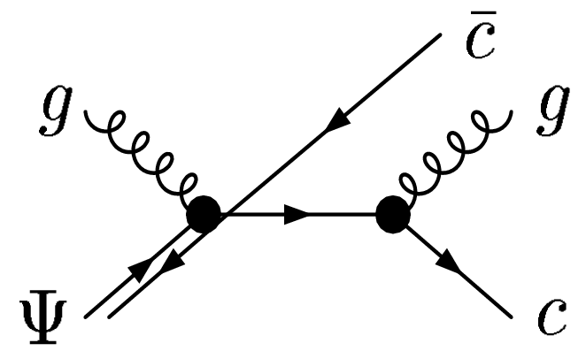
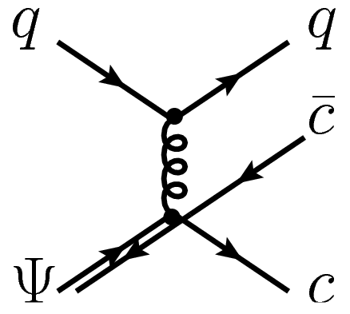
In-medium Dissociation Mechanisms
gluo-dissociation:
quasifree dissociation:
g+Ψ→c+
VS.
g(q)+Ψ→c+ +g(q)
[Bhanot and Peskin ‘79]
[Grandchamp and Rapp ‘01]
gluo-dissociation is inefficient with in-medium ε_{B}:
  with in-medium (small) ε_{B}, c and inside ψ are almost on shell
  on shell particle cannot absorb gluon without emission
  (e.g., no photoelectric effect on a free electron)
  gluon thermal mass further reduces the gluo-dissociation rate

Slide 11
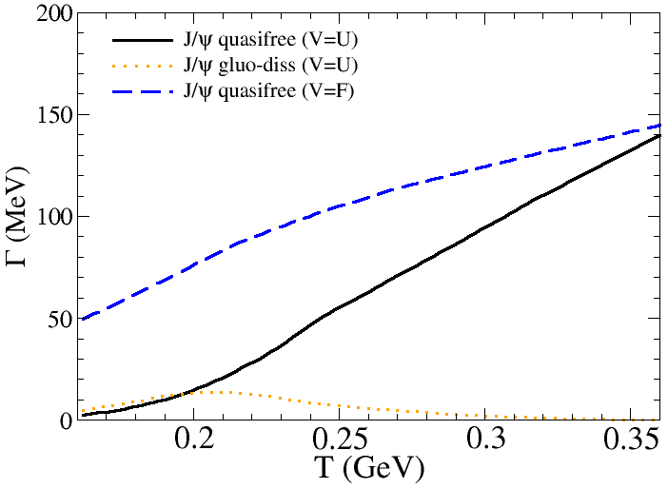
T and p Dependence of Quasifree Rate
gluo-dissociation is inefficient in even the strong binding scenario
quasifree rate increases with both temperature and ψ momentum
dependence on both is more pronounced in the strong binding scenario

Slide 12
Link between Lattice QCD and Exp. Data
lQCD potential
lQCD correlator
Initial conditions
(Binding energy)
Kinetic equations
diss. & reg. rates
Experimental observables

Slide 13
Link between Lattice QCD and Exp. Data
lQCD potential
lQCD correlator
Initial conditions
(Binding energy)
Kinetic equations
diss.& reg. rates
Experimental observables

Slide 14
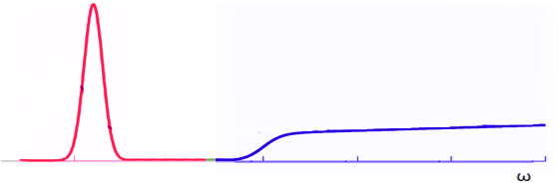
Model Spectral Functions
pole mass m_{Ψ}
model spectral function = resonance + continuum
threshold 2m_{c}*
width Γ_{Ψ}
in vacuum:
at finite temperature:
Z(T) reflects medium induced change of resonance strength
Z(T) is determined by requiring the
resulting correlator ratio consistent
with lQCD results
T_{diss}
T_{diss}
T_{diss}=2.0T_{c} V=U
T_{diss}=1.25T_{c} V=F
Z(T_{diss})=0

Slide 15
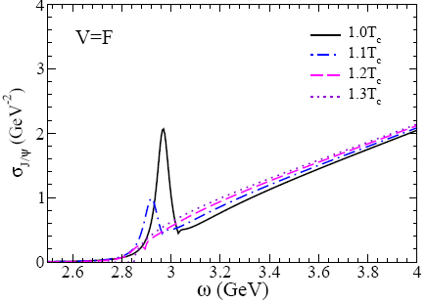
Correlators and Spectral Functions
weak binding strong binding
[Petreczky et al. ‘07]
obtained correlator ratios are compatible with lQCD results

Slide 16
Link between Lattice QCD and Exp. Data
lQCD potential
lQCD correlator
shadowing
nuclear absorption
Cronin
Initial conditions
(Binding energy)
Kinetic equations
diss.& reg. rates
Experimental observables
a set of dissociation and regeneration rates fully compatible with lQCD has been obtained

Slide 17
Link between Lattice QCD and Exp. Data
lQCD potential
lQCD correlator
Initial conditions
(Binding energy)
Kinetic equations
diss.& reg. rates
Experimental observables

Slide 18
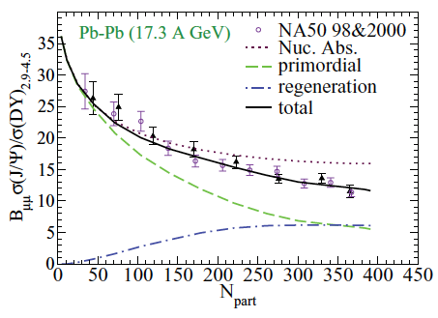
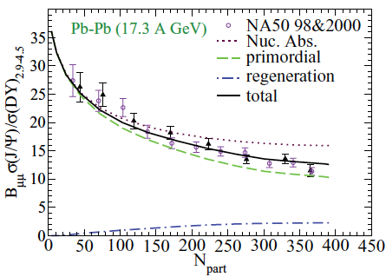
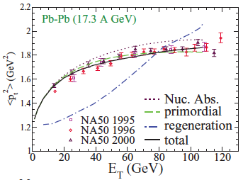
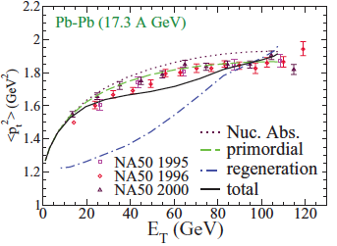
Compare to data from SPS NA50
weak binding (V=F) strong binding (V=U)
incl. J/psi yield
trans. momentum
primordial production dominates in strong binding scenario

Slide 19
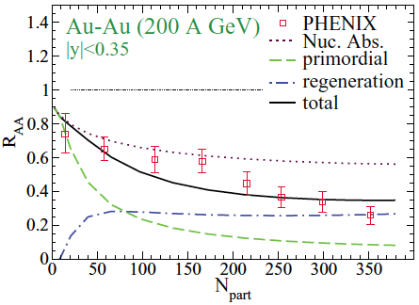
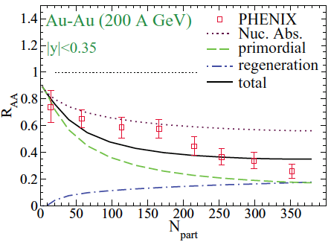
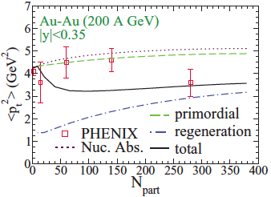
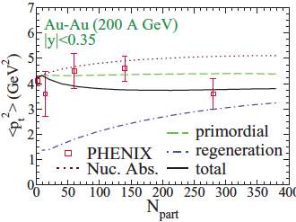
J/Ψ yield and <p_{t}²> at RHIC mid-y
weak binding (V=F) strong binding (V=U)
larger fraction for regenerated Ψ in weak binding scenario
strong binding scenario tends to better reproduce <p_{t}²> data
incl. J/psi yield
trans. momentum
See also [Thews ‘05],[Yan et al. ‘06],[Andronic et al. ‘07]

Slide 20
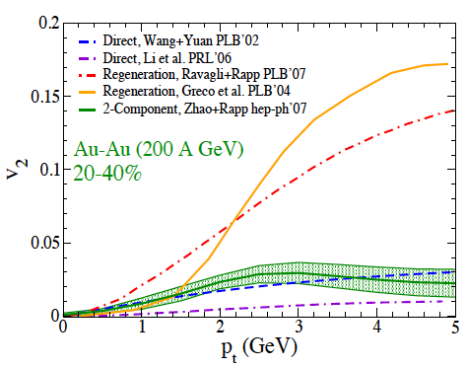
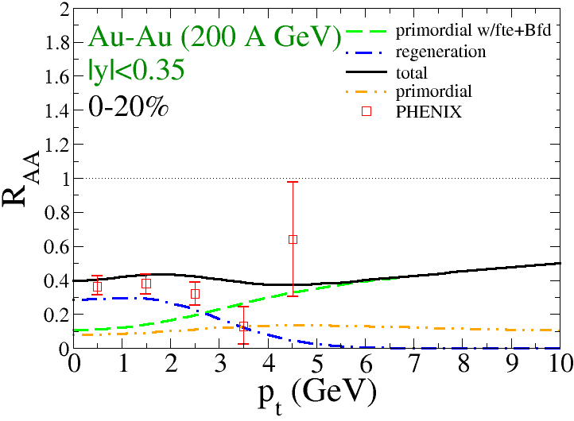
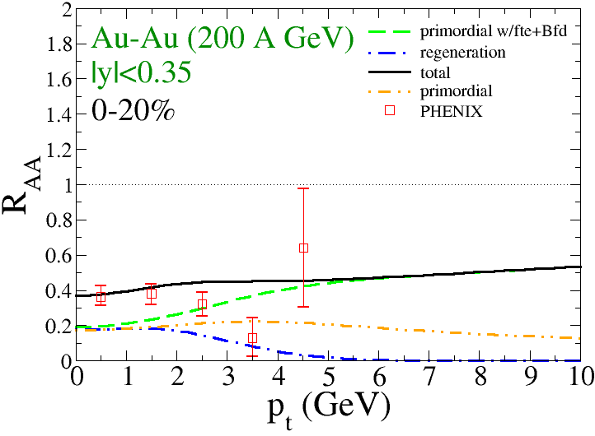
R_{AA}(p_{T}) and v₂(p_{T}) at RHIC
weak binding (V=F) strong binding (V=U)
[Zhao and Rapp ‘08]
primordial component dominates at high p_{t} (>5GeV)
significant regeneration component at low p_{t}
formation time effect and B-feeddown enhance high p_{t} J/Ψ
small v₂(p_{T}) for entire p_{T} range, reg. component vanishes at high p_{T}
[Gavin and Vogt ‘90, Blaizot and Ollitrault ‘88, Karsch and Petronzio ‘88]
Notes:
Zhuang

Slide 21
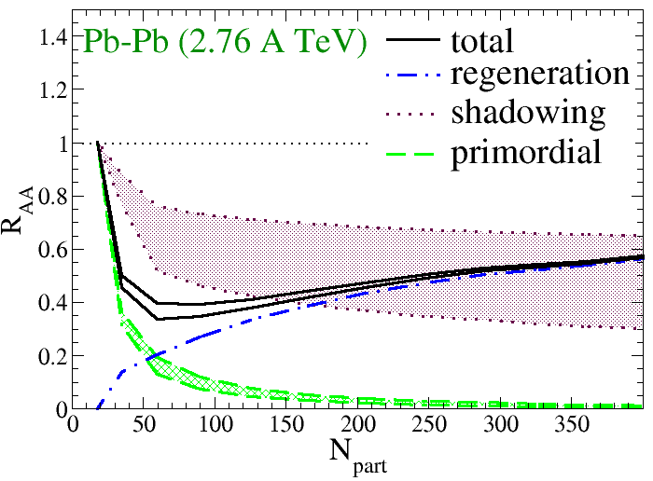
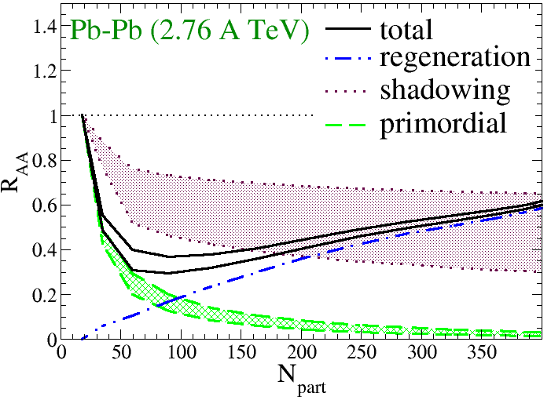
J/Ψ yield and <p_{t}²> at LHC
weak binding (V=F) strong binding (V=U)
regeneration component dominates except for peripheral collisions
R_{AA}<1 for central collisions (with , )
assuming no shadowing on c (upper limit estimate)

Slide 22
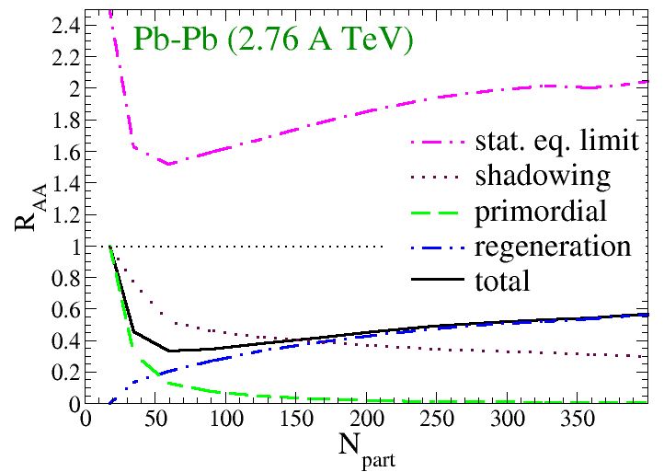
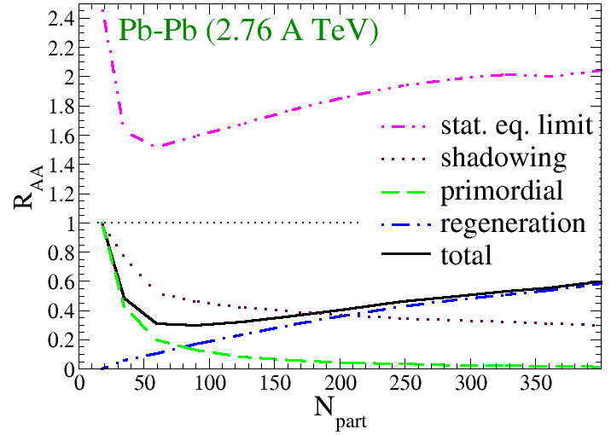
Compare to Statistical Model
weak binding (V=F) strong binding (V=U)
regeneration is lower than statistical limit:
statistical limit in QGP phase is more relevant for ψ regeneration
statistical limit in QGP is smaller than in hadronic phase (smaller ε_{B})
charm quark kinetic off-eq. reduces ψ regeneration
J/ψ is chemically off-equilibrium with cc (small reaction rate)

Slide 23
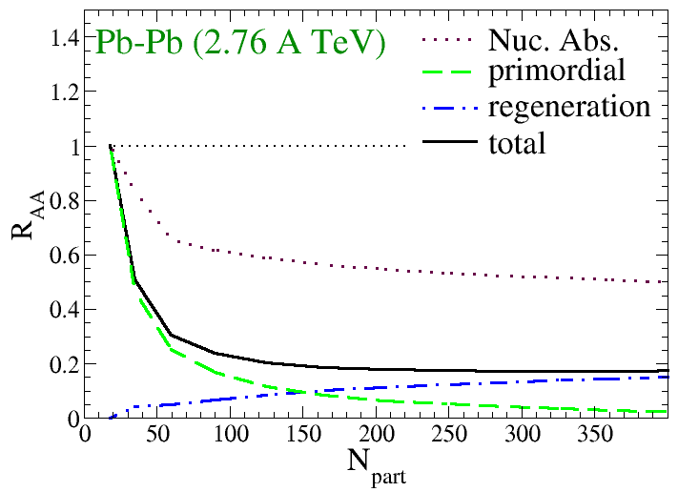
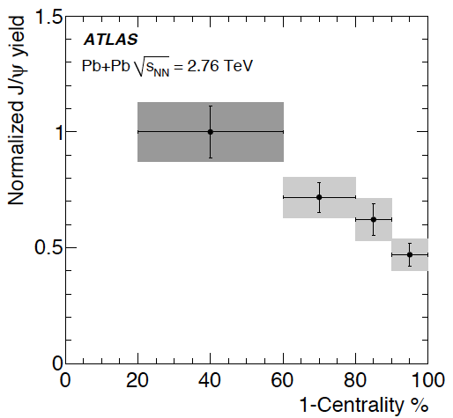
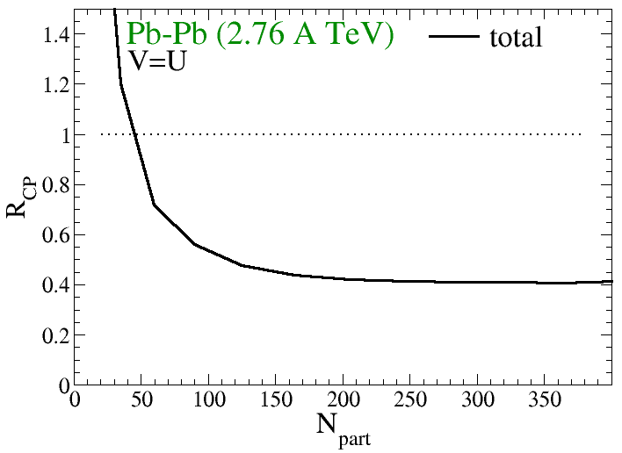
Compare to Atlas Results
shadowing on c decreasing regeneration
V=U
V=U
centrality dependence needs more understanding

Slide 24
Explicit Calculation of Regeneration Rate
in previous treatment, regeneration rate was evaluated using detailed balance
was evaluated using statistical model assuming thermal charm quark distribution
thermal charm quark distribution is not realistic even at RHIC ( )
need to calculate regeneration rate explicitly from non-thermal charm distribution
[van Hees et al. ’08, Riek et al. ‘10]

Slide 25
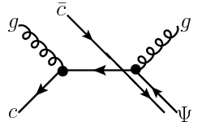

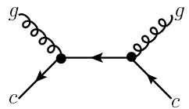
3-to-2 to 2-to-2 Reduction
diss.
• g(q)+Ψ c+c+g(q)
reg.
dissociation:
regeneration:
reduction of transition matrix according to detailed balance

Slide 26
Thermal vs. pQCD Charm Spectra
• regeneration from two types of charm spectra are evaluated:
1) thermal spectra:
2) pQCD spectra:
[van Hees ‘05]

Slide 27
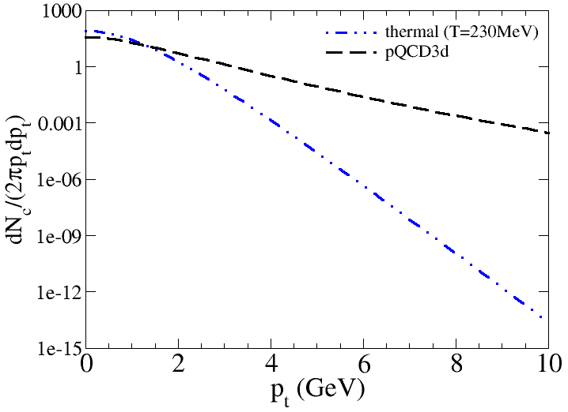
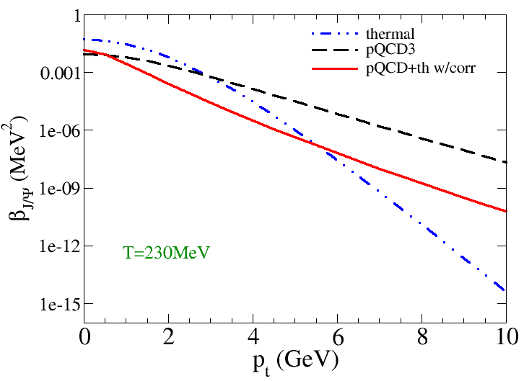
Reg. Rates from Different c Spectra
See also, [Greco et al. ’03, Yan et al ‘06]
• thermal : pQCD : pQCD+thermal = 1 : 0.28 : 0.47
• strongest reg. from thermal spectra (larger phase space overlap)
• introducing c and angular correlation decrease reg. for high p_{t} Ψ

Slide 28
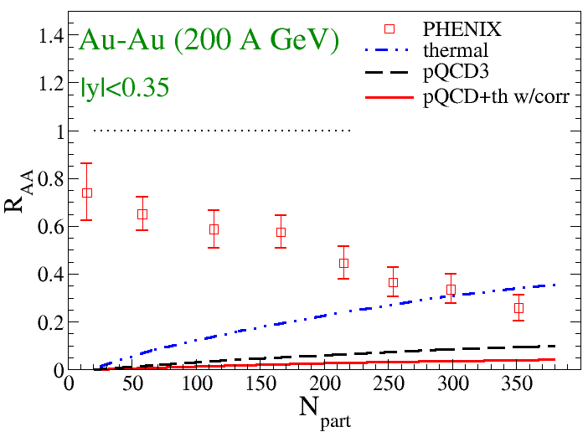
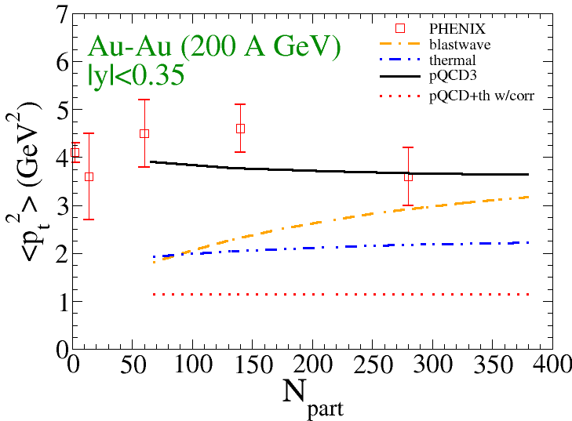
Ψ Regeneration from Different c Spectra
• strongest regeneration from thermal charm spectra
• pQCD spectra lead to larger <p_{t}²> of regenerated Ψ
• c angular correlation lead to small reg. and low <p_{t}²>
• blastwave overestimates <p_{t}²> from thermal charm spectra

Slide 29
Summary and Outlook
we setup a framework connecting Ψ equilibrium properties from lattice QCD with heavy-ion phenomenology
results reasonably well reproduce experimental data, corroborating the deconfining phase transition suggested by lattice QCD
strong binding scenario seems to better reproduce p_{t} data
R_{AA}<1 at LHC (despite dominance of regeneration) due to incomplete thermalization (unless the charm cross section is really large)
regeneration rates are explicitly evaluated for non-thermal charm quark phase space distribution
regeneration rates are very sensitive to charm quark phase space distribution
calculate Ψ regeneration from realistic time-dependent charm
phase space distribution from e.g., Langevin simulations
29

Slide 30
Thank you!
based on X. Zhao and R. Rapp Phys. Rev. C 82, 064905 (2010)

Slide 31
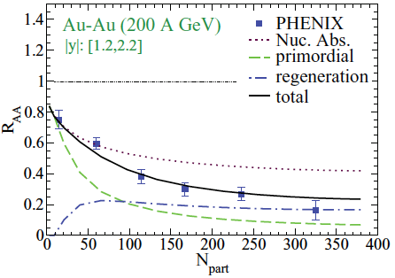
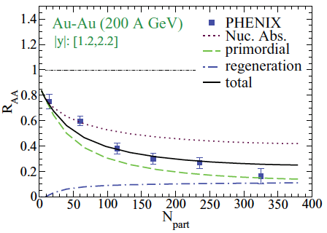
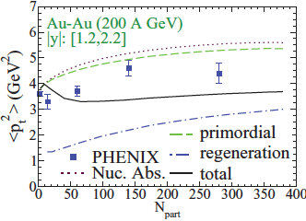
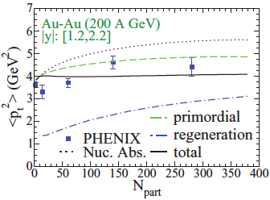
J/Ψ yield and <p_{t}²> at RHIC forward y
V=F V=U
larger fraction for reg.Ψ in weak binding scenario
strong binding tends to reproduce <p_{t}²> data
incl. J/psi yield
trans. momentum
31

Slide 32
J/Ψ suppression at forward vs mid-y
comparable hot medium effects
stronger suppression at forward rapidity due to CNM effects
32

Slide 33
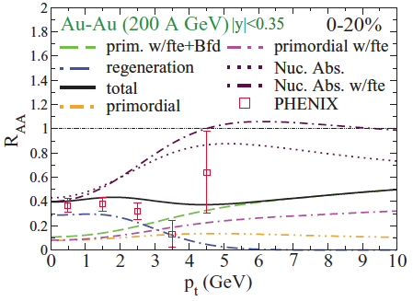
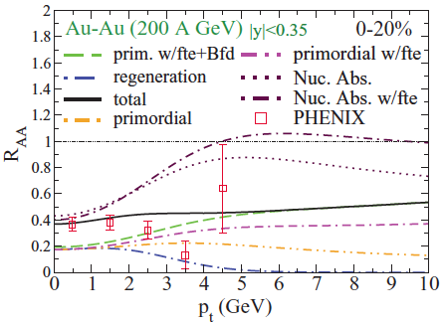
R_{AA}(p_{T}) at RHIC
V=F
V=U
Primordial component dominates at high p_{t} (>5GeV)
Significant regeneration component at low p_{t}
Formation time effect and B-feeddown enhance high p_{t} J/Ψ
See also
[Gavin and Vogt ‘90, Blaizot and Ollitrault ‘88, Karsch and Petronzio ‘88]
[Y.Liu et al. ‘09]
Notes:
Zhuang

Slide 34
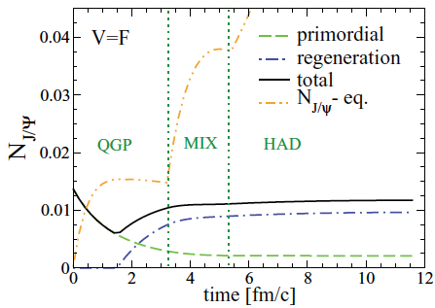
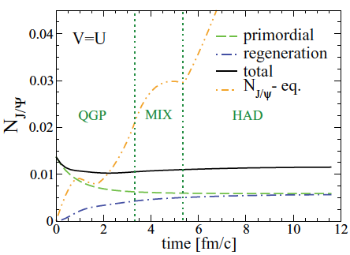
J/Ψ Abundance vs. Time at RHIC
V=F V=U
Dissoc. and Reg. mostly occur at QGP and mix phase
“Dip” structure for the weak binding scenario
34

Slide 35
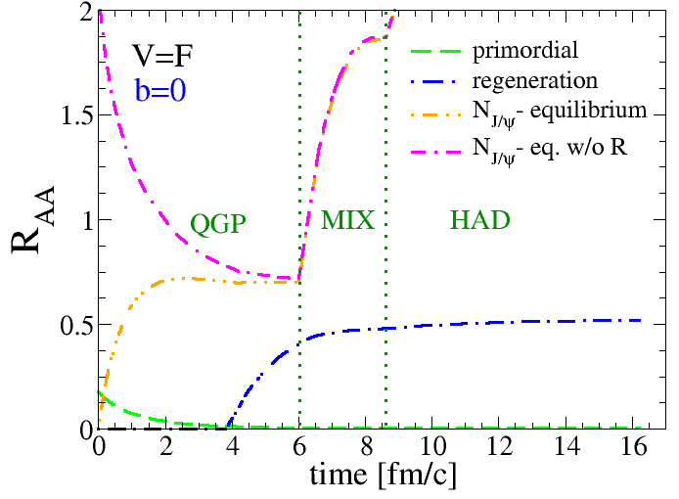
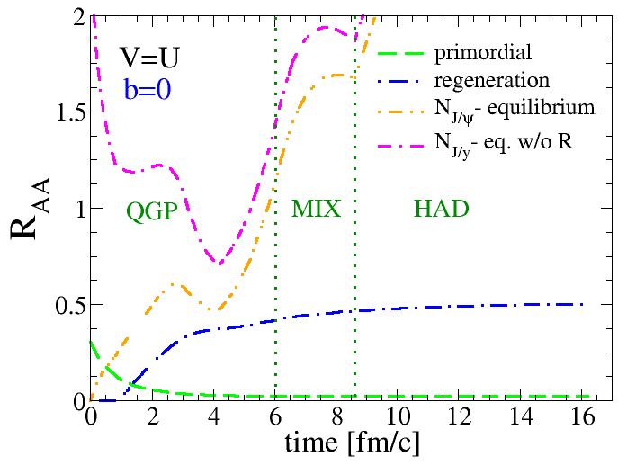
J/Ψ Abundance vs. Time at LHC
V=F V=U
regeneration is below statistical equilibrium limit
35

Slide 36
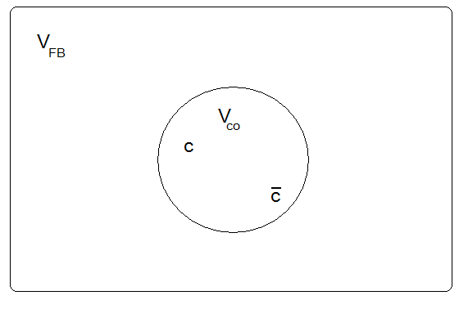
Ψ Reg. in Canonical Ensemble
Integer charm pair produced in each event
c and anti-c simultaneously produced in each event,
c and anti-c correlation volume
effect further increases
local c (anti-c) density

Slide 37
Ψ Reg. in Canonical Ensemble
• Larger regeneration in canonical ensemble
• Canonical ensemble effect is more pronounced for non-central collisions
• Correlation volume effect further increases Ψ regeneration

Slide 38
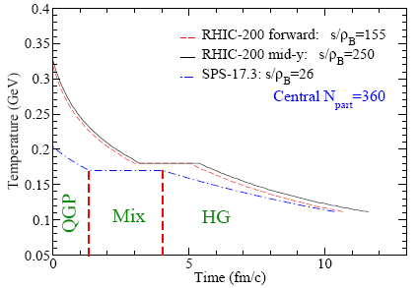
Fireball Evolution
, {v_{z},a_{t,}a_{z}} “consistent” with:
- final light-hadron flow
- hydro-dynamical evolution
isentropical expansion with constant S_{tot} (matched to N_{ch}) and
s/n_{B} (inferred from hadro-chemistry)
EoS: ideal massive parton gas in QGP, resonance gas in HG
[X.Zhao+R.Rapp ‘08]
38
Notes:
38
500->1000, empirical flow and hydro for time evolution

Slide 39
Primordial and Regeneration Components
Linearity of Boltzmann Eq. allows for decomposition of primordial and regeneration components
For primordial component we directly solve homogeneous Boltzmann Eq.
For regeneration component we solve a Rate Eq. for inclusive yield and estimate its p_{t} spectra using a locally thermal distribution boosted by medium flow.

Slide 40
Rate-Equation for Reg. Component
•
(Integrate over Ψ phase space)
[Grandchamp, Rapp ‘04]
• For thermal c spectra, N^{eq} follows from charm conservation:
[Braun-Munzinger et al. ’00, Gorenstein et al. ‘01]
• Non-thermal c spectra lead to less regeneration:
[Greco et al. ’03]
typical
[van Hees et al. ’08, Riek et al. ‘10]

Slide 41
Initial Condition and R_{AA}
is obtained from Ψ primordial production
assuming
follows from Glauber model with shadowing and nuclear absorption parameterized with an effective σ_{abs}
follows from Ψ spectra in pp collisions with Cronin effect applied
nuclear modification factor:
N_{coll}: Number of binary nucleon-nucleon collisions in AA collisions
R_{AA}=1, if without either cold nuclear matter (shadowing,
nuclear absorption, Cronin) or hot medium effects

Slide 42
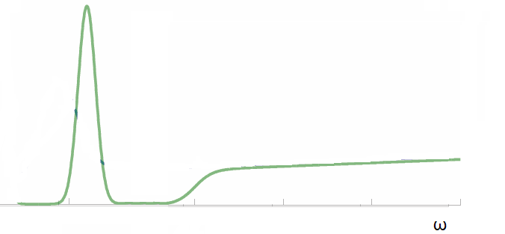
Correlators and Spectral Functions
two-point charmonium current correlation function:
charmonium spectral function:
pole mass m_{Ψ}(T),
threshold 2m_{c}*(T),
width Γ_{Ψ}(T)
lattice QCD suggests correlator ratio ~1 up to 2-3 T_{c}:
[Aarts et al. ’07, Datta te al ’04, Jakovac et al ‘07]

Slide 43
Initial Conditions
cold nuclear matter effects included in initial conditions
  nuclear shadowing:
  nuclear absorption:
  Cronin effect:
implementation for cold nuclear matter effects:
  nuclear shadowing
  nuclear absorption
  Cronin effect Gaussian smearing with smearing width guided by p(d)-A data
Glauber model with σ_{abs} from p(d)-A data

