Slide 1
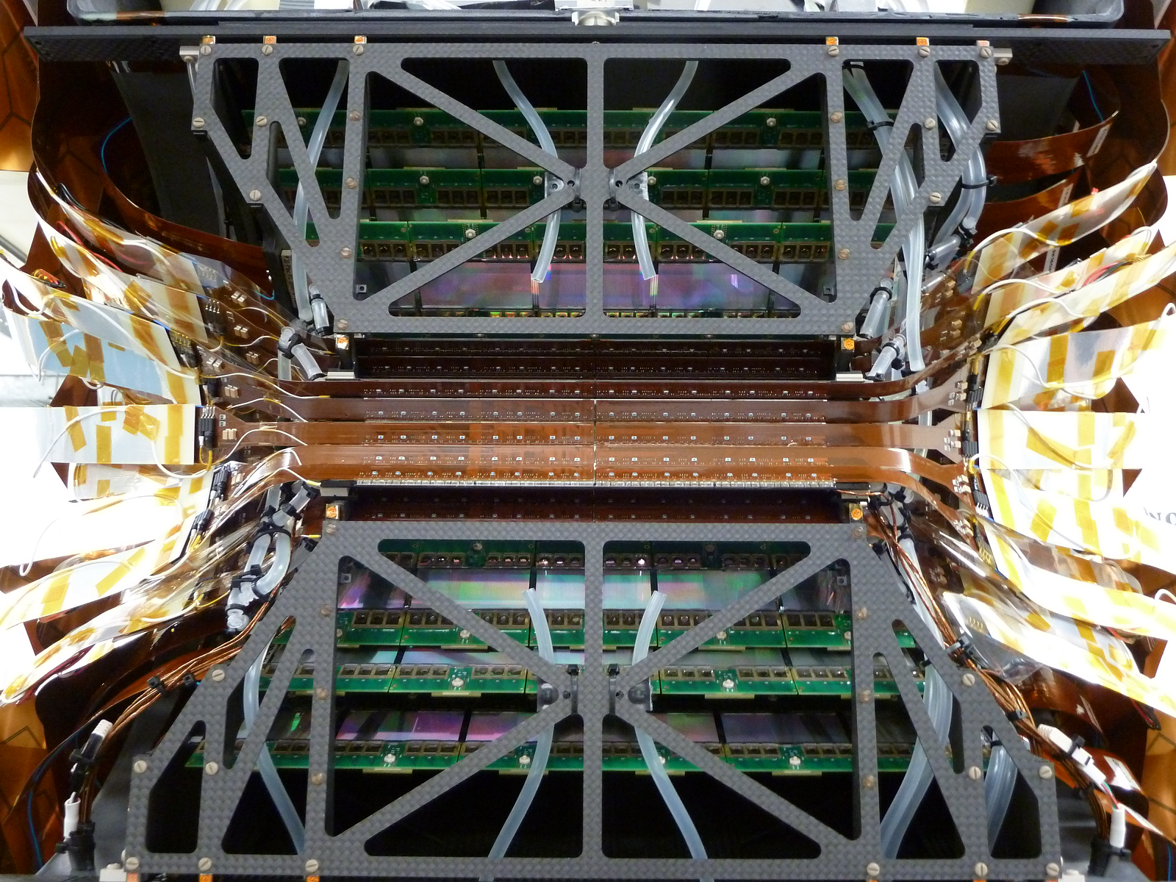
Status of PHENIX VTX Detector
5th Jan 2011
Maki Kurosawa
RIKEN
for the PHENIX VTX Collaborations

Slide 2
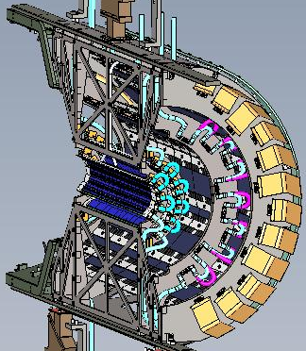
1. Physics Motivation of Silicon Vertex Detector
Physics Motivation
Investigation of QGP
Modification factor R_{AA} and elliptic flow v₂ with heavy flavor (charm, bottom)
Heavy flavor dependency of jet quenching
Spin structure of nucleon
Gluon spin structure (ΔG/G) with heavy flavor.
ΔG/G measurement by γ-jet correlation with precise x_{g} reconstruction
Requirements for Detector
Heavy flavor tagging
  spatial resolution → σ < 100μm
Reconstruction of jet
  Large acceptance → |η| < 1.2, Δφ ～ 2π
Total radiation length → X/X₀ < 2.5%/Layer
Radiation tolerance → 1Mrad in 10 years
RHIC clock cycle→ 10MHz
Silicon Vertex Detector (VTX)

Slide 3
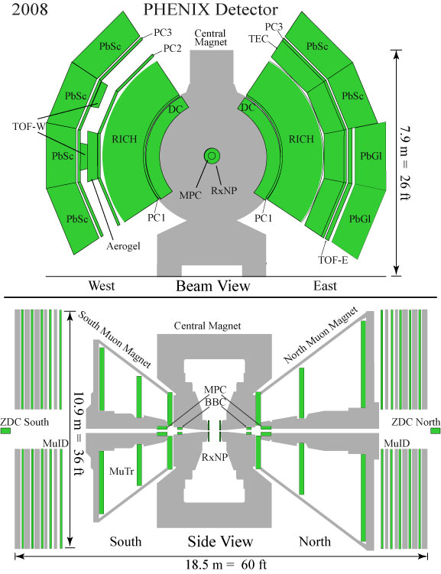
2. Overview of VTX
2008
Silicon Vertex Tracker
VTX (2010)
R_{AA} and v₂ measurement with heavy flavor
Gluon polarization (ΔG/G) measurement with heavy flavor and γ-jet correlation.

Slide 4
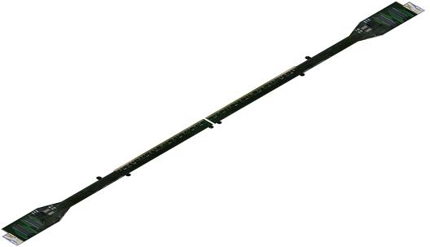
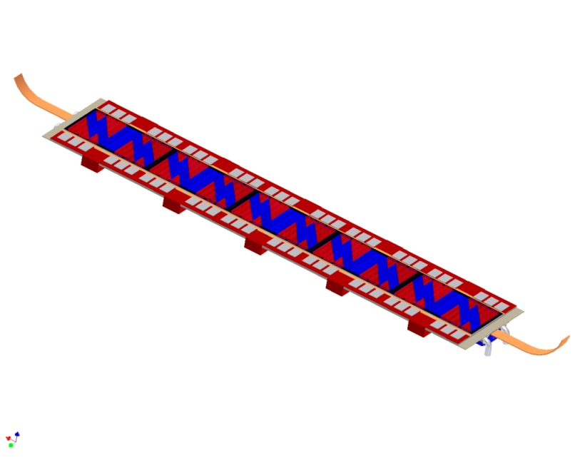
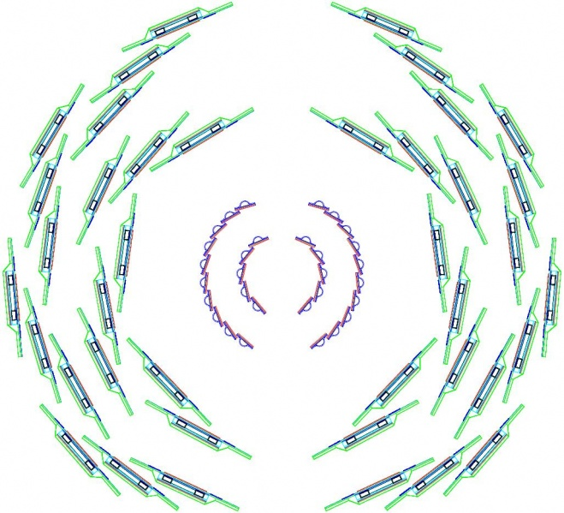
Silicon Vertex Tracker (VTX)
4 layers barrel structure
Inner 2 layer ： pixel detector
Outer 2 layer : strip pixel detector
pixel full ladder
22.7cm
Strip pixel full ladder
High spatial resolution : σ_{DCA}~ 100 μm
38.3cm
Large acceptance : |η| < 1.2, 2π for φ
2π for φ
pixel layer
r=5.0cm Δz=±10cm
r=2.5cm Δz=±10cm
|η| < 1.2
strip pixel layer
r=11.7cm Δz=±16cm
r=16.6cm Δz=±19cm

Slide 5
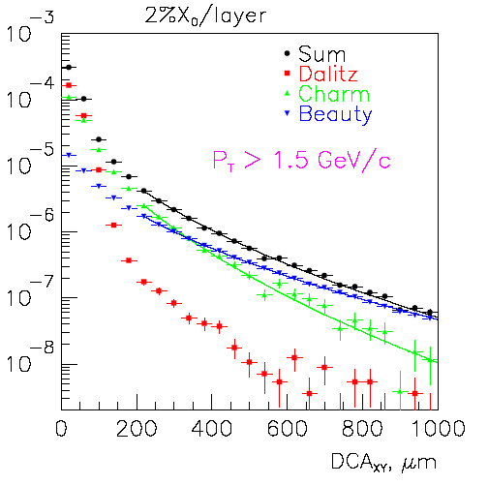
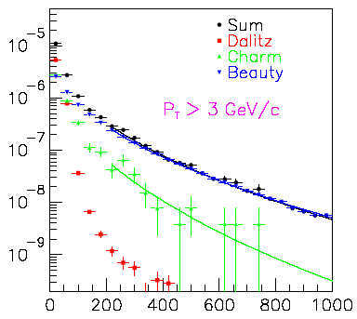
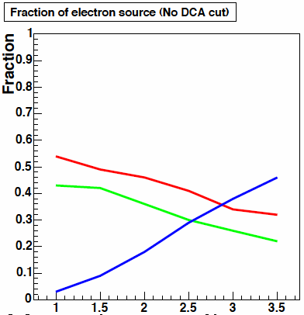
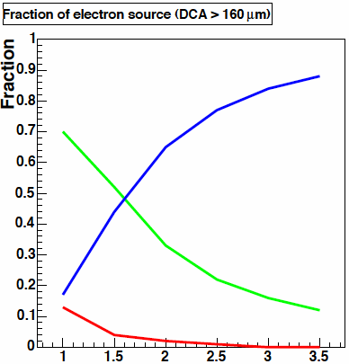
Separation of Charm / Beauty
charm and beauty separation with difference of their life time
e
Life time (cτ)
D⁰ : 125 mm
B⁰ : 464 mm
DCA
Simulation
D
p
p
B
By simultaneous fitting
the DCA distribution
with the expected shapes,
charm and beauty are separated.
e
Background
c quark
b quark
Subtraction of
background
pT (GeV/c)
DCA (μm)

Slide 6
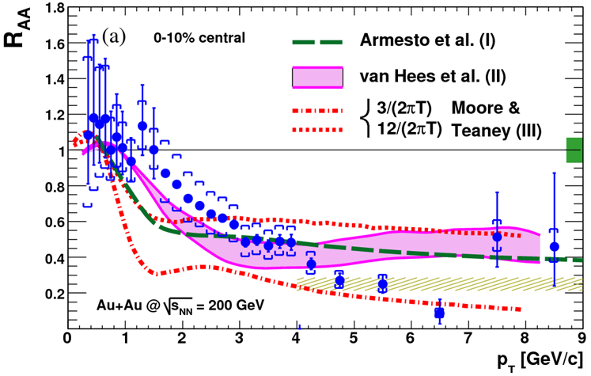
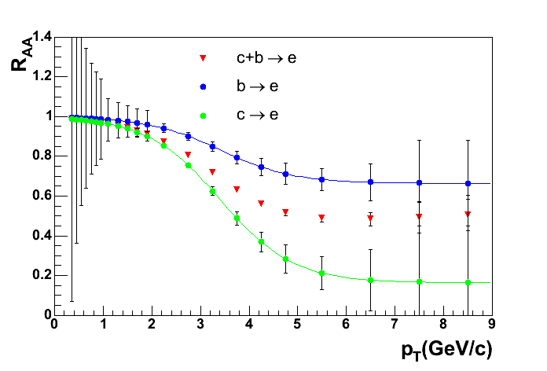
3. Physics Capability with VTX
Expected R_{AA}(b→e) and R_{AA}(c→e) with VTX
Expected with VTX (0.4/nb)
RUN4: PRL98,172301
Strong suppression of single electrons from heavy flavor decay is one of the most surprising results in RUN4.
The present measurement is mixture of b → e and c → e.
VTX can separately measure R_{AA} of b → e and c → e.
Notes:
6

Slide 7
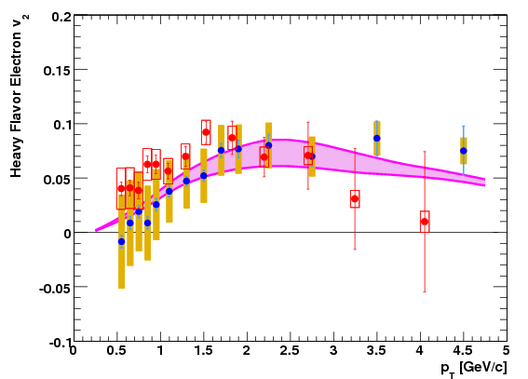
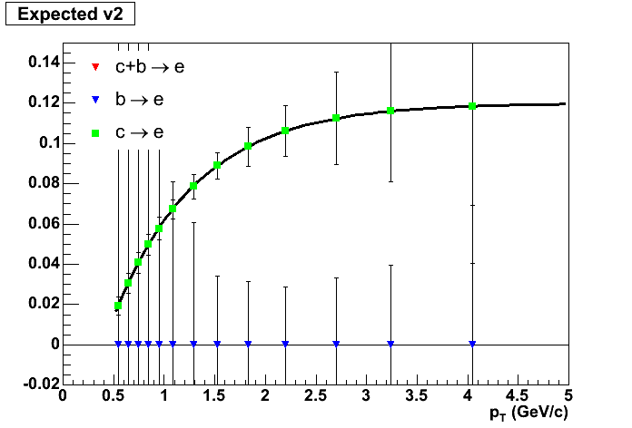

Expected v₂(b→e) and v₂(c→e) with VTX
RUN4 PRL98,172301
Expected with VTX (0.4/nb)
published
Run-4
PRELIMINARY
Run-7
New RUN7 points.
minimum-bias
  Rapp & van Hees,
  PRC 71, 034907 (2005)
V2 of single electron is measured by PHENIX in RUN4 and RUN7.
The measured v2 is mixture of b → e and c →e.
With VTX, we can separate b → e and c → e components.
Notes:
7

Slide 8
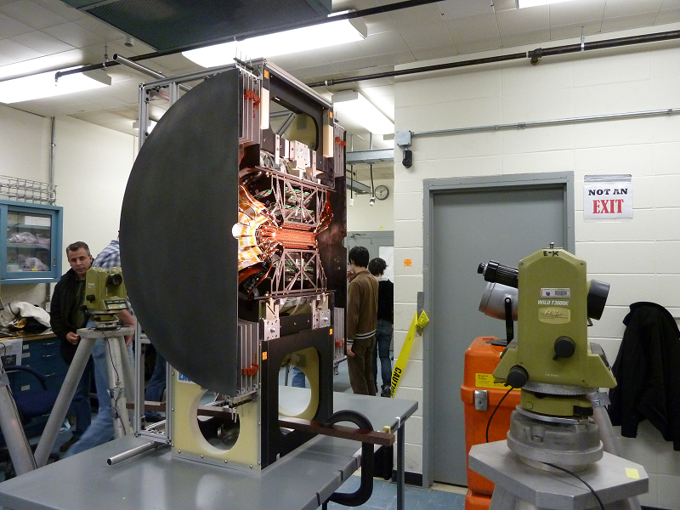
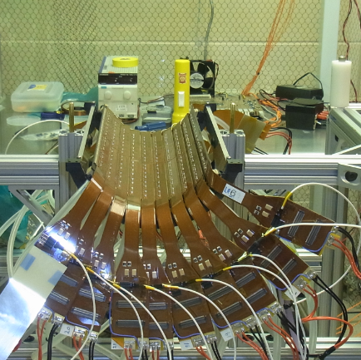
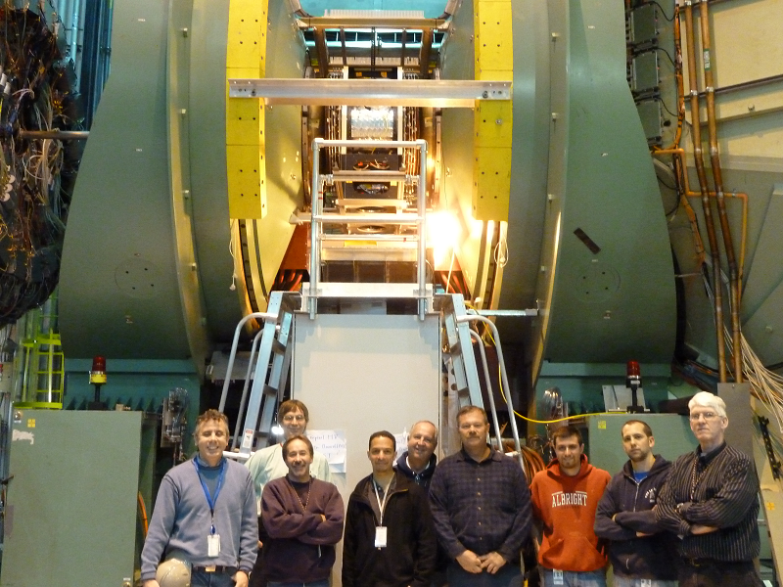
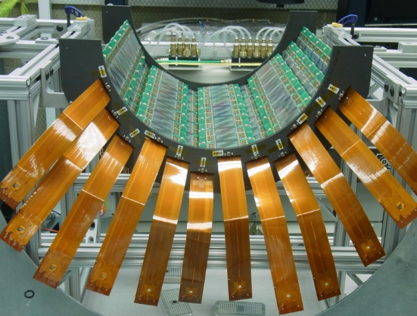
4. Production and Installation Status
Assembly of pixel (layer 0 and 1) and strip (layer 2 and 3) detector .
QA test of each layer.
Survey of each layer.
Install into IP.
Survey of West and East detector.
Commissioning of VTX without beam.
December
October
November
Mate pixel and strip detector.
Survey of half barrel (West and East)
QA test of half barrel.
Each half barrel were moved to IR
8

Slide 9
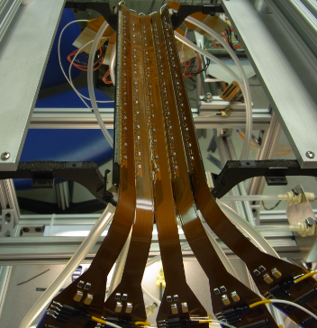
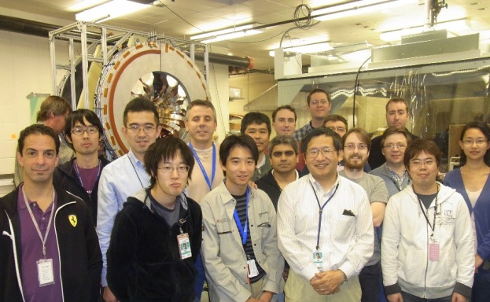
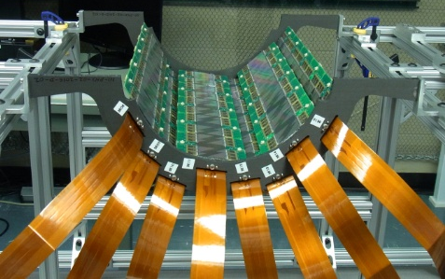
Each Layer of Half Barrel
Layer 0 (PIXEL)
5 ladders
Layer 1 (PIXEL)
10 ladders
VTX Team
Layer 2 (STRIP)
8 ladders
Layer 3 (STRIP)
12 ladders

Slide 10
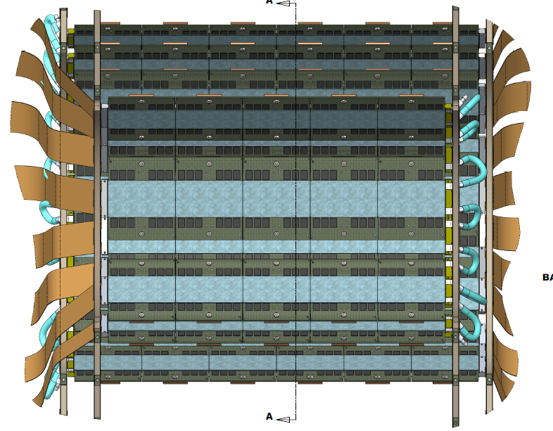
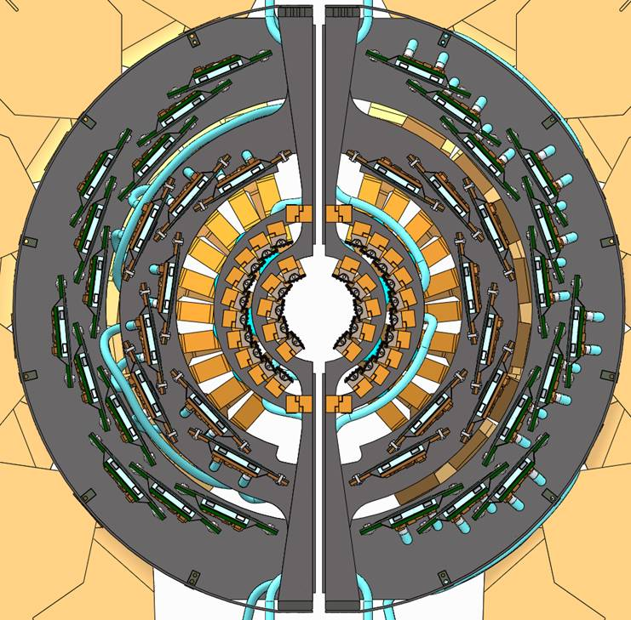
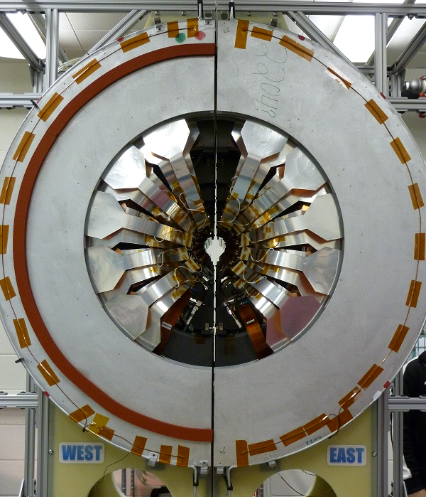

VTX Barrel
BEAM VIEW
SIDE VIEW
beam

Slide 11
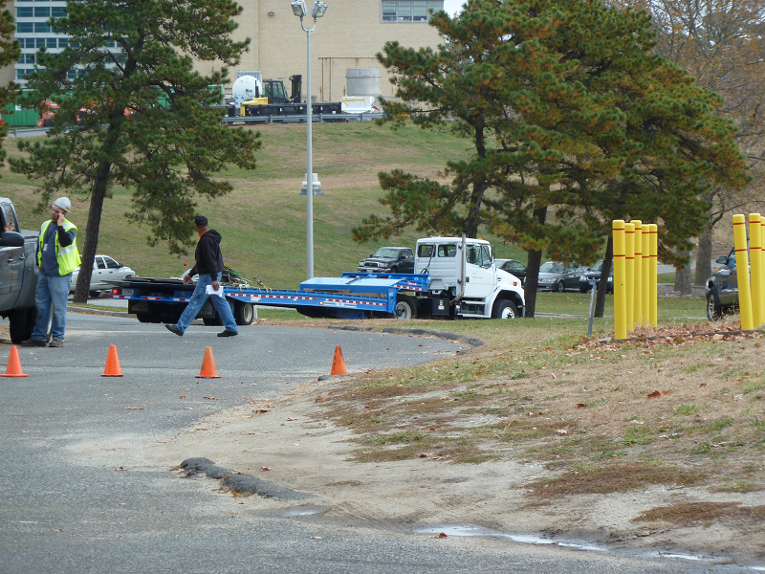
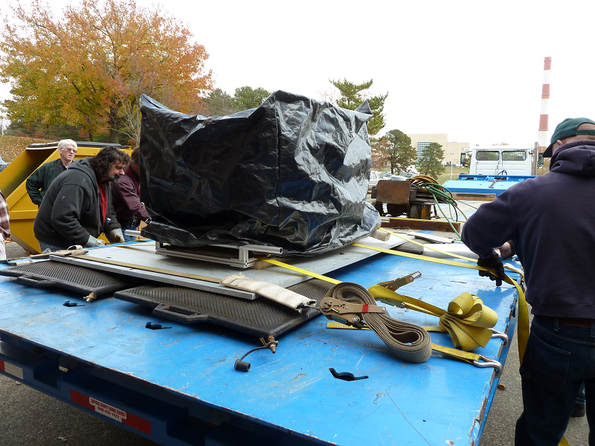
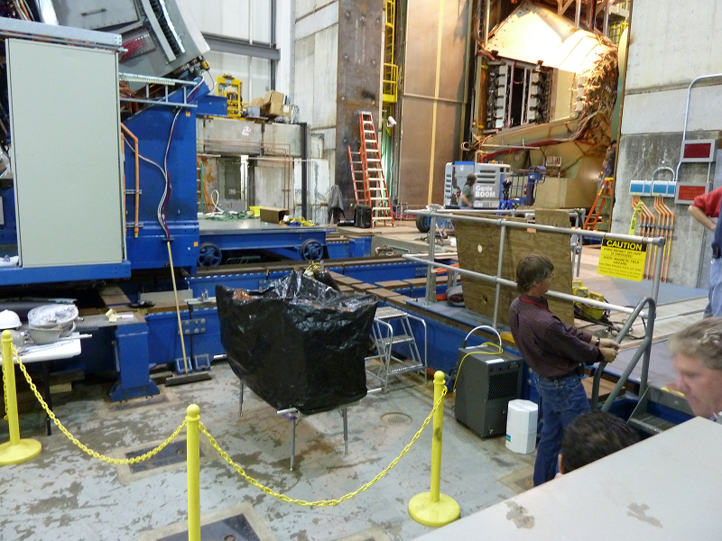
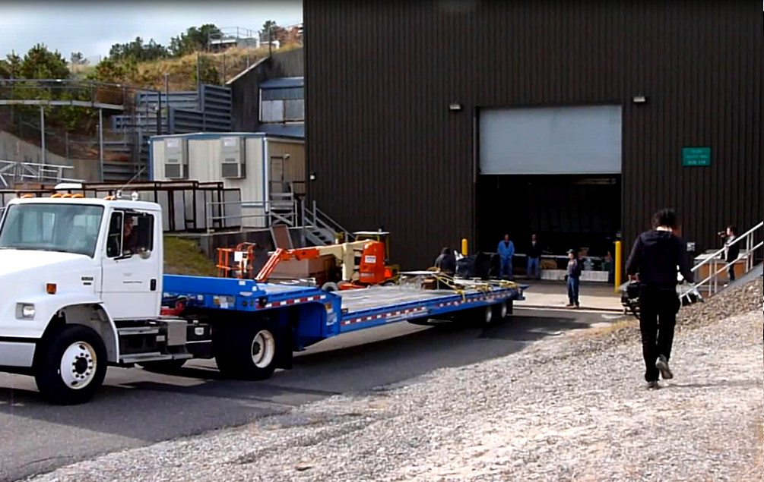
Move to IR
WEST
Detector
After survey, each half barrel detector was moved to AH.
Air cushion
Temporally place.

Slide 12
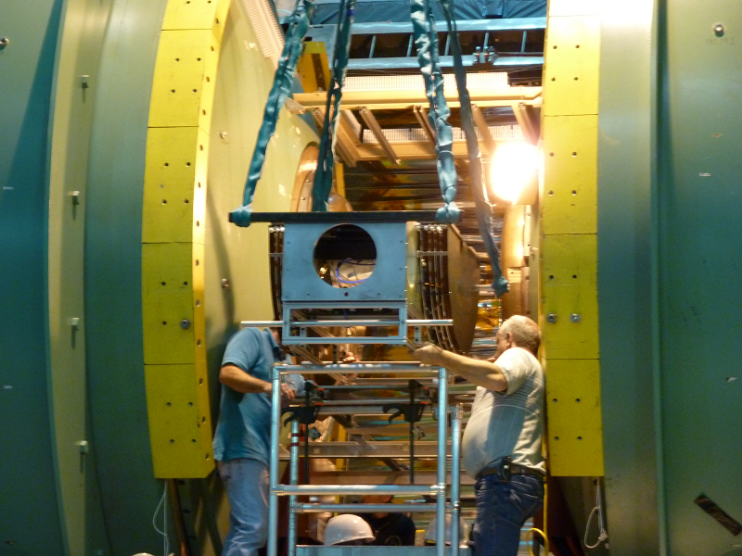
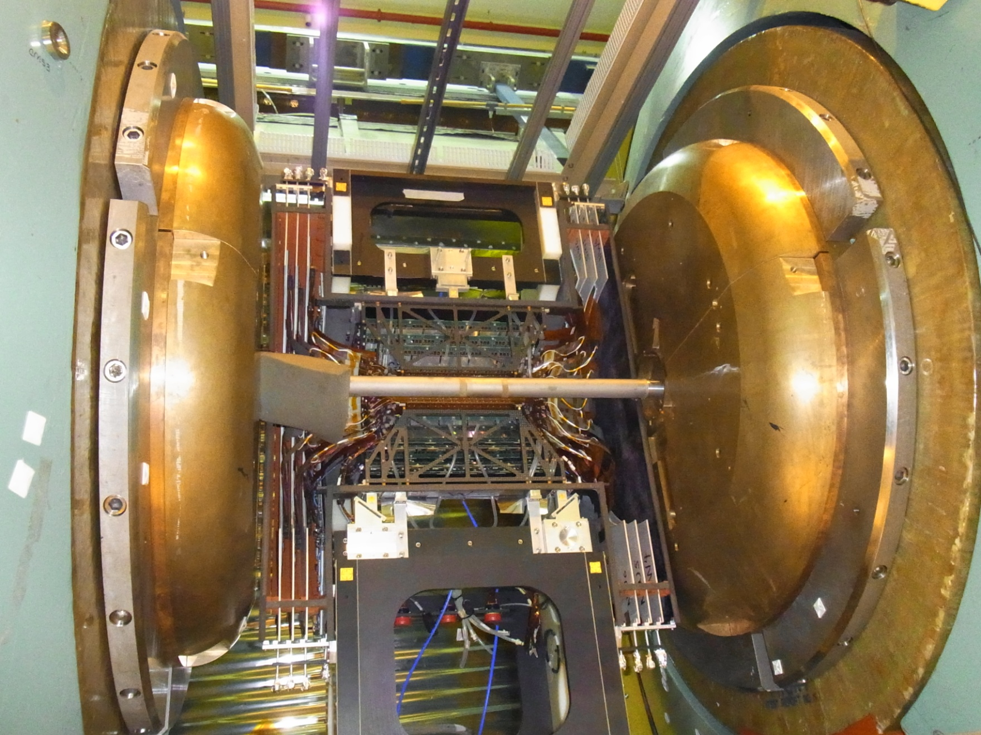
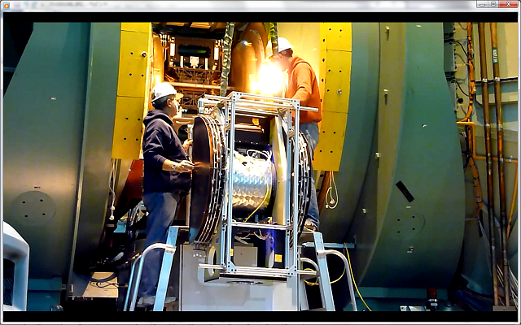
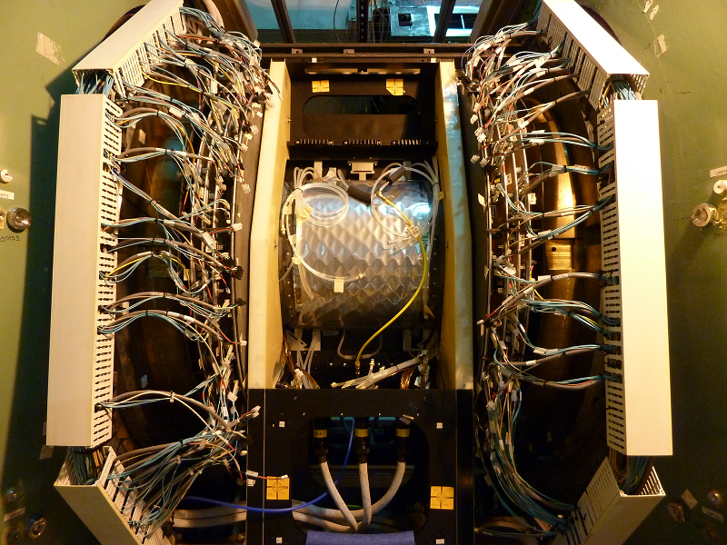
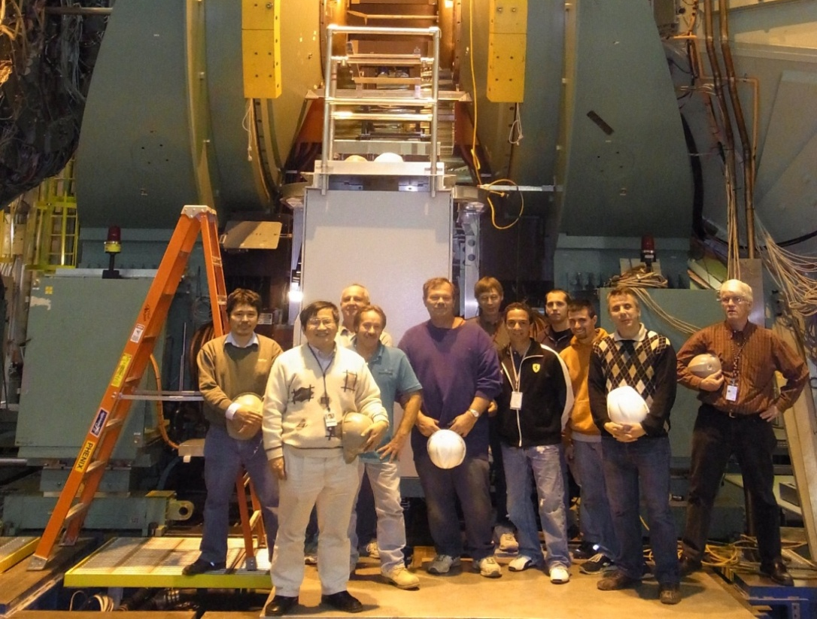
Installation of Full Barrel to IP
Half VTX installed on Nov 17th
Full VTX installed on Dec 1st after cabling
VTX group and PHENIX technician

Slide 13
VTX System
Cooling tube
Optical cable
FEM
Flow Sensor
Pixel/Strip Detectors
Thermo- sensor
Sensor cable
Power cable
Chiller
Interlock System
Power Supply
To remove power dissipation 1560W/VTX, need to cool down pixel/strip detectors.
To avoid detector destruction by heating, need safety interlock system
  Interlock trips off power supply by temperature and flow of coolant.

Slide 14
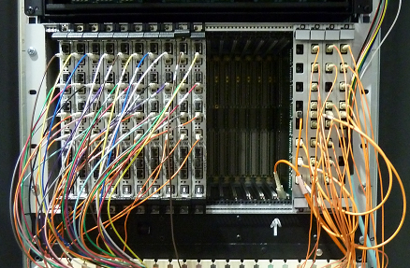
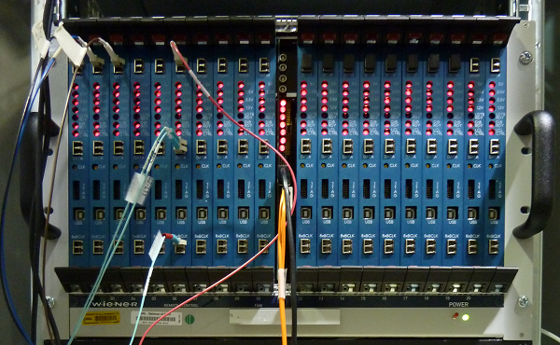
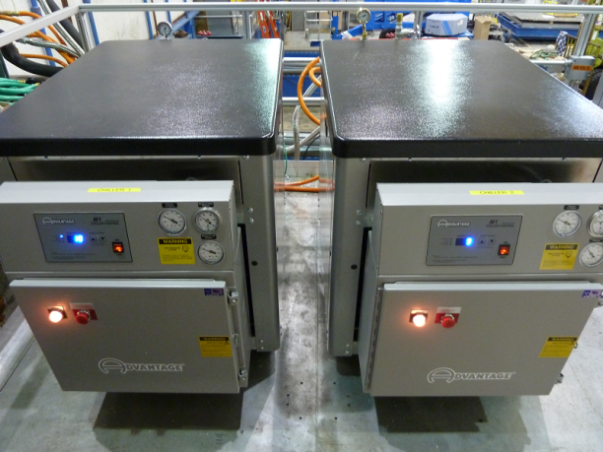
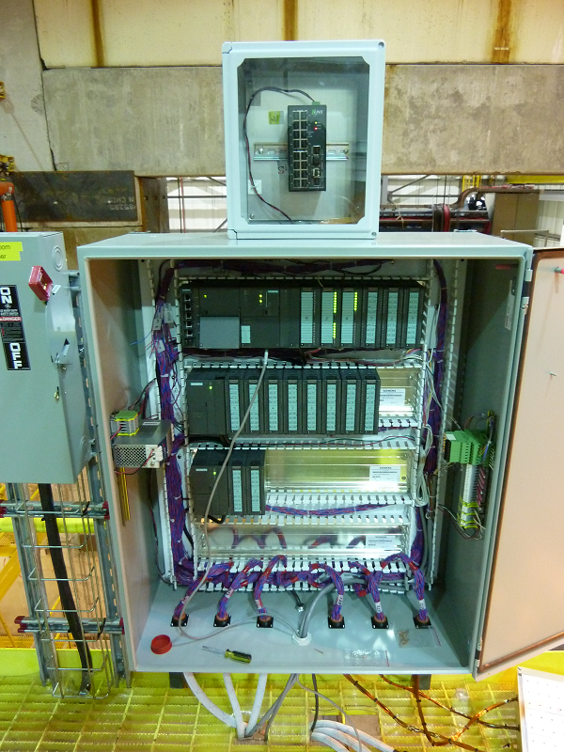
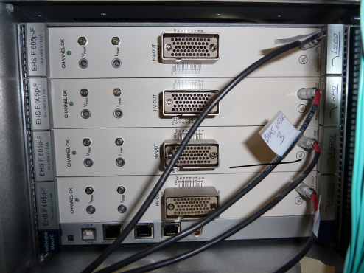
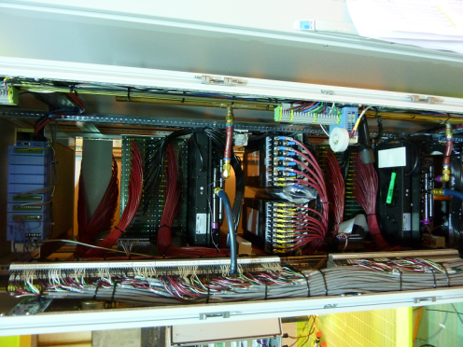
Installation Status
VTX Detector
Monitor of
Humidity
Flow pressure
FEM
Thermo sensor
Flow sensor
High Voltage
(Bias Voltage)
Low Voltage
(Readout Board)
Chiller1 Chiller2
Interlock System

Slide 15
Preparation Status
Completion of all the cabling and cooling connection.
Completion of power supply deployment and test of them.
Safety interlock system has been installed.
  Completion of temperature and flow interlock operation.
All the FEMs are in place and commissioned.
Final quality assurance test has been done.
Online monitoring tools are nearly completed.
Offline monitoring tools are under construction.

Slide 16
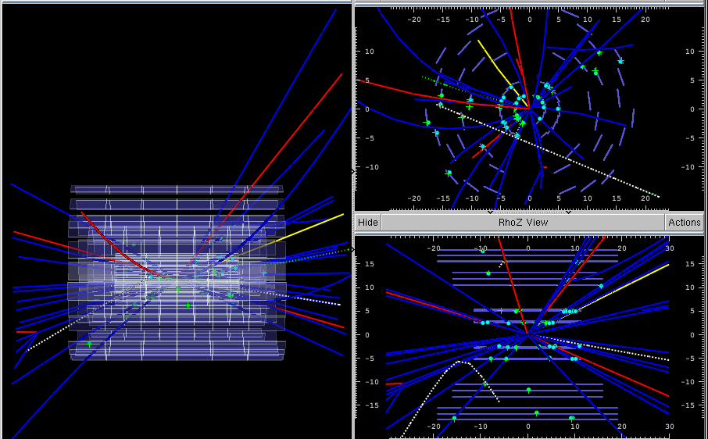
Event Display
Event display is ready

Slide 17
5. Schedule
Jan : Run p+p, commissioning of VTX with low multiplicity.
  Tune the VTX configuration to achieve full performance.
  DAQ commissioning.
  Calibration studies.
  Alignment studies.
Feb : Start 500GeV pp run.
  Single spin asymmetry in W production.
April : Start AuAu commissioning.
  Commissioning at high multiplicity and data rate.
April : Start 200Gev AuAu run
  Measurements of nuclear modification factor (R_{AA}) with charm and bottom.
  Measurements of elliptic flow for hadrons containing charm and bottom.

Slide 18
6. Summary
Silicon Vertex Tracker (VTX) will enhance physics capability of the PHENIX detector.
  VTX has a unique characteristic to separate charm and bottom events by the DCA resolution.
VTX has been successfully constructed and installed into IP.
VTX is ready for a commissioning stage with the beam on Jan 2011.

Slide 19
BACK UP SLIDES

Slide 20
Silicon Vertex Detector (VTX)
Four barrel detector.
Pixel (layer0, layer1)
Strip (layer2, layer3)
Pixel Detector
  Inner two layer.
  10 ladders (1st layer), 20 ladders (2nd layer)
  pixel size 450um x 50um (z x φ)
  4M pixels.
Strip Detector
  Outer two layer.
  16 ladders (3rd layer), 24 ladders (4th layer)
  stripixel size 1000um x 80um (z x φ)
  344k strips
layer0
layer1
layer2
layer3
Cross section of VTX detector
Four barrel detector

Slide 21
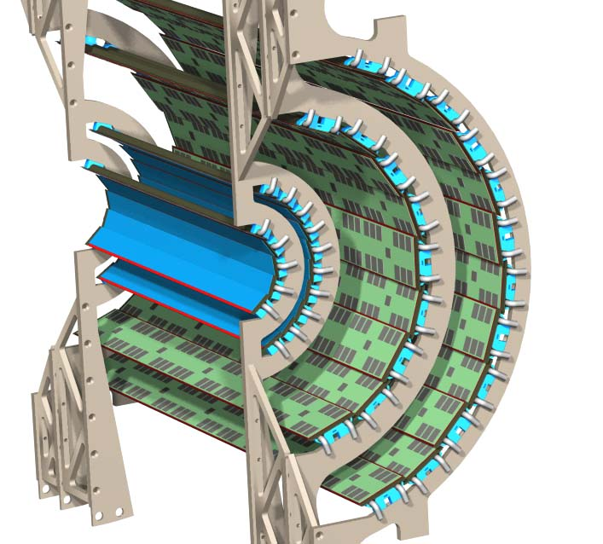
Silicon Vertex Detector
Four barrel layer detector
  Two internal layer of pixel detectors
  Two external layer of strip pixel detectors
pixel full ladder
Layer 1 : r = 2.5 cm 10 full ladder
Layer 2 : r = 5.0 cm 20 full ladder
22.7cm
strip pixel full ladder
Layer 3 : r = 10.0 cm 16 full ladder
Layer 4 : r = 14.0 cm 24 full ladder
38.3cm
VTX | Layer | 1 | 2 | 3 | 4
Channel count | Sensor size r × z (cm²) | 1.28 × 1.36 (cm²) (256 × 32 pixels) |  | 3.43 × 6.36 (cm²) (384 × 2 strips)
 | Channel size | 50 × 425 μm² |  | 80 × 1000 μm²
 | Readout channels | 1,310,720 | 2,621,440 | 138,240 | 239,616
Radiation Length (X/X₀) | Total | 1.44% |  | 3.6 %

Slide 22
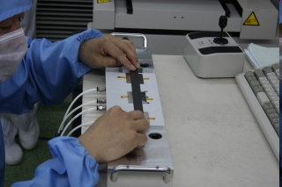
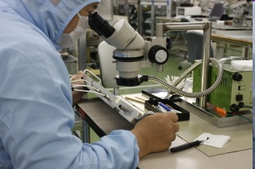
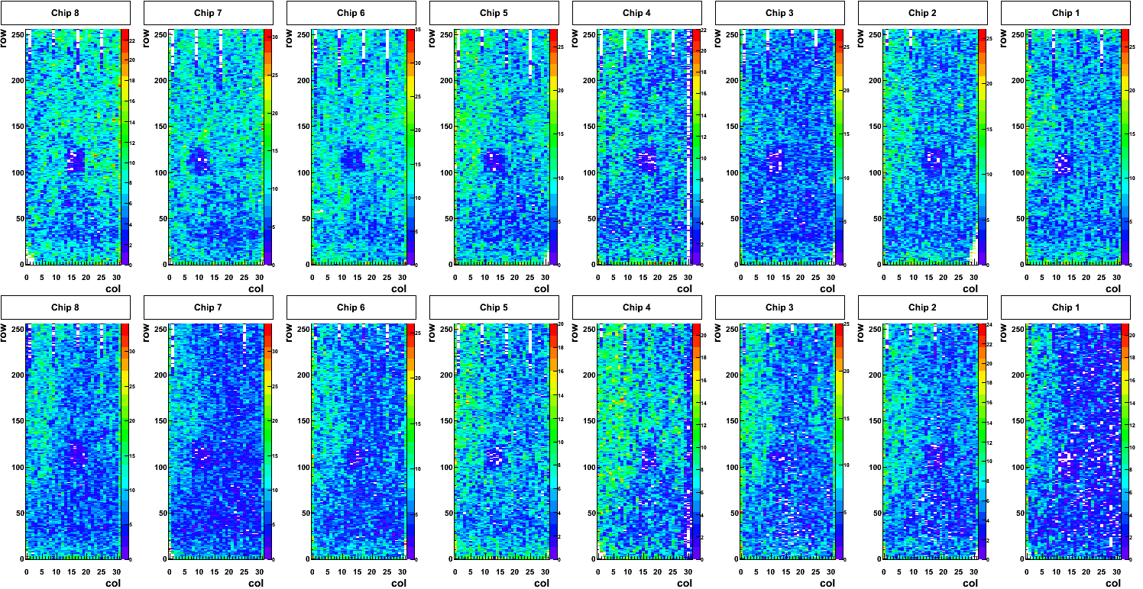

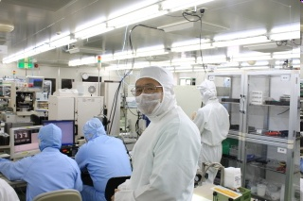
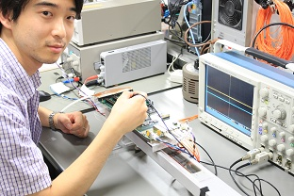
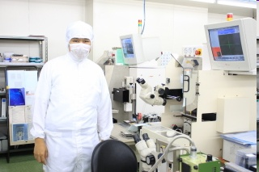
4. Current Status (Pixel Detector)

Slide 23
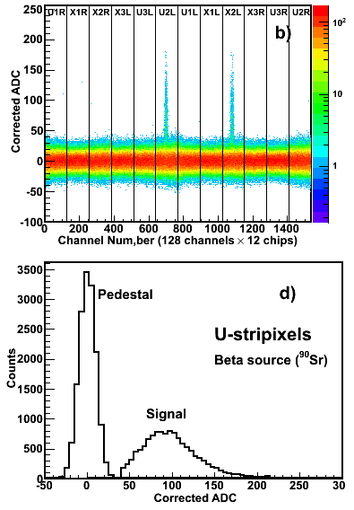
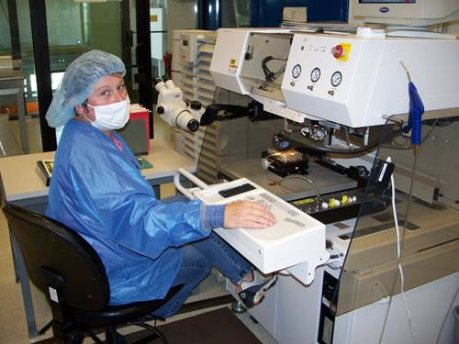
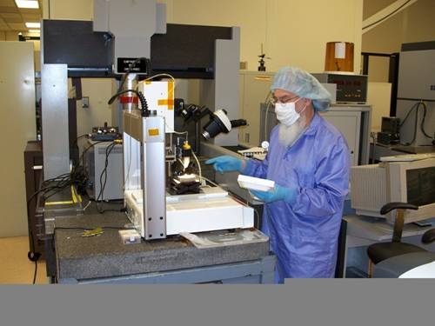





Current Status (Strip Pixel Detector)
signal
pedestal
More detail will be shown by Paul Kline (G7-6 9:30am).

Slide 24



Double Spin Asymmetry
Heavy flavor measurement
Gamma - jet correlation
Direct γ (pT(γ), h_{γ} )
Center of mass energy
Center of mass energy
Integrated Luminosity
Integrated Luminosity
A_{LL} distribution as function of p_{T}
A_{LL} distribution as function of x_{g}
PYTHIA Simulation
Jet
(h_{jet})
Simulation
Simulation
Δg = g
GRSV_std
GRSV_std
GRSV_std
Δg = -g
L = 300 pb ⁻¹
Δg = -g
Δg = g
P = 0.7
L = 300 pb ⁻¹
200μm < DCA
Δg = g
P = 0.7
Δg = -g
include backgrounds
p_{T} (GeV/c)
no backgrounds
x_{g}

Slide 25



Survey and Fit Test

Slide 26


Installation of WEST Barrel to IP

Slide 27



Installation of EAST Barrel to IP

Slide 28


Survey
1. Shoot survey points on each ladder for each layer and reference points on frame.
T12
GND cable
T0
T3
T7
E
T8
T15
C3
C2
C0
C1

Slide 29





Survey
2. Mate layer 0 and 1 (pixel), Mate layer 2 and 3 (strip)
Shoot reference points on frame.
Thermocouple
Center of Pin
P1WST
Center of Pin
P1WNT
North
South
Center of Pin
P1WSB
Center of Pin
P1WNB
Looking from West to East

Slide 30


Survey
3. Mate pixel and strip.
Shoot reference points on frame.
P1WR8
P1WR7
Top
P1WR6
P1WR5
Each Reference point
P1WR4
P1WR3
Bottom
P1WR1
P1WR2
Looking from IP

Slide 31

Survey
4. Shoot reference marks on barrel support frame.
EB3
EB3
EB1
EB2

Slide 32
Milestone
Install into IP.
Optical, LV and HV cable connection.
Final QA test of West and East detector.
Chiller and interlock system preparation.
Survey of West and East detector.
All pixel ladders were sent to BNL and QA test of all pixel ladders had been done.
Assembly of pixel (layer 0 and 1) and strip (layer 2 and 3) detector (Slide 4).
QA test of each layer.
Survey of each layer (Slide 5-8).
December
October
November
Mate layer 0 and 1, layer 2 and 3.
QA test of pixel and strip detector.
Mate pixel and strip detector.
QA test of each half barrel.
Survey of half barrel (West and East)
QA test again.
Move to IR

Slide 33

Final QA Results of Pixel Detector (WEST)
PULSE TEST at CHEMISTRY
PULSE TEST at IR
Couldn’t read test pulse from half chip additionally.
Dead area of WEST pixel detector is 0.6%.
Dead area of WEST strip detector is 0.3%.
Notes:
After mating of pixel and strip barrel

Slide 34

Final QA Results of Pixel Detector (EAST)
PULSE TEST at CHEMISTRY
PULSE TEST at IR
Couldn’t read test pulse from 5 chips additionally.
Dead area of EAST pixel detector is 4.7%.
Dead area of EAST strip detector is 0.5%.
As for 4 chips out of them, it seems the cause is electrical connection between extender and readout bus.
Notes:
11 additional

Slide 35



Chiller Status
Operate at 0 degree.
Flow test of three chillers were done.
  Flow during 1 day at 0 degree without VTX.
There is minor issue but they are almost ready.
Cooling tube will be connected to detector soon.
Chiller 1
Chiller 2
Chiller 3
Barrel
Barrel

Slide 36

Interlock System Status
Readout and control test are being performed with real thermocouple sensor.
  Current temperature could be monitored.
  Threshold value could be set correctly.
  Interlock system worked correctly with OPS.

Slide 37
DCM II Readout Test
Readout test through DCM II was successfully done.
  Read PRDF file (no hit data) through DCM II.
  Just using SPIRO board.
  Check event number, SPIRO ID, FEM ID, …
  All DCM II were delivered.
GTM
clock
Busy
SPIRO
FEM
DCM2

Slide 38
Preparation Status (SOFTWARE)
LV, HV control GUI (Done).
VTX detector monitor (Nearly completed).
  Temperature of detector (for interlock), coolant flow, pressure difference of coolant, N2 flow, humidity
DAQ (under construction)
Alignment tools (under construction)
Event display (Done).
Online monitor (partial)
  2D hit map, dead and hot channel monitor.
  Cluster size monitor.
Offline monitor (under construction)
  Track efficiency.
  Residual.
  …

Slide 39

HV Control GUI
HV rack was installed in IR.
Test of HV system had been done.
  Controlled voltage output and monitored.
1. Yellow warning – soft limit
(0.2 x current limit)
2. Red warning – hard limit (0.6 x current limit)
3. Current limit – trip current
(15 uA)

Slide 40

LV Control GUI
LV rack was installed in IR.
Test of LV system need to be done.
  Control voltage output and monitor.

Slide 41

Online Monitor 1
This shows 2D hit map.
  1 segment = 8×8 pixels (Barrel 0); 8×8 pixels (Barrel 1)
This is intended to show the position of hot pixel.

Slide 42

Online Monitor 2
Diagnosis will be displayed
Diagnosis will be displayed
This shows the # of hits for each chip (black) & for the hottest pixel in a chip (red).
This is intended to show the status of the chip (good, low efficiency, dead, hot)
  Low efficiency : # of hits for the chip is smaller than that for the other chips.
  Dead : # of hits for the chip = 0
  Hot : (# of hits for the chip) / (# of hits for the hottest pixel) ~ 1

Slide 43
B3-L11
Y
B3-L12
WEST
EAST
B2-L7
B2-L8
B1-L9
B1-L10
B0-L4
B0-L5
X
Z
B0-L0
B0-L9
B1-L0
B1-L19
B2-L0
B2-L15
B3-L0
B3-L23

Slide 45


Cooling Connection (West)
Barrel 0
Barrel 1

Slide 46

Logic of Interlock System (Barrel 0 West)
Big Wheel (North West)
BW4
Ladder (West)
SLOT5
North West
SLOT6
SLOT7
South West
Big Wheel (South West)
SLOT8
BW4
Temperature Monitoring

Slide 47
Tentative RHIC Run-11 Plan
FY11 initial funding guidance for RHIC ops. $1.6M below President’s request, but still up by 4% (≅ inflation) from FY10
Should ⇒ 27-28 cryoweeks of operation at projected power cost
Tentative Run Plan:
1.5 weeks cooldown/warmup
3.5 weeks pp commissioning (as per Wolfram -- do we still need that much before physics start?)
10 weeks 500 GeV pp (includes 1-2 days with IP2 collisions)
If VTX ready for productive ops:
2 weeks Au+Au commissioning
8 weeks 200 GeV Au+Au
1 week U+U setup
1.5 weeks 193 GeV U+U
1 week 18 GeV Au+Au
Total = 28.5 cryoweeks
If VTX not ready for productive ops:
2 more weeks 500 GeV pp
3 weeks U+U commissioning
2 weeks 193 GeV U+U
0.5 weeks Au+Au setup
1.5 weeks 18 GeV Au+Au
1.0 weeks 27 GeV Au+Au
0.5 weeks ~6 GeV Au+Au test
Total = 25.5 cryoweeks, carry more funds forward for Run 12

