Slide 1



Heavy-flavor
particle correlations
- From RHIC to LHC
André Mischke
Utrecht University
International Workshop on Heavy Quark Production in Heavy-ion Collisions
Purdue University – January 4-6, 2011

Slide 2
Outline
Introduction
Results from RHIC
Simulation studies for LHC energies
Summary
2

Slide 3
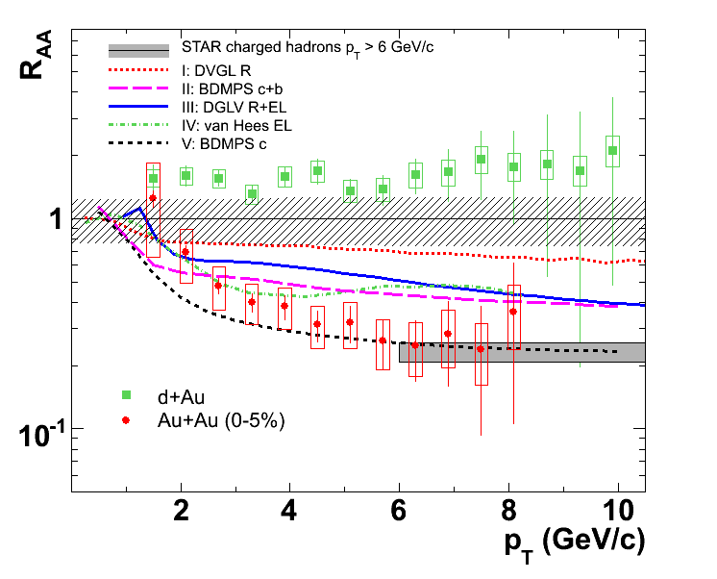

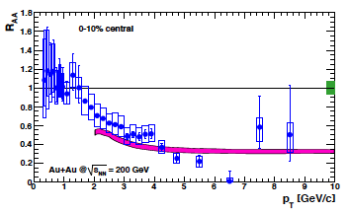

R_{AA} of single electrons at RHIC
Phys. Rev. Lett. 98, 192301 (2007) arXiv:1005.1627, subm. to PRC
Phys. Rev. Lett. 98, 172301 (2007)
--- A. Adil and I. Vitev, PLB649, 139 (2007)
light quark hadrons
R_{AA}(e) ≈ R_{AA}(h) at p_{T} > 6 GeV/c
Not in line with expectations from dead-cone effect
Purdue HF Workshop 2011
3

Slide 4
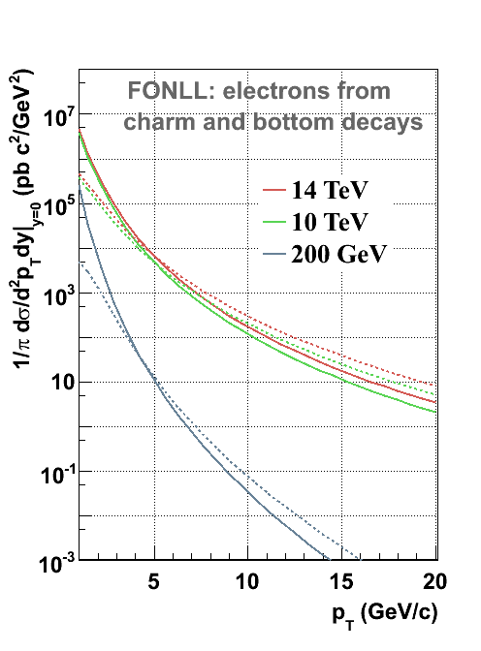
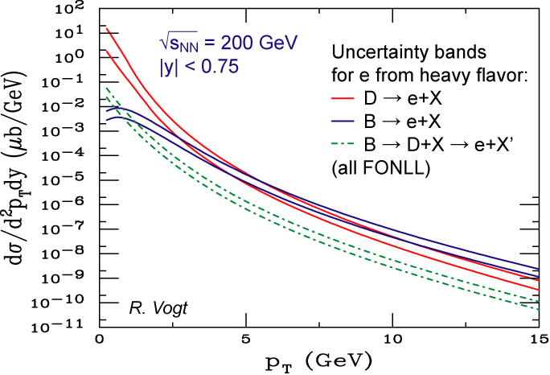
D and B contribution to single electrons
M. Cacciari et al., PRL 95, 122001 (2005)
NLO pQCD: D/B meson crossing point is largely unknown
Purdue HF Workshop 2011
4

Slide 5
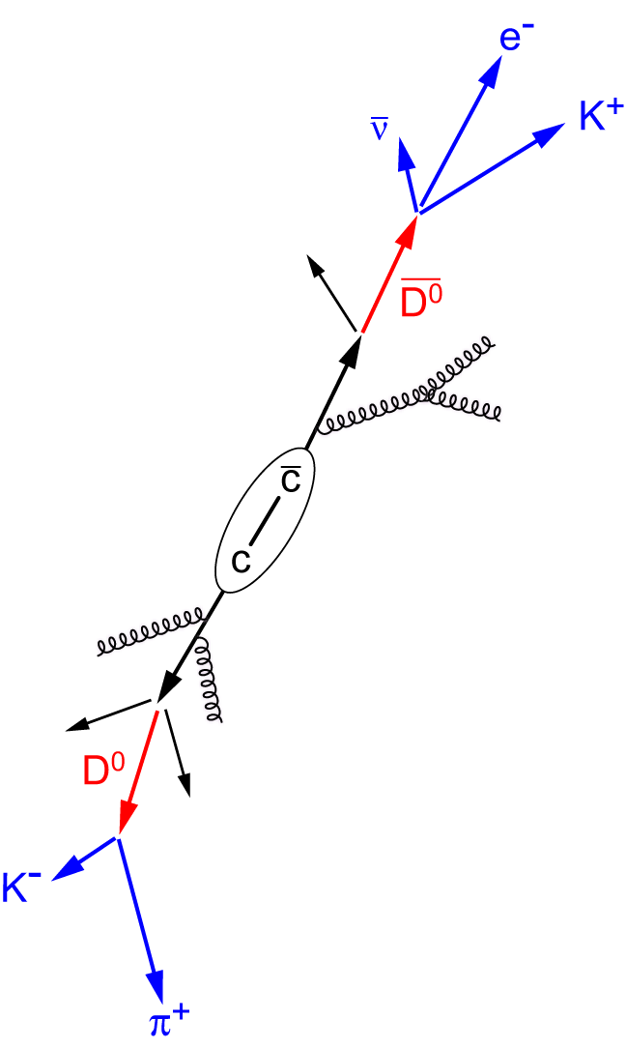
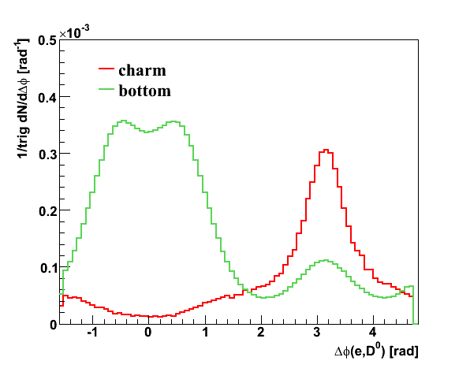
Heavy-flavor particle correlations
π⁺
Identify and separate charm and bottom quark pairs using
their decay topology
azimuthal angular correlation of their decay products
trigger side
e⁻
K⁻
–
ν_{e}
unlike-sign pairs
away-side
correlation
D⁰
D^{*0}
B⁻
3.83% 54% ~10%
b
charm production
A.M., PLB 671, 361 (2009)
–
like-sign pairs
near-side
correlation
b
PYTHIA, pp@200 GeV
–
B⁺
D⁰
Near- and away-side correlation peak expected for B decays
bottom dominant
π⁻
probe side
charm dominant
K⁺
5

Slide 6
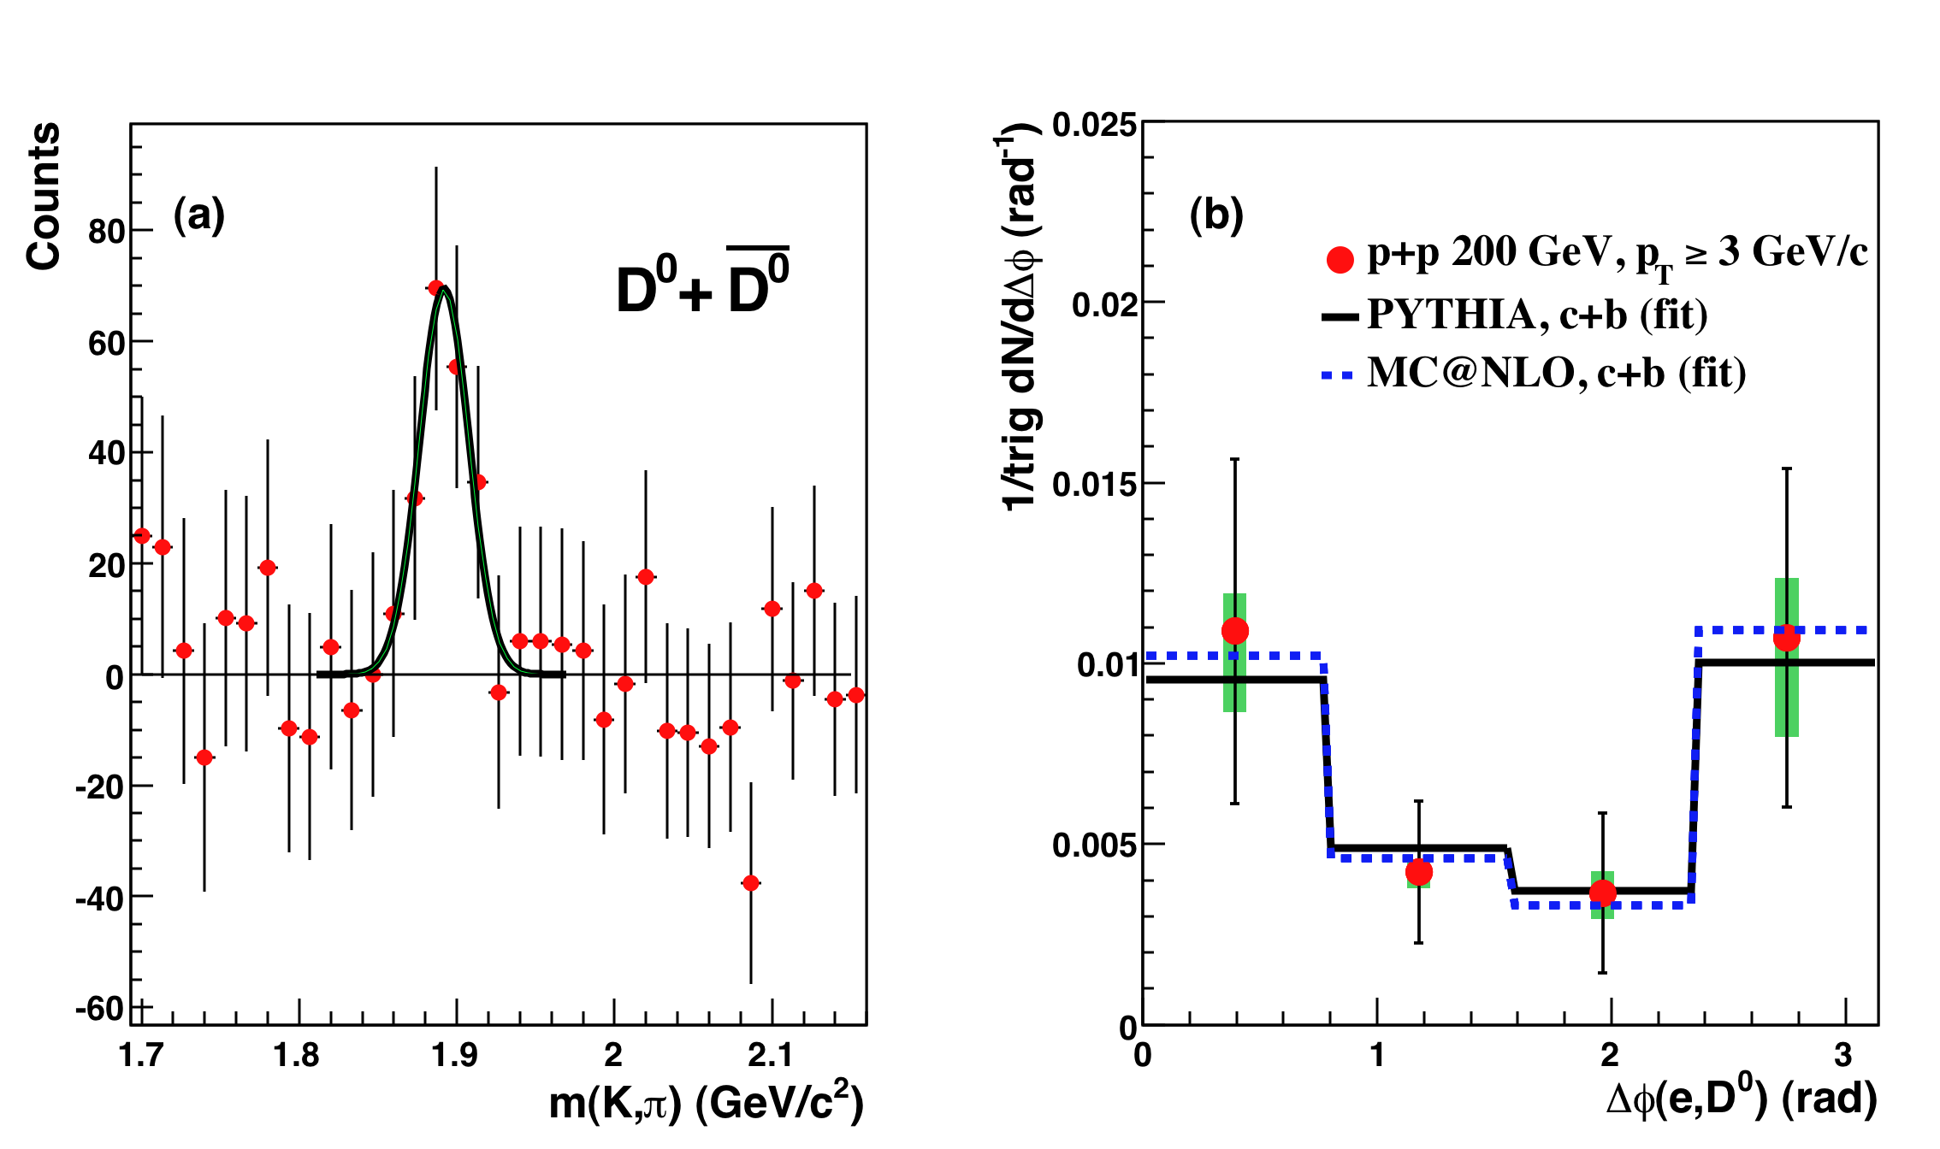
Single electron - D⁰ azimuthal correlations
STAR, Phys. Rev. Lett. 105, 202301 (2010)
Extraction of relative B contribution using different models:
essentially from B decays only
≈75% from charm
≈25% from beauty
6

Slide 7
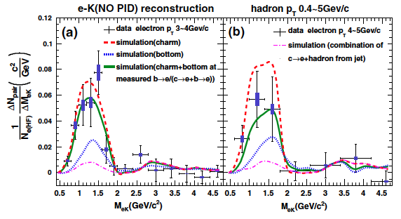
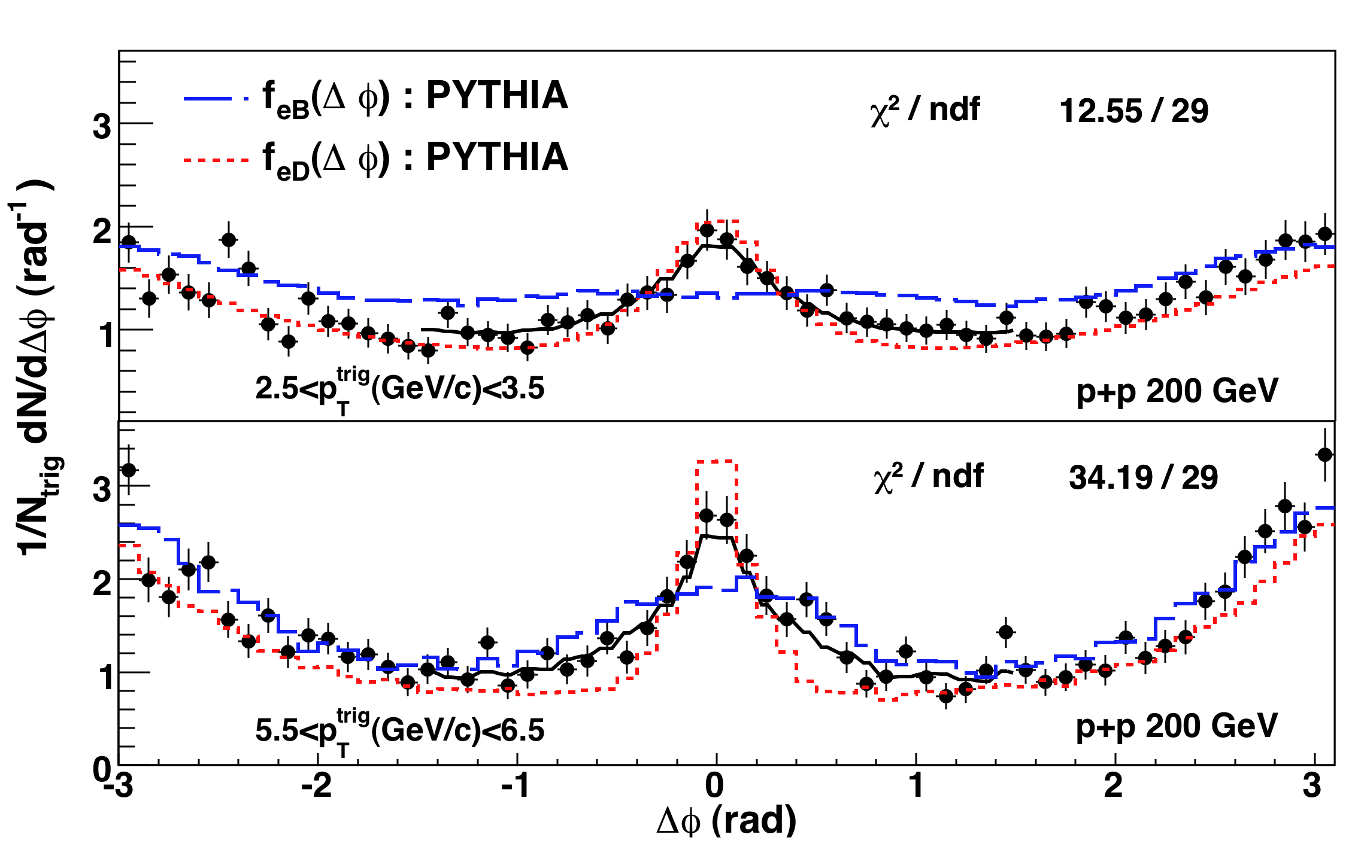
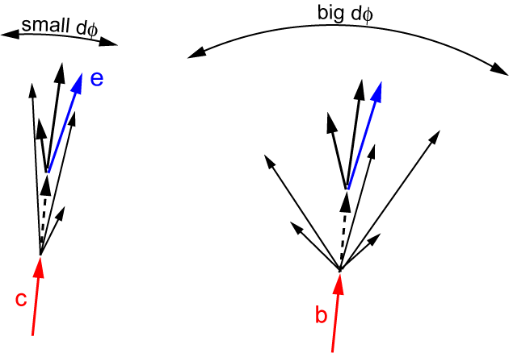
Electron-hadron azimuthal correlations
PHENIX, Phys. Rev. Lett. 103, 082002 (2009) STAR, Phys. Rev. Lett. 105, 202301 (2010)
Exploit different fragmentation of associated jets
X. Lin, arXiv:hep-ph/0602067
7

Slide 8
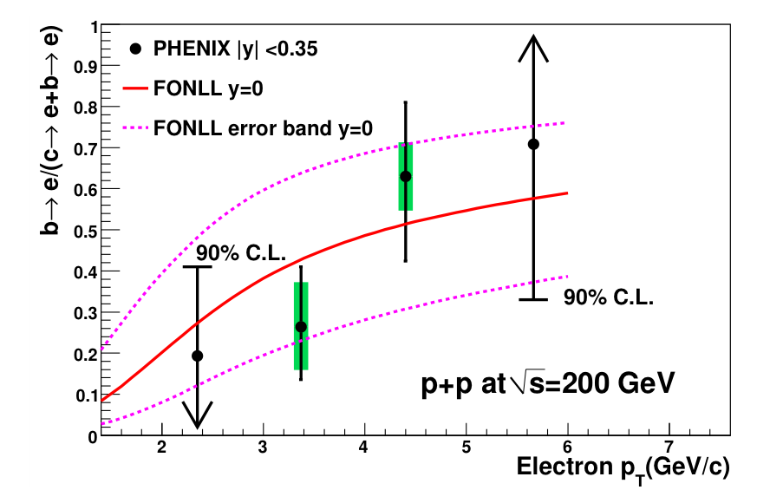
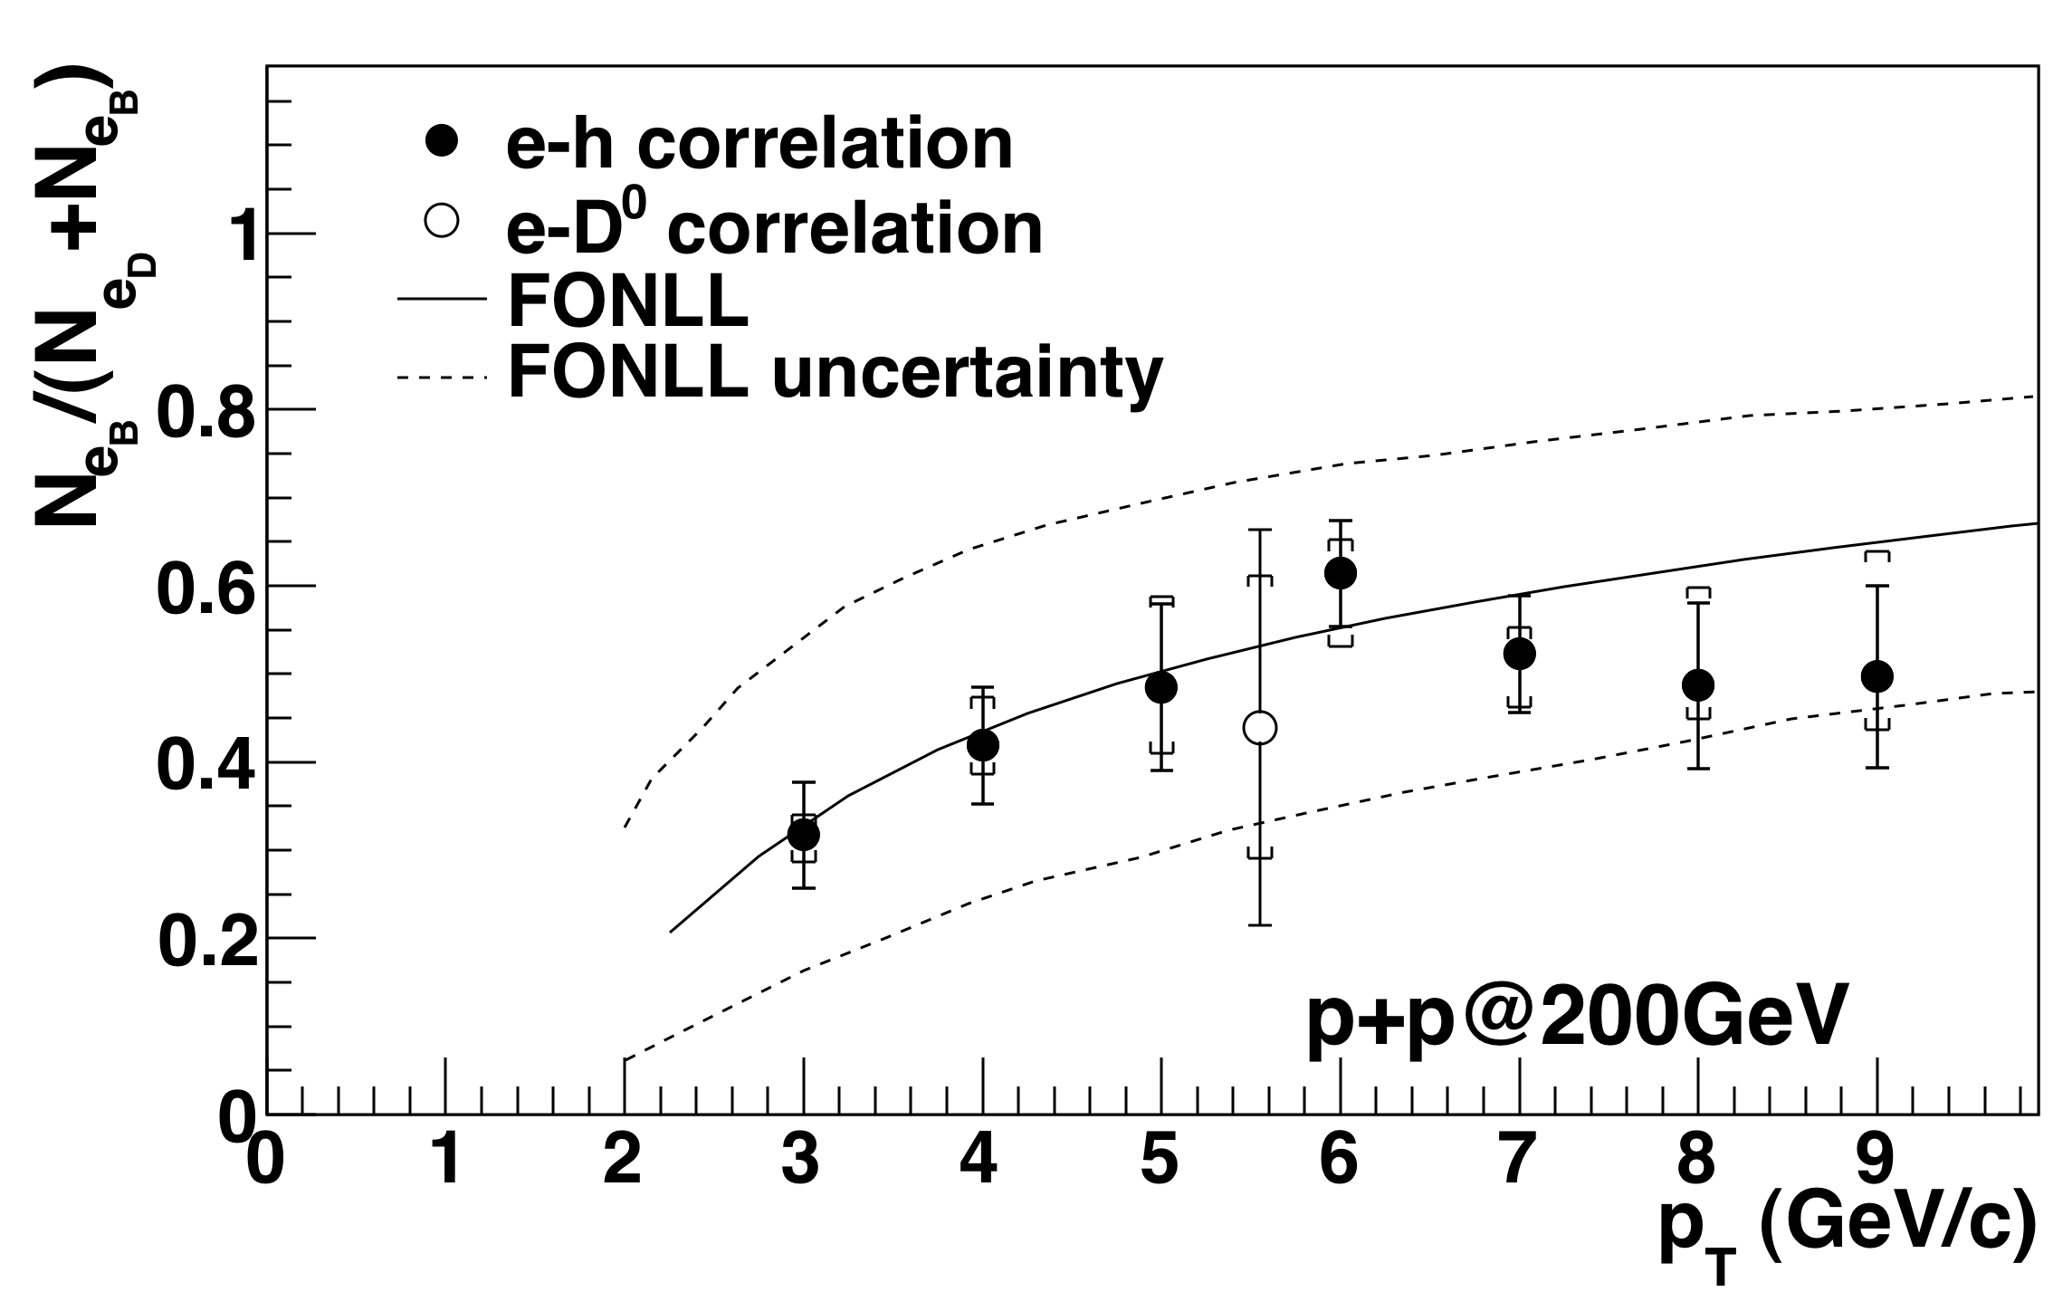
B contribution to single electrons
Phys. Rev. Lett. 103, 082002 (2009) Phys. Rev. Lett. 105, 202301 (2010)
B and D contributions comparable at p_{T} > 5 GeV/c and consistent with pQCD calculation at Fixed-Order plus Next-to-Leading Logarithm (FONLL)

Slide 9
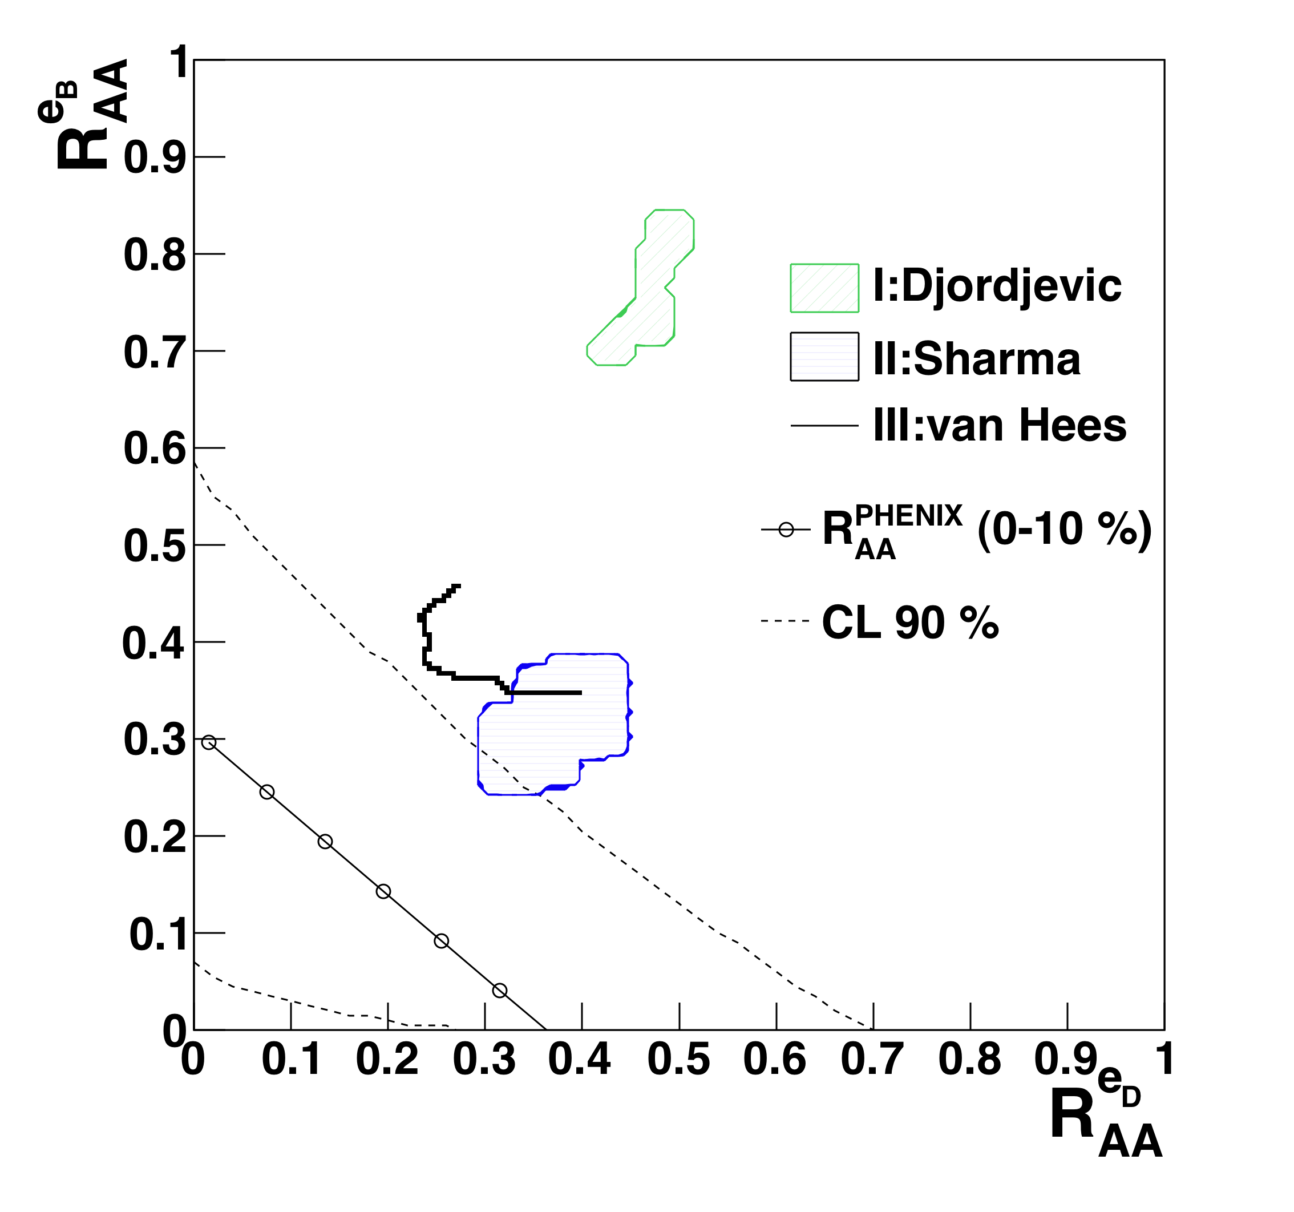
Comparison to energy loss models
Phys. Rev. Lett. 105, 202301 (2010)
R_{AA} = r_{B} R_{AA}^{eB} + (1-r_{B}) R_{AA}^{eD}
B production in heavy ion collisions stronger suppressed at high p_{T} than expected
Original radiative energy loss calculation excluded
Direct D and B measurements in heavy-ion collisions will come in the near future (silicon μ-vertex detector upgrades)
p_{T} > 5 GeV/c
I: M. Djordjevic et al., PLB 632, 81 (2006)
II: R. Sharma et al., PRC80, 054902 (2009)
III: H. van Hees et al., PRL 100, 192301 (2008)

Slide 10
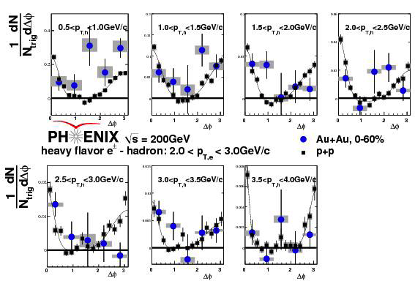
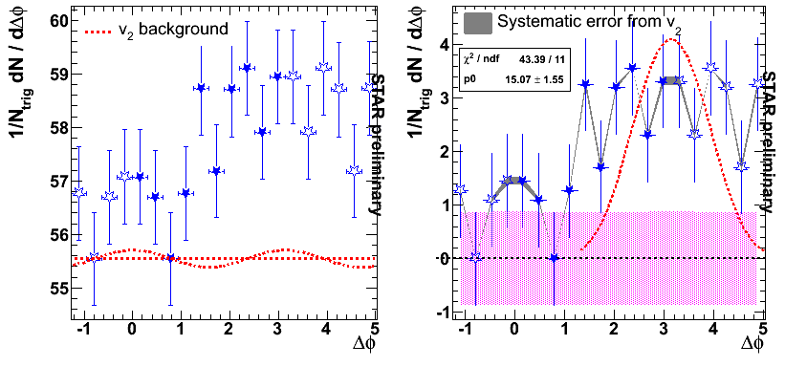
Single electron-hadron correlations in A+A
PHENIX, arXiv:1011.1477, subm. to Phys. Rev. C G. Wang, Hard Probes 2010
Away-side modification?
Improved statistics and better background rejection needed for conclusion

Slide 11
Heavy flavor production at LHC
Maximal collision energy: √s_{NN} = 5.52 TeV
Expected initial energy density: ~100 GeV/fm³
(10 times higher than at RHIC)
Relatively long-lived QGP phase
Thermal equilibrium reached
much faster(?)
→ Most of the in-medium effects
should be enhanced
Higher heavy-flavor production rates
Charm and bottom yields
- NLO pQCD predictions using MNR PDF
- ~factor 2 uncertainty for Pb-Pb from NLO and shadowing
system, √s_{NN}
pp @ 14 TeV
Pb-Pb (0-5%) @ 5.5 TeV
0.16 / 0.006
115 / 4.6

Slide 12
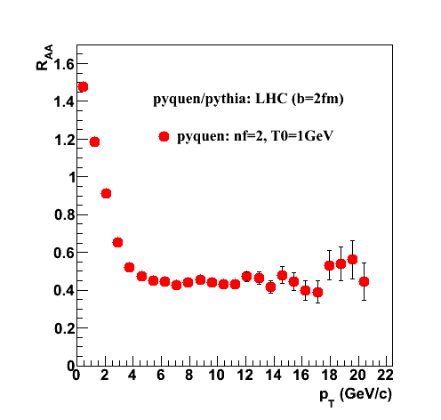
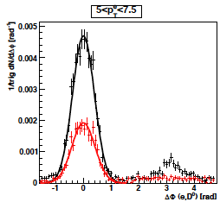
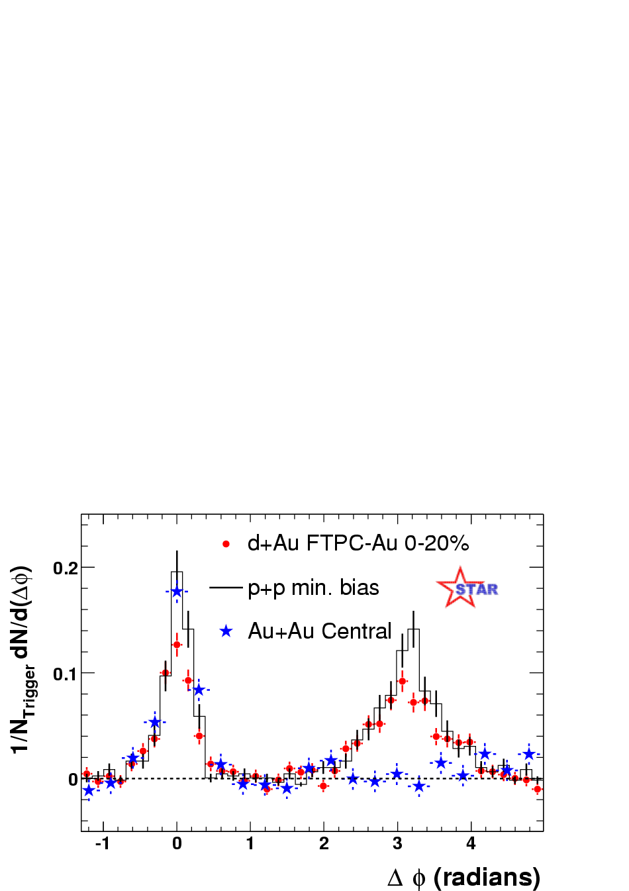
Single electron R_{AA} and correlations at LHC
Pyquen: Pb-Pb(5%) @ 5.5 TeV
T0 = 1 GeV
τ₀ = 0.15 fm/c
# quark flavours: 2
pp: Pythia
Pb-Pb: Pyquen
5 < p_{T}^{ele} < 7.5 GeV/c
Light hadrons
Electron R_{AA} similar to results from “more sophisticated” energy loss model calculations
Near side: B decays + charm from gluon splitting
Away side: charm flavor creation
12

Slide 13
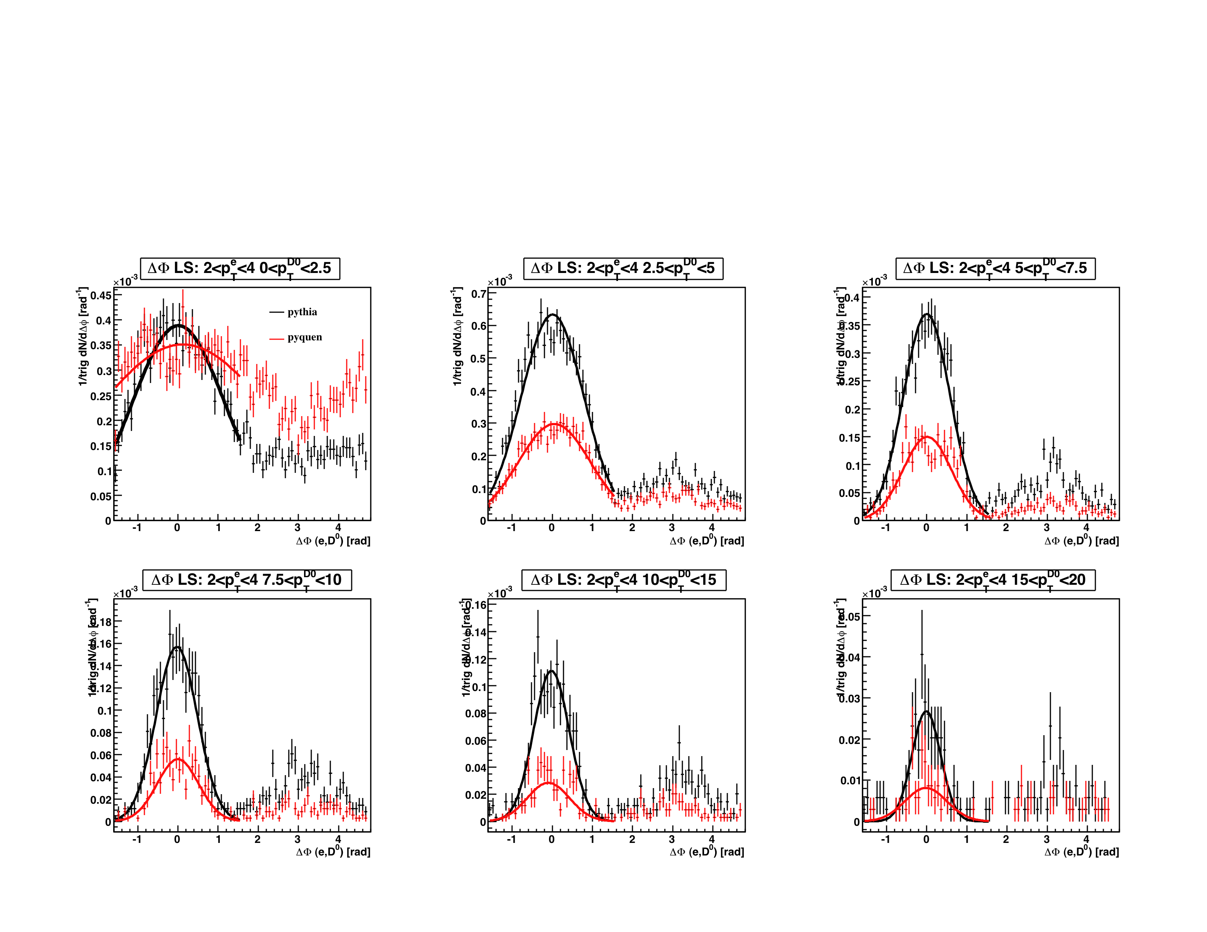
Single electron – D⁰ azimuthal correlations
2 < pT^{trigger ele} < 4 GeV/c
Pyquen: Pb-Pb(5%) @ 5.5 TeV
Pythia
Pyquen
different D⁰ p_{T} bins
Near side: B decays + gluon splitting charm
Away side: charm flavor creation
900M events
13

Slide 14
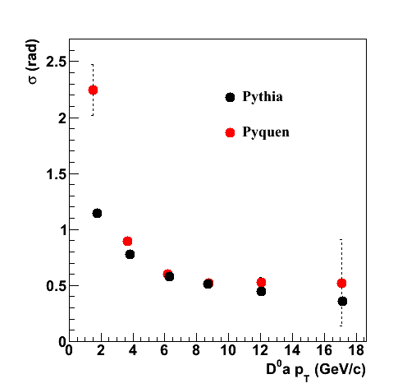
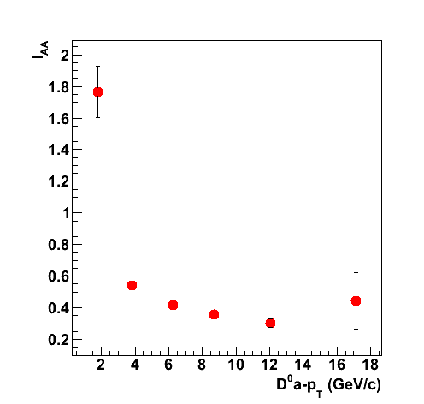
Δφ(e, D⁰): Near-side width and I_{AA}
2 < pT^{trigger ele} < 4 GeV/c
I_{AA} of near-side yield
Slightly broader peak for Pyquen compared to Pythia
Suppression of D⁰ yield for Pyquen
Next: fragmentation function
14

Slide 15
Charm production: NLO processes
Δφ ≈ π
Δφ ≈ 0
c
E. Norrbin, T. Sjostrand, Eur. Phys. J. C17, 137 (2000)
cbar
g
c
g
g
g
cbar
g
g
flavor creation gluon splitting
Leading order
  - flavor creation (FC)
Next-to-leading order
  - gluon splitting (GS)
  - flavor excitation
NLO processes become important at LHC energies
RHIC LHC
15

Slide 16
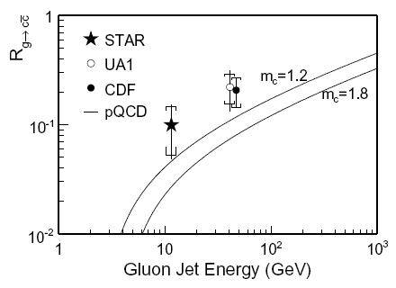
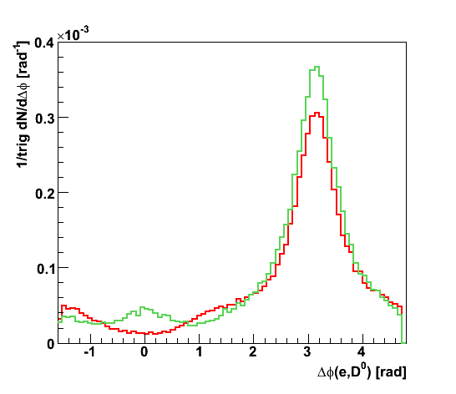
Gluon splitting rate
jet axis
D*
soft (GS)
hard (FC)
STAR, Phys. Rev. D79, 112006 (2009)
LHC ?
z = pL(D*)/Egluon-jet
MC@NLO
LO PYTHIA
A.M., PLB 671, 361 (2009)
MC@NLO
like-sign e-K pairs
3 < p_{T} < 7 GeV/c
“D* in jet” measurement
  - different fragmentation characteristic: soft charm FF for gluon jets
Azimuthal correlations of single electrons and D⁰ mesons
  gluon splitting (GS) contribution appears at near-side
16

Slide 17
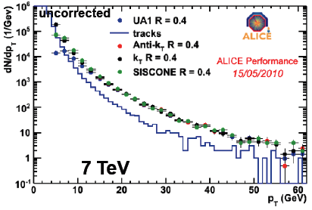
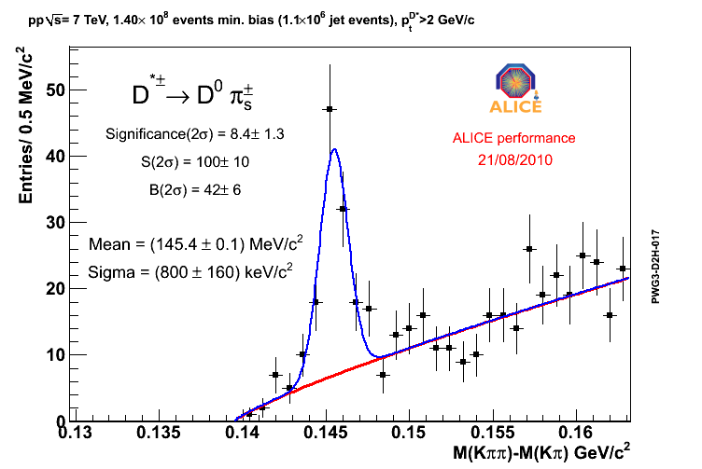
“D*⁺ in jet” analysis
A. Grelli, Proceedings of HQ2010
1.1M 7 TeV pp jet events
Charged track jets in |η| < 0.5
4 jet algorithms compared
Uncorrected spectra
UA1 jet reconstruction
  R_{cone size} = 0.4
  E_{thr} = 10 GeV
standard D*⁺ reconstruction
lower background
17

Slide 18
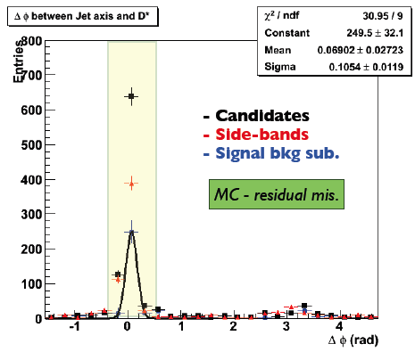
Δφ between leading particles and D*⁺
Full PYTHIA simulation, pp@10 TeV
gluon splitting +
flavor creation
Prove of principle
Needs more statistics and efficient trigger
18

Slide 19
Summary
Heavy quarks
  particularly good probes to study the properties of hot quark matter (especially the transport properties)
  abundantly produced at LHC energies
Jet-like correlations of heavy-flavor particles allow to study modification of fragmentation function in the medium
NLO processes (such as gluon splitting) become important: accessible via “charm content in jets” measurements
Many more to come!
19

Slide 20
Backup
20

Slide 21
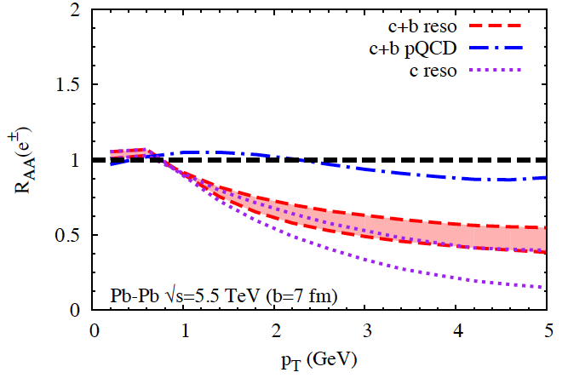
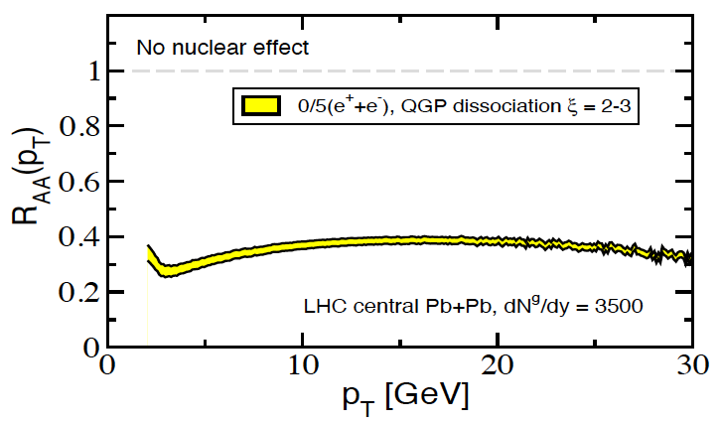
Single electron R_{AA} at LHC
Pyquen: Pb-Pb(5%) @ 5.5 TeV
T0 = 1 GeV
τ₀ = 0.15 fm/c
# quark flavors: 2
H. van Hees and R. Rapp, 2007
Pyquen
Pythia afterburner
Radiative (generalisation of BDMPS) and collisional energy loss (high-pT approximation)
I. Vitev, A. Adil & H. van Hees, 2007
21

Slide 22
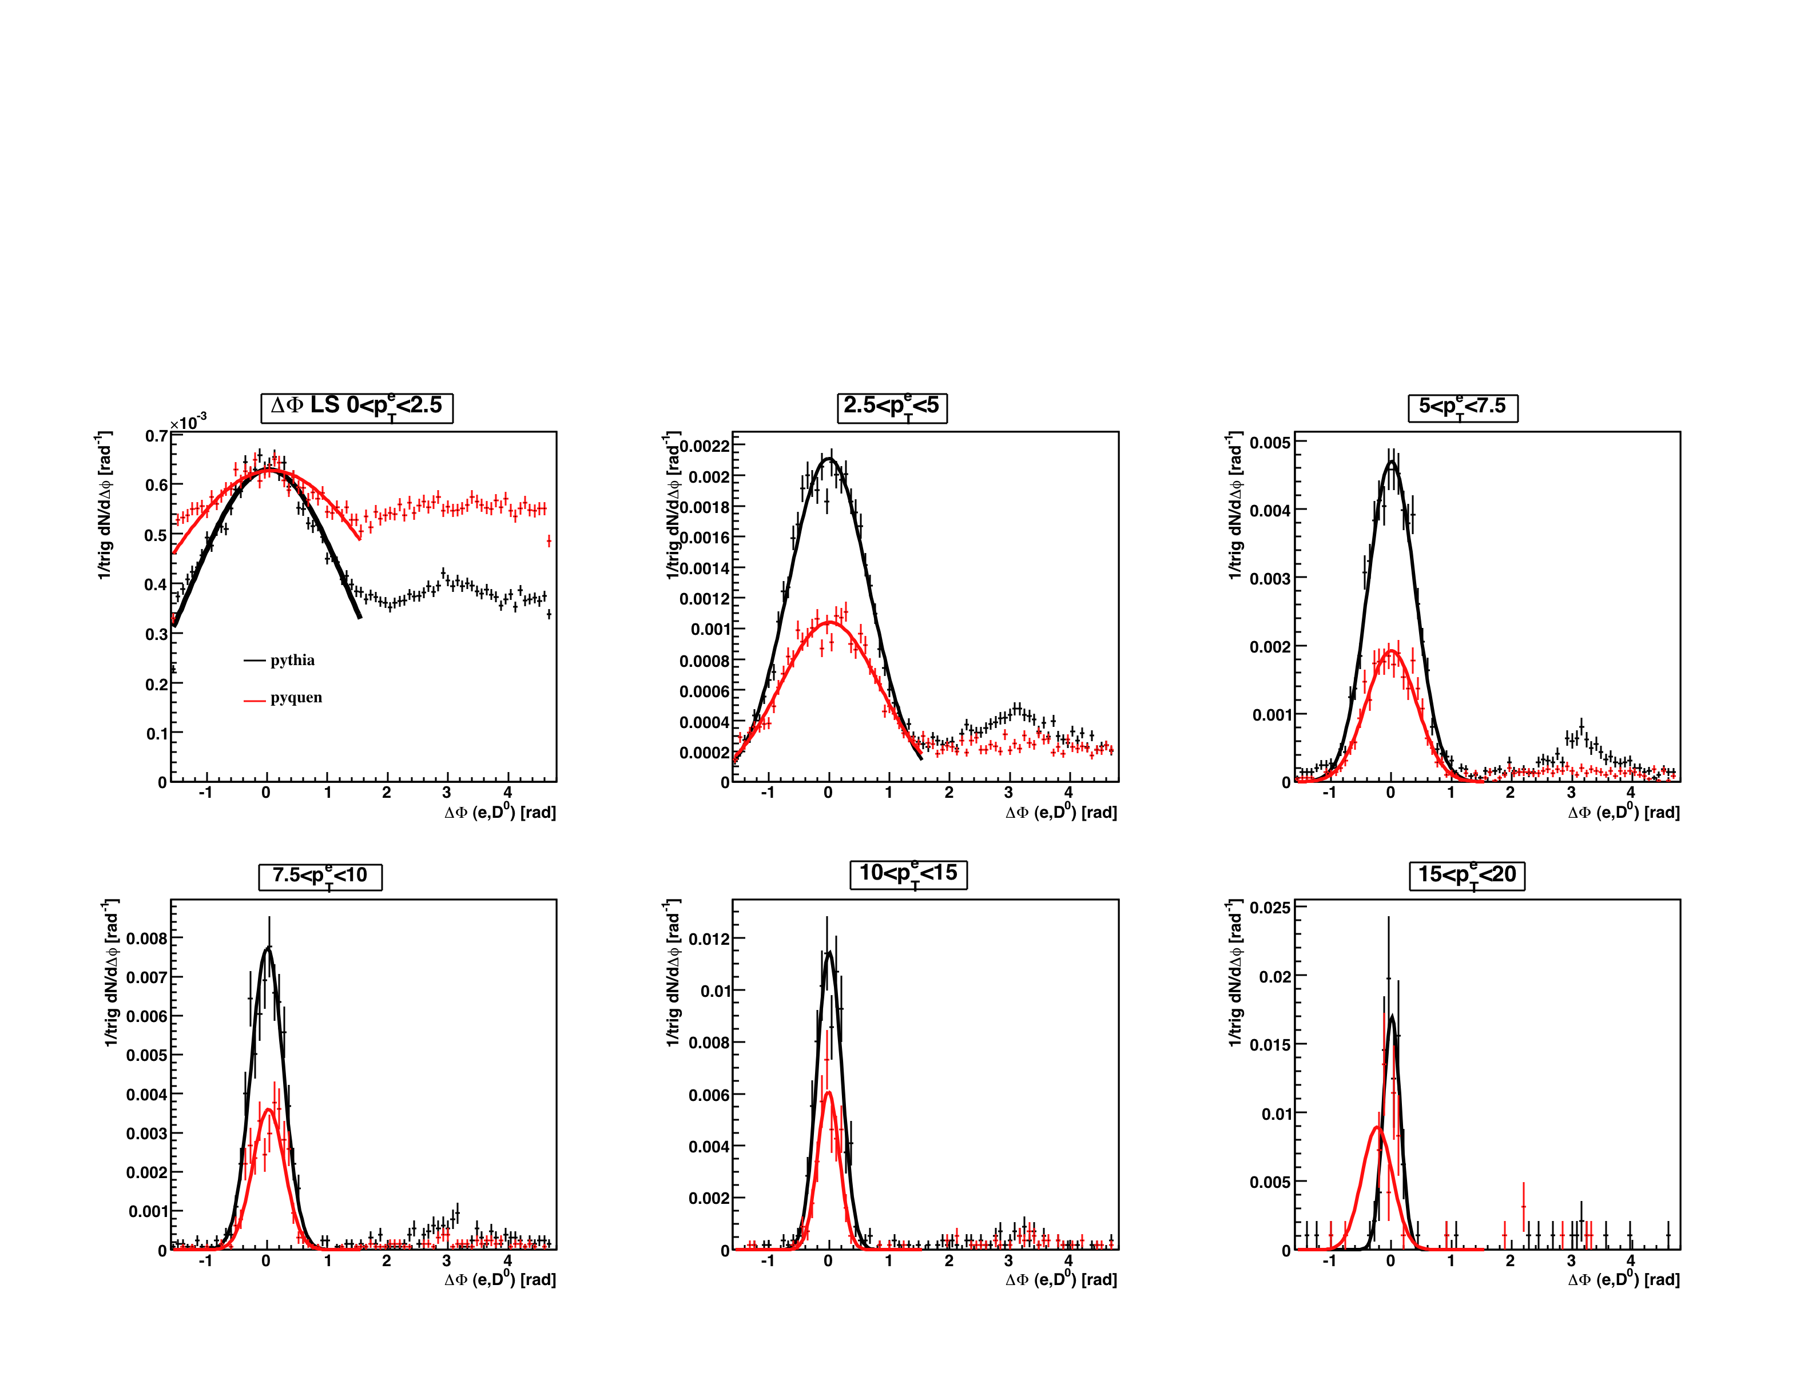
Δφ(e,D0) correlations for like-sign pairs
22

Slide 23
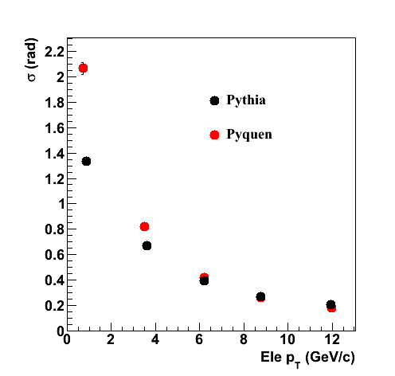
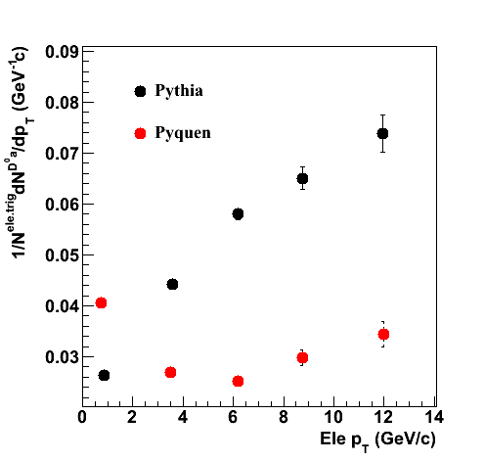
Near-side width and yield
23

Slide 24
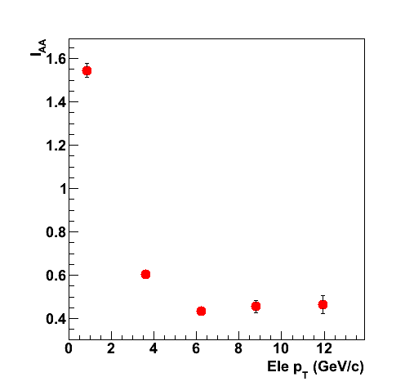
Near-side I_{AA}
24

Slide 25
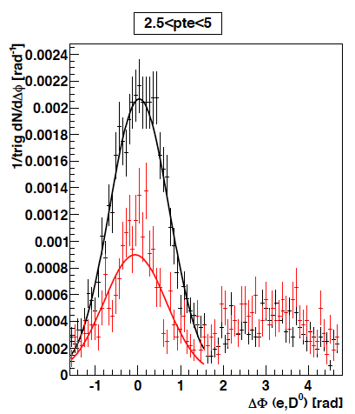
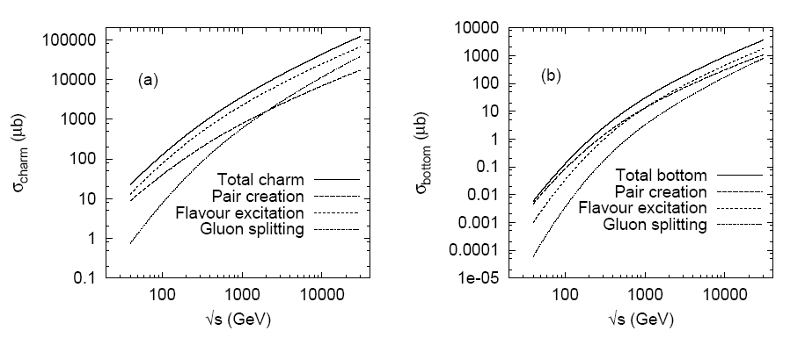
NLO processes
charm
GS charm + B decays
GS charm only
E. Norrbin and T. Sjostrand, Eur. Phys. J. C17, 137 (2000)
bottom
NLO processes (such as gluon splitting) become important at LHC
25

