Slide 1
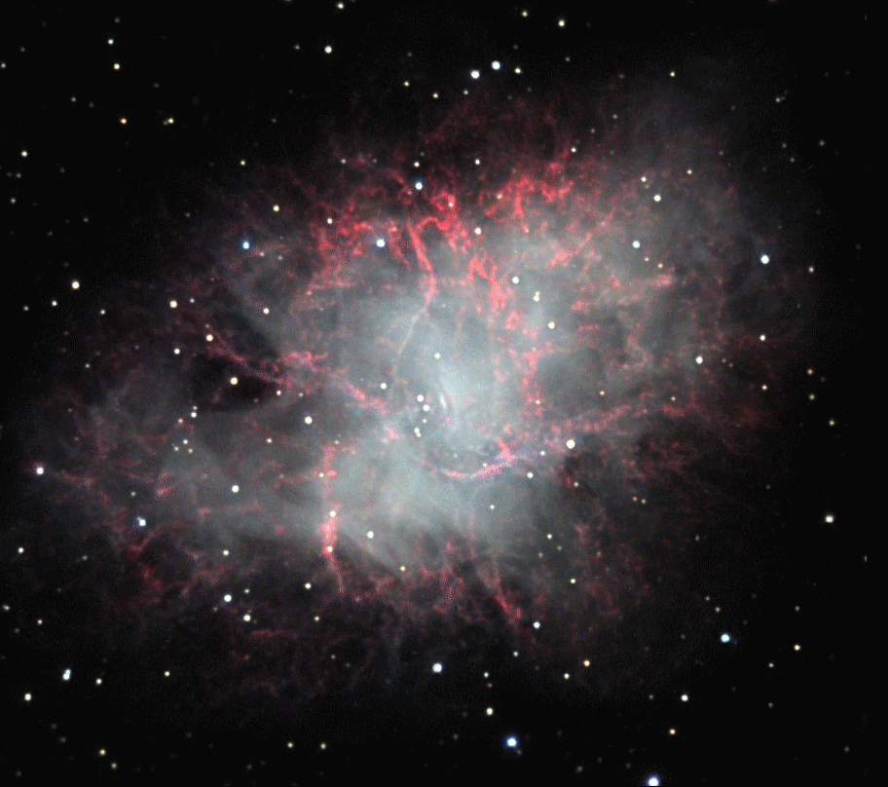
McGill University, June 13th 2017
"Constraining the Size of the Radio Counterpart
to the Repeating FRB 121102
Gregg Hallinan, Vikram Ravi
E-mail: gh@astro.caltech.edu

Slide 2
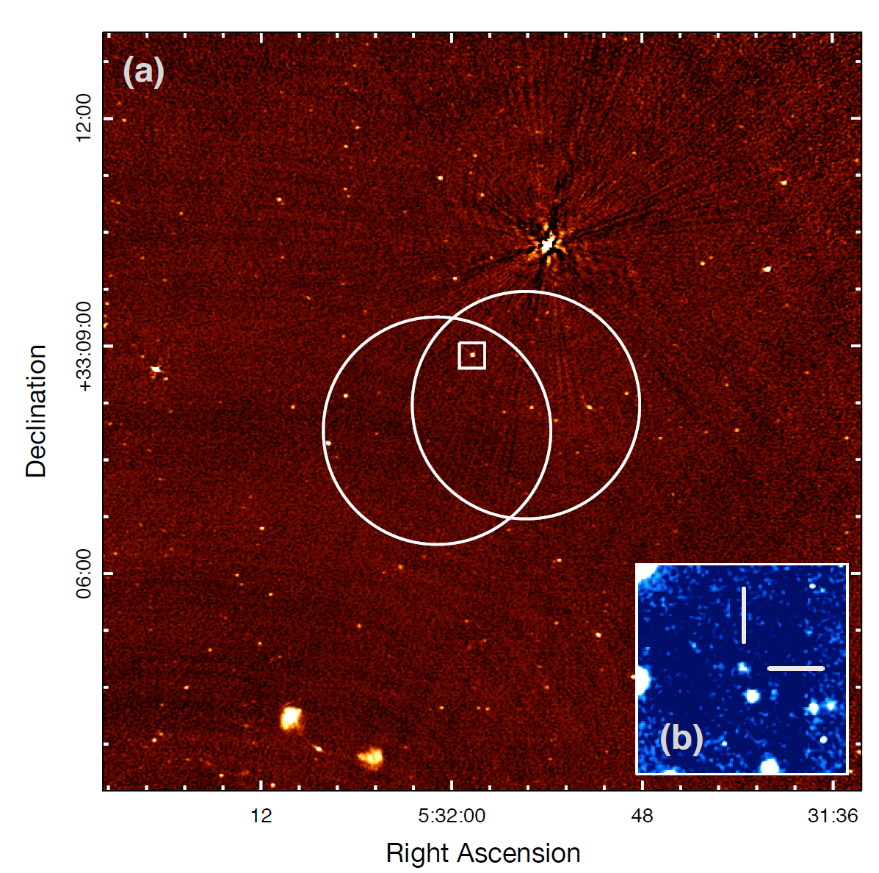
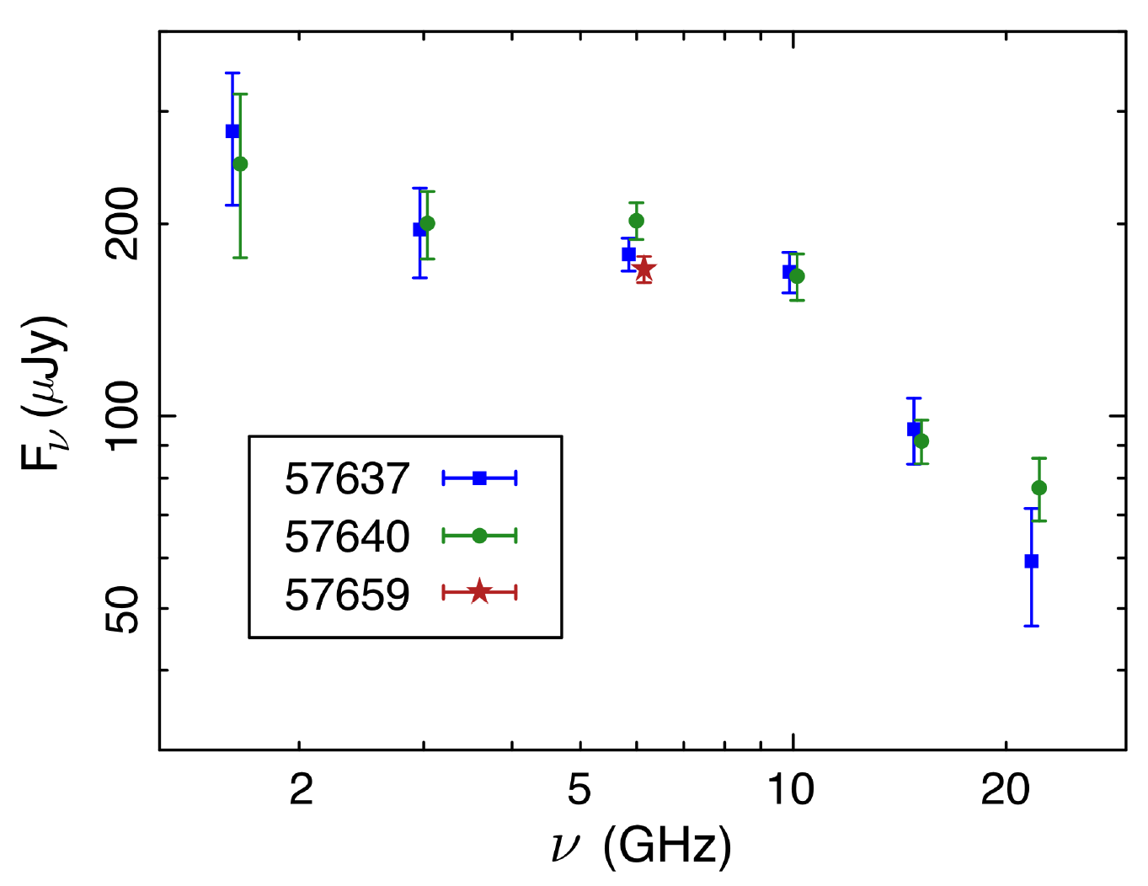
The Quiescent Radio Source Associated with FRB 121102
Chatterjee et al. 2017

Slide 3
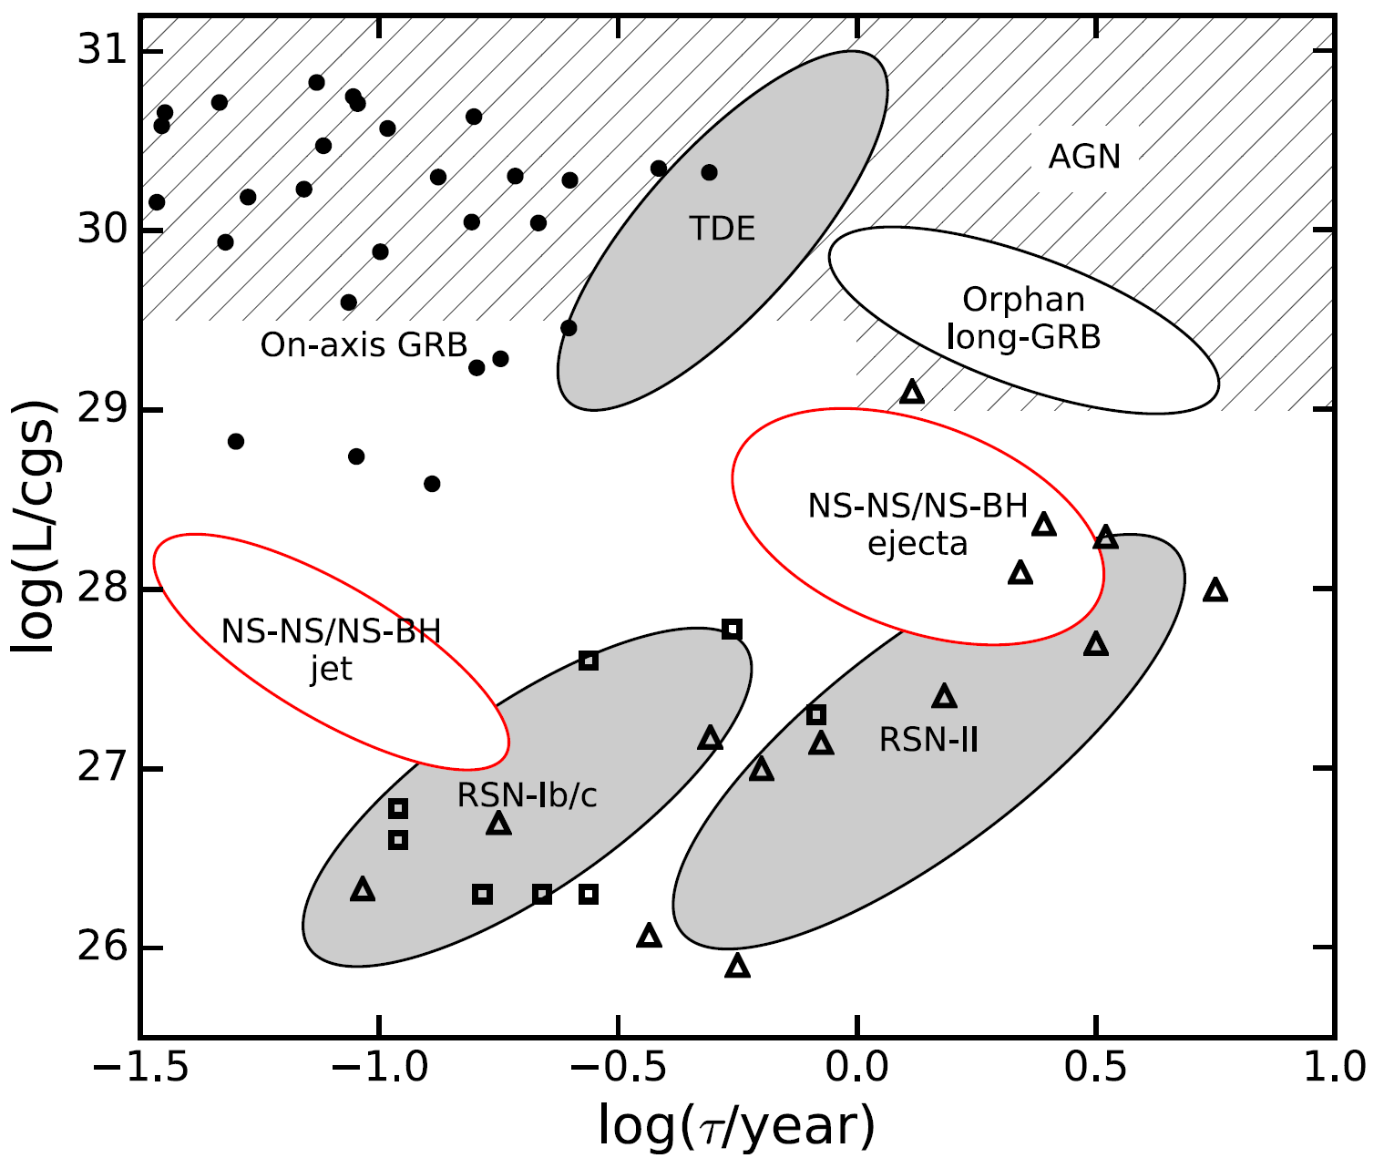
Adapted from Frail et al. 2012
Notes:
Filled cir-
cles, open triangles and squares repre-
sent detected on-axis GRBs, Type II
and Type Ib/c SNe respectively.

Slide 4
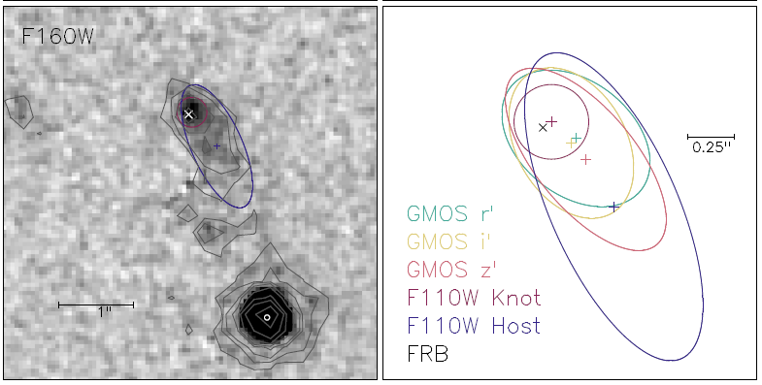
FRBs originate from a dwarf star-forming galaxy at z~0.19 (Tendulkar et al. 2017)
Radio source is offset from the light center of the galaxy (Tendulkar et al. 2017)
Co-located with FRBs to within ~40 pc (Marcote et al 2017)
Co-located with Hα emission (Bassa et al. 2017; Kokubo et al. 2017)
Bassa et al. 2017
Notes:
Filled cir-
cles, open triangles and squares repre-
sent detected on-axis GRBs, Type II
and Type Ib/c SNe respectively.

Slide 5
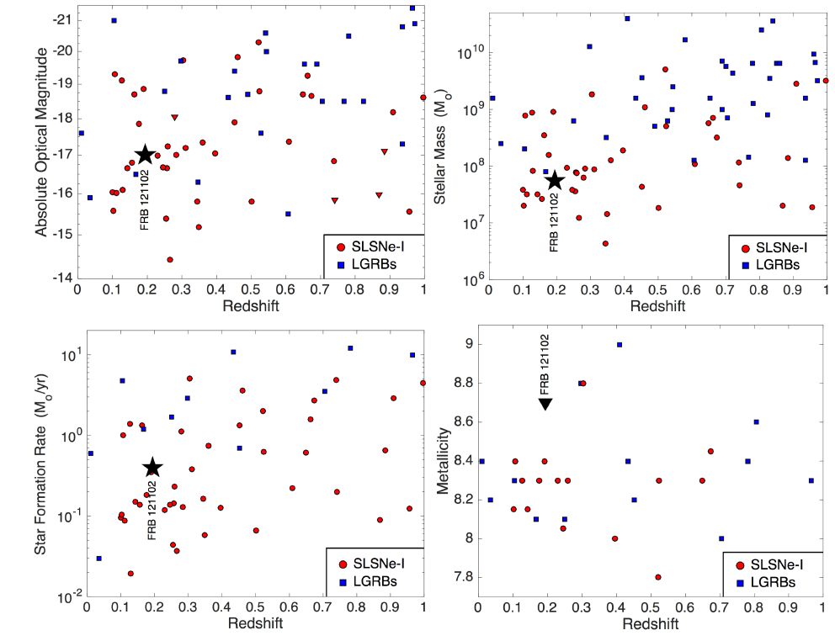
Both Tendulkar et al. 2017 and Marcote et al. 2017 note the similarity of the host galaxy to the hosts of long GRBs and SLSNe-1
Further developed by Metzger et al. 2017
Unified engine for LGRBs, SLSNe-1 and FRBs – a young rapidly spinning magnetar central engine
Various constraints suggest age of few decades to a century
Notes:
Filled cir-
cles, open triangles and squares repre-
sent detected on-axis GRBs, Type II
and Type Ib/c SNe respectively.

Slide 6
Interpreting the radio emission…
A plerion embedded in the supernova remnant, powered by the magnetar
Synchrotron emission from a shock formed at the interaction between the supernova ejecta and the circumstellar medium of the progenitor star
The late-time, off-axis afterglow of a jet launched at the time of formation of the magnetar
Model can be tested by constraining the radio emission source size
Differentiate between models – e.g. plerion/afterglow vs LLAGN
Constrain the age of a plerion/afterglow

Slide 7
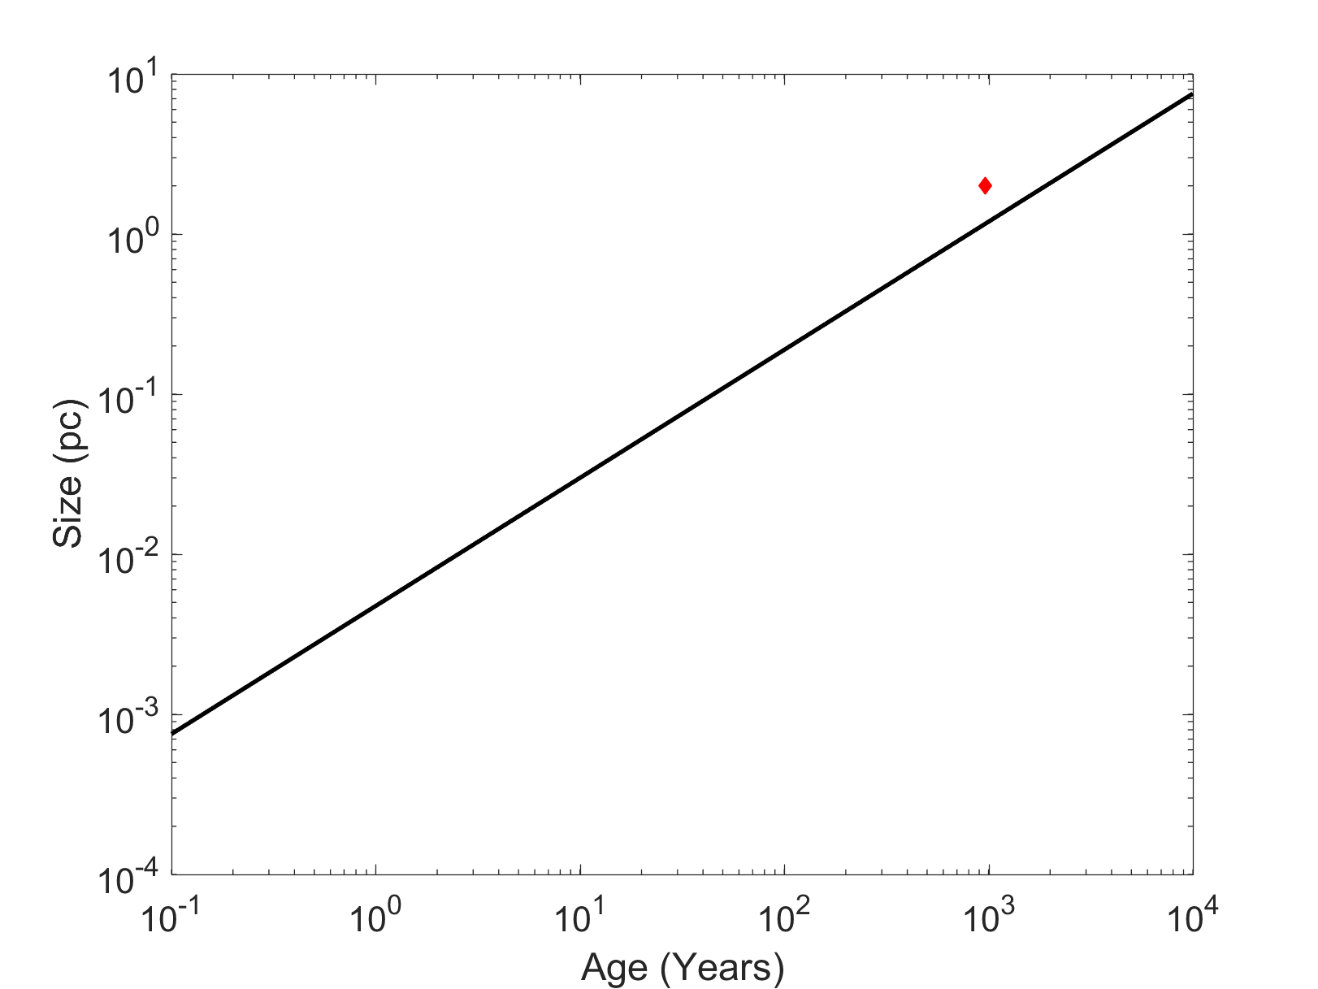
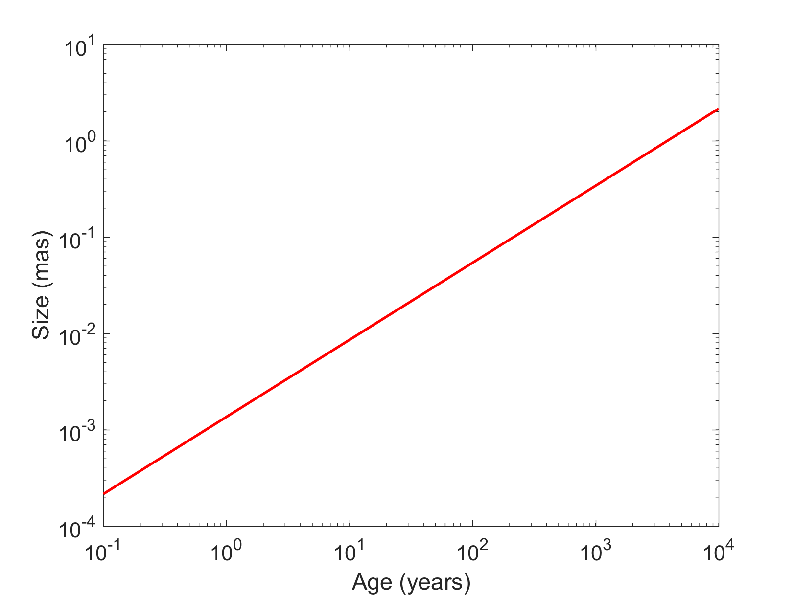
Expected growth of plerion/afterglow
Chevalier et al. 1977, Metzger et al. 2017
Crab plerion
Distance of FRB 121102
Notes:
Filled cir-
cles, open triangles and squares repre-
sent detected on-axis GRBs, Type II
and Type Ib/c SNe respectively.

Slide 8
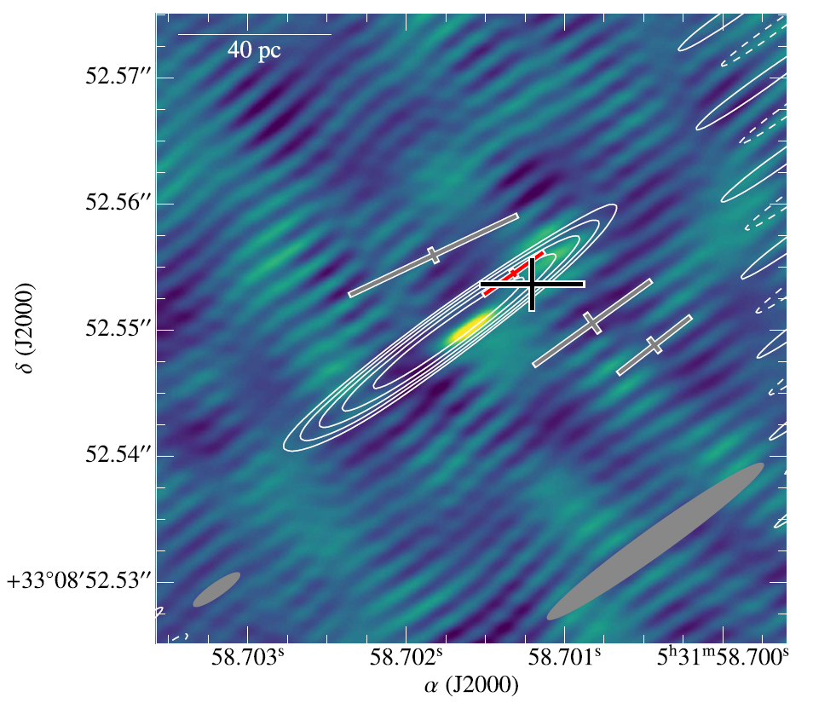
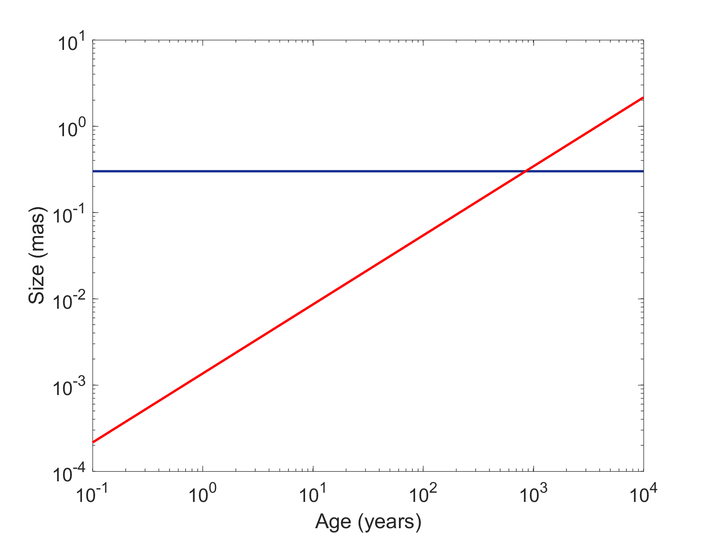
Limits from VLBI
0.2 mas
Marcote et al. 2017
Source resolved at ~2 mas at 1.7 GHz
<0.2 mas at 5 GHz
Notes:
Filled cir-
cles, open triangles and squares repre-
sent detected on-axis GRBs, Type II
and Type Ib/c SNe respectively.

Slide 9
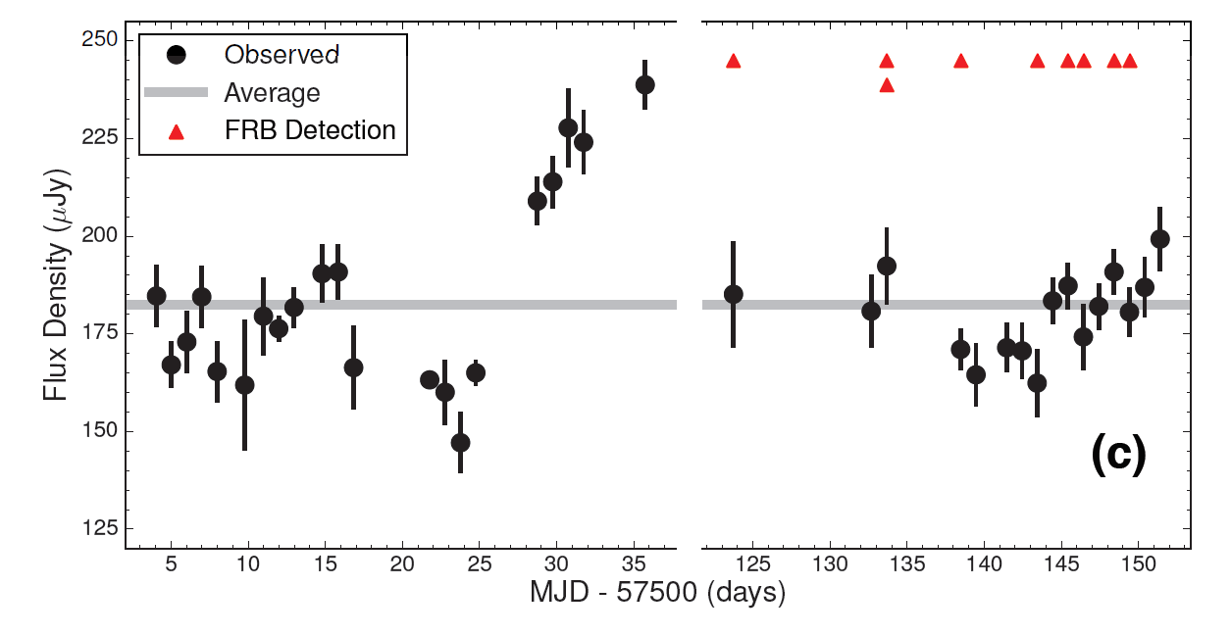
Refractive Scintillation
Source exhibits variability in the 3 GHz light curve
Both variability modulation index and time scale is consistent with refractive scintillation
Confirmed by the VLBI resolving the scattering disk
Notes:
Filled cir-
cles, open triangles and squares repre-
sent detected on-axis GRBs, Type II
and Type Ib/c SNe respectively.

Slide 10
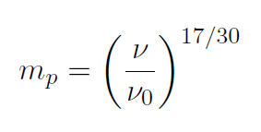
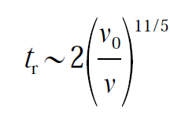
Refractive Scintillation
ν₀ = transition frequency between strong and weak scattering >38 GHz (NE2001)
Θ_{s} ∝ ν^{-11/5}
Scattering Disk size
Modulation index
Refractive Timescale (hours)
Walker et al. 1998
See also Waxman et al. 2017
Notes:
Filled cir-
cles, open triangles and squares repre-
sent detected on-axis GRBs, Type II
and Type Ib/c SNe respectively.

Slide 11
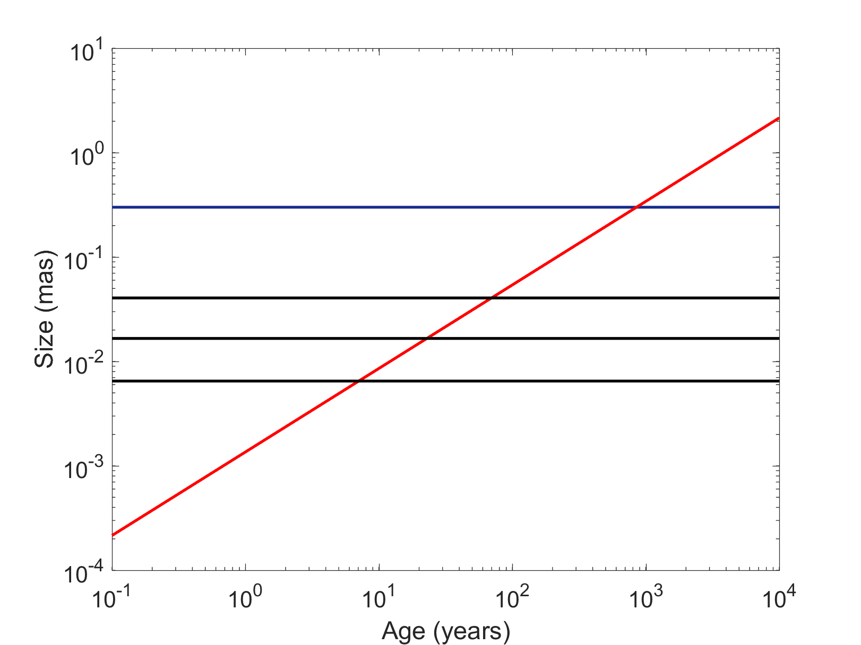
VLA Program
Observations at X band (8-12 GHz), Ku band (12-18 GHz) and K band (18-26 GHz)
Originally scheduled for D->C reconfiguration (May 15-25)
Moved to C configuration – ongoing!
3 Ku band epochs completed on June 8th, 10th and 11th
VLBI
X band
Ku band
K band
Notes:
Filled cir-
cles, open triangles and squares repre-
sent detected on-axis GRBs, Type II
and Type Ib/c SNe respectively.

Slide 12
Strategy
Interleave 2 gain calibrators to assess temporal stability
Use bright in-beam source to directly constrain flux of target
Notes:
Filled cir-
cles, open triangles and squares repre-
sent detected on-axis GRBs, Type II
and Type Ib/c SNe respectively.

Slide 13
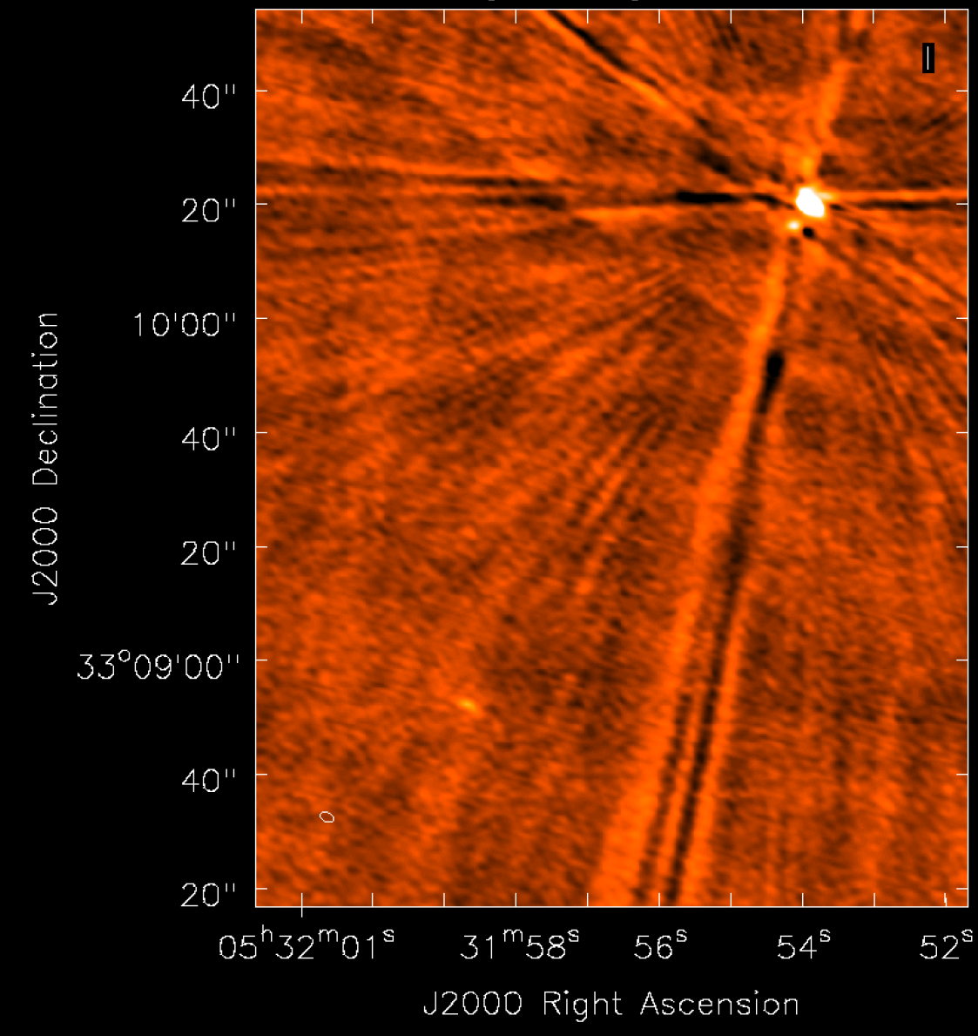
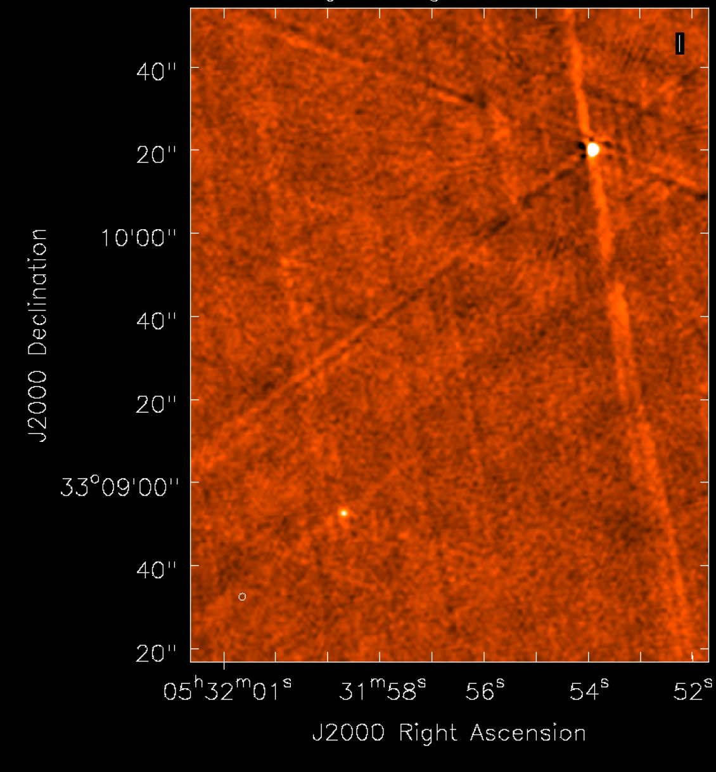
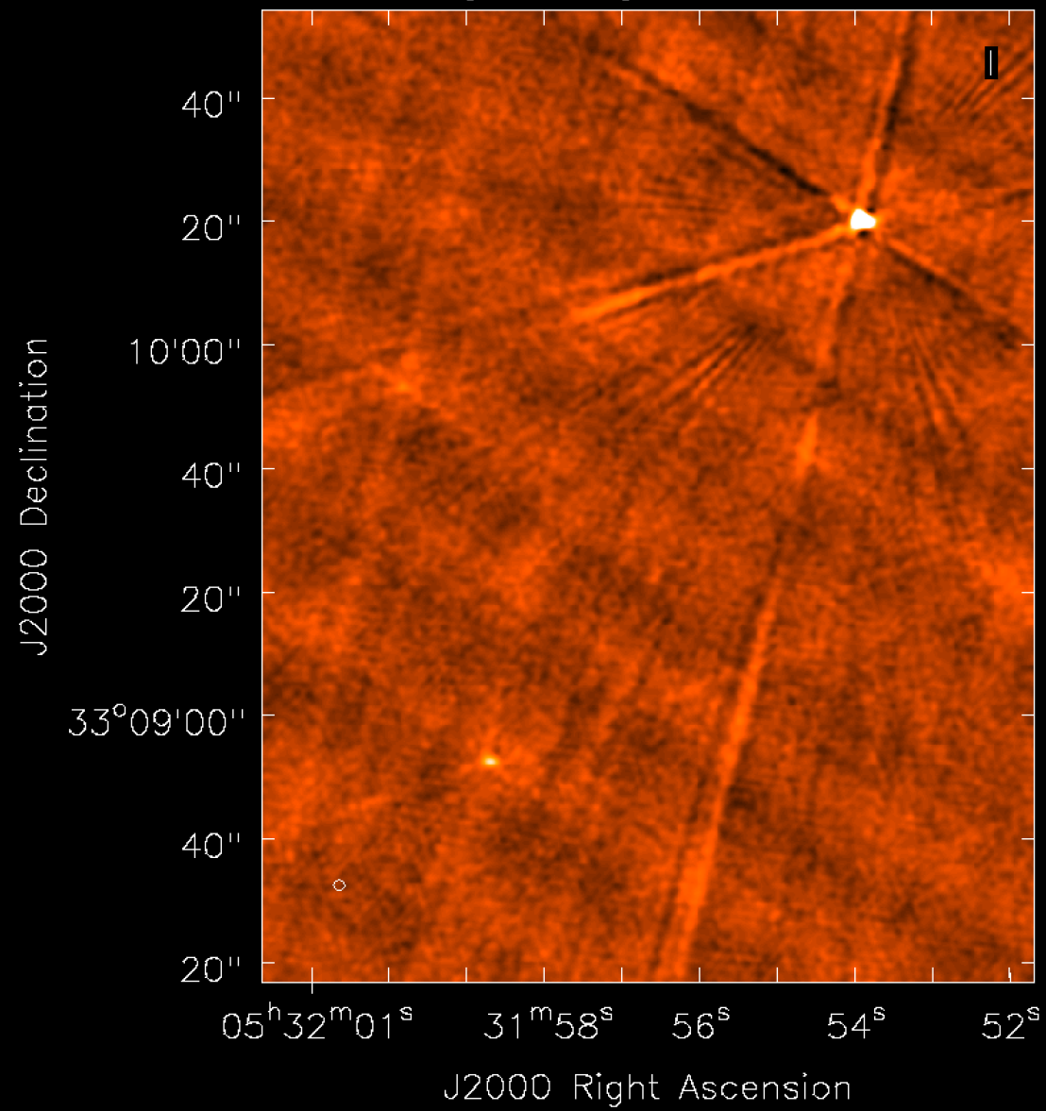
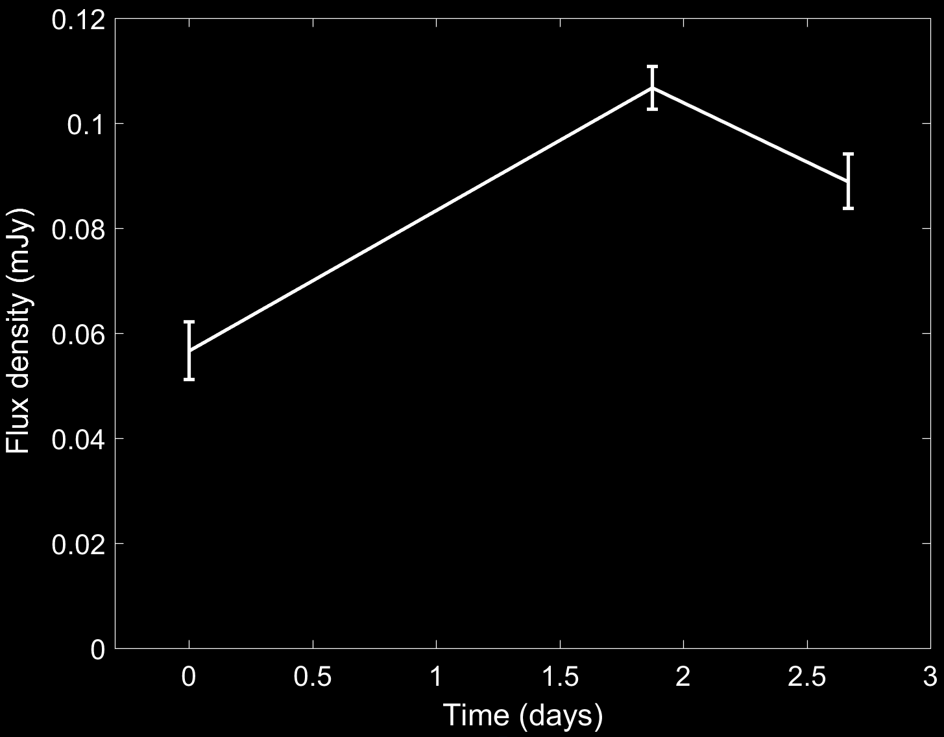
June 8th
June 10th
June 11th
Very preliminary…
To be taken with a very large grain of salt!

Slide 14
Summary
Constraining the size of the quiescent radio source associated with FRB 121102 is a powerful tool for distinguishing and constraining models
Refractive scintillation may be key
Observations underway from 8-25 GHz
Notes:
Filled cir-
cles, open triangles and squares repre-
sent detected on-axis GRBs, Type II
and Type Ib/c SNe respectively.

