Slide 1
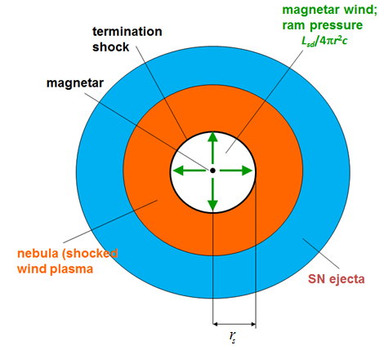
Model for FRB
At the onset of the burst, a strong magnetic perturbation produces MHD waves, which open the magnetosphere sweeping the magnetic field lines into a narrow pulse, l~r*, propagating outwards through the magnetized magnetar wind. FRB is generated when the pulse reaches the magnetar wind nebula.
The EM pulse pushes the plasma outwards like a magnetic piston.
nebula
e⁺ e⁻ B
ε=3p
The observed duration of the flare
cd
The synchrotron maser emission from the forward shock at the frequencies
reverse shock
forward shock
For the maser efficiency η, the energy the radio pulse

Slide 2
Downstream of the reverse shock
nebula
e⁺ e⁻ B
ε=3p
The maser emission at
cd
The e-m pulse picks up magnetospheric plasma and delivers it to the wind termination shock.
reverse shock
forward shock
Within the nebula, most of the particles find themselves at low energies whereas most of the energy is carried by particles with γ_{Ε}∼10⁴−10⁶. At the forward shock, they take all the energy of the pulse.
The energy of the pulse is emitted at the forward shock in UHE band

