Slide 1
Relativistic collisionless reconnection in electron-ion plasmas
Results from recent PIC simulations
Greg Werner
Dmitri Uzdensky
Jake Fish
Mitchell Begelman
Krzysztof Nalewajko
Benoît Cerutti
University of Colorado
JILA (Colorado)
NIST (Colorado)
Copernicus Astronomical Center
University of Grenoble
CNRS

Slide 2
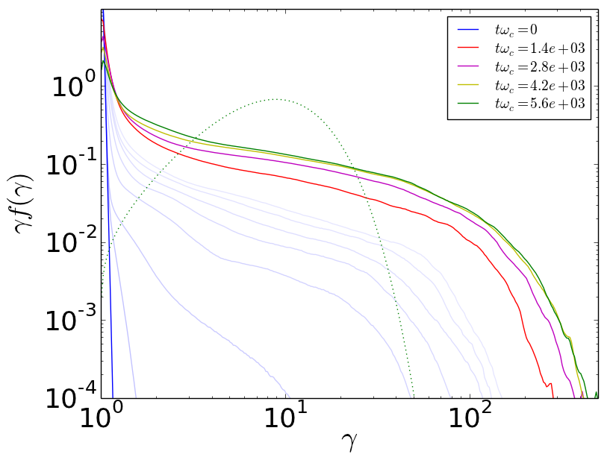
Relativistic pair (e⁻/e⁺) reconnection yields nonthermal particle acceleration
In the last few years, several groups have found nonthermal acceleration in electron/positron reconnection simulations (Sironi & Spitkovsky, 2014; Guo et al, 2014; Werner et al 2016).
Electron/positron makes for the easiest simulation, and is relevant, e.g., to PWNe.
slope = -p+1
high-energy cutoff

Slide 3
What about relativistic electron/proton(ion) reconnection?
Relativistic e/i reconnection is relevant to various astrophysical applications, possibly including accretion disc coronae of black holes, AGN jets, blazars...
Relativistic e/i reconnection studies bridge the recent work on relativistic pair reconnection and (the majority of reconnection research) work on non-relativistic e/i reconnection.
This presentation: start from relativistic pair reconnection, work toward non-relativistic e/i reconnection.

Slide 4
e/i reconnection: focus on mass ratio and (upstream) sigma
mass ratio M=m_{i}/m_{e}=1836
(upstream, cold) magnetization sigma:
scale of average ion energy gain relative to rest mass energy; i.e., how relativistic a typical ion is
scale of average electron energy gain (assuming relativistic electrons)
upstream density of electrons, ions
Importance of sigma parameters:
they set scale of “average” energy gain per particle;
they determine how relativistic particles are;
they determine length scales of “average” Larmor radius.
Therefore, we define a useful length scale:
In this talk, all lengths scale with ρ_{c} — hence with σ_{i}.

Slide 5
Varying σ_{i} controls the effect of m_{i}/m_{e}
When σ_{i} >> 1, ions are ultrarelativistic and follow the same trajectories as positrons with the same energy/particle (as long as radiation is irrelevant). In this regime e/i and pair reconnection are the same.
As σ_{i} decreases, ions become less relativistic; the ion rest mass becomes more important, and the typical ion Larmor radius becomes larger than the typical electron Larmor radius.
(Note: Jake Fish is currently exploring relativistic reconnection in situations where radiation is non-negligible, in the sense that it slows/cools high-energy electrons/positrons.)

Slide 6
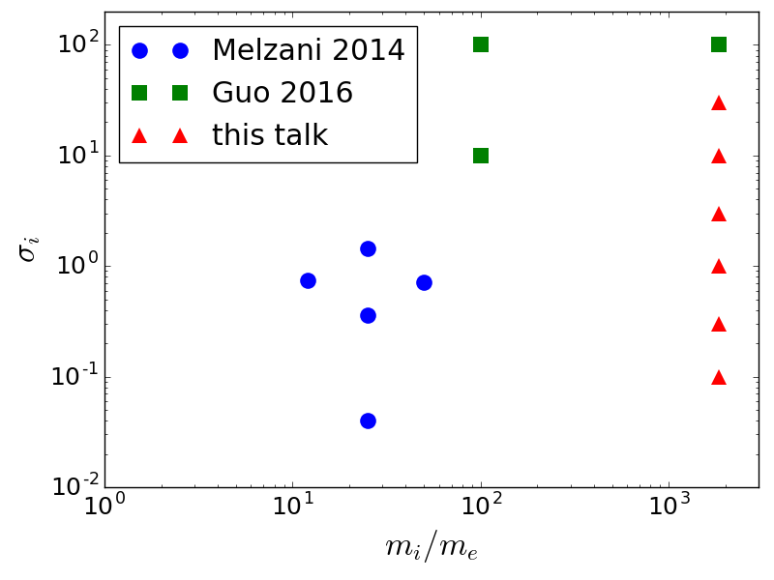
This talk: reconnection with relativistic electrons and sub/trans/very relativistic ions
PIC simulations of relativistic e/i reconnection
relativistic pair reconnection
relativistic
ions
non-relativistic
ions
σ_{e}>1: relativistic electrons
σ_{e}<1: non-rel elec.
easier computation
non-relativistic
e/i reconnection

Slide 7
A measure of bulk relativistic-ness: σ_{hot}
“hot sigma”: scale of energy gain per particle relative to h, enthalpy per particle – i.e., relative to a particle’s rest-mass plus its thermal energy.
For this slide: 1=3/2=3
When σ_{hot}>>1, we expect not only relativistic individual particle motion, but also relativistic bulk outflows from reconnection.
(A reminder of cold sigma definitions)

Slide 8
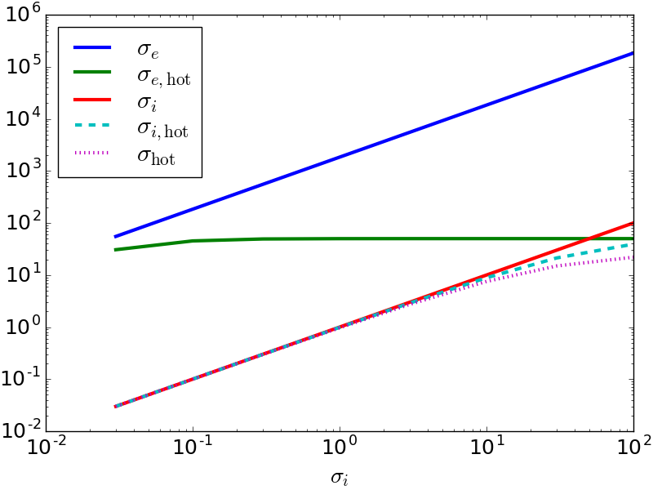
This work varies σ_{i}. Other σ-quantities vary in this way:
choose σ_{e,hot} ≈ 50: i.e., T_{b}~σ_{i}

Slide 9
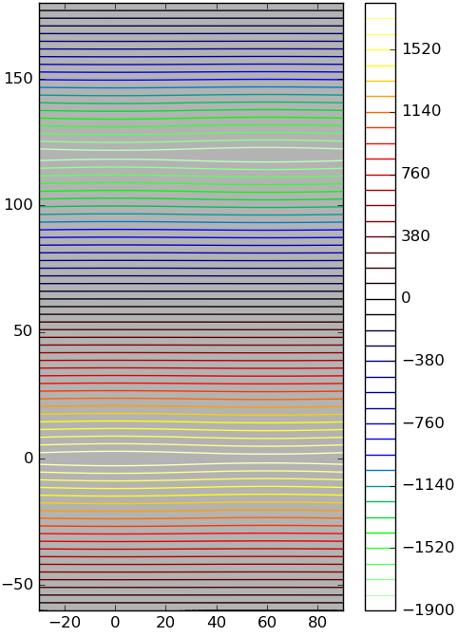
PIC Simulation allows self-consistent simulation or reconnection including kinetic effects
Start with “Double periodic” box,
with 2 (Harris) current sheets (layers) plus uniform background plasma.
Zero guide field (B_{z} = 0 for this talk).
Vorpal/VSim
using explicit, EM-PIC solver
distributed by Tech-X Corp.
-J_{z}
Lengths scale with ρ_{c}:
L_{x}=120ρ_{c}
L_{y}=2L_{x}
y/ρ_{c}
B₀
J_{z}
◉
◉
◉
◉
◉
◉
◉
x/ρ_{c}

Slide 10
Other simulation parameters
Common aspects of simulations:
B₀ = 17 G
B_{z} = 0
m_{e}= electron mass
m_{i}= proton mass
n_{b}/n_{d} = 0.5
= background/layer density
β_{d} = 0.3
= drift layer speed/c
T_{de} = T_{di}=T_{d}
= drift layer temperature
T_{be} = T_{bi} = σ_{e}m_{e}c²/200
= background temperature
1% perturbation of B very gently starts reconnection.
(subscript d = drift particles that form current layer
subscript b = uniform background density)

Slide 11
B evolution vs. σ_{i}
σ_{i}=0.1
σ_{i}=10

Slide 12
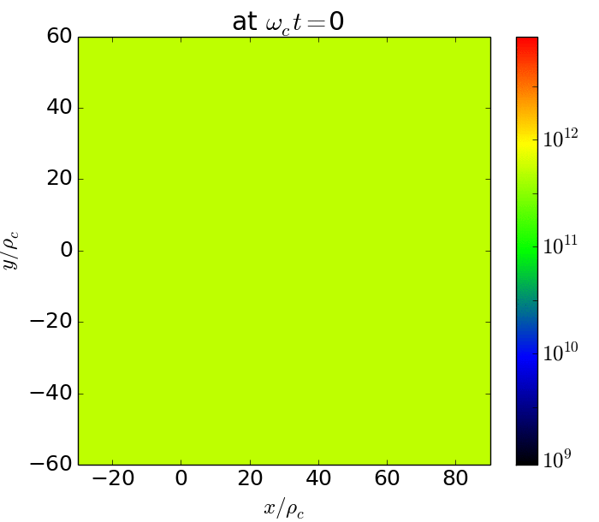
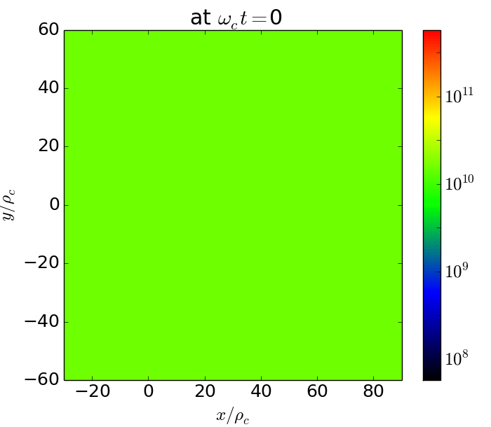
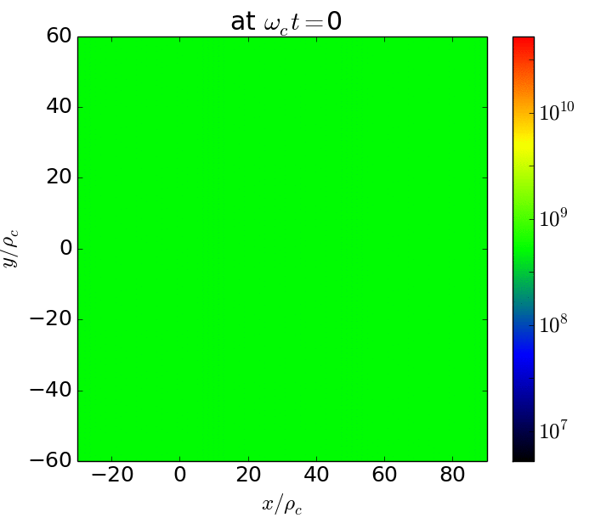
Density evolution vs. σ_{i}
(background) electron density vs. time.
σ_{i} =0.03
σ_{i} =1
σ_{i} =30

Slide 13
Next several slides: comparing σ_{i}=0.1 and σ_{i}=10
Displayed are various quantities vs. x and y, after ~1/2 of flux has reconnected.
At this time (roughly midway through reconnection), the initially-drifting particles have been swept out of X-points into O-points.

Slide 14
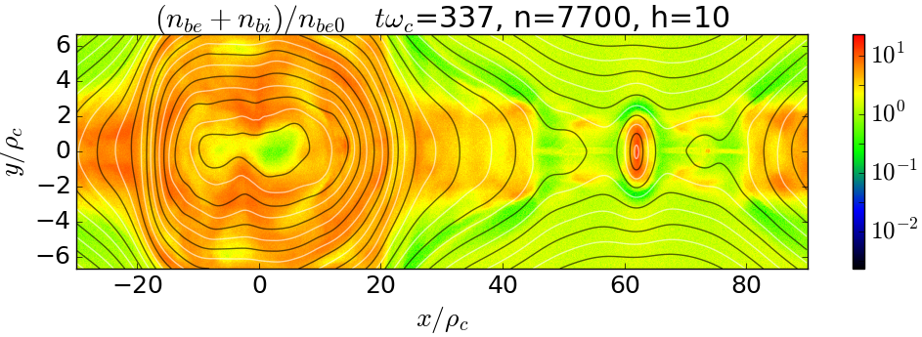
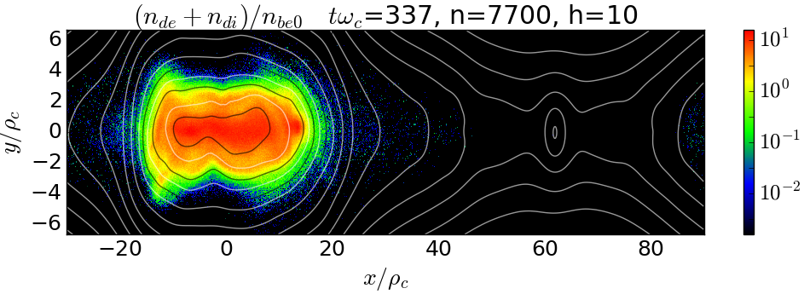
Drift particles have left X-point regions
σ_{i}=0.1
Background plasma density
(initially uniform across simulation)
(normalized to ρ_{c})
Drifting plasma density
(that formed initial Harris layer)

Slide 15
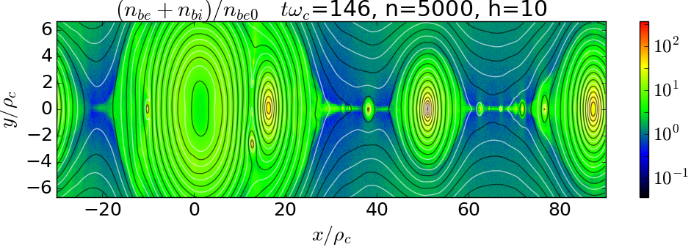
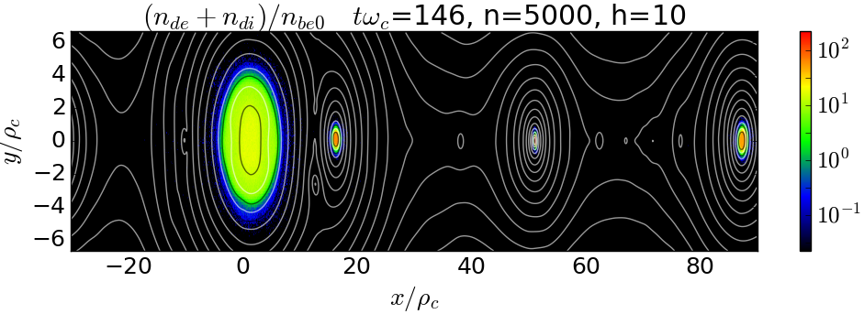
Drift particles have left X-point regions
σ_{i}=10
Background plasma density
(initially uniform across simulation)
Drifting plasma density
(that formed initial Harris layer)

Slide 16
The current layer size shrinks (rel. to ρ_{c}) as σ_{i} increases.
J_{z}: out-of-plane current.
σ_{i}=0.1
σ_{i}=10

Slide 17
Current separation/Hall effect weakens as σ_{i} increases
B_{z}: out-of-plane magnetic field
σ_{i}=0.1
σ_{i}=10

Slide 18
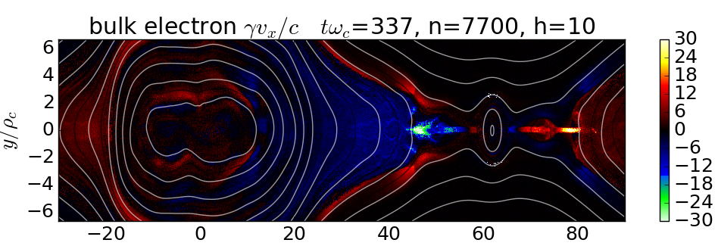
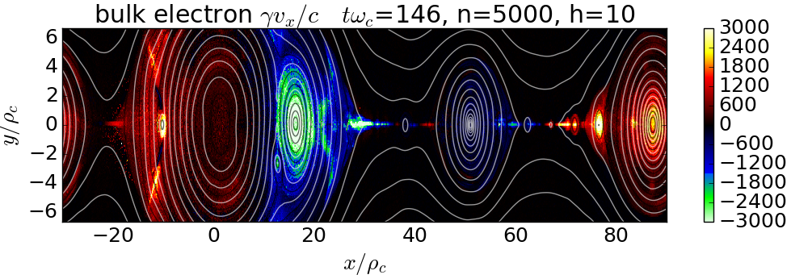
Electron outflows are relativistic even for small σ_{i}
for background-electrons
σ_{i}=0.1
σ_{e,hot}=50
σ_{i}=10
σ_{e,hot}=50

Slide 19
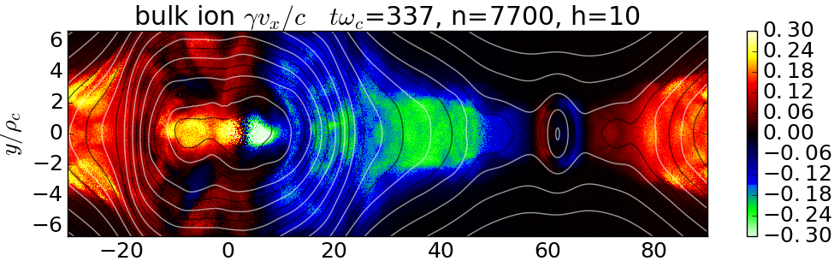
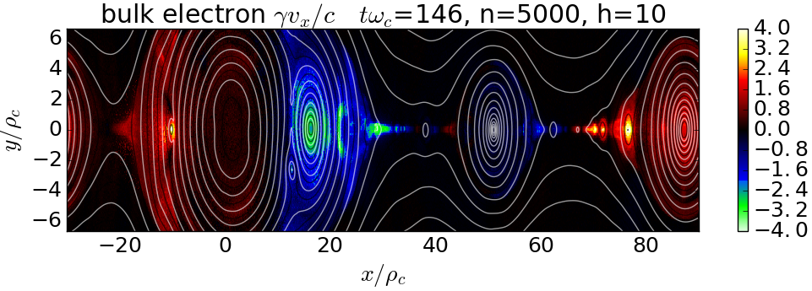
Ion outflows are sub-relativistic for small σ_{i}
for background-ions
σ_{i}=0.1
σ_{i,hot}=0.1
σ_{i}=10
σ_{i,hot}=8
bulk ion

Slide 20
Next several slides: summary of variation with σ_{i}

Slide 21
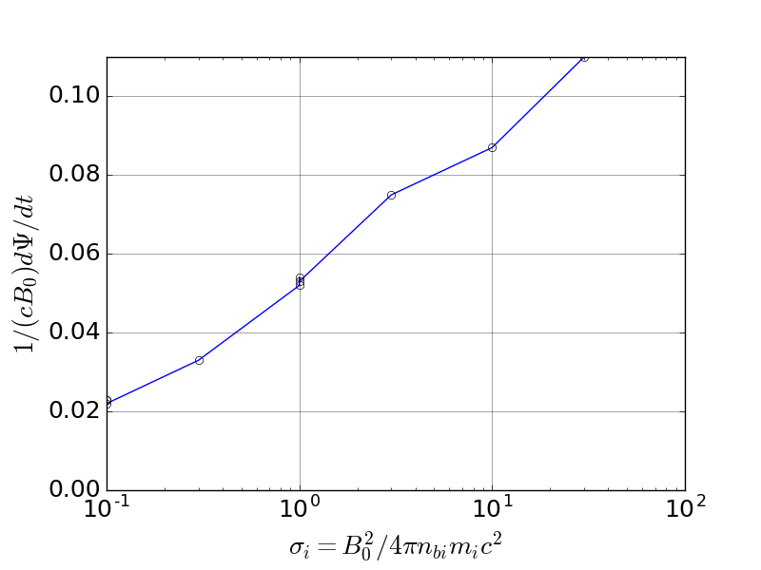
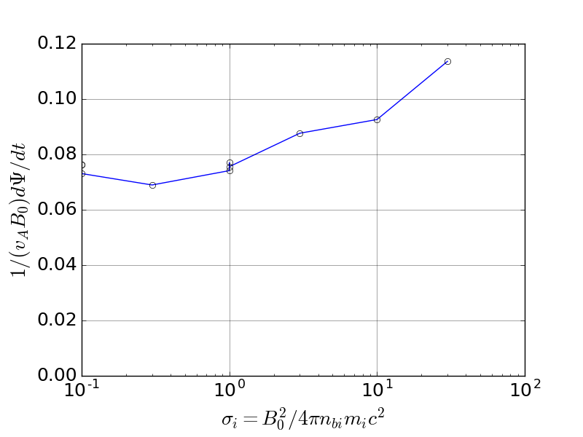
Reconnection rate increases with σ_{i}
Absolute rate of flux reconnection goes down as σ_{i} decreases.
But normalized reconnection rate is roughly independent of σ_{i}
Rate, relative to the Alfven velocity remains around 0.1 (as σ_{i} varies over a few orders of magnitude).

Slide 22
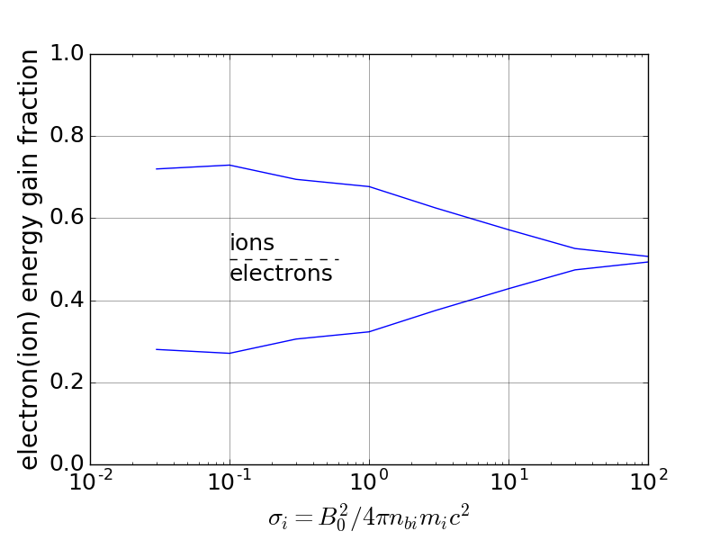
Ions gain more energy than electrons
At low σ_{i} ions gain about 2/3 of the dissipated magnetic energy, electrons 1/3;
At high σ_{i} (of course), electrons and ions are nearly identical.

Slide 23
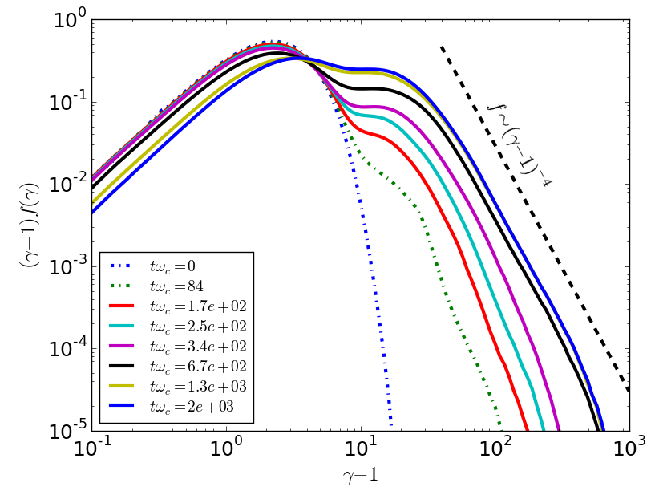
Nonthermal (power-law) electron acceleration even for σ_{i}<1 and σ_{hot}<1 (but σ_{e,hot}>1)
Evolution of background electron spectrum vs. time
σ_{i} = 0.1
σ_{hot} ≈ σ_{i,hot} ≈ 0.1
σ_{e} = 183.6
σ_{e,hot} ≈ 50

Slide 24
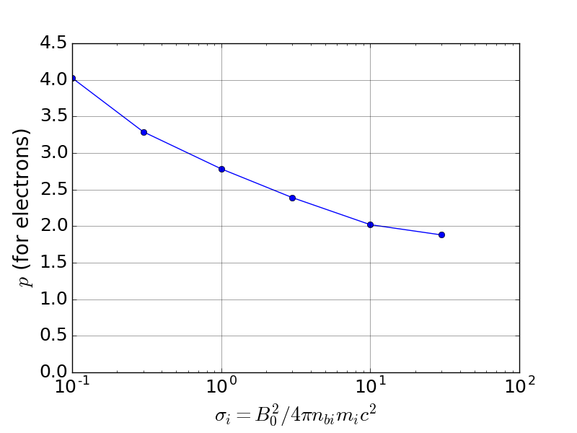
Larger σ_{i} yields harder (electron) power law
Note: With e⁻/e⁺ reconnection p~1 for large σ_{hot}. However, p~3 is possible only for small σ_{hot}. With e/i reconnection we can obtain p~3 with larger σ_{e,hot} but smaller σ_{i,hot}.

Slide 25
Conclusions
Relativistic e/i reconnection is the same as pair reconnection when ions are highly relativistic (σ_{i}>>1) and radiation is negligible.
(For σ_{i} not too small) we simulated a realistic mass ratio, m_{i}/m_{e} = 1836.
As ions become less relativistic, their Larmor radii become large (compared to electrons’) and charge separation increases:
reconnection (the rate of flux reconnection) slows;
structures (e.g., current layer) increase in size;
corresponding effects (e.g., Hall quadrupole field, in-plane electric field).
Modest σ_{i,hot} ~ 1 can result in
significant acceleration of electrons (σ_{e,hot} >> 1) to a nonthermal power law
relativistic electron outflows
Decreasing σ_{i} steepens the electron power law, even while σ_{e,hot} remains constant.
Possibly important consequence for systems with significant relativistic acceleration, σ_{e,hot} >> 1:
In this case, pair reconnection yields hard power laws, p approaching 1.
However, e/i reconnection can explain a range of p > 1.

