Slide 1
Stability of Astrophysical Jets – Steps Towards Greater Realism
By
Dinshaw S. Balsara and Jinho Kim (Univ. of Notre Dame)
(dbalsara@nd.edu; jkim46@nd.edu)
Maxim Lyutikov (Purdue University)
Serguei Komissarov (University of Leeds)

Slide 2
Plan of the Talk:-
Introduction
Setting up the Problem – The Need for Greater Realism
Stability of Current-Sheet Free Jets with Top Hat Velocity Profile
Stability of Current-Sheet Free Jets with Sheared Velocity Profile
Conclusions

Slide 3
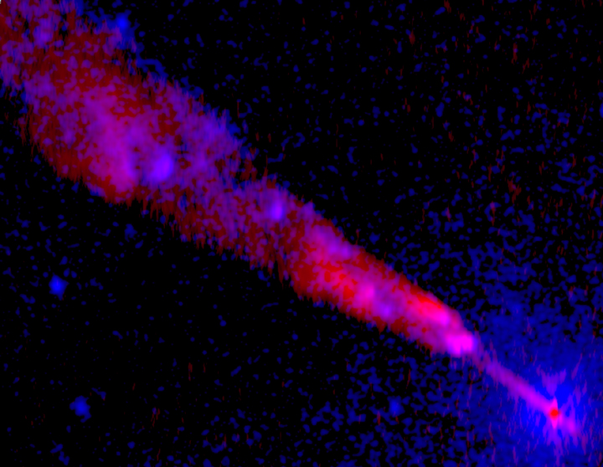
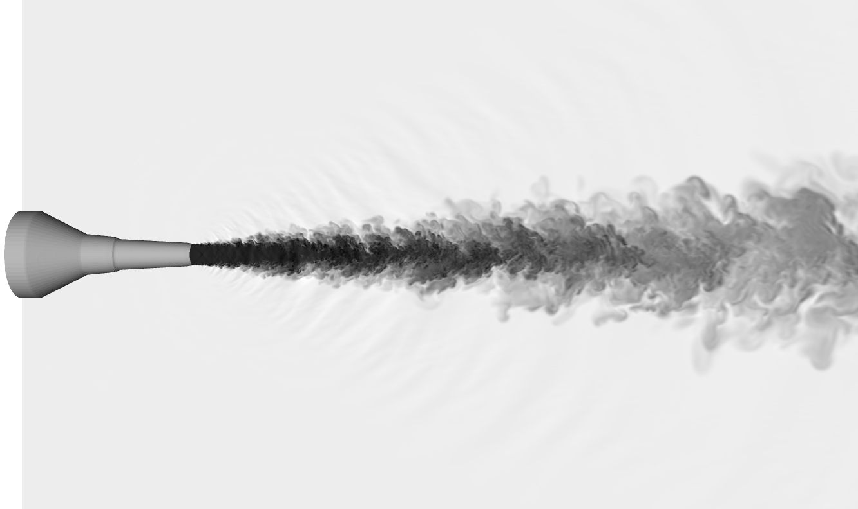
I) Introduction
Extragalactic; Protostellar; X-Ray Binaries; GRB all show evidence of jets
Amazingly stable – Jets propagate thousands to millions of jet radii.
Laboratory jet – destabilizes in ~20 jet radii
Cen A, Astrophysical jet – very stable

Slide 4
Possible Reasons for the Improved Stability of Astrophysical Jets:-
Effect of Environment (Porth & Komissarov 2015)
Magnetic Fields – Current Sheet Free Jets (Gourgouliatos et al. 2012)
Sheared Velocity Profile (Mizuno, Lyubarsky et al. 2012)
Realization that greater level of realism is needed in Stability Studies.
Older studies of jet stability did not include these effects; Why?
If some of these effects were included, other simplifying assumptions had to be made.
Eg. Zero pressure; Simple magnetic field geometry.
Simplifications were introduced because there was a great desire to use analytical functions, like Bessel functions, to carry out the stability analysis.
Goal Of This Study:- Include realistic magnetic-fields; realistic Shear; Non-Zero Pressure; Go beyond Analytic functions

Slide 5
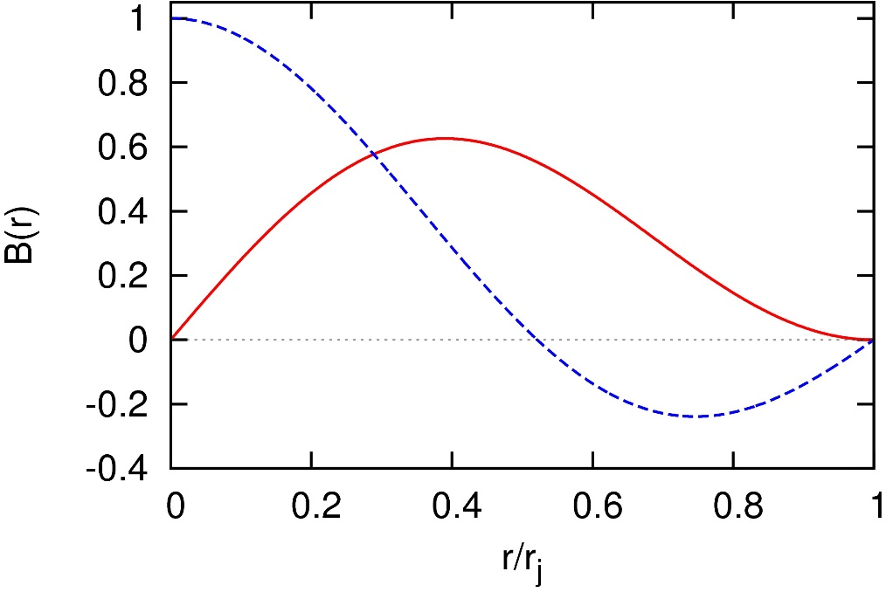
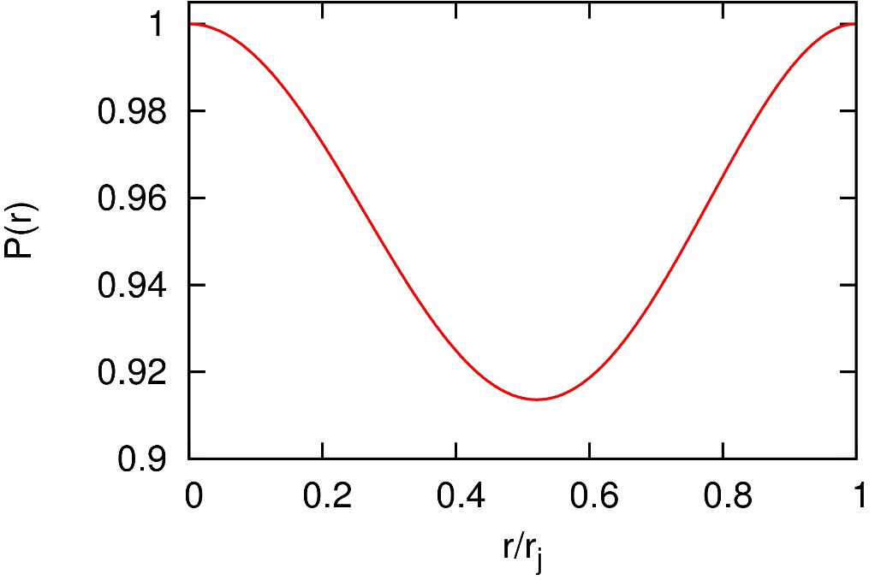
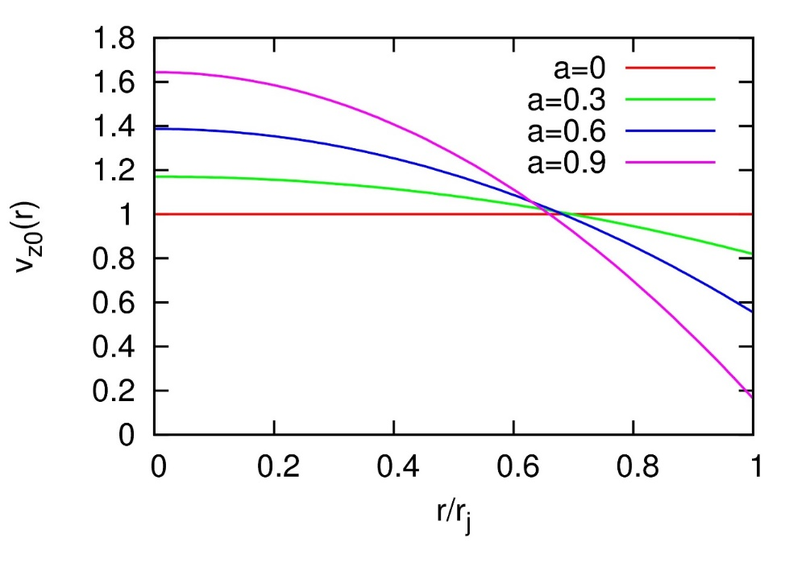
II) Setting up the Problem:-
Part 1 of our linear stability analysis:-
Current-Sheet-Free Magnetic Fields Realistic Pressure Profile (solve Grad-Shafranov)
Parametrized by plasma β = gas pressure/mag. pressure Needed for Equilibrium
B_{z}
B_{φ}
Part 2 of our linear stability analysis:-
Realistic shear profile introduced;
Shear parametrized by “a”

Slide 6
Linear analysis
1) Start with MHD equation:
$$\frac{∂ρ}{∂t}+∇⋅\left(ρv\right)=0$$
$$ρ\frac{∂v}{∂t}+ρv⋅∇v=\left(∇×B\right)×B−∇P$$
$$\frac{∂B}{∂t}=∇×\left(v×B\right)$$
$$∇∙B=0$$
$$P=κρ^{Γ}$$
2) Linearize MHD equations with
$$\left.δf(t,r,φ,z)=δf(r) exp(iωt−imφ−ikz\right)$$
3) Obtain two ordinary differential and seven algebraic equations
${δv}_{r}, δπ$
$$δρ,δP,{δv}_{φ},{δv}_{z},{δB}_{r},{δB}_{φ},{δB}_{z}$$
4) For each wavenumber “k”, determine real and imaginary frequency (ω) from boundary condition. ω_{R} – oscillation; ω_{I} – growth of instability!

Slide 7
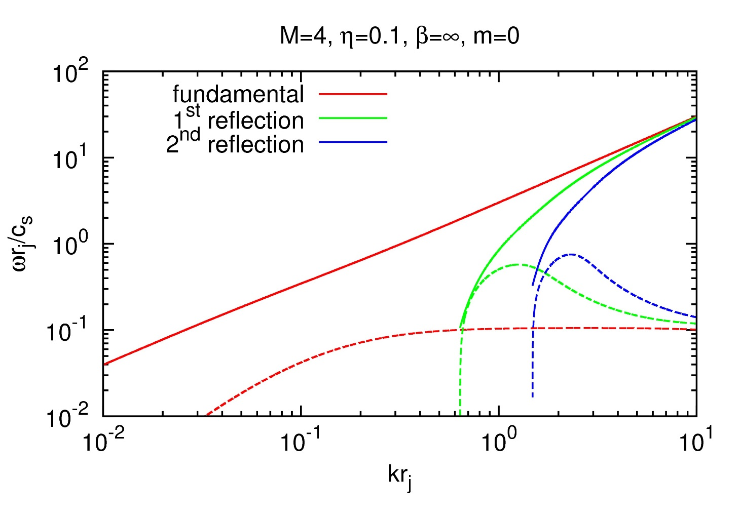
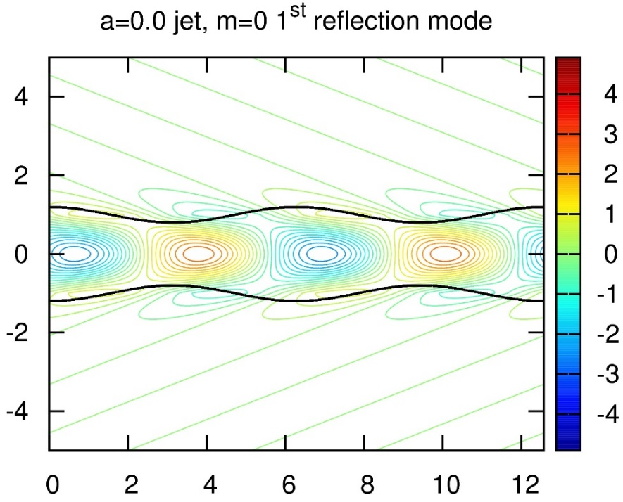
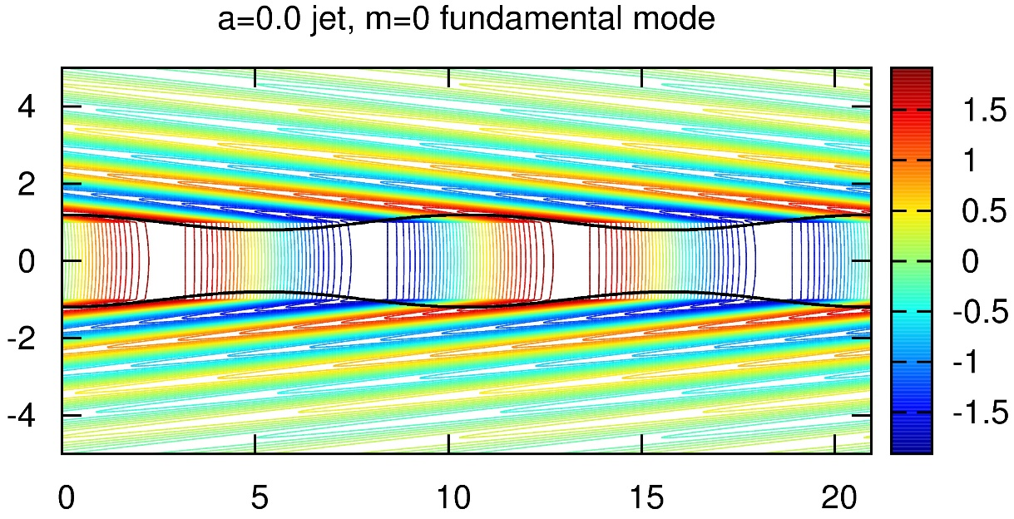
Hydrodynamic Pinch Modes:-
m=0
(Setting up a Baseline)
Stability Analysis
+
Pressure Profiles
Solid curve – ω_{R}
Dashed curve -- ω_{I}
Long wavelengths
Short wavelengths

Slide 8
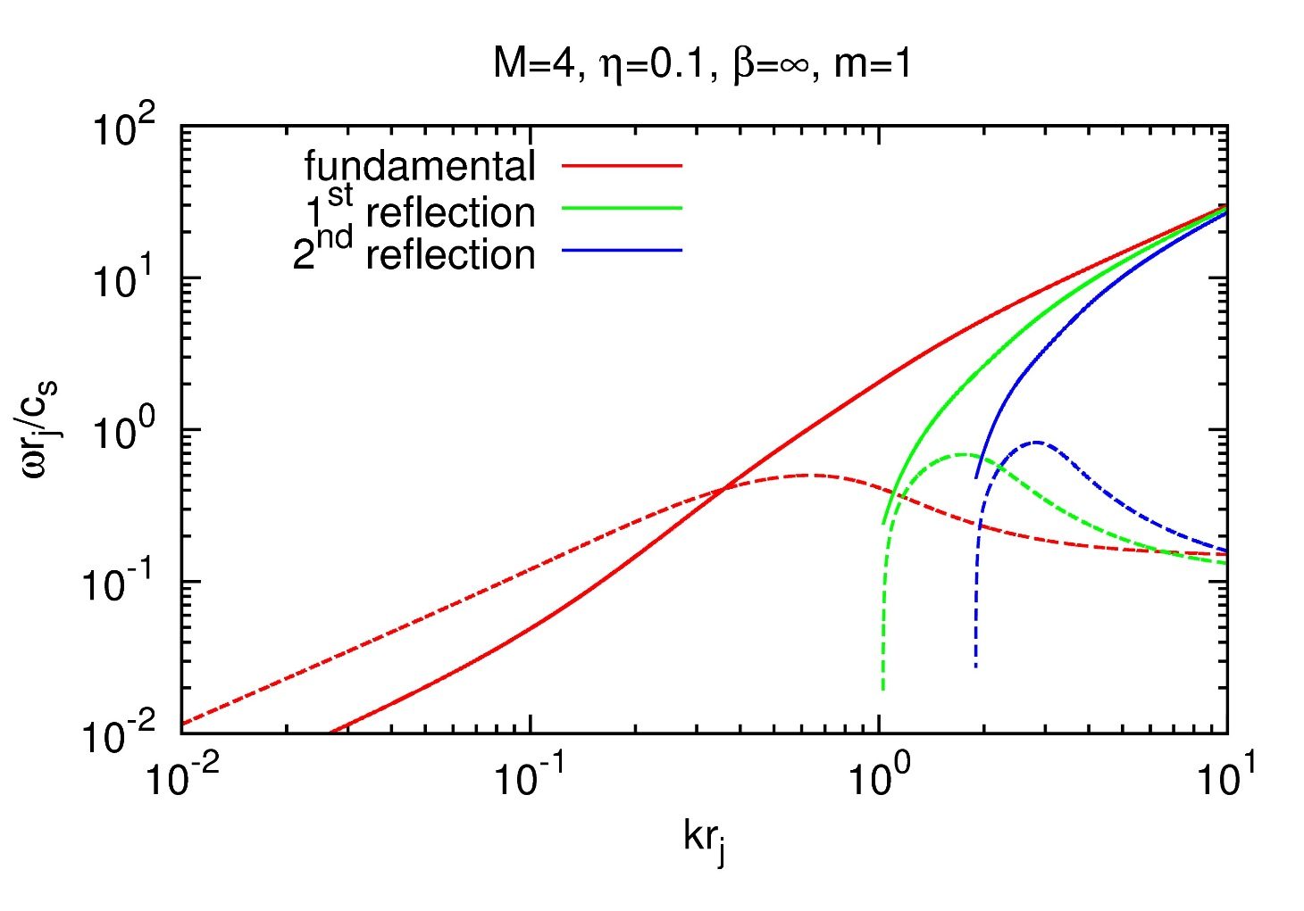
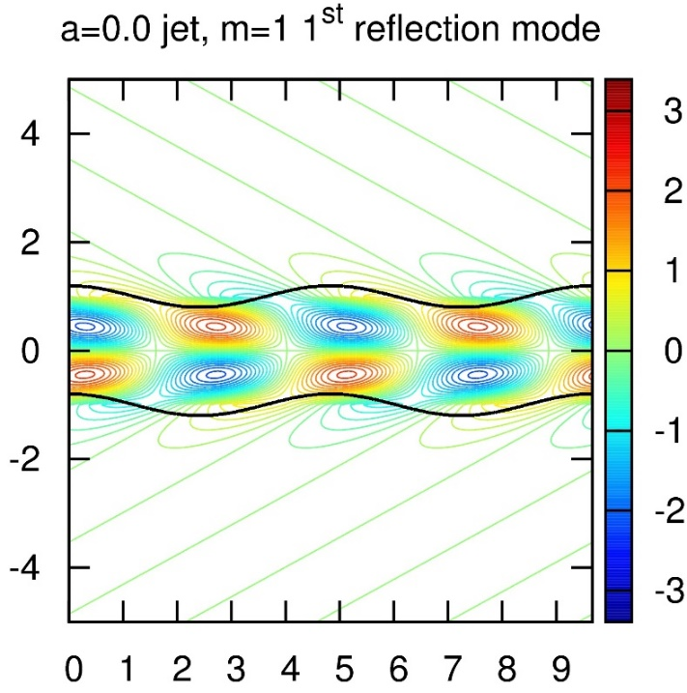
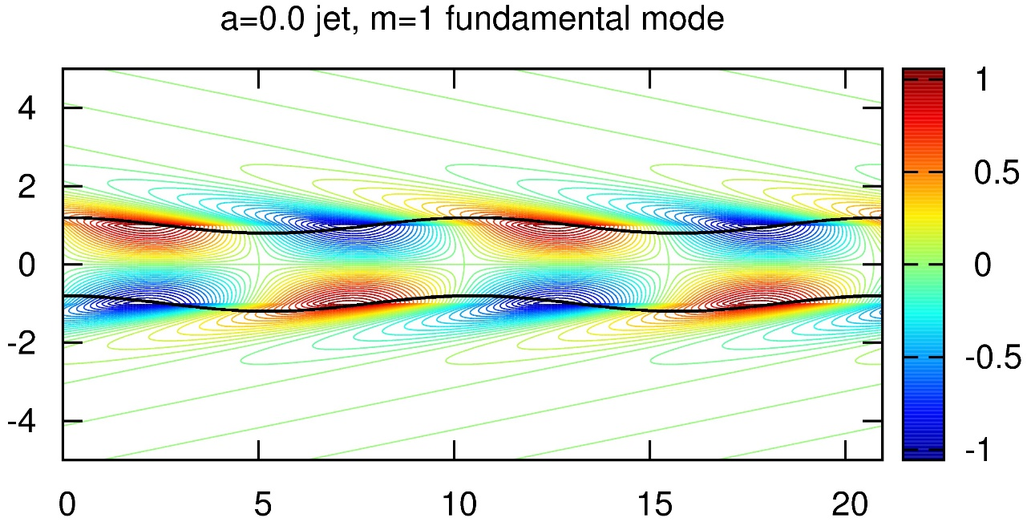
Hydrodynamic Kink Modes:-
m=1
(Setting up a Baseline)
Stability Analysis
+
Pressure Profiles
Solid curve – ω_{R}
Dashed curve -- ω_{I}
Long wavelengths
Short wavelengths

Slide 9
Getting rid of all jet instabilities is an improbable task. It is also counterproductive, since some instability is needed for particle acceleration.
We simply ask for the jet to propagate χ jet radii without destabilizing. We want:-
We will show this threshold with a dashed line in our plots. Everything below it is “effectively” stable. χ=400 used in this work.
Our fiducial jet has Mach number, M = 4, and jet density ratio, ρ_{jet} / ρ_{ambient} = 0.1.
Parameters to be Varied in this Study:-
β=gas pressure/magnetic pressure. Smaller values of β ➔ larger magnetic fields.
“a” . Larger values of “a” ➔ more shear.
Jet pressure is used as a proxy for jet stability.

Slide 10
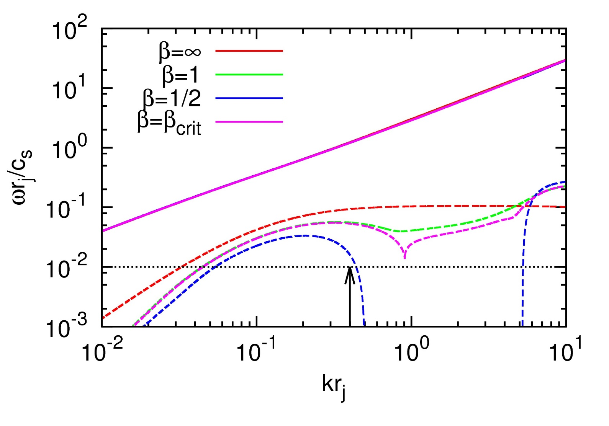
III) Magnetized Current-Sheet Free Jets with Top-Hat Velocity Profiles
Fundamental Mode of Pinch Instability (m=0)
Fiducial Jet (M=4, η=0.1) various values of magnetic field “β”.
(β=∞ ➔ no field; β =1/2 ➔ strong field)
Magnetic field helps stabilize the fundamental pinch modes of jets mostly at short wavelengths!
Solid curve – ω_{R}
Dashed curve -- ω_{I}
← Threshold for propagating 400 radii with < 1 e-folding.
Long wavelengths
Short wavelengths

Slide 11
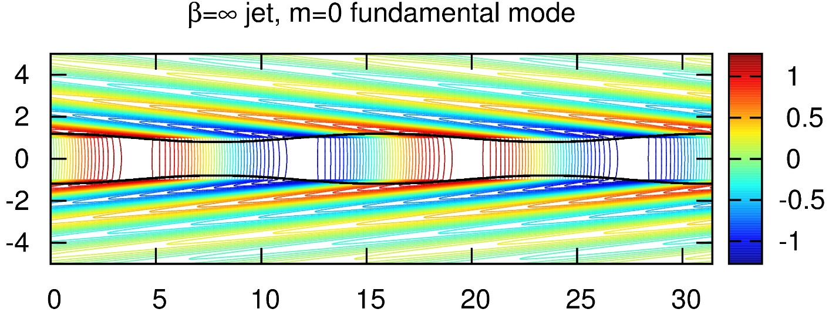
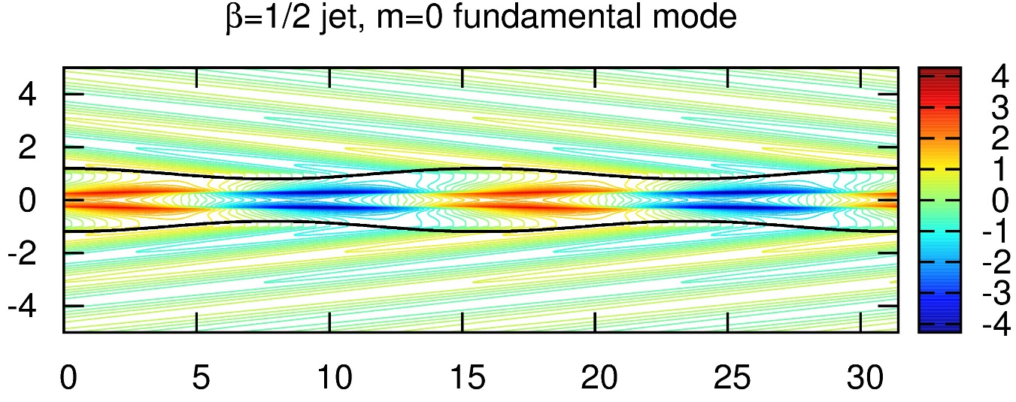
Magnetized Current-Sheet Free Jets with Top-Hat Velocity Profiles
Fundamental Mode of Pinch Instability (m=0)
Fiducial Jet (M=4, η=0.1) various values of magnetic field “β”.
(β=∞ ➔ no field; β =1/2 ➔ strong field) Strong B-field restricts the pressure fluctuations to lie within a narrow channel.
Magnetic field helps stabilize the fundamental pinch modes of jets mostly at short wavelengths!
Notice that toroidal field restricts the perturbations to a narrow channel within the jet.
Unmagnetized
Strongly magnetized

Slide 12
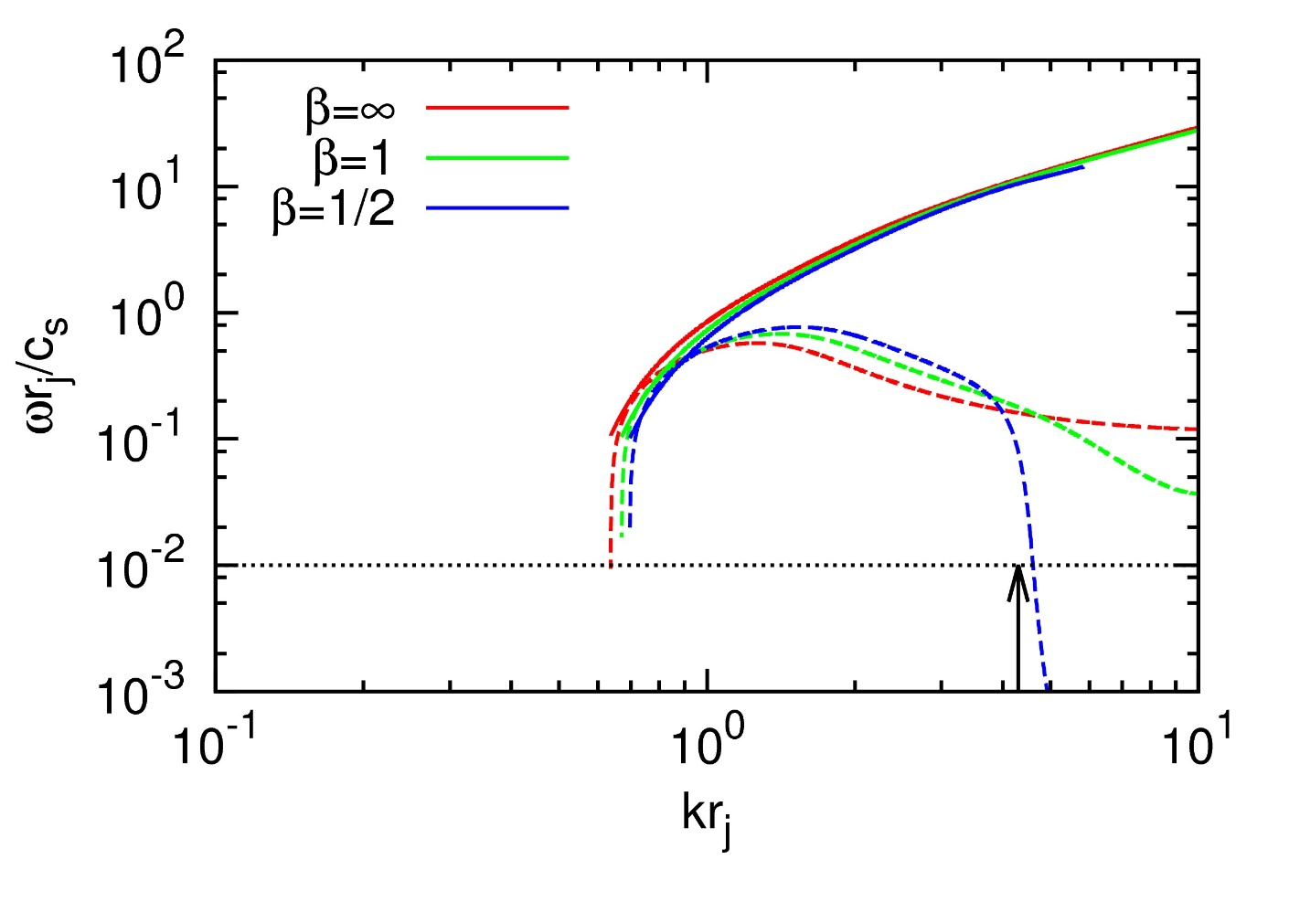
Magnetized Current-Sheet Free Jets with Top-Hat Velocity Profiles
1st reflection Mode of Pinch Instability (m=0)
Fiducial Jet (M=4, η=0.1) various values of magnetic field “β”.
(β=∞ ➔ no field; β =1/2 ➔ strong field)
Magnetic field helps stabilize the 1st reflection pinch modes of jets only at short wavelengths!
Solid curve – ω_{R}
Dashed curve -- ω_{I}
← Threshold for propagating 400 radii with < 1 e-folding.
Long wavelengths
Short wavelengths

Slide 13
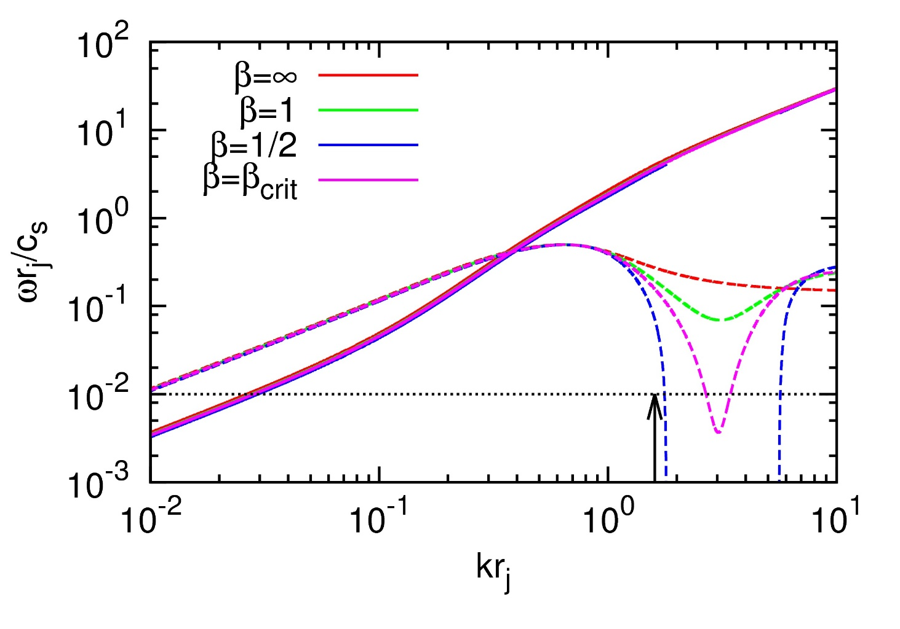
Magnetized Current-Sheet Free Jets with Top-Hat Velocity Profiles
Fundamental Mode of Kink Instability (m=1)
Fiducial Jet (M=4, η=0.1) various values of magnetic field “β”.
(β=∞ ➔ no field; β =1/2 ➔ strong field)
Magnetic field helps stabilize the fundamental kink modes of jets only at short wavelengths!
Solid curve – ω_{R}
Dashed curve -- ω_{I}
← Threshold for propagating 400 radii with < 1 e-folding.
Long wavelengths
Short wavelengths

Slide 14
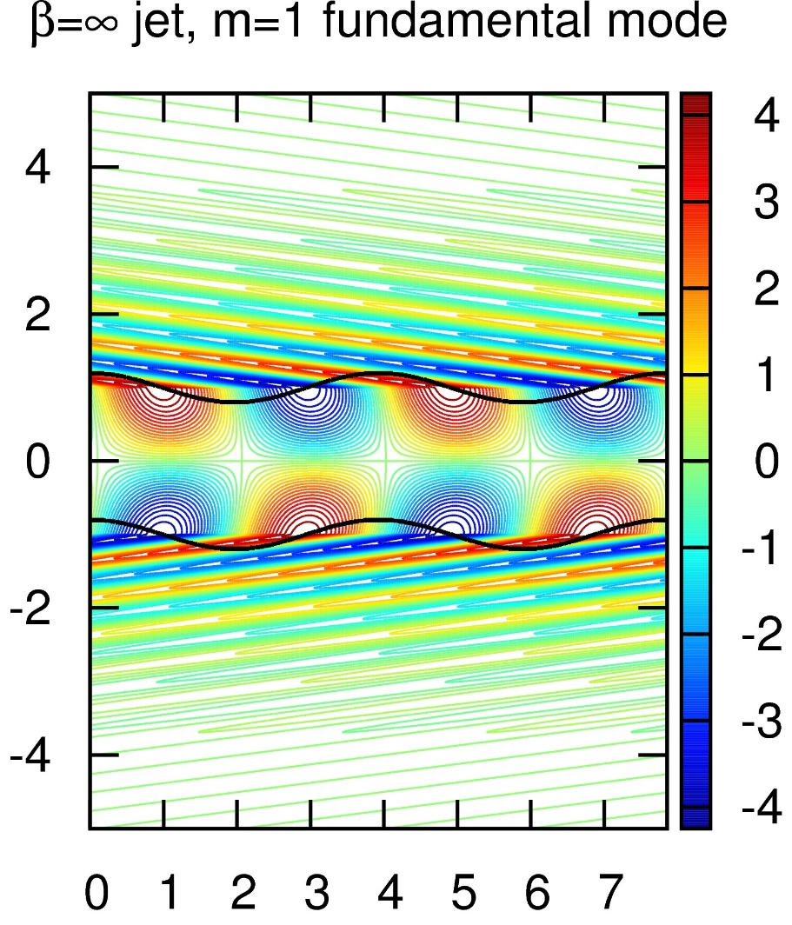
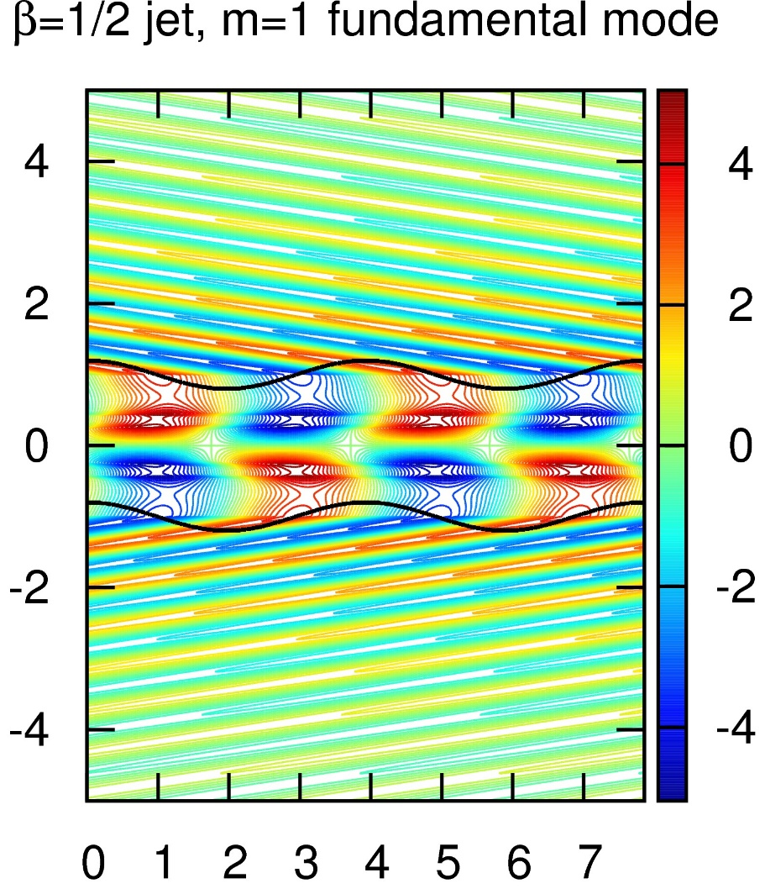
Magnetized Current-Sheet Free Jets with Top-Hat Velocity Profiles
Fundamental Mode of Kink Instability (m=1)
Fiducial Jet (M=4, η=0.1) various values of magnetic field “β”.
(β=∞ ➔ no field; β =1/2 ➔ strong field) Strong B-field restricts the pressure fluctuations to lie within a narrow channel.
Magnetic field helps stabilize the fundamental kink modes of jets only at short wavelengths!
Unmagnetized
Strongly
magnetized

Slide 15
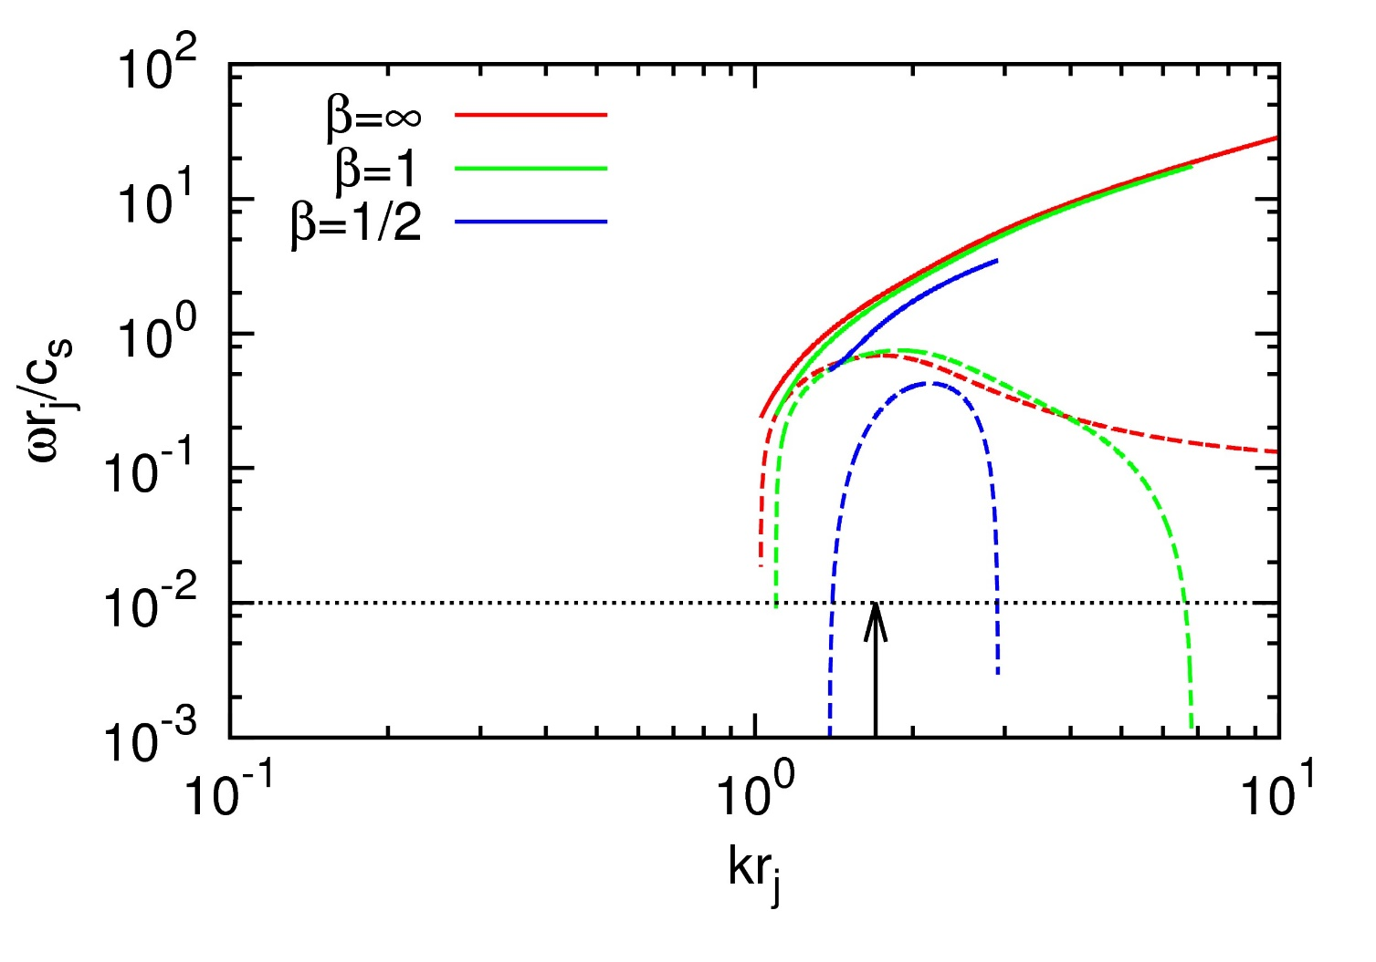
Magnetized Current-Sheet Free Jets with Top-Hat Velocity Profiles
1st reflection Mode of Kink Instability (m=1)
Fiducial Jet (M=4, η=0.1) various values of magnetic field “β”.
(β=∞ ➔ no field; β =1/2 ➔ strong field)
Magnetic field helps stabilize the 1st reflection kink modes of jets only at short wavelengths!
Solid curve – ω_{R}
Dashed curve -- ω_{I}
← Threshold for propagating 400 radii with < 1 e-folding.
Long wavelengths
Short wavelengths

Slide 16
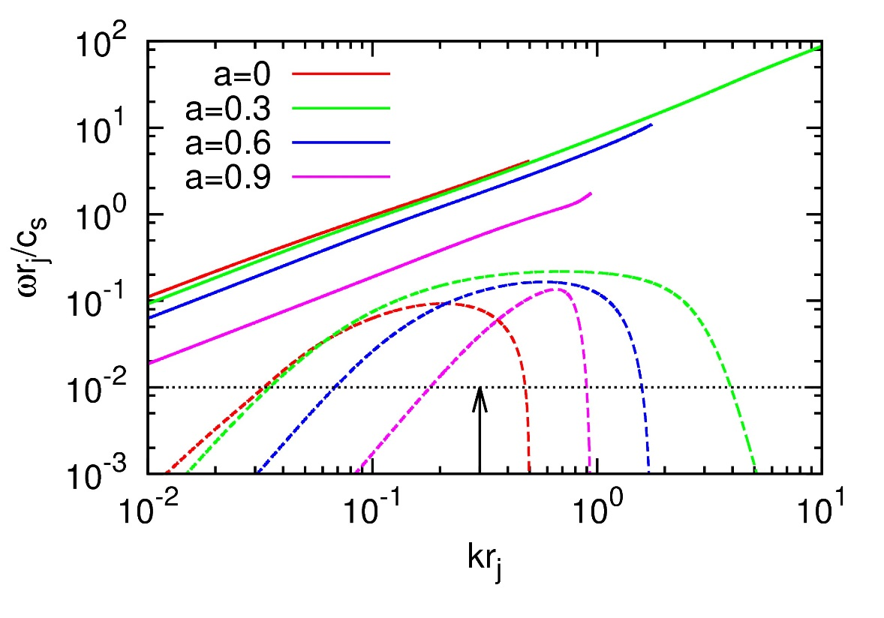
IV) Magnetized Current-Sheet Free Jets with Sheared Velocity Profiles
Fundamental Mode of Pinch Instability (m=0)
Fiducial Jet (M=4, η=0.1) β = 1/2 ; various values of shear “a”.
(a=0 ➔ no shear; a=0.9 ➔ high shear)
Shear helps stabilize the fundamental pinch modes of jets at long as well as short wavelengths!
Solid curve – ω_{R}
Dashed curve -- ω_{I}
← Threshold for propagating 400 radii with < 1 e-folding.
Long wavelengths
Short wavelengths

Slide 17
Magnetized Current-Sheet Free Jets with Sheared Velocity Profiles
Fundamental Mode of Pinch Instability (m=0)
Fiducial Jet (M=4, η=0.1) β = 1/2 ; various values of shear “a”.
(a=0 ➔ no shear; a=0.9 ➔ high shear) For same boundary amplitude, pressure perturbations decrease with increasing shear.
Shear helps stabilize the fundamental pinch modes of jets at long as well as short wavelengths!
No shear
Low shear
Modest shear
High shear

Slide 18
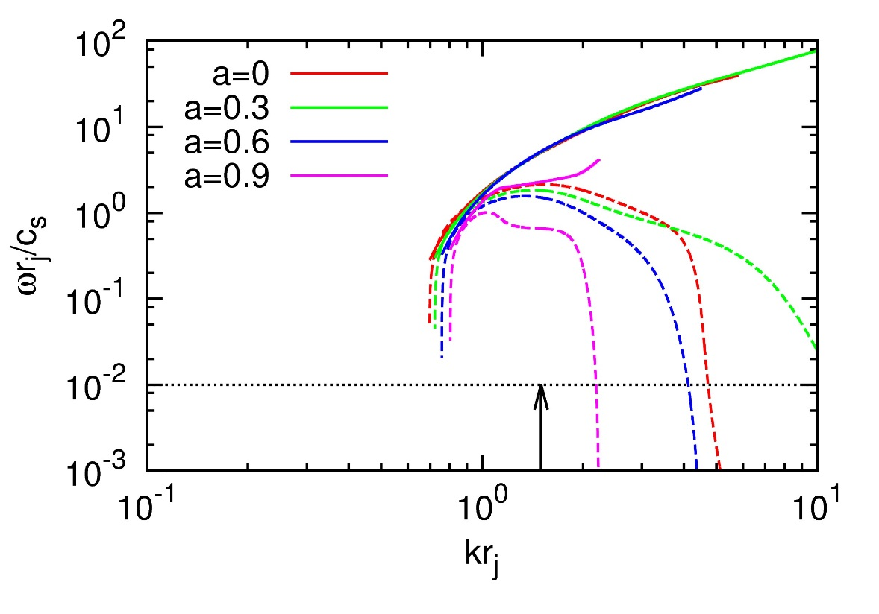
Magnetized Current-Sheet Free Jets with Sheared Velocity Profiles
1st Reflection Mode of Pinch Instability (m=0)
Fiducial Jet (M=4, η=0.1) β = 1/2 ; various values of shear “a”.
(a=0 ➔ no shear; a=0.9 ➔ high shear)
Shear helps stabilize the 1st reflection pinch modes of jets only at short wavelengths!
Solid curve – ω_{R}
Dashed curve -- ω_{I}
← Threshold for propagating 400 radii with < 1 e-folding.
Long wavelengths
Short wavelengths

Slide 19
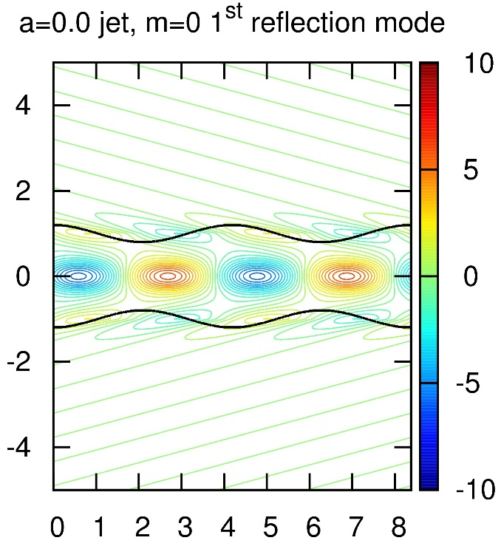
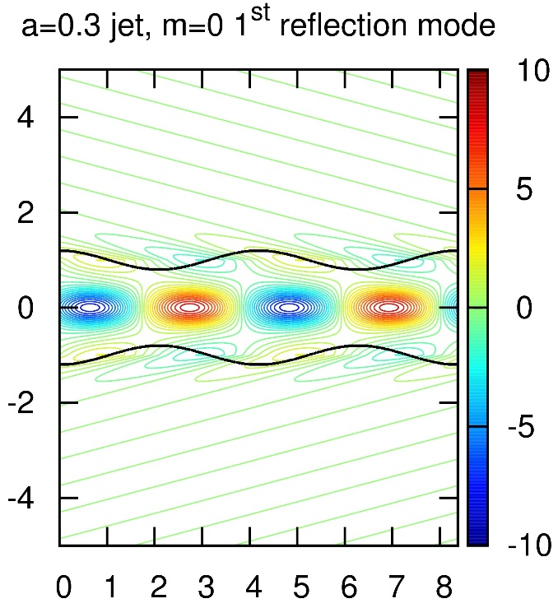
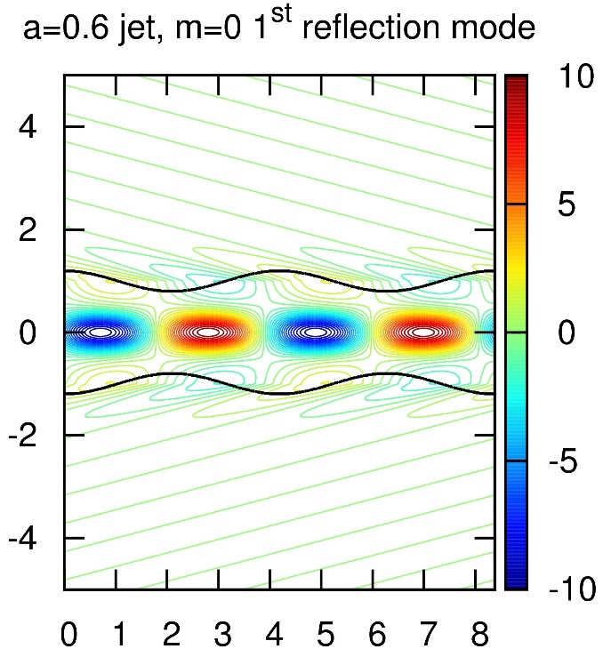
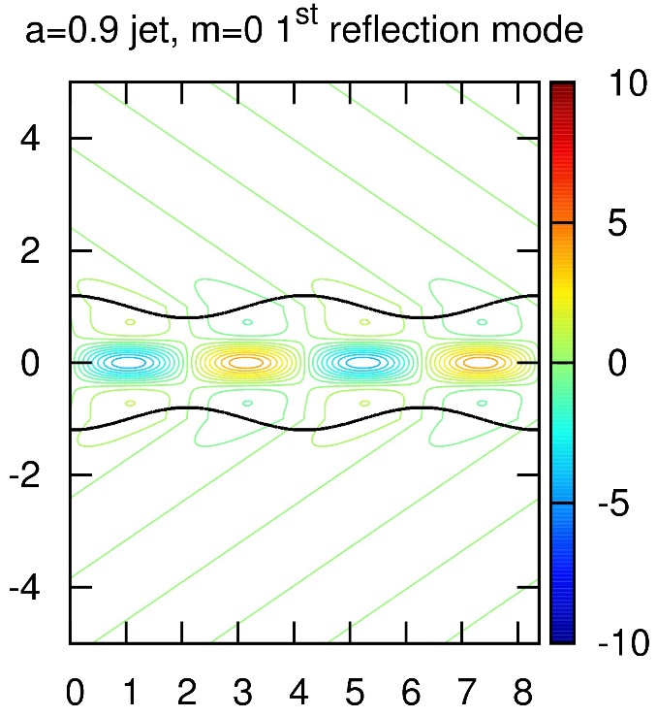
Magnetized Current-Sheet Free Jets with Sheared Velocity Profiles
1st Reflection Mode of Pinch Instability (m=0)
Fiducial Jet (M=4, η=0.1) β = 1/2 ; various values of shear “a”.
(a=0 ➔ no shear; a=0.9 ➔ high shear) For same boundary amplitude, pressure perturbations decrease with increasing shear.
Shear helps stabilize the 1st reflection pinch modes of jets only at short wavelengths!
No shear
Low shear
Modest shear
High shear

Slide 20
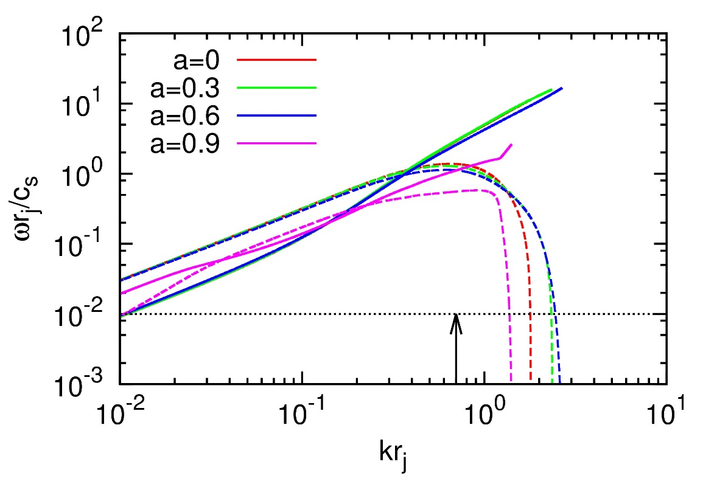
Magnetized Current-Sheet Free Jets with Sheared Velocity Profiles
Fundamental Mode of Kink (m=1)
Fiducial Jet (M=4, η=0.1) β = 1/2 ; various values of shear “a”.
(a=0 ➔ no shear; a=0.9 ➔ high shear)
Shear helps stabilize the fundamental kink modes of jets at short wavelengths + little at long wavelengths!
Solid curve – ω_{R}
Dashed curve -- ω_{I}
← Threshold for propagating 400 radii with < 1 e-folding.
Long wavelengths
Short wavelengths

Slide 21
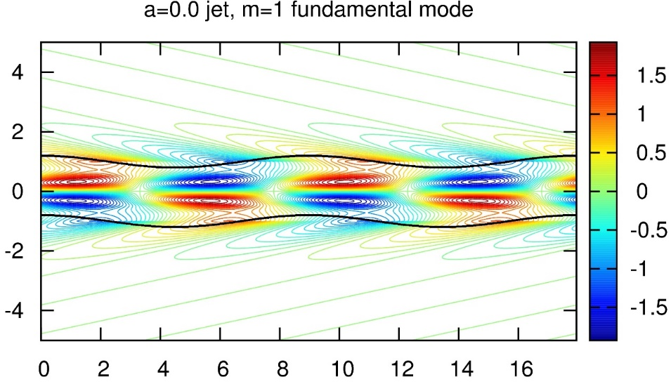
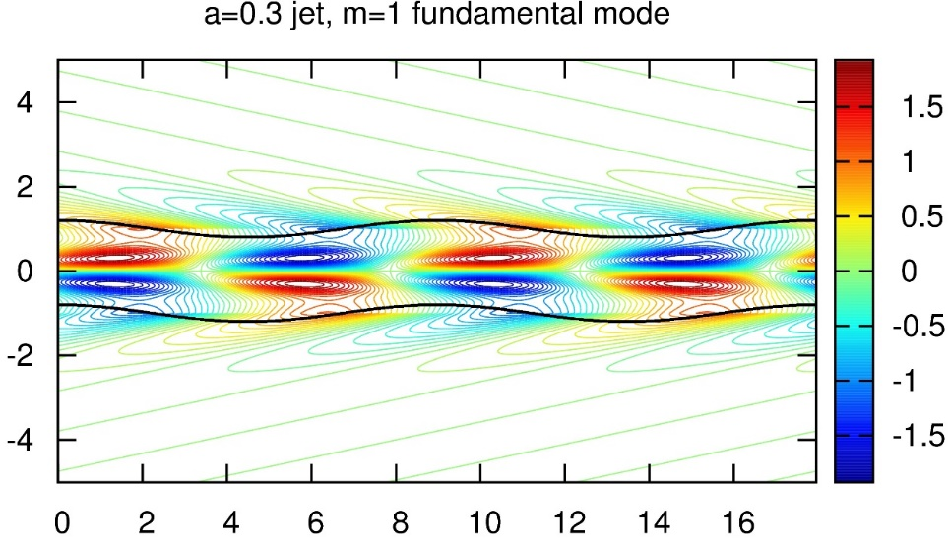
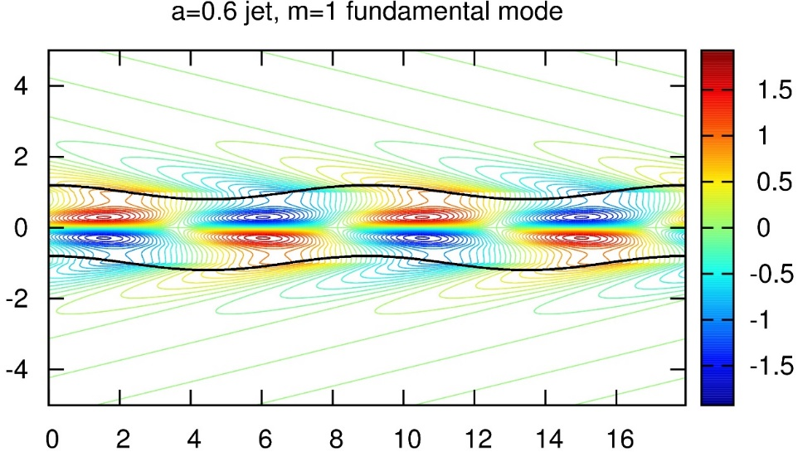
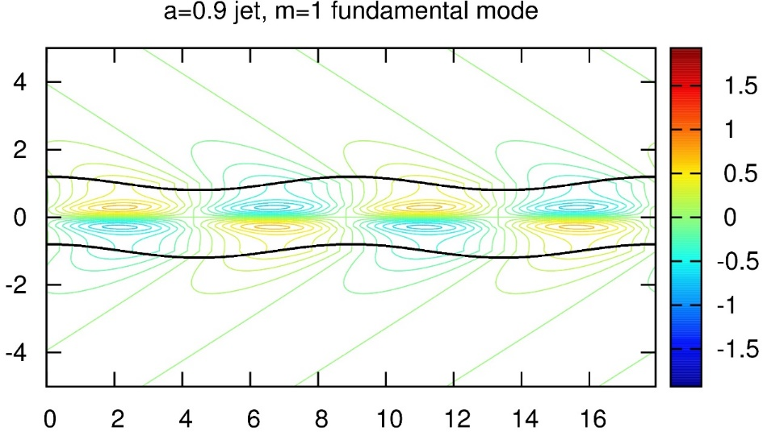
Magnetized Current-Sheet Free Jets with Sheared Velocity Profiles
Fundamental Modes of Kink (m=1)
Fiducial Jet (M=4, η=0.1) β = 1/2 ; various values of shear “a”.
(a=0 ➔ no shear; a=0.9 ➔ high shear) For same boundary amplitude, pressure perturbations decrease with increasing shear.
Shear helps stabilize the fundamental kink modes of jets at short wavelengths + little for long waves!
No shear
Low shear
Modest shear
High shear

Slide 22
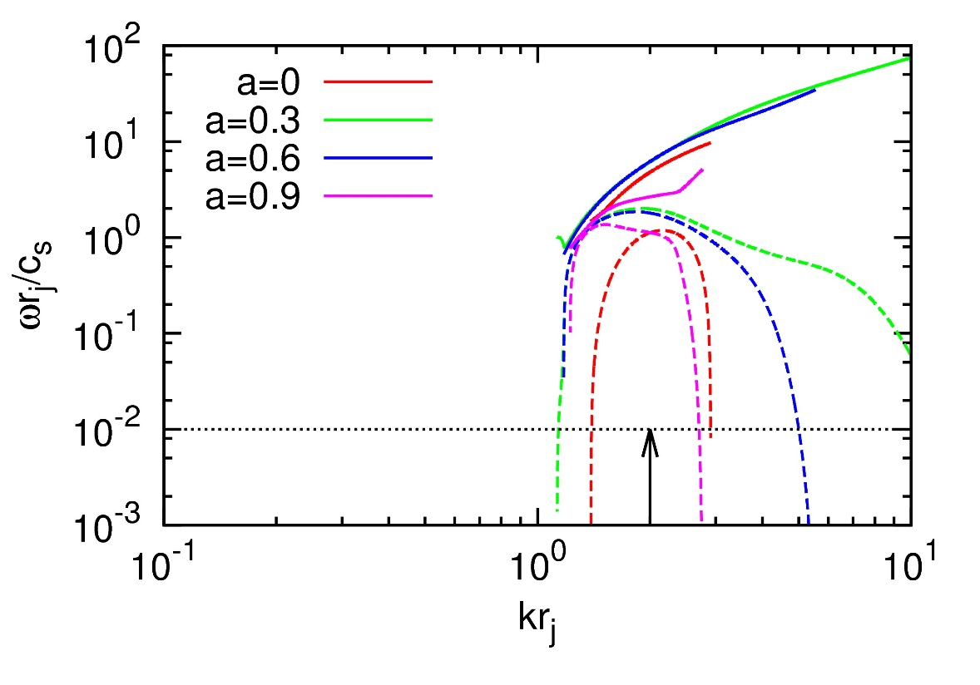
Magnetized Current-Sheet Free Jets with Sheared Velocity Profiles
1st reflection Mode of Kink (m=1)
Fiducial Jet (M=4, η=0.1) β = 1/2 ; various values of shear “a”.
(a=0 ➔ no shear; a=0.9 ➔ high shear)
Shear helps stabilize the 1st reflection kink modes of jets only at short wavelengths!
Solid curve – ω_{R}
Dashed curve -- ω_{I}
← Threshold for propagating 400 radii with < 1 e-folding.
Long wavelengths
Short wavelengths

Slide 23
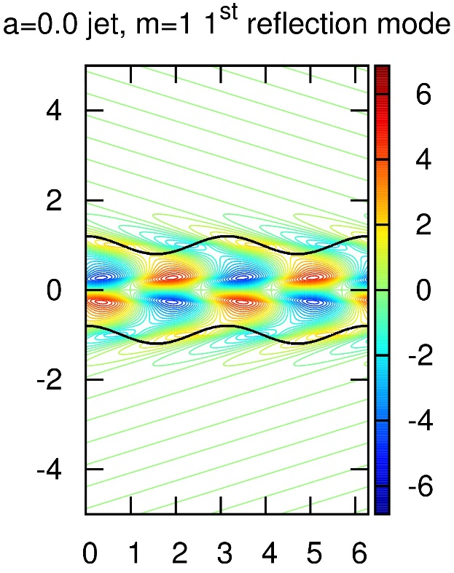
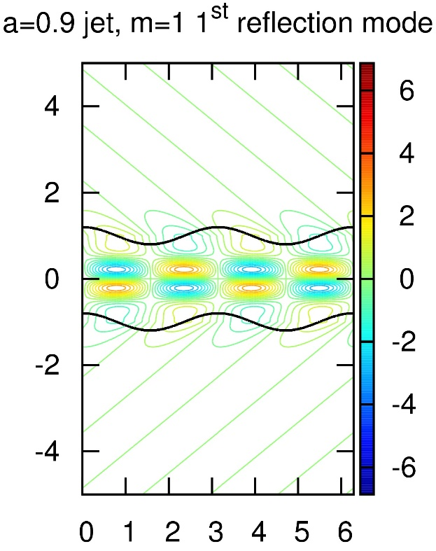
Magnetized Current-Sheet Free Jets with Sheared Velocity Profiles
1st reflection Mode of Kink Instability (m=1)
Fiducial Jet (M=4, η=0.1) β = 1/2 ; various values of shear “a”.
(a=0 ➔ no shear; a=0.9 ➔ high shear) For same boundary amplitude, pressure perturbations decrease with increasing shear.
Shear helps stabilize the 1st reflection kink modes of jets only at short wavelengths!
No shear
Low shear
Modest shear
High shear

Slide 24
Conclusions
We have carried out the stability analysis of current sheet free jets proposed by Gourgouliatos et al. (2012), as well as sheared jets (Mizuno, Lyubarsky et al. 2012).
We adopt a different, numerically motivated approach; jet can have any velocity and field profile. No further approximations, like considering only analytic functions, or jets with zero pressure.
We find that current-sheet-free magnetic field can significantly improve the jet stability at short wavelengths for all modes. For fields in excess of equipartition, the stability properties improve dramatically!
Shear, by contrast, improves the stability properties of pinch modes at short and long wavelengths.
Shear also improved the stability properties of kink modes at short wavelengths. Though the improvement at long wavelengths is present, it is not as dramatic.
It is important to get past top hat velocity profiles and simple B-fields in jet stability studies.

