Slide 1
The electrostatic current sheet and other interesting features of the pulsar magnetosphere
Ioannis Contopoulos
RCAAM, Academy of Athens
NRNU MEPhI

Slide 2
Currently, we have (a) good understanding of (the) overall electromagnetic structure of (the) pulsar magnetosphere
and
Large scale kinetic modeling of the magnetosphere is required
Maxim Lyutikov 2016

Slide 3
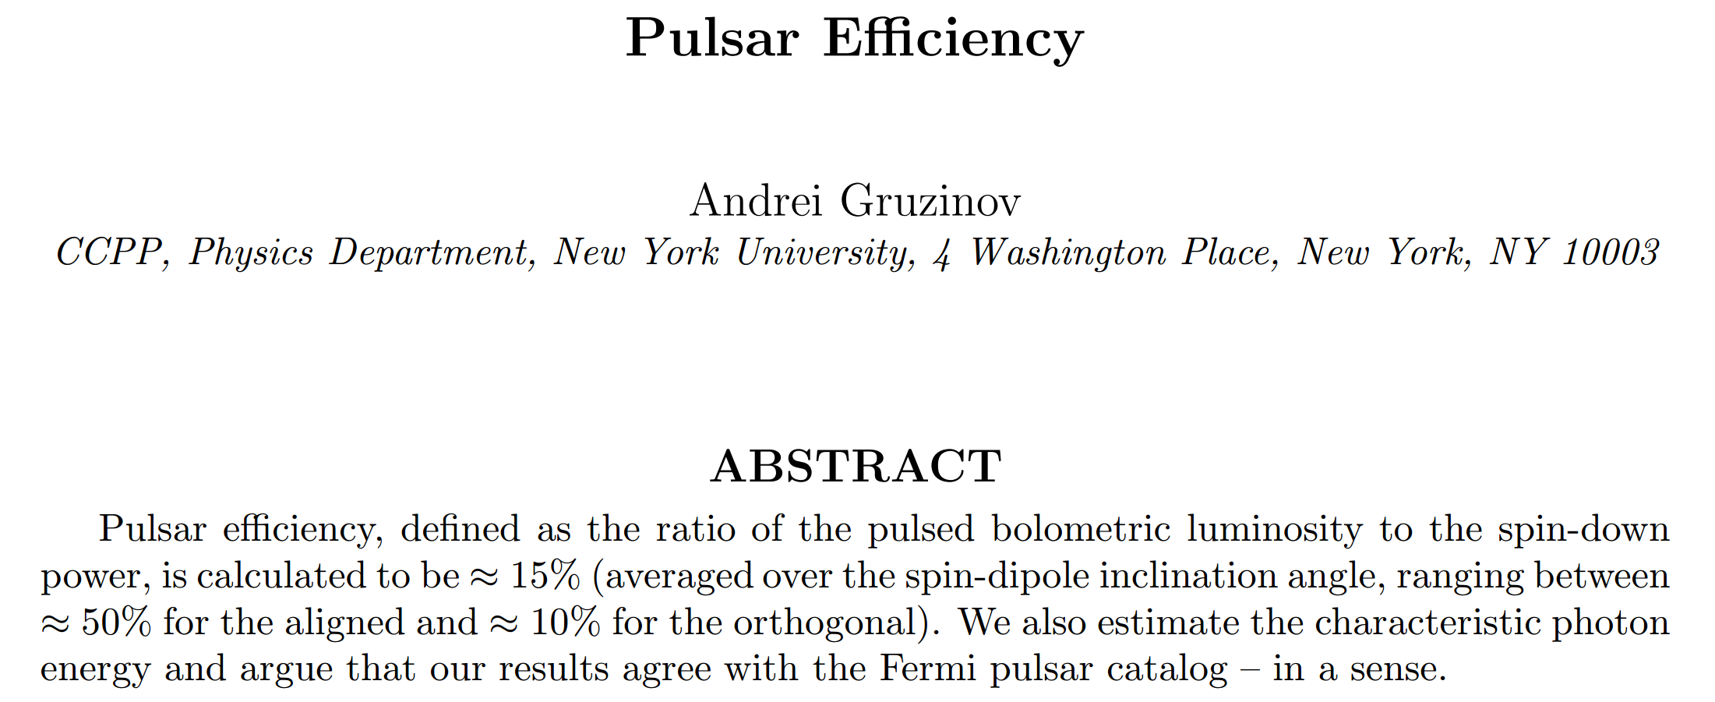

Slide 6
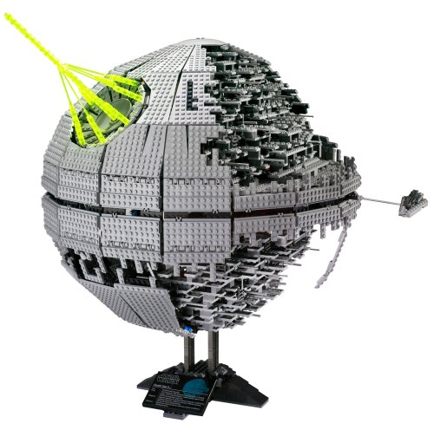
Limitations of numerical simulations
Lego tiles:
Light cylinder resolution:
2D: 10,000
3D: 100

Slide 7
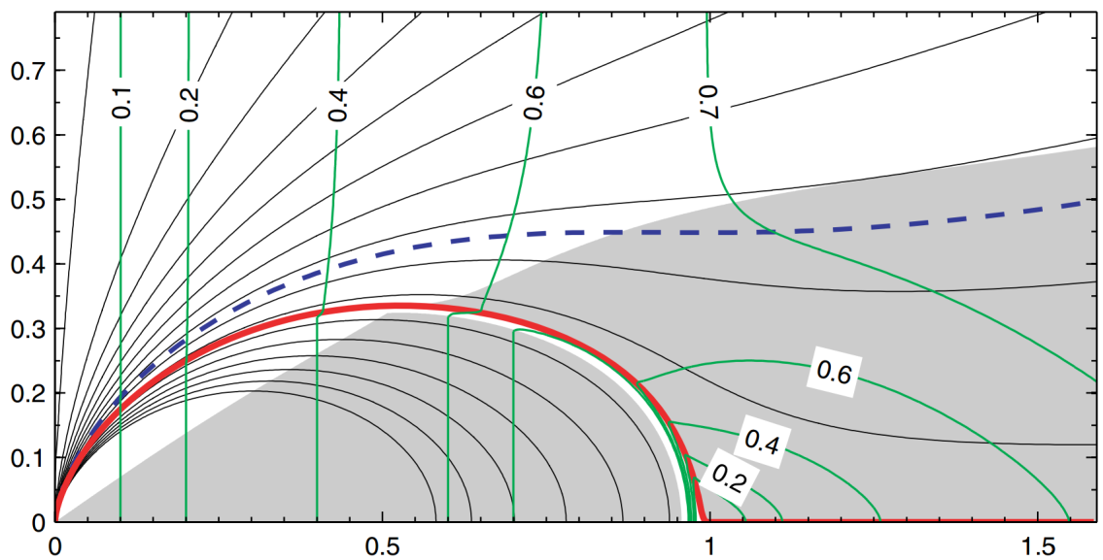
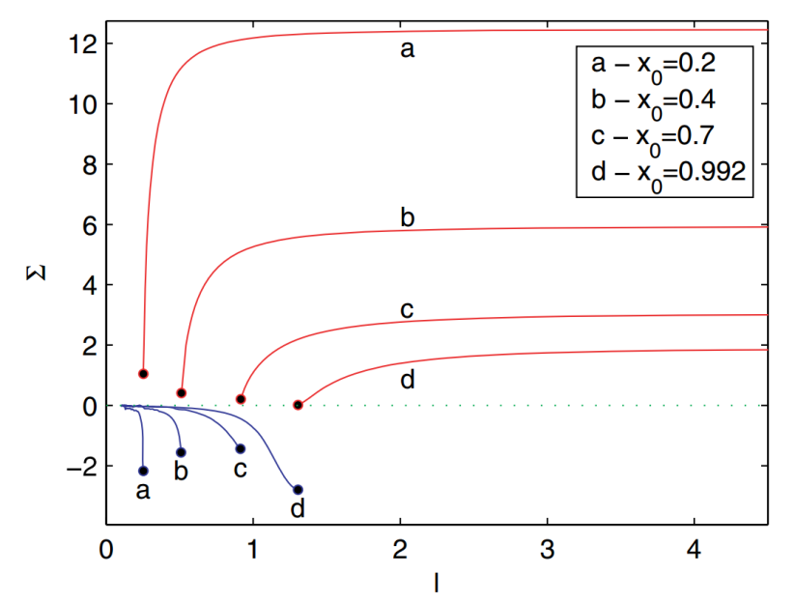
Limitations of numerical simulations
Lego tiles:
Light cylinder resolution:
2D: 10,000
3D: 100

Slide 8
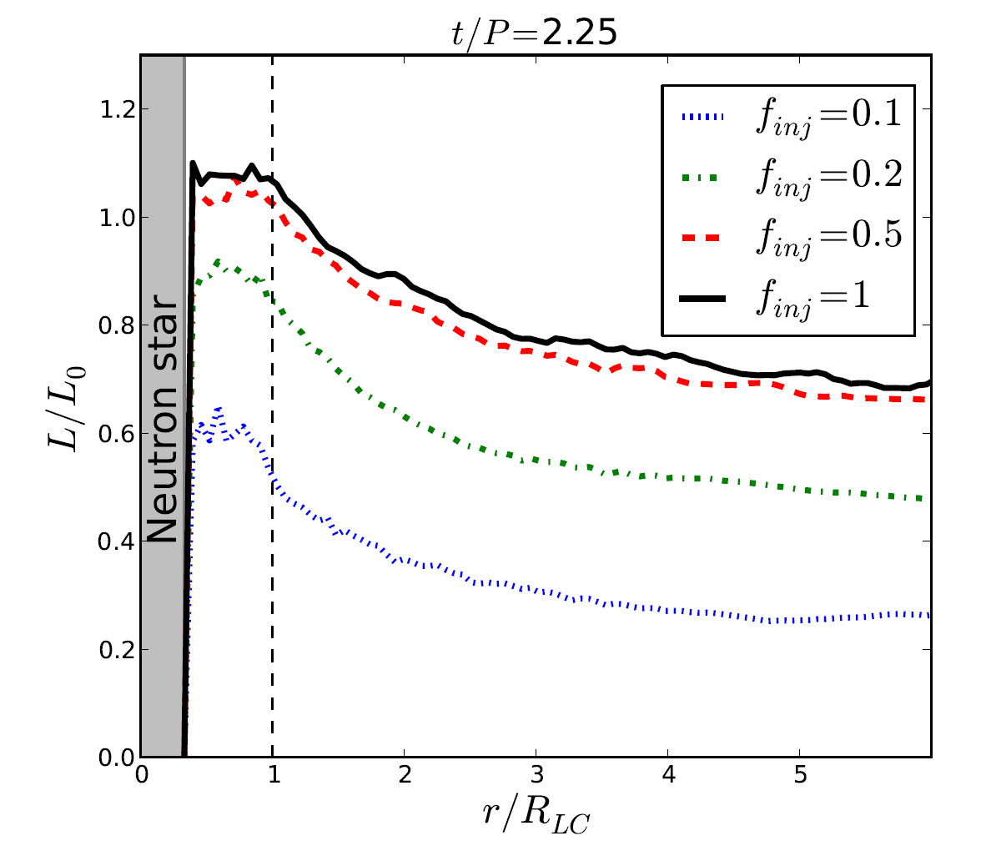
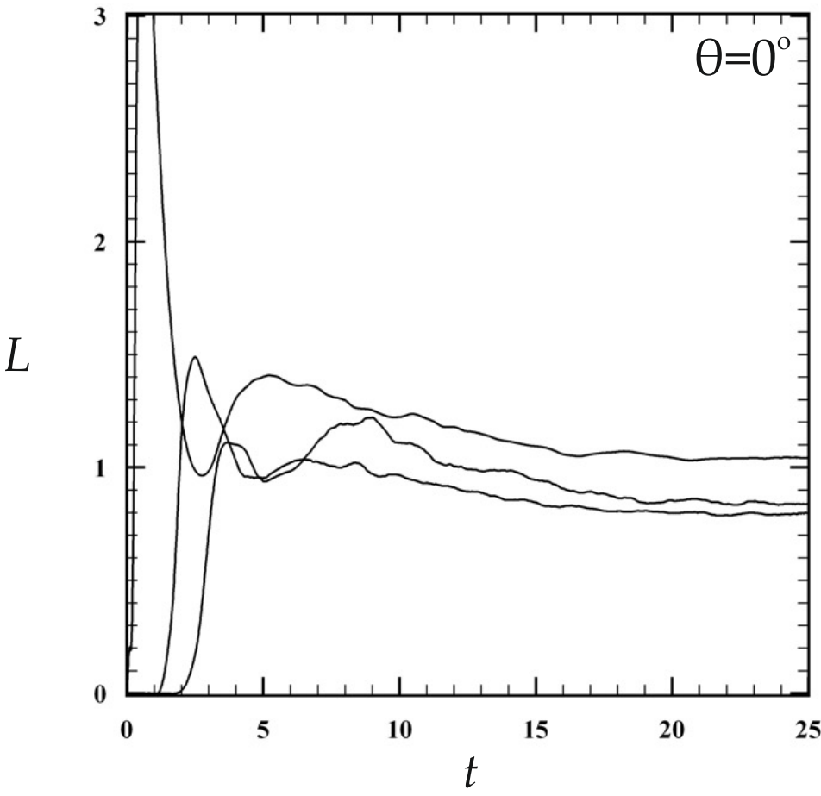
Limitations of numerical simulations
Lego tiles:
Light cylinder position:

Slide 9
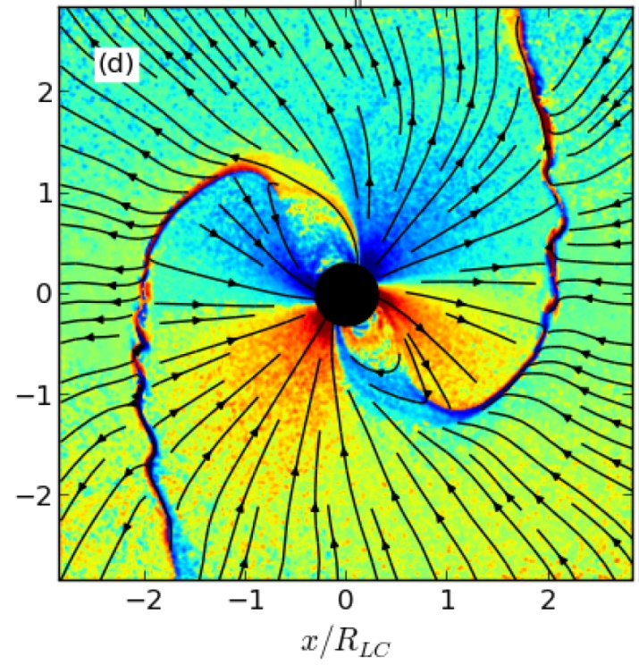
Limitations of numerical simulations
Lego tiles:
Light cylinder position:

Slide 11
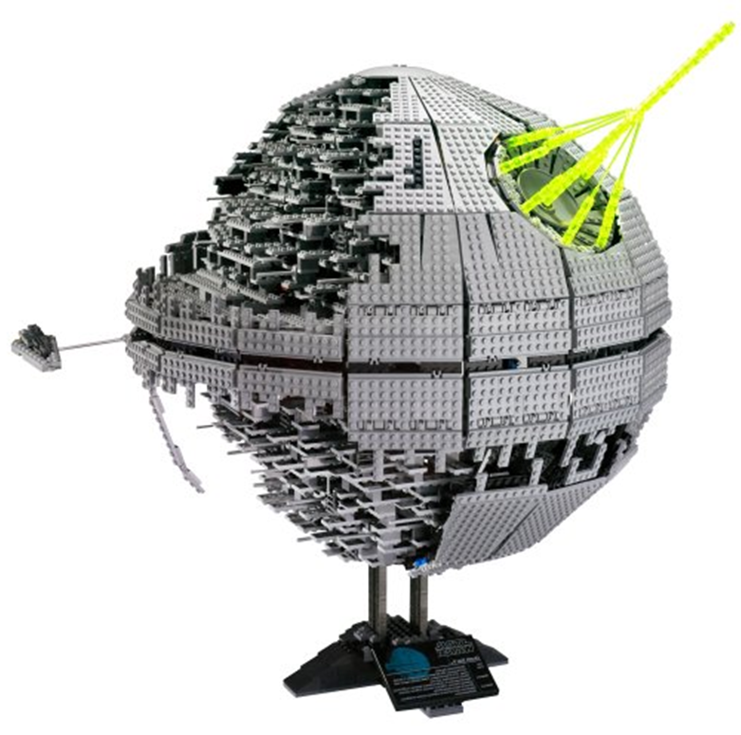
Limitations of numerical simulations
Death stars:
ρGJ , JGJ = ρGJ c
JCKF is a global quantity
(nothing to do with JGJ )

Slide 12
Limitations of numerical simulations
Death stars:
ρGJ , JGJ = ρGJ c
JCKF is a global quantity (nothing to do with JGJ )
Density floors
PIC simulations: “billiard balls”
Numerical treatment of CS: “trade secrets”
We need to return to our drawing boards and reconsider the global picture

Slide 13
What drives dissipation?

Slide 14
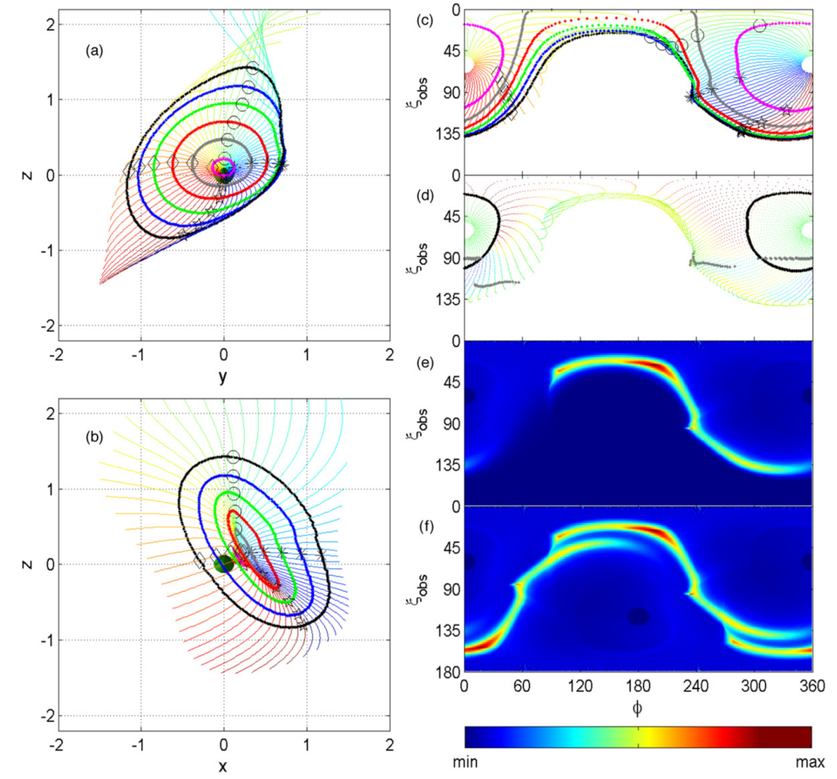
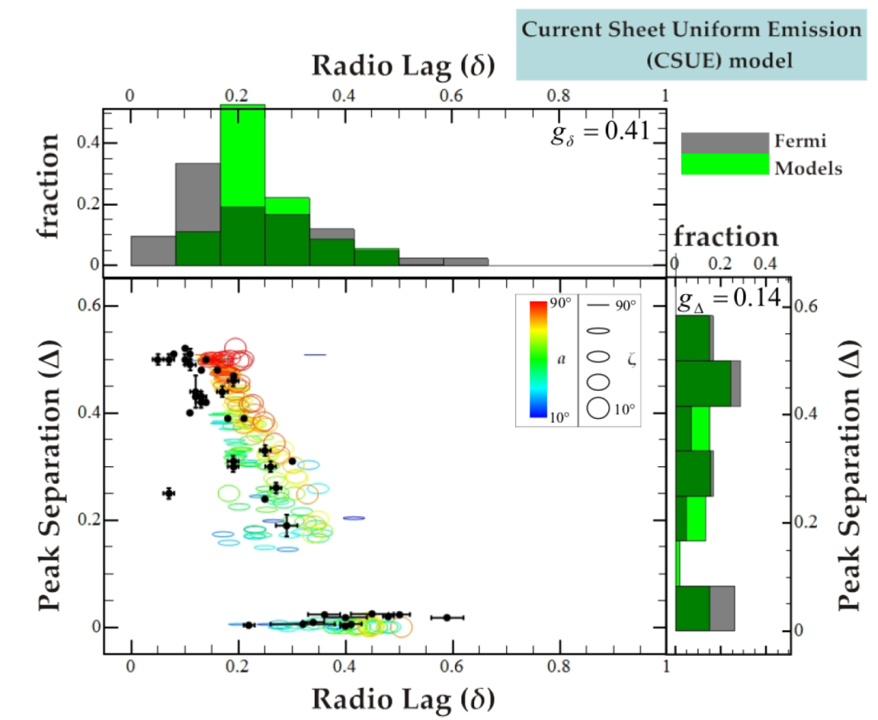
FFE magnetospheres with particle tracing
2010
2014

Slide 15
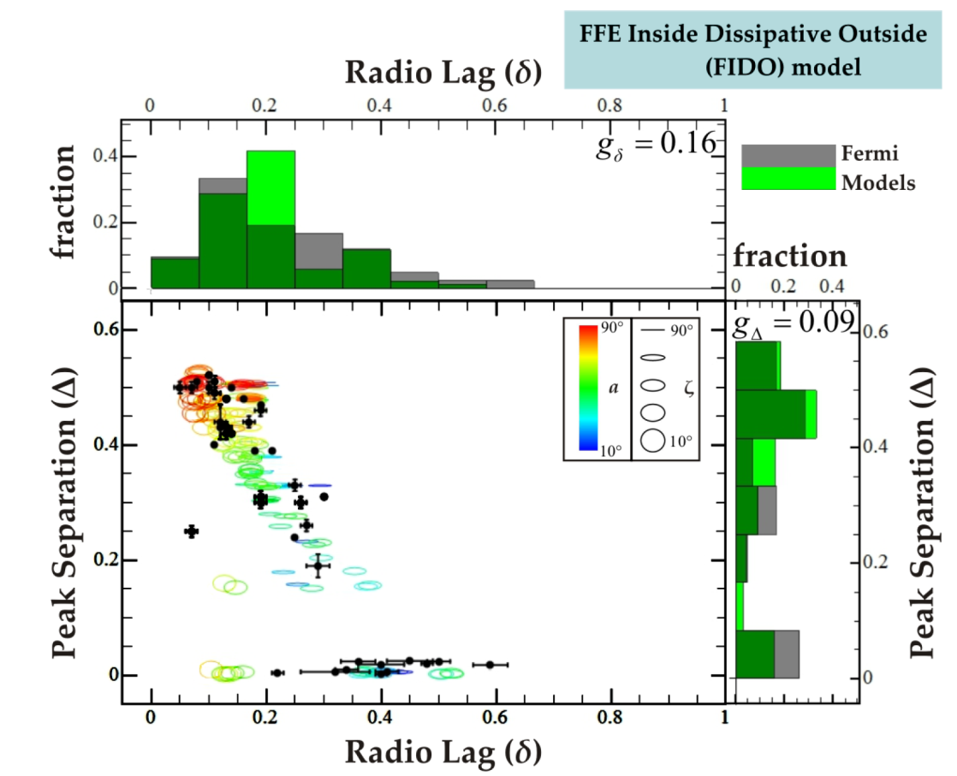
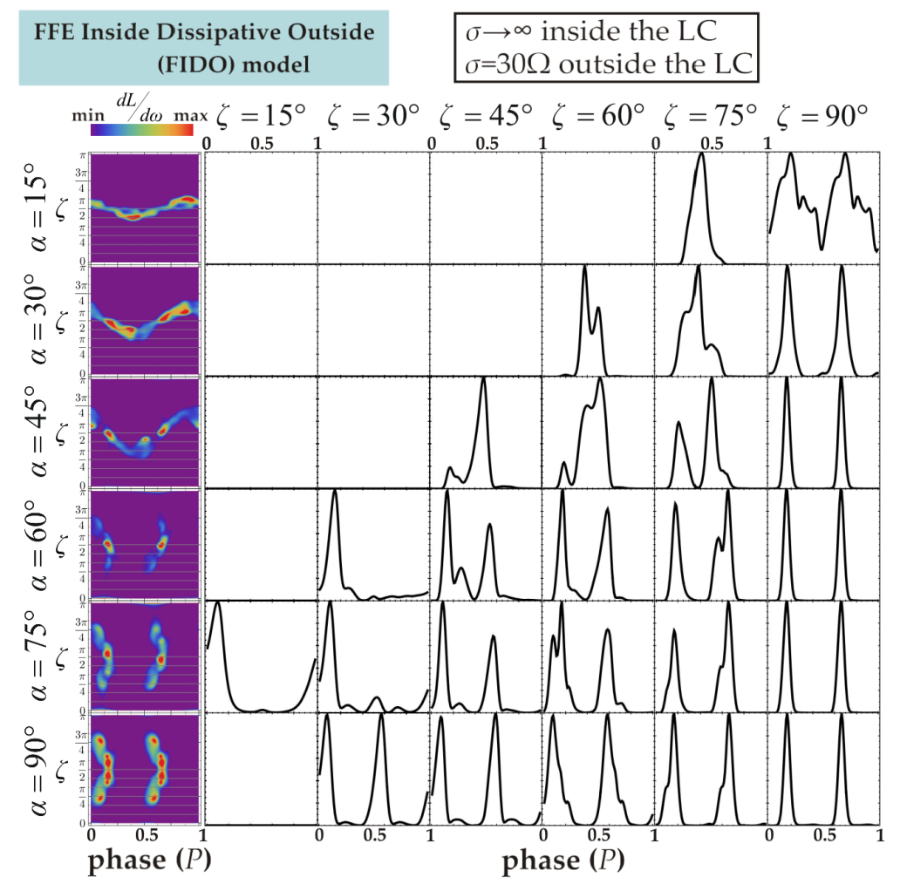
Dissipative magnetospheres with σ
2014

Slide 16
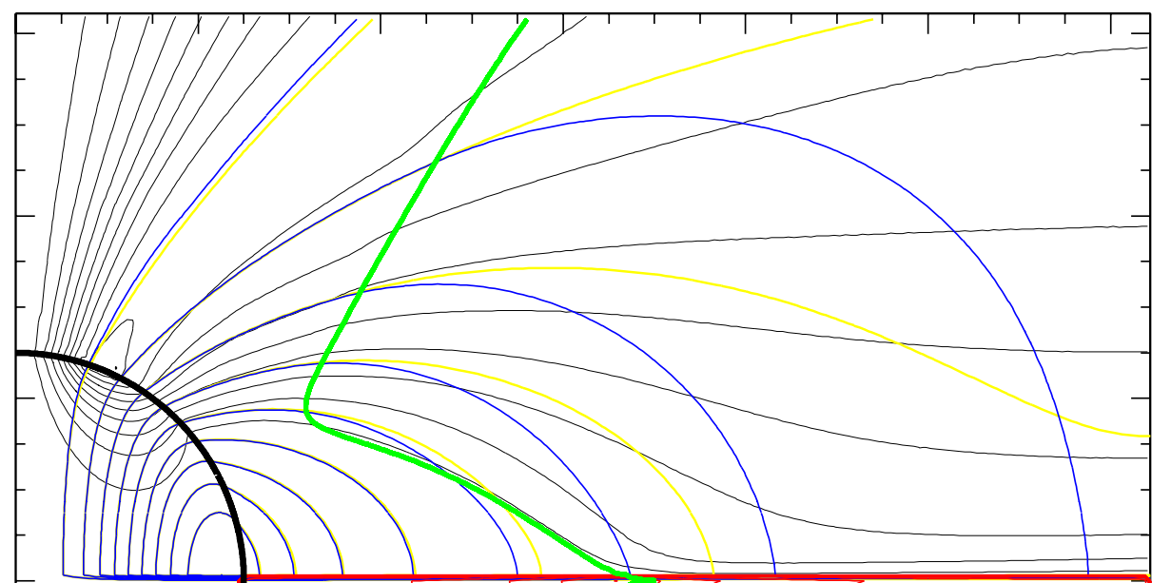
Dissipative magnetospheres with particle tracing
FFE
AE
J
B
2015, 2016

Slide 17
“Ab initio” magnetospheres
2016

Slide 18
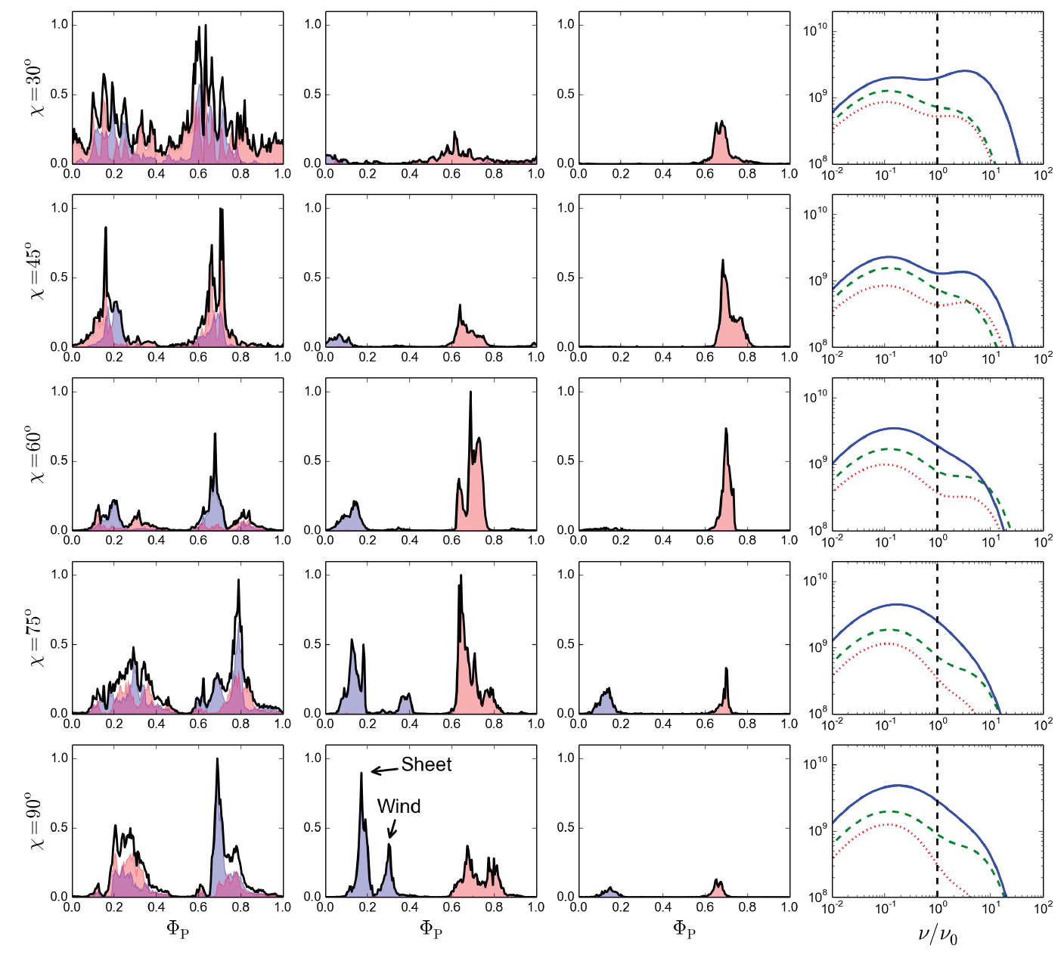
“Ab initio” magnetospheres
2016

Slide 19
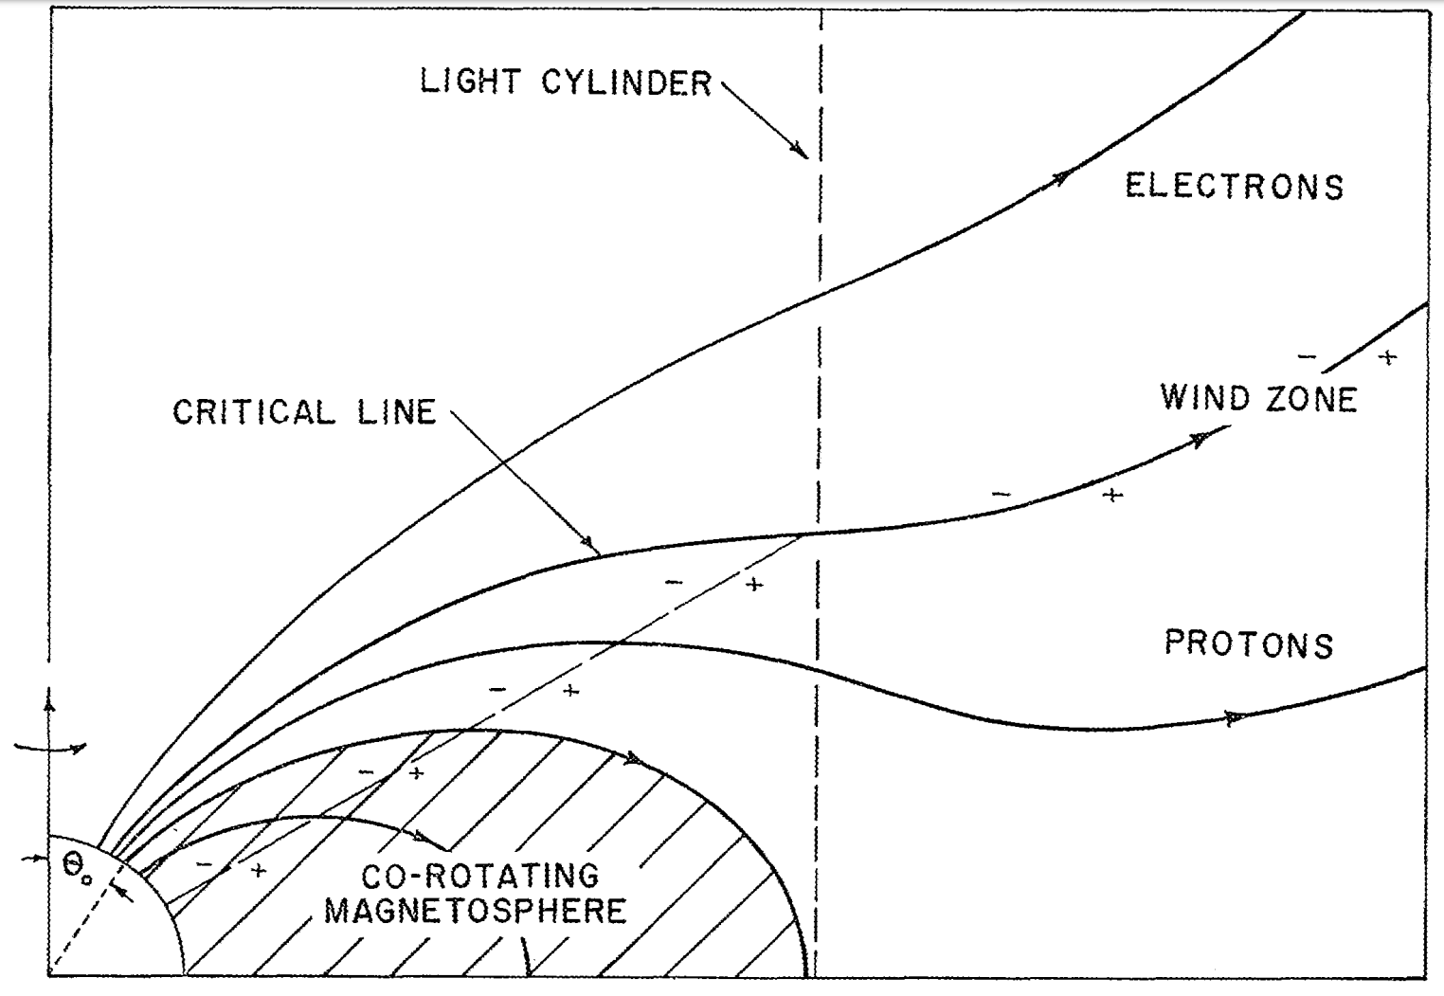
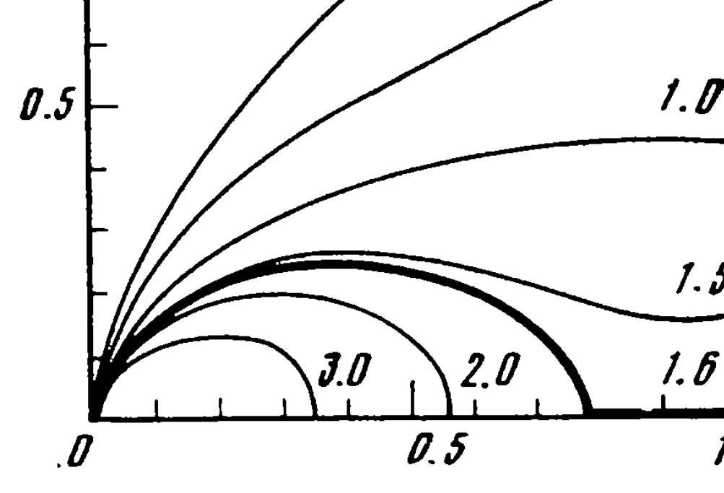
What drives dissipation?
1969
1990

Slide 20
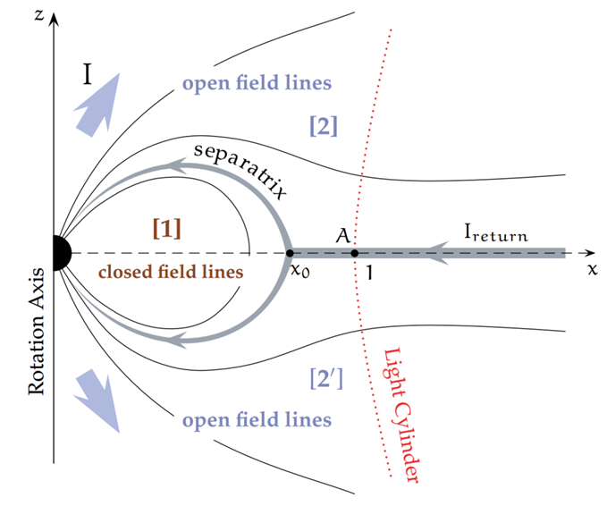
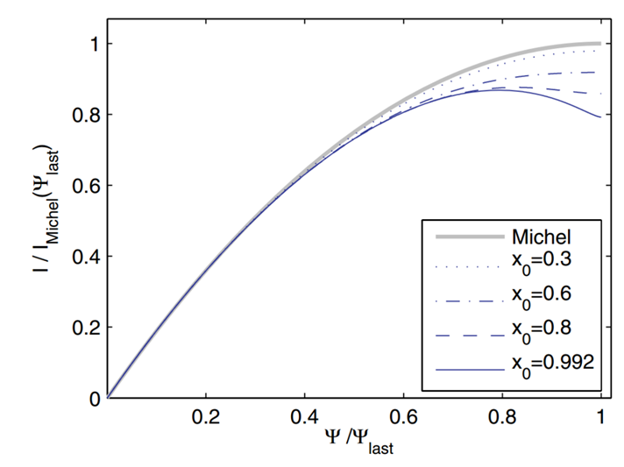
What drives dissipation?
1999, 2005; 2006

Slide 21
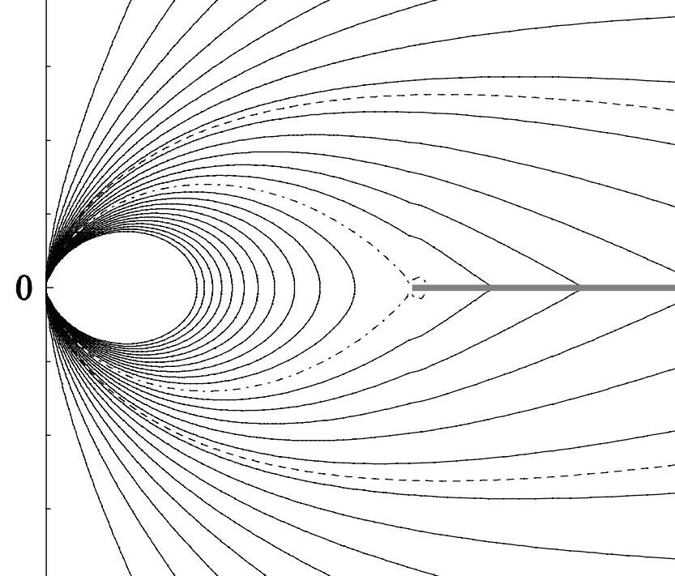
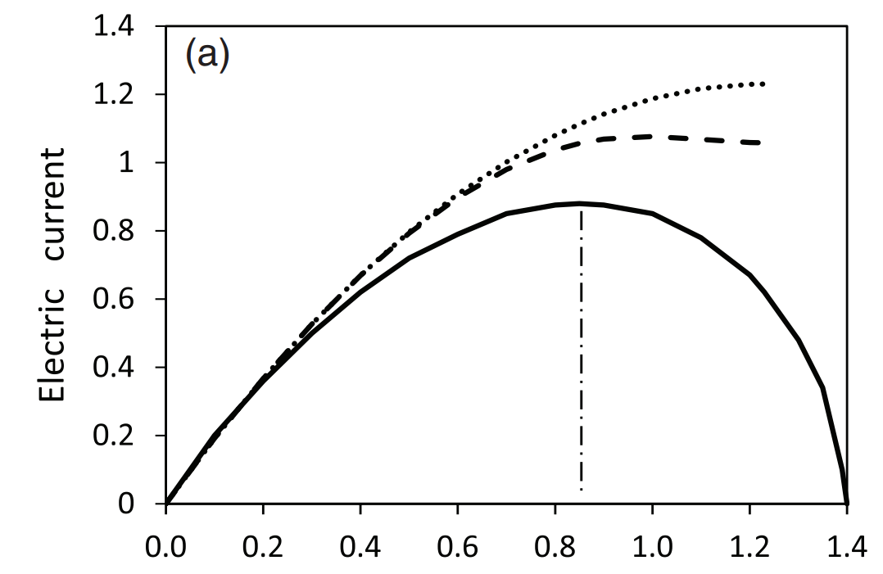
What drives dissipation?
2007, 2014

Slide 22
What drives dissipation?
EꞱ
E
Eǁ

Slide 23
What drives dissipation?
EꞱ
=xBr
Eǁ
=xBz

Slide 24
What drives dissipation?

Slide 25
What drives dissipation?

Slide 26
What drives dissipation?
Sironi, Spitkovsky, Arons 2013
Cowley 1985

Slide 27
The Y-point
EꞱ
= xBp

Slide 28
The Y-point
Bp, Ep, σ, all three vanish right outside the Y-point
It becomes problematic to support a current sheet through the Y-point, unless Bφ also vanishes there
There is no current sheet that returns to the star
CKF “proved” that the solution that is dissipationless everywhere is unique and it does contain a separatrix current sheet
The CKF-type solution cannot be valid anymore, and the magnetosphere must find a new very different global equilibrium that is strongly dissipative

Slide 29
The Y-point
2015

Slide 30
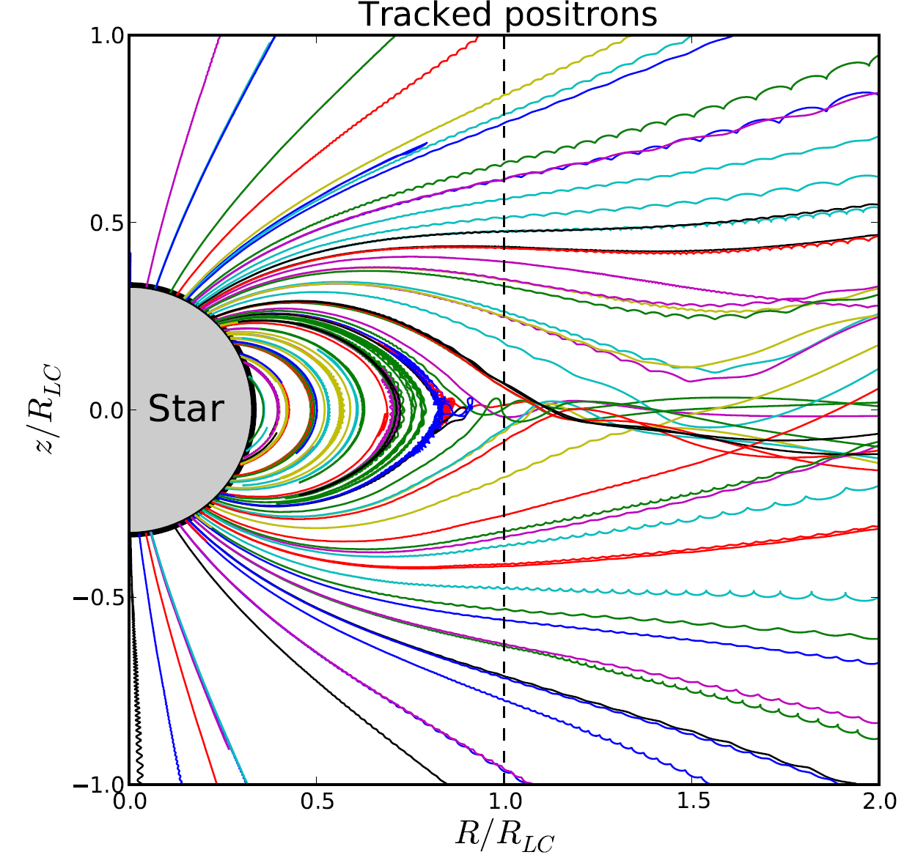
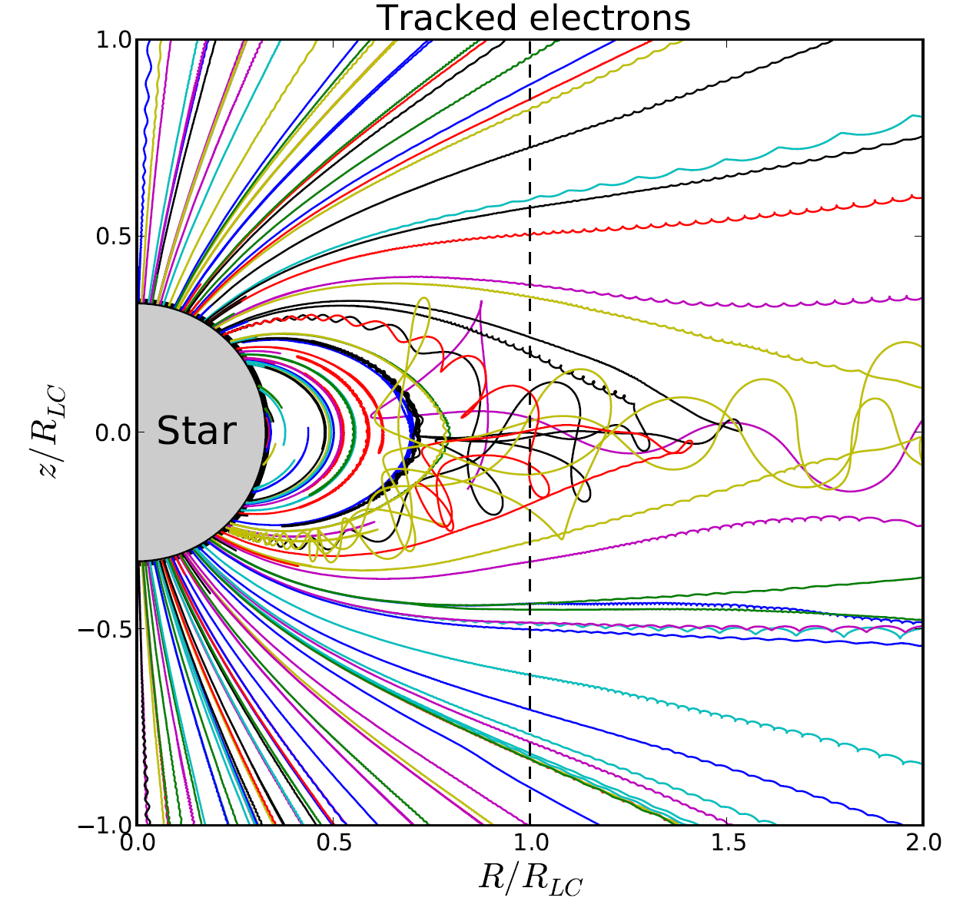
The Y-point
Cerutti et al. 2012; 2015

Slide 31
The Y-point
Force-Free Electrodynamics
Aristotelian Electrodynamics
Contopoulos 2016

Slide 32
The Y-point
FFE
FFE+AE: the `Device’
Contopoulos 2016

Slide 33
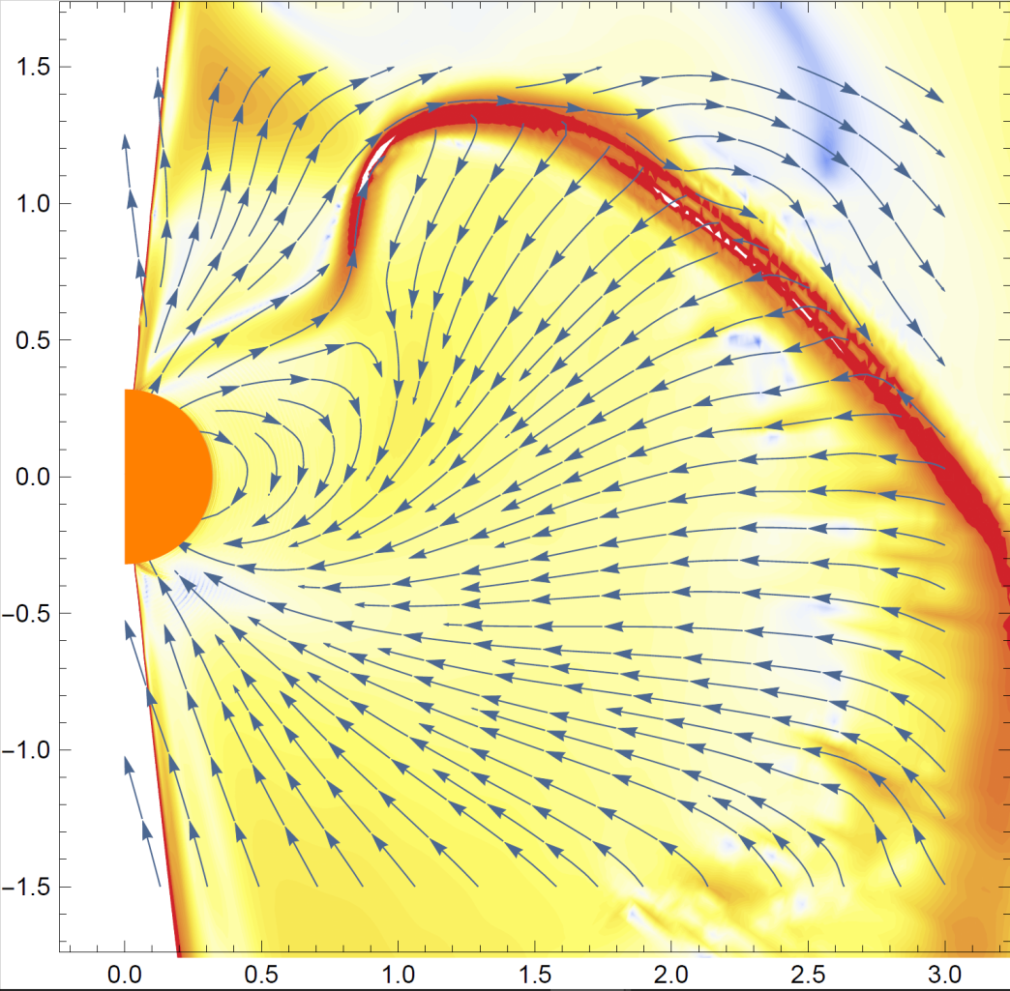
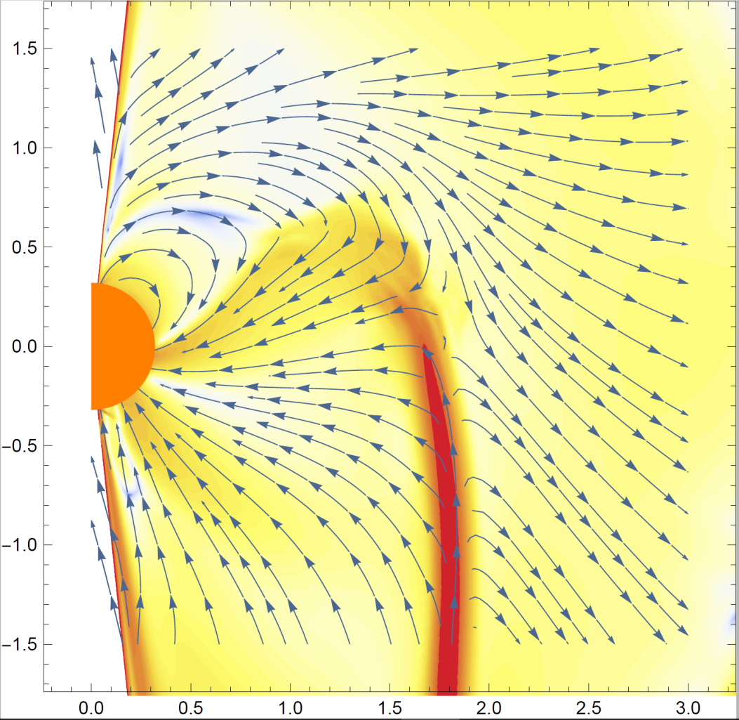
The Y-point
FFE
FFE+AE
Contopoulos 2016 in preparation

Slide 34
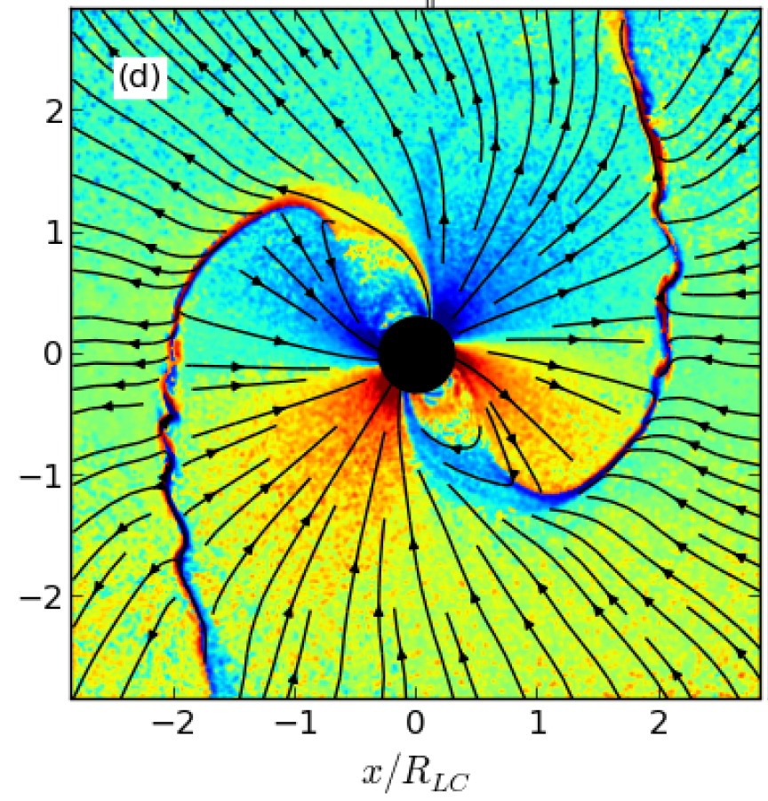
The Y-point
Cerutti et al. 2015
Philippov et al. 2015

Slide 35
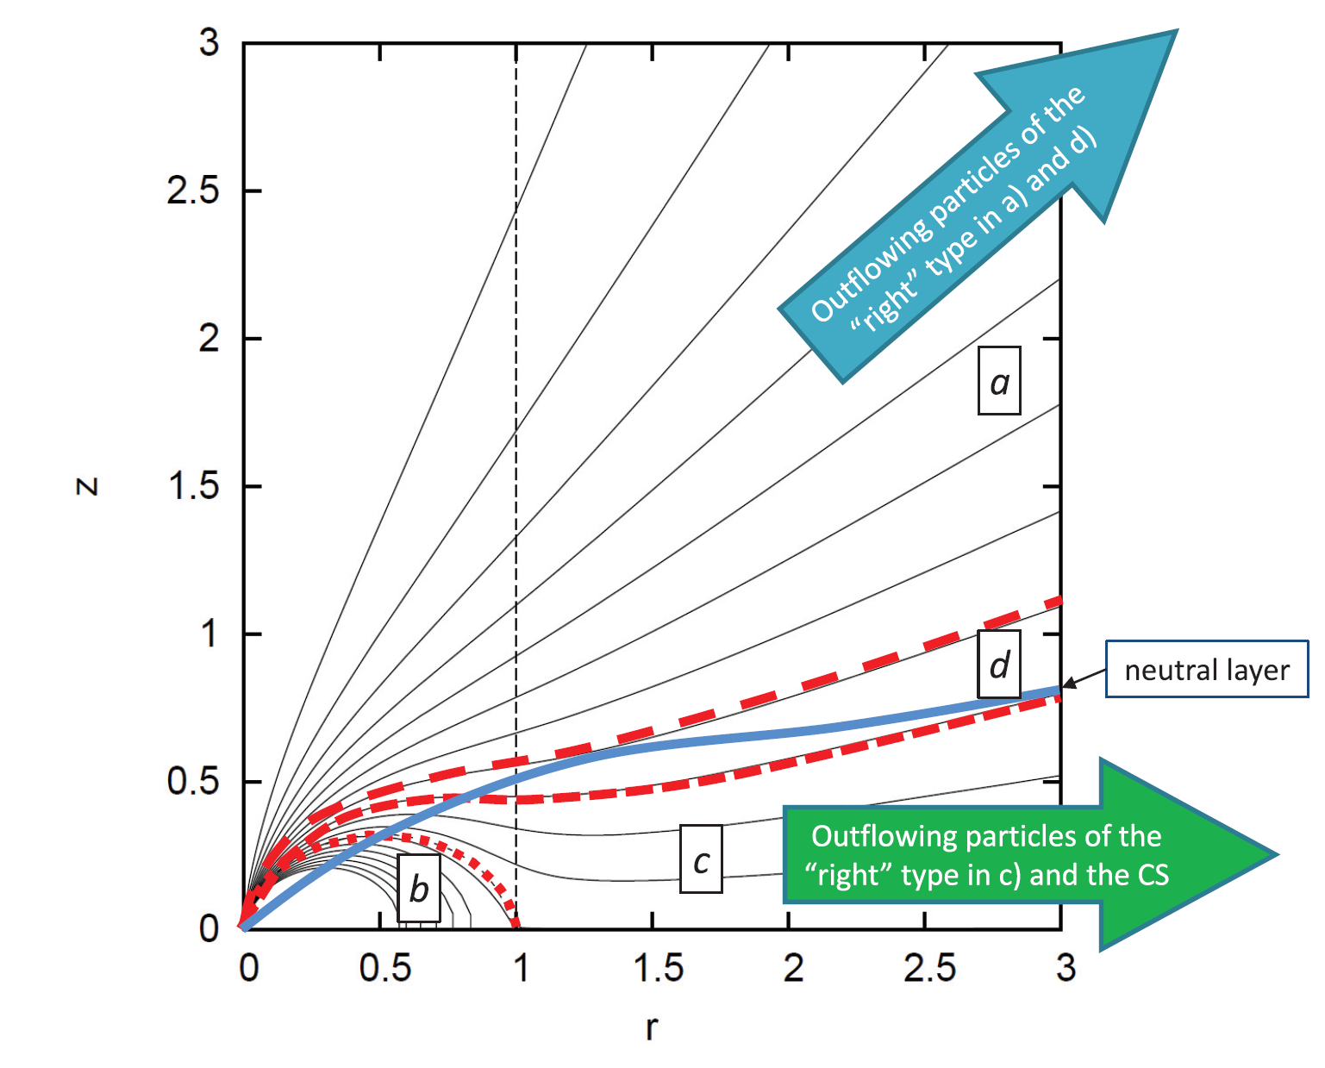
The crossings of the null surface
Contopoulos 2016

Slide 36
Epilogue
We can construct an “economical” magnetosphere with large corotating regions of one type of charge, threaded by fast outflowing streams of the other type of charge
Protons (instead of positrons) provided by the star?
Aligned pulsars different from counter-aligned ones
Strong hints (both theoretical and numerical) that the magnetosphere is strongly dissipative in the equatorial current sheet
FFE everywhere, AE in the equatorial CS
It is early for global “ab initio” PIC simulations
Our proposal:
Combine ideal MHD/FFE global simulations with focused PIC simulations of the equatorial CS and the Y-point

