Slide 1
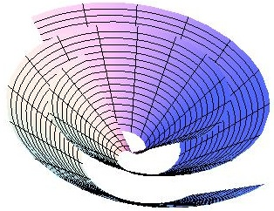
Spacetime Approach to Force-Free Magnetospheres
Sam Gralla
University of Maryland
NASA Einstein Fellow
Collaborators:
Daniel Brennan (UMD undergrad)
Ted Jacobson (UMD prof)
1305.6890, 1311.0752, 1401.6159, in prep

Slide 2
Force-Free Electrodynamics
Magnetically dominated plasma
Pulsars, AGN, …

Slide 3
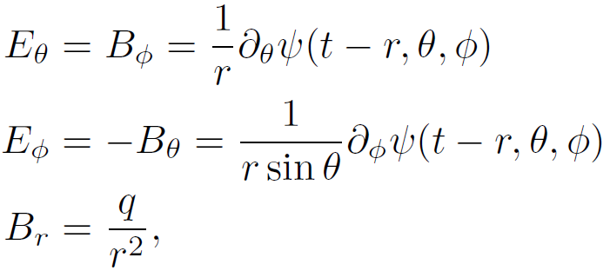
Exact Solution Family
Brennan, SEG, Jacobson 2013
SEG & Jacobson 2014
free function of three variables
number

Slide 4
Talk Outline
How did we find this?
What is it good for?
What else have we done?
spacetime approach
pulsars, general asymptotic behavior of “free” magnetospheres?
push the spacetime approach as far as possible…
Field sheet picture
No ingrown hair theorem
varia
In this talk:

Slide 5
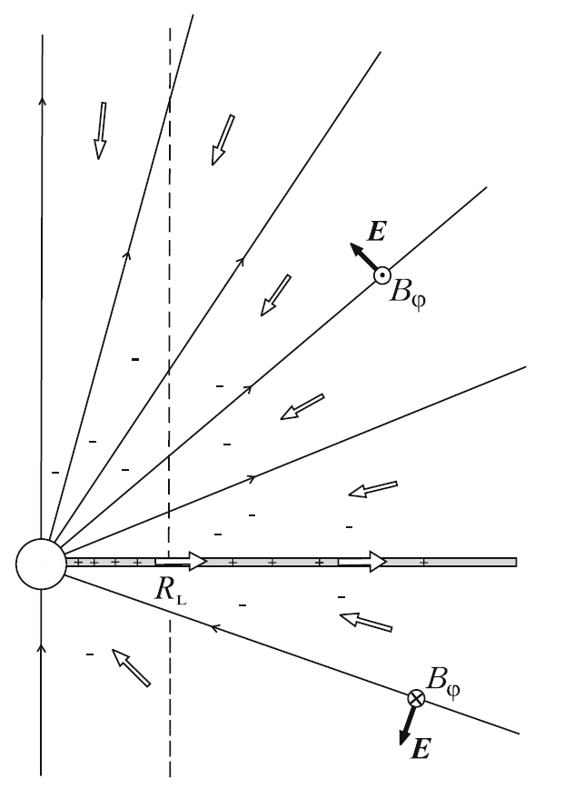
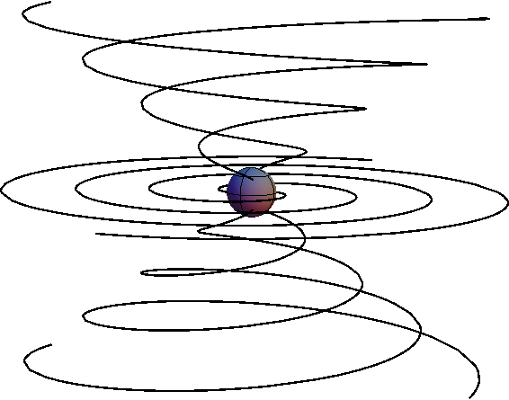
The Michel Monopole
Michel 1973
from Beskin 2010
In split form, can regard as
toy model for dipole pulsar
model for asymptotic pulsar magnetosphere
or

Slide 6
An Observation
The Michel monopole has charge and current satisfying
In spacetime language, the charge-current four-vector is lightlike or null.
This observation is powerful.
Null structure is fundamental to spacetime.

Slide 7
Menon & Dermer 2007
Family of stationary, axisymmetric exact solutions in Kerr
Parametrized by free function Λ(ϴ)
E²=B²
These solutions also have null four-current!
(Along the so-called principal null congruence(s) of Kerr.)

Slide 8
Null-Current Solutions
We assumed null current and used the Newman-Penrose formalism, which is designed to leverage null structure.
(Brennan, SEG, Jacobson 2013)
We found the general solution with null, radial current in flat, Schwarzschild, and Kerr (radial=PNC) spacetimes.
We later re-derived the solutions using the language of differential forms, where the calculations are simple and the physical content is clear (to the forms-initiated!)
(SEG & Jacobson 2014)
forms
example:

Slide 9
New Solutions
The general outgoing solution with radial, null current in flat spacetime is
magnetic monopole
outgoing Poynting flux
non-stationary & non-axisymmetric!
(Also valid in Schwarzschild, and we found analogous solutions in Kerr)
Michel monopole:
3+1:

Slide 10
Three Applications
Generalized monopole
Asymptotic magnetosphere
Non-scattering waves around black holes

Slide 11
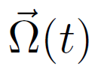
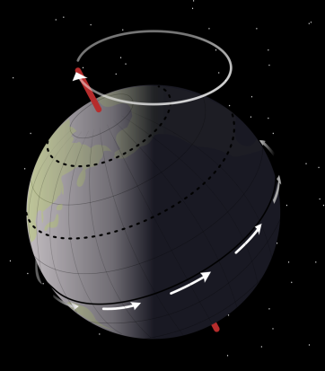
1. Generalized Monopole
Conducting sphere rotates arbitrarily
Michel’s rotating monopole is
(No E-field in rotating frame)
Whirling monopole:
(No E-field in whirling frame)
( )
Given , whirling magnetosphere is
Precession: a circular whirl
The flux agrees with the instantaneous Michel solution.
Can model (e.g.) a pulsar glitch

Slide 12
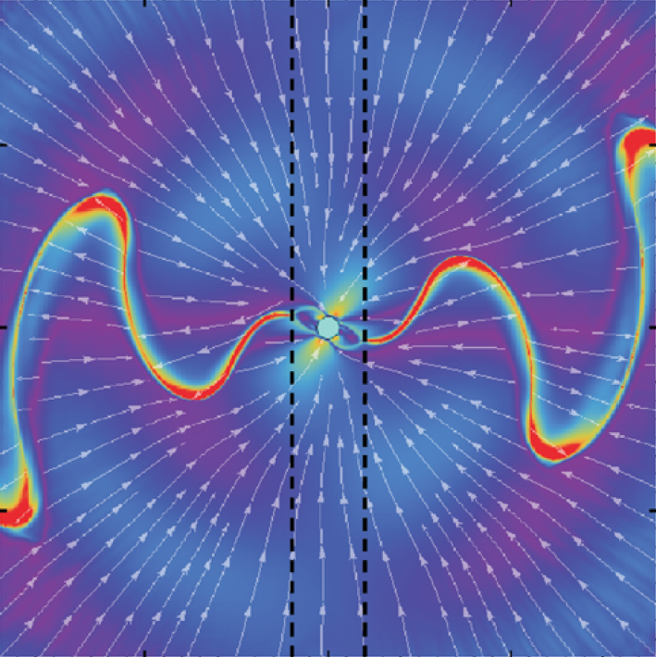
2. Asymptotic Magnetosphere
Conjecture: If outgoing boundary conditions are imposed at infinity, then for any interior boundary conditions the current will be asymptotically null and radial.
Related to Michel’s “minimal torque condition”
Numerical evidence from Kalapotharakos et al 2011
Evidence against from Tchekhovskoy et al 2013?
(any other evidence for/against?)
If so, these exact solutions describe the generic far-field behavior of force-free magnetospheres.
Could model outgoing kink in field lines originating from a glitch or catastrophic event.

Slide 13
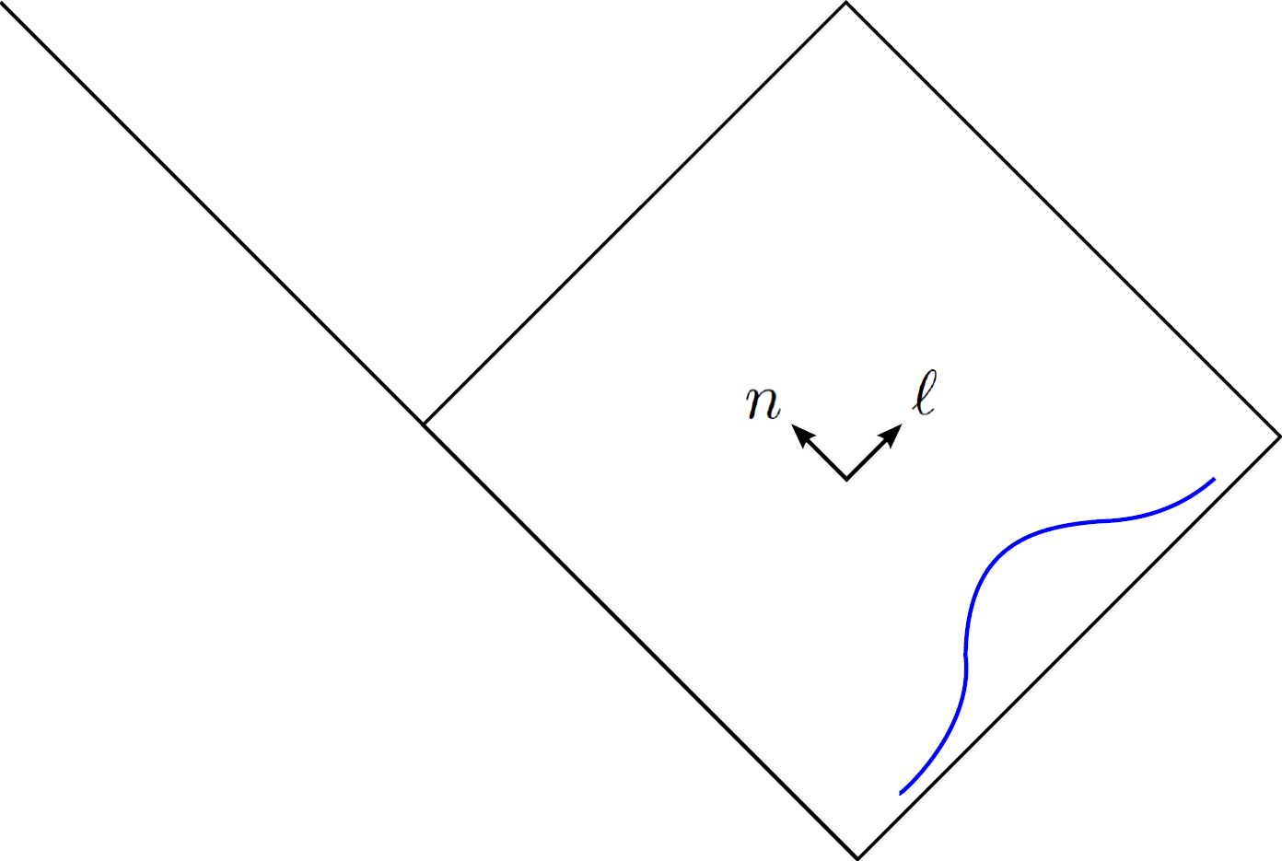
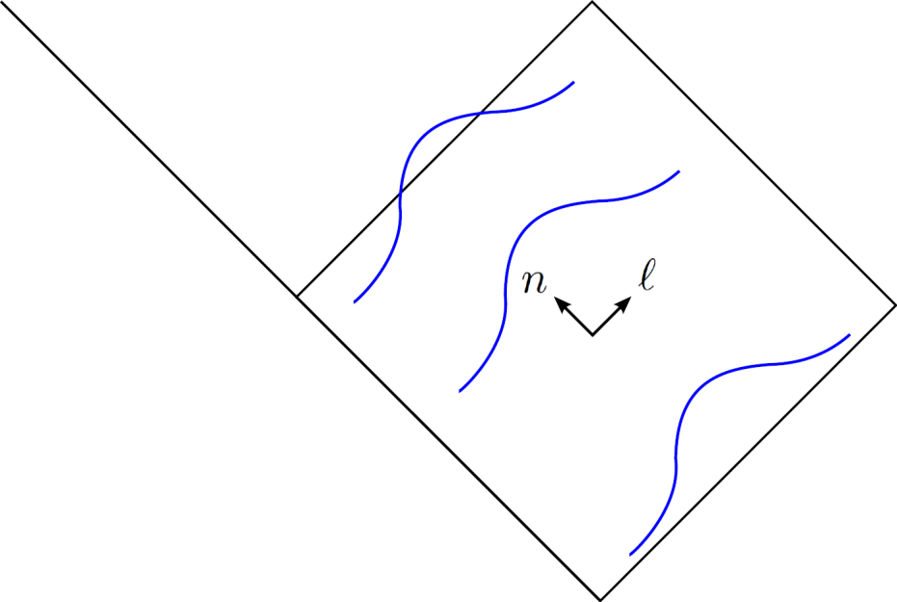
3. Non-Scattering Waves
Ingoing version in Schwarzschild (Eddington-Finklestein coordinates)
,
The free function can specify an initial wave packet…
…and the wave just goes in.
This was shocking to us! All other kinds of radiation scatter off the black hole.
In particular there are no vacuum electromagnetic waves like this.

Slide 14
Generalized monopole
Asymptotic magnetosphere
Non-scattering waves around black holes

Slide 15
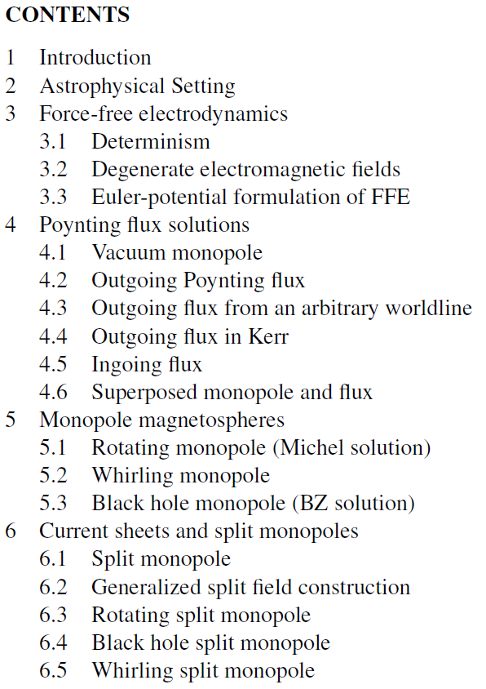
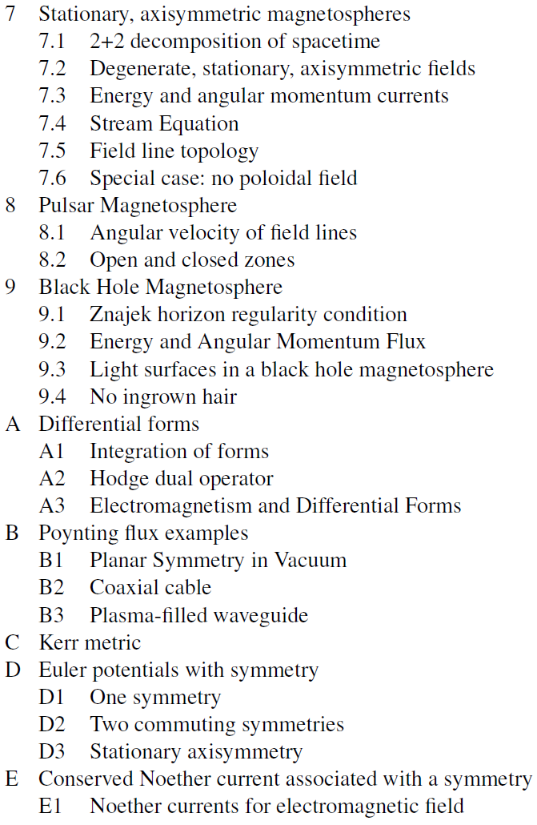
The Spacetime Approach
SEG&Jacobson 2014

Slide 16
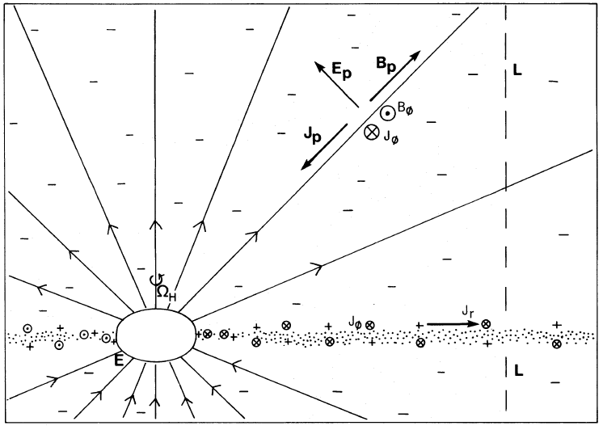
Black Hole Split Monopole
(Blandford-Znajek solution)
Promote the Michel solution to linearized Kerr (BL coordinates),
Solves equations provided . (Easily checked in forms approach)
Regularity on horizon implies
This first order piece is enough to see the energy extraction.

Slide 17
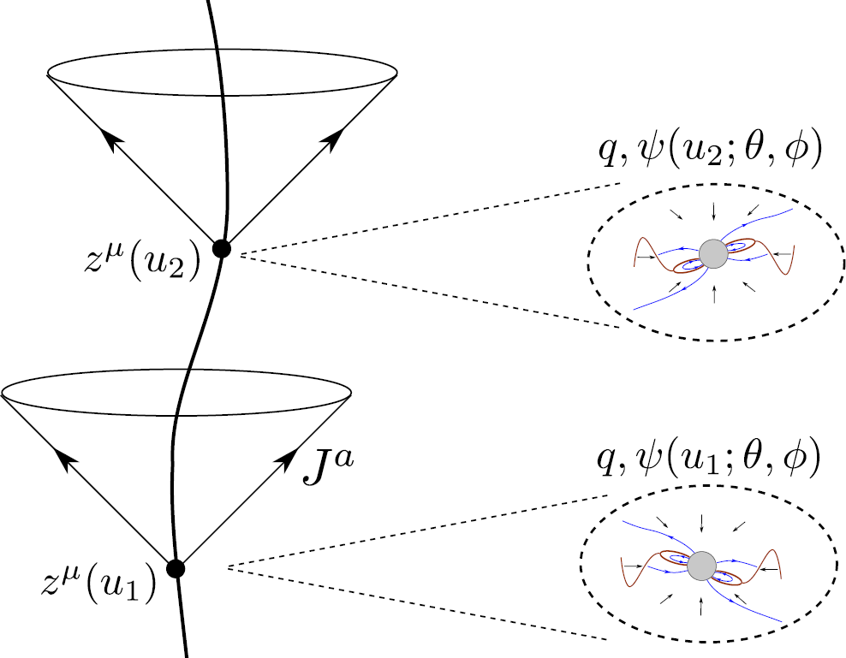
Accelerating Monopole
(Brennan & SEG 2013)
Assume null current along the light cones of an arbitrary timelike worldline.
moving magnetic monopole
Poynting flux
Extra power radiated due to acceleration:

Slide 18
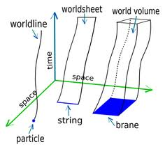
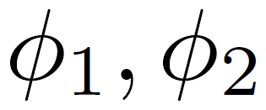
Euler Potentials & Field Sheets
Carter 1979, Uchida 1997
For a degenerate field F,
( )
Surfaces of constant :
worldsheets of magnetic field lines

Slide 19
Field sheet metric
(SEG&Jacobson 2014)
The spacetime metric induces a metric on each field sheet.
Particles* move on timelike geodesics of the field sheets
Alfven wave group velocity follows field sheet null geodesics
In stationary axisymmetry, every field sheet has a Killing vector,
field line angular velocity
Thus there is a conserved quantity along field sheet geodesics. This is the quantity used to calculate particle wind (e.g. CKF)
Where k is null is called a light surface. It’s a causal boundary for particle and Alfven propagation.
*neglecting cyclotron, drift, and curvature radiation reaction

Slide 20
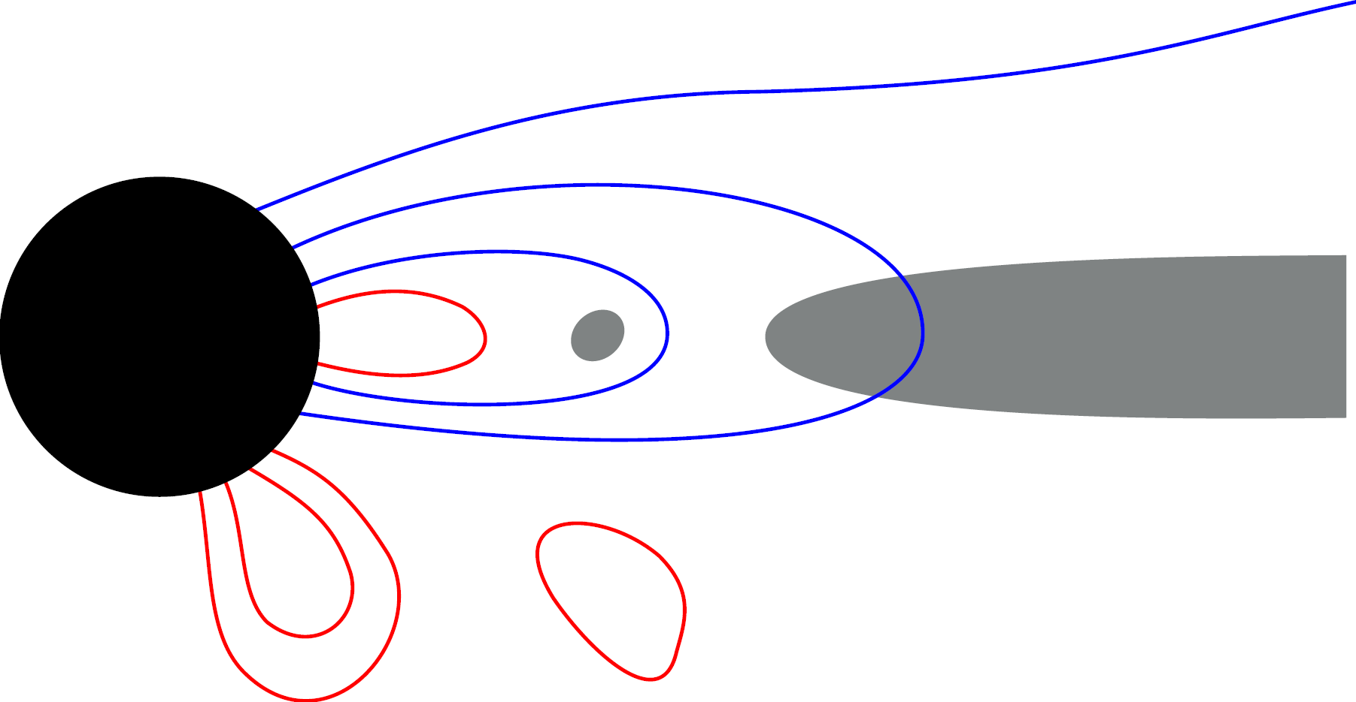
No Ingrown Hair
(MacDonald&Throne 1982; SEG&Jacobson 2014)
An astrophysical black hole can’t have its ``own’’ magnetic field.
(vacuum, stationary, axisymmetric, no charge = no magnetic field)
Force-free generalization: no closed field lines
allowed
not allowed
gray: not force-free

Slide 21
Extremal Znajek Condition
In the stream equation formulation for stationary, axisymmetric force-free fields in Kerr, there is a regularity condition on the horizon (Znajek 1977),
This condition is not sufficient for regularity in the extremal case a=M.
There we have an additional condition (SEG&Jacobson2014),

Slide 22
Stream Equation for No Poloidal Field
The usual Grad-Shafranov approach is built on the assumption of a non-vanishing poloidal magnetic field. If the field vanishes you have a different stream equation (SEG&Jacobson 2014)
Chi is the electrostatic potential,
See related work of Contopoulos (1995)

Slide 23
The Spacetime Approach
SEG&Jacobson 2014

Slide 24
We are taking a spacetime approach to force-free magnetospheres.
I presented:
1. Time-dependent, non-axisymmetric exact solutions:
Null current (J=ρc)
superposed monopole and Poynting flux
Do these give the general outer magnetosphere?
2. Varia
Field sheets, symmetries and particle wind
No ingrown hair theorem
Accelerated monopole
Extra Znajek condition for extremal Kerr
Stream equation for no poloidal field

