Slide 1
Relativistic Reconnection in Pairs:
Mass Transport (Acceleration?)
J. Arons
UC Berkeley
Question: How Does Return Current in PSR Magnetosphere Form?
What is density of current carriers?
Consequences (many): How do beamed gamma rays get emitted?
How do beamed lower energy photons from outer magnetosphere
get emitted?
What is the origin of torque fluctuations?
Basic Model: MHD Magnetosphere, fed by e± pairs from low altitude
polar flux tube (pair creation in high altitude may contribute)

Slide 2
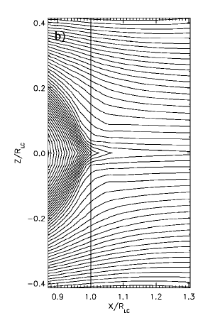
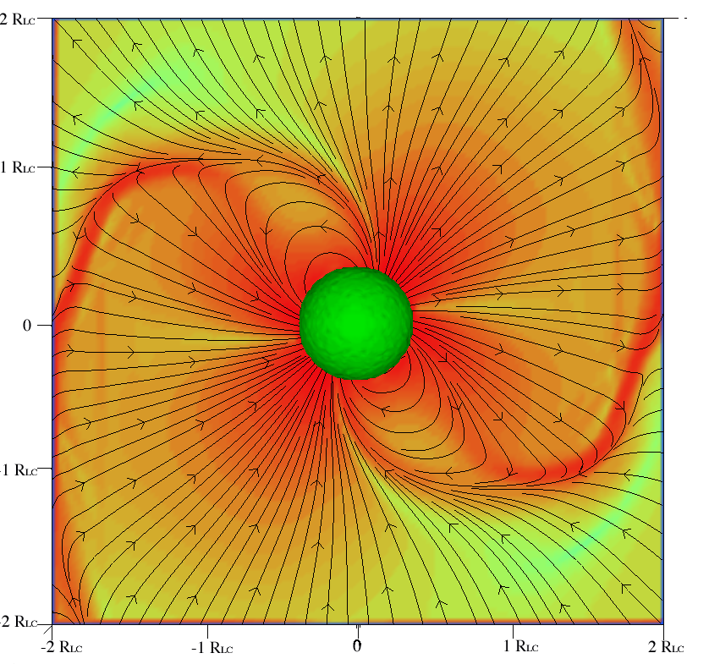

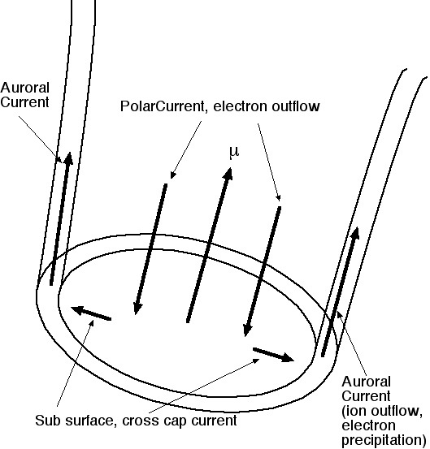
Magnetic Y-line feeds
Polar
Outflow v = c
☉
2δ
╳
Reconnection inflow
2l_{D}
Plasmoid
Field Aligned current
precipitating electrons supplied by diffusion box + upward ions from stellar atmosphere)
R_{L}
Reconnection E (radial in geometry shown) sustained by off diagonal pressure tensor ∝ ∂p_{i}/∂x_{j}
(“collisionless viscosity” – seen in all relativistic
reconnection in pairs 2D & 3D PIC simulations:
Hoshino & Zenitani; Bessho & Bhattacharjee;
Kagan, Milosavljeic & Spitkovsky,….)
X
w=relativistic enthalpy; anomalous resistivity, rad reaction neglected
Polar Cap
Obtuse geometry has precipitating positrons , electron outflow
Non-MHD inertial E ∝n⁻¹ (T/mc²): favors low density; hot = high energy
Acute rotator

Slide 3
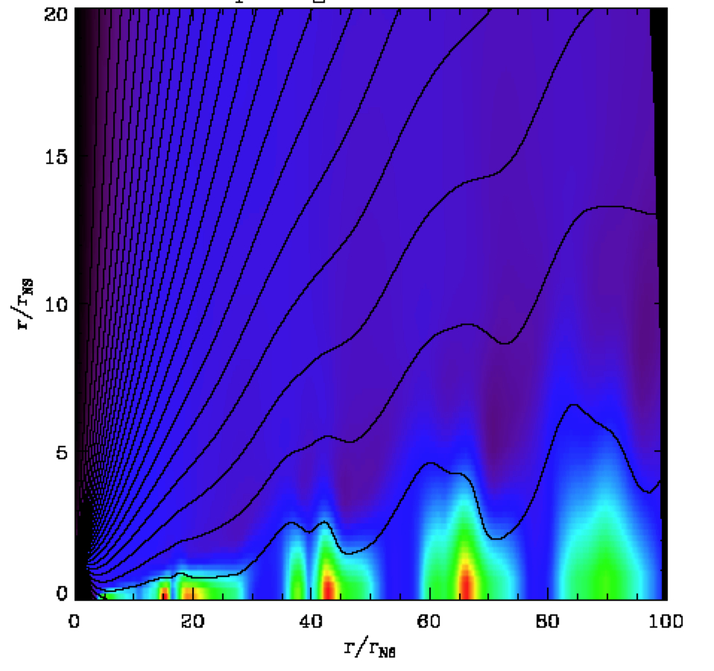
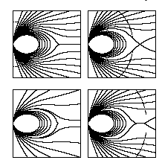
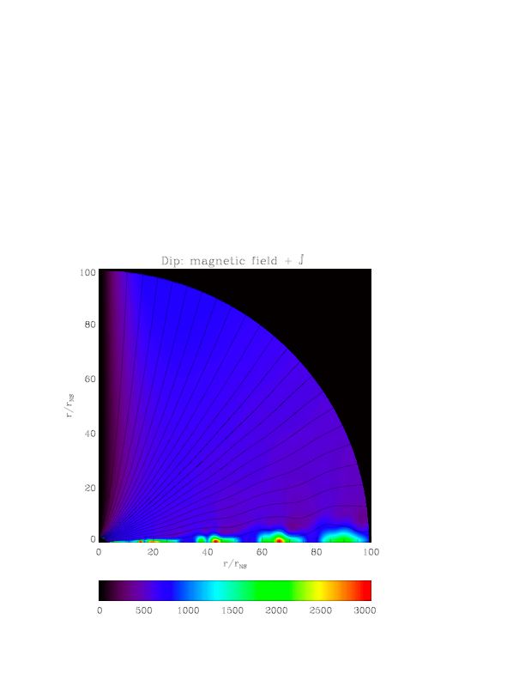
Reconnection/Return j
Sporadic X-Point, Plasmoid formation
occurs continuously
Contopoulos
Pairs all come from pole,
on open field lines
Sporadic reconnection
moves plasma across
B – ExB drift in
non-corotation E, time
variable E at all times
Bucciantini et al
Bucciantini et al 2006
relativistic MHD with numerical dissipation
(Contopoulos & Spitkovsky)
Plasma, j flow to star in thin separatrix layer
dynamics in (standing Kinetic Alfven wave
boundary layer)
AURORAL ACCELERATION
Kinetic Alfven wave extracts return current
(Torque fluctuations, limit cycles built in (drifting subpulses)?)

Slide 4
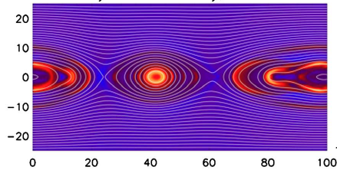
Unmagnetized
Diffusion region
Polar
Outflow v = c
☉
2δ
╳
Reconnection inflow
2l_{D}
Field Aligned Return Current
Plasmoid
Magnetic Y-line
Diffusion
Region
X
R_{L}
PIC reconnection simulation in pairs
Zenitani & Hesse (2½ D)
Electric return current channel
Downward electron beam,
upward ion beam
Downward positron beam,
upward electron beam

Slide 5
Acceleration in the Return Current Channel (including current sheet
beyond the light cylinder)
Total value of current fixed by the force free magnetosphere;
Reconnection modeled by steady flow, 2 fluid theory of diffusion
region – E_{rec} supported by off diagonal pressure tensor - viscosity
Channel current modeled as steady counterstreaming beams
Density of precipitating beam in the return current channel at r = R_{L}
set by density in diffusion region n_{diff}: reconnection inflow=exhaust:
(Lyubarsky 96)
= GJ density at LC ≅10^{6.2}cm⁻³ (Crab), β_{rec}~0.1,
β_{wind}=1, l_{D}/δ =10-100 (PIC sims, theory)
Multiplicity κ± = n_{pair}/n_{GJ} ≫10⁴ (perhaps 10⁷ in the Crab), B_{LC} = Φ/R_{LC}
Viscosity in diffusion region (bounce motion exchanges momentum
across flow) heats diffusion region plasma; synchrotron cooling
(curvature radiation with radius of curvature = δ) balances heating:

Slide 6
Reconnection flow supplies particles to Y-line/Current Sheet:
Return Current Formation – space charge limited flow out of
hot unmagnetized diffusion region
Direct Accelerator? Geophysics says no, accelerator = field aligned
E||, reconnection E is perp; could accelerate in B = 0 current
channel (Alfven, 1968) – guide field usually exists, suppresses
free acceleration
PIC Simulations of Relativistic Reconnection (in Pair Plasma)
Simple Current Sheet Geometry – no Y-line/magnetospheric
obstacle
Zenitani and Hoshino 2001-2008
Bessho and Bhattacharjee 2005, 2012
Hesse & Zenitani (NR pairs, 2007)
Sironi & Spitkovsky (2012); Kagan et al (2013)
Cerruti et al (2013 – not analyzed for reconnection physics)

Slide 7
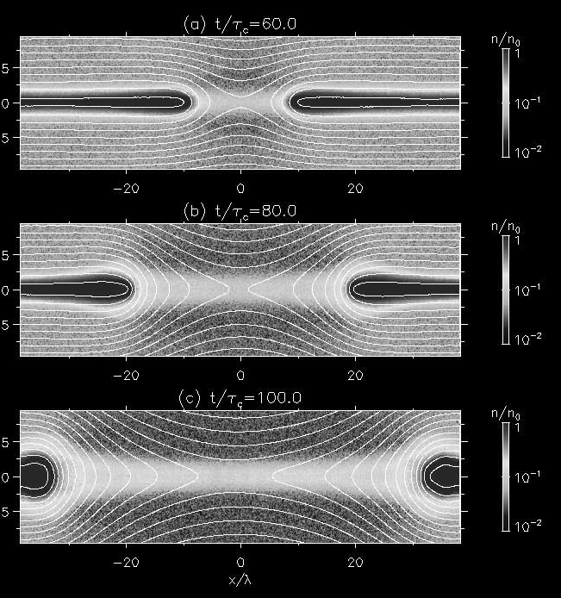
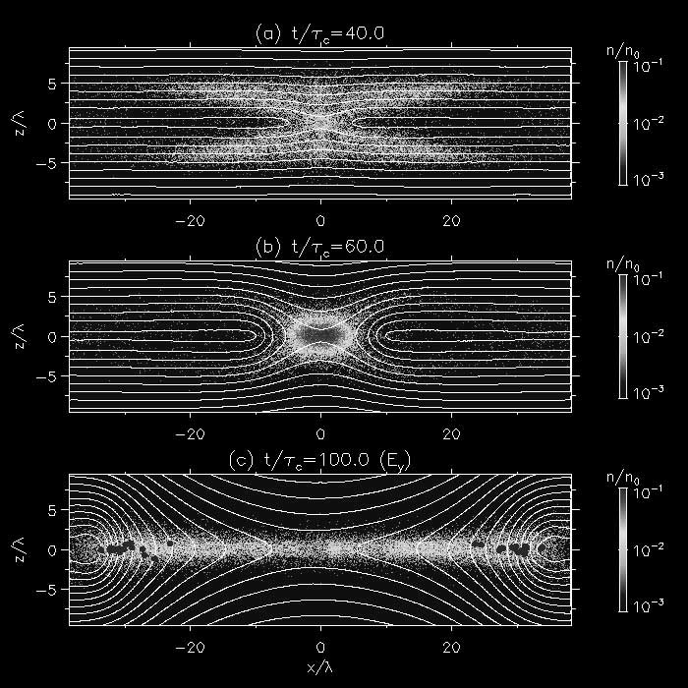
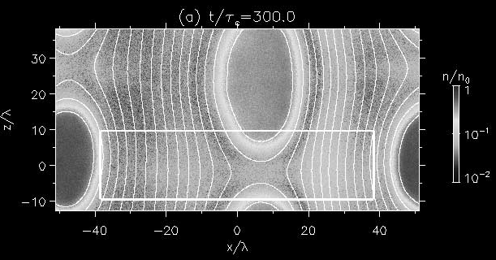
Zenitani & Hoshino snapshots – pairs current sheets tear (fast)
Density & B
t/τ_{c}=40
t/τ_{c}=60
t/τ_{c}=100
Accelerated Particles spatially,
ε > 50 mc²
t/τ_{c}=300
2D Plasmoid

Slide 8
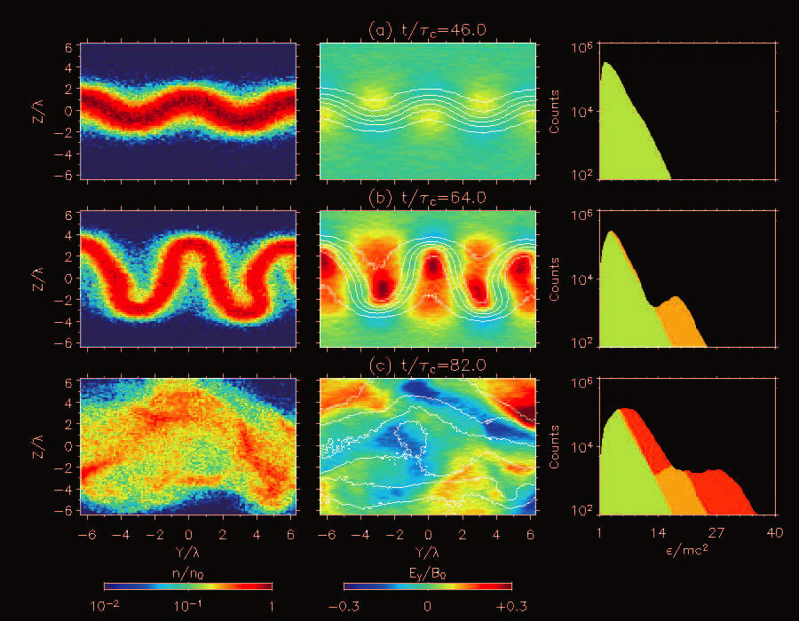
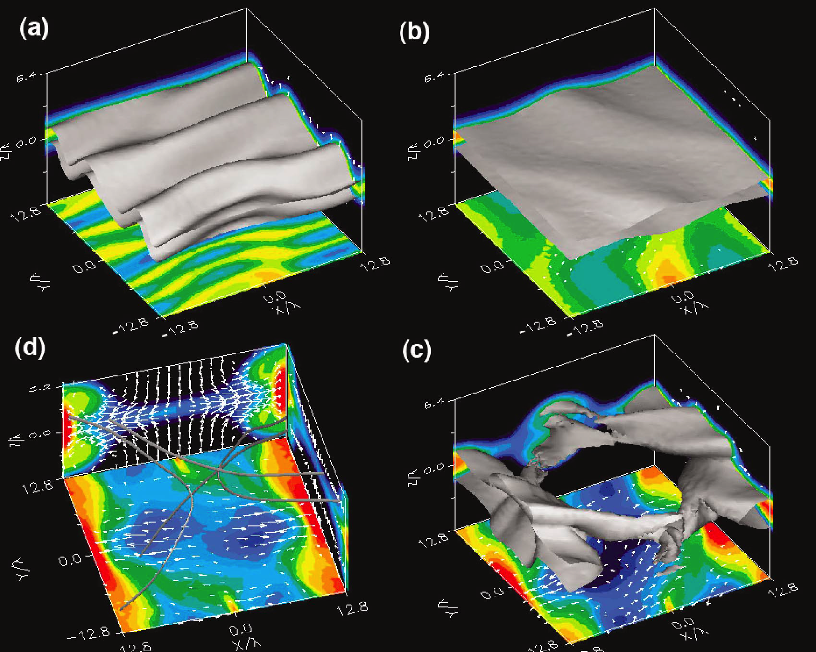
Sheet Kinks (Drift Kink Instability)
3D – Tearing & Kinks together
3D plasmoid = flux tube
Fermi II like acceleration, current sheet broadening
Maximum energies set by residence time – kinks cause drifts out of
accelerating E, ‘speiser’ orbits focus particles back into E –
NO UNIQUE ANSWER – set by current sheet length – macroscopic?
turbulence coherence lengths? gradient drifts in bent sheets?
Acceleration efficiency – how many particles flow through acceleration
(B≈0) region – related to what sets reconnection return current density
volume?

Slide 9
Polar
Outflow v = c
Reconnection Flow Model
2 fluid theory of E_{rec}, l_{D}/δ, etc
Takes pairs from polar outflow/
wind into diffusion region/closed
zone/current sheet at speed
|v_{z}|=cE_{rec}/B_{ext} = v_{rec}
Inflow rate_{diff} =2 n_{wind} |v_{z}|2πR_{LC}(2l_{D})
Outflow rate = v_{A}(out): locally steady
flow, ∝δ
set inflow = outflow⇒n_{diff}:
2 n_{diff} v_{A}(out)2πR_{LC}(2δ) = 2 n_{polar} _{wind} |v_{z}|2πR_{LC}(2l_{D})
Ε, Β_{out}, l_{D}, δ = T_{diff}/eB_{in} Simulations show l_{D}/δ from a few to ~ 100, v_{A}(out) = c???
ALL simulators report fast reconnection v_{rec} =(0.03-0.3)v_{A}(upstream)
All report E_{rec} based on pressure anisotropy: E_{y}∝∂P_{xy}/∂x, ∂P_{zy}/∂z
☉
2δ
╳
Reconnection inflow
2l_{D}
B_{φ}
Plasmoid
X
X

Slide 10
Diffusion region unmagnetized, shear flow:
Useful model: Pressure anisotropy viscous stress:
Useful model works in non-relativistic current sheet reconnection, gets
E, Β_{out}, l_{D}, δ = T_{diff}/eB_{in} of simulations ~ OK: viscous heating = adiabatic cooling
Relativistic (young PSR): viscous heating = radiation (“synchrotron” cooling
Relativistic (simulations): viscous heating = adiabatic cooling (Cerruti – radiative)
Solve as in Sweet-Parker model (2D current sheet geometry):
derivatives: ∂/∂z 1/δ, ∂/∂x 1/ l_{D} - solution still in progress
Use l_{D}, E from simulations (Kagan et al): , l_{D}/δ = 15, v_{rec} = 0.05 v_{A}(in)

Slide 11
= GJ density at LC ≅10^{6.2}cm⁻³ (Crab), β_{rec}~0.1,
β_{wind}=1, l_{D}/δ =10-100 (PIC sims, model)
Multiplicity κ± = n_{pair}/n_{GJ} ≫10⁴ (perhaps > 10⁷ in the Crab)
Viscous heating in diffusion = synchrotron cooling:
Density of particles at start of wind current sheet and precipitating onto star = n_{diff}
at start of current channels ~ 10¹³/cc in Crab
Y-line model same as 2d current sheet?

Slide 12
Current Sheet as Accelerator: Crab flares (Blazars)
Where
How long? Islands between X-lines merge?
E/B_{in}?
B_{in}? Is the B field outside the sheet uniform?
For Crab flares, with no Doppler Boost, L = light days, E/B_{in} < few:
B ~ milligauss
Hard or easy? Hard to have large magnetic overshoots in high
σ polar regions, if flux doesn’t accumulate, even 1 mG hard to reach
Time interval between flares – flux accumulation time?
Artifact of beaming (Doppler or kinetic)?

Slide 13
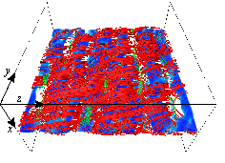
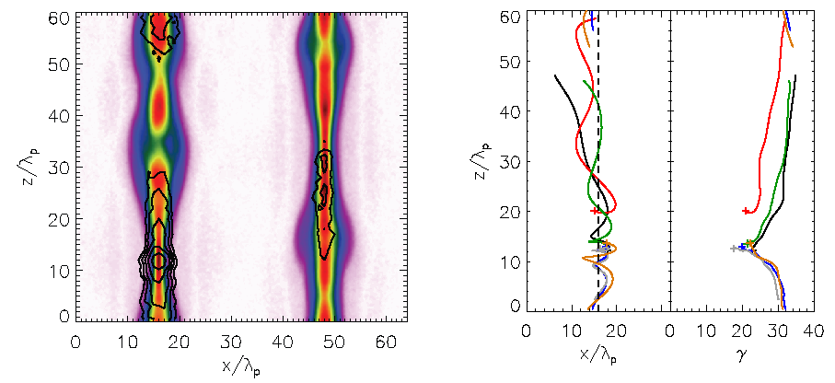
J₀
Kagan+ - 3D pairs, flux tubes quasi 2D (plasmoids),
fraction of volume with E along X-lines small
Tearing dominated (σ not large)
B₀
Where is E?

