Slide 1
Inclined Pulsar Magnetospheres in General Relativity:
Polar Caps for the Dipole, Quadrudipole and Beyond
Sam Gralla
University of Arizona
arXiv:1704.05062 (and ApJ)
with Alex Lupsasca & Sasha Philippov

Slide 2
At the first Purdue workshop (2014)…
magnetic field sheets of a monopole pulsar
…some new, GR-inspired techniques
“no ingrown hair” theorem

Slide 3
At the second workshop (2016)…
…some applications of these new methods
Non-dipolar fields
Analytic magnetospheres
Jets from moving conductors
High-energy particle collisions
Bunching of field lines on black holes

Slide 4
At the third workshop (today)…
…analytic formulae for pulsar polar cap properties including GR, inclination, non-dipolar field.
(SEG, Lupsasca, Philippov 2017)

Slide 5

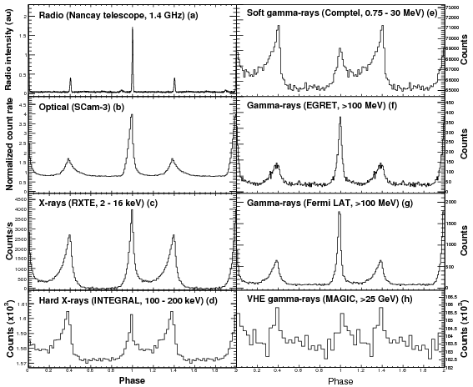
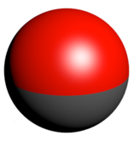
The Pulsar Problem
N
S
Simple ingredients
spinning, conducting magnet
Complex output
gamma, x-ray, radio, wind
A few numbers: M, R, Ω, I
One function: B_{r}(θ,φ)
lots of variation in emission properties

Slide 6
But which non-dipolar magnetic field to choose??
Need an efficient way to explore the parameter space.
Key idea: In the slow-spin limit ΩR<<c, the higher multipoles (and GR effects!) can be added in analytically to a dipolar, flat-space simulation
So simulate the dipole once and for all, find an analytic fit, and then we have analytic results for any magnetic field!
E.g., this is just a plot of some formulae:

Slide 7
More precisely…
Perfectly conducting star
Slow rotation
Force-free magnetosphere
Dipole dominates at light cylinder
We assume:
We provide:
Near-field configuration as a function of stellar parameters
M, R, Ω, I, B_{r}(θ,φ)
ρ_{e} and J near star
input
output
Use for efficient exploration of pair production, X-ray emission, …

Slide 8
In the pulsar problem, the small parameter is the ratio of two important scales:
(stellar radius)
ϵ =
<< 1
(light cylinder radius)
This means we need two separate perturbation expansions that are matched (method of matched asymptotic expansions):
Near zone:
Overlap:
Far zone:
(exists for small ε)

Slide 9
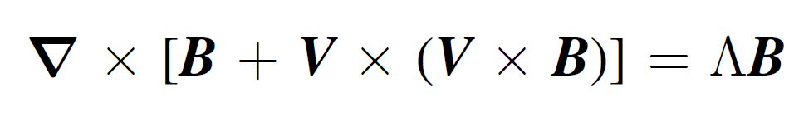
The matching is expedited by a
conserved quantity along magnetic field lines, roughly the redshifted field-aligned current.
Λ = Λ (φ₁,φ₂)
Euler potentials labeling field lines
The existence of Λ follows from:
  The force-free condition
  The co-rotation symmetry
  the frozen-in condition E+vxB=0 (perfectly conducting star)
Ways to understand Λ:
1) Inside light cylinder, the redshifted current measured by co-rotating observers
J_{c} = (Λ /α) B_{c}
In spacetime language, 2 and 3 mean that we have a symmetry tangent to the field sheets
GR redshift factor
2) A formula in flat spacetime:

Slide 10
History of Λ
Discovered by Mestel (Ap&SS 1973)
Used in Beskin, Gurevich & Istomin (ZhETF 1983)
Rediscovered by Uchida (MNRAS 1998)
Re-rediscovered by Gruzinov (ApJ 2006)
We found the general theorem for this type of conserved quantity and generalized to curved spacetime.

Slide 11
(stellar radius)
Putting Λ to work
ϵ =
<< 1
(light cylinder radius)
1) Far from the star, the leading-in-є solution is the force-free magnetosphere of a point rotating dipole in flat spacetime: solve numerically and fit for Λ.
2) Near the star, the leading-in-є solution is the vacuum magnetic field configuration, including higher multipoles and GR. Solve analytically.
3) “Paint” current on the near-zone by following field lines in from the far region, where Λ is known.
(Can do analytically with Euler potentials, otherwise simple numerics—ODEs.)

Slide 12
Example: Aligned Quadrudipole (dipole+quadrupole)
z/R_{L}
z/R*
Fit for current in far zone…
x/R_{L}
…and
paint it on
the near zone
x/R*

Slide 13
Inclined “fit”
α,β: Euler potentials for magnetic field
ι: Inclination (between spin / dipole)
J_{n}: Bessel function
sets the size of the polar cap
In axisymmetry, α=Ψ (the flux function) and β=φ (the azimuthal angle)

Slide 14
Λ over the polar cap
(dipole pulsar)
60^{ο}
90^{ο}
0^{ο}
30^{ο}
Numerical simulation
Analytic “fit”
Numerical and fit on a line through the cap

Slide 15
Polar cap recipe
Choose the stellar properties: mass, radius, moment of inertia
Choose the stellar magnetization: multipoles B_{lm}
Choose the inclination angle (between spin and dipole)
Write down B and find Euler potentials α,β (B = grad α x grad β)
(trivial if stellar field is intrinsically axisymmetric, e.g. inclined quadrudipole)
Plug in to Eqs. (37-38) to determine ρ_{e}, J near the star
Now use to determine pair production regions, X-ray flux, …

Slide 16
Role of GR for the pure dipole
J_{μ}J^{μ} = J² – (c ρ_{e})² (over the polar cap)
Flat space
(GM/R → 0)
GR, with flat cap size shown for comparison
Inclination:
0^{ο}
30^{ο}
60^{ο}
90^{ο}
GR makes the cap smaller and enables pair production (J_{μ}J^{μ} >0) at low inclinations

Slide 17
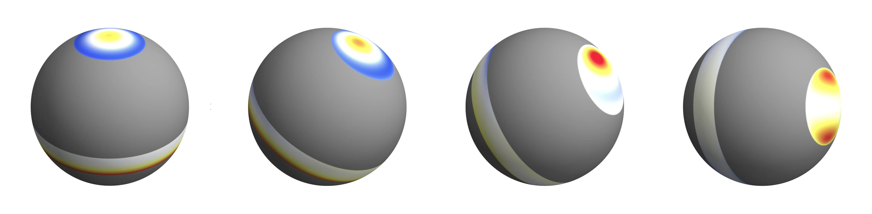
Proof of concept: GR Quadrudipole pulsar
(superposed dipole and quadrupole field)
Southern “polar cap” is annular. Method gives full details of current distribution.
Planned application: convert to X-ray flux and see if this would bias NICER measurements of neutron star equation of state.

Slide 18
Summary
Perfectly conducting star
Slow rotation
Force-free magnetosphere
Dipole dominates at light cylinder
We assume:
We provide:
Near-field configuration as a function of stellar parameters
M, R, Ω, I, B_{r}(θ,φ)
ρ_{e} and J near star
input
output
Use for efficient exploration of pair production, X-ray emission, …

Slide 19
Extra Slides

Slide 20
One key element of our analysis is a conserved quantity:
Suppose the field is force-free. Use the “three potential” formulation
Suppose also there is a symmetry tangent to the field sheets:
Then in three lines you can show:
(φ₁ and φ₂ label the field sheets— is conserved)
This shows the geometric origin of known conserved quantities and provides the generalization we need.

Slide 21
Quadrudipole pulsar
(superposed quadrupole and dipole moments)
Northern cap is a circle of size ~ε^{1/2}
Southern cap is an annulus of width ~ε

Slide 22
Multipolar Spindown Luminosity
Spindown luminosity determines only the dipolar component of field, and GR shifts the answer by ~60%.
GR correction factor:

Slide 23
Conditions for validity of approximation
Stellar field multipole moments
Dipole must dominate in overlap regime. Higher moments can still dominate at the star.
Polar cap size and shape

Slide 24
Do multipoles matter?
For radio emission, high multipoles are probably only important for millisecond pulsars, where emission might happen close in.
Do the narrow (~ε) annular polar caps explain modified beam size scaling of MSPs?
Do multipoles explain the increased pulse complexity of MSPs?
For x-ray, emission happens at the star, so higher multipoles are likely to be of essential importance e.g. for NICER measurements.
For gamma-ray, emission likely happens in the current sheet, so higher multipoles are probably irrelevant
Perhaps important for phase-lag between gamma and radio in MSPs

