Slide 1
Physics 53600 Electronics Techniques for Research
Now in PowerPoint!
Spring 2020 Semester
Prof. Matthew Jones

Slide 2
The usual ANNOUNCEMENT
Obvious changes to the course:
No in-person lectures: you’ll have to read the lecture notes yourself
No more labs: don’t worry about it – your grade will be based on work done so far
Remaining assignments will try to cover topics that would have been explored in the lab
Second mid-term: simplest to cancel it
Final exam: I think it will be a 24 hour exam with written responses that can be easily sent by e-mail.
Changes to grading scheme:
Old scheme: Assignments (30%) exams (40%) lab (30%)
New scheme: Assignments (50%) exams (25%) lab (25%)

Slide 3
The usual ANNOUNCEMENT
Because there won’t be any in-person lectures, you will have to read the lecture notes yourself.
To demonstrate that you have read them, you will be required to answer one or two simple questions before the next lecture is posted.
The question will probably be at the beginning and you just have to e-mail me the answer
mjones@physics.purdue.edu
To make this easy, please make your subject look like this:
“PHYS53600 Lecture xx questions Your Name”
These will be the remaining part of your assignment grade.

Slide 4
More ANNOUNCEMENTS
There will be a WebEx meeting on Thursday:
https://purdue.webex.com/purdue/j.php?MTID=m12fb7ef31cd88d9ae95cf6ac1dd56e27
Here are the relevant details:
I just want to be available to answer any questions and to discuss the proposed content of the final exam…
This is your opportunity to exert your influence…

Slide 5
LECTURE 28 QUESTIONS
You might not realize it, but most digital thermostats are essentially PLC units.
Describe (in general terms) the logic needed to control a furnace and an air conditioner to achieve a comfortable work environment.
What are the inputs?
What are the control outputs?
What is the Human Machine Interface?

Slide 6
Process Control and Automation
After taking this course you might understand (at least in principle) how to design analog and digital circuits to perform a wide range of useful things…
Just because you know how to design something doesn’t mean that you should design and build it…
Most common problems have already been solved in multiple ways…
Don’t re-invent the wheel!

Slide 7
Process Control and Automation
Instrumentation and data acquisition has been used in industrial applications since at least the 1960’s
A wide range of off-the-shelf solutions can be purchased at very reasonable prices
Several industry standards have emerged:
Transducer interfaces
Communication protocols
Mechanical interfaces
User interfaces

Slide 8
Example
A classic example of a process control application is temperature control
For example, a precision hot-plate:
User specifies the desired temperature
A sensor measures the current temperature
A heater is turned on to increase the temperature or turned off to decrease the temperature
Notice the time scales involved:
Temperature changes on the scale of seconds
Easy to implement a feedback loop that operates on the scale of milliseconds using a microcontroller

Slide 9
Example:
Notes:
This is a precision hot-plate at the Birck Nanofabrication Facility (somewhere across campus). The thing that is circled in red is essentially the “user interface” that lets you set the desired temperature and displays the measured temperature.

Slide 10
Process Control and Automation
The typical feedback loops consists of the following steps:
Measure a physical quantity
This is almost always done by converting the physical quantity to a voltage and sampling an ADC
Determine an appropriate response
Turn on a heater? Turn off a heater?
Perform the necessary action
Increase voltage, decrease voltage, turn something on… turn something off…
Perform these steps continuously in a loop

Slide 11
The Importance of Standards
The first step is to perform a measurement
Measuring temperature is one (common) example but there are lots of other things that could be measured:
Vacuum pressure
Humidity
Volume (liquid level)
The first standard to consider is how to interface a transducer with

Slide 12
Temperature Measurement Standards
There are several standard temperature transducers:
Thermocouples
Resistive Temperature Detectors
Thermocouples:
Two dissimilar metals in contact develop a potential difference that depends on temperature
RTD’s:
Usually made out of a pure metal (eg, platinum)
Resistance varies in a very predictable way with temperature
Thermistors:
Similar to RTD’s but can be made of almost any material
Wider variety of nominal resistances
Varying levels of stability compared with RTD’s

Slide 13
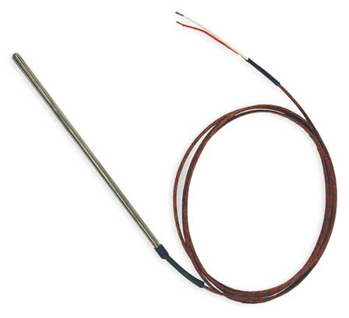
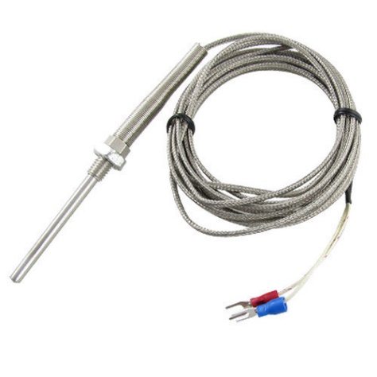
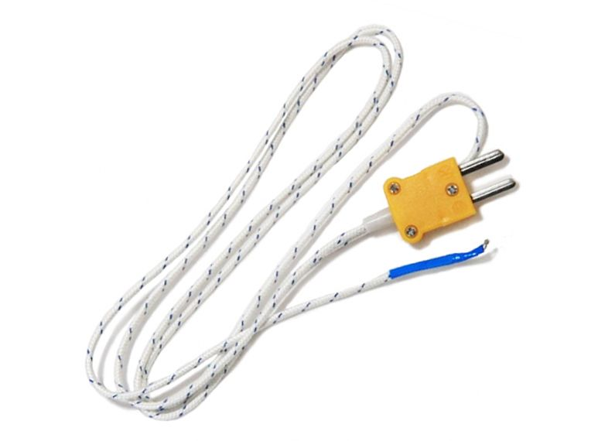
Temperature Measurement Standards
Standard thermocouples use very specific combinations metal alloys:
Name | Metal alloys | Useful temperature range
“Type K” | Chromel®/Alumel® | 0 to 1260 deg C
“Type J” | Iron/Constantan | 0 to 760 deg C
“Type T” | Copper/Constantan | -200 to 370 deg C
“Type E” | Chromel®/Constantan | 0 to 870 deg C
 | …many others…

Slide 14
Standard Transducer Outputs
Other transducers produce a voltage or current proportional to some physical quantity
Standard voltage/current ranges allow interoperability of equipment
Voltage output, 0-5 volts
Voltage output, 0-10 volts
Current output, 0-20 mA
Current output, 4-20 mA
Needs 3 wires
Can work with only two wires
Notes:
A transducer that provides a 4-20 mA current output only needs two wires (in principle) and acts like a current source that is independent of the supplied voltage (within reason).
The other types of outputs usually require power and a ground connection and then provide an output voltage or current that is measured with respect to the common ground.
Voltage outputs might experience voltage drops on long cables whereas the same current will flow regardless of the resistance of the cable (within reason).

Slide 15
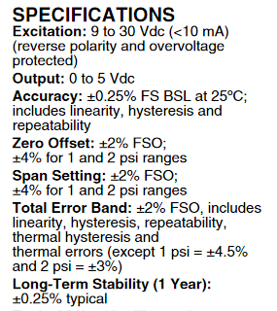
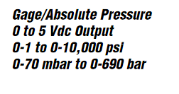
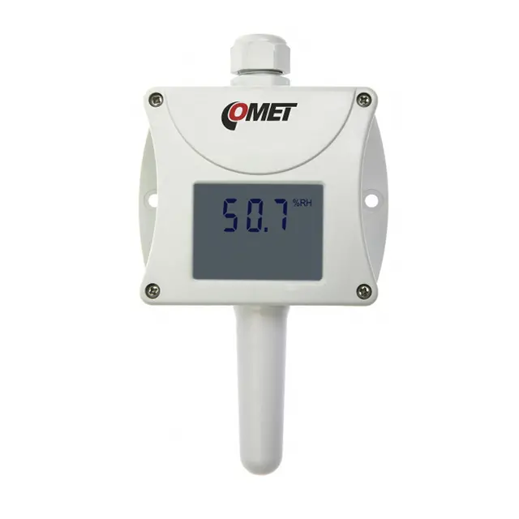
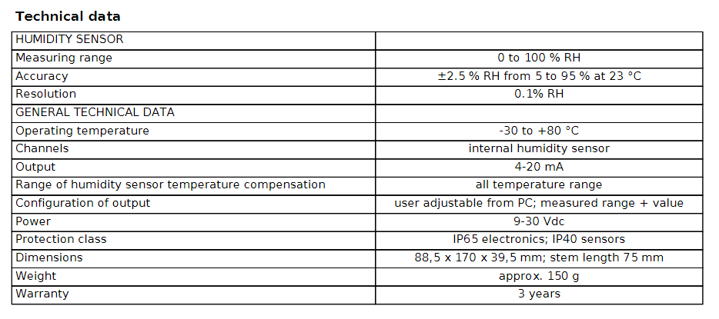
Transducers
Notes:
Standard voltage/current outputs already have all the signal conditioning electronics built in. These usually would consist of operational amplifier circuits but they can be quite sophisticated and provide many useful features such as
Overvoltage protection
Reverse polarity protection
Temperature stability
Guaranteed linearity and accuracy

Slide 16
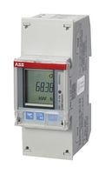
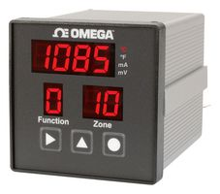
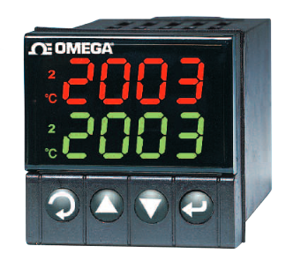
Industrial Automation Standards
Standard modules exist for many sensor readout and process control applications
Typical examples:
Standard mechanical interfaces
“Deutsches Institut fur Normung” (DIN)
Notes:
The advantage of standard mechanical interfaces is the partitioning of the mechanical and electrical functionality. A wide range of products will work with the same mechanical interface such as the size of the hole to be cut out of a panel.

Slide 17
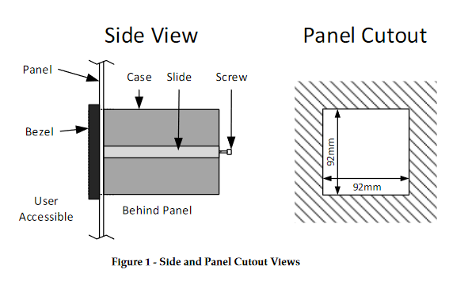
Mechanical Standards
¼ DIN standard:
Any equipment that conforms to the ¼ DIN standard will fit

Slide 18
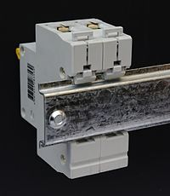
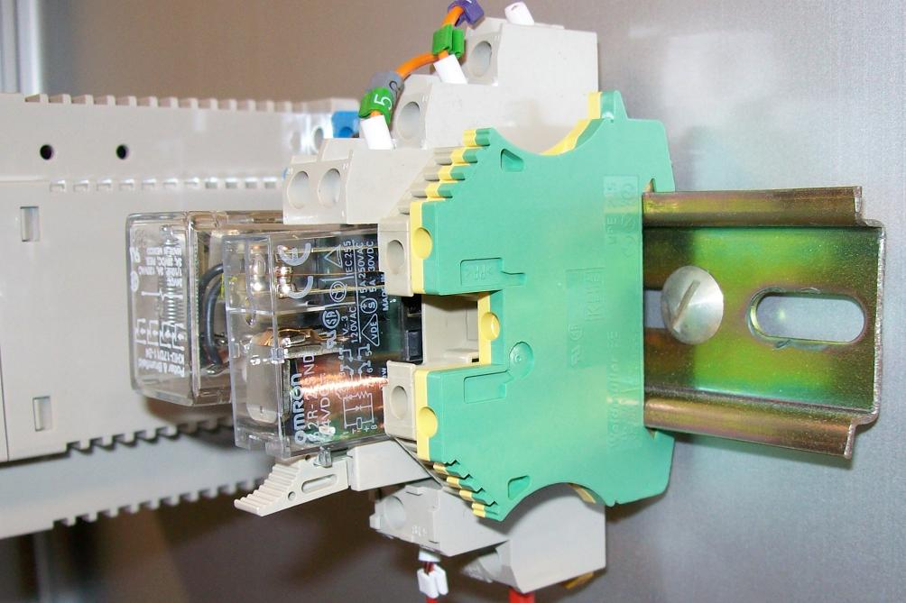
Mechanical Standards
DIN rail mounting standards (IEC/EN 60715)
Standard 35 mm mounting rail

Slide 19
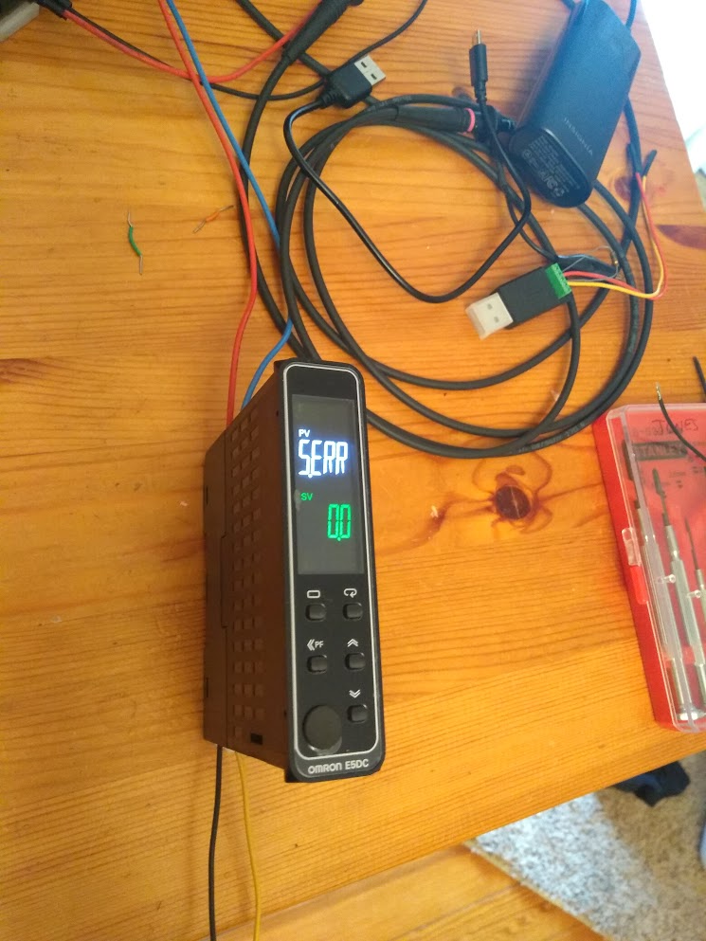
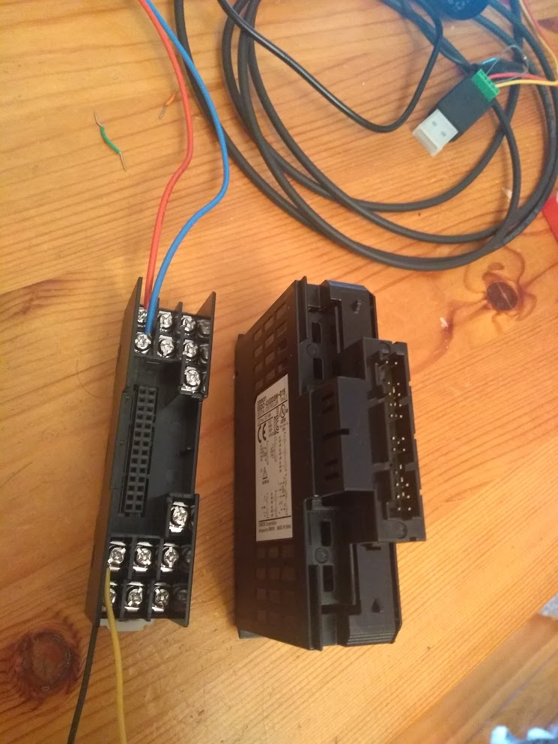
Typical Electrical Interfaces
Usually lots of screw terminals on the back:

Slide 20
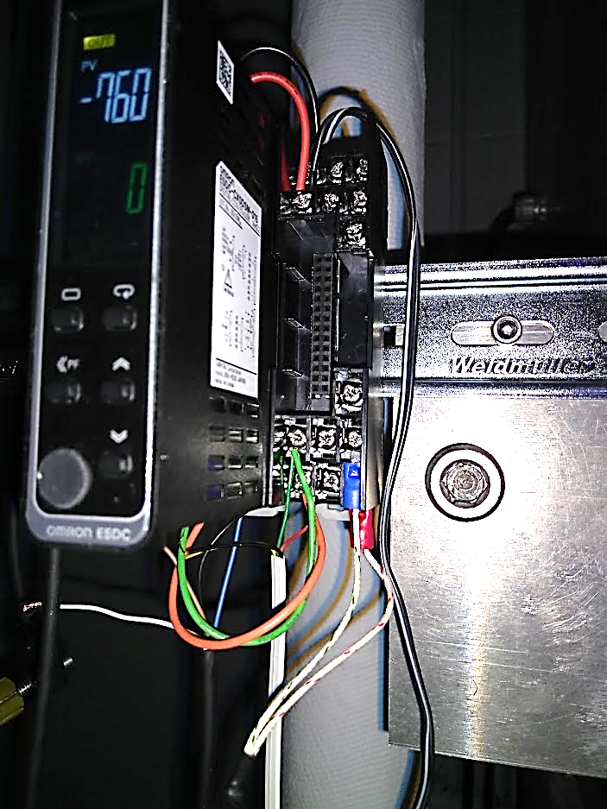
Typical Electrical Interfaces
Power connections
Control output
RS-485 network interface
Thermocouple/voltage/current inputs
Notes:
The data sheets provide the description for which screw terminals perform which functions.

Slide 21
Human Machine Interface (HMI)
The functionality can often be fully programmed by the controls on the front panel
But this might consist of only 3 or 4 buttons…
Simple operations like adjusting the “set point” might be straight forward
Configuration of alarm limits and responses might be more complicated
Important part of the documentation provided with the device
Notes:
Perhaps the most important thing is to be aware of what sorts of parameters *can* be controlled from the front panel. There are sometimes multiple “menus” of parameters (eg, communications settings, alarm limits, voltage input scale factors, input transducer type) which can be used to modify the non-volatile register settings.

Slide 22
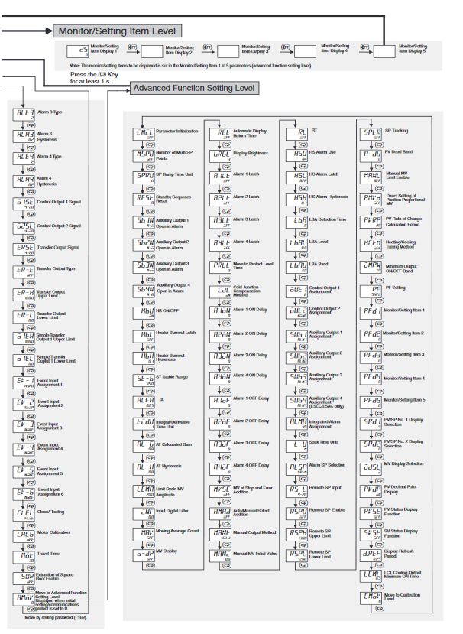
HMI Example
Notes:
This is an example of a fairly complicated menu structure.
Changing the set point is easy: just push the up-arrow or down-arrow button to change it.
Modifying the many other parameters is more complicated and involves navigating a series of “menus”… Switching between the menus is achieved by pushing one of the buttons for less than 1 second, at least 1 second, or greater than 3 seconds. Pushing another button cycles through the parameters in the menu and pushing the up-arrow or down-arrow buttons adjusts the parameters.
It’s a bit cumbersome, but you usually only have to set all the parameters once for normal operation.

Slide 23
Typical Application
Such modules can be used to provide autonomous closed-loop control of a device like a heater by means of relays (electrically controlled switches)
Relay is on when measured temperature is less than the set point
Relay is off when measured temperature is greater than the set point
On/off time is limited to be at least 20 seconds
Notes:
There are also auxiliary outputs like logic voltage outputs that can be asserted when the temperature exceeds preset limits.

Slide 24
Typical Application
Power (eg. 9 VDC)
Audible alarm
Heater power (eg. 24 VDC)
Heating element
Thermocouple temperature sensor
Notes:
The important point here is that you can build a sophisticated closed-loop control system just by attaching components to screw terminals with wires and modifying the appropriate control settings in the device. You don’t need to design and build a complete electronics system to do this all by yourself. You just buy it from a catalog for the low, low, price of only a few hundred bucks!

Slide 25
Communication Standards
What if you want to log the measured sensor parameters?
Many devices provide standard communication protocols over RS-485 networks.
Control of the UART interface:
Baud rate (eg, 9600, 38400, 115200 baud)
Parity bit (even, odd, none)
Stop bit (1 or 2)
Character size (almost always 8 bits)
Various standard communication protocols
Modbus RTU, Modbus ASCII (Industry standard)
CompoWay (Vendor specific)

Slide 26
Modbus Communications
Each device is assigned a unique address 0..255
A few special addresses are reserved
Each device stores its operating parameters in internal “registers” numbered 1..32767
MODBUS functions allows you to read or write individual registers or ranges of registers
Errors in message transmission are detected using a Cyclic-Redundancy-Check (CRC) algorithm
You can google for the details of how to calculate the 16-bit CRC used to validate the messages…

Slide 27
Modbus Communications
Data sent to the device
Data received from the device
Notes:
The advantage of Modbus RTU is that all data is in binary format and it takes half as many bytes to transfer the same amount of data compared with Modbus ASCII. The advantage of Modbus ASCII is that you can read the data being transferred on a terminal application.

Slide 28
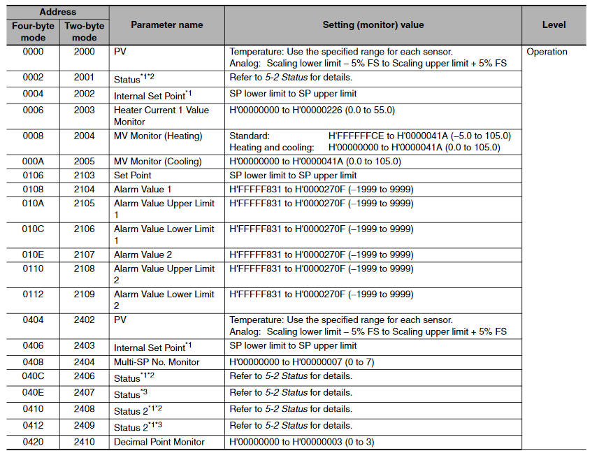
Modbus Communications
Example registers:
This one is the process variable (ie, the temperature)

Slide 29
Example
Distilling Methanol at atmospheric pressure:
Nominal boiling point
Experiment was terminated here
Measured temperature

Slide 30
Programmable Logic Controllers
Sometimes you need more sophisticated control over a piece of equipment
Examples:
A liquid CO₂ refrigerator needs to carefully control temperature and pressure or else you might accidentally destroy the seals in a pump
Control of superconducting solenoid
Response time is often slow (milliseconds) compared to the speed of typical microprocessors (microseconds)
Fully autonomous monitoring and control
Independent of any external computer or network

Slide 31
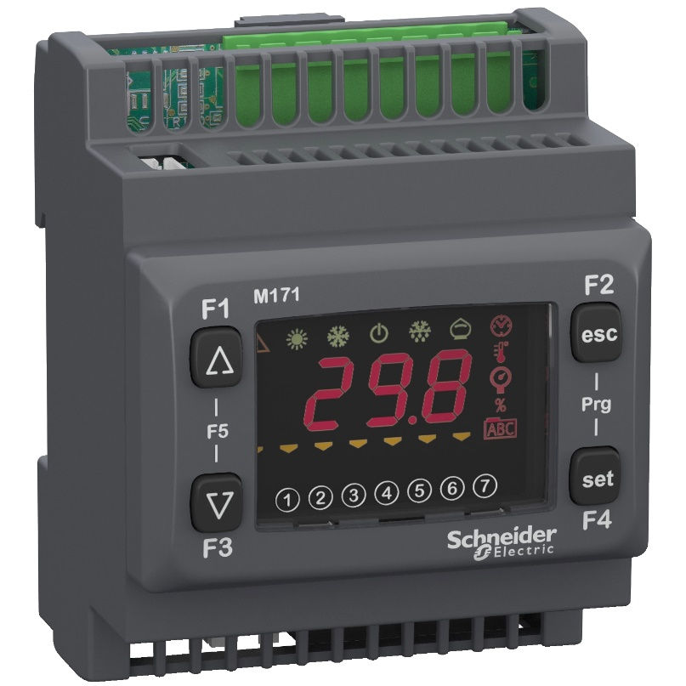
Programmable Logic Controllers
Commonly used for industrial automation/control applications
Example:
6 discrete inputs (digital logic)
6 discrete outputs (relays)
5 analog input (0-5 V, 0-10 V, 0-20 mA, 4-20 mA, etc…)
5 analog output
Standard DIN rail mounting
Control logic executed on internal microprocessor
Code generated using a proprietary development environment
Notes:
The proprietary development environment has a lot of advantages. It protects the user from having to know anything about the internal hardware design and automatically generates standard code that controls the low-level operation of the device.

Slide 32
Programmable Logic Controllers
Notes:
This is an example of the kind of programming environment that is provided. The control logic can make use of inputs and outputs as if they were just program variables.

Slide 33
Scalable Industrial Applications
Notes:
Large networks of sensors and remotely operated equipment can be assembled which communicate coherently using an RS-485 network and the Modbus protocol.

Slide 34
Summary
This was supposed to provide examples of common instrumentation problems
It is often faster/easier/cheaper to buy industry standard solutions rather than build them yourself
Sophisticated data acquisition systems can be built by just attaching wires to screw terminals
PLC’s are widely used when autonomous monitoring/control/safety is required.

