Slide 1
Physics 53600 Electronics Techniques for Research
Now in PowerPoint!
Spring 2020 Semester
Prof. Matthew Jones

Slide 2
The usual ANNOUNCEMENT
Obvious changes to the course:
No in-person lectures: you’ll have to read the lecture notes yourself
No more labs: don’t worry about it – your grade will be based on work done so far
Remaining assignments will try to cover topics that would have been explored in the lab
Second mid-term: simplest to cancel it
Final exam: I think it will be a 24 hour exam with written responses that can be easily sent by e-mail.
Changes to grading scheme:
Old scheme: Assignments (30%) exams (40%) lab (30%)
New scheme: Assignments (50%) exams (25%) lab (25%)

Slide 3
The usual ANNOUNCEMENT
Because there won’t be any in-person lectures, you will have to read the lecture notes yourself.
To demonstrate that you have read them, you will be required to answer one or two simple questions before the next lecture is posted.
The question will probably be at the beginning and you just have to e-mail me the answer
mjones@physics.purdue.edu
To make this easy, please make your subject look like this:
“PHYS53600 Lecture xx questions Your Name”
These will be the remaining part of your assignment grade.

Slide 4
More ANNOUNCEMENTS
Feel free to send me questions about the lecture material if there is anything you don’t understand.
Send me e-mail if you think it would be useful to arrange a time as a class to have a time where you can ask questions by video.
So far a couple of people have said it would be
Maybe something like Thursday, April 30th at 10:30 am EDT?

Slide 5
LECTURE 27 QUESTIONS
Describe a lab experience you have had (e.g. in research or an undergraduate lab) that would have benefited from using a data acquisition system
List some of the potential improvements
Precision of measurements?
Speed of data acquisition?
Volume of data recorded?
Direct recording of digital information?

Slide 6
Data Acquisition Systems
Common applications for electronics instrumentation in research is data acquisition and process control systems
Data acquisition:
Converting physical quantities to digital data
Usually a combination of a transducer and an analog-to-digital converter
Process control:
Manipulate a system to achieve a desired state
Notes:
A transducer is a general term for a device that turns a physical quantity into a voltage.
We will discuss analog to digital converters on the next page…
A digital system can manipulate another system by means of digital outputs (on/off) or voltage outputs which can be generated using digital-to-analog converters.

Slide 7
Analog-to-Digital Converters
Perhaps the simplest analog-to-digital converter is a comparator:
This looks like an operational amplifier, but the behavior is very different
The output is a digital logic level
Not usually incorporated into a feedback loop
The output will be ‘1’ when $v_{+}>v_{−}$ and ‘0’ otherwise.
Inverting input
-
+
Output
Non-Inverting input

Slide 8
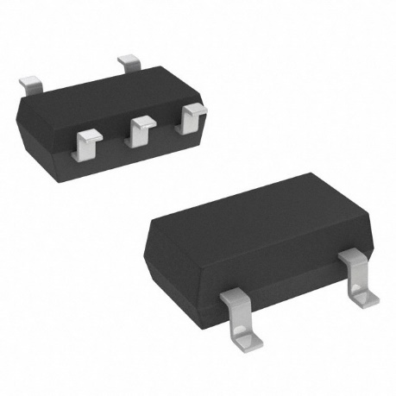
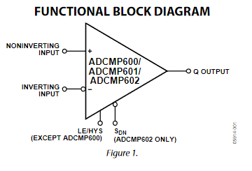
Analog-to-Digital Converter
High impedance inputs (>250 kΩ)
When the inverting input is driven by a voltage source, the output will be 0 or 1, depending on the voltage at the non-inverting input.
Notes:
Because the input impedance is very high, you could drive the inverting input using a resistor voltage divider, provided the Thevenin equivalent resistance in the divider is much less than the input impedance.

Slide 9
Analog-to-Digital Converter
Input voltage, $v_{in}$ where $v_{min}<v_{in}<v_{max}$
$n$-bit digital output:
Output should be a linear function of input voltage
Output is 0 when $v_{in}=v_{min}$
Output is 2^{n}-1 when $v_{in}=v_{max}$
There are several architectures that can achieve this…
For example: Analog Devices technical note

Slide 10
ADC Architectures
v_{max}
Flash ADC:
-
+
d2
Decoder logic
-
+
d1
Digital output
-
+
d0
Analog input
Notes:
The decoder logic would produce a 2-bit digital output:
0 if d0 = 0
1 if d1 = 0
2 if d2 = 0
3 otherwise
The advantage is that this architecture can be very fast. The disadvantage is that it requires a lot of analog circuitry (ie, area) when implemented on a chip. The number of comparators scales geometrically with the number of bits. For example, an 8-bit ADC requires 255 comparators and a 16-bit ADC requires 65535 comparators.

Slide 11
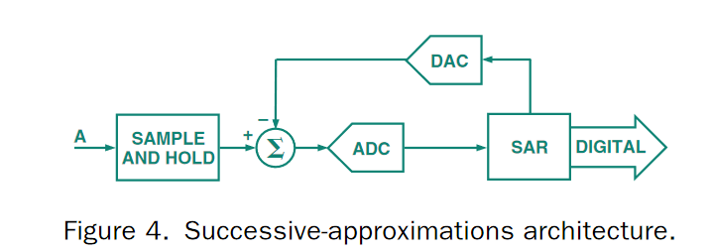
ADC Architectures
Other ADC architectures are often more efficient:
The Successive-approximations architecture dynamically adjusts the digital output such that an internally generated voltage will match the input
Resolution of n bits is achieved after n comparison cycles.
Notes:
SAR architectures are much more efficient than Flash ADC’s in terms of complexity and power dissipation. They can achieve high resolution at the expense of the n-cycle latency for retrieving the output. However, they can be pipelined so that a measurement is made every cycle. In this way, the input is digitized each clock cycle, but the value only comes out n-clock cycles later. Additional signal conditioning logic can add to the latency, but improve the performance (linearity, missing codes, etc…)

Slide 12
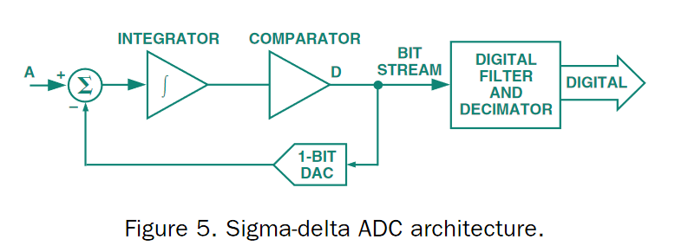
ADC Architectures
Other ADC architectures are often more efficient:
The Sigma-Delta architecture matches the integral of the input and an internally generated digital waveform.
Notes:
The S-D architecture can achieve very high bit resolutions with low-power consumption, but they are not well suited for high-speed signals. They can be ideal for sampling DC voltages, or signals with very low frequency components. The integrator makes them immune to high-frequency noise, since this gets averaged out.

Slide 13
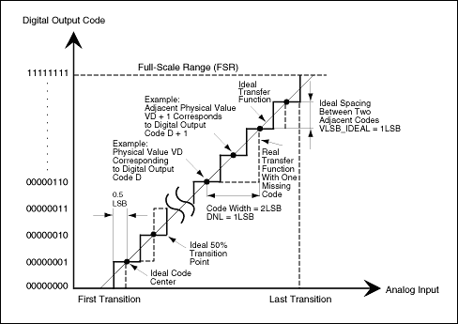
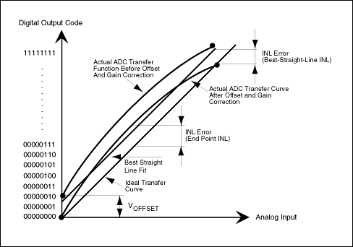
ADC Architectures
Quantifying ADC performance:
Sometimes there are tradeoffs between precision, resolution, and speed
Notes:
Some very undesirable properties (that vendors work hard to avoid) are non-monotonic output codes in response to a monotonic input and missing codes (output values are skipped).

Slide 14
ADC Architectures
Examples from Analog Devices:
High-speed ADC's (>20 MSPS)
Precision ADC's
Main characteristics:
Sample rate (eg, samples per second)
Resolution (number of bits)
Intrinsic signal-to-noise
Number of channels
Cost
Notes:
Some very undesirable properties (that vendors work hard to avoid) are non-monotonic output codes in response to a monotonic input and missing codes (output values are skipped).

Slide 15
Transducers
Many physical effects produce an electrical potential difference that changes in response to external conditions
Examples for measuring temperature:
The PN junction voltage depends on temperature (band-gap temperature reference)
Thermocouples (voltage difference across junction of dissimilar metals)
Resistors (some can have very predictable/repeatable R vs T relationships)
Mechanical transducers:
Piezoelectric devices (voltage output in response to pressure or strain on a crystal)
Variable resistors (mechanically adjustable resistance)
Optical transducers:
Photo-multiplier tubes, avalanche photodiodes, various semiconductor materials
Notes:
This certainly isn’t meant to be an exhaustive list…

Slide 16
Signal Conditioning
In most cases, transducers act like very non-ideal voltage or current sources
For example, they often have very high output impedance
Often, the voltage changes can be quite small
The input to an ADC might have a much lower input impedance
An analog circuit may be required to amplify a small signal and produce a proportional output voltage with a much lower impedance
This output can then be sampled using an ADC

Slide 17
Example: pH Meter
There are some well-established formulas that relate the output voltage from the pH sensor to the actual pH of a solution and to its temperature. Thus, the pH of a solution can be calculated (ie, using a computer), once the temperature and the sensor voltage are measured.
Notes:
The AD7793 is a 24-bit Sigma-Delta ADC. It also happens to provide some useful features like reference current outputs.
The AD8603 is an operational amplifier configured as a unity-gain amplifier (remember that the output will be continuously adjusted so that the – and + inputs match). The input impedance will be greater than 1 MOhm and the output impedance will be 10 kOhm which is small compared with the input impedance of the AD7793.
The digital interface to the ADC is an SPI bus. The purpose of the ADUM5401 is to isolate the power supplies used for the analog and digital circuits. Digital circuits are typically “noisy” and can introduce noise into sensitive analog circuits. There is not much point in having a very high resolution ADC (eg, 24 bits) if the level of noise is also high.

Slide 18
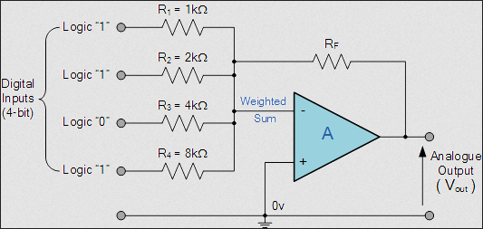
Digital-to-Analog Converters
Digital outputs can drive an op-amp circuit to produce an analog output:
Notice that the ratio of adjacent input resistors must be 2 for an output voltage to be proportional to the digital input.

Slide 19
Digital-to-Analog Converters
Examples from Analog Devices:
High speed DAC's
Precision DAC's
Example applications:
Precision control of DC output voltage (low speed)
Direct digital synthesis of radio signals (high speed)
Notes:
An interesting application that has only recently (ie, past 20 years) been possible has been the direct digital synthesis of radio signals using high-speed DAC’s and the direct sampling of radio signals by high-speed ADC’s. This allows all the signal processing to be performed digitally using high-speed digital logic. Applications include software-defined radio and synthetic aperture RADAR.

Slide 20
Data Acquisition Systems
Data acquisition systems typically require:
Generating output voltages to set desired operating conditions
Measuring physical quantities of interest
Instruments need to be controlled using a computer
Several systems have been developed over the years to achieve this

Slide 21
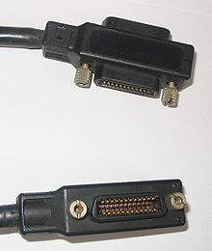
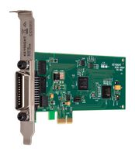
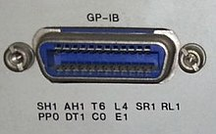
GPIB (IEEE-488) Interfaces
Originally developed by Hewlett-Packard in the 1960’s
Short-distance, multi-master, 8-bit parallel bus
A suitable interface card is needed to connect to a computer
Connector on equipment
Connectors on cable
Interface card

Slide 22
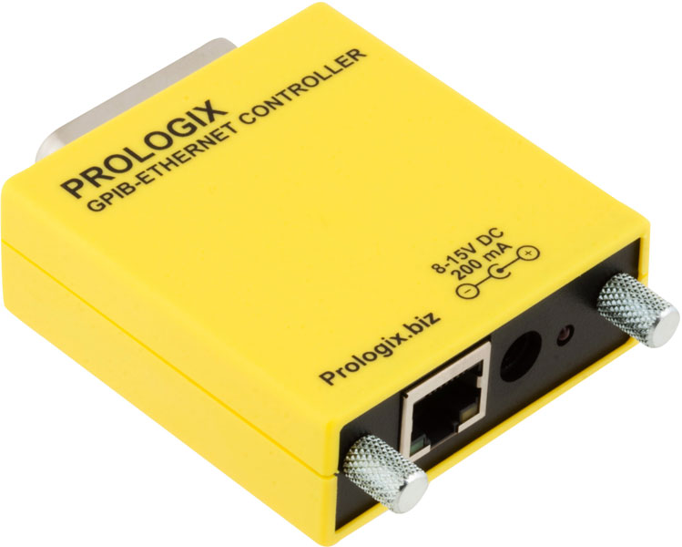
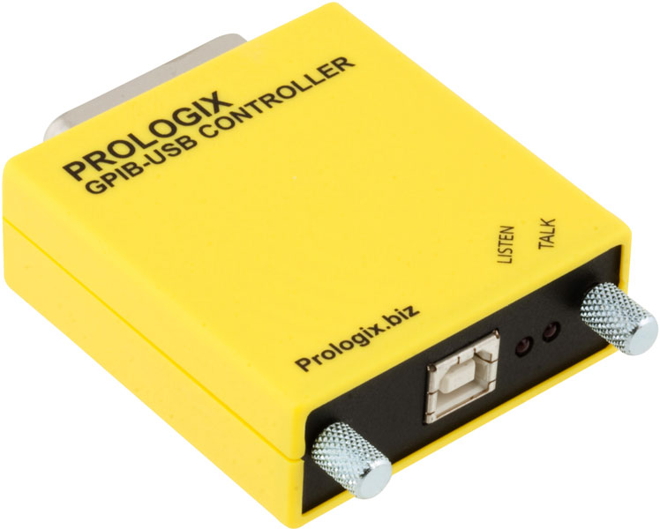
GPIB (IEEE-488) Interfaces
Lots of legacy equipment have GPIB interfaces
Newer equipment might provide similar functionality using other interfaces, such as Ethernet
Adapters between GPIB and Ethernet or USB can be quite useful for interfacing with older equipment

Slide 23
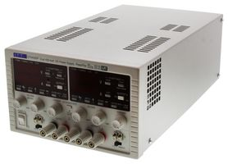
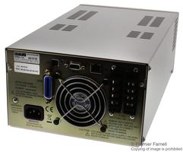
Examples of GPIB Equipment
Power supplies:
GPIB interface
Somewhere, deep inside the box, you would expect to find a DAC circuit…

Slide 24
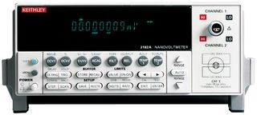
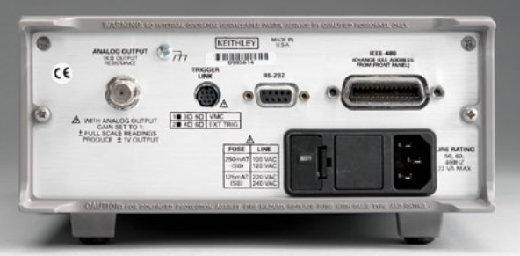
Examples of GPIB Equipment
Digital meters:
GPIB interface
Somewhere, deep inside the box, you would expect to find an ADC circuit…

Slide 25
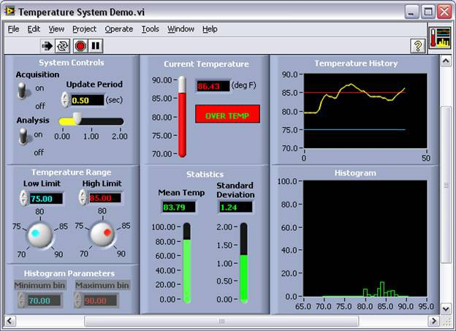
Software Interfaces
Most vendors provide sufficient documentation for remote operation via GPIB or Ethernet
National Instruments caters to small-to-medium sized lab-based data acquisition systems:
Academic software licensing (eg, LabVIEW)
Notes:
National Instruments is an example of a company that attempts to provide complete solutions for small-scale data acquisition systems, including transducers, signal processing electronics, measurement devices, and control/visualization software. It’s actually not a bad choice for small scale experimental setups. It may not be a good choice for large-scale operations (eg, a nuclear power plant) or commercial applications (eg, a building’s heating/ventilation system).

