Slide 1
Physics 53600 Electronics Techniques for Research
Now in PowerPoint!
Spring 2020 Semester
Prof. Matthew Jones

Slide 2
The usual ANNOUNCEMENT
Obvious changes to the course:
No in-person lectures: you’ll have to read the lecture notes yourself
No more labs: don’t worry about it – your grade will be based on work done so far
Remaining assignments will try to cover topics that would have been explored in the lab
Second mid-term: simplest to cancel it
Final exam: I think it will be a 24 hour exam with written responses that can be easily sent by e-mail.
Changes to grading scheme:
Old scheme: Assignments (30%) exams (40%) lab (30%)
New scheme: Assignments (50%) exams (25%) lab (25%)

Slide 3
The usual ANNOUNCEMENT
Because there won’t be any in-person lectures, you will have to read the lecture notes yourself.
To demonstrate that you have read them, you will be required to answer one or two simple questions before the next lecture is posted.
The question will probably be at the beginning and you just have to e-mail me the answer
mjones@physics.purdue.edu
To make this easy, please make your subject look like this:
“PHYS53600 Lecture xx questions Your Name”
These will be the remaining part of your assignment grade.

Slide 4
More ANNOUNCEMENTS
Feel free to send me questions about the lecture material if there is anything you don’t understand. I’m happy to give more explanation (and I’m soooo bored.)
Send me e-mail if you think it would be useful to arrange a time as a class to have a time where you can ask questions by video.
So far a couple of people have said it would be
Maybe something like Wednesday, April 30th at 10:30 am EDT?

Slide 5
LECTURE 26 QUESTIONS
Is 10:30 am on Thursday, April 30th (the normally scheduled class time) a good time for a Webex meeting to ask any questions you might have?
Describe an application where a processor would be well suited, as opposed to programmable logic.
Describe an application where programmable logic would be better suited.

Slide 6
Microprocessors
So far we have discussed
Analog electronics
Digital electronics
These are sometimes essential elements of data acquisition or signal processing systems
But they are not always the best choice…
The design process usually tries to optimize many different types of resources
Time (design time, implementation time)
Cost (design cost, cost to build, cost to maintain)
Performance (does the design satisfy the requirements?)
Available expertise
Notes:
Just because you might know how to, and have access to digital design resources doesn’t mean that is always the best or most elegant solution to a data acquisition or instrumentation problem.

Slide 7
Microprocessors
Microprocessors can be a very effective element of a data acquisition/instrumentation system
Advantages:
Reprogrammable
High level programming languages
Low cost
System-on-Chip integrates many digital logic elements into one device
Disadvantages:
Sequential program execution
Limited bandwidth
Sometimes too slow for some applications
Notes:
Microprocessors are not the perfect solution for everything, but combined with digital and analog logic (where appropriate) they can be ideal for performing complex tasks that are not time-critical. They are often very well suited for user interfaces, since people are usually pretty slow…

Slide 8
Microprocessors
An entire course could be dedicated to microprocessor architectures
Historically, using a microprocessor required designing an entire computer, complete with memory and I/O interfaces
Over the past 15 years most of these features have been integrated into processors to provide complete computer systems in one package.

Slide 9
System-on-Chip Microprocessors
Include more functionality than just the processor:
Electrically erasable read-only-memory (stores programs)
Static random-access-memory (stores data)
General purpose IO pins
Analog-to-digital converters
Serial communications devices
UART, I2C, SPI interfaces

Slide 10
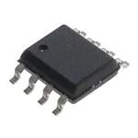
Example (cost is < $1)
You don’t need a lot of pins to have a fully functional SOC:
Microchip ATTINY13A-SSU:
Six I/O pins can be configured to perform various functions

Slide 11
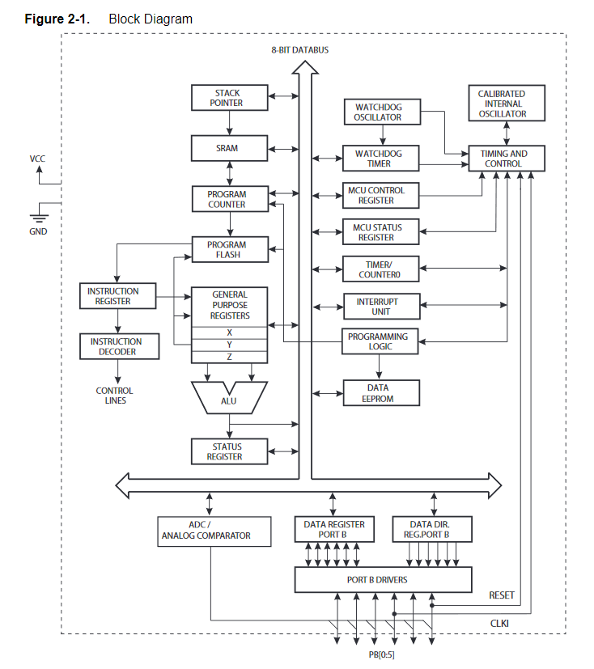
Example: ATTINY13A-SSU
There is a lot going on inside:
Three pins implement an SPI interface that can be used to write a program to the non-volatile memory
When powered on or reset, the processor executes the instructions stored in memory.

Slide 12
Example: ATTINY13A-SSU
Typically, a high-level programming language (an assembler or compiler) would be used to generate the executable program memory image.
This would then be downloaded into the non-volatile flash memory.

Slide 13
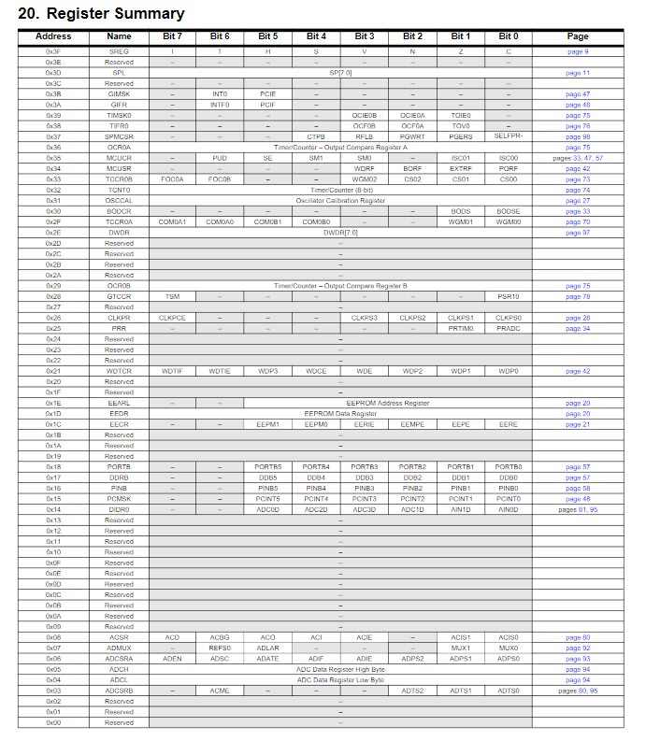
Example: ATTINY13A-SSU
The first 64 bytes of the address space control the operation of the chip:
Notes:
I don’t expect you to be able to read this, but it shows that, for example, the direction of the GPIO pins is controlled by the register at address 0x16, 0x17 and 0x18.
You could also configure these pins to be analog inputs, and use the analog-to-digital converter functions to sample their values.

Slide 14
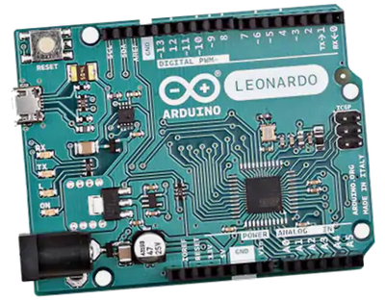
Example ($4)
The ATmega32U4 is used for the popular Arduino platform:
Features:
32 kB flash RAM
2.5 kB static RAM
USB interface
Serial port (UART)
12 channel 10-bit ADC
Lots more…
Notes:
Again, the program can be developed using a high-level programming language and downloaded into the flash RAM where it will begin executing when powered on or reset.

Slide 15
Example: ATmega32U4
As with the previous example, the peripherals are controlled using dedicated addresses
In this case there are 128 bytes reserved for peripheral control interfaces

Slide 16
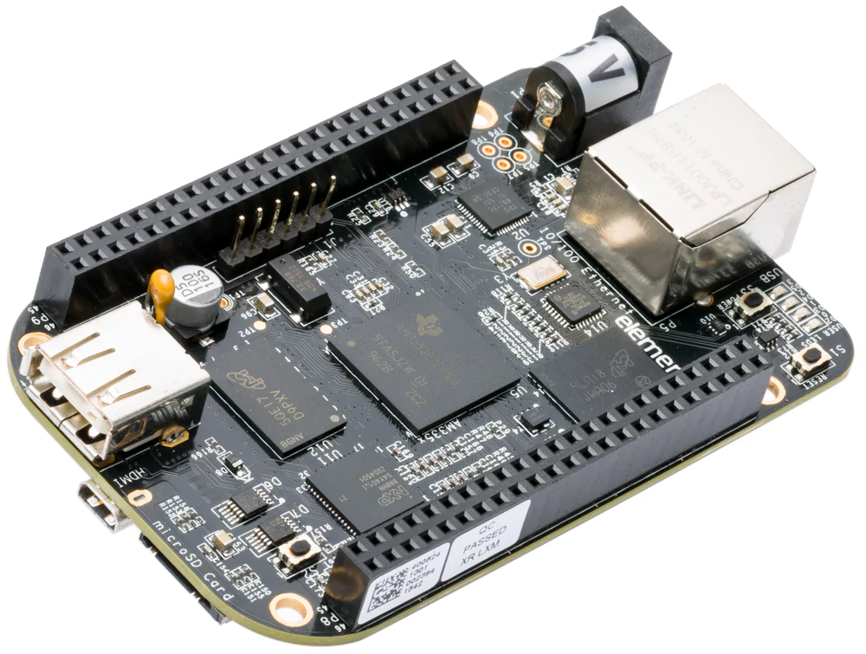
Example: Beaglebone ($50)
This is a single-board computer based on the CORTEX A8 processor:
Peripherals:
Ethernet
HDMI video
USB
GPIO pins
I2C, SPI, UART
ADC’s

Slide 17
Example: Beaglebone ($50)
The CORTEX A8 processor is powerful enough to run various operating systems (Linux/Adroid)
Typically written to a microSD memory card
Provides everything you would expect from a Linux environment
The Linux kernel attempts to control access to low-level hardware
This is an open-source project… it’s free, but you get what you pay for

Slide 18
Example: Beaglebone
Temperature/humidity/CO₂ sensor read out using I2C
Remote connection to processor over WiFi
Running Debian Linux distribution
RS485 network interfaced using USB
You can build quite complex data acquisition systems using inexpensive open-source hardware.

Slide 19
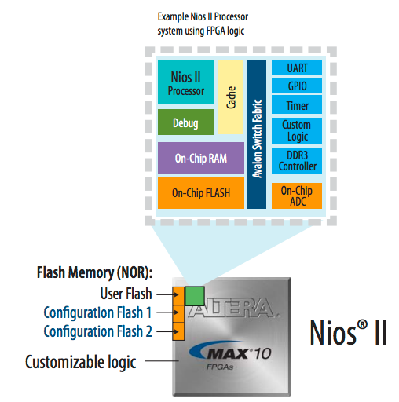
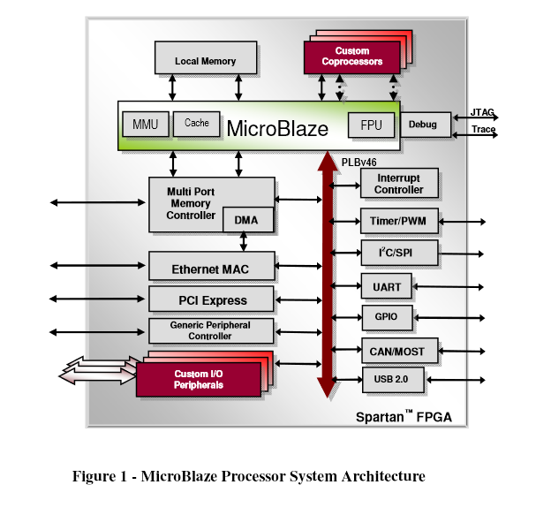
“Soft” Processors
Microprocessors can be implemented in programmable logic and interfaced directly with FPGA resources.
Xilinx provides free access to its MicroBlaze core designs
Intel (which bought Altera) provides it’s version (Nios-II)
Notes:
Depending on the requirements, these can also run version of Linux. There are open-source tools (like the GNU compiler) for developing programs which are stored as part of the FPGA configuration data.

Slide 20
Comparison of SOC and PC’s
At some point, you might really want to use a PC instead
Much more memory
Higher speeds
Multi-core processors
Higher network/memory bandwidth
Usually there is no direct access to hardware
Hardware interfaces must conform to the PC architecture
PCIe interfaces and associated software drivers
USB
Serial ports (eg. RS232)

Slide 21
Summary
Today, microprocessors and system-on-chip solutions are very powerful, inexpensive, and relatively easy to use
Some are very simple (small pin count)
Some are sophisticated but can be bought as modules and inserted into a design
No need to design a sophisticated PCB

