Slide 1
Physics 53600 Electronics Techniques for Research
Now in PowerPoint!
Spring 2020 Semester
Prof. Matthew Jones

Slide 2
The usual ANNOUNCEMENT
Obvious changes to the course:
No in-person lectures: you’ll have to read the lecture notes yourself
No more labs: don’t worry about it – your grade will be based on work done so far
Remaining assignments will try to cover topics that would have been explored in the lab
Second mid-term: simplest to cancel it
Final exam: I think it will be a 24 hour exam with written responses that can be easily sent by e-mail.
Changes to grading scheme:
Old scheme: Assignments (30%) exams (40%) lab (30%)
New scheme: Assignments (50%) exams (25%) lab (25%)

Slide 3
The usual ANNOUNCEMENT
Because there won’t be any in-person lectures, you will have to read the lecture notes yourself.
To demonstrate that you have read them, you will be required to answer one or two simple questions before the next lecture is posted.
The question will probably be at the beginning and you just have to e-mail me the answer
mjones@physics.purdue.edu
To make this easy, please make your subject look like this:
“PHYS53600 Lecture xx questions Your Name”
These will be part of your assignment grade, maybe contributing 10% of your total grade.

Slide 4
More ANNOUNCEMENTS
Feel free to send me questions about the lecture material if there is anything you don’t understand. I’m happy to give more explanation (and I’m soooo bored.)
Send me e-mail if you think it would be useful to arrange a time as a class to have a time where you can ask questions by video.

Slide 5
LECTURE 24 QUESTIONS
Some time before the final exam, do you want to arrange for a Webex meeting where everyone has the opportunity to ask questions about the lecture notes or other material in the course?
For-profit companies often pay thousands of dollars per year to use FPGA design tools but the same tools are often given away for free for academic/research use.
Why do you suppose that is?

Slide 6
Designing with Discrete Logic Circuits
Many of the digital circuits we have discussed so far exist as discrete integrated circuits.
They usually (but not always) require designing and fabricating a printed circuit board to be used reliably.
This design process can be time consuming, expensive, and error-prone.
Simple mistakes can be fixed by cutting traces on the PCB with a razor blade, or soldering “blue wires” where new connections are needed.
Notes:
I don’t know why the wires are always blue… they can actually come in many colors, but blue is fairly typical.

Slide 7
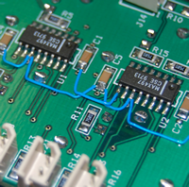
Fixing Mistakes on PCB’s
“Blue wire”
Blue wires
Notes:
Yes… I know it’s not really blue… but often they are.

Slide 8
Designing with Discrete Logic Circuits
Often it is useful to budget for two (or more) PCB production runs
First, a small number of prototype boards to find and fix mistakes
Second, a larger number of boards with a MUCH higher chance of having no mistakes
Hopefully you don’t need a third batch, but sometimes it’s inevitable
This process can be expensive in several ways
Design time and expertise required
Cost to manufacture
Cost of parts
Cost to assemble
Time needed to test, debug, re-design

Slide 9
Alternatives to Discrete Logic Circuits
It is of great benefit to be able to fix mistakes in logic without having to re-manufacture anything
Several ways to achieve this:
Programmable Logic Arrays
Field-Programmable Gate Arrays
Microprocessors/Microcontrollers
These are general-purpose logic devices that can be re-configured after assembly if necessary

Slide 10
Programmable Logic Arrays
First, consider some combinatorial logic
Use Boolean algebra to reduce any expression to a “sum-of-products”
Example: three-input “exclusive or”
$$q=x⊕y⊕z$$
$$=\left(x⋅\overline{y}+\overline{x}⋅y\right)⊕z$$
$$=\left(x⋅\overline{y}+\overline{x}⋅y\right)⋅\overline{z}+\overline{\left(x⋅\overline{y}+\overline{x}⋅y\right)}⋅z$$
$$=x⋅\overline{y}⋅\overline{z}+\overline{x}⋅y⋅\overline{z}+\overline{(x⋅\overline{y})}⋅\overline{(\overline{x}⋅y)}⋅z$$
$$=x⋅\overline{y}⋅\overline{z}+\overline{x}⋅y⋅\overline{z}+\left(\overline{x}+y\right)⋅(x+\overline{y})⋅z$$
$$=x⋅\overline{y}⋅\overline{z}+\overline{x}⋅y⋅\overline{z}+\overline{x}⋅\overline{y}⋅z+x⋅y⋅z$$
Notes:
This might not necessarily be considered to be a “pure” exclusive or operation because of the last term. It just ensures that an odd-number of inputs are true. Nevertheless, it illustrates the point that arbitrary Boolean expressions can be reduced to a “sum-of-products” which make use of only “and”, “or”, and “invert” operations.

Slide 11
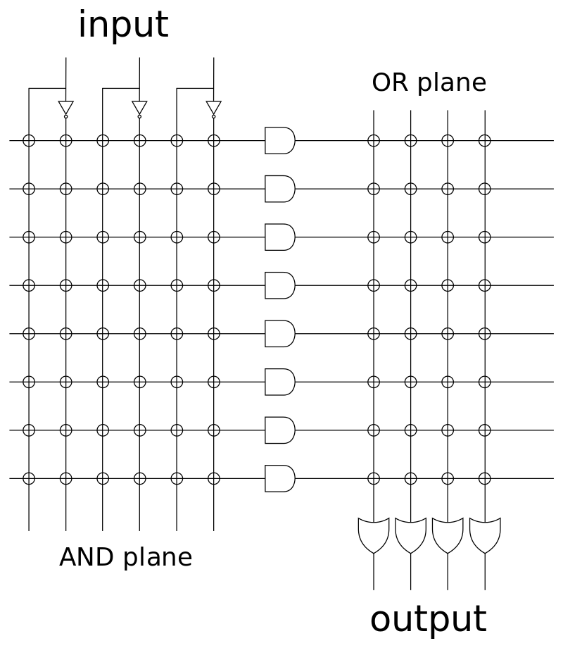
Programmable Logic Arrays
The original PLA’s (developed in the 1970’s) had arrays of AND and OR operations with optional inverters at each input.

Slide 12
Programmable Logic Arrays
The logic could be implemented by “burning fuses” that removed parts of the metal interconnect layer in the circuit.
The connections left behind implement the desired logic:
$$\overline{x}⋅\overline{y}⋅z$$
$$\overline{x}⋅y⋅\overline{z}$$
$$x⋅\overline{y}⋅\overline{z}$$
$$x⋅y⋅z$$
$$q$$
$$x$$
$$y$$
$$z$$
Notes:
Clearly, this implementation did not use all the available resources. There are three other independent functions that could be computed and provided at the other outputs.

Slide 13
Programmable Logic Arrays
These devices could only be programmed once
Still, if you got it wrong you could simply replace the component on a PCB with a new one
Newer PLA’s implemented combinatorial logic features in their available resources (called “macrocells”)
These require software to generate the physical configuration needed to implement the desired logic
They also require a programmer to physically “burn in” the design.
Then they are ready for use…
Newer designs are “Electrically Erasable” and can be reconfigured multiple times.
Notes:
Because these devices often have to be removed from the circuit to erase and re-program them, it can be useful to mount them in a socket, rather than permanently solder them to a PCB, at least for development. Once the logic is fully designed and tested, it would be safe to burn (ie, program) a whole bunch of these devices and solder them permanently.

Slide 14
Example: Atmel ATF16V8B
Things to notice:
Power (V_{CC} and GND) pins are in the usual place
There is a dedicated CLK input pin
There is a dedicated output-enable pin ($\overline{OE}$) which is active low.
There are 8 inputs and 8 outputs
They are INEXPENSIVE! This one costs only 86¢

Slide 15
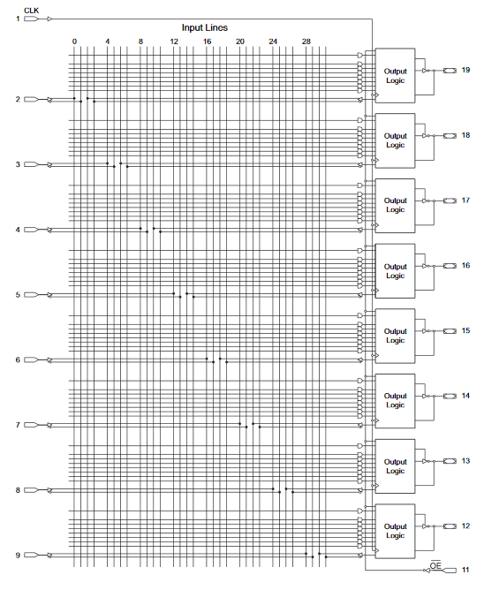
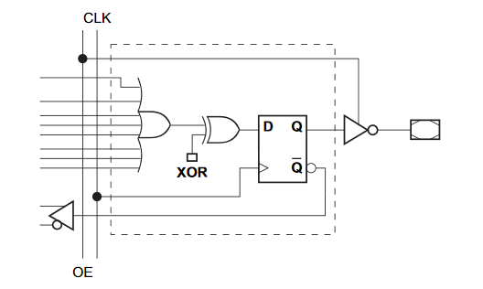
Example: Atmel ATF16V8B
Logic array:
This part is basically the same as in the previous example. The main difference is that now there is an “output logic” macrocell:

Slide 16
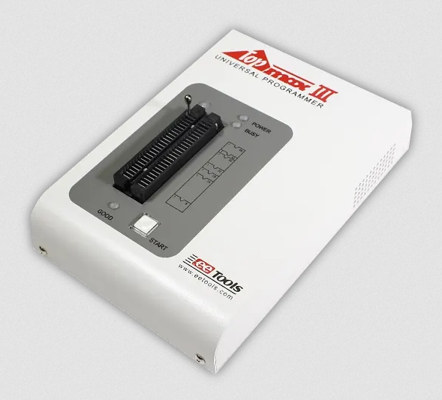
Example: Atmel ATF16V8B
The design software is usually free to download and install.
The programming interface is standard enough that there are many third-party programmers available
Usually interface to a PC using USB or some other interface.

Slide 17
Complex Programmable Logic Devices
The same idea has been extended to devices that have much more complex logic resources
Large numbers of inputs/outputs
Dedicated block memory
Large numbers of macrocells with sophisticated combinatorial/sequential logic
Dedicated networks for routing of clock signals
Many are “in-circuit” reprogrammable

Slide 18
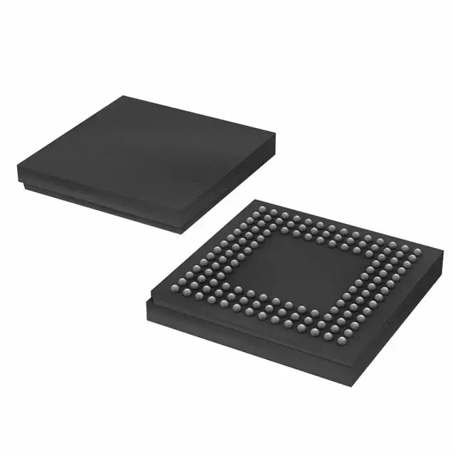
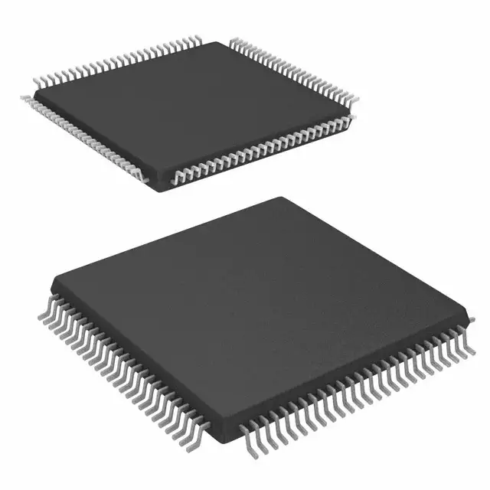
Example: Xilinx CoolRunner-II Series
These often have MANY inputs/outputs
They typically can have of the order of 100 pins
Various types of packages (leads on all sides, or ball grid arrays)

Slide 19
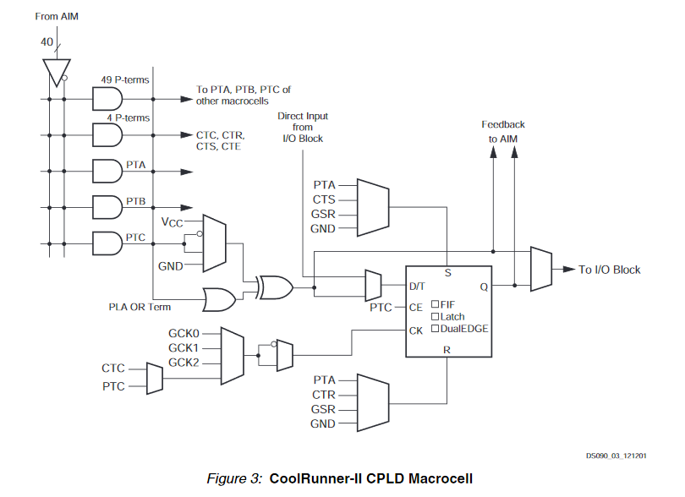
Example: Xilinx CoolRunner-II Series
Features: XC2C128 example ($9.05 each)
Separate core voltage (1.8 volts) and I/O voltages (1.5, 1.8, 2.5, 3.3 volts)
Dedicated pins for programming/debugging
Sophisticated macrocell architecture:
Notes:
Don’t bother trying to understand this diagram in detail. The point is that there are lots of logic resources that are available for use. Depending on the application, many of the resources might not be needed.

Slide 20
Field-Programmable Gate Arrays
These are sort of like CPLD’s, except that they download their configuration each time power is applied
These can have very sophisticated resources that are available for use:
High speed serial transceivers
Clock synthesizer circuits
Large block memory resources
Large numbers of macrocells
Dedicated clock routing fabric
Notes:
The term “fabric” just refers to the electrical connections that are made available for a particular purpose. I think the term might come from the fact that these signal routing circuits have a bunch of horizontal and vertical lines that get connected together to implement the optimal signal routing needed for an application.

Slide 21
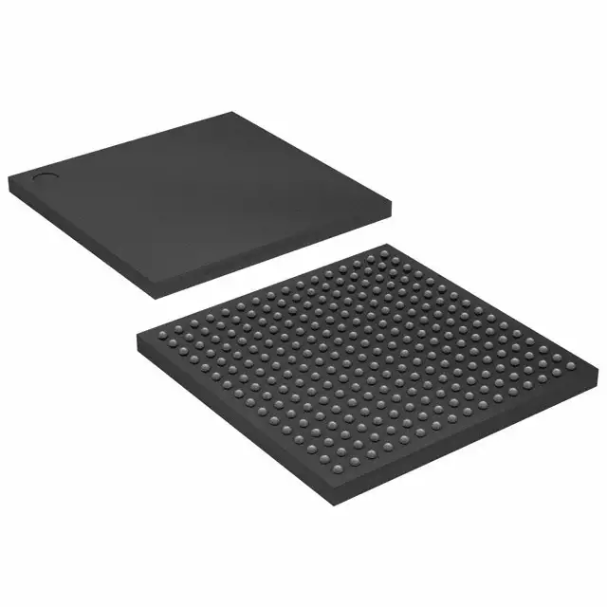
FPGA Example: Xilinx Spartan-3 series
Example: XC3S400-4FTG256C
173 I/O pins
Core voltage: 1.2 volts
896 logic blocks
8064 logic elements
400,000 logic gates
294,912 bits of RAM
Costs $34.95 each

Slide 22
Hardware Synthesis Tools
Now we have a new problem:
The resources are so abundant and sophisticated that it is essentially impossible for a human to specify each and every interconnection
Instead we rely on synthesis tools:
Emphasis on “describing” what we want the hardware to accomplish
This can be done using schematics and elementary logic blocks
More commonly done using a “Hardware Definition Language”
Rely on vendor-supplied software to translate the hardware “description” into configuration data

Slide 23
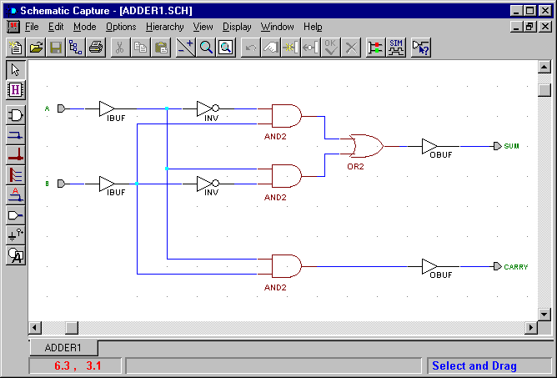
Hardware Synthesis Tools
Schematic capture using basic logic elements:

Slide 24
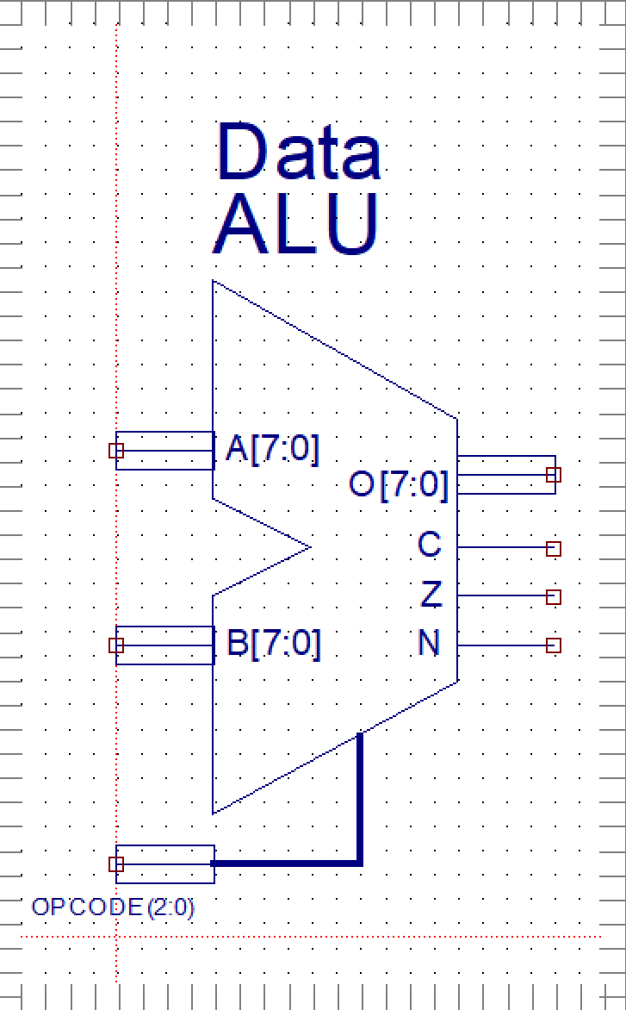
Hardware Synthesis Tools
You can also use libraries of sophisticated design elements:
For example, this is an Arithmetic Logic Unit (ALU) which could, for example, add or subtract the two 8-bit inputs based on the OPCODE inputs.

Slide 25
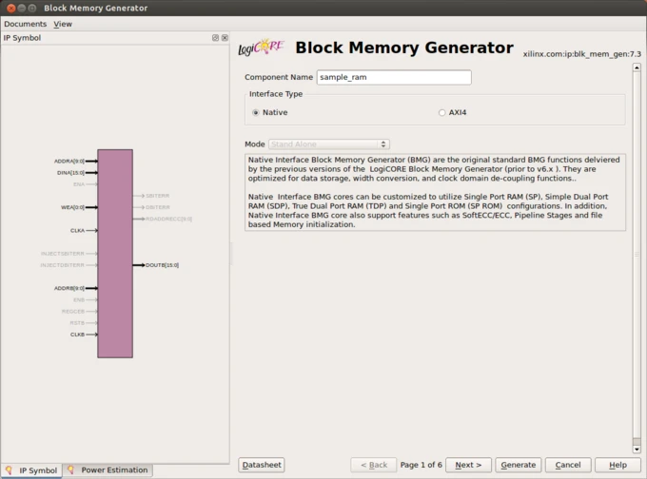
Hardware Synthesis Tools
You can also use libraries of sophisticated design elements which can be customized using the software tools provided.
This is an example of a block memory interface.
If you look carefully you can see that it has the same signals as the dual-port RAM we discussed previously (address bus, data bus, write enable, et…)

Slide 26
Hardware Synthesis Tools
The important thing to learn is that these tools are used to DESCRIBE how the design should function
They are not usually used to SPECIFY how the design should function
There are sophisticated optimization algorithms that are used to translate the design into the actual implementation

Slide 27
Hardware Constraints
Equally important is the way in which hardware constraints are specified
These can include
Which physical pins map to the signals in the schematic description
Timing constraints
Input constraints: when does data arrive at the inputs?
Timing constraints: frequencies of internal clock signals
Output constraints: relative timing of outputs

Slide 28
Hardware Constraints
The synthesis tools typically perform the following steps:
Logic reduction and mapping to resources
Placement of resources in configurable logic blocks
Routing of signals between the resources
This exercise usually turns into a big minimization problem
Any “solution” that satisfies the constraints is considered acceptable
Relies on detailed simulation and measurement of device properties

Slide 29
Hardware Definition Languages
Eventually, describing everything using schematics is no longer efficient
Today, we usually use high-level languages to describe the hardware we want to implement
Very common examples: Verilog and VHDL
They resemble programing languages, but they are used to describe hardware, not algorithms.

Slide 30
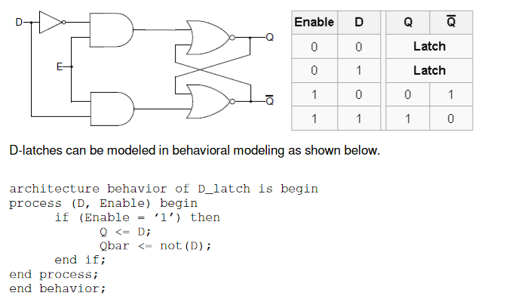
Hardware Definition Languages
The HDL gives the synthesis tools “hints” that can be easily mapped into hardware resources
Example: A simple D latch:
Notes:
Don’t worry about the syntax of VHDL. This is not supposed to be a course in VHDL hardware design but you can easily find lots of online resources and tutorials for VHDL.
The point I want to emphasize is that BOTH the schematic and the description of the way the logic should function using VHDL should result in an identical implementation in the FPGA. The user generally doesn’t care how it is implemented provided it performs the desired function and satisfies any constraints.
I can’t emphasize enough that VHDL is *NOT* a programming language. It is a hardware description language where the code is interpreted to decide how the hardware should be configured, not what algorithm is to be performed.

Slide 31
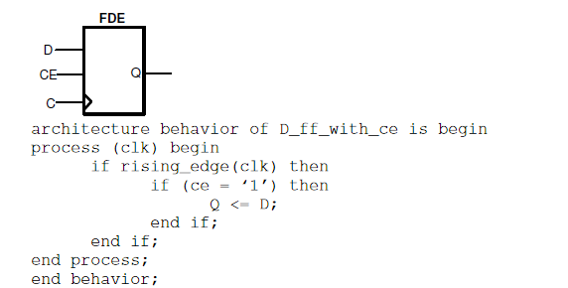
Hardware Definition Language
Many design elements rely on clock signals to synchronize the sampling of data
Example: An edge-sensitive D-type flip-flop:
Notes:
Again, the high-level synthesis tools use this description as a “hint” and it figures out how to implement this functionality using the configurable logic block resources that are available in the device.

Slide 32
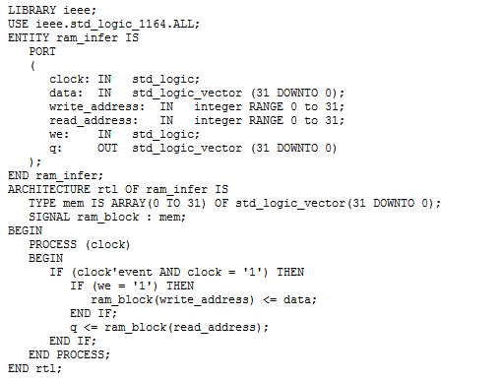
Hardware Definition Language
Here’s a more complex example showing the description of block memory:
Interface description
Architecture description
Notes:
You can think of a “memory” element as being like an array of numbers. The array index is the memory address and the array contents is the data stored in the memory.
The important point is that the high-level synthesis tools recognize this language construct and knows that it can be efficiently implemented using block RAM resources rather than, say, a whole bunch of flip-flops.

Slide 33
Practical Details
So suppose you have a problem that can be conveniently solved using an FPGA to implement all the logic
It can be very time consuming and expensive to design a printed circuit board with an FPGA on it
Usually needs at least a couple years of practical electrical engineering experience
But you can often BUY something that does most, if not all of what you need
Then you can program it using your custom logic design

Slide 34
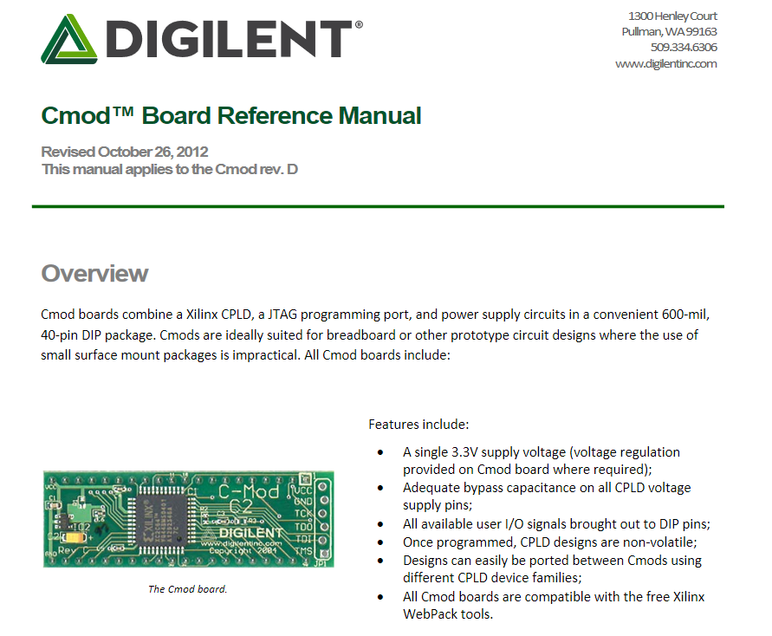
Demonstration Boards
Many companies sell “demonstration boards” that can be adapted to serve a specific application:
This one costs $25.00

Slide 35
Demonstration Boards
This cost $149.00

Slide 36
Demonstration Boards
This can be (but doesn’t have to be) plugged into the PCIe bus in a PC.
It provides high-speed network interfaces that connect directly to the FPGA.

Slide 37
Dedicated FPGA Modules
You often have to decide whether it is more economical (in terms of time and money) to design and build yourself or to just buy already existing hardware.
Especially if you have to pay your own electrical engineer, the net expense is often lower when you buy from a company.

