Slide 1
Physics 53600 Electronics Techniques for Research
Now in PowerPoint!
Spring 2020 Semester
Prof. Matthew Jones

Slide 2
The usual ANNOUNCEMENT
Obvious changes to the course:
No in-person lectures: you’ll have to read the lecture notes yourself
No more labs: don’t worry about it – your grade will be based on work done so far
Remaining assignments will try to cover topics that would have been explored in the lab
Second mid-term: simplest to cancel it
Final exam: I think it will be a 24 hour exam with written responses that can be easily sent by e-mail.
Changes to grading scheme:
Old scheme: Assignments (30%) exams (40%) lab (30%)
New scheme: Assignments (50%) exams (25%) lab (25%)

Slide 3
The usual ANNOUNCEMENT
Because there won’t be any in-person lectures, you will have to read the lecture notes yourself.
To demonstrate that you have read them, you will be required to answer one or two simple questions before the next lecture is posted.
The question will probably be at the beginning and you just have to e-mail me the answer
mjones@physics.purdue.edu
To make this easy, please make your subject look like this:
“PHYS53600 Lecture xx questions Your Name”
These will be part of your assignment grade, maybe contributing 10% of your total grade.

Slide 4
More ANNOUNCEMENTS
Feel free to send me questions about the lecture material if there is anything you don’t understand. I’m happy to give more explanation (and I’m soooo bored.)
Send me e-mail if you think it would be useful to arrange a time as a class to have a time where you can ask questions by video.

Slide 5
LECTURE 23 QUESTIONS
What are four problems that are solved by encoding data (eg, using 8b10b encoding)
On page 13, it shows how to terminate a transmission line using a resistor divider. Calculate the values of R₁ and R₂ that will work with the power supply voltages listed on that page. How much power does each termination dissipate?
Notes:
You can refer back to the scanned solutions for the midterm to find a good example for this calculation…

Slide 6
High Speed Serial Communications
Communication standards like RS-232, RS-422, and RS-485 typically operate at less than about 100 kbps (kilo-bits per second)
High speed communications like 1G or 10G Ethernet or PCIe operate at much higher rates over a wide range of distances
What is the maximum speed that can be easily achieved? What are the limitations?

Slide 7
AC Coupling
Differential signaling eliminates the need for a common ground reference
Differential pairs need to be terminated (somewhere) to prevent reflections
However, the common-mode voltage on the pair must remain reasonably close to ground if the signals are coupled directly
The DC current path can be broken by using capacitive coupling

Slide 8
Differential Drivers and Receivers
To understand the limitations of differential signaling networks it is important to understand the driver and receiver architecture.
We will start with ECL logic
ECL stands for Emitter Coupled Logic
The fundamental structure in the logic gates are NPN transistors configured as differential pairs
These are analog concepts applied to digital circuits

Slide 9
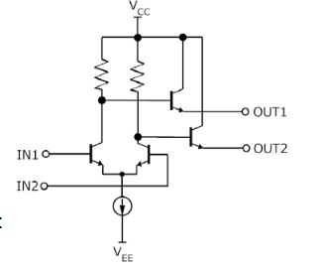
ECL Driver Architecture
This is a typical ECL logic circuit (a buffer):
For ECL logic, V_{CC}=ground and V_{EE}=-5.2 volts
For PECL logic, V_{CC}=5V and V_{EE}=ground.
Notes:
Differential ECL uses the same driver architecture as single-ended ECL logic. Single-ended ECL logic used ground as a reference since it was usually easier to keep the noise on a ground plane quiet, compared with the voltage generated by a power supply. This means that the power supply must be negative (with respect to ground) and all logic levels are also negative.
PECL stands for “Positive ECL” and ignores these practical advantages. It can be convenient, especially when interfacing with other logic families like TTL or CMOS which have positive supply voltages.

Slide 10
ECL Driver Circuits
The outputs of an ECL driver are the emitters of a pair of transistors
These act as very low impedance current sources and can drive large capacitive loads (like long cables)
The emitter must be at a lower voltage than the collector (and the base) for the transistor to be in the active region

Slide 11
ECL Receiver Circuits
Cables must be terminated with their characteristic impedance to prevent reflections
The termination voltage must be lower enough to put the driver transistors in the active region.
Typical termination voltage: $V_{TT}=−2 V$

Slide 12
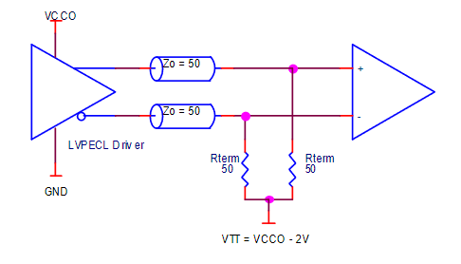
ECL Receiver Circuits
You can use a dedicated -2 volt power supply to provide the termination voltage
In this example, each signal looks like a single 50 Ω transmission line
Equivalent to a coupled pair of signals that act as a 100 Ω transmission line

Slide 13
ECL Receiver Circuits
If you don’t want to provide a dedicated -2 V power supply, you can make one using resistor dividers:
$$V_{CC}$$
V_{CC}=0V, V_{EE}=-5.2V
V_{TT}=-2 volts
$R_{∥}$=50 $Ω$
Now calculate R₁ and R₂…
$$R_{1}$$
$$V_{TT}$$
$$R_{2}$$
$$V_{EE}$$

Slide 14
Capacitive Coupling
V_{EE}
V_{EE}
The resistors at the driver end are needed to bias the output transistors.
The resistors at the receiving end eliminate reflections.
The capacitors break the DC current path, so now the receiver can be placed VERY far away from the driver.
Notes:
As a reminder, DC coupling is potentially bad because the “ground” in one piece of equipment might be many volts (sometimes hundreds of volts) different from the “ground” in another piece of equipment located a large distance away. Capacitive coupling blocks any DC component of the current on the signals and only transmits the voltage swings (from logic 0 to 1 or logic 1 to 0).

Slide 15
Capacitive Coupling
But now we have a problem… how do we transmit a long string of 0’s or 1’s?
This would look like a constant DC voltage
The capacitors would block this voltage and the receiver would gradually drift to V_{TT} at both inputs.
Not likely to work very well…

Slide 16
Data Encoding
Instead of sending the data directly, we can encode it so that we never send too many 0’s or 1’s in a row.
Example: 3b4b encoding
Notes:
Notice that only 14 of the 16 possible codes are used. There is no point in using the two codes that are all 0’s or all 1’s since this suffers from the same problem that we are trying to solve.

Slide 17
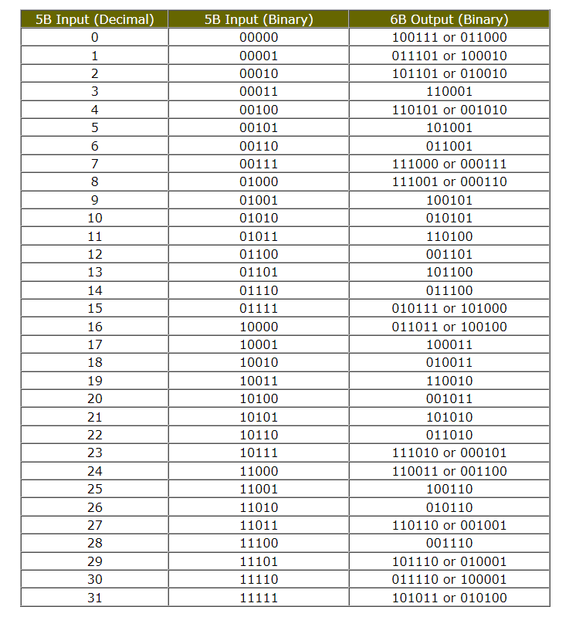
Data Encoding
5b6b encoding:
This coding scheme uses only 46 out of the total possible 64 output codes.
Notes:
The table is a lot larger but the principle is the same.

Slide 18
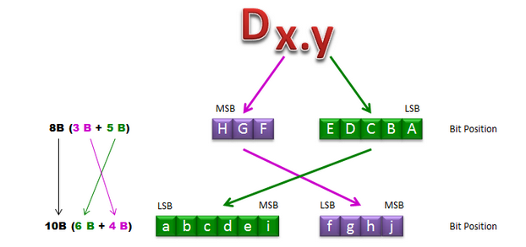
Data Encoding
8b10b encoding is useful when data is organized into 8-bit bytes.
It uses a combination of 3b4b and 5b6b encoding
Notes:
The data codes are labeled using the Dx.y notation where x is the 3-bits and y is the 5-bits of data to be encoded.

Slide 19
Running Disparity
The transmitter can also count the number of 0’s and 1’s transmitted and dynamically choose the output code so as to make them equal.
If there are more 0’s than 1’s, then pick a code from the RD- table.
If there are more 1’s than 0’s then pick a code from the RD+ table.
This ensures that on average, there are an equal number of 0’s and 1’s so the decoupling capacitors will not drift to a net DC offset.

Slide 20
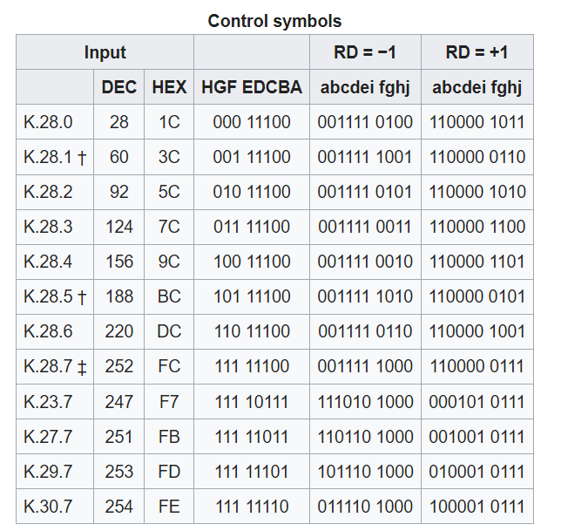
8b10b Encoding
There are some left over codes that can aren’t needed to encode the data
They are very useful to transmit “non-data” control characters

Slide 21
8b10b Control Characters
When a link is idle (no data being transmitted) it still needs to send 0’s and 1’s to maintain the DC balance
By convention, the transmitter can send a bunch of “idle” codes (K28.5)
K28.5 is special because its pattern of bits cannot be the result of any other combination of codes
This allows the word boundaries to be found in the serial data stream
Notes:
Remember that the data is usually received by a shift register which implements the serial-to-parallel conversion. But if we don’t know where the words begin and end, then the data will be completely scrambled. Instead, if we know that the transmitter is sending only idle characters, then we can figure out where the word boundaries are. Then, all subsequent words should be aligned with the same boundaries and we can interpret the 10 bits of received data using the decoder table.

Slide 22
Other Coding Schemes
64b66b encoding:
This doesn’t use a table of codes (it would be too large)
Instead, it calculates the codes dynamically using a simple binary polynomial
This effectively scrambles all the bits and makes them look like a random pattern of 0’s and 1’s
But they aren’t random and they can be unscrambled using a similar binary polynomial

Slide 23
Summary of Data Encoding
Eliminates long runs of 0’s and 1’s
Provides the ability to find word boundaries within the serial data stream
Error detection:
Several possible bit combinations don’t occur in the coding tables
If you receive such a combination then you know it must be an error in data transmission

Slide 24
Clock Recovery
How does the receiver know when to sample the data?
In the UART design, there was a high frequency master clock (1.8432 MHz) that got aligned using the START condition
If we know that the data stream contains lots of 0→1 and 1→0 transitions, then we can dynamically adjust the frequency and phase of a receiving clock to match the bit boundaries

Slide 25
Phase Locked Loops
The basic idea of a phase-locked loop is an oscillator in which the phase of a reference oscillator dynamically adjusted in a feedback loop
If the received transitions consistently arrive earlier than the reference clock edges, then decrease the phase
If the received transitions consistently arrive later than the reference clock edges, then increase the phase
This means that the frequencies of the clocks used by the transmitter and receiver don’t have to be perfectly matched (but they have to close).

Slide 26
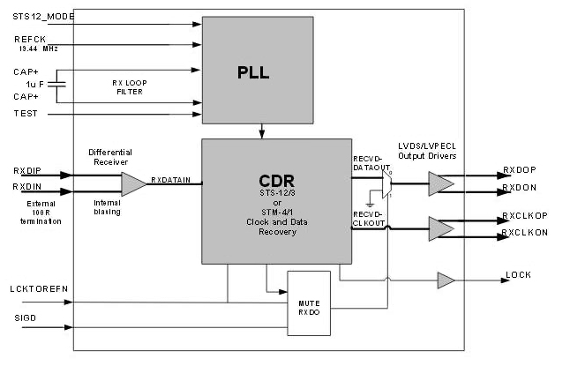
Clock/Data Recovery
A typical high-speed serial data receiver contains a clock/data recovery circuit:
Notes:
The important inputs (on the left) are data (RXDIP/RXDIN) and the reference clock (in this case 19.44 MHz) which drives the Phase Locked Loop. The PLL synthesizes a clock signal with a frequency that matches (or gets pretty close to) the frequency used by the transmitter. The Clock-Data-Recovery circuit (CDR) adjusts the phase of the clock to match the bit-boundaries found in the data input.
The output is now a copy of the data (RXDOP/RXDON) and the recovered clock (RXCLKOP/RXCLKON) that is phase-matched to the bit boundaries found in the data.
This recovered clock can be used to transfer the received data to a shift register to implement the serial-to-parallel conversion.

Slide 27
Clock/Data Recovery
This is another benefit of data encoding:
It is beneficial to have lots of 0→1 and 1→0 transitions so that the clock phase can be precisely determined
This whole scheme works extremely well provided drifts in the transmitter’s clock phase/frequency are slow compared with the bit rate

Slide 28
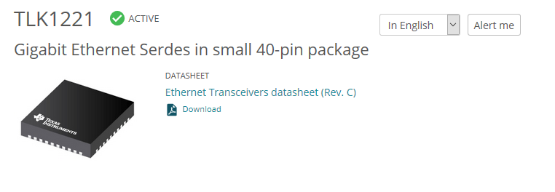
Implementation
All of these features are usually provided by dedicated integrated circuit components.
For example:

Slide 29
Example Implementation
Notes:
Now you can understand what most of these parts are doing. On the left (transmitter), 10-bits of data come in (TD) synchronous with the transmitter clock (REFCLKK). A typical example would be to use a 100 MHz clock (10ns period) so that 10 bits can be transmitted every 10 ns. This means that the bit rate on TXP/TXN would be 1 Gbps.
The received data comes in on the right (RXP/RXN) which drives the clock extraction circuit (same as clock recovery) and the serial-to-parallel conversion circuit. The serial-to-parallel conversion also detects where the word boundaries occur (comma detection) and outputs a 10-bit word that is aligned with the REFCLK input.
All the other signals can be used for diagnostics or control logic, but don’t really affect the fundamental principles used here.
In this case the TXP/TXN and RXP/RXN can be used to drive a standard Ethernet cable connector directly, or they can drive the inputs to a fiber optic transceiver module.

Slide 30
Summary
So those are more or less the principles behind high speed serial data transmission.
They are the same principles used for several standards:
Ethernet (over cables or fiber optics)
XAUI (10 Gbps network over 4 separate serial links)
USB (over cables)
PCIe (over PCB backplanes)
JESD204B (predictable data latency necessary for high-speed data acquisition systems)
Notes:
The standard PCI bus used to be a parallel bus that allowed peripherals to be plugged into a standard PC motherboard.
The PCIe standard allows much higher data transfer rates and is based on multiple high-speed serial links rather than a wide parallel data bus.
Of course, there needs to be additional logic to align all the serial data streams when there are more than one, but there are ways that this can be accomplished.

