Slide 1
Physics 53600 Electronics Techniques for Research
Now in PowerPoint!
Spring 2020 Semester
Prof. Matthew Jones

Slide 2
The usual ANNOUNCEMENT
Obvious changes to the course:
No in-person lectures: you’ll have to read the lecture notes yourself
No more labs: don’t worry about it – your grade will be based on work done so far
Remaining assignments will try to cover topics that would have been explored in the lab
Second mid-term: simplest to cancel it
Final exam: I’m not sure what to do about this yet, but I’ll figure something out.
Changes to grading scheme:
Old scheme: Assignments (30%) exams (40%) lab (30%)
New scheme: Assignments (50%) exams (25%) lab (25%)

Slide 3
The usual ANNOUNCEMENT
Because there won’t be any in-person lectures, you will have to read the lecture notes yourself.
To demonstrate that you have read them, you will be required to answer one or two simple questions before the next lecture is posted.
The question will be somewhere (like maybe at the end?) and you just have to e-mail me the answer
mjones@physics.purdue.edu
To make this easy, please make your subject look like this:
“PHYS53600 Lecture xx questions Your Name”
These will be part of your assignment grade, maybe contributing 10% of your total grade.

Slide 4
More ANNOUNCEMENTS
Feel free to send me questions about the lecture material if there is anything you don’t understand. I’m happy to give more explanation (and I’m soooo bored.)
Send me e-mail if you think it would be useful to arrange a time as a class to have a time where you can ask questions by video.

Slide 5
LECTURE 22 QUESTIONS
Why did the original RS-232 standard use such large voltage swings on its signals?
What are some advantages of RS-485 compared with RS-232?
What are the main differences between RS-422 and RS-485?
Notes:
Actually there is no question #2 – this is the only question today.

Slide 6
Serial Digital Data Transfer
So far we have considered various types of data transfer (both serial and parallel)
All types we have considered use a clock signal (or strobe, or whatever you want to call it) to synchronize the sampling of a data signal
This works, provided the data satisfies well-defined setup and hold times.
Today we will investigate two other forms of serial communication that don’t explicitly transmit clock signals
Notes:
Make sure you understand what setup and hold times are. They have been introduced in previous lectures…
The types that we will discuss are the UART (Universal Asynchronous Receiver/Transmitter) which is the basis for RS-232/RS-485/etc. communication and high-speed SERDES (Serialiser/Deserialiser) devices. Although a clock signal is needed by both the transmitter and the receiver, these are not transmitted between them as a dedicated signal.

Slide 7
Serial Data Transfer
We can first motivate the problem by considering transmitting serial data over a long distance (a few meters to a few hundred meters)
Then, if we can make this work then it should (in principle) work even better (ie, faster) over shorter distances

Slide 8
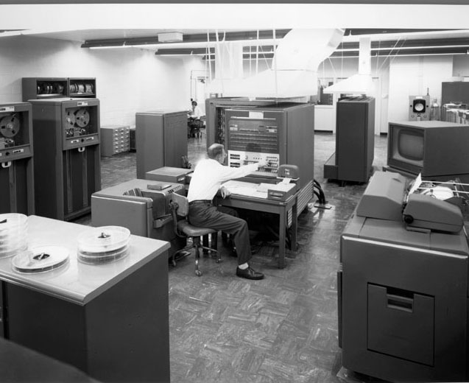
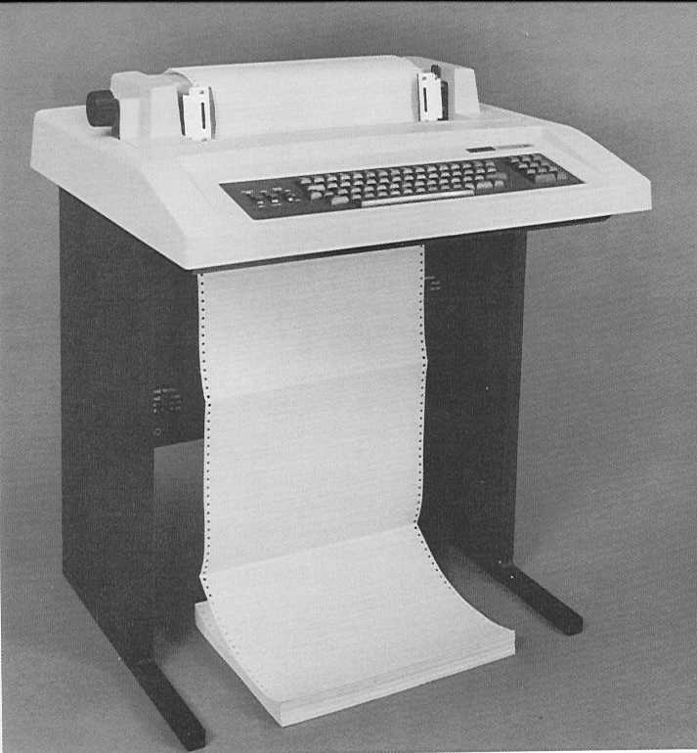
Serial Interfaces
With the emergence of mainframe computers in the 1950’s-1980’s, the human interfaces were usually located far away from the main computing hardware
100 meters
Located in a carefully controlled secure area
Located in a publically accessible area
Notes:
Human interfaces (terminals and teletypes) were considered to be “dumb” interfaces because they didn’t compute anything themselves – they only sent and received data from the main computer.
Would you believe that people used to edit documents (like computer programs) on teletypes? It’s an adventure when you can’t really backspace to erase mistakes. Some of these concepts have been retained in the DNA of modern editors, in particular “vi”.

Slide 9
Signal Skew
Obviously it will be easier and less expensive to have fewer signals (ie, wires) in an interface
But, if we send a dedicated clock signal then we must guarantee that the setup and hold times are respected even when the cable is very long
Without careful physical construction (which adds expense) it can be hard to guarantee that the electrical length of all conductors in a cable are the same.
It might work, but maybe can only be guaranteed to work at low speeds.
Notes:
This can be due to things like the capacitance of individual conductors being different because they might be in different physical proximity to a ground conductor on which the current returns.

Slide 10
Serial Data Transmission
Let’s consider a scheme where we ONLY transmit the data signal
This would only require two conductors
The problem is that the receiver doesn’t necessarily know when to sample the data
This is the basic problem with all serial communication and it is solved in various ways
Both receiver and transmitter must agree on the format of the data and the receiver can use this to deduce a local sample clock signal

Slide 11
Universal Asynchronous Receiver/Transmitter
This is the scheme used for several serial protocols (RS-232, RS-485, …)
Both receiver and transmitter have their own internal clocks
These clocks need to run at approximately the same frequency
There is no way to guarantee the phase difference
These internal clocks determine the rate at which bits are sent and received
This is called the baud rate

Slide 12
Baud Rate
Both receiver and transmitter start with a local oscillator that runs at about 1.8432 MHz
This is divided by integer factors to produce specific baud rates:
Baud rate | Divisor
300 | 6144
1200 | 1536
2400 | 768
9600 | 192
19,200 | 96
38,400 | 48
115,200 | 16

Slide 13
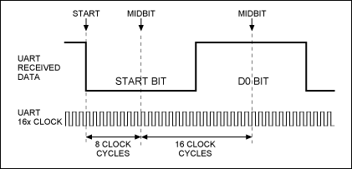
Start Bits
The transmitter begins by sending a START bit
The receiver detects the start bit and knows (approximately) what the phase of bit boundaries are
Notes:
The receiver needs to know how many clock cycles long the start bit is, but it doesn’t know when the leading edge of the data will arrive. So in this example, the receiver knows that bits are 16 clock cycles long so as soon as it detects the START transition it knows that data can be safely sampled 8 clock cycles later, and then on each subsequent 16 clock cycles.
This will work for short periods of time, provided the transmitter and receiver clocks are running at close to the same frequency.

Slide 14
Data Bits
After the start bit is detected, the transmitter can send a number of data bits
Both transmitter and receiver need to agree on how many
After the data has been transferred, the transmitter must get ready to send another start bit
This is like a STOP bit, and returns the signal to the opposite logic state of the START bit so that the next START edge can be detected

Slide 15
Error Detection
There are several ways to improve the signal-to-noise ratio on the electrical signals
Remember Shannon’s channel capacity theorem?
If errors are still possible, then there are some simple ways to detect them
At least you can try to detect some of them
One simple scheme is to transmit a “parity” bit that ensures that the total number of 1-bits in the data+parity is either even or odd:
Even parity: Only an even number of 1 bits
Odd parity: Only an odd number of 1 bits

Slide 16
Error Detection
The “bit-error-rate” (BER) is the rate at which bits are incorrectly received.
Parity will detect the flips of any single bit in the data+parity word
Example with 8-bit data words and one parity bit:
P(no errors) ≈ 1-BER⁹
P(one error) ≈ 9 x BER
P(two errors) ≈ 9 x 8 x BER²
There is still a (small) chance that there will be two bit flips in one word
This will not be detected by the parity bit
Notes:
The probability of correctly sending a bit is 1 minus the bit-error-rate. The probability of sending 9 bits correctly is this number raised to the power of 9, when we assume that the probability of errors on any bit is not correlated.
This is just binomial probability stuff.
Later we will discuss more reliable error detection and correction techniques.

Slide 17
Physical Interface
The protocol for transferring serial data is specified at the bit level (logic 0 or 1)
Physically, the electrical connections can be implemented in various ways.
It can also be convenient to provide other signals to help with data synchronization
Physical connectors:
DB-9 (male and female)
DB-25 (male and female)
RJ-11
RJ-45
No really good universal standard – often vendor dependent

Slide 18
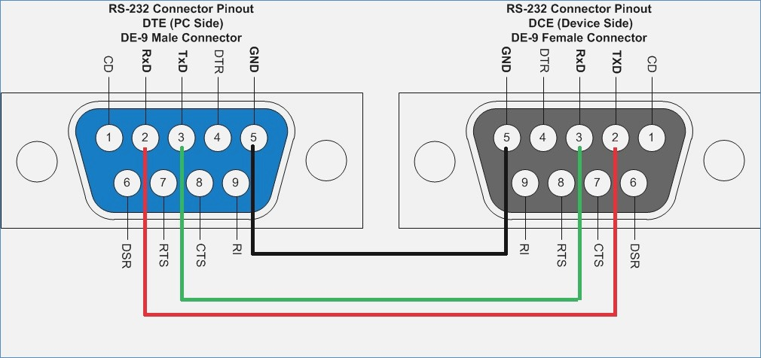
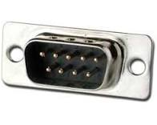
DB-9 Connectors
This is usually the bare minimum number of signals that are used
CTS and RTS signals are used for flow-control.
Notes:
If the transmitter has data available it can assert the “Request To Send” signal.
If the receiver runs out of memory for storing the incoming data, then it can de-assert the “Clear to Send” signal.
Both transmitter and receiver must agree on how to interpret these signals, if they are used at all.

Slide 19
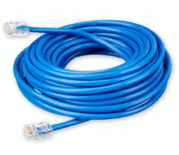
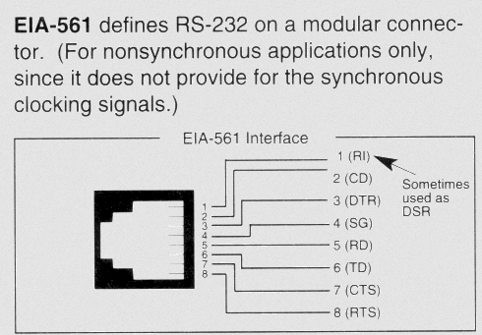
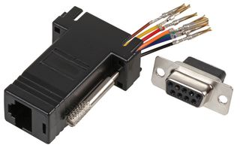
RJ-45 Connectors
RJ-45 connectors are convenient because they can use regular CAT-4/5 Ethernet cables with inexpensive connectors at both ends
Sometimes you have to make adapters to connect up your own weird equipment
Notes:
You can buy these kits where you plug the right colored wire into the correct pin number on the DB-9 connector to implement whatever wiring is necessary.
Sometimes this takes some trial and error… ☹

Slide 20
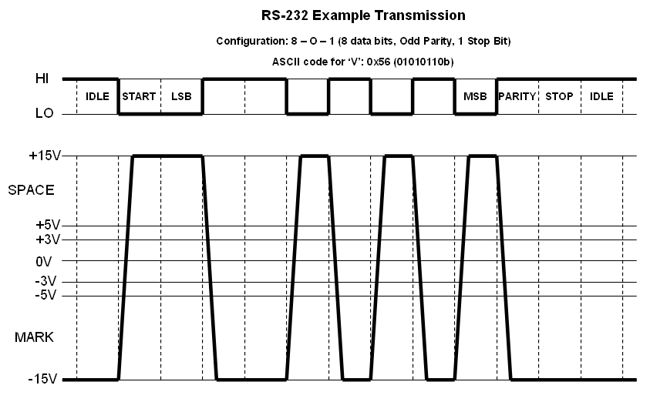
Electrical Interface
The original RS-232 specification used large voltage swings to increase the signal-to-noise ratio
The voltage levels were called “mark” and “space”:

Slide 21
Electrical Interface
In practice, it can be quite inconvenient to work with ±15 volt signals in digital circuits.
There are driver IC’s that will translate standard 3.3V or 5V logic levels to these higher voltages
For example:

Slide 22
Disadvantages of RS-232
The signals are single-ended
Noise is added linearly to the voltage being driven
The voltage swings are potentially large
They can radiate noise that might interfere with other circuits
The signals are ground-referenced
Both pieces of equipment have to be connected to the same electrical ground or else large currents might flow in the cable
The signals are point-to-point
You can’t share the signals with multiple devices on the same cable

Slide 23
RS-422/RS-485 Electrical Specification
The RS-422/RS-485 specification attempts to address many of these deficiencies.
The data that is transferred is still sent/received using the UART protocol
Additional conventions are required to allow multiple devices to share the same bus

Slide 24
RS-422/RS-485 Electrical Specification
Both use a single pair of wires to transfer differential signals:
There is no common ground connection
The wires act as a transmission line, so Z_{T} is needed to prevent reflections at the receiving end.
Notes:
Differential signals have the advantage that
they have no common ground reference
If they pick up noise, it is usually the same on both signals
The receiver only cares about the voltage difference (A>B or B>A) to define the logic levels

Slide 25
RS-422 Specification
With the RS-422 specification, one transmitter (the master) can send data to many (up to 10) receivers (slaves)
The master can also receive data (on a separate pair of signals) from many slaves that share the bus
The slaves have to decide who will transmit data at any given time.
Cables can be long! Up to 1 km with data rates less than 100 kbps (kilo-bits per second)

Slide 26
RS-485 Specification
The RS-485 specification is built on the RS-422 specification
They use the same differential signals
But the pair of signals is truly bidirectional
Not only can there be multiple slaves, but there can also be multiple masters
Up to 32 drivers and 32 receivers on a single pair
Now all the devices need to coordinate who will be driving the pair at any given time.

Slide 27
Example RS-485 Communications
A standard communication protocol is needed to make this work
One example is the MODBUS protocol
Each device is assigned an 8-bit address
Data is organized as a set of 16-bit registers
The master sends data in the following format:

Slide 28
Example RS-485 Communications
The master then releases the bus (goes to a high impedance state and starts listening)
The slave then transmits a response:
Error checking is performed by constructing a 16-bit word from the data
If the word calculated from the received data does not match the transmitted data, then an error must have occurred.
Notes:
Errors are not just due to picking up noise. They can also occur if two devices try to transmit data on the bus at the same time. This will not damage anything, but the data will definitely be corrupted.

Slide 29
Example of MODBUS Error Checking
Notes:
There are lots of other algorithms that can be used for error checking but this one is fairly simple to implement.

Slide 30
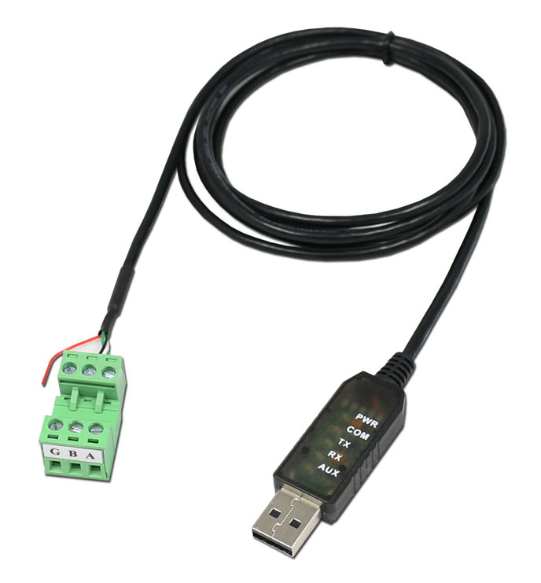
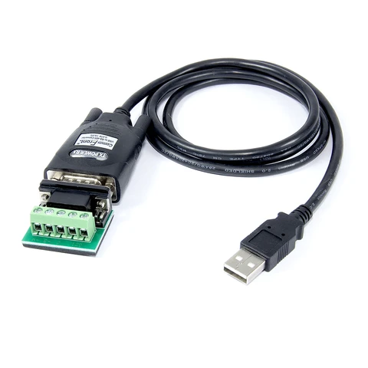
Examples of RS-485 Equipment
Lots of industrial equipment uses RS-485 for communications.
Most computers do not have a specific RS-485 interface.
You can buy RS-485 to USB converters:

Slide 31
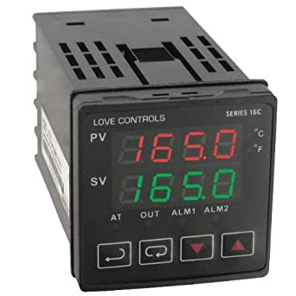
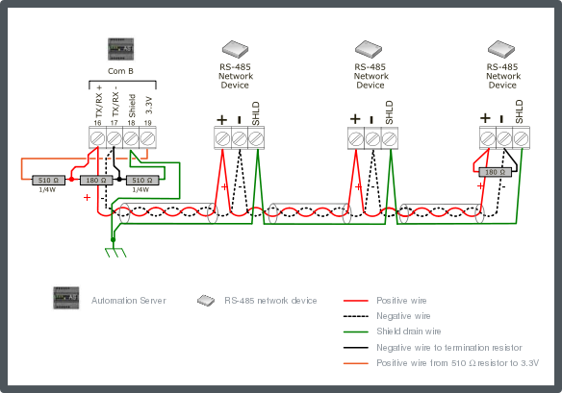
Examples of RS-485 Equipment
Notes:
This is an example of an industrial module that typically measures a voltage and will adjust an output (voltage or current) to implement a feedback loop for controlling a process. For example, if the input was temperature, the output could be a voltage that might control a heating element.
The set point and the measured value can be read by a computer over an RS-485 network. There can be many such devices on the same serial network.
These networks are often constructed by just attaching wires to screw-terminals on each device. There is usually no soldering involved.
You need to terminate the bus at both ends (not in the middle!) to prevent reflections on the transmission line.

