Slide 1
Physics 53600 Electronics Techniques for Research
Now in PowerPoint!
Spring 2020 Semester
Prof. Matthew Jones

Slide 2
The usual ANNOUNCEMENT
Obvious changes to the course:
No in-person lectures: you’ll have to read the lecture notes yourself
No more labs: don’t worry about it – your grade will be based on work done so far
Remaining assignments will try to cover topics that would have been explored in the lab
Second mid-term: simplest to cancel it
Final exam: I’m not sure what to do about this yet, but I’ll figure something out.
Changes to grading scheme:
Old scheme: Assignments (30%) exams (40%) lab (30%)
New scheme: Assignments (50%) exams (25%) lab (25%)

Slide 3
The usual ANNOUNCEMENT
Because there won’t be any in-person lectures, you will have to read the lecture notes yourself.
To demonstrate that you have read them, you will be required to answer one or two simple questions before the next lecture is posted.
The question will be somewhere (like maybe at the end?) and you just have to e-mail me the answer
mjones@physics.purdue.edu
To make this easy, please make your subject look like this:
“PHYS53600 Lecture xx questions Your Name”
These will be part of your assignment grade, maybe contributing 10% of your total grade.

Slide 4
More ANNOUNCEMENTS
Feel free to send me questions about the lecture material if there is anything you don’t understand. I’m happy to give more explanation (and I’m soooo bored.)
Send me e-mail if you think it would be useful to arrange a time as a class to have a time where you can ask questions by video.

Slide 5
LECTURE 21 QUESTION #1
What are some advantages and disadvantages of SPI compared with I²C serial communication?
Notes:
Actually there is no question #2 – this is the only question today.

Slide 6
Digital Data Transfer
So far we have considered two types of data transfer:
Parallel data transfer where all the data is provided at one time
Serial data transfer (SPI) where the data is provided one bit at a time
Both schemes use one signal (STROBE, SCLK, etc…) to synchronize data transfer.
Asserting this signal means that it is safe to sample the data signals.
Important to respect the setup and hold times at both ends of the data transfer

Slide 7
Disadvantage of SPI
The SPI interface is simple and convenient if you need to communicate with a small number of peripheral components.
Each peripheral component requires a dedicated SCS signal to enable it.
The number of signals needed is 3 + n where n is the number of SCS signals/number of components.
The I²C (or IIC) interface only uses two signals, independent of the number of peripheral components.

Slide 8
The Inter Integrated Circuit Interface
The IIC (or I²C) interface uses two signals:
SCL is like a clock signal
SDA is a bidirectional data signal
Both signals have open collector/open drain drivers
A component will either be in a high impedance state, or pull the signal to ground (logic 0)
Nothing bad happens when two components drive the signals simultaneously (although data might be corrupted)
Both signals require a pull-up resistor that will pull them to Vcc (3.3 volts or 5 volts) when all components are in a high impedance state.
Notes:
If ANY component pulls the signal to ground then the signal will be read as a logic level of ‘0’. If none of the components pull the signal to ground, then the signal will be read as a logic level of ‘1’. This is true for both the SCL and the SDA signals.

Slide 9
IIC Signals
Both SDA and SCL signals need to be pulled up to the positive power supply voltage by resistors:
Vdd
$$R_{p}$$
$$R_{p}$$
SDA
SCL

Slide 10
IIC Signals
Timing diagram:
V_{dd}
One of the components pulls the signal low. This creates a low-impedance path to ground and the signal quickly goes to a logic ‘0’.
When the component goes back to a high-impedance state, the signal charges back up to Vdd. The time constant is $R_{p}C$ where C is the total capacitance (sum of the input capacitance plus parasitic capacitance of wires or PCB traces)

Slide 11
IIC Signals
What value of $R_{p}$ should you use?
It is not all that critical…
A lower value will make the signal charge up to V_{dd} faster, but will dissipate more power when the signal is pulled low
A few kΩ is typical (maybe 2 kΩ to 10 kΩ)
Typical time constant:
If the parasitic capacitance is, say, 400 pF, then the time constant is $τ=R_{p}C=2 μs$
The maximum frequency on either signal must be less than about $1/τ$.
Typically, the maximum frequency is 100 kHz (standard mode) or 400 kHz (fast mode).
There is no lower limit on the frequency

Slide 12
IIC Signals
The signals are used for communication in the following way:
One component acts as the “master” and drives the SCL signal.
Another component acts as a “slave” and receives the SCL signal.
Initially, the master drives the SDA signal...
Notes:
Yeah, I know the master/slave thing is pretty stupid, but it’s been ubiquitous terminology since at least the 1960’s. I don’t really want to know what all those engineers with buzz cuts, short sleeved white shirts, thin leather ties and pocket protectors were into back then…

Slide 13
IIC Signals
Initially, all the slaves on the IIC bus are in an idle state.
In this state, all drivers are in a high-impedance state, so both SDA and SCL are pulled high
They wake up when the detect a “start condition”:
The start condition is defined as SDA being pulled low, while SCL remains high.
They go back to sleep when they detect a “stop condition”:
The stop condition is defined as SDA going high when SCL is high.
Otherwise, SDA should only change when SCL is in a low state.

Slide 14
IIC Signals
Timing diagram:

Slide 15
IIC Signals
Each IIC component has a 7-bit address associated with it.
This is usually built into the component but some of the lower-order bits can be changed by pulling pins on the device high or low (or left floating).
The master first transmits the 7-bit address of the device it wants to talk with, followed by a R/W bit.
The master then releases the SDA signal and looks for an acknowledgement from the slave.
If a slave recognizes its address, it pulls SDA low (ACK) which the master samples on the next rising edge of SCL.
If nobody recognizes the address then the SDA bus is pulled high (NACK).

Slide 16
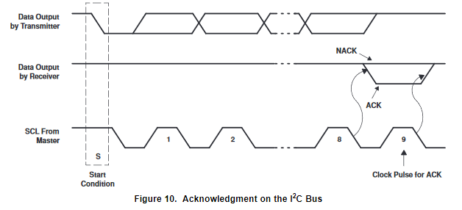
IIC Signals
Acknowledgment:
The ACK/NACK is asserted while SCL is low and is sampled by the master on the rising edge of SCL.

Slide 17
IIC Signals
Here is an example where the master writes data to the slave (for example, a control register):
After receiving the data, the slave sends another ACK signal.
The master then terminates the transaction with a stop condition.
Notes:
The address of the slave in this case is 1110xxx where xxx can be set by wiring three external pins on the component to be high or low. This way you can have several of the same component on the IIC bus, provided they are set to different addresses.

Slide 18
IIC Signals
Here is an example where the master reads data from the slave. In this case, R/W = 1.
The master issues an ACK if it wants to read more data, or a NACK if it is finished.

Slide 19
IIC Protocols
These examples show how a master and slave can communicate, but the details are often specific to the components being used.
Let’s look at some examples…

Slide 20
A network of temperature sensors
Suppose you needed to measure temperatures at several places in an experiment.
An example of a temperature sensor that communicates using IIC: The LM76 (Texas Instruments)

Slide 21
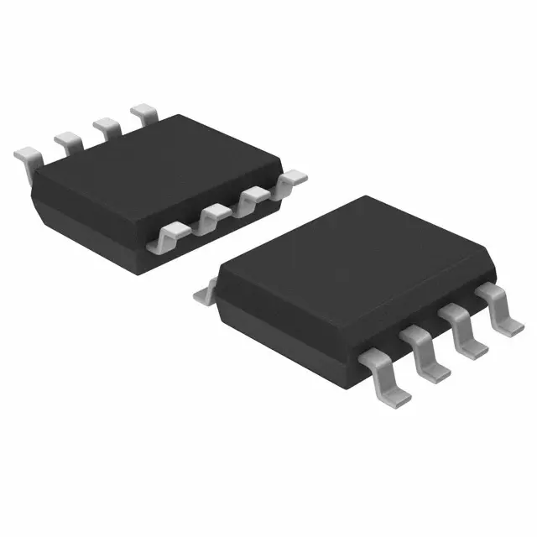
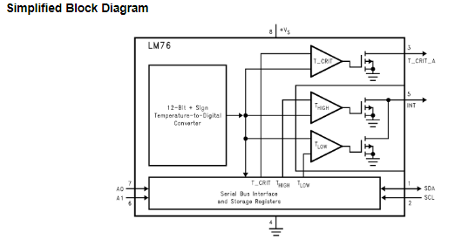
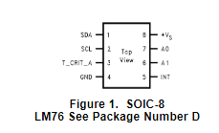
Temperature Sensor with IIC interface
The data sheet describes how it works:
Notes:
Here’s how to interpret all this information:
First, you need to provide the chip with power and ground. These are +Vs and GND. It says that +Vs can be 3.3 volts or 5 volts.
Next, you can see that it does indeed have an I2C interface. The SCL is an input and the SDA is bidirectional. Thus, this component can ONLY act as a slave (since it never drives SCL).
The I2C address can be configured using the A0 and A1 pins. You can connect these to ground or +Vs to change the address. Therefore, you can have at most 4 devices on the same bus without address conflicts. Later in the data sheet it states that the other bits of the address are set to 10010xx where xx = A1, A0.
The T_CRIT and the INT outputs are provided for convenience, but we won’t worry about them yet…

Slide 22
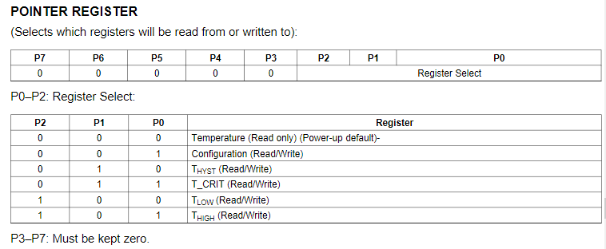
Temperature Sensor Example
The device has 8 internal 16-bit registers.
Register 0 is the actual temperature reading
Which register is being read/written is specified by setting the “pointer register”:

Slide 23
Temperature Sensor Example
The data sheet describes how to read the temperature:
Notes:
The master sends a START condition, then the address followed by the R/W bit set to 0 (because it needs to write to the pointer register). If the pointer byte was set to 00000000, then subsequent reads would return the data from the temperature register.
Next, the master sends a START condition followed by the address, but this time it sets the R/W bit to 1 (because it wants to read the temperature).
If the LM76 recognizes the address, then it sends an ACK followed by 16-bits of temperature data, split into two 8-bit bytes. Between the two bytes, the LM76 expects to receive an ACK from the master to indicate that the data was successfully received. If the master doesn’t want any more data then it sends a NACK condition followed by a STOP condition.

Slide 24
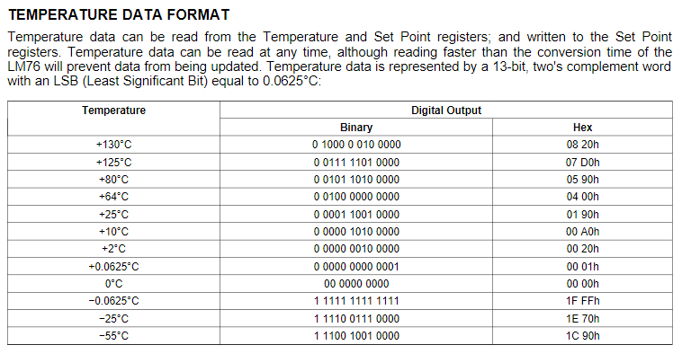
Temperature Sensor Example
The format of the data is specified in the data sheet:
Notes:
Once you write a 00000000 to the pointer register, then you can just keep reading the temperature. Conveniently, this is just a signed integer where the least significant bit is 0.0625 degrees Celsius. So you just read the13 bit temperature as an integer, and multiply by 0.0625 and you’ve got the temperature in degrees C.
But what are the CRIT, HIGH and LOW bits for???

Slide 25
Temperature Sensor Example
Suppose you needed to immediately report that a temperature exceeds some critical value…
You can do this by programming the other registers.
When the temperature exceeds the value in the T_CRIT register, the device will pull the T_CRIT_A output low.
How you use this signal is up to you… maybe you want to make it turn on a light or something.

Slide 26
Complete Design Example
+Vs
Host
SCL
SDA
LM76
A0 A1
LM76
A0 A1
LM76
A0 A1
+Vs
+Vs
Notes:
This design example does now show the use of the T_CRIT_A outputs, but the circuit could be set up to read these signals on separate host inputs. Because they are open-collector outputs, they would need to be pulled up to +Vs, the same way that SCL and SDA are.
The host is ALMOST ALWAYS some type of computer, or microcontroller (ie, a computer on a single chip). They can usually be programmed using high-level languages like C (but also sometimes Python or Java).
Now it is up to the host to implement the protocol for controlling SCL and reading/writing SDA at the appropriate times. Because there is no lower limit to the clock frequency, this can be done by writing a program to read/write the two pins connected to SCL and SDA.

