Slide 1
Physics 53600 Electronics Techniques for Research
Now in PowerPoint!
Spring 2020 Semester
Prof. Matthew Jones

Slide 2
ANNOUNCEMENT
Obvious changes to the course:
No in-person lectures: you’ll have to read the lecture notes yourself
No more labs: don’t worry about it – your grade will be based on work done so far
Remaining assignments will try to cover topics that would have been explored in the lab
Second mid-term: simplest to cancel it
Final exam: I’m not sure what to do about this yet, but I’ll figure something out.
Changes to grading scheme:
Old scheme: Assignments (30%) exams (40%) lab (30%)
New scheme: Assignments (50%) exams (25%) lab (25%)

Slide 3
ANNOUNCEMENT
Because there won’t be any in-person lectures, you will have to read the lecture notes yourself.
To demonstrate that you have read them, you will be required to answer one or two simple questions before the next lecture is posted.
The question will be somewhere (like maybe at the end?) and you just have to e-mail me the answer
mjones@physics.purdue.edu
To make this easy, please make your subject look like this:
“PHYS53600 Lecture xx questions Your Name”
These will be part of your assignment grade, maybe contributing 10% of your total grade.

Slide 4
LECTURE 19 QUESTION #1
What are four ways that can be used to increase channel capacity?
LECTURE 19 QUESTION #2
Although the SPI interface might not necessarily be very fast, what are some of its advantages?

Slide 5
Digital Data Transmission
The speed of digital circuits is often limited by the error-free rate at which data can be transferred
This includes transmission on all length scales:
Communication with Voyager 2 (10¹³ m)
Trans-oceanic cables (10⁶ m)
Commercial network infrastructure (10³ m)
Peripheral interfaces (1 m)
Computer backplanes (10⁻¹ m)
Printed circuit board interconnects (10⁻² m)
Within an integrated circuit (10⁻³ m)
Notes:
I just googled Voyager 2 to find out how far away it was as of 2018. It’s actually about twice this distance but these are just order-of-magnitude estimates. The data transfer rate in 2018 was 110 bits per second. When Voyager 2 was closer (like at the orbit of Jupiter) its data transfer rate was 115.2 kbits per second.

Slide 6
Digital Data Transmission
Fundamental limit is described by Shannon’s Channel Capacity Theorem:
$$c=b \log_{2}\left(1+s\right)$$
Where
$c$ is the error-free single-channel capacity (eg. in bits per second)
$b$ is the bandwidth of the channel
$s$ is the signal-to-noise ratio

Slide 7
Digital Data Transmission
There are several obvious ways to increase the rate at which data can be transferred:
Increase the bandwidth
Low bandwidth example: smoke signals
High bandwidth example: shielded coaxial cable
Increase the signal-to-noise ratio
Either increase the amplitude of the signal or reduce the amplitude of the noise
Detect and correct errors in data transmission
Increase the number of channels

Slide 8
Examples
There are many examples, but many of them are now obsolete because of their fundamental channel capacity limitations
They still serve as useful examples because they are easy to understand and analyze

Slide 9
Parallel Printer Interface
The parallel printer interface was developed in the 1970’s and was only superseded by other interfaces (like USB) in the 1990’s.
It was more-or-less standardized which allowed many manufacturers to design compatible equipment.
The standard specified both the electrical and physical interfaces.

Slide 10
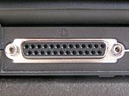
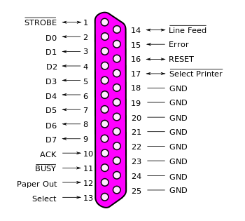
Parallel Printer Interface
Physical interface:
25-pin connector (DB-25)
25-conductor cable
Electrical interface:
8 parallel data signals
Several control signals
Lots of ground signals
Also specifies voltages (5 volt TTL logic levels)

Slide 11
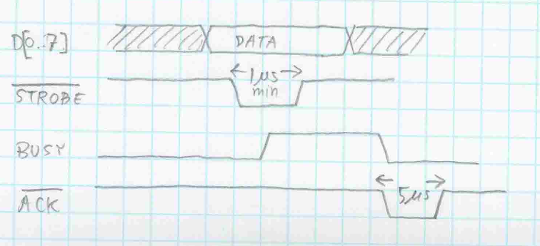
Parallel Printer Interface
Most communications could be achieved using only three control signals:
Timing diagram:
Computer
DATA 8
Printer
BUSY
STROBE
ACK
Notes:
We put the little slash (with the number 8) on a single line to indicate that there are actually 8 signals present that are all basically the same (the 8 data signals).
Here’s how to read the timing diagram…
The printer doesn’t care what the DATA is until the STROBE signal is asserted in a low state. The computer must assert STROBE for at least 1 us after the DATA signals have all stabilized to their intended value.
The printer asserts BUSY in a high state while it goes about printing the character represented by the 8 data signals. This can actually take quite some time (like maybe milliseconds) in cases where mechanical parts need to move (like the print head).
When the printer is ready for the next character it de-asserts BUSY and asserts ACK low for at least 5 us.
We like to say ASSERT and de-ASSERT when the actual logic level is defined somewhere else. Names of signals that are ASSERTED when low are usually indicated with a bar over them. When they are de-asserted, they go high again. Signals like BUSY are high when they are asserted. This terminology separates the logical operation of an interface from the electrical implementation of the interface.

Slide 12
Parallel Printer Interface
Maximum data transfer rate:
With this specification, the rate cannot be greater than about 150 kBytes per second.
Alternative specifications allowed rates of up to about 500 kBytes per second.
Disadvantages:
Expensive cables (25 conductors)
5 volt single-ended signals (generate RF noise)
Slow hand-shaking mechanism
Fundamental data synchronization mechanism:
STROBE indicates when it is safe to sample DATA
Notes:
The cables are expensive because someone (either a person or a robot) needs to solder all 25 pins at both ends. Other technologies were developed to make this easier, like using ribbon cables that could be mass-terminated, but generally the cost of the connector scales with the number of pins.
The cables (in principle) work like antennas and radiate RF noise that can be picked up by other electronic equipment (eg, other cables). This gets worse with larger voltage swings and faster signal transition times (remember when you take the Fourier transform of a step function you get lots of high-frequency components).
The “hand-shaking” mechanism refers to the way the signals are passed back and forth between the computer and the printer to negotiate when each is ready for the next character.

Slide 13
Memory Interface
Just because the parallel interface became obsolete for peripherals (like printers) doesn’t mean that the concepts are not still widely used!
In many cases this is still a very practical way to transfer data over short distances
Between integrated circuits on a printed circuit board
Between peripheral cards on a bus (like the older-generation PCI bus used in many PC’s)

Slide 14
Memory Interface
For example, consider the CY7C1020CV33 memory chip (32k x 16 bit static RAM)…
Signal interface:
Input address: $A_{0..14}$
Data input/output: $D_{0..15}$
Chip enable input: $\overline{CE}$
Write enable input: $\overline{WE}$
Output enable: $\overline{OE}$
Similarity with the parallel printer interface:
One signal (WE or OE) is used to indicate when it is safe to sample the address/data signals

Slide 15
Memory Interface
Notes:
This is mainly just for reference. Here’s how you should approach reading the data sheets…
First, try to identify the signals that you expect to be present. In this case you should be able to quickly find the address and data bus signals.
Then you can read the description to see how to use the other signals. Think about the read and write operations separately.
Try to figure out which signals are essential (for example CE and WE) and which ones are provided for convenience (BHE and BLE).
Make sure you understand which signals are tri-state logic (in this case the I/O signals) and what signal will enable their drivers (in this case it’s the OE signal).

Slide 16
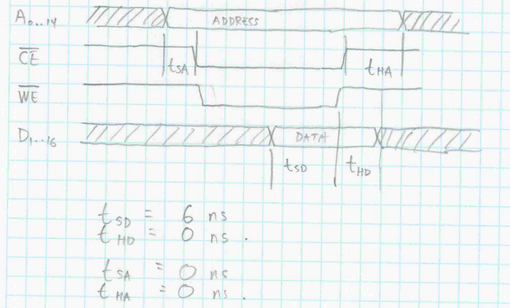
Memory Interface
Write operation:
Notes:
Look at the setup and hold times…
The data is sampled on the rising edge of WE. The data must be valid for at least 6 ns before this rising edge. For this particular device, the data can change immediately after the rising edge (zero hold time) but this is not always the case for other components.
There are no timing requirements on the setup and hold times for the address bus with respect to the CE input.

Slide 17
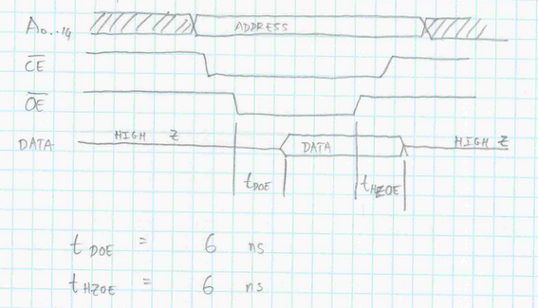
Memory Interface
Read operation:
Notes:
Look at the setup and hold times…
The data is presented on the D signals at most 6 ns after OE goes low. Data remains presented on the D signals at least 6 ns after OE goes high again.

Slide 18
Memory Interfaces
What is the maximum data transfer rate when writing?
In principle, you could transfer 16 bits every 6 ns… this would be 2.667 Gbits per second.
In practice it will be slower…
The signals on all the data lines might not all arrive at the same time (skew)
Propagation speed is about ½ c
Electrical connections that are physically close need extra delay (extra length) added so that all signals arrive at the same time
Notes:
This is a rhetorical question… you don’t need to send me e-mail with an answer.
The data signals might not all arrive at the same time because the electrical lengths of the interconnects on the printed circuit board could be different due to routing constraints.

Slide 19
Correcting for Signal Skew
You can see examples of this on most modern PCB layouts.
The modelling of high-speed signals on printed circuit boards can be a very important part of the design process.
Notes:
See all the wiggles on the traces? Those are adding extra length to those traces so that all signals arrive at the connector (the array of solder holes) at the same time.

Slide 20
Serial Data Transfer
Sometimes, high data transfer rates are not required and parallel interfaces present some disadvantages:
They require lots of physical resources (lots of pins on components, lots of wires in cables, lots of board space for routing)
When data rates are not critical it can be convenient to transfer data one bit at a time.
This requires a data format specification
Notes:
Examples of data format specification would be things like whether the least-significant or the most-significant bit is transferred first, and how the data should be interpreted.

Slide 21
Serial Peripheral Interface
The SPI interface is quite simple and is basically a standard for many integrated circuits that have internal registers that need to be programmed
Examples of actual devices that use the SPI interface will follow…
The SPI interface (usually) has 4 signals:
SDIN (serial data in)
SDOUT (serial data out)
SCLK (serial clock)
SCS (serial chip select – active low)
Notes:
If you don’t need bidirectional communication then you can get by with only 3 of the signals (but you always need SCLK and SCS)
The direction (in/out) depends on your point of view… this can sometimes be confusing. Usually we identify which component is generating the SCLK signal (the host) and then say that this component will drive SDOUT and receive SDIN.
Another component (like a peripheral) might receive SCLK and SCS, and then it would receive data on its own SDIN input and drive data on its own SDOUT signal.

Slide 22
SPI Interface
Electrical specification:
When SCS is high (de-asserted), then SDOUT will be in a high impedance state.
This allows many devices to share the SDIN/SDOUT/SCLK signals provided ONLY ONE has SCS low at any given time.
Data is sampled on the rising edge of SCLK
SCLK doesn’t have to have a fixed frequency
This isn’t really a formal standard, but it’s simple enough that it is not hard to implement correctly.
Notes:
The logic levels are not part of the standard. Depending on the device they could be 5 volt TTL, 3.3 volt CMOS, or even something else.

Slide 23
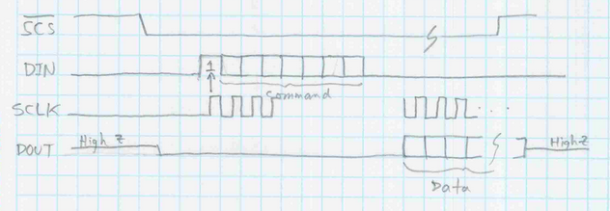
Example SPI Interface
SDIN is sampled on the rising edge of SCLK.
The first ‘1’ bit after SCS goes low indicates the start of a “command” (for example - this is not always the case).
If the command results in data being transferred out, it will appear on SDOUT.
SDOUT is asserted on the falling clock edge so that the host can sample it on the rising clock edge.

Slide 24
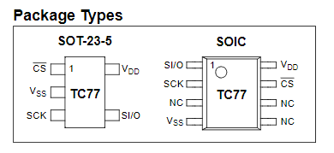
SPI Interface Example
Notes:
The SI/O pin is actually bidirectional. Its direction changes to an input after the first 16 clock cycles. This allows you to program a configuration register to put the chip into a low power shutdown mode, or make it active in a continuous temperature sampling mode.
This is also an example of how the SPI interface isn’t really a standard. But if you are familiar with the basic ideas, then it doesn’t take too much extra work to figure out how to use a specific SPI interface on any given device.

Slide 25
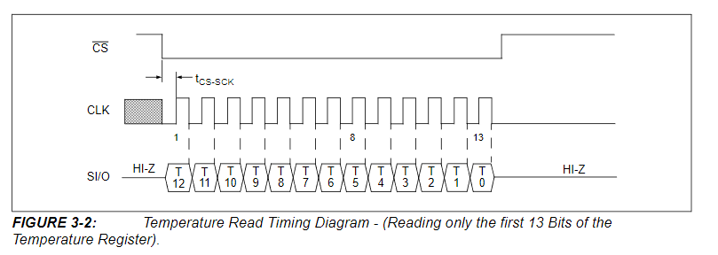
SPI Interface Example
Reading the temperature:

Slide 26
SPI Interface Example
You can connect many devices to the same bus and talk to them individually using different CS signals:
Host
SCLK
SDI
CS0
CS1
CS2
TC77
TC77
TC77

Slide 27
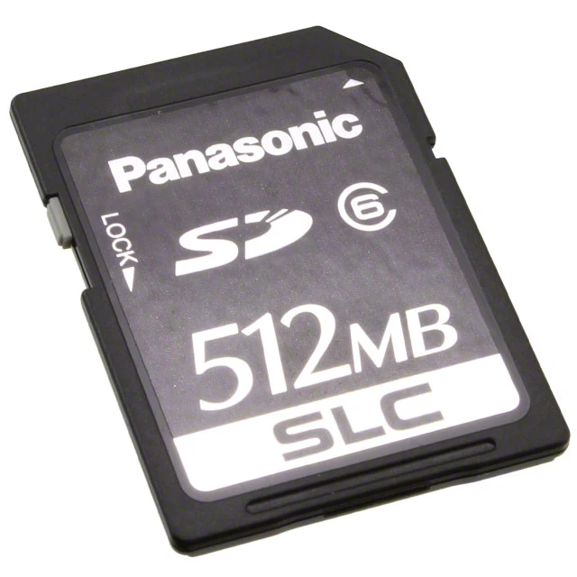
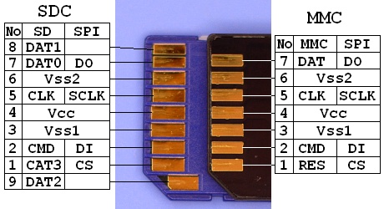
Example: SD memory interface
Secure Digital Memory Cards (SD cards) can be used with an SPI interface:
In this case we only care about the DO, SCLK, DI and CS signals.
Notes:
There are other operating modes that use other connections, but in SPI mode these are the signals that matter.
Obviously, you need to provide power (Vcc) and ground (Vss).

Slide 28
SD Memory Interface
The interface must be a standard to ensure interoperability of all SD cards and devices.
One example of a complete specification can be found here:
https://media.digikey.com/pdf/Data%20Sheets/Viking%20PDFs/PSFSD3yyyyQyyyy.pdf
These devices have two operating modes (SD mode and SPI mode) but we will only focus on the SPI mode.

Slide 29
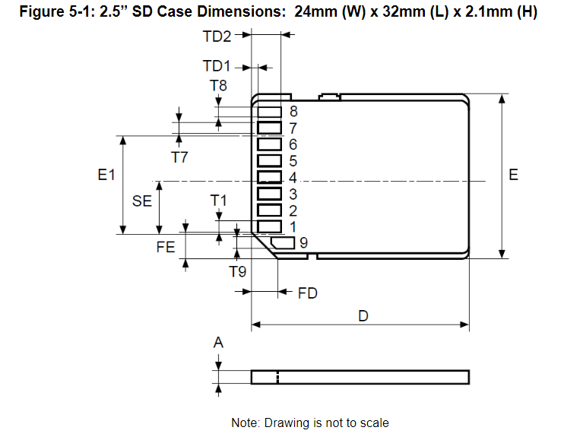
SD Card Mechanical Interface
Notes:
The mechanical specification is important to make sure things will physically fit, and to ensure that the pins are numbered consistently. This numbering scheme is common to all SD cards. Note that pin 9 (not used in the SPI interface) does not follow the obvious numbering convention of the other pins.

Slide 30
SD Card Physical Interface
Notes:
See! The interface is exactly as I have previously described.

Slide 31
SD Card SPI Interface
Data transfer is performed as previously described.
there is a command sent to the DI input…
…possibly followed by additional data
Data is read back from the DO output.
All that remains to be specified is how to send commands and interpret the data that is sent back.
You can find examples of the standard set of commands online
They consist of things like, “initialize”, “block read”, and “block write”

