Slide 1
Physics 53600 Electronics Techniques for Research
Now in PowerPoint!
Spring 2020 Semester
Prof. Matthew Jones

Slide 2
ANNOUNCEMENT
Obvious changes to the course:
No in-person lectures: you’ll have to read the lecture notes yourself
No more labs: don’t worry about it – your grade will be based on work done so far
Remaining assignments will try to cover topics that would have been explored in the lab
Second mid-term: simplest to cancel it
Final exam: I’m not sure what to do about this yet, but I’ll figure something out.
Changes to grading scheme:
Old scheme: Assignments (30%) exams (40%) lab (30%)
New scheme: Assignments (50%) exams (25%) lab (25%)

Slide 3
ANNOUNCEMENT
Because there won’t be any in-person lectures, you will have to read the lecture notes yourself.
To demonstrate that you have read them, you will be required to answer one or two simple questions before the next lecture is posted.
The question will be somewhere (like maybe at the end?) and you just have to e-mail me the answer
mjones@physics.purdue.edu
To make this easy, please make your subject look like this:
“PHYS53600 Lecture xx questions Your Name”
These will be part of your assignment grade, maybe contributing 10% of your total grade.

Slide 4
ANNOUNCEMENT
Remember that you have Assignment #4 due today, March 26th!
Please scan, or somehow generate a PDF file of your solutions and e-mail them to the grader
lim185@purdue.edu
It might be useful to use a standard subject:
“PHYS53600 Assignment #4 Your Name”

Slide 5
LECTURE 19 QUESTION #1
Why is a ripple counter a bad design for a binary counter?
LECTURE 19 QUESTION #2
Why is it good design practice to distinguish between clock signals and normal logic signals?

Slide 6
Other Sequential Logic Elements
More sophisticated functional components can be constructed out of flip-flops
Usually, you don’t need to understand exactly how they are constructed – you mostly need to understand their interfaces
You can normally treat them as “black boxes” where the details are hidden, but the interface is well-defined.

Slide 7
Counters
The first example is a “ripple counter”:
D
Q
Q
D
Q
Q
D
Q
Q
CLK
CLR
CLR
CLR
CLR
$$C_{0}$$
$$C_{1}$$
$$C_{2}$$
Notes:
Now you need to think about how this works, working from the left to the right.
First, suppose that CLR was asserted which will set all the outputs to zero.
Then the Q-bar of the first latch will be set to one which will be the input to D.
On the first rising edge of the clock signal, D will be latched, Q will go to one and Q-bar will go to zero.
On the next rising edge of the clock signal, Q will again be set to zero but Q-bar makes a transition from zero to one, which triggers the clock input on the second flip-flop.
This sequence continues from left to right, with each flip-flop toggling at half the frequency of the one to its left.

Slide 8
Counters
The outputs simply count in binary:
Clock cycle | C₂ | C₁ | C₀
0 | 0 | 0 | 0
1 | 0 | 0 | 1
2 | 0 | 1 | 0
3 | 0 | 1 | 1
4 | 1 | 0 | 0
5 | 1 | 0 | 1
6 | 1 | 1 | 0
7 | 1 | 1 | 1
8 | 0 | 0 | 0
Notes:
Obviously, the cycle repeats itself. If you wanted to count higher then you would just add more flip-flops to the right of the circuit, following exactly the same pattern.

Slide 9
Ripple Counters
Ripple counters are easy to construct
You just wire up a bunch of flip-flops with no additional logic
The problem arises due to the finite propagation delay that is inherent in all logic circuits
They have the undesirable property of having lots of intermediate states
The output doesn’t simply switch from one binary value to the next
There are lots of intermediate values that are rapidly cycled through before the final number stabilizes
Notes:
You shouldn’t have too much trouble finding the answer to question #1 on this page.

Slide 10
Ripple Counters
The output will briefly give the values 0111, 0110, 0100, 0000 before stabilizing at 1000.

Slide 11
Ripple Counters
When would this not matter?
Consider a human interface that displays a count on (for example) a 7-segment LED display
The intermediate transitions probably happen too fast for the human eye to perceive
When would this matter?
If the output was latched on the leading edge of the input clock, then the maximum possible clock frequency would be $f_{max}≈1/(n×T_{pd})$
This rapidly becomes very impractical

Slide 12
Synchronous Counters
Consider the following circuit constructed of JK flip-flops
They toggle when J=K=1
No transition when J=K=0
Vcc
J
K
J
K
J
K
Q
Q
Q
CLR
CLR
CLR
CLK
CLR
$$C_{0}$$
$$C_{1}$$
$$C_{2}$$
Notes:
Now you can see that the first flip-flop will toggle with each rising edge of the clock.
The second flip-flop will toggle only when the first flip-flop has Q=1
The third flip-flop will toggle only when both the first and second flip-flops have Q=1
This pattern can be continued by adding similar flip-flops to the right…

Slide 13
Synchronous Counters
The big difference between the ripple counter and this design is that now the inputs are valid long before the next clock edge.
The output switches synchronously with the clock edge with no intermediate states.
The maximum clock frequency is $f_{max}≈1/T_{pd}$ and is independent of the number of stages

Slide 14
Dedicated Clock Networks
It can be important to distinguish between clock signals and normal logic signals
Clock signals:
Often drive a large number of inputs (large C)
This requires drivers with low output impedance R so that RC remains small
Dedicated routing (ie, wiring) allows the signals to arrive at all inputs at (nearly) the same time (this is called clock skew)
This helps to make the behavior of logic circuits more predictable
Notes:
Remember that the input to any logic circuit has some intrinsic capacitance associated with it.
When you have a single clock signal driving many clock inputs, you usually need to add together all the capacitances.
When the output impedance of the clock driver is R, then it takes a finite amount of time (t=R*C) for all the inputs to charge up to the point where they see that the input has switched
Skew is just the maximum difference in time between the clock edge arriving at all the clock inputs. Remember that the signal propagates usually at a speed that is typically about ½ c. This is pretty fast, but it is easy to make clock signals that are faster than these propagation delays.
For example, consider that the typical clock frequency in modern electronics is of the order of 1 GHz (can be as high as a few GHz). These require high-speed drivers so that the rise time of the clock edge is of the order of 10-100 ps.
Clock frequencies INSIDE integrated circuits can be much higher than this, but the physical size is so small (few square mm) that propagation delays are usually ignored. This is NOT the case for printed circuit boards or other methods used to connect together integrated circuits. This is also not the case for programmable logic devices that can have their internal clock and logic resources reconfigured to perform arbitrary functions.

Slide 15
Dedicated Clock Networks
It can be important to distinguish between clock signals and normal logic signals
Logic signals:
Usually only drive a relatively small number of other inputs
Only timing constraint is their signal propagation is faster that the clock period (plus setup time)
Don’t need low output impedance drivers
Lower power consumption
Fewer constraints on signal routing (ie, wiring)
Notes:
Lower power drivers can be constructed with smaller transistors, use less power, and occupy a smaller area
It doesn’t matter what the skew is, so long as all signals have stabilized before the next clock edge.
I guess this is the answer to question #2…

Slide 16
Other Logic Elements
Lots of other logic elements can be constructed using flip-flops.
Shift register:
Input
D
Q
D
Q
D
Q
CLR
CLR
CLR
CLK
CLR
$$C_{0}$$
$$C_{1}$$
$$C_{2}$$

Slide 17
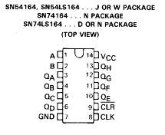
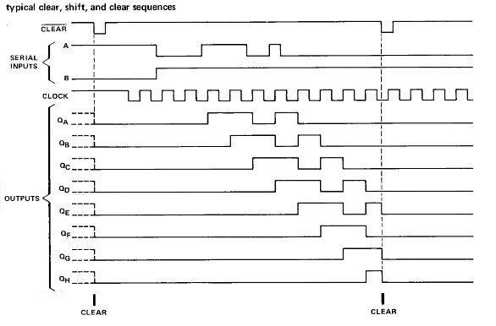
Shift Register
Serial to parallel shift register: 74LS164
Notes:
This has two inputs (A and B) which are directly routed to an AND gate so that the input will shift in a 1 only when A and B are both high. This might be convenient but if the feature is not needed they can just be connected together and driven by a signal logic signal.

Slide 18
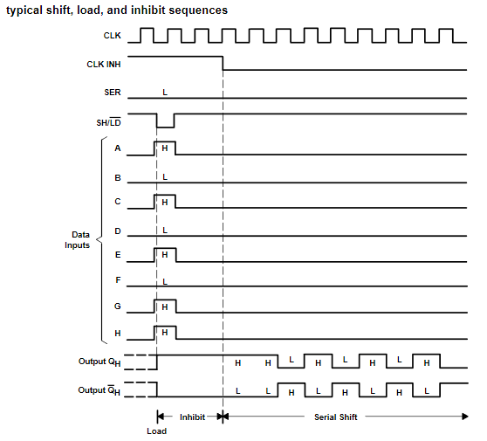
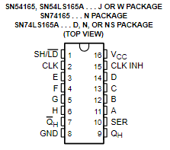
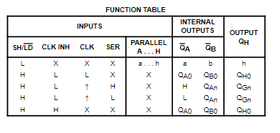
Shift Register
The 74LS195 is a parallel-to-serial shift register:
Notes:
Description:
The ’165 and ’LS165A are 8-bit serial shift registers that shift the data in the direction of QA toward QH when clocked. Parallel-in access to each stage is made available by eight individual, direct data inputs that are enabled by a low level at the shift/load (SH/LD) input. These registers also feature gated clock (CLK) inputs and complementary outputs from the eighth bit. All inputs are diode-clamped to minimize transmission-line effects, thereby simplifying system design. Clocking is accomplished through a two-input positive-NOR gate, permitting one input to be used as a clock-inhibit function. Holding either of the clock inputs high inhibits clocking, and holding either clock input low with SH/LD high enables the other clock input. Clock inhibit (CLK INH) should be changed to the high level only while CLK is high. Parallel loading is inhibited as long as SH/LDis high. Data at the parallel inputs are loaded directly into the register while SH/LD is low, independently of the levels of CLK, CLK INH, or serial (SER) inputs.

Slide 19
Memory
The basic function of a memory element is to store and subsequently retrieve data (ie, bits)
Required inputs:
Data (one bit)
Address (n bits)
The number of bits that can be stored determines the width of the address bus
If the address bus has n bits, then you can store 2^{n} bits in the memory element.
Required outputs:
Data (one bit)
Other signals are needed to control the operation
Read vs write, for example.

Slide 20
Conceptual Design
Conceptually, a memory element could be constructed using flip-flops (to store each bit) and a decoder (combinatorial logic) to enable an individual memory element selected by the input address.
To store multiple bits simultaneously, just use multiple one-bit memory elements in parallel.
In practice, there are lots of tricks to make memory more efficient (cost, size, speed)

Slide 21
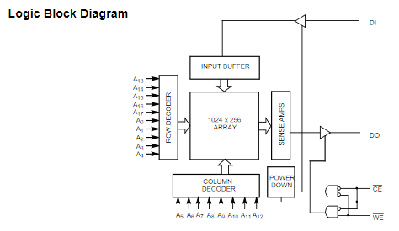
Example Memory Element
Notes:
The memory elements themselves are organized as a two-dimensional array (row x column).
The address decoders select an individual row and column.
There is only one address bus (18 bits wide), one bit input and one bit output. The output (DO) is driven when WE (write enable) is high, and the input (DI) is stored when WE is low.
The output (tri-state logic) is in a high impedance state when CE (chip enable) is high or WE is low.
This particular device is obsolete, but is useful to illustrate how a typical static memory device works.

Slide 22
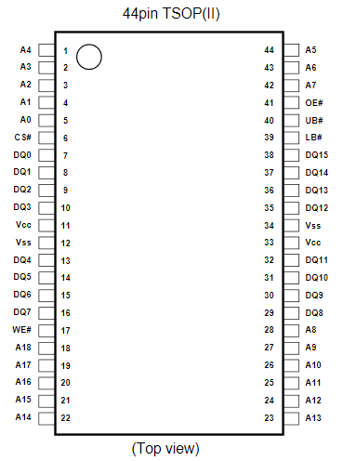
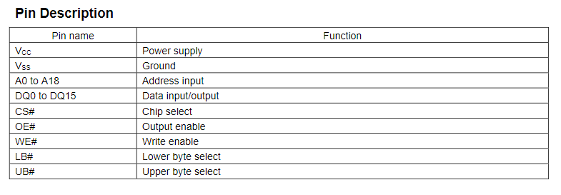
A Modern Example
Functionally, this is very similar to the previous example.
Although each memory element stores 16 bits, you can selectively write to either the upper or the lower (or both) byte by means of the LB# and UB# inputs.

Slide 23
Dual Port RAM
Sometimes reading and writing must be asynchronous
In a data acquisition system, data samples can be written at a constant rate
The process analyzing the data retrieves it as needed in an unspecified
Dual Port RAM has two independent address and data busses.
Potential conflicts if both busses try to write to the same address simultaneously

Slide 24
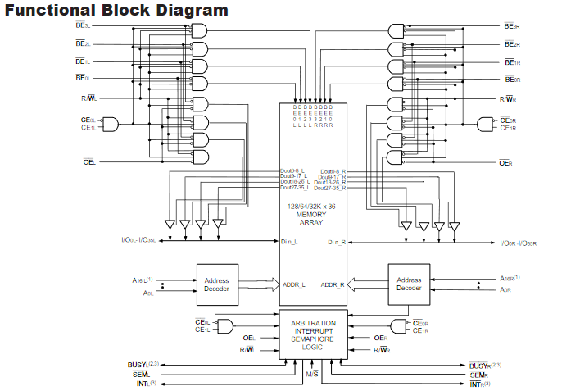
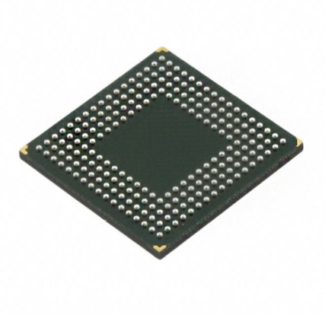
Dual Port RAM Example
Notes:
Left and right sides are basically identical.
Each has byte-enable inputs, chip enable, output enable, read/write signals, and separate address/data busses.
There is additional logic that can be useful to avoid address collisions (arbitration interrupt semaphore logic).
Because there are so many signals that come into/out of the chip, it is practical to package them as a ball-grid-array which is really only useable when soldered to a printed circuit board.

Slide 25
FIFO’s
Lots of applications require reading and writing data at different rates.
A FIFO (First In First Out) is a block of memory where the read and write addresses are automatically incremented with each read/write.
The AVERAGE write rate must not exceed the AVERAGE read rate, or else the memory will fill up.
The INSTANTANEOUS rates can be very different.

Slide 26
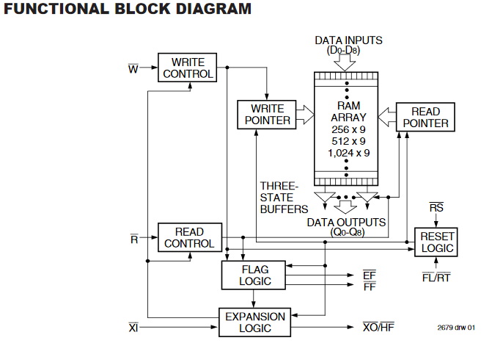
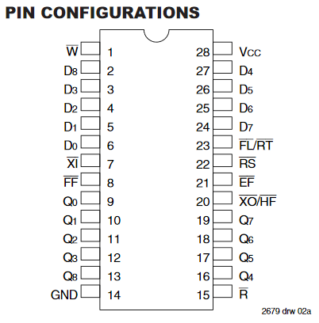
FIFO’s

Slide 27
Dynamic RAM
The previous examples are static RAM (SRAM) which work as described.
They retain the information stored in them as long as power is applied.
An alternative is dynamic RAM (DRAM):
Lower power
Higher speed
Higher density
Lower cost
But it is forgetful… it needs to be periodically reminded even when power is applied.
Notes:
RAM = Random Access Memory

Slide 28
Dynamic RAM
A dynamic RAM storage element consists of one transistor and one capacitor per bit.
This is much simpler than using a flip-flop for each bit.
Charge stored in each memory element can gradually dissipate, so the DRAM contents needs to be periodically refreshed.
While it is being refreshed, it is not available for read/write operations.
Requires external memory controller components, but on average, the cost is lower and the speed is higher.

Slide 29
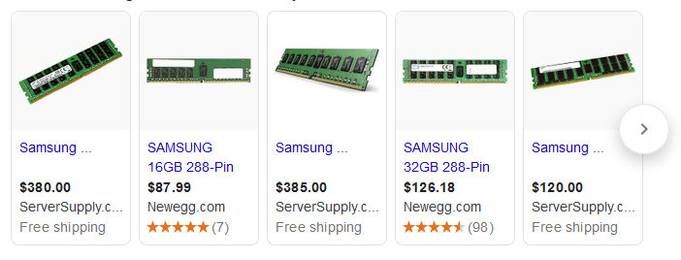
Current State of the Art
Usually used as packaged modules that combine all the necessary support logic, or which interface to standard interface signals.
Notes:
Everybody wants more memory, with lower cost, smaller size, and lower power for things like computers and cell phones.

Slide 30
Other Types of RAM
Read only memory (older technology)
Retains data even when power is removed
Can only be programmed once, using special circuitry.
Erasable ROM could be erased by exposing to UV light.
Electrically Erasable Read Only Memory
Can be programmed and erased electronically
Slower than SRAM or DRAM
Limited number of erase/write cycles
Example: SIM cards, SD cards, thumb drives, etc…

