Slide 1
Hazard Communication Program
Department of Physics and Astronomy

Slide 2
Welcome to the Hazard Communication Program training module for the Department of Physics and Astronomy. This training program consists of five sections and will take you approximately 30 minutes to complete.
The Purpose of this training is:
To provide employees with the knowledge to understand the hazards of the chemicals they work with
To provide a safer and healthier workplace for all employees
To ensure regulatory compliance with the State and Federal Right to Know Law 29 CFR 1910.1200
All employees are covered by the Hazard Communication Program

Slide 3
Rights and Responsibilities
Safety is the responsibility of everyone, but there are specific responsibilities at the employee, department and university level.

Slide 4
Responsibilities - Employee
EMPLOYEE
- To use the available information and stay informed about hazards in the work area
- To use the safety techniques and hygiene practices as a routine part of daily activities
- To participate in the appropriate training sessions

Slide 5
Responsibilities - Department
The department provides Designated Trained Individuals (DTIs) whose duties include:
Ensuring chemical inventories and employee exposure records are maintained
Ensuring Safety Data Sheets (SDSs) for work areas are up to date
Conducting employee training and keeping records of training
Ensuring safe and healthful work conditions are maintained
Contacting REM with questions
Department DTIs
Boshra Afra, PHYS 217D, 494-3001, afra@purdue.edu
Keith Schmitter, PHYS 001, 494-5531, schmittk@purdue.edu
Aaron Mull, PHYS 032, 494-5533, acmull@purdue.edu
Ken Mueller, PHYS B172, 494-5382, kam@purdue.edu

Slide 6
Responsibilities - Purdue
Purdue Radiological and Environmental Management (REM) www.purdue.edu/rem
Trains Designated Trained Individuals (DTIs)
Conducts Work Area Audits
Assists with MSDS (or SDS) acquisition
Program Oversight

Slide 7
Employee Rights
To be informed about the known health and physical hazards in the work area
To be trained to use proper safety techniques and hygiene practices
To inform the DTI about accidents or hazardous situations in the work area without fear of repercussions from your supervisor or the university
To file a formal complaint with IOSHA
Indiana Department of Labor
Indiana State Government Center South
Indianapolis, IN 46204-2287
(317) 232-2655
www.in.gov/dol/2733.htm

Slide 8
Hazard Communication Manual
The department is required to maintain a hard copy of its Hazard Communication Program. You can find copies in rooms S153, 144, 162, 217D, and 370.

Slide 9
Section 1
Building Emergency Plan

Slide 10
Physics Building Emergency Plan
The department has employees in 3 buildings on campus:
Physics Building (PHYS)
Birck Nanotechnology Center (BRK)
Wetherill Building (WTHR)
Copies of each Building Emergency Plan can be found at http://www.physics.purdue.edu/resources/safety.html.
This training module will address only the PHYS Building Emergency Plan (BEP).

Slide 11
Introduction
The BEP is designed to provide students, faculty, staff and visitors basic warning notification system, shelter-in-place and building evacuation emergency information for natural and human-caused incidents.
You should also be familiar with the Purdue Emergency Procedures Guide at http://www.purdue.edu/emergency_preparedness/.
If you have any questions about the BEP, contact the PHYS building deputy (Keith Schmitter, schmittk@purdue.edu) or the Campus Emergency Preparedness and Planning Office at (765) 494-0446.

Slide 12
Response to Alarms
REMEMBER, WHEN YOU HEAR:
ALL HAZARDS SIRENS immediately seek shelter (Shelter-In-Place) in a safe location within closest facility
FIRE ALARMS immediately evacuate the building and move to a safe location
In both cases, you should seek additional clarifying information by all possible means…Purdue Homepage, TV, radio, email, etc.

Slide 13
PRIME Lab Alarms
If you work in the PRIME Lab area, you may also hear other alarms.
PRIME Lab RADIATION ALARMS (S182 and S171): Quickly move out of the immediate area of the sensor that is in alarm condition. Report this condition to the accelerator operator.
PRIME Lab OXYGEN DEFICIENCY ALARMS (S182): These alarms have an audible warning plus a flashing blue light. In the event of an alarm quickly move out of the S-182 area and evacuate the rest of the sub-basement level. A member of the engineering and operations staff will check the validity of the alarm with a portable oxygen monitor and other means. If the alarm is found to be valid, the remainder of PRIME Lab must be evacuated, and evacuation signs should be placed on both PRIME Lab entrances. All evacuated personnel should meet in the hallway near room 1 in the Physics building.
PRIME Lab SUMP PUMP ALARM Contact Physical Facilities immediately. No evacuation is required.

Slide 14
Emergency Evacuation Procedures
When a fire alarm sounds, evacuate the building promptly using the nearest designated exit routes.
Take keys, coats, ID, or any other critical personal items with you.
Close doors as rooms are vacated.
Assist those who need help, but do not put yourself at risk attempting to rescue trapped or injured individuals. Note their location and inform emergency responders.
Use stairs only. NO ELEVATORS.
Go to the Emergency Assembly Area.
Follow instructions of the building deputy or fire and police personnel.
DO NOT re-enter the building until authorized to do so by fire or police personnel.
You may briefly delay evacuating if you need time to shut down electrical and other equipment, especially any that involves flame, explosive vapors, or hazardous materials.

Slide 15
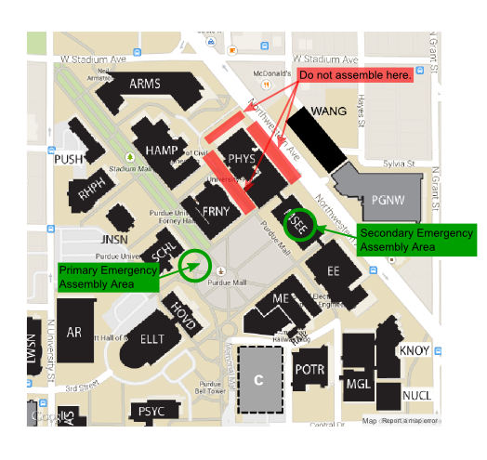
Emergency Assembly Area
Primary location: In order not to interfere with emergency personnel, proceed to the west portion of the Engineering Mall and assemble in the area between Hovde Hall, Schleman Hall and the fountain. DO NOT assemble between the building and Northwestern Avenue or between the building and Forney Hall, Hampton Hall, Armstrong Hall.
Secondary location (in case of inclement weather): MSEE Atrium, ground floor.

Slide 16
Shelter in Place Procedures
You may be required to Shelter In Place for events such as:
Tornado warning or other severe weather events.
Hazardous materials release.
Active shooter, building intruder, or civil disturbance.
As directed by police personnel for any other situation that requires you to find protection within a building.
Purdue ALERT, the University’s emergency warning system will be used to announce the “shelter in place” situation.

Slide 17
Shelter In Place – Severe Weather
Proceed to the basement or subbasement.
Position yourself in the safest portion of the area away from glass.
Be prepared to kneel facing a wall and cover your head.
Any occupant who encounters a student or visitor should direct them to take appropriate actions.
Assist physically disabled individuals as possible.
Try to obtain additional clarifying information by all possible means (Purdue homepage, radio, email, etc.).

Slide 18
Shelter in Place – Hazardous Materials
If you are “sheltering” due to a hazardous materials (HAZMAT) accidental release of toxic chemicals the air quality may be threatened and sheltering in place keeps you inside an area offering more protection. For a HAZMAT situation you should, if possible, take the following actions:
Close all windows and doors.
Move to the shelter in place location.
Do not go outside or attempt to drive unless you are specifically instructed to evacuate.
Do not use elevators as they may pump air into or out of the building.
Any occupant who encounters a student or visitor should direct them to take appropriate actions.
Any occupant that encounters a physically disabled individual should assist them if possible.
Try and obtain additional clarifying information by all possible means (e.g. Purdue Homepage, TV, radio, email, etc.)
(PRIME Lab Only) Do NOT operate the PRIME Lab emergency purge system since this will draw additional outside air.

Slide 19
Shelter in Place – Active Shooter
If you are sheltering due to an active shooter, building intruder or a civil disturbance on campus, immediately go to a safe location (normally the police department or the All Hazards Outdoors Sirens will be the notification method).
1) RUN | 2) HIDE | 3) FIGHT
If there is an accessible escape path, attempt to evacuate the premises | If evacuation is not possible, find a place to hide where the active shooter is less likely to find you. | As a last resort, and only when your life is in imminent danger, attempt to disrupt and/or incapacitate the active shooter
Have an escape route in mind | Your hiding place should be out of the shooter’s view and provide protection if shots are fired in your direction. | Act as aggressively as possible against him/her
Evacuate regardless or whether others agree to follow | Lock and/or blockade the door. | Throw items and improvise weapons
Leave belongings behind | Silence your cell phone and other noise sources (radio, tv, computer). | Yell
Help others to escape if possible | Hide behind large items | Commit to your actions
Warn others about entering the area | Remain quiet
Keep hands visible
Follow all instructions of any police
Do not attempt to moved wounded people
Call 911 when safe

Slide 20
Section 2
Hazardous Characteristics and Effects of Chemicals

Slide 21
Chemical health and physical hazards
Almost all employee at Purdue will encounter chemicals while performing their jobs
A chemical is considered hazardous if it possesses one or more health or physical hazardous characteristics
Chemical health effects can be of two types:
acute health effect - the body reacts immediately to the exposure (example: ammonia vapor exposure causes immediate irritation to the eyes)
chronic health effects - the body reacts months or years following the exposure (example: methylene chloride may cause liver disease or cancer after many years of exposure)
Types of Chemical Hazards
Health Hazards | Physical Hazards
Acutely Toxic | Explosives
Corrosive/Irritant | Reactive – self, air, or water
Sensitizer | Flammable
Toxic – specific organs | Oxidizers
Carcinogenic | Cryogenic liquids
Reproductive toxin | Gases under pressure
Asphyxiant | Corrosive to metals
Aspiration hazard

Slide 22
Routes of Entry
Chemicals must gain entry into the body to cause harm
There are four potential routes of exposure to a chemical
Most common
Inhalation – taken into the body through the lungs
Absorption – taken into the body through the skin
Less common
Ingestion – taken into the body orally
Injection – taken into the body through broken skin
We can protect ourselves from most chemical exposures by handling chemicals in well ventilated areas and wearing personal protective equipment (PPE).

Slide 23
Symptoms of Over-Exposure
Symptoms of chemical exposure vary by chemical but common signs on chemical over-exposure include:
Dizziness or light-headedness
Difficulty breathing
Coughing or wheezing
Teary eyes/runny nose
Nausea
Skin reddening, irritation or blistering
If you develop symptoms while working with a chemical:
Stop work
Place the chemical in storage and leave the area
Inform your supervisor and seek medical assistance if necessary
Follow up with REM

Slide 24
Chemical Exposure Assessment
Personnel from REM routinely inspect operations handling or storing hazardous chemicals.
Estimates of employee exposures are made from these observations to minimize exposure.
Formal air monitoring has been conducted in many locations where hazardous chemicals are routinely handled.
REM will evaluate exposures of employees who
Suspect and report that they have been overexposed to a toxic chemical
Are displaying symptoms of overexposure
Concerns about chemical exposures should be brought to the attention of REM and your supervisor immediately.

Slide 25
Medical Consultation
Medical attention and follow-up examinations are provided to individuals who:
develop signs or symptoms of exposure to a toxic chemical
were exposed to a toxic chemical during a chemical incident
Individuals with serious or life-threatening injuries should immediately dial 911 for assistance
Emergency treatment is provided at:
Franciscan St. Elizabeth Health
IU Health Arnett Hospital Emergency Room
Non-emergency treatment is available through:
Regional Occupational Care Center (ROCC)
IU Health Arnett Occupational Services

Slide 26
Section 3
Chemical Container Labeling and Safety Data Sheets

Slide 27
Introduction
Chemical hazard information can be found on the Safety Data Sheet (SDS) and the product label.
Before handling a hazardous chemical you must know the appropriate safeguards to follow including how to:
Properly store and handle the chemical
Respond to a spill or release
Dispose of the chemical
Your supervisor, lab manager, or other responsible individual will review these procedures with you.
Especially important is knowing the appropriate Personal Protective Equipment (PPE) to wear and any special ventilation requirements necessary while handling the chemical.

Slide 28
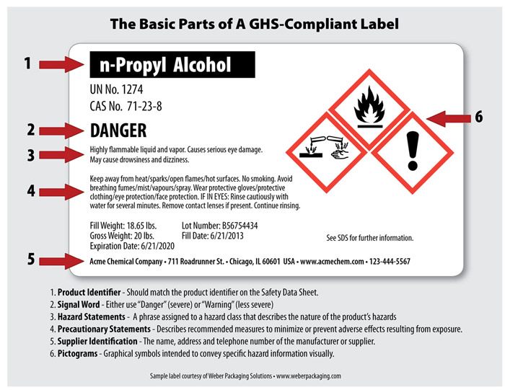
Container Labels and SDS’s
Beginning in 2015, OSHA regulations required safe handling information to be printed on all hazardous chemical container labels.
This is required by the Globally Harmonized System of Classification and Labeling of Chemicals (GHS).

Slide 29
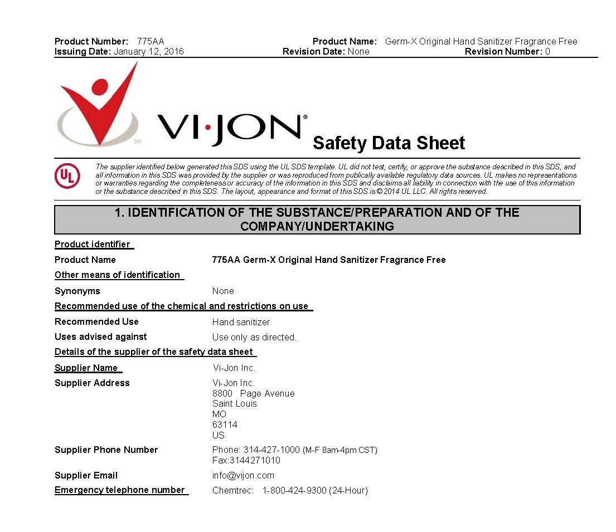
Container Labels and SDS’s
In addition to the label, the SDS is your best source for information about the chemical’s hazardous properties, appropriate handling and storage practices and how to respond to exposure or emergency situations.
Fun Safety Fact: Hand sanitizer has an SDS!

Slide 30
For any given chemical, every manufacturer’s or distributor’s label will contain exactly the same information
Product identifier
Signal word
Hazard statements
Precautionary statements
Supplier identification
Pictograms
Notes:
On chemical labels, the product name will be prominently displayed. Frequently additional items such as the catalog number, the United Nations (UN) number or Chemical Abstract Service (CAS) number are included. Common names may also be on the label.
The company is required to have the company name and address in addition to an emergency phone number. Many companies supply additional information such as a web site URL.
For a GHS label there are only 2 choices for a hazard signal word if one is used.
WARNING
DANGER
The signal words mean:
1. If there is no significant hazard there will be no signal word
2. WARNING is used for moderate hazards and
3. DANGER is used for more severe hazards
A GHS label will contain one or more pictograms. The pictograms usually are not labeled, so it is important to be remember the meaning of each of the pictograms. Some of the pictograms have a single meaning while others cover a group of related hazards.

Slide 31
Label Content - Pictograms
A pictogram describes a chemical’s hazardous characteristic with an image
Image courtesy of ShutterStock

Slide 32
Label contents - pictograms
Health hazard
This pictogram is reserved for chemical containers that cause the most severe adverse health effects to specific body organs or systems.
It includes the following categories of health hazards:
Carcinogen | May cause cancer
Mutagenicity | May cause mutations in future generations
Reproductive Toxicity | May interfere with sexual function, fertility, and development of offspring
Respiratory Sensitizer | May cause allergy or asthma symptoms or breathing difficulties
Target Organ Toxicity | May cause damage to specific organs but is not lethal
Aspiration Toxicity | May cause chemical pneumonia or pulmonary injury or death

Slide 33
Label contents - pictograms
Flame
This pictogram is placed on chemical containers that may start or contribute to a fire. It includes the following categories of materials:
Flammables | easily ignited, burns quickly
Pyrophorics | spontaneously igniting in air or water reactive
Self-Heating | spontaneously heats in air but not pyrophoric
Emits Flammable Gas | reacts with water to emit a flammable gas
Self Reactives | liable to undergo strongly exothermic decomposition but not explosive
Organic Peroxides | derivatives of hydrogen peroxide that undergo exothermic decomposition but not explosive

Slide 34
Label contents - pictograms
Exclamation mark
This pictogram indicates materials that are health hazards that can harm the body in specific ways. Items in this category are much less toxic than items that use the skull and crossbones pictogram. It includes the following categories of materials:
Irritant (skin & eyes) | may cause reversible inflammation or other discomfort to the body
Skin Sensitizer | may induce an allergic response following skin contact
Acute Toxicity | adverse effects occurring following short term exposure to a substance
Narcotic Effects | central nervous system depression (drowsiness, loss of reflexes or coordination)
Respiratory Tract Irritant | cough, pain, choking, and breathing difficulties
Hazardous to Ozone Layer | not mandatory

Slide 35
Label contents - pictograms
Gas cylinder
This pictogram is placed on containers of gases under at least 29 pounds per square inch of pressure

Slide 36
Label contents - pictograms
Corrosion
This pictogram indicates materials that are corrosive. It includes the following categories of materials:
Skin Corrosion / Burns | may cause irreversible damage to the skin
Eye Damage | may cause tissue damage in the eye that is not fully reversible
Corrosive to Metals | material which by chemical action will damage or destroy metals

Slide 37
Label contents - pictograms
Exploding Bomb
This pictogram is placed on chemical containers of explosive chemicals. It includes the following categories of materials:
Explosives | Materials capable of chemical reactions producing gases that damage surroundings
Self-Reactives | unstable substances liable to undergo strongly exothermic reactions
Organic Peroxides | derivatives of hydrogen peroxide that may undergo exothermic decomposition

Slide 38
Label contents - pictograms
Flame over circle
This pictogram is placed on containers of chemicals that are oxidizers (chemicals that when mixed or in contact with combustible materials may cause a fire or explosion, or intensify a fire).
These materials may be solid, liquid, or gas.

Slide 39
Label contents - pictograms
Skull and crossbones
This pictogram is placed on chemical containers that are extremely toxic (fatal) to moderately acutely toxic.
It includes materials in which adverse effects occur following short term exposure to the substance. These materials are more toxic that the items given the Exclamation Mark pictogram.

Slide 40
Label contents - pictograms
Environmental
This pictogram is placed on containers of chemicals that represent a hazard to the aquatic environment and does not convey any workplace related hazard information.
It is a non-mandatory classification since OSHA does not have regulatory authority to address environmental concerns. It is included to support other regulatory agencies like the EPA.

Slide 41
LabEl contents - pictograms
Most chemical hazards are represented by pictograms on the new labels, but not all.
These hazards include:
chemicals on the lowest end of the hazard spectrum in a hazard class
an OSHA defined hazard of which there are two - combustible dusts and an asphyxiant

Slide 42
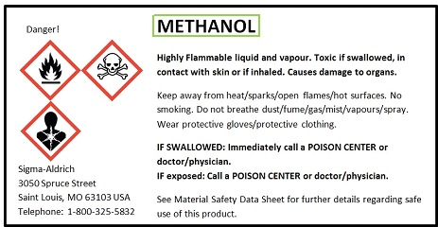
Label contents – signal words
The signal word is a label element that conveys the severity of the hazard when handling the chemical.
There are two signal words used on chemical labels:
Danger - used for the more severe hazards
Warning - used for less severe hazards

Slide 43
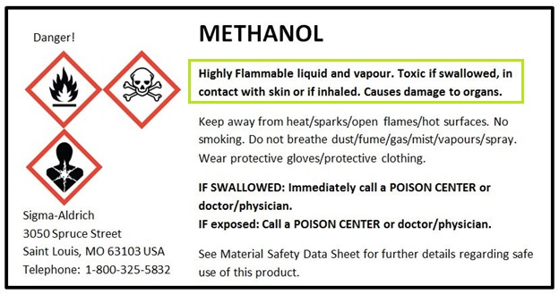
Label contents – the hazard statement
A Globally Harmonized System (GHS) Label contains one or more hazard statements to convey information about the chemical’s hazardous characteristics and degree of risk.
A hazard statement has been assigned to each of OSHA’s chemical hazard categories and must appear on the label
Examples of Hazard Statements
Statement associated with the MOST hazardous chemical in a category
Extremely flammable liquid and vapor
Fatal if swallowed
Causes severe skin burns and eye damage
Statement associated with the LEAST hazardous chemical in a category
Combustible liquid
Harmful if swallowed
Cause eye irritation

Slide 44
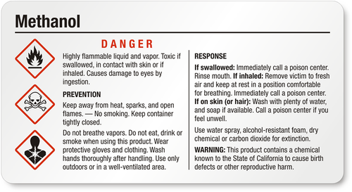
Label contents – precautionary statements
The second major type of information found on labels is precautionary or safe handling information
Precautionary statements provide four types of information:
how to avoid the hazard when handling the chemical
how to properly store the chemical
what to do if the hazard is not avoided
how to dispose of the chemical
Each chemical hazard category defined by OSHA has been assigned specific precautionary statements and these will appear on the label

Slide 45
Label contents – precautionary statements
Some precautionary statement are conditional or depend on some condition in the workplace
An example of a conditional statement is:
“If inadequate ventilation, wear respiratory protection”
If you find conditional statements on labels make sure you understand them before proceeding.
If you are unsure how to respond to a conditional statement, consult the chemical’s safety data sheet, or ask your supervisior, REM, or other knowledgeable person.

Slide 46
Label contents – precautionary statements
Other precautionary statements will refer you to the safety data sheet, SDS, for information.
Examples found on labels of chemicals with cancer causing potential are:
“Obtain special instructions before use”
“Do not handle until all safety precautions have been read and understood”
Again, consult the chemical’s safety data sheet or ask your supervisor, REM, or other knowledgeable person before handling this type of chemical.

Slide 47
Label contents – Additional Issues
Most chemicals belong to more than one hazard category and the label will have multiple pictograms, hazard statements and precautionary statements
Labels will have one signal word which will represent the most hazardous characteristic associated with the chemical
If acute toxicity of the chemical is not known for the chemical, this will be stated on the label

Slide 48
Label contents – secondary container labeling
If you transfer a hazardous chemical from a stock container to a secondary container, you must transfer some basic information to the new container.
This includes:
The name of the chemical or chemical product
The hazardous properties associated with the chemical
The ONLY EXCEPTION to this requirement is if the chemical will be immediately used by the individual making the transfer.
REM will provide blank secondary container labels on request.

Slide 49
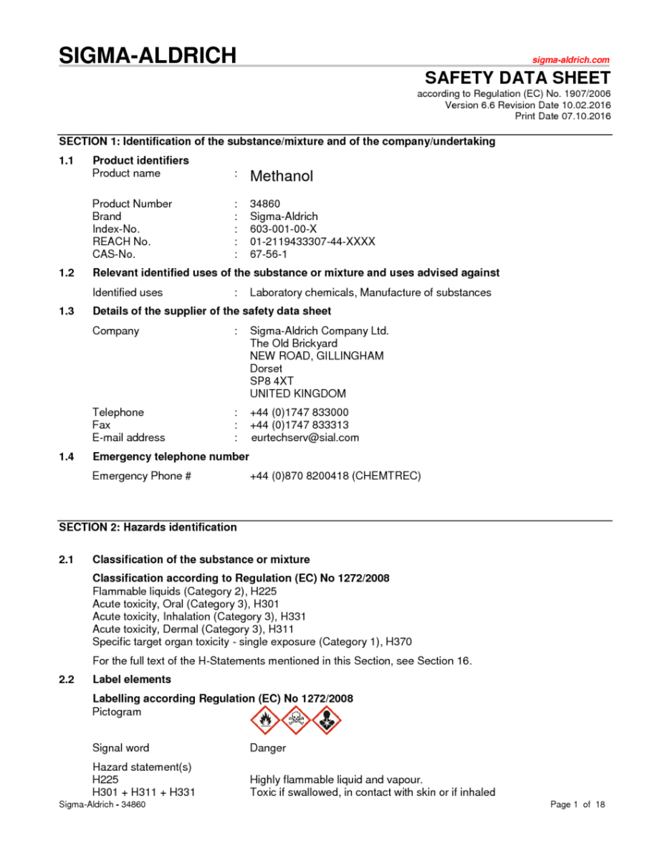
Safety Data Sheet Contents
Safety Data Sheets (SDSs) are multi-page documents that contain a lot more health and safety information about a chemical than the label. These replace the old Material Data Safety Sheets (MSDS) that may still be present in several work areas.
You can locate the safety data sheet for a chemical by matching up the name on the label with the name on the safety data sheet.
The health and safety information placed in safety data sheets, as well as the layout of this information, is now specified by federal regulation and as of 2015 will be consistent across all manufacturers and distributors.

Slide 50
SDS Sections
Safety data sheets have sixteen sections with sections 1 through 11 providing health and safety information particularly useful to handlers of chemicals. This training will take you through each section of a SDS for Methanol.

Slide 51
SDS Section 1 - Identification
Remember, the name of the label will always match the name on the SDS.

Slide 52
SDS Section 2 – Hazards Identification
The information in Section 2 is exactly as the same as the information placed on the label.

Slide 53
SDS Section 3 – Composition
If a substance is not listed because a trade secret is claimed, it will be noted.

Slide 54
SDS Section 4 – First Aid
This section describes the initial care that should be given by untrained responders.

Slide 55
SDS Section 5 – Fire-fighting Measures
SDS Section 5 – Firefighting measures

Slide 56
SDS Section 6 – Accidental Release
Recommendations on the appropriate response to spills, leaks, or releases, including containment and cleanup practices that prevent or minimize exposure to people and damage to property or the environment. It may also include recommendations that distinguish between responses for large and small spills where the spill volume has a significant impact on the hazard.

Slide 57
SDS Section 7 - Handling
SDS Section 7 – Handling and Storage

Slide 58
SDS Section 8 – Exposure Control
Pay attention to the individual protection measures!

Slide 59
SDS Section 9 – Physical/Chemical Properties
The physical and chemical properties of a chemical is very helpful in estimating the hazard associated with handling a chemical

Slide 60
SDS Section 10 – Stability and Reactivity
SDS Section 10 – Stability and reactivity

Slide 61
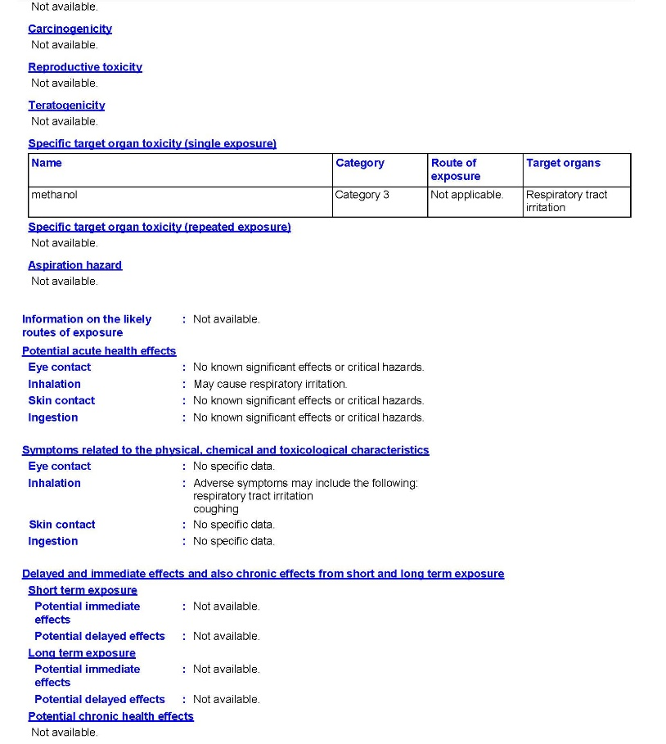
SDS Section 11 - Toxicology
Section 11 – Toxicological information
Information is provided on the likely routes of exposure, a description of the immediate, and long-term effects of exposure, the symptoms of exposure and numerical measures of acute toxicity. It will also note if the substance has been identified as a known or potential carcinogen or is a reproductive toxin.

Slide 62
SDS Section 12 - Ecology
Section 12 – Ecological Information
The information found in Sections 12 to 16 is not related to handling the chemical safely

Slide 63
SDS Section 13 - Disposal
SDS Section 13 – Disposal Consierations

Slide 64
SDS Section 14 - Transport
SDS Section 14 – Transport information

Slide 65
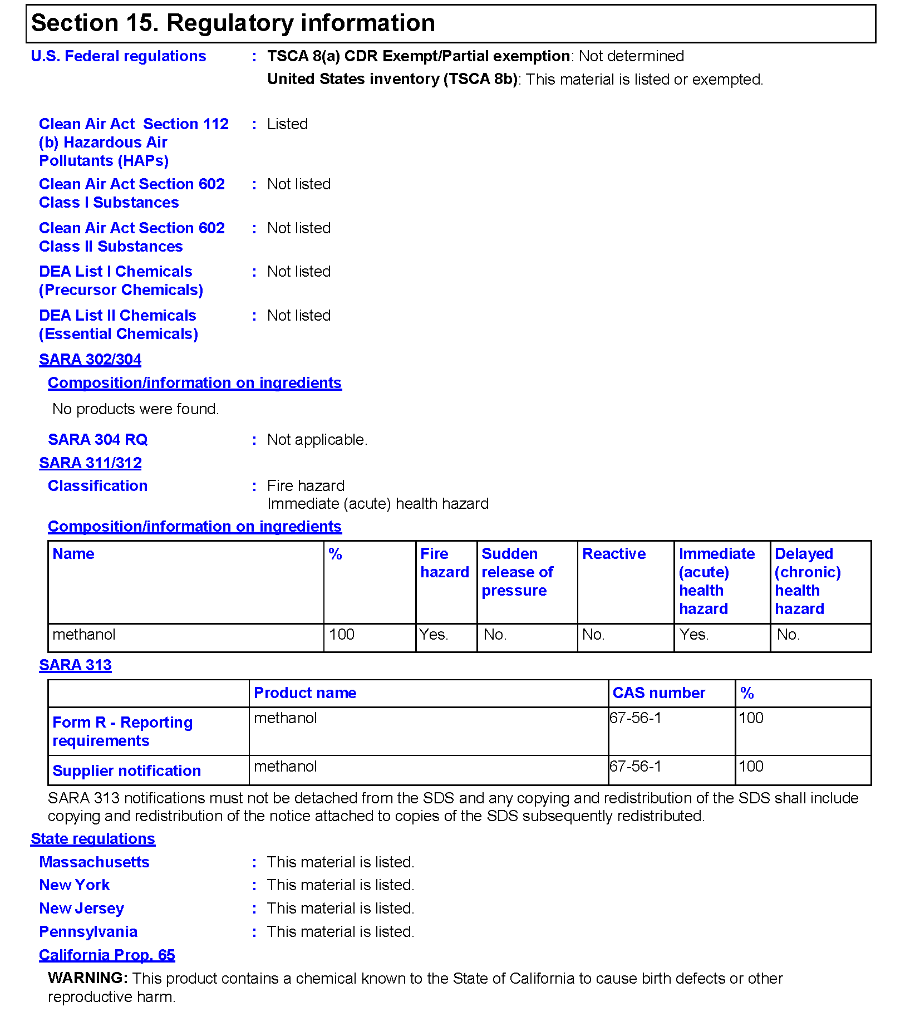
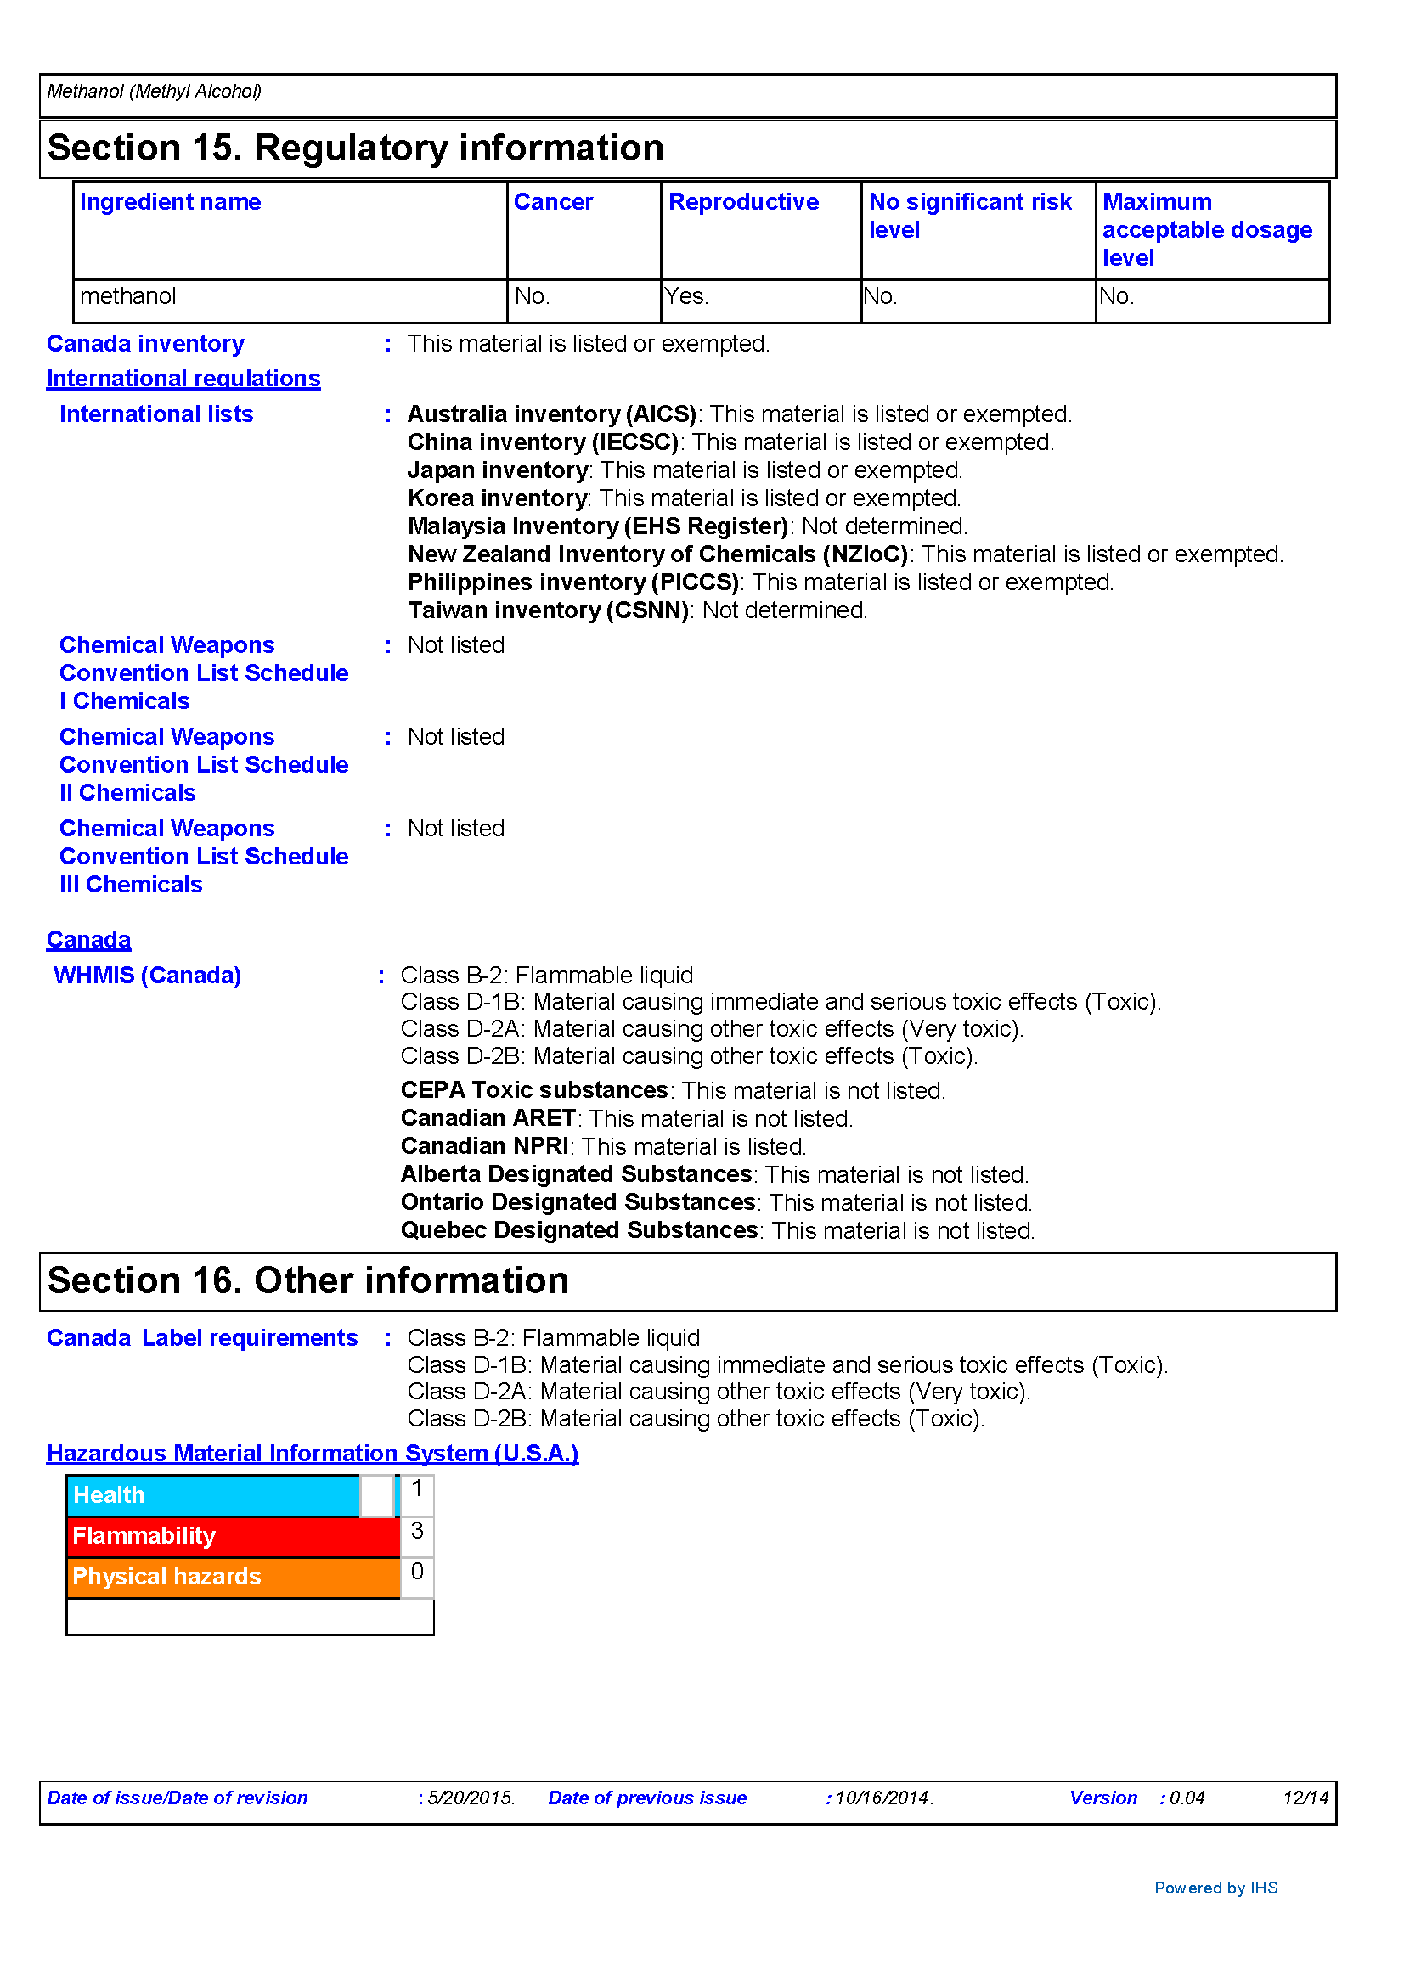
SDS Section 15 - Regulatory
SDS Section 15 – Regulatory Information

Slide 66
SDS Section 16 - Other
Section 16 – Other Information

Slide 67
Safety data sheet contents - additional issues
Safety data sheets must be completely filled out - none of the required information may be left blank.
When a preparer does not find relevant information for any required element, the safety data sheet must state “no applicable information found.”

Slide 68
Chemical lists & safety data sheet access
Safety Data Sheets should be available in your work area, with REM or accessible from a computer.
A list of the hazardous chemicals you handle as part of your job is maintained in your work area.
Safety data sheets for these chemicals are available in your work area or from your supervisor.
The REM office can assist you locate information on the hazards and safe handling practices associated with the specific chemicals.
IF YOU CAN’T FIND AN SDS, ASK.

Slide 69
Working with Hazardous Chemicals
Before working with a chemical:
You must be aware of the chemical hazards associated with it and how to minimize your exposure.
Perform a hazard assessment to evaluate the potential for exposures and identify appropriate exposure controls. Your supervisor or REM can assist with this assessment.
If you have questions about the proper handling of a hazardous chemical, contact your supervisor or REM.

Slide 70
Section 4
Controlling Physical and Health Hazards

Slide 71
Controlling Physical and Health Hazards
There are a number of ways that you can safeguard your health and physical safety when using hazardous materials. These measures include:
Method
Product substitution | Can you use a chemical that does the same job, but is less toxic?
Engineering controls | Know when to work in a fume hood or a glove box.
Personal protective equipment | Masks, eye protection, gloves, aprons, and other protective equipment and clothing are designed to protect you while you work. USE THEM!

Slide 72
Controlling Physical and Health Hazards
There are a number of ways that you can safeguard your health and physical safety when using hazardous materials. These measures include:
Method
Training and communication | If you don’t know how to work with a chemical, ask! Make sure everyone in your work area knows the possible hazards.
Environmental monitoring | REM regularly monitors labs to insure exposure limits are not reached. You should notify REM of any materials used where they are likely to cause high exposure.
Personal monitoring | Be on the lookout for any physical symptoms which would indicate that you or your coworkers have been overexposed to any hazardous chemical. Symptoms, such as skin rashes, dizziness, eye or throat irritations or strong odors, should be reported to your supervisor.

Slide 73
Section 5
Additional Hazards in the PHYS Building

Slide 74
Additional Hazards in PHYS
As an employee of the Department of Physics and Astronomy, you may occasionally have reasons to be in areas that have hazards beyond chemical exposure. The most frequent hazards to be aware of are:
Lasers
Radiation sources
Cryogenic liquids
Machine shops
The following section addresses what you need to know if you are a non-user in an area where these items are found. If you plan to use any of these in your regular duties, you will need to receive training from REM.

Slide 75
Safety in Laser LAbs
Areas with Class 3B or 4 lasers should have a sign or light on the door warning you that they are present and when they are in use.
Direct exposure to a Class 3B lasers can result in eye damage.
Exposure to direct beam or scattered light from a Class 4 laser can result in eye and skin damage.
Use caution when entering these areas and do so only when the laser users are aware of your presence. Laser light is not always visible when in use.
Do not touch any laser equipment unless you have been certified by REM.

Slide 76
Safety in Radiation Areas
Radiation use areas will be labeled on the door, work area, and storage area.
Use caution when entering these areas and do so only when the users are aware of your presence. As a “non-radiation” worker, your exposure limits are 2% of those of “radiation” workers.
Assume you do not know where radiation sources have been used within the lab.
Do not bring food or drink into radiation areas where a “No eating or drinking” sign is on the outside door. Ingestion of radioactive materials can result in damage at the cellular level.
Do not place personal items on work spaces where radioactive materials are used.
Wash your hands after leaving the area.

Slide 77
Cryogenic liquids
Many labs in PHYS use cryogenic liquids (having a temperature of −150 °C or lower.) The most commonly encountered cryogens in PHYS are liquid nitrogen, liquid oxygen, liquid argon, and liquid helium.
Cryogens can cause terrible "burns" (death of living tissue caused by the extreme cold) on skin and eyes.
Asphyxiation is a potential hazard in closed areas when nitrogen, argon, and helium are in use. You do not have any warning with these gases. You simply pass out.
Do not handle cryogenics unless you have been trained by the users of the laboratory you are visiting.

Slide 78
Safety in Machine Shops
When entering the machine shops in the Physics Building it’s important that you follow the following procedures:
Wear safety glasses while in the shop
No loose clothing may be worn in the shop including ties, scarves and loose sleeves. Open-toed shoes, short pants, or skirts are also prohibited.
Do not operate any of the equipment
Do not startle or approach anyone operating equipment. If you must speak with them, wait until they complete their task.

Slide 79
You have now completed all of the training materials for HAZCOM safety in the department.
Please visit https://purdue.qualtrics.com/jfe/form/SV_1TWTZPO6ZhsMG2h
to take the course test. You must pass the test at the 90% level.

