Slide 1
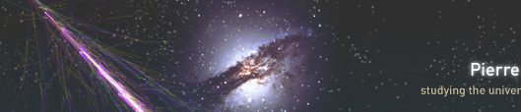
An Ultra-High-Energy
Cosmic Ray Experiment
Glenn Sembroski
QuarkNet
Summer Workshop
July 24,2012

Slide 2
The Big Question
Which has become the Big Mystery
Where do Cosmic Rays come from?
A multi-part question. i.e. Lots of small mysteries
Different answers for different energy regimes
Different answers for different Cosmic-Ray particle types

Slide 3
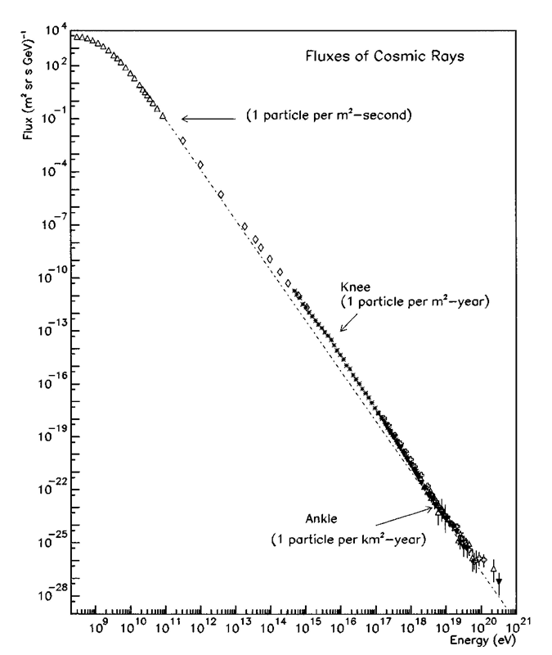
Charged Cosmic Rays
Measured spectrum has lots of features which raise questions:
Why does the spectrum follow a power law: Energy ^{- alpha} where alpha is typically around 2.5?
Why is there a “Knee”?
Why is there an “Ankle”?
Is there a cutoff at ultra-high energies, and if so why there and not lower(GZK effect)?
Just how can you make Cosmic Rays of ultra high energies?

Slide 4
Another Question
How was this spectrum measured?
Depends on energy range
Taken ~100 years
Balloon born detectors
Rocket born detectors
Satellite born detectors
Ground base detectors
All use different/same techniques and methods.

Slide 5
Too Many Questions
Concentrate on the highest energy cosmic rays. What do we know?

Slide 6
Not so many Questions
Lots of structure.
Why does the spectrum not continue?
Why does it NOT stop at the GZK cutoff (next slide)?
What can be the source?
Is there a time dependence?
A direction dependence?
Galactic source or Extra-Galactic.

Slide 7
Greisen-Zatsepin-Kuzmin (GZK) cutoff
At very high energies, a proton can “collide” with a low energy photon
The universe is full of low energy photons
  the cosmic microwave background radiation
Very (and Ultra) high energy protons can’t travel very far without interacting with the CMB photons

Slide 8
GZK Mystery
It has been proposed that cosmic rays with energies <3 x 10¹⁸ ev are galactic in origin (or at least “local”)
Above this energy random deflections by the galactic magnetic fields are ineffectual in changing CR direction.
Above 3 x 10¹⁸ ev presently measured CR do NOT appear to come from the galactic plane but appear to come from random directions in the sky. (Well, maybe random..)

Slide 9
GZK Mystery cont.
GZK effect implies that all CR with energies above 10²⁰ ev from extra-galactic sources would be “scattered” down to energies below 10²⁰ ev.
However, we have seen a number of CR with energies above 10²⁰ ev .
Solution: We Need More Data!

Slide 10
Pierre Auger Observatory
From original CR spectrum plot, CR intensity above 10¹⁸ ev is ~1particle/km²/year
We need a really big detector.
Satellites are way to small” ~1m²
We need a detection area the size of Rhode Island — over 3,000 km² (1,200 sq mi) — in order to record a large number of these events.
That sounds very expensive!

Slide 11
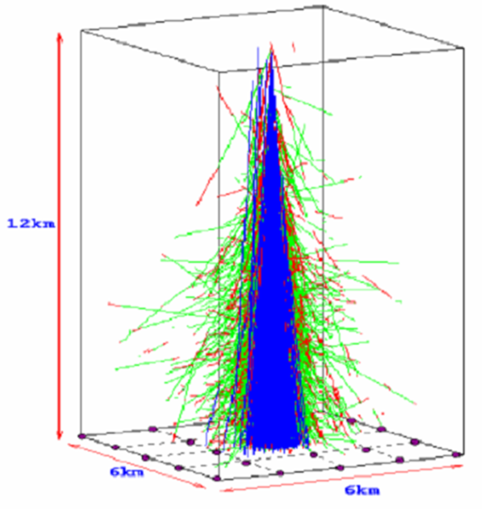
Pierre Auger Observatory cont.
But we can take advantage of the fact that energetic particles entering the earth’s atmosphere create particle cascades.
A 10²⁰ eV particle creates a cascade with many millions of particles spread over an area of up to 16 sq km.
The atmosphere is part of the detector.
Large spread of particles allows us to “sparsely” sample the showers.

Slide 12
Pierre Auger Observatory cont.
Auger has 1600 10m sq surface detectors (SD) spread over 3000 sq km
SD Detectors are place on a grid with 1.6 km spacing.
Array is in a desert in remote, dark, isolated, arid area of Argentina.
Can see Galactic center.

Slide 13
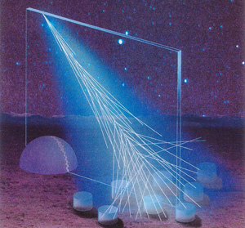
Pierre Auger Observatory cont.
Second detector system consists of 4 atmosphere shower track florescence detectors overlooking SD array.

Slide 14
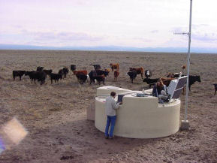
Auger Surface Detector (SD)
Uses “Water Cherenkov” technique to detect charged shower particles.
V=C charged particle generates Cherenkov light (mostly blue) when going through water
Water in SD has area 10m², Depth of 1.2 m
3- 9 inch diameter PMTs view water volume.
Can detect individual muons.

Slide 15
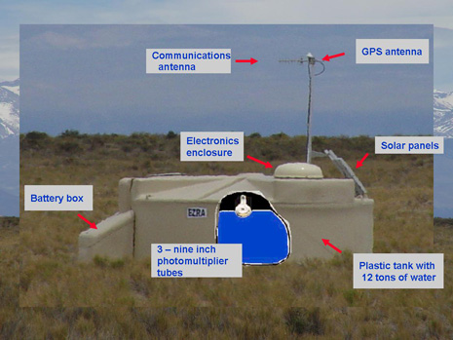
Auger SD Trigger and Data Acquisition
Trigger requires 3 fold coincidence between pmts at 1.75 single muon pulse height (TH-T1 trigger).
Second stage of trigger is Time-Over-Threshold trigger (TOT-T2).
TOT requires 2 of 3 pmt’s with coincident pulses > 300 ns long. Insures we have a real shower.

Slide 16
Auger SD Trigger and Data Acquisition cont.
T2 Trigger along with time-stamp sent to central data acquisition station (CDAS).
A T3 array trigger is formed in the CDAS
T3 requires coincidence of 3 SD T2 triggers.
Also requires the 3 SD are “neighbors”
Produces about 1600 events /day.
Upon declaration of T3 , CDAS requests event data from relevant SD’s and stores for later offline analysis.

Slide 17
Auger Data Analysis
Offline analysis uses measurement (and fitting) to lateral distribution of particle density to estimate energy of shower.
Timing information used to estimate shower (and thus primary) direction.
Stereo Florescence detectors also provide energy and direction info but only have 13% live time (moonless nights).
Note that simulations are used to “calibrate” the analysis.
Thus there is probably some unknown systematic error in the energy estimation.

Slide 18
Auger Data Results
Data Taking began in 2004.
Array completed in 2008
As of 2011 Auger detected > 64000 events with energies above 3 x 10 ¹⁸ ev
>5000 events with energies above 10 ¹⁹ ev
Highest energy seen from Auger is ~ 2.1 X 10 ²⁰ ev. With an uncertainty of ~ 25 %

Slide 19
Auger Data Results cont.
No statistically relevant correlation found to AGN or other extra galactic sources.
No clustering found
No correlation with galactic sources found.

Slide 20
Auger Improvements
AMIGA:Auger Muons and Infill for the Ground Array
30 m2 plastic scintillators buried ∼ 3.0 m underground
Infill detector: Addition of SD on a graded fine scale spacing 433,750 and 1500 m apart.

Slide 21
Auger Improvements cont.
prototype radiotelescope array (AERA — Auger Engineering Radio Array) for detecting radioemission from the shower cascade
Auger North? Colorado/Kansas

