Slide 1
Heavy Quarkonia measurements
in PHENIX
Byungil Kim
For the PHENIX Collaboration
International Workshop on Heavy Quark Production
in Heavy-ion Collisions
PURDUE, January 4-6, 2011

Slide 2
Outline
▶ Introduction
- Heavy quarkonia
- J/ψ production mechanisms
▶ PHENIX detector
▶ J/ψ measurements
- p+p collisions
- d+Au collisions (Cold nuclear matter)
- Au+Au and Cu+Cu collisions (Hot nuclear matter)
▶ Υ measurements
▶ ψ΄ and χ_{c} measurements
▶ Summary

Slide 3
Heavy quarkonia (I)
▶ QGP is a state of deconfined quarks and gluons which
is predicted by lattice Quantum Chromodynamics (QCD)
calculations to be formed above T_{c} = 170 MeV.
▶ Heavy quarkonia measurements are good probes to study
the formation of QGP.
▶ Heavy quark production is sensitive to the formation
of QGP via a color screening.
r_{D}
T. Matsui and H. Satz, Phys. Lett. B178, 416 (1986)

Slide 4
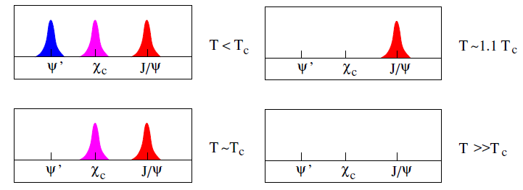
Heavy quarkonia (II)
▶ They have large masses and are produced at the early
stage of the collision via hard-scattering of gluons.
▶ Large binding energy (small radius) makes them harder to
dissociate via interactions with the surrounding hadrons.
H. Satz, J. Phys. G 32, R25 (2006)
▶ Different charmonium states will be melted by increasing
temperature enough to dissociate the binding strength.

Slide 5
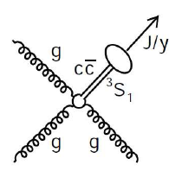
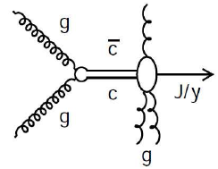
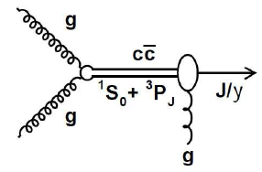
J/ψ production (I)
By gluon fusion in initial collisions:
▶ Color Singlet model (CSM): R. Baier et al., PLB102, 364 (1981)
- pair is in color singlet state.
- No change of color or spin states.
▶ Color Evaporation model (CEM): H. Fritzsch, PLB67,217 (1977)
- doesn’t have constraints on the color or other quantum numbers.
- multiple gluon emissions
▶ Color Octet model (COM): G. T. Bodwin et al., PRD51, 1125 (1995)
- pair is in the color octet state.
- one or some gluon emission
CSM
CEM
COM
J/ψ
J/ψ
J/ψ

Slide 6
J/ψ production (II)
By recombination in Au+Au collisions:
▶ In abundant energy and charm quark densities,
→ J/ψ regeneration by coalescence of charm and anti-charm quarks.
▶ It is possible to
→ enhance J/ψ yield by increasing collision energy.
→ inherit the charm quark flow.
→ affect on the distribution of azimuthal anisotropy υ₂.
c
c
c
c
c
c
c
c
c
c
c
c
φ : azimuthal angle of emitted particle
Ψ_{R} : reaction plane angle

Slide 7
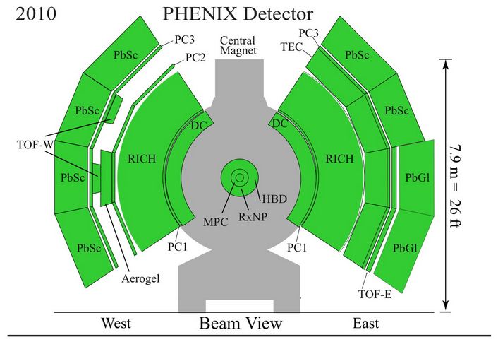
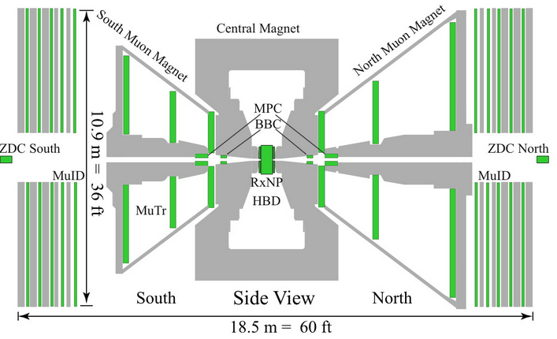
PHENIX detector
- Global detectors
BBC: MB trigger, vertex, centrality and reaction plane determinations
ZDC: centrality and reaction plane determinations
- Mid rapidity, |y|<0.35
By using Drift Chamber, Pad
Chamber, EMCal and RICH,
measure J/ψ, Υ and ψ΄ → e⁺e⁻
χ_{c} → e⁺e⁻ + γ
- Forward and backward
rapidity, 1.2<|y|<2.2
By MuTR and MuID
measure J/ψ, Υ → μ⁺μ⁻

Slide 8
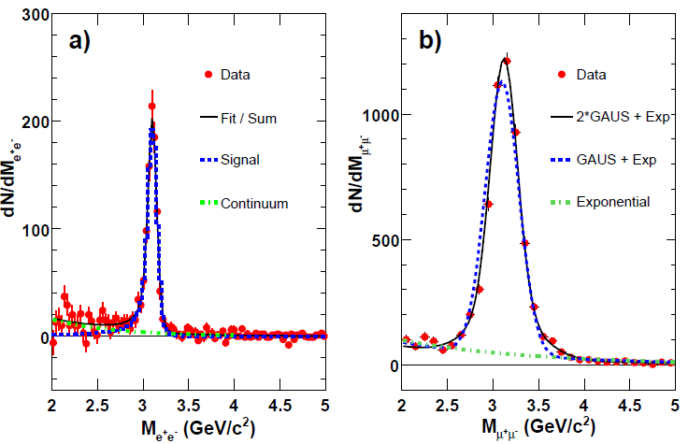
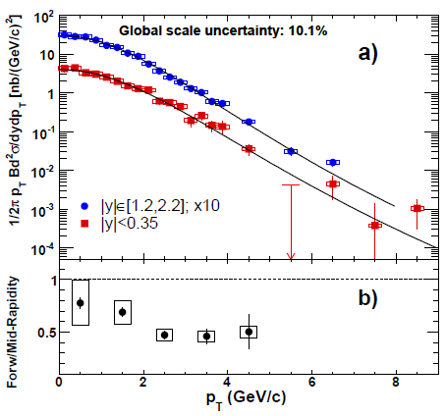
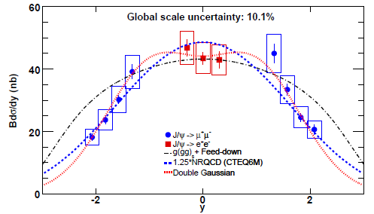
J/ψ in p+p collisions
PHENIX, Phys. Rev. Lett. 98, 232002 (2007)
J/ψ→e⁺ e⁻
J/ψ→μ⁺ μ⁻
Run5
σ: ~70 MeV
σ: ~170 MeV
Run5
▶ To measure baseline cross sections
for the heavy ion collisions and
to study production mechanisms.
▶ At forward rapidity, the rapidity
shape falls steeply and p_{T} spectrum
shows a softening.

Slide 9
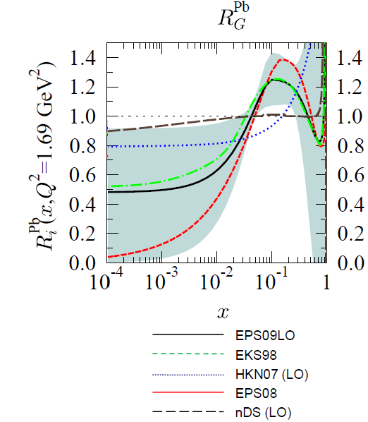
Cold Nuclear Matter (I)
: Modifications of heavy quarkonia production in absence of QGP
▶ Depletion of initial gluon
distribution function in heavy
nuclei at small x
(Gluon shadowing)
▶ Interaction of bound state
or J/ψ with the target/projectile
nucleons (Nuclear absorption)
▶ Initial state energy loss
▶ Multiple interactions of gluons
inside the nuclei (Cronin effect)
→ p_{T} broadening
Anti-
shadowing
Shadowing
K. J. Eskola et al., arXiv:0902.4154 [hep-ph]

Slide 10
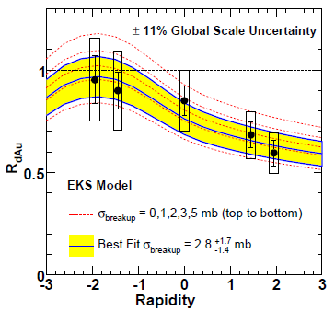
Cold Nuclear Matter (II)
: 2003 (2.74 nb⁻¹) and 2008 (80 nb⁻¹) d+Au collisions
PHENIX, Phys. Rev. C 77, 024912 (2008)
▶ Rapidity dependence
Positive rapidity:
d going direction and small x region
Negative rapidity:
Au going direction and large x region
▶ Stronger suppression at
positive rapidity consistent with
the expectation from the gluon
shadowing models and
nuclear absorbtion.
▶ From the fit data gives
2003

Slide 11
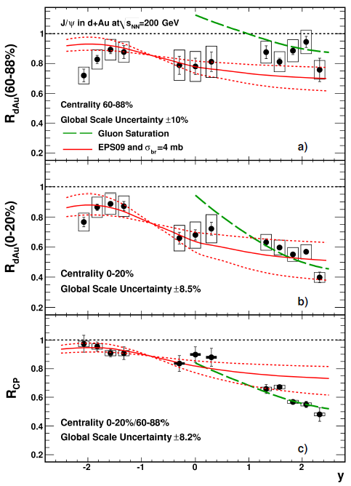
Cold Nuclear Matter (III)
▶ 30x more statistics than 2003
run in 2008 d+Au collisions
→ allow to provide many
centrality (4) and rapidity bins (9)
2008
▶ Most of systematic errors cancel
out in R_{cp}.
▶ Rapidity dependence:
R_{cp} ~ 1 at negative rapidity
At positive rapidity, R_{cp} < 1 and
decreases in most central collisions.
▶ Data cannot be described
by EPS09 and σ_{breakup}.
▶ Gluon saturation can only describe
the forward rapidity.
PHENIX, arXiv:1010.1246 [nucl-ex]

Slide 12
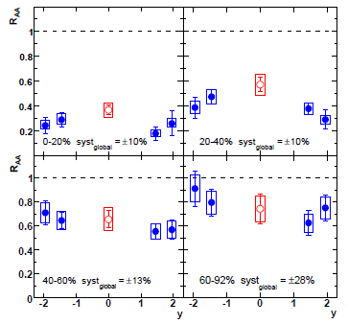
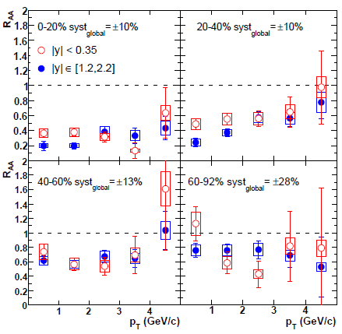
Hot Nuclear Matter (I)
: Hot nuclear matter effects (with QGP formation) in Au+Au collisions
▶ Color screening and/or dissociation of
▶ Regeneration of J/ψ from and quarks
▶ Scattering with hadron comovers
▶ Nuclear modification factor
if Au+Au is simply superposition of p+p, R_{AA} =1
Run4 Au+Au
200 GeV
p_{T} dependence?
: Need more statistics
Phys. Rev. Lett. 98, 232301 (2007)

Slide 13
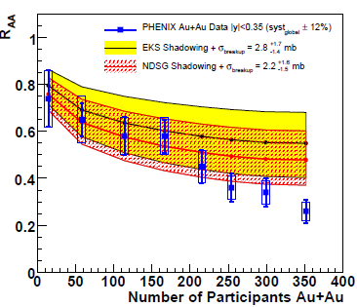
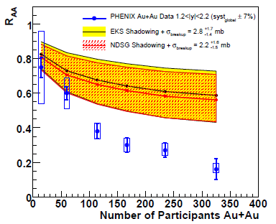
Hot Nuclear Matter (II)
▶ For the most central collisions, R_{AA} is below 0.3 (0.2) at mid (forward) rapidity.
▶ Larger than the suppression expected by extrapolating CNM effects
measured in d+Au. EKS: K.J. Eskola, V.J. Kolhinen, and R. Vogt, Nucl. Phys. A696 729 (2001).
NDSG: D. deFlorian and R. Sassot, Phys. Rev. D69, 074028 (2004).
▶ More suppression at forward rapidity.
- Different CNM extrapolation and (or) regeneration effect in different rapidity?
▶ More detailed analysis with Run7 is in progress.
Notes:
Significant J/ψ suppression relative to binary scaling of proton-proton is observed for central Au+Au collisions in PHENIX.

Slide 14
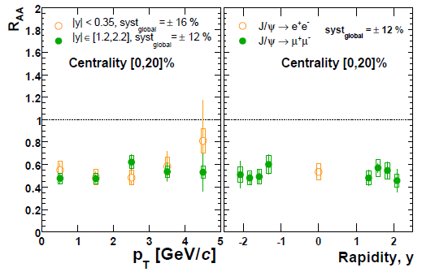
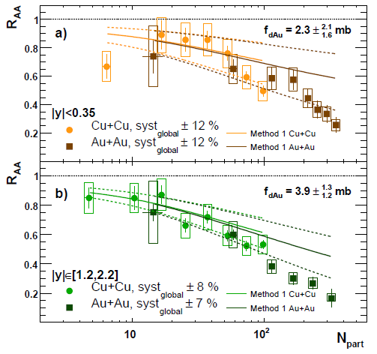
J/ψ in Cu+Cu collisions
: To study hot nuclear matter effects at medium energy density.
Run4 AuAu
Run5 CuCu
▶ p_{T} and rapidity dependence of R_{AA}
→ Show similar behavior for mid and
forward rapidity.
▶ Centrality denpendence of R_{AA}
→ Applied theoretical calculations including modified initial PDF and J/ψ breakup
cross section obtained from d+Au data (EKS98and NDSG shadowing models).
→ Good agreement between Cu+Cu and Au+Au about the dependence of
suppression on N_{part}.

Slide 15
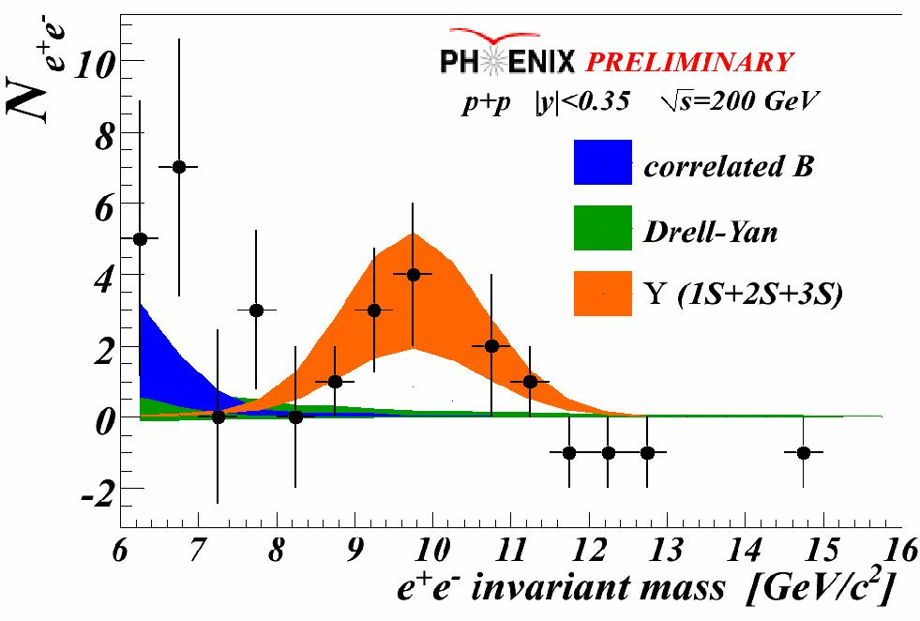
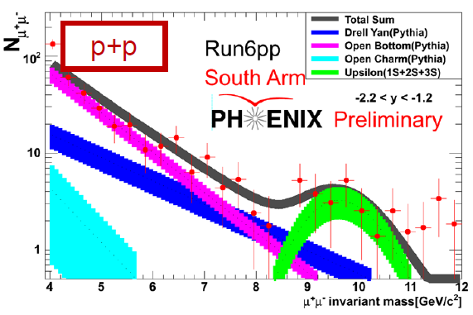
Υ measurement (I)
: Υ (1S+2S+3S) measurements in p+p collisions
▶ At forward (mid) rapidity
with dimuon (di-electron) decay.
▶ Measure total cross section

Slide 16
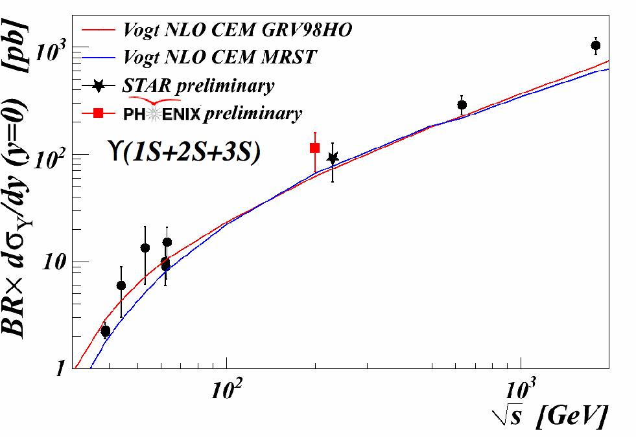
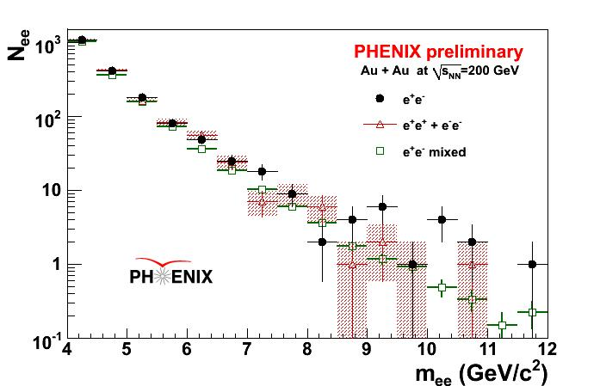
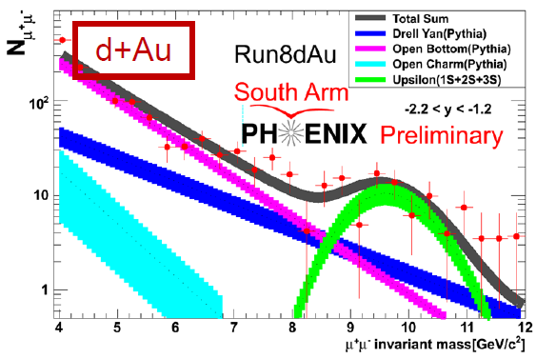
Υ measurement (II)
▶ is compatible with
STAR result.
▶ Also the continuum underneath
the Υ family peak has been
carefully studied.
▶ Measurements in
Au+Au (Υ → e⁺+e⁻) and
d+Au (Υ → μ⁺ + μ⁻) for
the nuclear modification.

Slide 17
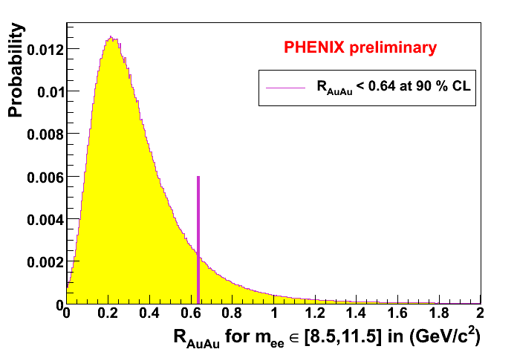
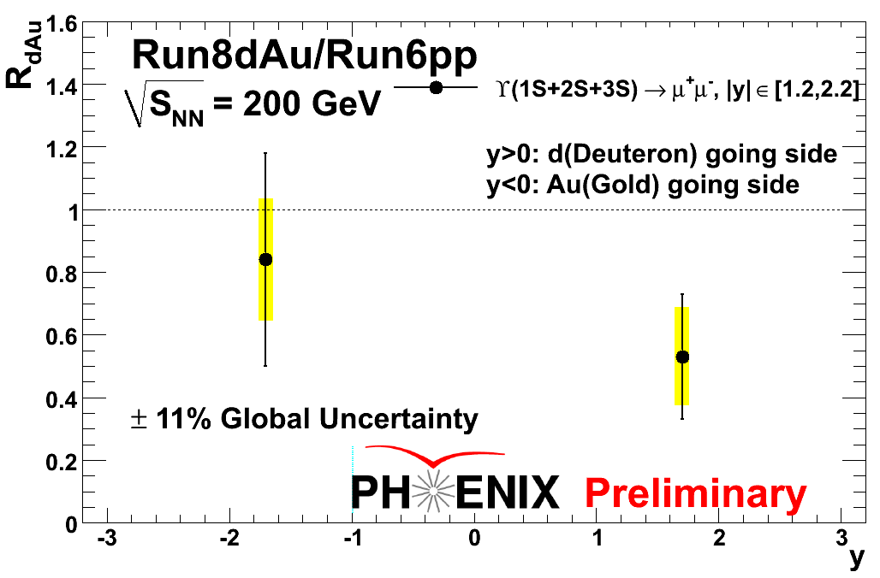
Υ measurement (III)
: Υ (1S+2S+3S) suppression
Rapidity | decay | R_{dAu}±Stat.±Sys. | R_{AA}
y [-2.2,-1.2] | Υ → μ⁺ + μ⁻ | 0.84±0.34±0.20 | not yet
y [-0.35, 0.35] | Υ → e⁺ + e⁻ | not yet | <0.64 90% CL
y [1.2, 2.2] | Υ → μ⁺ + μ⁻ | 0.53±0.20±0.16 | not yet
▶ Υ suppression similar to that of the J/ψ in d+Au collisions.

Slide 18
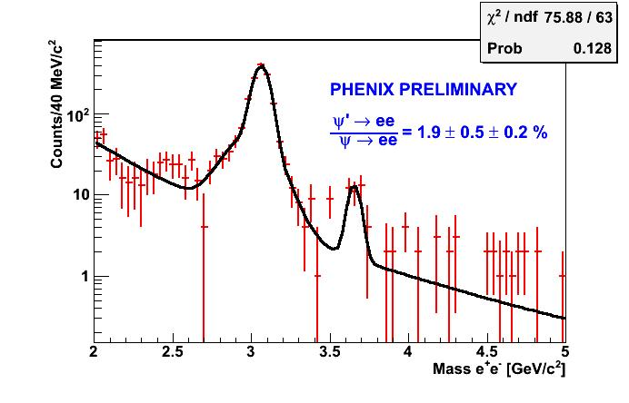
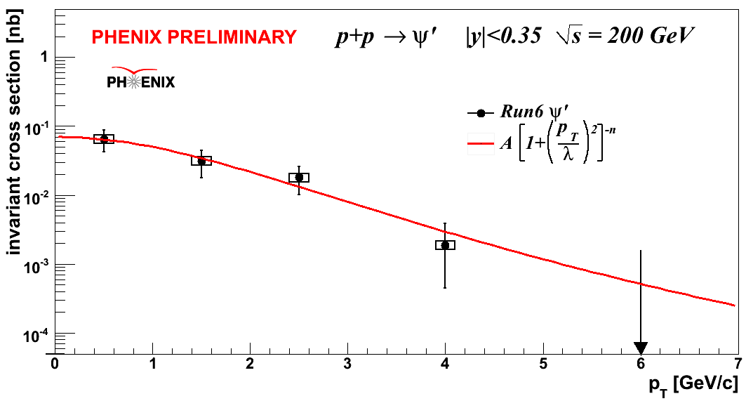
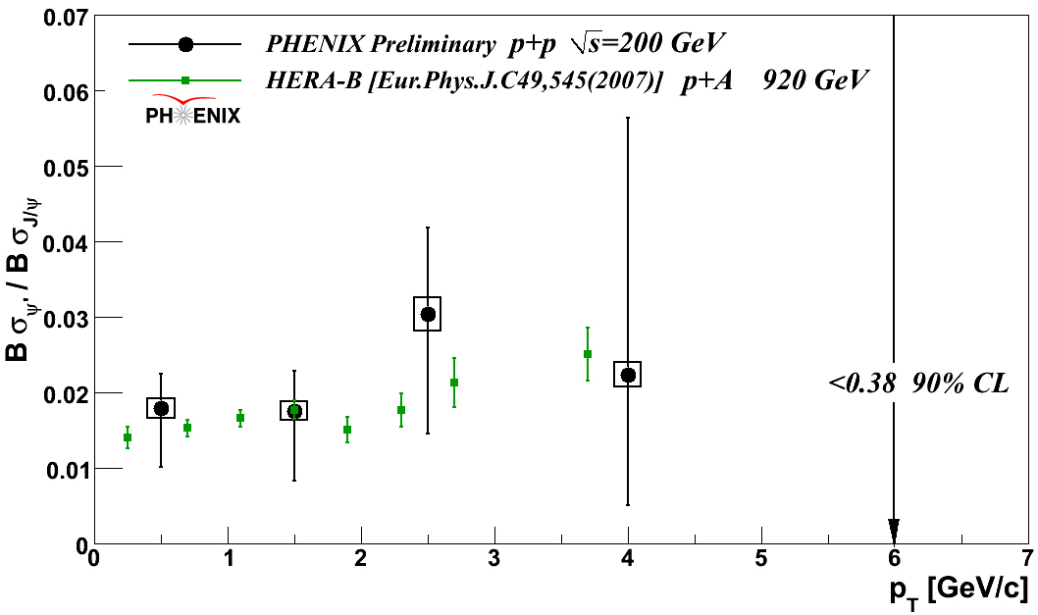
ψ΄ measurement in p+p collisions
Run6
▶ At mid rapidity, |y| < 0.35
▶ Feed-down, ψ΄→J/ψ
▶ Ratio doesn’t show
strong energy or p_{T} dependence.
▶ Need more statistics.
PHENIX | World ave.
8.6±2.5% | 8.1±0.3%
*P. Faccioli et al., arXiv:0809.2153 [hep-ph]

Slide 19
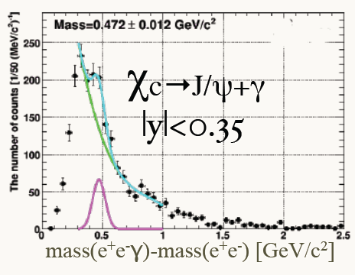
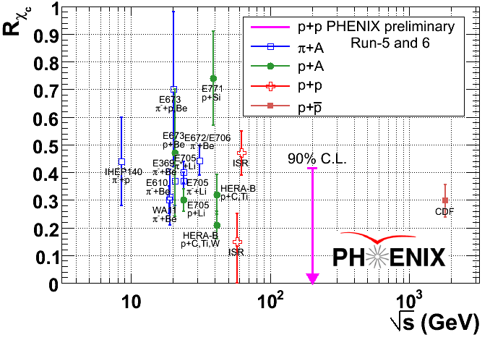
χ_{c} measurement in p+p collisions
▶ At mid rapidity, |y| < 0.35
▶ Feed-down, χ_{c}→J/ψ+γ
▶ Need more statistics and
S/B improvement for more
detailed analysis.
PHENIX | World ave.
<42% (90% CL) | 25±5%
*P. Faccioli et al., arXiv:0809.2153 [hep-ph]
Notes:
This is a difficult measurement because the photon energy is low.

Slide 20
Summary
▶ Heavy quarkonia measurements are good probes for the QGP search.
▶ J/ψ has been measured in p+p, d+Au, Au+Au and Cu+Cu collisions and
studied intensively to understand CNM and anomalous suppression.
→ There is a long paper in preparation about the J/ψ in d+Au containing
more details.
▶ PHENIX has measured different quarkonium states (Υ, ψ΄ and χ_{c})
at different rapidity regions.
→ A long paper with final ψ΄ and χ_{c} feed-down measurements is going to be
released very soon.
▶ Work in grogress
→ Collisional energy dependence of heavy quarkonia production
at = 500, 200, 62.4 and 39 GeV.
▶ For more detailed heavy quarkonia analyses,
detector upgrade and high luminosity are essential.

