Slide 1
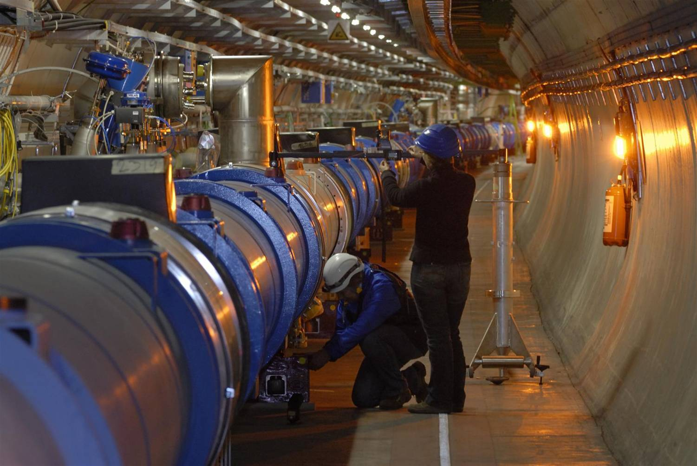
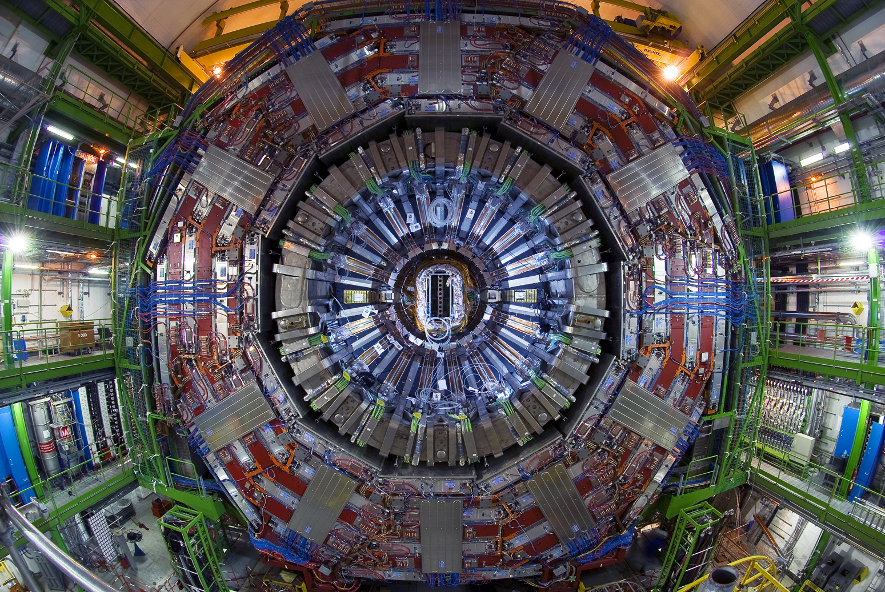
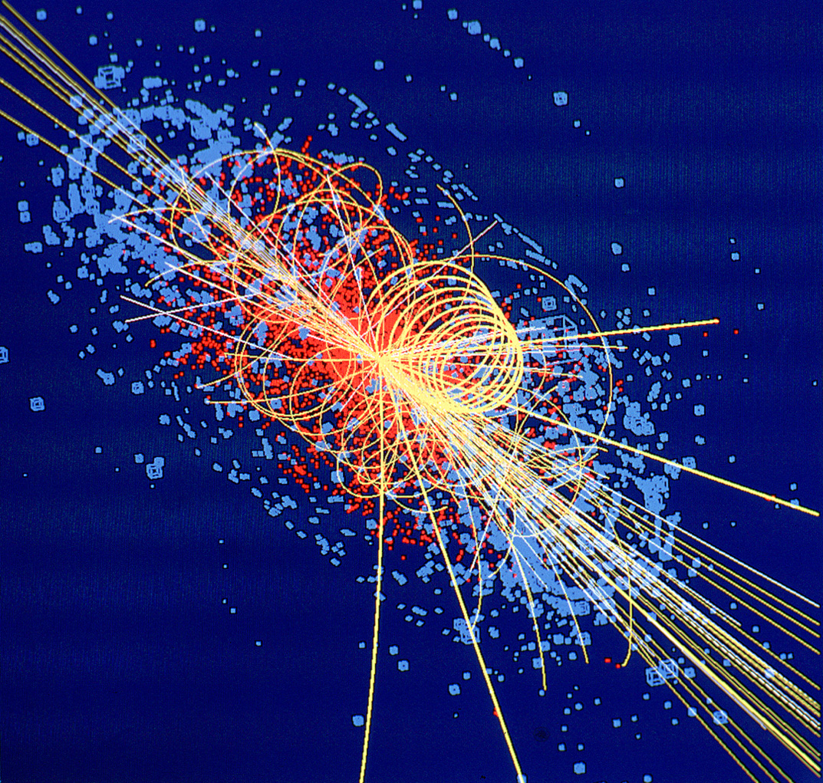
Challenges at the
Large Hadron Collider
Nick Sinanis

Slide 2
Outline
Introduction
  Why do we go to the energy frontier
The Large Hadron Collider
  The machine and the physics
The Compact Muon Solenoid detector
  Construction, Commissioning, Preparation for data taking
Challenges
  Online event selection
  Distributed Computing and Analysis
Summary

Slide 3
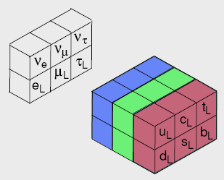
The Standard Model
More than 50 years of experimentation using accelerators, and ensuing theoretical syntheses have produced what we call the “Standard Model”
  This SM is a gauge theory of matter and forces
  It’s a quantum field
  theory that describes
  point-like fermions
  (quarks and leptons)
    Matter Particles
  That interact through
  the exchange of vector
  bosons (photons, W±
  and Z, and gluons)
    Force Carriers
“Generations” of Matter Particles (Sources of Fields)
boson
Quarks come
in three colors
fermion’
What about gravity and the graviton?
(Once thought irrelevant to particle physics)
fermion

Slide 4
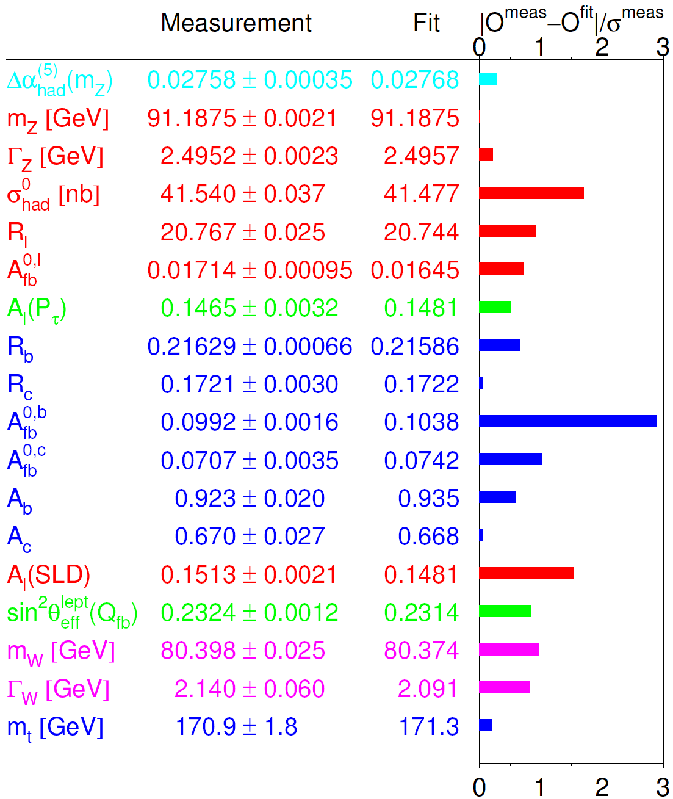
The Standard Model and Beyond
Very successful model which contains all known particles in particle physics today.
Describes the interaction between spin 1/2 particles (quarks and leptons) mediated by spin 1 gauge bosons (gauge symmetry).
After many years,
  No unambiguous evidence of new physics!
Leaves many questions unanswered:
  Electroweak Symmetry Breaking?
    How? Unitarity Problem? Hierarchy Problem?
  Standard Model Patchwork?
    Are there additional symmetries?
      Leptons and quarks?
      Fermions and bosons?
    Grand Unification?
  Missing Dark Matter?
    Not part of the SM...what is it?
LEP Electroweak Working Group
х²/ndof = 18.2/13 (15% probability)

Slide 5
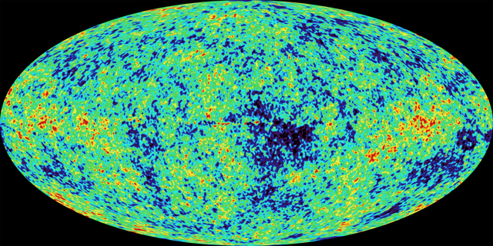
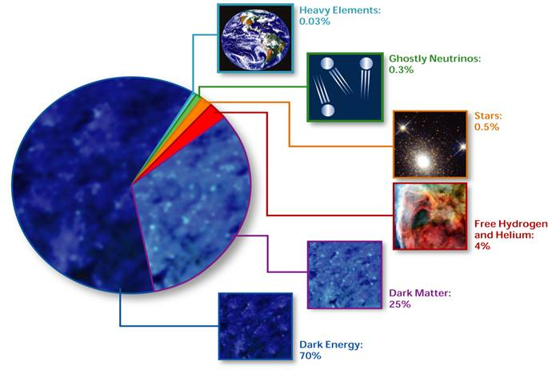
The Universe
What shapes the cosmos?
  Old answer: Gravity – through mass and energy observed in the universe
But now we know that:
  There is much more mass than we expect from just the stars we see, or from the amount of helium that was formed in the early universe... Solution: Dark matter
  The velocity of distant galaxies indicates that, in addition to the mass that slows down expansion of the universe, there is also some new kind of energy driving that expansion outward!
  Solution: Dark Energy
So, if we’re so smart, why don’t we know what 96% of the universe is made of?
  Back to the accelerators!
Quarks and leptons
4%

Slide 6
New Phenomena
There are many indications that new physics phenomena are to be expected at the TeV energy scale. Effects should appear which help us with several general issues:
  the generation of mass (Higgs mechanism or alternatives), if not the W_{L}W_{L} scattering will diverge above 1 TeV
  why the Higgs boson mass is so low (SUSY, extra dimensions or alternatives)
  trying to incorporate gravity within the Standard Model
  trying to understand the Dark Matter observations in the universe
  many more...
Model builders have become very creative these days...
  Large number of predicted models
  Large number of predicted signatures
    Pick any arbitrary signature ➔ there exists a model which predicts it!
  We really do not know what nature has in store for us beyond the SM!
In general the LHC was designed as a machine to address as much as possible the above issues. This “broadband” discovery machine aims for the largest possible energy and the largest possible luminosity.

Slide 7
Probing the TeV Energy Scale
Higher energy: Reproduce conditions of early Universe
TeV energy scale: Expect breakdown of current calculations unless a new interaction or phenomenon appears
Many theories, but need data to distinguish between them
What might we find:
  The mechanism that generates mass for all elementary particles
    In Standard Model, masses generated through interaction with a new particle the Higgs boson
    Other options possible, but we know that the phenomena occurs somewhere between 100 and 1000 GeV
  A new Symmetry of Nature
    Supersymmetry gives each particle a partner
    Would provide one source of the Dark Matter observed in the Universe
  Extra Space-Time Dimensions
    String theory inspired
    This would revolutionize Physics!
  These are only some of the possibilities

Slide 8
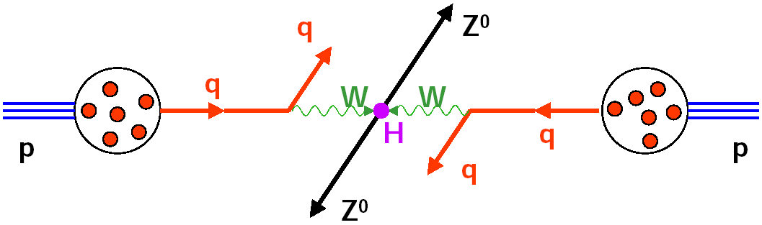
Higgs Production in pp Collisions
Collider:
u
Really colliding ‘partons’: qg, qq, gg
E_{Quark} is on average
only 1/6 of E_{Proton}
u
u
u
d
d
E_{beam}
½E_{beam}
½E_{beam}
E_{CM} ~ 1/3 E_{beam}
→ Proton-proton collider with E_{p} ≥ 7 TeV

Slide 9
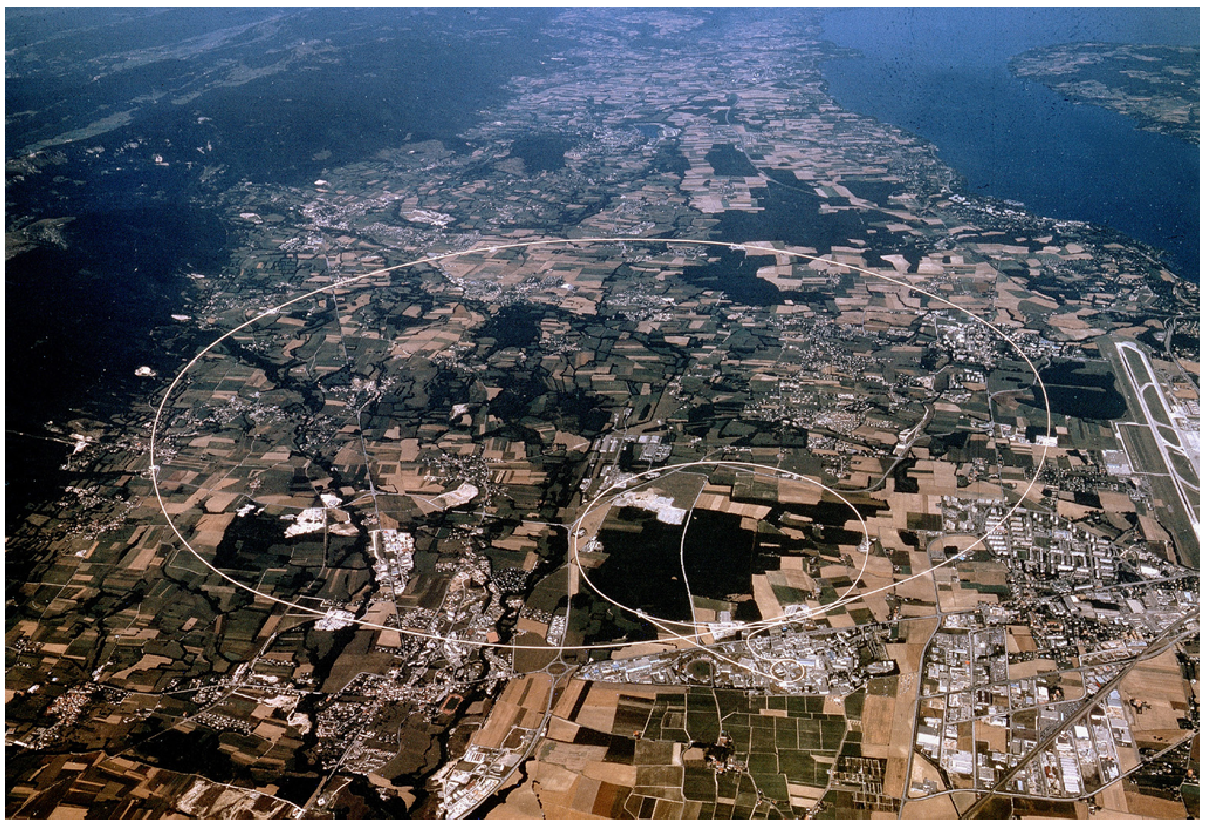
Large Hadron Collider
Large Hadron Collider
27 km circumference
Lake Geneva
CMS
LHCb
ALICE
ATLAS

Slide 10
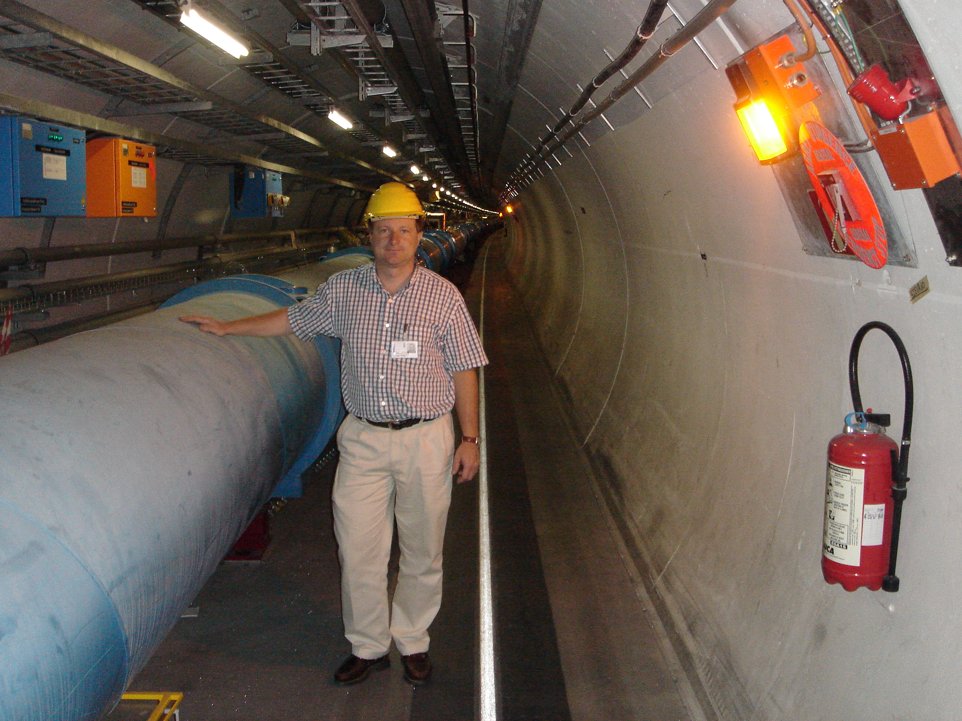
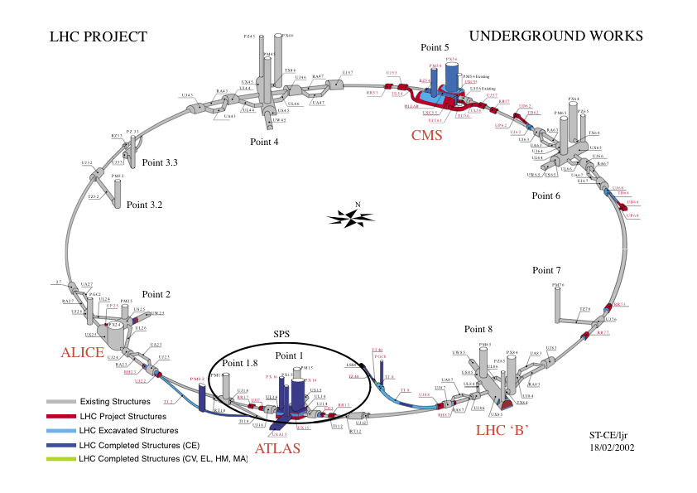
The Large Hadron Collider
7 TeV on 7 TeV proton-proton collider, 27 km ring
  7 times higher energy than the Tevatron at Fermilab
  100 times higher design luminosity than Tevatron (L=10³⁴ cm⁻²s⁻¹)
1232 superconducting 8.4 T dipole magnets @ T=1.9º K
  Largest cryogenic structure, with 40 ktons of mass to cool
4 experiments
  ATLAS
  CMS
  LHCb
  ALICE

Slide 11
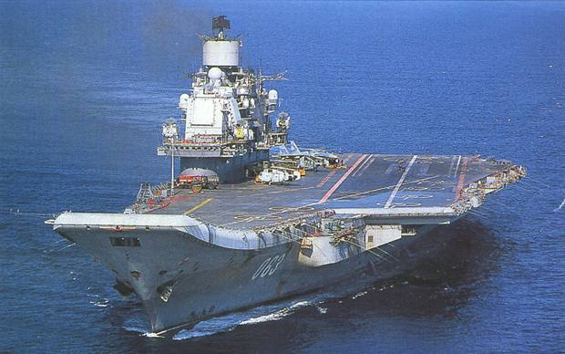
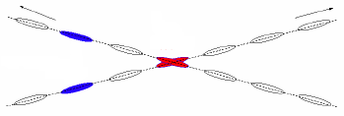
LHC Parameters
Beam energy 7 TeV
Dipole field 8.4 T
Dipole current 11700 A
Instantaneous luminosity L 10³⁴ cm⁻²s⁻¹
Integrated luminosity/year ~ 100 fb⁻¹
Circulating current/beam 0.53 A
Number of bunches 2808+2808
Bunch spacing 25 ns
Protons per bunch 10¹¹
R.m.s. beam radius at IP1/5 16 μm
R.m.s. bunch length 7.5 cm
Stored beam energy 360 MJ
Crossing angle 300 μrad
Number of events per crossing ~20
Luminosity lifetime 10 hours
N = L x σ (pp → X)
n. of protons
per bunch
n. of bunches
n. of turns
per second
Tevatron: 36+36
beam size at IP
(σ_{x,y} = 16 μm)
Tevatron: 396 ns
x200 Tevatron
two beams, 2808 bunches each, separated by 25 ns
'long range’ interactions
crossing angle
Aircraft carrier at 12 knots

Slide 12
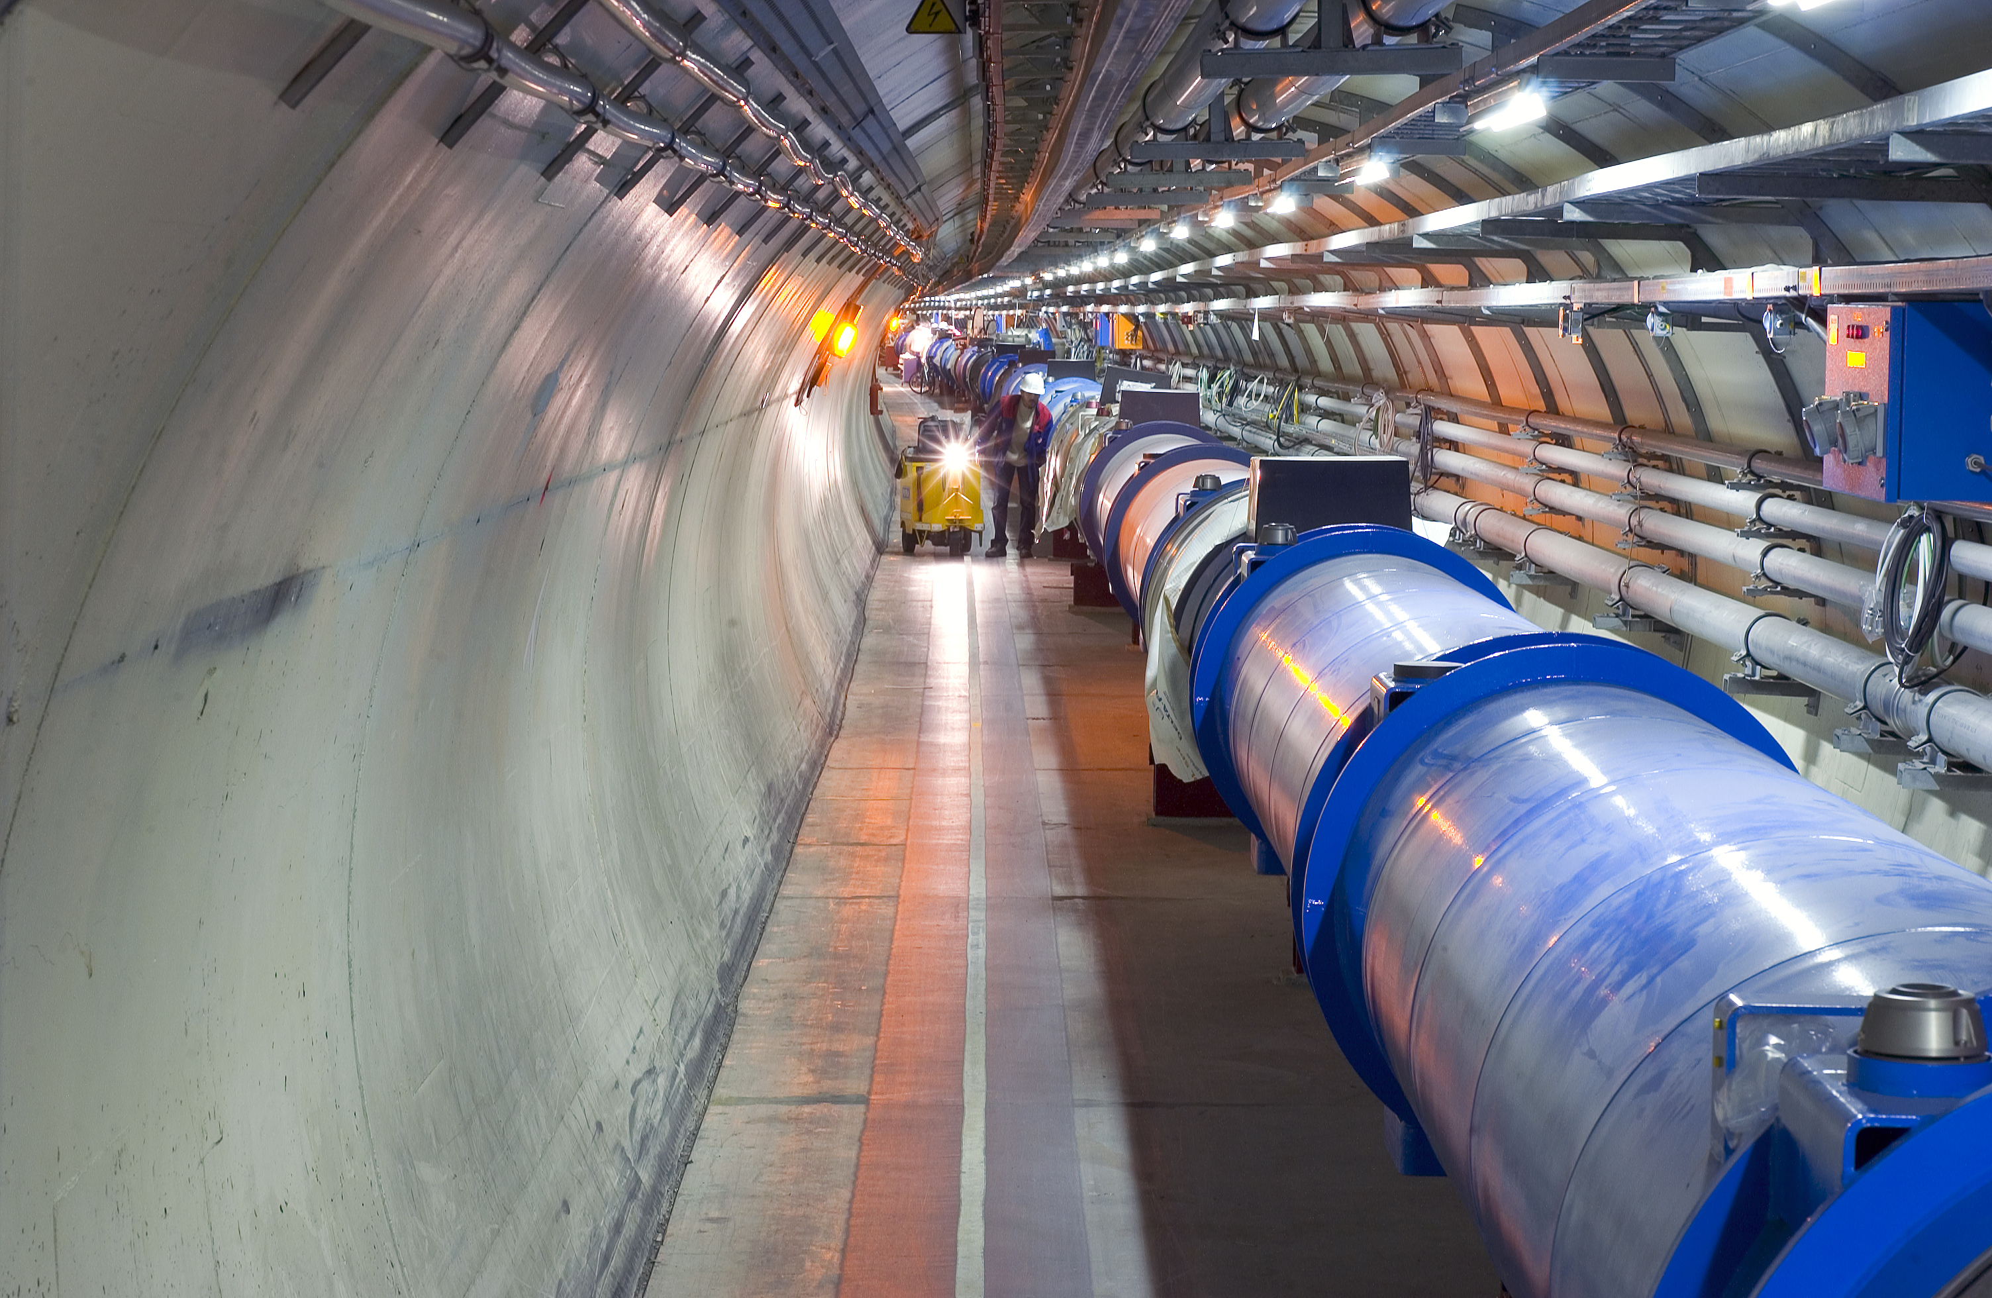
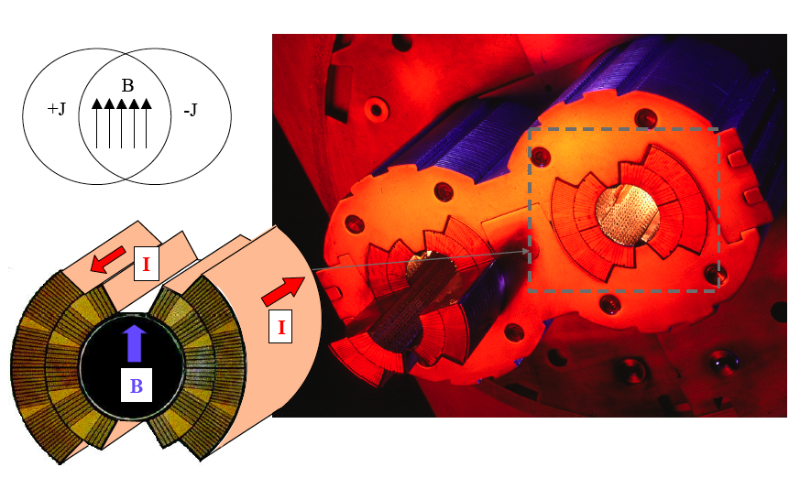
Machine most challenging component:
1232 high-tech superconducting dipole magnets
Dipole field: 8.4 T
Operation temperature: 1.9 K
Dipole current: 11700 A
Dipole weight: 34 tons
7600 km of Nb-Ti superconducting cable
p(TeV) = 0.3 B(T) R(km)
With typical magnet packing factor of ~70%, need 1232 magnets providing B=8.4 T
for 7 TeV beams

Slide 13
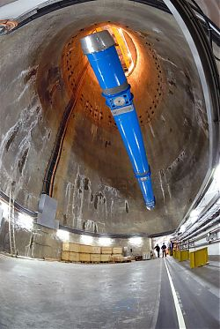
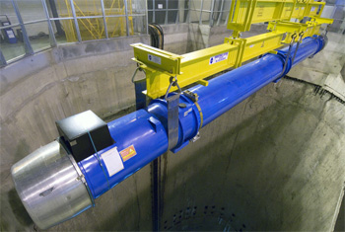
LHC Installation
Final dipole magnet (of more than 1700 LHC
magnets) being lowered for placing in the
tunnel ~50 - 100 meters below ground.
(April 26, 2007)
(Coils of NbTi superconductor cable - 1Mkg
of material in all - operated at 2K.)
15m long
30 tonnes

Slide 14
LHC History
The most ambitious project in high-energy physics ever, and one
of the most ambitious in science more generally
Workshop on a Large Hadron Collider in the LEP tunnel, Lausanne
Rubbia “Long-Range Planning Committee” recommends
Large Hadron Collider as the right choice for CERN’s future
ECFA LHC Workshop, Aachen
1992 General Meeting on LHC Physics and Detectors, Evian les Bains
1993 Letters of Intent (ATLAS and CMS selected by LHCC)
Technical Proposals approved
1996 Approval to move to construction (ceiling of 475 MCHF)
Memorandum of Understanding for construction signed
1998 Construction begins (after approval of Technical Design Reports)
2000 CMS assembly begins above ground. LEP closes
2004 CMS underground caverns completed
CMS ready for first proton-proton Collisions
2008 Official LHC inauguration: 21 Oct 2008

Slide 15
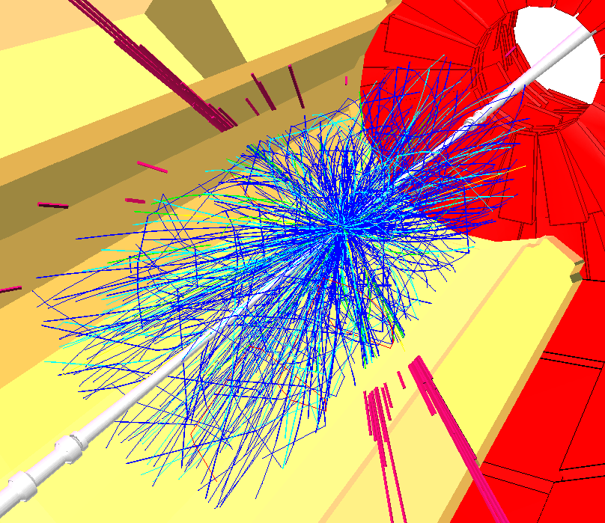
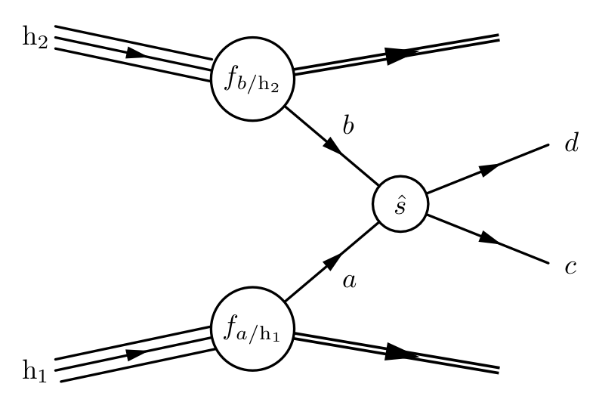



Collisions at the LHC
Protons, E_{beam}=7 TeV
Centre-of-Mass Energy = 14 TeV
Beam crossings : 40 Million / sec
p p - collisions : ~1 Billion / sec
Events to tape : ~100 / sec, each 1-2 MByte

Slide 16
LHC Challenges
Detector design
  Must have fast response:
    otherwise will integrate over many bunch crossings (response time: 20-40 ns)
  Must be highly granular:
    minimize probability that pile-up particles be in the same detectors element as interesting object
  Must be radiation resistant:
    high flux of particles from pp collisions → high radiation environment
Event selection
  Out of a billion interactions/sec select one hundred for further analysis
    need to reject most interactions
    high rejection power while preserving sensitivity for rare processes
  On-line event selection ultimately determines the physics output of the LHC experiments
Computing/Analysis
  Store data at ≈100 Hz; Petabytes of data per year
  Large scale distributed computing

Slide 17
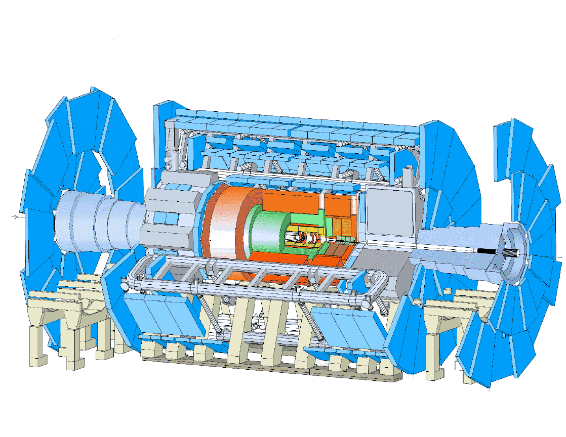
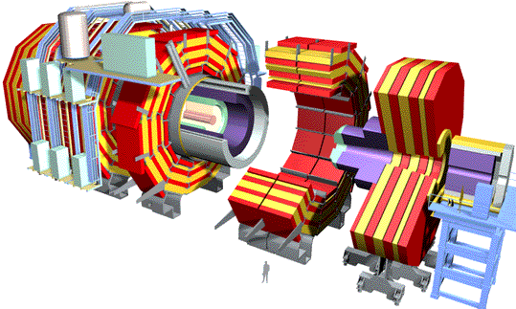
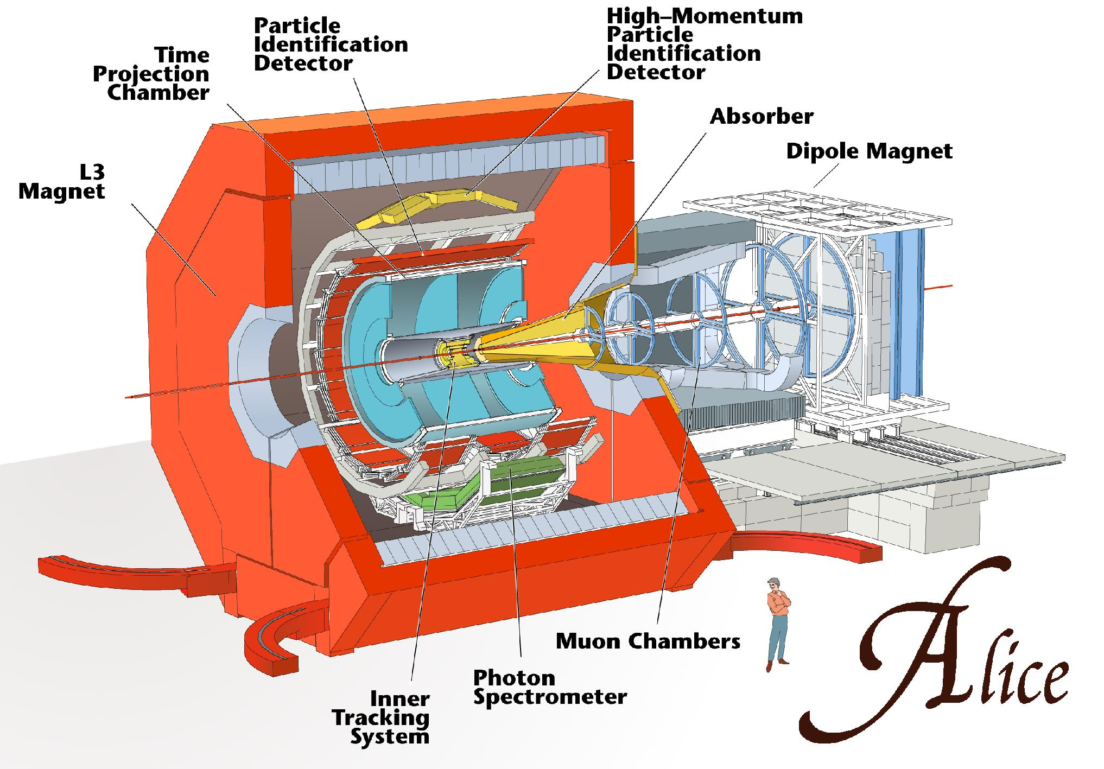
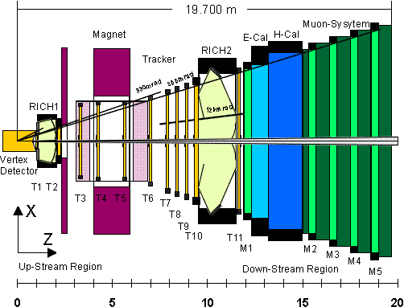
LHC Experiments

Slide 18
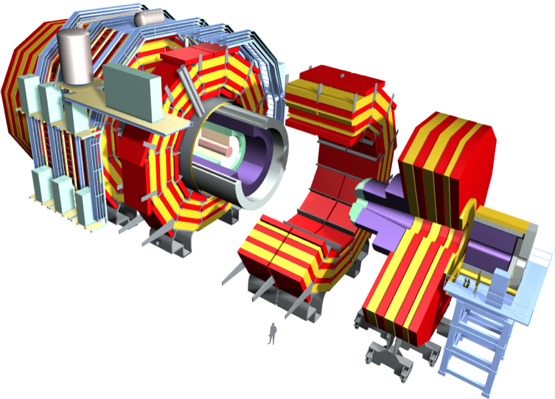
Compact Muon Solenoid Detector
Superconducting
Coil, 4 Tesla
CALORIMETERS
ECAL
HCAL
76k scintillating
PbWO4 crystals
Plastic scintillator/brass
sandwich
IRON YOKE
TRACKER
Pixels
Silicon Microstrips
210 m² of silicon sensors
9.6M channels
MUON
ENDCAPS
MUON BARREL
Total weight 12500 t
Overall diameter 15 m
Overall length 21.6 m
Drift Tube
Resistive Plate
Chambers (DT)
Chambers (RPC)
Cathode Strip Chambers (CSC)
Resistive Plate Chambers (RPC)

Slide 19
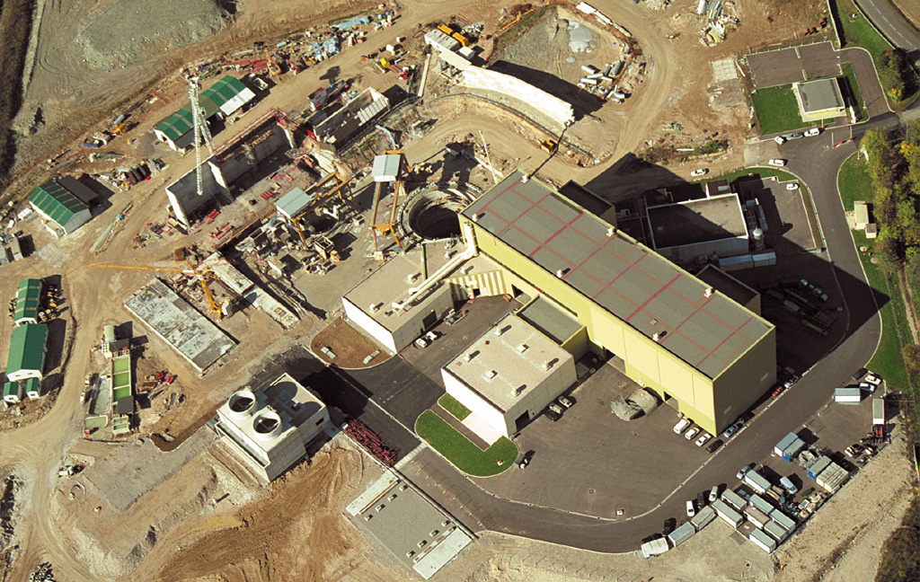
CMS Site Under Construction

Slide 20
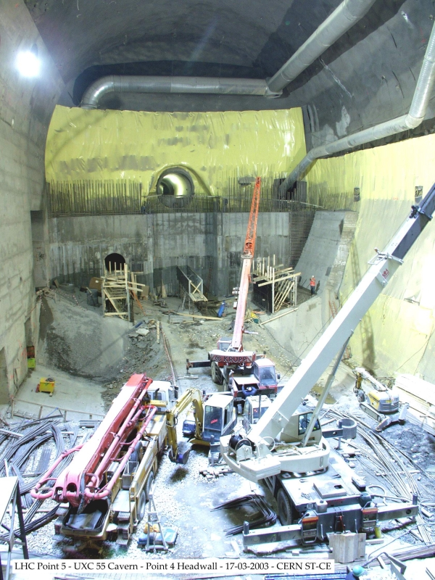
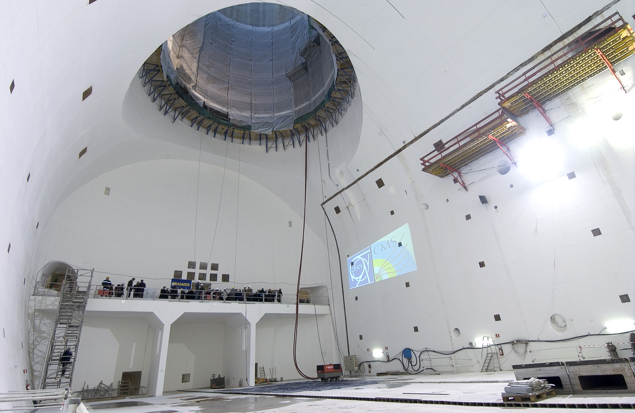
Experiment Cavern
2003
2004

Slide 21
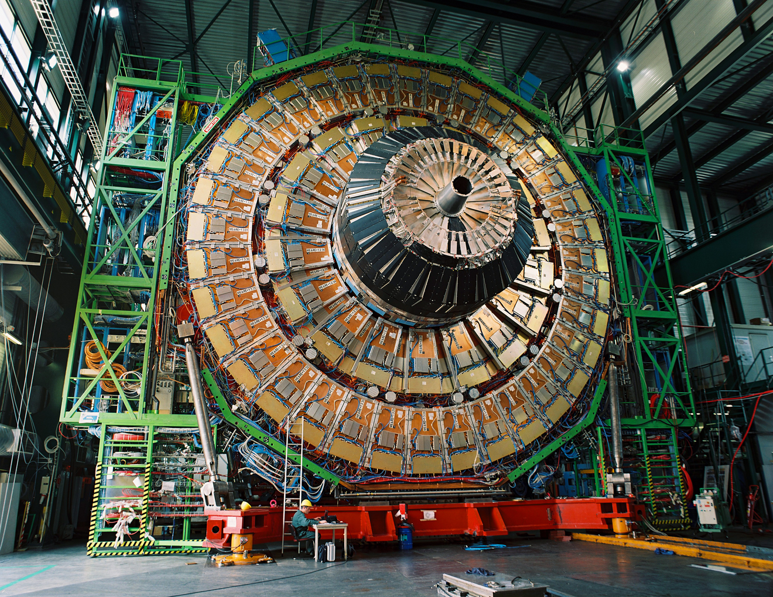
CMS Assembled & Tested on Surface
A Muon Endcap Disk
Surface Assembly Hall
Supports for ECAL Endcap
HCAL Endcap

Slide 22
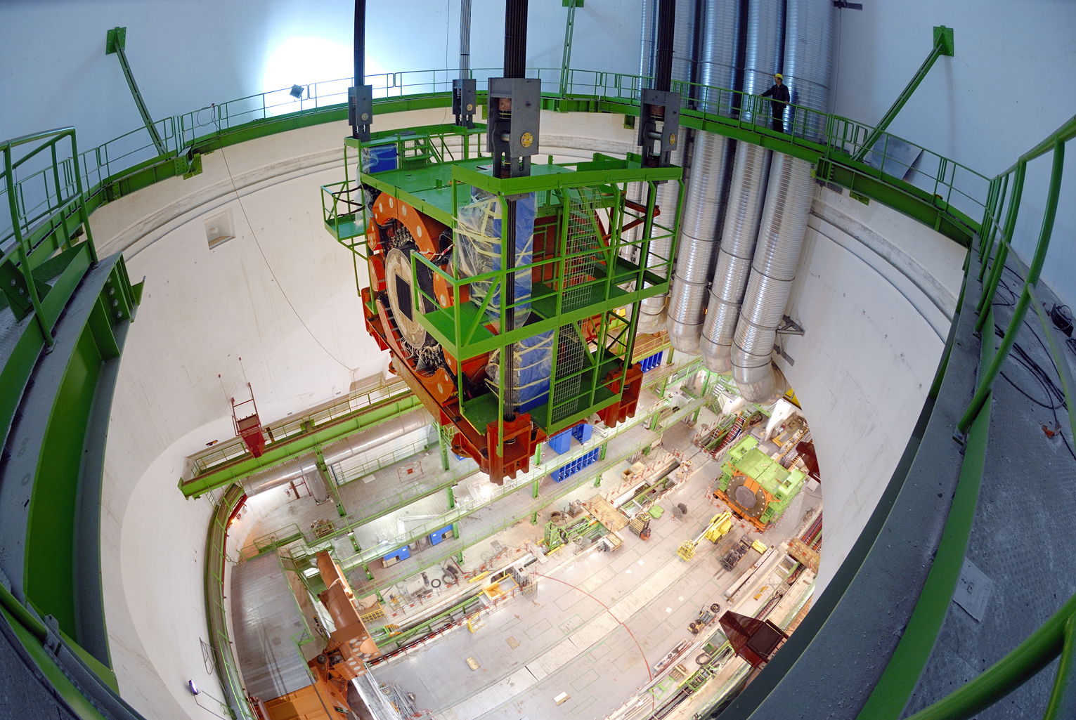
Lowering the Detector
HF Nov 2006

Slide 23
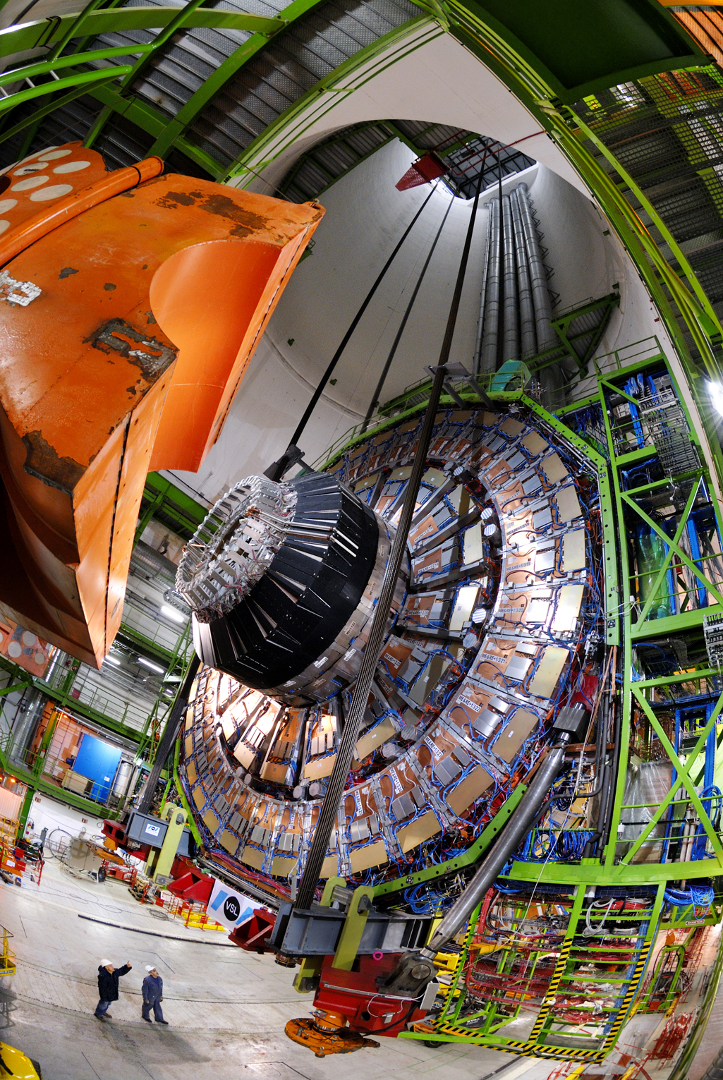
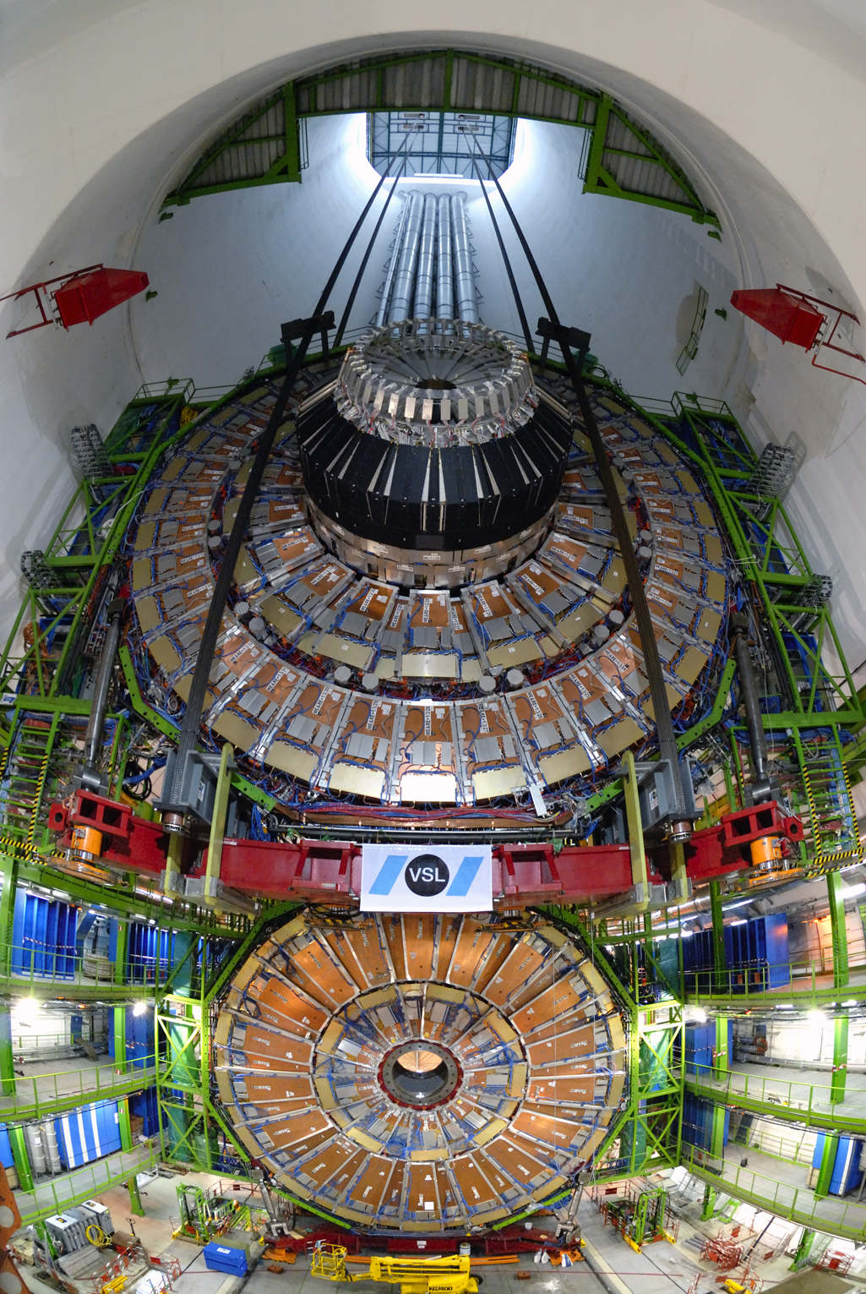
Lowering the Detector
YE+1 (Jan 2007)

Slide 24
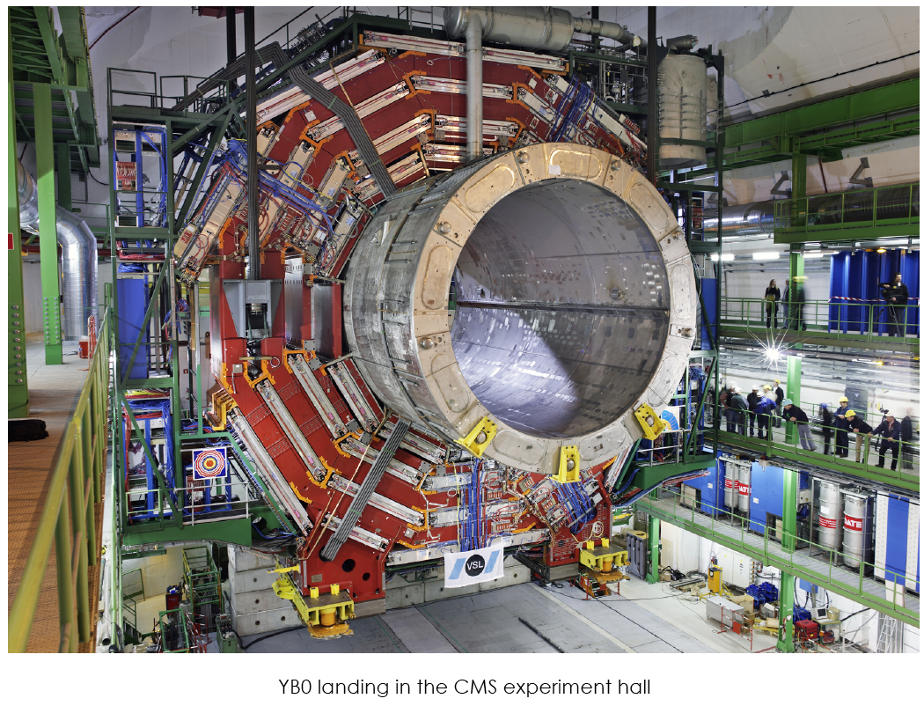
Lowering the Detector
YB0 lowering

Slide 25
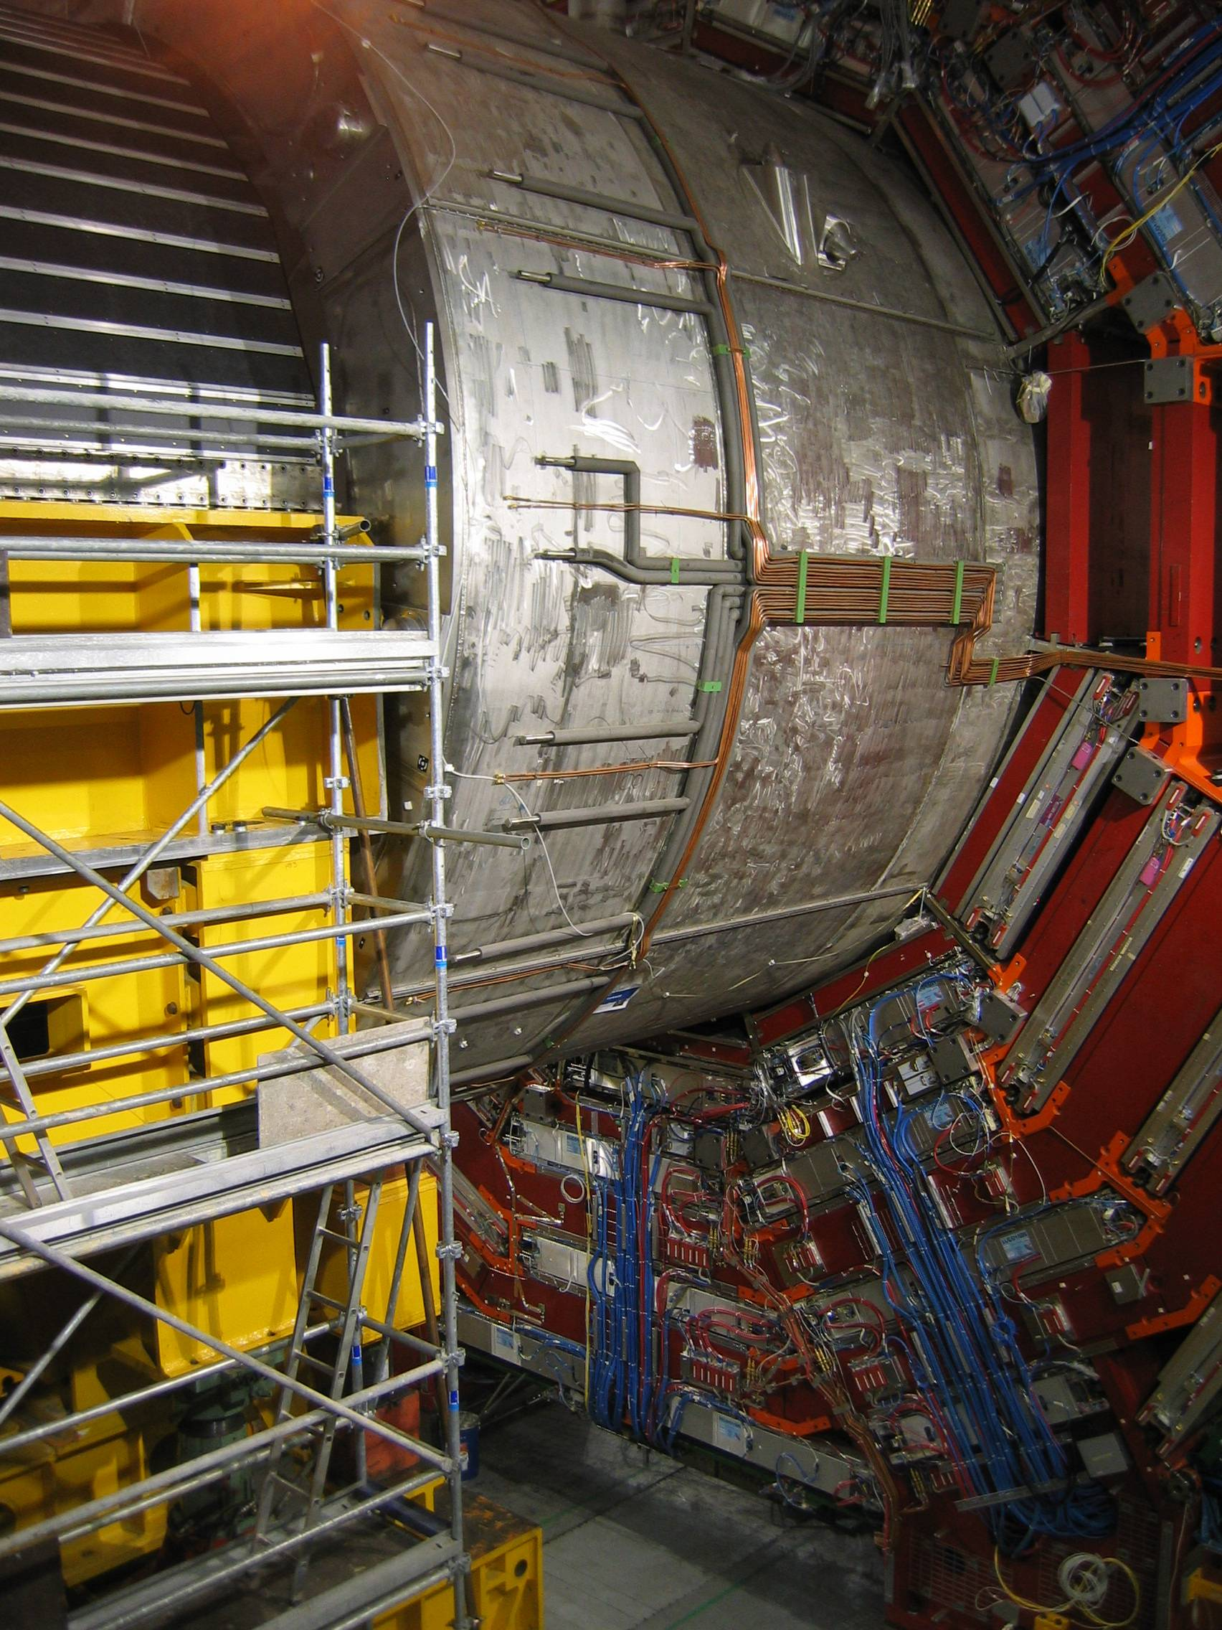
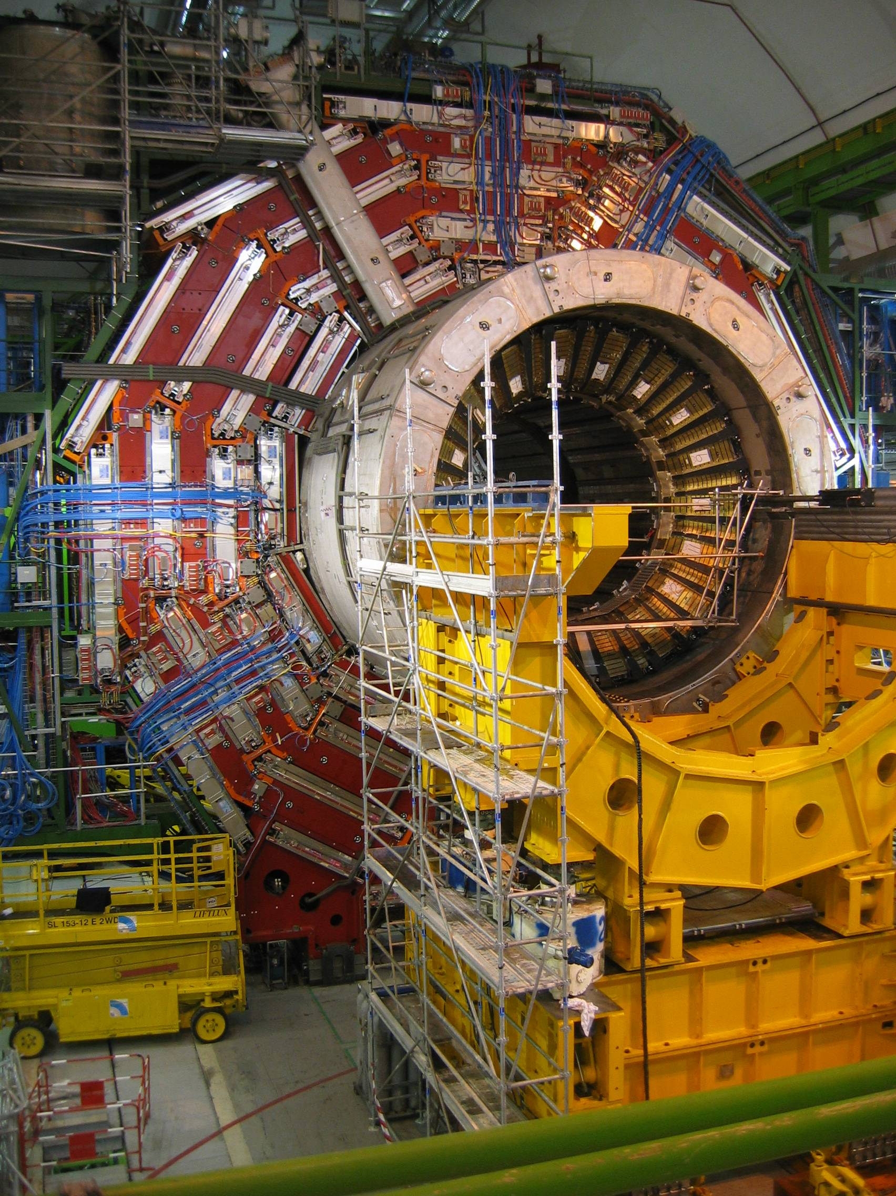
Putting the Detector in Place
HCAL barrel Apr 2007

Slide 26
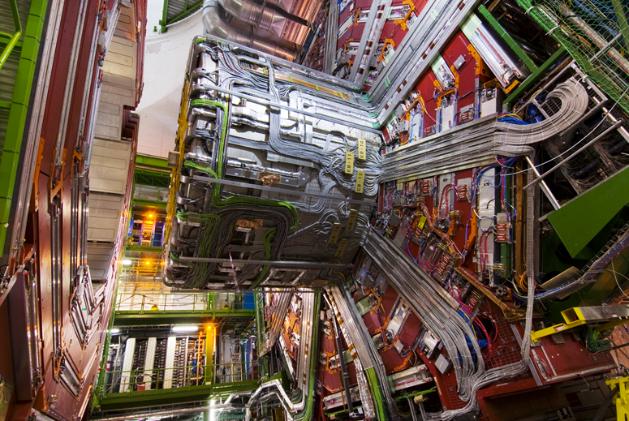
Completion of Services on YB0
Nov 2007

Slide 27

Silicon Strip Tracker, Dec 2007
200 m² of Silicon strip detectors

Slide 28
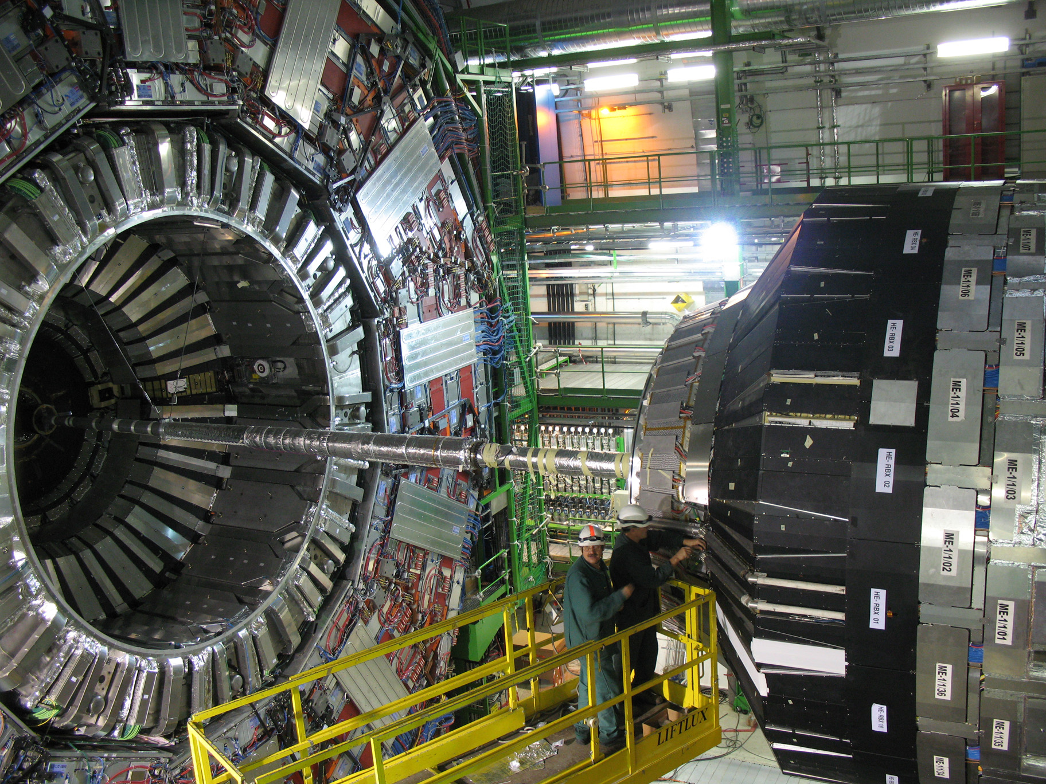
Beam-pipe Installed, May 2008

Slide 29
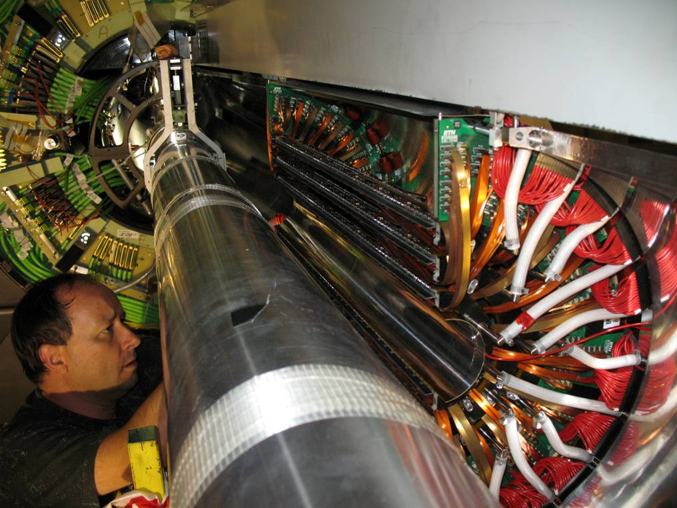
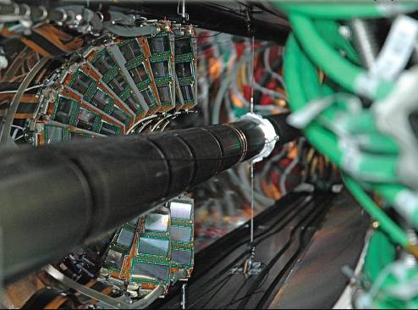
Installation of the Pixel System, Aug 2008
A 66 megapixel “camera”
  Makes precise measurements of charged particle impact
  parameters to tag particles
  with a small but finite lifetime

Slide 30
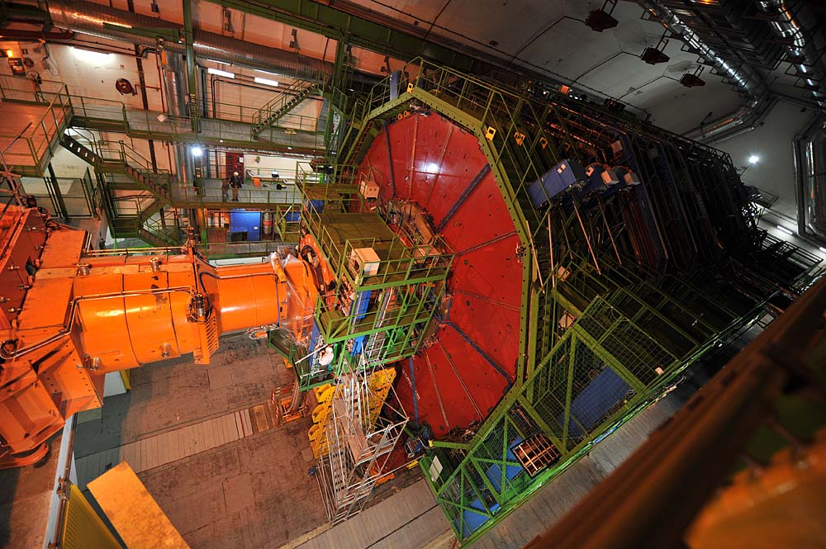
Final Closure – Sep 2008

Slide 31
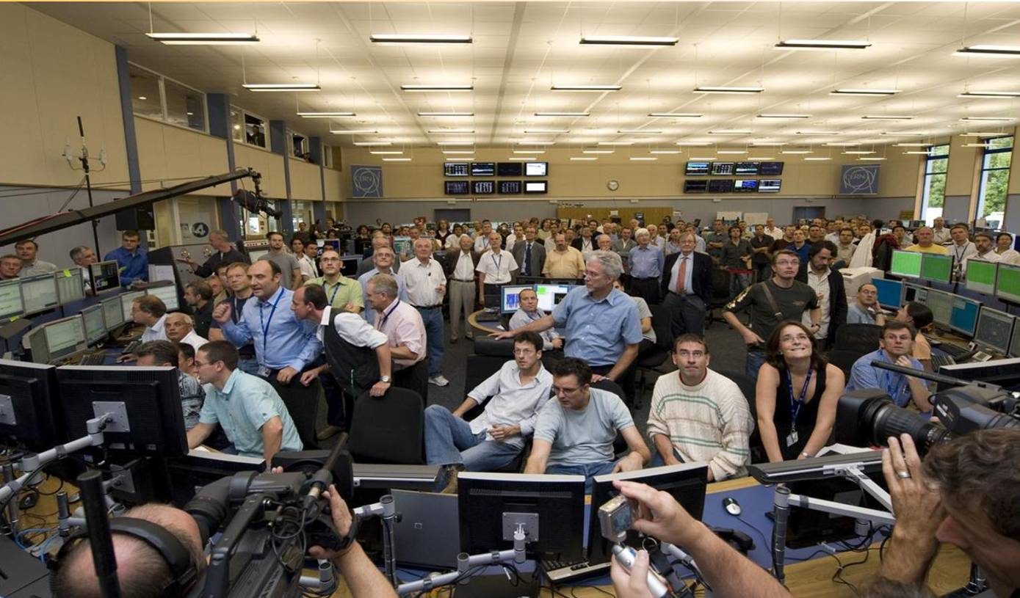
LHC Start-up: Sep. 10, 2008
Carlo Rubbia: Nobel laureate and former CERN director who launched the LHC
Lyn Evans, LHC Project Leader

Slide 32
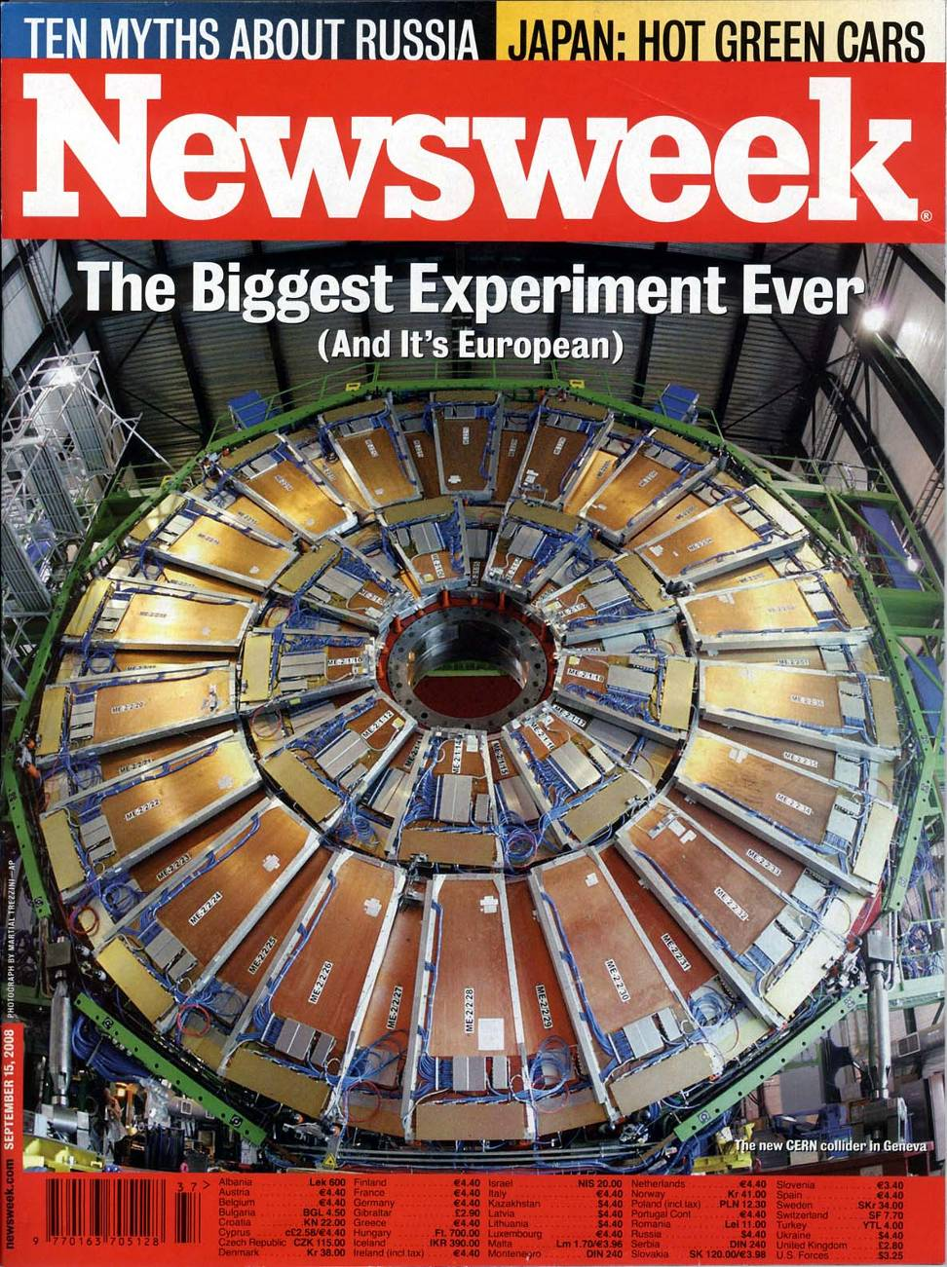

Sep. 10 – Big Media Day

Slide 33
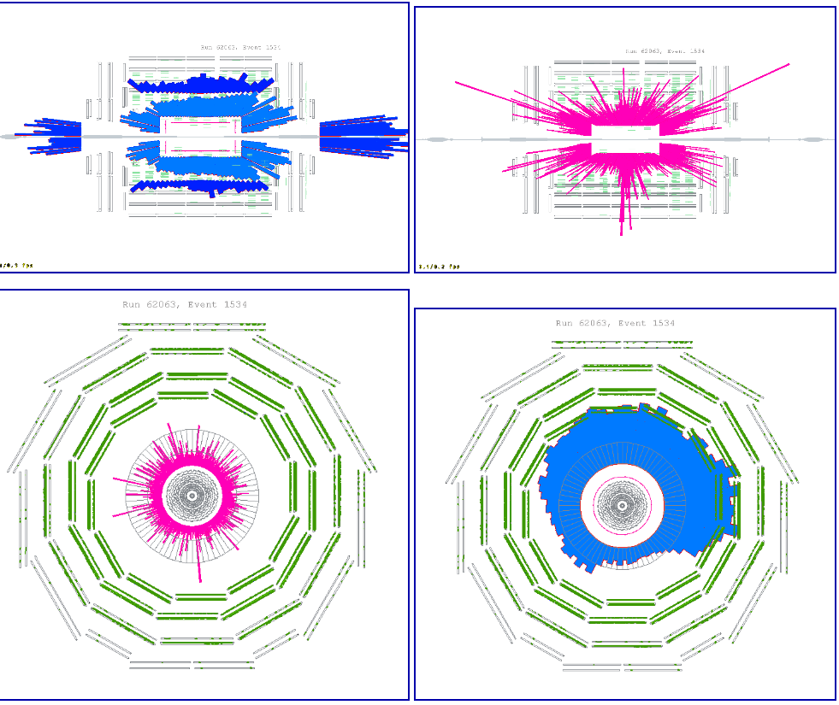
First Events: Collimators Closed
~2×10⁹ protons on collimator ~150 m upstream of CMS
ECAL- pink; HB,HE - light blue; HO,HF - dark blue; Muon DT - green; Tracker Off

Slide 34
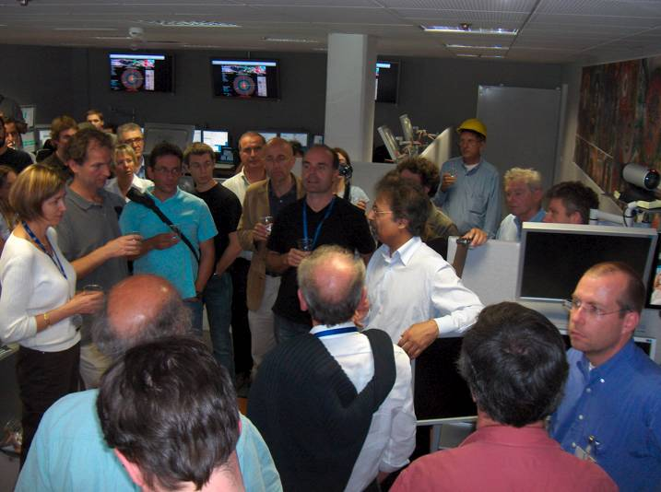
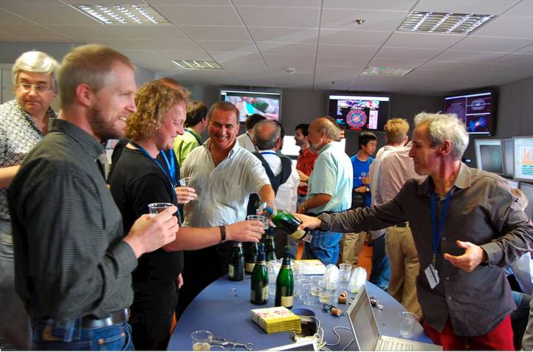

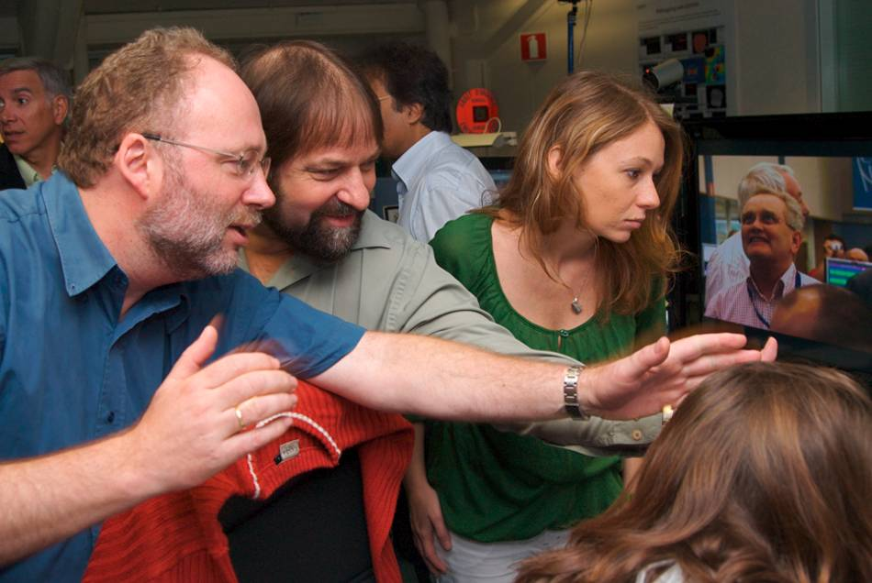
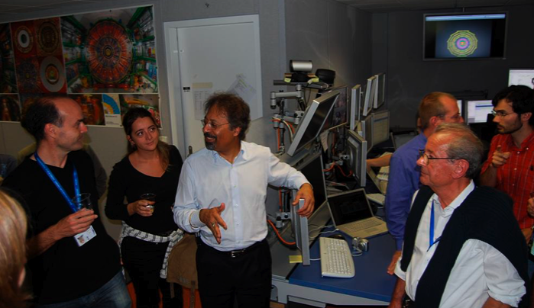
The Excitement of the First LHC Beam Measurements at CMS (September 2008)

Slide 35
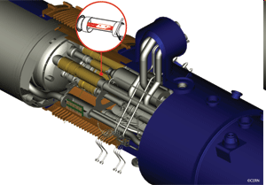
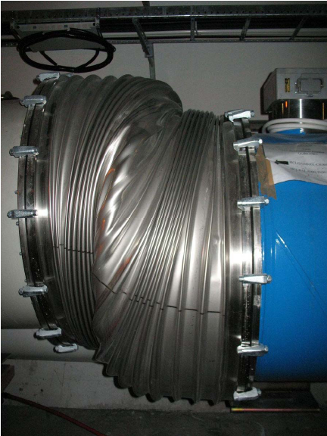

Setback: Friday, Sep. 19
An incident occurred during a powering test of one LHC sector for commissioning beam operation to 5 TeV
  Massive helium loss in one arc of the tunnel
  (2 tons initially), cryogenics and vacuum lost
The cause of the incident was determined to be a faulty electrical connection (“bus bar”) between a dipole and a quadrupole
  Mechanical damage occurred
  Need to extract and repair dipole
  and quadrupole magnets in the region
Not enough time to make repairs before winter shutdown
→ Aim to restart LHC operations Fall 2009
Notes:
Let’s review what the CMS experiment achieved

Slide 36
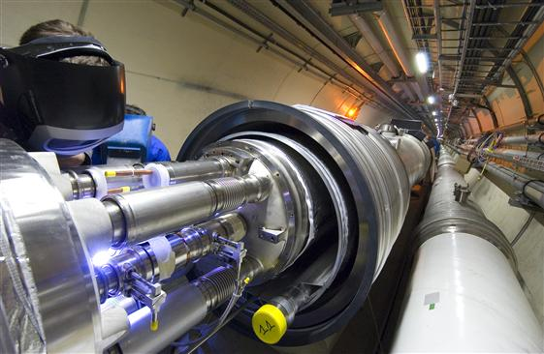
Arc and Helium Released
Liquid
to
Gas
Expansion
Factor
1000

Slide 37
LHC Schedule
First collisions ~Nov 2009
Physics running during winter 2009 - 2010
5 TeV/beam for Physics
  Machine protection will be tested with beam (at 0.5 TeV energy levels)
Estimated integrated luminosity
  During first 100 days of operation ≈100 pb⁻¹
    Peak L of 5×10³¹ = 10% gives 0.5 pb⁻¹/day
    Peak L of 2×10³² = 10% gives 2.0 pb⁻¹/day
  During next 100 days of operation ≈200 pb⁻¹
Then towards end of year ions (to be planned in detail soon)

Slide 38
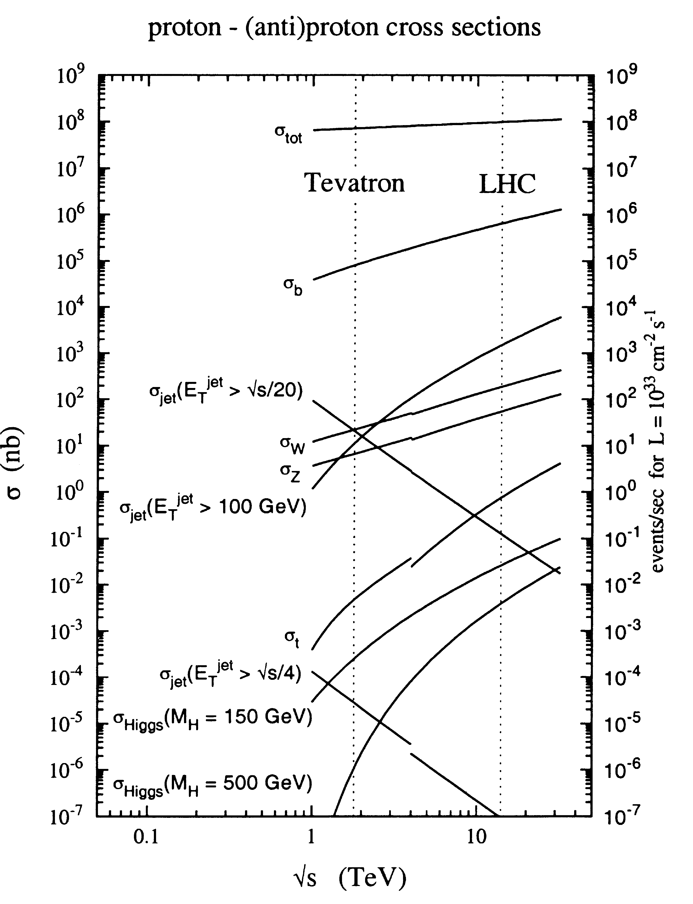
Physics Selection
Interactions/s:
  Lum = 10³⁴ cm^{–2}s^{–1} = 10⁷ mb^{–1} Hz
  σ_{inel}(pp) = 70 mb
  Interaction Rate, R = 7×10⁸ Hz
Events/ beam crossing:
  Δt = 25 ns = 2.5×10^{–8} s
  Interactions/crossing = 17.5
Cross-section of physics processes:
  inelastic: 10⁹ Hz
  Higgs (600 GeV) : 10^{–2} Hz
Selection needed: 1:10¹⁰ ⁻¹¹
  before branching fractions
W
Z
Operating conditions:
A “good” event containing a Higgs decay +
~20 extra “bad” (minimum bias) interactions

Slide 39




pp Collisions at 14 TeV at 10³⁴ cm⁻²s⁻¹
All tracks with p_{T} > 1 GeV
e
μ
e
μ
H →ZZ* → 2e2μ

Slide 40
Event Selection
~20 collisions/25ns
25 ns
Time
(10⁹ event/sec)
10⁷ channels
(10¹⁶ bit/sec)
The challenge is the identification of the most interesting (and potentially entirely new) physics processes amidst the much more copious occurrence of well-understood and studied processes.
On-line event selection
  Costume electronics (FPGAs, ASICs)
  Online computing farm
    A single processor analyzes one event at a time
Out of a billion interactions/sec select one hundred for further analysis
  Need to reject most interactions
  Can store data at ≈100 Hz (= 100 events/s)

Slide 41

CMS Trigger Overview
Level-1: hardware trigger, 40 MHz → 100 kHz (75 kHz)
  Only calorimeter and muon information used
    Electron/photon triggers
    Jet and missing E_{T} triggers
    Muon triggers
  L1 decision based on trigger objects
  with η/ϕ information
  Custom-built electronics
  Latency: < 3.2 μs (128 bx)
HLT: software trigger, 100 kHz → O(10²)Hz
  Beyond Level-1 there is a High-Level Trigger running
  on a single processor farm (no dedicated L2 hardware)
  DAQ designed to accept Level-1 rate of 100 kHz
  Access to full event data (full granularity and resolution)
  Rejection factor of ~1000
40 MHz
100 kHz
100 Hz

Slide 42




Event Selection Stages
ON-line
OFF-line
LEVEL-1 Trigger
Hardwired processors (ASIC, FPGA)
Pipelined massive parallel
HIGH-LEVEL Triggers
Farms of
processors
Reconstruction&ANALYSIS
TIER0/1/2
Centers
25ns
3µs
ms
sec
hour
year
10⁻⁹
10⁻⁶
10⁻³
10
10³
10⁶
sec
Giga
Tera
Petabit

Slide 43


Data Acquisition System

Slide 44

High-Level Trigger

Slide 45

High-Level Trigger Overview
Detectors
Front-end pipelines
(10⁷ channels)
40 MHz
Readout buffers
(1000 units)
10⁵ Hz
Event builder
Processor farm
(4×10⁶ MIPS)
10² Hz
High-Level Trigger, CPU farms
Finer granularity precise measurement
Clean particle signature (π⁰-γ, isolation,…)
Track reconstruction and detector matching
Kinematics: Effective mass cut and topology
Full event reconstruction and analysis
Successive
improvements:
background
event filtering,
physics selection

Slide 46

Muon Reconstruction

Slide 47

Data Recording
Collision rate: 40 MHz
Event size: ≈ 1 MByte
Data size: 1 MByte/event
100 events/s → 100 MByte/s
10⁷ s data taking per year (30%)
Data size: 1 PetaByte =
10³ TByte = 10⁶ GByte per year
40 MHz (40 TB/sec)
Level-1 - special hardware
75 KHz (75 GB/sec)
HLT - PCs
100 Hz
(100 MB/sec)
data recording &
offline analysis
~ PetaBytes/year
~10⁹ events/year
~10³ batch and interactive users

Slide 48




LHC Data Challenge
Balloon
(30 Km)
The LHC generates 40×10⁶ collisions / s
Combined the 4 experiments record:
  100 interesting collision per second
  1 ÷ 12 MB / collision ⇒ 0.1 ÷ 1.2 GB / s
  ~ 10 PB (10¹⁶ B) per year (10¹⁰ collisions / y)
  LHC data correspond to 20×10⁶ DVD’s / year!
    Space equivalent to 400,000 large PC disks
  Computing power ~ 10⁵ of today’s PC
LHC data: DVD
stack after 1 year!
(~ 20 Km)
Airplane
(10 Km)
Mt. Blanc
(4.8 Km)
Using parallelism is the only way to analyze this amount of data in
a reasonable amount of time

Slide 49
Distributed Computing at CMS
The CMS computing system is highly distributed, by necessity and by design:
  No single site has resources to handle necessary computing hardware
  Networks and Grid middleware make distributed computing possible
  Can take advantage of resources/expertise at individual institutes, and get “buy-in” from local regions.
CMS is going with a “tiered” system:
  Tier-0 (= CERN): first-pass reconstruction, archiving -- keep up with the incoming data!
  At most one Tier-1 facility per country (FNAL in US): archive part of the data, re-reconstruction with improved software, high-volume data skims, archiving of simulation.

Slide 50
CMS Data Flow
Prompt Reconstruction
TIER-0
CAF
Calibration
Express-Stream
Analysis
CASTOR
600MB/s
50-500MB/s
Re-Reco
Skims
TIER-1
TIER-1
TIER-1
50-500MB/s
~20MB/s
Simulation
Analysis
TIER-2
TIER-2
TIER-2
TIER-2

Slide 51
Analysis Computing
PetaBytes of data to be explored and analyzed by 1000s of globally dispersed scientists, in hundred of teams.
  Analysis is distributed worldwide
Tough problem: Many clients, unpredictable behavior, short timescales (conferences), large peaks of load.
In addition, analysis computing normally competes to some extent with production activities
  Tape drives, Network, Staging systems
Technical Issues
  Balance proximity to large computational and data facilities, vs. proximity to more local resources and users
  Special issues: Co-scheduling of data and CPU
Software: Complex C++ code; under constant development

Slide 52
Data Grid Challenges
Global scientific communities, served by networks with bandwidths varying by orders of magnitude, need to perform computationally demanding analyses of geographically distributed datasets that will grow by at least 3 orders of magnitude over the next decade, from the 100 Terabyte to the 100 Petabyte scale.
Provide a new degree of transparency in how data is handled and processed
  Data is acquired at a small number of facilities
  Data is accessed and processed at many locations
  The processing of data and data transfers can be costly
  The scientific community needs to access both raw data as well as processed data in an efficient and well managed way on a national and international scale

Slide 53
Summary
LHC will provide proton­proton collisions at 10 TeV soon
LHC will provide access to conditions not seen since the early Universe
  Analysis of LHC data has potential to change how we view the world
  But LHC analysis will require finesse and care
LHC is likely to provide answers to many key questions in Physics
All expectations are based on a detailed understanding of particles and forces within the SM that we have garnered over the past several decades
With the expected clarifications, we will address some very major issues pertaining to the universe, for example:
  What is cosmic dark matter? Is it made of SUSY neutralinos?
  Is the universe filled with a Higgs field? Is it related to dark energy?
  What is the structure of space-time? Are there extra space dimensions?
CMS is eagerly awaiting data
Exciting times ahead – stay tuned!

Slide 54

BPix: Dressing of Supply Tube

Slide 55


Expected Discovery Reach
As a function of integrated luminosity for different discovery channels (1 fb⁻¹)
Significant reach with a low as ~100 pb⁻¹
CMSSM:
CMSSM:
CMS Preliminary
1 fb⁻¹
Phys. Lett. B, 657/1-3 (2007)
Preferred region @ 95%CL:
Jets+MET+μ
Jets+MET
Expected Tevatron Reach
Discoverable with just 6 pb⁻¹
Excludable with less than 1 fb⁻¹!
Jets+MET+2OSl
Jets+MET+2SSμ
Tevatron
Reach

Slide 56
LHC Design Luminosity Profile
Z’@6TeV
ADD X-dim@9TeV
SUSY@3TeV
3000
Compositeness@40TeV
H(120GeV)→γγ
300
Higgs@200GeV
SUSY@1TeV
30
SHUTDOWN
200 fb⁻¹/yr
10-20
fb⁻¹/yr
100 fb⁻¹/yr
1000 fb⁻¹/yr
2008 2010 2012 2014 2016 2018 2020
First physics run: O(1fb⁻¹)

Slide 57




Expected Performance
Tracking
HCAL
b-tagging

Slide 58
Expected Tracker Performance
Selected figure-of-merit | ATLAS | CMS
Rec. Eff. Muons with pT=1GeV | 97% | 97%
Rec. Eff. Pions p_{T}=1GeV | 84% | 80%
Rec. Eff. El. pT=5GeV | 90% | 85%
σp_{T} for p_{T}=1GeV η=0 | 1.3% | 0.7%
σp_{T} for p_{T}=100GeV η=0 | 3.8% | 1.5%
Transverse σi.p. for p_{T}=1GeV | 75μm | 90μm
Longitunal σi.p. for p_{T}=1GeV | 150μm | 125μm

Slide 59
Example Trigger Menus
Trigger type | ATLAS (GeV) Threshold | CMS (GeV) Threshold
Inclusive isolated e/γ | 25 | 29
Two electrons/Two photons | 15 | 17
Inclusive isolated muon | 20 | 14
Two muons | 6 | 3
Inclusive τ-jet | - | 86
Two τ-jet | - | 59
τ-jet and E^{T}_{miss} | 25 and 30 | -
1-jet, 3-jets, 4-jets | 200,90,65 | 177,86,70
Jet and E^{T}_{miss} | 60 and 60
Electron and Jet |  | 21 and 45
Electron-Muon | 15*10 | -
+calibration, monitoring, etc…

Slide 60
Designed Detector Performance
 | Expected Day 0 | Goals for Physics
ECAL uniformity | ~ 2% | < 1%
Lepton energy scale | 0.5—2% | 0.1%
HCAL uniformity | 2—3% | < 1%
Jet energy scale | <10% | 1%
Tracker alignment | 20—200 μm in Rφ | O(10 μm)

Slide 61

CMS Tracker Material Budgets

Slide 62

Physics at the LHC
LHC
  ~order of magnitude higher beam energy
Standard Model:
  QCD (p_{T} > 100 GeV)
    100x higher than any previous collider
  Electroweak
    10x higher than any previous collider
  Top
    100x higher than any previous collider
  Use to commission & calibrate
  detectors
New Phenomena Factory?
  Low Mass SUSY, Z’, Contact Interactions, etc
  Could appear almost immediately!
Discovery Interpretation
  Is it SUSY? Extra Dimensions? Something else?
  Can we disentangle the new phenomena?
L = 10³³cm⁻² s⁻¹
GHz
10¹⁵
10¹⁴
MHz
10¹³
10¹²
10¹¹
kHz
10¹⁰
10⁹
10⁸
Hz
10⁷
10⁶
10⁵
mHz
10⁴
10³
10²
μHz
10¹
10⁰
10⁻¹

Slide 63


Standard Model Events
Obtaining orders in magnitude in both the integrated luminosity and the energy, we will collect a huge amount of Standard Model benchmarks channels.
  ~10⁹ events/10fb⁻¹ W (200 per second)
  ~10⁸ events/10fb⁻¹ Z (50 per second)
  ~10⁷ events/10fb⁻¹ tt (1 per second)
These can be used as control/calibration samples for searches beyond the Standard Model, but can also be used to scrutinize even further the Standard Model.
rates@10³³

Slide 64
Physics Roadmap
Early beam, up to 10 pb⁻¹:
  Detector synchronization, alignment with beam-halo events, minimum-bias events. Earliest in-situ alignment and calibration
  Commission trigger, start “physics commissioning”:
    Physics objects; measure jet and lepton rates; observe W, Z, top
    And, of course, first look at possible extraordinary signatures…
Physics collisions, 100 pb⁻¹: measure Standard Model, start search
  10⁶ W→lν (l = e,μ); 10⁵ Z→ll (l =e, μ); 10⁴ ttbar→μ+X;
  10³ QCD jets pT > 1 TeV
  Improve understanding of physics objects; jet energy scale from W→jj’; extensive use (and understanding) of b-tagging
  Measure/understand backgrounds to SUSY and Higgs searches
  Initial MSSM (and some SM) Higgs sensitivity
  Early look for excesses from SUSY& Z’/jj resonances. SUSY hints (?): 10² 1 TeV Gluinos
Physics collisions, 1000pb⁻¹: entering Higgs discovery era
  Explore large part of SUSY and resonances at ~ few TeV
L for 1 month run (10⁶ sec) | Integrated L | Trigger | Process | Jet & MET Physics Object Commissioning
10²³ | 100 mb⁻¹ | None σ_{I}~ 50 mb | Inelastic non-diff | Input to tweak Pythia, Study beam bkgs.
10²⁴ | 1 μb⁻¹ | Setup Jet | Inelastic non-diff | Calib in azimuth
10²⁵ | 10 μb⁻¹ | Jet σ(gg) ~ 90 μb σ(ggg) ~ 6 μb | g+g -> g+g g+g -> g+g+g | Establish JJ cross section
10²⁶ | 100 μb⁻¹ | Jet | g+g -> g+g g+g -> g+g+g | Dijet balance for polar angle – Establish MET
10²⁷ | 1 nb⁻¹ | Jet Setup Photon σ(qγ) ~ 20 nb | g+g -> g+g g+g -> g+g+g q+g -> q+γ | Dijet masses – start jet balance J+γ calib Courtesy D. Green

Slide 65



QCD Multijet Background
Dijets typically back to back
  MET from jet E mismeasurement
Suppress by requiring
  Well separated Jet & MET objects
  Typically ≥ 3 jets
  Cut on H_{T} (~ 2 p^{Hat}_{T})
Muon triggers (include isol.)
  helps…a lot! →
Prescaled jet triggers
  extract the low E_{T} shape and normalisation directly from data
Control Regions
  Relax cuts; Extrapolate into Signal Region
No cuts
“μ Trigger”
“μ Trigger” + E_{T}^{Jet1}>900 GeV
“μ Trigger”+ E_{T}^{Jet1}>900 + MET>200 GeV
CMS
High Level
Trigger
Notes:
Inelastic cross-section at LHC ~ 55 mb : QCD bkgs are huge!
Strategies: (1) suppress, (2) measure from data
Typical QCD rejection cuts + muon trigger
pre-scaled jet triggers
Electroweak backgrounds are also important →

Slide 66



Jet Energy Calibration/Systematics
Direct photon production:
  qg → qγ (90%) qqbar → gγ (10%)
p_{T}(Jet) = p_{T}(γ)
  use peak position to eliminate effect of tail from ISR
Estimated Jet Energy Scale Uncertainty:
  Between 3% and 10% for P_{T} ∈ [20, 50] GeV
CMS
γ jet
ttbar → WWbb → jjlνbb
  Rescale jet with relative energy shift ΔC
Fit resulting W mass spectrum & constrain to world avg.
  m_{W}(ΔC|data) = M_{W}^{PDG}
Compare with Monte Carlo
  For ~6 fb-1: ΔC_{meas} = -14.96 ± 0.26 %
    (ΔC_{true} = -14.53 %)
Requires well understood b-tag (tracker)
Limited by pileup syst. uncertainty: 3%
CMS
t t
measured shift ΔC_{meas}
ΔC(%)
JES Systematic Uncertainty for P_{T} > 50 GeV

Slide 67

MET Shape Systematics
Study effect of non-Gaussian tails in jet E_{T} resolution contributing to fake MET
  Approx. 15% of all
  jets are mismeasured
Exaggerate
non-Gaussian Tails
  Weight each jet (up to 3)
  in event
    Jet in Non-Gaussian tail: 1.15
    Jet in Gaussian peak : 1.00
  Combine into one event weight
Three different scenarios
  3 jets under measured
  2 jets under measured
  1 jet under measured
Overall Systematic Effect : ≈7%
CMS
t t

Slide 68


Use Track and Muon System to Calibrate Calorimeter (MET)
CMS PTDR
Z→μμ Standard Candle
  Derive MET corrections from Z→μμ Sample
  Apply to SUSY Sample (to test)
Useful to help systematically understand MET tails from
  Detector problems in low pT events
    high pT requires significantly more statistics
  Non-Gaussian Jet Energy mis-measurements
Some fine tuning required
  But basically works
CMS
CMS
SUSY
LM1

Slide 69

Jet energy scale from W→jj
Rescale each jet with relative energy shift ΔC (rescaling |p| to keep jetmass invariant)
Remake/refit the obtained W mass spectrum → m_{W}(ΔC) from fit
Solve the simple equation m_{W}(ΔC|data) = M_{W}^{PDG} → best estimate for ΔC
Compare this measured shift with the true shift from Monte Carlo information
(for well matched jet-parton couples (ΔR<0.2) one can determine the average ΔC)
Result : ΔC_{meas} = -14.96 ± 0.26 % (ΔC_{true} = -14.53 %) with 5.41fb⁻¹
CMS Note
2006/025
m_{W}
L = 0.33fb⁻¹
true shift ΔC_{true}
used space-angle match
(~1% effects with ΔR)
measured shift ΔC_{meas}
ΔC(%)
E_{rec}/E_{gen}
scaling to 1fb⁻¹ incl. electron channel : 0.4%
Pile-up (On/Off) = 3%

Slide 70

Inclusive OS Dilepton + Jet + MET
Cuts (optimize @ LM1):
  2 OS SF isolated
  leptons (e,µ)
    p_{T} > 10 GeV
  MET > 200 GeV
  ≥2 jets:
    E_{T}¹>100 GeV
    E_{T}²>60 GeV
    |η| < 3
Background (1 fb⁻¹)
  200 events, mostly t-tbar
  Systematic uncertainty 20%
LM1 Signal (1 fb⁻¹)
  850 events
Subtract different favor leptons
m_{ll}^{max} = 80.4 ± 0.5 (stat) ± 1.0 (misalign) GeV
CMS PTDR

Slide 71

Higgs Search
Needed ∫Ldt (fb⁻¹)
of well-understood data
per experiment
≤ 1 fb⁻¹ for 95% C.L. exclusion
≤ 5 fb⁻¹ for 5σ discovery
over full allowed mass range
10
1
Events / 0.5 GeV
10⁻¹
ATLAS + CMS
(March 2006)
m_{H} (GeV)
Most difficult region:
need to combine several
channels (e.g. H → γγ,
qqH→qqττ) with small S/B
For m_{H} > 140 GeV discovery easier with H → ZZ^{(*)} → 4l
(narrow mass peak, small B). H → WW → lνlν (dominant at ~160 GeV) is counting experiment (no mass peak)

Slide 72


Supersymmetry in CMS

Slide 73

Summary of Discovery Prospects in SUSY
Various search topologies
?
Tevatron reach
  Squark and gluino masses up to about 2 TeV with 10 fb⁻¹,
  2.5 TeV ultimately at LHC

Slide 74



Event Reconstruction

Slide 75
Puzzles in Particle Physics
The Standard Model, although very successful, is an incomplete theory
  need a more complete and fundamental theory of which SM is low-E approximation
The precision of calculations in the Standard Model depends on the Higgs mechanism in the theory, which generates mass for particles
  But the associated Higgs boson has not yet been directly observed
  Need higher energy and higher luminosity to increase production yield
The Higgs mass must be fine-tuned to extremely high precision, as it receives radiative corrections to its mass in calculations
  Protected by Supersymmetry?
    A symmetry sort of like antimatter, but with opposite spin rather than charge (bosons ↔ fermions)
    Not observed, so presumably at a higher energy scale
  Protected by other new forces/particles? (Z’, W’, technicolor)
  Protected by (compactified) extra dimensions?
Any unification of the fundamental forces?
What is the dark matter in the universe?
  Supersymmetry can lead to stable massive neutral particles

Slide 76
CMS Data Flow
40 MHz
Detector Channels
COLLISION RATE
16 Million channels
LEVEL-1
TRIGGER
3 Gigacell buffers
Charge
Time
Pattern
Energy
100 kHz
1 Megabyte
EVENT DATA
1 Terabit/s
READOUT
50,000 data
channels
200 Gigabyte
BUFFERS
~400 Readout memories
EVENT BUILDER
A large switching network (400+400 ports) with
a total throughput of ~400 Gbit/s forms the interconnection
between the sources (deep buffers) and the
destinations (buffers before farm CPUs).
The Event Manager distributes event building
commands (assigns events to destinations).
500 Gigabit/s
SWITCH Network
100 Hz
Filtered
Events
5 TeraIPS
EVENT FILTER
A set of high performance commercial processors
organized into many farms for on-line and off-line applications.
Gigabit/s
SERVICE LAN
Computing services
Petabyte
ARCHIVE

Slide 77

Muon System
No ME 4/2
Limited ME 1/1
Readout between
2.1< |η| < 2.4;
ganged strips
76

Slide 78

Muon Detectors
Three types of gaseous particle detectors for muon identification:
  Drift Tubes (DT) in the central barrel region
  Cathode Strip Chambers (CSC) in the endcap region
  Resistive Plate Chambers (RPC) in both the barrel and endcaps
The DT and CSC detectors are used to obtain a precise measurement of the position and thus the momentum of the muons, whereas the RPC chambers are dedicated to providing fast information for the Level-1 trigger

Slide 79


Local Pattern Recognition (I)
DT’s and CSC’s are multi-layer detectors:
First step of muon reconstruction is local pattern recognition
Reconstruct track segments in the DT and CSC detectors
Barrel (DT):
  Reconstruct position of each channel above threshold using effective drift velocity
  Reconstruct φ super-layer hits (time-space conversion)
    Drift velocity depends on B field and impact angle
  Cluster hits (linear fit): 2D segment
  Fit 2D lines separately in r-φ and r-z through the 8+4 layers of chamber
    L/R ambiguities solved by best χ²
  Combine into 3D segments, use segment position and direction for tracking
    Resolution: 100 μm in φ view, direction ~1mrad
  Apply impact angle correction on time-to-distance relation and refit
  Calculate position (center of gravity) of the track-segment and its angle in the super-layer (+error matrix)
up to 12 hits/station

Slide 80


Local Pattern Recognition (II)
Endcaps (CSC):
  Reconstruct 3D hits
  Associate hits with linear fit
    only one hit per layer
  Fit “Gatti” function to the spatial shape of
  3-strip charge distribution to determine
  centroid of cluster in layer
  Associate two projections by time coincidence
  Fit 3D segments through the collection of wire and strip clusters in chamber
    linear fit
  Resolution: 120–250 μm form bending coordinate, depending on chamber
up to 6 hits/station

Slide 81




Local Pattern Recognition (II)
Endcaps (CSC):
  Reconstruct 3D hits
  Associate hits with linear fit
    only one hit per layer
  Fit “Gatti” function to the spatial shape of
  3-strip charge distribution to determine
  centroid of cluster in layer
  Associate two projections by time coincidence
  Fit 3D segments through the collection of wire and strip clusters in chamber
    linear fit
  Resolution: 120–250 μm form bending coordinate, depending on chamber
up to 6 hits/station

Slide 82

Tracking Strategy
Rely on few measurement layers, each able to provide robust (clean) and precise coordinate determination
2 to 3 Silicon Pixel, and 10 to 14 Silicon Strip Measurement Layers
At high luminosity (~ 20 min. bias events every 25 ns):
R = 10 cm 25 cm 60 cm
N_{ch}/(cm²*25ns) = 1.0 0.10 0.01
Radius ~ 110 cm, Length ~ 270 cm
η~1.7
R-phi (Z-phi) only
measurement layers
6 layers
TOB
R-phi (Z-phi) & Stereo
measurement layers
η~2.4
4 layers
TIB
3 disks TID
9 disks TEC

Slide 83

Muon p_{T} Resolution

