Slide 1
The effect of radiation on the reconnection rate in the striped wind model
(& applicability to GRBs)
Based on works by
Asaf Pe’er (UCC)
In collaboration with
Damien Begue (Stockholm), Yuri Lyubarsky (BGU)
May 2016
Begue & AP, 2015, Ap.J. 802, 134
AP, 2016, arXiv:1604.06590
Begue, AP, Lyubarsky, 2016, in prep.

Slide 2
Outline
Motivation: Are GRB outflows Poynting flux dominated ?
Testable predictions on the striped wind model:
- Upper limits: L_{th}/L_{k} <= 30%;
L_{NT} <= L_{K}
Detailed modeling of radiation effect on the current sheet evolution:
- Dynamically: Minor effect;
- Photons stay within reconnection layer until r_{trans.} <~r_{phot.}
Emission from the photosphere: > few MeV

Slide 3
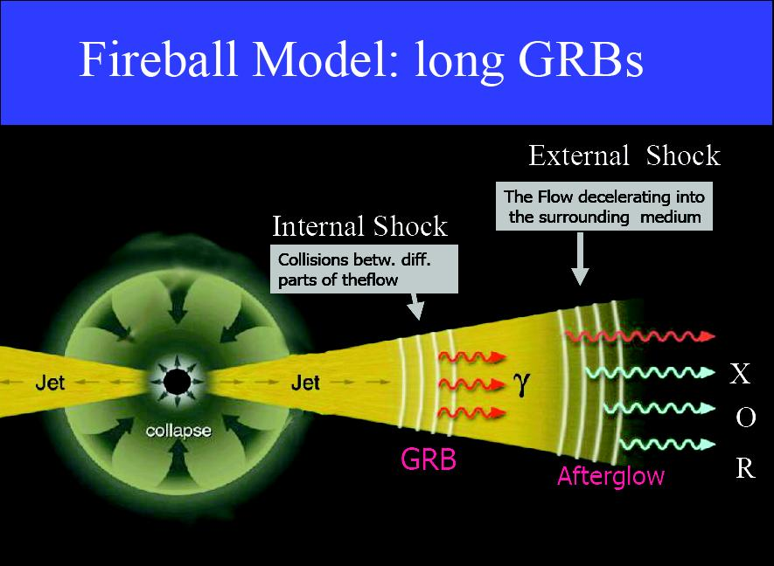
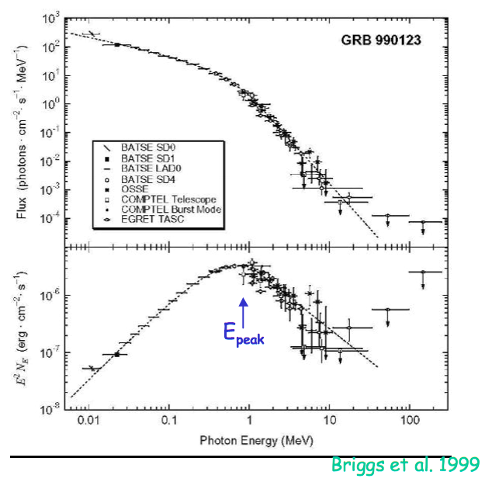
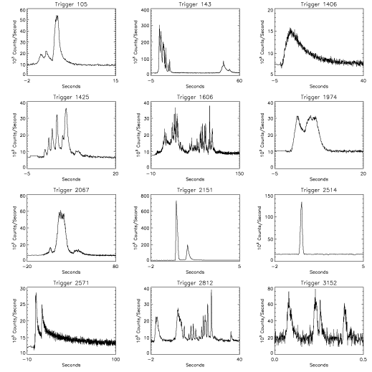
Motivation: what is the role of B-field in accelerating and energy dissipation in GRB jets ?
Rees & Meszaros, 1992, 1994
Can this
be explained with that ?
“Classical” fireball (weak B-field):
- (Very) Low efficiency in E_{k} dissipation via shocks
- Difficulties explaining the observed spectrum
Tchekhovskoy, McKinney & Narayan, 2011

Slide 4
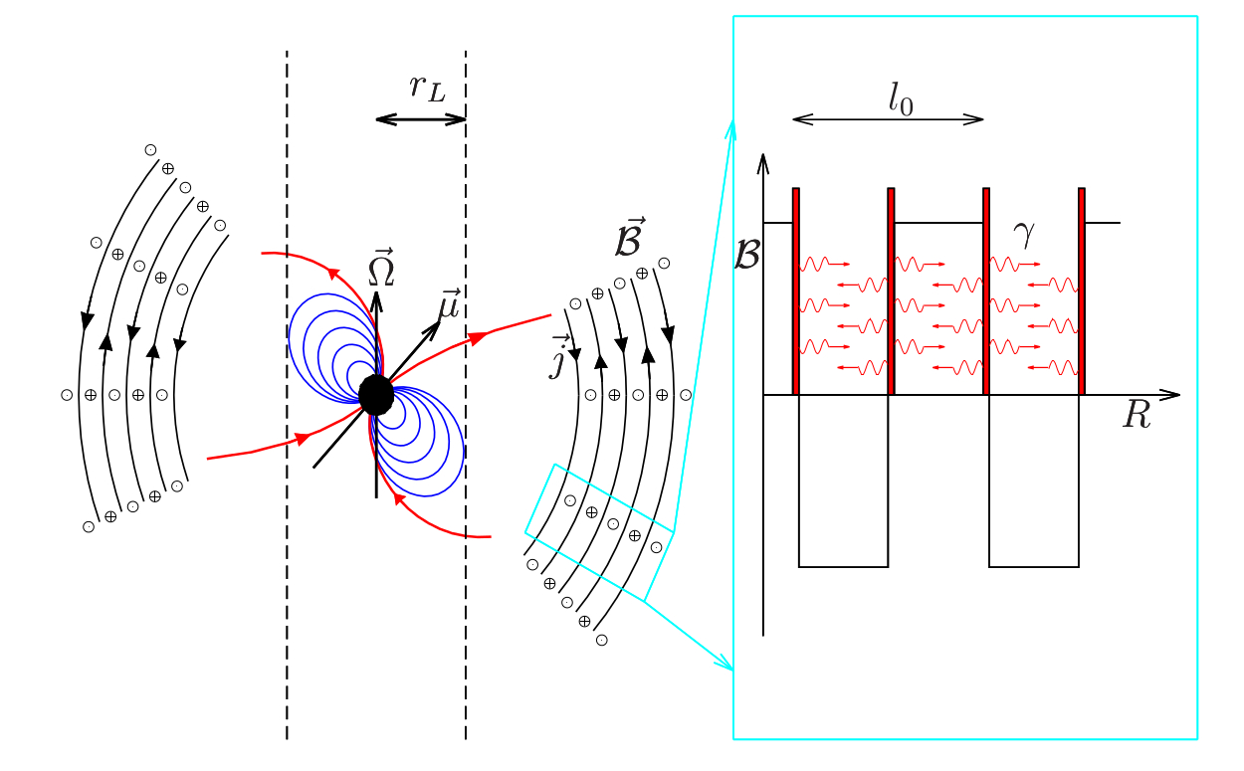
The “striped wind” model
Highly magnetized spinning compact object
Characteristic scaling!
Expected in pulsar winds
(Kennel & Coroniti 84
Coroniti 90)
In GRB contest:
Core collapse of massive star /
Binary mergers
“Proto-magnetar”
(Usov 92, Thompson, 94
Metzger + 11, Bucciantini+12)
Figure: D. Begue
Metzger & Piro, 2014

Slide 5
Outline
Motivation: Are GRB outflows Poynting flux dominated ?
Testable predictions on the striped wind model:
- Upper limits: L_{th}/L_{k} <= 30%;
L_{NT} <= L_{K}
Detailed modeling of radiation on the current sheet evolution
- Dynamically: Minor effect;
- Photons stay within reconnection layer until r_{trans.} <~r_{phot.}
Emission from the photosphere: > few MeV

Slide 6
Basic assumptions & dynamic scaling
* Above Alfvenic radius: v=v_{r}, B = Β_{φ} >> B_{r}, B_{θ} ;
* B-field decays at a constant rate,
→ This is enough to provide the scaling law
Drenkhahn 02; Drenkhahn & Spruit 02; Tchekhovskoy + 08; Meszaros & Rees 11..
Simple argument
(Valid for 1d)
(Peer 16):

Slide 7
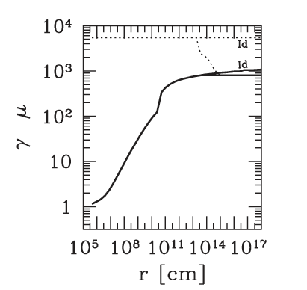
“Universal” dynamic scaling
Drenkhahn, 02,
Drenkhahn & Spruit 02
Giannios 06
Similar results obtained for
more complicated geometry /
More sophisticated treatment of reconnection
Tchekhovskoy et. al. 08, McKinney & Uzdensky 12

Slide 8
Transfer of dissipated energy: dynamic equations
Continuity
Energy
Momentum
Drenkhahn & Spruit 02
Eq. of state
Enthalpy
Emissivity
(Assuming isotropic!)
* For Γ>>1, these result in simple scaling laws, e(r)~r^{-7/3}, ρ(r)~r^{-7/3}
* After some algebra (1st order approx.):
Pe’er 16

Slide 9
Dynamic equations (2)
*For k=0 (below the photosphere):
Drenkhahn & Spruit 02: L_{th}/L_{k}~5%
The observed thermal energy cannot exceed 30% of the kinetic energy
at the photosphere (typically, only few % of the final kinetic energy)

Slide 10
Dynamic equations (3)
^
*For k>>4(γ-1)~1 (universal):
(Drenkhahn & Spruit 02: k=10⁴)

Slide 11
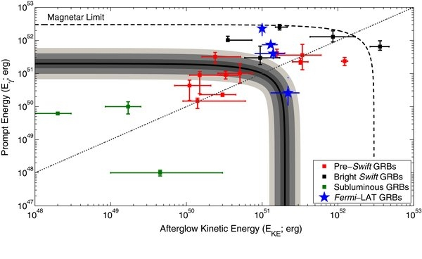
Confronting with observations (1)
L_{th}, L_{NT} – released during prompt phase;
L_{k} – deduced from afterglow measurements
Cenko + 11
See also: Kumar 00, Zhang+02, Racusin+11, Lazzati+13; …
In most GRBs (16/22~70%), L_{prompt} > L_{AG}

Slide 12
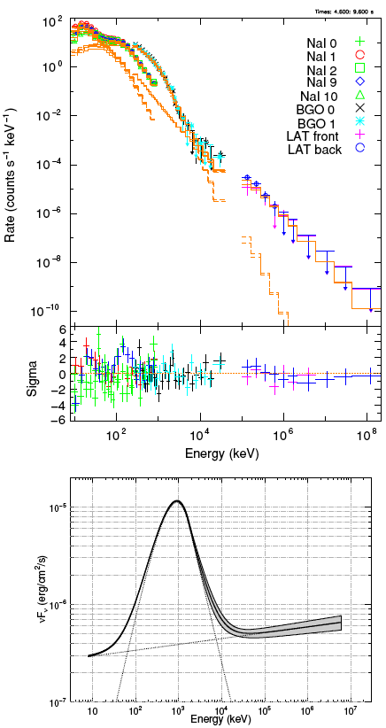
Confronting with observations (2)
In few GRBs, thermal component is very pronounced..
GRB090902B (Abdo+09)
While in most, it is weak/ lacking
GRB110721A (Iyyani+13)
But..

Slide 13
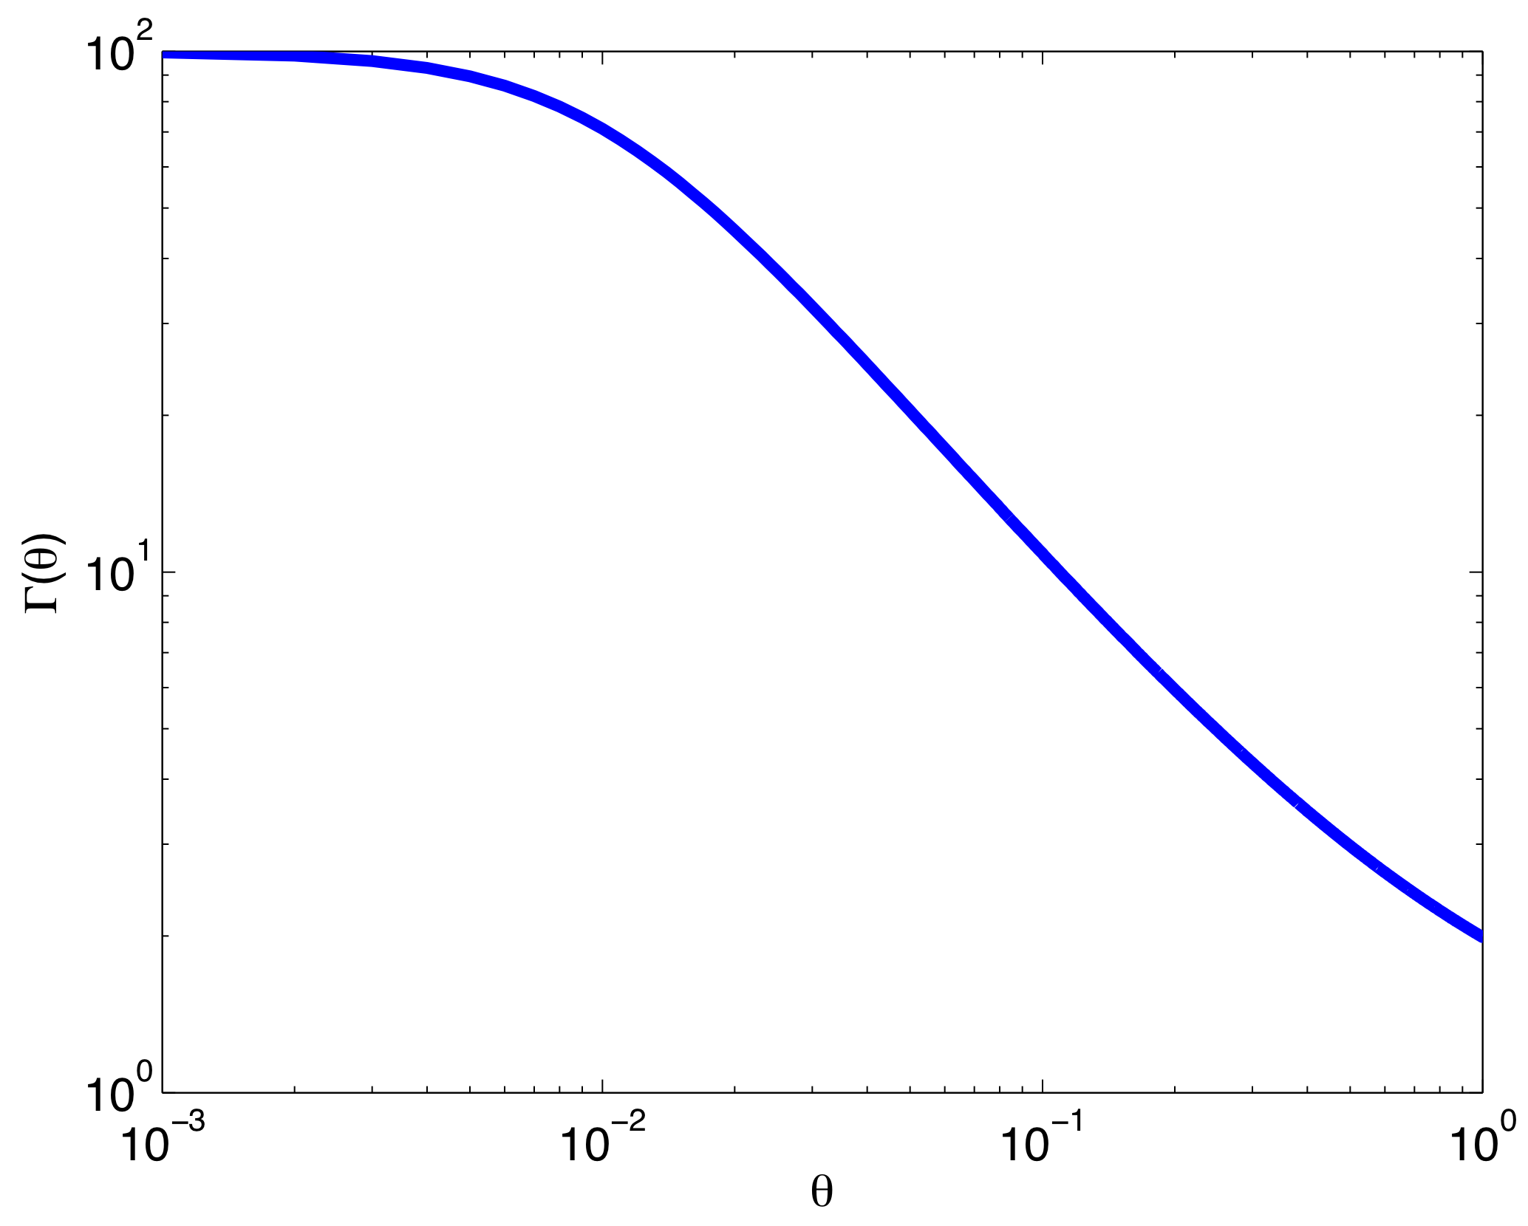
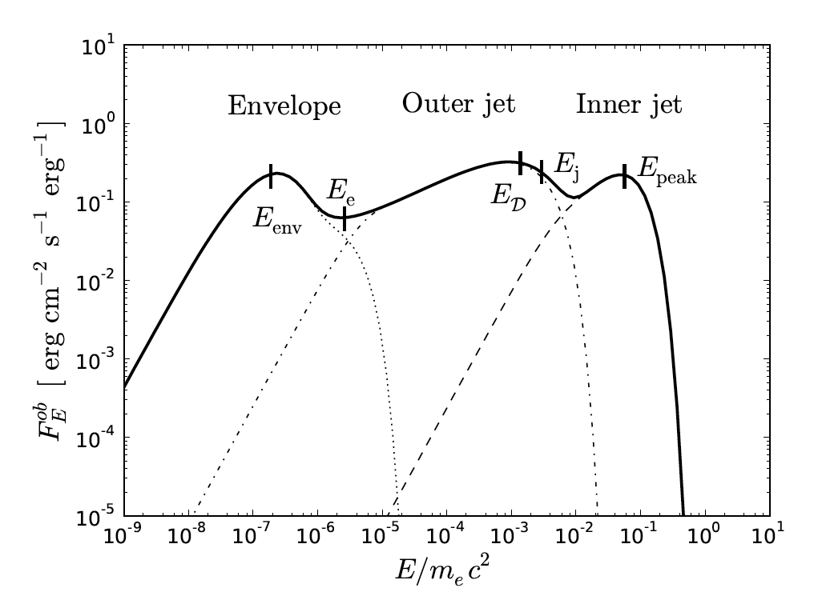
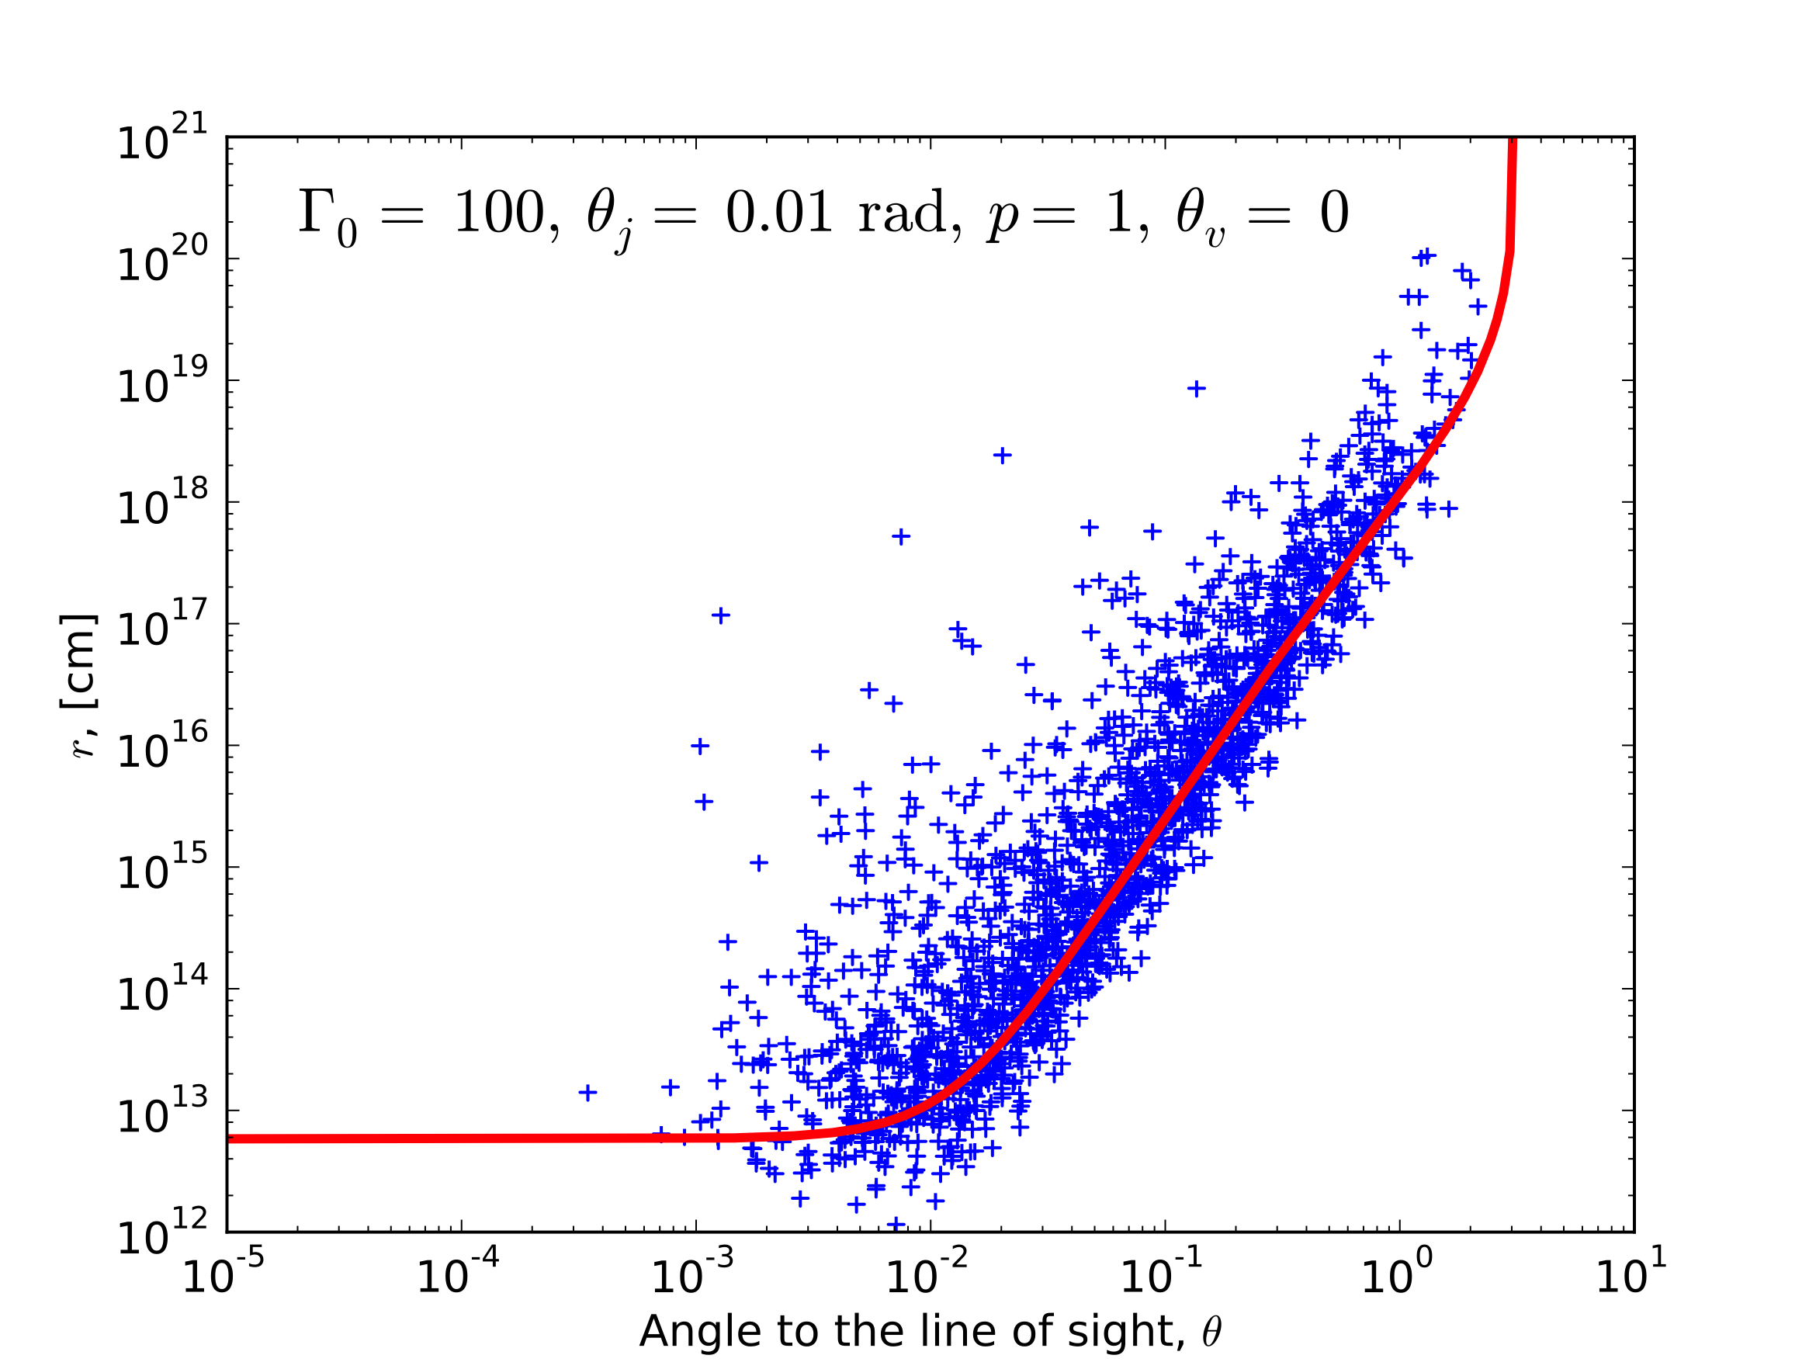
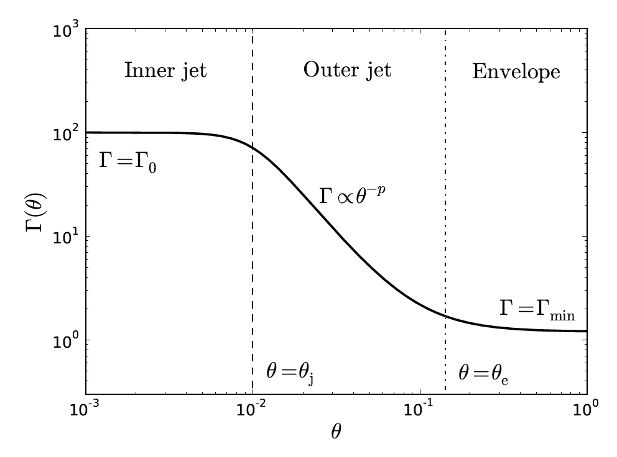
Thermal emission may be strongly distorted by various effects
(e.g., the relativistic “limb darkening”)
Γ
θ
Rapidly evolving.
No firm conclusion yet.
Lundman+13;
See also Pe’er 08, Beloborodov 10, Pe’er & Ryde 11

Slide 14
Outline
Motivation: Are GRB outflows Poynting flux dominated ?
Testable predictions on the striped wind model:
- Upper limits: L_{th}/L_{k} <= 30%;
L_{NT} <= L_{K}
Detailed modeling of radiation on the current sheet evolution
- Dynamically: Minor effect;
- Photons stay within reconnection layer until r_{trans.} <~r_{phot.}
Emission from the photosphere: > few MeV

Slide 15
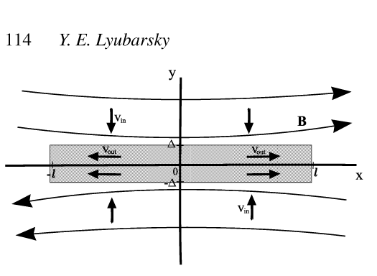
Radiation effect on the reconnection dynamics
Begue, Pe’er & Lyubarsky, 2016, in prep.
Lyubarsky & Kirk 01; Lyubarsky 05;
Sironi & Spitkovsky 14;….
There are 2 distinguishable regions.
Emission (acc.,..)
- only in “hot” region
Reconnection layer: hot, non-magnetized
Width − Δ
n
?
B
B
B
Cold, magnetized region

Slide 16
Eqs. governing the 2-region system
Continuity
Energy
entropy
Eqs. of state
Enthalpy
Flux freezing
(cold region (2))
Pressure balance
Width − Δ
n
B
B
B
?
Reconnection rate:
Cold, magnetized region (2)

Slide 17
Two asymptotic scenarios
Width − Δ
n
B
B
B
?
Cold, magnetized region (2)
Energy released remains inside the current sheet
(long diffusion time in reconnection layer: τ_{Δ}>>1)
→ magnetized region is cold: p₂<<b²; e₂= n₂’mc²
Energy released redistributes in magnetized (cold) region
(short diffusion time inside current sheet, τ_{Δ}<<1)
[photons do not completely leave the flow below the photosphere!]
→ n₁’ >>n₂’ to balance magnetic pressure
- energy density in both regions dominated by radiation

Slide 18
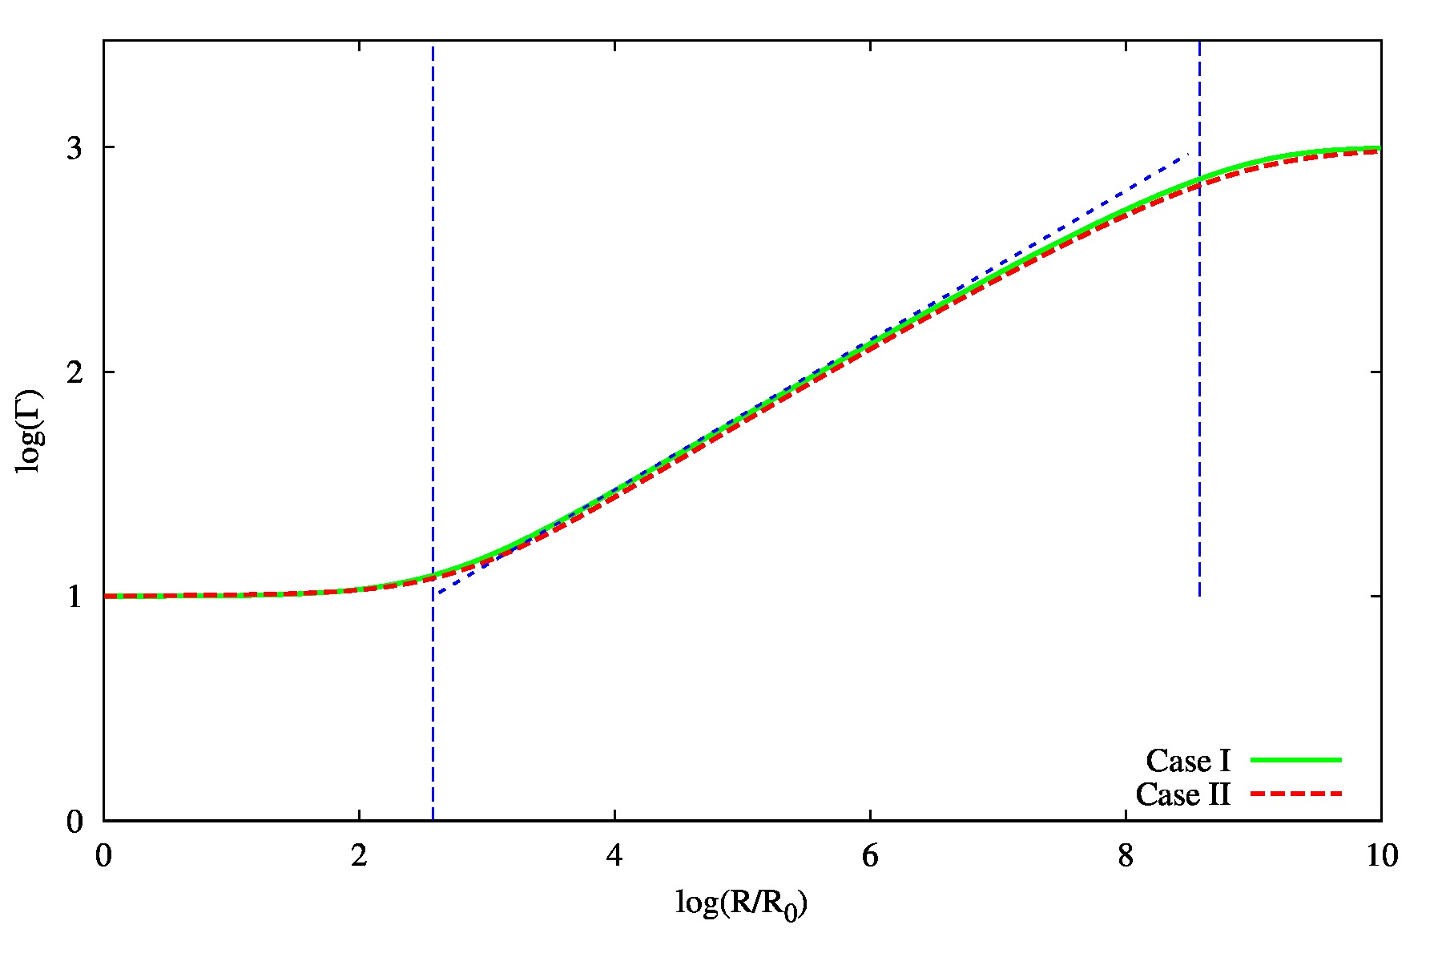
Results 1. Lorentz factor evolution
Case I: τ_{Δ}>>1;
Case II: τ_{Δ}<<1
-In both cases, Γ_{1,2}~r^{1/3}
- nearly the same coefficient:
Evolution of Γ is not sensitive to τ_{Δ} inside reconnection layer

Slide 19
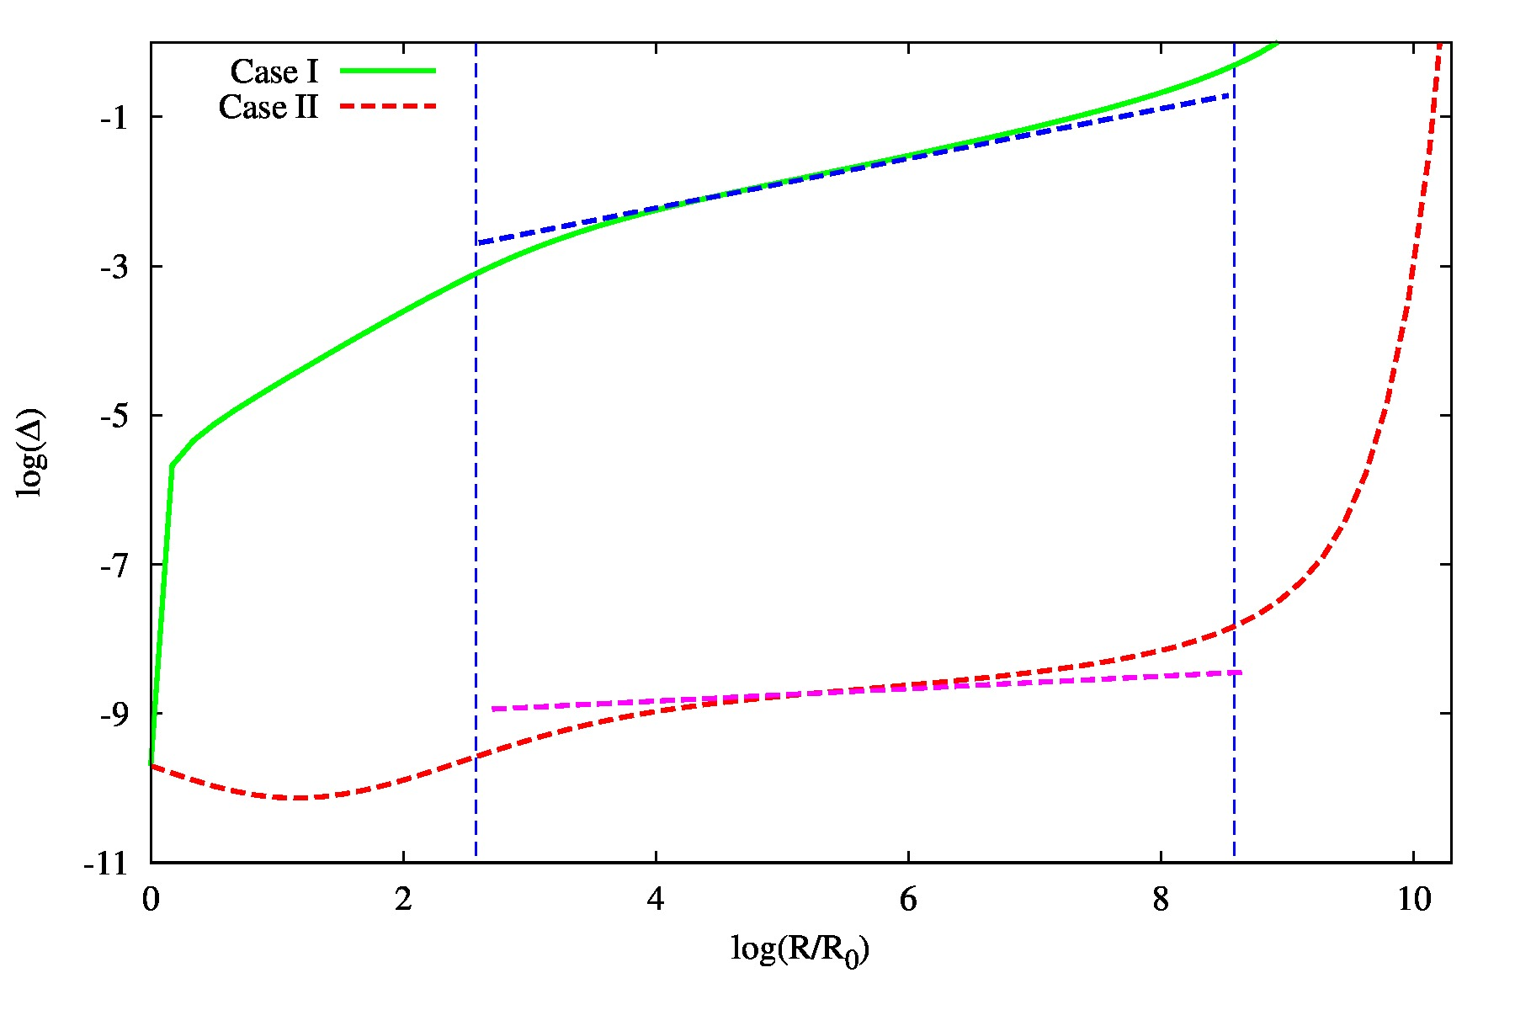
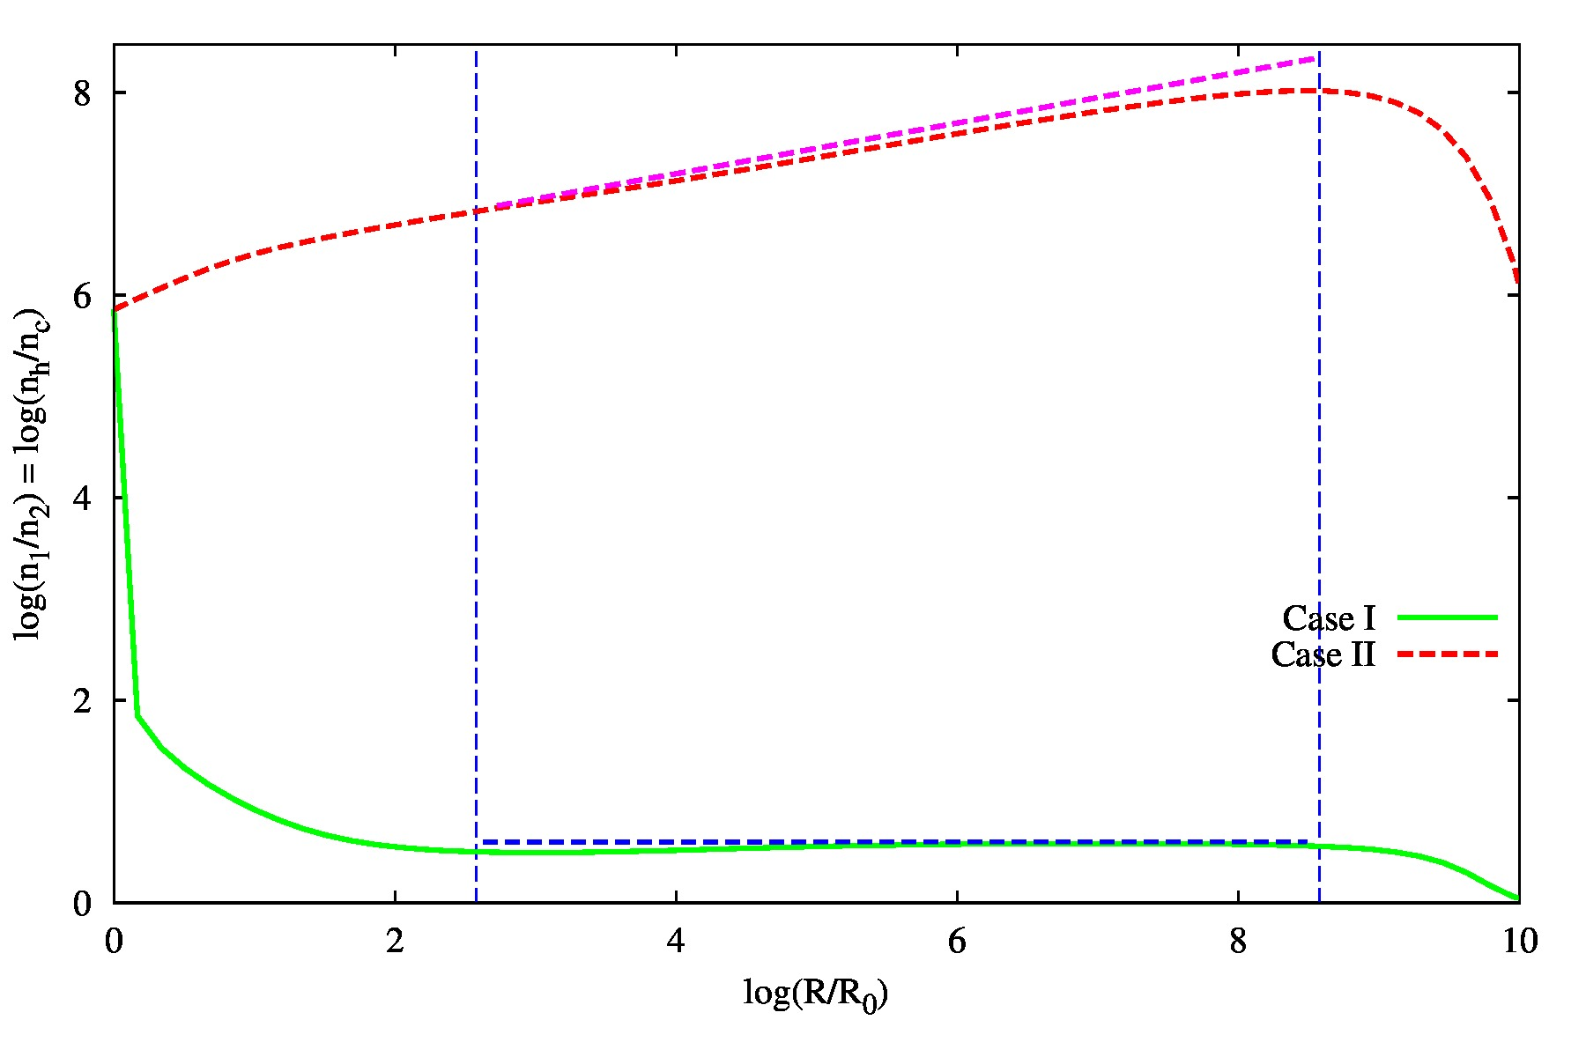
Results -2: Case I, Evolution of density ratio & reconnection layer width
Case I: τ_{Δ}>>1;
Case II: τ_{Δ}<<1
-Case I: cold magnetized region
Δ~r^{1/3} ; n₁/n₂ = 4
Reconnection layer width, Δ
Density ratio, n₁/n₂
Begue, Pe’er & Lyubarsky, 2016, in prep.

Slide 20
Results -2: Case I, Evolution of density ratio & reconnection layer width
Case I: τ_{Δ}>>1;
Case II: τ_{Δ}<<1
-Case I: cold magnetized region
Δ~r^{1/3} ; n₁/n₂ = 4
Reconnection layer width, Δ
Density ratio, n₁/n₂
Begue, Pe’er & Lyubarsky, 2016, in prep.

Slide 21
Results -2: Case II, Evolution of density ratio & reconnection layer width
Case I: τ_{Δ}>>1;
Case II: τ_{Δ}<<1
-Case II: radiation escapes, Δ does not grow fast
n₁ >>n₂ to balance magnetic pressure
Δ~r^{1/12} ; n₁/n₂~r^{1/3}
Reconnection layer width, Δ
Density ratio, n₁/n₂

Slide 22
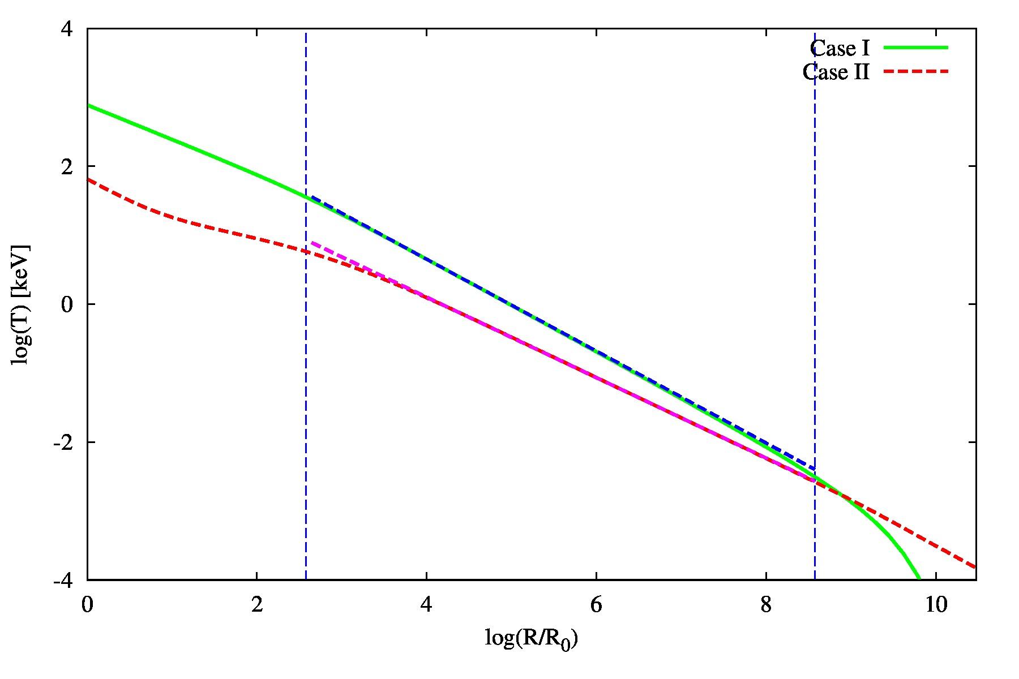
Results 3: Evolution of Temperature – similar in two scenarios
Case I: τ_{Δ}>>1 → T’~r^{-2/3}
Case II: τ_{Δ}<<1→ T’~r^{-7/12}
(same temperature of gas & radiation)

Slide 23

“Reality”: what we expect to happen ?
Case I: τ_{Δ}>>1; Case II: τ_{Δ}<<1
Width − Δ
Phot. radius
Diffusion
Absorption
Emission
n
B
B
B
?
Cold, magnetized region (2)
Case I: τ_{Δ}>>1;
photons stay within Δ
photons diffuse out;
Δ shrinks
Diffusion within Δ
Photosphere
– photon escape
Effective
emission
Transition radius
I→ II
10⁷
4*10⁷
8*10⁸
9*10¹⁰
7*10¹¹
Radius [cm]

Slide 24
“Reality”: what we expect to happen ?
Case I: τ_{Δ}>>1; Case II: τ_{Δ}<<1
Width − Δ
n
B
B
B
?
Case I: τ_{Δ}>>1;
photons stay within Δ
Cold, magnetized region (2)
photons diffuse out;
Δ shrinks
Diffusion within Δ
Photosphere
– photon escape
Effective
emission
Transition radius
10⁷
4*10⁷
8*10⁸
9*10¹⁰
7*10¹¹
Radius [cm]
Case I (photons stay within Δ) is valid at r< r_{trn.}~ 9*10¹⁰ cm <~ r_{ph}
At r>~r_{trns.} gradual transition to case II
(can’t be fully achieved below r_{ph})
Minor observational effect;
Possible effect on the reconnection rate - ?
Begue, Pe’er & Lyubarsky, 2016, in prep.

Slide 25
Outline
Motivation: Are GRB outflows Poynting flux dominated ?
Testable predictions on the striped wind model:
- Upper limits: L_{th}/L_{k} <= 30%;
L_{NT} <= L_{K}
Detailed modeling of radiation on the current sheet evolution
- Dynamically: Minor effect;
- Photons stay within reconnection layer until r_{trans.} <~r_{phot.}
Emission from the photosphere: > few MeV

Slide 26
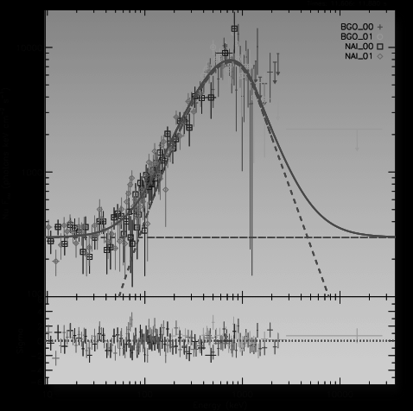
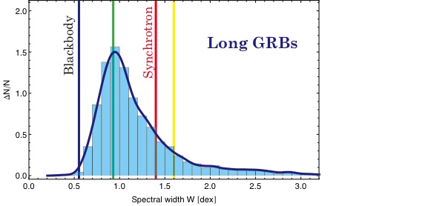
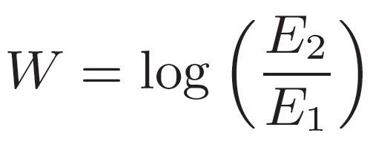
Confronting with observations (3):
GRB’s “photospheric revolution”
Monoenergetic electrons
Slow cooling Maxwellian
Slow cooling Power law
Fast cooling→
W=FWHM
Axelsson & Borgonovo, 2015, ApJ; Yu et. al., 2015
Irrespective of the electron’s distribution, dissipation mechanism, …
(optically thin) synchrotron emission CANNOT explain GRB spectra
of nearly 100% of GRBs

Slide 27
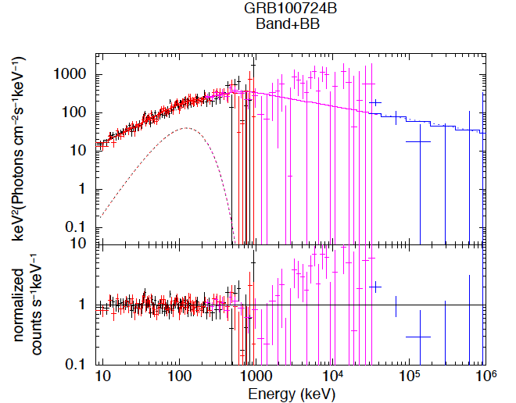
Confronting with observations (3):
GRB’s “photospheric revolution”
Guiriec+11
Ahlgren+15
GRB110721A (Iyyani+13)
In many GRBs, a thermal component is observed at ~few 100’s keV
(It was not looked for previously !)
Can this be explained within high-σ model ?

Slide 28
Thermal signature of high-σ model
Basic idea: photon production rate
✜ As long as full thermalization.
✜ Photon production processes:
- double Compton
- Brem.
- cyclo-Synch.
Magnetized flows:
Condition fulfilled only for r < r_{supp} ~ 5*10⁹ cm
Vurm, Lyubarsky & Piran (13)
Beloborodov (13)
Begue & AP (15)

Slide 29
Thermal signature of high-σ model
Photon production rate:
✜ At r > r_{supp} ~ 5*10⁹ cm photon emission suppressed.
→ Full thermalization impossible
✜ At r< r_{ph}~7*10¹¹ cm photons are coupled to the plasma
→ photon # is conserved by multiple IC
✜ Continuous reconnection → continuous electron heating
At r< r_{c} ~ 2*10¹¹ cm Efficient radiative cooling
→ Energy is divided between e⁻, γ
→ photon temperature increases
✜ At r_{c} ~ 2*10¹¹ cm < r < r_{ph}~7*10¹¹ cm → inefficient cooling,
T_{e} increases
→ Photons: Wien spectrum, with T’~ u’/<n_{γ}>

Slide 30
Electron temperature
T’(e⁻)
Efficient photon
production
Efficient e⁻
cooling
Inefficient e⁻
cooling
T’~r^{-7/12}
Inefficient photon production

Slide 31
Using thermal emission to constrain jet magnetization
Photon starvation → Wien spectrum with
T^{ob} = T’ Γ(r_{ph}) >~3 - 5 MeV
Reconnection rates
Magnetization

Slide 32
Using thermal emission to constrain jet magnetization
E_{pk} vs. L_{th}
High σ → high E_{pk}, low L_{th}
High reconnection rate → High E_{pk}

Slide 33
Summary
Testable predictions of the striped wind model:
- Upper limits: L_{th}/L_{k} <= 30%;
L_{NT} <= L_{K}
Detailed modeling of radiation effect
on the current sheet evolution
- Dynamically: Minor effect;
- Photons stay within reconnection layer until r_{trans.} <~r_{phot.}
- Possible effect on reconnection rate at r_{trans.}?
Emission from the photosphere: > few MeV
Bottom line: when confronting GRB observations,
the “striped wind” model faces severe challenges !
Case I: τ_{Δ}>>1;
Begue & AP, 2015, Ap.J. 802, 134; AP, 2016, arXiv:1604.06590; Begue, AP, Lyubarsky, 2016, in prep.

